Slide 2
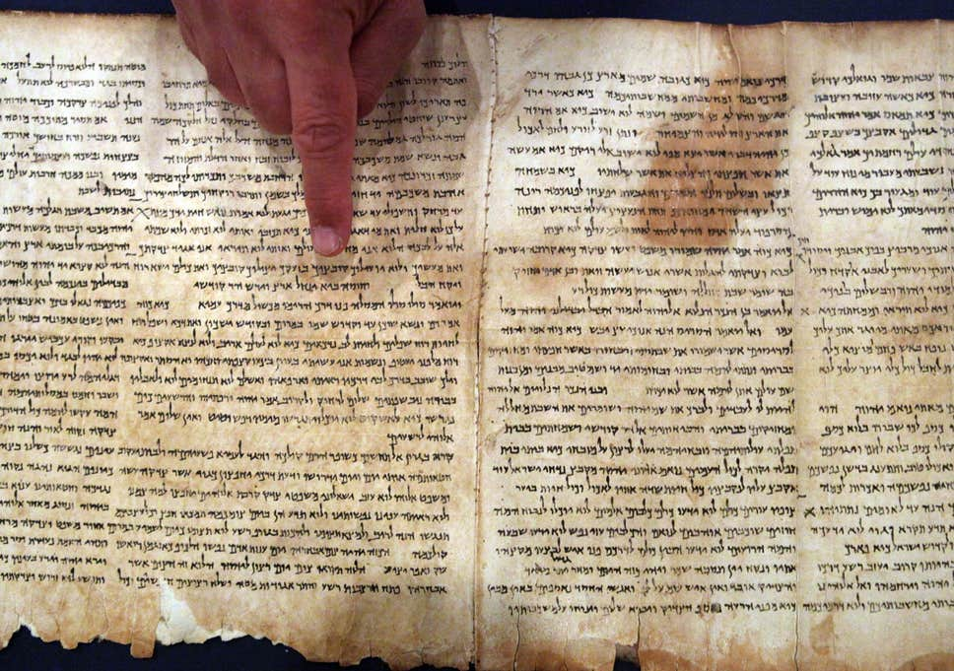
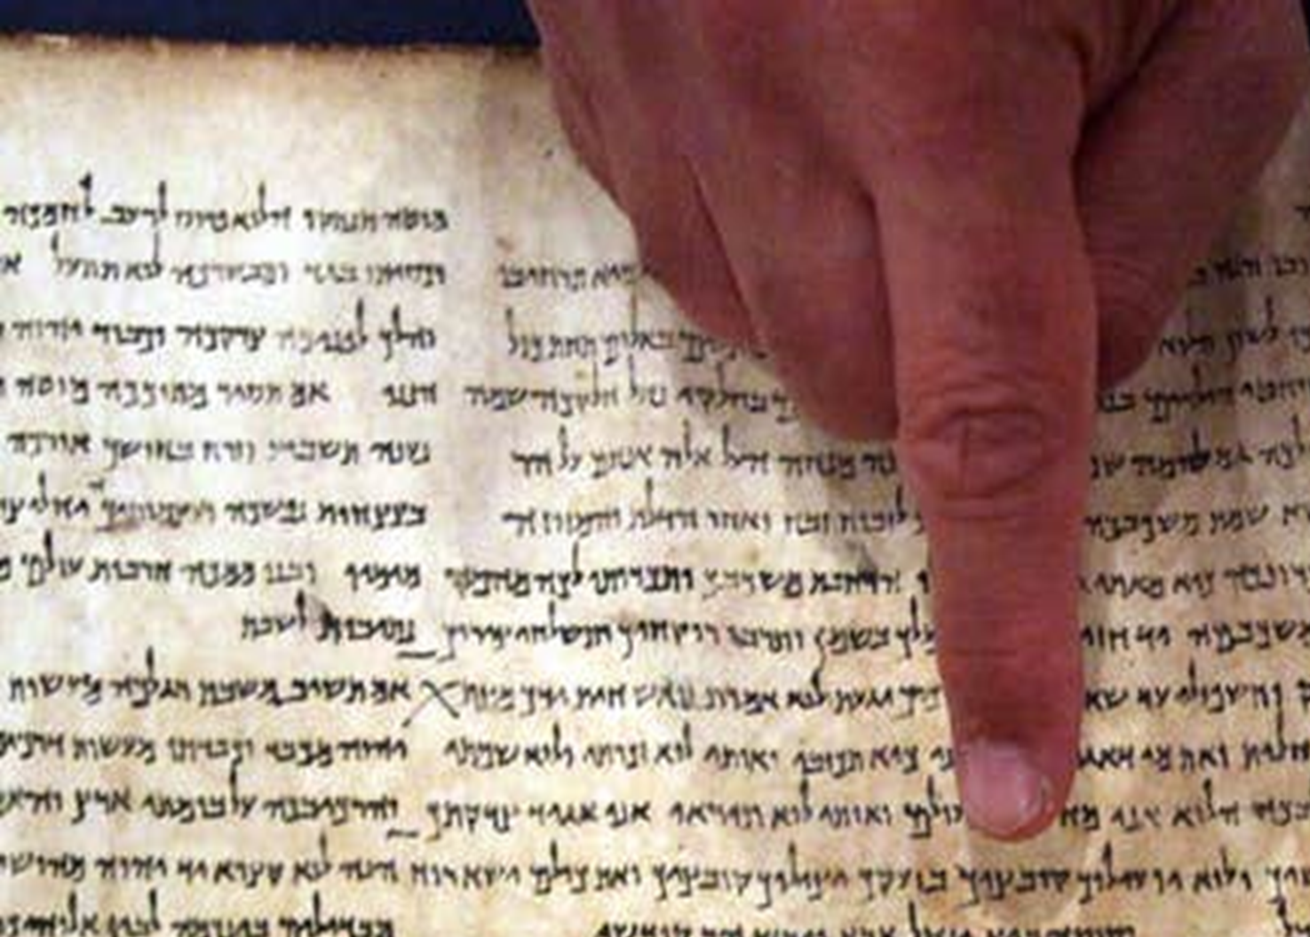

Commands
Ron Bert
May 30, 2020

Slide 3
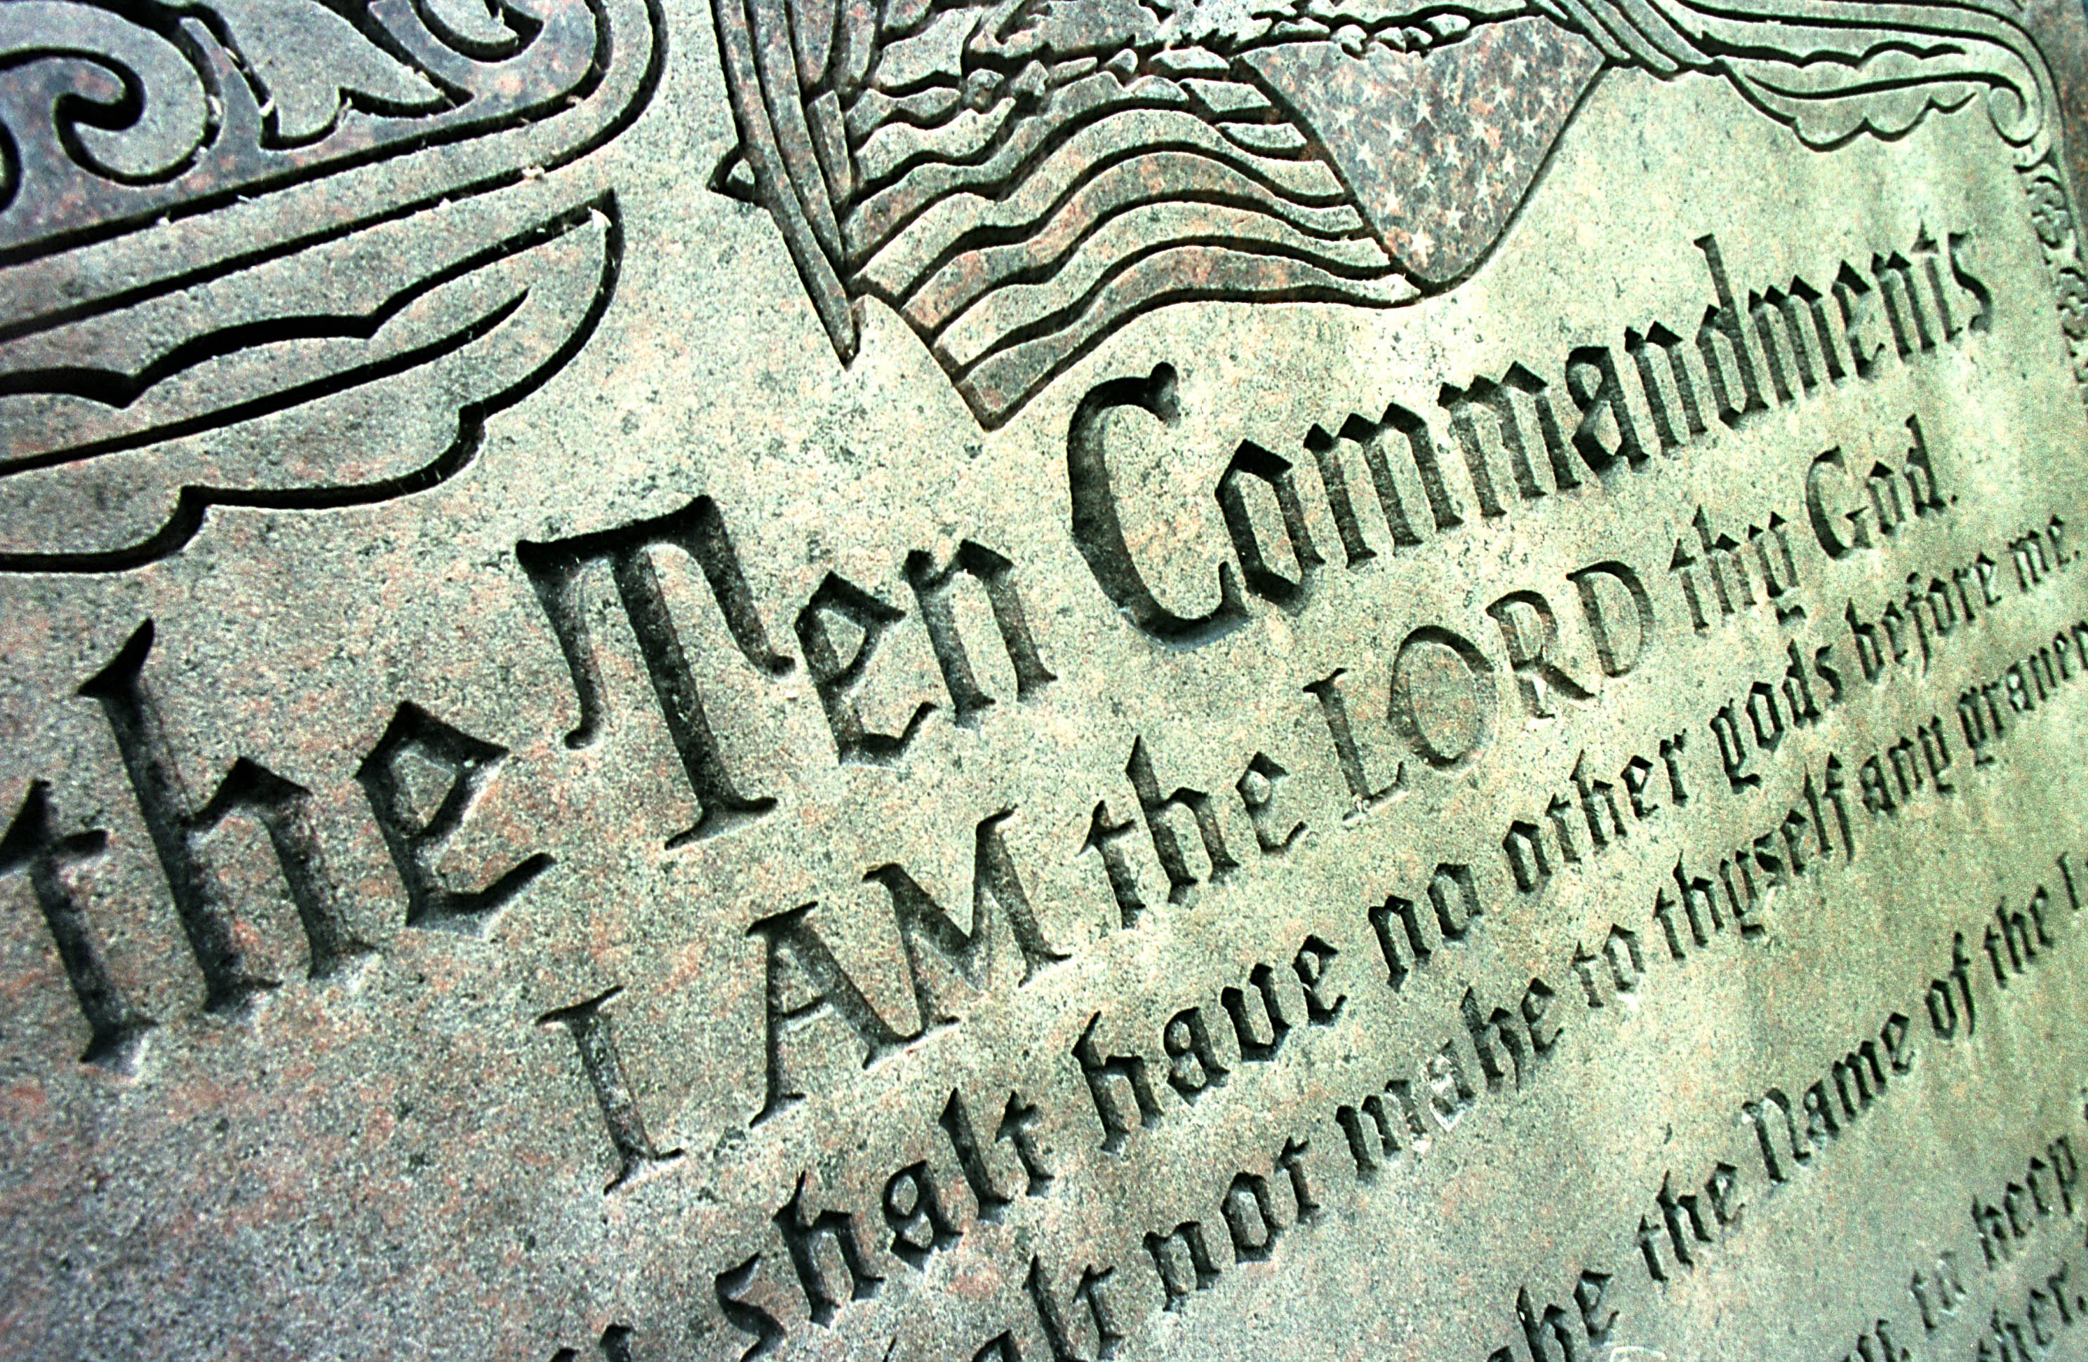
The statutes of the LORD are right, rejoicing the heart; The commandment of the LORD is pure, enlightening the eyes; — Psalms 19:8
rejoicing
enlightening
enlightening
Notes:
Truth never changes in its’ true value.

Slide 4

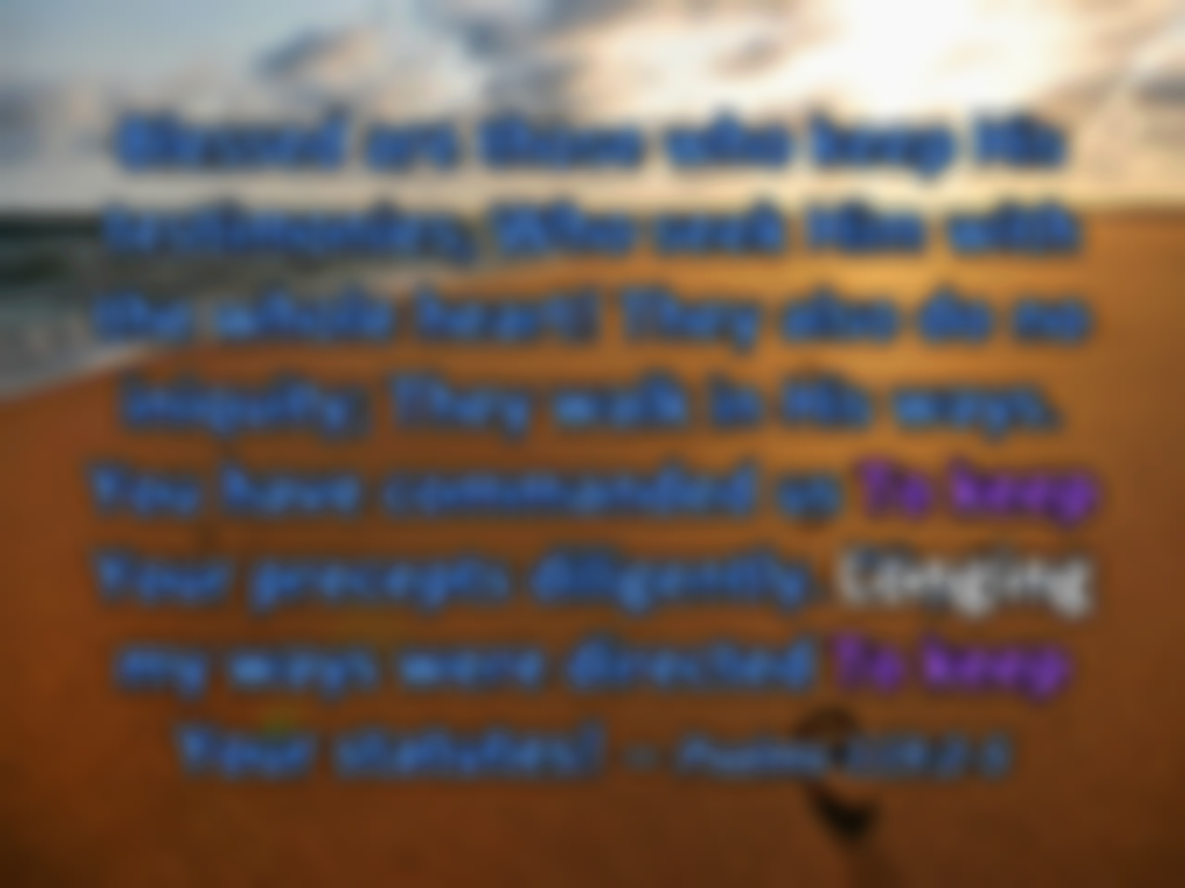

Blessed are those who keep His testimonies, Who seek Him with the whole heart! They also do no iniquity; They walk in His ways. You have commanded us To keep Your precepts diligently. Oh, that my ways were directed To keep Your statutes! — Psalms 119:2-5
walk in His ways
walk in His ways
in
. .
To keep
Longing
. .
To keep
Notes:
Striving to be good is not an activity that ever ceases. Keeping aligned with His ways brings about the best of character traits possible. Some people have no desire to be good and actively descend into their loathsome behaviors, with no concern to improve.

Slide 5

Brethren, I write no new commandment to you, but an old commandment which you have had from the beginning. The old commandment is the word which you heard from the beginning. Again, a new commandment I write to you, which thing is true in Him and in you, because the darkness is passing away, and the true light is already shining. — 1st John 2:7-8
in
in
in Him and in you
in Him and in you
true light
true light
true light
Notes:
To recognize the light of God is to see yourself in the naked truth that He is. When one stands in the light, accountability to God either builds greater character, or in defiance, a choice is made to reject God, for the path of darkness and despair that ensues.

Slide 6

… but now has been made manifest, and by the prophetic Scriptures has been made known to all nations, according to the commandment of the everlasting God, for obedience to the faith -- — Romans 16:26
true light
commandment
commandment
for obedience to the faith
for obedience to the faith

Slide 7

Now the purpose of the commandment is love from a pure heart, from a good conscience, and from sincere faith, … — 1st Timothy 1:5
commandment
commandment
love
from a pure
heart
love:
→ from a pure heart
→ from a good conscience
→ from sincere faith
from a good conscience
from sincere faith

Slide 8
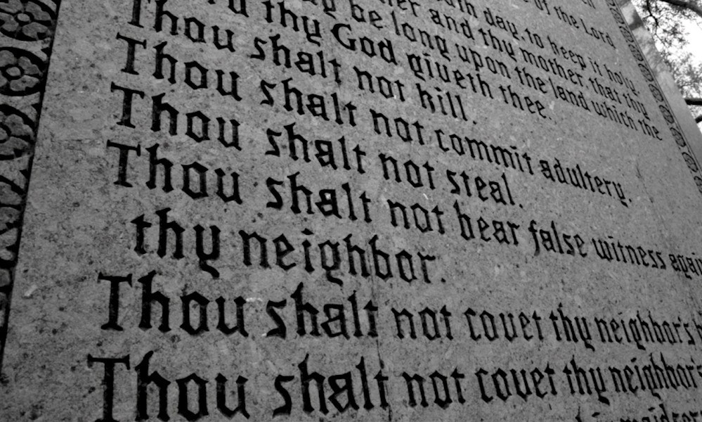
So He said to him, "Why do you call Me good? No one is good but One, that is, God. But if you want to enter into life, keep the commandments." He said to Him, "Which ones?" Jesus said, "'You shall not murder,' 'You shall not commit adultery,' 'You shall not steal,' 'You shall not bear false witness,' 'Honor your father and your mother,' and, 'You shall love your neighbor as yourself.'" — Matthew19:17-19
want to enter into life
want to enter into life
want to enter into life
want to enter into life:
• You shall not murder
• You shall not commit adultery
• You shall not steal
• You shall not bear false witness
• Honor your father and your mother
• You shall love your neighbor as yourself
commandment
You
shall not murder
You shall not commit
adultery
You shall not steal
You shall
not bear false witness
Honor your
father and your mother
You shall
love your neighbor as yourself
Notes:
Murder is not the same as killing. We kill flies, spiders, ants, and beetles. Killing heinous souls purges society of escalating evils, and is condoned by God to protect those of decency, assisting in keeping work fun, and not duty to the drudgery of supporting delinquents at the cost of the whole social tranquility. Note that when one lies the truth is stolen.

Slide 9

Jesus said to him," 'You shall love the LORD your God with all your heart, with all your soul, and with all your mind.' This is the first and great commandment. And the second is like it: 'You shall love your neighbor as yourself.' On these two commandments hang all the Law and the Prophets." — Matthew 22:37
the first and great commandment:
1) love the LORD your God
with all your heart
with all your soul
with all your mind
the second commandment:
2) love your neighbor as yourself
love
the LORD your God
with all your
heart
with all your soul
with
→
all your mind
the first and
→
great commandment
the
→
second
love your
neighbor as yourself
hang
commandment
hang
Old Testament
Notes:
When two laws establish all else that comes after or before them, they should certainly be considered with all earnestly.

Slide 10

"This is My commandment, that you love one another as I have loved you." — John 15:12
commandment
commandment
Notes:
Without love a hopelessness fills the void of emptiness.

Slide 11

And this commandment we have from Him: that he who loves God must love his brother also. — 1st John 4:21
command
commandment
command

Slide 12
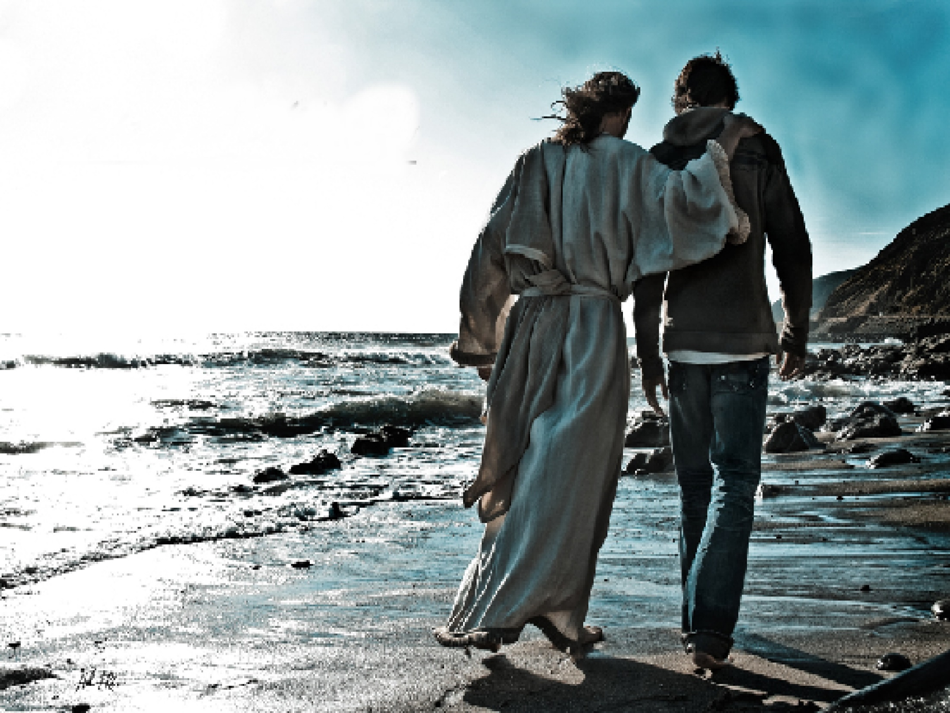
"You are My friends if you do whatever I command you." — John 15:14
friend
friend
command

Slide 13

"Honor your father and mother," which is the first commandment with promise: "that it may be well with you and you may live long on the earth." — Ephesians 6:2-3
Honor
Honor
commandment
live
live
commandment
Notes:
Part of friendship is honoring the life of another. Pure hearts wish no harm and hold no scheming; only hoping for the best that can be.

Slide 14

If anyone thinks himself to be a prophet or spiritual, let him acknowledge that the things which I write to you are the commandments of the Lord. — 1st Corinthians 14:37
commandments
I write to you
I write to you
commandments of the Lord
commandments of the Lord
commandment
commandments
Notes:
Many reduce the word of God to trivial, and selective convenience out of context to suit lifestyle. Ignoring the whole word of God leads to not following any of it. The infinite does not cater to the finite. How is it that we reject what has been delivered and place this higher truth below supposedly manmade truths? The Bible is a divinely inspired comprehensive all inclusive work to be embraced in its’ entirety.

Slide 15

For this is the love of God, that we keep His commandments. And His commandments are not burdensome. For whatever is born of God overcomes the world. And this is the victory that has overcome the world -- our faith. — 1st John 5:3-4
love of God
love of God
we keep
we keep
His commandments
His
commandments
God
God
overcome
overcome
our faith

Slide 16
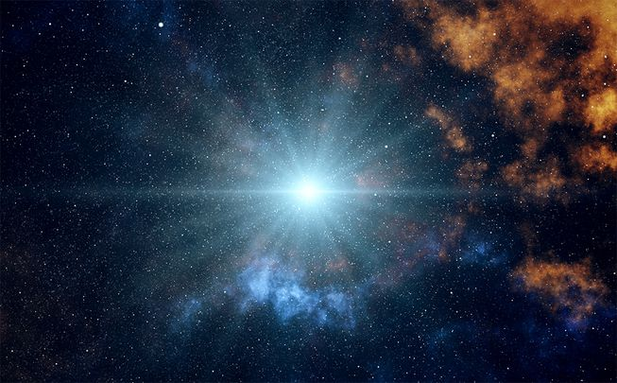
But that no one is justified by the law in the sight of God is evident, for "the just shall live by faith." Yet the law is not of faith, but "the man who does them shall live by them." — Galatians 3:11-12
live by faith
live by faith
God
God
Notes:
God has risen to the occasion to deliver salvations plan to all of us. Arrogant and defiant hearts do not live under His instructions, but rather argue with self-exalted views. Faith is not man imposed but an acceptance of God Himself.

Slide 17

He has shown you, O man, what is good; And what does the LORD require of you But to do justly, To love mercy, And to walk humbly with your God? — Micah 6:8
the LORD requires of us:
❶ to do justly
❷ To love mercy
❸ to walk humbly with God
s
the LORD
honestly
require
of
to do justly
To
us
compassion
love mercy
to walk humbly
humility
with
God
God

Slide 18


Blessed are those who do His commandments, that they may have the right to the tree of life, and may enter through the gates into the city. — Revelation 22:14
do
do
. .
the right to the tree of life
enter

Slide 19


Let us hear the conclusion of the whole matter: Fear God and keep His commandments, For this is man's all. For God will bring every work into judgment, Including every secret thing, Whether good or evil. — Ecclesiastes 12:13-14
God
good
evil

Slide 20













Slide 21
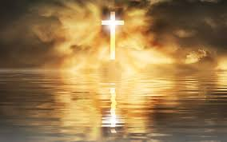
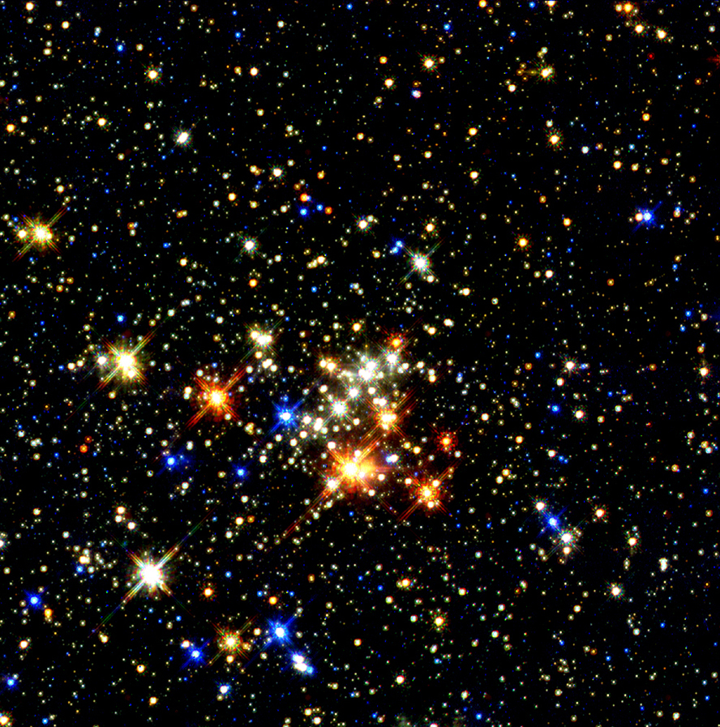
→ God’s pure commandments illuminate direction
→ All souls are called to walk in His ways
→ The light of God’s truth shines upon us
→ In good conscience a sincere pure heart hears
→ To love God above all frees a soul to soar
→ We are commanded to love one another
→ To be a considered a friend of God one must obey
→ None of God’s word should be deemed insignificant
→ Faith builds confidence to endure in Him
→ True faith acts living by His word
→ God requires honesty, kindness, and humble hearts
→ Access to heaven involves obedience to His word
→ Man’s all is to keep God’s commandments
Wonders of God is not a call to wander away
Notes:
Wonders of God is not a call to wander away

Slide 23

Please visit http://www.LoveFromGod.com to explore further
Ronald Bert Channel on
Notes:
Eternity never ends.

