Slide 2
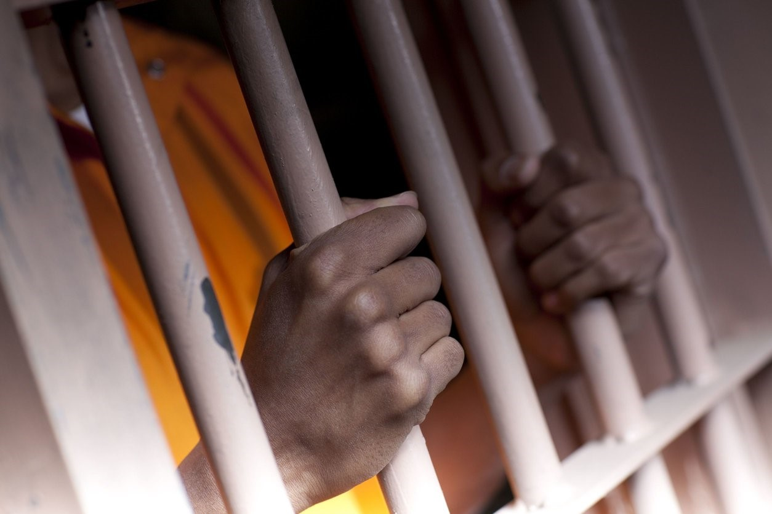
Capital Crime
Ron Bert
July 5, 2020

Slide 3
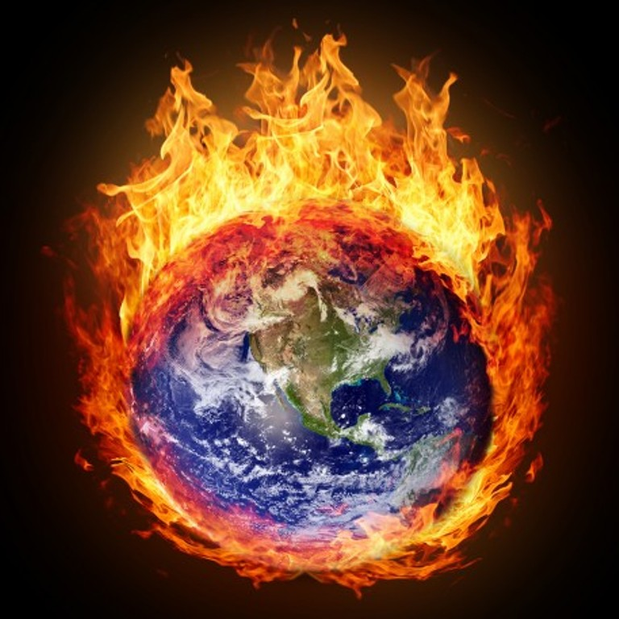
The earth is also defiled under its inhabitants, Because they have transgressed the laws, Changed the ordinance, Broken the everlasting covenant. — Isaiah 24:5
transgressed
s
transgressed
Changed
ord
Broken
Changed
Broken
w
words
Notes:
By turning from what God has instructed, to protect us, we destroy ourselves.

Slide 4
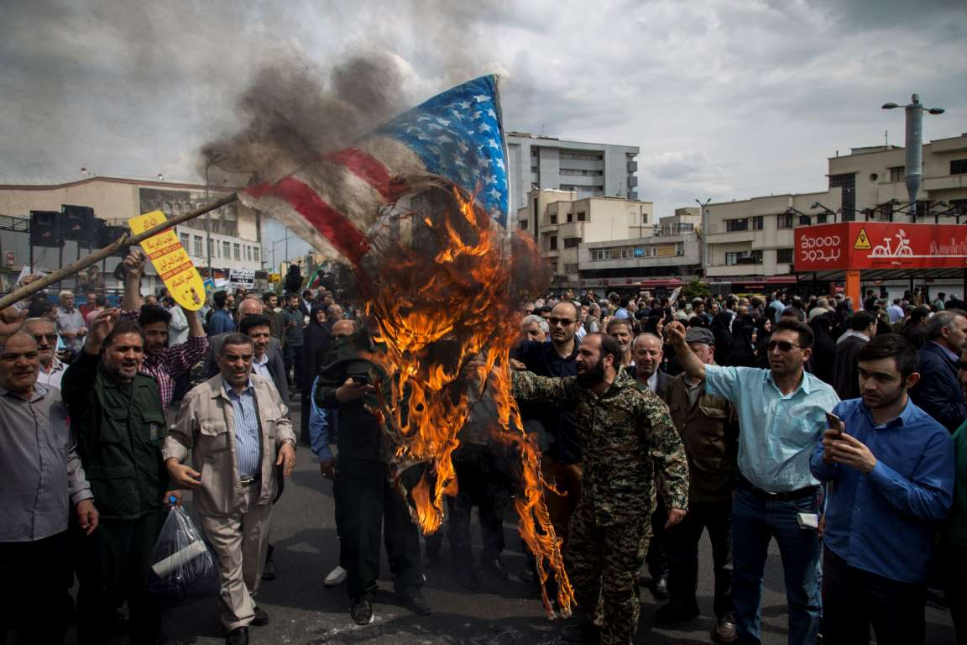
Hear, O earth! Behold, I will certainly bring calamity on this people - The fruit of their thoughts, Because they have not heeded My words, Nor My law, but rejected it. — Jeremiah 6:19
Hear, O earth! Behold, I will certainly bring calamity on this people - The fruit of their thoughts, Because they have not heeded My words, Nor My law, but rejected it. — Jeremiah 6:19
Because
Because
My words
words
heed
My words
rejected
rejected
Notes:
They say a picture is worth a thousand words, but multiplied among men, it can become an endless endeavor. Anger is a prevalent emotion hard to overcome. Forgiveness and understanding is void from many hearts. A wagon load of corpses comes by this way. Words among men can be the most inflammatory or the dearest of concern.

Slide 5
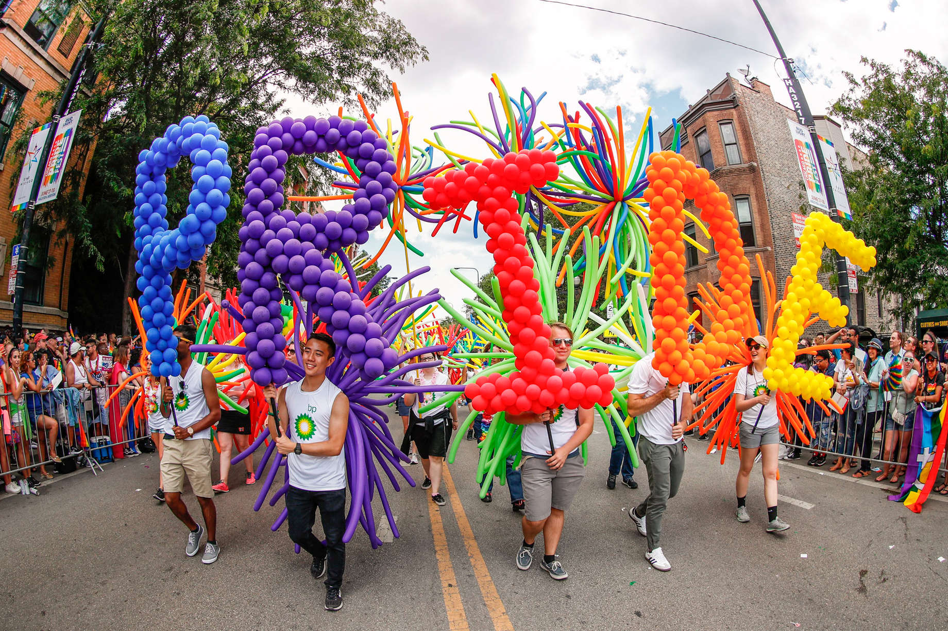
Woe to those who call evil good, and good evil; Who put darkness for light, and light for darkness; Who put bitter for sweet, and sweet for bitter! — Isaiah 5:20
who
Woe
who
Notes:
The fruits of deviancy from God’s will only leads to hell without hope. No sinner holding an unrepentant heart will find pride before His shadow of judgment. Exchanging truth for dishonor and exalting man’s will over God’s law is a certain abomination in His sight. Unforgettable is the rainbow created by God to declare His hope and love for our return from evil lusting pursuits. The truth cannot be reversed though man claims it can.

Slide 6
These six things the LORD hates, Yes, seven are an abomination to Him: A proud look, A lying tongue, Hands that shed innocent blood, A heart that devises wicked plans, Feet that are swift in running to evil, A false witness who speaks lies, And one who sows discord among brethren. — Proverbs 6:16-19
LORD
LORD
①
Pride
②
innocent blood
shed innocent blood
innocent blood
③
Murder
④
⑤
⑥
who
⑦
Notes:
God has no ambiguity when it comes to good and bad. Pride involves a better than you attitude; better than God? God certainly expresses His displeasure with murderers, and the shedding of innocent blood.

Slide 7
The fear of the LORD is to hate evil; Pride and arrogance and the evil way And the perverse mouth I hate. — Proverbs 8:13
the LORD
LORD
the LORD hates:
● Pride and arrogance ● the evil way
● the perverse mouth
the LORD hates:
● Pride and arrogance ● the evil way
● the perverse mouth
s
hate
Pride and arrogance
Pride and arrogance
Pride and arrogance
the evil way
the
perverse mouth
obstinate
stubborn
headstrong
Notes:
The Lord has made clear those things against goodness. If one sees, His hand is the light in our darkness.

Slide 8
Where there is no revelation, the people cast off restraint; But happy is he who keeps the law. — Proverbs 29:18
law
vision
perish
lawlessness
Notes:
Laws were created to establish right from wrong.

Slide 9
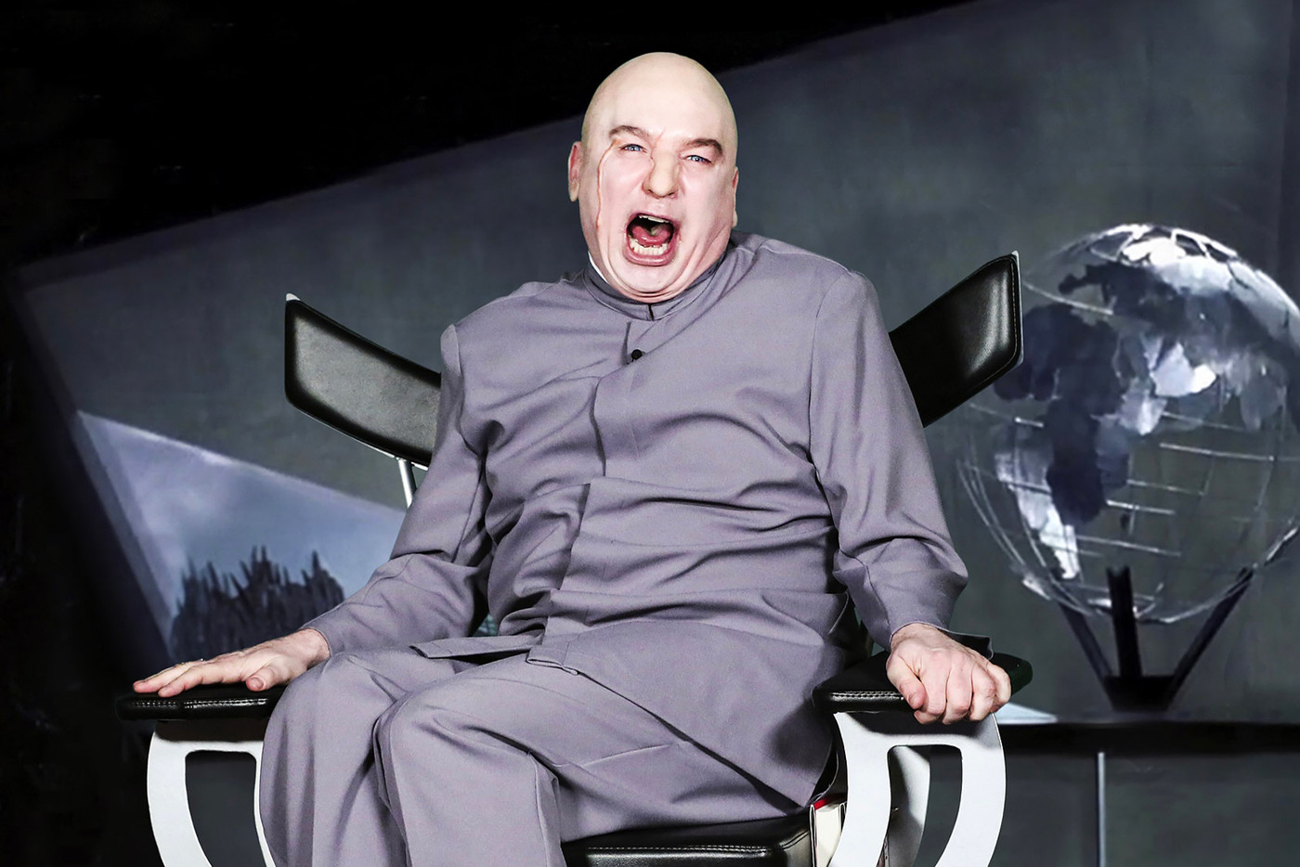
But we know that the law is good if one uses it lawfully, knowing this: that the law is not made for a righteous person, but for the lawless and insubordinate, for the ungodly and for sinners, for the unholy and profane, for murderers of fathers and murderers of mothers, for manslayers, for fornicators, for sodomites, for kidnappers, for liars, for perjurers, and if there is any other thing that is contrary to sound doctrine, … — 1st Timothy 1:8-10
law is made for:
● the lawless and insubordinate
● the ungodly
● sinners
● unholy and profane
● murderers of fathers and mothers
● manslayers
● fornicators ● liars
● sodomites ● perjurers
● kidnappers
● contrary to sound doctrine
law is
made for
the lawless and insubordinate
the
ungodly
sinners
unholy
and profane
murderers of fathers and
mothers
manslayers
fornicators
sodomites
kidnappers
liars
perjurers
contrary to sound
doctrine
Notes:
Authority is a castle that chains man to be orderly.

Slide 10
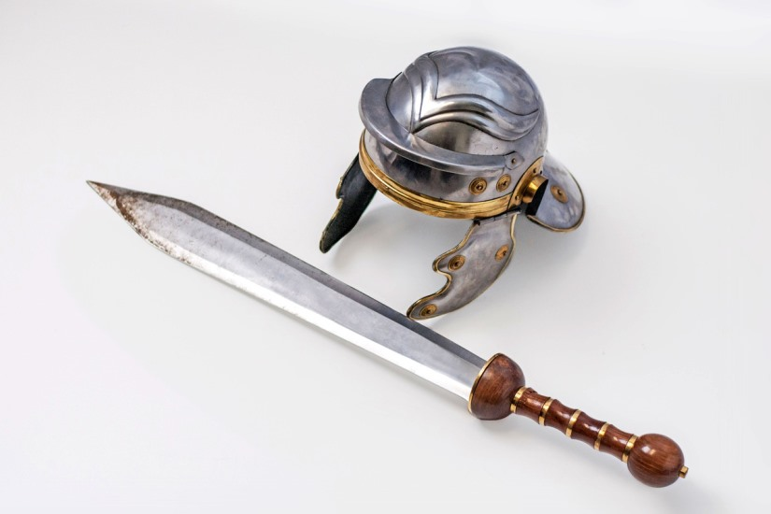
For rulers are not a terror to good works, but to evil. Do you want to be unafraid of the authority? Do what is good, and you will have praise from the same. For he is God's minister to you for good. But if you do evil, be afraid; for he does not bear the sword in vain; for he is God's minister, an avenger to execute wrath on him who practices evil. — Romans 13:3-4
authority
authority
is God's minister
is God's minister
is God's minister
Execution
bear the sword
bear the sword
avenger to execute
avenger to execute
who practices evil
who practices evil
Notes:
To live in peace, an agreement for common decency must be agreed upon. As rules are broken, authority has the responsibility to return order as quickly as possible. Exacting justice is not a quagmire of delays. Make no mistake, God authorizes execution for those that break His ordinances, and if not done by man, judgment day will enforce His will for Goodness over evil’s influence.

Slide 11
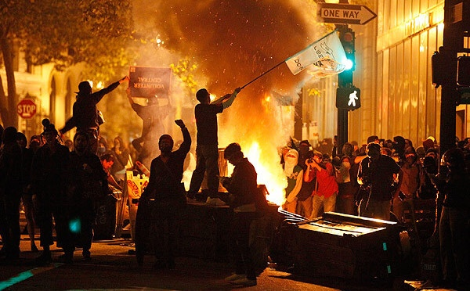
Because the sentence against an evil work is not executed speedily, therefore the heart of the sons of men is fully set in them to do evil. — Ecclesiastes 8:11
sentence against an
sentence against an evil work
not executed speedily
sets hearts to do evil
evil work
not executed speedily
heart
s
s
set
to do evil
Notes:
Without enforcing laws expeditiously, societies invite an avalanche of evil.

Slide 12
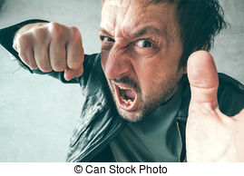
Let grace be shown to the wicked, Yet he will not learn righteousness; In the land of uprightness he will deal unjustly, And will not behold the majesty of the LORD. — Isaiah 26:10
X
grace
not learn
not learn
Criminals
deal unjustly
deal unjustly
not behold
not behold
Notes:
Grace has been shown to all. There are those who will never take advantage of the goodness offered, in sharing together, where selfishness reigns. By not purging society of the most heinous criminals, the burden of their continuing care lessens the quality of life for all.

Slide 13
"Then many false prophets will rise up and deceive many. And because lawlessness will abound, the love of many will grow cold. But he who endures to the end shall be saved." — Matthew 24:11-13
because lawlessness
because lawlessness
the love of many will grow cold
the love of many will grow cold
sense
endures
endures
shall be saved
shall be saved
Notes:
Lawlessness is the curse of all.

Slide 14
"You shall not murder." — Exodus 20:13
"He who strikes a man so that he dies shall surely be put to death."— Exodus 21:12
"'Whoever kills any man shall surely be put to death.'" — Leviticus 24:17

Slide 15
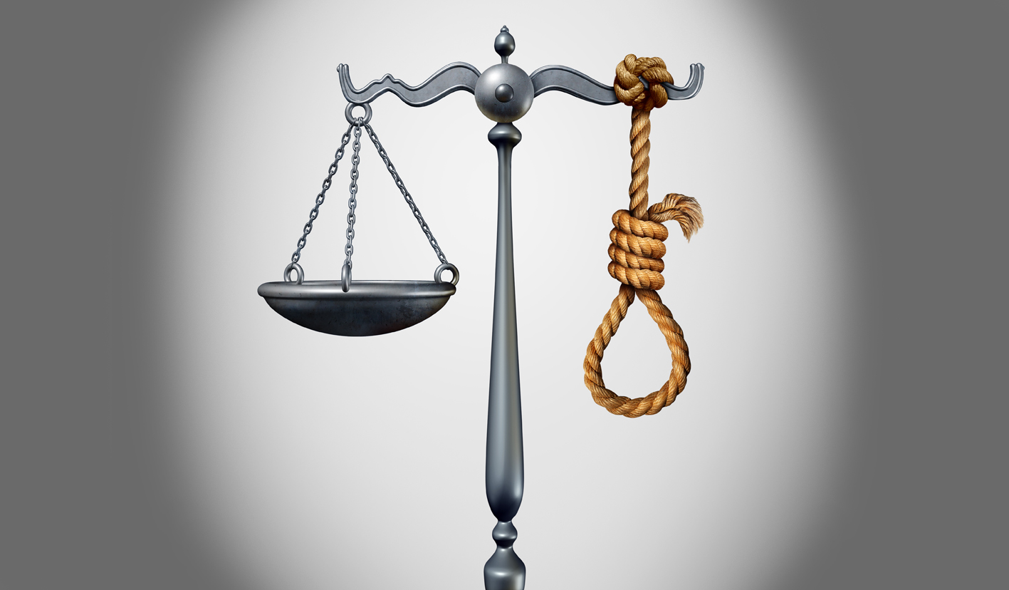
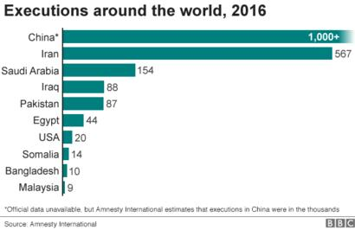
"Whoever sheds man's blood, By man his blood shall be shed; For in the image of God He made man." — Genesis 9:6
sheds man's
blood
sheds
man's
blood
By
man
his blood
shed
By man
his blood
shed
Justice
Notes:
God commands capital punishment for murderers.

Slide 16
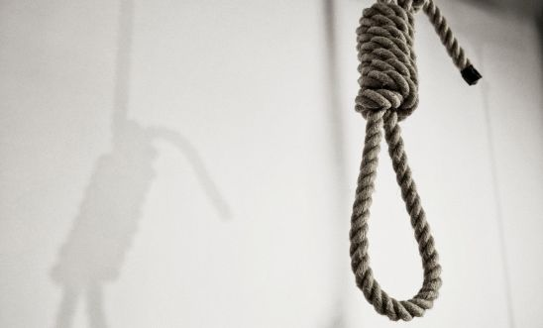
"For if I am an offender, or have committed anything deserving of death, I do not object to dying; but if there is nothing in these things of which these men accuse me, no one can deliver me to them. I appeal to Caesar." — Acts 25:11
deserving of death, I do not object
deserving of death
deserving of death, I do not object
Notes:
The Apostle Paul, through Holy Spirit’s inspiration, agrees with capital punishment when appropriate.

Slide 17
"For out of the heart proceed evil thoughts, murders, adulteries, fornications, thefts, false witness, blasphemies." — Matthew 15:19
out of the heart proceed:
● evil thoughts
● murders
● adulteries
● fornications
● thefts
● false witness
● blasphemies
out of the heart proceed
evil
thoughts
murders
adulteries
fornications
thefts
false witness
blasphemies
Notes:
Conscience is crucial for the soul that wishes salvation. Knowing what God wills for His creation and His plan can only be discovered by diligent study and effort to adhere to what has been given.

Slide 18
He said to Him, "Which ones?" Jesus said, "'You shall not murder,' 'You shall not commit adultery,' 'You shall not steal,' 'You shall not bear false witness,' — Matthew 19:18
Jesus said You shall not:
● murder
● commit adultery
● steal
● bear false witness
murder
Jesus said
You shall not
murder
murder
commit
adultery
steal
bear false witness
Notes:
Murder is what takes a soul away from the tree of life where God see all.

Slide 19
Whoever hates his brother is a murderer, and you know that no murderer has eternal life abiding in him. By this we know love, because He laid down His life for us. And we also ought to lay down our lives for the brethren. — 1st John 3:15-16
hate is a
murderer
hate
is a
hate
hate
no murderer
has eternal life
murderer
no
murder
murder
murderer
has eternal life
know love,
He laid down
His life for us
know love,
He laid down
His life for
us
ought to lay down
our
lives for the brethren
ought to lay down our
lives for the brethren
Notes:
Jesus laid His life down for all, and asks that we follow, in caring for others, even when it is difficult.

Slide 20
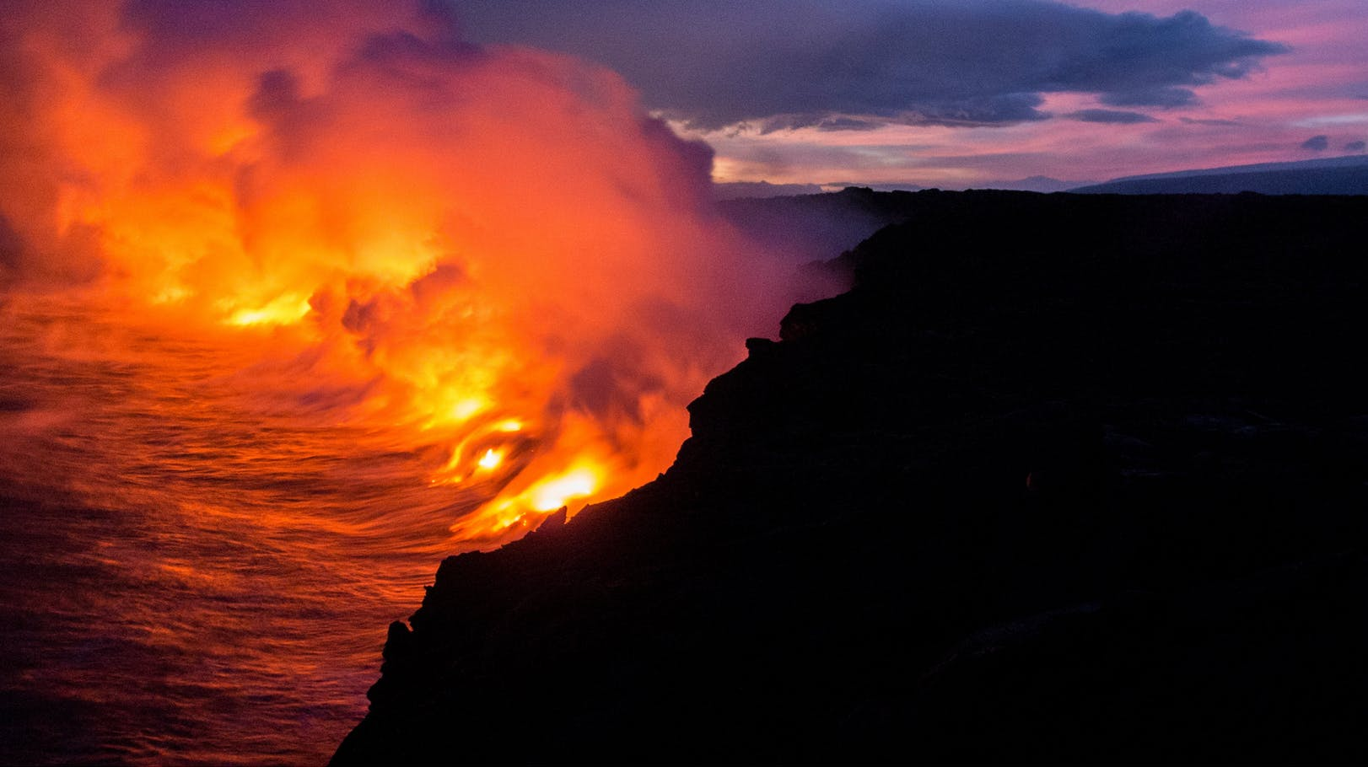
Beloved, do not avenge yourselves, but rather give place to wrath; for it is written, "Vengeance is Mine, I will repay," says the Lord. — Romans 12:9
LOVE
give
give
ANGER
Notes:
It is a challenge not to want revenge when one has been done wrong. Jesus suffer under the lies and false accusations levied against Him. God has promised those hindering the ascension of souls will receive their just lonely end.

Slide 21
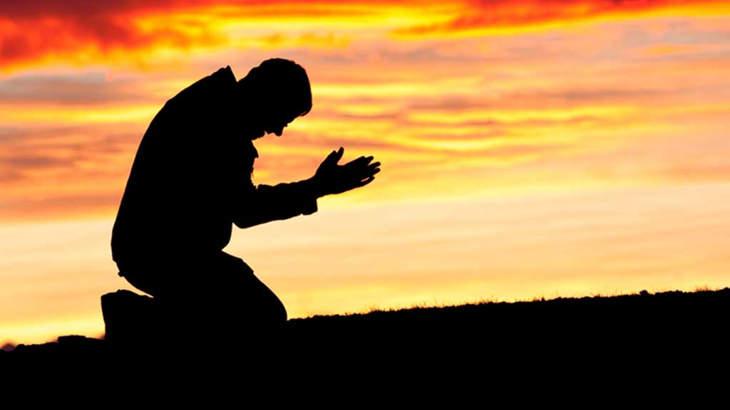
If we confess our sins, He is faithful and just to forgive us our sins and to cleanse us from all unrighteousness. — 1st John 1:9
confess
confess
Notes:
Part of coming to the truth with God is confessing those things we are most challenged with. Prayer is our portal to heaven.

Slide 22
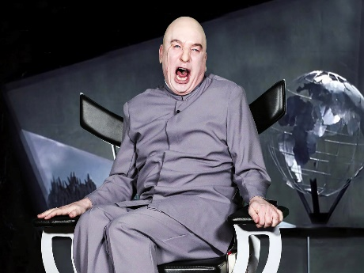
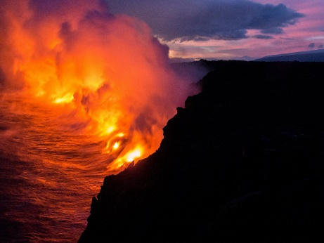

Slide 23
→ Earth is defiled for the breaking of God’s Word
→ Rejecting God’s law plunges people into calamity
→ Evil reverses truth asserting lies as true
→ God is clear on what He calls evil abominations
→ Without truth, the people destroy themselves
→ Rulers are a terror to those practicing evil
→ By not enforcing laws rapidly only increases sin
→ Fair hands of justice cannot change driven evil
→ Hearts grow cold from abounding lawless lies
→ God proclaims murderers shall be executed by man
→ The Apostle Paul condoned the death penalty
→ Hateful hearts are murderous with no inheritance
→ God will exact justice where man cannot
Villains have little conscience for God’s Word
Notes:
Villains have little conscience for God’s Word

Slide 25
Please visit http://www.LoveFromGod.com to explore further
Ronald Bert Channel on
Notes:
Eternity never ends.

