Slide 1
Notes:
In darkness there is nothing revealed.

Slide 2

Call to be Christian
Ron Bert
February 18, 2018
Notes:
Many are called but few are chosen, shown by their willingness to pursue His truth over that of the impulsiveness of flesh. It is God that declares morality.

Slide 3

Jesus said to him," 'You shall love the LORD your God with all your heart, with all your soul, and with all your mind.' This is the first and great commandment." — Matthew 22:37-38
all your
● all your heart
● all your soul
● all your mind
all
heart
all your soul
#1
all
all your mind
all
Notes:
The thoughts of the bottom of one’s heart discloses true desire and or the ability to control it. It can be a challenge to allow His truth to enlighten ones heart if one does not wish to hear.

Slide 4

"And the second is like it: 'You shall love your neighbor as yourself.' On these two commandments hang all the Law and the Prophets." — Matthew 22:39-40
#2
Notes:
As sand blows upon the dunes of life, our encounters in flesh expose a greater call to spirit over that which decays before us all. The Word reveals that our highest quality is to love life, and with those that would share in cherishing this, blessings come.

Slide 5
"And the second is like it: 'You shall love your neighbor as yourself.' On these two commandments hang all the Law and the Prophets." — Matthew 22:39-40
1+2
hang all
. .
Law and the Prophets
Old Testament
Law and the Prophets

Slide 6

"Therefore, whatever you want men to do to you, do also to them, for this is the Law and the Prophets." — Matthew 7:12
want men to do to you
→ do also to them
want men to do to you
do
=
GOLDEN RULE
also to them
is
Law and the Prophets
Notes:
Without others we are nothing.

Slide 7

"This is My commandment, that you love one another as I have loved you. — John 15:12
My commandment
My commandment
love
love
love
Notes:
We were created to enjoy what God designed; love for, and of, one another. To the shame of our hearts we all fall short. To be in the circle of love more often than not reveals blessings over the curse where hate consumes the soul.

Slide 8
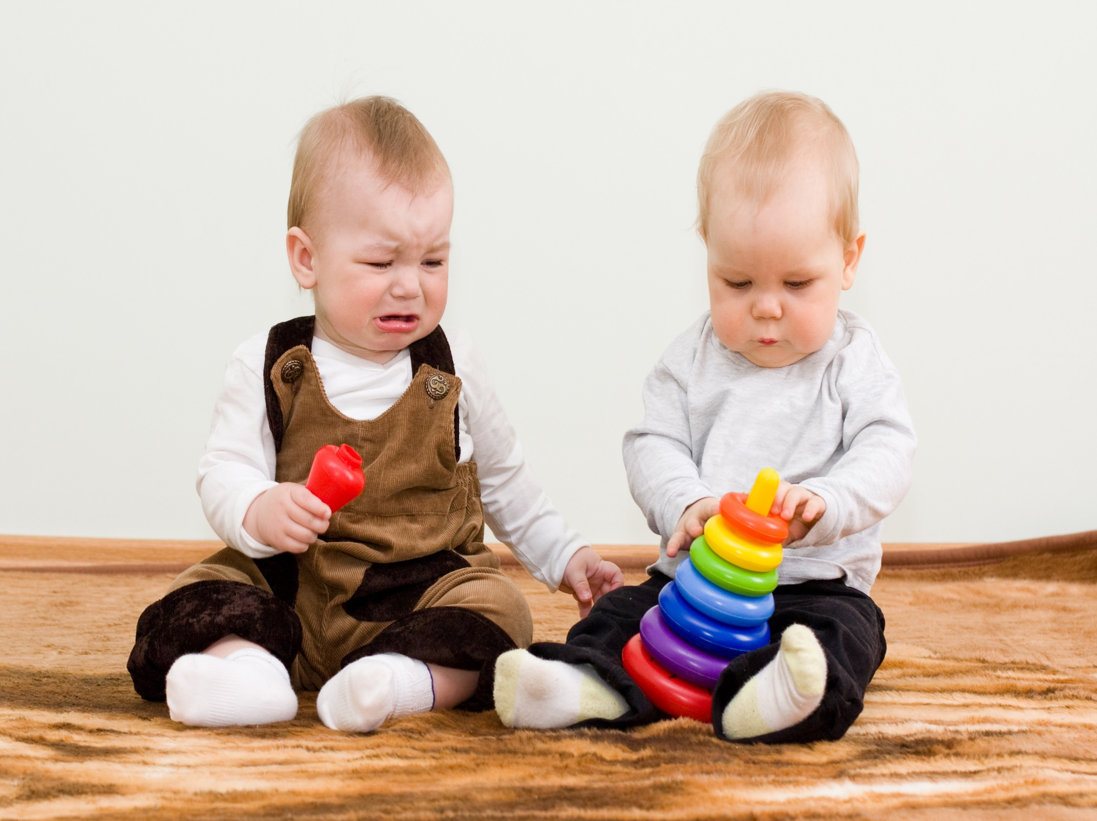
Let nothing be done through selfish ambition or conceit, but in lowliness of mind let each esteem others better than himself. — Philippians 2:3
Honor
Respect
Prize
Regard
esteem
esteem
esteem
love
others
Value
others
Admiration
Reverence
Appreciation
Notes:
In caring for others is where life can fullest be seen. Only in compassion for others divulges the true height of love. Selfishness and or contempt is an empty box of no returns leaving the heart alone and lonely.

Slide 9
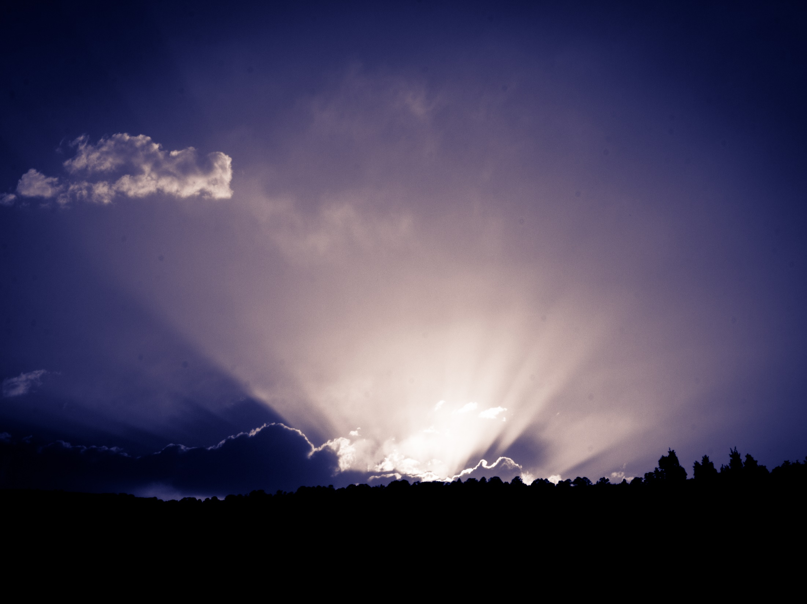
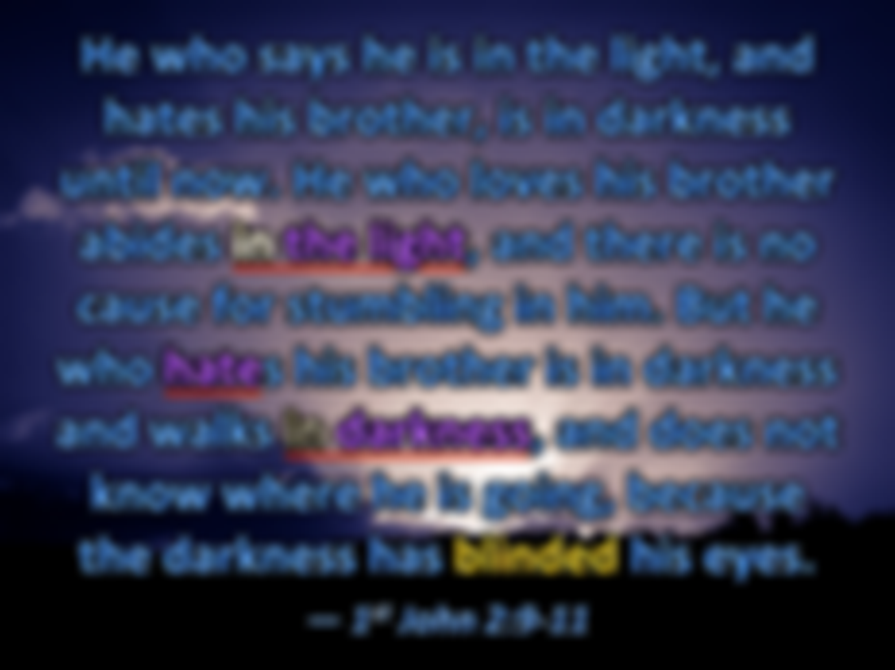

He who says he is in the light, and hates his brother, is in darkness until now. He who loves his brother abides in the light, and there is no cause for stumbling in him. But he who hates his brother is in darkness and walks in darkness, and does not know where he is going, because the darkness has blinded his eyes. — 1st John 2:9-11
in
in the light
in the light
hate
hate
in
in darkness
in darkness
Notes:
Hate and despising others is what devours a soul in the darkness of heart.

Slide 10
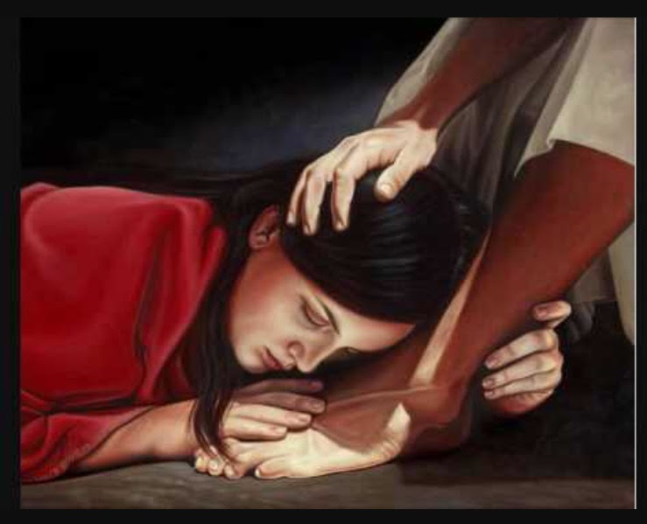
We know that we have passed from death to life, because we love the brethren. He who does not love his brother abides in death. Whoever hates his brother is a murderer, and you know that no murderer has eternal life abiding in him. By this we know love, because He laid down His life for us. And we also ought to lay down our lives for the brethren. — 1st John 3:14-16
who does not love
who does not love
in
in death
in death
=
hates his brother
murders
a murderer
hates his brother
a murderer
murder
s
Notes:
It is love that lifts a soul higher than life itself. Love is greater than we can know, where heaven generously sprinkles its’ gifts.

Slide 11
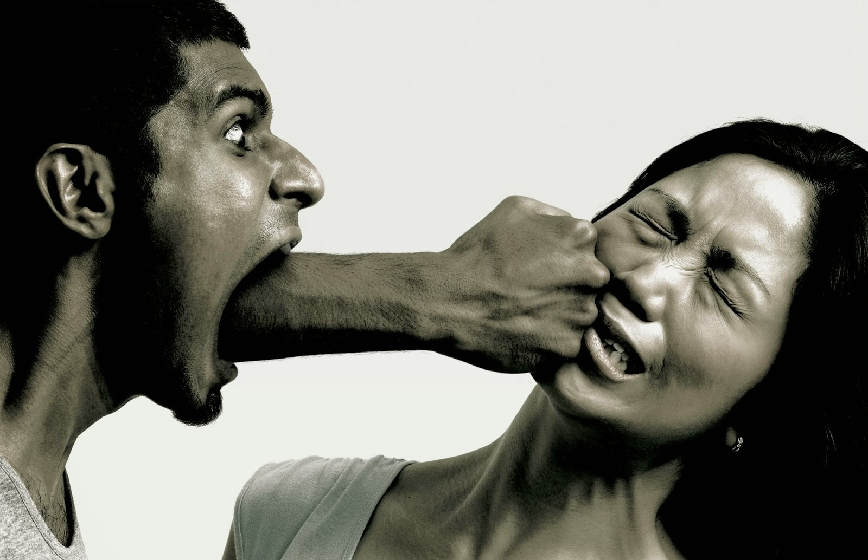
And He said, "What comes out of a man, that defiles a man. For from within, out of the heart of men, proceed evil thoughts, adulteries, fornications, murders, thefts, covetousness, wickedness, deceit, lewdness, an evil eye, blasphemy, pride, foolishness. All these evil things come from within and defile a man." — Mark 7:20-23
evil thoughts
adulteries
fornications
murders
thefts
murders
covetousness
wickedness
deceit
wickedness
lewdness
an evil eye
blasphemy
pride
foolishness
from within
from within
Notes:
Fighting words often condemn one in a merciless reprisal.

Slide 12

It is actually reported that there is sexual immorality among you, and such sexual immorality as is not even named among the Gentiles -- that a man has his father's wife! And you are puffed up, and have not rather mourned, that he who has done this deed might be taken away from among you. — 1st Corinthians 5:1-2
immorality
immorality
corruption
dishonesty
wickedness
taken
away from
among you
wickedness
deed
deed
taken
away from
among you
Notes:
Without punishment for actions, lawlessness can become the rule of disorder. Morality is a set of righteous principles handed down by God Himself. All liars are immoral. It is an instruction to shun the unrepentful.

Slide 13

But if anyone has caused grief, he has not grieved me, but all of you to some extent -- not to be too severe. This punishment which was inflicted by the majority is sufficient for such a man, so that, on the contrary, you ought rather to forgive and comfort him, lest perhaps such a one be swallowed up with too much sorrow. Therefore I urge you to reaffirm your love to him. — 2nd Corinthians 2:5-8
grief
grief
But if anyone has caused grief, he has not grieved me, but all of you to some extent -- not to be too severe. This punishment which was inflicted by the majority is sufficient for such a man, so that, on the contrary, you ought rather to forgive and comfort him, lest perhaps such a one be swallowed up with too much sorrow. Therefore I urge you to reaffirm your love to him. — 2nd Corinthians 2:5-8
But if anyone has caused grief, he has not grieved me, but all of you to some extent -- not to be too severe. This punishment which was inflicted by the majority is sufficient for such a man, so that, on the contrary, you ought rather to forgive and comfort him, lest perhaps such a one be swallowed up with too much sorrow. Therefore I urge you to reaffirm your love to him. — 2nd Corinthians 2:5-8
all of you
repentance
X
X
forgive
comfort
forgive
comfort
inflict pain ?
reaffirm
our love
reaffirm
our love
Notes:
A true repenting soul should be welcomed over the haughty hearts of rejection. Grudges serve no one. It is punishment for sin that exposes a soul to repentance or not. Sin should not be treated as casual. Angels rejoice in the face of repentance.

Slide 14

The fear of the LORD is to hate evil; Pride and arrogance and the evil way And the perverse mouth I hate. — Proverbs 8:13
Pride and arrogance
Pride and arrogance
Notes:
Without mercy in heart, the arrogant see not God but their own anger buries them. The house of God is all about us in all of our travels. All cursing defiles His holiness.

Slide 15

If someone says, "I love God," and hates his brother, he is a liar; for he who does not love his brother whom he has seen, how can he love God whom he has not seen? And this commandment we have from Him: that he who loves God must love his brother also. — 1st John 4:20-21
I love God
hates
a liar
I love God a liar who hates
who
commandment
commandment
must love his brother
must love his brother
Notes:
For His truth to shine upon a heart, His ways must be observed, otherwise the deception of excuses accept sin without recourse. There will be no notes from mommy excusing the guilty.

Slide 16

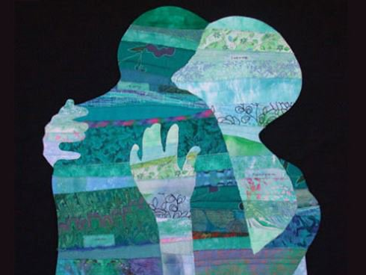
Let love be without hypocrisy. Abhor what is evil. Cling to what is good. Be kindly affectionate to one another with brotherly love, in honor giving preference to one another; not lagging in diligence, fervent in spirit, serving the Lord; — Romans 12:9-11
love
without hypocrisy
without hypocrisy
love
love
without hypocrisy
s
in
e
in honor
love without hypocrisy
serves the Lord
in
in diligence
serv
serving the Lord
serving the Lord
the Lord
Notes:
True love makes no excuse and holds no guilt. In pursuit of Him, all are lifted higher.

Slide 17

… in all things showing yourself to be a pattern of good works; in doctrine showing integrity, reverence, incorruptibility, sound speech that cannot be condemned, that one who is an opponent may be ashamed, having nothing evil to say of you. — Titus 2:7-8
pattern of good works
pattern of good works
→ in doctrine
● showing integrity
● reverence
● incorruptibility
● sound speech
→ cannot be condemned
in doctrine
showing integrity
in
reverence
incorruptibility
sound speech
cannot be
condemned
Notes:
In wisdom the heart refines that true character of brilliant godliness, and this is what we all struggle to achieve.

Slide 18

Honor all people. Love the brotherhood. Fear God. Honor the king. — 1st Peter 2:17
Honor
Honor all
Honor
Honor all
Notes:
His Word is plain without exception. It is man that diverges from the holiness He calls for.

Slide 19
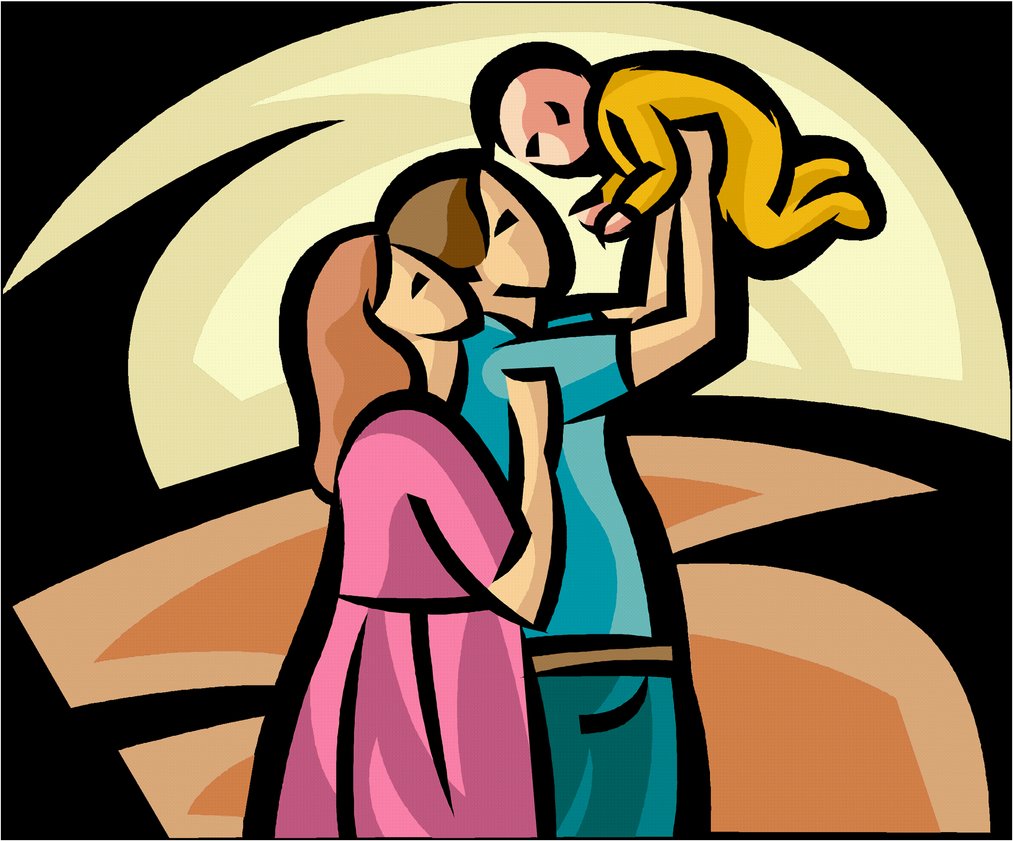
"Honor your father and your mother, that your days may be long upon the land which the LORD your God is giving you." — Exodus 20:12
Honor
honor
Notes:
Honor is a trait best observed opening the wells of love and respect.

Slide 20
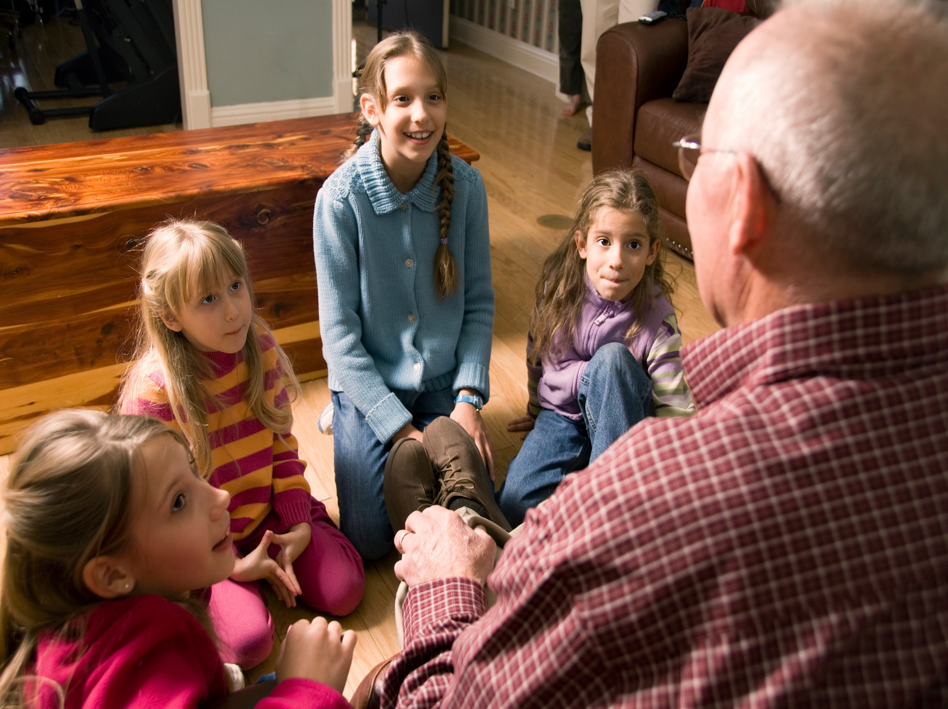
'You shall rise before the gray headed and honor the presence of an old man, and fear your God: I am the LORD.' — Leviticus 19:32
honor
honor
honor
an old man
Notes:
The experience of time, if endured, delivers the exceptional.

Slide 21

Therefore, brethren, having boldness to enter the Holiest by the blood of Jesus, by a new and living way which He consecrated for us, through the veil, that is, His flesh, and having a High Priest over the house of God, let us draw near with a true heart in full assurance of faith, having our hearts sprinkled from an evil conscience and our bodies washed with pure water. — Hebrews 10:19-22
boldness to
enter the Holiest
by the blood of Jesus
boldness to enter the Holiest
by the blood of Jesus
by a new and living way
which He consecrated for us
through the veil
His flesh
by a new and living way
which He
consecrated for us
through the veil
His flesh
draw near
draw near
a true heart in full assurance of faith
a true heart in full assurance of faith
Notes:
All open hearted examine the truth of His Words were His own sacrifice seals our salvation. We see God because we see Jesus.

Slide 22

Let us hold fast the confession of our hope without wavering, for He who promised is faithful. And let us consider one another in order to stir up love and good works, not forsaking the assembling of ourselves together, as is the manner of some, but exhorting one another, and so much the more as you see the Day approaching. — Hebrews 10:23-25
hold fast
hold fast
consider
one another
stir up love and good works
stir up love and good works
assembling
exhorting
one another
Notes:
Attachment to God has no separation in encouraging one another as we rise back to Him. There is an urgency as all are limited in our time together.

Slide 23
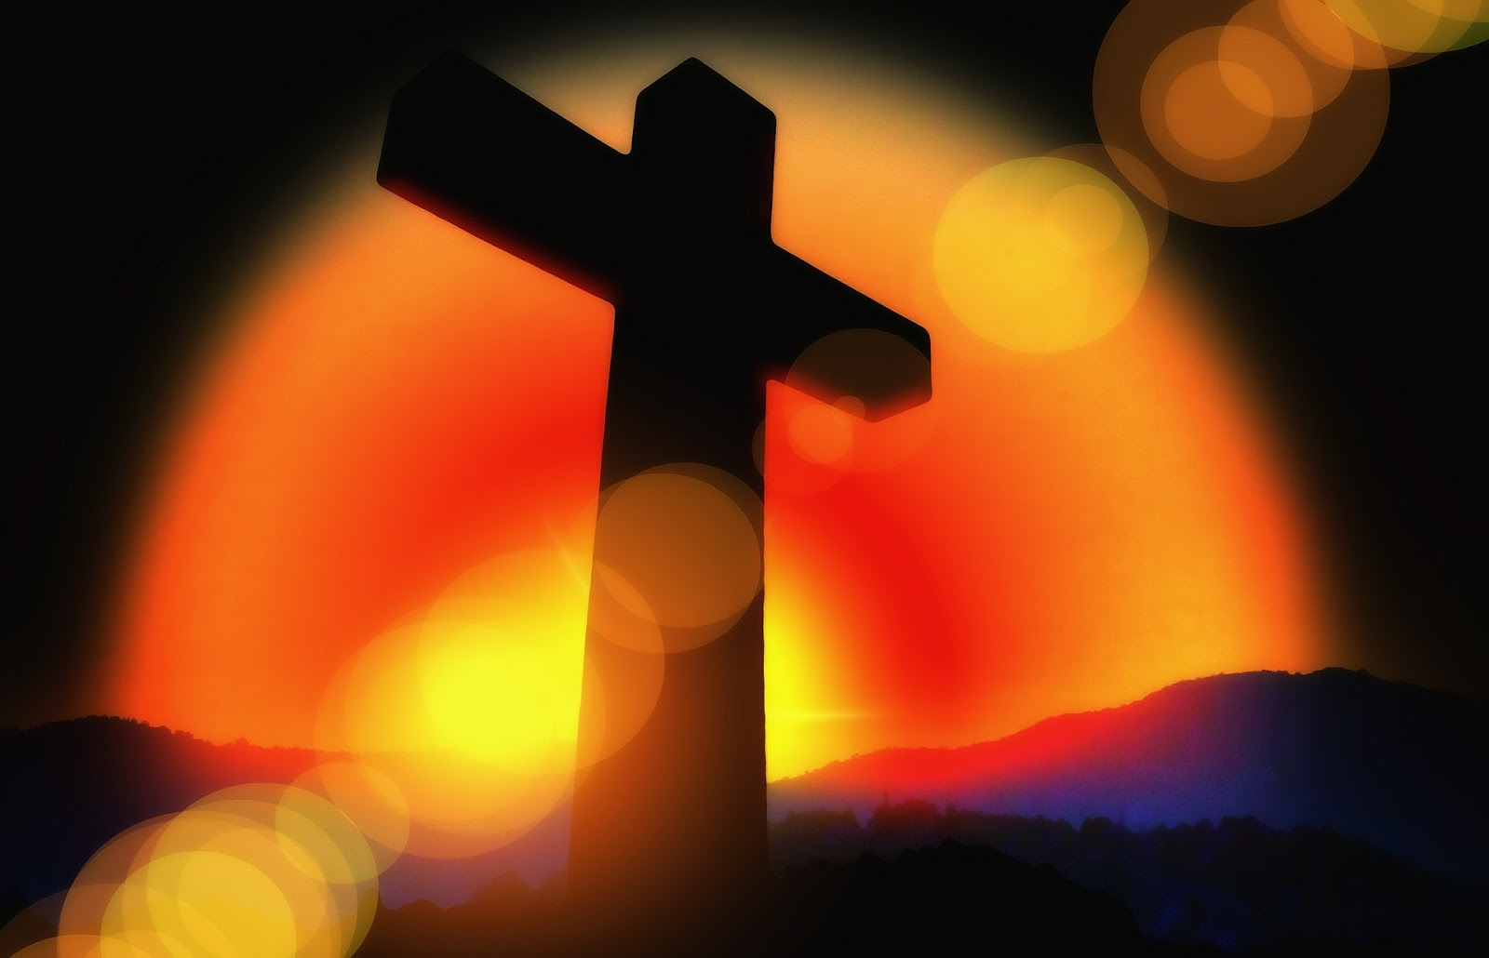
For if we sin willfully after we have received the knowledge of the truth, there no longer remains a sacrifice for sins, but a certain fearful expectation of judgment, and fiery indignation which will devour the adversaries. — Hebrews 10:26-27
sin willfully
sin willfully
GUILT
Notes:
His water is that of life, and where there is no repentance, the desert of darkness drowns the faithless. A guilty heart can be a sign of repentance otherwise a seared conscience ignores any kind of decency. A true heart is the highest of all appreciations life can deliver.

Slide 24
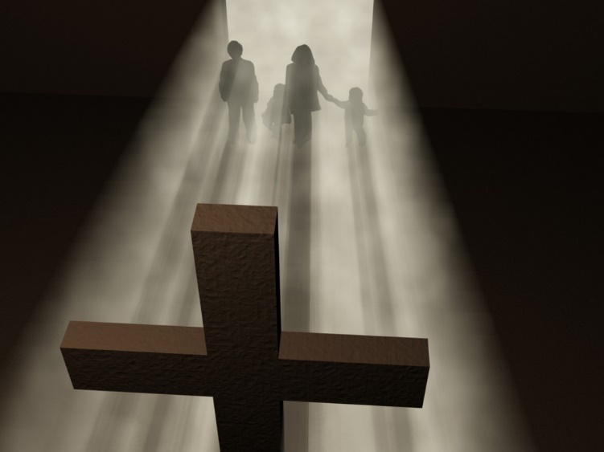
Anyone who has rejected Moses' law dies without mercy on the testimony of two or three witnesses. Of how much worse punishment, do you suppose, will he be thought worthy who has trampled the Son of God underfoot, counted the blood of the covenant by which he was sanctified a common thing, and insulted the Spirit of grace? — Hebrews 10:28-29
God
trampled the Son of God
the blood of the covenant
a common thing
insulted the Spirit of grace
trampled the Son of God
→
the blood of the
covenant
God
dismiss
a common thing
insulted the
Love One Another
Spirit of grace
Notes:
By not exalting His glorious act, offering salvation to all, dismissing His love denies the love for all. Woe to us if we dismiss love for each other, especially the brethren. Grumbling is an act of defiance in the dark.

Slide 25


For we know Him who said, "Vengeance is Mine, I will repay," says the Lord. And again, "The LORD will judge His people." It is a fearful thing to fall into the hands of the living God. — Hebrews 10:30-31
. .
know Him
. .
will judge His people
God
Notes:
It will be the Lord that will shine His truth on all of our actions. His is a realm where only the righteous dwell.

Slide 26
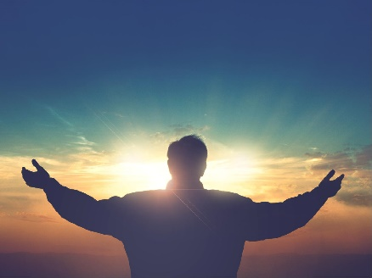

















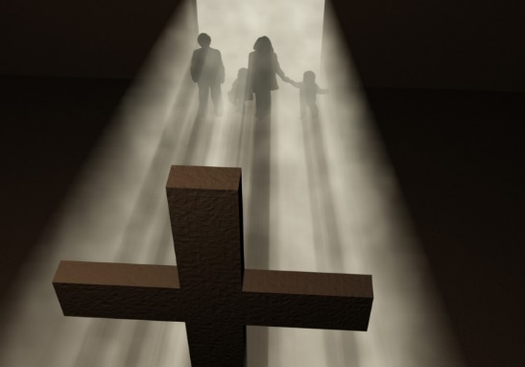



Slide 27

→ Do unto others as you would have them do to you
→ Laws: Love the Lord with your all & neighbor as self
→ On these 2 laws hang all the Law and the Prophets
→ Esteem others better than self
→ Whoever hates one is a murderer / no eternal life
→ What comes out of one is what defiles one
→ Shun immoral unless repentance turns then forgive
→ Law: he who loves God must love his brother also
→ Let love be without hypocrisy serving the Lord
→ Show yourself a pattern of good works free of guilt
→ Honor all people. Love the brotherhood. Fear God.
→ Draw near to God w/true heart in full assurance
→ Willfully sinning after knowing His truth condemns
Life is in God over contempt for others
Notes:
Life is in God over contempt for others.

Slide 28
Notes:
Darkness holds the emptiness of all that cannot be found.

Slide 29

Please visit http://www.RonBert.com to explore further
Ronald Bert Channel on
Notes:
Eternity never ends.

