Slide 2
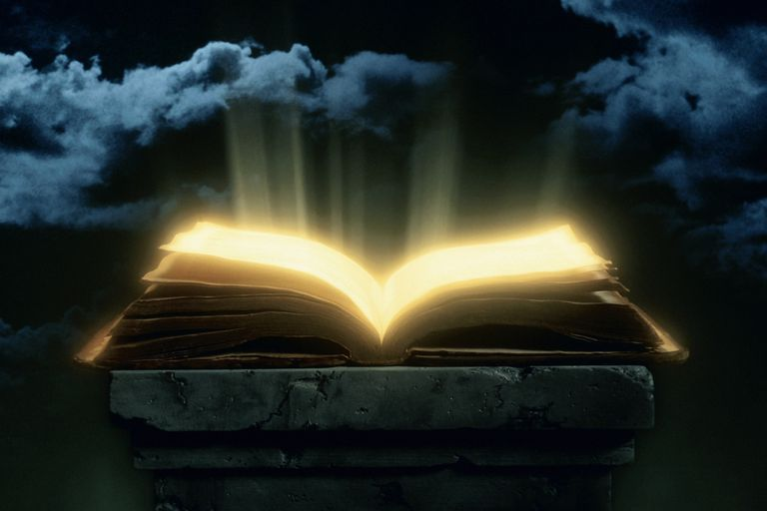
Book of Life
Ron Bert
June 30, 2019

Slide 3
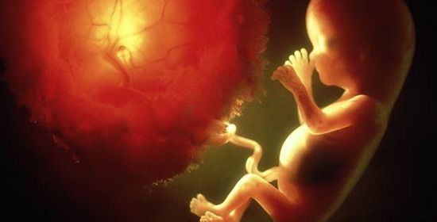
Your eyes saw
in Your book
all were written
in
Your eyes saw my substance, being yet unformed. And in Your book they all were written, The days fashioned for me, When as yet there were none of them. — Psalms 139:16
Your eyes saw
my substance
my substance
book
my substance
being yet unformed
in
Your book
all were
in Your book
Your book
book
↙
my substance
being yet unformed
days fashioned for me
yet there were none of them
written
days
days fashioned for
me
as yet
yet there were
no
none of them
→
←
Notes:
The Bible confirms that at the point of conception a heavenly soul is created. Laws of man do not supersede the announced ordinances of God. The Book of God includes life in His light.

Slide 4

And further, my son, be admonished by these. Of making many books there is no end, and much study is wearisome to the flesh. — Ecclesiastes 12:12
book
"But you, Daniel, shut up the words, and seal the book until the time of the end; many shall run to and fro, and knowledge shall increase." — Daniel 12:4
seal
the book
book
until the
seal
the book
book
until the
end
many shall run
end
many shall run
knowledge shall increase
knowledge shall increase
GOD
Men
Notes:
Knowledge cannot replace the wisdom of God that transcends knowledge itself. Some choose to see God while others deny His power and grace of salvation. While God has knowledge of souls, souls do not necessarily have knowledge of God. It is in this creation, where choice is given, that God examines the merits of hearts.

Slide 5
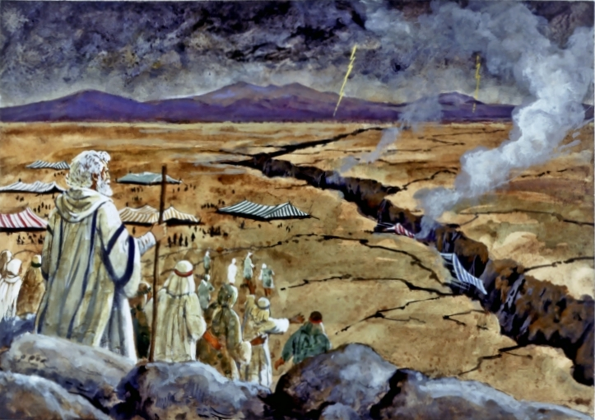
And the LORD said to Moses, "Whoever has sinned against Me, I will blot him out of My book. — Exodus 32:33
the LORD said
the LORD said
My book
book
My book
My book
God
For the wages of sin is death, but the gift of God is eternal life in Christ Jesus our Lord. — Romans 6:23
HELL
death
sin
death
God
eternal life
in
eternal life
HEAVEN
Christ Jesus
Notes:
God watches all, and as such, our actions will reveal the destiny we choose, either in Him or not.

Slide 6

For this is good and acceptable in the sight of God our Savior, who desires all men to be saved and to come to the knowledge of the truth. For there is one God and one Mediator between God and men, the Man Christ Jesus, who gave Himself a ransom for all, to be testified in due time, for which I was appointed a preacher and an apostle -- I am speaking the truth in Christ and not lying -- a teacher of the Gentiles in faith and truth. — 1st Timothy 2:3-7
God our Savior
desires all men to
be saved
come to the knowledge of
the truth
God our Savior
desires all men to be saved
come to the knowledge of the truth
God
God
God
Notes:
The question will always remain, do we come to God or a substitute? His truth is plain in His call to come, and through His son, Christ Jesus our savior God incarnate.

Slide 7
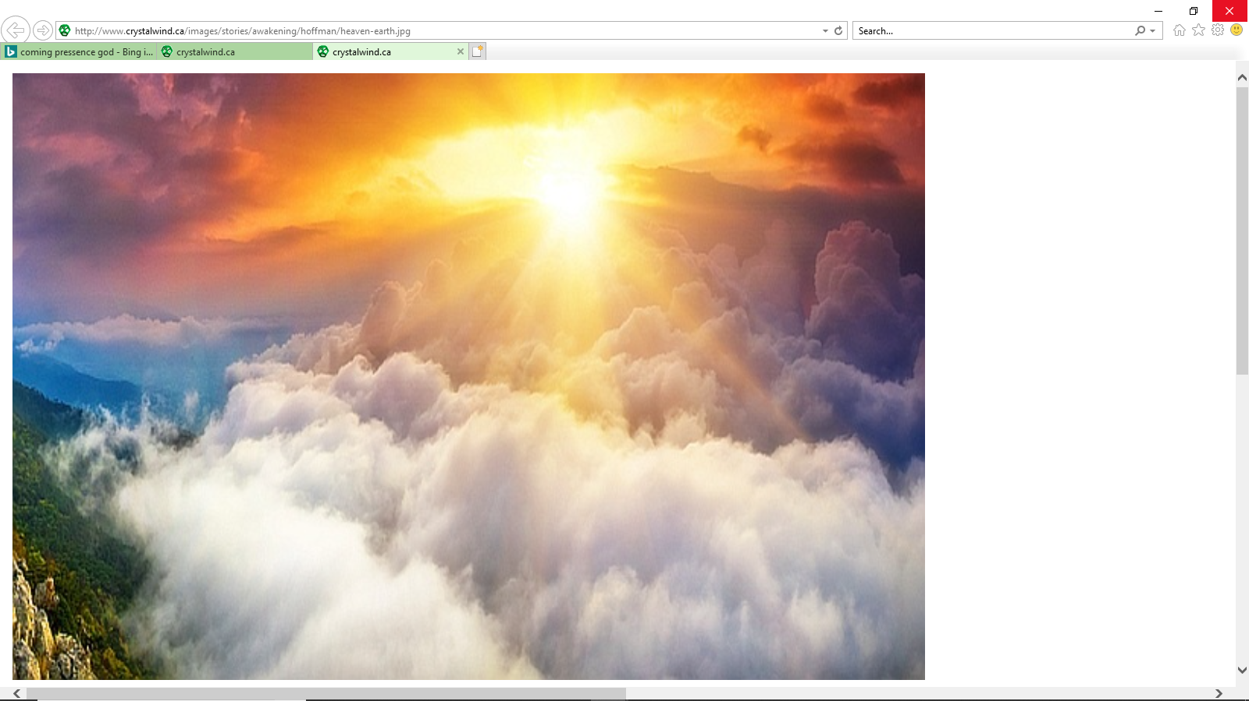
Be diligent to present yourself approved to God, a worker who does not need to be ashamed, rightly dividing the word of truth. — 2nd Timothy 2:15
writes chapters
present yourself
present yourself
God
to God
God
worker
to God
the word
worker
Notes:
The word of truth is written for man to know how to approach that which has been denied, a return to His eternal kingdom of life.

Slide 8

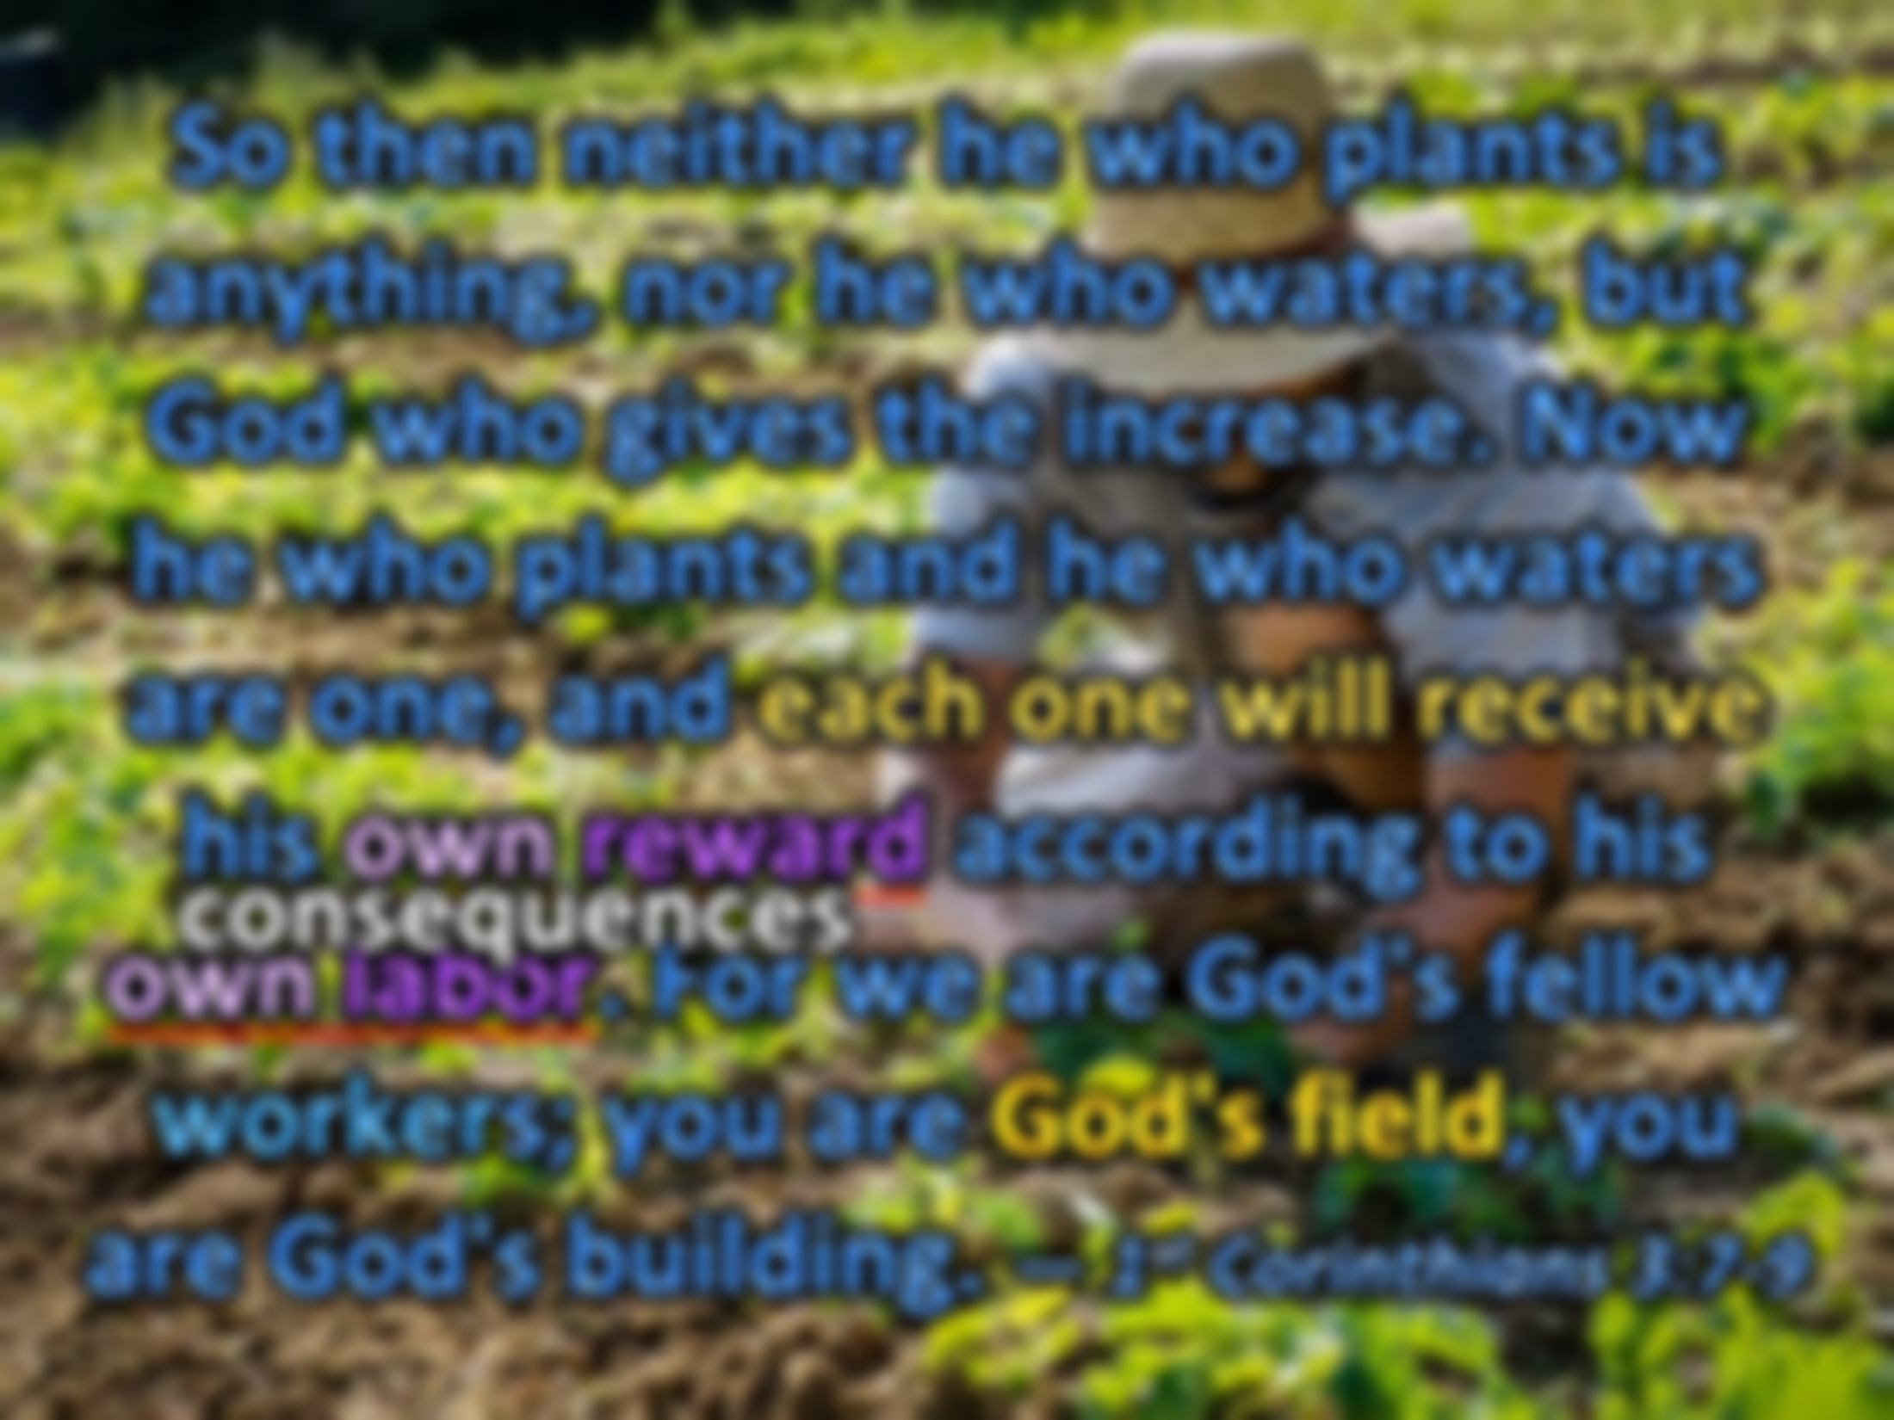

So then neither he who plants is anything, nor he who waters, but God who gives the increase. Now he who plants and he who waters are one, and each one will receive his own reward according to his own labor. For we are God's fellow workers; you are God's field, you are God's building. — 1st Corinthians 3:7-9
Life Light Time
God who gives the increase
gives
God who gives the increase
labor
own reward
own
worker
own reward
consequences
Actions
own
labor
own labor
own labor
worker
God's field
Notes:
Each of us is a worker. The fruits of which are shown by our labors. Where one labors for good, another schemes for evil. As it is God’s kingdom, the field will be purged of the weeds that have no root in Him. Power belongs to the Lord, not men.

Slide 9
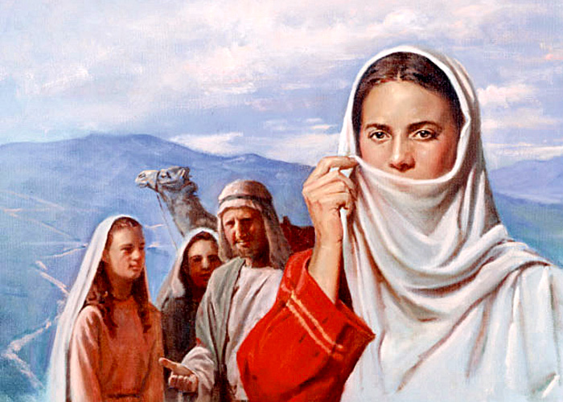
And I urge you also, true companion, help these women who labored with me in the gospel, with Clement also, and the rest of my fellow workers, whose names are in the Book of Life. — Philippians 4:3
And I urge you also, true companion, help these women who labored with me in the gospel, with Clement also, and the rest of my fellow workers, whose names are in the Book of Life. — Philippians 4:3
And I urge you also, true companion, help these women who labored with me in the gospel, with Clement also, and the rest of my fellow workers, whose names are in the Book of Life. — Philippians 4:3
in
labored with me in the
labored with me in the
labor
gospel
Clement
choice
A good name is better than precious ointment, And the day of death than the day of one's birth; — Ecclesiastes 7:1
A good name is better than precious ointment, And the day of death than the day of one's birth; — Ecclesiastes 7:1
A good name is better than precious ointment, And the day of death than the day of one's birth; — Ecclesiastes 7:1
A good name
fellow workers
A good name
worker
fellow workers
A good name is to be chosen rather than great riches, Loving favor rather than silver and gold.
— Proverbs 22:1
A good name is to be chosen
A good name is to be chosen
names are in the Book of Life
name
the day
names are in the Book of Life
in
the day
death
Spirit
Materialism
birth
Notes:
Certainly women are called as equally to be servants and laborers in His kingdom.

Slide 10
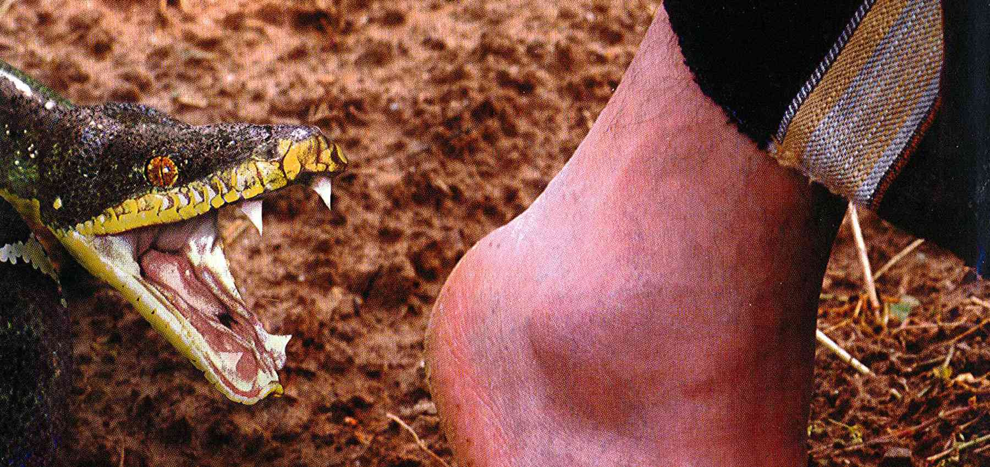
"Behold, I give you the authority to trample on serpents and scorpions, and over all the power of the enemy, and nothing shall by any means hurt you. Nevertheless do not rejoice in this, that the spirits are subject to you, but rather rejoice because your names are written in heaven." — Luke 10:19-20
I give you
I give you
the power
the power
arrogance
Book of Life
do not rejoice in this
do not rejoice in this
rejoice because
your names are
your names are
in
written in heaven
written in heaven
written in heaven
Notes:
Many gifts and talents have been spread about His kingdom of life throughout time. More important than rejoicing in one's own talents is rejoicing in the forgiveness and grace He offers to all, especially made available to ourselves.

Slide 11

"He who overcomes shall be clothed in white garments, and I will not blot out his name from the Book of Life; but I will confess his name before My Father and before His angels." — Revelation 3:5
overcomes
white garment
overcomes
Book of Life
Notes:
To be in the Book of Life one must overcome the practicing of those things He has commanded not to practice. The reward is greater than the passing sinful practice, and so many cannot muster the strength to overcome the weakness they cannot defeat.

Slide 12
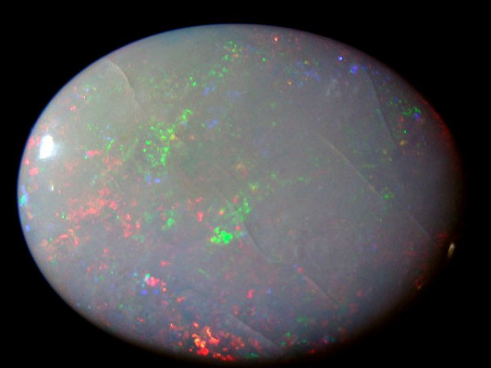
"He who has an ear, let him hear what the Spirit says to the churches. To him who overcomes I will give some of the hidden manna to eat. And I will give him a white stone, and on the stone a new name written which no one knows except him who receives it."' — Revelation 2:17
overcomes
give
give
Life
overcomes
to eat
to eat
white stone
white stone
new name
new name
written

Slide 13

"He who has an ear, let him hear what the Spirit says to the churches. To him who overcomes I will give to eat from the tree of life, which is in the midst of the Paradise of God." — Revelation 2:7
I will
T o him who overcomes
overcomes
I will
give to eat
tree of life
is in
tree of life
Paradise of God
Notes:
God has promised that those who overcome will partake in the eternal life giving fruit of His giving.

Slide 14
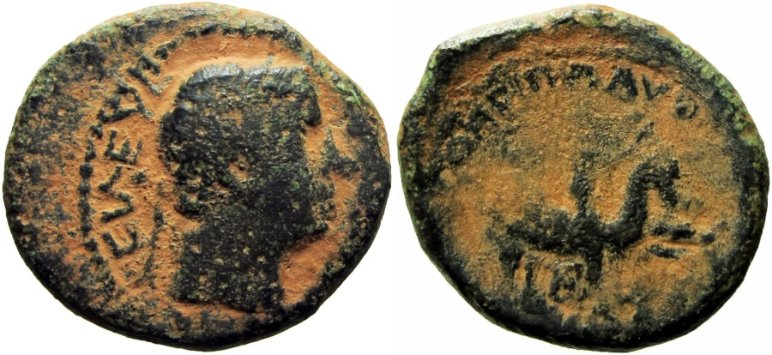
"But I will show you whom you should fear: Fear Him who, after He has killed, has power to cast into hell; yes, I say to you, fear Him! Are not five sparrows sold for two copper coins? And not one of them is forgotten before God. But the very hairs of your head are all numbered. Do not fear therefore; you are of more value than many sparrows. Also I say to you, whoever confesses Me before men, him the Son of Man also will confess before the angels of God. But he who denies Me before men will be denied before the angels of God." — Luke 12:5-9
I will
confesses Me before men, him the Son of Man also will confess before the angels of God
confesses Me before men, him the Son of Man also will confess before the angels of God
confesses
he who denies Me before men will be denied before the angels of God
he who denies Me before men will be denied before the angels of God
denies
heaven
hell
confesses Me
before men, him the
Son of Man
also will
confess before the
angels of God
he who denies Me
before men will be
denied
before the
angels of God
Notes:
Many hearts perceive their destination of choice. Both those descending and ascending have an inkling of the path they reach out for.

Slide 15

But there shall by no means enter it anything that defiles, or causes an abomination or a lie, but only those who are written in the Lamb's Book of Life. — Revelation 21:27
defiles
a lie
defiles
abomination
a lie
abomination
X
in
only those who are written
only those who are written
Lamb's Book of Life
Notes:
Darkness will have no entrance through the gate of eternal light.

Slide 16

Let them be blotted out of the book of the living, And not be written with the righteous. — Psalms 69:28
unrighteous
X
them
book of the living
book
in
living
book of the living
written
the
righteous
written with
the righteous
the righteous
righteous written in the living book
Notes:
Only the righteous will appear in His book of the living. By righteous it is a call to His ways, and not the pompous elite that only find favor with themselves.

Slide 17
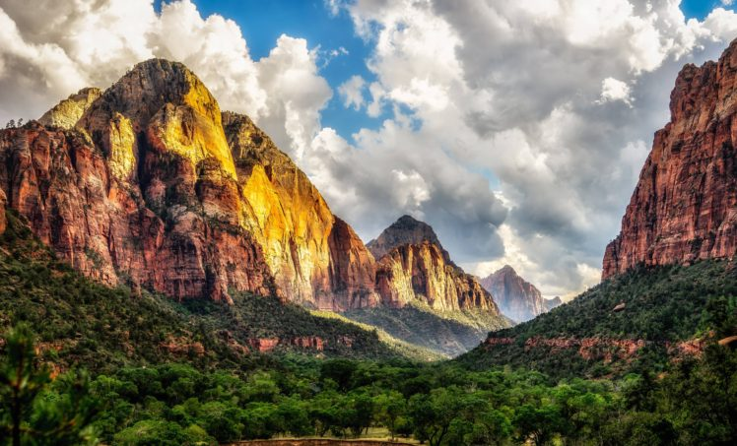
But you have come to Mount Zion and to the city of the living God, the heavenly Jerusalem, to an innumerable company of angels, to the general assembly and church of the firstborn who are registered in heaven, to God the Judge of all, to the spirits of just men made perfect, to Jesus the Mediator of the new covenant, and to the blood of sprinkling that speaks better things than that of Abel. — Hebrews 12:22-24
to Mount Zion
to
∙ to Mount Zion
∙ to the living God
the heavenly Jerusalem
∙ to an innumerable company of angels
∙ to the general assembly of the firstborn who are registered in heaven
∙ to God the Judge of all
∙ to the spirits of just men made perfect
∙ to Jesus the Mediator
to
the living God
the heavenly
Jerusalem
to an innumerable company
to
of angels
to the general assembly
Jesus
to
of the firstborn
who are
in
registered in heaven
registered in heaven
to God the Judge
registered in heaven
to
of all
in
to the spirits of just men made
perfect
to Jesus the Mediator
to
Jesus
Life
to
to the blood
to the blood
to
Jesus
Jesus
Notes:
For all those who desire to arrive in heaven, Jesus is the only master and mediator between God and men.

Slide 18
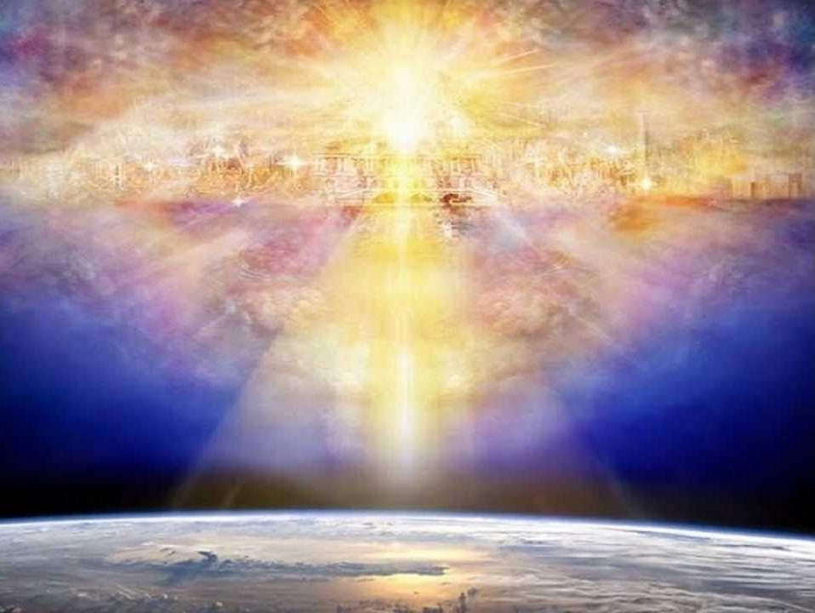
Therefore God also has highly exalted Him and given Him the name which is above every name, that at the name of Jesus every knee should bow, of those in heaven, and of those on earth, and of those under the earth, and that every tongue should confess that Jesus Christ is Lord, to the glory of God the Father. — Philippians 2:9-11
the name
the name
of Jesus every knee should bow
Jesus
knee
of those in heaven
of those in heaven
knee
on earth
on earth
Jesus Christ
Jesus Christ
glory of God
glory of God
Notes:
It is God’s own proclamation that all will return to Him through Jesus, either knowingly of unknowingly. Quite a fearful thing to fall into the hands of a living God without knowledge of Him.

Slide 19
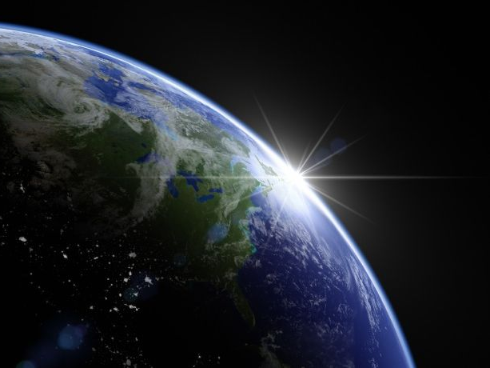
For it is written: "As I live, says the LORD, Every knee shall bow to Me, And every tongue shall confess to God." — Romans 14:11
As I live
knee
confess to God
confess to God

Slide 20
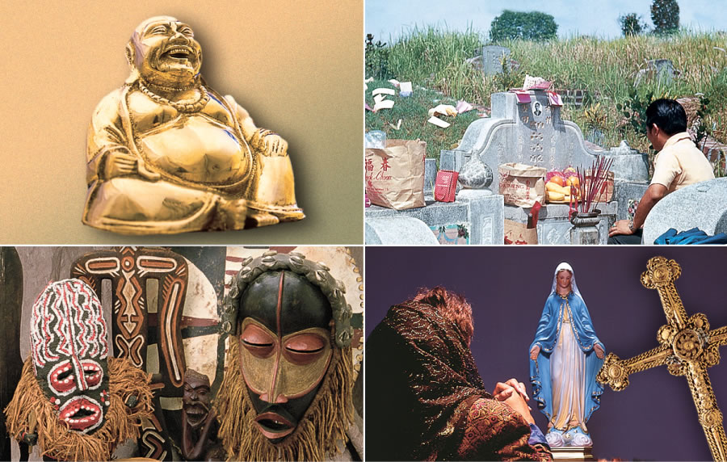
All who dwell on the earth will worship him, whose names have not been written in the Book of Life of the Lamb slain from the foundation of the world. — Revelation 13:8
worship the dead
false religion
worship him
worship him
not been written in the Book of Life
not
not
written in the Book of Life
not been written in the Book of Life
X
not written in the Book of Life
worship delusion
worship idols
Notes:
Those not written in the Book of life have denied where He calls us out, to be in Him, rather choosing to worship creations of man’s imagination.

Slide 21

"The beast that you saw was, and is not, and will ascend out of the bottomless pit and go to perdition. And those who dwell on the earth will marvel, whose names are not written in the Book of Life from the foundation of the world, when they see the beast that was, and is not, and yet is." — Revelation 17:8
will marvel
→
witness true death
not written in the Book of Life
not written in the Book of Life
. .
eternal damnation
Notes:
There is an abstraction of where those that are not are. Nothing good comes to those dealt to this eternal damnation.

Slide 22
"The beast that you saw was, and is not, and will ascend out of the bottomless pit and go to perdition. And those who dwell on the earth will marvel, whose names are not written in the Book of Life from the foundation of the world, when they see the beast that was, and is not, and yet is." — Revelation 17:8
Book of Life
Book of Life
Temporary evil
Notes:
There is an abstraction of where those that are not are. Nothing good comes to those dealt to this eternal damnation.

Slide 23
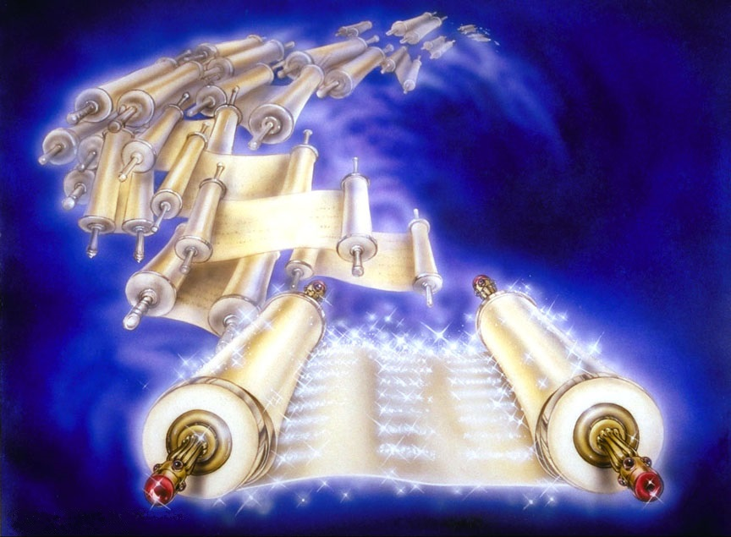
And I saw the dead, small and great, standing before God, and books were opened. And another book was opened, which is the Book of Life. And the dead were judged according to their works, by the things which were written in the books. — Revelation 20:12
books were opened
books were opened
Book of Life
life
Book of Life
life
judged according to their works
judged according to their works
Notes:
Terminal time will come as time’s gravity runs out. The well will be purged of all those who have not made it to His fountain of life. Salvation is a work of character and willingness to share in His truth and spirit.

Slide 24
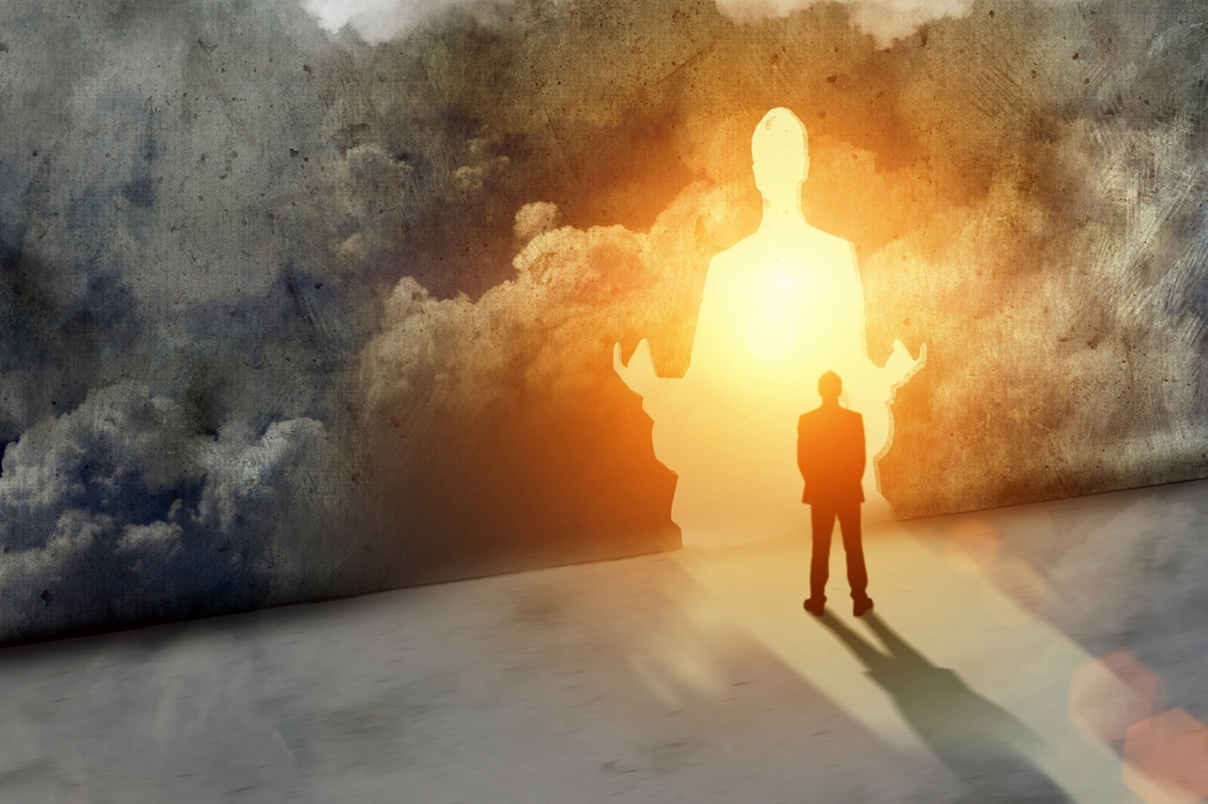
And many of those who sleep in the dust of the earth shall awake, Some to everlasting life, Some to shame and everlasting contempt. — Daniel 12:2
everlasting life
life
everlasting life
everlasting contempt
everlasting contempt
Notes:
Heaven and hell are real with the latter most dreadful.

Slide 25
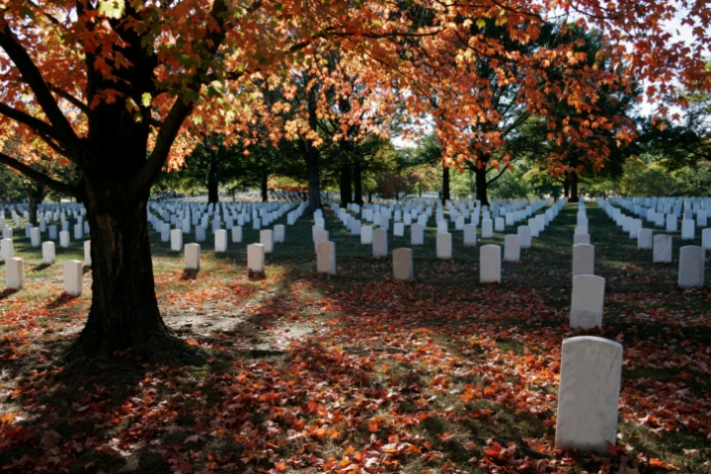
"Do not marvel at this; for the hour is coming in which all who are in the graves will hear His voice and come forth -- those who have done good, to the resurrection of life, and those who have done evil, to the resurrection of condemnation." — John 5:28-29
done good
resurrection
of life
done good
resurrection
of life
done good
done evil
resurrection of
condemnation
done evil
resurrection of
condemnation
resurrection of life
resurrection of life
resurrection
of life
done evil
resurrection
of
condemnation
Notes:
A divide between good and bad is an eventuality for all He calls forth.

Slide 26
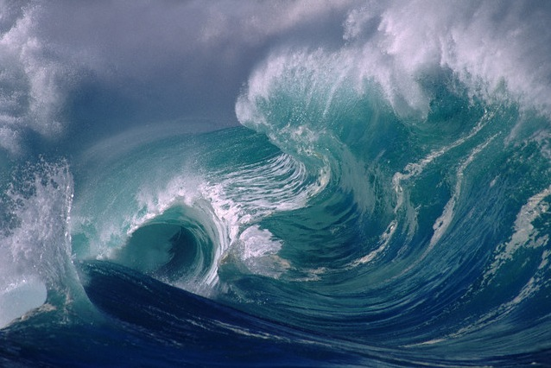
The sea gave up the dead who were in it, and Death and Hades delivered up the dead who were in them. And they were judged, each one according to his works.
Then Death and Hades were cast into the lake of fire. This is the second death. — Revelation 20:13-14
judged
each one according to his works
each one according to his works
lake of fire
lake of fire
lake of fire
second death
second death
Notes:
Let no one fool you that works are not an essential part of our eternal judgment. It is awareness of this judgment, of our works, that makes men of higher integrity under accountability. No one is impervious to God’s own wave of truth.

Slide 27
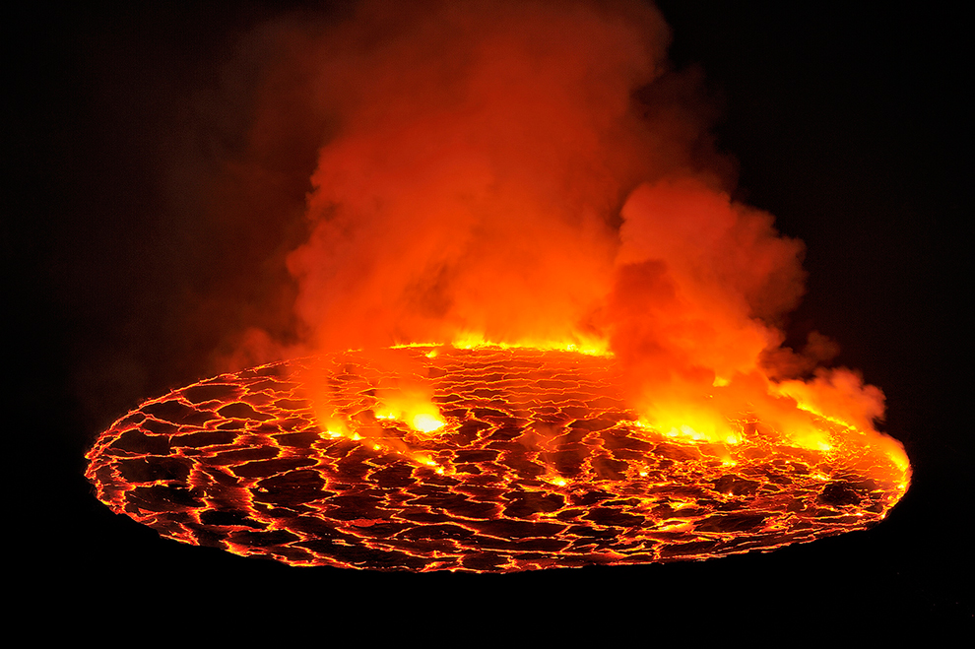
And anyone not found written in the Book of Life was cast into the lake of fire. — Revelation 20:15
not found
in
not found
written in
Book of Life
Book of Life
lake of fire
written in
Notes:
Destruction is an inevitable consequence, for the casting off of God, in the lustful preferences of man.

Slide 28
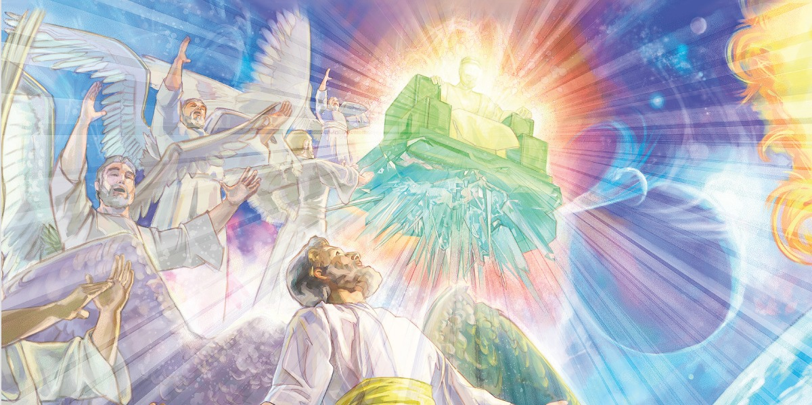
At that time Michael shall stand up, The great prince who stands watch over the sons of your people; And there shall be a time of trouble, Such as never was since there was a nation, Even to that time. And at that time your people shall be delivered, Every one who is found written in the book. — Daniel 12:1
"And many of those who sleep in the dust of the earth shall awake, Some to everlasting life, Some to shame and everlasting contempt." — Daniel 12:2
HEAVEN
everlasting life
everlasting contempt
outside
HELL
delivered
Every one who is found
saved
rescued
released
liberated
Every one who is found
freed
the book
written in the book
written in
written in the book
Notes:
Deliverance cannot be done alone as it is a gift of God, so observance in His call is vital for salvation.

Slide 29

Blessed are those who do His commandments, that they may have the right to the tree of life, and may enter through the gates into the city. But outside are dogs and sorcerers and sexually immoral and murderers and idolaters, and whoever loves and practices a lie. — Revelation 22:14-15
do
Blessed are those who do His commandments, that they may have the right to the tree of life, and may enter through the gates into the city. But outside are dogs and sorcerers and sexually immoral and murderers and idolaters, and whoever loves and practices a lie. — Revelation 22:14-15
Blessed
those who do
those who do
outside:
• dogs
• sorcerers
• sexually immoral
• murderers
• idolaters
• whoever practices a lie
tree of life
have the right to the tree of life
have the right to the tree of life
outside
outside
dogs
sorcerers
sexually
immoral
murderers
idolaters
whoever
practices a lie
Notes:
Those whose works are of the darkness, which He has clearly defined in His goodness, will not find His blessings.

Slide 30
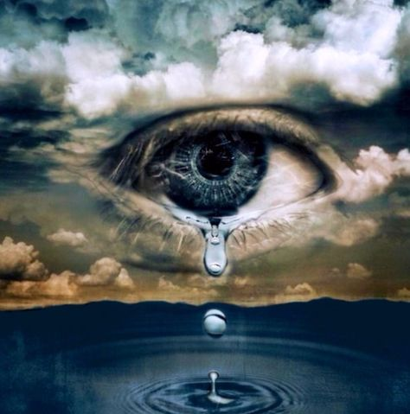
You number my wanderings; Put my tears into Your bottle; Are they not in Your book? — Psalms 56:8
in
Your book

Slide 31
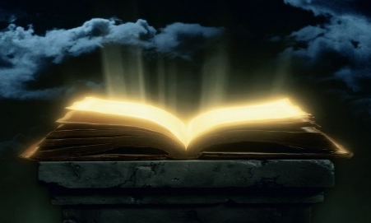

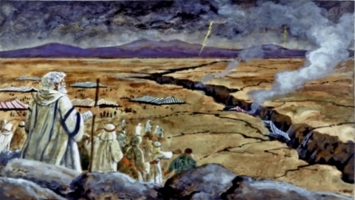


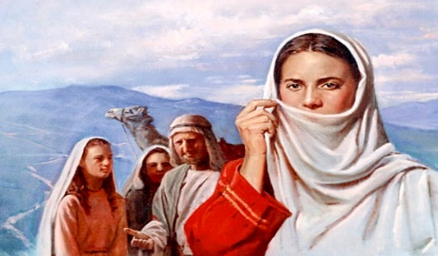
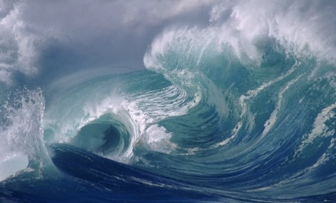


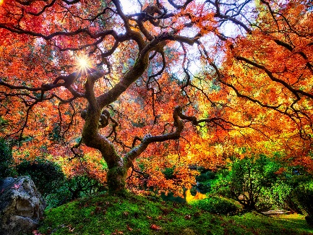






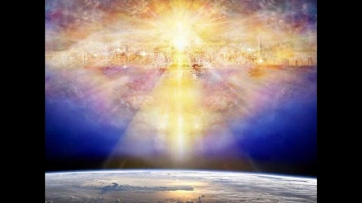


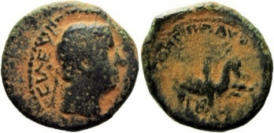


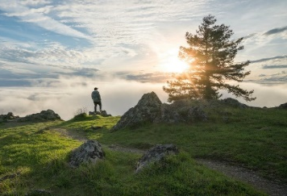


Slide 32

→ It is sin that blots one’s name out of God’s book
→ God wants all to be saved & come to know truth
→ God’s workers are His field and holy building
→ Workers of gospel have names in the Book of Life
→ Rejoice name written in heaven over given talents
→ One must overcome to eat of the tree of life
→ All abominable that defiles or lies not in Book/Life
→ Sacrifice of Jesus brings us directly to God
→ All will confess and bow to Jesus Christ
→ All are judged by what is written in the Book of Life
→ The good receive life where evil gets condemnation
→ Anyone not in the Book of Life cast in Lake of Fire
→ Obedience blesses with the right to the tree of life
Joy is where life flourishes in His presence
Notes:
Joy is where life flourishes in His presence

Slide 33
XXX

Slide 34

Please visit http://www.RonBert.com to explore further
Ronald Bert Channel on
Notes:
Eternity never ends.

Slide 35
Underline
→ ● a hope
in
Underline
EXPAND SPECIAL
wipe
XXX
bubble
golden
Thread
Blue
Magnify
Red
COLOR
COLOR
COLOR
COLOR
COLOR
COLOR
COLOR
COLOR
COLOR
COLOR
COLOR
COLOR
COLOR
COLOR
COLOR
COLOR
COLOR
COLOR
COLOR
COLOR
COLOR

Slide 36



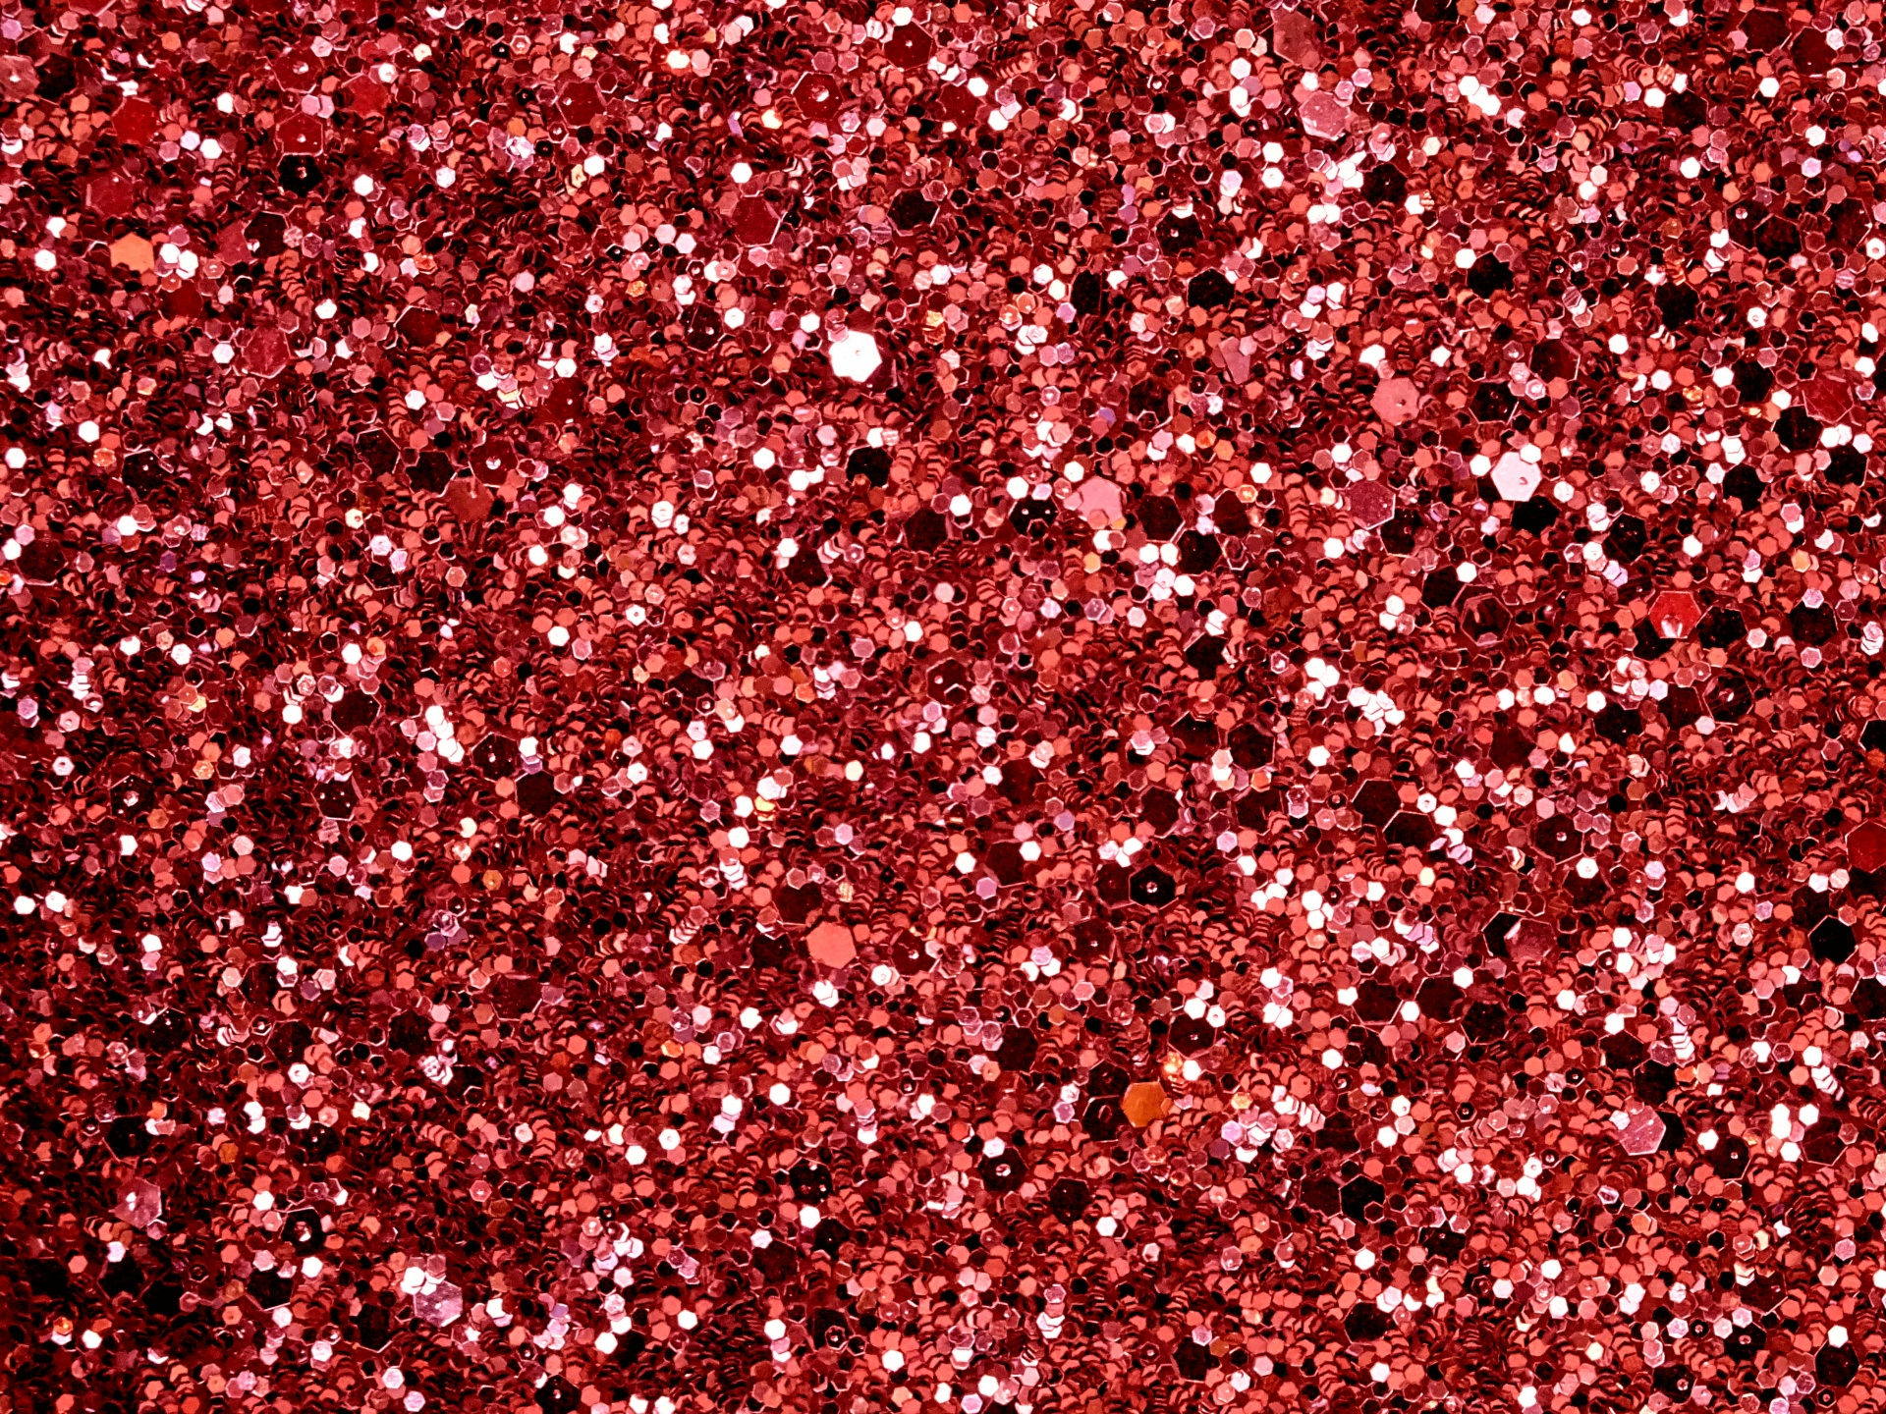

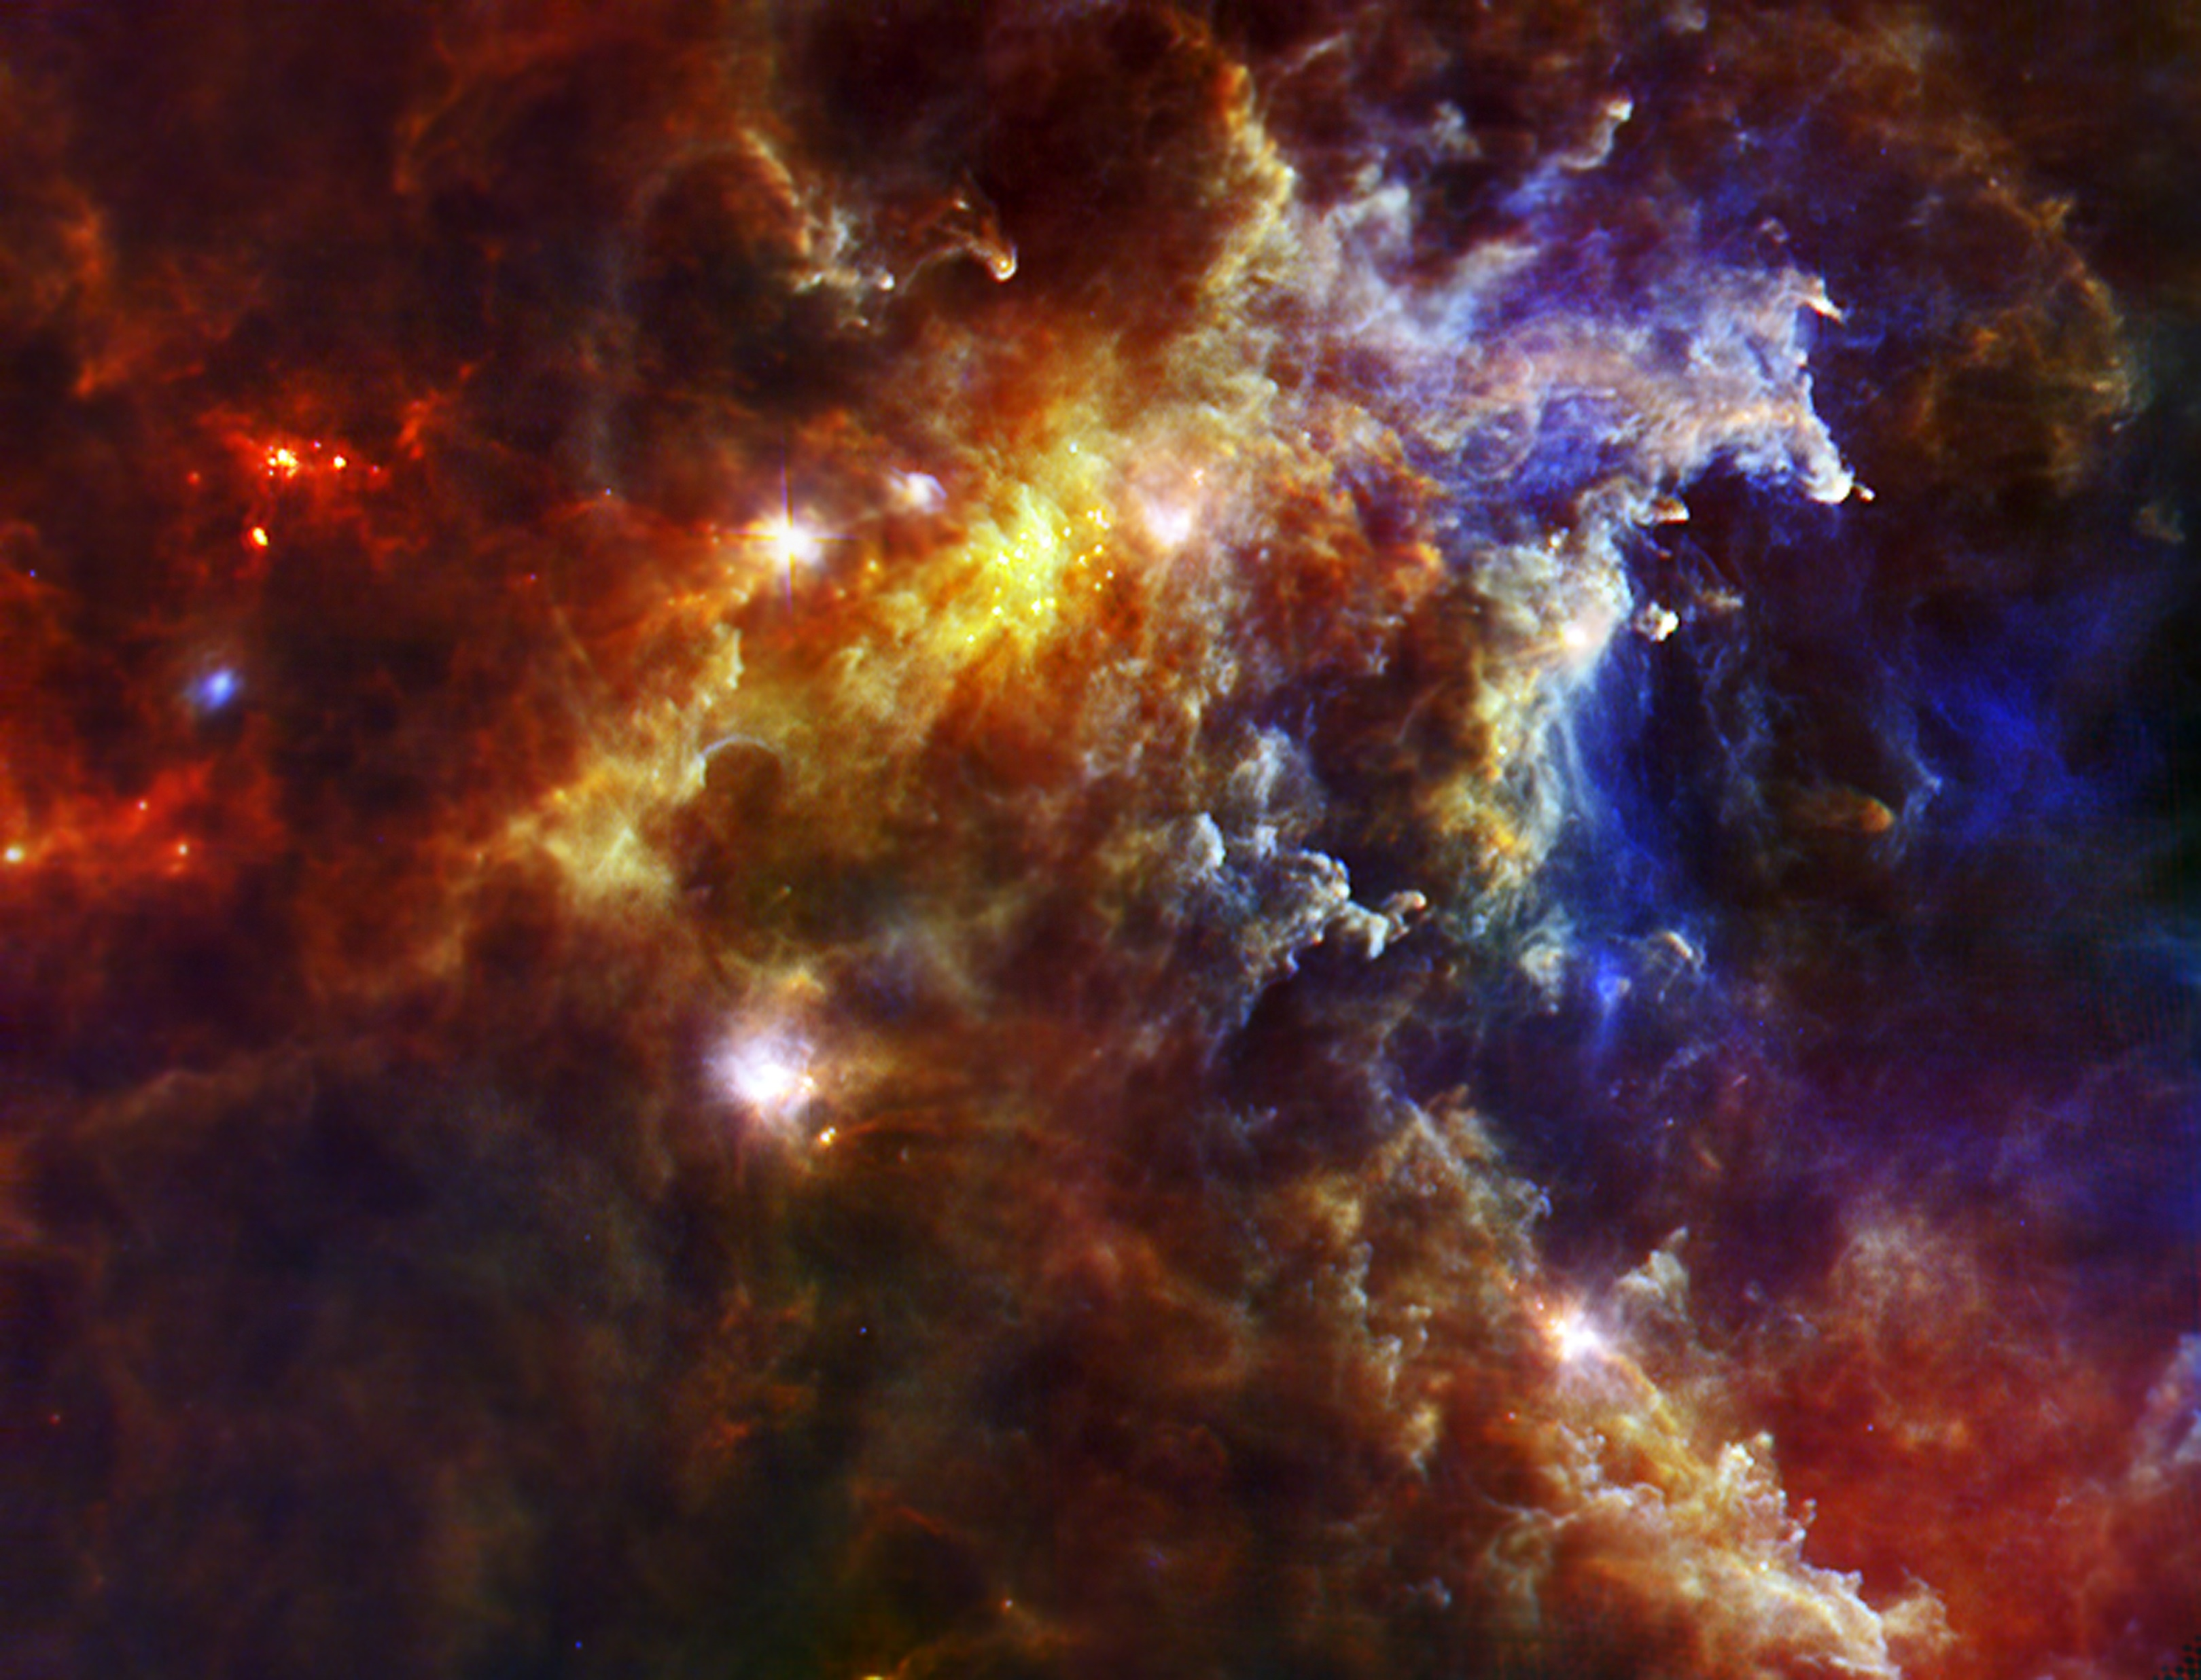


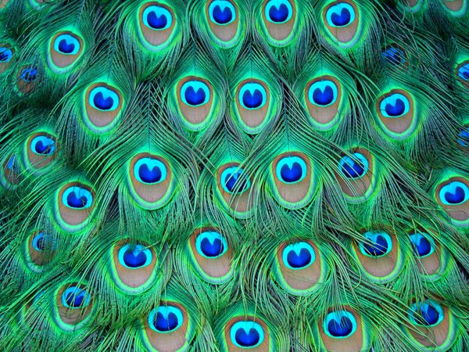




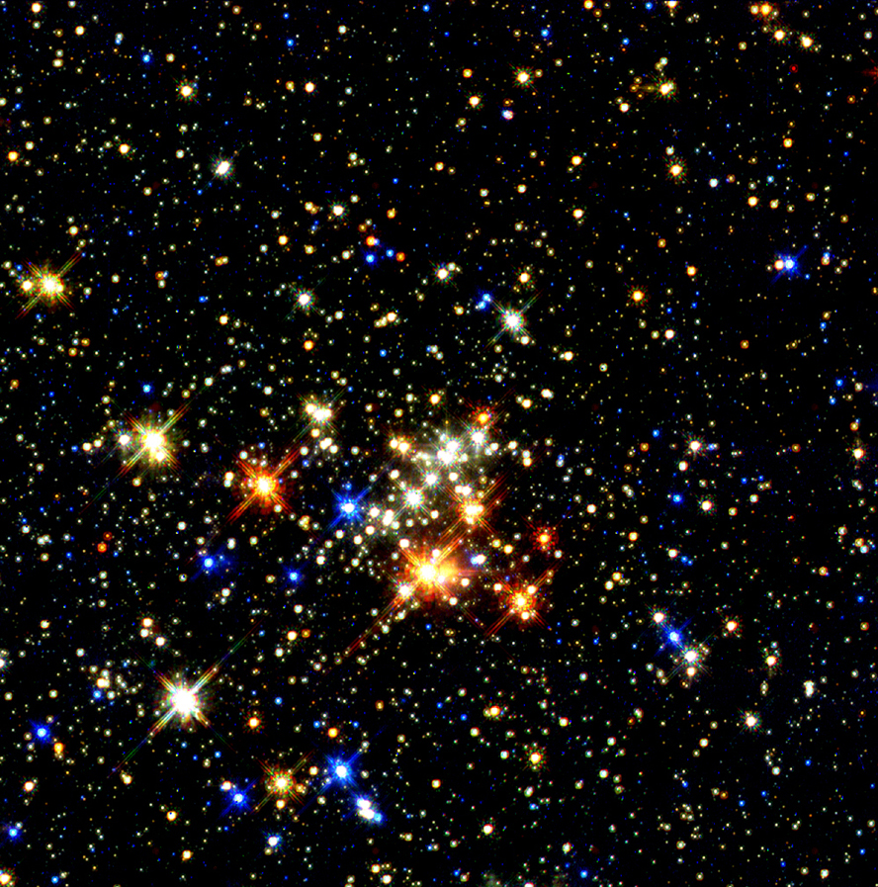
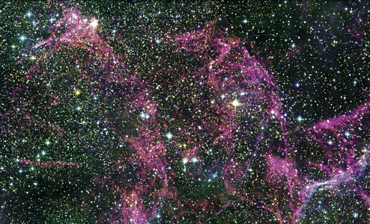
WATER
Opal
JUNGLE
ROSE
BLAST
SPARKLE
RAINBOW
STELLAR
GOLD
RUBIES
FLARE
SKY
UNIVERSE
COLOR
STARS
COLOR
Galaxy

Slide 37
You number my wanderings; Put my tears into Your bottle; Are they not in Your book? — Psalms 56:8
in
Your book
Notes:
In life we weep for the children where the heartless devour spirit. Do not let your sorrows defeat your courage to remain faithful.

