Slide 2
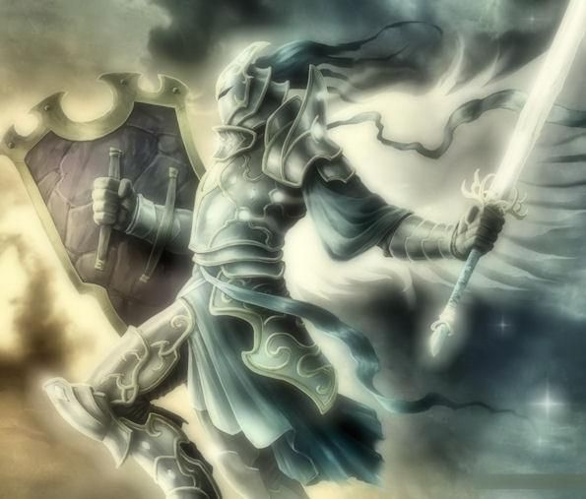
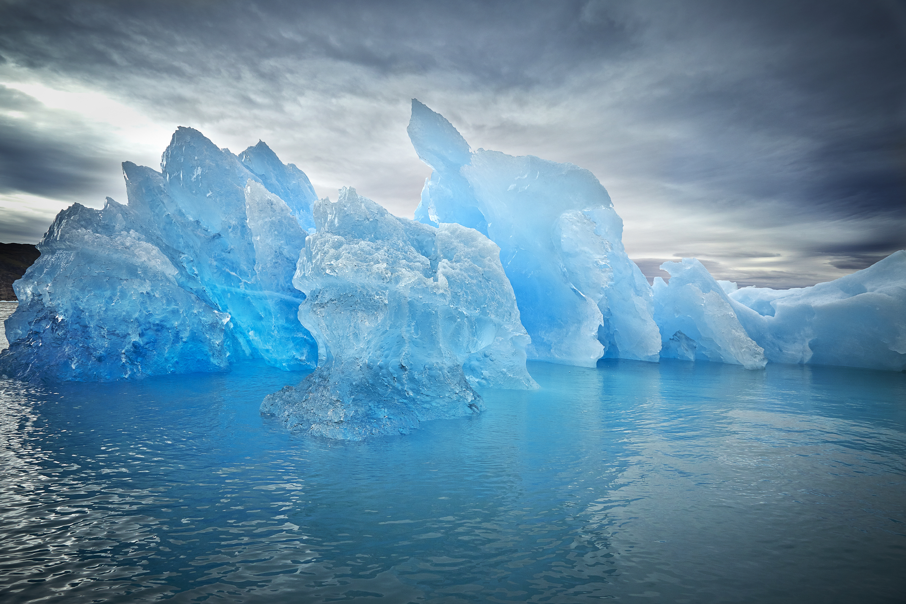
Be Strong in the LORD
(A bed sheet study)
Ron Bert
August 23, 2020

Slide 3
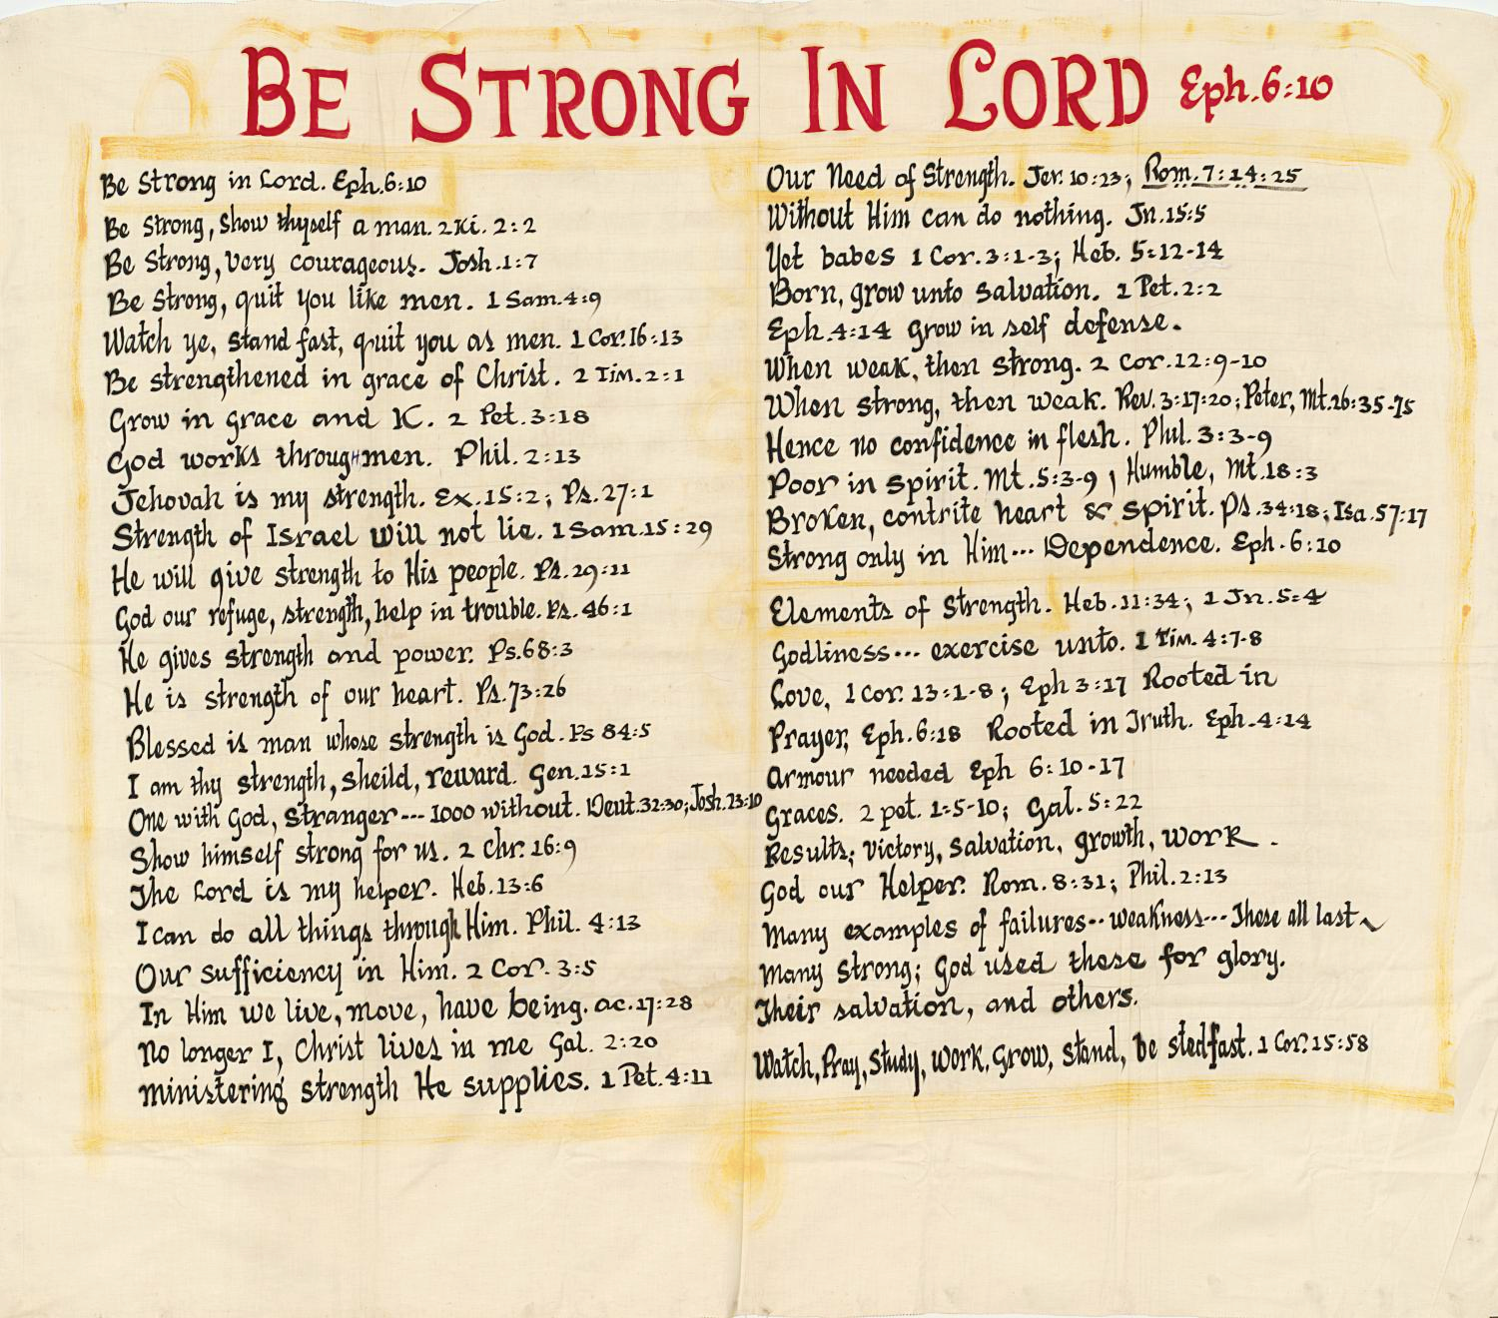

Slide 4
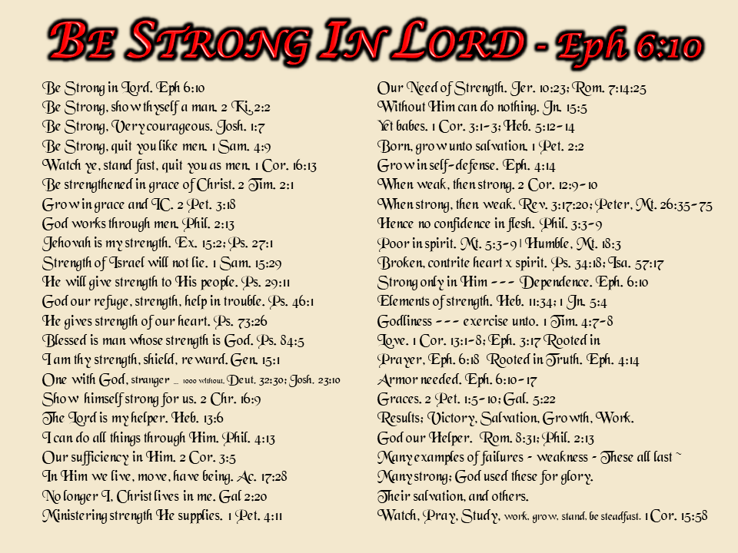

Slide 5

Notes:
Quit you as men

Slide 6
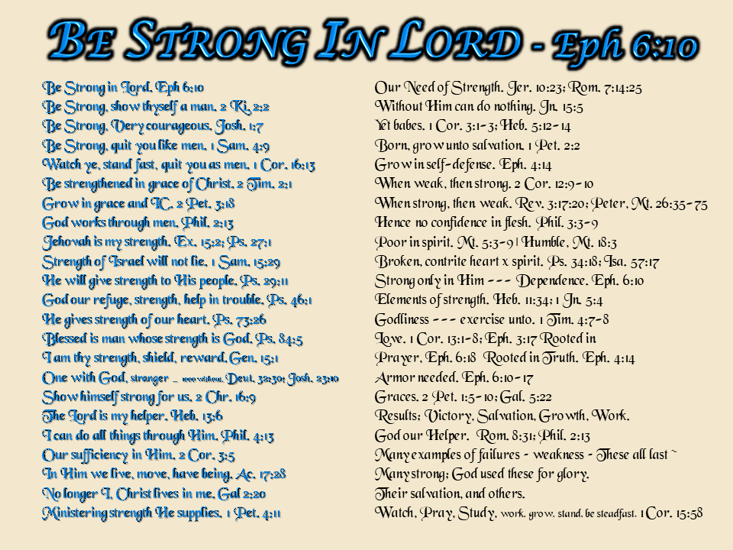
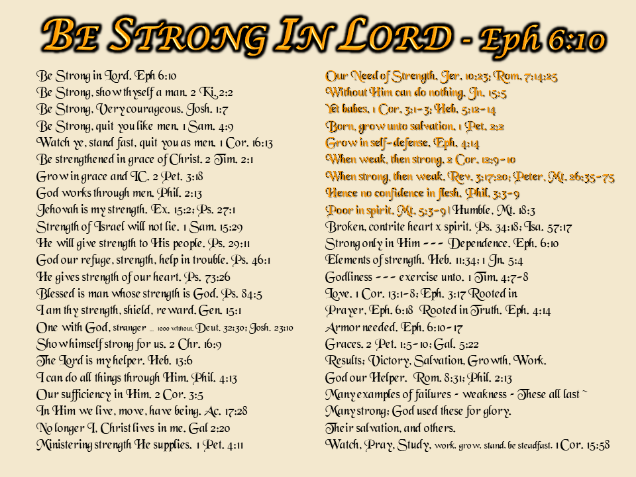
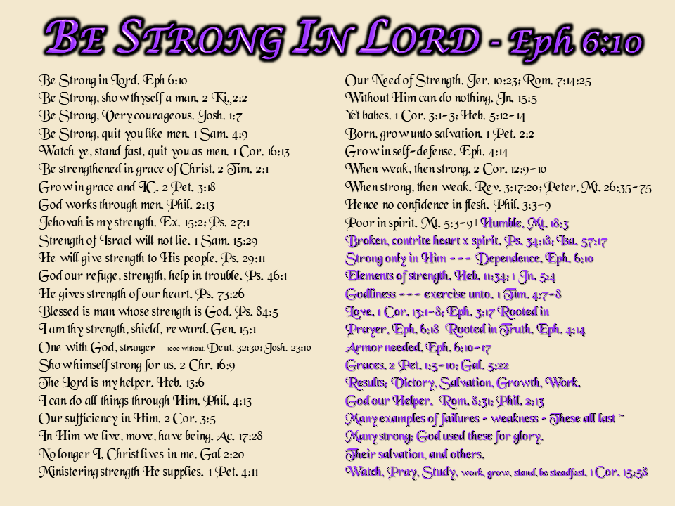
#1
#2
#3

Slide 7
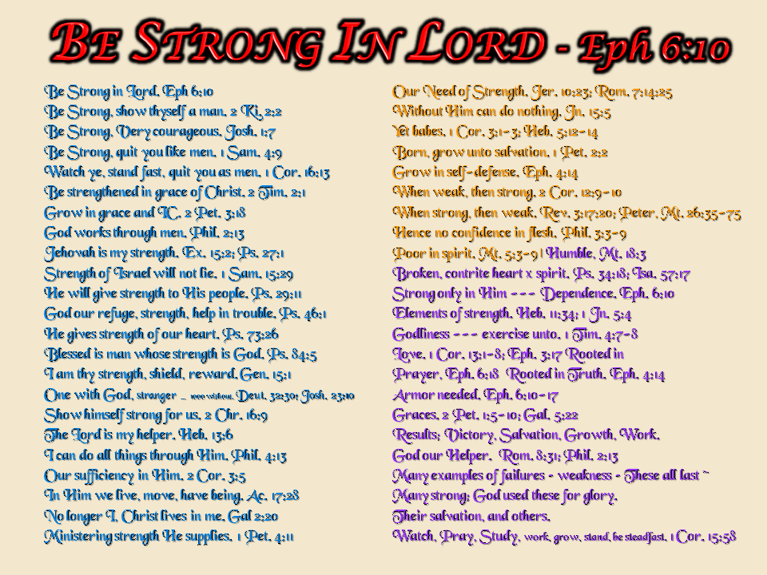

Slide 8
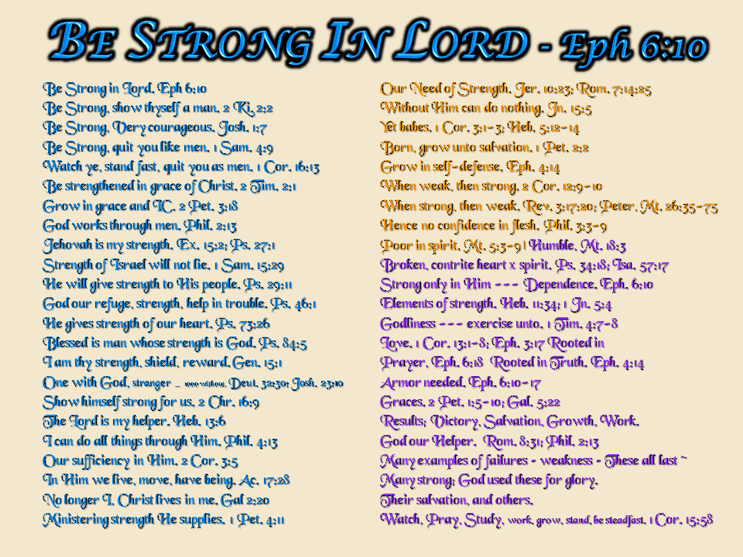
BE STRONG IN LORD - Eph 6:10

Slide 9

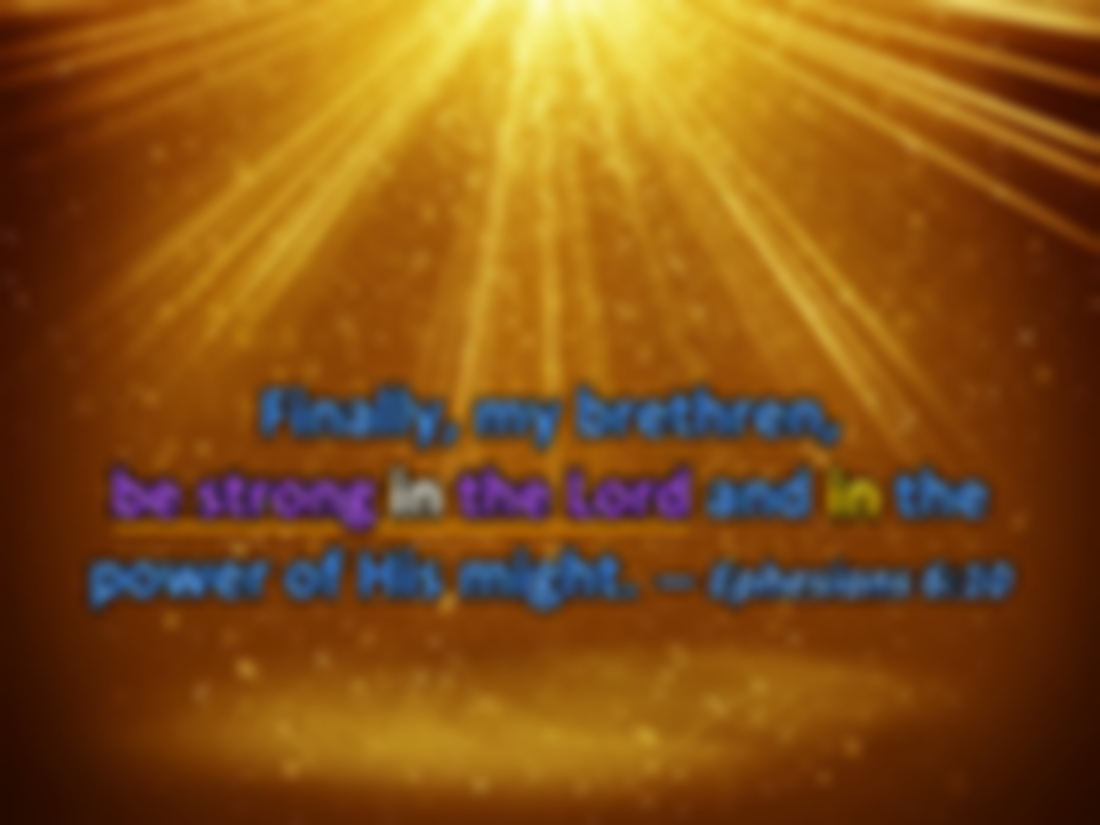

Finally, my brethren, be strong in the Lord and in the power of His might. — Ephesians 6:10
His Power
His Might
in
be strong in the Lord
. .
Notes:
Comfort comes by knowing God is, Almighty God.

Slide 10
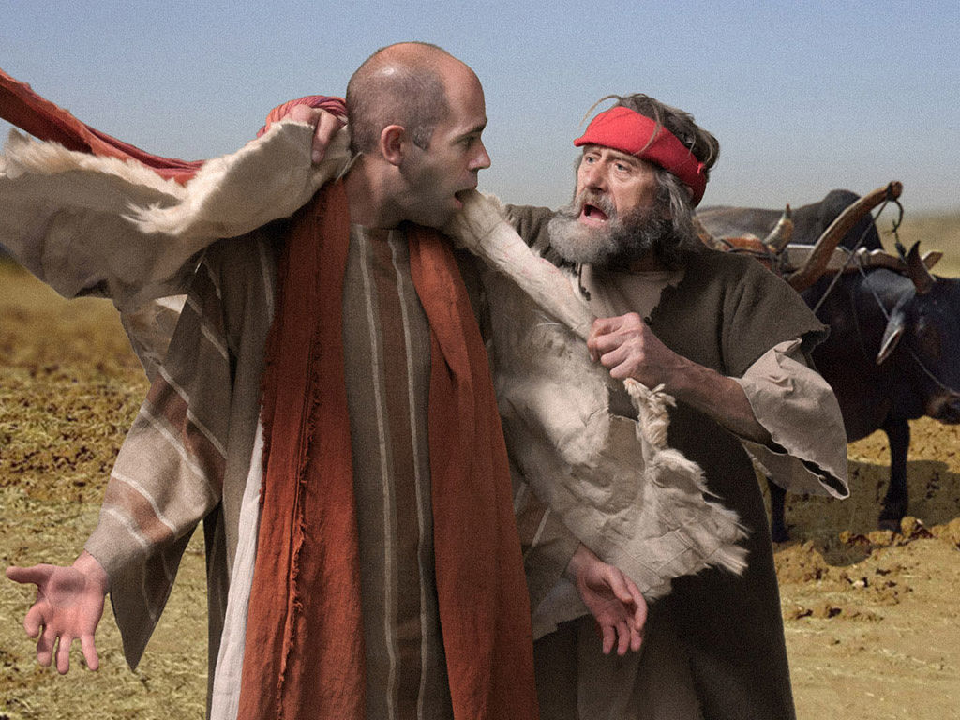
Then Elijah said to Elisha, "Stay here, please, for the LORD has sent me on to Bethel." But Elisha said, "As the LORD lives, and as your soul lives, I will not leave you!" So they went down to Bethel. — 2nd Kings 2:2
do
loyalty
I will not leave you
I will not leave you
do
Notes:
Mature individuals are mutually loyal to those they know. Problems arise when self interests and self-seeking people, with hidden agendas, take advantage of those with generous hearts. Those treacherous are not men of their word shamefully void of integrity.

Slide 11

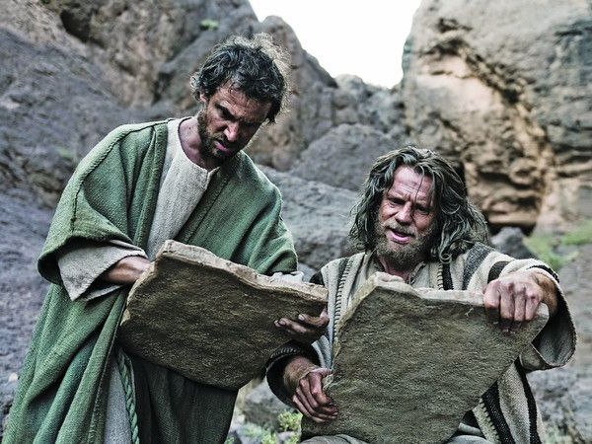
"Only be strong and very courageous, that you may observe to do according to all the law which Moses My servant commanded you; do not turn from it to the right hand or to the left, that you may prosper wherever you go." — Joshua 1:7
be strong
be strong
be
be strong
Be strong
observe
courageous
courageous
observe
do
do
do
do
do not turn
do not turn
hypocrisy
Notes:
We are told to be strong and courageous. To achieve this, one has to know one’s purpose, with clarity. Indecision has plagued all burdened by uncertainty.
Be = 4,600+
Do = 2,200 +
Is = 5,500 –
In = 9,300 +

Slide 12
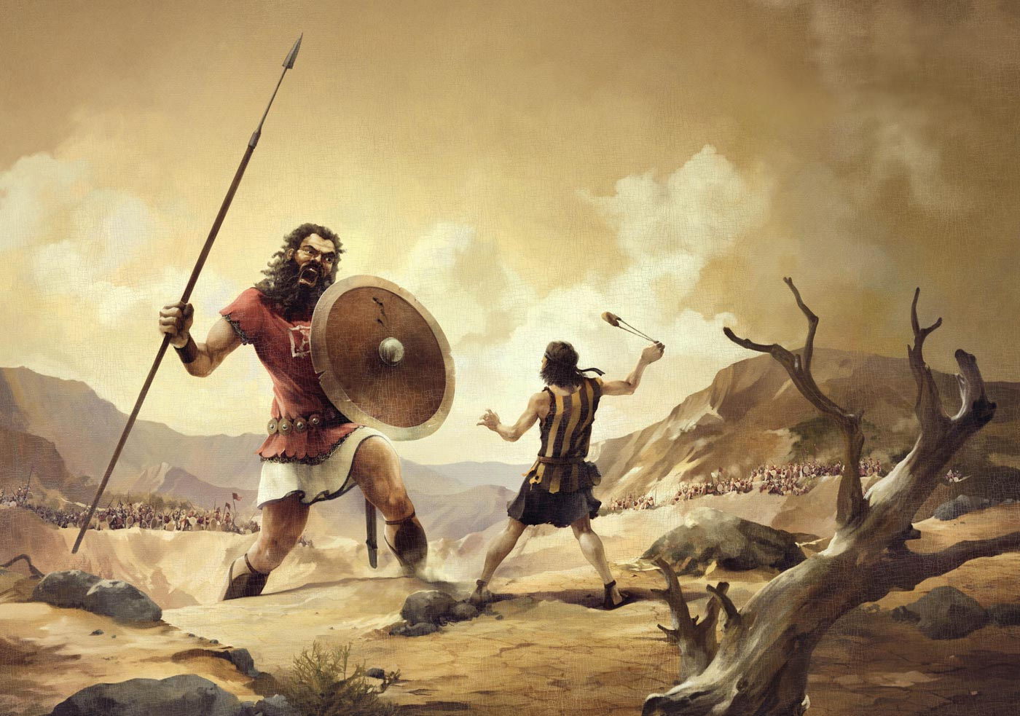
"Be strong and conduct yourselves like men, you Philistines, that you do not become servants of the Hebrews, as they have been to you. Conduct yourselves like men, and fight!" — 1st Samuel 4:9
strong
conduct
Be strong
Be strong
Be strong
like men
like men
servants
strong
Conduct
fight
fight
Notes:
Do not quit the pursuit, for men to be men, where the strength to defend what one believes endures. God commands men to be men and nothing less. If one does not stand forward in belief, advancing shadows creep upon the fears in cowardice. No matter who one is, the instructions to fight for truth, justice, and honor, is the way to life.

Slide 13


Watch, stand fast in the faith, be brave, be strong. — 1st Corinthians 16:13
Watch
in
in the faith
strong
in the faith
be
brave
be
strong
Notes:
Watching is a sign of inner awareness. Obscurity has always led to confusion without purpose. God commands intelligence in knowing the faith given by His word.

Slide 14


You therefore, my son, be strong in the grace that is in Christ Jesus. — 2nd Timothy 2:1
strong
in
in
Christ Jesus
in the grace that is in Christ Jesus
Christ Jesus
. .
grace
grace
grace
grace
grace
grace
grace
grace
Notes:
Grace comes by what Christ did, so that we may believe unto salvation.

Slide 15
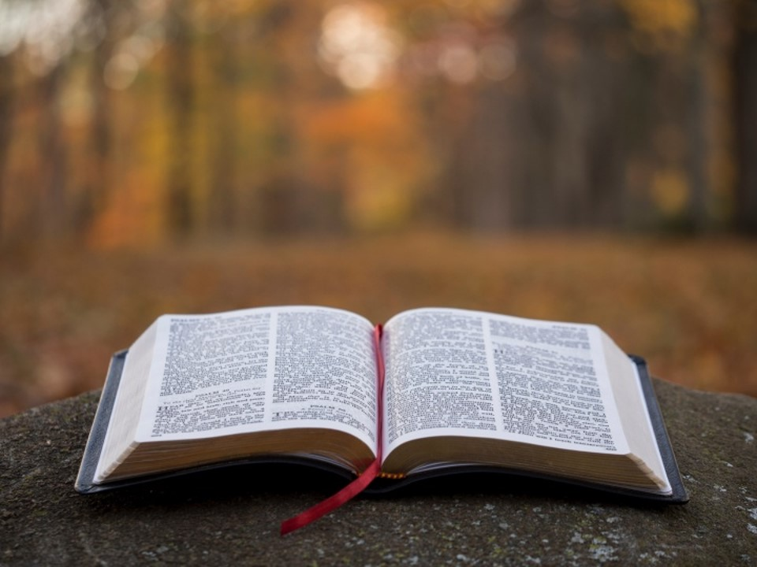

… but grow in the grace and knowledge of our Lord and Savior Jesus Christ. To Him be the glory both now and forever. Amen. — 2nd Peter 3:18
grow
in
grow
understanding
Lord and Savior
Jesus Christ
Jesus Christ
Notes:
Knowledge is key to growing in and practicing His truth.

Slide 16
God

Slide 17



… for it is God who works in you both to will and to do for His good pleasure. — Philippians 2:13
God
in
God who works in you
God
. .
Notes:
To find the truth of God, guides us into His favor and blessings. We are called to be in His service. Does one work for self or God? Do we pull weeds as good neighbors or neglect to bless those whom we know not but are accountable to?

Slide 18


The LORD is my strength and song, And He has become my salvation; He is my God, and I will praise Him; My father's God, and I will exalt Him. — Exodus 15:2
=
my strength
my salvation
my salvation
=
my God
I will praise Him
. .
I will exalt Him
. .
Notes:
Our strength is found in the commitment we obtain in giving of ourselves.

Slide 19
my salvation
my
my
my salvation
Notes:
Our strength is found in the commitment we obtain in giving of ourselves.

Slide 20
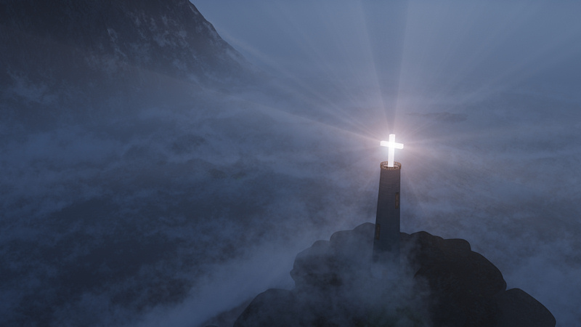
[A Psalm of David.] The LORD is my light and my salvation; Whom shall I fear? The LORD is the strength of my life; Of whom shall I be afraid? — Psalms 27:1
=
my salvation
my light and my salvation
my light and my salvation
=
my life
my life
Notes:
The LORD is the source of all that comes forth. Most personal, He gives life to those He has created to live.

Slide 21
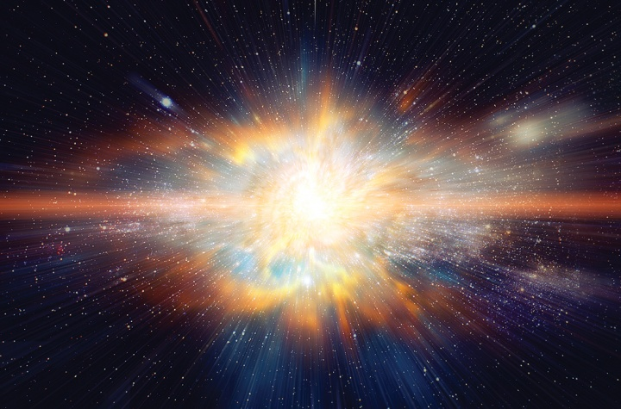
"And also the Strength of Israel will not lie nor relent. For He is not a man, that He should relent." — 1st Samuel 15:29
All faithful
Strength of Israel
. .
Truthful steadfastness
will not lie nor relent
. .
my life
Notes:
God is the strength of all who believe.

Slide 22
"And also the Strength of Israel will not lie nor relent. For He is not a man, that He should relent." — 1st Samuel 15:29
All faithful
Strength of Israel
. .
LORD
God
give-up
surrender
yield

Slide 23

The LORD will give strength to His people; The LORD will bless His people with peace. — Psalms 29:11
strength
give strength
LORD
strength
peace
peace
Notes:
Peace is a blessing God gives to those who see Him with His patience for our return, as a mother waits to give birth.

Slide 24

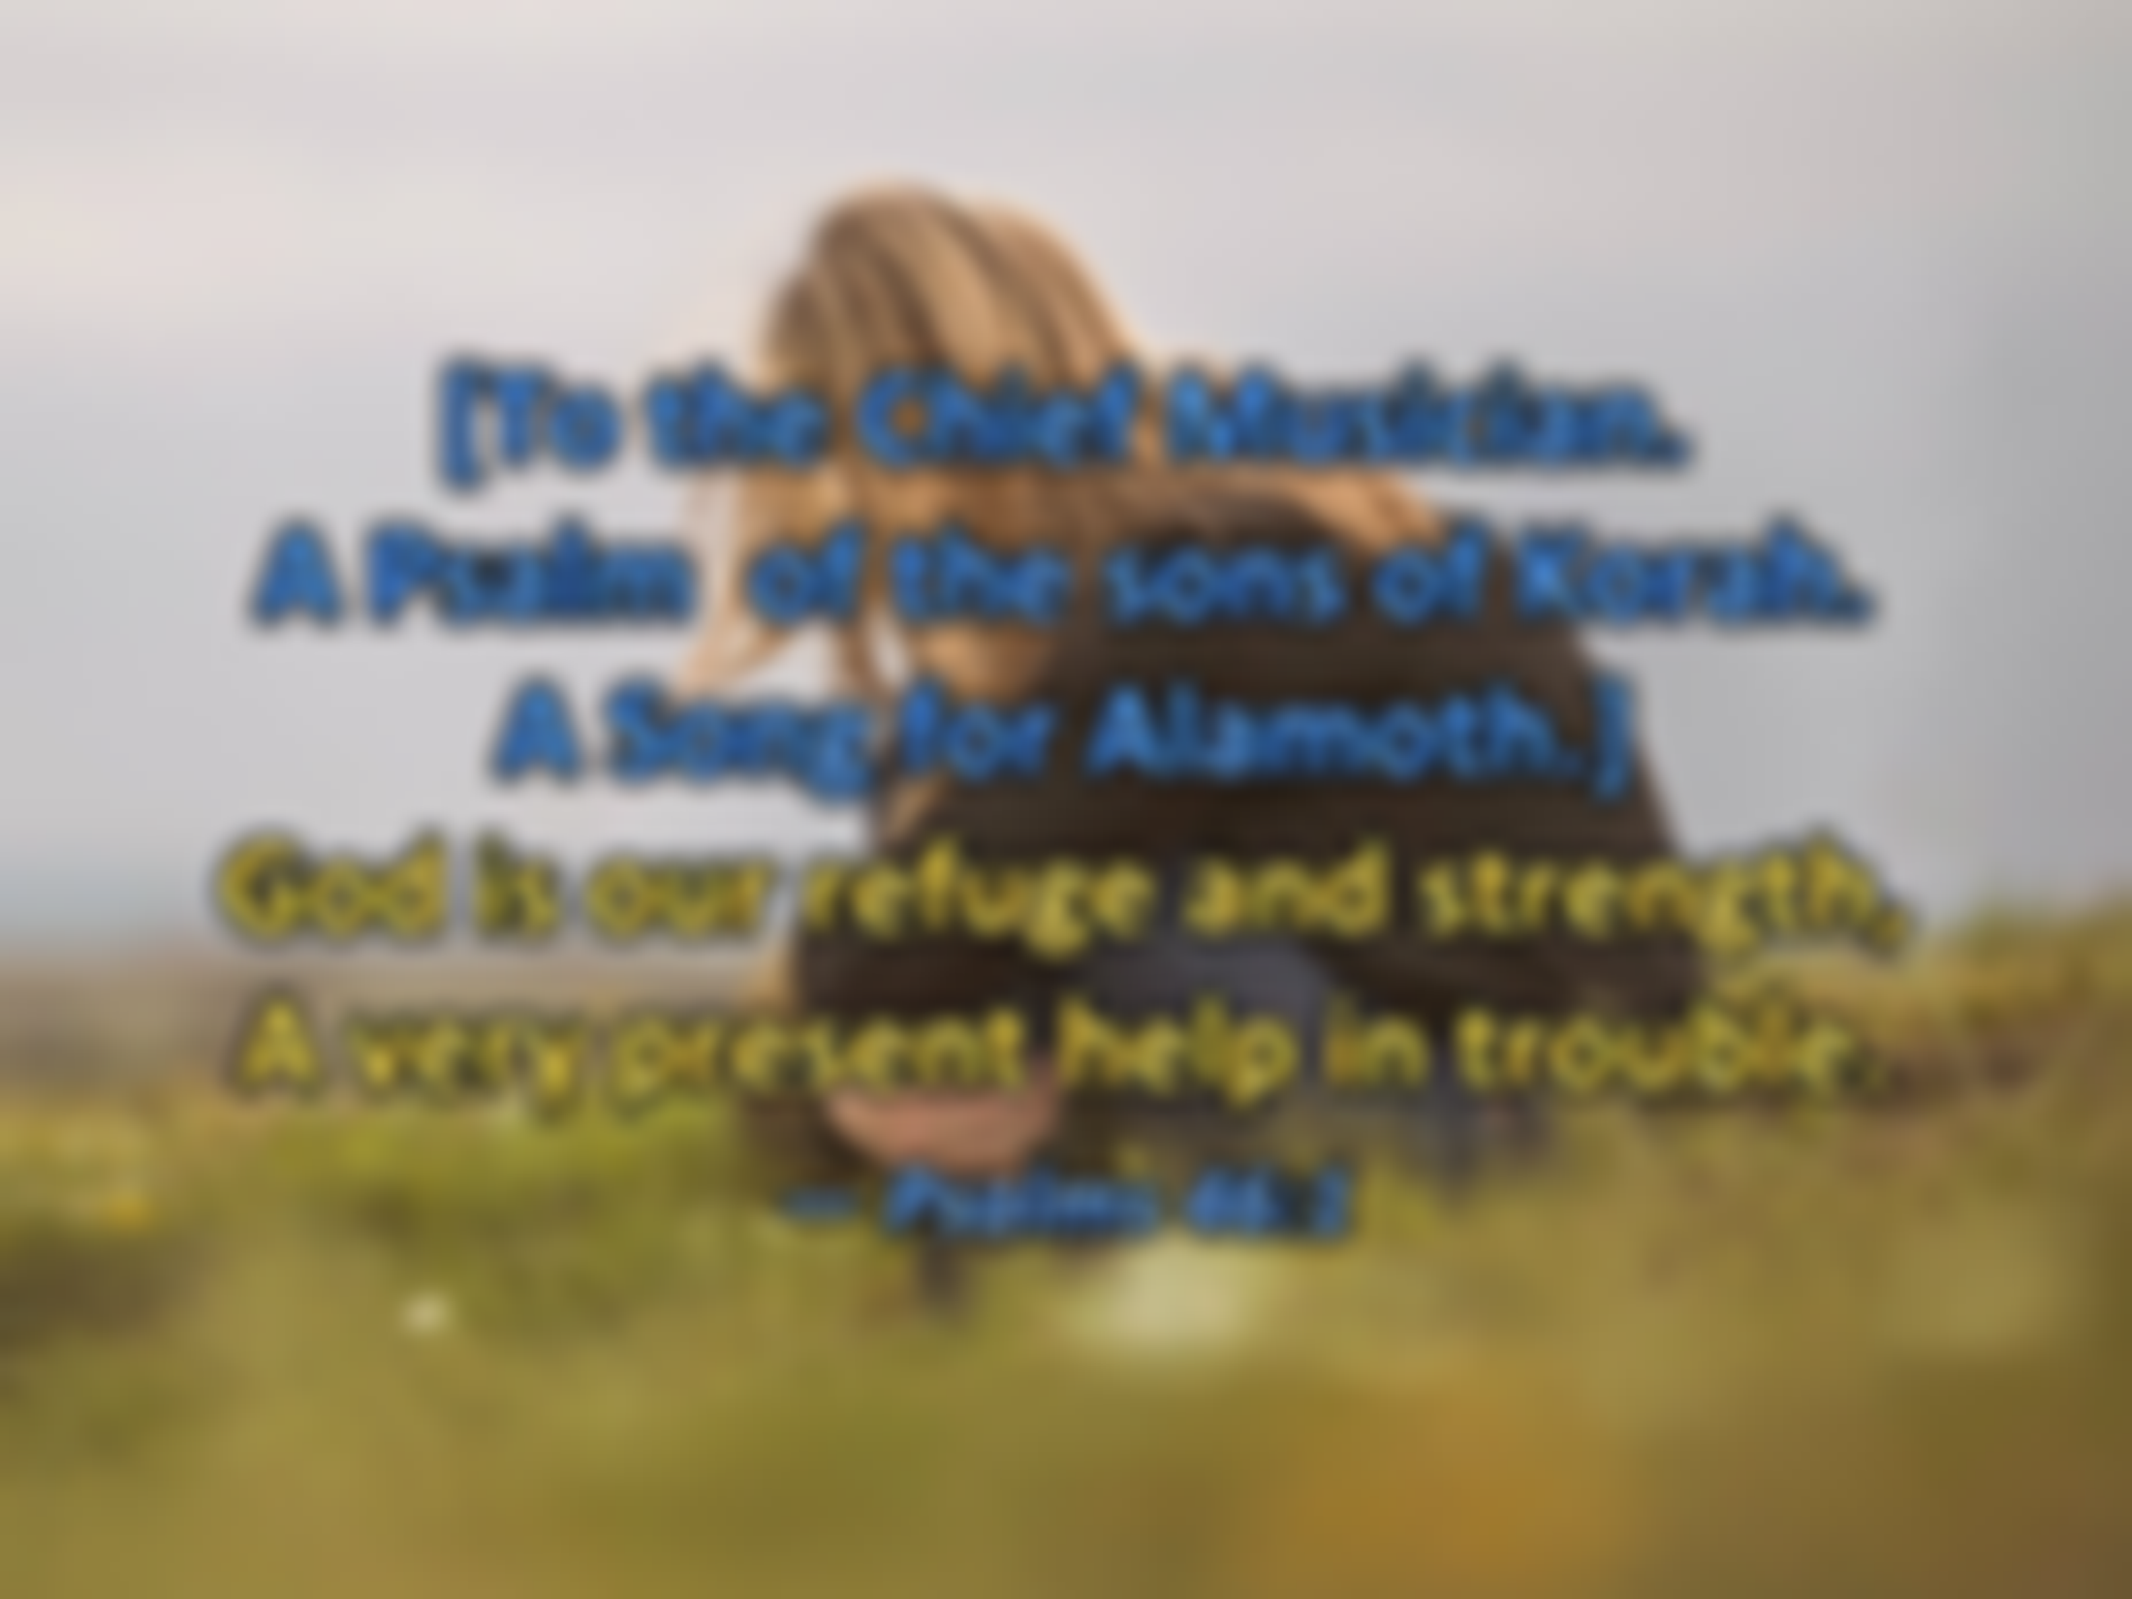


[To the Chief Musician. A Psalm of the sons of Korah. A Song for Alamoth.] God is our refuge and strength, A very present help in trouble. — Psalms 46:1
Savior
strength
=
strength
in
present help in trouble
present help in trouble
Notes:
No one else can help like the instant prayer, to relieve a soul’s miseries. Many feel like garbage inside from all the criticism and rejections to the worthlessness of the mundane; Bodies with more stress than purpose. Purpose is the juice that builds kingdoms and secures the peace or turmoil of the current standing civilization.

Slide 25
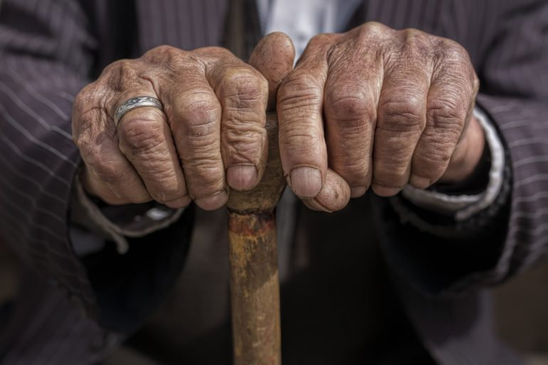
My flesh and my heart fail; But God is the strength of my heart and my portion forever. — Psalms 73:26
carnal
heart flesh
spirit
flesh
heart
=
strength
God is the strength of my heart
strength
God is the strength of my heart
Notes:
Things will not always go well with our lives. Situations present themselves as time does, with broken parts, and failing health. To trust in the material represents weakness, whereby strength is achieved through a steadfast faith, when perceived above measure. When eternity is seen as valuable, the temporary becomes less burdensome.

Slide 26

Blessed is the man whose strength is in You, Whose heart is set on pilgrimage. — Psalms 84:5
Blessed
is
Blessed
is
strength
heart
is
pilgrimage
heart
pilgrimage
Notes:
When one’s destination is set on heaven, goals and or projects more ably endure day to day, as they do have continuance. Instructions of not worrying of tomorrow or yesterday lessen the panic many experience without a higher purpose.

Slide 27
t
t
t
Notes:
When one’s destination is set on heaven, goals and or projects more ably endure day to day, as they do have continuance. Instructions of not worrying of tomorrow or yesterday lessen the panic many experience without a higher purpose.

Slide 28

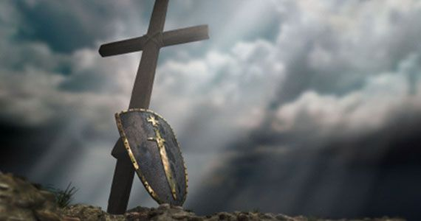
After these things the word of the LORD came to Abram in a vision, saying, "Do not be afraid, Abram. I am your shield, your exceedingly great reward." — Genesis 15:1
not to be afraid
LORD
to
LORD
exceedingly great reward
not
be afraid
Do not be afraid
I am your shield
exceedingly
I am your shield
great reward
Notes:
Trust in God brings the rewards of comfort, knowing He will. Tragedies come and go, pleasures as well, but eternal Spirit remains as a call to come, return to the wonder and presence of God’s own creation. God does not fear as we turn away; sorrow comes to Him for the loss of souls without Him.

Slide 29
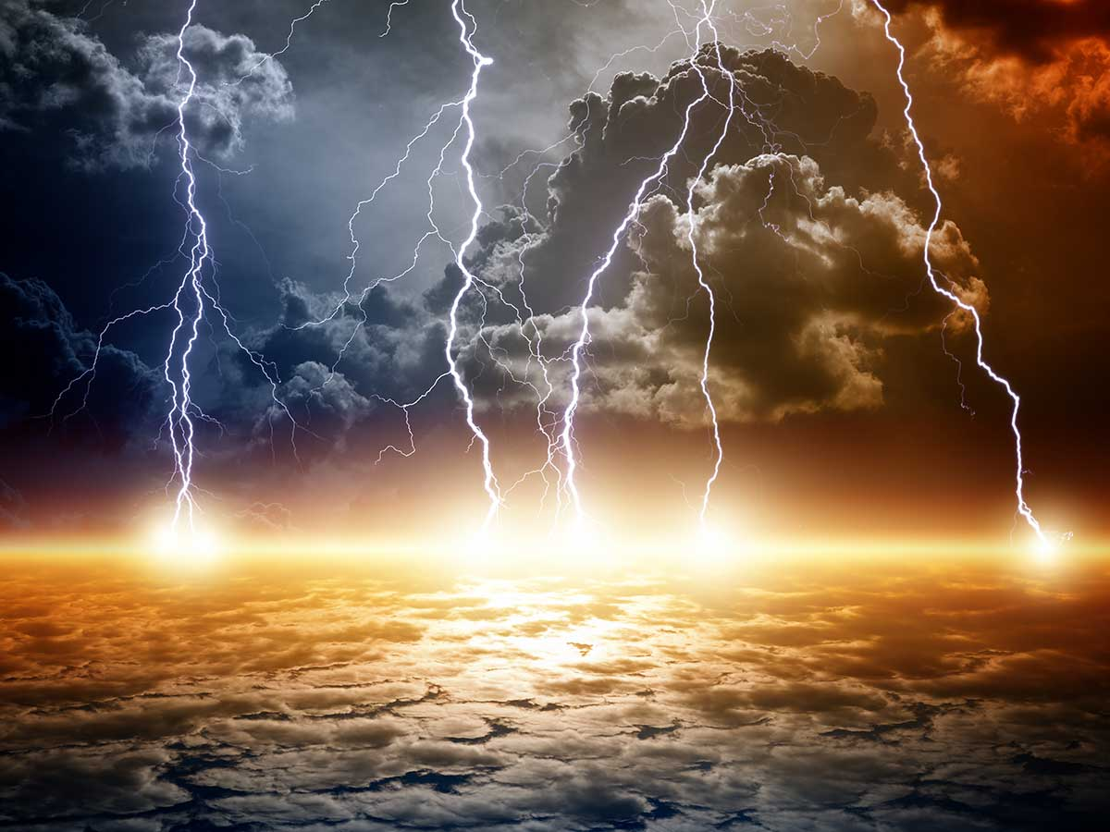
How could one chase a thousand, And two put ten thousand to flight, Unless their Rock had sold them, And the LORD had surrendered them? — Deuteronomy 32:30
True God
one
thousand
one
thousand
Unless
Unless
False God
Notes:
God’s influence cannot be measured, and His promise to protect the faithful occurs, even if we can not understand or comprehend how He proceeds in accomplishing soul retrieval. His power cannot be denied as implemented.

Slide 30
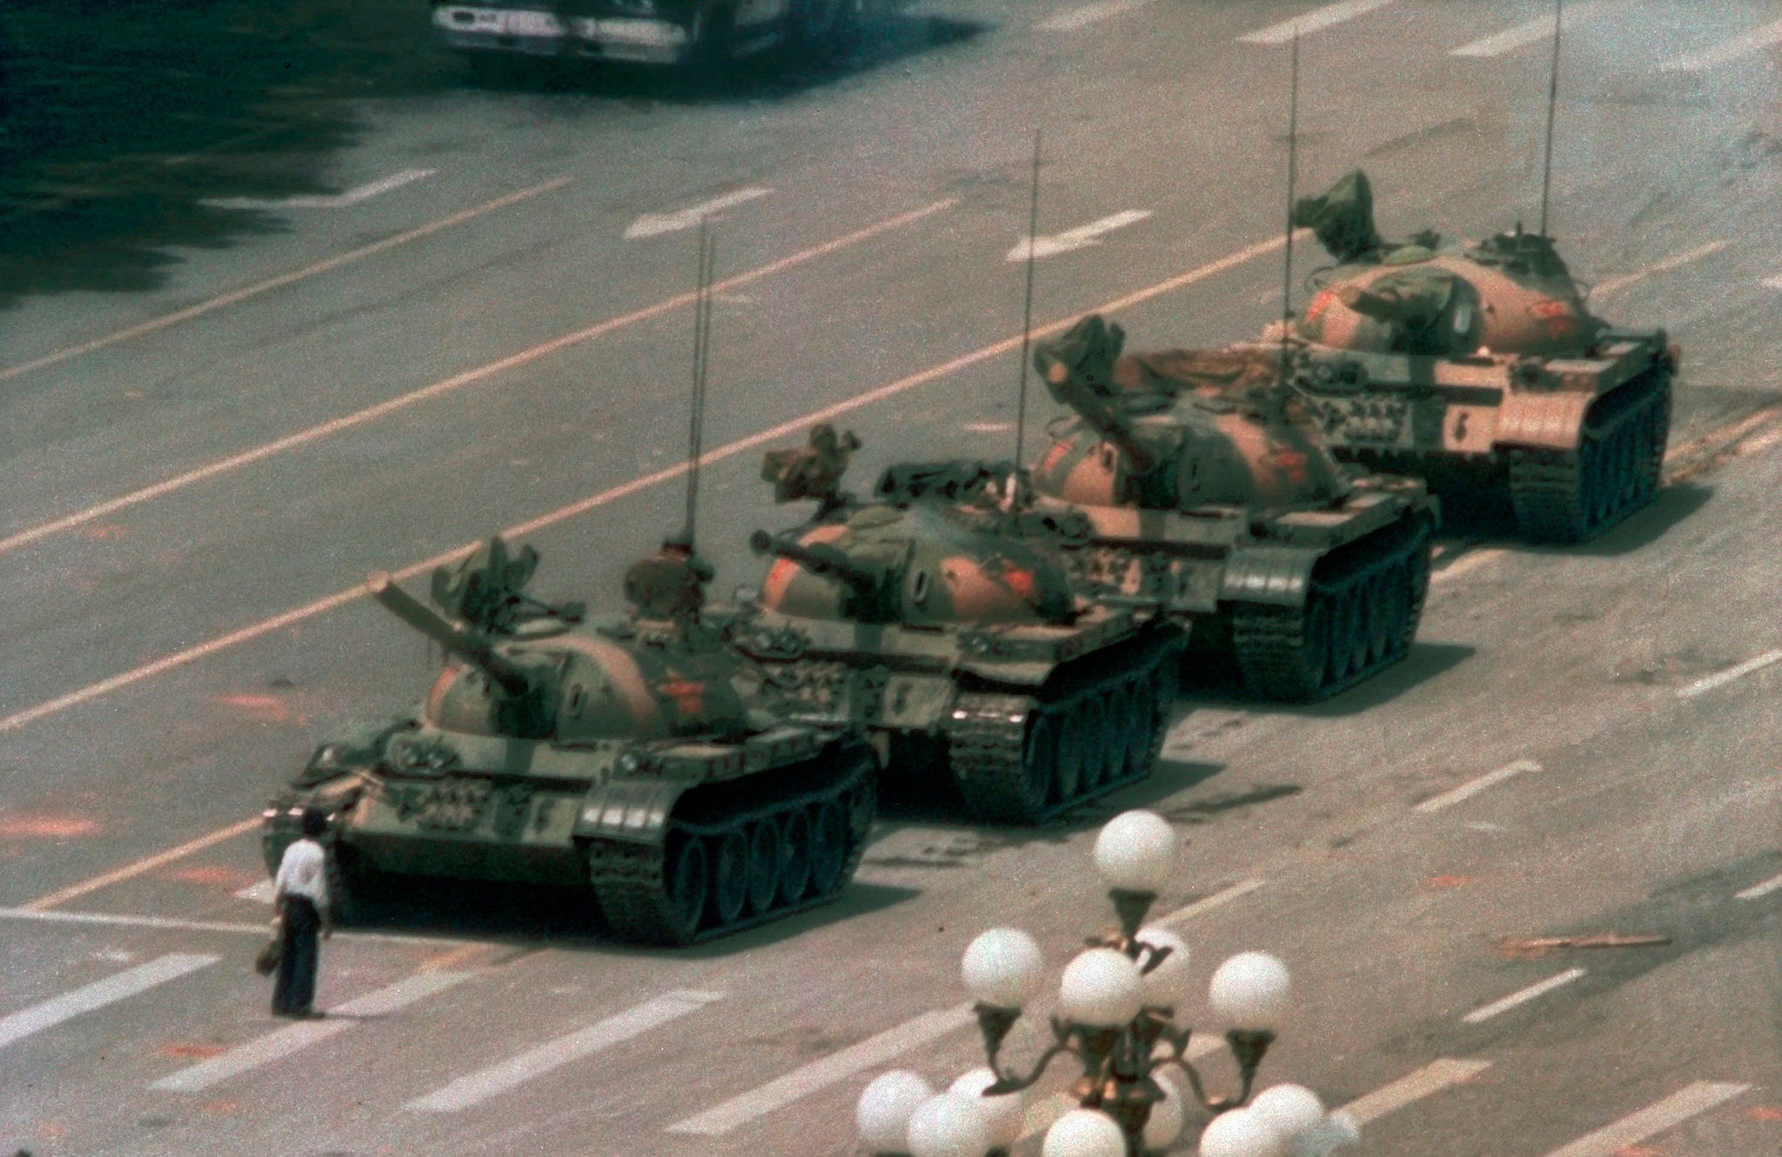
"One man of you shall chase a thousand, for the LORD your God is He who fights for you, as He promised you." — Joshua 23:10
LORD
thousand
LORD
He who fights
He who fights
promised you
promised you
Notes:
At times, the odds do seem overwhelming. We know the battle belongs to the Lord. The flesh may fail, but His eternal plan will unfold as justice will prevail. One man’s faith can help save a multitude.

Slide 31
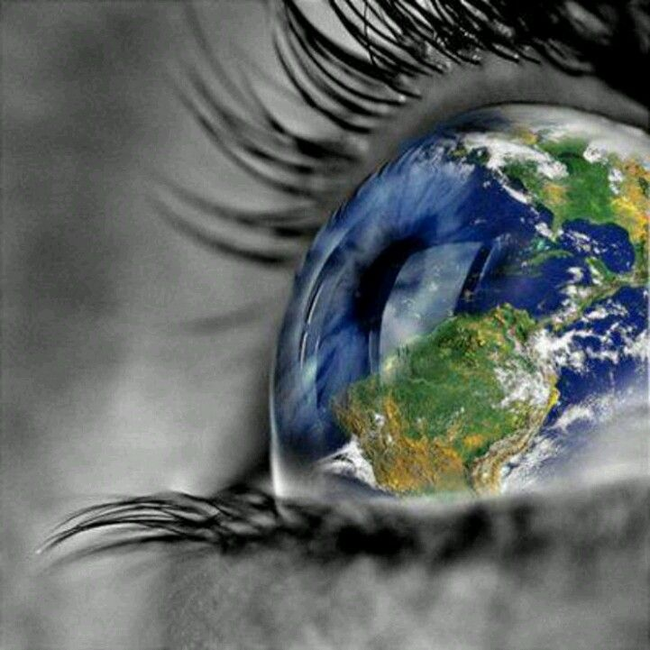
"For the eyes of the LORD run to and fro throughout the whole earth, to show Himself strong on behalf of those whose heart is loyal to Him. In this you have done foolishly; therefore from now on you shall have wars." — 2nd Chronicles 16:9
LORD
show Himself strong
show Himself strong
LORD
loyal
done foolishly
do
shall have wars
shall have wars
Notes:
The LORD’s vision has no limit. His presence has had undeniable results, mostly forgotten. Men who ignore Him pursue foolish acts of either selfishness or violence, and we have all fallen to these regretful acts. The fact is, He has created intercessory acts to protect all, and especially the faithful through providence. Truth is easily remembered while lies are best obscure. All take God for granted.

Slide 32



So we may boldly say: "The LORD is my helper; I will not fear. What can man do to me?" — Hebrews 13:6
LORD
my helper
not fear
. .
Notes:
Our faith is larger than the world in all that it is. To pursue God is to find eternity.

Slide 33
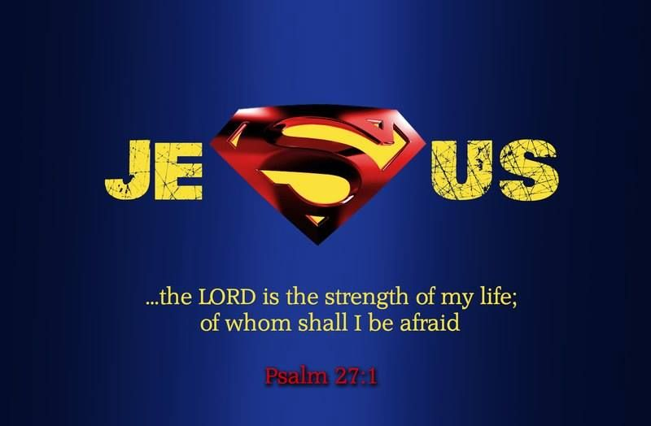

I can do all things through Christ who strengthens me. — Philippians 4:13
Christ
strengthens
strengthens
Notes:
Faith is what moves all that is ahead.

Slide 34

Not that we are sufficient of ourselves to think of anything as being from ourselves, but our sufficiency is from God, … — 2nd Corinthians 3:5
=
sufficiency is from God
sufficiency is from God
Notes:
The ego inflates to where pride destroys loving empathy for others. Pride can be a symptom of hostile desperation, and loss to a deeper insecurity. Closeness to God delivers our sufficiency to be brave.

Slide 35
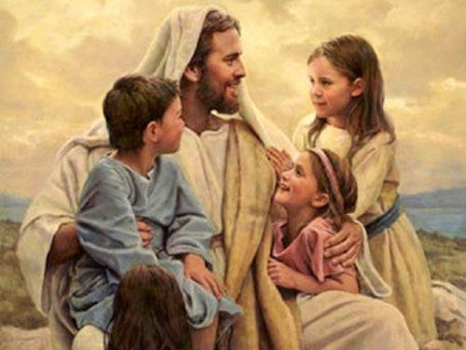

"… for in Him we live and move and have our being, as also some of your own poets have said, 'For we are also His offspring.'" — Acts 17:28
in Him
we live
we live
His creation
Notes:
The reason we have life is because He loves us.

Slide 36
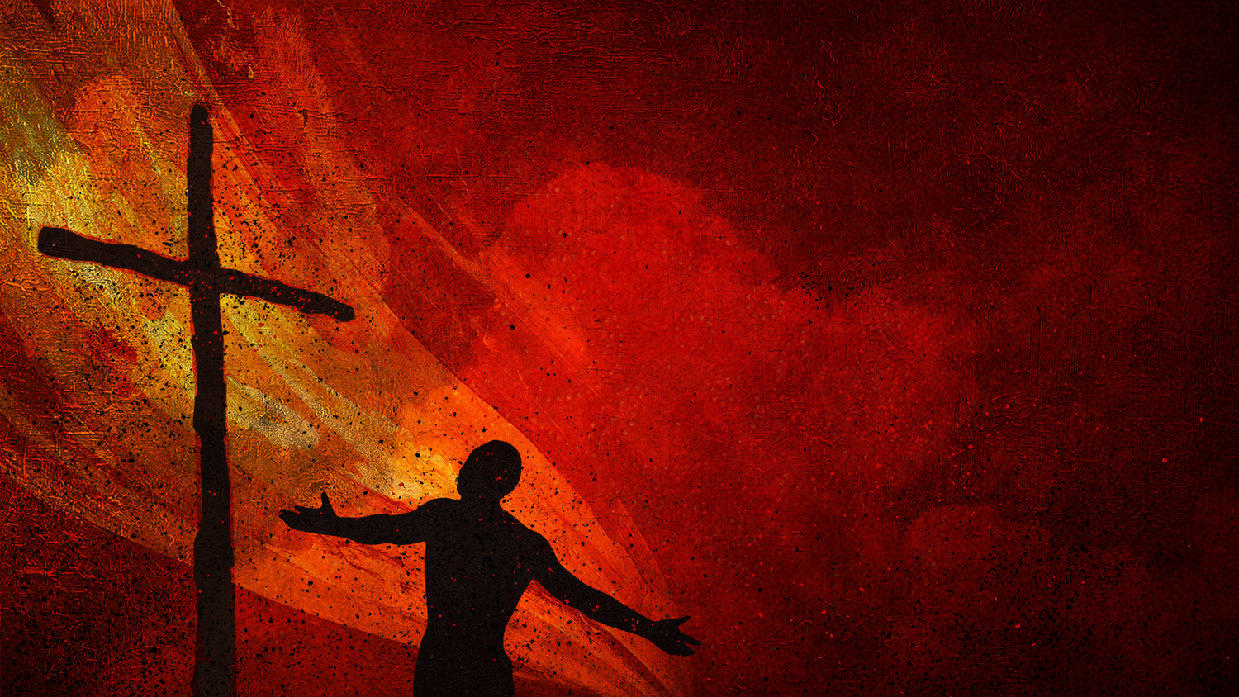
"I have been crucified with Christ; it is no longer I who live, but Christ lives in me; and the life which I now live in the flesh I live by faith in the Son of God, who loved me and gave Himself for me." — Galatians 2:20
Christ
live by faith
in
Christ
Christ lives in me
Christ
live
Christ lives in me
gave Himself for me
by faith
gave Himself
for me
Notes:
Bowing to the truth of God, through Christ, delivers us into His glorious kingdom that lifts all above our hopes. To truly know of His love, it is barely speakable for His awesome marvels.

Slide 37
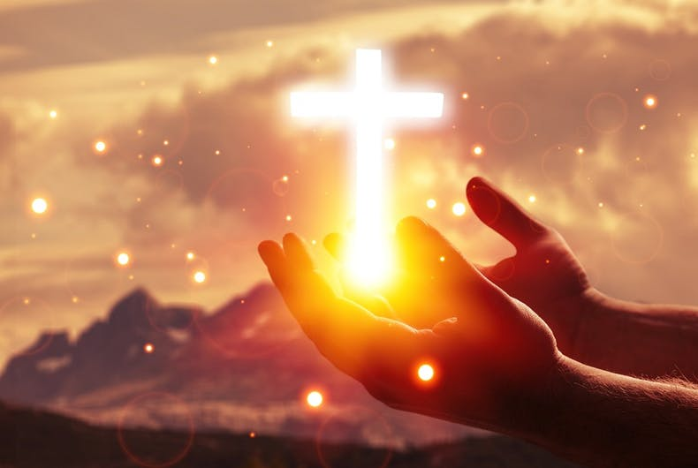
If anyone speaks, let him speak as the oracles of God. If anyone ministers, let him do it as with the ability which God supplies, that in all things God may be glorified through Jesus Christ, to whom belong the glory and the dominion forever and ever. Amen. — 1st Peter 4:11
God
God
in
God
in all things
. .
Christ
glorified through Jesus Christ
Jesus Christ
. .
Notes:
In word and action, trouble arrives when we disregard His wisdom, either in denial or forgetfulness. Human pursuits often disregard what is most precious and tender. When one does not forget God, a better soul is derived.

Slide 38
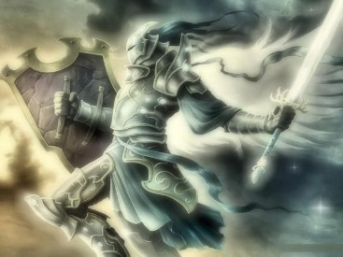
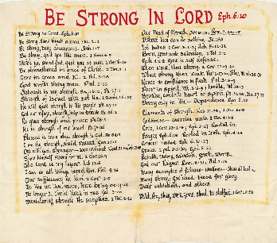










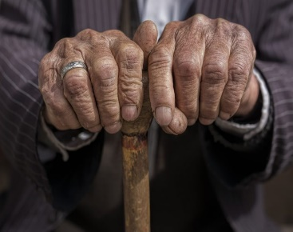

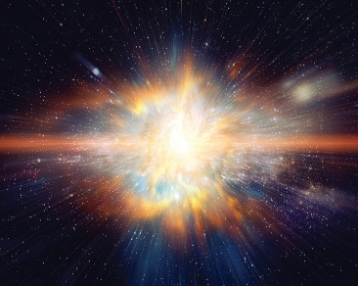








Notes:
Blessed are all who hear His word

Slide 39
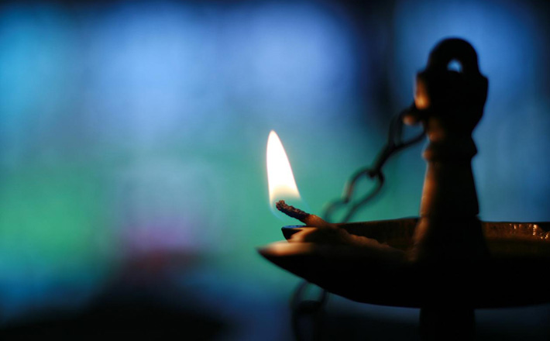

→ Be strong in the LORD and His power
→ Stand by one another through thick and thin
→ It takes courage to stand by the faith given by God
→ God calls us to fight for the principles of truth
→ Grow in His grace and knowledge of Christ
→ Strength through God is impervious to man
→ Deepest peace comes by unyielding belief
→ God is here now to help in all our troubles
→ God is a shield to those who believe
→ No number can defeat the single truth of God
→ God helps us where mankind never will or can
→ It is God that gives us, not that we give ourselves
→ Christ lives in us when we submit to His will
God seems to come from nowhere, but everywhere
Notes:
God seems to come from nowhere, but everywhere

Slide 41
Be Strong in the LORD
(A bed sheet study)
2
Ron Bert
August 30, 2020

Slide 43

Our Need of Strength. Jer. 10:23; Rom. 7:14:25
Without Him can do nothing. Jn. 15:5
Yet babes. 1 Cor. 3:1-3; Heb. 5:12-14
Born, grow unto salvation. 1 Pet. 2:2
Grow in self-defense. Eph. 4:14
When weak, then strong. 2 Cor. 12:9-10
When strong, then weak. Rev. 3:17:20; Peter, Mt. 26:35-75
Hence no confidence in flesh. Phil. 3:3-9
Poor in spirit. Mt. 5:3-9 |
BE STRONG IN LORD - Eph 6:10
#2
#1
#3

Slide 44
Our Need of Strength. Jer. 10:23; Rom. 7:14:25
Without Him can do nothing. Jn. 15:5
Yet babes. 1 Cor. 3:1-3; Heb. 5:12-14
Born, grow unto salvation. 1 Pet. 2:2
Grow in self-defense. Eph. 4:14
When weak, then strong. 2 Cor. 12:9-10
When strong, then weak. Rev. 3:17:20; Peter, Mt. 26:35-75
Hence no confidence in flesh. Phil. 3:3-9
Poor in spirit. Mt. 5:3-9 |
BE STRONG IN LORD - Eph 6:10

Slide 45
O LORD, I know the way of man is not in himself; It is not in man who walks to direct his own steps. — Jeremiah 10:23
LORD
direct
direct
Notes:
Only God has the clarity of all that is happening. It is surely unfortunate across the ocean of time where man has killed his brother, sister, mother and father, in fits of anger, absent of a godly life. Consulting God is a matter of trust in His ultimate care.

Slide 46
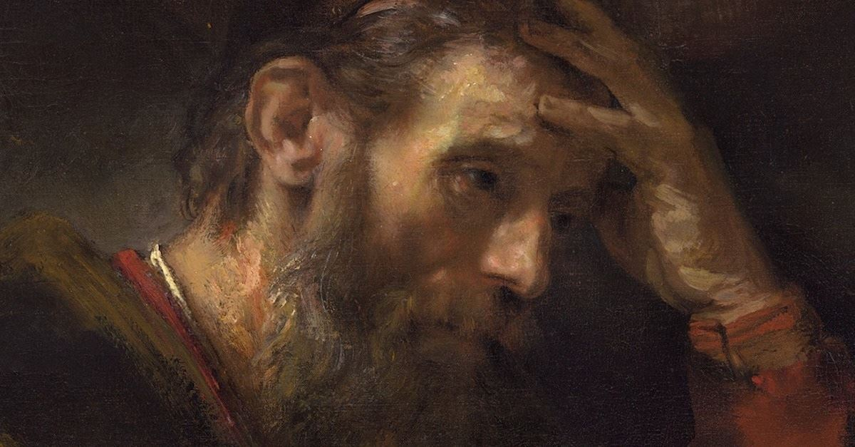
For we know that the law is spiritual, but I am carnal, sold under sin. For what I am doing, I do not understand. For what I will to do, that I do not practice; but what I hate, that I do. If, then, I do what I will not to do, I agree with the law that it is good. But now, it is no longer I who do it, but sin that dwells in me. — Romans 7:14-17
sensual
wanton
fleshly
worldly
Battle of the spirit
what I hate, that I do
what I hate, that I do
sin that dwells in me
sin that dwells in me
Notes:
All schemers shall be found out, and if one’s efforts are merely to gain advantage, at the cost of undermining others, self-evaluation and repentance is required. For one not to regret the sin that is in us, is to deny the purpose God looks for, souls that care for one another.

Slide 47
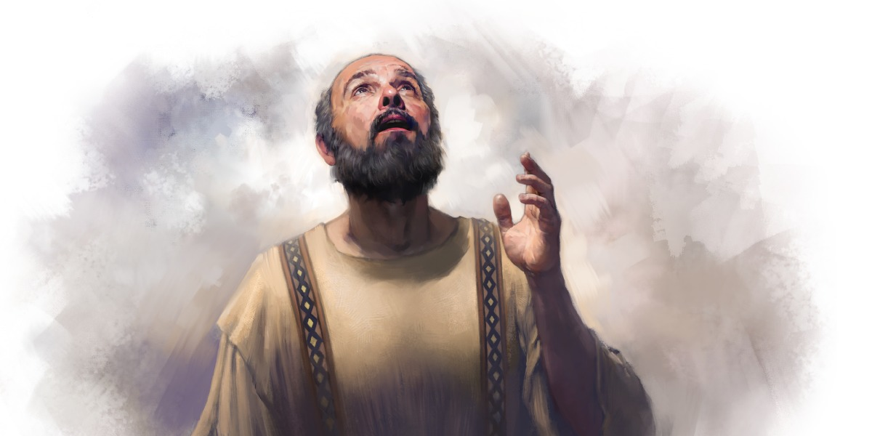
For I know that in me (that is, in my flesh) nothing good dwells; for to will is present with me, but how to perform what is good I do not find. For the good that I will to do, I do not do; but the evil I will not to do, that I practice. Now if I do what I will not to do, it is no longer I who do it, but sin that dwells in me. I find then a law, that evil is present with me, the one who wills to do good. — Romans 7:18-21
Confident
Honesty
Love
Friendliness
mind
goodness
SIN
that I will to do, I do not do
that I will to do, I do not do
Hate
Deception
evil
Spiritual
Insecure
Shy
one who wills to do good
one who wills to do good
Notes:
To build a good life one has to crawl out of the lingering sins, or rise from the guilt of those things done against others. It is to divide the selfish from the generous, doing over taking, nobly upright verses habitually greedy.

Slide 48
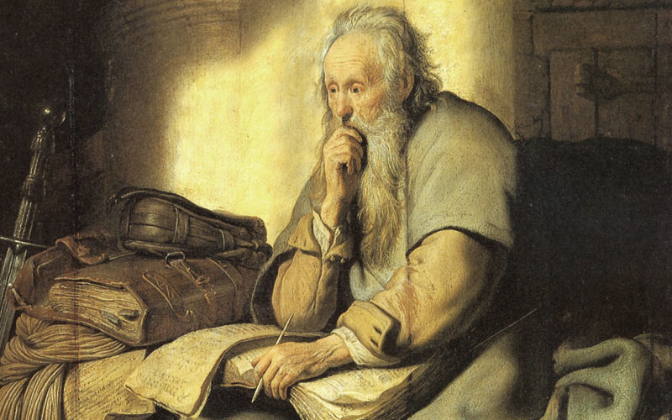
For I delight in the law of God according to the inward man. But I see another law in my members, warring against the law of my mind, and bringing me into captivity to the law of sin which is in my members. O wretched man that I am! Who will deliver me from this body of death? I thank God -- through Jesus Christ our Lord! So then, with the mind I myself serve the law of God, but with the flesh the law of sin. — Romans 7:22-25
inward man
inward man
mind
I thank God
through Jesus Christ our Lord
● with the mind serve the law of God
● with the flesh the law of sin
Jesus Christ
deliver me
deliver me
I thank God
through Jesus
Christ our Lord
with the mind
serve the law of God
with
the flesh the law of sin
Notes:
Charades have no cover in the light of truth. If security is a desire, games have to be put away for the genuine to shine. True strength is stolen if one chooses to run as a rat devouring at will. One has to maintain a call to God for deliverance. In the flesh, we are not free of the flesh, and our closest approach to God is through the mind of spirit. It is a test of desires, and thankfulness over unthankfulness; hopeful verses hopeless. It is the mind that controls the spirit.

Slide 49

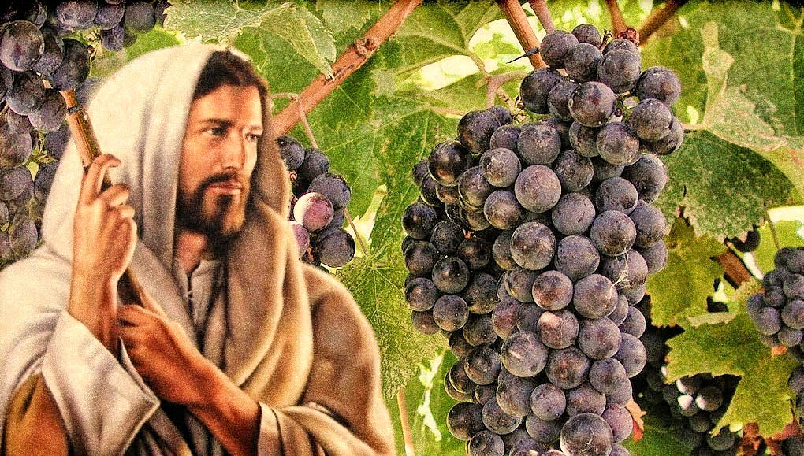
"I am the vine, you are the branches. He who abides in Me, and I in him, bears much fruit; for without Me you can do nothing." — John 15:5
"I am the vine, you are the branches. He who abides in Me, and I in him, bears much fruit; for without Me you can do nothing." — John 15:5
I am
I am
in
Notes:
When one cleaves to God the fruit of truth is made available.

Slide 50

And I, brethren, could not speak to you as to spiritual people but as to carnal, as to babes in Christ. I fed you with milk and not with solid food; for until now you were not able to receive it, and even now you are still not able; for you are still carnal. For where there are envy, strife, and divisions among you, are you not carnal and behaving like mere men? — 1st Corinthians 3:1-3
not as to spiritual people
but carnal as to babes in Christ
|
↓
envy, strife, and divisions
↘ ↙
mere men
as to spiritual people
but
X
as to babes in Christ
not
in
Christ
Thorns
carnal
carnal
carnal
envy, strife, and divisions
envy, strife, and divisions
envy, strife, and divisions
Worldly
mere men
mere men
mere men
Notes:
Innocent hearts are open to love. When the flesh overrides the mind of spirit, envy and strife plague the whole. Babes in Christ have carnal minds, yet to put on the maturity of true spiritual behaviors. Do we choose to be mere men or something more?

Slide 51
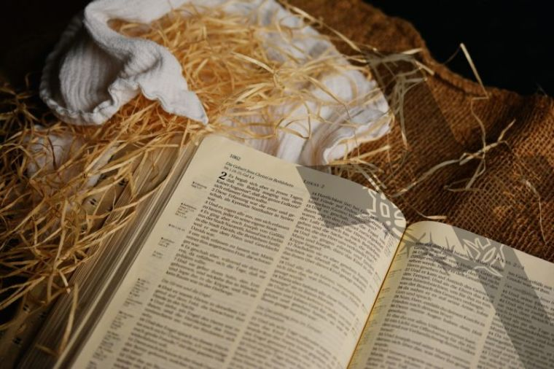
For though by this time you ought to be teachers, you need someone to teach you again the first principles of the oracles of God; and you have come to need milk and not solid food. For everyone who partakes only of milk is unskilled in the word of righteousness, for he is a babe. But solid food belongs to those who are of full age, that is, those who by reason of use have their senses exercised to discern both good and evil. — Hebrews 5:12-14
ught
word of righteousness
principles of the oracles of God
↙↓↘
● teachers =
↑
● unskilled =
teachers
again
principles of the oracles of
God
need
senses exercised by reason
those who are of full age
discern both good and evil
ta
unskilled
word of righteousness
babe
those who are
of full age
s
by reason
senses exercised
discern
babe needs taught again
both good and evil
Notes:
Many may speak the word of God, but in actions they do not do what they have heard. For God to be worshiped in spirit and truth one must attend to the details, for if a man forgets how to tie his shoe, how can he walk effectively?

Slide 52
word of righteousness
principles of the oracles of God
↙↓↘
● teachers =
↑
● unskilled =
Lives by the Word
Applies Instructions
Lives by the World
Discards Instructions

Slide 53


… as newborn babes, desire the pure milk of the word, that you may grow thereby, … — 1st Peter 2:2
desire
desire
the word
the word
Notes:
By what we seek is how we grow. Each has to start on the path to acquiring the knowledge of good and evil, and then distinguishing between the two. It is a battle we all must face.

Slide 54

… that we should no longer be children, tossed to and fro and carried about with every wind of doctrine, by the trickery of men, in the cunning craftiness of deceitful plotting, … — Ephesians 4:14
children
tossed to and fro
with every wind of doctrine
→ by the trickery of men
in the cunning craftiness
of deceitful plotting
children
children
duped
children
tossed to and fro
with every wind of
doctrine
by the trickery of men
trickery
trickery
in the cunning craftiness
of
carnal
cunning
cunning
deceitful plotting
deceitful
deceitful
Notes:
Monsters can hide behind sheets of kind, yet hollow words. Merciless greed too often destroys true churches, and or relationships, and changes the holiness of sanctuary into self-serving cash cows for the elite. A serious question for any serious God fearing church is, is the intent to serve God or man? If it is merely for the glory of money, it is not to the glory of God.

Slide 55
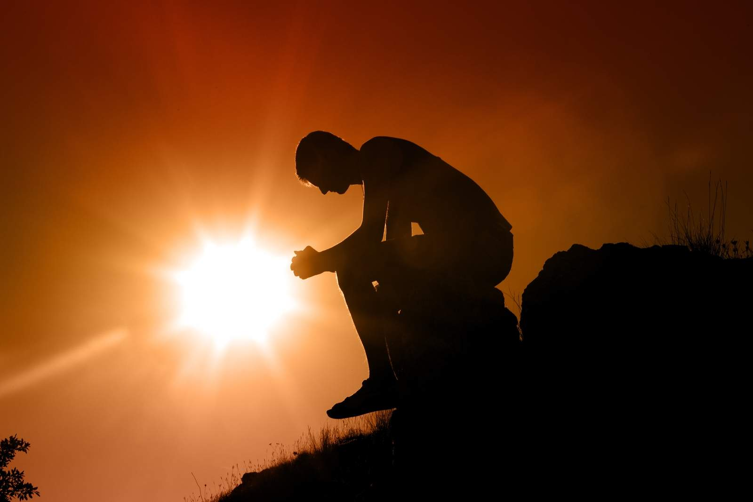
And He said to me, "My grace is sufficient for you, for My strength is made perfect in weakness." Therefore most gladly I will rather boast in my infirmities, that the power of Christ may rest upon me. Therefore I take pleasure in infirmities, in reproaches, in needs, in persecutions, in distresses, for Christ's sake. For when I am weak, then I am strong. — 2nd Corinthians 12:9-10
strength
weakness
power of Christ
spiritual
Christ
carnal
when I am weak
. .
I am strong
. .
Notes:
It is when times are challenged that deep wells of faith surface, for those of faith. Desire’s direction has much to say about whether one falls into anger or remorse. Reflections of thought rarely come to the simple minded who more often respond to impulse.

Slide 56
rich
rich

Slide 57
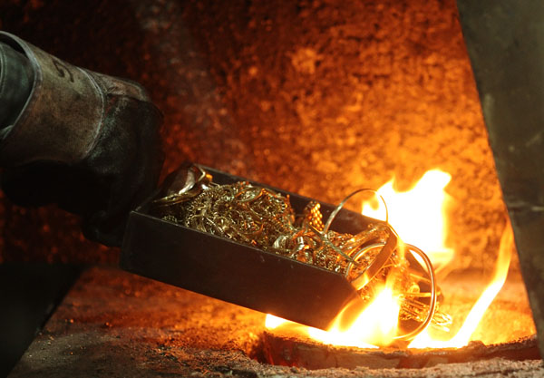
"Because you say, 'I am rich, have become wealthy, and have need of nothing' -- and do not know that you are wretched, miserable, poor, blind, and naked -- counsel you to buy from Me gold refined in the fire, that you may be rich; and white garments, that you may be clothed, that the shame of your nakedness may not be revealed; and anoint your eyes with eye salve, that you may see." — Revelation 3:17-18
arrogance
wretched, miserable, poor, blind
. .
faith in the word
rich
white
shame of
nakedness
revealed
that you may see
. .
Notes:
Banking on the material inevitably fails for each of us. Sealed in eternity is the light that comes from within our hearts, where God wants to hold us in His love of life. Arrogance leaves one cold where the humble will find warmth. Claims are made the Bible is science fiction, and this a matter of belief, to be or not to be. Isolated or joined, the eternal choice each is called to make.

Slide 58
"Because you say, 'I am rich, have become wealthy, and have need of nothing' -- and do not know that you are wretched, miserable, poor, blind, and naked -- counsel you to buy from Me gold refined in the fire, that you may be rich; and white garments, that you may be clothed, that the shame of your nakedness may not be revealed; and anoint your eyes with eye salve, that you may see." — Revelation 3:17-18
arrogance
shame of
nakedness
shame of nakedness revealed
revealed
faith in the word
love
white
that you may see
. .

Slide 59

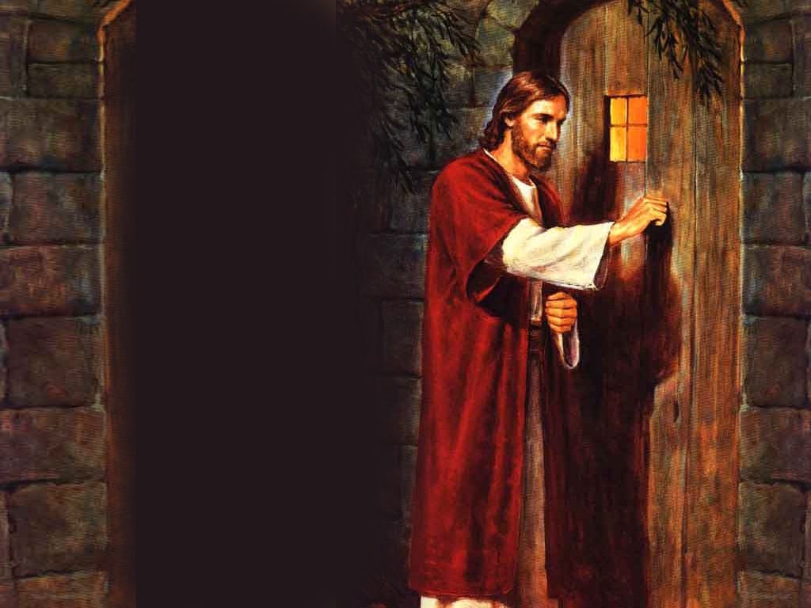
"As many as I love, I rebuke and chasten. Therefore be zealous and repent. "Behold, I stand at the door and knock. If anyone hears My voice and opens the door, I will come in to him and dine with him, and he with Me." — Revelation 3:19-20
"As many as I love, I rebuke and chasten. Therefore be zealous and repent. "Behold, I stand at the door and knock. If anyone hears My voice and opens the door, I will come in to him and dine with him, and he with Me." — Revelation 3:19-20
be
hears
hears
love
Notes:
To see Jesus one hears God.

Slide 60
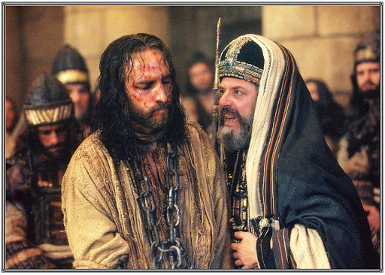
And the high priest arose and said to Him, "Do You answer nothing? What is it these men testify against You?" But Jesus kept silent. And the high priest answered and said to Him, "I put You under oath by the living God: Tell us if You are the Christ, the Son of God!" Jesus said to him, "It is as you said. Nevertheless, I say to you, hereafter you will see the Son of Man sitting at the right hand of the Power, and coming on the clouds of heaven." — Matthew 26:62-64
Jesus
Christ Jesus
Christ
Tell us if You are the Christ
Tell us if You are the Christ
It is as you
It is as you
said
said
Power
Notes:
Most believe Christ was at least a prophet of God. As such, prophets do not lie in the delivery of the word given to them by God Himself, where earth is a distant remnant in view of God’s omnipotence. Jesus swore by oath that He was the Son of God, the Christ sent forth so all could know personal divinity without human interference. Other religions that accept Jesus, as at least a prophet, but then disregard His words of His own divinity, are not true religions, but social concoctions of man to manipulate and control by confusion and subversion.

Slide 61
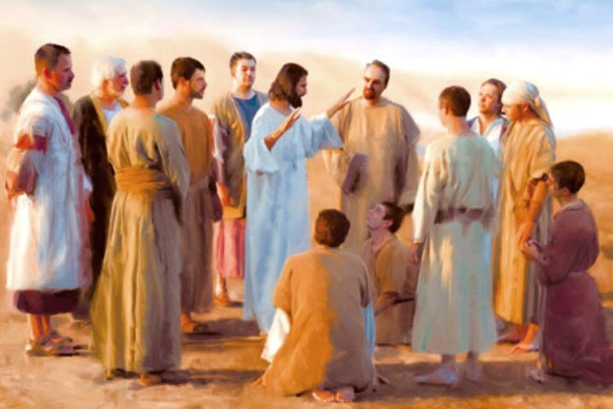
Peter said to Him, "Even if I have to die with You, I will not deny You!" And so said all the disciples. — Matthew 26:35
Christ Jesus
with You
deny
with You
SIN
deny
Notes:
Many have the intent to remain loyal through thick and thin. All eventually come to one’s knees, in the face of truth and human failures. With a final bow before Him, we will be seen for who we are.

Slide 62
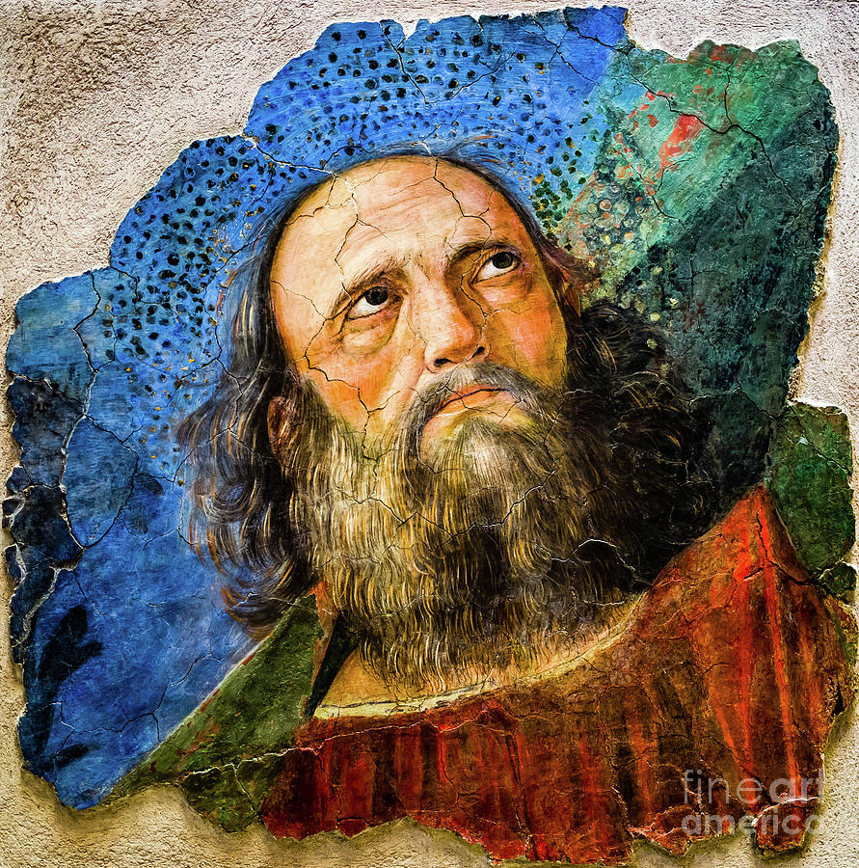
For we are the circumcision, who worship God in the Spirit, rejoice in Christ Jesus, and have no confidence in the flesh, though I also might have confidence in the flesh. If anyone else thinks he may have confidence in the flesh, I more so: — Philippians 3:3-4
God
in
in
Christ Jesus
Christ Jesus
Christ Jesus
in
humble
no confidence in the flesh
no confidence in the flesh
pride
in
confidence in the flesh
confidence in the flesh
Notes:
To truly be holy one must put off the flesh and embrace the spirit. Most will be unable to do this, mired in the quagmire of living for fleshly impulsiveness.

Slide 63
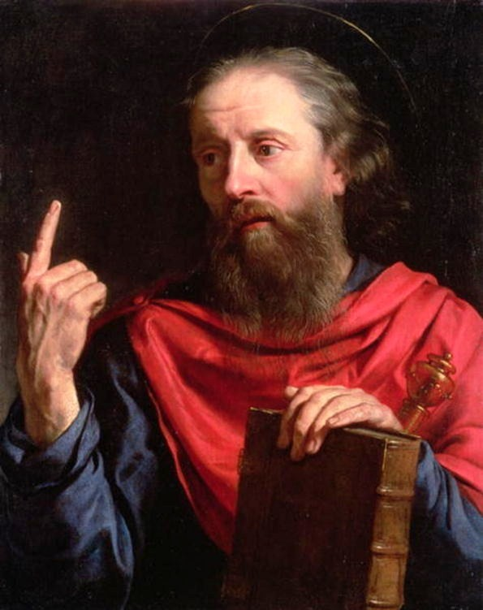
… circumcised the eighth day, of the stock of Israel, of the tribe of Benjamin, a Hebrew of the Hebrews; concerning the law, a Pharisee; concerning zeal, persecuting the church; concerning the righteousness which is in the law, blameless. But what things were gain to me, these I have counted loss for Christ. — Philippians 3:5-7
Taught
for Christ
Christ
for Christ
Learned
Notes:
Confidence in the flesh reduces to arrogance. The proud have caused the bulk of misery, all saints have encountered.

Slide 64
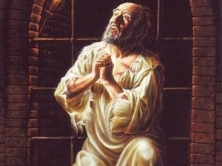
Yet indeed I also count all things loss for the excellence of the knowledge of Christ Jesus my Lord, for whom I have suffered the loss of all things, and count them as rubbish, that I may gain Christ and be found in Him, not having my own righteousness, which is from the law, but that which is through faith in Christ, the righteousness which is from God by faith; — Philippians 3:8-9
→ excellence of the knowledge
of Christ Jesus my Lord
that I may gain Christ
found in Him
not having my own righteousness
↓
but that which is through faith
in Christ ↕
righteousness which is from God
excellence of the knowledge
of
Christ Jesus my Lord
that I may gain
in
pride
Christ
found in Him
not having
be found in Him
be found in Him
my own righteousness
but that which is through faith
in Christ
righteousness which is
in
Christ
from God
by faith
God
by faith
God
Notes:
To see through the spirit brings emancipation to the flesh.

Slide 65
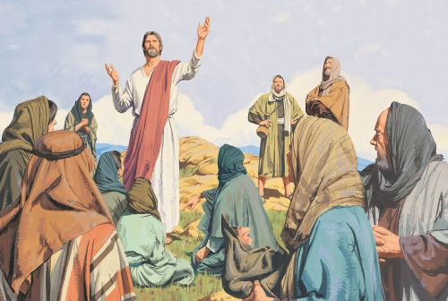
"Blessed are the poor in spirit, For theirs is the kingdom of heaven. Blessed are those who mourn, For they shall be comforted. Blessed are the meek, For they shall inherit the earth. Blessed are those who hunger and thirst for righteousness, For they shall be filled. Blessed are the merciful, For they shall obtain mercy. Blessed are the pure in heart, For they shall see God. Blessed are the peacemakers, For they shall be called sons of God." — Matthew 5:3-9
poor in spirit
kingdom of heaven
poor in spirit → kingdom of heaven
who mourn → comforted
the meek → inherit the earth
who hunger for righteousness → filled
the merciful → obtain mercy
the pure in heart → shall see God
peacemakers → called sons of God
who mourn
comforted
the meek
inherit
the earth
who hunger
for righteousness
filled
the merciful
obtain mercy
the pure in
heart
shall see God
peacemakers
called
sons of God
Notes:
Poor in spirit is to hold remorse for all earthly evils and dominations by the arrogant oppressors who steal truth and promote lies in their deceptions. The sermon on the mount gave us all the truth of humanity.

Slide 66
poor in spirit → kingdom of heaven
who mourn → comforted
the meek → inherit the earth
who hunger for righteousness → filled
the merciful → obtain mercy
the pure in heart → shall see God
peacemakers → called sons of God
Humility
Repent
Gentleness
Peace
Love
Wisdom
Godly

Slide 67




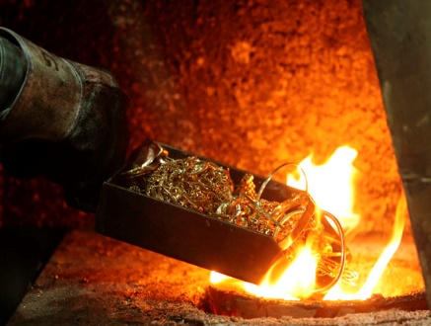



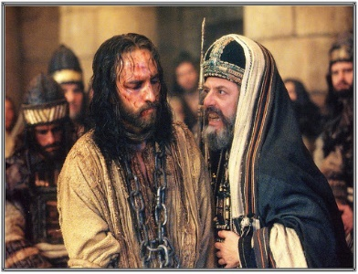

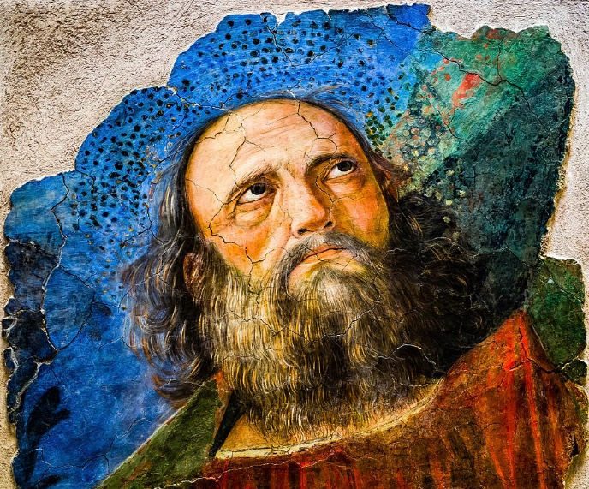



Slide 68

→ Man needs God to direct his walk in life
→ Sin is what dwells in our fleshly lusts, against spirit
→ The mind has the power of self-control to do good
→ The faithful inward man serves God battling sin
→ Without abiding in Christ we are powerless in life
→ Envy, strife, and divisions remain among mere men
→ It is not wise to be unskilled in God’s word
→ Avoid crafty and deceitful with foreign doctrines
→ In weakness the depth of strength is found
→ Arrogance blinds the heart from seeing His truths
→ The best of intentions often fall short
→ To be in Christ rises past the simple flesh
→ Jesus speaks of blessings now and to come
Souls of spirit have higher values
Notes:
Souls of spirit have higher values

Slide 70
Be Strong in the LORD
(A bed sheet study)
3
Ron Bert
September 6, 2020

Slide 72
Poor in spirit. Mt. 5:3-9 | Humble, Mt. 18:3
Broken, contrite heart x spirit. Ps. 34:18; Isa. 57:17
Strong only in Him --- Dependence. Eph. 6:10
Elements of strength. Heb. 11:34; 1 Jn. 5:4
Godliness --- exercise unto. 1 Tim. 4:7-8
Love. 1 Cor. 13:1-8; Eph. 3:17 Rooted in
Prayer, Eph. 6:18 Rooted in Truth. Eph. 4:14
Armor needed. Eph. 6:10-17
Graces. 2 Pet. 1:5-10; Gal. 5:22
Results; Victory, Salvation, Growth, Work.
God our Helper. Rom. 8:31; Phil. 2:13
Many examples of failures – weakness – These all last ~
Many strong; God used these for glory.
Their salvation, and others.
Watch, Pray, Study, work, grow, stand, be steadfast. 1 Cor. 15:58
BE STRONG IN LORD - Eph 6:10
#2
#1
#3

Slide 73
Poor in spirit. Mt. 5:3-9 | Humble, Mt. 18:3
Broken, contrite heart x spirit. Ps. 34:18; Isa. 57:17
Strong only in Him --- Dependence. Eph. 6:10
Elements of strength. Heb. 11:34; 1 Jn. 5:4
Godliness --- exercise unto. 1 Tim. 4:7-8
Love. 1 Cor. 13:1-8; Eph. 3:17 Rooted in
Prayer, Eph. 6:18 Rooted in Truth. Eph. 4:14
Armor needed. Eph. 6:10-17
Graces. 2 Pet. 1:5-10; Gal. 5:22
Results; Victory, Salvation, Growth, Work.
God our Helper. Rom. 8:31; Phil. 2:13
Many examples of failures – weakness – These all last ~
Many strong; God used these for glory.
Their salvation, and others.
Watch, Pray, Study, work, grow, stand, be steadfast. 1 Cor. 15:58
BE STRONG IN LORD - Eph 6:10

Slide 74
… and said, "Assuredly, I say to you, unless you are converted and become as little children, you will by no means enter the kingdom of heaven. — Matthew 18:3
converted
converted
innocence
Notes:
To regain what was lost, one has to turn back to the Lord. The change occurs when one accepts His light of creation, and not just your own.

Slide 75
heart

Slide 76
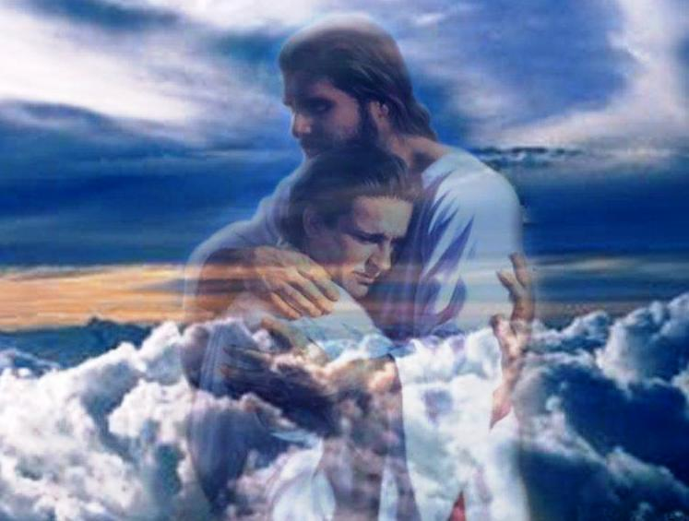
The LORD is near to those who have a broken heart, And saves such as have a contrite spirit. — Psalms 34:18
=
The LORD is near
The LORD is near
heart
And saves
And saves
heart
remorseful
ashamed
regretful
sorry
Proud arrogance
Denial
Notes:
When one chooses to believe in God, God renders multiple benefits. No maybe’s for a faith of assurance, where reliance brings feelings of satisfaction and peace in knowing He cares. In a world of violence and mistrust, He alone has the power above all to deliver saving grace, and in view of such human hostilities. What is gained cannot be paid for, only submitted to. To lift from all that is down, trust in Him, is the sole cause souls are able to rise to see eternity.

Slide 77
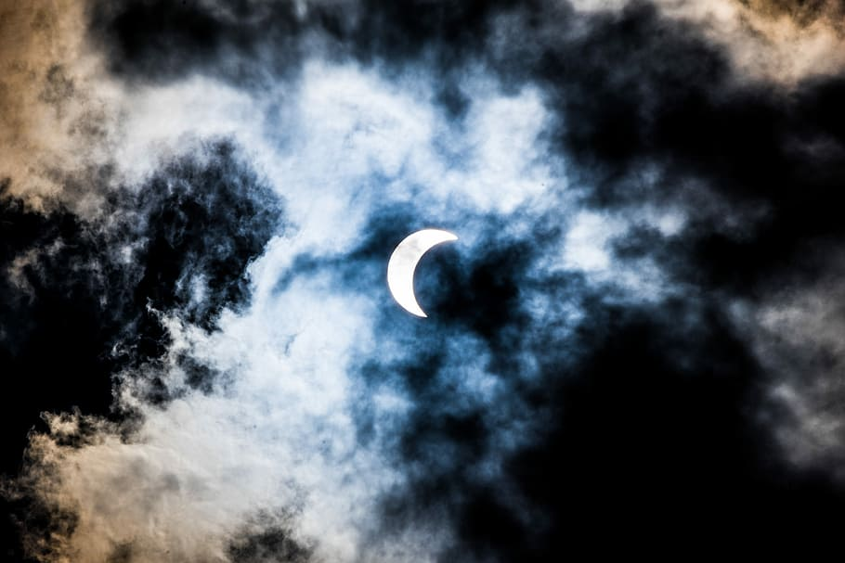
For the iniquity of his covetousness I was angry and struck him; I hid and was angry, And he went on backsliding in the way of his heart. — Isaiah 57:17
heart
I hid
I hid and was angry
I hid and was angry
Violent anger helps no one
Notes:
Anger is a source of regret which bring an honest soul low. Violence steals whatever peace that could be had, and destroys relationships. Anger generally causes one to hide in isolation from others.

Slide 78

Finally, my brethren, be strong in the Lord and in the power of His might. — Ephesians 6:10
strong
in
be strong in the Lord
be strong in the Lord
strong
Notes:
To be strong in the LORD is to trust He will do, in His time, to bring freedom and harmony to the faithful.

Slide 79

… quenched the violence of fire, escaped the edge of the sword, out of weakness were made strong, became valiant in battle, turned to flight the armies of the aliens. — Hebrews 11:34
fearless
courageous
noble
strong
brave
valiant
valiant
Notes:
God desires that we be courageous in our faith.

Slide 80

For whatever is born of God overcomes the world. And this is the victory that has overcome the world -- our faith. — 1st John 5:4
faith
faith
Notes:
Faith is so powerful where the sky has no top.

Slide 81


But reject profane and old wives' fables, and exercise yourself toward godliness. For bodily exercise profits a little, but godliness is profitable for all things, having promise of the life that now is and of that which is to come. — 1st Timothy 4:7-8
But reject profane and old wives' fables, and exercise yourself toward godliness. For bodily exercise profits a little, but godliness is profitable for all things, having promise of the life that now is and of that which is to come. — 1st Timothy 4:7-8
=
godliness is profitable for all
godliness is profitable for all
Notes:
Gossip and fables do little for the kindness of a heart. Godliness is the epitome of a soul. And if eternity starts now as it is, when do we decide to partake?

Slide 82

Though I speak with the tongues of men and of angels, but have not love, I have become sounding brass or a clanging cymbal. And though I have the gift of prophecy, and understand all mysteries and all knowledge, and though I have all faith, so that I could remove mountains, but have not love, I am nothing. — 1st Corinthians 13:1-2
speak with
tongues of
● speak with tongues of angels
● have the gift of prophecy
● understand all mysteries
and all knowledge
● have all faith
჻ but have not love
I am nothing
angels
have not love
have not love
have
the gift of prophecy
understand
all mysteries
and all knowledge
have all faith
have all faith
have all faith
but have not love
I am nothing
am nothing
am nothing
Notes:
Faith without love has no value. Faith alone will not save one as internal reflection has very little to do with outward expressions of sacrifice and unconditional devotion for others.

Slide 83

And though I bestow all my goods to feed the poor, and though I give my body to be burned, but have not love, it profits me nothing. Love suffers long and is kind; love does not envy; love does not parade itself, is not puffed up; does not behave rudely, does not seek its own, is not provoked, thinks no evil; — 1st Corinthians 13:3-5
Love:
● suffers long and is kind
● does not envy
● does not parade itself
● is not puffed up
● does not behave rudely
● does not seek its own
● is not provoked
● thinks no evil
Love
suffers
long and is kind
does not envy
does not parade itself
is not
puffed up
does not behave rudely
does not seek its own
is not
provoked
thinks no evil
Notes:
Love is pure in its composure as all reach out to grasp it. A symphony can only be heard when one is present.

Slide 84



… does not rejoice in iniquity, but rejoices in the truth; bears all things, believes all things, hopes all things, endures all things. Love never fails. But whether there are prophecies, they will fail; whether there are tongues, they will cease; whether there is knowledge, it will vanish away. — 1st Corinthians 13:6-8
in
rejoices in the truth
. .
endures all things
Love
. .
Notes:
Truth in love has no greater value.

Slide 85



… that Christ may dwell in your hearts through faith; that you, being rooted and grounded in love, … — Ephesians 3:17
in
dwell in
. .
through faith
. .
in
love
in love
. .
Notes:
In coming to Christ the love of God is revealed.

Slide 86

… praying always with all prayer and supplication in the Spirit, being watchful to this end with all perseverance and supplication for all the saints ~ — Ephesians 6:18
always
always
watchful
watchful
Notes:
To be in God there is no avoidance.

Slide 87

… that we should no longer be children, tossed to and fro and carried about with every wind of doctrine, by the trickery of men, in the cunning craftiness of deceitful plotting, … — Ephesians 4:14
children
tossed to and fro
with every wind of doctrine
→ by the trickery of men
in the cunning craftiness
of deceitful plotting
children
children
duped
children
tossed to and fro
with every wind of
doctrine
by the trickery of men
trickery
trickery
in the cunning craftiness
of
carnal
cunning
cunning
deceitful plotting
deceitful
deceitful
Notes:
Ocean’s toss and turn, but without the confidence and assurance God commands, that storm will devour a faithless soul.

Slide 88

Finally, my brethren, be strong in the Lord and in the power of His might. Put on the whole armor of God, that you may be able to stand against the wiles of the devil. For we do not wrestle against flesh and blood, but against principalities, against powers, against the rulers of the darkness of this age, against spiritual hosts of wickedness in the heavenly places. — Ephesians 6:10-12
armor
armor
Put on the whole armor of God
Put on the whole armor of God
Notes:
No one can deny we all need to be assisted with better, nobler hearts. We all fall short.

Slide 89

Therefore take up the whole armor of God, that you may be able to withstand in the evil day, and having done all, to stand. Stand therefore, having girded your waist with truth, having put on the breastplate of righteousness, and having shod your feet with the preparation of the gospel of peace; above all, taking the shield of faith with which you will be able to quench all the fiery darts of the wicked one. And take the helmet of salvation, and the sword of the Spirit, which is the word of God; — Ephesians 6:13-17
armor
the whole armor of God
Stand in the whole armor of God:
→ gird your waist with truth
→ put on the breastplate of righteousness
→ prepare feet with the gospel of peace
● above all:
→ the shield of faith
→ the helmet of salvation
→ the sword of the Spirit
    the word of God
in
Stand
truth
truth
gird
your waist with
righteousness
righteousness
truth
put on the breastplate of
peace
peace
righteousness
feet
with
prepar
the gospel of peace
above all
the shield of faith
faith
trust
faith
e
salvation
deliverance
salvation
the helmet
of salvation
the sword of the Spirit
word of God
knowledge
word of God
the word of God
Notes:
Much needs to be done to shine in His light as godly creatures. Goals reach out to the future where hope fulfills what will be certain; that which is to come.

Slide 90

But also for this very reason, giving all diligence, add to your faith virtue, to virtue knowledge, to knowledge self-control, to self-control perseverance, to perseverance godliness, to godliness brotherly kindness, and to brotherly kindness love. — 2nd Peter 1:5-7
giving all diligence:
giving all diligence
faith
virtue
knowledge
self
control
+
perseverance
godliness
brotherly
kindness
love
Notes:
If only we could all understand the deep care and concern He has for our uplifting of Spirit. God is a wave upon man when the fire of truth is desired above the lies of man’s manipulations, and the tyrants that would oppress us. To always live to diligently improve in all facets of goodness wholly benefits.

Slide 91

For if these things are yours and abound, you will be neither barren nor unfruitful in the knowledge of our Lord Jesus Christ. For he who lacks these things is shortsighted, even to blindness, and has forgotten that he was cleansed from his old sins. Therefore, brethren, be even more diligent to make your call and election sure, for if you do these things you will never stumble; — 2nd Peter 1:8-10
if these things are yours and abound
neither barren nor unfruitful
knowledge of Jesus
Christ
lacks these things is
blind and has
forgotten cleansed from
old sins
make your call
. .
sure
sure
Notes:
The qualities the Bible expresses for our lives are for the best possible existence, and are given so we can know right from wrong. When we neglect to share this holy knowledge or abandon our children to the confusion of sinful natures, hopelessness rather than hope becomes us. Apathy and anarchy inevitably ensue.

Slide 92
if these things are yours and abound
lacks these things
is blind and has
forgotten cleansed
from old sins
Faith
Knowledge
Love
neither barren
nor unfruitful
Virtue
Self-control
Brotherly
kindness
Godliness
Perseverance
knowledge of Jesus Christ
Notes:
The qualities the Bible expresses for our lives are for the best possible existence, and are given so we can know right from wrong. When we neglect to share this holy knowledge or abandon our children to the confusion of sinful natures, hopelessness rather than hope becomes us. Apathy and anarchy inevitably ensue.

Slide 93

But the fruit of the Spirit is love, joy, peace, longsuffering, kindness, goodness, faithfulness, … — Galatians 5:22
fruit of the Spirit:
● love
● joy
● peace
● longsuffering
● kindness
● goodness
● faithfulness
fruit of the Spirit
=
love
joy
peace
longsuffering
kindness
goodness
faithfulness
Notes:
Fruits of truth abound in His word, as to our true nature of living to the fullest.

Slide 94

What then shall we say to these things? If God is for us, who can be against us? — Romans 8:31
God
God
Notes:
With God all things are possible, and more importantly, endurable. Seeking God is what brings more than all could desire; immeasurable life.

Slide 95

… for it is God who works in you both to will and to do for His good pleasure. — Philippians 2:13
God
Notes:
To not see God working through us is to live a life of isolation, with little hope of eternal blessings, and all the wonders to behold.

Slide 96

Therefore, my beloved brethren, be steadfast, immovable, always abounding in the work of the Lord, knowing that your labor is not in vain in the Lord. — 1st Corinthians 15:58
always
always
in
abounding in the work
. .
Notes:
Always is a word that commands commitment.

Slide 97
















Slide 98
→ Without humble hearts heaven is out of reach
→ God is near to those with broken contrite hearts
→ We need to depend on the Lord’s strength & power
→ Our strength comes by confidence in our faith
→ Godliness focuses on life rejecting hearsay & fables
→ Love is the key component of all that is good
→ Prayer is to be a constant meditation of Spirit
→ Truth should take priority over deceptions of man
→ Our armor: truth, righteousness & gospel of peace
→ Virtue/knowledge/control/patience/kindness…love
→ Fruits of Spirit: love, joy, peace, longsuffering, faith
→ God works through us to increase His will
→ Be steadfast abounding in the work of God
Diligent hearts rise to know His truth
Notes:
Diligent hearts rise to know His truth

Slide 100

Please visit http://www.RonBert.com to explore further
Ronald Bert Channel on
Notes:
Eternity never ends.

