Slide 2
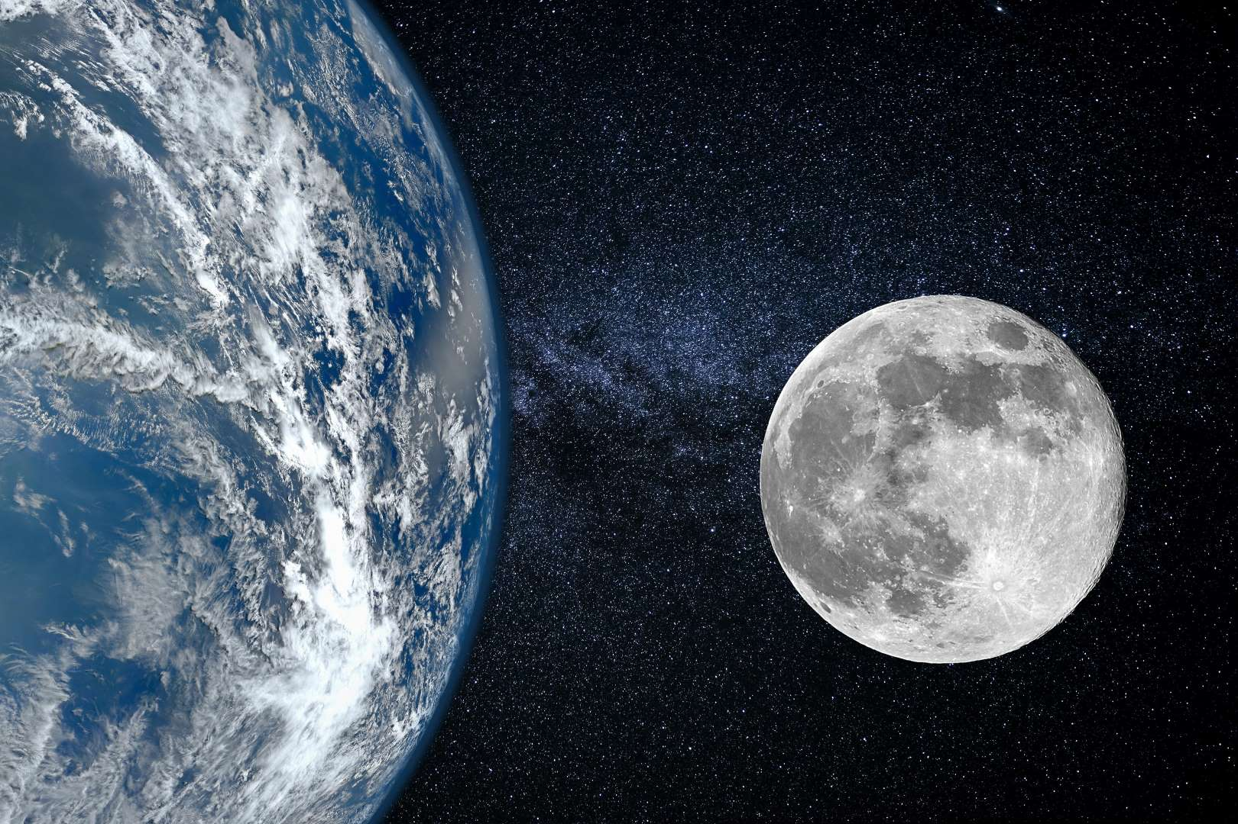
All
1
Ron Bert
February 6, 2022
Notes:
No matter nation or people, God knows all that has been done.

Slide 3
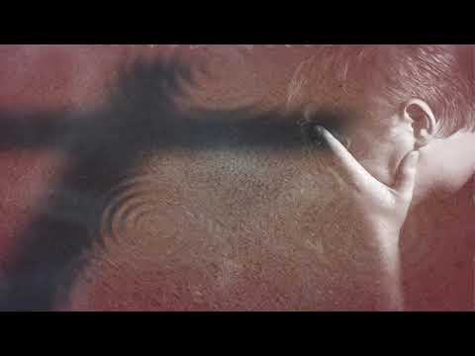
… for all have sinned and fall short of the glory of God, … — Romans 3:23
all have sinned
all
all have sinned
all
Notes:
We must beg beyond pride and self-seeking for forgiveness.

Slide 4
But the Scripture has confined all under sin, that the promise by faith in Jesus Christ might be given to those who believe. — Galatians 3:22
all under sin
all
all under sin
promise
promise
in
by faith in Jesus Christ
might be
by faith in Jesus Christ
might be
Jesus Christ
all
who believe
given
who believe
given
Notes:
Under sin, God is attempting to redeem us through Jesus Christ. Recall, even the demons believe in God and tremble. Belief has no effect if not equaled in action.

Slide 5
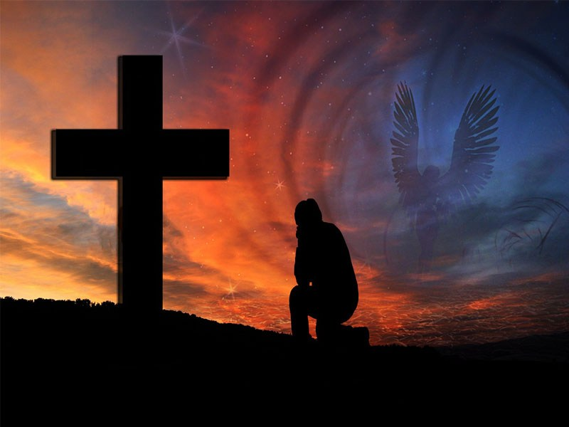
… and that we may be delivered from unreasonable and wicked men; for not all have faith. — 2nd Thessalonians 3:2
not all have faith
all
not all have faith
all
Notes:
If one wants to be as free as a bird then one’s all must surrender, to God, who controls the flight of all things. Not all are honest; public officials lie to themselves and the citizensc they supposedly serve. Civilizations more often are built upon the lies of men wishing to be served, over the true call to service, which God Himself has commanded us to observe.

Slide 6
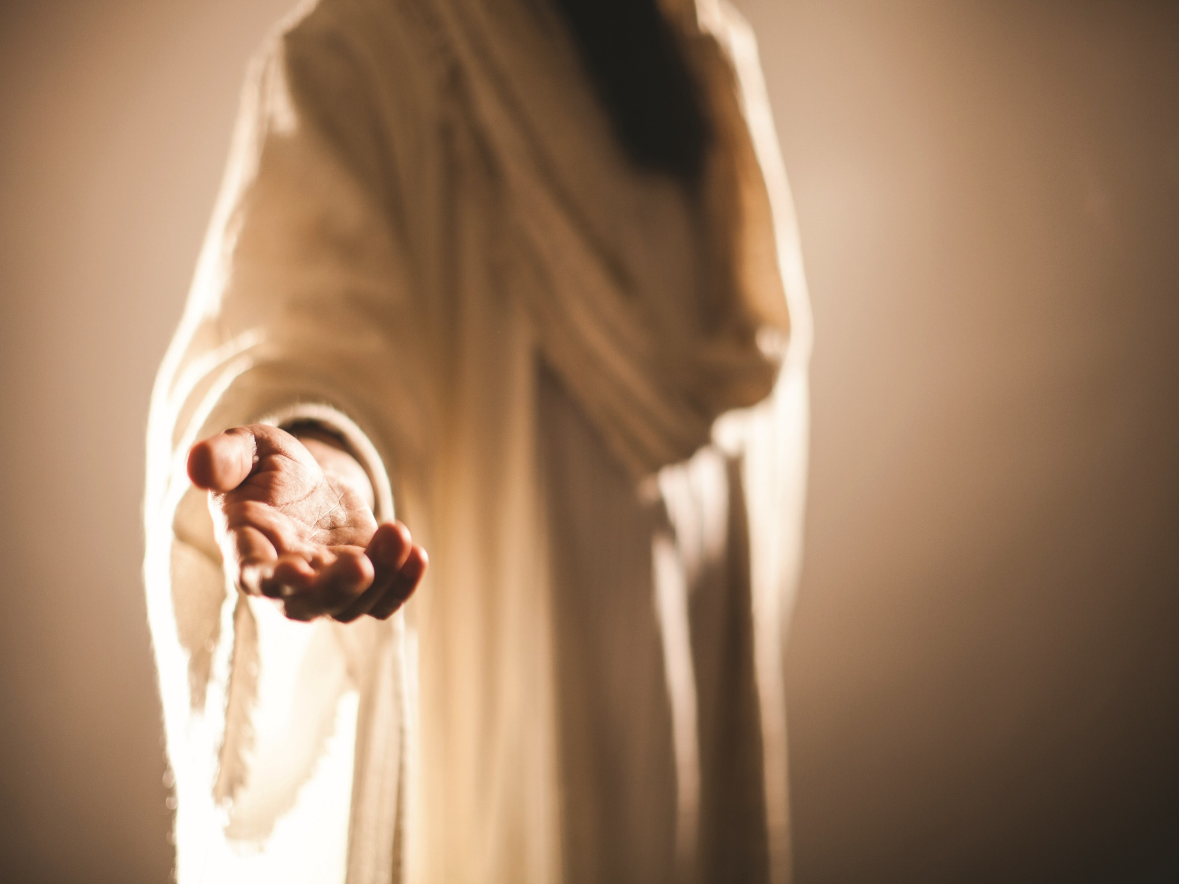
The Lord is not slack concerning His promise, as some count slackness, but is longsuffering toward us, not willing that any should perish but that all should come to repentance. — 2nd Peter 3:9
The Lord
The Lord
Lord
all
is longsuffering
is longsuffering
Salvation
all should
all
all should
atonement
come to repentance
remorse
shame
come to repentance
sorrow
regret
Notes:
God waits for hearts to awaken in His truths of Grace and goodness. If our baby was trapped in a well, how long would we hope for it to be saved?

Slide 7
… who desires all men to be saved and to come to the knowledge of the truth. — 1st Timothy 2:4
desires all men to be saved
all
all
desires all men to be saved
come to
come to
all
all
truth
truth
Notes:
Truth is what brings us back to the light. Salvation is predicated upon our actions in relation to the truth He has spoken in His holy word.

Slide 8
And there are diversities of activities, but it is the same God who works all in all. — 1st Corinthians 12:6
God who works all in all
God who works all in all
God
all
in
all
all
Notes:
All things have been given the freedom of motion. No matter if grasses are frozen or trees bask in sunlight, the presence of the Lord holds all reality cohesively. Without His touch all would simply disintegrate.

Slide 9
But the manifestation of the Spirit is given to each one for the profit of all: — 1st Corinthians 12:7
all
Spirit is given
each one
all
profit of all
profit of all
Notes:
Each of us has an essence of becoming, and if we can recognize our purpose, fulfillment arrives.

Slide 10
But one and the same Spirit works all these things, distributing to each one individually as He wills. — 1st Corinthians 12:11
one
Spirit
one
Spirit
. .
all
works all these things
. .
each one individually
as He wills
Notes:
Each has a special gift, and if recognized, peace becomes, with the tightness on which we stand onward. It is God’s plan to establish truth in the heart’s of living souls.

Slide 11
But one and the same Spirit works all these things, distributing to each one individually as He wills. — 1st Corinthians 12:11
one
Spirit
one
Spirit
. .
all
all
works all these things
. .
as He wills
UNIQUE
Notes:
Each has a special gift, and if recognized, peace becomes, with the tightness on which we stand onward. It is God’s plan to establish truth in the heart’s of living souls.

Slide 12
For as the body is one and has many members, but all the members of that one body, being many, are one body, so also is Christ. — 1st Corinthians 12:12
all
all
all
all
all
members
members
one body
one body
all
Christ
Christ
Notes:
Unity is bonding with His holy promise, in His given truths. No matter how short or tall, thin or obese, God welcomes all faithful.

Slide 13
For by one Spirit we were all baptized into one body -- whether Jews or Greeks, whether slaves or free -- and have all been made to drink into one Spirit. — 1st Corinthians 12:13
by one Spirit
one Spirit
by one Spirit
all
baptized
all baptized
one body
all baptized
one body
all
all
Notes:
In our return to God, it is His way, not the ways of men. One answer will be given as we arrive face to face in His glorious light. Did we receive His gift or rebel in a sea of misfortune?

Slide 14
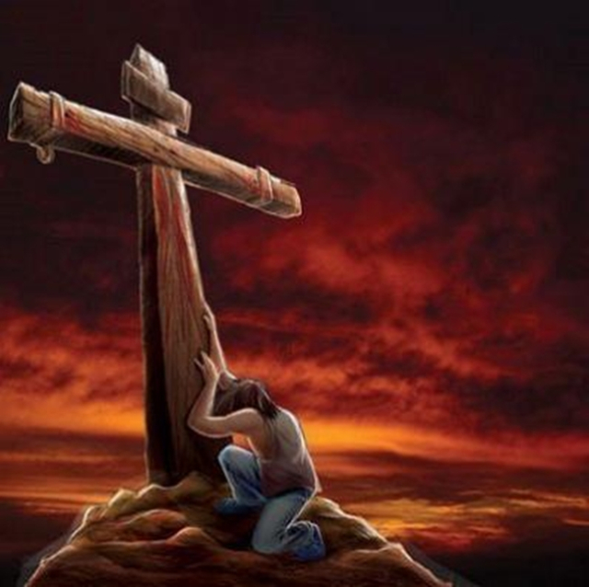
For there is no distinction between Jew and Greek, for the same Lord over all is rich to all who call upon Him. — Romans 10:12
all
Lord over all
all
Lord over all
rich to all
rich to all
call
who call upon Him
who call upon Him
Notes:
Key is to call on the Lord no matter past sins, and to come to repentance, in view of His godly guidance.

Slide 15
And we know that all things work together for good to those who love God, to those who are the called according to His purpose. — Romans 8:28
all things work
all
all
all things work
for good
who
for good
who
love God
love God
love God
all
His purpose
all
His purpose
Notes:
All who desire to be better, for self and others, must realize we are part of His grand plan to return to the original goodness intended. Moral integrity of spirit has always been His fundamental component of creation where life dwells. He is the puzzle maker waiting to see what parts fit in place or not. It is love of God that guides a heart.

Slide 16
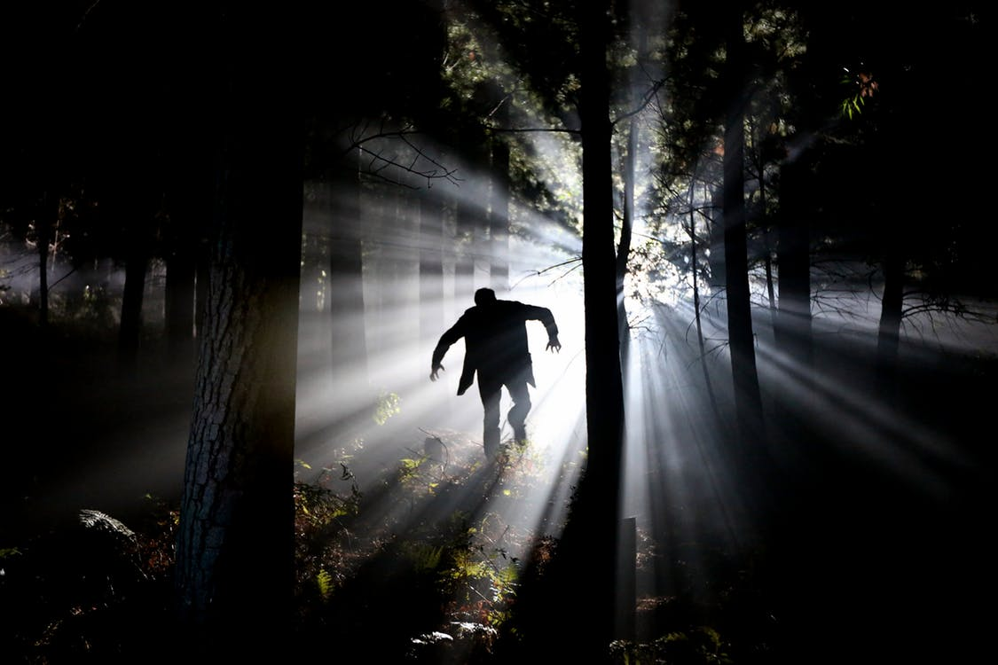
Therefore, just as through one man sin entered the world, and death through sin, and thus death spread to all men, because all sinned -- — Romans 5:12
all
death
death
to all men
because all
all
all
to all men
because all
all
sinned
sinned
Notes:
Sin comes to all who leave God and pursue their own desires without regard for Him who created all. Which path do you choose? To run to the light or fall to the darkness? Direction declares destiny.

Slide 17
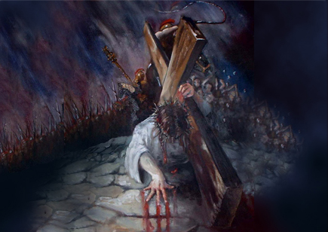
Therefore, as through one man's offense judgment came to all men, resulting in condemnation, even so through one Man's righteous act the free gift came to all men, resulting in justification of life. — Romans 5:18
all
judgment came to all
judgment came to all
all
righteous act
free gift
all
life
Notes:
Christ gave His all, and continues to do so. Where do we place our all is what He watches for. Again, the free gift of life waits for all who would grasp it. By Christ’s sacrifice, it now has become clear, God wants to justify life and its’ purpose.

Slide 18
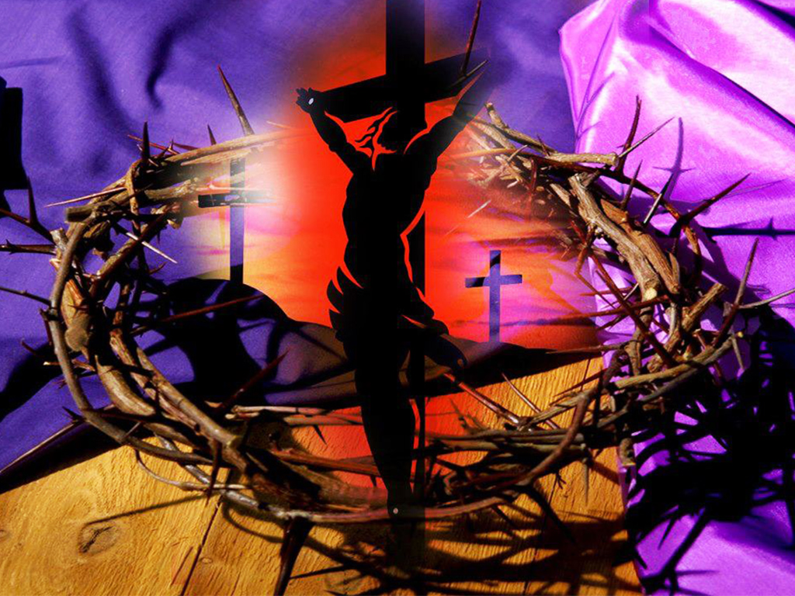
For the death that He died, He died to sin once for all; but the life that He lives, He lives to God. — Romans 6:10
all
once for all
once for all
all
He lives
lives to God
Notes:
What a blessing we find in undeserved forgiveness. His life sets truth as a premium to be obtained. No one, no matter belief or faith, or not, can deny life is tangible, real to the senses. Satisfying the senses distinguishes whether one exercises self-control or if the zest for lust is unrestrained, discarding His called for decency order. Living for lust is not living to God where all higher purpose dwells. Civilizations that focus on the flesh are soon extinguished to the past failures of spirit. The corridors of history, and the present, prove man is a failure in exalting God’s ways.

Slide 19
For of Him and through Him and to Him are all things, to whom be glory forever. Amen. — Romans 11:36
all
all
to Him are all things
all
all
to Him are all things
Him
Notes:
All reality seen or not originates from His gifts of freedom among life.

Slide 20
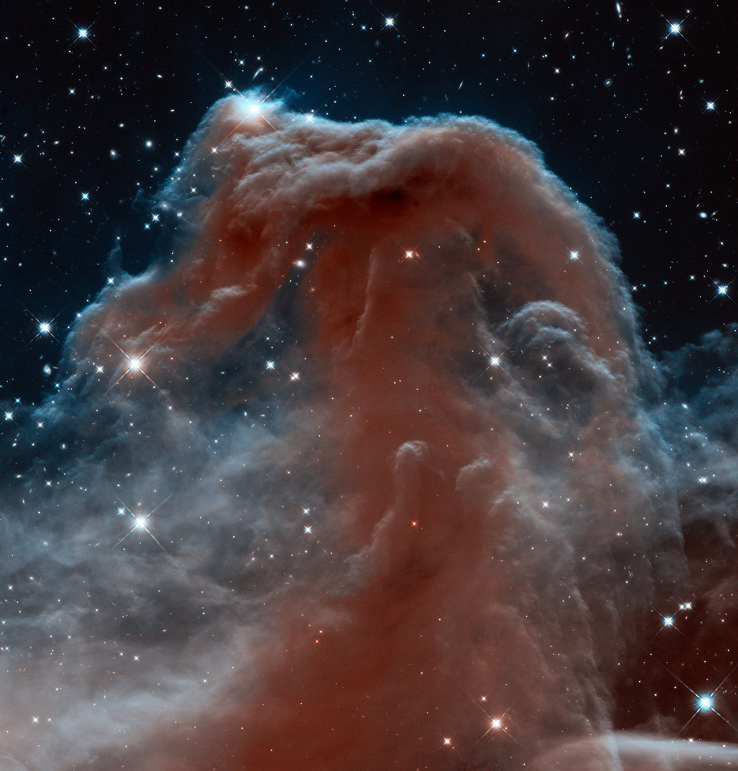
He is the image of the invisible God, the firstborn over all creation. For by Him all things were created that are in heaven and that are on earth, visible and invisible, whether thrones or dominions or principalities or powers. All things were created through Him and for Him. — Colossians 1:15-16
all
firstborn over all
all
all
all
firstborn over all
all
creation
all
creation
all
all
All things were created
All things were created
through Him and for Him
through Him and for Him
Notes:
What an expanse waiting for all those who hope in His adventure ahead.

Slide 21
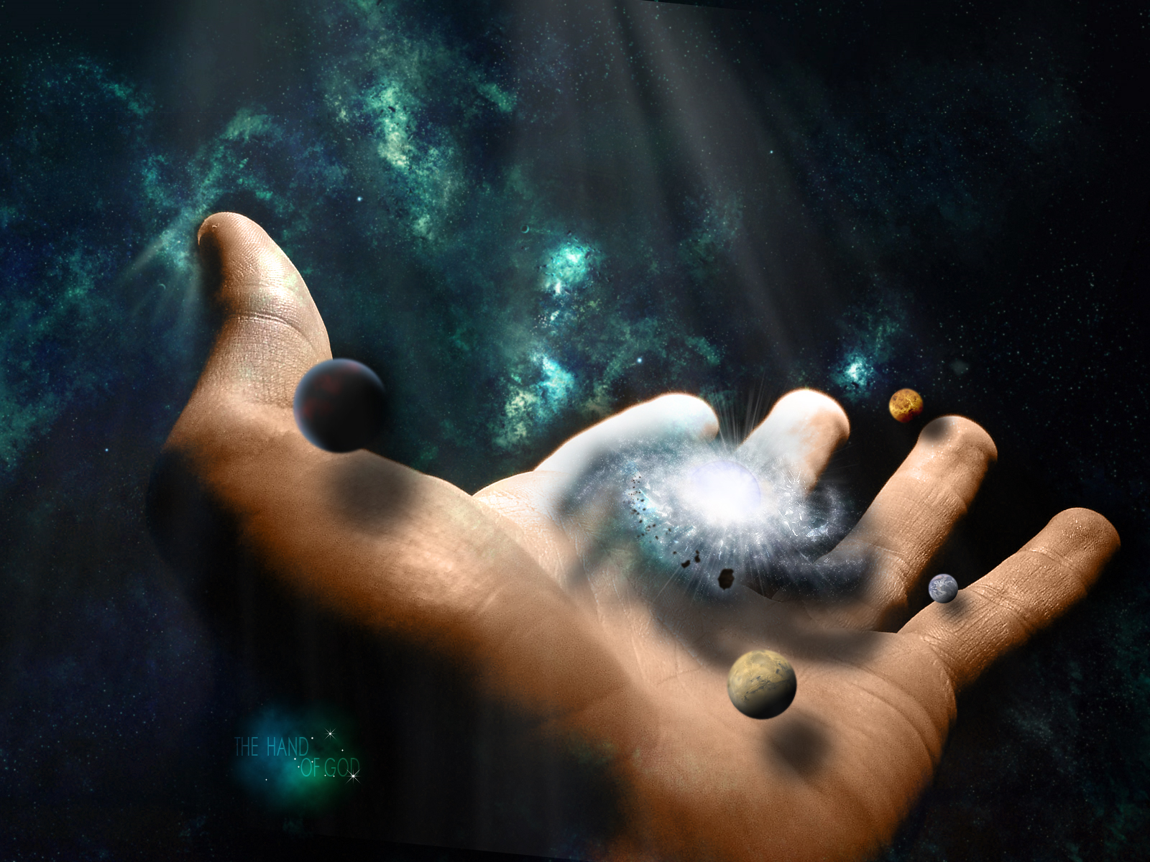
And He is before all things, and in Him all things consist. And He is the head of the body, the church, who is the beginning, the firstborn from the dead, that in all things He may have the preeminence. For it pleased the Father that in Him all the fullness should dwell, … — Colossians 1:17-19
He is before all things
=
all
He is before all things
He
all
in
all
in all things He
in all things He
may have the preeminence
may have the preeminence
all
Notes:
In Him true wisdom endures across all ages.

Slide 22
… and by Him to reconcile all things to Himself, by Him, whether things on earth or things in heaven, having made peace through the blood of His cross. — Colossians 1:20
reconcile
reconcile
all
all things to Himself
all
all
all things to Himself
all
made peace
through the blood of His cross
Notes:
A soul saving path has been delivered for all that have become lost upon time’s bondage.

Slide 23
For the love of Christ compels us, because we judge thus: that if One died for all, then all died; and He died for all, that those who live should live no longer for themselves, but for Him who died for them and rose again. — 2nd Corinthians 5:14-15
all
all
then all died
One died for all
then all died
One died for all
He died for all
all
He died for all
live
for themselves
for Him
Notes:
To find life’s purpose, one needs to see who originally sacrificed, so that we may all live and savor life..

Slide 24
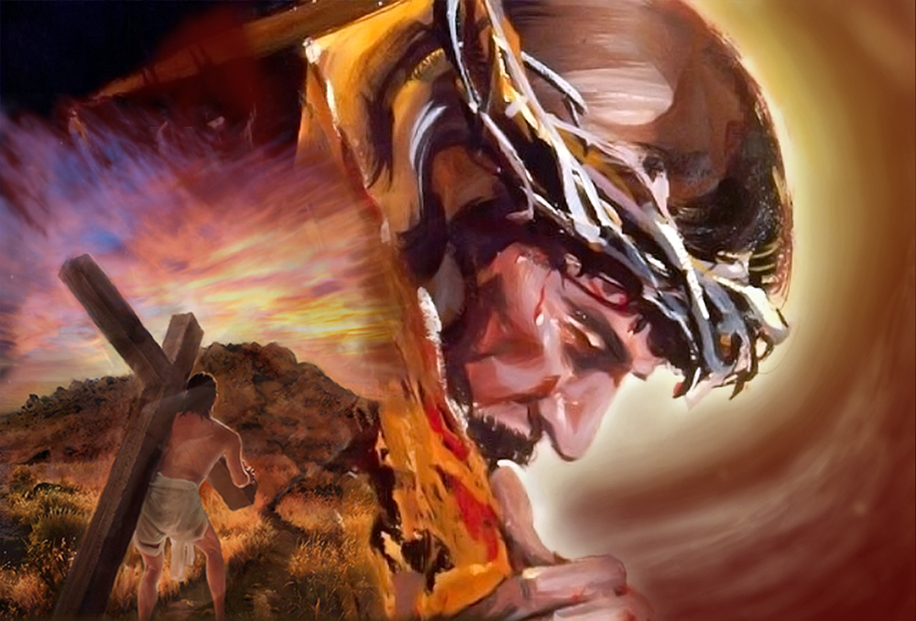
Therefore, if anyone is in Christ, he is a new creation; old things have passed away; behold, all things have become new. Now all things are of God, who has reconciled us to Himself through Jesus Christ, and has given us the ministry of reconciliation, … — 2nd Corinthians 5:17-18
Therefore, if anyone is in Christ, he is a new creation; old things have passed away; behold, all things have become new. Now all things are of God, who has reconciled us to Himself through Jesus Christ, and has given us the ministry of reconciliation, … — 2nd Corinthians 5:17-18
all
all things are of God
all things are of God
all
given
settlement
compromise
understanding
appeasement
reunion
Notes:
To be reconciled to God, one must reach within to draw upon the very heart of God. It is an approach to a destination unbelievable for those that endure trials of the flesh.

Slide 25
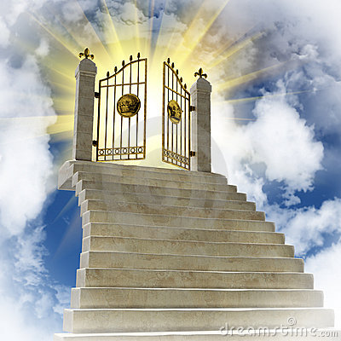
And having been perfected, He became the author of eternal salvation to all who obey Him, … — Hebrews 5:9
all
eternal
eternal
all
salvation to all who obey Him
all
salvation to all who obey Him
Notes:
Heaven is a destination none of us has arrived at of yet. If we can endure the tortures of living in the flesh, rather than refusing this releasing to spirit, we find true meaning of why.

Slide 26
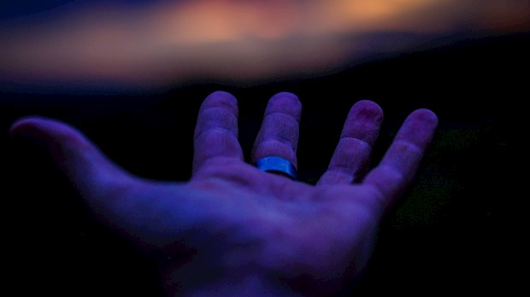
All unrighteousness is sin, and there is sin not leading to death. — 1st John 5:17
All unrighteousness is sin
all
All unrighteousness is sin
all
sin not leading to death
Notes:
Finding forgiveness in Christ frees us from the sin that condemns us. He carries what we are unable to.

Slide 27
Then Philip said, "If you believe with all your heart, you may." And he answered and said, "I believe that Jesus Christ is the Son of God." — Acts 8:37
all
with all your heart
all
with all your heart
all
Jesus Christ is
Notes:
As eternity is written on the hearts of all, to believe is an act of a good conscience clear of opinion. His written truth is plain for all to see. What we wear on our sleeves is generally who we are. Many multi-media participants have much shame to bear. Belief in God is a call to action in good behavior.

Slide 28
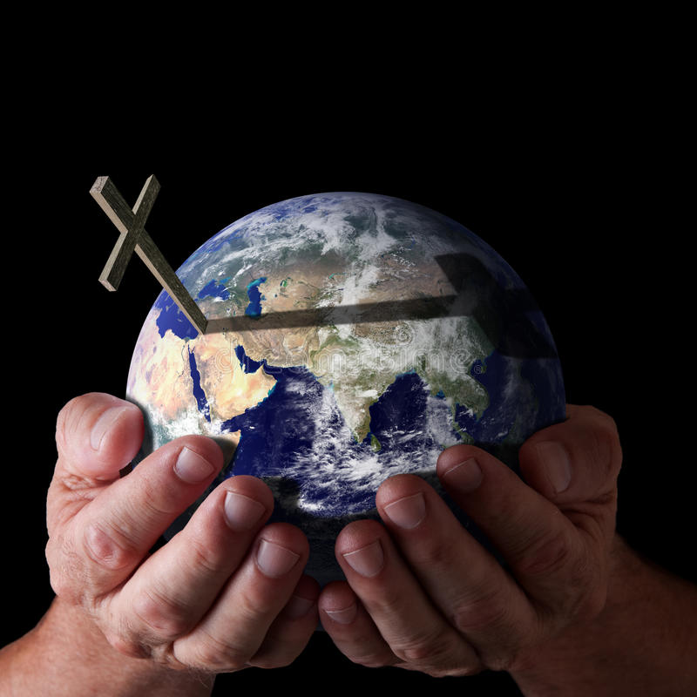
You have forgiven the iniquity of Your people; You have covered all their sin. Selah — Psalms 85:2
covered
. .
all
all their sin
Notes:
He has paid the price to cover all sins, and what a missed opportunity coming, for all those who reject what He has delivered, at the cost of life itself.

Slide 29
You have forgiven the iniquity of Your people; You have covered all their sin. Selah — Psalms 85:2
covered
all
. .
all
all their sin
Notes:
He has paid the price to cover all sins, and what a missed opportunity coming, for all those who reject what He has delivered, at the cost of life itself.

Slide 30
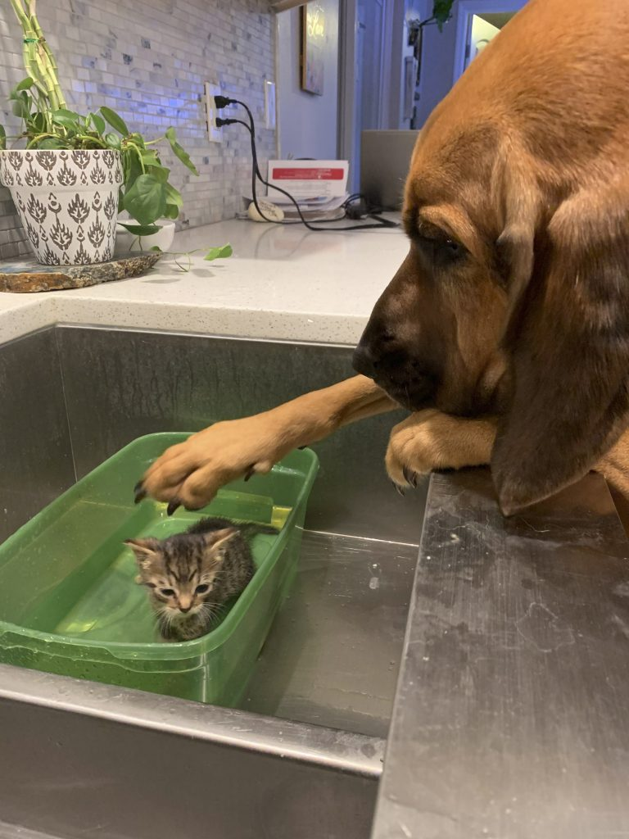
Hatred stirs up strife, But love covers all sins. — Proverbs 10:12
all
love covers all sins
all
all
love covers all sins
all
Notes:
Love’s highest call touches all. Love maintains more than one can give.

Slide 31
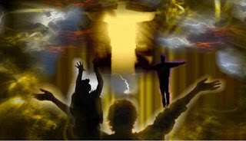
Behold, I tell you a mystery: We shall not all sleep, but we shall all be changed -- — 1st Corinthians 15:51
all
all
all be changed
all
all be changed
Notes:
A great awakening is coming, both terrifying, and anticipated, by all. For better or worse each will come to know without excuse.

Slide 32
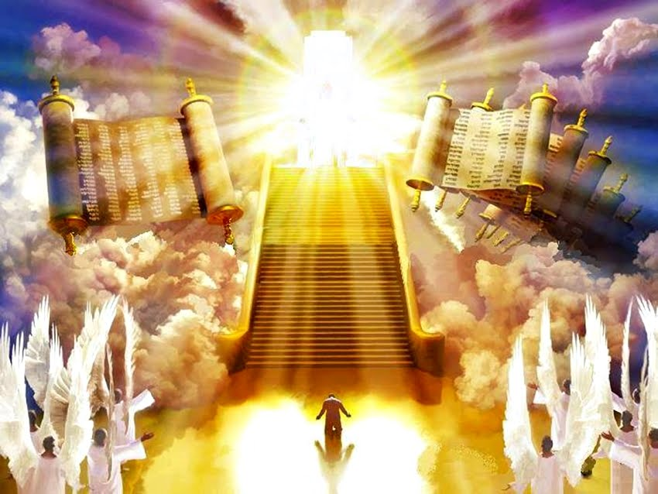
For we must all appear before the judgment seat of Christ, that each one may receive the things done in the body, according to what he has done, whether good or bad. — 2nd Corinthians 5:10
. .
all
we must all appear before
Christ
Christ
good
bad
Notes:
To arrive will be sweet to all who hear and obey. Good will find its’ reward where as bad descends in oblivion.

Slide 33
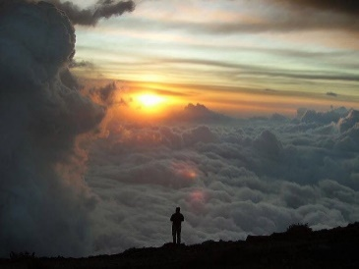
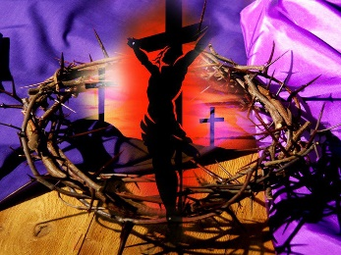
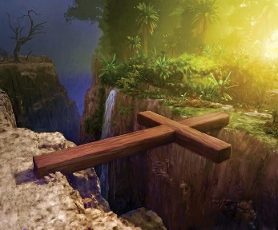
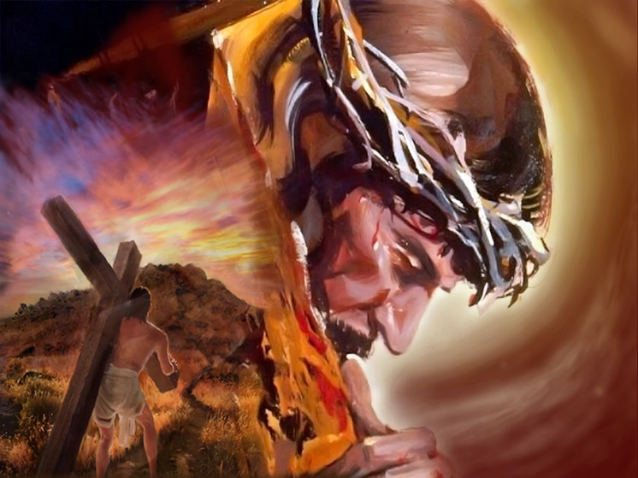
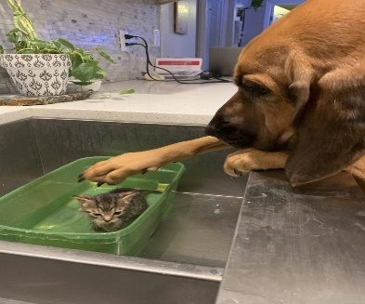
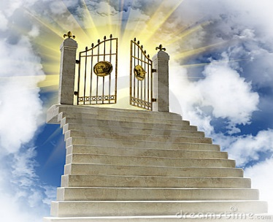

Slide 34
→ All are confined under sin and fall short
→ God now commands all to come to repentance
→ God desires all to be saved with knowledge of truth
→ All members are one body under and in Christ
→ All works for the good who are called in Him
→ God’s offers the free gift of life to all
→ All was created through Him and for Him
→ God reconciles all to Himself through Christ
→ Christ died for all that we might live righteously
→ All becomes new when one turns to Christ
→ Eternal salvation to all who obey Him
→ All unrighteousness is sin; love covers all sins
→ All must appear before the judgment seat of Christ
He supplies the sands of Time but for a moment
Notes:
He supplies the sands of Time but for a moment

Slide 35
Notes:
Anxieties cause desperations that cripple peace of mind. This world is unable to satisfy what the spirit needs to survive whole. Freedom is found in what is most simple, love of God. Each thankful breath brings us closer.

Slide 37
All
2
Ron Bert
March 6, 2022

Slide 38
Therefore, as we have opportunity, let us do good to all, especially to those who are of the household of faith. — Galatians 6:10
do
all
all
good to all
good to all
Notes:
The call is to bond with those like minded in the faith.

Slide 39
Honor all people. Love the brotherhood. Fear God. Honor the king. — 1st Peter 2:17
all
all
Honor all people
Honor all people
Notes:
It is a challenge to adhere to the principles declared in His word. Sin surrounds the syphons of man.

Slide 40
Do all things without complaining and disputing, … — Philippians 2:14
Do
Do all things without complaining
all
all
Do all things without complaining
all
Repay no one evil for evil. Have regard for good things in the sight of all men. — Romans 12:17
regard for good
regard for good
all men
all
all men
Notes:
His word instructs for the betterment of all.

Slide 41
If it is possible, as much as depends on you, live peaceably with all men. — Romans 12:18
all
live peaceably
live peaceably
with all men
all
all
all
with all men
. .
… to speak evil of no one, to be peaceable, gentle, showing all humility to all men. — Titus 3:2
all
all
all
humility
to all men
humility
to all men
Notes:
To become a godly creature, many bad habits must be left to the past. God instructs us to consider all, with a good conscience, and a heart of understanding. Purging bad habits is the sore chore. Virtuous possessions are certainly noble qualities, for any and all, that have the power to exercise these wisdoms. God want us to see from the inside more so than just the outside.

Slide 42
Greet all the brethren with a holy kiss. — 1st Thessalonians 5:26
Greet all the brethren
all
all
Greet all the brethren
all
Let all that you do be done with love. — 1st Corinthians 16:14
do
all that you do
all
all that you do
with love
love
with love
Notes:
As is repeated, love is the key to freedom.

Slide 43
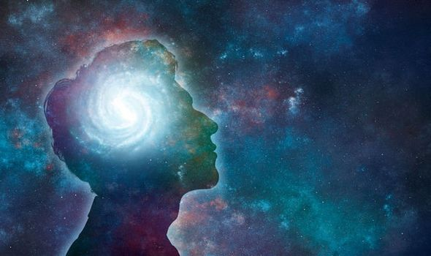
Therefore, whether you eat or drink, or whatever you do, do all to the glory of God. — 1st Corinthians 10:31
all
do
do
do all to the glory of God
all
do all to the glory of God
Notes:
A thankful heart has little to fear under the petty threats of man.

Slide 44
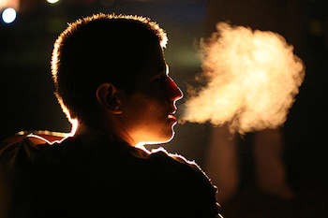
… giving thanks always for all things to God the Father in the name of our Lord Jesus Christ, …. — Ephesians 5:20
all
thanks
thanks
all things to God
in
all
all things to God
Christ
Notes:
Every breath is a promise of more.

Slide 45
… above all, taking the shield of faith with which you will be able to quench all the fiery darts of the wicked one. — Ephesians 6:16
above all
all
above all
all
faith
faith
protection
Notes:
Our hope, in love of God, lifts us to a higher plain where eternity has no boundaries.

Slide 46
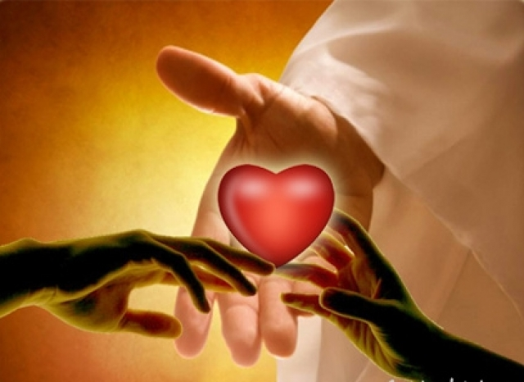
But above all these things put on love, which is the bond of perfection. — Colossians 3:14
all
above all
all
above all
love
love
love
Notes:
To accept what He has done brings us closer to knowing why we are. We all have a musical string that vibrates to the ear of God Himself.

Slide 47
And above all things have fervent love for one another, for "love will cover a multitude of sins." — 1st Peter 4:8
above all things
all
above all things
love
one another
all
love
one another
Notes:
Sharing comforts the soul in the face of all hardships.

Slide 49
All
4
Ron Bert
March 27, 2022

Slide 50
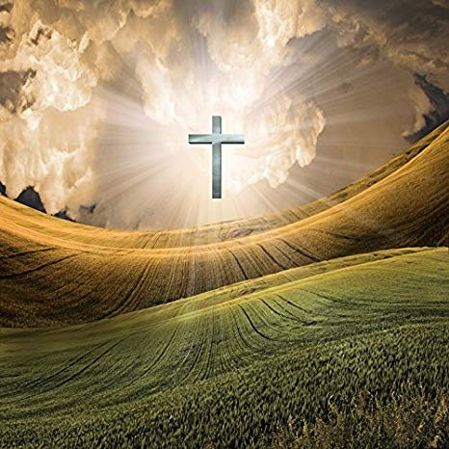
Test all things; hold fast what is good. — 1st Thessalonians 5:21
hold fast
what is good
Test all things
all
hold fast
what
Test all things
is good
all
Notes:
To examine is the quest of life in its’ purest form.

Slide 51
Now we exhort you, brethren, warn those who are unruly, comfort the fainthearted, uphold the weak, be patient with all. — 1st Thessalonians 5:14
all
be patient with all
all
be patient with all
Notes:
Standing in the truth is a delicate dance as sin avalanches upon our children.

Slide 52
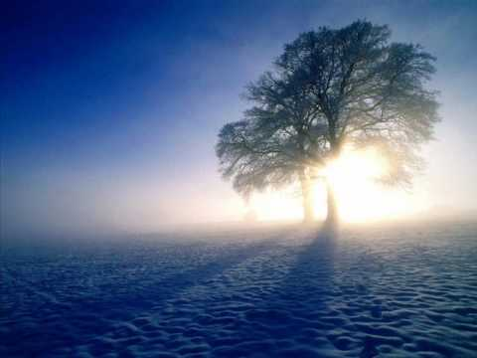
Preach the word! Be ready in season and out of season. Convince, rebuke, exhort, with all longsuffering and teaching. — 2nd Timothy 4:2
all
persuade
correct
encourage
all longsuffering and teaching
all
all longsuffering and teaching
Notes:
Without the knowledge of the tree of life, death is next of kin. We must through reason correct errors uplifting the strength of truth.

Slide 53
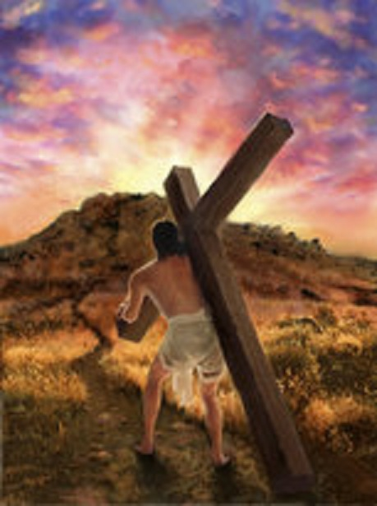
But you be watchful in all things, endure afflictions, do the work of an evangelist, fulfill your ministry. — 2nd Timothy 4:5
watchful in all things
all
watchful in all things
all
do
Notes:
To climb on is what the faithful do. Looking back into the valleys of darkness is a snare to all those who fall back, losing a heart of devotion. Anticipating the best ahead heals the soul from the tragic poisons of past errors. Distractions have always been the temptation of all.

Slide 54
… but as He who called you is holy, you also be holy in all your conduct, — 1st Peter 1:15
be holy
↓
laying aside all:
● malice
● deceit
● hypocrisy
● envy
● evil speaking
be
all
holy in all your conduct
all
all
all
holy
in
all
holy in all your conduct
Therefore, laying aside all malice, all deceit, hypocrisy, envy, and all evil speaking, … — 1st Peter 2:1
laying aside all
malice
all
deceit
hypocrisy
envy
evil speaking
Notes:
Redundancy, to achieve clarity, is found in the truth He delivers. Scholars and laymen alike have no excuse in understanding what He make plain. As mere men we all have challenges to be better, leaving evils behind, while shining in the light.

Slide 55
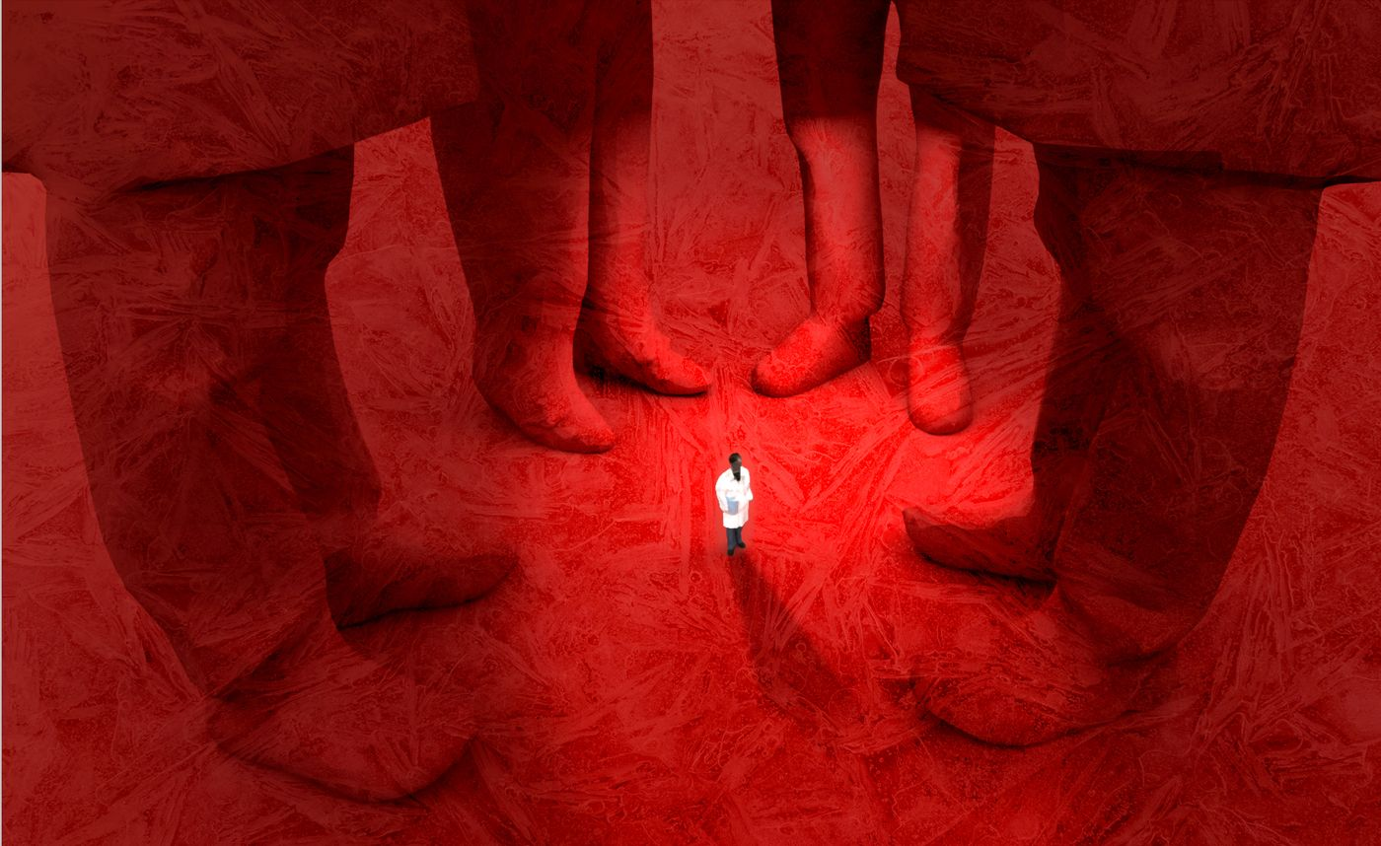
Therefore lay aside all filthiness and overflow of wickedness, and receive with meekness the implanted word, which is able to save your souls. — James 1:21
lay aside all filthiness
all
lay aside all filthiness
receive
receive
all
word
word
save your souls
save your souls
Notes:
Peace comes to all who truly find and act on His truth.

Slide 56
If we confess our sins, He is faithful and just to forgive us our sins and to cleanse us from all unrighteousness. — 1st John 1:9
all
cleanse us from all
all
cleanse us from all
unrighteousness
unrighteousness
Notes:
Releasing the heart’s prison, created by the self, comes by accepting His forgiveness in love beyond measure.

Slide 57
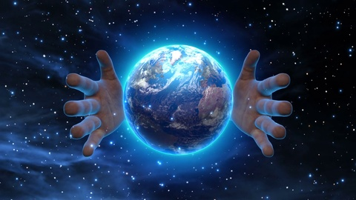
For all that is in the world -- the lust of the flesh, the lust of the eyes, and the pride of life -- is not of the Father but is of the world. — 1st John 2:16
all
all that is in the world
all that is in the world
lust
lust
pride
pride
not of the Father
all
not of the Father
Notes:
His truth rings above the dust left behind. Sexual immorality has always been the tragic downfall of all civilizations seeking higher consciousness. The raping of man does not exhibit the glory of God. Predators of the flesh only see themselves, and what lies below, never noticing the call of the stars.

Slide 58
For if our heart condemns us, God is greater than our heart, and knows all things. — 1st John 3:20
all
God
our heart
God
knows all things
all
knows all things
Notes:
God understands more than we know, and will extend mercy to genuine hearts seeking His grace.

Slide 59
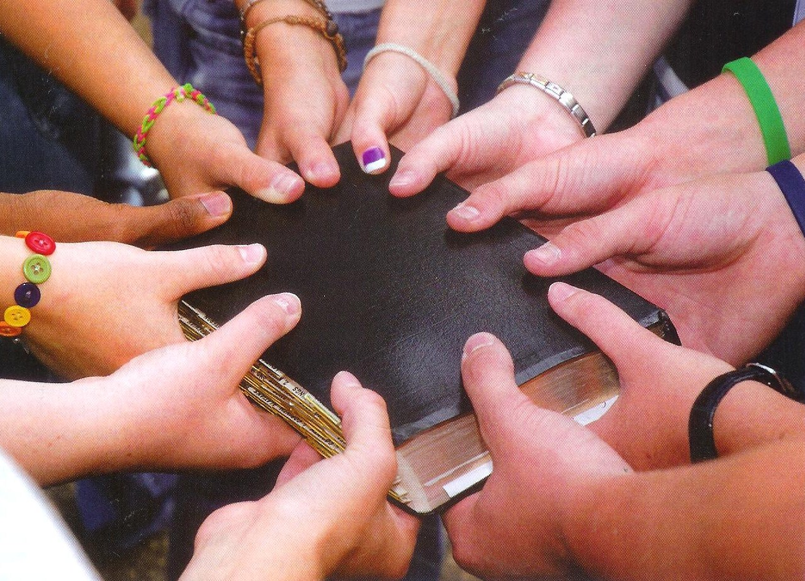
Now I plead with you, brethren, by the name of our Lord Jesus Christ, that you all speak the same thing, and that there be no divisions among you, but that you be perfectly joined together in the same mind and in the same judgment. — 1st Corinthians 1:10
Lord Jesus Christ
all speak the same thing
all
all speak the same thing
all
same mind
same mind
same judgment
same judgment
Notes:
Argmentative divisions are created by men and women who arrogantly deny His word. Blindness, and seared hearts, cut the innocence of truth.

Slide 60
But why do you judge your brother? Or why do you show contempt for your brother? For we shall all stand before the judgment seat of Christ. — Romans 14:10
do
all
do
all stand before
all
all stand before
the judgment seat of Christ
the judgment seat of Christ
Christ
Notes:
Hate is what divides even those who would be holy. Do you want to come to God as an derisive soul? It is crushing to be convicted by yourself, and better sooner than later. To bury hate is to be made anew, in His love, lifting the soul to heaven’s eternal promise.

Slide 61
Finally, all of you be of one mind, having compassion for one another; love as brothers, be tenderhearted, be courteous; — 1st Peter 3:8
all of you be of one mind
all
one mind
all of you be of one mind
compassion for one
all
another
love as brothers
be
one mind:
● compassion for one another
● love as brothers
● be tenderhearted
● be courteous
tenderhearted
be courteous
Notes:
To be free in heart and mind, only by following His truth can this wonderful experience be obtained. Knowing truth is freedoms magnet.

Slide 62
… casting all your care upon Him, for He cares for you. — 1st Peter 5:7
casting all your care upon Him
all
casting all your care upon Him
all
He cares for you
Notes:
Whatever the swing may deliver, trusting in Him is where faith touches eternity. Jesus is like the one helping to push you higher on the swing.

Slide 63
Let your gentleness be known to all men. The Lord is at hand. — Philippians 4:5
gentleness
gentleness
be known to all men
all
all
be known to all men
Lord
Notes:
Sanctuary is found in one’s own heart. Tantrums and anger do not declare the glory of the Lord.

Slide 64
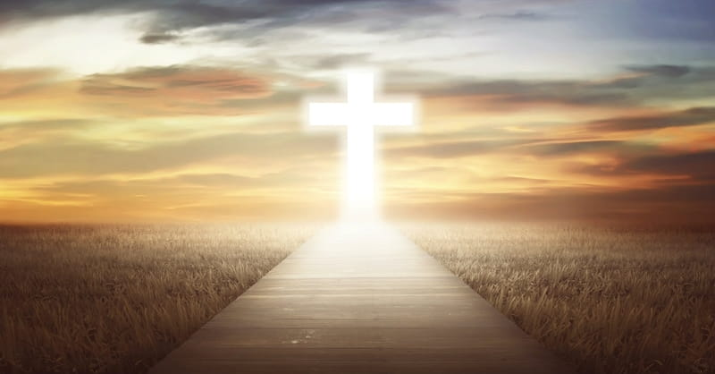
… and the peace of God, which surpasses all understanding, will guard your hearts and minds through Christ Jesus. — Philippians 4:7
all
peace of God
peace of God
surpasses all understanding
all
surpasses all understanding
heart
mind
Christ Jesus
Christ Jesus
Notes:
Peace is priceless and is the gift He gives. When one accepts His forgiveness, being forgiven releases unbounded joy.

Slide 65
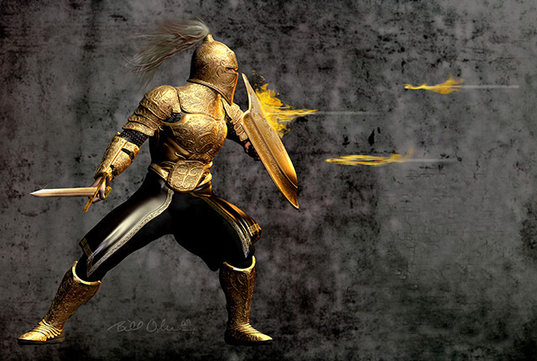
I can do all things through Christ who strengthens me. — Philippians 4:13
do
all
do all things through
do all things through
Christ
Christ
all
Notes:
A defender of one’s own life is found in pursuit of that upward call creating truth’s armor. Christ is the golden arrow slicing through all deceptions.

Slide 66
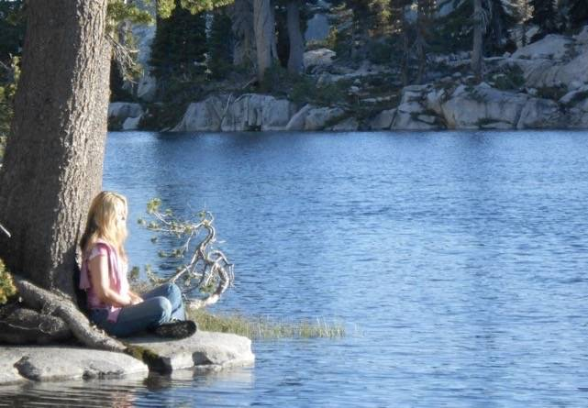
Meditate on these things; give yourself entirely to them, that your progress may be evident to all. — 1st Timothy 4:15
progress
evident
progress
evident
all
. .
to all
Notes:
God’s clearest call is to remember, and in thankfulness, the Lord will deliver.

Slide 67
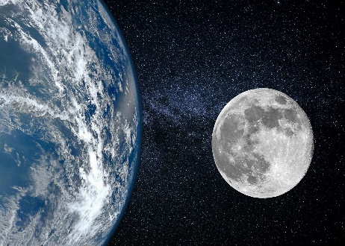

Slide 68
→ As we have opportunity, do good to all
→ Do all things without complaining and disputing
→ Have regard for all good and humility to all men
→ Let all that you do be done with love
→ Give thanks always for all things to God in Christ
→ Test all things and be patient with all
→ Be watchful in all things enduring afflictions
→ Lay aside all malice, deceit, hypocrisy, envy, & evils
→ All evils in the world, lust & pride, are fading away
→ God knows all things and is greater than our hearts
→ All should speak same things in mind & judgment
→ Cast all your cares upon Him for He cares
→ God’s peace surpasses all understanding
His gift of life is an eternal call to come to Him
Notes:
His gift of life is an eternal call to come to Him.

Slide 70
Please visit http://www.LoveFromGod.com to explore further
Ronald Bert Channel on
Notes:
Eternity never ends.

