Slide 2
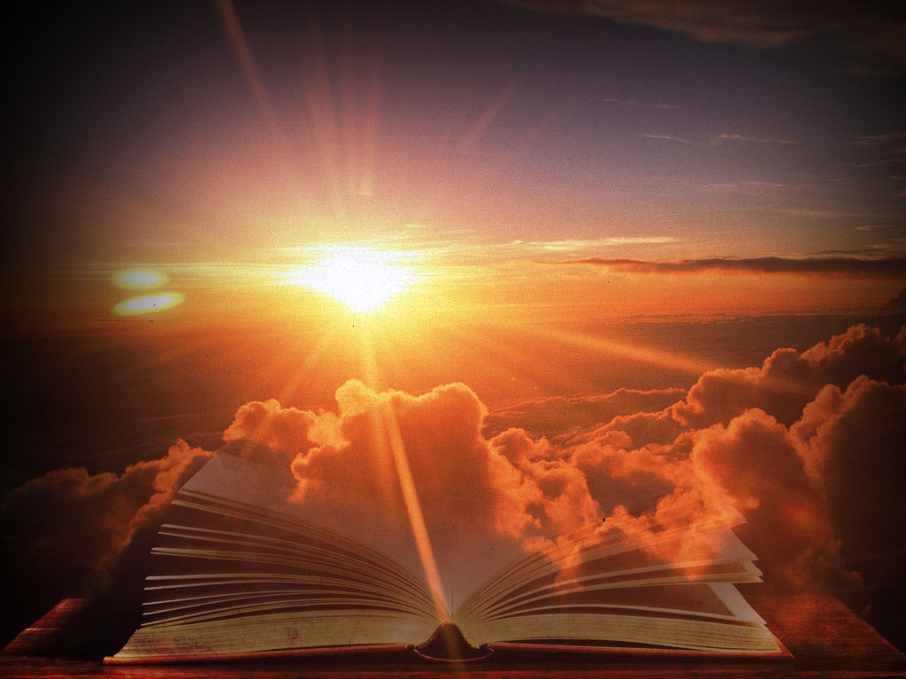
Word of God
Ron Bert
February 7, 2020

Slide 3
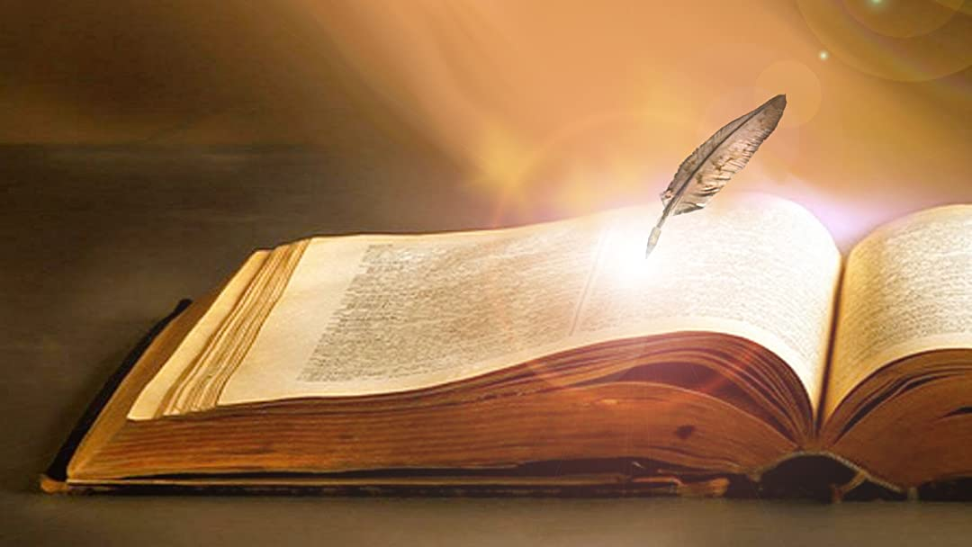
Every word of God is pure; He is a shield to those who put their trust in Him. Do not add to His words, Lest He rebuke you, and you be found a liar. — Proverbs 30:5-6
word of God
Every word of God is pure
word
of God
Every word of God is pure
word of God
shield
trust
Notes:
In simplest terms, the Bible’s words are given to open the hearts, of all, to God’s will and evaluation of life through the truth.

Slide 4
For the word of God is living and powerful, and sharper than any two-edged sword, piercing even to the division of soul and spirit, and of joints and marrow, and is a discerner of the thoughts and intents of the heart. — Hebrews 4:12
word of God
=
word of God is living
living
. .
piercing
truth
truth
of soul and spirit
touch of conscience
Notes:
No weapon can defeat the truth.

Slide 5
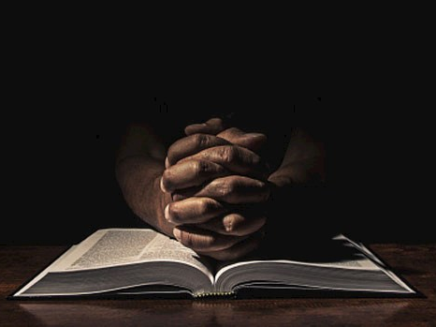
For we can do nothing against the truth, but for the truth. — 2nd Corinthians 13:8
truth
truth
Changeless / Eternal
Notes:
Truth stands as the pillar of reality.

Slide 6
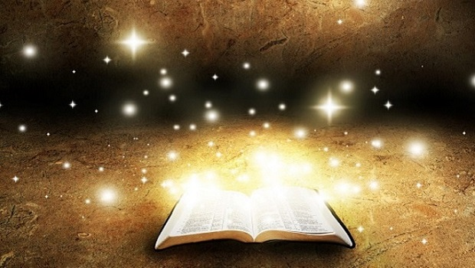
By the word of the LORD the heavens were made, And all the host of them by the breath of His mouth. — Psalms 33:6
heavens made by His breath
By the word
heavens
made
by
breath
His
By the word
Notes:
God; creator of all that comes forth. The closest thing we have to the truth is the Word of God.

Slide 7
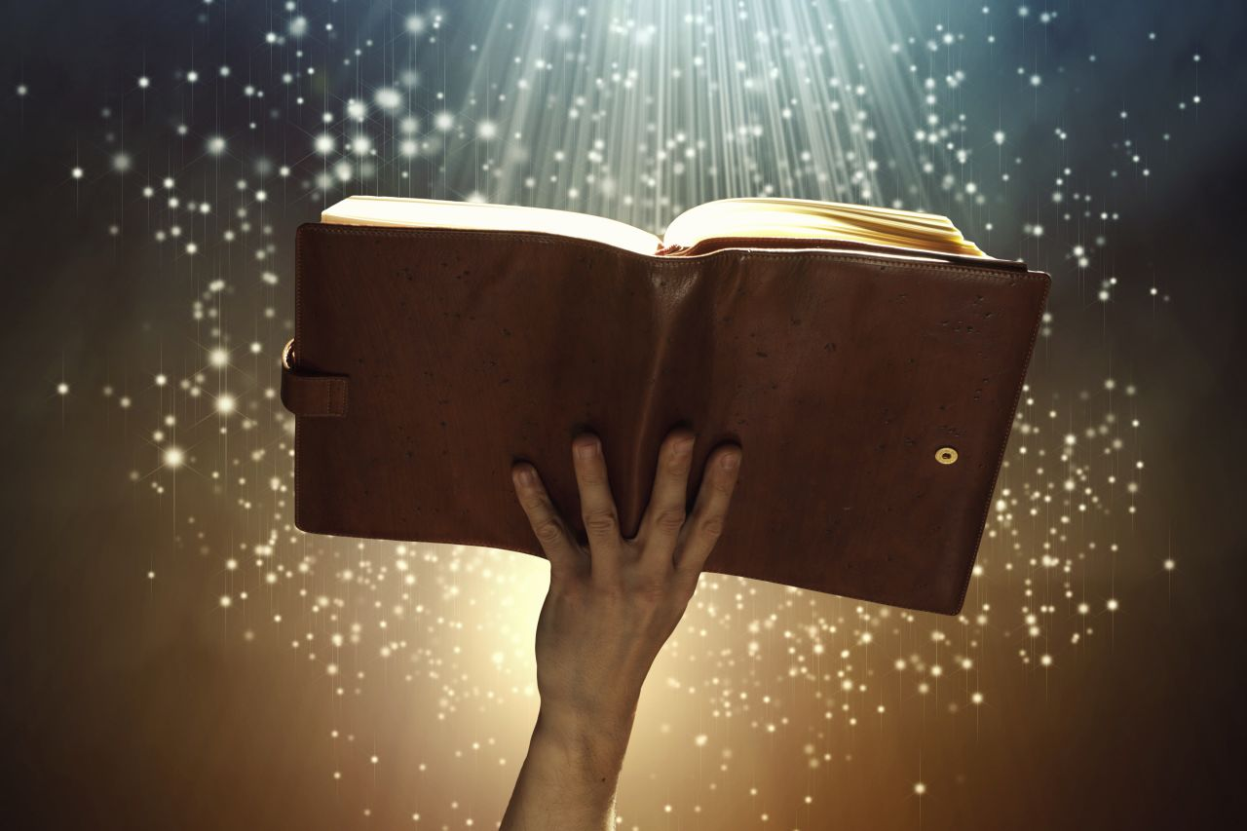
By the word
Notes:
Praise is a well that surpasses all known.

Slide 8
By faith we understand that the worlds were framed by the word of God, so that the things which are seen were not made of things which are visible. — Hebrews 11:3
By faith
belief
. .
framed
by the word
of God
the things
. .
. .
made
made
Notes:
Praise is a well that surpasses all known.

Slide 9
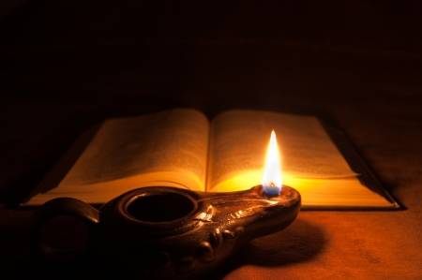
So then faith comes by hearing, and hearing by the word of God. — Romans 10:17
knowing
faith ↔ hearing ↔ word of God
trust
faith
truth
faith comes by hearing
. .
hearing
word of God
hearing by the word of God
. .
Word
Notes:
It is said knowledge is power, and if we succumb to remaining purposely oblivious to His word, calamities untold will arrive. God’s word is the oil that lights our way.

Slide 10
Word

Slide 11
Word

Slide 12
And the Word became flesh and dwelt among us, and we beheld His glory, the glory as of the only begotten of the Father, full of grace and truth. — John 1:14
Word
glory
grace and truth
Forgiveness and love
Notes:
God’s presence remains more than obvious as He conspicuously sacrificed His own life for our enlightenment. The word rises due to His desire for glory in truth.

Slide 13
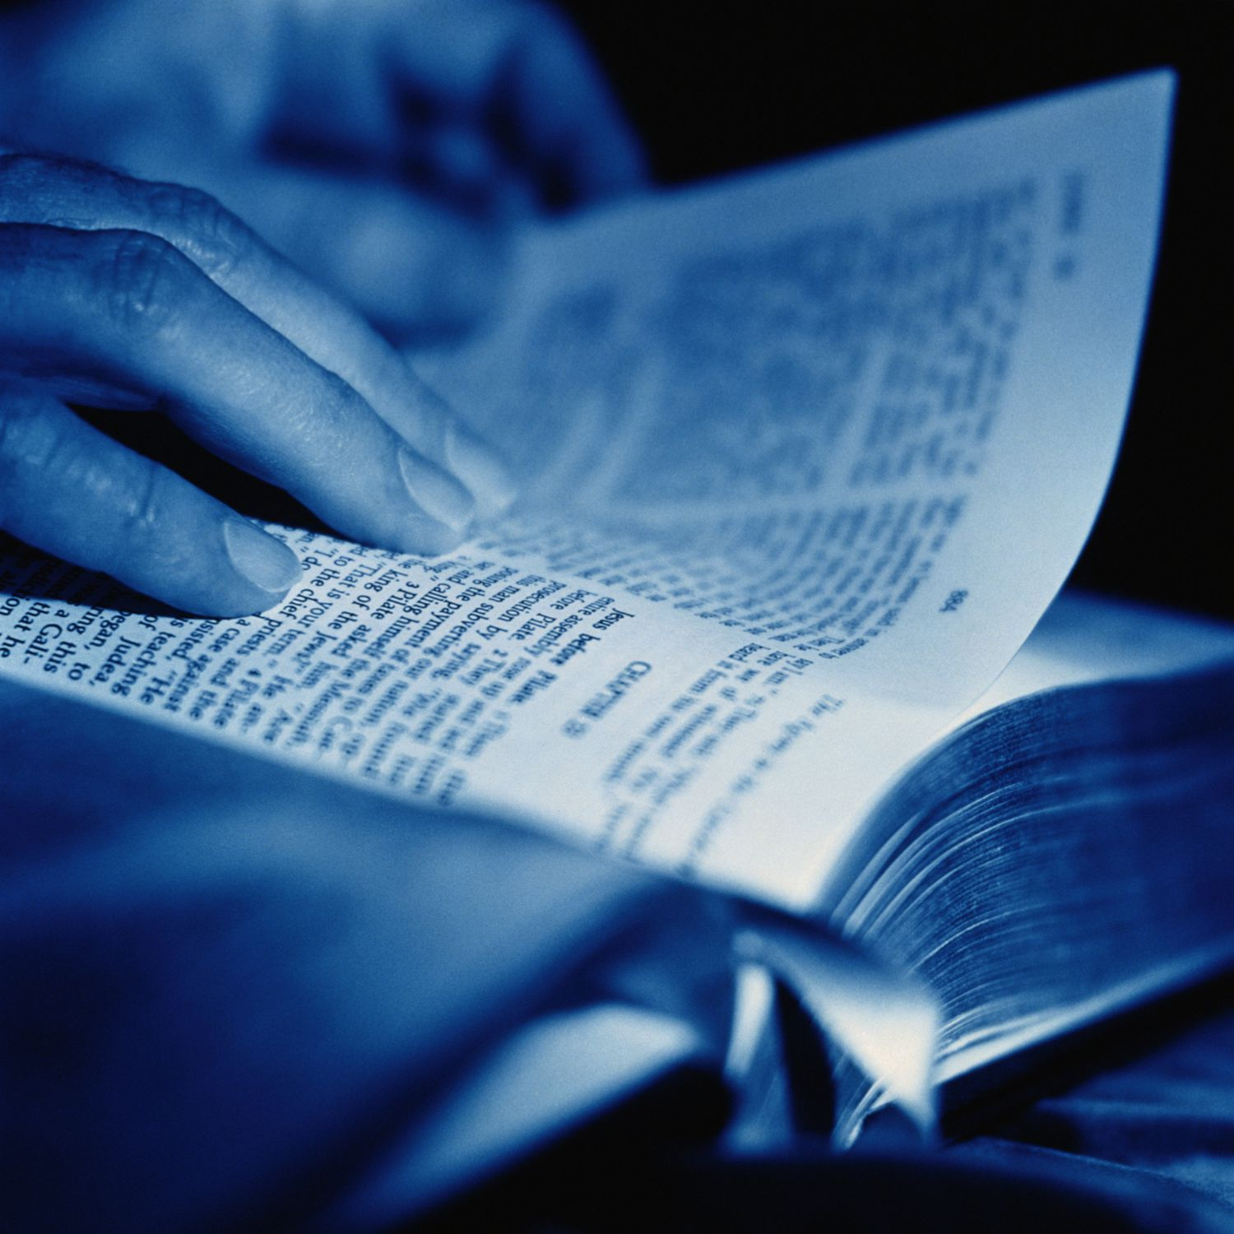
For this reason we also thank God without ceasing, because when you received the word of God which you heard from us, you welcomed it not as the word of men, but as it is in truth, the word of God, which also effectively works in you who believe. — 1st Thessalonians 2:13
thank God
thank God
without ceasing
without ceasing
TRUTH
received
word of God
word of God
effectively works in you who
Belief = Action
believe
Notes:
Truth has innately been written across all time and space, where true hearts can see deeper than any wish built on hope, and faith stands everyday.

Slide 14
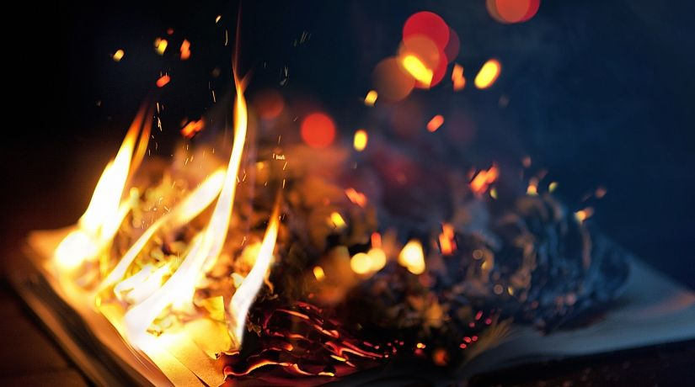
… that you may be mindful of the words which were spoken before by the holy prophets, and of the commandment of us, the apostles of the Lord and Savior, knowing this first: that scoffers will come in the last days, walking according to their own lusts, and saying, "Where is the promise of His coming? For since the fathers fell asleep, all things continue as they were from the beginning of creation." — 2nd Peter 3:2-4
… that you may be mindful of the words which were spoken before by the holy prophets, and of the commandment of us, the apostles of the Lord and Savior, knowing this first: that scoffers will come in the last days, walking according to their own lusts, and saying, "Where is the promise of His coming? For since the fathers fell asleep, all things continue as they were from the beginning of creation." — 2nd Peter 3:2-4
mindful of the words
mindful of the words
Warning
SELF
own
Notes:
Warnings of advancing charlatans and or those degrading His words fill the cymbals of time.

Slide 15
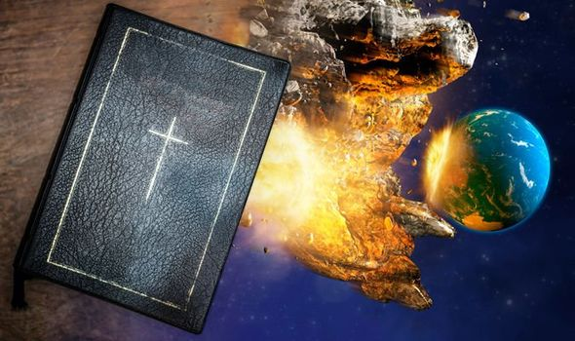
For this they willfully forget: that by the word of God the heavens were of old, and the earth standing out of water and in the water, by which the world that then existed perished, being flooded with water. But the heavens and the earth which are now preserved by the same word, are reserved for fire until the day of judgment and perdition of ungodly men. — 2nd Peter 3:5-7
seared conscience
purposely oblivious
willfully forget
willfully forget
word of God
word of God
now preserved
word of God
destruction
cleansing
fire
Notes:
Abrupt is the shock in each breath where life is lost to evil over innocence.

Slide 16
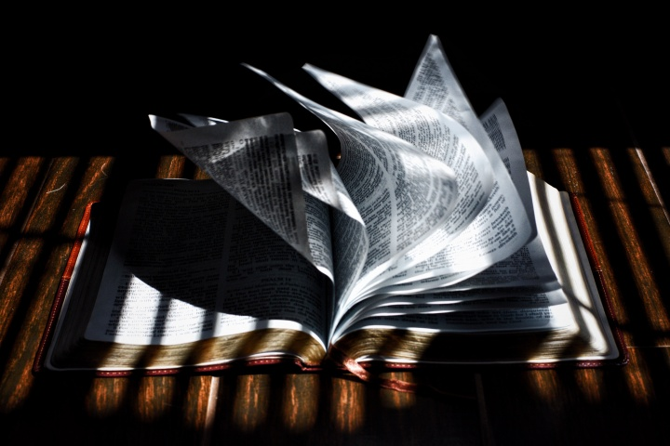
"For Moses said, 'Honor your father and your mother'; and, 'He who curses father or mother, let him be put to death.' "But you say, 'If a man says to his father or mother, "Whatever profit you might have received from me is Corban"-' (that is, a gift to God), then you no longer let him do anything for his father or his mother, making the word of God of no effect through your tradition which you have handed down. And many such things you do." — Mark 7:10-13
Disrespect
Greed
word of God
word of God of no effect
. .
word of God
Notes:
To many the Bible is a prison to be freed from. Not caring for the truth delivered, the heart drifts toward selfish pursuits abandoning responsibilities of family. Shame for the death of spirit where hate overtakes compassion.

Slide 17
"For Moses said, 'Honor your father and your mother'; and, 'He who curses father or mother, let him be put to death.' "But you say, 'If a man says to his father or mother, "Whatever profit you might have received from me is Corban"-' (that is, a gift to God), then you no longer let him do anything for his father or his mother, making the word of God of no effect through your tradition which you have handed down. And many such things you do." — Mark 7:10-13
word of God
word of God of no effect
. .
word of God
many such things
many such things
Notes:
To many the Bible is a prison to be freed from. Not caring for the truth delivered, the heart drifts toward selfish pursuits abandoning responsibilities of family. Shame for the death of spirit where hate overtakes compassion. Sin is an empty hole filled to the brim.

Slide 18
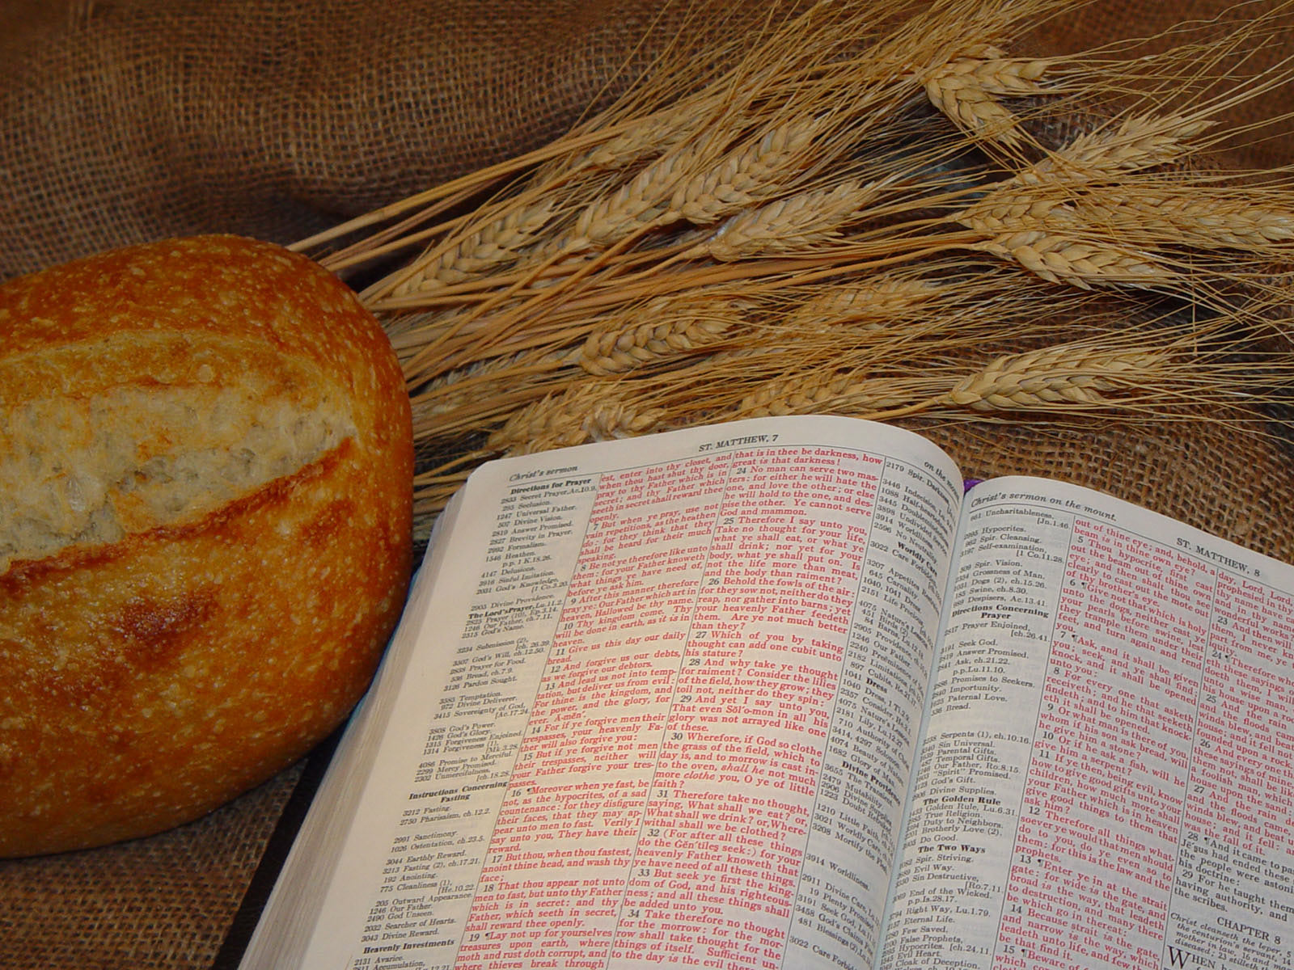
But Jesus answered him, saying, "It is written, 'Man shall not live by bread alone, but by every word of God.'" — Luke 4:4
Materialism
Eternal
Temporary
Spirit
word of God
word of God
Notes:
In life, no sustenance can replace faith, that call to return to the heights of heaven’s eternity where decency is the rule of law.

Slide 19
And He said, "To you it has been given to know the mysteries of the kingdom of God, but to the rest it is given in parables, that 'Seeing they may not see, And hearing they may not understand.' Now the parable is this: The seed is the word of God." — Luke 8:10-11
TRUTH
Blind
not see
See
Deaf
not understand
hear
seed
The seed
The seed
word of God
word of God
is the word of God
is the word of God
Notes:
Cherish what is not seen, but is.

Slide 20
Then His mother and brothers came to Him, and could not approach Him because of the crowd. And it was told Him by some, who said, "Your mother and Your brothers are standing outside, desiring to see You." But He answered and said to them, "My mother and My brothers are these who hear the word of God and do it." — Luke 8:19-21
word of God
word of God
do
who hear the word of God and do it
word of God
who hear the word of God and do it
know
Action
Notes:
Hearing the word is coming to the light given by God Himself.

Slide 21
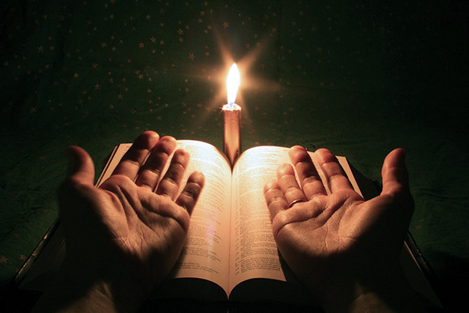
But He said, "More than that, blessed are those who hear the word of God and keep it!" — Luke 11:28
know
word of God
act on
keep it
keep it
word of God
Notes:
Purity is such a challenge where God has been forgotten.

Slide 22
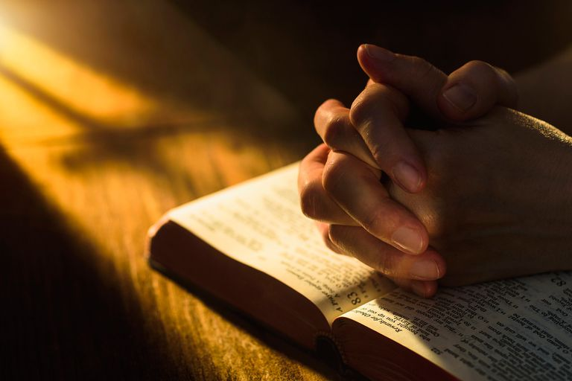
And when they had prayed, the place where they were assembled together was shaken; and they were all filled with the Holy Spirit, and they spoke the word of God with boldness. — Acts 4:31
word of God
spoke
word of God
with boldness
Notes:
Balance of sense is part of understanding, between hate and love, darkness and the light. No man can see honestly without plowing through all the spewing of man’s countless wrongs. True courage of character remains in all that is holy special, to all that hold for a brighter day.

Slide 23
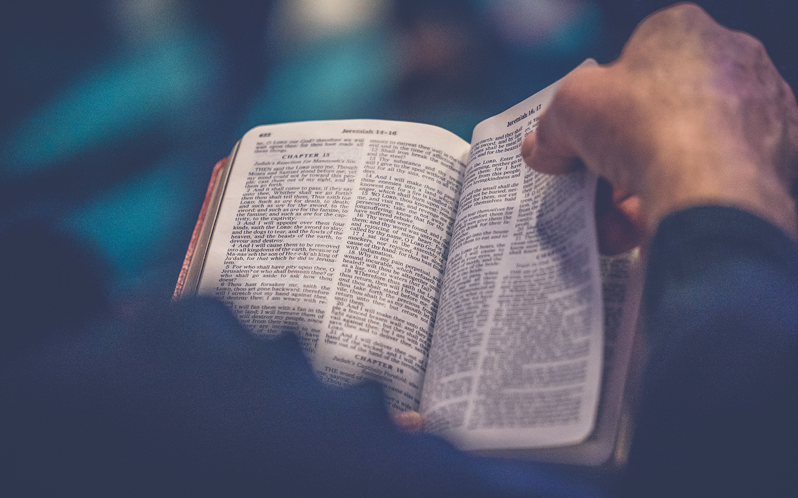
Then the word of God spread, and the number of the disciples multiplied greatly in Jerusalem, and a great many of the priests were obedient to the faith. — Acts 6:7
word of God
word of God
obedient to the faith
the faith
obedient to the faith
Trust
Truth
Notes:
Living water comes to believers who thirst for the truth and apply it until the end of time.

Slide 24
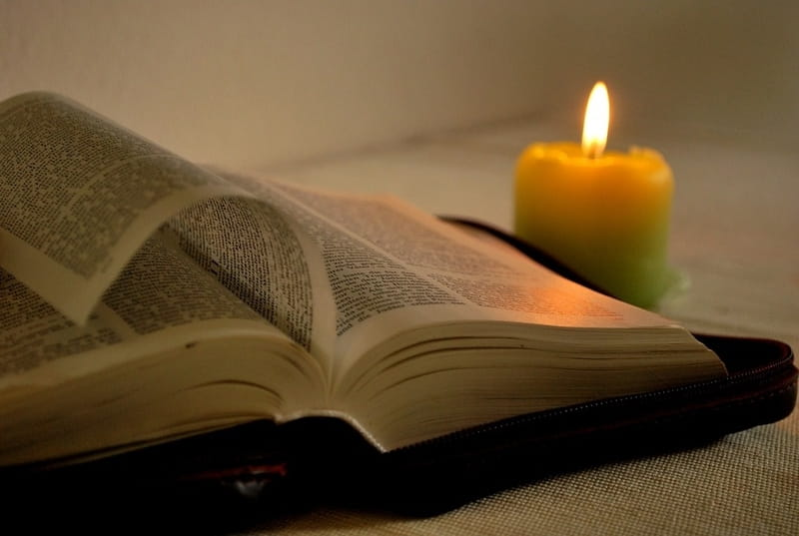
Now the apostles and brethren who were in Judea heard that the Gentiles had also received the word of God. — Acts 11:1
For all
received
word of God
Notes:
God’s word has come for all, regardless of past sins, inspiring life to live.

Slide 25
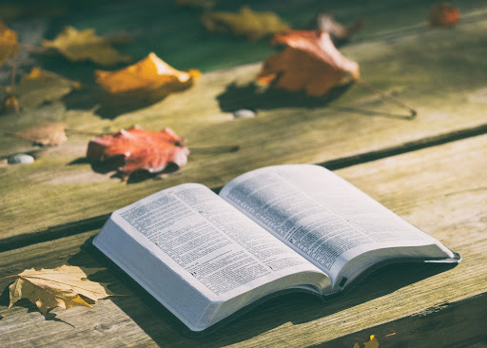
So the word of the LORD grew mightily and prevailed. — Acts 19:20
word of the LORD
word of the LORD
is victorious
triumphed
succeeded
Notes:
Where the word of God dwells, the people rejoice in His service.

Slide 26
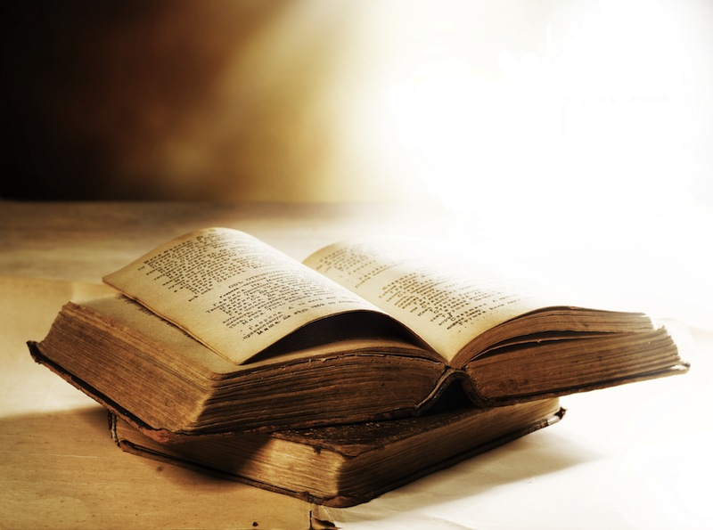
But the word of the LORD endures forever." Now this is the word which by the gospel was preached to you. — 1st Peter 1:25
word of the LORD
endures forever
endures forever
word of God
Notes:
Transcendence extends to our eventual return to His presence.

Slide 27
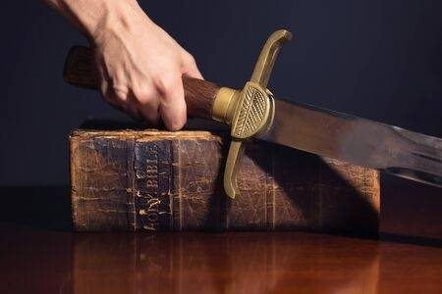
And take the helmet of salvation, and the sword of the Spirit, which is the word of God; — Ephesians 6:17
minds
helmet
helmet
voices
sword
sword
word of God
Word of God
Notes:
Truth cuts all lies to rubble.

Slide 28
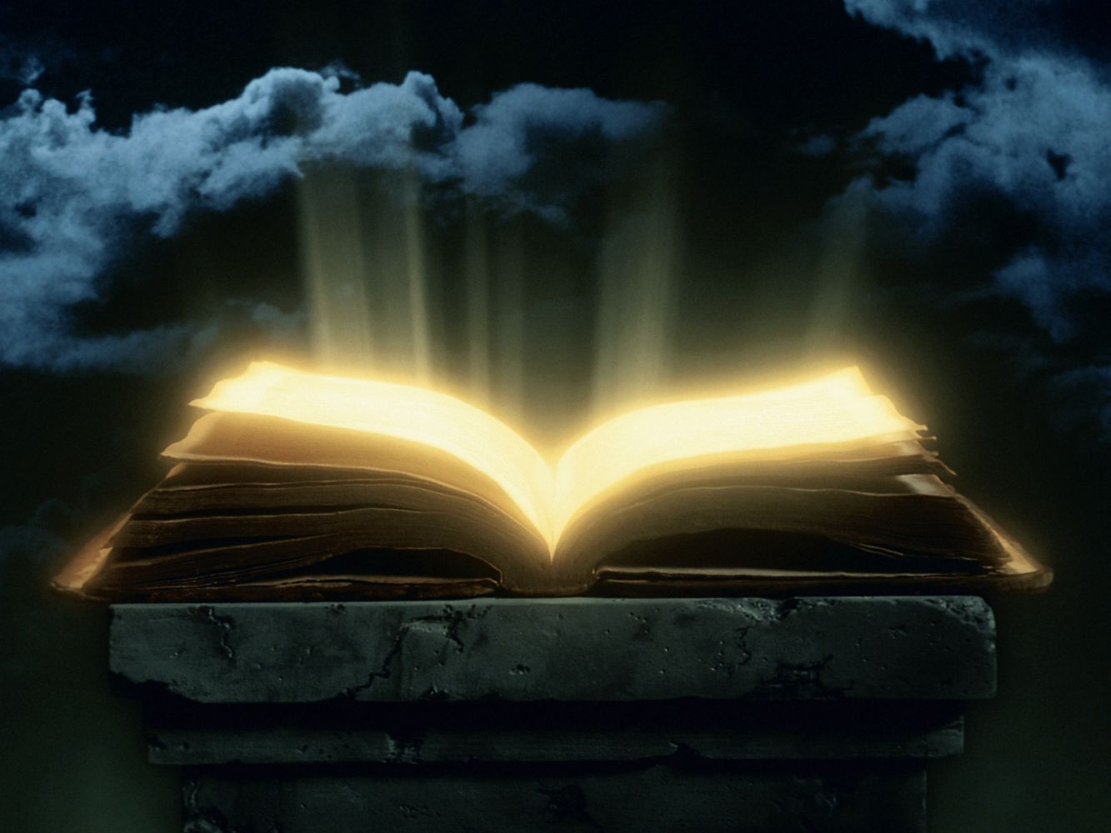
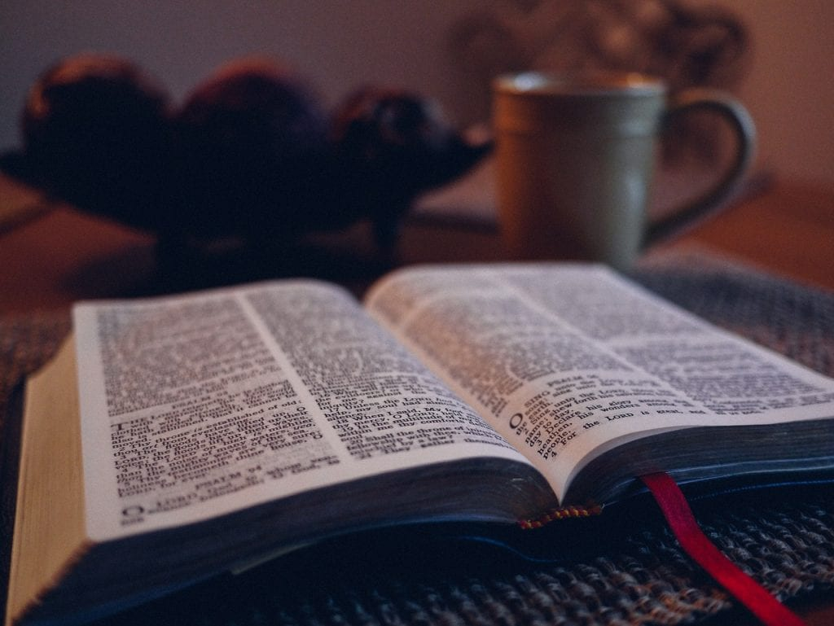
Now I saw heaven opened, and behold, a white horse. And He who sat on him was called Faithful and True, and in righteousness He judges and makes war. His eyes were like a flame of fire, and on His head were many crowns. He had a name written that no one knew except Himself. He was clothed with a robe dipped in blood, and His name is called The Word of God. — Revelation 19:11-13
Faithful and True, and in
Faithful and True, and in righteousness
↓
He judges
↓
His name is called The Word of God
in
righteousness
He judges
Christ
=
His name is called
The Word of God
Word of God
Notes:
God’s own example of love through sacrifice has exalted all that is true.

Slide 29
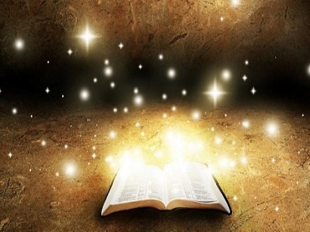
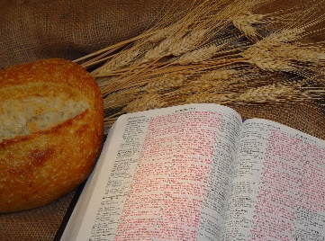
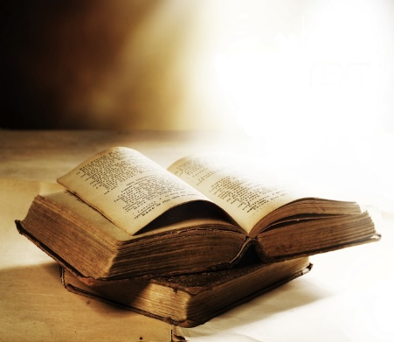

Slide 30
→ God’s pure word shields those who trust Him
→ God’s word is a living powerful razor of truth
→ Truth does not change but must be discovered
→ All that is was framed by the word of God
→ Hearing God’s word brings the faith He desires
→ God Himself dwells with us full of grace and truth
→ God’s word effectively works in those who believe
→ By God’s word fire will judge the actions of men
→ Selfish traditions halt the effective working of God
→ By the word of God man finds life’s fullest
→ God’s word seeds the truth in all hearts
→ Blessed are those who keep God’s word
→ God’s word is the sword of our earthly defense
God’s word lifts souls in hope of our place in Him
Notes:
God’s word lifts souls in hope of our place in Him

Slide 31
Word
d
h
e
a
r
t
Mercy
e
B
u
y
B
Word
e
W
Truth
o
u
r
d
d
y
.
p
worship
s
pure
pillar
Notes:
So it is the Word in which we seek truth. Nothing is more valuable than the truth for its’ foundation builds on all that is noble. Truth serves a heart mercifully joining one with the divine. Our deeds are purely in the midst of our hearts as the pillar defining who we are. We need to keep our thoughts pure as it is in fact the pillar of our faith in the sight of God. Pray He preserves us from wicked temptations. May we be found worthy in the tower of His great living truth. More than what we think, it is about what we do.

Slide 33
Please visit http://www.RonBert.com to explore further
Ronald Bert Channel on
Notes:
Eternity never ends.

