Slide 1
Notes:
Darkness fills empty hearts.

Slide 2
What GOD Hates
Ron Bert
January 18, 2015
Notes:
Innate to our character, those things God hates we should also hate.

Slide 3
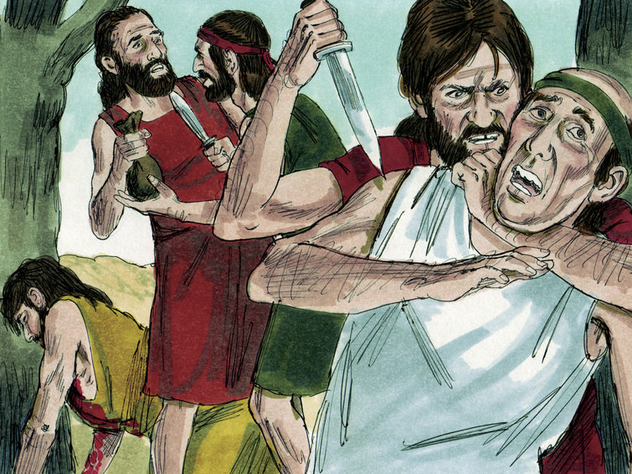
Then the LORD saw that the wickedness of man was great in the earth, and that every intent of the thoughts of his heart was only evil continually. And the LORD was sorry that He had made man on the earth, and He was grieved in His heart. – Genesis 6:5-6
wickedness
thoughts of his heart
thoughts of his heart
evil continually
evil continually
Notes:
If thoughts become only evil, God has no place in His light to embrace these types of souls.

Slide 4
For You are not a God who takes pleasure in wickedness, Nor shall evil dwell with You. The boastful shall not stand in Your sight; You hate all workers of iniquity. You shall destroy those who speak falsehood; The LORD abhors the bloodthirsty and deceitful man. – Psalms 5:4-6
wickedness
The LORD tests the righteous, But the wicked and the one who loves violence His soul hates. – Psalm 11:5
workers of iniquity
LORD tests
all
hate all workers of iniquity
LORD
LORD tests
hate all workers of iniquity
wicked
the wicked
the wicked
LORD
His soul hates
soul
hate
His soul hates
bloodthirsty and deceitful
bloodthirsty and deceitful
Notes:
The Lord hates what is not in the straight uncovered honest light. Wickedness hides in the shadows of its’ own darkness. It is important to note that God has a soul in which we were created in His image so feelings are part of this heritage.

Slide 5
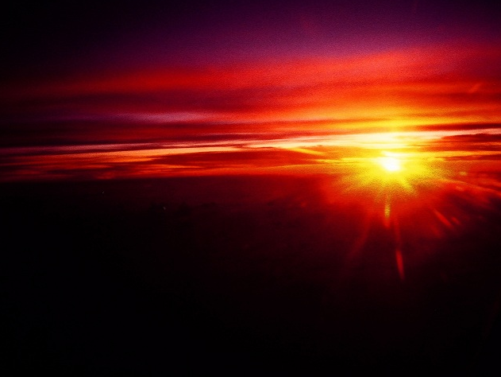
"I, wisdom, dwell with prudence, And find out knowledge and discretion. The fear of the LORD is to hate evil; Pride and arrogance and the evil way And the perverse mouth I hate." – Proverbs 8:12-13
hate
For the perverse person is an abomination to the LORD, But His secret counsel is with the upright. – Proverbs 3:32
hate
hate evil
hate evil
The LORD by wisdom founded the earth; By understanding He established the heavens; – Proverbs 3:19
Have you heard the counsel of God? Do you limit wisdom to yourself? – Job 15:8
by wisdom
There is no wisdom or understanding Or counsel against the LORD. – Proverbs 21:30
by wisdom
LORD
perverse
the LORD
LORD
the LORD
counsel
By understanding
By understanding
counsel
wisdom
constrain
restrict
cap
hate
is with the upright
is with the upright
LORD
He established
Notes:
In God’s wisdom the truth is declared as to what God despises in His goodness. Man making the distinction that he is wiser than God expressing God’s failings falls short of any glory and steps up pride over one’s natural humble thankfulness. God establishes the greatest of all realities in love for life to develop. The Bible draws out mans deficiencies, not God’s.

Slide 6
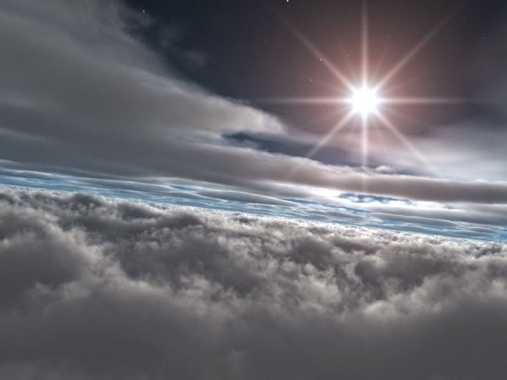
These six things the LORD hates, Yes, seven are an abomination to Him: A proud look, A lying tongue, Hands that shed innocent blood, A heart that devises wicked plans, Feet that are swift in running to evil, A false witness who speaks lies, And one who sows discord among brethren. – Proverbs 6:16-19
hate
These six things the LORD hates, Yes, seven are an abomination to Him: A proud look, A lying tongue, Hands that shed innocent blood, A heart that devises wicked plans, Feet that are swift in running to evil, A false witness who speaks lies, And one who sows discord among brethren. – Proverbs 6:16-19
repugnant
abomination
①
②
atrocity
① Proudful
detestable
③
② Liars
④
③ Murderers
disgust
abomination
⑤
④ Deceivers
⑥
⑤ Corrupt
horror
⑦
⑥ Perjurer
disgrace
⑦ Divisiveness
Notes:
Specifics as to what exactly are abominations to Him have been made clear.

Slide 7
Dishonest scales are an abomination to the LORD, But a just weight is His delight. – Proverbs 11:1
abomination
truth
His delight
His
His delight
Notes:
Justice and truth are what is held in the highest of regard as it is what God is. Unjust are all lies. In man’s desperation concoctions are devised to fool the innocent and dishonesty plagues all that would or could be noble.

Slide 8
"You shall not have in your house differing measures, a large and a small. You shall have a perfect and just weight, a perfect and just measure, that your days may be lengthened in the land which the LORD your God is giving you. For all who do such things, all who behave unrighteously, are an abomination to the LORD your God." – Deuteronomy 25:14-16
o
d
h
t
s
dishonesty
all who behave unrighteously
i
s
e
n
all who behave unrighteously
abomination
y
Notes:
For all those that would choose to cheat are an abomination in His sight.

Slide 9
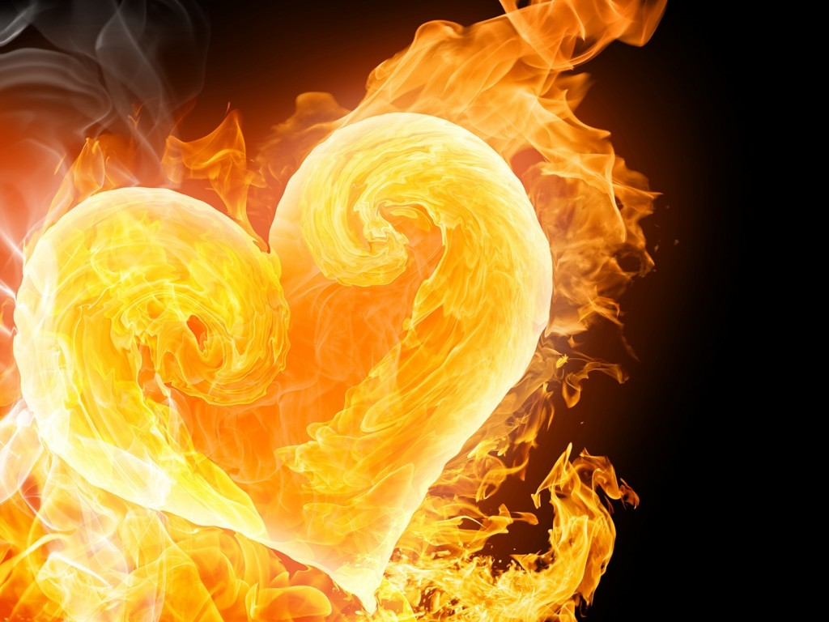
Those who are of a perverse heart are an abomination to the LORD, But the blameless in their ways are His delight. – Proverbs 11:20
Murderous Plots
Disobedient
Mean
Cheaters
Hateful
Rebellious
Wicked
Vicious
Liars
heart
gossip
Whoever secretly slanders his neighbor, Him I will destroy; The one who has a haughty look and a proud heart, Him I will not endure. – Psalm 101:5
abomination
the blameless
the blameless
snobbery
His delight
His
His delight
Notes:
Heartless without compassion, perverted souls will find no solace in His ways.

Slide 10
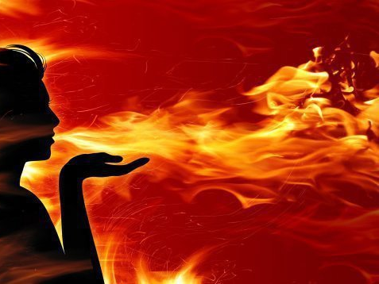
Lying lips are an abomination to the LORD, But those who deal truthfully are His delight. – Proverbs 12:22
abomination
abomination
who deal truthfully
who deal truthfully
His delight
His
His delight
Notes:
Liars breathe deception in whom the Lord has no delight.

Slide 11
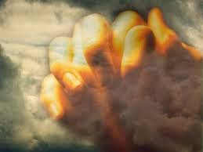
The sacrifice of the wicked is an abomination to the LORD, But the prayer of the upright is His delight. – Proverbs 15:8
One who turns away his ear from hearing the law, Even his prayer is an abomination. – Proverbs 28:9
turns away
LORD
abomination
abomination
prayer
upright is His delight
His
His
upright is His delight
LORD
Notes:
Proud to the bone, the unrighteous can be oblivious to their own wickedness as they sacrifice nothing. God will not hear those that refuse to hear Him.

Slide 12
"For I, the LORD, love justice; I hate robbery for burnt offering; I will direct their work in truth, And will make with them an everlasting covenant." – Isaiah 61:8
LORD
love
love justice
love justice
I hate robbery
I hate robbery
in
in truth
in truth
Notes:
Cheating, stealing, deceptive hearts know not of the love or fear of God or His justice, which God Himself poises as essential; to be just of spirit.

Slide 13
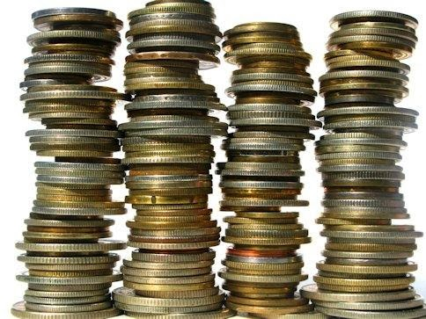
"You shall not bring the wages of a harlot or the price of a dog to the house of the LORD your God for any vowed offering, for both of these are an abomination to the LORD your God." – Deuteronomy 23:18
e
c
LORD
r
e
h
a
abomination
t
Notes:
God values honesty, not deceit. One cannot cheat God. Money made by sinful dishonest means or Dirty money is just that to God, filthy.

Slide 14
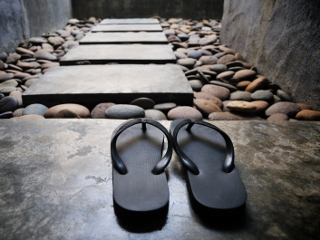
The way of the wicked is an abomination to the LORD, But He loves him who follows righteousness. – Proverbs 15:9
abomination
abomination
LORD
He loves him who follows
He
loves
He loves him who follows
righteousness
righteousness
Notes:
Our walk in life is a choice, to stand strong in faith or to abide in desperate pleasures void of empathy.

Slide 15
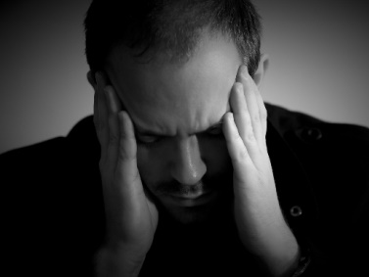
The thoughts of the wicked are an abomination to the LORD, But the words of the pure are pleasant. – Proverbs 15:26
thoughts
thoughts
abomination
LORD
pure are pleasant
pure are pleasant
Notes:
Our thoughts control our state of being. Trust in Him secures immeasurable wealth beyond the ordinary.

Slide 16
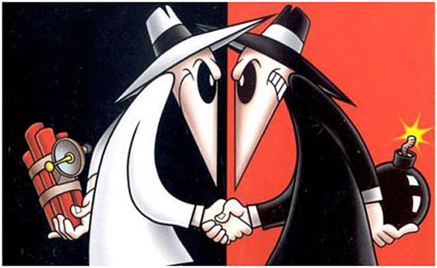
"'Let none of you think evil in your heart against your neighbor; And do not love a false oath. For all these are things that I hate,' Says the LORD." – Zechariah 8:17
For we ourselves were also once foolish, disobedient, deceived, serving various lusts and pleasures, living in malice and envy, hateful and hating one another. – Titus 3:3
"But let your 'Yes' be 'Yes,' and your 'No,' 'No.' For whatever is more than these is from the evil one." – Matthew 5:37
Whoever hates his brother is a murderer, and you know that no murderer has eternal life abiding in him. – 1st John 3:15
think evil
think evil
false oath
false oath
I hate
I hate
LORD
LORD
LORD
Notes:
One must righteously hate those abominations God declares to remain of sound mind. To hold passions of hate for Him or His creation is to miss the purpose of living engaging in finite pettiness over embracing His omnipotence. Hating individuals kills the purpose of living and God declares that those that hate are nothing but murderers of both self and others.

Slide 17
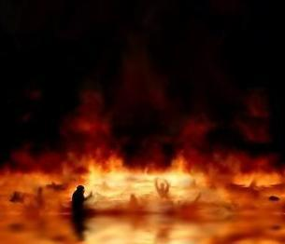
Everyone proud in heart is an abomination to the LORD; Though they join forces, none will go unpunished. – Proverbs 16:5
proud in heart
in
proud in heart
abomination to the LORD
LORD
Notes:
For the proud, they will be unable to overcome the slaughter to come.

Slide 18
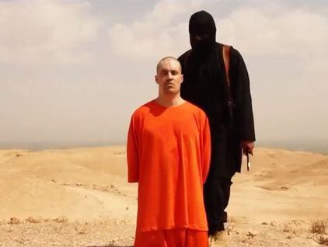
He who justifies the wicked, and he who condemns the just, Both of them alike are an abomination to the LORD. – Proverbs 17:15
abomination
abomination to the LORD
abomination
Notes:
Evil shines in its’ cowardly hiding amid darkness. There will be no where to hide for those committing abominations void of His presence and or understanding the ways of His call.

Slide 19
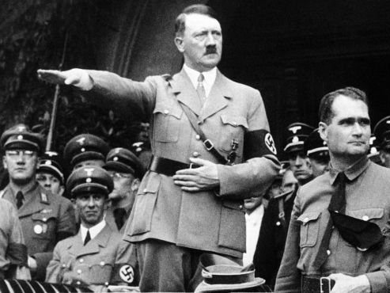
wicked
unrighteous
sinful
mean
un
An unjust man is an abomination to the righteous, And he who is upright in the way is an abomination to the wicked. – Proverbs 29:27
unfair
righteous
heartless
unholy
abomination
Notes:
Light hates darkness and darkness hates Light. There is darkness which is clear for all to see which remains horrific as it displays throughout time.

Slide 20
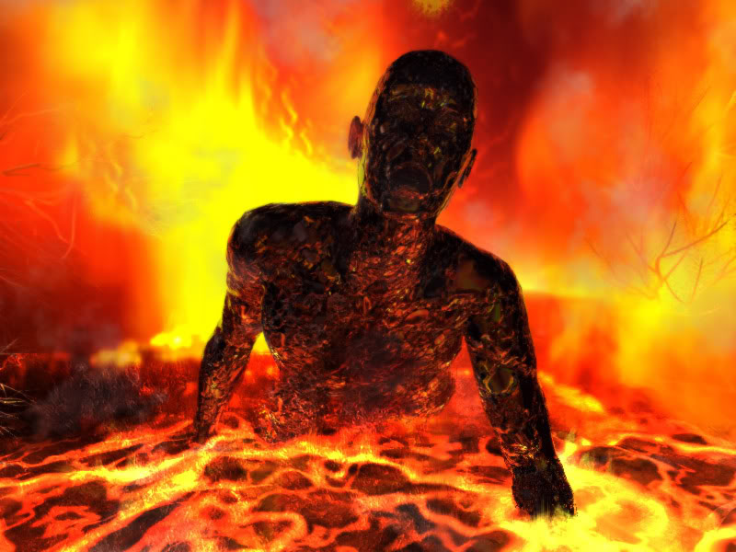
Do you not know that the unrighteous will not inherit the kingdom of God? Do not be deceived. Neither fornicators, nor idolaters, nor adulterers, nor homosexuals, nor sodomites, nor thieves, nor covetous, nor drunkards, nor revilers, nor extortioners will inherit the kingdom of God. – 1st Corinthians 6:9-10
Now the works of the flesh are evident, which are: adultery, fornication, uncleanness, lewdness, idolatry, sorcery, hatred, contentions, jealousies, outbursts of wrath, selfish ambitions, dissensions, heresies, envy, murders, drunkenness, revelries, and the like; of which I tell you beforehand, just as I also told you in time past, that those who practice such things will not inherit the kingdom of God. – Galatians 5:19-21
works of the flesh:
● fornicators
● idolaters
● adulterers
● homosexuals
● sodomites
● thieves
● covetous
● drunkards
● revilers
● extortioners
works of the flesh
adultery
fornication
unrighteous
● outbursts of wrath
● selfish ambitions
● dissensions
● heresies
● envy
● murders
● drunkenness
● revelries
● and the like
● adultery
● fornication
● uncleanness
● lewdness
● idolatry
● sorcery
● hatred
● contentions
● jealousies
unrighteous
uncleanness
lewdness
idolatry
sorcery
hatred
contentions
jealousies
outbursts
fornicators
idolaters
of wrath
selfish ambitions
dissensions
unrighteous
=
adulterers
homosexuals
heresies
envy
murders
drunkenness
revelries
and the like
sodomites
thieves
covetous
drunkards
revilers
extortioners
Notes:
Reserved is hell for all that is those dark abominations in the sight of God.

Slide 21
"For the LORD God of Israel says That He hates divorce, For it covers one's garment with violence," Says the LORD of hosts. "Therefore take heed to your spirit, That you do not deal treacherously." – Malachi 2:16
LORD
He hates divorce
He hates divorce
do not deal treacherously
do not deal treacherously
Notes:
As marriage reflects commitment to the bond of life, so God too hates divorce from the life He has established. Hate for each other glorifies nothing and extinguishes the light of the soul.

Slide 22
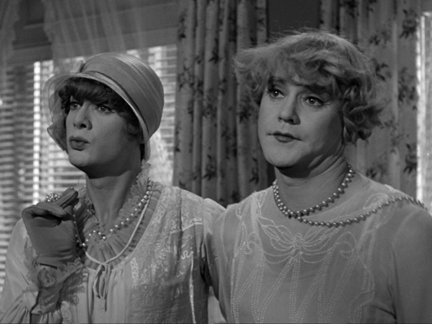
"A woman shall not wear anything that pertains to a man, nor shall a man put on a woman's garment, for all who do so are an abomination to the LORD your God." – Deuteronomy 22:5
LORD
Notes:
What God has declared has been blurred by civilizations that choose to ignore His called out for principles. Evil embraces lawlessness as entertainment. Transvestitism is not condoned by God. It may be giddy for the uninhibited and jokesters often dismiss knowledge of God.

Slide 23
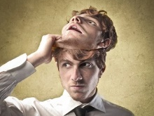
Let love be without hypocrisy. Abhor what is evil. Cling to what is good – Romans 12:9
evil
Abstain from every form of evil. – 1st Thessalonians 5:22
Notes:
To establish ones soul in the spirit of truth, the shadows of sin must be purged in His uncovered light. Each individual has a choice to reckon with as eternity unfolds ahead.

Slide 24
"He who rejects Me, and does not receive My words, has that which judges him – the word that I have spoken will judge him in the last day. – John 12:48
receive My words
receive My words
Notes:
It is the word of God that revives us in preparation for the judgment we must all face. Dismissing God will not excuse individual accountability and just punishment or reward for each God given soul.

Slide 25
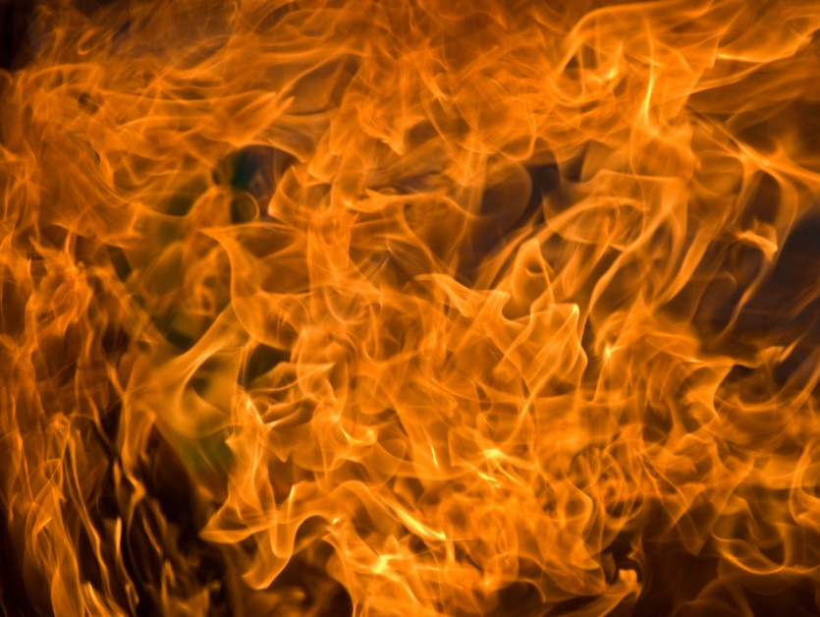
"For the LORD your God is a consuming fire, a jealous God." – Deuteronomy 4:24
Notes:
Without loyalty to the true Living God, no refuge will be found. A baptism of fire will purge God’s kingdom of the wicked abominations He and all that are good abhor.

Slide 26
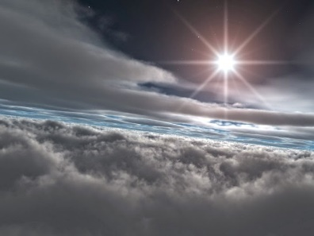
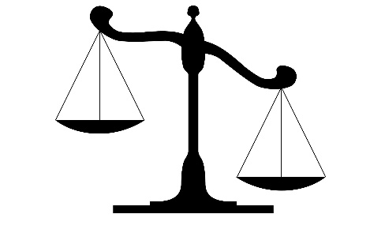
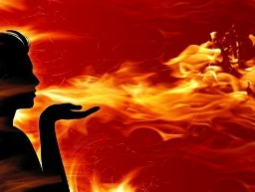
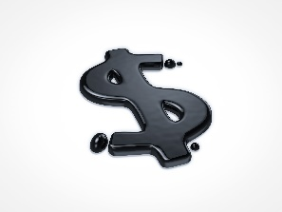
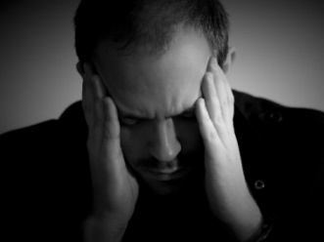
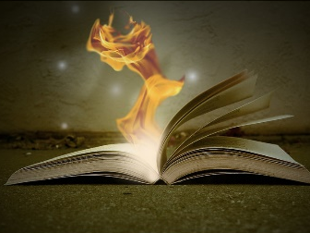

Slide 27
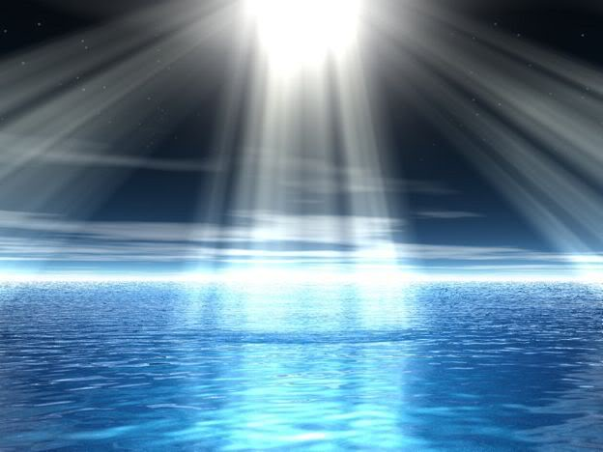
Evil shall not dwell with God
All workers of iniquity and/or All who behave unrighteously
The boastful, proud, and arrogant
A proud look and/or Everyone proud in heart
A lying tongue and/or Lying lips
Hands that shed innocent blood and/or Bloodthirsty and deceitful
A heart that devises wicked plans and/or a perverse heart
The thoughts of the wicked and/or thinking evil in your heart
Feet that are swift in running to evil and/or The way of the wicked
He who justifies the wicked, and he who condemns the just
A false witness who speaks lies or one who speaks falsehoods
Dishonest scales
Sacrifice of the wicked and/or a false oath – hypocrite’s prayers
Robbery for burnt offering and/or Dirty money as an offering
Divorce and Cross dressing
One who sows discord among brethren
God seeks honest souls in the face of His light
WHAT GOD HATES
Notes:
God’s honesty implores us to know of Him and to become in Him. For those not immersed in Him will have no excuse for their shameless lack of choice. Commitment to God drives what is eternal.
God seeks honest souls in the face of His light

Slide 28
Notes:
It is a choice between good and evil, light or darkness.

Slide 29
PART II BELOW

Slide 30
Notes:
To rise from an empty life filled with unsatisfiable desires, one must look to His light.

Slide 31
What GOD Hates
Ron Bert
Part II
January 18, 2015
Notes:
Innate to our character, those things God hates we should also hate.

Slide 32
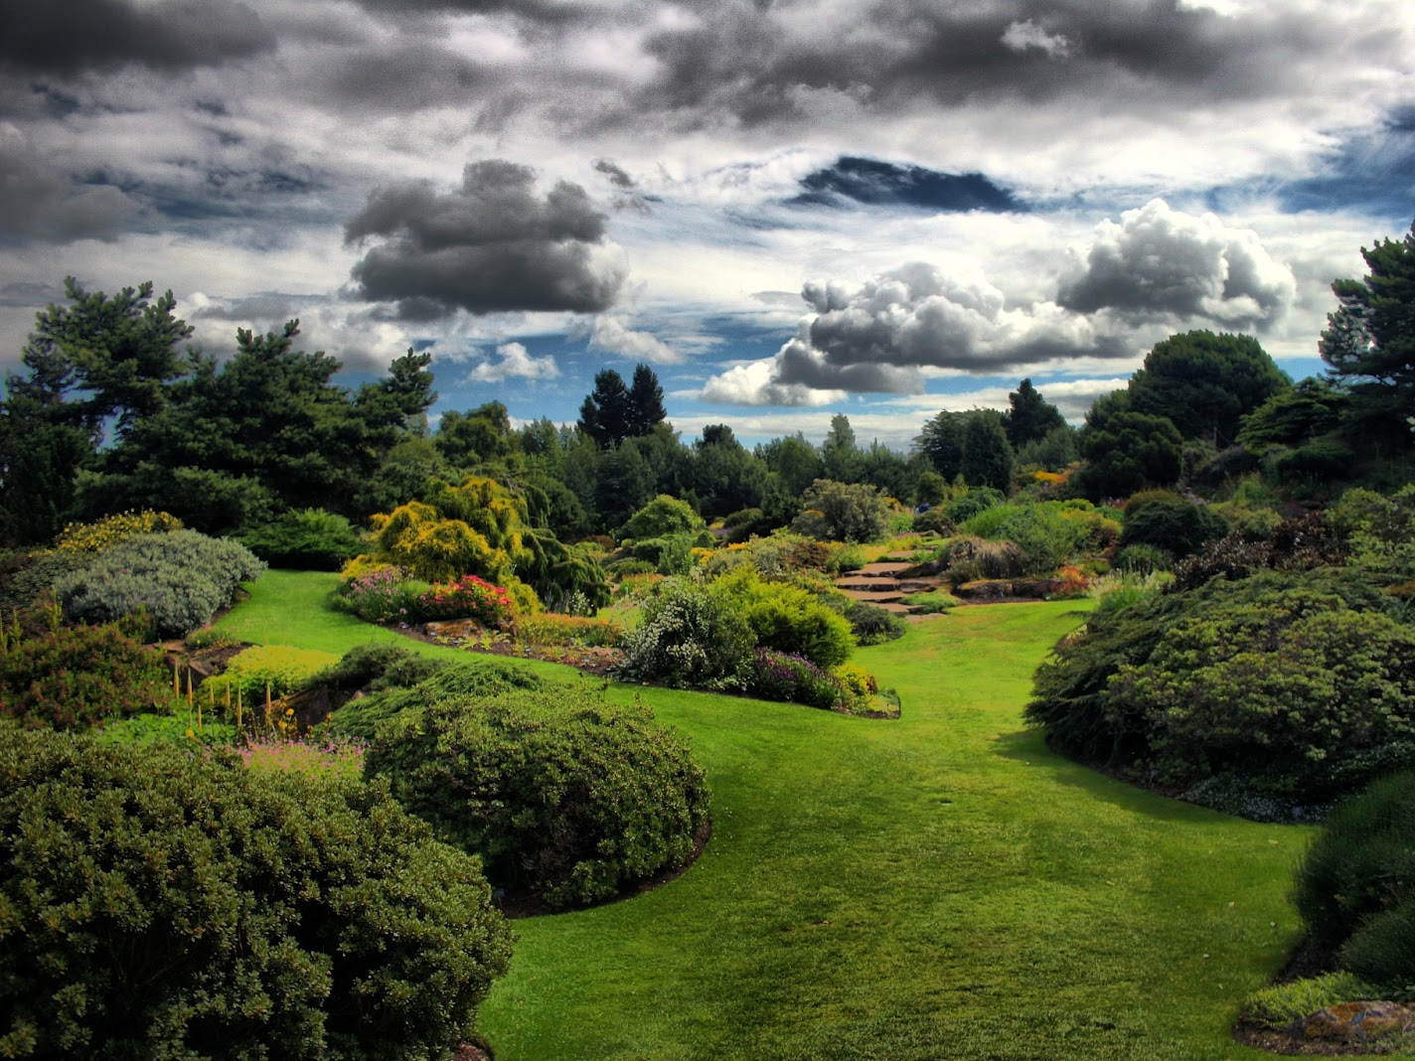
"So it shall be, when the LORD your God brings you into the land of which He swore to your fathers, to Abraham, Isaac, and Jacob, to give you large and beautiful cities which you did not build, houses full of all good things, which you did not fill, hewn-out wells which you did not dig, vineyards and olive trees which you did not plant - when you have eaten and are full …" – Deuteronomy 6:10-11
LORD
when you have
when you have
eaten and are full
eaten and are full
Notes:
The ancient Jews had an opportunity to embrace God’s blessings. Most dream of paradise where sanctuary never ends; An imaginative realm hard to comprehend.

Slide 33
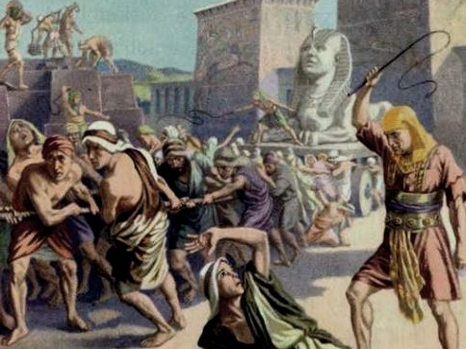
"… then beware, lest you forget the LORD who brought you out of the land of Egypt, from the house of bondage. You shall fear the LORD your God and serve Him, and shall take oaths in His name. You shall not go after other gods, the gods of the peoples who are all around you …" – Deuteronomy 6:12-14
beware, lest you forget
beware, lest you forget
LORD
Notes:
For history shows the forgetfulness held in the hearts of men, that in God, paradise was an assurance given. Who can claim to know the ages of truth in occurrence of what condemned each individual heart to its’ own oblivion or not. Examples have been given to expose the turmoil souls hold.

Slide 34
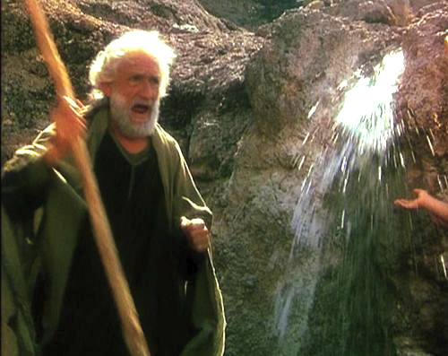
"… (for the LORD your God is a jealous God among you), lest the anger of the LORD your God be aroused against you and destroy you from the face of the earth. "Y ou shall not tempt the LORD your God as you tempted Him in Massah." – Deuteronomy 6:15-16
LORD
LORD
You shall not tempt the LORD
. .
LORD
Notes:
Disgust without any thankfulness leads to denial of God.

Slide 35
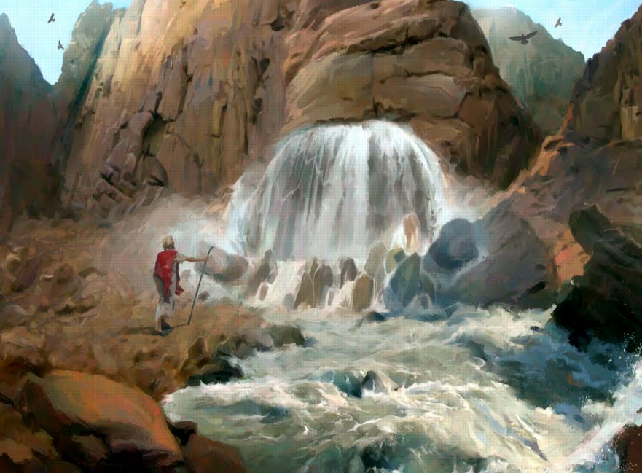
"Behold, I will stand before you there on the rock in Horeb; and you shall strike the rock, and water will come out of it, that the people may drink." And Moses did so in the sight of the elders of Israel. So he called the name of the place Massah and Meribah, because of the contention of the children of Israel, and because they tempted the LORD, saying, "Is the LORD among us or not?" – Exodus 17:6-7
Now these things became our examples, to the intent that we should not lust after evil things as they also lusted. – 1st Corinthians 10:6
not lust after evil things
not lust after evil things
contention
contention
Is the LORD among us or not?
LORD
Notes:
Many shown truth question the presence of God in feelings of abandonment. God is larger than life that can be seen, being that He is the life giver.

Slide 36
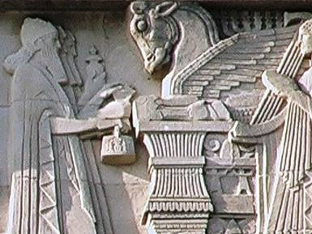
"When the LORD your God cuts off from before you the nations which you go to dispossess, and you displace them and dwell in their land, take heed to yourself that you are not ensnared to follow them, after they are destroyed from before you, and that you do not inquire after their gods, saying, 'How did these nations serve their gods? I also will do likewise.' " – Deuteronomy 12:29-30
LORD
take heed
take heed
not
not
follow them
follow them
Notes:
Warnings from God have always been to remain loyal in regard to His supremacy, over elevating creations of man in man’s limited, though talented, imagination. Stubborn hearts claim to know what is best in the regulation of justice over others in the name of God through delusional notions masking the real truth of God. God simply asks all to be in His service reflecting His innate glory of character over that of self-seeking serving whims of man.

Slide 37
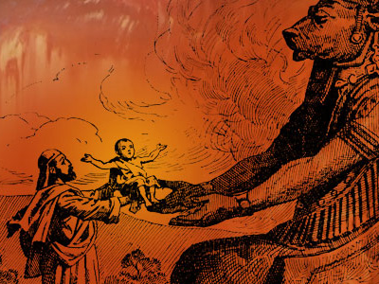
"You shall not worship the LORD your God in that way; for every abomination to the LORD which He hates they have done to their gods; for they burn even their sons and daughters in the fire to their gods." – Deuteronomy 12:31
"There shall not be found among you anyone who makes his son or his daughter pass through the fire, or one who practices witchcraft, or a soothsayer, or one who interprets omens, or a sorcerer, or one who conjures spells, or a medium, or a spiritist, or one who calls up the dead. For all who do these things are an abomination to the LORD, and because of these abominations the LORD your God drives them out from before you." – Deuteronomy 18:10-12
LORD
"'And you shall not walk in the statutes of the nation which I am casting out before you; for they commit all these things, and therefore I abhor them.'" – Leviticus 20:23
LORD
LORD
before you
Notes:
Ignored, history shows man’s destructive creations going against God’s will for decency. Choices to go against God litter the epochs of man.

Slide 38
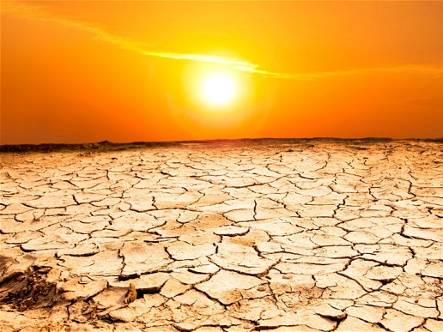
"Moreover all these curses shall come upon you and pursue and overtake you, until you are destroyed, because you did not obey the voice of the LORD your God, to keep His commandments and His statutes which He commanded you. And they shall be upon you for a sign and a wonder, and on your descendants forever." – Deuteronomy 28:45-46
LORD
did not obey the voice of the LORD
did not obey the voice of the LORD
Notes:
God’s example of removing rebellion after rebellion, leaving only desolation, is an inheritance of the defiant best left unwelcomed.

Slide 39
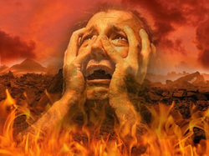
"Because you did not serve the LORD your God with joy and gladness of heart, for the abundance of everything, therefore you shall serve your enemies, whom the LORD will send against you, in hunger, in thirst, in nakedness, and in need of everything; and He will put a yoke of iron on your neck until He has destroyed you." – Deuteronomy 28:47-48
LORD
serve the LORD
serve the LORD
with joy and gladness
with joy and gladness
of heart
heart
of heart
LORD
Notes:
For those choosing not to joyously serve in the true ways of God, a self inflicted destruction will come upon them.

Slide 40
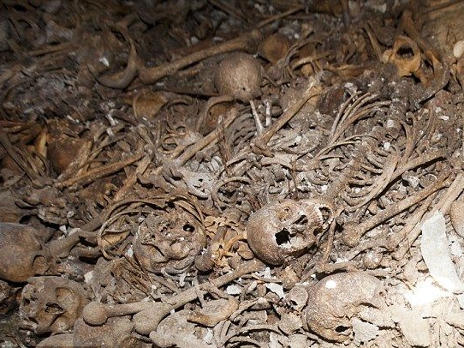
"You shall eat the fruit of your own body, the flesh of your sons and your daughters whom the LORD your God has given you, in the siege and desperate straits in which your enemy shall distress you." – Deuteronomy 28:53
LORD
desperate straits
desperate straits
Notes:
Heinous descriptions can never announce the horror of those engulfed in God’s punishment due to individuals bad choices to abandon Him.

Slide 41
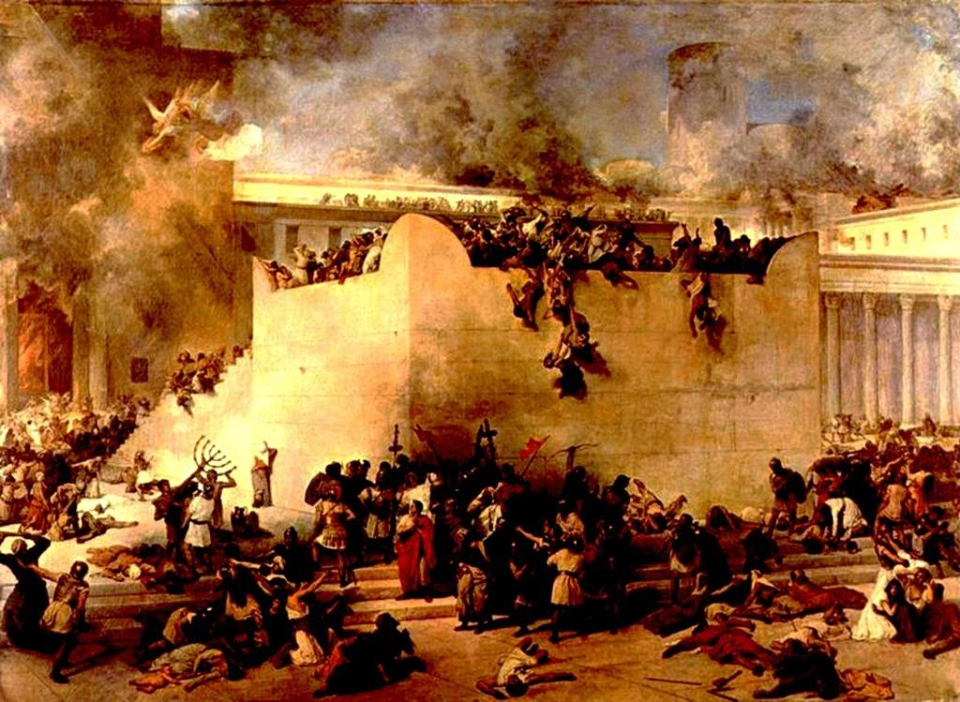
"All their wickedness is in Gilgal, For there I hated them. Because of the evil of their deeds I will drive them from My house; I will love them no more. All their princes are rebellious." – Hosea 9:15
I hated
I hated
evil
their deeds
their deeds
evil
Notes:
Without love of God, societies tear in their own abominations.

Slide 42
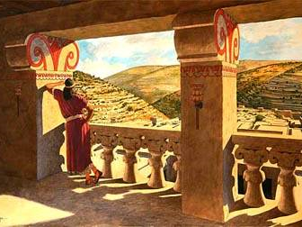
"And it shall come to pass at that time That I will search Jerusalem with lamps, And punish the men Who are settled in complacency, Who say in their heart, 'The LORD will not do good, Nor will He do evil.'" – Zephaniah 1:12
punish
punish
settled in complacency
in
heart
settled in complacency
heart
evil
Notes:
And while the rich choose comfort in oblivion, God is ignored.

Slide 43
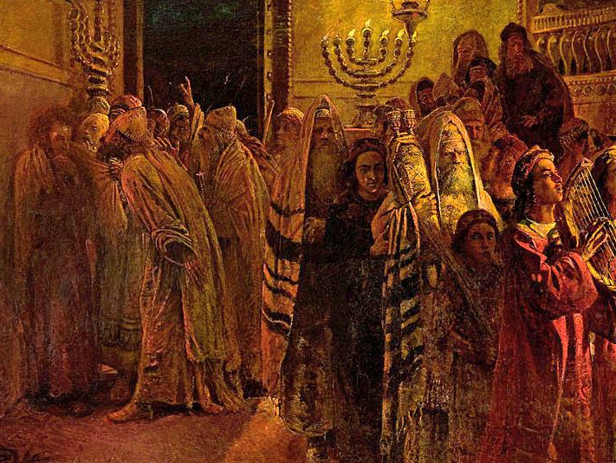
Woe to you who are at ease in Zion, And trust in Mount Samaria, Notable persons in the chief nation, To whom the house of Israel comes! Go over to Calneh and see; And from there go to Hamath the great; Then go down to Gath of the Philistines. Are you better than these kingdoms? Or is their territory greater than your territory? – Amos 6:1-2
Woe to you who are at ease
Woe to you who
Woe to you who are at ease
Woe to you who
trust in
Human worship
in
trust in
heart
Notes:
The proud excuse themselves from any error.

Slide 44
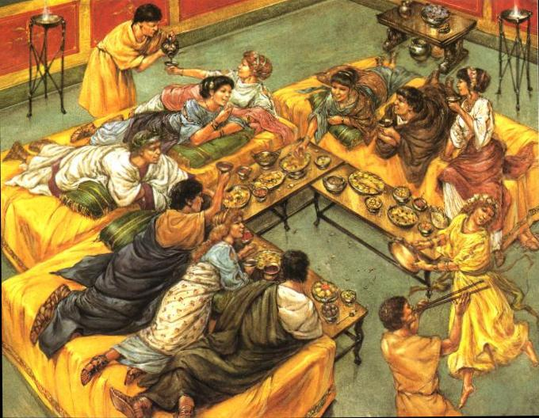
Woe to you who put far off the day of doom, Who cause the seat of violence to come near; Who lie on beds of ivory, Stretch out on your couches, Eat lambs from the flock And calves from the midst of the stall; Who sing idly to the sound of stringed instruments, And invent for yourselves musical instruments like David; – Amos 6:3-5
Who drink wine from bowls, And anoint yourselves with the best ointments, But are not grieved for the affliction of Joseph. Therefore they shall now go captive as the first of the captives, And those who recline at banquets shall be removed. – Amos 6:6-7
Woe to you who
put far off
put far off
not grieved
not grieved
Notes:
Woe has always been upon those indulging in self-seeking without regard for the greater good of all.

Slide 45
heart
Notes:
Woe has always been upon those indulging in self-seeking without regard for the greater good of all.

Slide 46
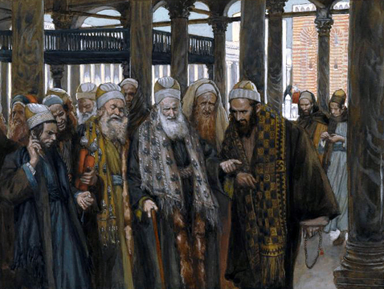
The Lord GOD has sworn by Himself, The LORD God of hosts says: "I abhor the pride of Jacob, And hate his palaces; Therefore I will deliver up the city And all that is in it." – Amos 6:8
abhor
I abhor the pride
I abhor the pride
heart
abhor
Notes:
Those in joint concert proudly manipulating society for personal benefit, without consulting for the justice God declares, walk the road of destruction. Surely, those that smugly dismiss those under their care shall invite personal and societal damnation.

Slide 47
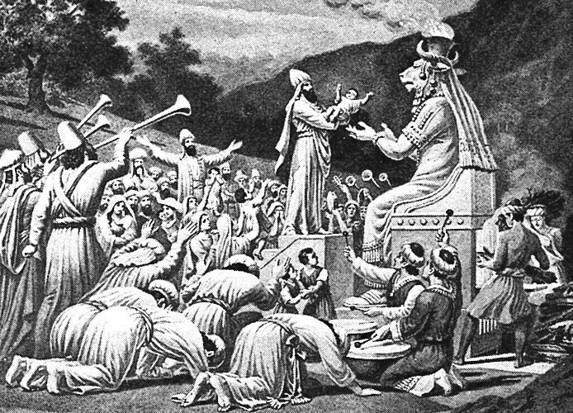
'And after all this, if you do not obey Me, but walk contrary to Me, then I also will walk contrary to you in fury; and I, even I, will chastise you seven times for your sins. You shall eat the flesh of your sons, and you shall eat the flesh of your daughters. I will destroy your high places, cut down your incense altars, and cast your carcasses on the lifeless forms of your idols; and My soul shall abhor you. – Leviticus 26:27-30
do not obey Me
do not obey Me
Bring no more futile sacrifices; Incense is an abomination to Me. The New Moons, the Sabbaths, and the calling of assemblies - I cannot endure iniquity and the sacred meeting. Your New Moons and your appointed feasts My soul hates; They are a trouble to Me, I am weary of bearing them. – Isaiah 1:13-14
walk contrary to Me
futile sacrifices
walk contrary to Me
futile sacrifices
fury
abomination to Me
abomination to Me
destroy
My soul hates
My soul hates
My soul
abhor
Notes:
To worship creation, given by God, is to arose His anger against the lie.

Slide 48
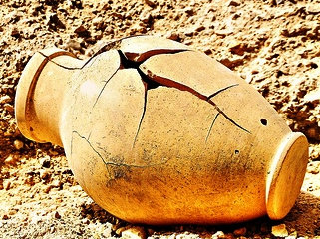
"Has a nation changed its gods, Which are not gods? But My people have changed their Glory For what does not profit. Be astonished, O heavens, at this, And be horribly afraid; Be very desolate," says the LORD. "For My people have committed two evils: They have forsaken Me, the fountain of living waters, And hewn themselves cisterns-broken cisterns that can hold no water." – Jeremiah 2:11-13
forsaken
forsaken Me
forsaken Me
hewn themselves
hewn themselves
Notes:
There is no profit in worshipping a self created god of no substance.

Slide 49
Have you not brought this on yourself, In that you have forsaken the LORD your God When He led you in the way? And now why take the road to Egypt, To drink the waters of Sihor? Or why take the road to Assyria, To drink the waters of the River? – Jeremiah 2:17-18
brought this on
forsaken
forsaken
yourself
Notes:
A cesspool of stench awaits those that choose self over God.

Slide 50
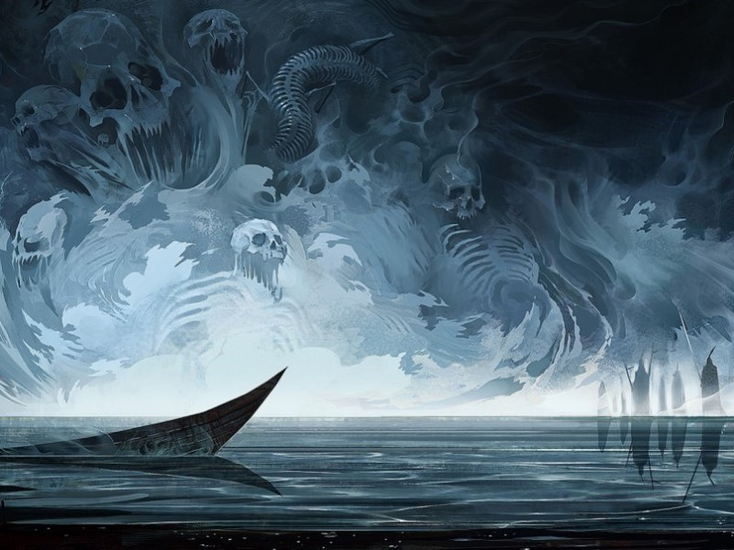
Your own wickedness will correct you, And your backslidings will rebuke you. Know therefore and see that it is an evil and bitter thing That you have forsaken the LORD your God, And the fear of Me is not in you," Says the Lord GOD of hosts. – Jeremiah 2:19
forsaken
LORD
fear of Me
fear of Me
not in you
in
not in you
Notes:
Wickedness will taste the bitterness of there own just punishment. Without fear of God, there is not even regard for man.

Slide 51
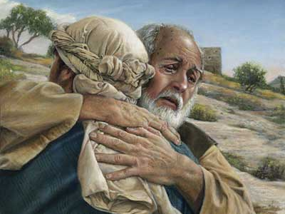
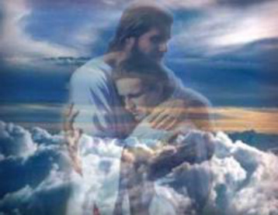
"Go and proclaim these words toward the north, and say: 'Return, backsliding Israel,' says the LORD; 'I will not cause My anger to fall on you. For I am merciful,' says the LORD; 'I will not remain angry forever. ' " – Jeremiah 3:12
Return
Return
LORD
says the LORD
says the LORD
I am merciful
I am merciful
LORD
Notes:
God waits for our eternal return where mercy replaces anger.

Slide 52
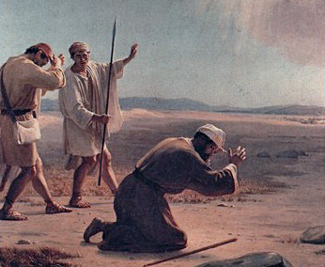
'Only acknowledge your iniquity, That you have transgressed against the LORD your God, And have scattered your charms To alien deities under every green tree, And you have not obeyed My voice,' says the LORD. – Jeremiah 3:13
LORD
"Thus says the LORD of hosts, the God of Israel: 'You have seen all the calamity that I have brought on Jerusalem and on all the cities of Judah; and behold, this day they are a desolation, and no one dwells in them, because of their wickedness which they have committed to provoke Me to anger, in that they went to burn incense and to serve other gods whom they did not know, they nor you nor your fathers. However I have sent to you all My servants the prophets, rising early and sending them, saying, "Oh, do not do this abominable thing that I hate!" ' " – Jeremiah 44:2-4
acknowledge your iniquity
acknowledge your iniquity
LORD
serve other gods
serve other gods
you have not obeyed My voice
you have not obeyed My voice
do not do
do not do
that I hate
that I hate
Notes:
Conditional to our return, we must confess that we have not obeyed. God leaves us with examples for all to know that life without Him can only lead to desolation.

Slide 53
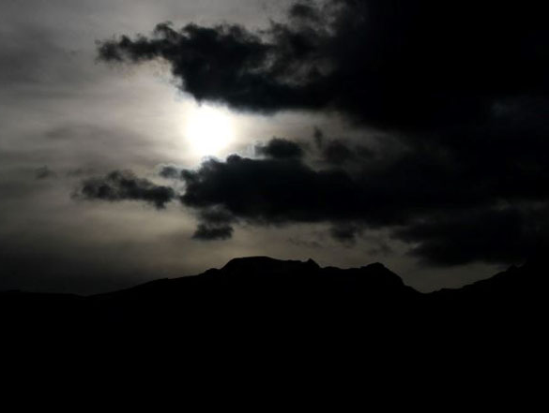
Hear and give ear: Do not be proud, For the LORD has spoken. Give glory to the LORD your God Before He causes darkness, And before your feet stumble On the dark mountains, And while you are looking for light, He turns it into the shadow of death And makes it dense darkness. – Jeremiah 13:15-16
Do not be proud
Do not be proud
Give glory
LORD
Give glory
LORD
to the LORD
LORD
LORD
to the LORD
Notes:
For all those to proud to exalt God’s glory over self invite suffocating darkness.

Slide 54
Hate evil, love good; Establish justice in the gate. It may be that the LORD God of hosts Will be gracious to the remnant of Joseph. – Amos 5:15
LORD
Notes:
God calls for just love, for without such, man has demonstrated his demise into chaos repeatedly.

Slide 55
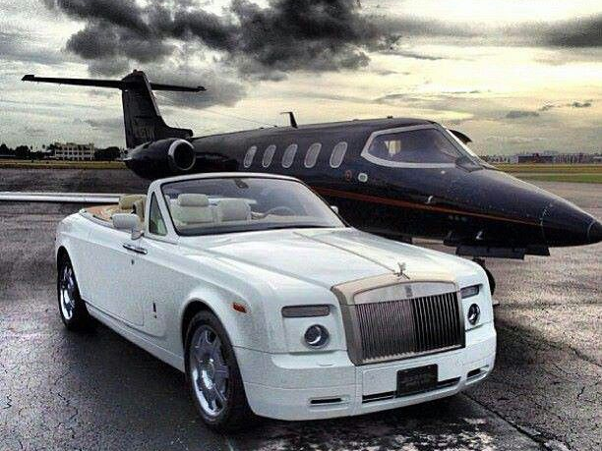
And He said to them, "You are those who justify yourselves before men, but God knows your hearts. For what is highly esteemed among men is an abomination in the sight of God. – Luke 16:15
Where do wars and fights come from among you? Do they not come from your desires for pleasure that war in your members? You lust and do not have. You murder and covet and cannot obtain. You fight and war. Yet you do not have because you do not ask. You ask and do not receive, because you ask amiss, that you may spend it on your pleasures. Adulterers and adulteresses! Do you not know that friendship with the world is enmity with God? Whoever therefore wants to be a friend of the world makes himself an enemy of God. – James 4:1-4
desires
desires
murder and covet
murder and covet
God knows your hearts
. .
Notes:
Without love of God, nothing of substance can justify a soul.

Slide 56
"He who overcomes shall inherit all things, and I will be his God and he shall be My son. But the cowardly, unbelieving, abominable, murderers, sexually immoral, sorcerers, idolaters, and all liars shall have their part in the lake which burns with fire and brimstone, which is the second death." – Revelation 21:7-8
He who overcomes
He who overcomes:
the cowardly
unbelieving
abominable
murderers
sexually immoral
sorcerers
idolaters
all liars
the cowardly
unbelieving
abominable
murderers
sexually immoral
sorcerers
idolaters
all liars
Notes:
Overcoming the abominations of man entitles one to truly enter into the eternal kingdom of God. There is no doubt in a true God fearing soul. We all remain victims of countless ages of rebellious souls. To be wise is to know good over evil.

Slide 57
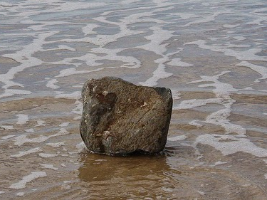
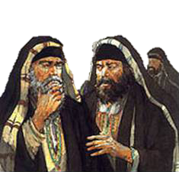
"But I have a few things against you, because you have there those who hold the doctrine of Balaam, who taught Balak to put a stumbling block before the children of Israel, to eat things sacrificed to idols, and to commit sexual immorality. Thus you also have those who hold the doctrine of the Nicolaitans, which thing I hate." – Revelation 2:14-15
things against you
things against you
sacrificed to idols
sexual immorality
Multiple wives
I hate
I hate
Notes:
How is it that individuals who claim spiritual authority, especially perverted men, command women or young boys as subjects for their sexual pleasures? God rules, not man. Anyone demanding sex to gain access to God goes contrary to the teachings of God Himself.

Slide 58
"Therefore I will judge you, O house of Israel, every one according to his ways," says the Lord GOD. "Repent, and turn from all your transgressions, so that iniquity will not be your ruin." –Ezekiel 18:30
"Therefore say to the house of Israel, 'Thus says the Lord GOD: "Repent, turn away from your idols, and turn your faces away from all your abominations." ' " – Ezekiel 14:6
Repent, and turn
Repent, and turn
turn
turn
Repent
Notes:
To stand justified in the presence of God, one must first kneel humbled in His grace. Individual repentance is what He calls for.

Slide 59
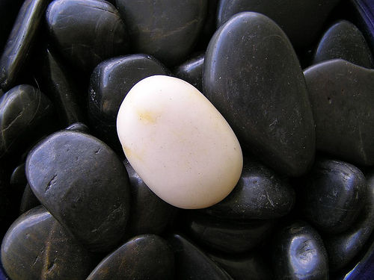
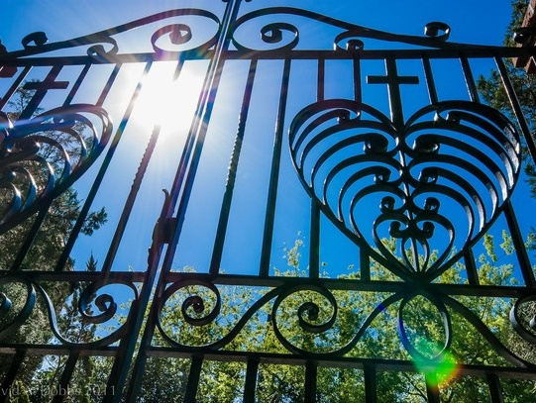
Repent
" 'Repent, or else I will come to you quickly and will fight against them with the sword of My mouth. "He who has an ear, let him hear what the Spirit says to the churches. To him who overcomes I will give some of the hidden manna to eat. And I will give him a white stone, and on the stone a new name written which no one knows except him who receives it.' " – Revelation 2:16-17
sword of My mouth
who
. .
who
overcomes
white stone
a new
name
overcomes
white stone
a new
name
Notes:
God’s sword commands the fire of truth and will cut all to the quick. Darkness will not survive as He pulls out His own naming each in His merciful tender love. Would you choose the rebuking of God’s word now or after it is to late as time runs out and pronouncements are made.

Slide 61
Those who do not fear Him
Those who go after other Gods
Those that doubt in Him
Those in the pursuit of man’s way rather than of God’s
Abominations of false worship
Lack of obedience consumed in self-serving
Those not joyfully acknowledging all abundance in the Lord
Those complacent of heart trusting in the kingdom of man
Those who indulge without regard for afflictions of others
All the pride of man
Those that ignore His call to return forsaking Him
Those that do not acknowledge their sin
The cowardly, unbelieving, abominable, murderers, sexually immoral, sorcerers, idolaters, and all liars
God offers a Bridge of Saving Grace
WHAT GOD HATES
Notes:
God has made clear those things which He abhors. It is up to each of us to pursue Him in earnest to achieve the life He intended for us. To overcome the pitfalls that entrap most to the rocky shards of broken lives, all need the bridge of saving grace that Jesus offers, to enter in His light. To be pure in His presence, we must be as an infant child is, dependent upon His love.

Slide 62
Notes:
In darkness, there is no sanctuary.

Slide 63
Please visit http://www.RonBert.com to explore further
Ronald Bert Channel on
Notes:
Eternity never ends.

