Slide 1
Notes:
Darkness has no bottom.

Slide 2
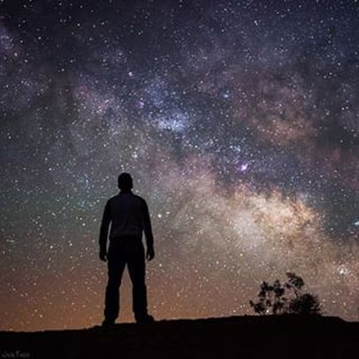
Watchmen
Ron Bert
January 15, 2017
Notes:
He calls for us to be watchful in His light.

Slide 3
"Watch therefore, for you do not know what hour your Lord is coming. But know this, that if the master of the house had known what hour the thief would come, he would have watched and not allowed his house to be broken into." — Matthew 24:42-43
Watch
Watch
the
Lord
is coming
know this
the Lord
is coming
would have watched
Notes:
To be watchful is a repeating key message found in the Lord’s word to us. Serious and grave is that we come to know God is real, and that our meeting is immanent.

Slide 4
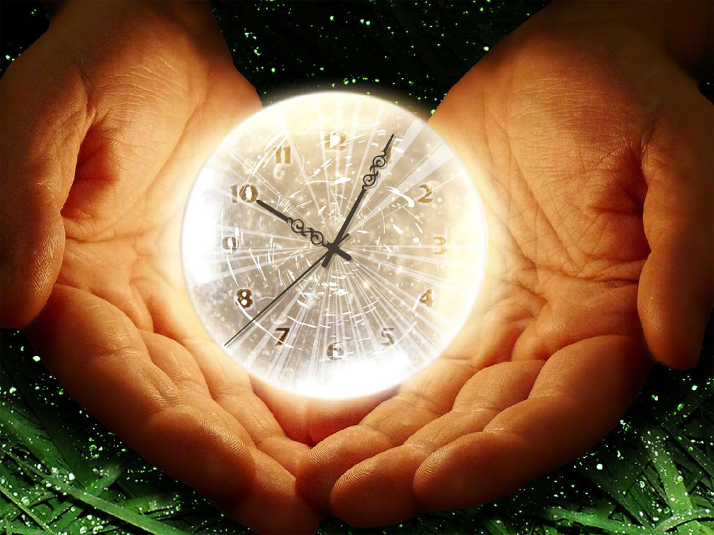
"Therefore you also be ready, for the Son of Man is coming at an hour you do not expect." — Matthew 24:44
be ready
be ready
Son of Man
is coming
Notes:
We are most seriously warned to be ready for He is coming.

Slide 5
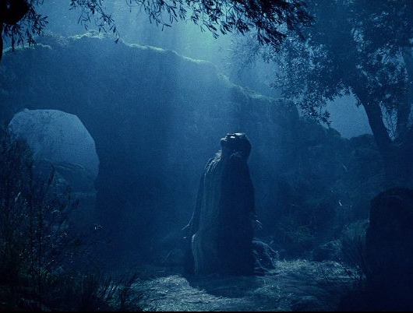
"Watch and pray, lest you enter into temptation. The spirit indeed is willing, but the flesh is weak." — Matthew 26:41
Watch
Watch and pray
Watch and pray
pray
Son of Man
Watch
Notes:
The flesh can be such a heavy agonizing anchor. It is extremely important that we do not sever our personal relationship with God. Preparing to meet your maker does not involve a vacation. Casually ignoring Him retreating from daily, if not in each moment, prayer leads to immersion in the world. Our perspective must remain in its proper domain, eternity. To forget our source can mire one in the temporary passings where the heart or soul of man is being tested for resolve. Too often generic popular memory verses get sanitized and we can miss the importance of the simple truth such as watching and praying. It is tragic when lusting desires replace lifting love in distant aching hearts.

Slide 6
"Watch therefore, for you do not know when the master of the house is coming -- in the evening, at midnight, at the crowing of the rooster, or in the morning -- lest, coming suddenly, he find you sleeping. And what I say to you, I say to all: Watch!" — Mark 13:35-37
Watch
master
the master
the master
is coming
is coming
Watch
master
Watch
Notes:
As we approach the midnight hour, who is your master? Is time your master, or instead of a thief, is it an exciting blessing with opportunities for more? Time is a creation of God where it is a statement, a condition of what we will do with limitations and confinement. Can we handle or endure being below God? We are all in a realm of material bondage. Will we find desperate outrage or gentle thankfulness? Genuine engagement with others or an isolated implosion in to the self? God is socially timeless waiting to see what we look for and who we will choose to become. In discovery, the excitement our heart holds can be challenged by all that creation offers. One must rise to the top above creation’s magnificence to regard the creator deeply over the finite descending unquenchable desires. Peace is a calm without desire. To watch is synonymous with to come. Amen.

Slide 7
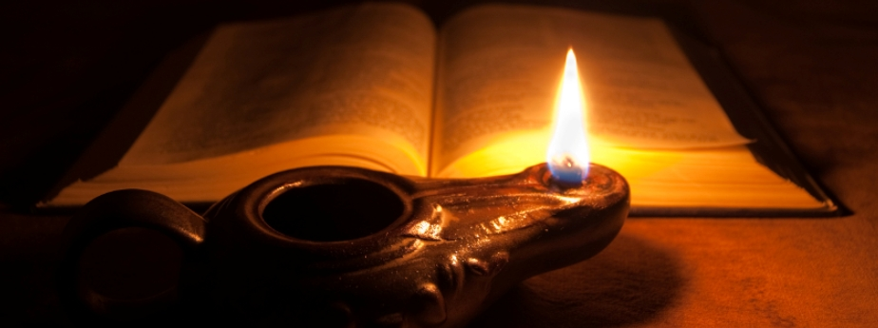
"For where your treasure is, there your heart will be also. Let your waist be girded and your lamps burning; and you yourselves be like men who wait for their master, when he will return from the wedding, that when he comes and knocks they may open to him immediately." — Luke 12:34-36
treasure
your heart
your heart
master
lamps burning
burning
lamps burning
who wait
who wait
master
Notes:
Is the string of your heart connected to heaven or tied to a video game? Time is where management can not be ignored. Preparing for this or that can seem an endless exercise, especially where decay and dust constantly approach. What one fills the self with becomes that which one is. Waiting for God or not expresses either a heart of impulsive recklessness or patient control. God is asking us for presence in Him over careless disregard. Purpose, one way or another, has always involved passion of thought. How close is He in our heart of thoughts? To wait for the master to arrive is to pay attention to Him. Surely, if we are truly waiting for the master, we are looking for Him.

Slide 8
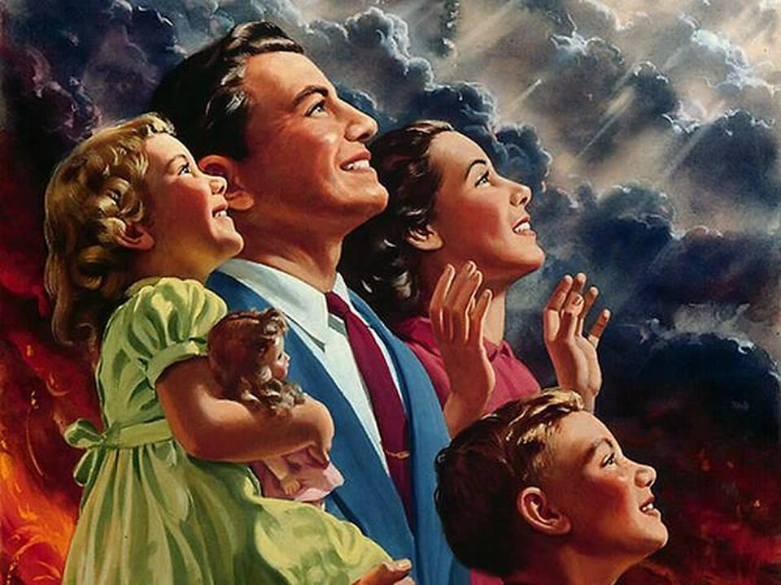
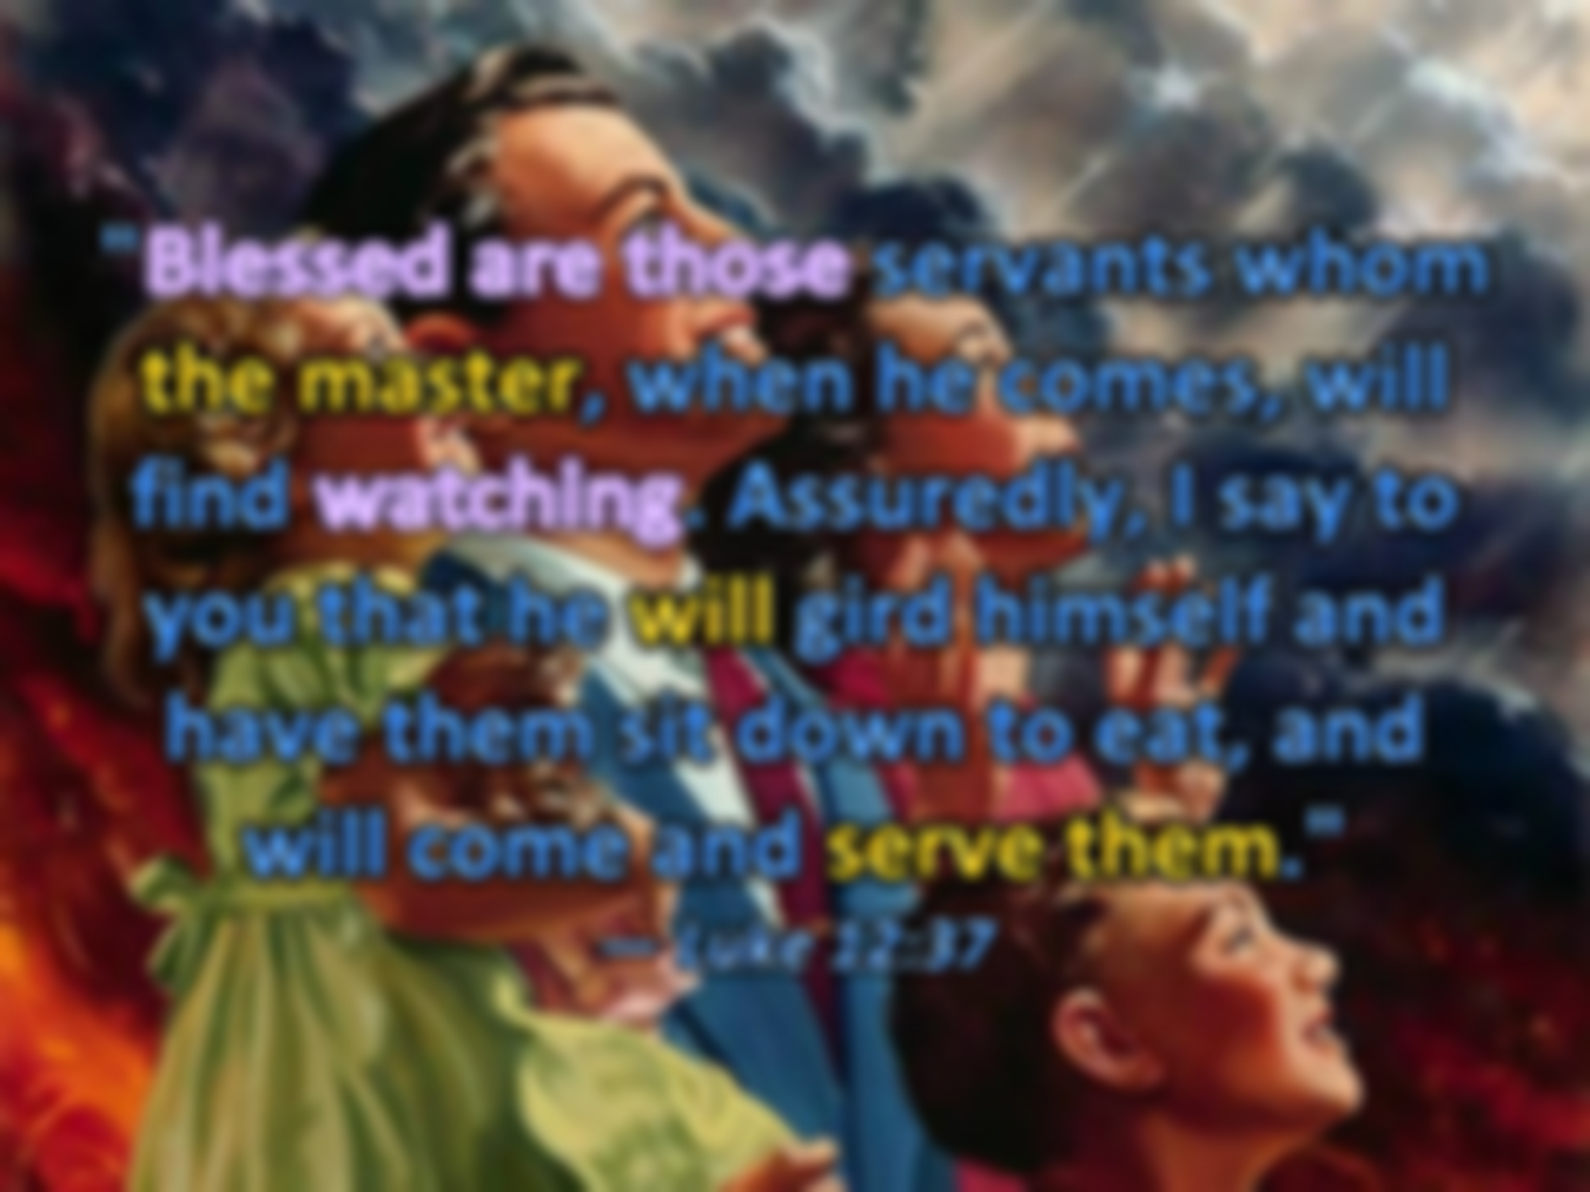
"Blessed are those servants whom the master, when he comes, will find watching. Assuredly, I say to you that he will gird himself and have them sit down to eat, and will come and serve them." — Luke 12:37
Blessed are those
master
watching
Notes:
What God has instore for those that love Him is beyond the light we can see. Is not that which is above all more valuable than all that which is below? The faithful incessantly watch for His coming.

Slide 9
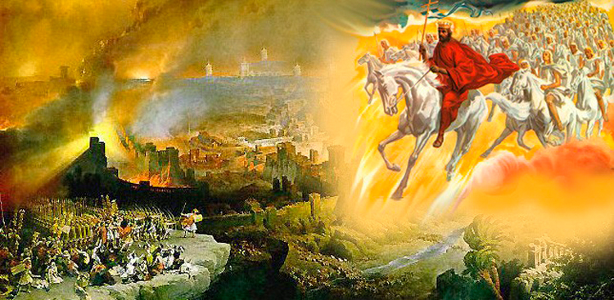
"Therefore you also be ready, for the Son of Man is coming at an hour you do not expect." — Luke 12:40
Therefore
be ready
Therefore
Notes:
No matter how many times time has given us death, it always comes as unexpected. We feel almost impervious to its affects denning it will happen to us, though we fear and watch for it in others. Children cry for their parents demise in the trap of mortal life. If we watch and wait for death, cannot we watch and wait for life? Time itself is death of the moment. God’s repeated warning is in all that is, that it is coming to an end. What will be the impetus of our muster while we live under in this constraint of dying time? God calls for us to be higher than where we are and see Him for the greater glory that He is. Simple minds are limited alone to the earth where dust decays. Belief in more than mere sands upon the wind is where the faithful rise to eternally meet God.

Slide 10
For the time will come when they will not endure sound doctrine, but according to their own desires, because they have itching ears, they will heap up for themselves teachers; — 2nd Timothy 4:3
endure
not endure
not endure
Pacifists
Peace & Love
Atheism
Spiritism
Wicca/Paganism
Satan Worship
Science/Humanism
Transgenderism
Homosexuals
own desires
own desires
Christianity
Islam
endure
Taoism
Confucianism
Buddhism
Judaism
Notes:
If the Bible is a lie, then there is no God. If there is a God, then the Bible is His word of proclaimed inspired truths, and all others facsimiles lack credibility. False religion is more popular to mankind for it is man’s creation created for self-satisfaction, and pleasure seeking; an acceptance of uncondoned behaviors, over that of an intimate submission, and immediate accountability, to God. Many in their distance from God answer to self without considering His ways or that we all must eventually answer to God. It is a blatant dismissing of spiritual accountability, while embracing and catering to the flesh. He has announced His judgment seat, by which we all must pass, through Christ, not Buddha, or some figment of Allah; Jehovah is His name. He does not coexist with evil’s end. Misgivings in proper worship, almost unbeknownst to casual wanderers, ensnare one in the tangibles, disregarding those things which are from above. When Christ asks if the faith will be upon the earth when He returns, He is asking if hearts will pursue God over self. Running away from His inspired word to another will not draw the blessings we hope for, such as peace, love, sanctuary of heart. He calls to all through His word and no man can replace that.

Slide 11
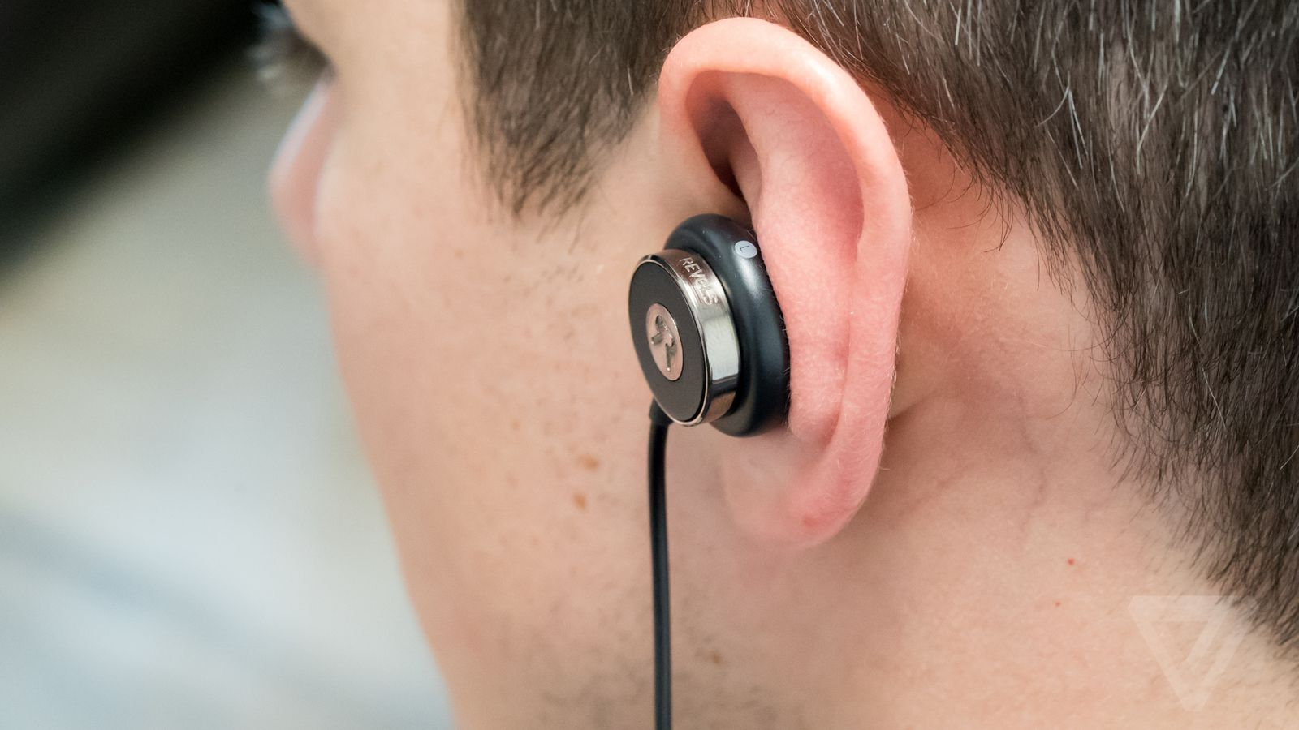
… and they will turn their ears away from the truth, and be turned aside to fables. But you be watchful in all things, endure afflictions, do the work of an evangelist, fulfill your ministry. — 2nd Timothy 4:4-5
… and they will turn their ears away from the truth, and be turned aside to fables. But you be watchful in all things, endure afflictions, do the work of an evangelist, fulfill your ministry. — 2nd Timothy 4:4-5
they will turn
they will turn
from the truth
from the truth
watch
endure
watch
Notes:
What we choose to hear and or regard is what we believe; passion is defining. What we carry is who we are. Many turn from God not desiring His ways. Truth can not be altered to fit illusions of what is not. Heaven is One way and our emancipation into it comes by His ways, and called out for behaviors and or habits of soul. Dedication, determination, consideration, all define what we are. Certain truths cannot be ignored whereas arrogance defeats humble submission in His presence, which is what He looks for from us, not by dogmatic insistence, but from an eagerly willing and loving thankful stance. Mature Christians are removed from guilt as He bears that weight upon Himself welcoming the faithful. We love Him for He loves us first with such a greater intent than we can fully know. May our belief always be tempered in His furnace of truth. Humbly call and pray for His guidance and wisdom to be revealed, that our hearts may be softened and thorns removed.

Slide 12
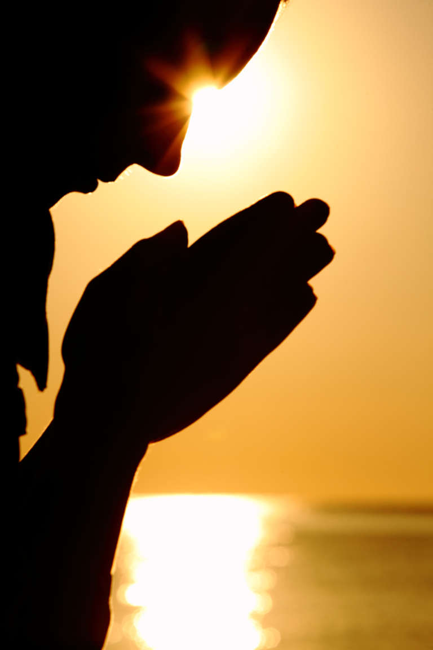
You are all sons of light and sons of the day. We are not of the night nor of darkness. Therefore let us not sleep, as others do, but let us watch and be sober. — 1st Thessalonians 5:5-6
sleep
sons of light
sons of light
sober
sleep
watch
sober
Notes:
Light is our lesson in life. Vision and blindness are upon us. Wake up to God is the call. Pay attention, to know Him is where reality fits truth over lies. Strength of character is to remove oneself from the vices that cause stupor. Sentient capabilities are best served in life with the tingles of real conscious living, over those unmitigated desperate escapes from that which confronts one, whatever painful or suffering situations may be. Excuse has no champion. Running to the hole of self pity and or misery serves no one. Drugs and dependence is not reliance on God. One can live as dead if God is absent. Put off sin and watch for God is the solution to the problem for all, especially for the afflicted under the despair of oppression. All are inherently good enough to rise back to Him and His saving grace; it is the choice He offers as He pleads for our return. He is making a distinction between those that sleep verses those who choose to be sober, and in this is defined His judgment to come.

Slide 13
For those who sleep, sleep at night, and those who get drunk are drunk at night. But let us who are of the day be sober, putting on the breastplate of faith and love, and as a helmet the hope of salvation. — 1st Thessalonians 5:7-8
helmet
sleep
sober
faith
faith
faith
love
helmet
hope
love
hope
love
hope
Notes:
What draws us into eternity is our faith where our hope remains in His love.

Slide 14
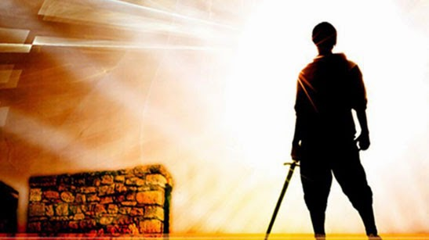
And take the helmet of salvation, and the sword of the Spirit, which is the word of God; praying always with all prayer and supplication in the Spirit, being watchful to this end with all perseverance and supplication for all the saints — Ephesians 6:17-18
helmet
hope
sword
sword
defense
word of God
praying always
word of God
pray
watchful
prayers
in
the Spirit
watchful
the Spirit
ers
Notes:
True Christians fall more deeply into prayer as we grow closer to Him in understanding and love. Is our hope casual or something more serious? The word is our defense to protect the treasure we hold dearest.

Slide 15
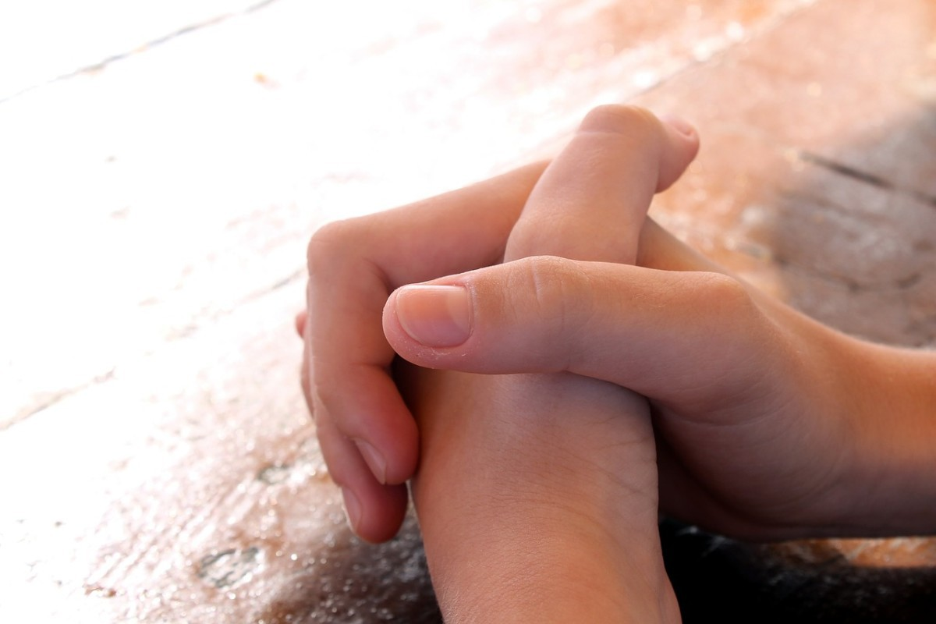
But the end of all things is at hand; therefore be serious and watchful in your prayers. And above all things have fervent love for one another, for "love will cover a multitude of sins." — 1st Peter 4:7-8
watchful
watchful
prayers
above all things
above all things
love
Notes:
To those that habitually hate, themselves and or others, along with blaming family members, they can find solace and exoneration through love. Love both starts and ends with God. In fact, love covers all sins and is how Christ has come to save us. Lift your heart in the light of His love and you will find life.

Slide 16
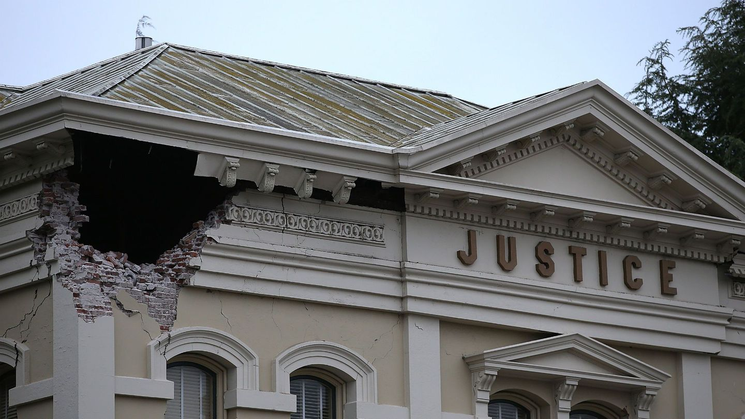
"Be watchful, and strengthen the things which remain, that are ready to die, for I have not found your works perfect before God." — Revelation 3:2
watchful
watch
goodness
watch
Notes:
There is a hole in the justice of man. Our goodness is fading upon legalizing lawlessness. Who among us can claim justice can be served without regard for accountability for all under God? When men’s whims rise above God’s rules, to favor the sinfulness, blessings shall evaporate from view. Commit your heart to God and He will establish your thoughts.

Slide 17
"Remember therefore how you have received and heard; hold fast and repent. Therefore if you will not watch, I will come upon you as a thief, and you will not know what hour I will come upon you. — Revelation 3:3
hold fast
X
thief
hold fast
repent
Therefore
X
watch
repent
watch
thief
Notes:
God has written right and wrong upon our hearts for those who will listen. Therefore is a defining and conclusive word. It is, therefore believe. To deny Him and His ways therefore announces one’s end. Souls are accountable to a higher order than the petty ordinances of man that slosh in confusion and preference.

Slide 18
"Behold, I am coming as a thief. Blessed is he who watches, and keeps his garments, lest he walk naked and they see his shame." — Revelation 16:15
to take life
thief
Blessed
Blessed
watch
put on Christ
SINFULNESS
Notes:
There is a thief waiting in the corner of all of our lives. It is coming to take our lives, and in the flash of a moment, we will all be standing before Him. Being ready in Him preserves our dignity over the shame we all must bear.

Slide 19
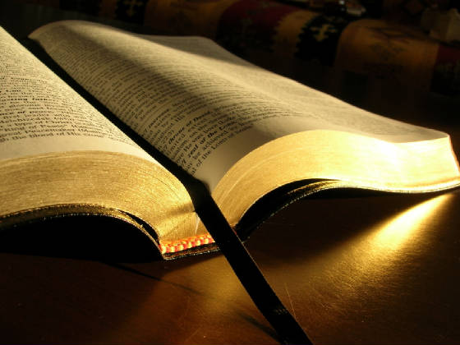
"Now therefore, listen to me, my children, For blessed are those who keep my ways. Hear instruction and be wise, And do not disdain it." — Proverbs 8:32-33
Condescension
Scorn
Disregard
therefore
listen
therefore
Contempt
Blessed
Ridicule
keep my ways
Hear
keep my ways
Reject
do
Disrespect
not
disdain
Belittling
Despise
Notes:
If one chooses not to hear God and His word, there will be no sacrifice of mercy for this one.

Slide 20
"Blessed is the man who listens to me, Watching daily at my gates, Waiting at the posts of my doors. For whoever finds me finds life, And obtains favor from the LORD; But he who sins against me wrongs his own soul; All those who hate me love death." — Proverbs 8:34-36
Blessed
"Blessed is the man who listens to me, Watching daily at my gates, Waiting at the posts of my doors. For whoever finds me finds life, And obtains favor from the LORD; But he who sins against me wrongs his own soul; All those who hate me love death." — Proverbs 8:34-36
listen
listen
Watch
Watch
find
life
find
life
present yourself
favor from the LORD
present yourself
Be diligent to present yourself approved to God, a worker who does not need to be ashamed, rightly dividing the word of truth. — 2nd Timothy 2:15
And I heard another voice from heaven saying, "Come out of her, my people, lest you share in her sins, and lest you receive of her plagues. — Revelation 18:4
And I heard another voice from heaven saying, "Come out of her, my people, lest you share in her sins, and lest you receive of her plagues. — Revelation 18:4
And I heard another voice from heaven saying, "Come out of her, my people, lest you share in her sins, and lest you receive of her plagues. — Revelation 18:4
Come out of her
Come out of her
Notes:
To turn away from truth is to invite death. It is true that he who loses his life for the sake of knowing God finds his life as living waters refresh and lift the spirit. I was raised in a family of professing atheists. I wholeheartedly believe atheists believe in God, it is just that they hate Him rather choosing careless pleasures over regard for His word. How Can one come out of the sinful world if one does not know what to look for, in relation to God’s will? Ignoring His ways will not exempt one from purposed ignorance.

Slide 21
Watch, stand fast in the faith, be brave, be strong. Let all that you do be done with love. — 1st Corinthians 16:13-14
Watch
in
love
all
all
done with love
love
done with love
Notes:
The test remains for each of us whether we choose to courageously believe or not. In any event, He calls us all out to have love in all we do. Love is the innocence of creation that bear eternity on our souls.

Slide 22
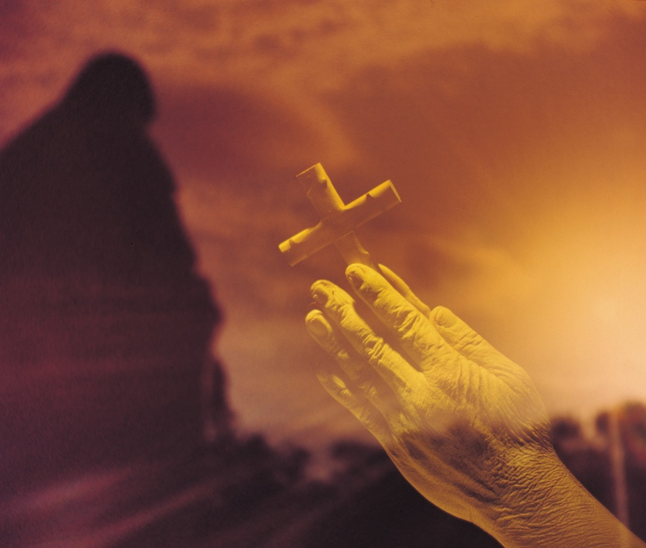
But sanctify the Lord God in your hearts, and always be ready to give a defense to everyone who asks you a reason for the hope that is in you, with meekness and fear; — 1st Peter 3:15
sanctify the Lord God
in
heart
l
e
o
love
v
hope
Notes:
Eternal life has no comparison and for us it is a hope in Him. Our faith is our victory while we live out our lives waiting upon His promise. Hope cuts truthfully the razor of our faith.

Slide 23
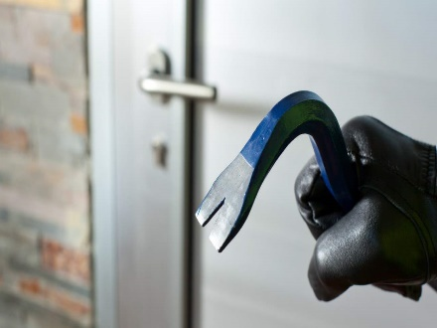
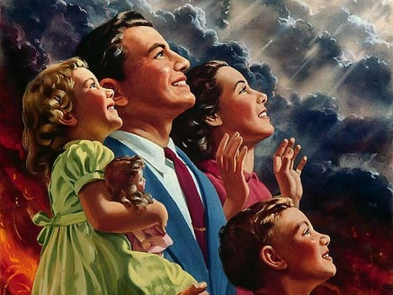
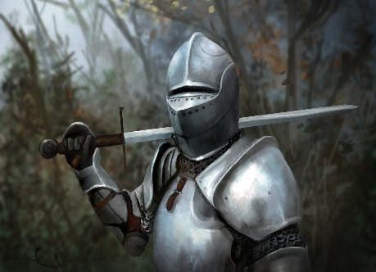
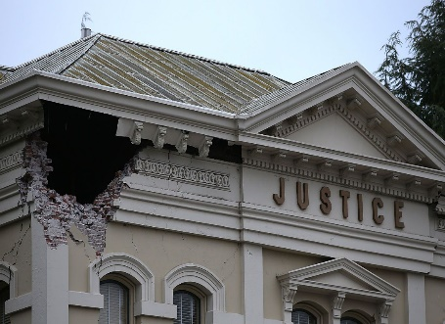
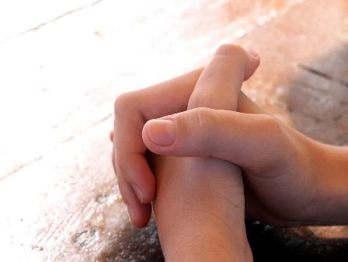
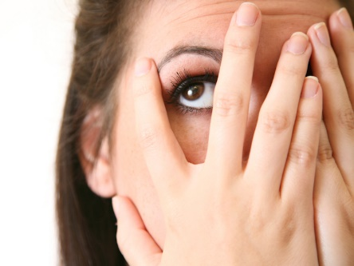
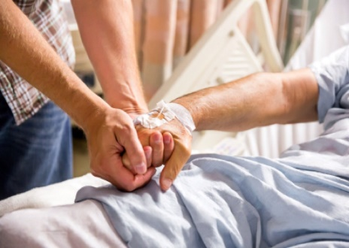
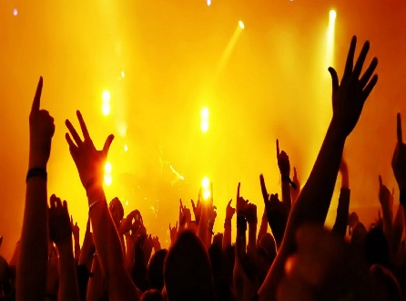

Slide 24
→ Watch for we do not know when the Lord is coming
→ Watch and pray, lest you enter into temptation
→ Be ready always to receive the master
→ Times of false teaching and deception are upon us
→ Do not sleep but watch and be sober
→ Salvation is in His word and keeping prayerful
→ The end is here so be seriously watchful in prayer
→ Hold fast and repent
→ Blessed are who keep His ways and do not disdain it
→ All those who hate me love death
→ Watch, stand fast in the faith, be brave, & be strong
→ Let all that you do be done with love
→ Sanctify the Lord God in your heart-ready to answer
Watching for the Lord welcomes His coming
Notes:
Watching for the Lord welcomes His coming.

Slide 25
Notes:
Time is a vacuum retreating into the darkness.

Slide 26
Please visit http://www.RonBert.com/watchmen.htm to explore further
Ronald Bert Channel on
Notes:
Eternity never ends.

