Slide 2
The Truth Will Set You Free
Ron Bert
February 25, 2024

Slide 3
"And you shall know the truth, and the truth shall make you free." — John 8:32

Slide 4
"When I say to the wicked, 'You shall surely die,' and you give him no warning, nor speak to warn the wicked from his wicked way, to save his life, that same wicked man shall die in his iniquity; but his blood I will require at your hand." — Ezekiel 3:18
God says
God says the wicked shall surely die and you give him no warning nor speak to warn the wicked to save his life that same wicked man shall die in his iniquity but his blood I will require at your hand
God
say
the wicked
↓
shall surely die
and you give him no warning nor speak to warn the wicked
s
and you
→
give him no warning
nor speak to
warn the wicked
→
to save his life
←
Life
to save his life
that same
wicked man
shall die in his
die in his iniquity
in
iniquity
but his blood
I will
↘
↙
require at your hand
To Be Honest
I will require at your hand

Slide 6
"Yet, if you warn the wicked, and he does not turn from his wickedness, nor from his wicked way, he shall die in his iniquity; but you have delivered your soul." — Ezekiel 3:19
To tell the truth
Yet, if you warn the wicked and he does not turn from his wickedness nor from his wicked way he shall die in his iniquity but you have delivered your soul
Y et, if you warn the wicked
↓
and he does not turn
from his
turn
wickedness
nor from his wicked
way
he shall die in his iniquity
die in his iniquity
but you have delivered your soul
in
. .
but you have delivered your soul

Slide 7
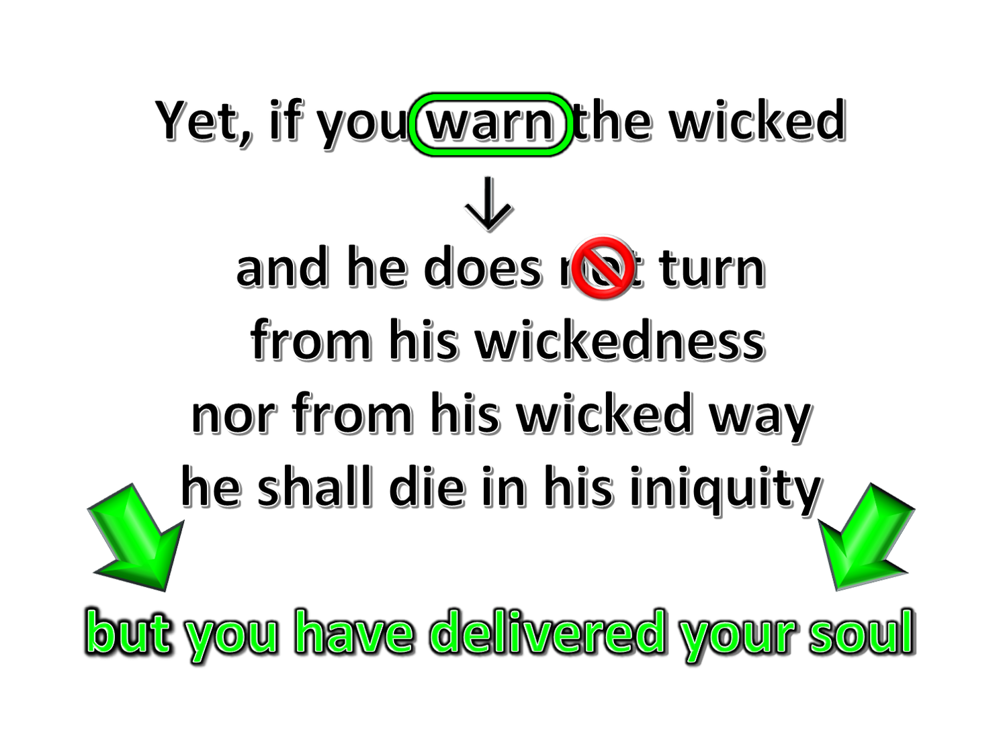

Slide 8
"Again, when a righteous man turns from his righteousness and commits iniquity, and I lay a stumbling block before him, he shall die; because you did not give him warning, he shall die in his sin, and his righteousness which he has done shall not be remembered; but his blood I will require at your hand." — Ezekiel 3:20
turns from
stubbornness
when a righteous man turns from his righteousness and commits iniquity stumbling before him, he shall die because you did not give him warning he shall die in his sin his righteousness shall not be remembered but his blood I will require at your hand
. .
when a righteous man turns
"Again, when a righteous man turns from his righteousness and commits iniquity, and I lay a stumbling block before him, he shall die; because you did not give him warning, he shall die in his sin, and his righteousness which he has done shall not be remembered; but his blood I will require at your hand." — Ezekiel 3:20
righteousness
trials
righteousness
from his
righteousness and commits
falsehoods
↘
turmoil
iniquity
stumbling
sin
evil
injustice
iniquity
dishonesty
corruption
stumbling block
prejudice
. .
before him, he shall die
because you
negativity
insecurity
because you did not give him warning
did not give him warning
he shall die in
avoidance
bigotry
his sin
his righteousness
hypercritical
but
shall not be remembered
not be remembered
his blood I will require at your hand
but his blood I will require at your hand
. .
Notes:
excuses

Slide 9
not be remembered

Slide 10
"Nevertheless if you warn the righteous man that the righteous should not sin, and he does not sin, he shall surely live because he took warning; also you will have delivered your soul." — Ezekiel 3:21
with Truth
if you warn the righteous man that he should not sin and he does not sin he shall surely live because he took warning you will have delivered your soul
if you warn the
righteous man
that
he
↓
should not sin
and he does not sin
. .
he shall surely live
because he
live
live
took warning
you will have
→
delivered your soul
you will have delivered your soul
you will have delivered your soul

Slide 11
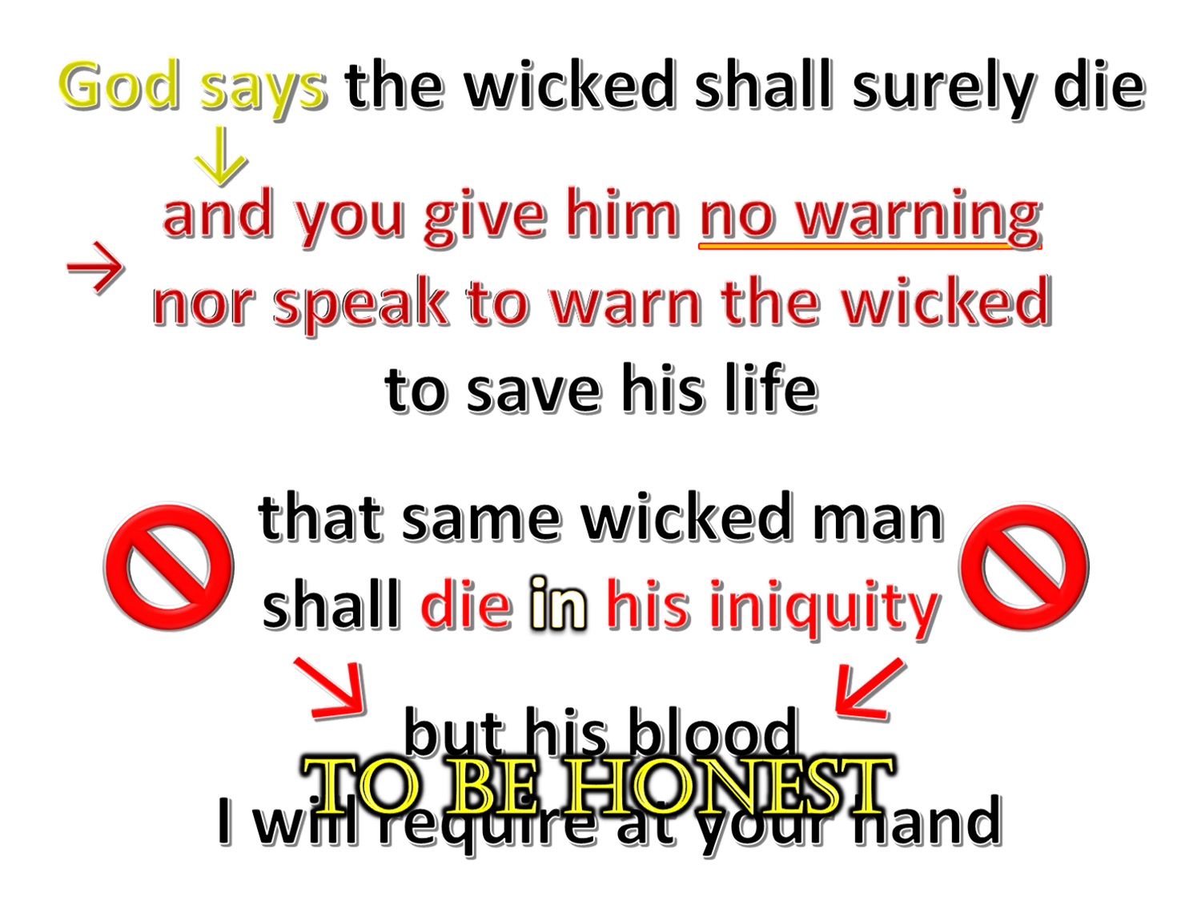
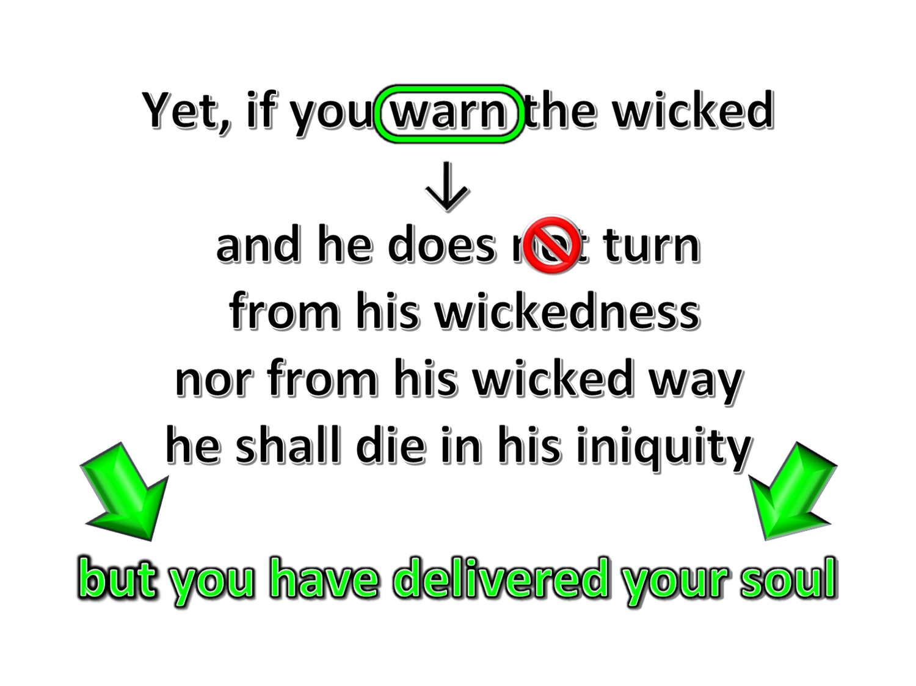
Ezekiel 3:18-21

Slide 12
Actions of a Watchman Witness
God commands we honestly and candidly warn those who sin
Condition | Wicked | Who Turn from Righteousness | Not Warn | Warn | Not Hear | Hear | Death | Life | Watchman Accountable | Watchman Delivered
Condition | X |  | X |  |  | N/A | X |  | X
 | X |  |  | X | X |  | X |  |  | X
 | X |  |  | X |  | X |  | X |  | X
 |  | X | X |  |  | N/A | X |  | X
 |  | X |  | X | X |  | X |  |  | X
 |  | X |  | X |  | X |  | X |  | X
Condition | Wicked | Who Turn from Righteousness | Not Warn | Warn | Not Hear | Hear | Death | Life | Watchman Accountable | Watchman Delivered
Condition | X |  | X |  |  | N/A | X |  | X
 | X |  |  | X | X |  | X |  |  | X
 | X |  |  | X |  | X |  | X |  | X
 |  | X | X |  |  | N/A | X |  | X
 |  | X |  | X | X |  | X |  |  | X
 |  | X |  | X |  | X |  | X |  | X
Condition | Wicked | Who Turn from Righteousness | Not Warn | Warn | Not Hear | Hear | Death | Life | Watchman Accountable | Watchman Delivered
Condition | X |  | X |  |  | N/A | X |  | X
 | X |  |  | X | X |  | X |  |  | X
 | X |  |  | X |  | X |  | X |  | X
 |  | X | X |  |  | N/A | X |  | X
 |  | X |  | X | X |  | X |  |  | X
 |  | X |  | X |  | X |  | X |  | X
Condition | Wicked | Who Turn from Righteousness | Not Warn | Warn | Not Hear | Hear | Death | Life | Watchman Accountable | Watchman Delivered
Condition | X |  | X |  |  | N/A | X |  | X
 | X |  |  | X | X |  | X |  |  | X
 | X |  |  | X |  | X |  | X |  | X
 |  | X | X |  |  | N/A | X |  | X
 |  | X |  | X | X |  | X |  |  | X
 |  | X |  | X |  | X |  | X |  | X

Slide 13
Therefore, putting away lying, "Let each one of you speak truth with his neighbor," for we are members of one another. "Be angry, and do not sin": do not let the sun go down on your wrath, nor give place to the devil. Let him who stole steal no longer, but rather let him labor, working with his hands what is good, that he may have something to give him who has need. Let no corrupt word proceed out of your mouth, but what is good for necessary edification, that it may impart grace to the hearers. And do not grieve the Holy Spirit of God, by whom you were sealed for the day of redemption. Let all bitterness, wrath, anger, clamor, and evil speaking be put away from you, with all malice. And be kind to one another, tenderhearted, forgiving one another, just as God in Christ forgave you. — Ephesians 4:25-32
speak truth
putting away lying
Let each one of you
speak truth
Let each one of you speak truth putting away lying Let no corrupt word proceed out of your mouth, but what is good for necessary edification who stole steal no longer, but rather let him labor, working with his hands what is good, that he may have something to give him who has need do not let the sun go down on your wrath Let all bitterness, wrath, anger, clamor, and evil speaking be put away from you, with all malice And be kind to one another, tenderhearted, forgiving one another, just as God in Christ forgave you
speak truth
do not let the
sun go down on your wrath
for necessary edification
for necessary edification
who stole steal no longer , but rather let him
labor,
labor
working with his hands what is good, that he may
what is good
have something to give him who has need
Let no
=
is
to give
who has need
corrupt word proceed out of your mouth,
but what is
good for necessary edification
Let
all bitterness, wrath , anger , clamor, and evil
speaking be
put away from you, with all malice
And be kind to one
kind to one another , tenderhearted
another , tenderhearted,
forgiving one another , just as
forgiving one another
in
God in Christ forgave you
forgiving one another
God in Christ

Slide 14
For God has not given us a spirit of fear, but of power and of love and of a sound mind. — 2nd Timothy 1:7
truth
lying
↑
speak truth
speak truth
Let each one of you speak truth putting away lying Let no corrupt word proceed out of your mouth, but what is good for necessary edification who stole steal no longer, but rather let him labor, working with his hands what is good, that he may have something to give him who has need do not let the sun go down on your wrath Let all bitterness, wrath, anger, clamor, and evil speaking be put away from you, with all malice And be kind to one another, tenderhearted, forgiving one another, just as God in Christ forgave you
power
love
Wheat
word
sound
mind
for necessary edification
power
for necessary edification
kind
good
need
word
labor
forgiving
tenderhearted
evil
steal
anger
wrath
malice
clamor
bitterness
sound mind
labor
steal
courage
labor
follow
what is good
=
good
own
who has need
to give
need
love
destructive ways
fear
wrath
bitterness
anger
clamor
evil
And many will follow their destructive ways, because of whom the way of truth will be blasphemed.— 2nd Peter 2:2
Weeds
follow
destructive
malice
ways
kind to one another , tenderhearted
kind
tenderhearted
↓
forgiving one another
in
forgiving
forgiving one another
God in Christ
Notes:
2Ti 1:7 For God has not given us a spirit of fear, but of power and of love and of a sound mind.
2Pe 2:2 And many will follow their destructive ways, because of whom the way of truth will be blasphemed.

Slide 15
Let each of you look out not only for his own interests, but also for the interests of others. — Philippians 2:4
look out
Heaven
for
own interests
↑
also for the interests of others
for
look out for own interests also for the interests of others
for well-being
own
own
care
Let no one seek his own, but each one the other's well-being. — 1st Corinthians 10:24
↙
↘
compassion
well-being

Slide 16
But if anyone does not provide for his own, and especially for those of his household, he has denied the faith and is worse than an unbeliever. — 1st Timothy 5:8
Truth
do not provide for his own his household he has denied the faith is worse than an unbeliever
do not
do
not provide for
his own
↓
he has denied
his household
the faith
is worse than an
→
unbeliever
←

Slide 17
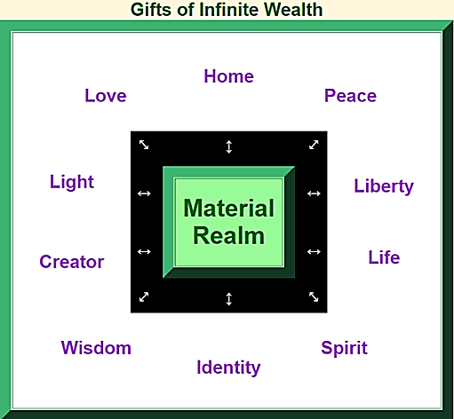
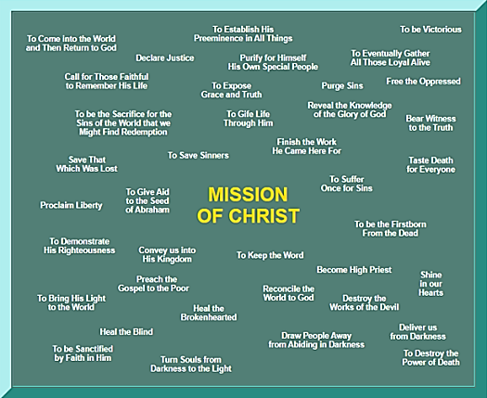
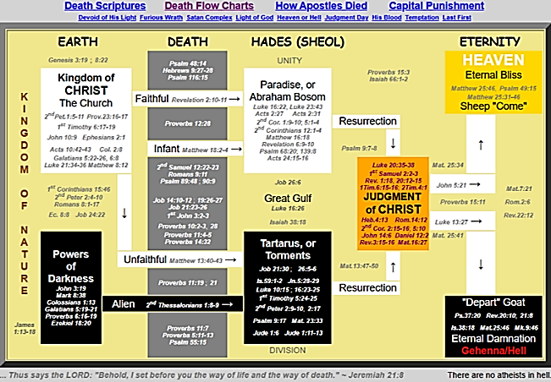
But be doers of the word, and not hearers only, deceiving yourselves. — James 1:22
honest
listen
tip of iceberg
careful
humble
regard
apply
do
X
deceiving
deceiving
ignore
disregard
liars
depth of truth
conceited
contempt
envy
Notes:
Listen careful honest humble
contempt envy conceited liars

Slide 18
For if anyone thinks himself to be something, when he is nothing, he deceives himself. But let each one examine his own work, and then he will have rejoicing in himself alone, and not in another. For each one shall bear his own load. Let him who is taught the word share in all good things with him who teaches. Do not be deceived, God is not mocked; for whatever a man sows, that he will also reap. For he who sows to his flesh will of the flesh reap corruption, but he who sows to the Spirit will of the Spirit reap everlasting life.— Galatians 6:3-8
exalted
For if anyone thinks himself to be something he deceives himself when he is nothing let each one examine his own work For each one shall bear his own load who is taught the word share in all good things with him who teaches Do not be deceived, God is not mocked whatever a man sows, that he will also reap to his flesh corruption to the Spirit everlasting life
For if anyone thinks himself to be something
lies to
←
=
is
when he is nothing
he deceives himself
let
deceives
each one examine his own work
work
judged by
←
For each one shall bear his own load
who is taught the word
share in all
=
is
good things with him who teaches
Do not
share
in
. .
be deceived, God is not mocked
whatever
deceived
a man sows, that he will also reap
→
to his flesh
corruption
to the Spirit
Lust
to his flesh → corruption
Selfishness
Deceitful
everlasting life
Genuine
to the Spirit → everlasting life
Generosity
Love
Notes:
Lust love
Selfishness Generosity
Deceitful Genuine

Slide 19
If anyone teaches otherwise and does not consent to wholesome words, even the words of our Lord Jesus Christ, and to the doctrine which accords with godliness, he is proud, knowing nothing, but is obsessed with disputes and arguments over words, from which come envy, strife, reviling, evil suspicions, useless wranglings of men of corrupt minds and destitute of the truth, who suppose that godliness is a means of gain. From such withdraw yourself. Now godliness with contentment is great gain. — 1st Timothy 6:3-6
who does not consent to wholesome words to the doctrine which accords with godliness
does not
consent to wholesome words
who
Lord Jesus Christ
to the doctrine which
he is proud, knowing nothing, obsessed with disputes and arguments over words from which come envy, strife, reviling, evil suspicions, useless wranglings of men of corrupt minds and destitute of the truth who suppose that godliness is a means of gain
accords with godliness
he is proud, knowing
nothing,
obsessed
with disputes and
arguments over words
from which come envy,
strife, reviling,
evil suspicions, useless wranglings
of men
of corrupt minds and destitute of the
truth
who suppose that godliness is a means of
gain
From such withdraw yourself
Now
From such withdraw yourself
godliness with contentment is great gain
Now godliness with contentment is great gain

Slide 20
who does not consent to wholesome words to the doctrine which accords with godliness he is proud, knowing nothing, obsessed with disputes and arguments over words from which come envy, strife, reviling, evil suspicions, useless wranglings of men of corrupt minds and destitute of the truth who suppose that godliness is a means of gain From such withdraw yourself Now godliness with contentment is great gain
. .
who does not consent to wholesome words to the doctrine which accords with godliness
does not
do
he is ● proud ● knowing nothing ● obsessed with disputes arguments over words which come ● envy ● strife ● reviling ● evil suspicions ● useless wranglings suppose that godliness is a means of gain
self-absorbed
. .
annoyed
the doctrine
↗
↓
short fuse
despise correction
←
lack wisdom
know them by their fruits
he is proud, knowing nothing, obsessed with disputes and arguments over words from which come envy, strife, reviling, evil suspicions, useless wranglings of men of corrupt minds and destitute of the truth who suppose that godliness is a means of gain
he is
proud
knowing nothing
obsessed
↘
And He spoke a parable to them: "Can the blind lead the blind? Will they not both fall into the ditch?" — Luke 6:39
with disputes
arguments over words
desperation
manipulator
gullible
which come
envy
strife
reviling
Ditch Digger
liar
men
evil suspicions
useless wranglings
delusional
Con-artist
↙
of corrupt minds
destitute of the truth
men of corrupt minds destitute of the truth
suppose that godliness is a means of gain
↑
↙
→
From such withdraw yourself
←
→
←
Ø a work for God
dishonest
gain
a job
Now godliness with contentment is great gain
Now godliness with contentment is great gain
Notes:
Ditch digger
Gullible and simple minded fall into their snares
Not a passionate work to God

Slide 21
Remind them of these things, charging them before the Lord not to strive about words to no profit, to the ruin of the hearers. Be diligent to present yourself approved to God, a worker who does not need to be ashamed, rightly dividing the word of truth. But shun profane and idle babblings, for they will increase to more ungodliness. And their message will spread like cancer. Hymenaeus and Philetus are of this sort, … — 2nd Timothy 2:14-17
Remind them of these things charging them before the Lord not to strive about words to no profit, to the ruin of the hearers. Be diligent to present yourself approved to God, a worker who does not need to be ashamed, rightly dividing the word of truth. But shun profane and idle babblings, for they will increase to more ungodliness. their message will spread like cancer.
Remind them of these things
charging
Remind them of these things
them
before the Lord not to strive about
gossip
words
to no profit, to the ruin of the
↓
Be diligent to present yourself
hearers.
↑
approved
to God, a worker who does not
need to be
ashamed, rightly dividing the
do
word of truth.
But shun profane and idle
babblings, for
they will increase to more
ungodliness.
back-stabbing
their message will spread
like cancer.
divisions
↓
↓
death
↓

Slide 22
(for the fruit of the Spirit is in all goodness, righteousness, and truth), finding out what is acceptable to the Lord. And have no fellowship with the unfruitful works of darkness, but rather expose them. — Ephesians 5:9-11
fruit of the Spirit is in ● all goodness ● righteousness ● truth what is acceptable to the Lord have no fellowship with the unfruitful works of darkness but rather expose them
m
=
in
is
fruit of the Spirit
is in
all
will of God
For this is the will of God, that by doing good you may put to silence the ignorance of foolish men -- as free, yet not using liberty as a cloak for vice, but as bondservants of God. — 1st Peter 2:15-16
=
is
… having a good conscience, that when they defame you as evildoers, those who revile your good conduct in Christ may be ashamed. — 1st Peter 3:16
goodness
righteousness
truth
do
defame you as evildoers
what is acceptable to the
who revile
your good conduct
↑
→
in
Christ
may be ashamed
Lord
have no fellowship with
the unfruitful works of darkness
↓
but rather expose them
darkness
→
tell the truth
Notes:
1st Peter 3:16 … having a good conscience, that when they defame you as evildoers, those who revile your good conduct in Christ may be ashamed.

Slide 23
→ God calls for honesty for salvation to be had
→ It takes courage to proclaim the truth
→ To remain righteous is a challenge
→ To “hear or not to hear” God’s Truth is the call
→ In the depth of a heart lies one’s own truth
→ Our approach to joy is found in helping
→ The despicable selfish seek only for self
→ Acting on truth is more than carelessly dismissing it
→ Wicked conceited souls proclaim magnificence
→ The ditch digger wants you to believe the lie
→ Understanding comes by seeing what is said
→ What is acceptable to God is made clear
→ God wills we hold compassion in truth humbly
Lies push prisons where truth unlocks heaven

Slide 25
Please visit http://www.RonBert.com to explore further
Ronald Bert Channel on
Notes:
Eternity never ends.

