Slide 1
Notes:
Darkness has no root.

Slide 2
THE PURE WORD
Ron Bert
September 17, 2017
Notes:
In the totality of all reality His message is clear. His word is the silver and gold of our lives.

Slide 3
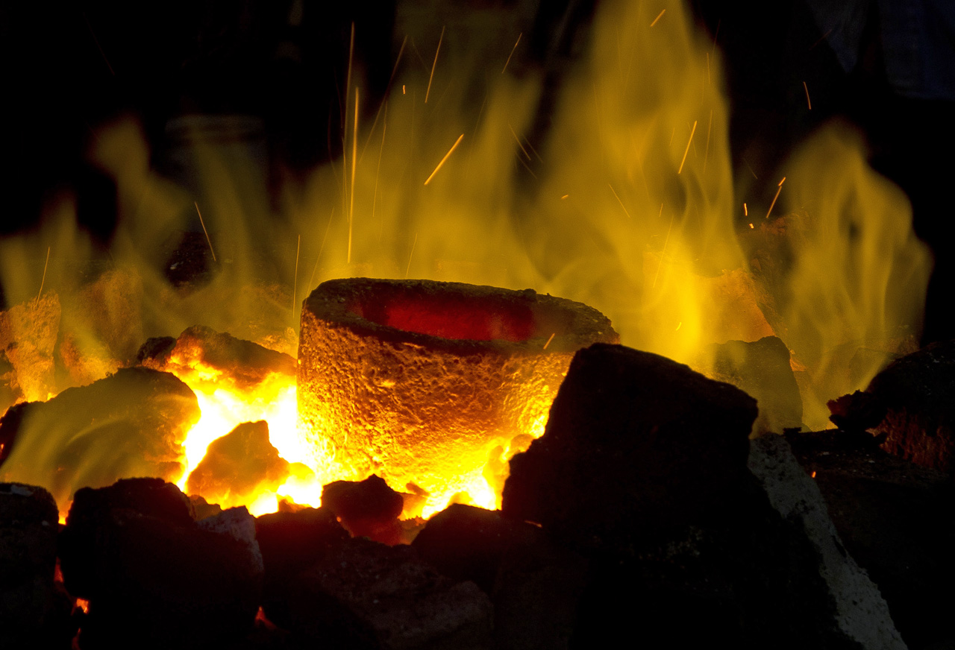
The words of the LORD are pure words, Like silver tried in a furnace of earth, Purified seven times. You shall keep them, O LORD, You shall preserve them from this generation forever. — Psalms 12:6-7
word
pure
pure
word
word
from this generation forever
from this generation forever
Notes:
The word melts all lies in the brilliance of its’ shining truth.

Slide 4
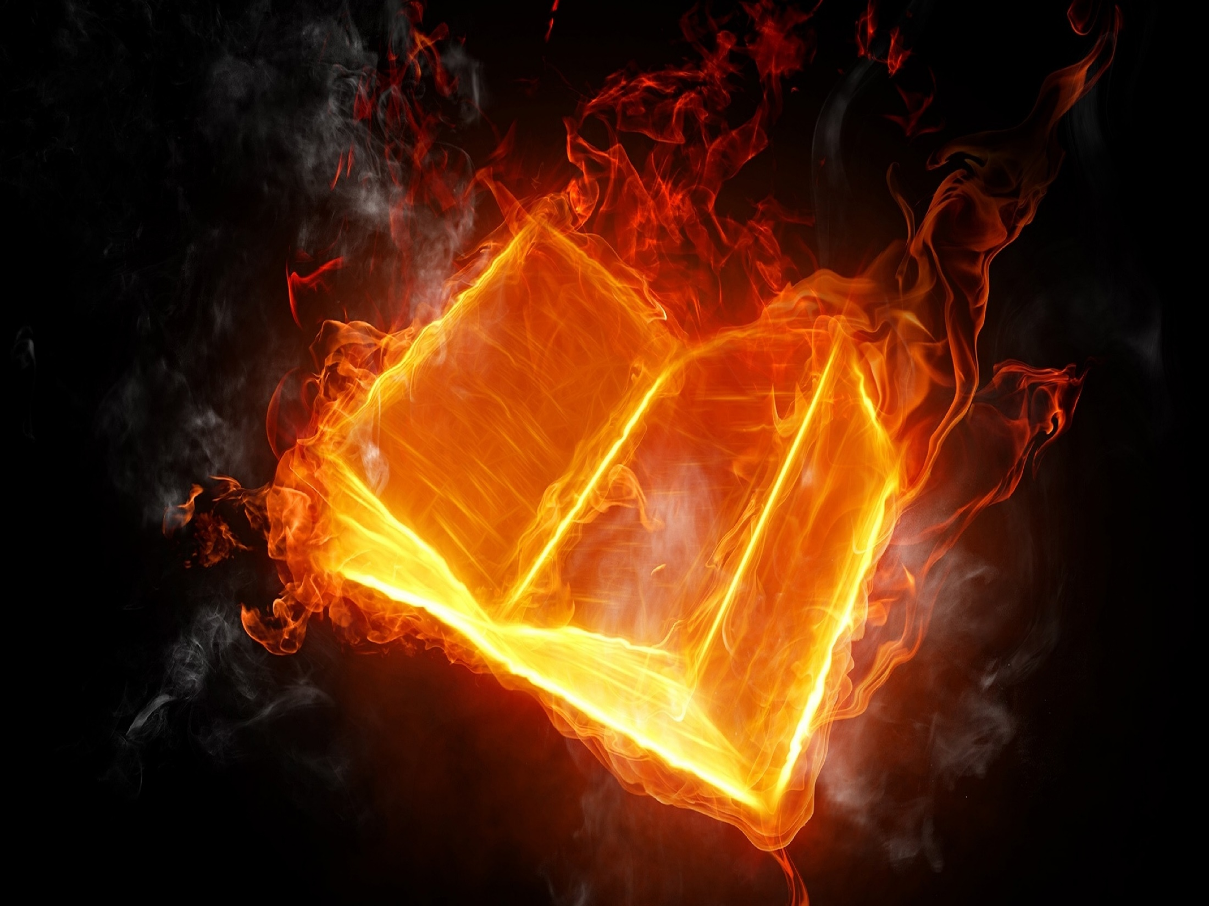
"Is not My word like a fire?" says the LORD, "And like a hammer that breaks the rock in pieces?" — Jeremiah 23:29
word
word
word
word
Notes:
The word stretches from one corner to the other. It’s light cannot be hidden; it is the four corners of truth.

Slide 5
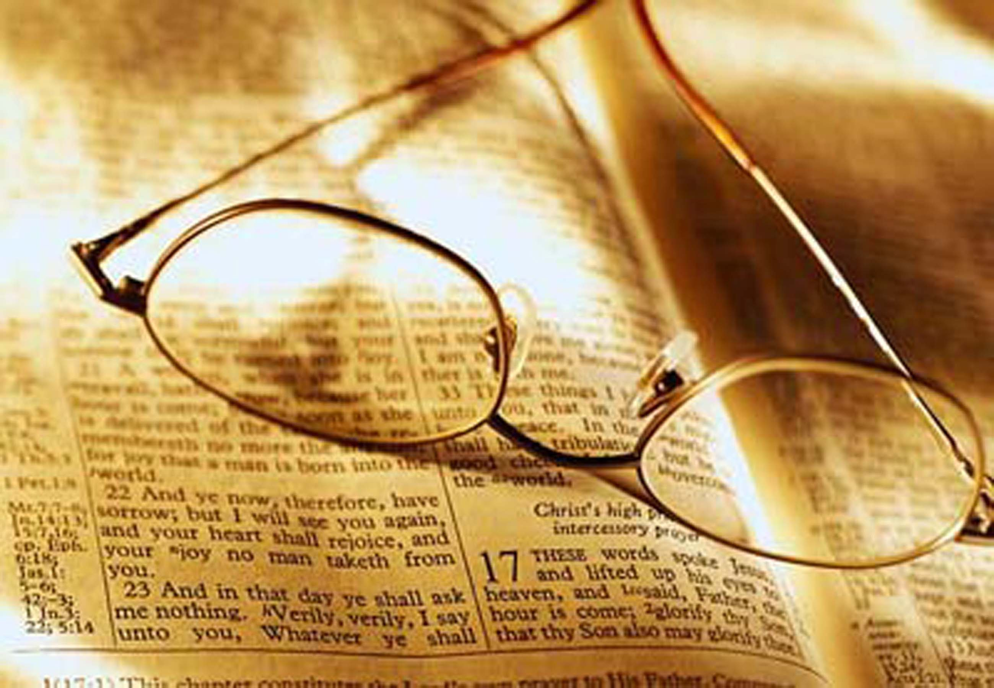
KAPH. My soul faints for Your salvation, But I hope in Your word. My eyes fail from searching Your word, Saying, "When will You comfort me?" — Psalms 119:81-82
in
. .
word
I hope in Your word
word
word
Notes:
The word is a study in life in God.

Slide 6
NUN. Your word is a lamp to my feet And a light to my path. — Psalms 119:105
word
word
Notes:
In Him we live and our light is given to know Him.

Slide 7
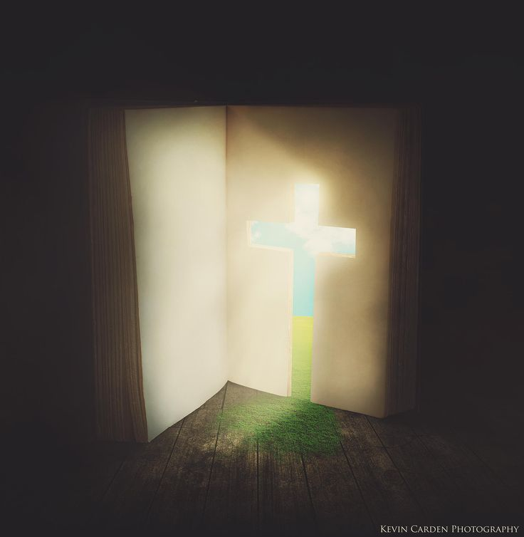
The entrance of Your words gives light; It gives understanding to the simple. — Psalms 119:130
word
word
word
word
It gives understanding
It gives understanding
Notes:
Through His own blood the truth comes to us. His light gives us the brilliance of truth.

Slide 8
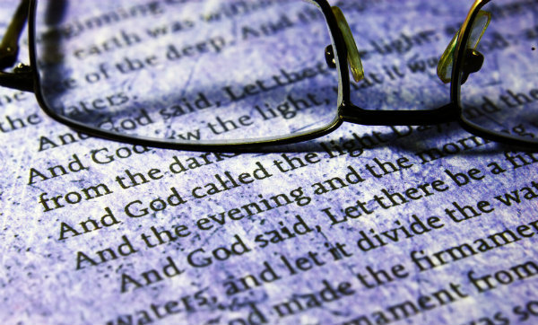
Every word of God is pure; He is a shield to those who put their trust in Him. Do not add to His words, Lest He rebuke you, and you be found a liar. — Proverbs 30:5-6
word
pure
shield
word
shield
who
trust
who
trust
His words
word
His words
Notes:
Purity has no compare in its’ entirety.

Slide 9
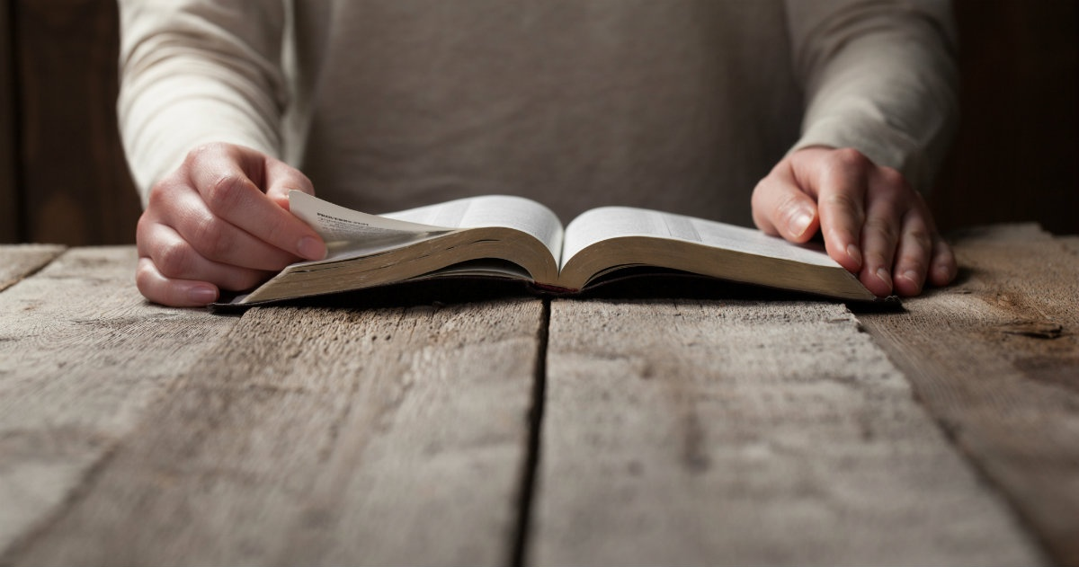
So they read distinctly from the book, in the Law of God; and they gave the sense, and helped them to understand the reading. — Nehemiah 8:8
word
word
read distinctly
definitely
specifically
unquestionably
clearly
bluntly
read distinctly
w
o
r
d
Notes:
They read from God’s word, not some other reference created to guide man.

Slide 10
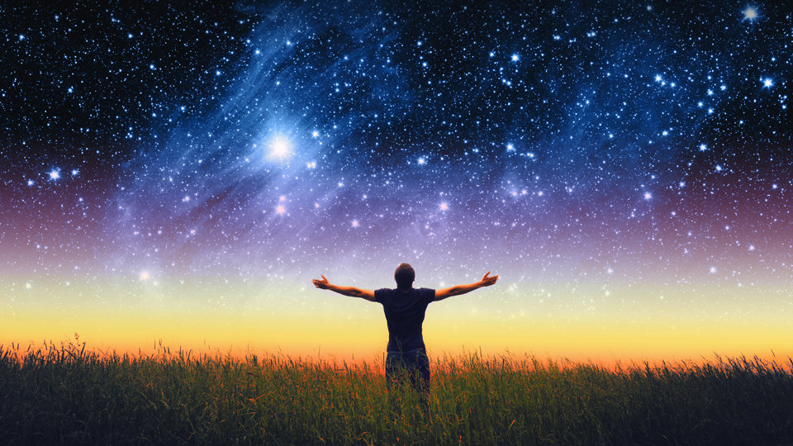
… in hope of eternal life which God, who cannot lie, promised before time began, but has in due time manifested His word through preaching, which was committed to me according to the commandment of God our Savior; — Titus 1:2-3
in
hope
hope
God
in
His word
word
His word
word
God
Notes:
The good word is the horizon of all of our lives. It is the light of life.

Slide 11
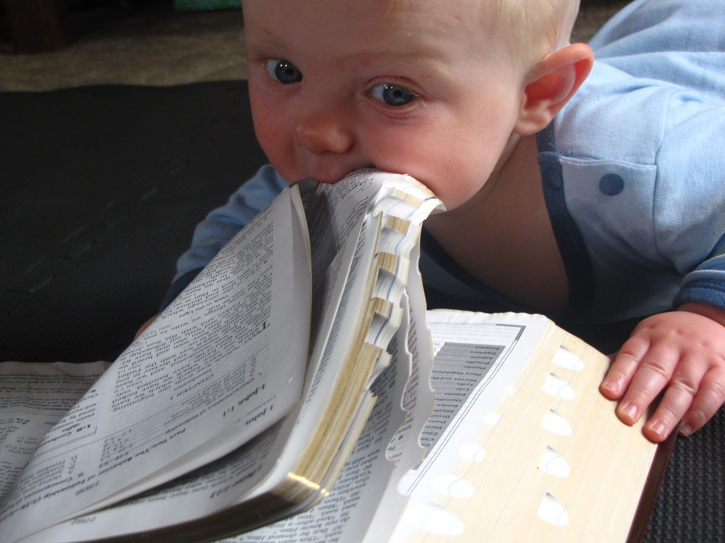
Therefore, laying aside all malice, all deceit, hypocrisy, envy, and all evil speaking, as newborn babes, desire the pure milk of the word, that you may grow thereby, if indeed you have tasted that the Lord is gracious. — 1st Peter 2:1-3
laying aside
laying aside
hatred
word
dishonesty
two-faced
bitterness
filthiness
pure milk
word
taste
taste
know
Notes:
What one ponders upon is the food for thought one lives by.

Slide 12
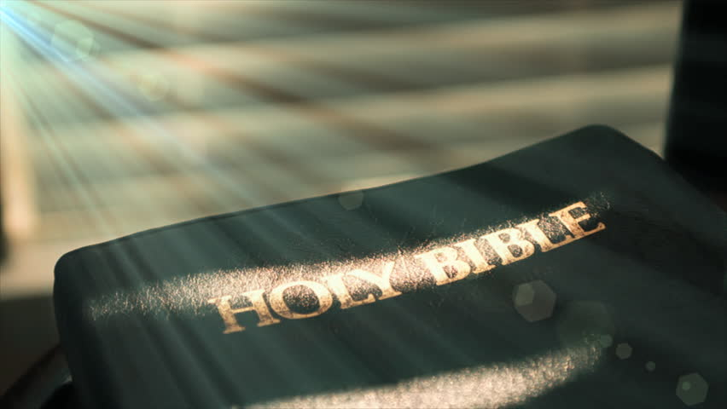
Therefore we must give the more earnest heed to the things we have heard, lest we drift away. For if the word spoken through angels proved steadfast, and every transgression and disobedience received a just reward, how shall we escape if we neglect so great a salvation, which at the first began to be spoken by the Lord, and was confirmed to us by those who heard Him, God also bearing witness both with signs and wonders, with various miracles, and gifts of the Holy Spirit, according to His own will? — Hebrews 2:1-4
word
word
so great a salvation
so great a salvation
Notes:
To miss the message given of God leaves one powerless in the day of judgment.

Slide 13
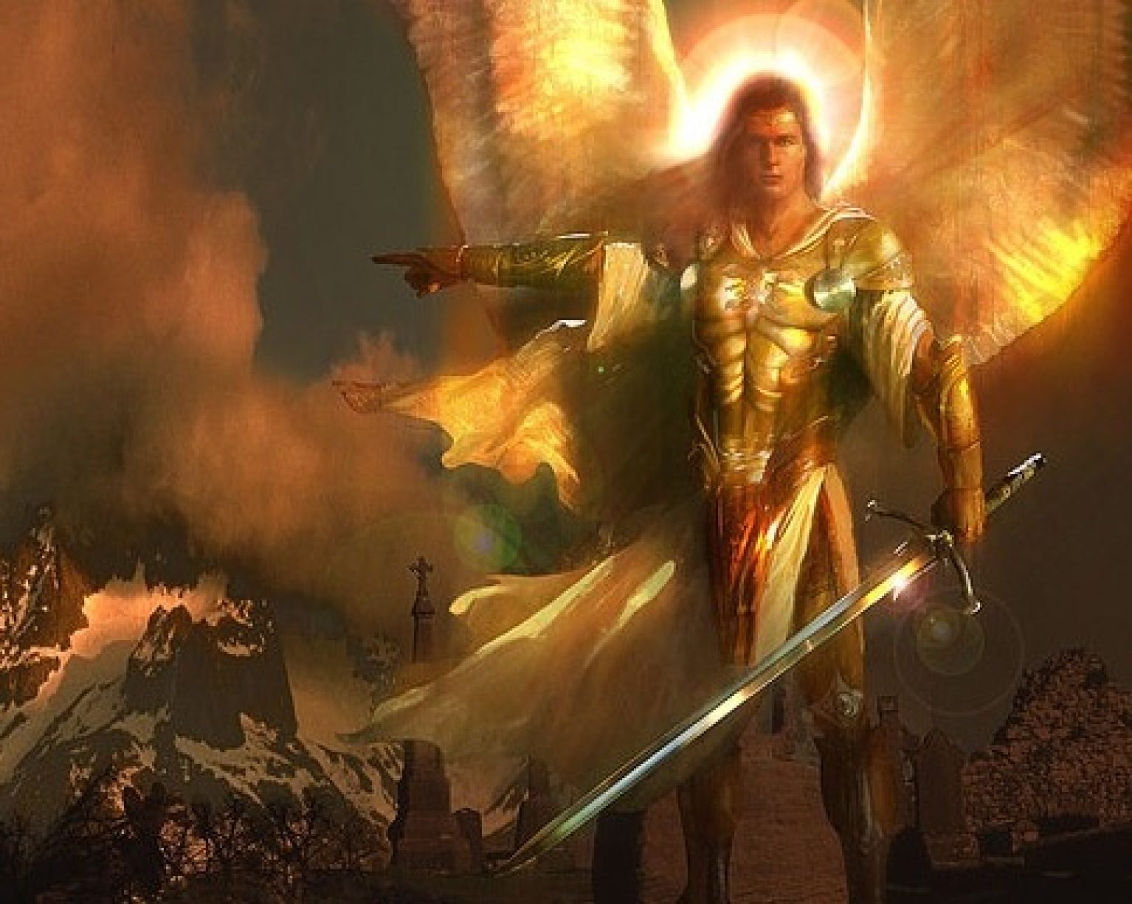
But even if we, or an angel from heaven, preach any other gospel to you than what we have preached to you, let him be accursed. As we have said before, so now I say again, if anyone preaches any other gospel to you than what you have received, let him be accursed. — Galatians 1:8-9
gospel
word
word
gospel
Notes:
We are told to take up the sword of truth and live with good wholesome courage.

Slide 14
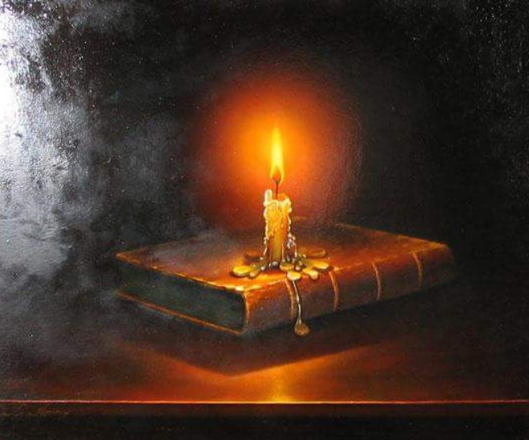
For it is impossible for those who were once enlightened, and have tasted the heavenly gift, and have become partakers of the Holy Spirit, and have tasted the good word of God and the powers of the age to come, if they fall away, to renew them again to repentance, since they crucify again for themselves the Son of God, and put Him to an open shame. — Hebrews 6:4-6
word
tasted the good word
tasted the good word
word
word
word
X
Notes:
The word is our cornerstone to the light from within. It is the light of our hearts.

Slide 15
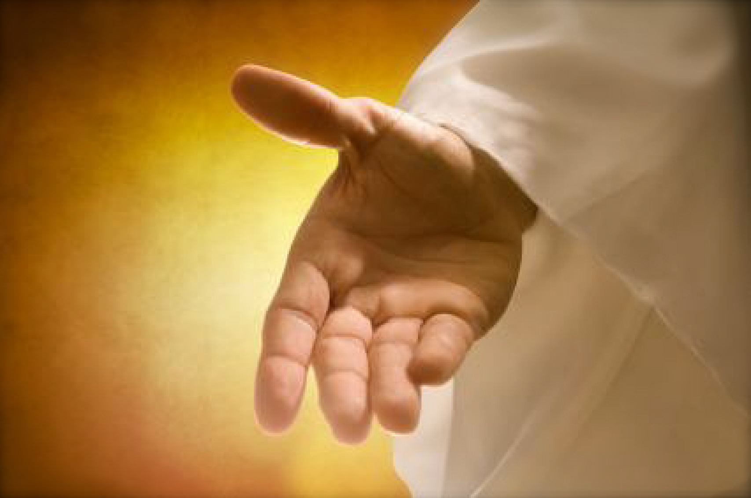
But the word of the LORD endures forever." Now this is the word which by the gospel was preached to you. — 1st Peter 1:25
word
endures forever
endures forever
word
word
Notes:
His word was hand delivered by God Himself.

Slide 16
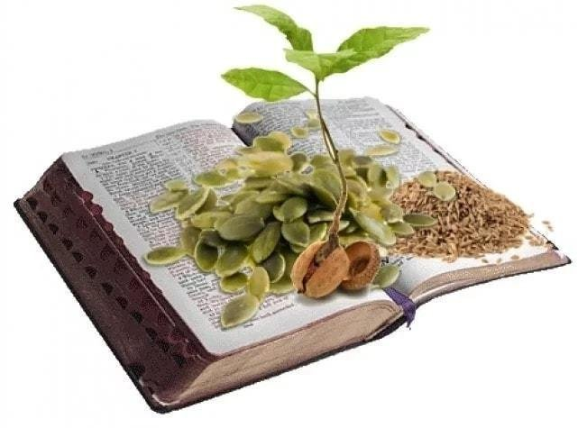
"Now the parable is this: The seed is the word of God." — Luke 8:11
Word
Word
Word
word
Notes:
What is planted in us is what we reflect.

Slide 17
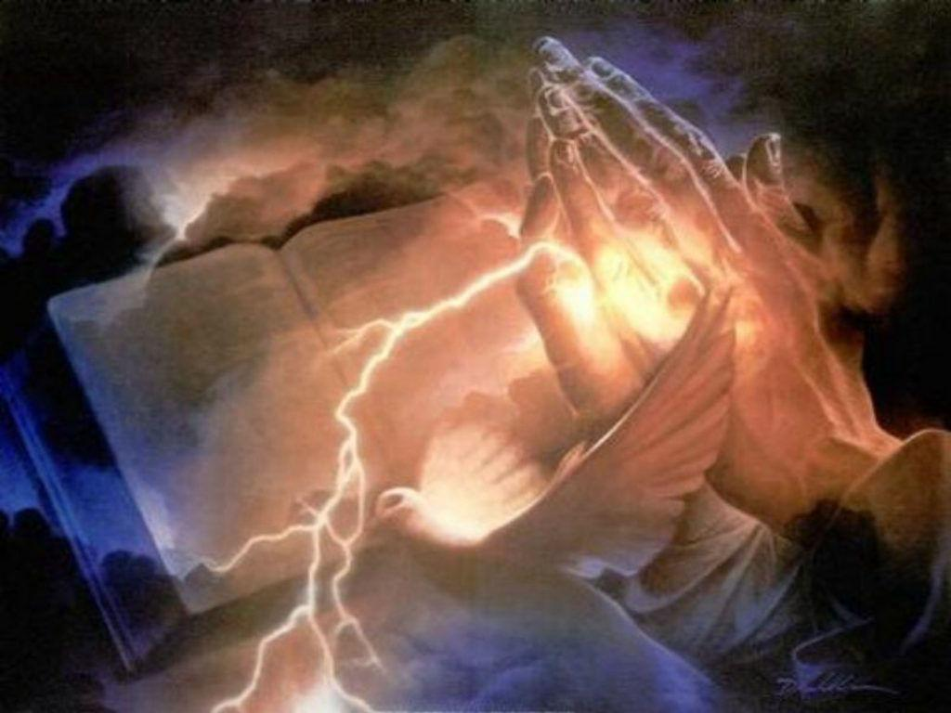
In the beginning was the Word, and the Word was with God, and the Word was God. He was in the beginning with God. All things were made through Him, and without Him nothing was made that was made. In Him was life, and the life was the light of men. And the light shines in the darkness, and the darkness did not comprehend it. — John 1:1-5
Word
Word
Word
Word
in
the life was the
in Him was life
the life was the
In Him was life
Him
light of men
light of men
Notes:
His hand touches the truth for all mankind to know truth.

Slide 18
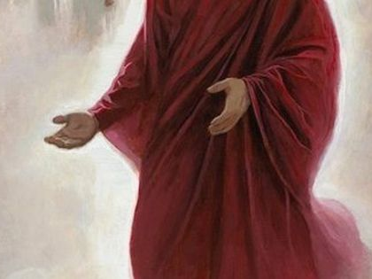
He was clothed with a robe dipped in blood, and His name is called The Word of God. — Revelation 19:13
sacrifice of life
word
truth of Spirit
Word
Notes:
There is no greater love than the sacrifice of God and His conveyance of it to us. The sacrifice of His life for us, to have life, and His deliverance of the truth of His eternal Spirt, has set us free.

Slide 19
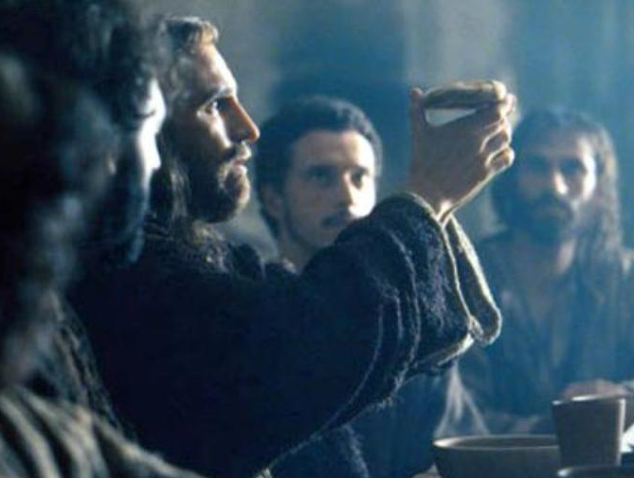
He sent His word and healed them, And delivered them from their destructions. — Psalms 107:20
word
sent His word
His
sent His word
delivered
Notes:
In remembrance of Him we are healed.

Slide 20
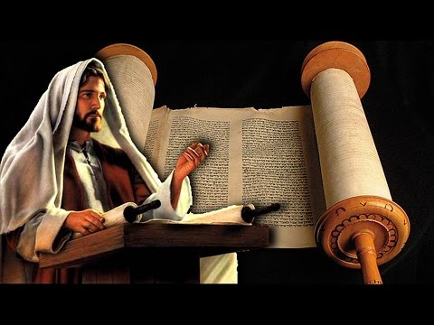
"Do not think that I came to destroy the Law or the Prophets. I did not come to destroy but to fulfill. For assuredly, I say to you, till heaven and earth pass away, one jot or one tittle will by no means pass from the law till all is fulfilled." — Matthew 5:17-18
Heaven and earth will pass away
delivered
Heaven and earth
pass away
will
Notes:
He has delivered us with the truth by the hand of God.

Slide 21
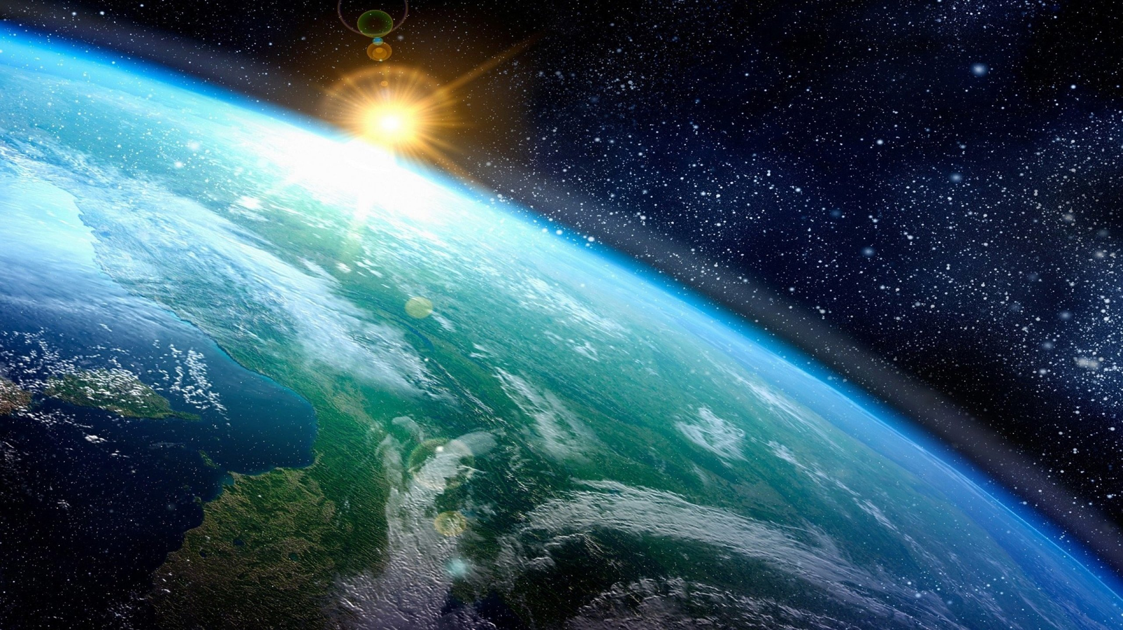
"Heaven and earth will pass away, but My words will by no means pass away." — Matthew 24:35
Heaven and earth will pass away
word
word
Notes:
His word is greater than all the storms the world could ever know.

Slide 22
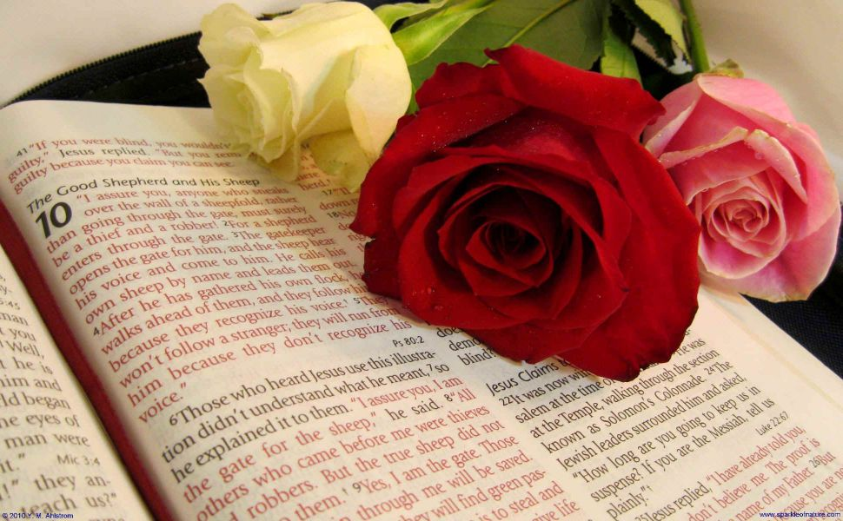
"The grass withers, the flower fades, But the word of our God stands forever." — Isaiah 40:8
word
word
word of our God
word of our God
word
word
God
stands forever
Notes:
Sweet is the smell of the word’s pureness.

Slide 23
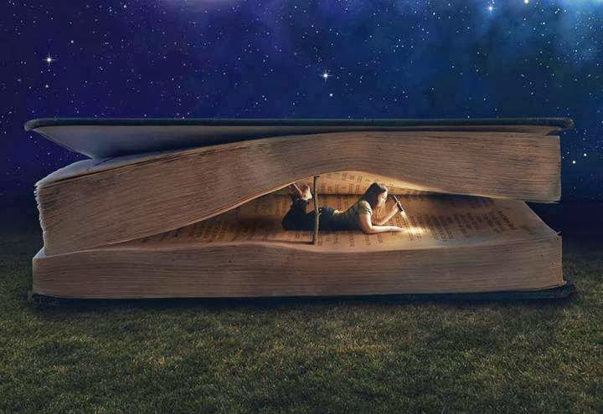
Every word of God is pure; He is a shield to those who put their trust in Him. Do not add to His words, Lest He rebuke you, and you be found a liar. — Proverbs 30-5-6
word
pure
word
trust
in Him
trust in Him
word
The statutes of the LORD are right, rejoicing the heart; The commandment of the LORD is pure, enlightening the eyes; — Psalms 19:8
LORD
LORD
Notes:
How much we desire places what is important to our hearts.

Slide 24
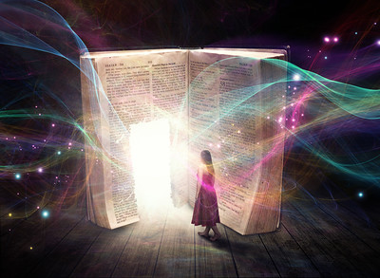
Blessed is he who reads and those who hear the words of this prophecy, and keep those things which are written in it; for the time is near. — Revelation 1:3
HEART
R
E
A
D
R
E
A
D
E
A
D
PURE
word
A
D
hear the words
keep
PATH
keep
W
O
R
D
Notes:
It is one thing to hear the word, but to keep it, apply it, is the challenge of us all.

Slide 25
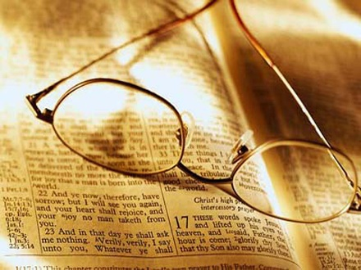
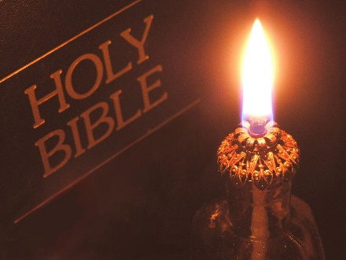
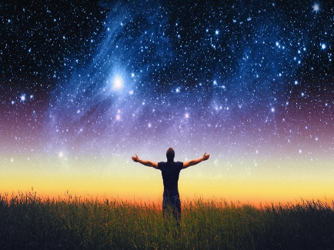
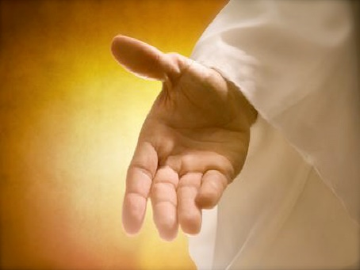
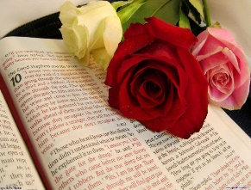

Slide 26
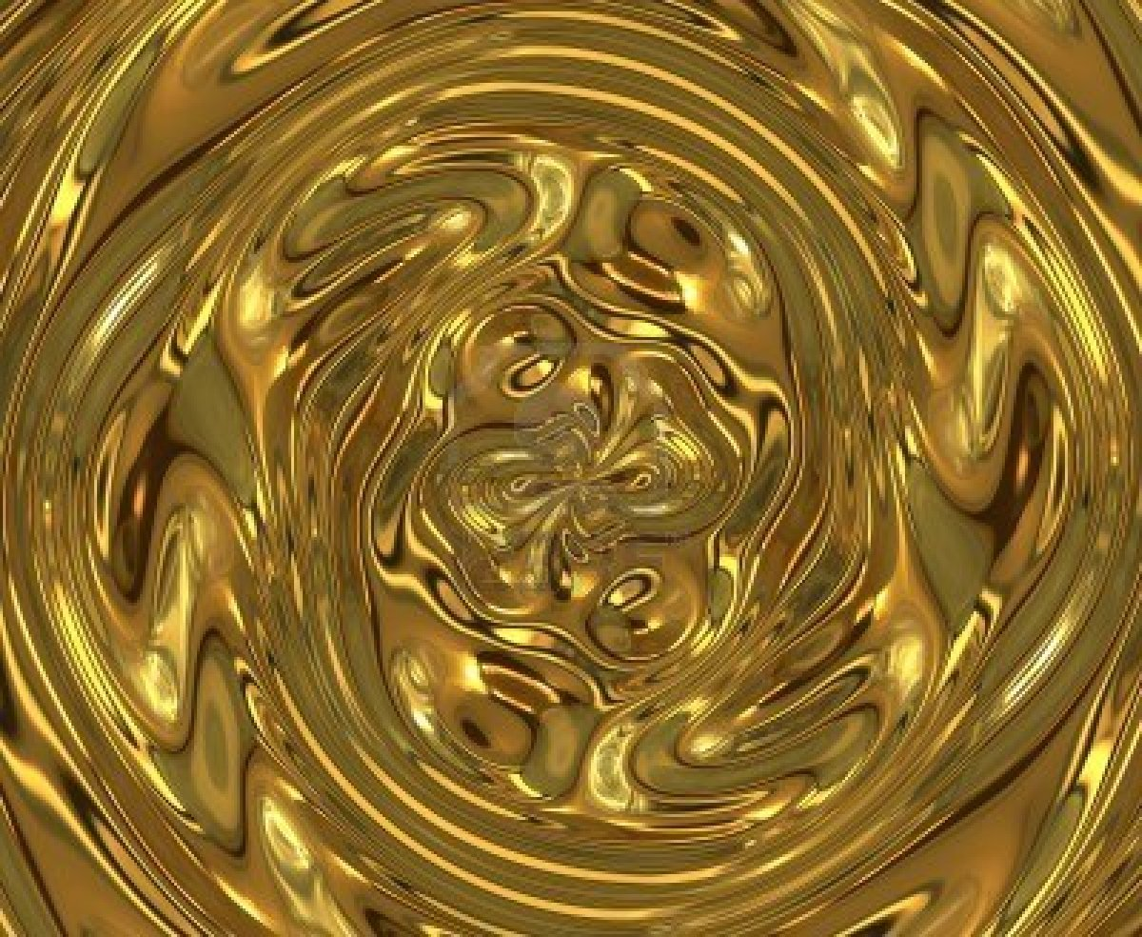
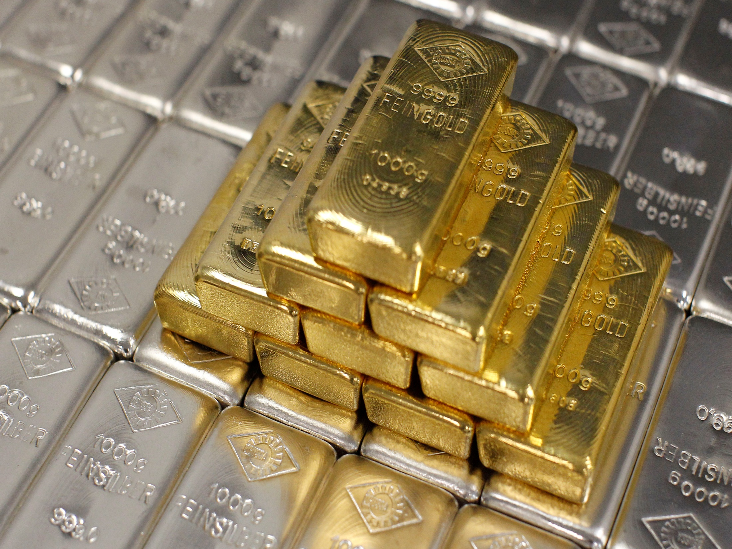
→ The words of the LORD are pure words
→ His word is like a fire that breaks a rock to pieces
→ We hope in His word
→ His word is a lamp to our feet and to our path
→ Do not add to His words, lest He rebuke you
→ God manifested His word through preaching
→ Desire the pure milk of the word
→ A soul is in danger if unwilling to hear His word
→ Reject any other gospel than what was once sent
→ Casting off the word nullifies His sacrifice for sins
→ In the sacrifice of Jesus is The Word of God
→ The word of our God stands forever
→ Blessed is he who keeps the word of God
His Word is the Choice Notes from Heaven
Notes:
His Word is the Choice Notes from Heaven

Slide 27
Notes:
Darkness has no intersection.

Slide 28
Please visit http://www.LoveFromGod.com to explore further
Ronald Bert Channel on
Notes:
Eternity never ends.

