Slide 1
Notes:
Darkness uncovers her colorless veil.

Slide 2
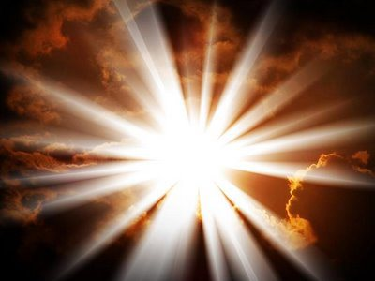
Ron Bert
The Force
0
May 19, 2019
Notes:
By the force of God all that is is.

Slide 3
How forceful are right words! But what does your arguing prove? — Job 6:25
The entirety of Your word is truth, And every one of Your righteous judgments endures forever. — Psalm 119:160
How forceful
. .
force
f
. .
words
o
Notes:
His word is positively Almighty straight truth.

Slide 4
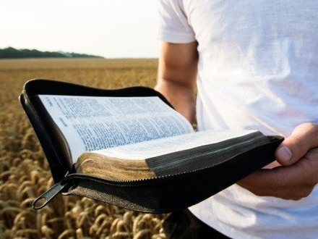
… yet in the church I would rather speak five words with my understanding, that I may teach others also, than ten thousand words in a tongue. — 1st Corinthians 14:19
word
understanding
word
word
Notes:
Simple and clear is the truth His word holds for all to see. It does not take many words to see His truth of might.

Slide 5
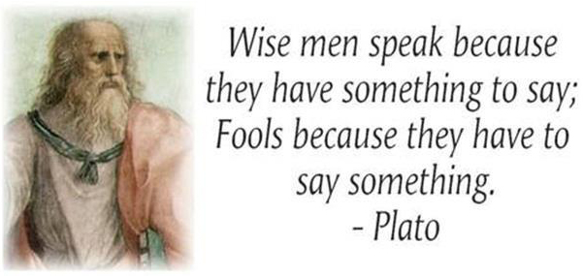
A fool also multiplies words. No man knows what is to be; Who can tell him what will be after him? — Ecclesiastes 10:14
word
word
Notes:
Fools erect lies to fall into stumbling holes of their own conviction.

Slide 6
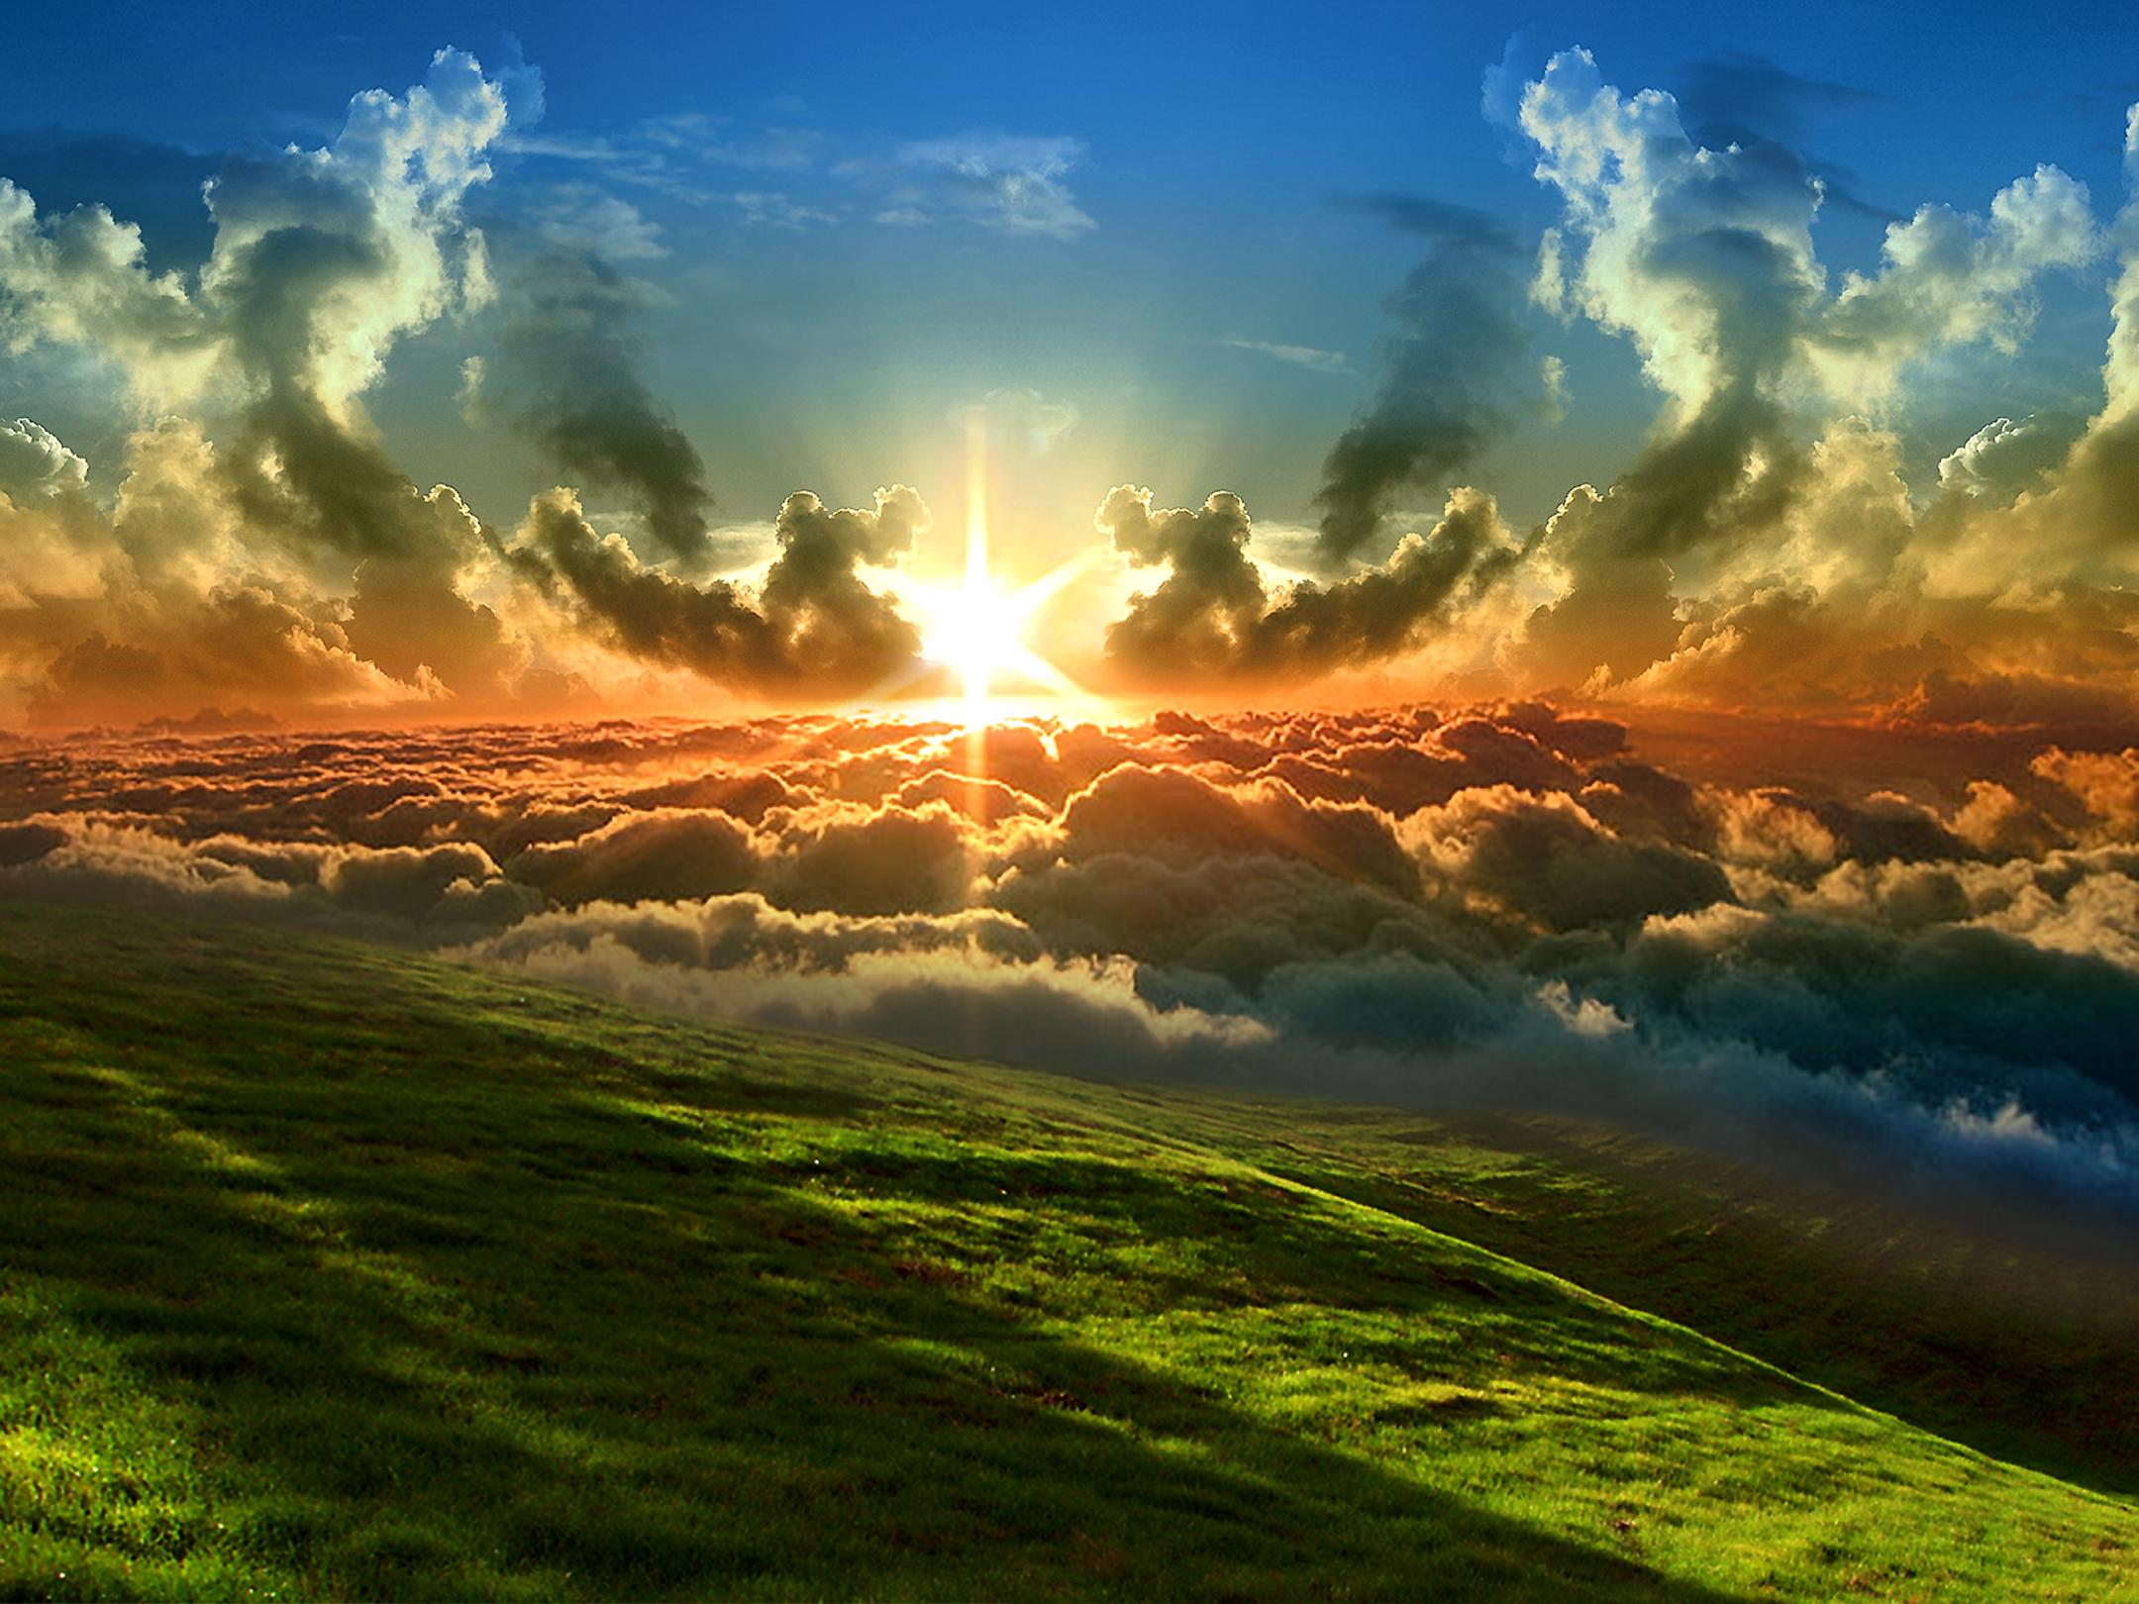
For the kingdom of God is not in word but in power. — 1st Corinthians 4:20
kingdom
kingdom
word
in
Notes:
More than mere words of man, God rules by force of power.

Slide 7
Your kingdom is an everlasting kingdom, And Your dominion endures throughout all generations. — Psalm 145:13
kingdom
kingdom
kingdom
everlasting
kingdom
throughout all
Notes:
Light passes time in its’ eternal presence.

Slide 8
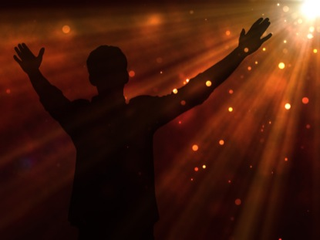
For I am full of words; The spirit within me compels me. — Job 32:18
Force
But there is a spirit in man, And the breath of the Almighty gives him understanding. — Job 32:8
For
spirit
c
e
spirit within me
Notes:
Transcending beyond all words, force of spirit has more.

Slide 9
My help comes from the LORD, Who made heaven and earth. — Psalm 121:2
spirit
LORD
help comes from
made heaven and earth
Notes:
Helpless without God’s omnipotence, we need the creator to becomes as we are.

Slide 10
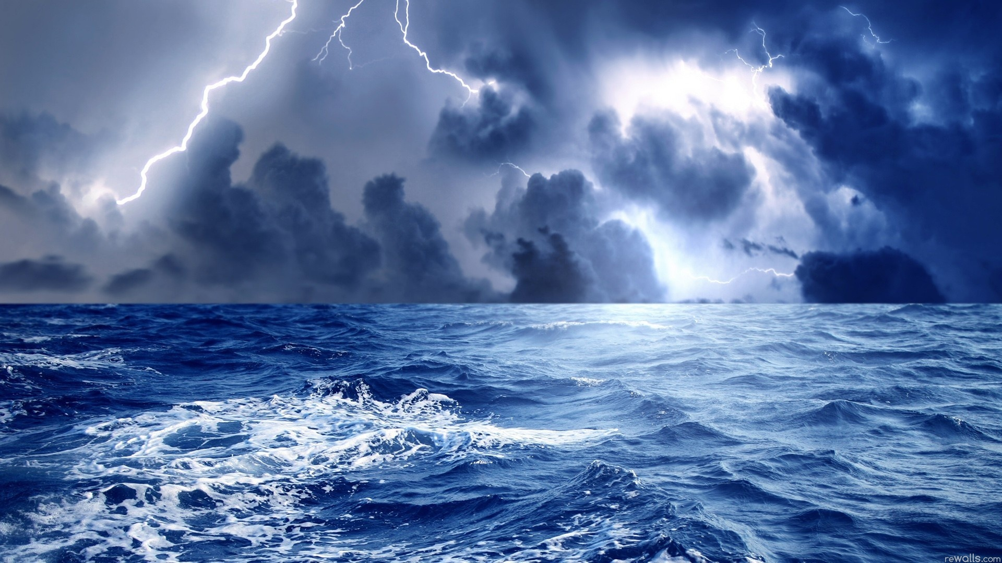
The voice of the LORD is powerful; The voice of the LORD is full of majesty. — Psalm 29:4
LORD
power
LORD
LORD
LORD
power
Notes:
His voice rages across all barriers assuming all tones.

Slide 11
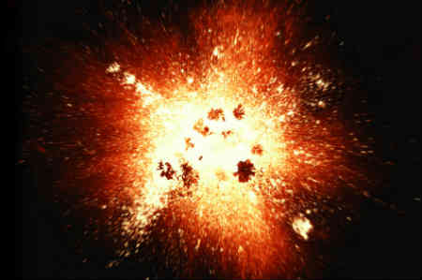
God has spoken once, Twice I have heard this: That power belongs to God. — Psalm 62:11
heard
heard
power
Notes:
Explosive truth cuts all darkness in His doubling light.

Slide 12
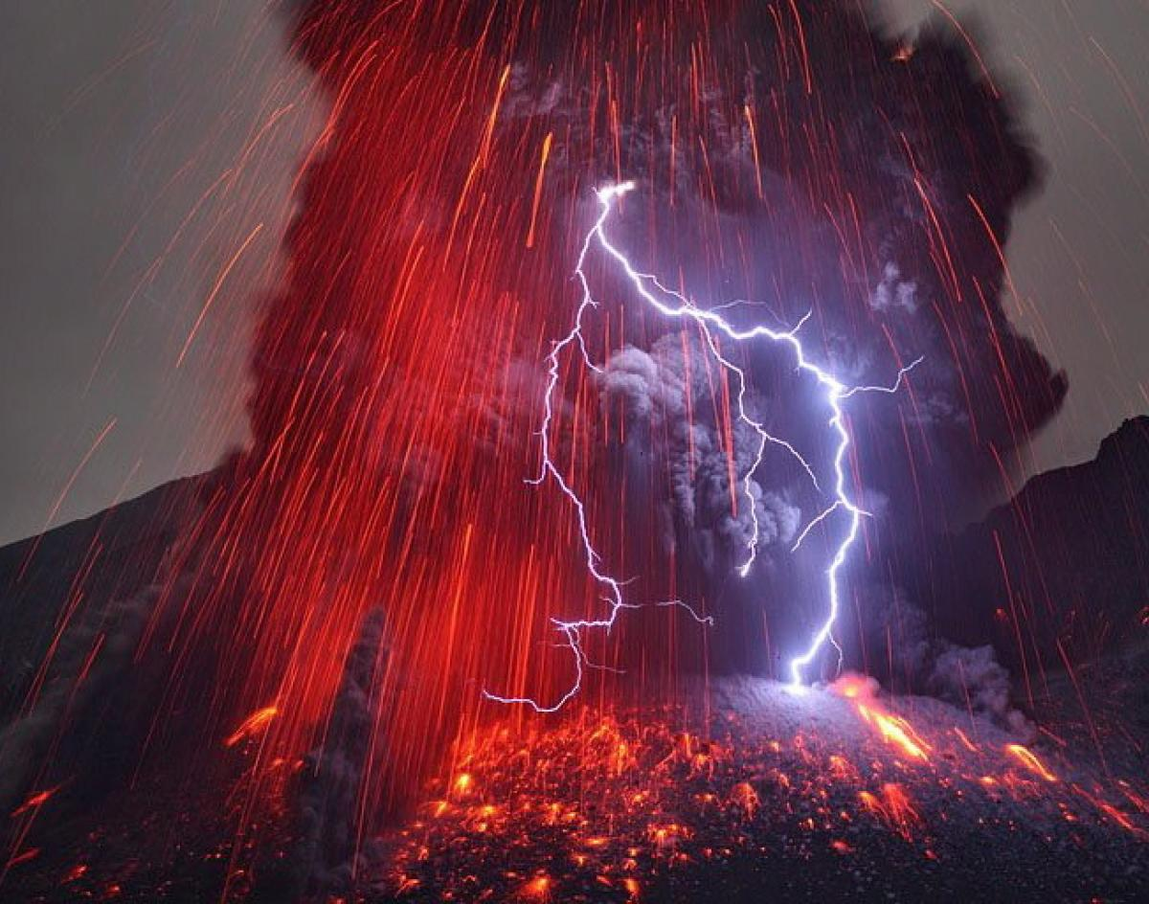
"Is not My word like a fire?" says the LORD, "And like a hammer that breaks the rock in pieces?" — Jeremiah 23:29
rd
LORD
h
heard
ea
Notes:
Truth’s fire charges across the deceptions of man.

Slide 13
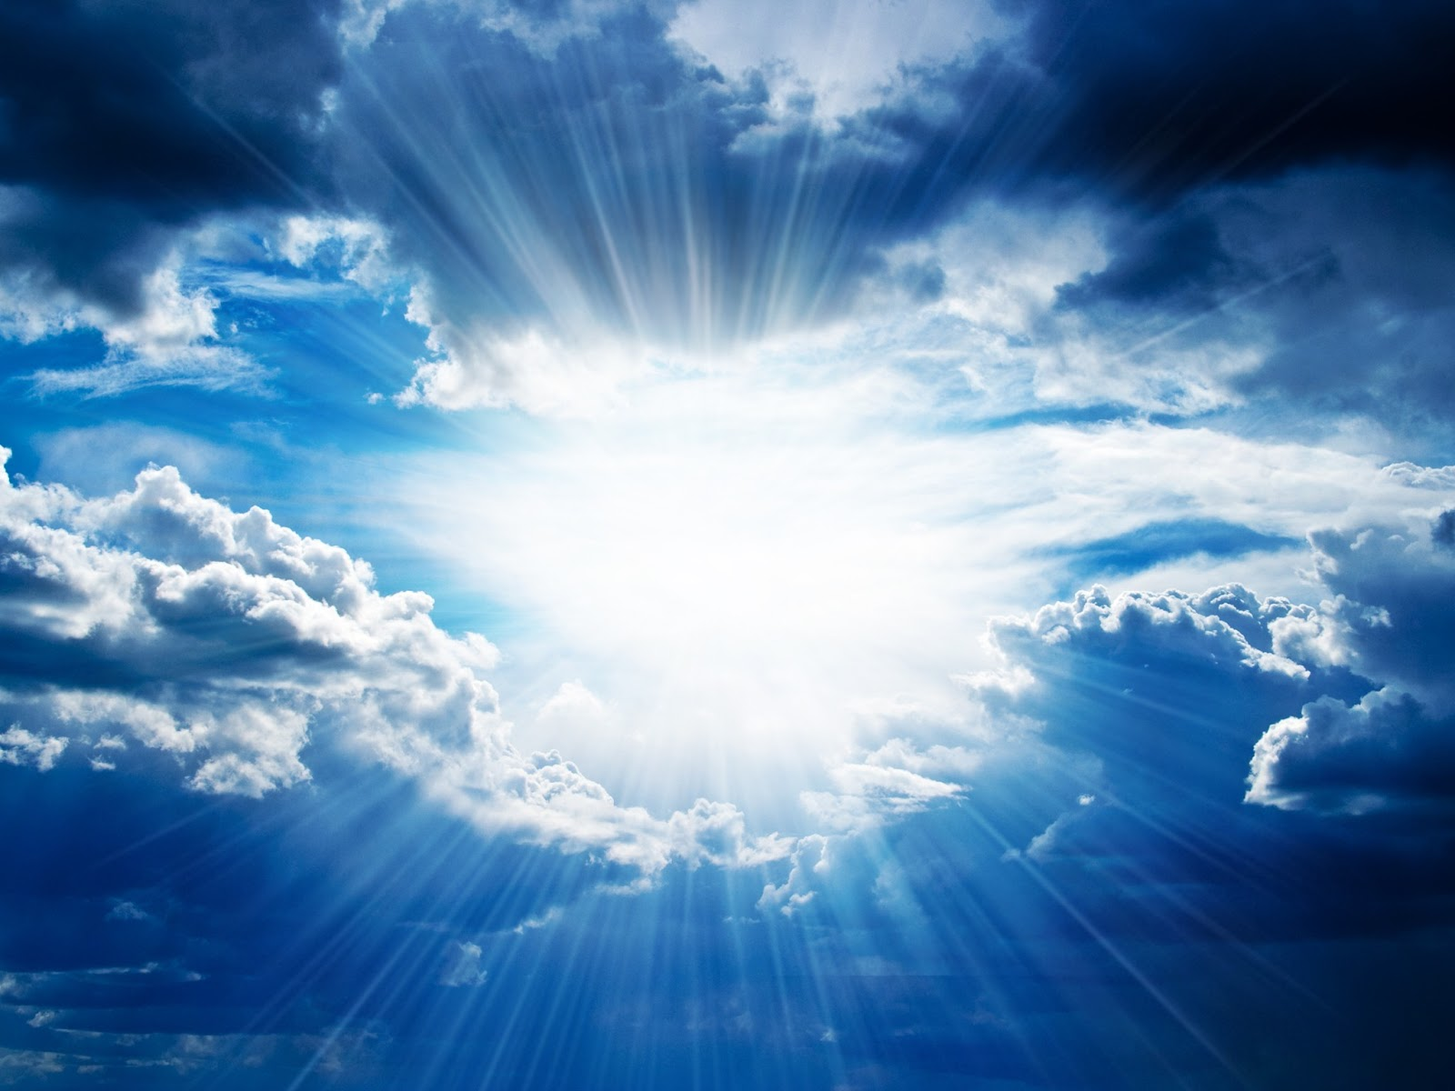
The burden of the word of the LORD against Israel. Thus says the LORD, who stretches out the heavens, lays the foundation of the earth, and forms the spirit of man within him: — Zechariah 12:1
LORD
LORD
LORD
LORD
stretches out
stretches out
lays the foundation
FORCE
forms the spirit
forms the spirit
Notes:
There is no greater truth than the Creator of life in man.

Slide 14
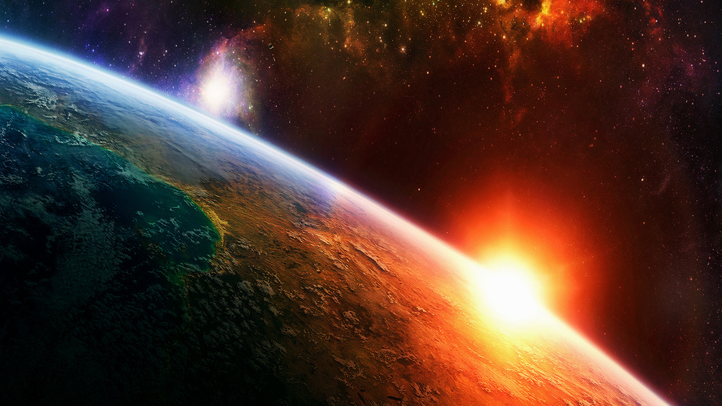
I have made the earth, And created man on it. I - My hands -stretched out the heavens, And all their host I have commanded. — Isaiah 45:12
force
made the earth
● made the earth
● created man on it
● stretched out the heavens
● commands all hosts
created man on it
s
stretches out
stretched out the heavens
forms the spirit
s
command
all
host
command
Notes:
Greater than any substance, He glorifies permanency.

Slide 15
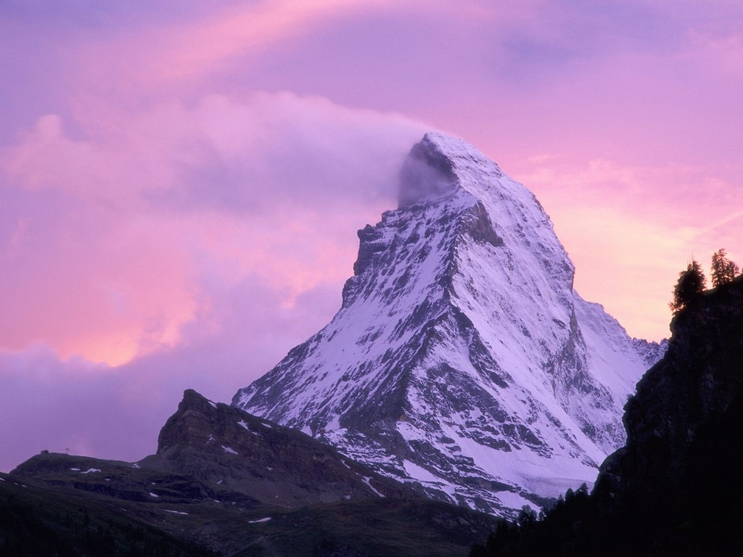
For behold, He who forms mountains, And creates the wind, Who declares to man what his thought is, And makes the morning darkness, Who treads the high places of the earth - The LORD God of hosts is His name. — Amos 4:13
He who
for
c
e
force
creates
LORD
LORD
Notes:
It is He that allows men to be to know.

Slide 16
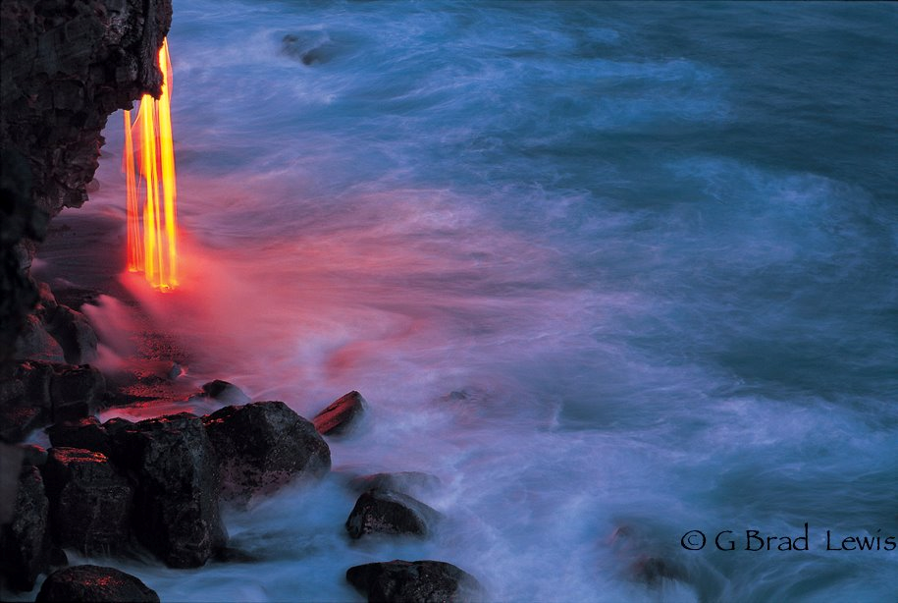
He made the Pleiades and Orion; He turns the shadow of death into morning And makes the day dark as night; He calls for the waters of the sea And pours them out on the face of the earth; The LORD is His name. — Amos 5:8
LORD
LORD
Notes:
His molten womb clears the darkness.

Slide 17
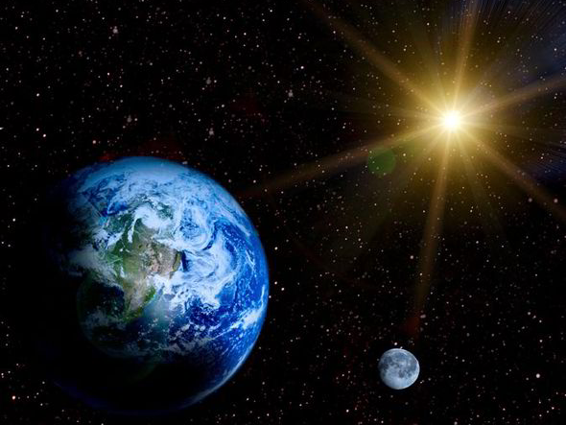
Have you not known? Have you not heard? The everlasting God, the LORD, The Creator of the ends of the earth, Neither faints nor is weary. His understanding is unsearchable. — Isaiah 40:28
Persistence
LORD
Neither faints nor is weary
Neither faints nor is
weary
understand
understand
Notes:
Sure is His lastingness among the house of life.

Slide 18
Indeed these are the mere edges of His ways, And how small a whisper we hear of Him! But the thunder of His power who can understand?" — Job 26:14
God
God
His power
understand
Notes:
To fathom His depths could only scratch the surface of much more.

Slide 19
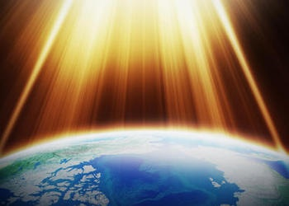
O God, You are more awesome than Your holy places. The God of Israel is He who gives strength and power to His people. Blessed be God! — Psalm 68:35
awesome
God
God
God
strength
strength and power
strength
Notes:
His essentialness belongs to all the glory that He is.

Slide 20
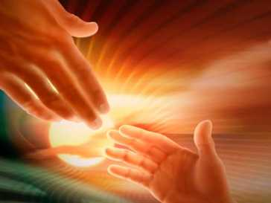
Trust in the LORD forever, For in YAH, the LORD, is everlasting strength. — Isaiah 26:4
Trust
forever
in
everlasting strength
strength
forever
Notes:
To live is to know there is no life without him.

Slide 21
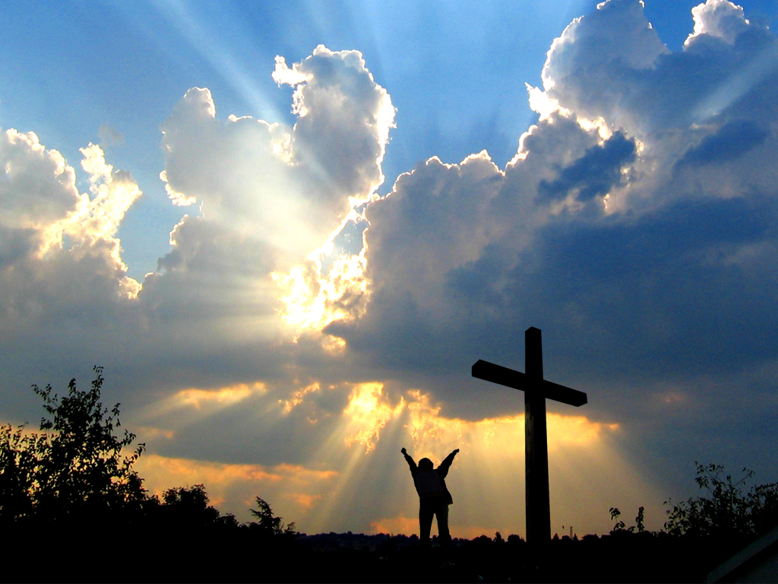
For this is God, Our God forever and ever; He will be our guide Even to death. — Psalm 48:14
guide
Even to death
forever
Notes:
Through the clouds, He is our light unto sanctuary. It is goosebumps.

Slide 22
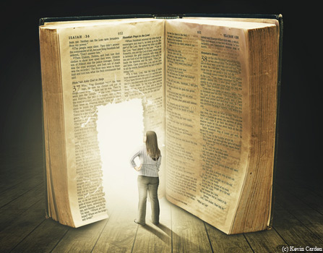
For the word of God is living and powerful, and sharper than any two-edged sword, piercing even to the division of soul and spirit, and of joints and marrow, and is a discerner of the thoughts and intents of the heart. — Hebrews 4:12
l
i
f
g
e
guide
life
i
d
e
u
Notes:
His power radiates throughout His freely given truth.

Slide 23
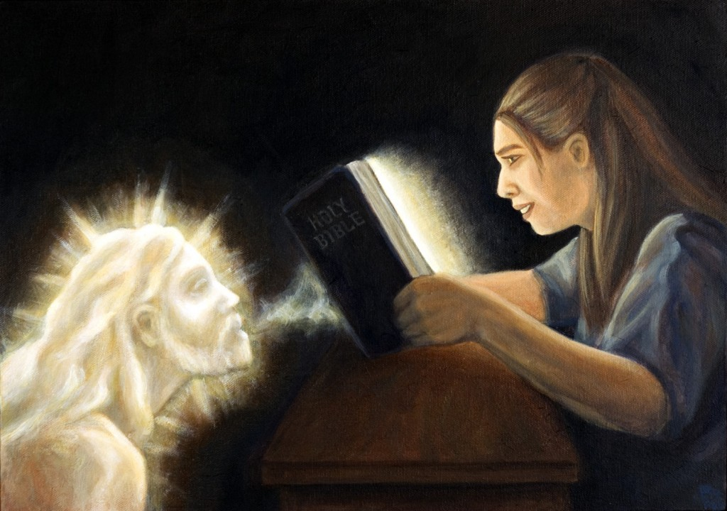
The Spirit of God has made me, And the breath of the Almighty gives me life. — Job 33:4
God
God has made me
life
gives me life
God
Notes:
The breath He gives tests our moment.

Slide 24
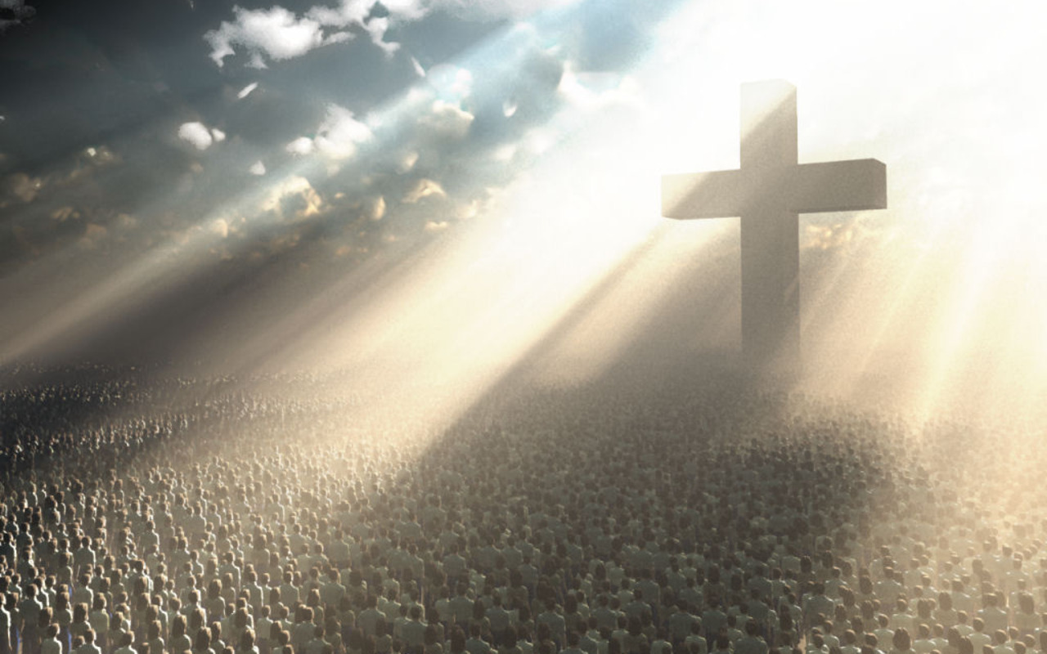
"The law and the prophets were until John. Since that time the kingdom of God has been preached, and everyone is pressing into it." — Luke 16:16
God
kingdom of God
pressing into it
into
Notes:
His Kingdom is a door opening to each heart to come.

Slide 25
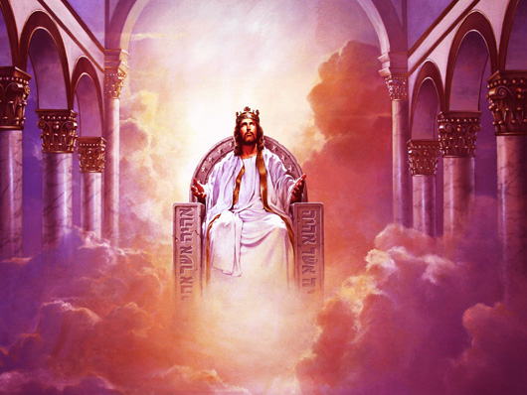
But Christ came as High Priest of the good things to come, with the greater and more perfect tabernacle not made with hands, that is, not of this creation. — Hebrews 9:11
Christ came
good things to come
good things to come
greater and more perfect
greater and more perfect
not made with hands
not made with hands
● good things to come
● greater and more perfect
● not made with hands
● not of this creation
not of this creation
not of this creation
Notes:
His position is purity itself above the corruption this realm is hindered by.

Slide 26
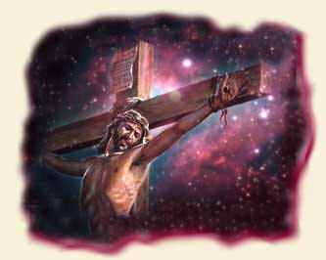
Not with the blood of goats and calves, but with His own blood He entered the Most Holy Place once for all, having obtained eternal redemption. — Hebrews 9:12
Rescue
Recovery
Restoration
with His own blood
Salvation
blood
Life
Deliverance
eternal
Emancipation
redemption
Liberation
Notes:
His sacrifice redeems those that would have Him.

Slide 27
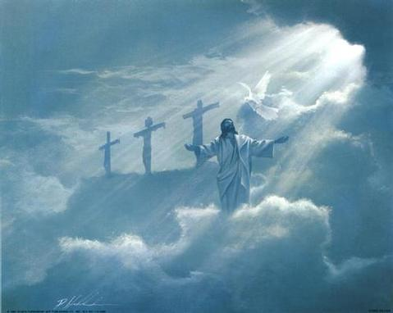
For if the blood of bulls and goats and the ashes of a heifer, sprinkling the unclean, sanctifies for the purifying of the flesh, how much more shall the blood of Christ, who through the eternal Spirit offered Himself without spot to God, cleanse your conscience from dead works to serve the living God? — Hebrews 9:13-14
Christ
blood
Christ
through the eternal Spirit
cleanse your conscience
serve the living God
Notes:
In Him God reveals Himself purely so that none can deny His call to be in honest service.

Slide 28
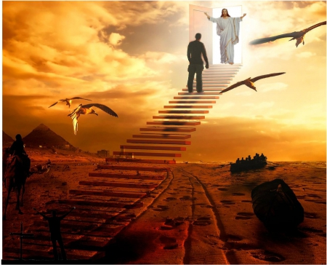
And for this reason He is the Mediator of the new covenant, by means of death, for the redemption of the transgressions under the first covenant, that those who are called may receive the promise of the eternal inheritance. — Hebrews 9:15
Christ
who
are
called
receive
the promise
eternal
inheritance
Notes:
His eternal purpose is to redeem holy life from that which rejects it. One must hear the call and respond in order to inherit the promise of the eternal blessing. In the countless shifting sands crossing the eons of time, from the agonies of raising pyramids to the terror of sinking boats, all will return humbly bowing before Him.

Slide 29
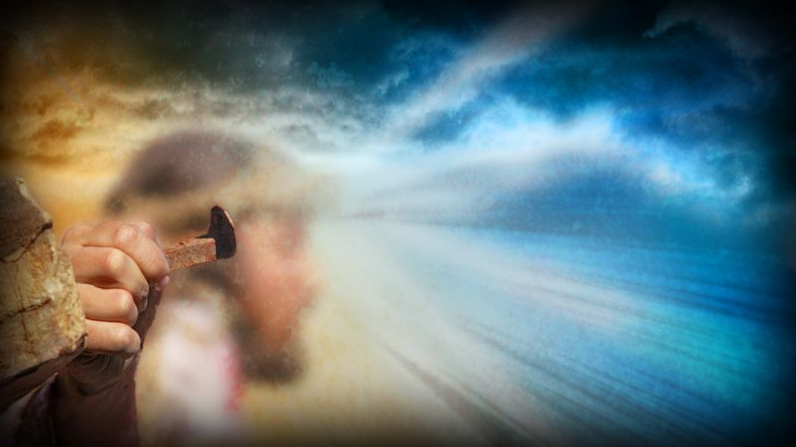
For where there is a testament, there must also of necessity be the death of the testator. For a testament is in force after men are dead, since it has no power at all while the testator lives. — Hebrews 9:16-17
eternal inheritance
testament is in force
His blood
in
in force
eternal inheritance
Notes:
He Himself stepped down from heaven to allow us a path home. His death consecrated our redemption through His resurrection into eternal life.

Slide 30
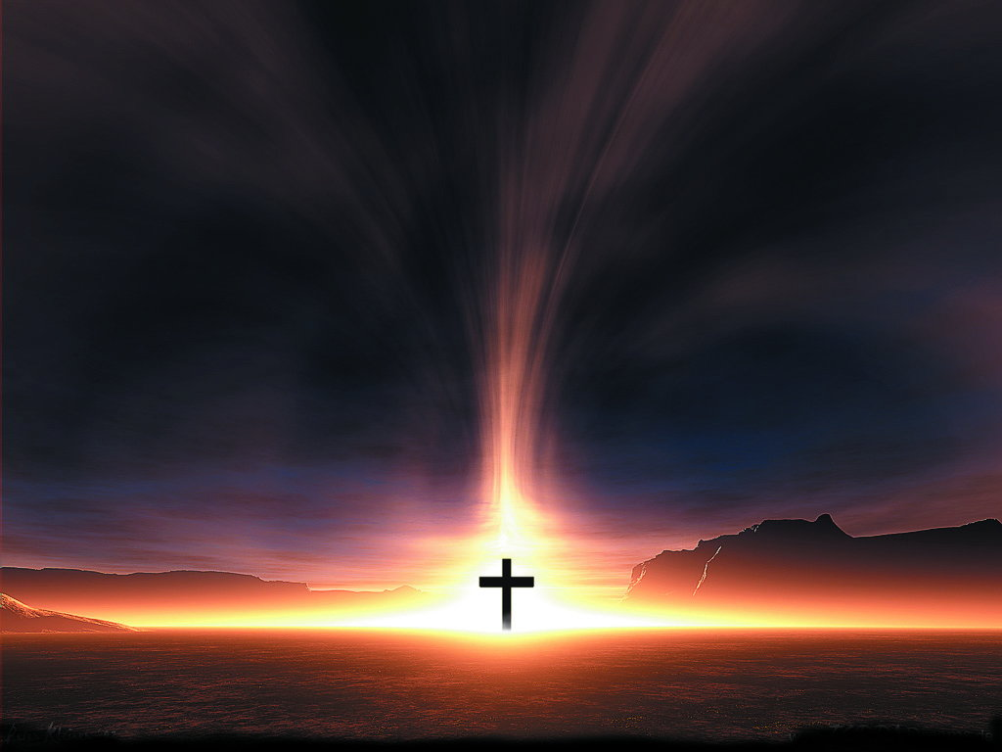
For the grace of God that brings salvation has appeared to all men, teaching us that, denying ungodliness and worldly lusts, we should live soberly, righteously, and godly in the present age, looking for the blessed hope and glorious appearing of our great God and Savior Jesus Christ, who gave Himself for us, that He might redeem us from every lawless deed and purify for Himself His own special people, zealous for good works. — Titus 2:11-14
For the grace of God that brings salvation
grace of God
has appeared to all men
teaching us
deny
ungodliness and worldly
lusts
should live soberly
righteously
teaching us:
• deny ungodliness and worldly lusts
• should live soberly
righteously
godly in the present age
• looking for the hope
↘ of Savior Jesus Christ
godly in the present age
looking for
the
hope
of
Savior Jesus Christ
Force
testament is in force
Notes:
No greater life in light can be who calls each heart to truth in Him.

Slide 31
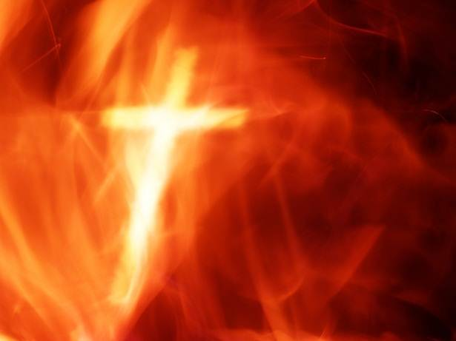
Therefore, since we are receiving a kingdom which cannot be shaken, let us have grace, by which we may serve God acceptably with reverence and godly fear. For our God is a consuming fire. — Hebrews 12:28-29
Force is God
a consuming fire
God
ce
a
For
is
consuming fire
Notes:
No shadow will be found to hide in with the coming of His brilliant judgments.

Slide 32
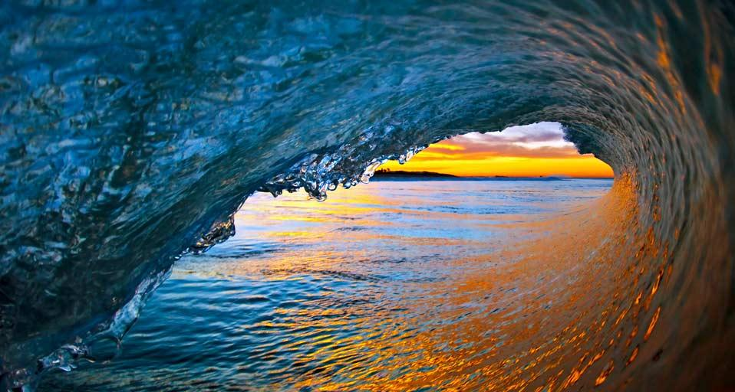
→ Right words have force
→ More than words, God holds power
→ His dominion resides across all barriers
→ His voice is the commanding sound of all
→ God is all powerful, Creator of all
→ His word pierces all darkness in His force of light
→ His unending instant force is enigmatic
→ God is greater than all that is perceivable
→ The word of God cuts to the heart of a soul
→ By force of God’s Spirit we live & are made alive
→ His testament promise of eternal life is in force
→ A calling salvation asking to respond in His ways
→ The power in which He lives is a consuming fire
No Force is Greater than Our God
Notes:
As waves open upon golden shores, His rising is life itself.

Slide 33
Notes:
There is nothing certain to care for in sightless darkness.

Slide 34
Please visit http://www.LoveFromGod.com to explore further
Ronald Bert Channel on
Notes:
Eternity never ends.

