Slide 1
Notes:
Darkness has a colorless extent.

Slide 2
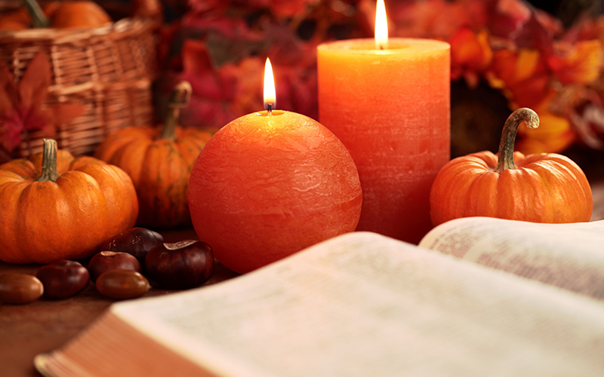
Thankfulness
Ron Bert
November 20, 2016
Notes:
How many of us dismiss happiness to be had for the drudgery of mundane miseries? Life is a choice to wallow with no one near or rejoice for those close, no matter circumstance or affiliations. It bottom lines on to feel love or contempt, and this choice defines the quality of living life.

Slide 3
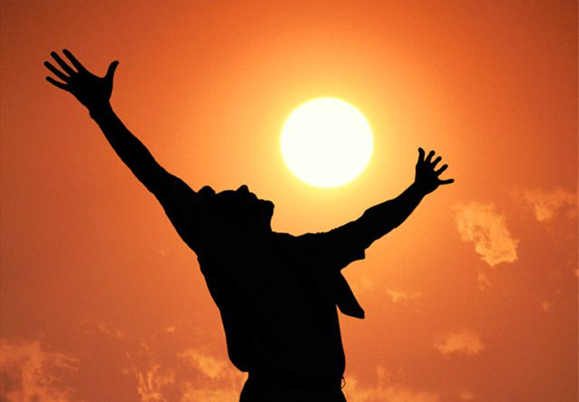
{A Psalm. A Song for the Sabbath day.} It is good to give thanks to the LORD, And to sing praises to Your name, O Most High; — Psalms 92:1
good to give thanks
good to give thanks
to
to the LORD
to the LORD
LORD
Notes:
We are not helpless animals without hope. His presence allows rest from carrying the burdens alone.

Slide 4
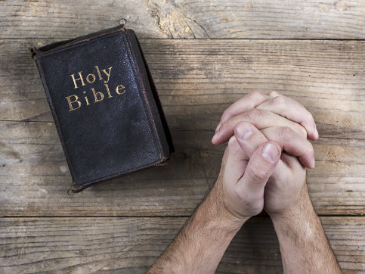
I rejoice at Your word As one who finds great treasure. — Psalms 119:162
Your word
Your word
great treasure
great treasure
Notes:
Mental delicacies abound in the revealing of countless pearls contained in the light of His unending divine truths. These have been given to us that we may know how better able to survive what we all have in common, loss. Loss is a test in exposing true character. Again, it is a choice to climb or fall, and many choose the latter slide over the rigorous demands where integrity stands.

Slide 5
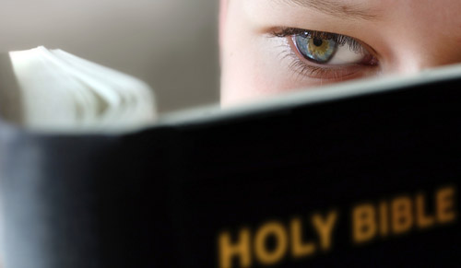
Therefore do not be unwise, but understand what the will of the Lord is. And do not be drunk with wine, in which is dissipation; but be filled with the Spirit, speaking to one another in psalms and hymns and spiritual songs, singing and making melody in your heart to the Lord, … — Ephesians 5:17-19
Therefore
do not be unwise
Therefore
understand
the will of the
Lord
do not be drunk
→ do not be unwise
→ understand the will of the Lord
→ do not be drunk
→ be filled with the Spirit
→ speaking in your heart to the Lord
be filled with the Spirit
speaking
in your heart
in
to the Lord
Notes:
There is no greater glory than the Lord. If one believes, the heart is called out to confess that spirit of dedication and loyalty, all to the Almighty. And who would deny God other than those on the road of condemnation? In the courtroom of life, three things are sure, taxes, death, and meeting our Maker.

Slide 6
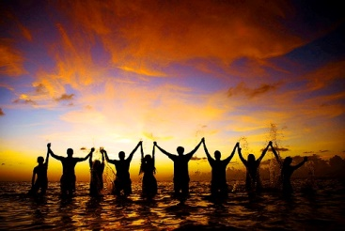
… giving thanks always for all things to God the Father in the name of our Lord Jesus Christ, submitting to one another in the fear of God. — Ephesians 5:20-21
thanks
giving thanks always
giving thanks always
to
in
God
Lord Jesus Christ
in
fear of God
Notes:
It is truth that more is better and being thankful together has the advantages of unity. In such a state of disunion, how much better is joy over the dread? To be found finds one lifting back to God, the source of all enlightenment.

Slide 7
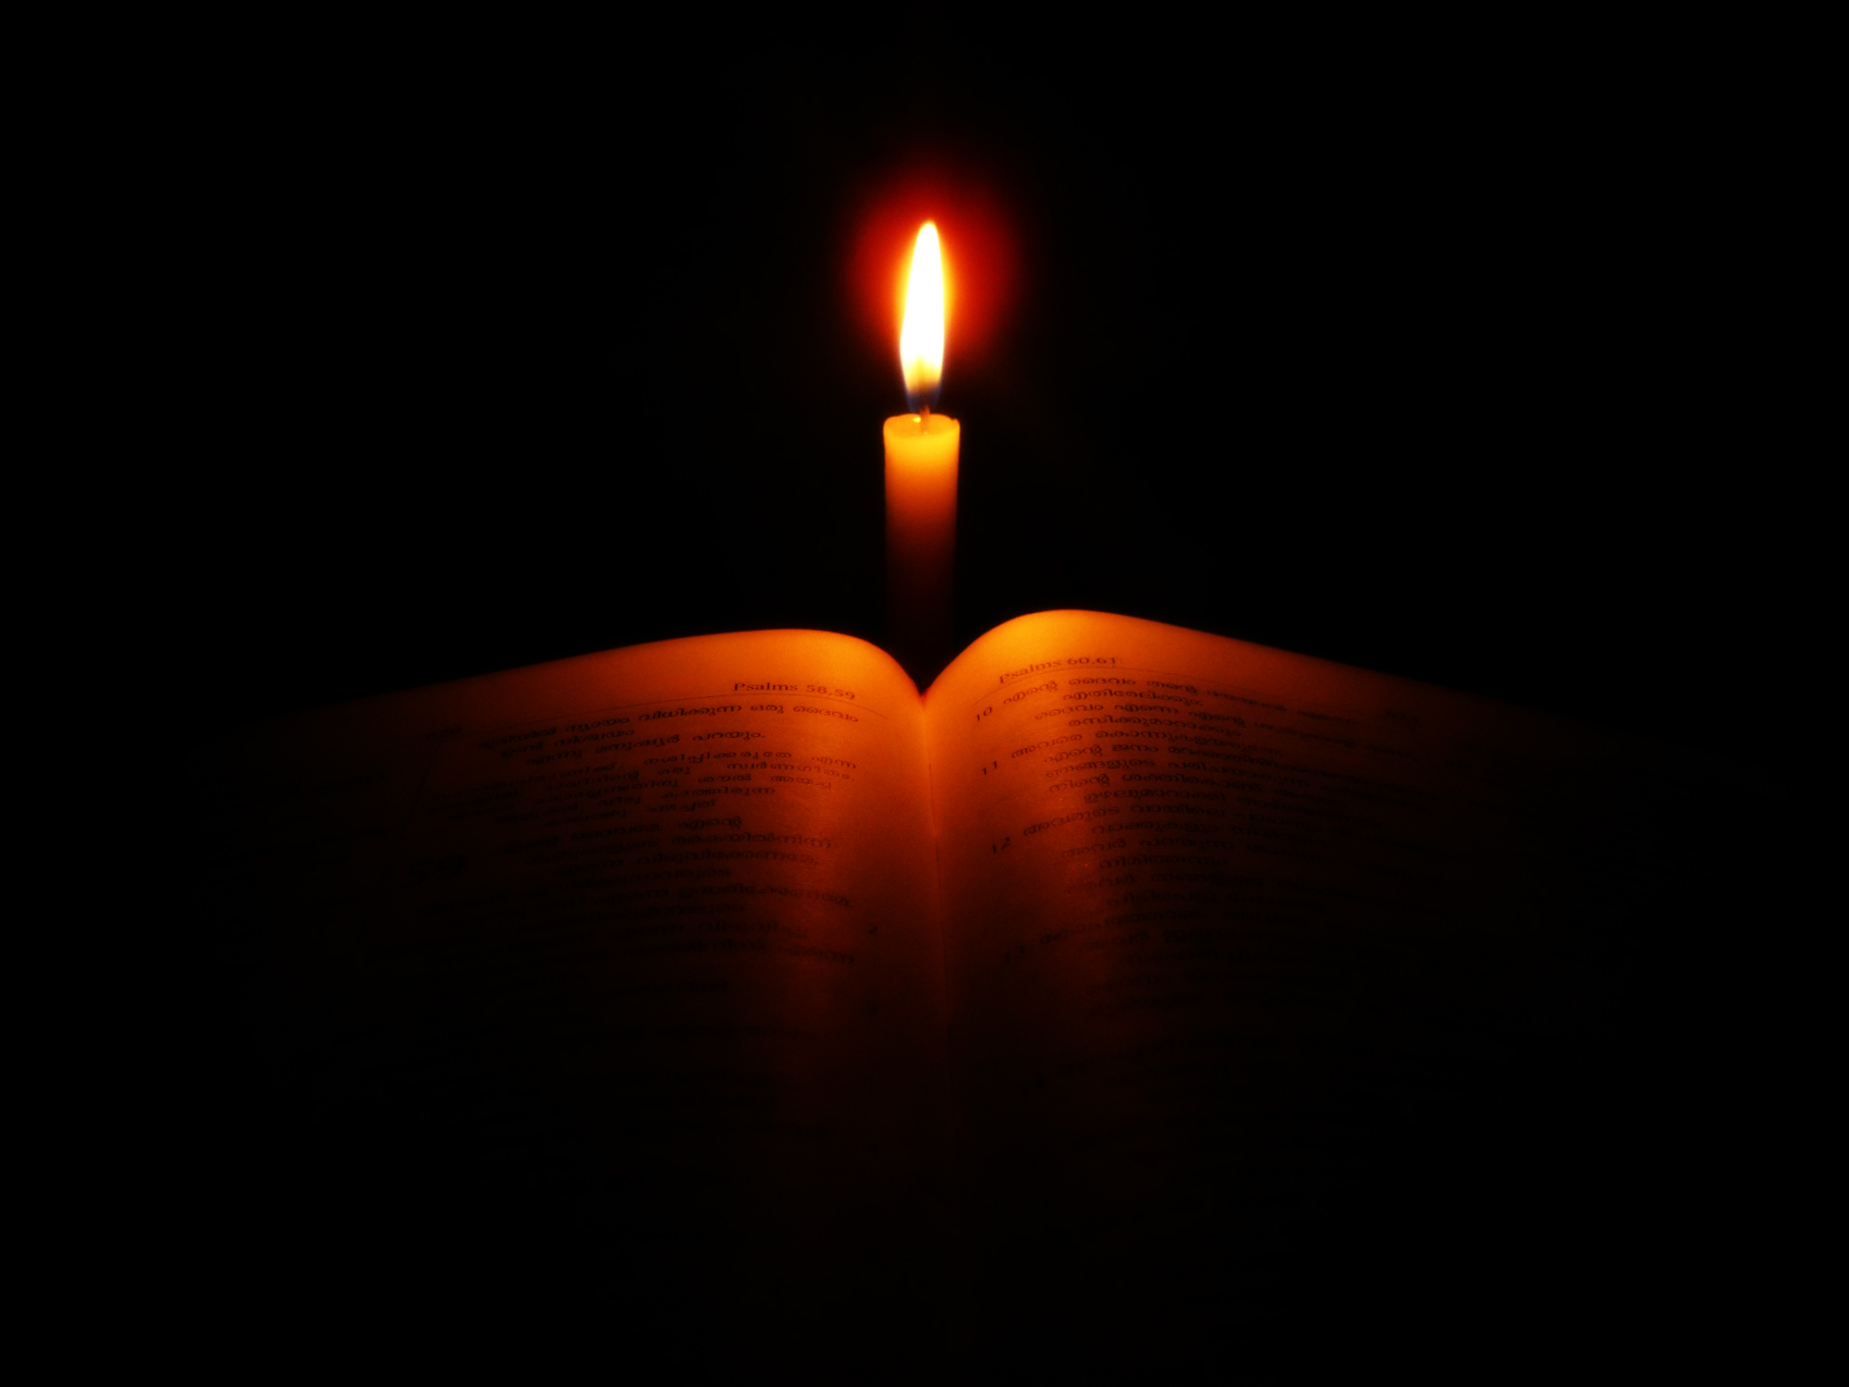
At midnight I will rise to give thanks to You, Because of Your righteous judgments. — Psalms 119:62
thanks
righteous judgments
righteous judgments
FAIR
Notes:
When one wakes up at night with that churning washing machine growl, is He part of your return to sleep? Relying on His strength should be thankfully welcomed as a driving protective force, which it is. Thanks is the light of the heart that pierces all darkness.

Slide 8
Be anxious for nothing, but in everything by prayer and supplication, with thanksgiving, let your requests be made known to God; and the peace of God, which surpasses all understanding, will guard your hearts and minds through Christ Jesus. — Philippians 4:6 -7
in everything
in
in everything
thanks
giv
with thanksgiving
with thanksgiving
gives the peace
trust
the peace
es
through
through
Christ Jesus
Christ Jesus
Christ Jesus
Notes:
For one to take full advantage of what belief in Him provides, trust is the essential component. It is one fully trusts that those healing strengthening benefits come into play. If God is for us, what can man do? This is the comfort zone of eternal rewards.

Slide 9
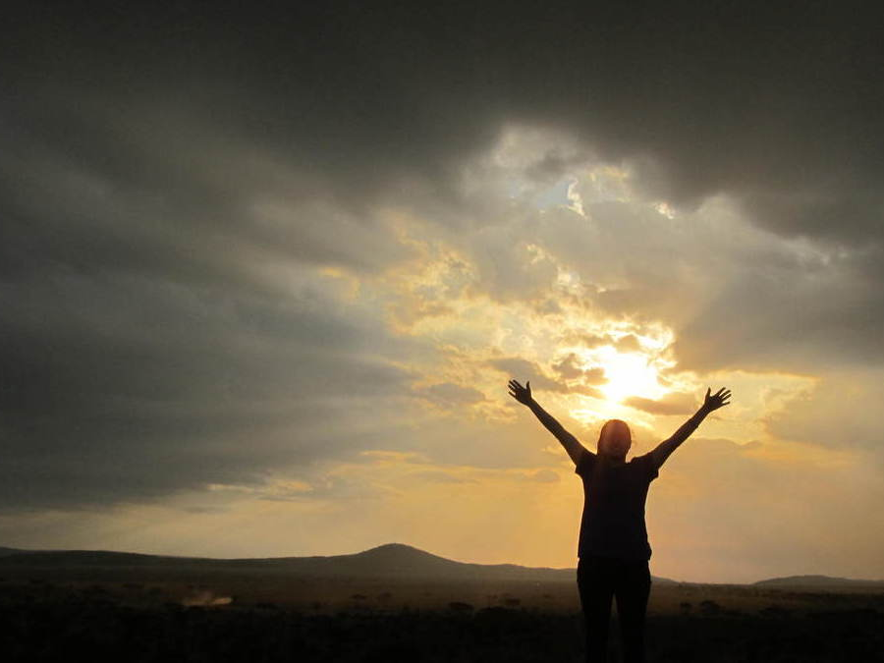
"Therefore I say to you, do not worry about your life, what you will eat or what you will drink; nor about your body, what you will put on. Is not life more than food and the body more than clothing?" — Matthew 6:25
Therefore
s
do not
do not
worry
u
worry
life
t
trust
life
r
t
Notes:
Hard to apply is the command not to worry, and if one doubts, this has a more active hindrance to one’s genuine faith. Do you thank God amiss for the things you covet for, or more to the point, thank Him for just being there with a supportive will of principles and justice? The nature of who we are alive is unveiling before Him.

Slide 10
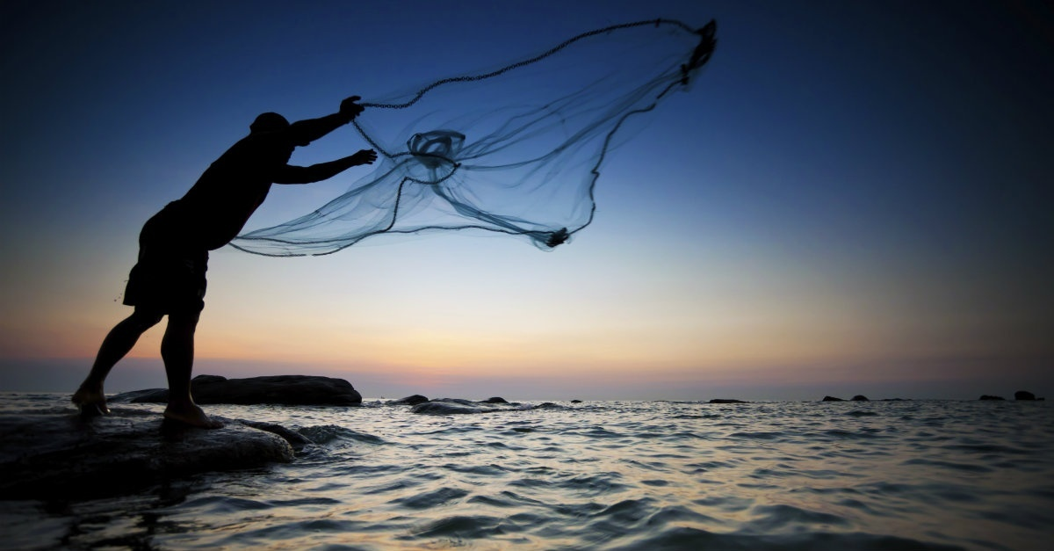
Therefore humble yourselves under the mighty hand of God, that He may exalt you in due time, casting all your care upon Him, for He cares for you. — 1st Peter 5:6 -7
Therefore
God
all
casting all your care upon Him
Him
casting all your care upon Him
Notes:
Many of us have loss resulting in pain which can turn to anger masked by arrogance. Without a humble heart, honesty can be blurred in misconceptions of one’s own making. Only an open releasing submissive heart can allow God and others to sincerely care for the soul that one is. In such an isolated world of self-seeking narcissistic embryos, dropping hostile perceived protective facades is difficult for the disturbed. Attack is routine where love has no breeding ground.

Slide 11
But above all these things put on love, which is the bond of perfection. And let the peace of God rule in your hearts, to which also you were called in one body; and be thankful. — Colossians 3:14-15
above all
. .
love
peace
God
in
Notes:
Glory is thankful love in His name.

Slide 12
But above all these things put on love, which is the bond of perfection. And let the peace of God rule in your hearts, to which also you were called in one body; and be thankful. — Colossians 3:14-15
God
in
called
called
. .
be thankful
Notes:
Glory is thankful love in His name.

Slide 13
And whatever you do in word or deed, do all in the name of the Lord Jesus, giving thanks to God the Father through Him. — Colossians 3:17
whatever you do
whatever you do
do
all in
giving
thanks
God
Him
through Him
through Him
Notes:
To develop the true nature God intended for His autonomous life, His principles need to be acquired. One is thankfulness in the fact of just living. This can be difficult as man assaults man in the corruption of all that is evil. Murderous outrage befalls all nations.

Slide 14
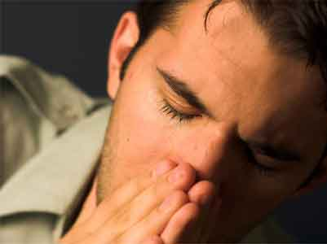
Continue earnestly in prayer, being vigilant in it with thanksgiving; — Colossians 4:2
Continue earnestly in prayer
in
Continue earnestly in prayer
giving
thanks
alert
aware
cautious
heedful
watchful
thanksgiving
thanks
giving
Notes:
Our relationship with God Himself is what holds our anchor to eternity, ultimately free of the temporary wickedness that man perpetrates upon himself.

Slide 15
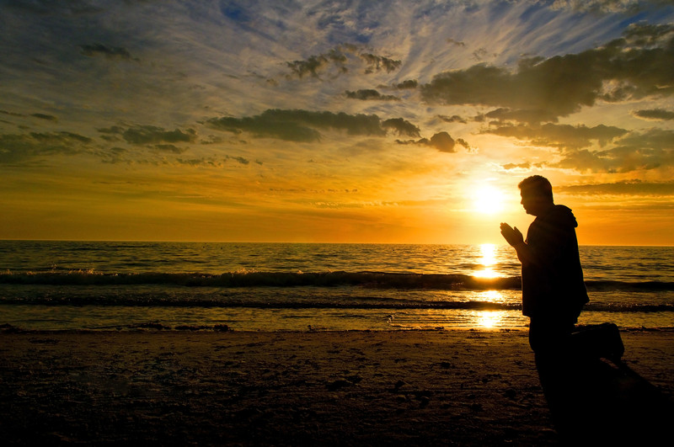
Therefore by Him let us continually offer the sacrifice of praise to God, that is, the fruit of our lips, giving thanks to His name. But do not forget to do good and to share, for with such sacrifices God is well pleased.— Hebrews13:15 -16
Therefore
b
e
by Him
to be praised
praise
to
d
to
praise to God
praise to God
giving
thanks
do good
to share
Notes:
As we are called to an eternal connection, one should never forget or ignore that calling. In this case “Pray unceasingly” has all to do with acknowledging His ever-persistent presence. One does not throw a parent away, at least an honorable unselfish child would not. It is by Him that we are anything that we are; let it be thankful.

Slide 16
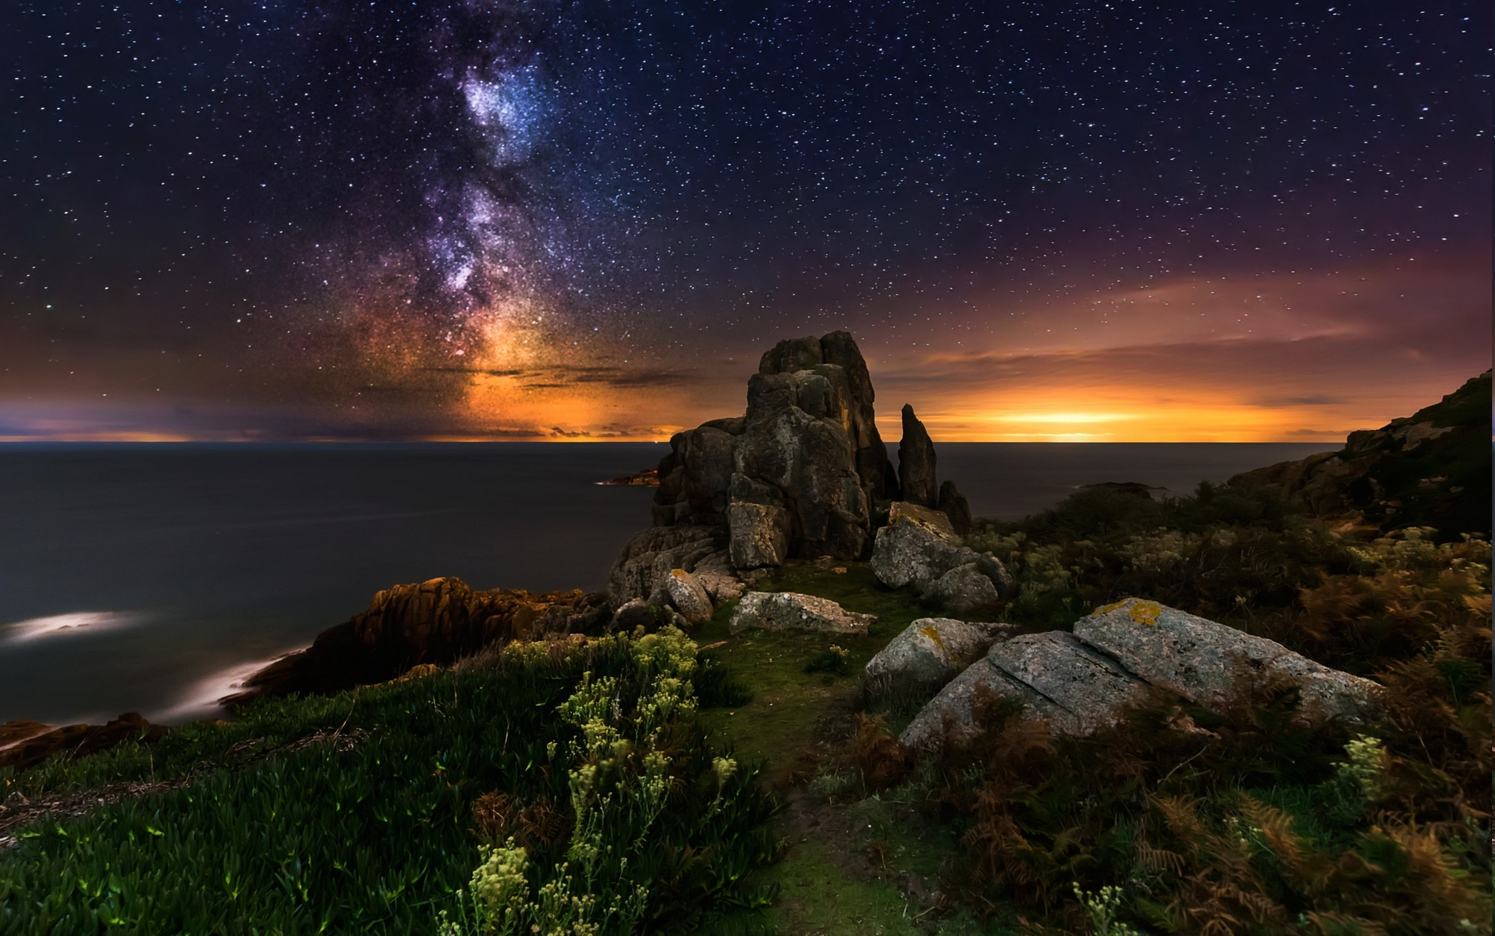
For the LORD is great and greatly to be praised; He is also to be feared above all gods. For all the gods of the peoples are idols, But the LORD made the heavens. — 1st Chronicles 16:25-26
i
n
y
to be praised
r
everything
e
v
g
th
e
made
made
Notes:
Since the Lord has created everything He is due the respect and honor that is afforded Him. His plan encompasses more than is comprehendible, but we are assured it is within reasons to gain loyalty over rebellion. Our birth into Him is no mistake as it is an eternal living condition mutually sought after.

Slide 17
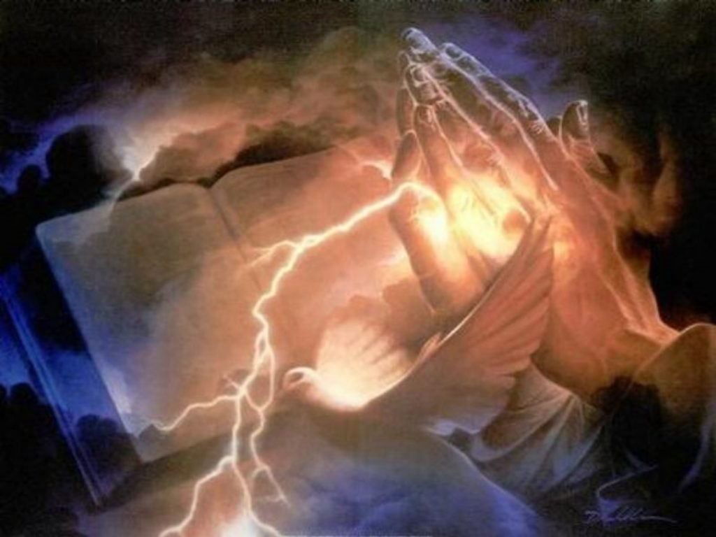
Rejoice always, pray without ceasing, in everything give thanks; for this is the will of God in Christ Jesus for you. — 1st Thessalonians 5:16 -18
everything
in
everything give thanks
everything give thanks
this is the will of God
for
Jesus Christ
Christ
Jesus
in
Christ Jesus
Notes:
With all that is before us and more, any thankfulness is short of what and where it needs to be.

Slide 18
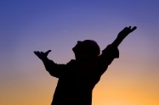
But thanks be to God, who gives us the victory through our Lord Jesus Christ. — 1st Corinthians 15:57
thanks be to God
victory
victory
Jesus Christ
Christ
Notes:
God has given us such an opportunity to regain eternal standing with Him. Jesus comforts us confirming the promises set in ages past.

Slide 19
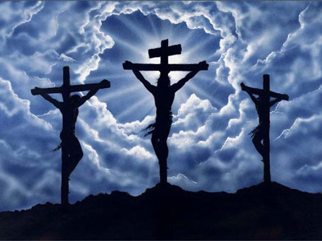
Now thanks be to God who always leads us in triumph in Christ, and through us diffuses the fragrance of His knowledge in every place. — 2nd Corinthians 2:14
thanks be to God
God
Christ
triumph in Christ
in
triumph in Christ
through us
diffuses the fragrance
His knowledge in every place
in
His knowledge in every place
Notes:
God senses the very essence of our being and wills that we know Him. God came to the earth living in Christ to reach our hearts.

Slide 20
For we are to God the fragrance of Christ among those who are being saved and among those who are perishing. To the one we are the aroma of death leading to death, and to the other the aroma of life leading to life. And who is sufficient for these things? — 2nd Corinthians 2:15 -16
God
fragrance of
Christ
Christ
God
aroma of life
fragrance of Christ
aroma of death
aroma of death
aroma of
Judgment
life
Notes:
For the noble inclined in His will rejoicing will be the refreshment. Those enmeshed in their own will, ignoring the call, fade upon a shadows wisp. Living or dying, our character will rise to meet God our Lord Jesus Christ.

Slide 21
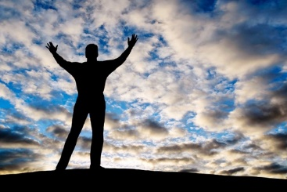
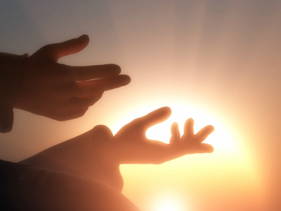
Thanks be to God for His indescribable gift! — 2nd Corinthians 9:15
God
God
Notes:
God’s own sacrifice is what has released us into that which is more than unique; but a reflection of the qualities and attributes of God Himself in life given freely to be that it is. Our choice to thankfully recognize this or not defines who we are and how we believe. Faith is a quest for that which in better in all of us.

Slide 22
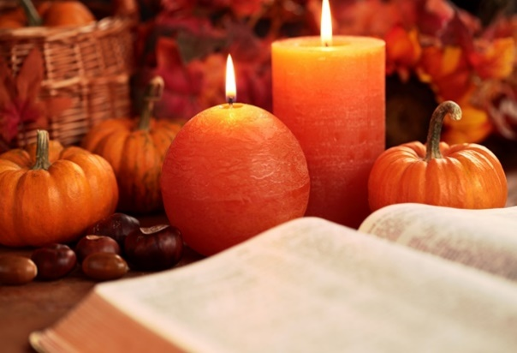
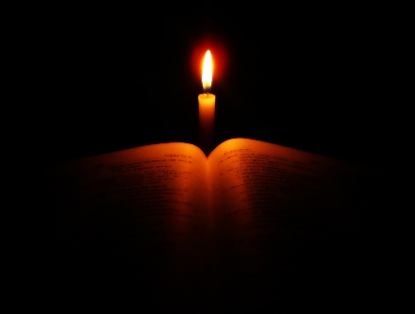
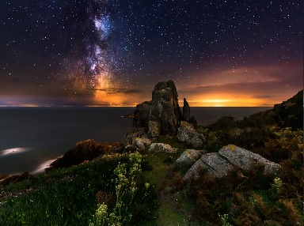

Slide 23
→ It is good to give thanks to the LORD and in praise
→ Understand what the will of the Lord is
→ Gives thanks always for all things in Christ
→ Give thanks for His righteous judgments
→ In calm prayer give thanks which guards the heart
→ Do not worry about your life
→ Humble yourself casting all your cares upon Him
→ Whatever you do give thanks to God through Christ
→ Be vigilant in prayer with thanksgiving
→ Give thanks to the name of God
→ The LORD is great and greatly to be praised
→ In everything give thanks for this is the will of God
→ Our thanks is victory through our Lord Jesus Christ
Thankfulness is a grateful call to the Lord
Notes:
Thankfulness is a grateful call to the Lord.

Slide 24
Notes:
Darkness has nothing to steal.

Slide 25
Please visit http://www.RonBert.com to explore further
Ronald Bert Channel on
Notes:
Eternity never ends.

