Slide 2
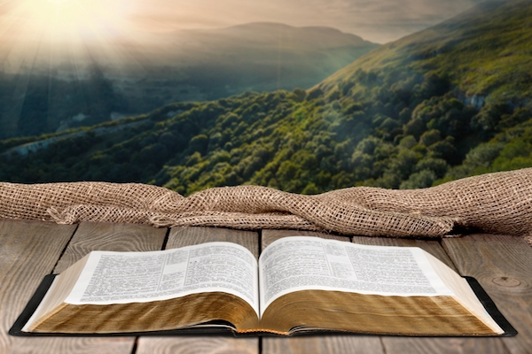
All Sufficiency of the Word of God
Ron Bert
November 22, 2020

Slide 3
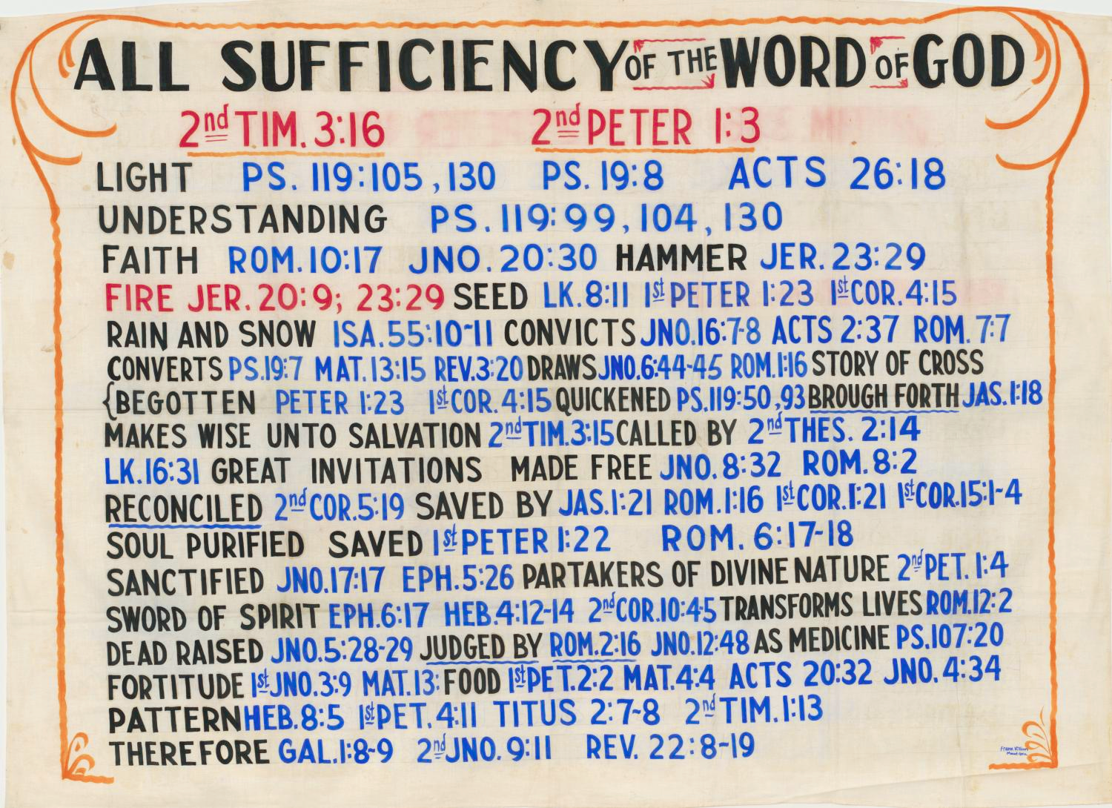

Slide 5
#1
#2
#3

Slide 6
ALL SUFFICIENCY WORD GOD
ALL SUFFICIENCY WORD GOD
OF THE
OF THE
OF
OF
#3

Slide 7
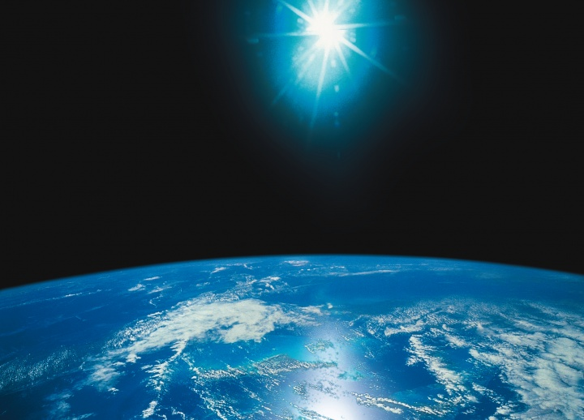
All Scripture is given by inspiration of God, and is profitable for doctrine, for reproof, for correction, for instruction in righteousness, … — 2nd Timothy 3:16
All Scripture:
● profitable for doctrine
● for reproof
● for correction
● for instruction in righteousness
All Scripture
profitable for doctrine
for
reproof
for correction
for
instruction in righteousness
Notes:
All are told His word is inspired directly for us to be admonished and encouraged.

Slide 8
… as His divine power has given to us all things that pertain to life and godliness, through the knowledge of Him who called us by glory and virtue, … — 2nd Peter 1:3
life and godliness
through the
through the
knowledge of Him
knowledge of Him
Notes:
In His word all goodness is revealed.

Slide 9
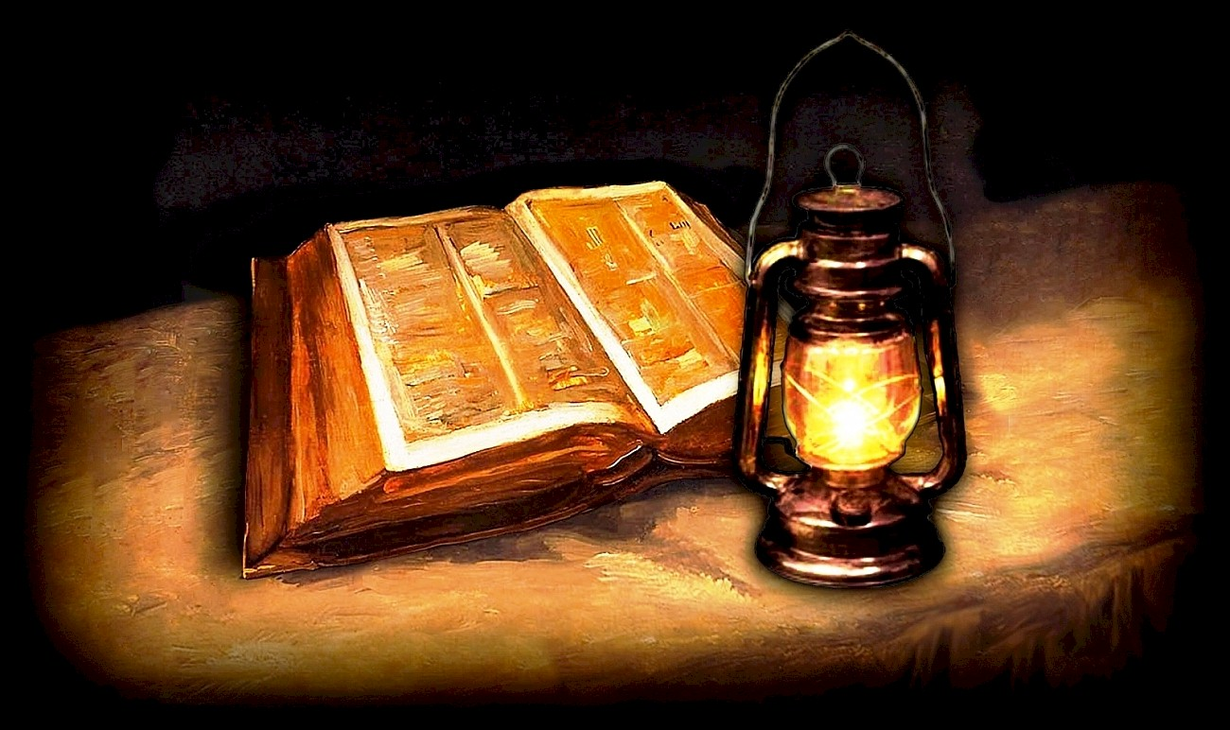
NUN. Your word is a lamp to my feet And a light to my path. — Psalms 119:105
word =
light
light
light to my path
light to my path
Notes:
His word is our guide to that goodness, that all pure hearts hope for.

Slide 10
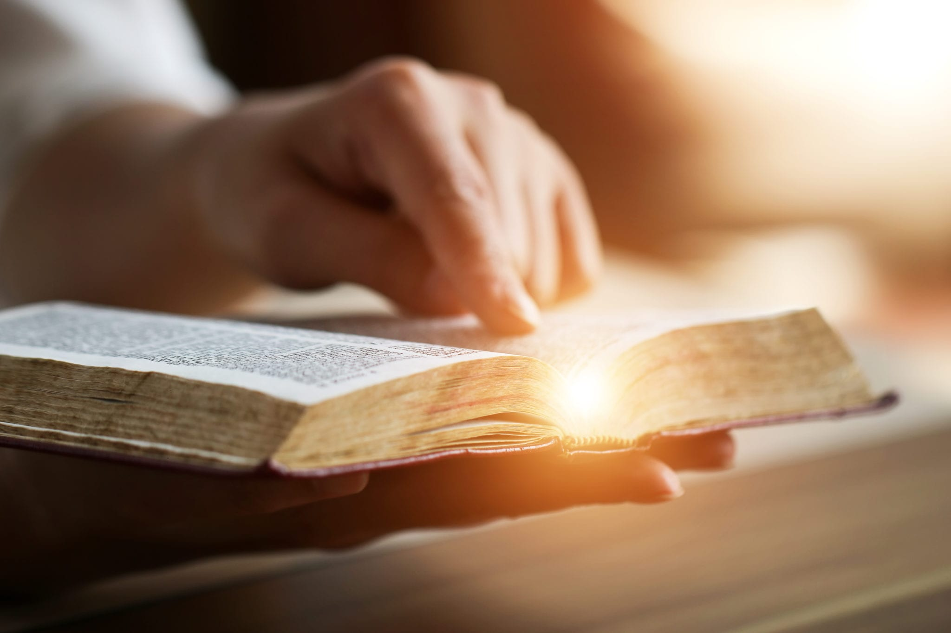
The entrance of Your words gives light; It gives understanding to the simple. — Psalms 119:130
Your words
light
Notes:
The light of understanding is surely a welcome sight to all.

Slide 11
The statutes of the LORD are right, rejoicing the heart; The commandment of the LORD is pure, enlightening the eyes; — Psalms 19:8
eyes
rejoicing the heart
. .
eyes
Notes:
What brings the minds eye to understanding is truth in the light.

Slide 12
eyes

Slide 13
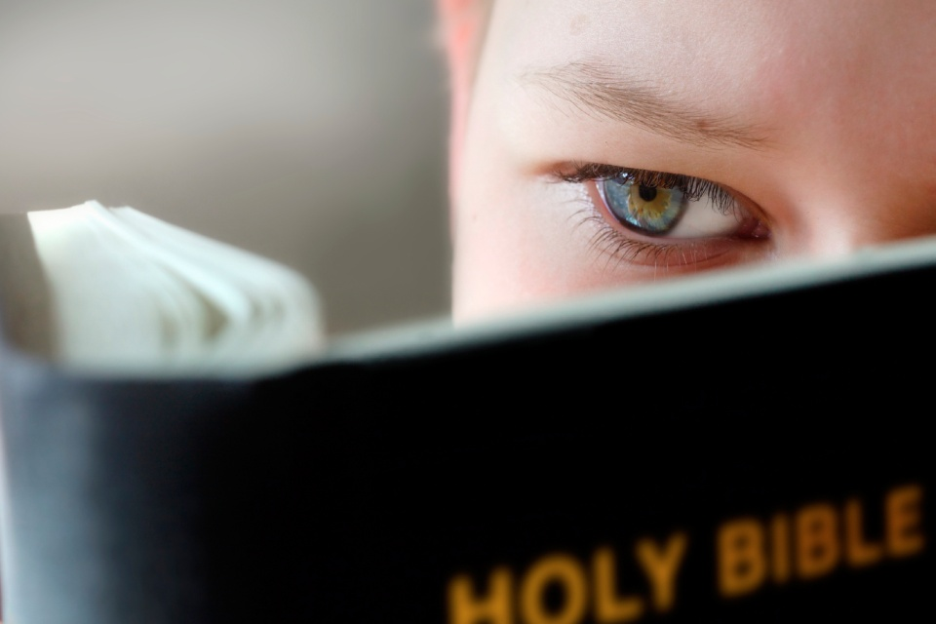
'… to open their eyes, in order to turn them from darkness to light, and from the power of Satan to God, that they may receive forgiveness of sins and an inheritance among those who are sanctified by faith in Me.' — Acts 26:18
to open their eyes
● to turn from darkness to light
● from the power of Satan to God
→ may receive forgiveness of sins
an inheritance
↑
who are sanctified by faith in Me
eyes
to open their eyes
to
turn
from darkness to light
from the power of Satan to
God
may receive
forgiveness of sins
an
inheritance
in
who
are sanctified by faith in Me
in
Me
Notes:
Insight, or say vision, makes a statement against darkness.

Slide 14
I have more understanding than all my teachers, For Your testimonies are my meditation. — Psalms 119:99
more
I have more understanding than all my teachers, For Your testimonies are my meditation. — Psalms 119:99
more
than all my teachers
than all my teachers
Notes:
Only God can reveal the deepest of all truths a soul can know.

Slide 15
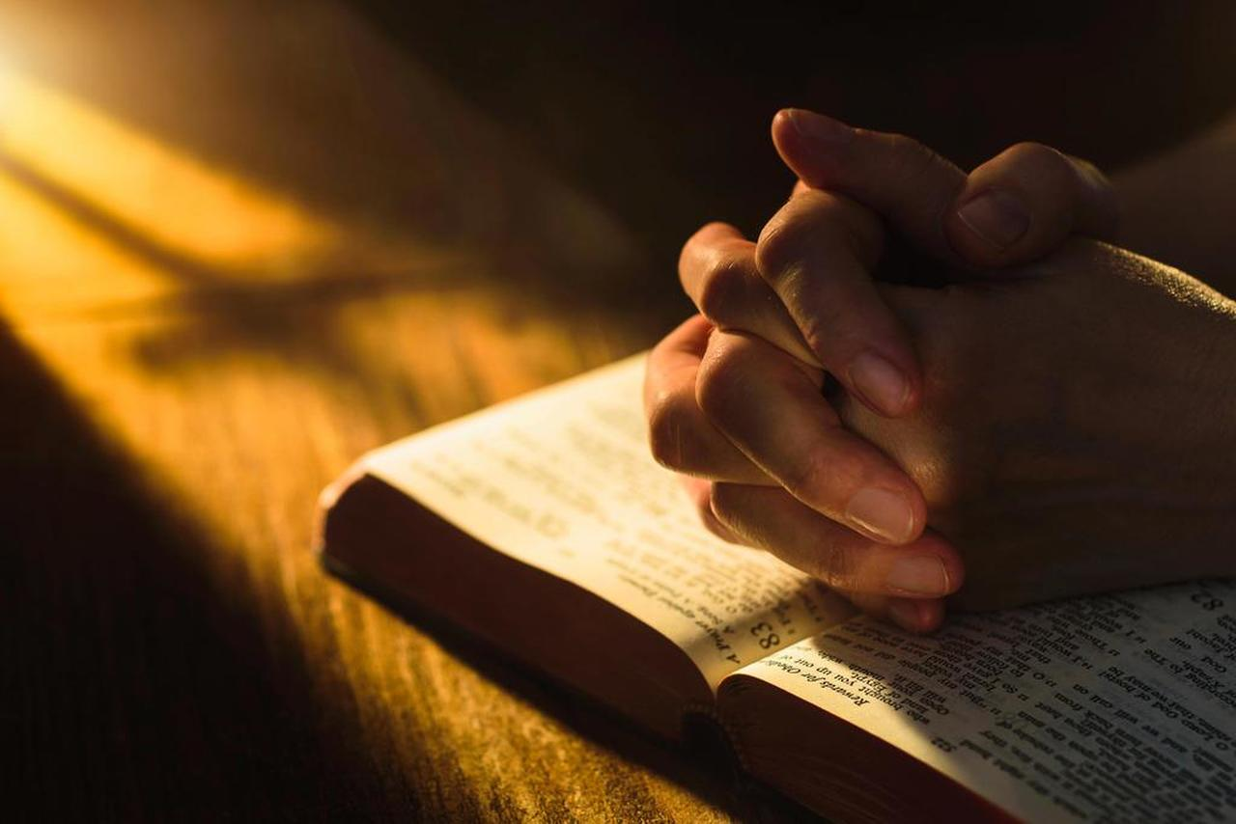
Through Your precepts I get understanding; Therefore I hate every false way. — Psalms 119:104
understanding
understanding
understanding
Notes:
To know truth one’s heart has to be open to God as the source of all.

Slide 16
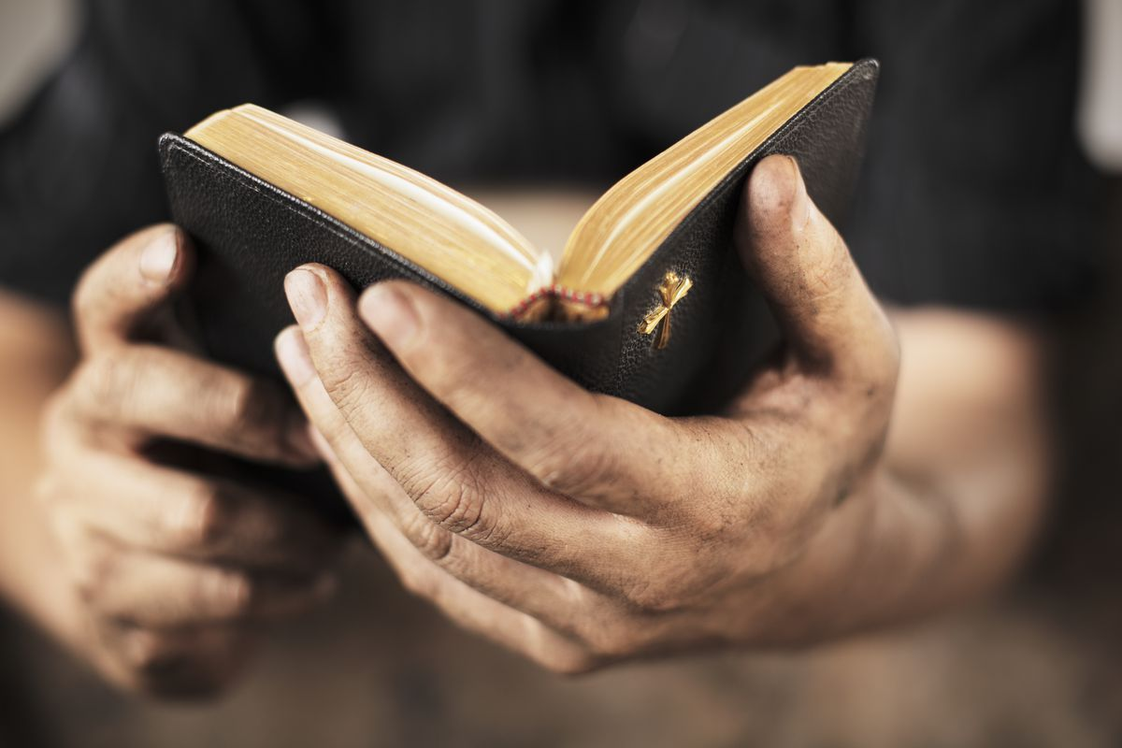
So then faith comes by hearing, and hearing by the word of God. — Romans 10:17
understanding
word of God
word of God
Notes:
True spiritual faith is a result of knowing and acting on His given word.

Slide 17
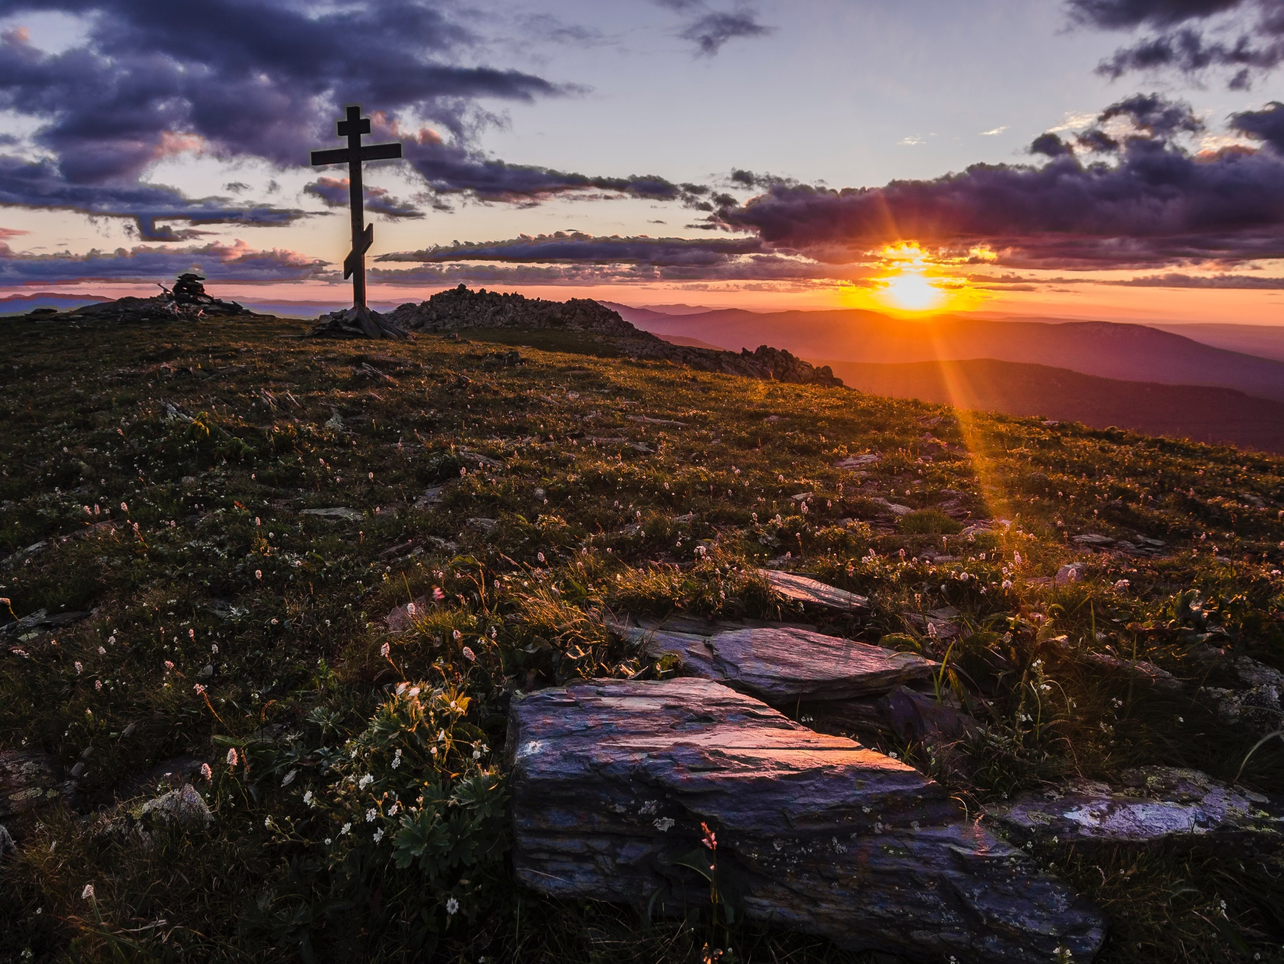
And truly Jesus did many other signs in the presence of His disciples, which are not written in this book; — John 20:30
Jesus
Jesus
Notes:
Jesus, the great emancipator; rock of salvation.

Slide 18
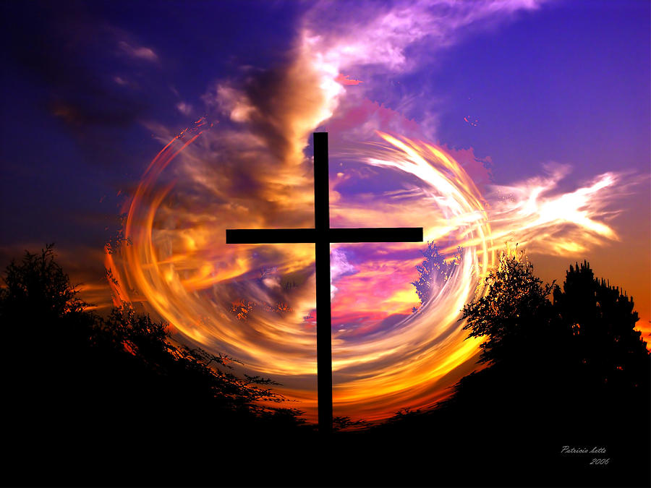
"Is not My word like a fire?" says the LORD, And like a hammer that breaks the rock in pieces?" — Jeremiah 23:29
word
My word like a fire
My word like a fire
word
Jesus
Notes:
No weight is greater than His power to illuminate life before us. God puts enormous value on the word He has given to us.

Slide 19
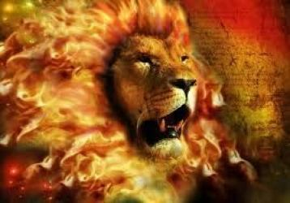
Then I said, "I will not make mention of Him, Nor speak anymore in His name." But His word was in my heart like a burning fire Shut up in my bones; I was weary of holding it back, And I could not. — Jeremiah 20:9
word
in
word
word
word
burning fire
burning fire
Notes:
Faith is a fire from within that can not be contained, for those that truly believe. God’s own breath torched truth for all to know.

Slide 20
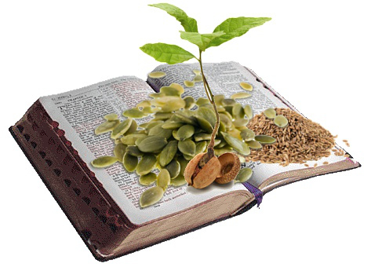
"Now the parable is this: The seed is the word of God." — Luke 8:11
word of God
word
word of God
Notes:
As a seed grows to maturity, so too He calls our spirit to rise in His truth.

Slide 21
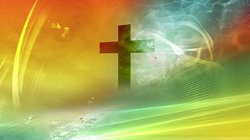
… having been born again, not of corruptible seed but incorruptible, through the word of God which lives and abides forever, … — 1st Peter 1:23
through the word of God
word of God
. .
Notes:
To escape corruption, one must grasp the incorruptible word of God.

Slide 22
the gospel

Slide 23
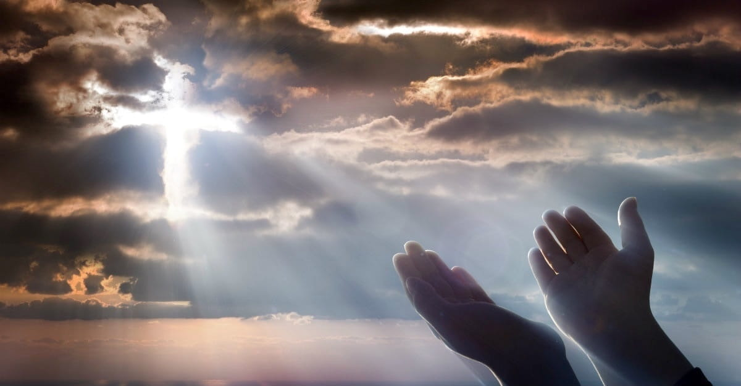
For though you might have ten thousand instructors in Christ, yet you do not have many fathers; for in Christ Jesus I have begotten you through the gospel. — 1st Corinthians 4:15
in
in Christ Jesus
Christ Jesus
in Christ Jesus
the gospel
through the gospel
through the gospel
Notes:
A single act of sacrifice has given us the true purpose of living autonomously in God’s own light.

Slide 24
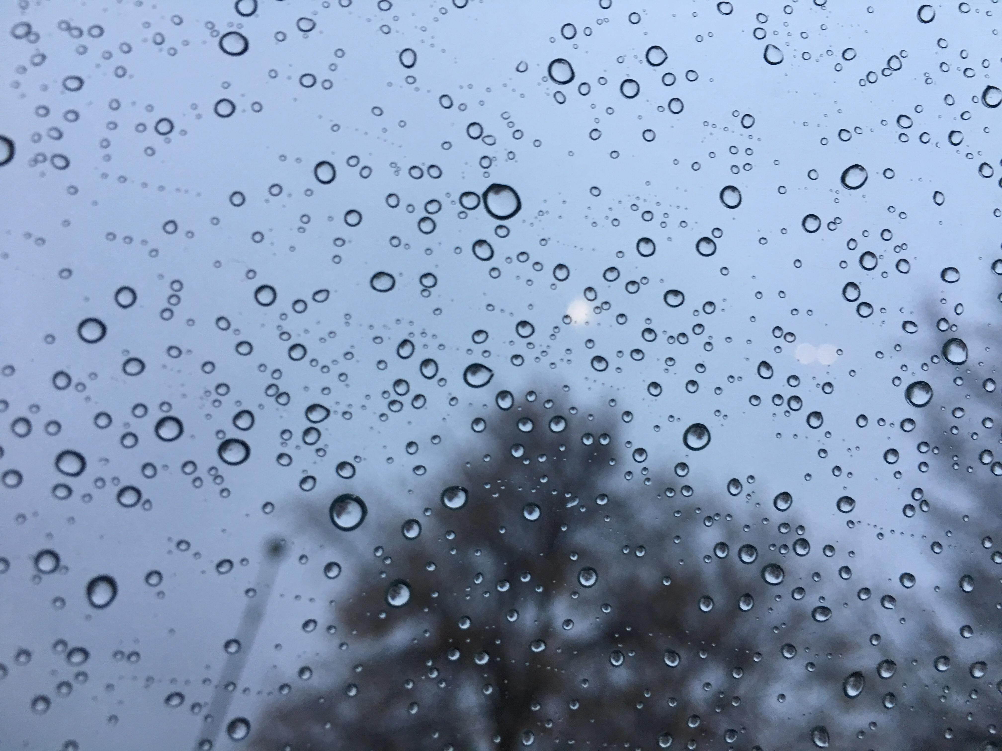
"For as the rain comes down, and the snow from heaven, And do not return there, But water the earth, And make it bring forth and bud, That it may give seed to the sower And bread to the eater, So shall My word be that goes forth from My mouth; It shall not return to Me void, But it shall accomplish what I please, And it shall prosper in the thing for which I sent it." — Isaiah 55:10-11
My word
My word
shall prosper
shall prosper
Notes:
No show can replicate what God has done, allowing life to grow and flourish in the womb of His love.

Slide 25
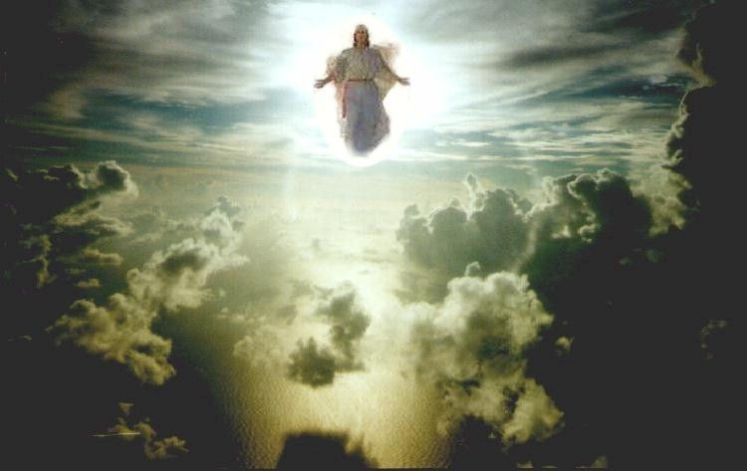
"Nevertheless I tell you the truth. It is to your advantage that I go away; for if I do not go away, the Helper will not come to you; but if I depart, I will send Him to you. "And when He has come, He will convict the world of sin, and of righteousness, and of judgment: — John 16:7-8
the truth
the truth
I will send the Helper to you
He will convict the world of sin
of righteousness, and of judgment
the
Helper
I will send
to you
He will
convict the world of sin
of
righteousness, and of judgment
Notes:
This world is a sinful realm, whereby righteous judgment will come to those who fall away from His offered grace.

Slide 26
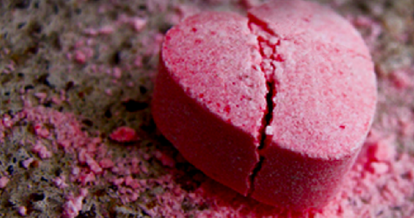
Now when they heard this, they were cut to the heart, and said to Peter and the rest of the apostles, "Men and brethren, what shall we do?" — Acts 2:37
do
do
Notes:
Broken hearts find truth in the sorrow of knowing cause and effect. God demands we do, and not just hear the words, for His call to action.
2240 do’s.

Slide 27
What shall we say then? Is the law sin? Certainly not! On the contrary, I would not have known sin except through the law. For I would not have known covetousness unless the law had said, "You shall not covet." — Romans 7:7
Notes:
God’s word clearly exposes His truth for us to know good from evil. Many maintain a mental fog, enveloped in lies that cause His word to vanish, preferring the whims of man’s selfish desires.

Slide 28
The Law
convicts sin

Slide 29
The law of the LORD is perfect, converting the soul; The testimony of the LORD is sure, making wise the simple; — Psalms 19:7
law of the LORD = perfect
testimony of the LORD = sure
converting the soul
making wise the simple
law of the LORD
law of the LORD
law of the LORD
perfect
converting the soul
testimony of the LORD
sure
making wise the simple
Notes:
To find His word is the gasp all seek; unequivocal life. His law expresses all that is spiritually good, condemning sins of the flesh.

Slide 30
"'For the hearts of this people have grown dull. Their ears are hard of hearing, And their eyes they have closed, Lest they should see with their eyes and hear with their ears, Lest they should understand with their hearts and turn, So that I should heal them.' — Matthew 13:15
see with their eyes
hear with their ears
understand with
their hearts and turn
I should heal them
see
see
hear
hear
see with
their eyes
hear with their
understand
understand
ears
understand
with
their hearts and turn
heal
heal
I should heal them
Notes:
To pursue God, the pursuits of the world become secondary.

Slide 31
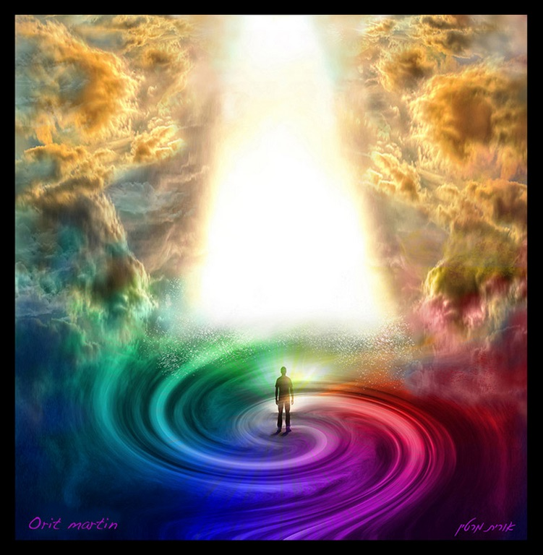
"Behold, I stand at the door and knock. If anyone hears My voice and opens the door, I will come in to him and dine with him, and he with Me." — Revelation 3:20
hears
hears
Me
Me
Notes:
A door is the entrance to a path chosen.

Slide 32
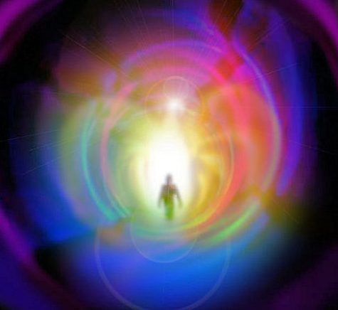
"No one can come to Me unless the Father who sent Me draws him; and I will raise him up at the last day. It is written in the prophets, 'And they shall all be taught by God.' Therefore everyone who has heard and learned from the Father comes to Me." — John 6:44-45
Me
Me
Me
heard and learned
heard and learned
comes to Me
comes to Me
Notes:
God’s word is the teacher of what no sound can imitate. A deep sensation of a speechless moment, just a call to be. Who we are is what we seek, either it be to build or to destroy. It is to hear, or not to hear. Me is a word, and a concept, that needs examination in relation to all the Me’s in life. All centers on the moment, and so too, God is the center of all that is Me. Father, Son, and Holy Spirit reveals God as He is for us to know, the great Me.

Slide 33
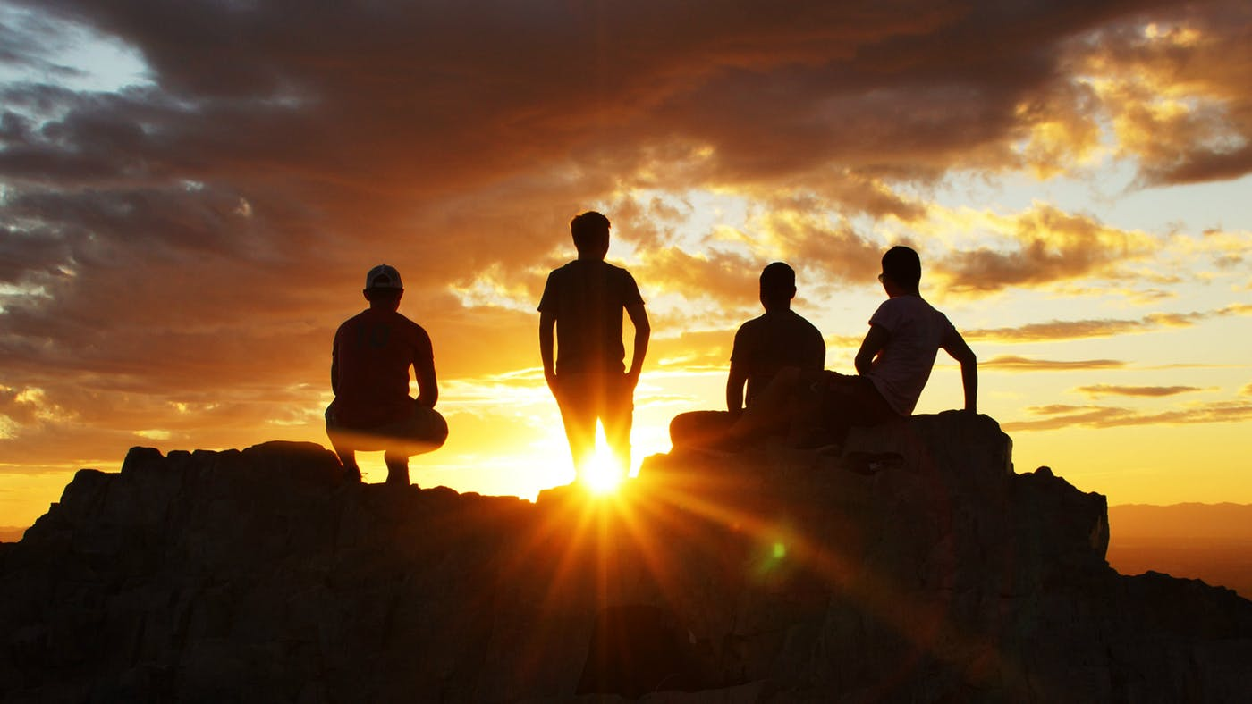
For I am not ashamed of the gospel of Christ, for it is the power of God to salvation for everyone who believes, for the Jew first and also for the Greek. — Romans 1:16
gospel of Christ
Christ
. .
of God to salvation
. .
Notes:
How can the truth bring shame when it holds no lies?

Slide 34
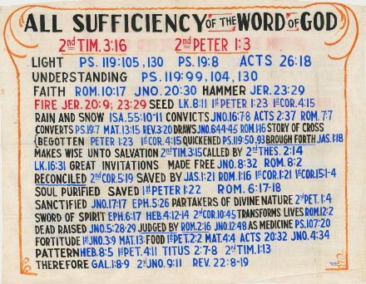
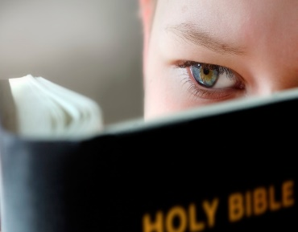
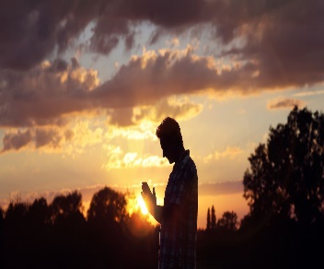
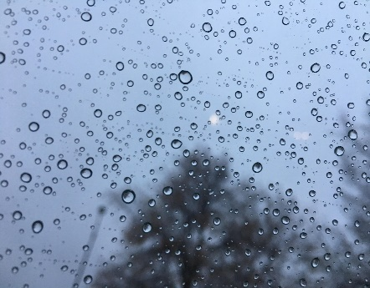

Slide 35
→ All scripture is to improve every facet of life
→ God’s light is our guiding path to a better life
→ His word allows us to see between good and evil
→ True faith comes by hearing the word of God
→ God’s word is the fire penetrating to the core of all
→ God plants His seed in us through His given word
→ God’s seed empowers those who eat of its’ fruit
→ God’s word convicts sin in His righteous judgment
→ Guilt is a sign to come to repentance
→ God’s word converts the soul to become wise
→ Healing comes through the heart as it understands
→ Jesus waits for each soul at the door to eternity
→ As it is written, God is our teacher in Christ
Eternity is the freedom God delivers to the faithful
Notes:
Eternity is the freedom God delivers to the faithful

Slide 37
All Sufficiency of the Word of God
2
Ron Bert
November 29, 2020

Slide 40
ALL SUFFICIENCY WORD GOD
OF THE
OF
#1
#2
#3

Slide 41
… having been born again, not of corruptible seed but incorruptible, through the word of God which lives and abides forever, … — 1st Peter 1:23
born again
. .
through the word of God
. .
Notes:
It is through the word of God that we find life in the truth.

Slide 42
For though you might have ten thousand instructors in Christ, yet you do not have many fathers; for in Christ Jesus I have begotten you through the gospel. — 1st Corinthians 4:15
in
precipitated
produced
created
caused
Christ Jesus
begotten
begotten
Notes:
To be begotten in the image of the Creator, one has to first be in the mind of Christ, as in a return to dependency upon God’s own power to maintain life.

Slide 43
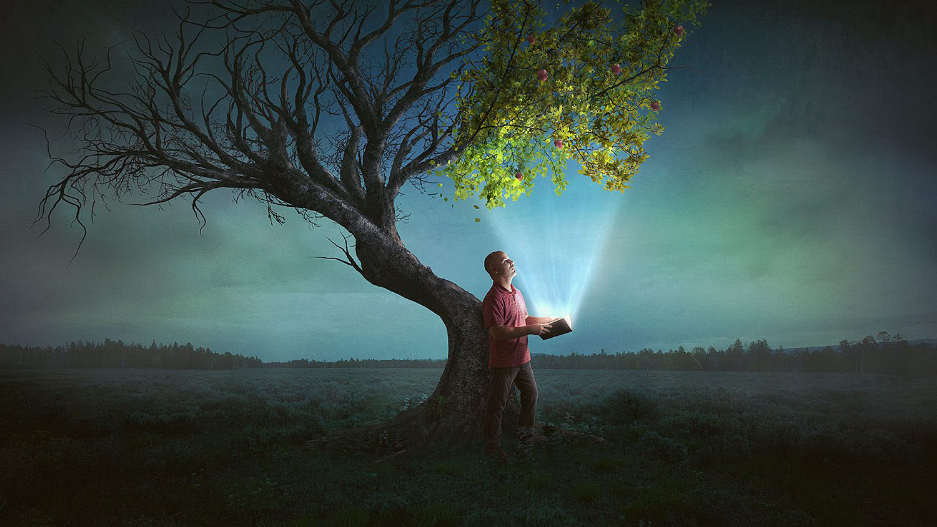
This is my comfort in my affliction, For Your word has given me life. — Psalms 119:50
in
in my affliction
in my affliction
life
given me life
life
given me life
life
Notes:
Each of us seeks life for the best it can be, or at least those who still hold on, to hope, push on. Too often calamities cause heartache without support from those around us. Tragic when there is no one to laugh with. In these troubling times for all, without depending on and regarding God, our service to others is diminished, and temperaments are less than encouraging. Either one rises to life or drops into death, as we all battle between these two dichotomies. We need the truth of light to give us life.

Slide 44
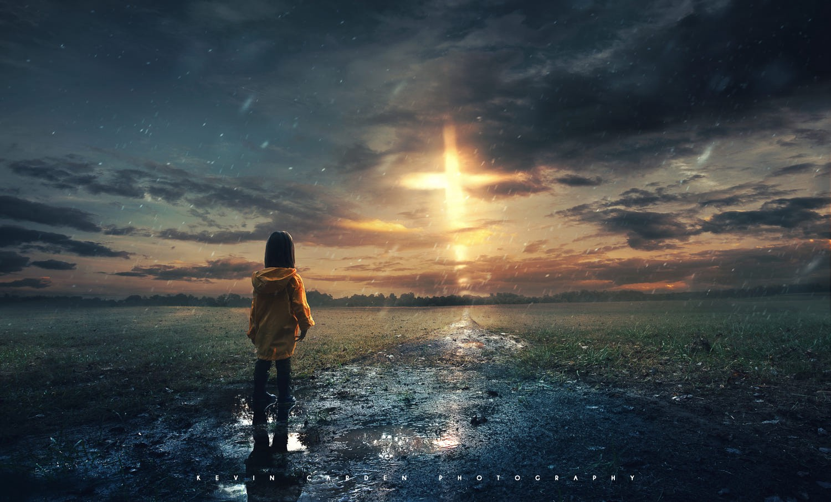
I will never forget Your precepts, For by them You have given me life. — Psalms 119:93
forget
given
given
life
forget
Notes:
Surely, it is God’s word that rings out true across the ages. As we gaze out to the horizon of our lives, do we choose to forget that which gave us life to know? His is a test of patience waiting to see who each of us becomes.

Slide 45
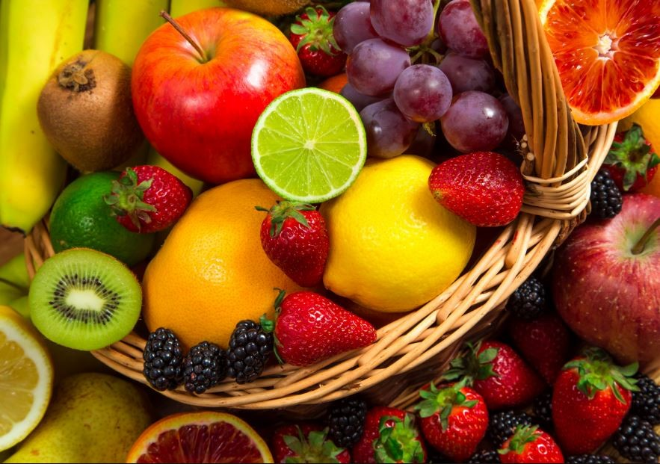
Of His own will He brought us forth by the word of truth, that we might be a kind of firstfruits of His creatures. — James 1:18
word of truth
word of truth
Begotten
forget
Notes:
Much more than just the word of truth, He has given life to each of us to be. To be brought forth in His word is to be begotten. One is either a tender creation sweet to our surroundings, or uneven destructive dissent clamors against the roses. In our field of life, fruits both flourish and rot. To drink the word of life refreshes the soul.

Slide 46
… and that from childhood you have known the Holy Scriptures, which are able to make you wise for salvation through faith which is in Christ Jesus. — 2nd Timothy 3:15
Holy Scriptures
able to make you wise
↓
for salvation
through faith
↑
which is in Christ Jesus
Holy Scriptures
able to make you wise
for salvation
through faith
which
is in Christ Jesus
in
Christ Jesus
Notes:
Fortunate who find His word in youth, deepening the commencement of eternal meditations.

Slide 47
… to which He called you by our gospel, for the obtaining of the glory of our Lord Jesus Christ. — 2nd Thessalonians 2:14
He called you
. .
Notes:
A call from God Himself echoes across the ages of this world. It is not by force He controls our choices, as it is a test of each one’s freedom of spirit. What we seek to obtain, and how it settles or disquiets the soul, declares the path we travel. Words do not paint the bottom of a heart, it is either the color of love, or something left behind. Life plows forward while death darkens the way.

Slide 48
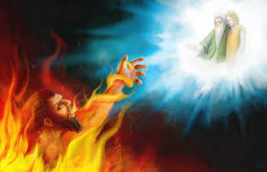
"But he said to him, 'If they do not hear Moses and the prophets, neither will they be persuaded though one rise from the dead.'" — Luke 16:31
hear
hear
Notes:
Many will not hear His holy call to return to a righteous heart. It is truly incredible, that as we endure the incompetence of others, be they so called professionals or self-proclaimed egotists, that we inevitably become the enemy as they stumble in on themselves, and their own abominable uncaring failings. Liars and quacks always run from the light. Look, we all ride broken hearts, and it is when we choose lack of compassion for one another, this is when we go mad and lose our God.

Slide 49
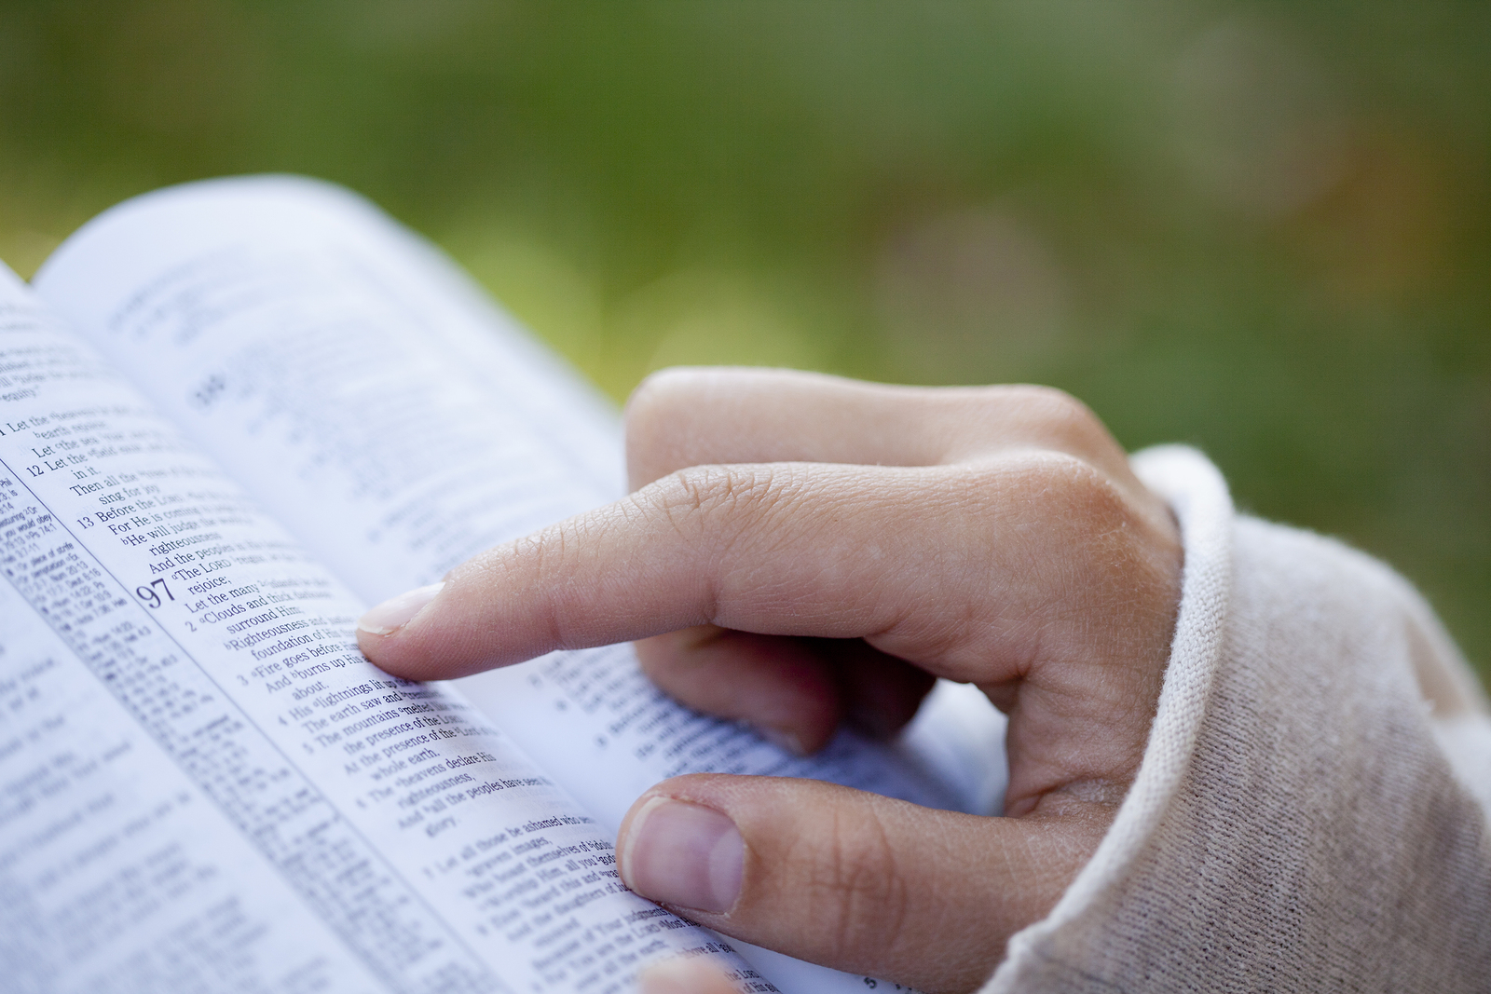
"And you shall know the truth, and the truth shall make you free." — John 8:32
know
know
Notes:
Freedom can not be had without truth.

Slide 50
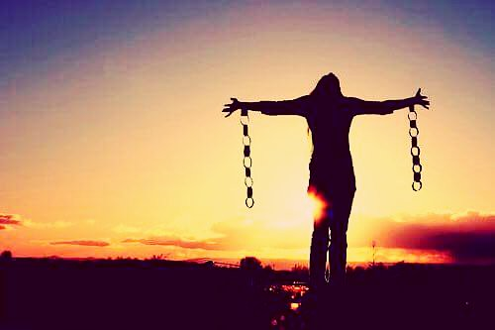
For the law of the Spirit of life in Christ Jesus has made me free from the law of sin and death. — Romans 8:2
in Christ
law of the Spirit of life
in
in Christ
in Christ Jesus has made me free
Christ Jesus
in Christ Jesus has made me free
law of sin and death
Notes:
Those that listen hear heaven’s call to life from death. A smile is an expression of freedom to rise from those frowns of despair.

Slide 51
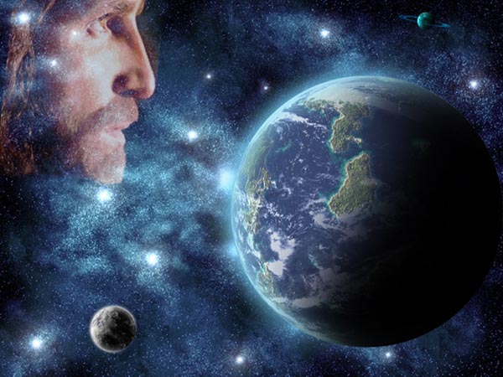
… that is, that God was in Christ reconciling the world to Himself, not imputing their trespasses to them, and has committed to us the word of reconciliation. — 2nd Corinthians 5:19
in Christ
word
word
settlement
resolution
compromise
reunion
understanding
word of reconciliation
word of reconciliation
Notes:
True treasure rises beyond the material where the keys of peace reside and love reigns.

Slide 52
Therefore lay aside all filthiness and overflow of wickedness, and receive with meekness the implanted word, which is able to save your souls. — James 1:21
lay aside all filthiness
and overflow
of wickedness
lay aside
all filthiness
and overflow
of wickedness
receive with
meekness the
implanted word
able to save
your souls
receive with
meekness the
word
implanted word
able to
implanted word
implanted word
save
your souls
Notes:
To refuse the word’s pureness of truth sinks a soul into self-oblivion. Ignoring truth does not change truth.

Slide 53
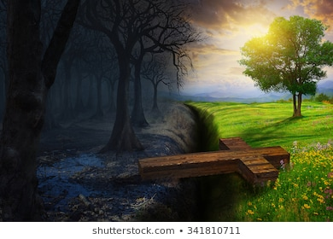
For I am not ashamed of the gospel of Christ, for it is the power of God to salvation for everyone who believes, for the Jew first and also for the Greek. — Romans 1:16
gospel of Christ
power of God to salvation
for everyone who believes
of
Christ
gospel of Christ
power
of God to salvation
for everyone
who believes
Light
Darkness
Notes:
No power is greater than what has been given for all to equally know; His loving sacrificial call to return. This offer of reconciliation is made to all who believe. And as in belief, action or decisions are made. Knowing if one jumps off of a high bridge, injury or death will occur, action calls not to jump, if it is for life one chooses. Actions involve choices. Restraint and self-control against sin is God’s call to action. Sin’s most heinous color is when it rides the razors of hate.

Slide 54
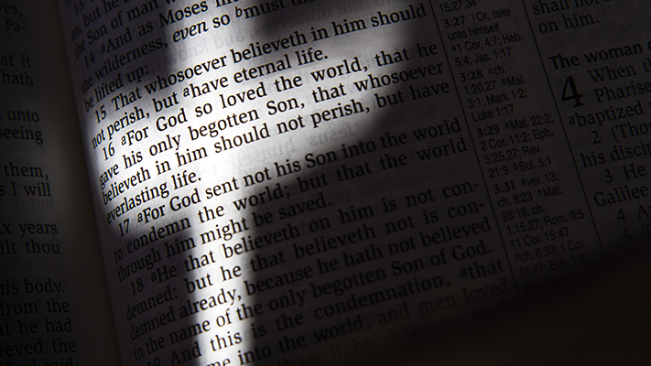
For since, in the wisdom of God, the world through wisdom did not know God, it pleased God through the foolishness of the message preached to save those who believe. — 1st Corinthians 1:21
Notes:
It is God’s plan for meek hearts to see truth, and find peace in His love, while the absent proud fall in the blindness of disrespectful meanness. Faith is a creation of God to test a soul’s determination.

Slide 55
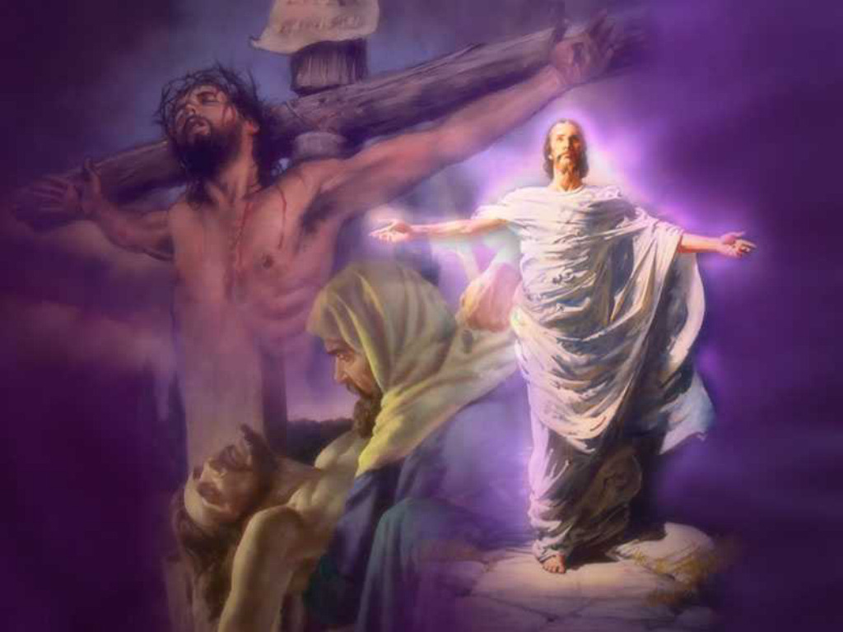
Moreover, brethren, I declare to you the gospel which I preached to you, which also you received and in which you stand, by which also you are saved, if you hold fast that word which I preached to you -- unless you believed in vain. For I delivered to you first of all that which I also received: that Christ died for our sins according to the Scriptures, and that He was buried, and that He rose again the third day according to the Scriptures, … — 1st Corinthians 15:1-4
Christ died for our sins
Christ
. .
Notes:
Christ lived, died, was buried, and rose again, to show us the meanings of life and living through God in a wicked world. He is also the sacrifice that shields us from our own sins that cannot be overcome without Him. His Spirit came to heal those who seek that better way, to live without fear. To those who endure, an awaiting promise for the faithful is just a moment ahead. How shallow where time dissolves what is permanent. Placing emphasis on the eternal clears one’s perspective.

Slide 56
Spirit

Slide 57
Since you have purified your souls in obeying the truth through the Spirit in sincere love of the brethren, love one another fervently with a pure heart, … — 1st Peter 1:22
obeying the truth
Spirit
in
in sincere love
. .
Notes:
Deepening faith acts upon the word spoken by God, while the most of those drowning have no hold. For anyone to be genuine, love must rise to the surface in overcoming the darkness left below.

Slide 58
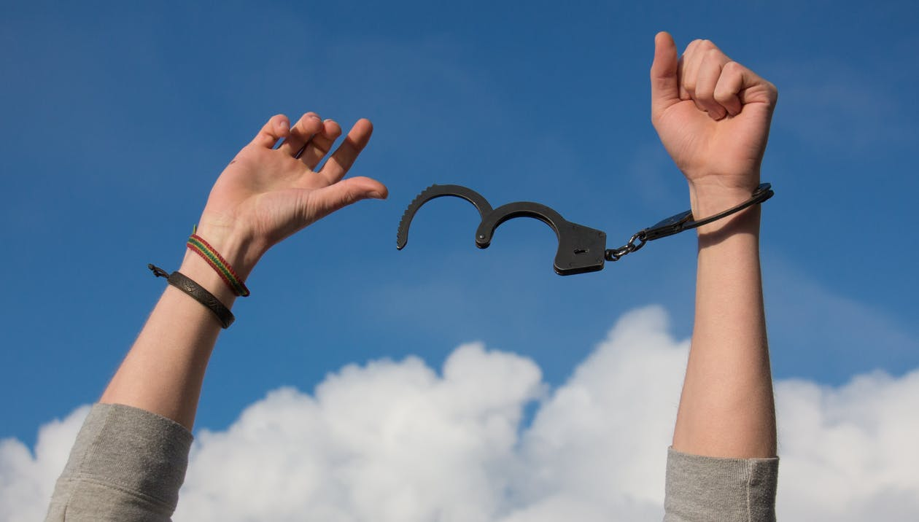
But God be thanked that though you were slaves of sin, yet you obeyed from the heart that form of doctrine to which you were delivered. And having been set free from sin, you became slaves of righteousness. — Romans 6:17-18
obeyed from the heart
doctrine
doctrine
righteousness
righteousness
Notes:
To serve an eternal purpose brings a freedom no earthly manifestation can deliver. Faith provides permanence in a temporary world.

Slide 59
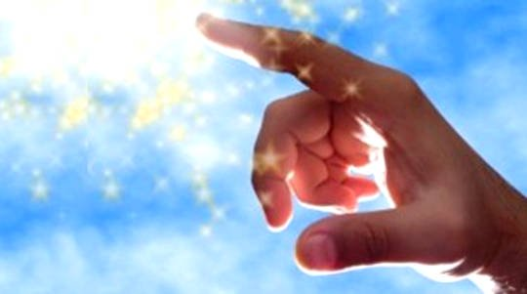
"Sanctify them by Your truth. Your word is truth." — John 17:17
word
word
Notes:
Either one believes or not. In between has no value where the mediocre will find no rest upon His judgment. Inaction will be judged as faithlessness. There can be no split between spring and winter, either we are warm or cold through the duration.

Slide 60
… that He might sanctify and cleanse her with the washing of water by the word, … — Ephesians 5:26
cleanse
cleanse
word
by the word
by the word
Notes:
God wants us to carry clean hearts, unafraid in the truth of His light. When we allow our minds to consider His word, we fall less as we rise in His call to be wise.

Slide 61
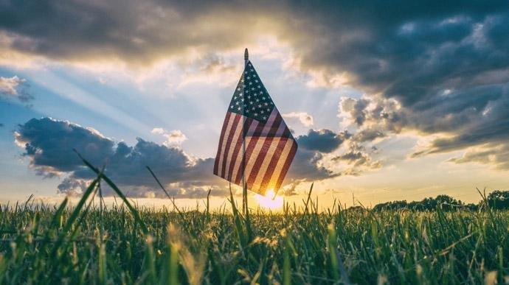
… by which have been given to us exceedingly great and precious promises, that through these you may be partakers of the divine nature, having escaped the corruption that is in the world through lust. — 2nd Peter 1:4
great
partaker
partaker
escape
escape
the world
. .
Notes:
Certainly, depending upon His precious promises frees us from the corruption that swirls around us all. What should be shown honor is more often not, because of human failings to regard the noble over the despicable. Handshakes or fists exposes ones deepest treasures. What makes a people great is found in their value for each other. Trust, honesty, bravery, and yes, humor is what drives all that is great in mankind. To lose these is to lose civilization itself.

Slide 62
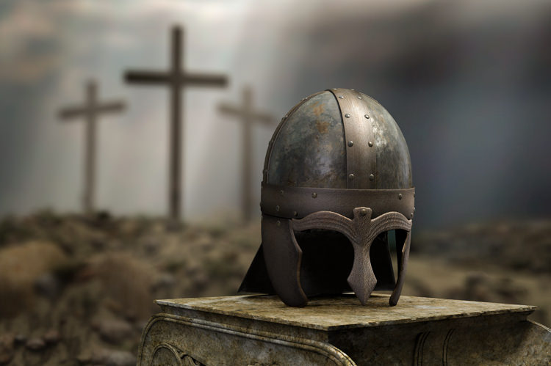
helmet

Slide 63
And take the helmet of salvation, and the sword of the Spirit, which is the word of God; — Ephesians 6:17
helmet
sword
sword
word of God
. .
Notes:
Our defense is in our knowledge of Him through the Holy scriptures. Hope is the medicine that blossoms upon the hearts of the faithful. Without the helmet of truth there can be no other way.

Slide 64
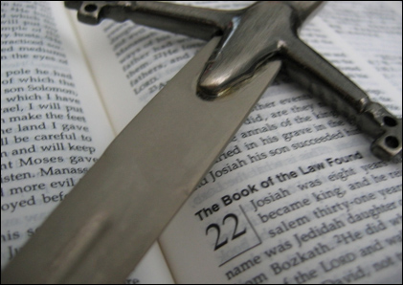
For the word of God is living and powerful, and sharper than any two-edged sword, piercing even to the division of soul and spirit, and of joints and marrow, and is a discerner of the thoughts and intents of the heart. And there is no creature hidden from His sight, but all things are naked and open to the eyes of Him to whom we must give account. Seeing then that we have a great High Priest who has passed through the heavens, Jesus the Son of God, let us hold fast our confession. — Hebrews 4:12-14
word of God
living and powerful
word of God
word of God = living and powerful
↓
piercing the division of soul and spirit
= a discerner of the thoughts
intents of the heart
● no creature hidden
of Jesus whom we must give account
Seeing let us hold fast our confession
piercing
the division of soul and
spirit
discerner of the thoughts
intents of the
heart
no creature hidden
a
of
whom we must give
account
Seeing
Jesus
let us hold
fast our confession
Notes:
The pending notice has been delivered to mankind. Hidden in time is a wind that will pass as all will come to stand naked before Him.

Slide 65
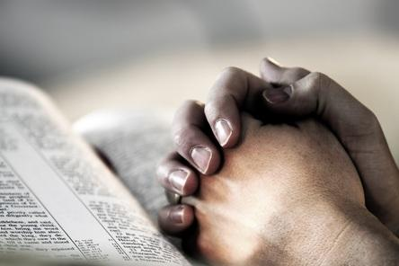
For the weapons of our warfare are not carnal but mighty in God for pulling down strongholds, casting down arguments and every high thing that exalts itself against the knowledge of God, bringing every thought into captivity to the obedience of Christ, … — 2nd Corinthians 10:4-5
in
mighty in God
knowledge of God
knowledge of God
obedience of Christ
obedience of Christ
Notes:
The greatest weapon is knowledge supported by the truth.

Slide 66
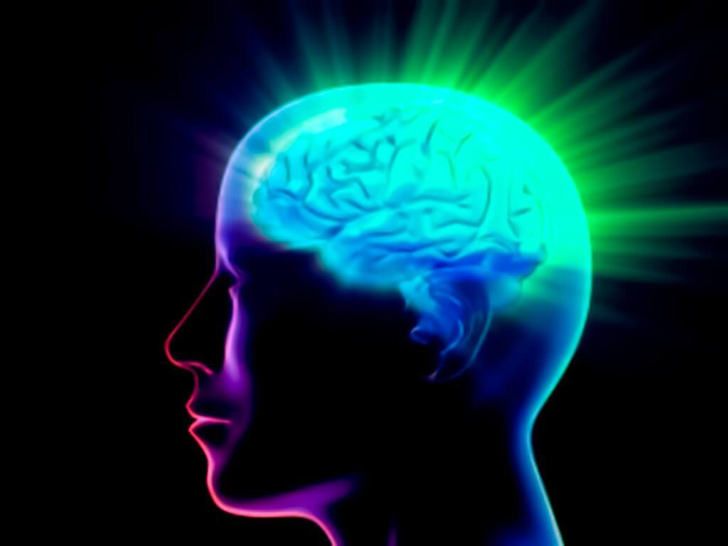
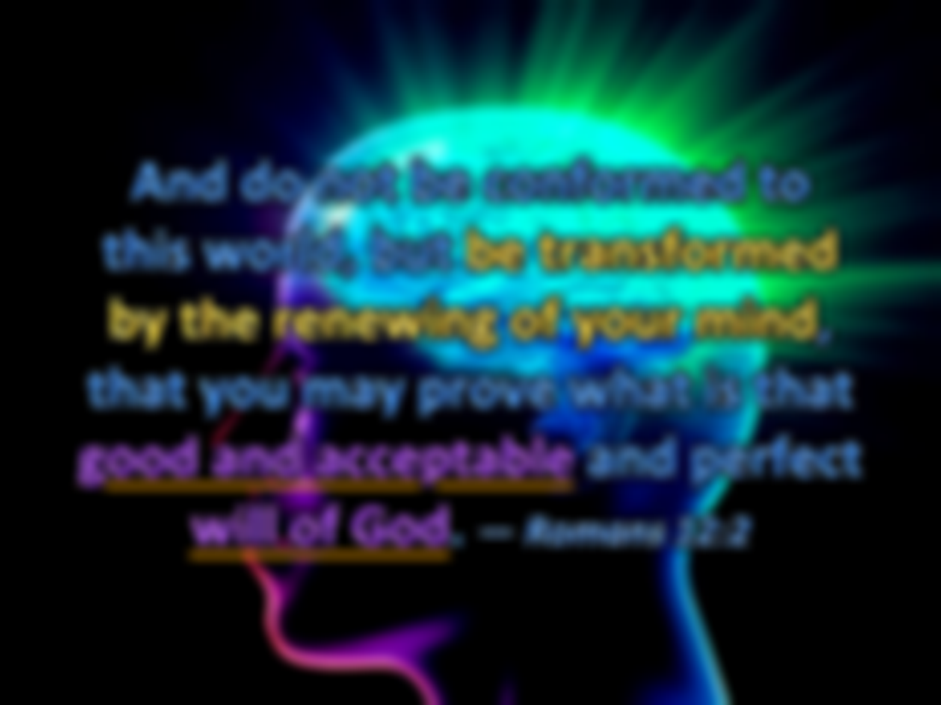
And do not be conformed to this world, but be transformed by the renewing of your mind, that you may prove what is that good and acceptable and perfect will of God. — Romans 12:2
good and acceptable
good and acceptable
will of God
will of God
Notes:
What we seek is who we become. If we seek God, it is in nature to become holy. Seeking humanism only finds emptiness. Many find themselves prisoners of the flesh missing that higher calling. Our choices define our destination in His kingdom of eternal life, either alive in Him or dead without. God does not expect His creatures to remain stagnant.

Slide 67
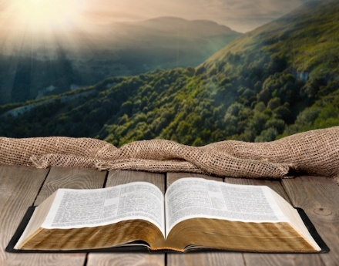
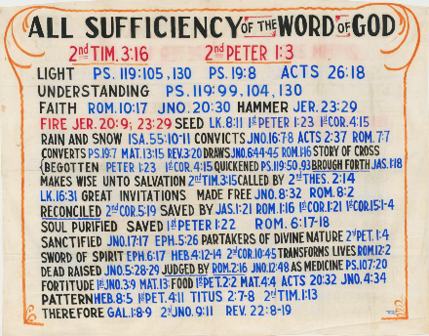
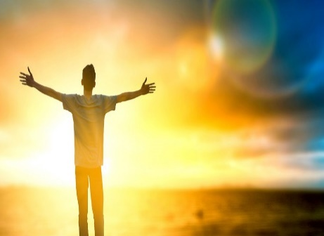
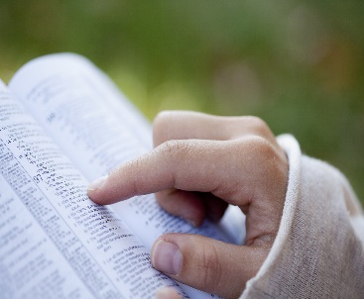
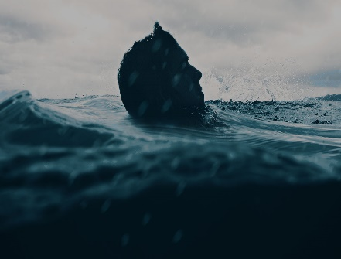
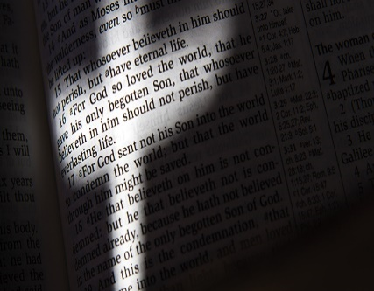

Slide 68
→ He calls for us to come out of the corruptible
→ God’s word comforts one during afflictions
→ God begets us with His own word of truth
→ The gospel call goes forth to come to Christ
→ Life in Christ frees us from the law of sin and death
→ It is receiving the word that is able to save our souls
→ God’s own sacrifice in Jesus allows us to stand
→ Obedience from the heart is devotion to God
→ God’s word washes our hearts and cleanses the soul
→ His promise renders an escape to a divine nature
→ God’s word moves the spirit and convicts the sinner
→ Virtuous weapons are maintained by God’s truth
→ Be renewed transformed into doing the will of God
Time reveals a heart’s image for God or not
Notes:
Time reveals a heart’s image for God or not

Slide 70
All Sufficiency of the Word of God
3
Ron Bert
December 6, 2020

Slide 73
ALL SUFFICIENCY WORD GOD
OF THE
OF
#1
#2
#3

Slide 74
"Do not marvel at this; for the hour is coming in which all who are in the graves will hear His voice and come forth --those who have done good, to the resurrection of life, and those who have done evil, to the resurrection of condemnation." — John 5:28-29
done good → resurrection of life
done evil → resurrection of
condemnation
done good
resurrection of life
done evil
resurrection
of
condemnation
Notes:
Two destinations lie ahead. Common sense declares truth concerning the matter of life and death.

Slide 75
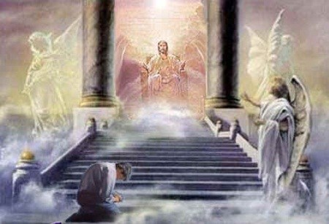
… in the day when God will judge the secrets of men by Jesus Christ, according to my gospel. — Romans 2:16
the
God will judge
God will judge
by Jesus Christ
according to the gospel
the secrets of men
the secrets of men
by Jesus Christ
according to
gospel
Notes:
No surprises as the word has been delivered.

Slide 76
"He who rejects Me, and does not receive My words, has that which judges him -- the word that I have spoken will judge him in the last day." — John 12:48
word
word
the word
the word
will judge him
will judge him
Notes:
If only more people took God’s word to heart, peace would abound. Many proud individuals account to themselves only, outraged by any interference from others.

Slide 77
He sent His word and healed them, And delivered them from their destructions. — Psalms 107:20
word
word
healed
word
delivered
delivered
Notes:
It is the word that delivers and heals us.

Slide 78
Whoever has been born of God does not sin, for His seed remains in him; and he cannot sin, because he has been born of God. — 1st John 3:9
seed
born of God
born of God
seed
His seed remains
His seed remains
Notes:
The gift of God is forgiveness for all those who earnestly plea for His salvation.

Slide 79
"But he who received seed on the good ground is he who hears the word and understands it, who indeed bears fruit and produces: some a hundredfold, some sixty, some thirty." — Matthew 13:23
seed
word
understands it
understands it
word
action
bears fruit and produces
bears fruit and produces
Notes:
Diligent effort equates directly to results. Careless or careful indicates potential outcomes.

Slide 80
… as newborn babes, desire the pure milk of the word, that you may grow thereby, … — 1st Peter 2:2
word
word
Notes:
The word is a pearl without price. A heart that gleams from within has more than the moon can shine.

Slide 81
But He answered and said, "It is written, 'Man shall not live by bread alone, but by every word that proceeds from the mouth of God.'" — Matthew 4:4
word
word
word
word
of God
of God
Notes:
An eternal meal has been prepared for all who would choose to eat of it.

Slide 82
"So now, brethren, I commend you to God and to the word of His grace, which is able to build you up and give you an inheritance among all those who are sanctified." — Acts 20:32
the word of His grace
able to build you up
give you an inheritance
↑
all who are sanctified
word
the word of His
teaches
grace
able to build you
improvement
up
give you an inheritance
all
who are
sanctified
sanctified
sanctified
Notes:
One must ask where one’s heart of consideration is, and if one bases decisions and or avoidances on His word.

Slide 83
Jesus said to them, My food is to do the will of Him who sent Me, and to finish His work." — John 4:34
to do the will of Him
to do the will of Him
Notes:
Jesus was that example of how we should respond to the call of God.

Slide 84
… who serve the copy and shadow of the heavenly things, as Moses was divinely instructed when he was about to make the tabernacle. For He said, "See that you make all things according to the pattern shown you on the mountain." — Hebrews 8:5
all things according to
. .
pattern shown you
. .
Notes:
God’s word includes warnings to follow what it includes, not what it does not include.

Slide 85
God

Slide 86
If anyone speaks, let him speak as the oracles of God. If anyone ministers, let him do it as with the ability which God supplies, that in all things God may be glorified through Jesus Christ, to whom belong the glory and the dominion forever and ever. Amen. — 1st Peter 4:11
in all things
in
in all things
all things
all things
through Jesus Christ
God
God
God
Jesus Christ
through Jesus Christ
Notes:
One needs to consider Christ in contemplating actions in life. To glorify God increases the goodness a soul maintains.
Through – 472 times in Bible

Slide 87
… in all things showing yourself to be a pattern of good works; in doctrine showing integrity, reverence, incorruptibility, sound speech that cannot be condemned, that one who is an opponent may be ashamed, having nothing evil to say of you. — Titus 2:7-8
in all things
be a pattern of good works in doctrine:
● showing integrity
● reverence
● incorruptibility
● sound speech
not condemned
in all things
in all things
be a pattern of good works
be a pattern of good works
pattern
be a pattern of good works
in
pattern
in doctrine
showing integrity
reverence
incorruptibility
sound
speech
not
condemned
Notes:
As we walk the path in life, one knows good from evil, if one has an inkling of good, and it is good that must be pursued if salvation is to be had. As the waves hit the beach of our lives, are we able to resist being dragged out to sea?

Slide 88
Hold fast the pattern of sound words which you have heard from me, in faith and love which are in Christ Jesus. — 2nd Timothy 1:13
Hold fast
pattern
Hold fast
pattern of sound
Hold fast
words
which you have heard
Hold fast
pattern of sound words
which you have heard
● in faith and love
● in Christ Jesus
in faith and love
in
Christ Jesus
in
in
Christ Jesus
Notes:
God’s word shows the pattern for behavior He looks for in His creatures. It is a clear line between moral an immoral behavior. This is what God calls for.

Slide 89
But even if we, or an angel from heaven, preach any other gospel to you than what we have preached to you, let him be accursed. As we have said before, so now I say again, if anyone preaches any other gospel to you than what you have received, let him be accursed. — Galatians 1:8-9
any other gospel
. .
be accursed
. .
Notes:
God’s word has been delivered not to be altered. It declares itself complete and sufficient to instruct as it is. Man wishes to change standards based on social whims or authoritarian demands. It is not God that changes, that is left to the slippery slopes of man.

Slide 90
doctrine of Christ

Slide 91
Whoever transgresses and does not abide in the doctrine of Christ does not have God. He who abides in the doctrine of Christ has both the Father and the Son. If anyone comes to you and does not bring this doctrine, do not receive him into your house nor greet him; for he who greets him shares in his evil deeds. — 2nd John 1:9-11
does not
does not abide in the doctrine of Christ
doctrine of Christ
abide in the
doctrine of
Christ
Human Declarations
God’s Proclamation
abides in the doctrine of Christ
abides in
the
doctrine
of Christ
Hell
Heaven
Notes:
Each of us make choices daily for and against the word of God. We all need improvement, not one is without need.

Slide 92
Now I, John, saw and heard these things. And when I heard and saw, I fell down to worship before the feet of the angel who showed me these things. Then he said to me, "See that you do not do that. For I am your fellow servant, and of your brethren the prophets, and of those who keep the words of this book. Worship God." — Revelation 22:8-9
this book
servant
this book
keep the words of this book
keep
Worship God
Worship God
Notes:
Nothing but God should be the focus of our worship. Thankfulness for what He has created for us to know, and be, should take precedence. If we worship creation, or those things created, it does not align with the truth of what God has done, and what He rightly deserves.
Keep = 361 time in Bible

Slide 93
And he said to me, "Do not seal the words of the prophecy of this book, for the time is at hand. He who is unjust, let him be unjust still; he who is filthy, let him be filthy still; he who is righteous, let him be righteous still; he who is holy, let him be holy still." And behold, I am coming quickly, and My reward is with Me, to give to every one according to his work." — Revelation 22:10-12
this book
unjust
filthy
righteous
holy
Actions
Notes:
All will be held accountable for both things done good and bad. His grace will be sufficient if our nobility outweighs our wickedness.

Slide 94
"I am the Alpha and the Omega, the Beginning and the End, the First and the Last." Blessed are those who do His commandments, that they may have the right to the tree of life, and may enter through the gates into the city. But outside are dogs and sorcerers and sexually immoral and murderers and idolaters, and whoever loves and practices a lie. — Revelation 22:13-15
outside are:
● dogs
● sorcerers
● sexually immoral
● murderers
● idolaters
● whoever loves a lie
● whoever practices a lie
who do
who do
right to the tree of life
right to the tree of life
outside are
dogs
sorcerers
sexually immoral
murderers
idolaters
whoever loves
whoever
practices a lie
a lie
Notes:
We need to be careful that we are not deceiving ourselves and practicing those things that are offensive to God. To be heaven bound one must give it that good old college try. As Winston Churchill said, “Never give up.”

Slide 95
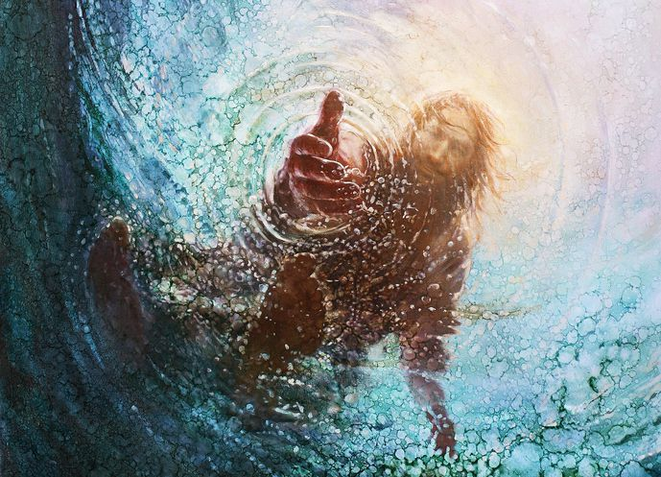
"I, Jesus, have sent My angel to testify to you these things in the churches. I am the Root and the Offspring of David, the Bright and Morning Star." And the Spirit and the bride say, "Come!" And let him who hears say, "Come!" And let him who thirsts come. Whoever desires, let him take the water of life freely. — Revelation 22:16-17
I am the Root
Come
Come
Whoever desires
Whoever desires
water of life freely
water of life freely
Notes:
Come is the call, before it is too late and the door to eternal life closes, with a deafening exasperation of expired! To be included in His Book of Life one has to come on His terms. The terms are written in His word for all to know.

Slide 96
Book of Life

Slide 97
For I testify to everyone who hears the words of the prophecy of this book: If anyone adds to these things, God will add to him the plagues that are written in this book; and if anyone takes away from the words of the book of this prophecy, God shall take away his part from the Book of Life, from the holy city, and from the things which are written in this book. — Revelation 22:18-19
hears
hears
of this book
. .
in
in this book
Book of Life
in this book
Notes:
To hear the word of God edifies the soul and improves all aspects of living. If it is one's desire to love, this cannot be done without a humble submission to God in repentance. Then, and only then, can a spirit rise past all foolish mistakes accepting His breathless offer.

Slide 99
→ A resurrection is coming, life for good, death for evil
→ The word of God will be judgment’s gauge
→ God’s own sacrifice protects the faithful seekers
→ Desire the nurturing word eagerly
→ Sanctified in His word builds an inheritance
→ To do the will of God is to finish the race
→ God wills we follow the pattern of good works
→ To change the doctrine of Christ is damning
→ Only those abiding in Jesus will find salvation
→ We are to worship God & no creation of His making
→ Blessing for all who obey His call to noble service
→ Jesus is the root of Spirit that pleas we Come
→ To hear and act on His word offers life in Him
In God life is more than exotic where angels live
Notes:
In God life is more than exotic where angels live

Slide 101
Please visit http://www.RonBert.com to explore further
Ronald Bert Channel on
Notes:
Eternity never ends.

