Slide 1
Notes:
Darkness oh darkness, how art thou able to see?

Slide 2
Sheep/Goats
Ron Bert
December 5, 2021

Slide 3
Notes:
No Light is Greater

Slide 4
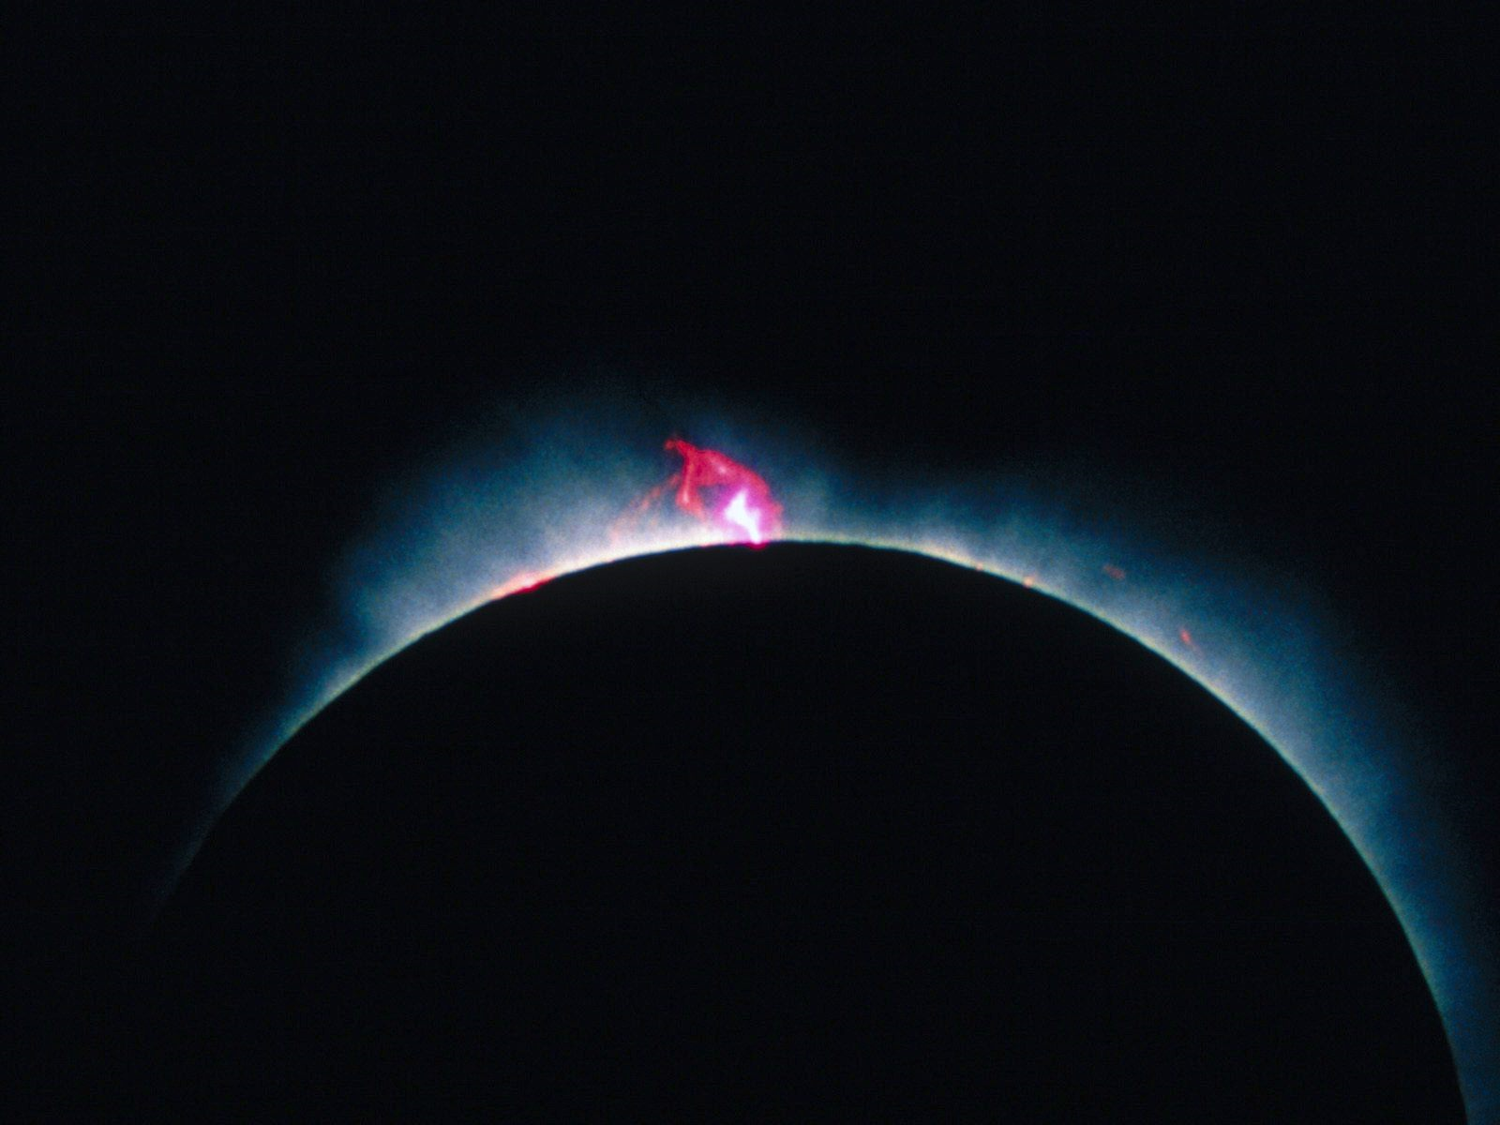
2nd John
Judges
Joshua
1st John
Ruth
Deuteronomy
3rd John
2nd Peter
Numbers
1st & 2nd Samuel
Jude
1st Peter
Leviticus
Obadiah
Revelation
1st Corinthians
1st & 2nd Kings
Exodus
Amos
Jonah
James
2nd Corinthians
1st & 2nd Chronicles
Romans
Genesis
Joel
Galatians
Micah
Hebrews
Ezra
"Is not My word like a fire?"
"Is not My word like a fire?"
Hosea
Ephesians
Nehemiah
Daniel
Nahum
Philemon
Matthew
Malachi
Acts
Esther
Philippians
Habakkuk
Ezekiel
Titus
Zechariah
Mark
John
Job
Lamentations
Zephaniah
2nd Timothy
Colossians
Luke
Psalms
Haggai
Jeremiah
1st Timothy
Proverbs
1st Thessalonians
Isaiah
Ecclesiastes
2nd Thessalonians
Song of Solomon
Notes:
Only each humble heart can admit to how much one has examined His word concerning His presence among us. Sixty six books, 39 in the Old Testament and 27 in the New are open for review. To miss the Lord is to undermine the deepest reasons for living.

Slide 5
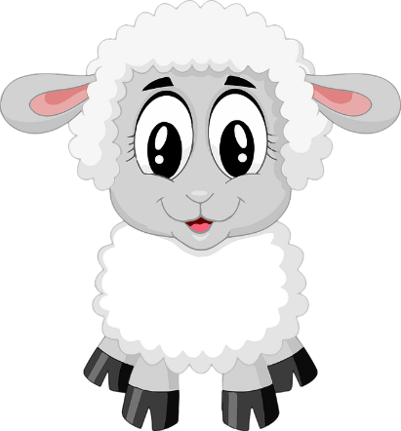
Judgment
Proud
Judgmental
Righteous
Show Mercy
Empathy
Generous
Depart from Me
Come
Closer
Top
Dwellers
Kingdom Inheritance
Bottom
Dwellers
Everlasting Fire
Eternal Punishment
Eternal Punishment
Everlasting
Life
Everlasting
Life
Notes:
No Light is Greater

Slide 6
"Do not marvel at this; for the hour is coming in which all who are in the graves will hear His voice and come forth - those who have done good, to the resurrection of life, and those who have done evil, to the resurrection of condemnation." — John 5:28-29
of life
of life
of condemnation
of condemnation
Notes:
No Light is Greater

Slide 7
… He makes His sun rise on the evil and on the good …
Matthew 5:44-45
… He remains faithful …
2nd Timothy 2:13
Pureness of His Light
Unrighteous
Hope
1st John 1:5
Hebrews 6:19
1st Corinthians 6:9-10
Respectful Angels
Liars
Light of life
Faith
Fools
Psalms 36:9
Believers
Revelation 21:8
Truth
Hebrews 11:1
Psalms 14:1
Psalms 103:19-20
Unbelievers
Outer Darkness
John 3:16
Psalms 100:5
Wise
GOD
GOD
GOD
GOD
GOD
UNKIND
Righteous
Titus 1:15
Matthew 8:12
Unprofitable Servant
Proverbs 16:4
1st John 5:20
SHEEP
GOATS
Disrespectful Angels
Jesus Christ Saves
GOATS
Falling
KIND
Unfaithful
1st Peter 5:5-11
Proverbs 12:28
Matthew 25:30
Death
Hate
Fallen
Children of light
2nd Peter 2:4
Titus 3:4-7
Matthew 25:32-33
Proverbs 24:16
Rising
2nd Timothy 3:1-4
Faithful
SHEEP
1st John 3:15
Romans 6:23
Chained Angels
Ephesians 5:6-11
Psalms 36:12
Evil Deeds
John 8:12
Luke 22:45-46
Forgiveness of sins
John 10:27
Job 34:21-22
Jude 1:6
Reserved Darkness
Job 21:30
Love
Acts 26:18
2nd Peter 2:17
1st Corinthians 13:4-6
Notes:
In the realm of His light there are believers and unbelievers. He has revealed what is and what will be. After all is said and done, it is God that remains above all for all that is faithful in His goodness. The righteous will not witness the ultimate demise of the unrighteous, however, the wicked will witness good’s ascension. To dismiss the trumpets played for all to hear is to fall on a fools silent shock. Hearts will deposit where they have sought.

Slide 8
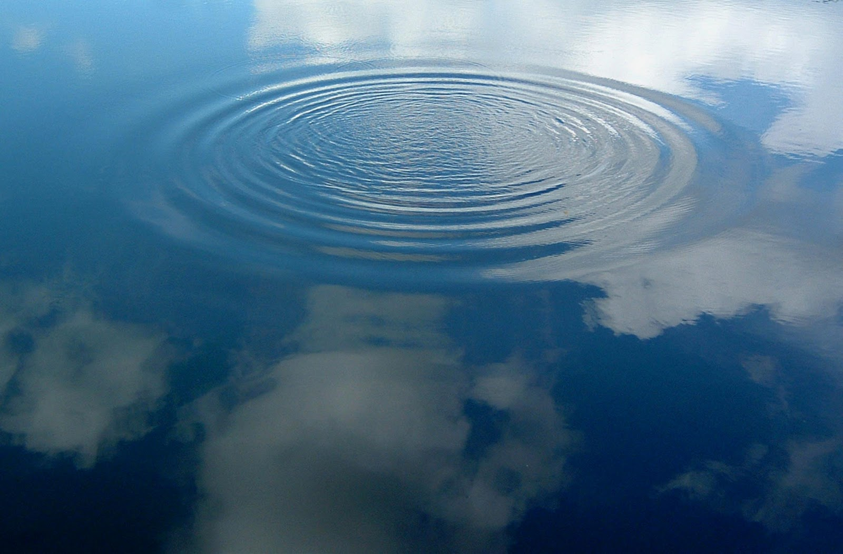
GOD
Jesus Christ

Slide 9
But when the kindness and the love of God our Savior toward man appeared, not by works of righteousness which we have done, but according to His mercy He saved us, through the washing of regeneration and renewing of the Holy Spirit, whom He poured out on us abundantly through Jesus Christ our Savior, that having been justified by His grace we should become heirs according to the hope of eternal life. — Titus 3:4-7
love of
Savior
God
our Savior
Holy Spirit
His mercy
saved us
renewing of the Holy
God
Christ
Christ
Spirit
Jesus Christ
Jesus Christ
justified by His
justified by His
grace
heirs
grace
we should become heirs
hope of eternal life
hope
. .

Slide 11
→ Coming to God is a decision made on purpose
→ His word is the truth that pierces all falsehoods
→ God will separate the good souls from the bad souls
→ Pride will be condemning as the meek are justified
→ Through Christ, the faithful have their sins forgiven
→ Pure religion is to care for the widows and orphans
→ Believers have faith in hope of forgiveness of sins
→ Unrighteous fools hate and practice evil in lies
→ God warns both goats & sheep of coming judgment
→ Already, disrespectful angels reserved in darkness
→ Christian life is a call to rise increasing in faith
→ Jesus Christ saves
→ Justified by His grace, we become heirs
Acceptance of God is to be Immersed in Him

Slide 13
Please visit http://www.RonBert.com to explore further
Ronald Bert Channel on
Notes:
Eternity never ends.

