Slide 2
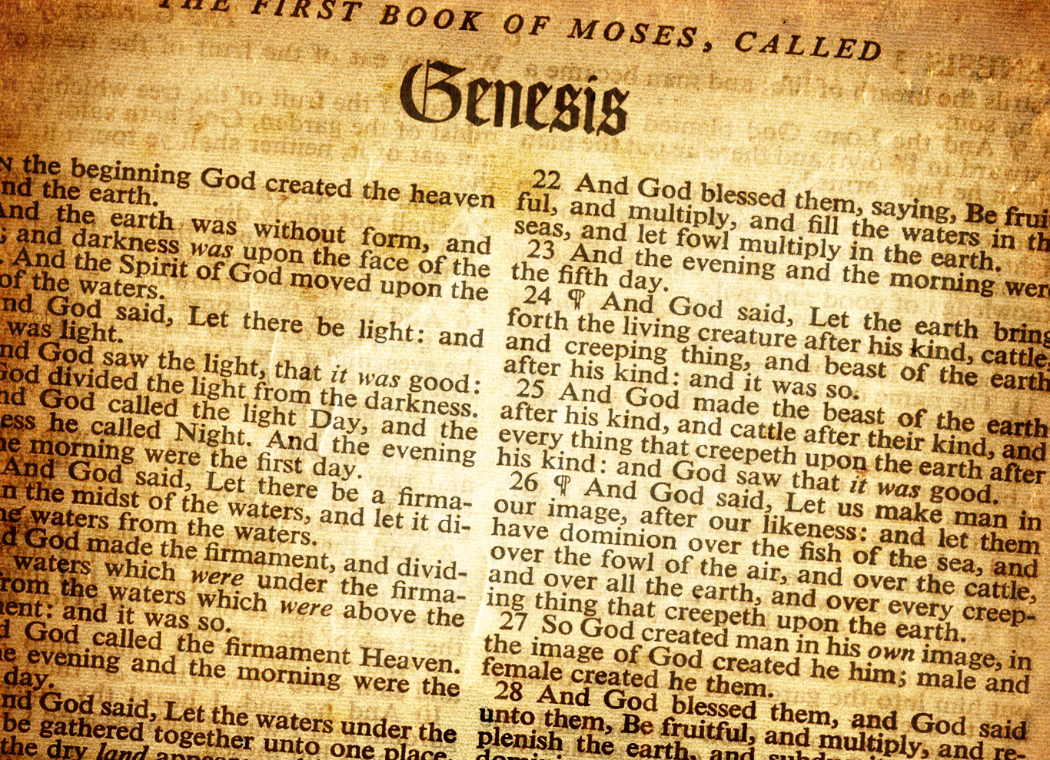
Scripture
Ron Bert
September 23, 2018

Slide 3
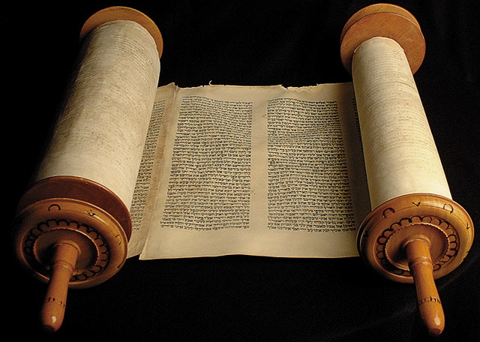
If anyone speaks, let him speak as the oracles of God. If anyone ministers, let him do it as with the ability which God supplies, that in all things God may be glorified through Jesus Christ, to whom belong the glory and the dominion forever and ever. Amen. — 1st Peter 411
If anyone speaks
God
do
God
God
Jesus Christ
glory

Slide 4
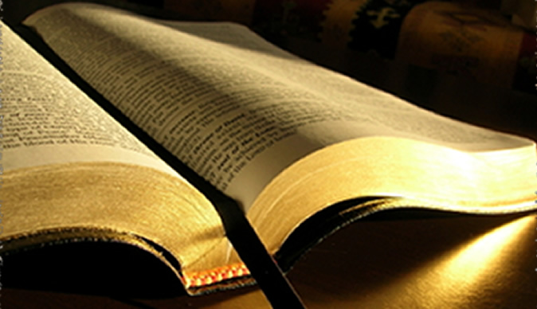
"But I will tell you what is noted in the Scripture of Truth. (No one upholds me against these, except Michael your prince." — Daniel 10:21
Scripture
Scripture of Truth
Scripture
Truth
"God is Spirit, and those who worship Him must worship in spirit and truth."." — John 4:24

Slide 5
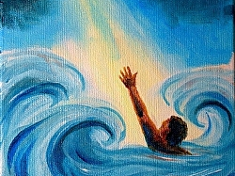
For the Scripture says, "Whoever believes on Him will not be put to shame." — Romans 10:11
Scripture
Scripture says
believes
GOD
Scripture
↑
Substance

Slide 6
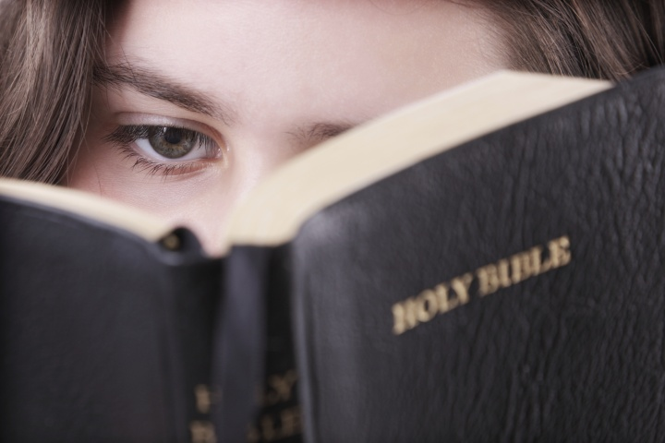
And He opened their understanding, that they might comprehend the Scriptures. — Luke 24:45
Scripture
comprehend the Scriptures
Scripture
↑
Comprehensible

Slide 7
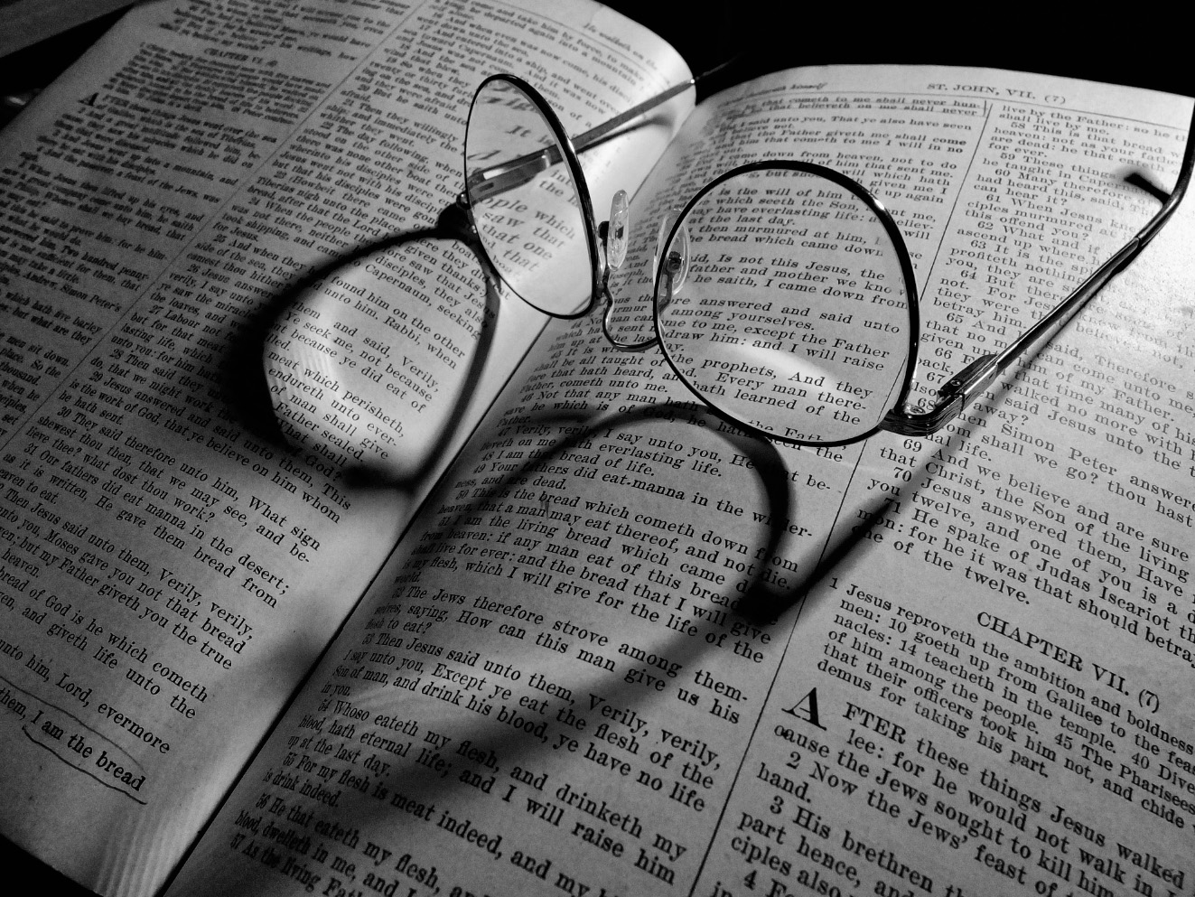
"You search the Scriptures, for in them you think you have eternal life; and these are they which testify of Me." — John 5:39
Searchable
↓
Scripture
search the Scriptures
Scripture

Slide 8
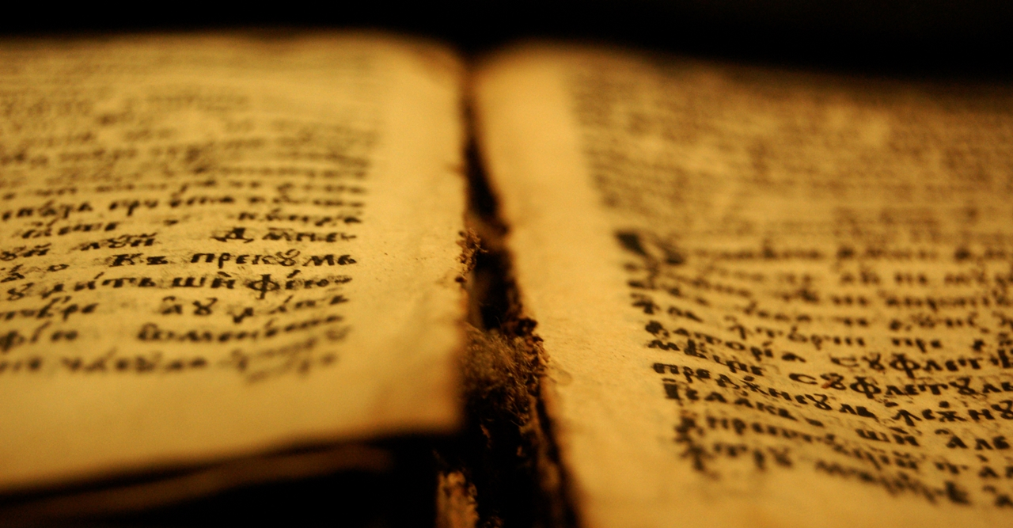
"If He called them gods, to whom the word of God came (and the Scripture cannot be broken), …" — John 10:35
Scripture cannot be broken
Scripture
Scripture
↑
Cannot be broken

Slide 9
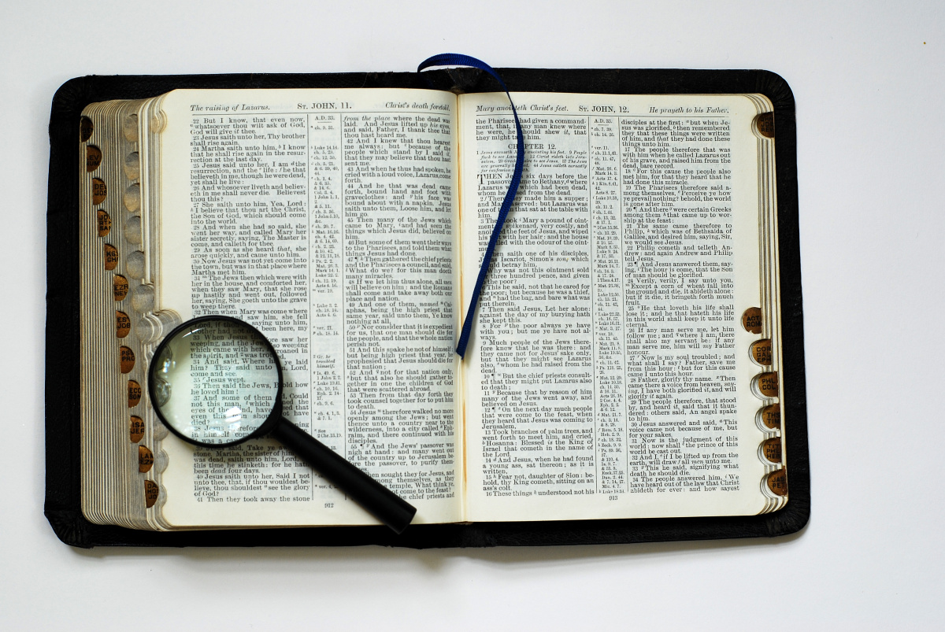
For as yet they did not know the Scripture, that He must rise again from the dead. — John 20:9
Knowable
↓
Scripture
Scripture
know the Scripture

Slide 10
… for he vigorously refuted the Jews publicly, showing from the Scriptures that Jesus is the Christ. — Acts 18:28
Scriptures that Jesus is the Christ
Scripture
Scripture
↑
Shows Jesus is the Christ

Slide 11
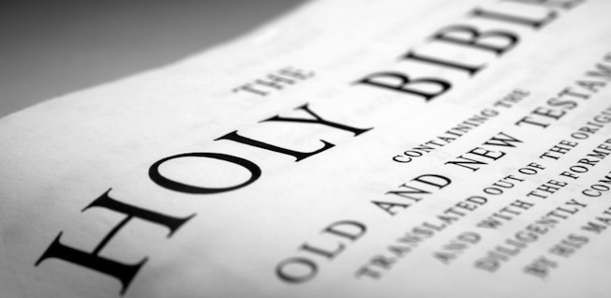
… which He promised before through His prophets in the Holy Scriptures, … — Romans 1:2
Scripture
Holy Scriptures
Scripture
↑
Is Holy

Slide 12
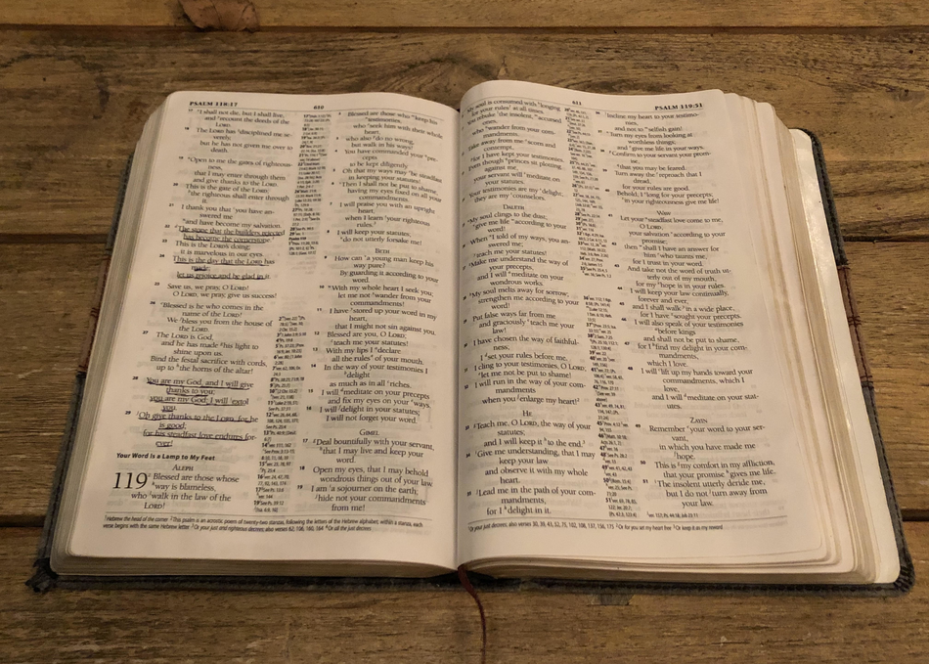
For whatever things were written before were written for our learning, that we through the patience and comfort of the Scriptures might have hope. — Romans 15:4
Scripture
comfort of
Scriptures might have hope
Scripture
↑
Gives Hope

Slide 13
… but now has been made manifest, and by the prophetic Scriptures has been made known to all nations, according to the commandment of the everlasting God, for obedience to the faith … — Romans 16:26
Scriptures
Scripture
Scripture
to all nations
↑
For all nations

Slide 14
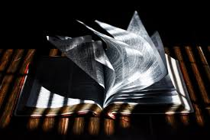
All Scripture is given by inspiration of God, and is profitable for doctrine, for reproof, for correction, for instruction in righteousness, — 2nd Timothy 3:16
Scripture
God breathed
↓
Scripture
Scripture is given
of God

Slide 15
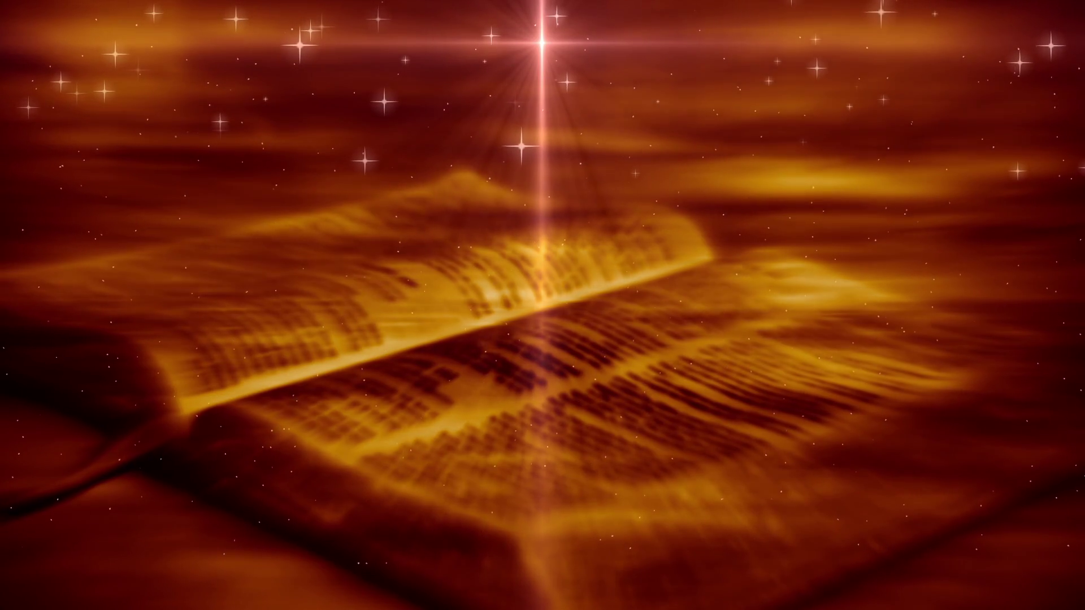
Scripture says about itself: ● Is Truth ● Substance of faith ● Is Comprehensible ● Is Searchable ● Cannot be Broken ● Is Knowable ● States Jesus is the Christ ● Is Holy ● Gives Hope ● Is for all Nations ● Is God Breathed
Scripture

Slide 16
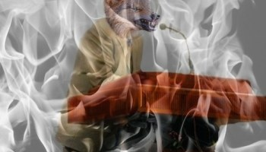
For the time will come when they will not endure sound doctrine, but according to their own desires, because they have itching ears, they will heap up for themselves teachers; — 2nd Timothy 4:3
Scripture gives warnings:
Scripture
not endure sound doctrine

Slide 17
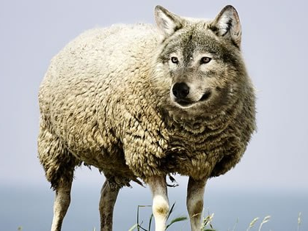
By covetousness they will exploit you with deceptive words; for a long time their judgment has not been idle, and their destruction does not slumber. — 2nd Peter 2:3
greed
deceptive words

Slide 18
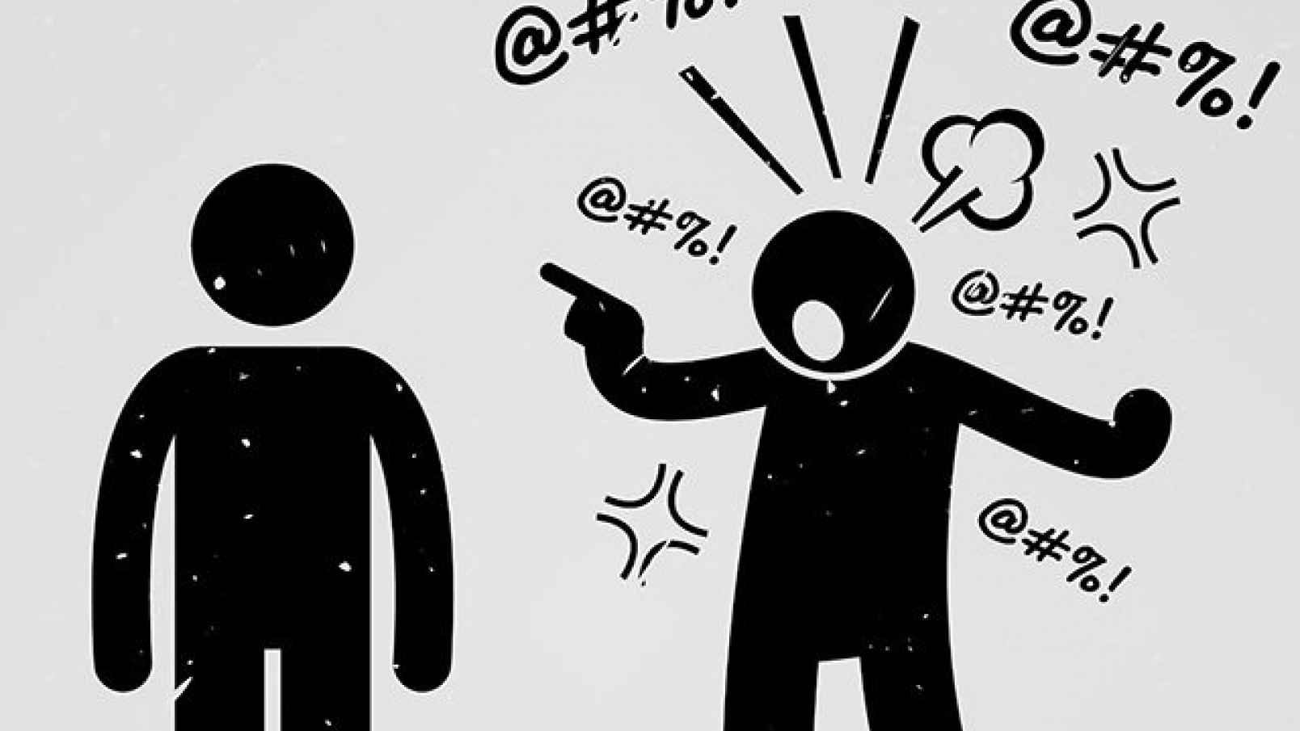
But shun profane and idle babblings, for they will increase to more ungodliness. — 2nd Timothy 2:16
ungodliness

Slide 19
All Scripture is given by inspiration of God, and is profitable for doctrine, for reproof, for correction, for instruction in righteousness, that the man of God may be complete, thoroughly equipped for every good work. — 2nd Timothy 3:16-17
How Scripture helps us:
God
● for doctrine
● for reproof
● for correction
● for instruction in righteousness
for
doctrine
for reproof
for
correction
for instruction in
righteousness
good works

Slide 20
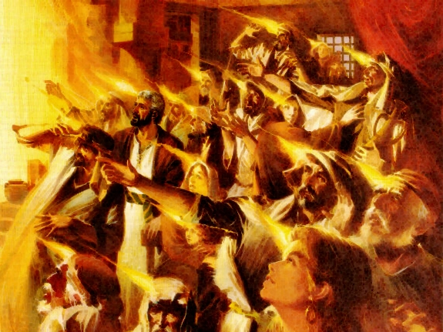
Now when they heard this, they were cut to the heart, and said to Peter and the rest of the apostles, "Men and brethren, what shall we do?" — Acts 2:37
heard
cut to the heart
what shall we
do
↑
Convicts

Slide 21
The law of the LORD is perfect, converting the soul; The testimony of the LORD is sure, making wise the simple; — Psalms 19:7
Converts
↓
Do
D
converting the soul
o

Slide 22
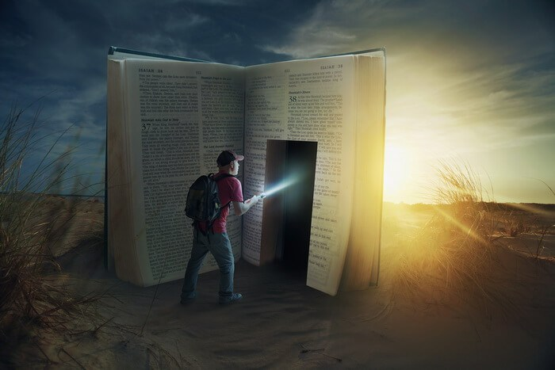
This is my comfort in my affliction, For Your word has given me life. — Psalms 119:50
My son, give attention to my words; Incline your ear to my sayings. Do not let them depart from your eyes; Keep them in the midst of your heart; For they are life to those who find them, And health to all their flesh. Keep your heart with all diligence, For out of it spring the issues of life. — Proverbs 4:20-23
Do
Your word has given me life
life
↑
Gives
Life
life

Slide 23
I have chosen the way of truth; Your judgments I have laid before me. — Psalms 119:30
Gives Understanding
↓
the way of truth

Slide 24
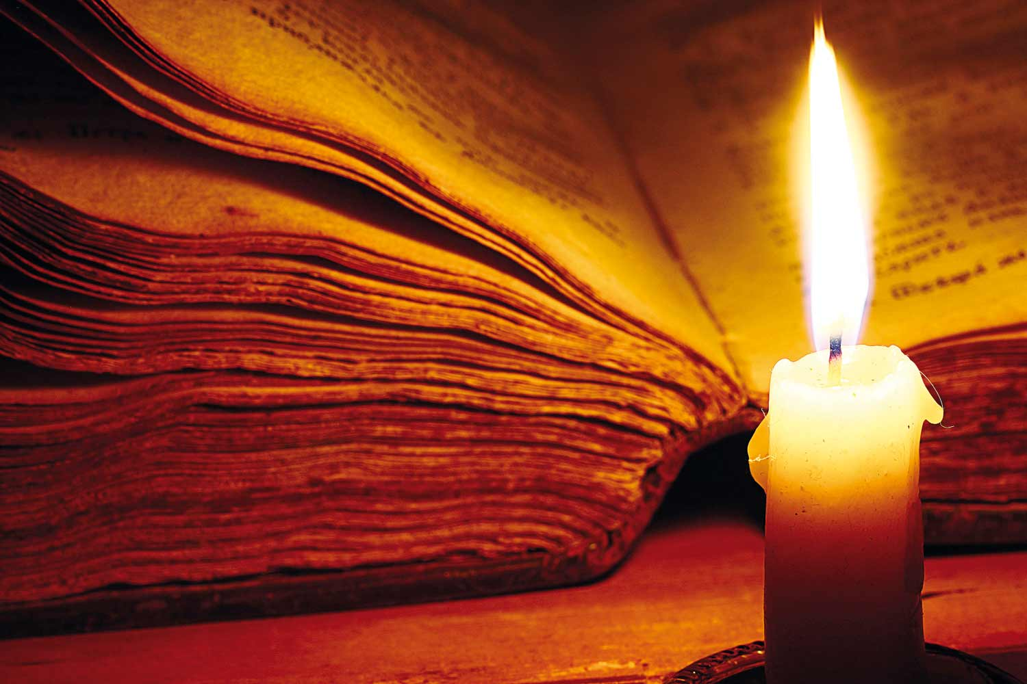
NUN. Your word is a lamp to my feet And a light to my path. — Psalms 119:105
Enlightens
↓
truth
u
r
Your word
t
a light
th

Slide 25
"And you shall know the truth, and the truth shall make you free." — John 8:32
truth
truth
truth
the truth
shall make you free
truth
↑
Sets One free

Slide 26
"Sanctify them by Your truth. Your word is truth." — John 17:17
Sanctifies
↓
truth
truth
Sanctify them by Your truth
word
word

Slide 27
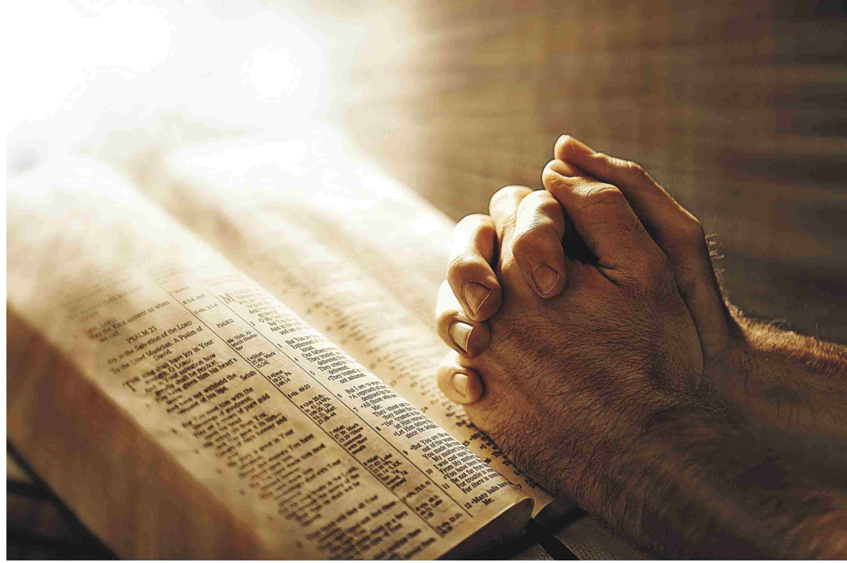
"You are already clean because of the word which I have spoken to you. — John 15:3
word
Cleanses
↓
clean
word
because of the word

Slide 28
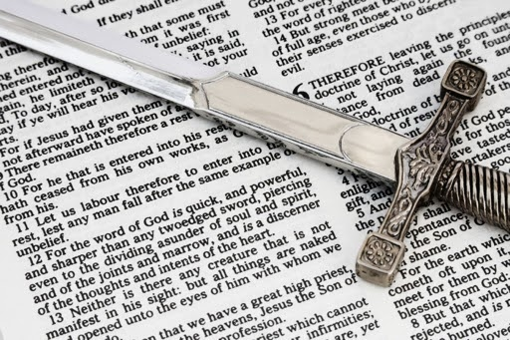
For the word of God is living and powerful, and sharper than any two-edged sword, piercing even to the division of soul and spirit, and of joints and marrow, and is a discerner of the thoughts and intents of the heart. — Hebrews 4:12
word
word of God
heart
↑
Cuts to the heart

Slide 29
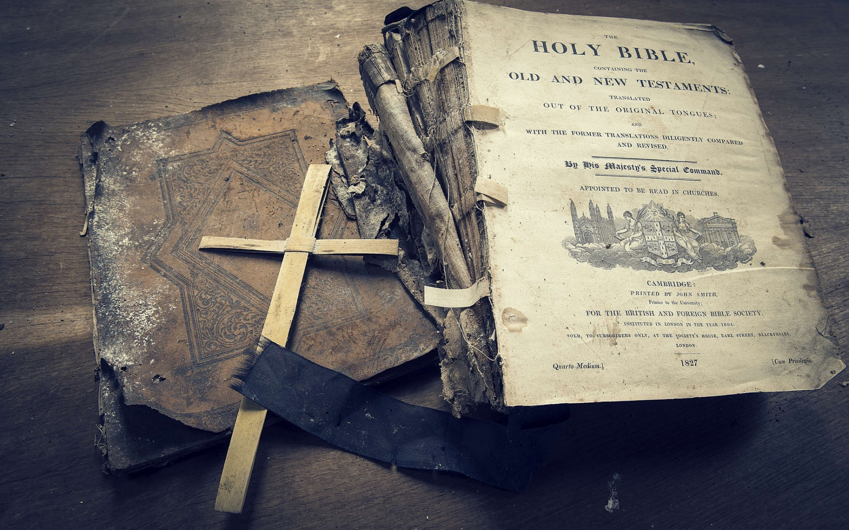
How Scripture helps us: ● Good for reproof, correction, instruction ● Convicts ● Converts ● Gives Life ● Gives Understanding ● Enlightens ● Sets One Free ● Sanctifies ● Cleanses ● Cuts to the heart
ear

Slide 30
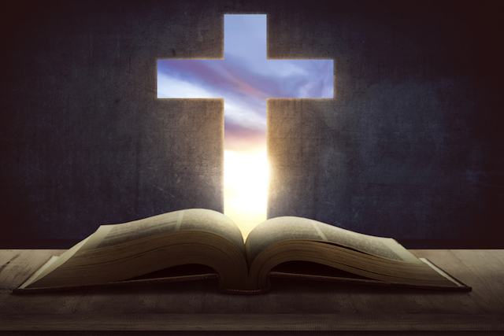
So then faith comes by hearing, and hearing by the word of God. — Romans 10:17

Slide 31
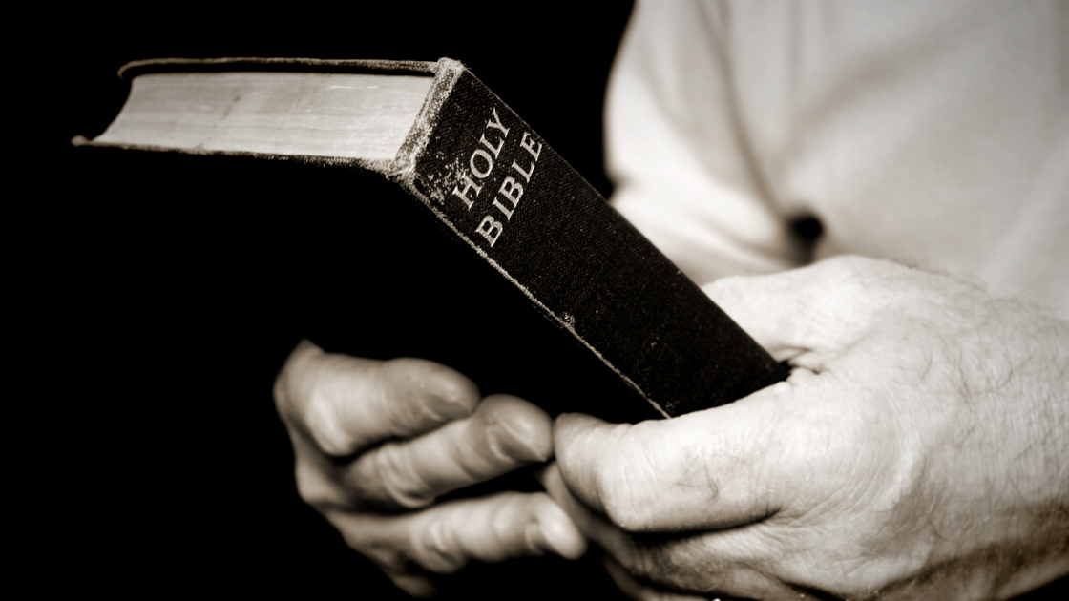
… by which also you are saved, if you hold fast that word which I preached to you -- unless you believed in vain. — 1st Corinthians 15:2
For I delivered to you first of all that which I also received: that Christ died for our sins according to the Scriptures, .... — 1st Corinthians 15:3
But the Scripture has confined all under sin, that the promise by faith in Jesus Christ might be given to those who believe.— Galatians 3:22
… by which also you are saved, if you hold fast that word which I preached to you -- unless you believed in vain. — 1st Corinthians 15:2
Scripture
sin
hold fast
Christ died for our sins
faith in Jesus Christ
in
believe

Slide 32
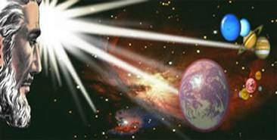
… that is, that God was in Christ reconciling the world to Himself, not imputing their trespasses to them, and has committed to us the word of reconciliation. Now then, we are ambassadors for Christ, as though God were pleading through us: we implore you on Christ's behalf, be reconciled to God. — 2nd Corinthians 5:19-20
in
Resigned
Submissive
Acquiescent
Settled
word of reconciliation
Merged
Joined
Reunited
reconciled

Slide 33
→ God wants us to consider His word before we speak
→ Scripture is truth & contains the substance of faith
→ Scripture is knowable, searchable, and not broken
→ Scripture reveals Jesus is the Christ & gives us hope
→ Scripture is Holy & for all nations - of God’s making
→ False teachers will validate ungodly doctrines
→ Greed will drive an exploiter’s deceptive words
→ Unbridled words will only increase ungodliness
→ Study is good for reproof, correction, & instruction
→ Study convicts, converts, gives life, & understanding
→ Study enlightens, sets free, sanctifies, & cleanses
→ True Faith holds fast to hearing His piercing word
→ God is reconciling us through Jesus with His word
His Word awakens truth reviving the soul
Notes:
His Word awakens truth reviving the soul

Slide 36
Please visit http://www.LoveFromGod.com to explore further
Ronald Bert Channel on
Notes:
Eternity never ends.

