Slide 1
Notes:
Darkness rides on the heels of light.

Slide 2
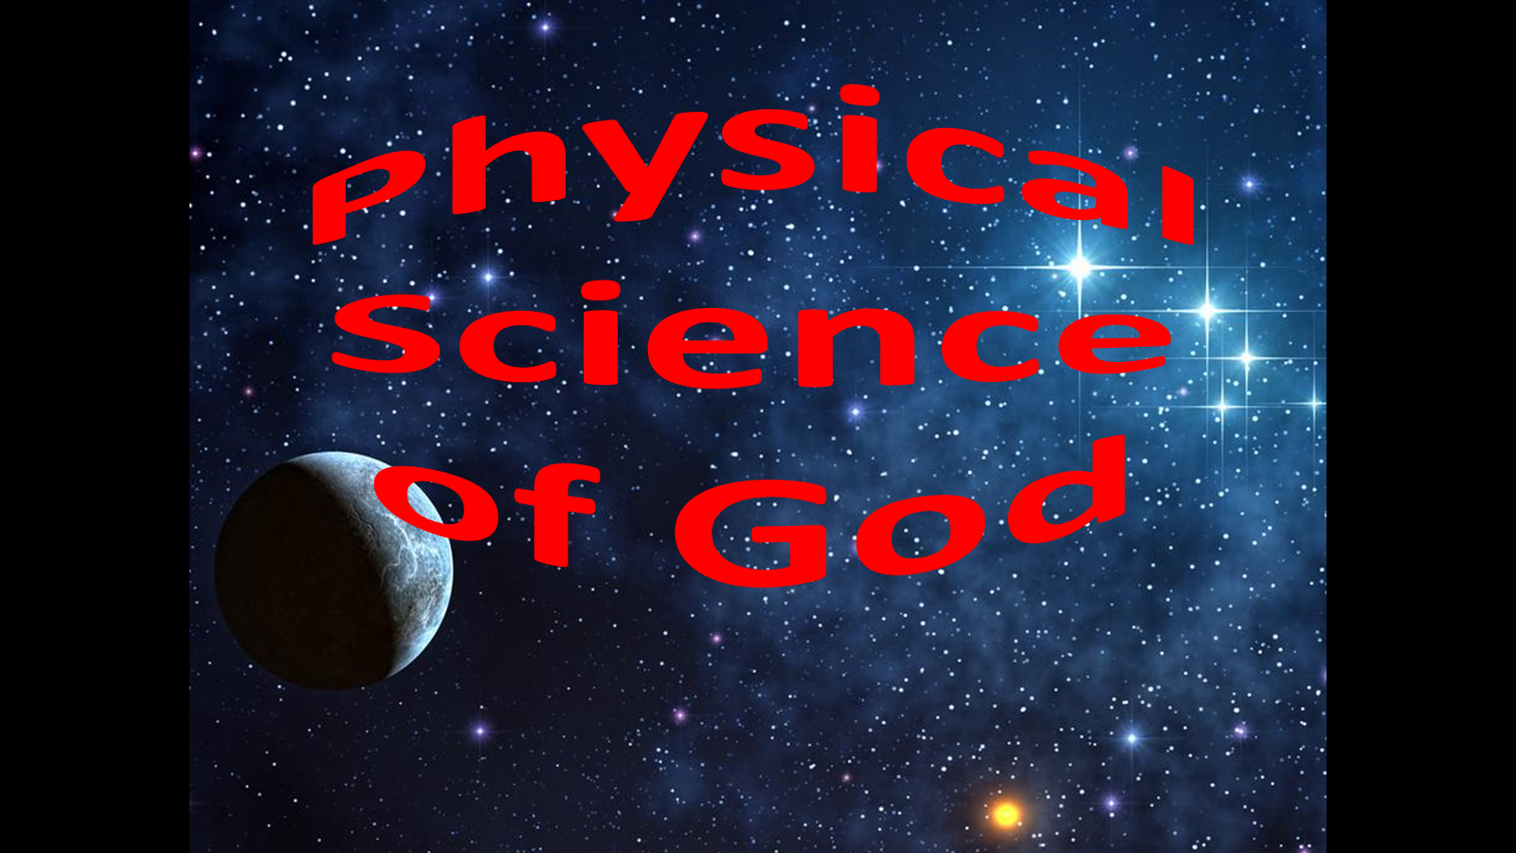
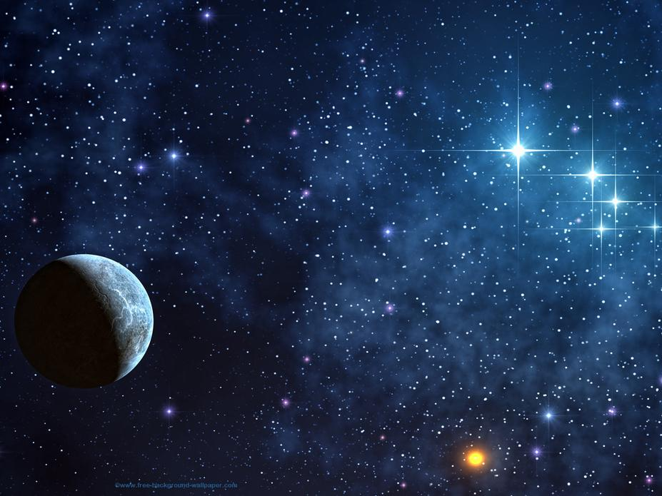
Physical
Science
of God
September 18, 2016
Ron Bert
Notes:
In all that is, God’s presence is what establishes reality. No matter any of our speculations, it is the way God has it. I suppose there comes a time in every preacher’s career where he wishes to take back a sermon that went south. Generally these failure sermons teach the preacher more than those waiting to leave. This was one of those sermons. Errors arose because I tried to fit His inspired word to match my contemporary world knowledge. In studying God’s word we must remain open to be transformed by it, in order to come closer to God’s truth, over any pre-conceived notions. I had always exalted light in its’ purest form putting it at the top of the creation chain, how could anything be greater? And this matched how I was raised, understanding “The Big Bang” theory. My fellow brethren helped my error in reasoning. The biggest thing I learned was to see creation in a new light. I had never really considered the creation of matter before light. I saw Genesis 1:1 as a summary statement, more than a literal sequence of events. The light came on when I took His word as truer than how I was trying to change it. I believe this problem with fitting the Big Bang to match scripture is widespread and very prevalent in our modern day culture. I do leave this sermon intact below to point out how easy it is to misunderstand, and those vices or convincing illustrations that may be used. I believe I innocently deceived myself as my true intent was to honor and glorify God. God is glorified in that He teaches the preachers too. If I rebuilt this sermon it would drastically change to state how the world misinterprets God’s word. Whereas there is not a “Big Bang” as the original creation event, certain principles and natural laws may still be applicable as to how the present functions physically. Whatever it is chosen to be called, Steady Expanding State or whatever, I believe the present can be described with many of the Big Bang characteristics as space and time exhibits behaviors consistent with its’ initial propagating premise. It is just how this propagation commenced that we will never really accurately know. I certainly cannot explain miracles or when and where they may have occurred. I see life in the moment as a miracle, with the ability of lifting the faithful closer to that higher truth, where trust and belief opens the heart to His will, and immeasurable joy connects with the divine. Largely, we should just be thankful that it has come to be that it is, a local event at all real points. In His realm for us it is the present that we should be most concerned about identifying, over distant speculations. I will most definitely be reluctant to give another involved sermon on science. Forgive the following errors, where included, below:

Slide 3
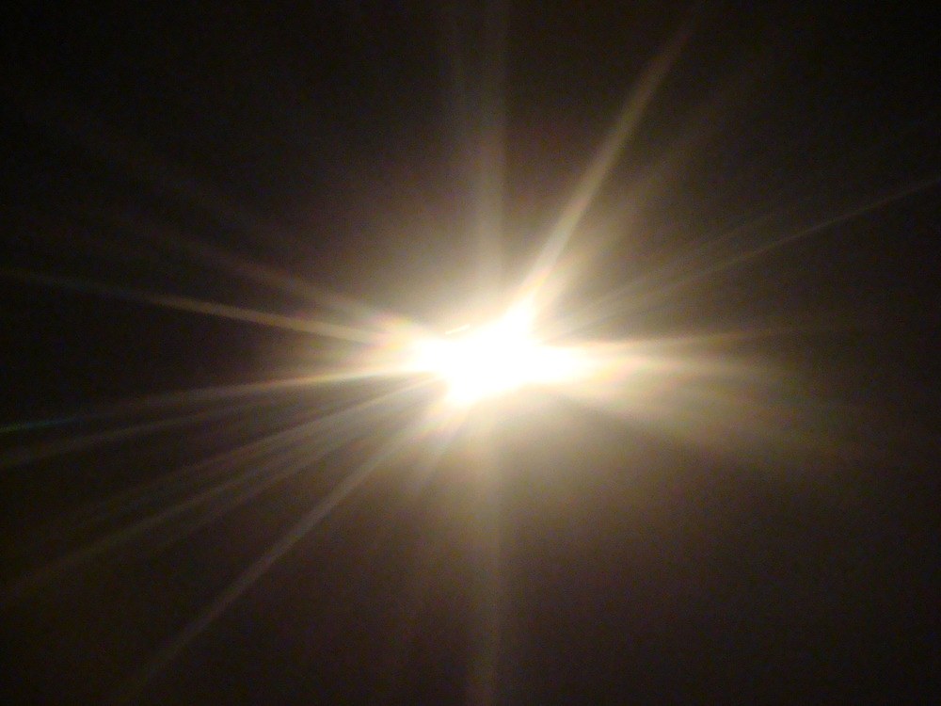
"Where is the way to the dwelling of light? And , where is its place, …" — Job 38:19
light
light
light
light
darkness
darkness
darkness
darkness
darkness
darkness
Notes:
What is under examination is the consideration of light in the darkness or darkness in the light.

Slide 4
The earth was without form, and void; and darkness was on the face of the deep. And the Spirit of God was hovering over the face of the waters. — Genesis 1:2
without form
darkness
face of the deep
.
Spirit of God
over the face
Notes:
God is witness to that which was not before creation, reality from the void of nothing. It is the quantum foundation of darkness that supports the extent and expanse of physical light. From both below and above, God has established what light forms into. It is His universe given to us to know of Him. Discovery is an endless journey into perceiving Him.

Slide 5
Spirit of GOD
No Light
Outside GOD
And He
is before all
things, and in
Him all things consist.
— Colossians 1:17
Darkness
Deep Emptiness
Notes:
Belief can be in many instances a matter of opinion, and in its’ many forms it has certainly caused divisions among countless generations of mankind. If we agree that God is supreme and creation is of His understanding and wisdom, why would it be wrong to see God in what we can observe in the natural universe, and cleave to how it may match up with His inspired word? Are we to diligently seek Him out with our all? More often it is man condemning man over developing clarity and I do not believe God would want us to not understand, as His call is for us to understand. As one day is a thousand years, where do we draw the literal line in understanding His truth? Let us remain open and pray to return to sensibility over confusion among men. Clearly, before matter or light as we know it, God viewed deep darkness in the empty void of pre-creation. This darkness existed outside of God. Mentioned is this lightless realm primed to be creation’s womb where His introduction of light would come forth.

Slide 6
Then God said, "Let there be light"; and there was light. — Genesis 1:3
Notes:
In the empty void, the shear presence of God brought out onward light into the nothingness. No power is greater or could be. It is not said that the Spirit of God is separate from His creation of light.

Slide 7
OF GOD
And God saw the light,
that it
was good;
SPIRIT
.
.
and God
— Genesis 1:4
divided the light from the darkness
Notes:
He remains with oversight of all ongoings. Then light separated in and between areas swirling in voids of darkness. Overall, Light serves God’s purpose in separating good from bad as the butter of life is clarified. His presence qualifies in all that has shine. Light emancipates onward as darkness fades away to the distances of below or above, both synonymous extremes in the realm of unending darkness. The end of darkness is the beginning of light.

Slide 8
He drew a circular horizon on the face of the waters, At the boundary of light and darkness. — Job 26:10
Basic
Origin of
our Universe
While as yet He had not made the earth or the fields, Or the primeval dust of the world. When He prepared the heavens, I was there, When He drew a circle on the face of the deep, … — Proverbs 8:26-27
Simple
Origin of
our Universe
. .
primeval
Original
'I form the light and create darkness, I make peace and create calamity; I, the LORD, do all these things.' — Isaiah 45:7
.
.
Primitive
circular horizon
. .
Primordial
Rudimentary
. .
boundary of light
Elementary
Notes:
We need God to define science, not science to define God. As perceived chaos shatters across the calm, His is the substance of creation maintaining in and out at all real points known. To this inclusive absolute light, impinging upon the present at all real points, it exposes His exquisite delicate violent free beauty, with the circle or sphere as the first geometric object. The sphere is the most naturally occurring symmetrical form in the universe as it is the base form of nature itself. For us light has been separated as it intermingles with the darkness. The sphere of light is the origin of our universe by the declaration of God Himself. He also declares it is a universe of purpose with His wisdom taking precedence over all.

Slide 9
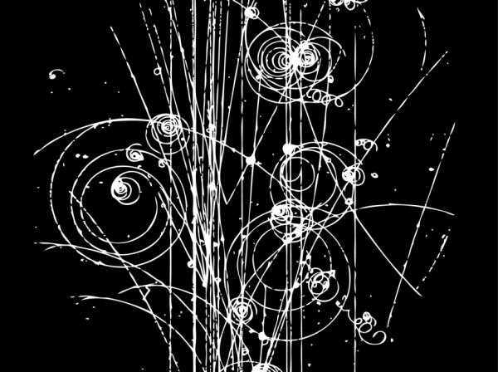
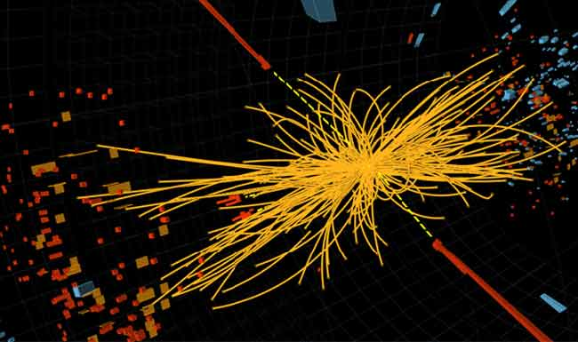
Desolation
Destruction
Upheaval
Origin of
our Universe
Explosion
'I form the light and create darkness, I make peace and create calamity; I, the LORD, do all these things.' — Isaiah 45:7
Harsh conditions
.
Past
Bang
calm
Deluge
calamity
Danger
Cataclysm
The Present
Difficulty
Notes:
Not only is the universe a stage of what is to come as light evaporates upon the darkness, it is an announcement to all angels and hopeful striving human life. It is a witness, where each soul must resolve both internal and external existence in Him, over denning His omniscient unending presence.
Darkness is set just beyond the nugget of light prepared for those choosing to remain alone swelling in loneliness, separate from Him and His ordinances. Unavoidable is both physical and spiritual considerations in such the lives we live. The spiritual realm supersedes and preexists the physical universe. Fundamentally, God’s universe is perfect created for His pleasure maintaining the redemptive qualities of retrieving His autonomous children of light. It is in His shadow that we see His light, given of His everlasting bosom comes pure absolute love, in creation above knowledge. Light is God’s nipple to mankind.
For the material universe, God creates both minimum inert matter at relative rest in relation to hyper active velocities approaching what is maximum. In search for the initial smallest of primeval particles, linear accelerators have blasted particles up against aluminum plates in hydrogen bubble chambers. The tracks left from these particle annihilations are insinuated to be the soup of the original creation, just after the introduction of light. Note the circular vanishings as the inward containment releases outward. Labs like CERN, a circular accelerator, smash particles into each other to further examine these smallest of forms that exist in matter, distinct from photon propagation. Substances called out, such as Charm and Strange lead to the Boson of sub atomic particles, as they parabolicly hold witness in the hyperbolic creation that unfolds before us all. Dividing matter leaps beyond observation as we cannot perceive the edge that maintains reality. God has made elusive and curious His endless present moment.
The mathematical Pi screams out defining His endless spiral into creation at all points. Lessons of His wisdom surely blaze forward in all that is coming from His purposed loving call, given to all; His creation of free life in His image: to be aware of more than self.

Slide 10
"Known to God from eternity are all His works." — Acts 15:18
Origin of
our Universe
.
Past
The Present
Notes:
A main component of the present is its’ reflections of past actions affecting continuing unfolding’s, as a curtain reveals what is to come from that which has been. At the speed of light all expands enlarging and becoming more diffuse as deep darkness welcomes the light. It is His enduring timeless presence that calls upon life touching all.

Slide 11
By faith we understand that the worlds were framed by the word of God, so that the things which are seen were not made of things which are visible. — Hebrews 11:3
"Known to God from eternity are all His works." — Acts 15:18
Origin of
our Universe
by
made by
things
not seen
things
.
Past
seen
not
made
The Present
Notes:
The paradox of His truth is that all remains real from the beginning where nothing is hidden, though we cannot perceive this as it is, being physically isolated, from what is wholly present. Light has spiraled intermingling around the deep dark voids God created for motion to affect upon itself, as substance, in all of its’ forms, continues to commence. Time opens the portal of change and synthesizes becoming.

Slide 12
He alone spreads out the heavens, And treads on the waves of the sea; — Job 9:8
spreads out
made by
things
not seen
Origin of
our Universe
At Light Speed
.
Past
Moments in Space
The Present
Notes:
In the bubble of motion, time hinges from the beginning viewing the end result, which is the present. To see God is to know His extent surpasses all that is in the shadow of time’s passing. The past reflects all that has come from the source of His endless presence. Absolute Time is singular and cannot be dissected as separate components, as distinctly given by the law of God in His one expanse. Time dilation maintains various references unique to local conditions, but no matter what real reality is, it can never be removed from the present.

Slide 13
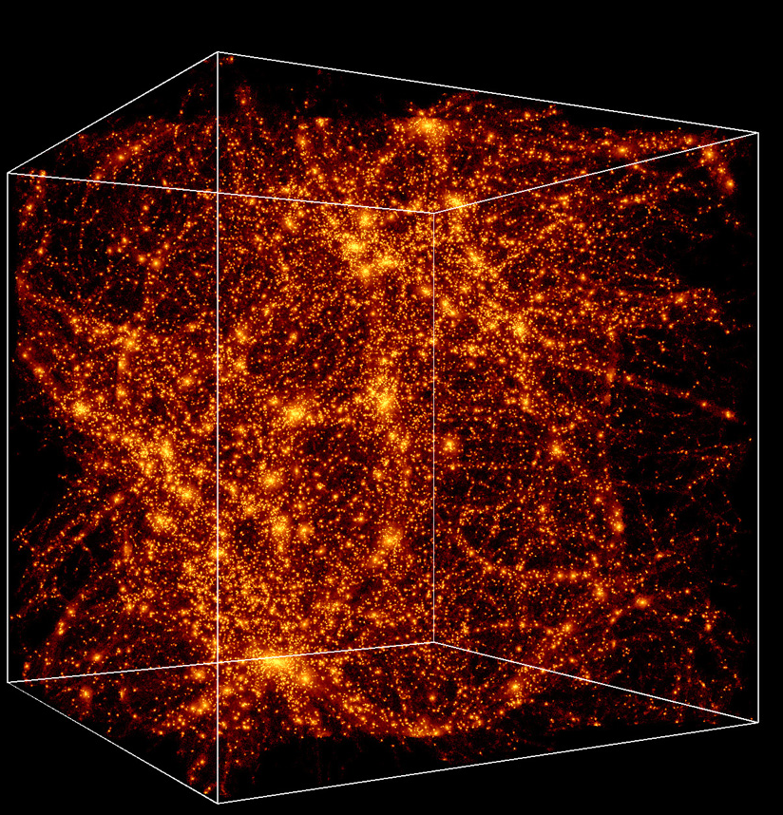
The LORD by wisdom founded the earth; By understanding He established the heavens; — Proverbs 3:19
He alone spreads out the heavens, And treads on the waves of the sea; — Job 9:8
spreads out
Origin of
our Universe
At Light Speed
.
Past
Moments in Space
The Present
Notes:
God with His wisdom created the heavens, and such is the structure of His universe, for us to witness the darkness swallowing the light. Modern science can only perceive some 5% of the visible universe where 27% is estimated as dark matter, and 68% is unexplainable Dark Energy. Dark Energy is quintessentially the greatest modern day mystery in cosmology. It has been labeled the quintessence of the universe as it appears that the expansion of the universe is uncharacteristically and perplexingly increasing.

Slide 14
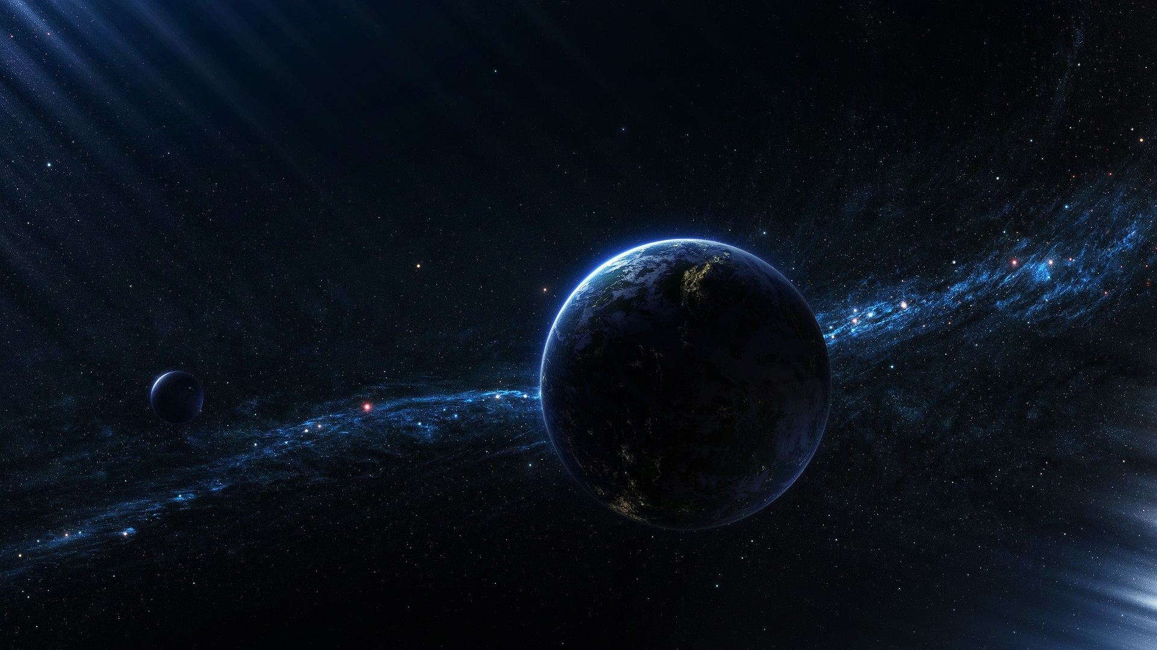
He has made the earth by His power; He has established the world by His wisdom, And stretched out the heaven by His understanding. — Jeremiah 51:15
by His power
power
The LORD by wisdom founded the earth; By understanding He established the heavens; — Proverbs 3:19
Origin of
our Universe
by His
At Light Speed
wisdom
.
Past
understanding
. .
Moments in Space
by His
understanding
The Present
Notes:
Though we are confused by what we see, God is not. By His power He established truth as plain as can be. It is given to us to comprehend what has been set before all. His word declares an expansion is the order of law. His way is consistent while we struggle to clearly rise from obscure misconceptions and or inconsistencies in perceived observations.

Slide 15
He has made the earth by His power; He has established the world by His wisdom, And stretched out the heaven by His understanding. — Jeremiah 51:15
Origin of
our Universe
At Light Speed
.
Past
. .
Moments in Space
The Present
Notes:
What can not be denied is that the present hovers upon every isolated finite moment, as eternity extends out beyond each point. Since the majority of, if not all of reality, cannot be observed, creative thinking and keen insight is required to expose that which is beyond mere mortal comprehension.

Slide 16
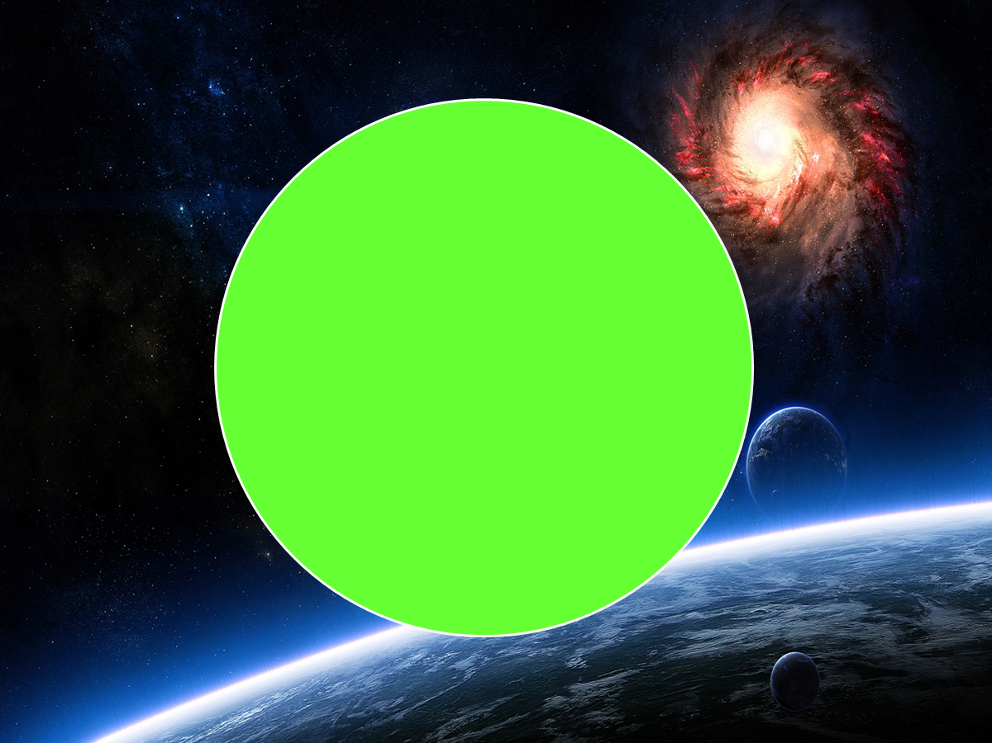
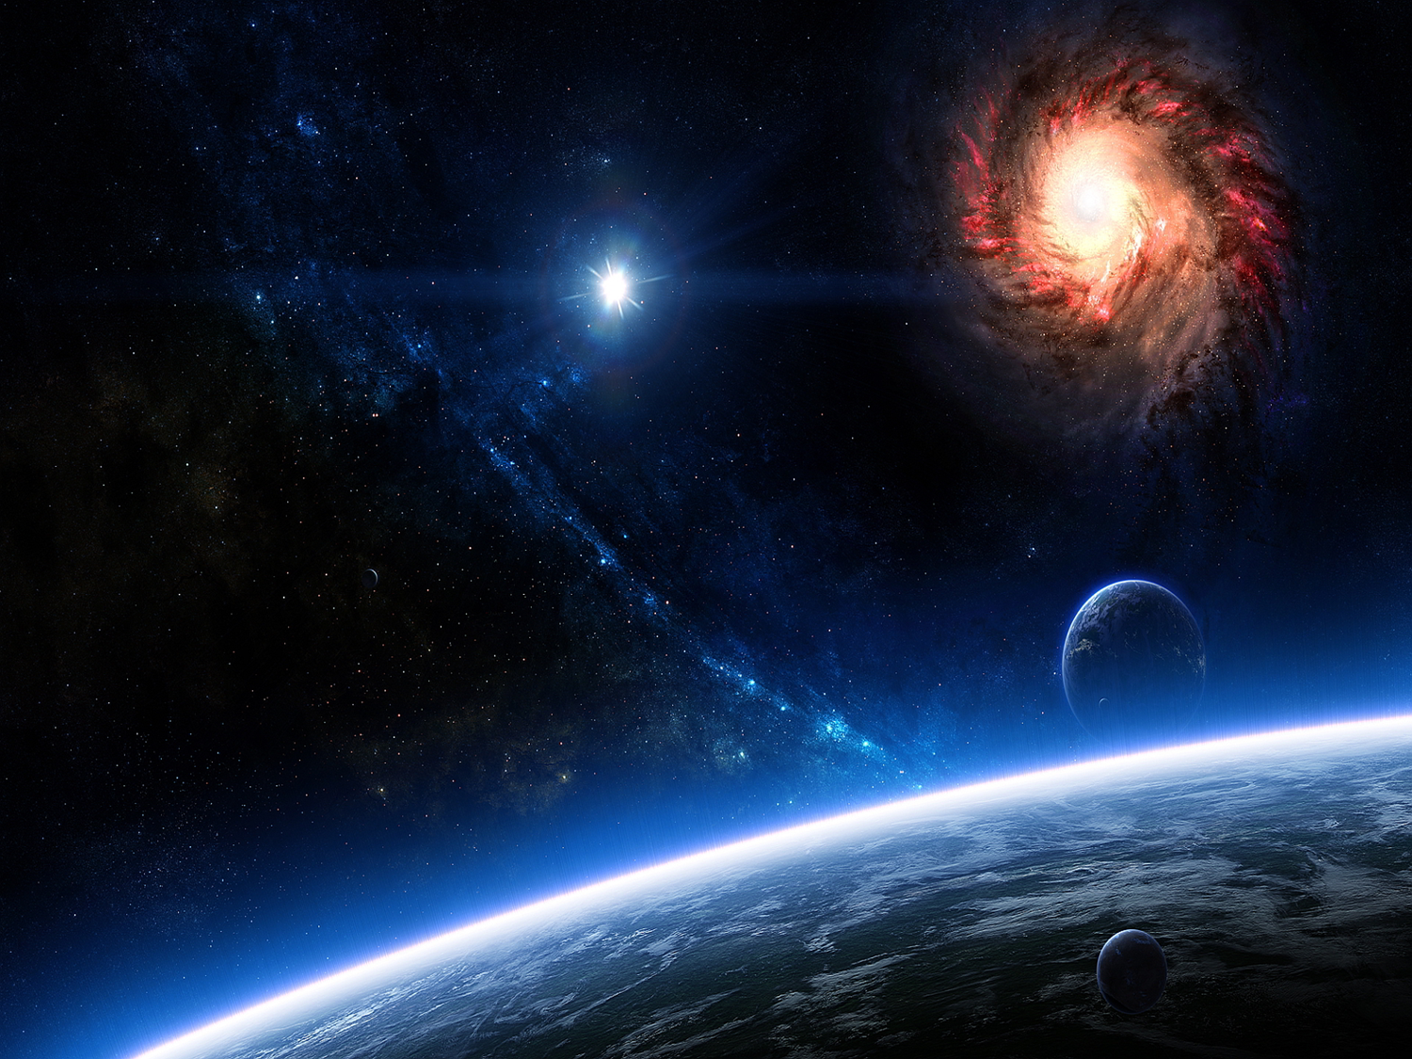
OF GOD
You
They will perish, but You will endure; Yes, they will all grow old like a garment; Like a cloak You will change them, And they will be changed. — Psalms 102:26
perish
will endure
perish
Of old You laid the foundation of the earth, And the heavens are the work of Your hands. — Psalms 102:25
THERMODYNAMICS
Origin of
our Universe
TIME
grow old
SPIRIT
grow old
At Light Speed
But You are the same, And Your years will have no end. — Psalms 102:27
change
change
.
Past
Moments in Space
The Present
Notes:
While God has declared that He has never removed Himself from His absolute creation, He has isolated all in creation to the confines of time in a fading concentration of His initial pure energy. Thermodynamics is a result of time.

Slide 17
OF GOD
Power
"The LORD possessed me at the beginning of His way, Before His works of old. I have been established from everlasting, From the beginning, before there was ever an earth." — Proverbs 8:22-23
. .
Intelligent
Design
SPIRIT
Wisdom
From the beginning
. .
Understanding
Notes:
God in His word arranged all by an intelligence we can only hope to fathom, half less imagine. It is that He is.

Slide 18
Intelligent
Design
In the beginning God created the heavens and the earth. — Genesis 1:1
Origin of
our Universe
At Light Speed
From the beginning
.
Past
Moments in Space
The Present
Notes:
It is God’s creation, not ours. To achieve understanding, it can only be acquired by humbly approaching God Himself. The general question is how did light come to be as we see it.

Slide 19
Then God said, "Let the waters under the heavens be gathered together into one place, and let the dry land appear"; and it was so. — Genesis 1:9
In the beginning God created the heavens and the earth. — Genesis 1:1
Origin of
our Universe
At Light Speed
God’s
Flash
.
Past
one
No
More
place
Moments in Space
The
Beginning
The Present
Notes:
The clues have all been given. One space, one time, one expanse. The answer lies in the present, or that which we can and cannot perceive. God’s original creation or flash of light is beyond what we can observe, as is the past gone by. We know the past is not retrievable though its’ image surrounds all that lies ahead.

Slide 20
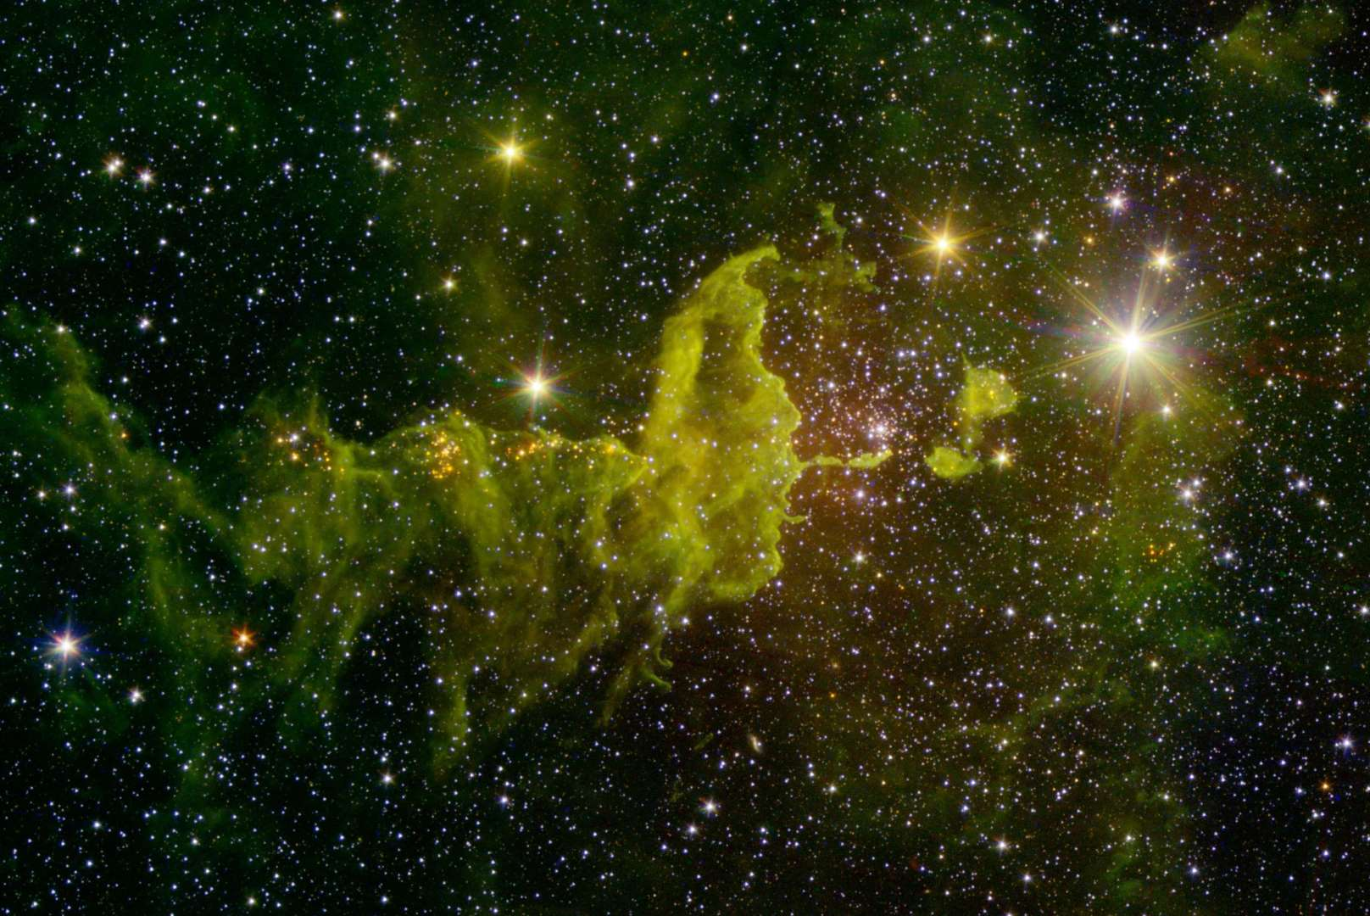
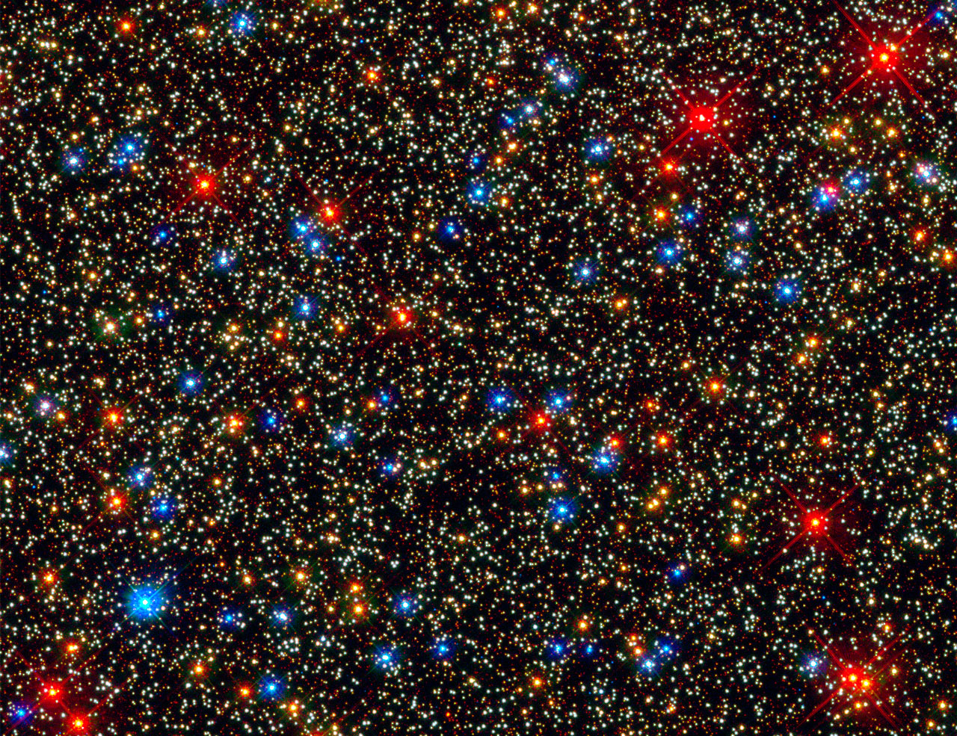
Top
By the word of the LORD the heavens were made, And all the host of them by the breath of His mouth. — Psalms 33:6
"Is not God in the height of heaven? And see the highest stars, how lofty they are!" — Job 22:12
As the heavens for height and the earth for depth, So the heart of kings is unsearchable. — Proverbs 25:3
. .
height
Past Expansion
Each Point Surrounded by Past Echoes in the Future
. .
A Present of Light and Darkness
depth
God’s
Flash
.
.
.
At Light Speed
Bottom
The Present
The
Present
Notes:
The paradox is that the future unfolds from past reflections in the present. God declares that at every point, a condition of top to bottom exists. All points maintain this extreme position of bottom to top or top to bottom. It is how reality slips forward unified as one, and it is the web of the present. The present is universal whereas amazingly most of the present is a construct of the past. The past is real where the future is yet to be, while the future holds this bulk of the past. Each point is surrounded by past images. To gaze to the end of the universe is to look further back in the previous ‘presents’ of time. The speed of light is the wind of time. All that has been is still contained in the absolute image of what is. As God declares, nothing is hidden from Him.

Slide 21
Declaring the end
end
from the beginning
beginning
Declaring the end from the beginning, And from ancient times
things that are
not yet done, …
— Isaiah 46:10
c = 186,000 mi/sec
Diameter of the Universe
Shrinking Diameter
186,000,000 mi/sec
Past Expansion
.
.
God’s
Flash
.
.
The Beginning
6
5
4
3
2
1
Slowing
Relative
Speed
At Light Speed
The End
The Beginning
The Present
Notes:
The farther back one goes in time the smaller the physical universe becomes. Also, we know from relativity that this compression of distance shortens time sequences and should increase speeds. This is not physically observable except for clues in what currently mystifies us, concerning Dark Energy. It is more than apparent that the initial creation days of our universe, that now appears to be eons longer, is actually due to these expansion and variable speed considerations. In fact time flows forward at the ‘present’ speed of light, allowing the present to remain in one place, universally. Whereas the speed of light may fluctuate over the eons of time, it could never be noticed as such in the present. Unbeknownst to each of us is that we are expanding at light speed; we just don’t know it because it is unperceivable to us, as is our 65,000 miles/hour around the sun, and then 500,000 miles/hour about the core of the Milky Way galaxy, or then, yes, in fact, the speed of light in relation to the edge of the universe. The speed of light is the minimum speed, and it is the basis for the flow of time itself. If we could stop time, and look to a static past section, of even our own lives, whereas our mass would remain, our volume would be found to be ever increasing. Our present self would appear to be gigantic to our younger self. From one moment to the next, as the universe increases in size, so does all that exists. I want to emphasize that if we could see this change over time, we would be ginormous in relation to what we physically were in years past. Earth in the past was the size of a current grain of sand.
We currently observe a universe with a diameter of roughly 28 billion light years, and of course, this is based upon our current observation of the speed of light. We assume this diameter on being able to ‘supposedly’ observe 14 billion light years out in any single arbitrary direction. While the universe is known to be expanding, it is estimated that the actual ‘present’ diameter is 93 billion light years, again, based upon observations of the current speed of light. What baffles modern science is why the universe appears to be accelerating based on extremely distant Super Nova observations. This Dark Energy dilemma is easily remedied with this past higher density and acceleration consideration. We are fooled in believing the universe is older than it actually is whereas the diameter may be correct.
The current speed of light is a snail’s pace in relation to distant racing speeds. What we observe is of a remnant once gone by, while in a space much smaller, when a higher velocity image was yet to fall before us, now just slowing coming in to current view. It is not reality that deceives us, it is we that deceive ourselves.
Clearly He created the end at the same moment He created the beginning. God made a universe where we can actually see His timelessness right in front of us, though it requires a leap of faith into that which is for us, unperceivable, the present, as we witness the past. The shear mass of the surrounding universe holds past images coming at us. Much of the future is already in transit, all the way back to the beginning, or as it is, our searching out to the ends of this universe.

Slide 22
"I am the Alpha and the Omega, the Beginning and the End," says the Lord, "who is and
who was and who is to
come, the Almighty."
— Revelation 1:8
… who alone has immortality, dwelling in unapproachable light, whom no man has seen or can see, to whom be honor and everlasting power. Amen. — 1st Timothy 6:16
"I am the Alpha and the Omega, the Beginning and the End, the First and the Last." — Revelation 22:13
unapproachable light
. .
who is
The
First
The
Last
who was
who is to
PAST
.
FUTURE
.
Alpha
Omega
.
come
The End
The Beginning
The Present
Notes:
Curiosity is one of the gifts given of God. God has always known, and what is understandable to Him is for us to discover. By grace he has given us the abilities to realize the depth and the width of realities present. In His word He reveals the secrets of truth plainly taught. The simple of heart see higher than those weighted down with the heavy corridors of endless learning, struggling, yet never understanding. This is not the will of God for man to rebel in arrogant disgust and contempt for one another mired in animosities. His lessons enlighten the wise to see turning to that which is better. Clearly, His creation stretches from the beginning to the end which contains these same two points as equal, embracing all that is included in between as the absolute present. God is so great He shows Himself in creation by being more than what can be seen. Great be our visible invisible God!

Slide 23
L I G H T
Thus says
the LORD, your
Redeemer, And He who
formed you from the womb:
"I am the LORD, who makes
all things, Who stretches
out the heavens all alone,
Who spreads abroad the
earth by Myself;"
— Isaiah 44:24
the LORD
your
G
G
D
G
L I G H
GOD
Redeemer
I
S
WISDOM
W SDOM
Liberator
DARK
A
Deliverer
.
H
IM
TIME
E
Savior
Notes:
God has established what is for the benefit of His eternal creation. He waits for His creation to come back to Him, both metaphorically united and physically connected, as in all that He has done, His call is to return. The evidence is in all that He has created. Jesus is His, our portal, for the redemption of mankind.

Slide 24
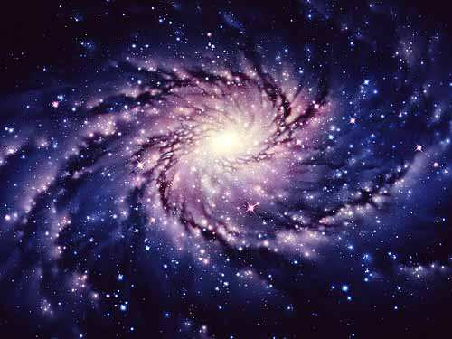
→ The Spirit of God existed prior to light as we know it
→ God is before all things and is in all things
→ God created light from which all has come
→ God created darkness for light to commence
→ God divided the light from the darkness
→ The circle forms the boundary of light and darkness
→ He was before the formation of matter
→ The universe is made of things which are not visible
→ Thermodynamics of Time is in an expanding universe
→ He created a singular location present space universe
→ God’s universe maintains bottom to top at all points
→ God’s pure light is unapproachable and unperceivable
→ God begins now extending through all to the finish
GOD’S LIGHT
IS EVERLASTING
Notes:
God’s Light is Everlasting.

Slide 25
Notes:
Darkness has no hope.

Slide 26
Physical
Science
of God
II
September 18, 2016
Ron Bert
Notes:
The universe of light in the darkness is God’s creation. It is a test of souls to whether they pursue lust for creation or thankfulness for the creator.

Slide 27
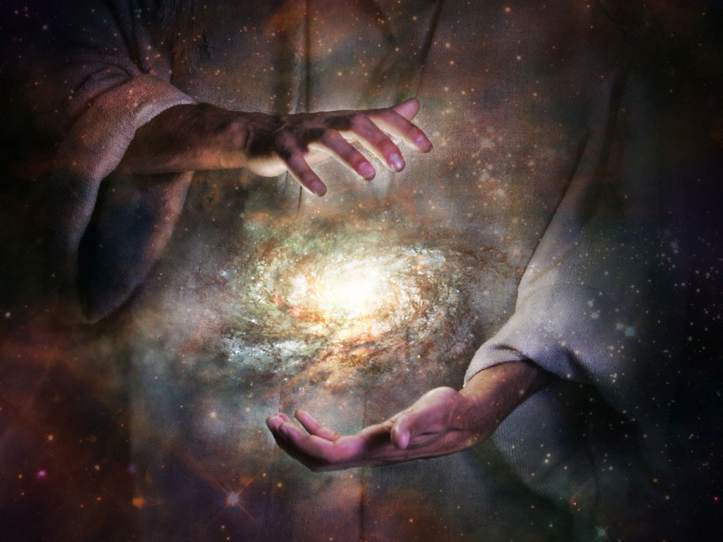
For every house is built by someone, but He who built all things is God. — Hebrews 3:4
God
Notes:
More than this sermon can ever express is the all of God. He has made everything so life can experience the uniqueness of living in an endless realm of dissolving material light. In this God touches us with His eternal being while He calls for us to search Him out.

Slide 28
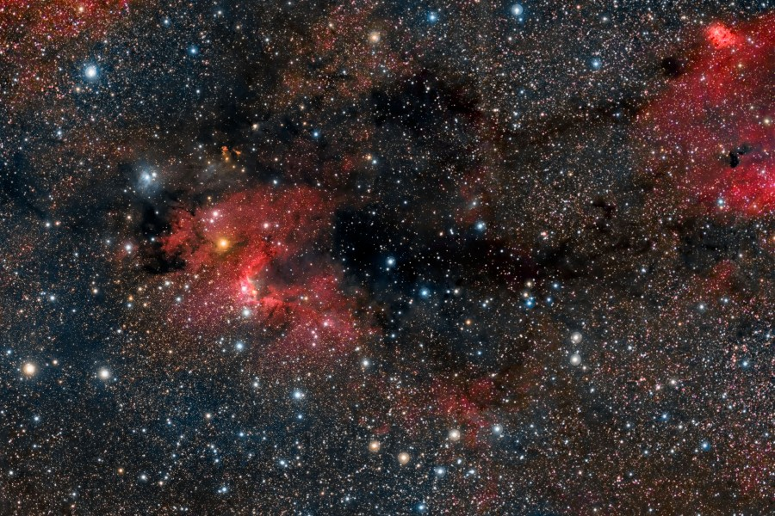
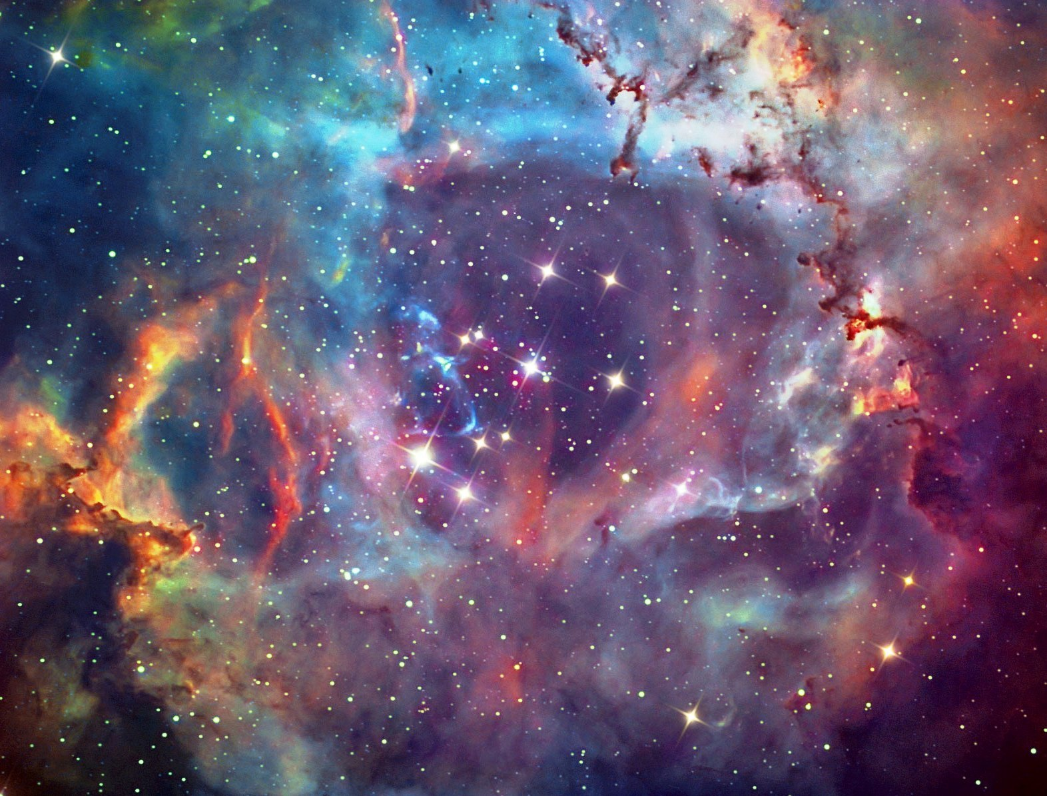
The works of the LORD are great, Studied by all who have pleasure in them. — Psalm 111:2
God
Notes:
What little clues are written in His word, that deal with His creation, challenge us to seek out what and why He has ordered it the way He has. What a wonderful creation that is more for the essence of living than the prolific deaths we witness. He watches for those who want to know.

Slide 29
Do you know the ordinances of the heavens? Can you set their dominion over the earth? — Job 38:33
Notes:
God displays His truths by example. Expanses of light and darkness litter the view we perceive.

Slide 30
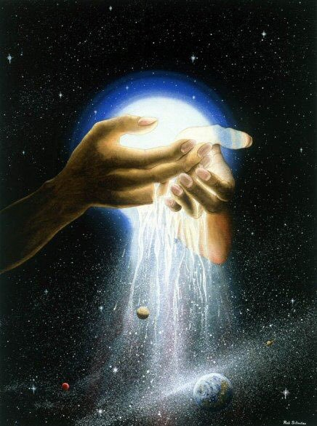
Who has measured the waters in the hollow of His hand, Measured heaven with a span And calculated the dust of the earth in a measure? Weighed the mountains in scales And the hills in a balance? — Isaiah 40:12
measure
Notes:
He indicates that accurate measurement, both small and large, is at most, a best guess, with absolute exactness impossible, as His expanse leaves our local experience more than rapidly with motion considerations untold. He has established His universe where question is simple with reaching answers. Independence is the origin of His creation.

Slide 31
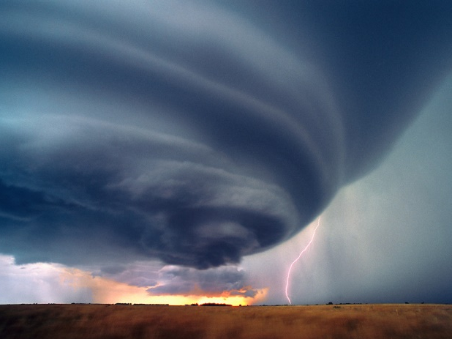
To establish a weight for the wind, And apportion the waters by measure. When He made a law for the rain, And a path for the thunderbolt, … — Job 28:25-26
l
ight
weight
measure
path
Notes:
He instructs us to the nature of density and concentration of particles causing excited friction. Energy from the simplest of interactions accumulate to release in reattaching to a more inward bound mass.

Slide 32
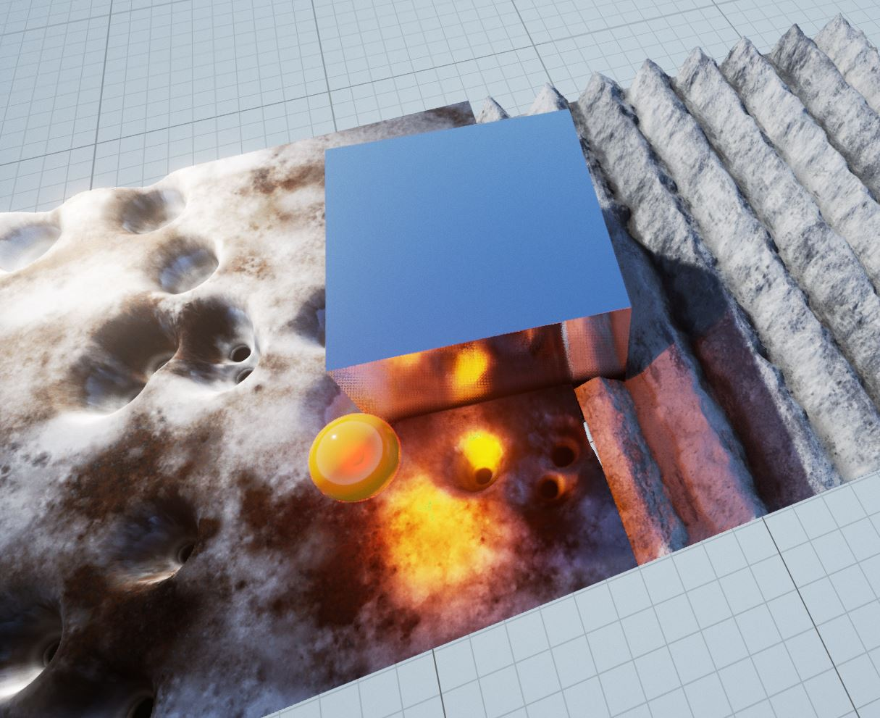
By what way is light diffused, Or the east wind scattered over the earth? — Job 38:24
light
Notes:
We are challenged to engage understanding with light, in either emission or absorption, from and to all the various forms of matter.

Slide 33
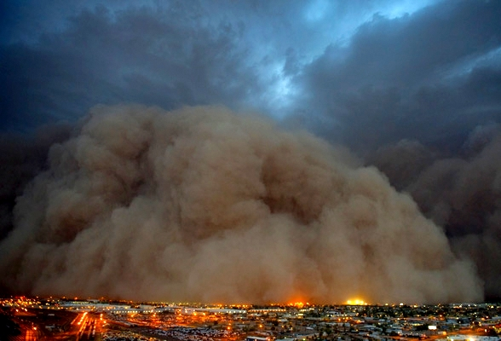
The LORD is slow to anger and great in power, And will not at all acquit the wicked. The LORD has His way In the whirlwind and in the storm, And the clouds are the dust of His feet. — Nahum 1:3
LORD
LORD
w
irl
s
dust of His feet
swirl
Notes:
The LORD certainly causes calamity in the vortex of becoming, where He rises past what we perceive. He reminds us that to live above anger is where the abode of peace remains. God is judge of all that occurs under the clouds of His creation. He who is not for God is against God. The wicked have a homeless destination.

Slide 34
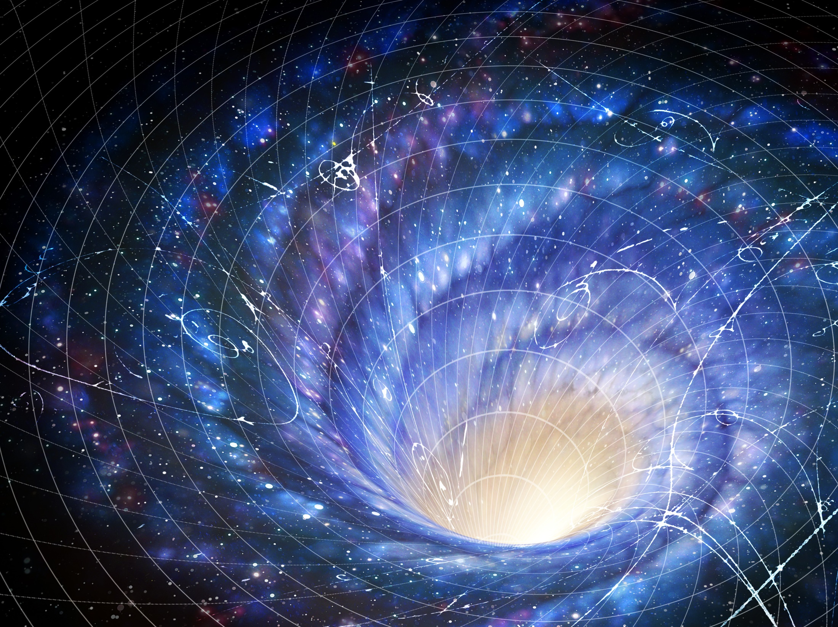
He alone spreads out the heavens, And treads on the waves of the sea; He made the Bear, Orion, and the Pleiades, And the chambers of the south; He does great things past finding out, Yes, wonders without number. — Job 9:8-10
south
south
swirl
Notes:
The nature of our universe can only end up being an assumption where first hand visualizations are impossible. A key clue is that the southern extreme attempts to attach at the bottom of substance. Long understood is that ‘going south’ is reaching downward or a dropping away.

Slide 35
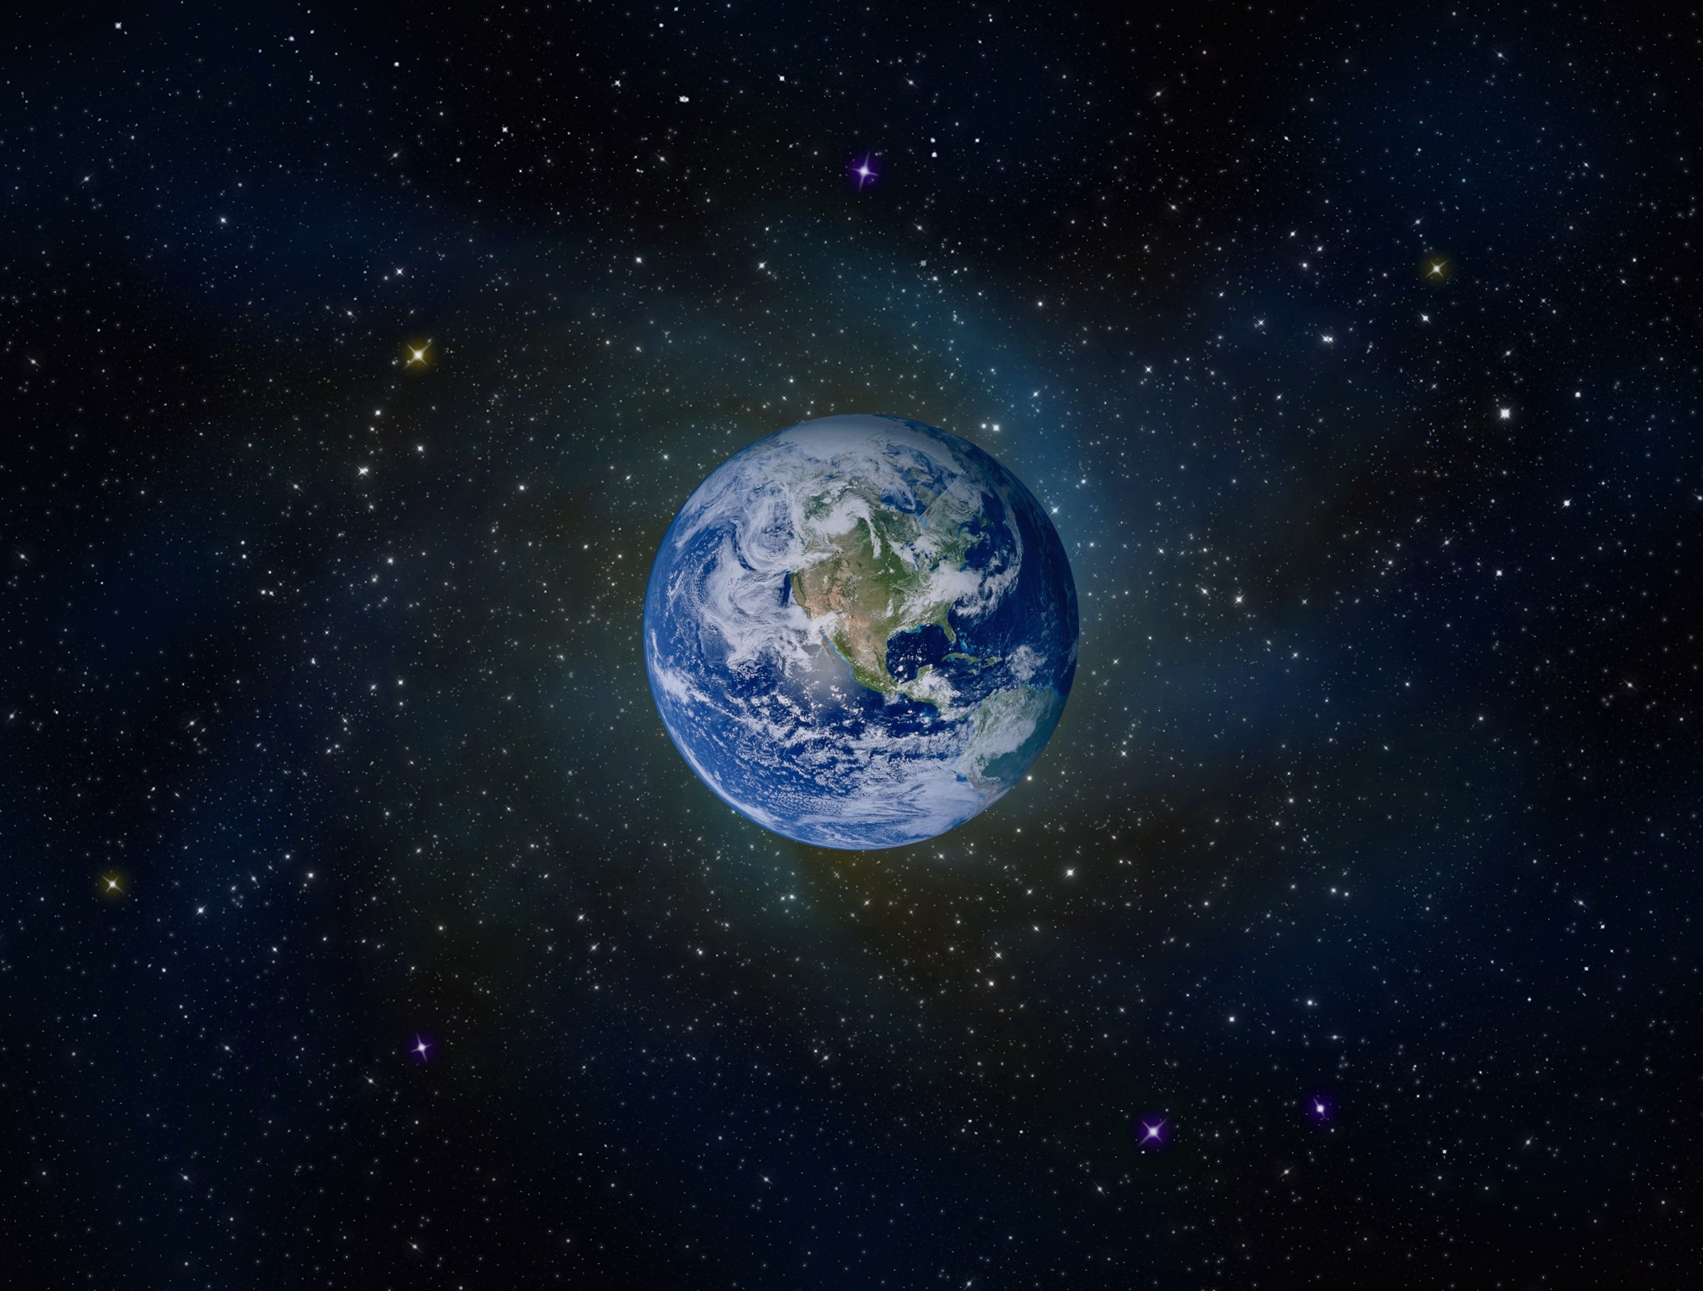
He stretches out the north over empty space; He hangs the earth on nothing. — Job 26:7
south
north
empty space
Notes:
The northern extreme would attach in an upward attempt to connect. These definitions explains our duel parabolic hyperbolic nature as time passes. As for hanging the earth on nothing, is not the darkness of nothing the foundation for the entrance of God’s creation of light?

Slide 36
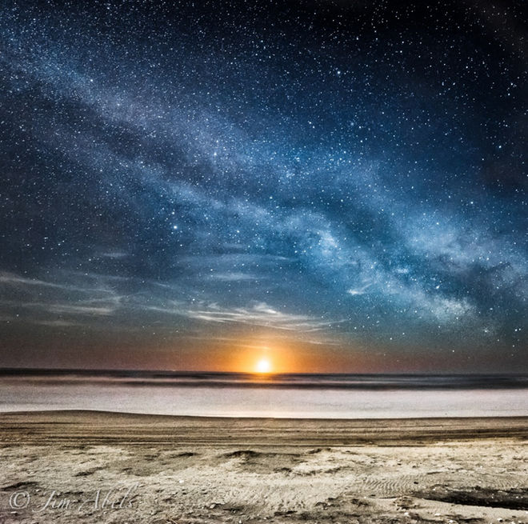
For since the creation of the world His invisible attributes are clearly seen, being understood by the things that are made, even His eternal power and Godhead, so that they are without excuse, … — Romans 1:20
understood
Notes:
His greatness unfolds before all as a lesson for remembrance to something larger than life. It is the will of God as the life giver to allow freedom to find, and know of, His surety, as it is. What one believes reveals the heart God waits to see.

Slide 37
And He changes the times and the seasons; He removes kings and raises up kings; He gives wisdom to the wise And knowledge to those who have understanding. He reveals deep and secret things; He knows what is in the darkness, And light dwells with Him. — Daniel 2:21-22
wisdom
knowledge
understood
understood
He reveals
He knows what is in the darkness
And light dwells with Him
Notes:
Temporalities of time mesh with desires to know as He allows what is to be. He has established darkness for light to hover around and knows exactly why it is that it is. What is wisdom but knowledge understood.

Slide 38
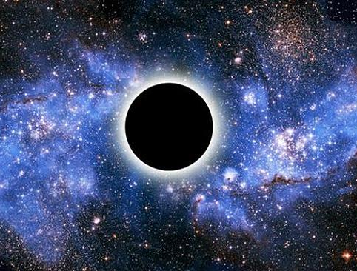
Have you comprehended the breadth of the earth? Tell Me, if you know all this. "Where is the way to the dwelling of light? And darkness, where is its place, That you may take it to its territory, That you may know the paths to its home? — Job 38:18-20
darkness
Notes:
Along with all of the challenges of not knowing, He tasks us to know, or at least to question the reasons for darkness, both physically and metaphorically. It is perplexing to call darkness home but it is a place, and what He declares this universe has been established upon, nothing. Out of nothing, His is more than what is, and that says more than can be said.

Slide 39
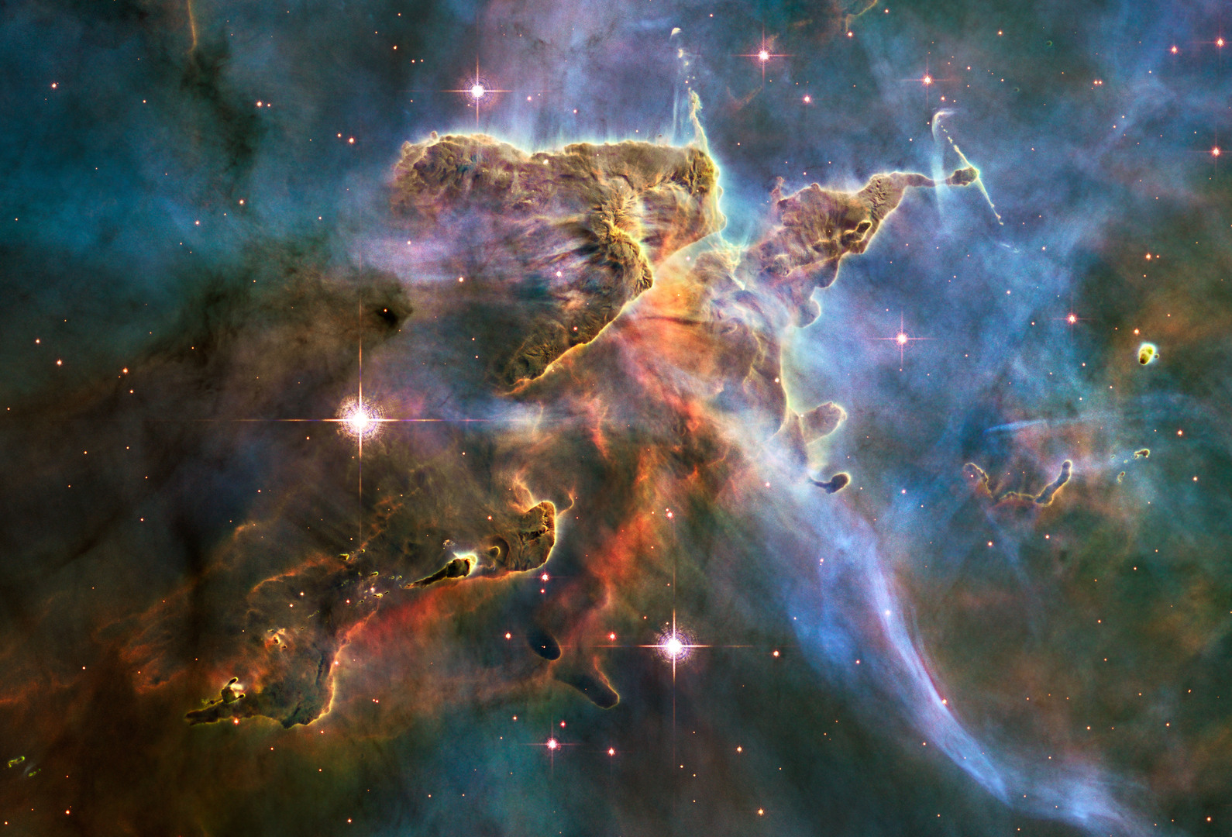
This is the message which we have heard from Him and declare to you, that God is light and in Him is no darkness at all. — 1st John 1:5
darkness
Notes:
Light is the basis for God’s beginning, for us, over us. Darkness is the void where He created that which was not part of Him.

Slide 40
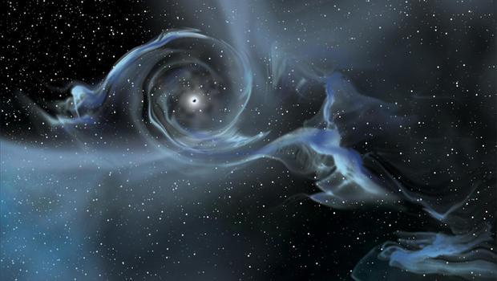
"I clothe the heavens with blackness, And I make sackcloth their covering." — Isaiah 50:3
blackness
Notes:
As He expresses His light, darkness invades covering light over with empty distance as time passes.

Slide 41
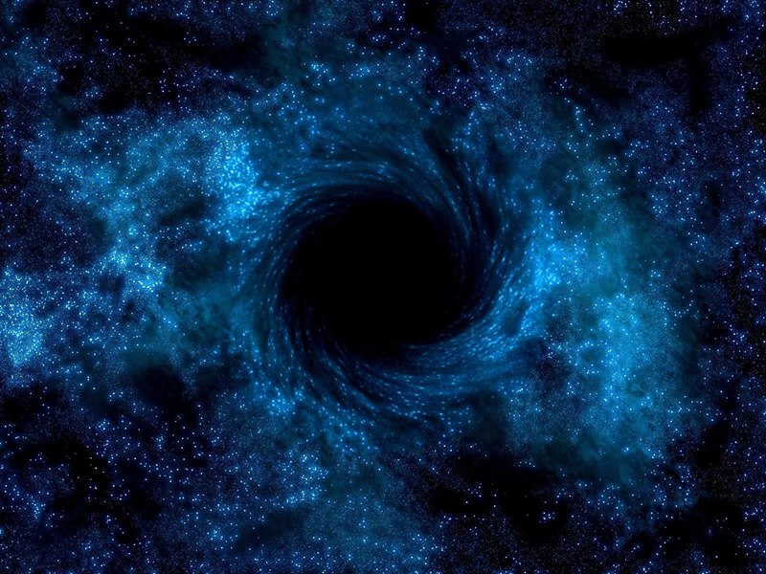
'And cast the unprofitable servant into the outer darkness. There will be weeping and gnashing of teeth.' — Matthew 25:30
outer darkness
blackness
Notes:
He specifically speaks of an outer darkness separate from the light He attaches to. In the extremes, a point of light would be perceptible, whereas total detachment from light would deliver a rangeless scope of nothing, not even a point of light for reference.

Slide 42
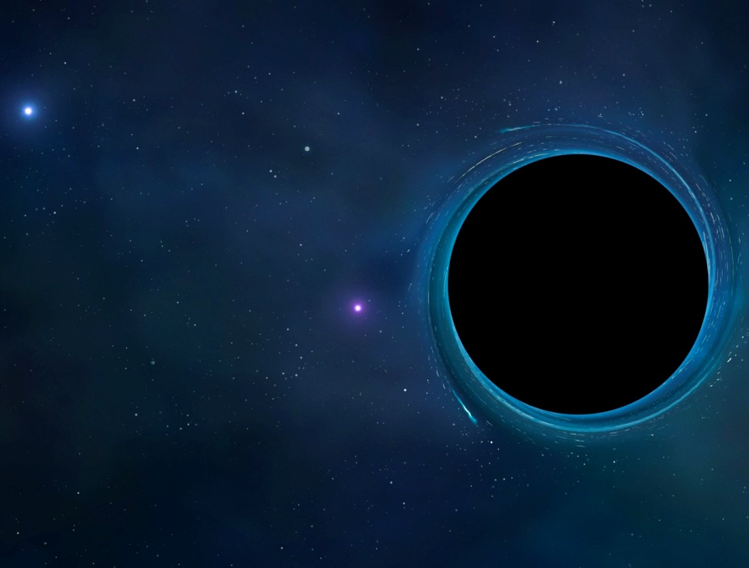
… raging waves of the sea, foaming up their own shame; wandering stars for whom is reserved the blackness of darkness forever. — Jude 1:13
blackness
of
darkness
forever
Notes:
There is a darkness where black has no color. It remains in isolation void of light in any form of substance. Some scriptures intuitively encompass more than one subject, such as here, explaining the physical nature of spirituality. Defining physical attributes of His whole essence includes the nature of His brilliant integrity. A destiny awaits for those that reject His truth absent of His presence.

Slide 43
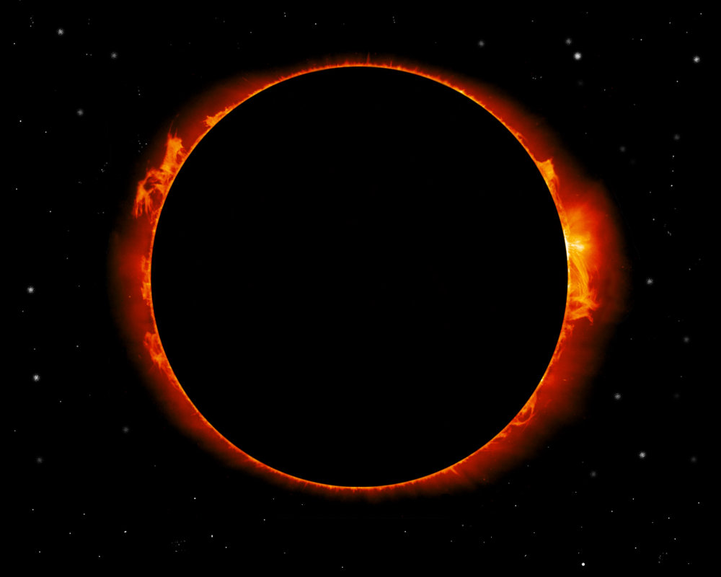
" 'A land as dark as darkness itself, As the shadow of death, without any order, Where even the light is like darkness.' " — Job 10:22
darkness
without
order
Notes:
There is a realm where life has no meaning when darkness overtakes the light, casting it off, in the endless distance of nowhere.

Slide 44
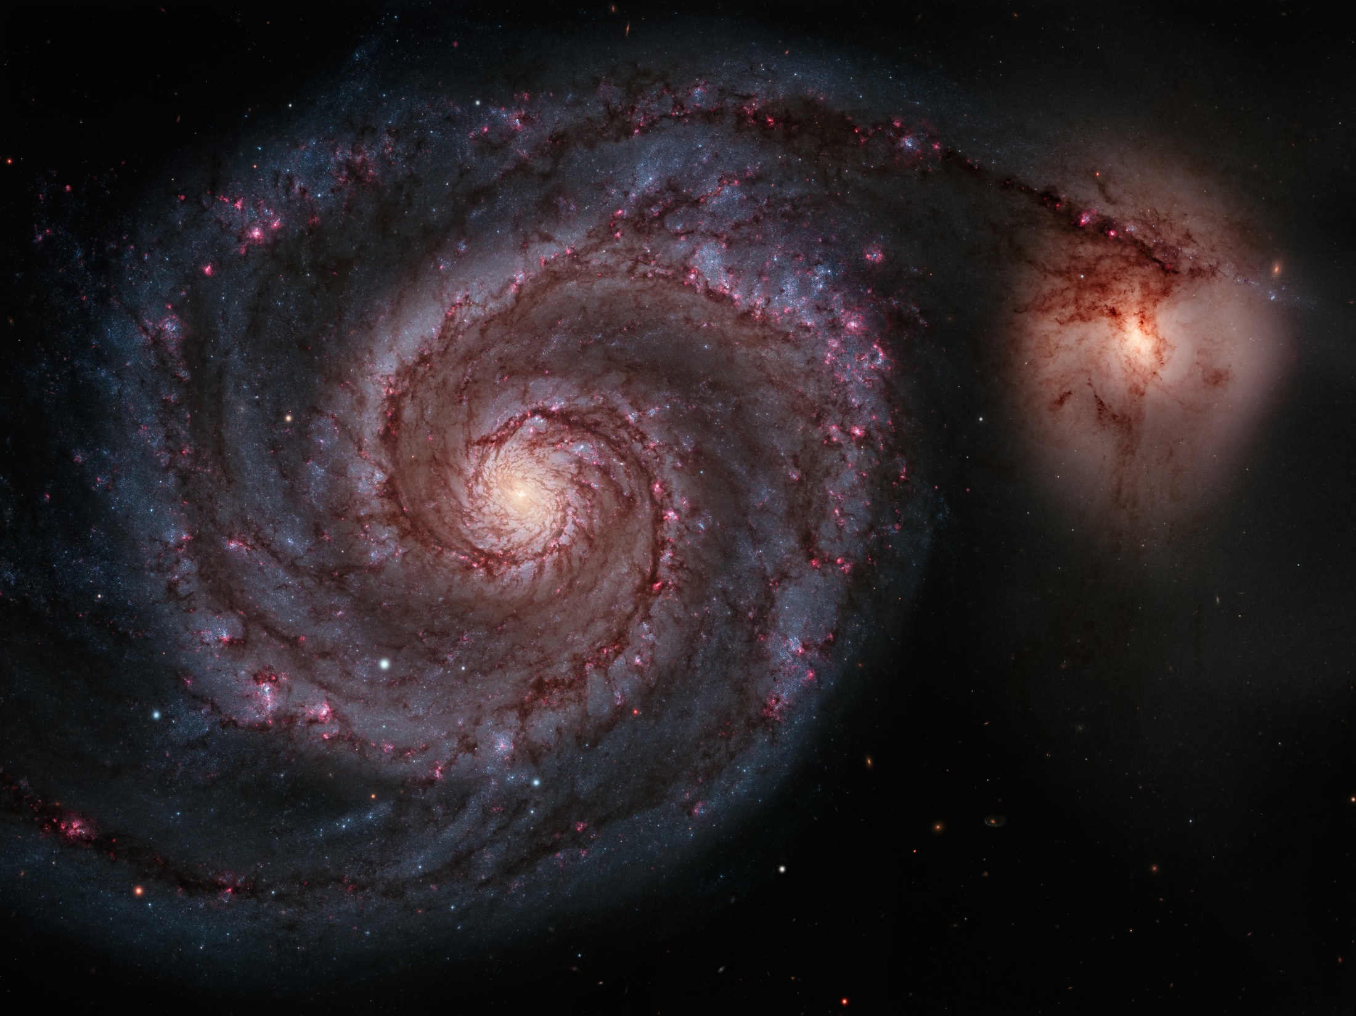
Lift up your eyes on high, And see who has created these things, Who brings out their host by number; He calls them all by name, By the greatness of His might And the strength of His power; Not one is missing. — Isaiah 40:26
number
name
might
power
Notes:
To see what is and how it is structured for the benefit of all, one must look up to see the truths of His order. Acceptance of His understanding allows a clearer picture of why it is. To let God answer for His own creation informs us as to why the oceans freely rage across time cracking from the melting heat of ago.

Slide 45
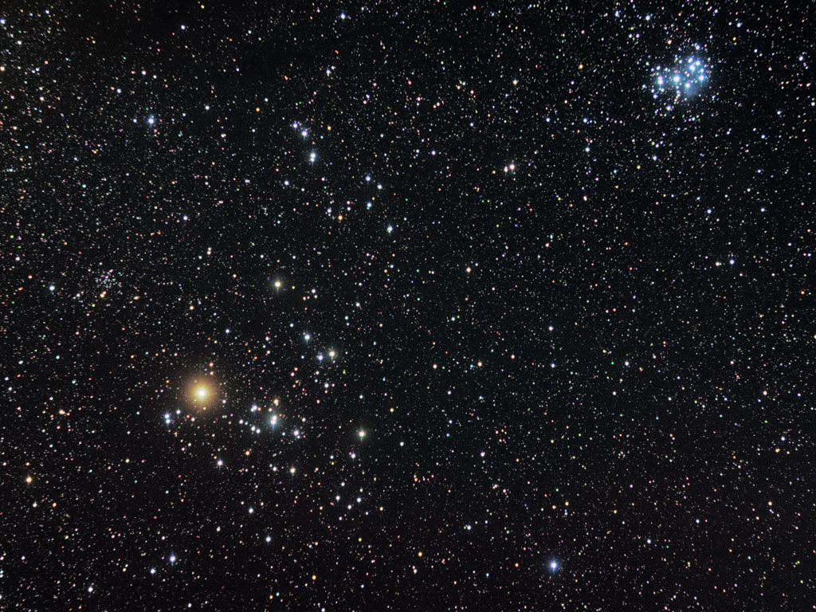
He counts the number of the stars; He calls them all by name. Great is our Lord, and mighty in power; His understanding is infinite. — Psalm 147:4-5
number
stars
name
might
power
Notes:
To rely on God to allow us to know, what better instructor could be but He who knows all?

Slide 46
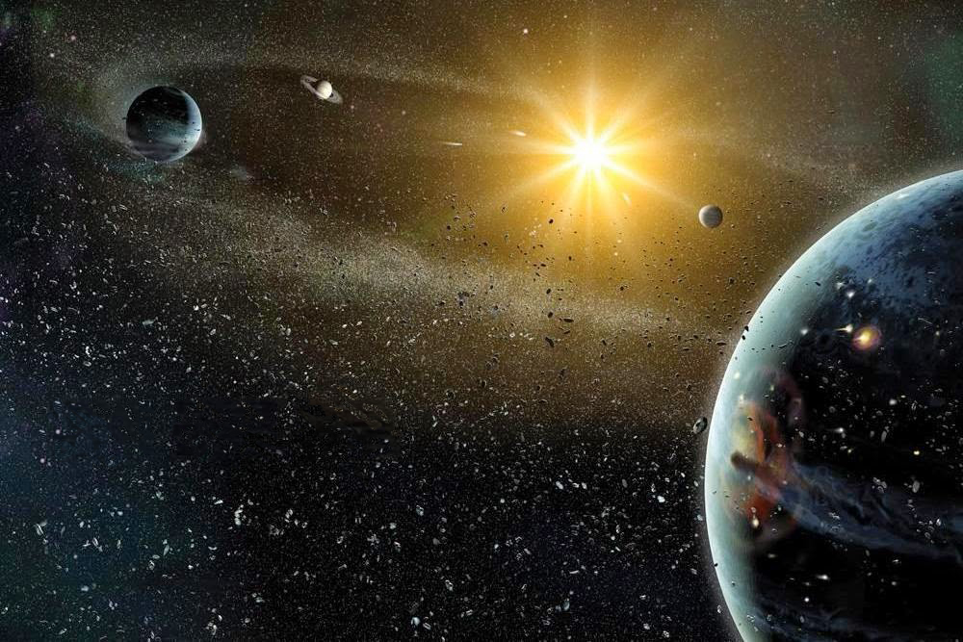
Its rising is from one end of heaven, And its circuit to the other end; And there is nothing hidden from its heat. — Psalm 19:6
stars
Notes:
His stars, all counted and named, have presence touching the entirety of His creation. Again, He declares no separation in the present structure of His creation. His warmth is of what is life giving.

Slide 47
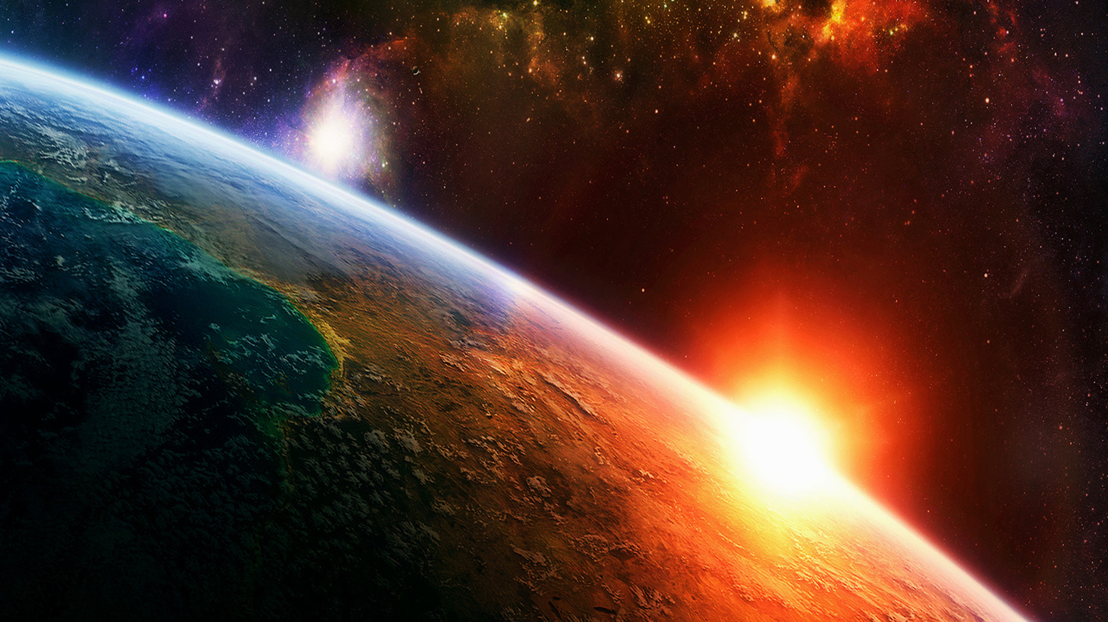
There are also celestial bodies and terrestrial bodies; but the glory of the celestial is one, and the glory of the terrestrial is another. There is one glory of the sun, another glory of the moon, and another glory of the stars; for one star differs from another star in glory. — 1st Corinthians 15:40-41
moon
Notes:
More about other stars and their bodies, we will never know, but interactions of what is close and far have integral importance. The entire universe could reflect the smallest of His creations. How profound to be in this magnificent existence where the macro mirrors the micro.

Slide 48
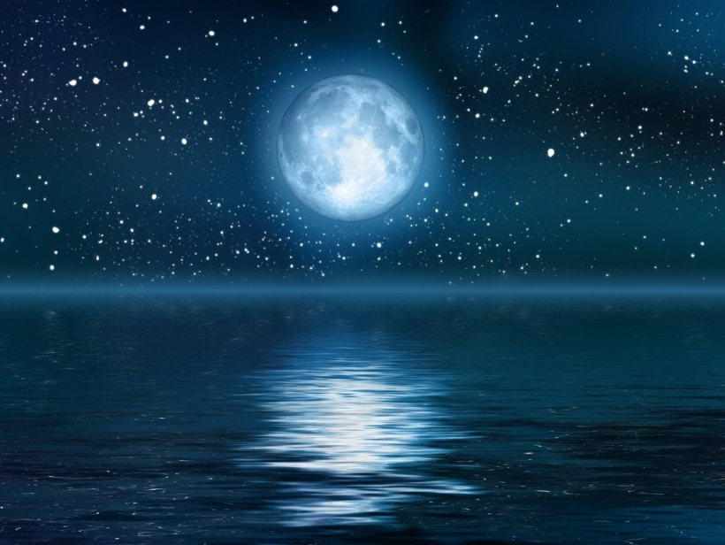
Thus says the LORD, Who gives the sun for a light by day, The ordinances of the moon and the stars for a light by night, Who disturbs the sea, And its waves roar (The LORD of hosts is His name): — Jeremiah 31:35
moon
Notes:
Long known before mankind’s understanding took hold is where forces stretch out across space. Without the moon our oceans would remain stagnate cesspools. Proximity has direct correlation to the amount of disruptive forces bodies have upon one another.

Slide 49
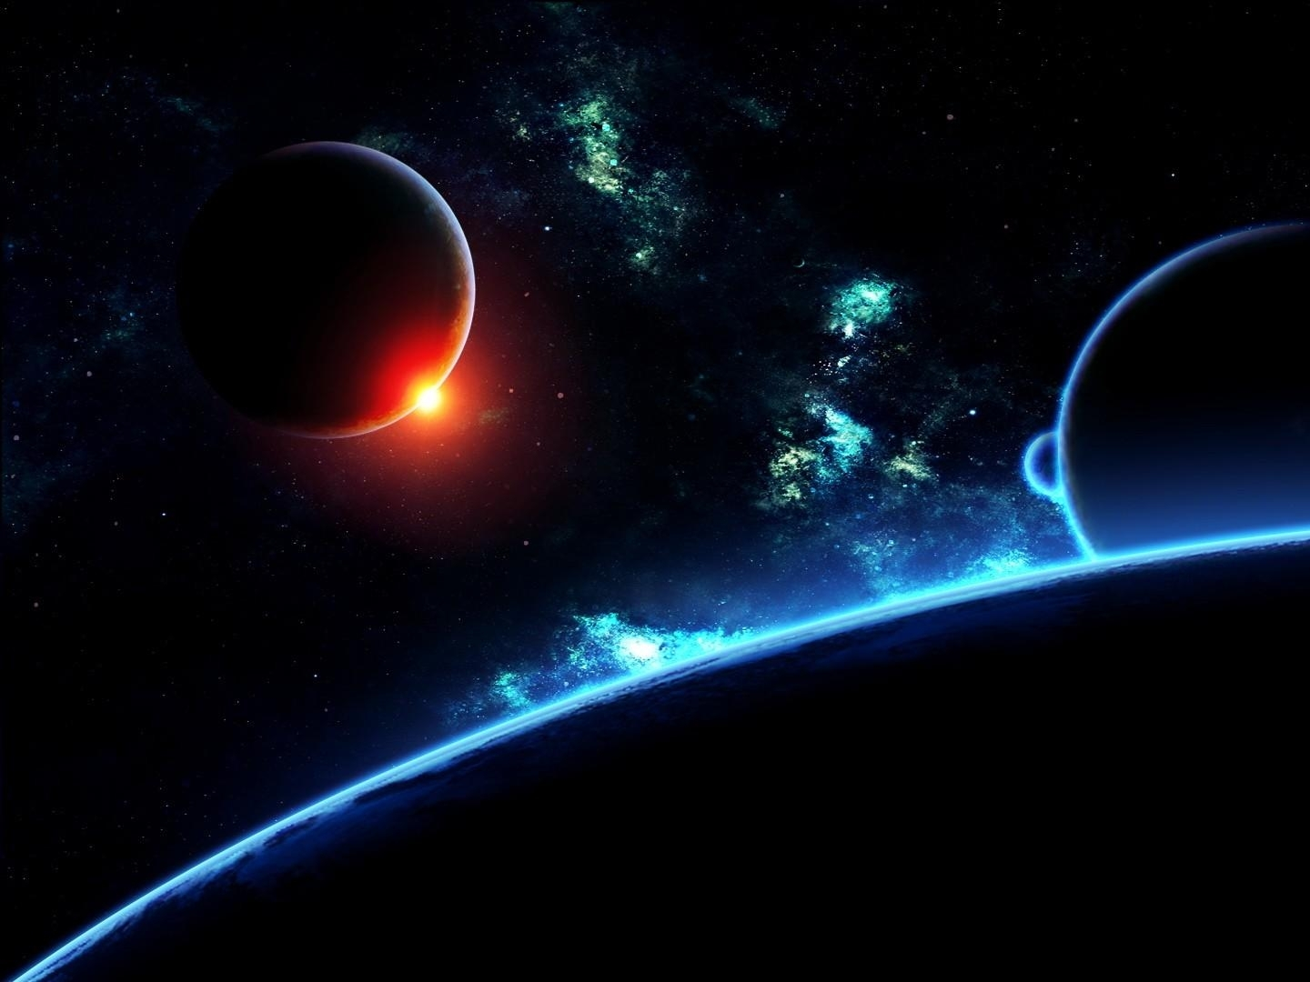
"The secret things belong to the LORD our God, but those things which are revealed belong to us and to our children forever, that we may do all the words of this law." — Deuteronomy 29:29
God
Notes:
God has not only established all natural laws, but he has set spiritual ordinances governing His creation of sentient life in order. For us not to follow God can only blind those who would care to know. The Lord has created many things for the benefit of creation even if unbeknownst to us, so that we may live in an existence of temporarily becoming, as He watches for our awakening. Most of what is knowable we will never know.

Slide 50
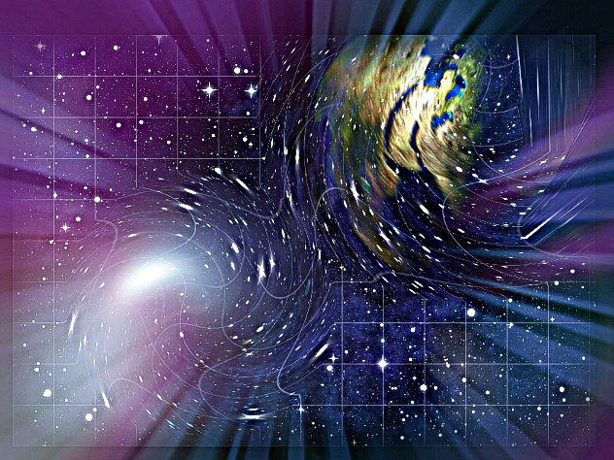
It is the glory of God to conceal a matter, But the glory of kings is to search out a matter. — Proverbs 25:2
God
Notes:
God in His great understanding has challenged us to live knowing those things special to His creation.

Slide 51
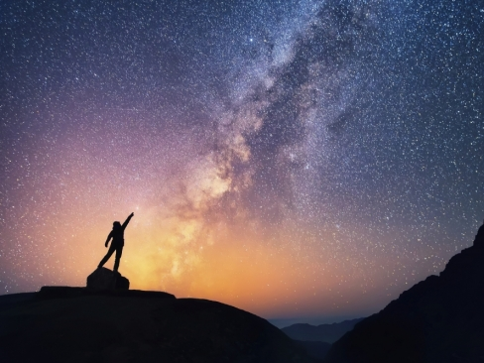
"Indeed heaven and the highest heavens belong to the LORD your God, also the earth with all that is in it." — Deuteronomy 10:14
the
highest
God
God
in
Notes:
His creation and all that it contains still falls short of a greater truth yet to be revealed, to all that live in the flesh of mankind of woman. If you are not in to the Lord you deny that which is part of yourself. The true glory is that He gives all that is. Certainly God has made all through His understanding and if we are to be anything concerning being scientifically adept, to the nature of reality, we must consider all that He has revealed. It is God that teaches us, not that we teach God, and He graciously has given the clues to eternal truths. And what have we done with the little truth of parabolic light being converted to hyperbolic? - Nuclear weapons that terrorize the meek and oppress the masses? Shame on man for his lust for power over considerations of love.

Slide 52
→ God has made all and it is His works we observe
→ God challenges us to know more than we can
→ Only God has the power to measure anything
→ He brings a south’s bottom rising to the north’s top
→ God’s invisible attributes allow us to see God
→ God has nothing to do with where darkness resides
→ He allows darkness to mix in His creation of light
→ There is an outer darkness void of God in blackness
→ Absolute darkness has an orderless lifeless existence
→ God exposes Himself in His distant creation
→ No light is hidden in His creation as He knows all
→ God placed the moon with physical purpose for life
→ We only know what God allows as He asks us to know
His truths cannot
be replaced
Notes:
It is amazing that in search to understand God, or for that matter any clarity, hate is so pervasive. Self-deceptions of power and festering greed mired in jealousies steal from the humble that search to know and care simply, for the families and children they love. Our nations have lost innocence as we search to know in the shadows of terror and where impulsiveness has crippled decent maturity. Each of us holds ignorance as our greatest quality, which is unnoticed by the arrogant ‘knowing,’ as they yell, “Come to me,” while God shows us all, ‘See Me.’ As I am inclined to astronomical quantum truths, this study has been geared in perceiving His physical spatial creation over that of the life sciences. Greater than any physical truth is His coming judgment of souls. It would be our greatest regret not to meet the Light of All discarded to the darkness. Come He calls to all free in Him where choice declares destiny.
His truths cannot be replaced.

Slide 53
Notes:
Darkness has no sound of sense.

Slide 54
Please visit http://www.LoveFromGod.com to explore further
Ronald Bert Channel on
Notes:
Eternity never ends.

Slide 55
Notes:
No Light is Greater

