Slide 1
Notes:
In darkness there is no vision. FONT RESIZE BETTER IN POWERPOINT 2013

Slide 2
Saints are Those Alive in Christ
Ron Bert
March 24, 2019
Notes:
It is faithful saints that shine the light of God.

Slide 3
What is a saint?
Saints holy ones
"hagios" true believers
=
Saints are used in the Old and New Testaments of God's people.
God's people
Notes:
Saints are true believers that are holy to God.

Slide 4
As for the saints who are on the earth, "They are the excellent ones, in whom is all my delight." – Psalm 16:3
Saints are alive on the earth.
Testimony of Ananias in Damascus
Testimony of Paul in Jerusalem
Testimony of Peter in Lydda
Damascus Jerusalem Lydda
"This I also did in Jerusalem, and many of the saints I shut up in prison, having received authority from the chief priests; and when they were put to death, I cast my vote against them." – Acts 26:10
Testimony of Peter in Lydda
Lydda
Now it came to pass, as Peter went through all parts of the country, that he also came down to the saints who dwelt in Lydda. – Acts 9:32
Then Ananias answered, "Lord, I have heard from many about this man, how much harm he has done to Your saints in Jerusalem. – Acts 9:13
earth
Testimony of Paul in Jerusalem
Jerusalem
Testimony of Ananias in Damascus
Damascus
Testimony of God
Notes:
The Bible is filled with testimonies of saints being local common folks.

Slide 5
Paul, an apostle of Jesus Christ by the will of God, and Timothy our brother, To the church of God which is at Corinth, with all the saints who are in all Achaia: – 2nd Corinthians 1:1
Saints are alive on the earth.
Damascus Jerusalem Lydda
Ephesus Philippi Colosse
Corinth Rome Italy
To the saints and faithful brethren in Christ who are in Colosse: Grace to you and peace from God our Father and the Lord Jesus Christ. – Colossians 1:2
Paul, an apostle of Jesus Christ by the will of God, To the saints who are in Ephesus, and faithful in Christ Jesus: – Ephesians 1:1
Paul and Timothy, bondservants of Jesus Christ, To all the saints in Christ Jesus who are in Philippi, with the bishops and deacons: – Philippians 1:1
Rome
To all who are in Rome, beloved of God, called to be saints: Grace to you and peace from God our Father and the Lord Jesus Christ. – Romans 1:7
Colosse
Greet all those who rule over you, and all the saints. Those from Italy greet you. – Hebrews 13:24
Ephesus
Philippi
Corinth
Italy
Notes:
Saints are called out living in numerous cities throughout the ancient world.

Slide 6
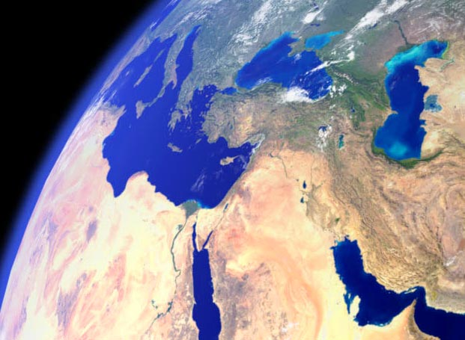
Saints are alive on the earth.
.
Damascus Jerusalem Lydda
Damascus
Jerusalem
Lydda
.
Ephesus Philippi Colosse
Ephesus
Philippi
Colosse
.
.
.
Corinth Rome Italy
Corinth
Rome
Italy
.
Antioch
.
.
.
Notes:
The evidence of saints living on earth is unequivocal.

Slide 7
Saints are individuals.
Greet Philologus and Julia, Nereus and his sister, and Olympas, and all the saints who are with them. – Romans 16:15
All the saints greet you, but especially those who are of Caesar's household. – Philippians 4:22
saints
But now I am going to Jerusalem to minister to the saints. – Romans 15:25
When they envied Moses in the camp, And Aaron the saint of the LORD, – Psalm 106:16
saint
saints
saints
Notes:
Saints stand on the promise of God as witnessed by the sacrifice of His only begotten Son.

Slide 8
For God is not the author of confusion but of peace, as in all the churches of the saints. – 1st Corinthians 14:33
Saints are individuals.
Our God of peace
speaks to us plainly.
Saints are common folks.
And He Himself gave some to be apostles, some prophets, some evangelists, and some pastors and teachers, for the equipping of the saints for the work of ministry, for the edifying of the body of Christ, till we all come to the unity of the faith and of the knowledge of the Son of God, to a perfect man, to the measure of the stature of the fullness of Christ; – Ephesians 4:11 -13
for the equipping of
the saints
saints
unity
knowledge
fullness of Christ
Notes:
It is through knowledge that one come to the fullness that Christ offers.

Slide 9
Saints are people of God.
Saints are common folks.
Now, therefore, you are no longer strangers and foreigners, but fellow citizens with the saints and members of the household of God, having been built on the foundation of the apostles and prophets, Jesus Christ Himself being the chief cornerstone, in whom the whole building, being joined together, grows into a holy temple in the Lord, in whom you also are being built together for a dwelling place of God in the Spirit. – Ephesians 2:19-22
saints
members of the household of God
saints
saints
saints
saints
apostles and prophets
Jesus Christ Himself
Notes:
Christ as the foundation, apostles and prophets support the saints of all regions.

Slide 10
Saints are made
from the inside out.
Saints are people of God.
dwell in your hearts
in
For this reason I bow my knees to the Father of our Lord Jesus Christ, from whom the whole family in heaven and earth is named, that He would grant you, according to the riches of His glory, to be strengthened with might through His Spirit in the inner man, … – Ephesians 3:14-16
… that Christ may dwell in your hearts through faith; that you, being rooted and grounded in love, may be able to comprehend with all the saints what is the width and length and depth and height -- to know the love of Christ which passes knowledge; that you may be filled with all the fullness of God. – Ephesians 3:17-19
Now godliness with contentment is great gain. – 1st Timothy 6:6
saints
His Spirit
in
inner
fullness of God
fullness of God
Notes:
It is from within that God supplies the gift of peace when ones root reaches heaven.

Slide 11
Saints are made
from the inside out.
So continuing daily with one accord in the temple, and breaking bread from house to house, they ate their food with gladness and simplicity of heart, praising God and having favor with all the people. And the Lord added to the church daily those who were being saved. – Acts 2:46-47
simplicity of heart
God
God
the Lord added
Lord
to the church

Slide 12
Saints are made
from the inside out.
Here is the patience of the saints; here are those who keep the commandments of God and the faith of Jesus. – Revelation 14:12
Be kindly affectionate to one another with brotherly love, in honor giving preference to one another; not lagging in diligence, fervent in spirit, serving the Lord; rejoicing in hope, patient in tribulation, continuing steadfastly in prayer; distributing to the needs of the saints, given to hospitality. – Romans 12:10-13
Sing praise to the LORD, You saints of His, And give thanks at the remembrance of His holy name. – Psalms 30:4
Let the saints be joyful in glory; Let them sing aloud on their beds. – Psalms 149:5
saints
be joyful
Sing praise
saints
saints
saints
give thanks
in
in glory
keep
❶
of
God
❷
of
saints
saints

Slide 13
① Saints are alive on the earth
Damascus Jerusalem Lydda
Ephesus Philippi Colosse
Corinth Rome Italy
② Saints are individuals
③ Our God of peace speaks to us plainly
④ Saints are common folks
⑤ Saints are people of God
⑥ Saints stand on the foundation God has set
Apostles and prophets
JESUS CHRIST
⑦ Saints are made from the inside out
Saints are those
who come to God
Notes:
Saints are those who come to God.

Slide 14
Notes:
Darkness has no vision of His brilliance.

Slide 15
Saints are Those Alive in Christ
Ron Bert
II
March 31, 2019
Notes:
In Christ life comes to be.

Slide 16
…the eyes of your understanding being enlightened; that you may know what is the hope of His calling, what are the riches of the glory of His inheritance in the saints, – Ephesians 1:18
Saints are called
to have understanding.
…the eyes of your understanding being enlightened; that you may know what is the hope of His calling, what are the riches of the glory of His inheritance in the saints, – Ephesians 1:18
know
saints
saints
Notes:
To know His truth is to obtain the glory of an eternal soul.

Slide 17
Beloved, while I was very diligent to write to you concerning our common salvation, I found it necessary to write to you exhorting you to contend earnestly for the faith which was once for all delivered to the saints. – Jude 1:3
The message of salvation has
been given to His saints on earth.
Saints are called
to have understanding.
Beloved, while I was very diligent to write to you concerning our common salvation, I found it necessary to write to you exhorting you to contend earnestly for the faith which was once for all delivered to the saints. – Jude 1:3
common salvation
saints
once for all
saints
saints
delivered to the saints
Notes:
Saints understand His word has been once delivered not to be manipulated or modified by man.

Slide 18
I will hear what God the LORD will speak, For He will speak peace To His people and to His saints; But let them not turn back to folly. – Psalm 85:8
Saints are warned not to
fall away from God’s word.
The message of salvation has
been given to His saints on earth.
I will hear what God the LORD will speak, For He will speak peace To His people and to His saints; But let them not turn back to folly. – Psalm 85:8
hear
saints
saints
Notes:
God calls all saints to grow in Him not stepping back to previous errors devoured in sin.

Slide 19
You who love the LORD, hate evil! He preserves the souls of His saints; He delivers them out of the hand of the wicked. – Psalm 97:10
Saints are warned not to
fall away from God’s word.
Saints are to righteously love the Lord who is our protection.
For the LORD loves justice, And does not forsake His saints; They are preserved forever, But the descendants of the wicked shall be cut off. – Psalm 37:28
You who love the LORD, hate evil! He preserves the souls of His saints; He delivers them out of the hand of the wicked. – Psalm 97:10
saints
preserves
saints
preserved forever
delivers
Notes:
Justice will be served as all will know God is God.

Slide 20
Dare any of you, having a matter against another, go to law before the unrighteous, and not before the saints? – 1st Corinthians 6:1
Saints are told to work out problems among themselves.
Righteousness will judge and declare one’s eternal condition.
Saints are to righteously love the Lord who is our protection.
Oh, love the LORD, all you His saints! For the LORD preserves the faithful, And fully repays the proud person. Be of good courage, And He shall strengthen your heart, All you who hope in the LORD. – Psalm 31:23-24
Do you not know that the saints will judge the world? And if the world will be judged by you, are you unworthy to judge the smallest matters? – 1st Corinthians 6:2
proud person
law before the unrighteous
saints
smallest matters
Notes:
Saints are instructed to work along with one another no matter the situation. God does not will for His creatures to turn on one another. Righteousness will judge and declare the eternal creatures of God.

Slide 21
He will guard the feet of His saints, But the wicked shall be silent in darkness. "For by strength no man shall prevail." – 1st Samuel 2:9
Saints know salvation
is not of themselves.
Eternity is
the inheritance of the saints.
Righteousness will judge and declare one’s eternal condition.
Resurrection from the dead
by God has been demonstrated.
The Lord God loves His saints.
"The nations were angry, and Your wrath has come, And the time of the dead, that they should be judged, And that You should reward Your servants the prophets and the saints, And those who fear Your name, small and great, And should destroy those who destroy the earth." – Revelation 11:18
Nevertheless the solid foundation of God stands, having this seal: "The Lord knows those who are His," and, "Let everyone who names the name of Christ depart from iniquity." – 2nd Timothy 2:19
For not he who commends himself is approved, but whom the Lord commends. – 2nd Corinthians 10:18
… and the graves were opened; and many bodies of the saints who had fallen asleep were raised; – Matthew 27:52
'But the saints of the Most High shall receive the kingdom, and possess the kingdom forever, even forever and ever.' – Daniel 7:18
saints
saints
Precious in the sight of the Lord is the death of His saints. – Psalm 116:15
saints
receive the kingdom
wicked
You should reward
in
LIFE
LIFE
silent in darkness
the saints
saints
forever
whom the Lord commends
saints
Notes:
We wait for the sky to reveal truth above mere shadows.

Slide 22
For it pleased those from Macedonia and Achaia to make a certain contribution for the poor among the saints who are in Jerusalem. – Romans 15:26
Eternity is
the inheritance of the saints.
Our actions should please us
as servants of the Living God.
Be kindly affectionate to one another with brotherly love, in honor giving preference to one another; not lagging in diligence, fervent in spirit, serving the Lord; rejoicing in hope, patient in tribulation, continuing steadfastly in prayer; distributing to the needs of the saints, given to hospitality. – Romans 12:10-13
pleased
to make
a
contribution
needs
saints
Notes:
In serving Him life is fulfilled.

Slide 23
Now concerning the collection for the saints, as I have given orders to the churches of Galatia, so you must do also: – 1st Corinthians 16:1
It is through our service
that we find rewards of spirit.
Our actions should please us
as servants of the Living God.
Acts of service and compassion should be done by those able.
Though challenged in life our Love of God renders sacrifice.
… that in a great trial of affliction the abundance of their joy and their deep poverty abounded in the riches of their liberality. – 2nd Corinthians 8:2
… giving thanks to the Father who has qualified us to be partakers of the inheritance of the saints in the light. – Colossians 1:12
thanks
For the administration of this service not only supplies the needs of the saints, but also is abounding through many thanksgivings to God, … – 2nd Corinthians 9:12
For the administration of this service not only supplies the needs of the saints, but also is abounding through many thanksgivings to God, … – 2nd Corinthians 9:12
to the Father
saints
saints
saints
saints
saints in the light
thanksgivings to God
thanks
Notes:
A saint’s heart is thankful for the love He sacrificed for us.

Slide 24
For God is not unjust to forget your work and labor of love which you have shown toward His name, in that you have ministered to the saints, and do minister. And we desire that each one of you show the same diligence to the full assurance of hope until the end, that you do not become sluggish, but imitate those who through faith and patience inherit the promises. – Hebrews 6:10-12
Though challenged in life our Love of God renders sacrifice.
Saints keep and actively practice
their faith as steward examples.
Saints are called
to perform righteous acts.
Greet every saint in Christ Jesus. The brethren who are with me greet you. – Philippians 4:21
Are they not all ministering spirits sent forth to minister for those who will inherit salvation? – Hebrews 1:14
And to her it was granted to be arrayed in fine linen, clean and bright, for the fine linen is the righteous acts of the saints. – Revelation 19:8
saints
minister
saint
in
Greet
saint
Christ Jesus
each one of you
diligence
saints
righteous acts of the saints
hope
faith and patience
Notes:
As the great commission declares, saints not only embrace the message once delivered but they share the reason for their belief. As angles ministered to mankind, so we too are instructed to continue the effort in announcing salvation is at hand. Righteousness stands on an unending firm faith.

Slide 25
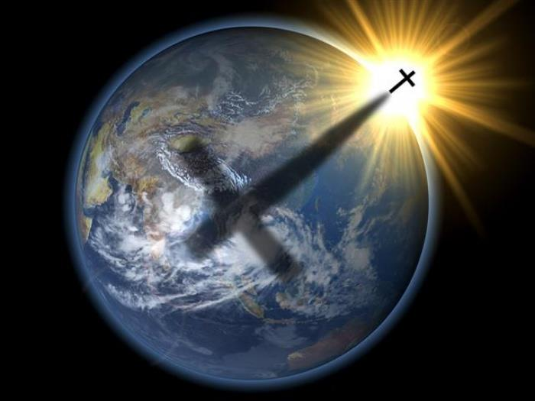
① Saints are called to have an understanding of the inheritance
② The message of salvation has been given to His saints on earth
③ Saints are warned not to fall away from God’s word
④ Saints righteously love the Lord who is our protection
⑤ Saints know salvation in not of themselves
⑥ Righteousness will judge and declare one’s eternal condition
⑦ Saints know salvation is not in themselves
⑧ The Lord God loves His saints
⑨ Resurrection from the dead has been made known by God
⑩ Eternal life is promised as an inheritance to the saints of God
⑪ Our actions should please us as servants of the Living God
⑫ Acts of service and compassion should be done by those able
⑬ It is through our service that we find rewards of spirit
⑭ Though challenged in life our Love of God renders sacrifice
⑮ Saints are asked to actively practice their faith as examples
⑯ Saints are called to perform righteous act
Saints are called
to perform righteous acts.
Jesus calls out
to all of His saints
saint
saints
Notes:
The Light of the world is to know the truth in Him.

Slide 26
Notes:
His truth is the satisfying refreshment of never thirsting.

Slide 27
Notes:
Darkness has no key out.

Slide 28
Please visit http://www.LoveFromGod.com/saints.htm to explore further
Notes:
Eternity never ends.

Slide 29
"For no one does anything in secret while he himself seeks to be known openly. If You do these things, show Yourself to the world." - John 7:4
Notes:
Upon the end, the beginning will come in His Light.

