Slide 1
Notes:
Eerie the silence of darkness. Darkness has no contemplation.

Slide 2
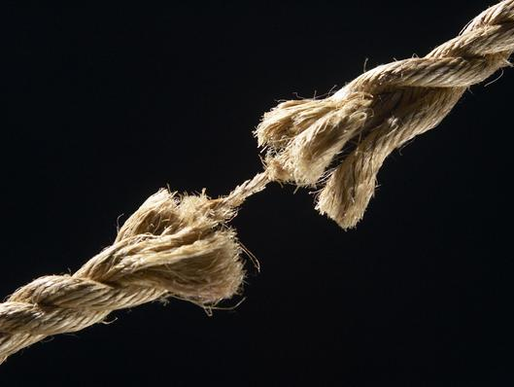
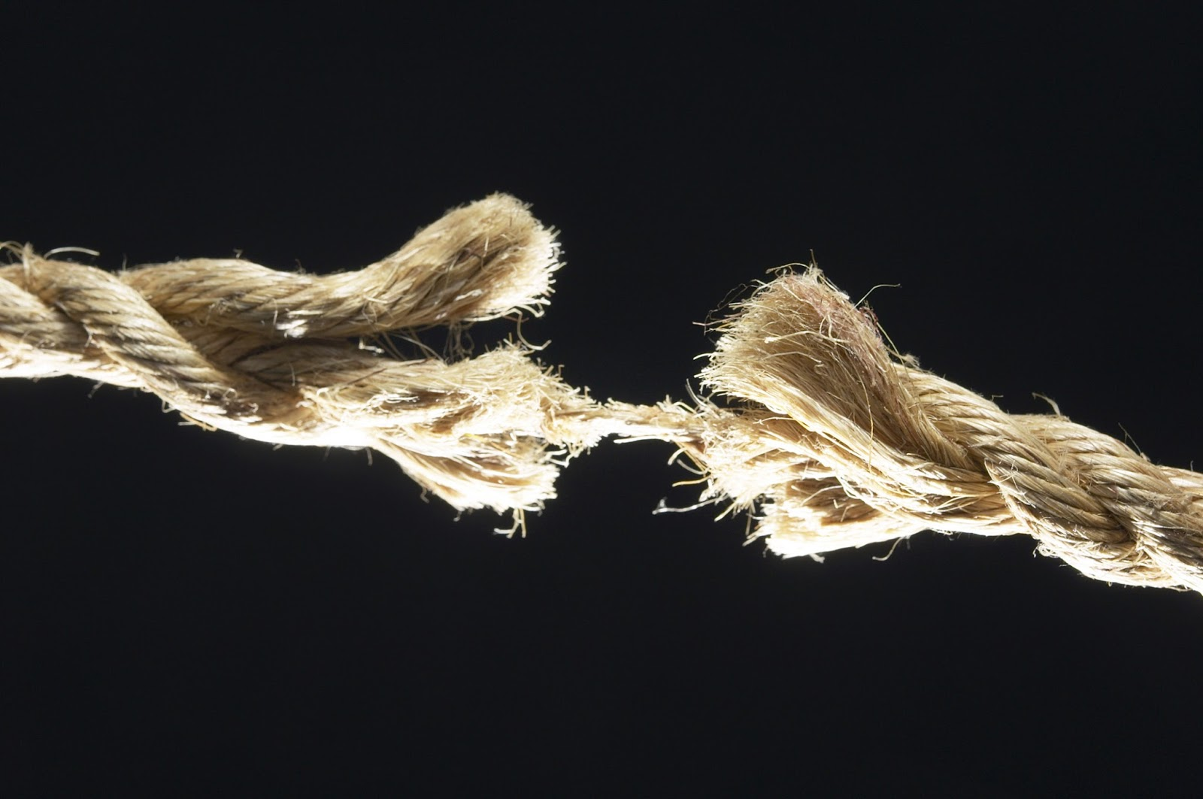
Ron Bert
Ropes
Ropes
April 7, 2019
Notes:
Each of us has had patience stretched to the breaking point. Suffering in life can draw one to the brink of floundering.

Slide 3
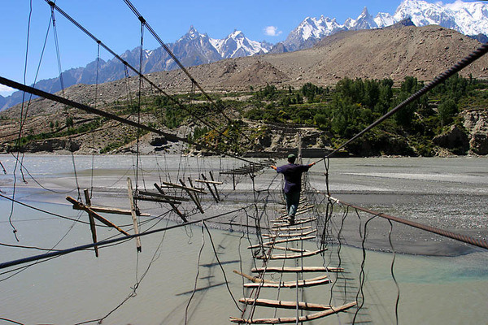
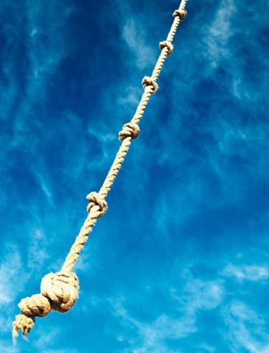
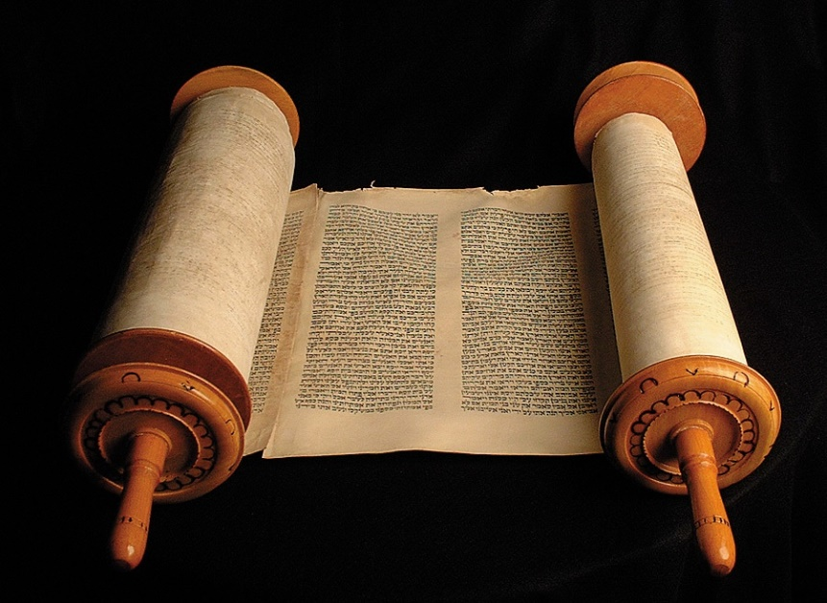
If I say, "My foot slips," Your mercy, O LORD, will hold me up. – Psalms 94:18
Not that I have already attained, or am already perfected; but I press on, that I may lay hold of that for which Christ Jesus has also laid hold of me. – Philippians 3:12
Heaven
hold
hold
Christ Jesus
hold
hold
Notes:
Life's path can be precarious at best. Every plateau leads to another mountain. Many search for a saving rope or life preserver cast. That ladder of salvation has already descended from heaven’s gates in the form of God’s own given word.

Slide 4
faith
faith
"But seek first the kingdom of God and His righteousness, and all these things shall be added to you." – Matthew 6:33
"But seek first the kingdom of God and His righteousness, and all these things shall be added to you." – Matthew 6:33
"But seek first the kingdom of God and His righteousness, and all these things shall be added to you." – Matthew 6:33
f
i
h
a
t
Notes:
Seeking His word enlightens all souls who genuinely desire an honest humble relationship with that which is greater than self. God’s test is to see if we have the character to rise beyond selfish desires mired in evil pursuits. Without personally examining the treasures found in the Bible, one can not hope to know God and His purpose. His light descends from above and it is what inspires our faith.

Slide 5
Fight the good fight of faith, lay hold on eternal life, to which you were also called and have confessed the good confession in the presence of many witnesses. – 1st Timothy 6:12
faith
faith
eternal life
hold
lay hold
hold
Notes:
Eternal life must be earned by putting away that which one knows is contrary to His word and submitting to the goodness and obedience He calls out for, from a pure heart. God’s ladder is the rope to eternity if we don’t let go.

Slide 6
Let us hold fast the confession of our hope without wavering, for He who promised is faithful. – Hebrews 10:23
faith
hold
hold
hold
hold fast
hope
hold
Notes:
As sure as God is we wait for His promised commitment revealed in our own steadfast commitment to His ways.

Slide 7
For we have become partakers of Christ if we hold the beginning of our confidence steadfast to the end, … – Hebrews 3:14
faith
hold
Christ
Christ
if we
hold
hold
Notes:
Once belief in God’s way of goodness has begun, it is a single path to the light if the darkness of evil is held at bay.

Slide 8
My righteousness I hold fast, and will not let it go; My heart shall not reproach me as long as I live. – Job 27:6
faith
righteous
hold
hold
righteous
will not let it go
live
Notes:
Job had commitment to God, no matter his circumstance, for His love of God.

Slide 9
Yet the righteous will hold to his way, And he who has clean hands will be stronger and stronger. – Job 17:9
righteous
faith
righteous
hold
righteous
righteous
will hold
Notes:
To be good is hard work and yet it becomes simpler if preferred as a matter of choice.

Slide 10
But the righteousness of faith speaks in this way, "Do not say in your heart, 'Who will ascend into heaven?' "
But the righteousness of faith speaks in this way, "Do not say in your heart, 'Who will ascend into heaven?' "
righteous
faith
word
For if we would judge ourselves, we would not be judged. – 1st Corinthians 11:31
For if we would judge ourselves, we would not be judged. – 1st Corinthians 11:31
w
(that is, to bring Christ down from above) or, " 'Who will descend into the abyss?'" (that is, to bring Christ up from the dead). – Romans 10:6 -7
(that is, to bring Christ down from above) or, " 'Who will descend into the abyss?'" (that is, to bring Christ up from the dead). – Romans 10:6-7
r
d
Christ
down
o
up
Notes:
Christ came to show us life, not in that we should judge others as to whether they are going to heaven or hell. The word tells us to examine ourselves more so than the micro-scoping we place upon others. His instructions simply include judging self over others remaining unbiased. A challenge for all.

Slide 11
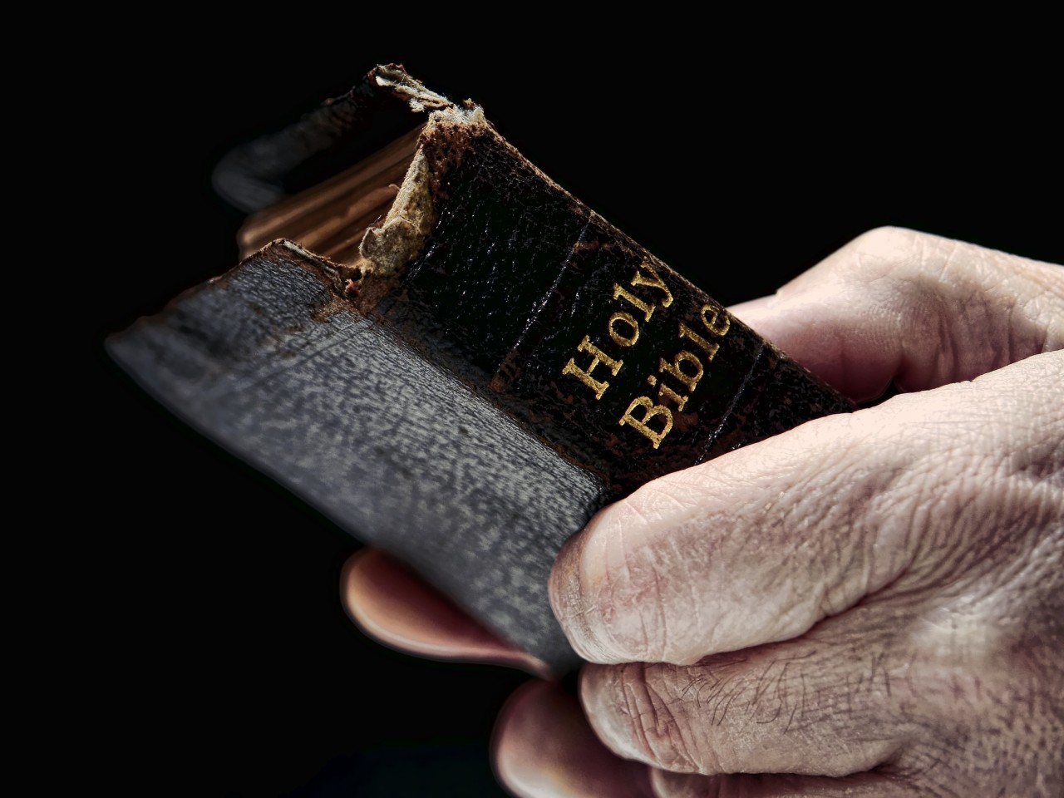
But what does it say? "The word is near you, in your mouth and in your heart" (that is, the word of faith which we preach): that if you confess with your mouth the Lord Jesus and believe in your heart that God has raised Him from the dead, you will be saved. For with the heart one believes unto righteousness, and with the mouth confession is made unto salvation. – Romans 10:8-10
But what does it say? "The word is near you, in your mouth and in your heart" (that is, the word of faith which we preach): that if you confess with your mouth the Lord Jesus and believe in your heart that God has raised Him from the dead, you will be saved. For with the heart one believes unto righteousness, and with the mouth confession is made unto salvation. – Romans 10:8-10
But what does it say? "The word is near you, in your mouth and in your heart" (that is, the word of faith which we preach): that if you confess with your mouth the Lord Jesus and believe in your heart that God has raised Him from the dead, you will be saved. For with the heart one believes unto righteousness, and with the mouth confession is made unto salvation. – Romans 10:8-10
faith
word of faith
word of faith
word
confess
confess
and believe
and believe
in your heart
in your heart
God has raised Him
with the heart one believes
Notes:
The strength of one’s faith is directly connected to familiarity with His given glorious word which maintains all higher truth for mankind. Our faith develops as the word filters in to our hearts. Knowing and believing upon all that Jesus is establishes a natural confession.

Slide 12
Now faith is the substance of things hoped for, the evidence of things not seen. – Hebrews 11:1
Now faith is the substance of things hoped for, the evidence of things not seen. – Hebrews 11:1
faith
faith
faith
hope
hope
Therefore, brethren, stand fast and hold the traditions which you were taught, whether by word or our epistle. – 2nd Thessalonians 2:15
She is a tree of life to those who take hold of her, And happy are all who retain her. – Proverbs 3:18
hold
take hold
Notes:
The Christian walk in life perceives a draw or an anchor to that which is to come, promised by what can not be seen, but His presence is felt. Faith is what reaches out ahead enduring the climb home.

Slide 13
Blessed be the God and Father of our Lord Jesus Christ, who according to His abundant mercy has begotten us again to a living hope through the resurrection of Jesus Christ from the dead, to an inheritance incorruptible and undefiled and that does not fade away, reserved in heaven for you, who are kept by the power of God through faith for salvation ready to be revealed in the last time. – 1st Peter 1:3-5
Blessed be the God and Father of our Lord Jesus Christ, who according to His abundant mercy has begotten us again to a living hope through the resurrection of Jesus Christ from the dead, to an inheritance incorruptible and undefiled and that does not fade away, reserved in heaven for you, who are kept by the power of God through faith for salvation ready to be revealed in the last time. – 1st Peter 1:3-5
hope
living hope
hope
hope
hope
through faith
faith
faith
Notes:
Our living hope through faith comes by the delivered word of mercy exposing His unequaled truth, and by no other means obtainable, His clarity of reality is given. Our rope is our hope. Heaven waits for each faithful true soul responding to His call.

Slide 14
This hope we have as an anchor of the soul, both sure and steadfast, and which enters the Presence behind the veil, … – Hebrews 6:19
hope
This hope we have as an anchor of the soul, both sure and steadfast, and which enters the Presence behind the veil, … – Hebrews 6:19
anchor
Notes:
This anchor that pulls a soul to heaven is a construction of hope in the face of futility. This hope we hold is an attachment extending well past all the stars to the throne of God Himself.

Slide 15
For the creation was subjected to futility, not willingly, but because of Him who subjected it in hope; – Romans 8:20
For the creation was subjected to futility, not willingly, but because of Him who subjected it in hope; – Romans 8:20
futility
Deliver those who are drawn toward death, And hold back those stumbling to the slaughter. – Proverbs 24:11
Deliver those who are drawn toward death, And hold back those stumbling to the slaughter. – Proverbs 24:11
hope
Notes:
It is by God, His universal truth brings us to Him, the test of our return. God’s healing plan has hope as an integral part of this return. The mortality of a fading earth; all about us futility extends upon the winds of sand. Modern science declares entropy and the eventual destruction of all matter via proton decay releasing her parabolic containment to a hyperbolic evaporation. Not much left as time will run out in a quadzillion or so moments ahead. There are more pressing issues to concern ourselves with. God does not want us to seek death but embrace the life we have been given. We are asked to overcome our miseries and help those that need to obtain life over death.

Slide 16
And now abide faith, hope, love, these three; but the greatest of these is love. – 1st Corinthians 13:13
faith
hope
And now abide faith, hope, love, these three; but the greatest of these is love. – 1st Corinthians 13:13
love
Notes:
In hope our faith is shown by the love we hold. To experience the true fullness of God, faith anchored in hope pails in comparison to the love He holds for each one of us. Who can hold the bottom of a heart but God Himself.

Slide 17
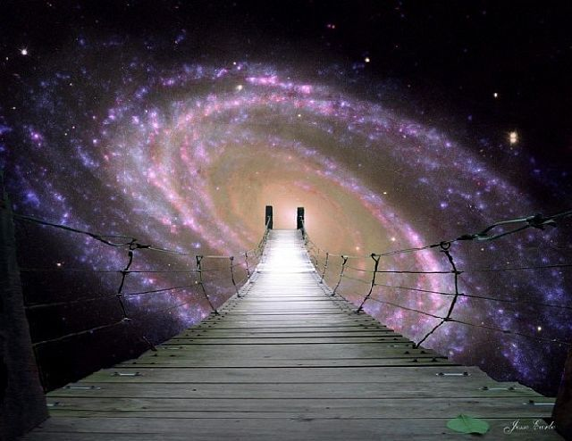
Hold fast the pattern of sound words which you have heard from me, in faith and love which are in Christ Jesus. – 2nd Timothy 1:13
"Remember therefore how you have received and heard; hold fast and repent. Therefore if you will not watch, I will come upon you as a thief, and you will not know what hour I will come upon you." – Revelation 3:3
hold fast and repent
Hold fast
in
in
Notes:
Without His words giving truth to a soul there would be little hope of salvation. The message remains to be watchful with purpose to be in Him.

Slide 18
Notes:
Darkness has no shine.

Slide 19
Ron Bert
Ropes
PART II
Ropes
April 28, 2019
Notes:
Light splits into darkness. To hold truth above lies defines the righteous.

Slide 20
Take firm hold of instruction, do not let go; Keep her, for she is your life. – Proverbs 4:13
firm hold
Notes:
It is by knowledge we find wisdom which brings the deepest senses of life.

Slide 21
But the natural man does not receive the things of the Spirit of God, for they are foolishness to him; nor can he know them, because they are spiritually discerned. – 1st Corinthians 2:14
But the natural man does not receive the things of the Spirit of God, for they are foolishness to him; nor can he know them, because they are spiritually discerned. – 1st Corinthians 2:14
natural man
natural man
God
not
not
Spirit of God
Spirit of God
God
God
foolishness
foolishness
know
know
spiritually
spiritually
discerned
discerned
Notes:
Not all hold to the truth of God but believe man has power over the fundamental building blocks of nature. Many claim superiority over His knowledge with visions of their own, declaring powers of creation. Fundamentally, all power emanates from God. He is the source and it is not of us. As the wind can not be controlled, so mankind has not the power to blow stars from one place to another. Great are those who know how little we are.

Slide 22
Draw near to God and He will draw near to you. Cleanse your hands, you sinners; and purify your hearts, you double-minded. – James 4:8
Draw near to God and He will draw near to you. Cleanse your hands, you sinners; and purify your hearts, you double-minded. – James 4:8
God
Draw near
double-minded
doubt
Notes:
In coming closer to God, a single mindedness controls over the deceptions of indecision. It is through open honest hearts that we are able to humbly return to God.

Slide 23
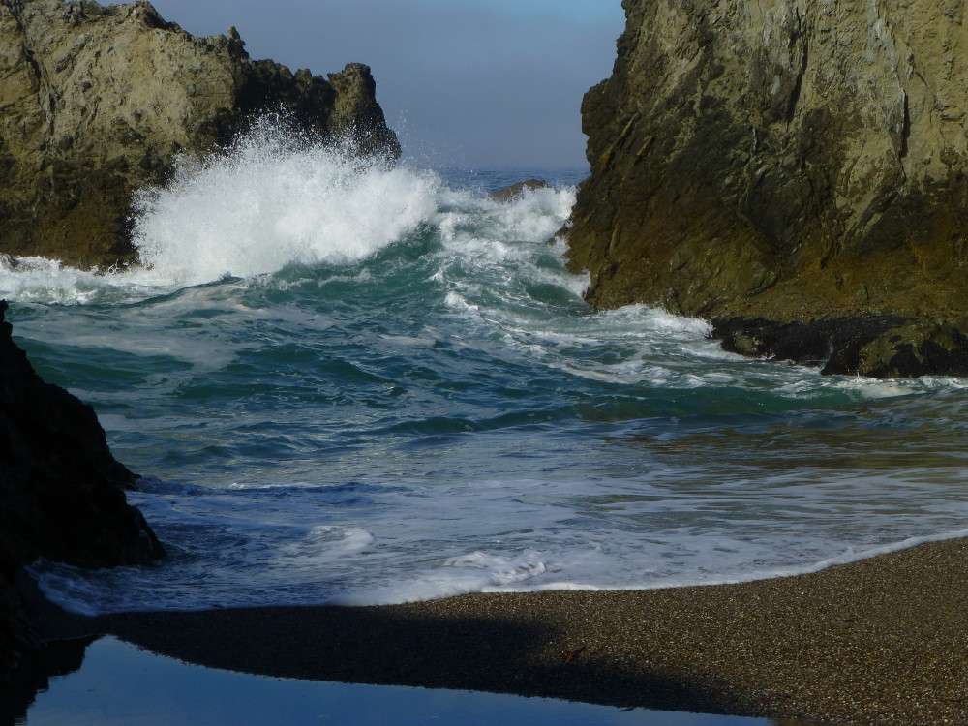
But let him ask in faith, with no doubting, for he who doubts is like a wave of the sea driven and tossed by the wind. For let not that man suppose that he will receive anything from the Lord; he is a double-minded man, unstable in all his ways. – James 1:6-8
in faith
But let him ask in faith, with no doubting, for he who doubts is like a wave of the sea driven and tossed by the wind. For let not that man suppose that he will receive anything from the Lord; he is a double-minded man, unstable in all his ways. – James 1:6-8
But let him ask in faith, with no doubting, for he who doubts is like a wave of the sea driven and tossed by the wind. For let not that man suppose that he will receive anything from the Lord; he is a double-minded man, unstable in all his ways. – James 1:6-8
trust
Lord
double-minded
LORD
Notes:
Without single purpose in His direction, the waves of time slosh about crashing from one rock to the other pulverizing certainty. Expecting something from God after He sacrificed Himself, for us to know, is a fools paradise. Fools inevitably doubt in their own short lived delight.

Slide 24
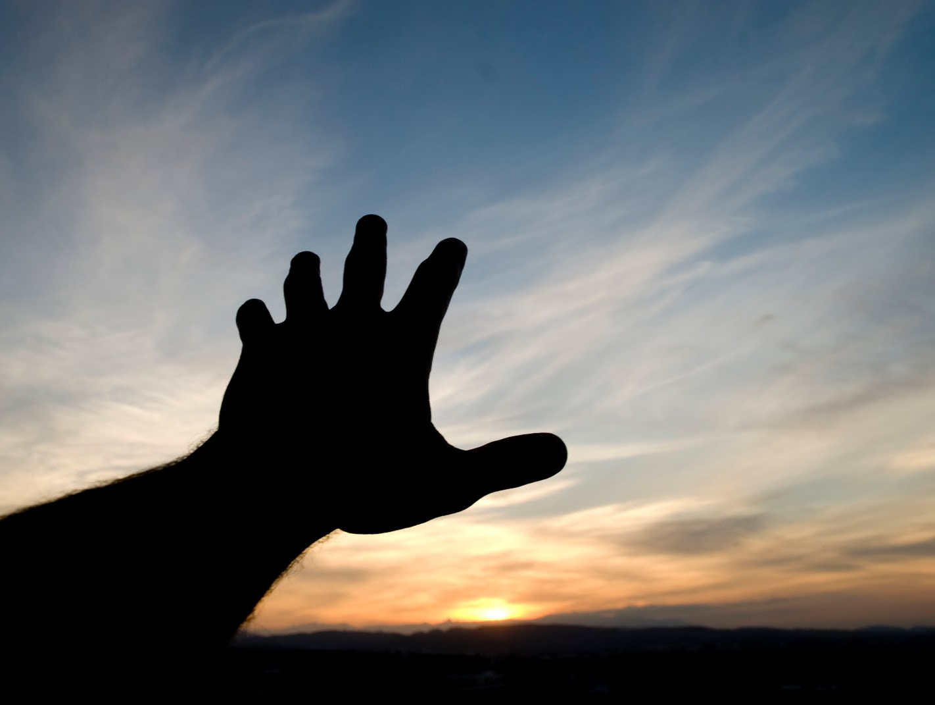
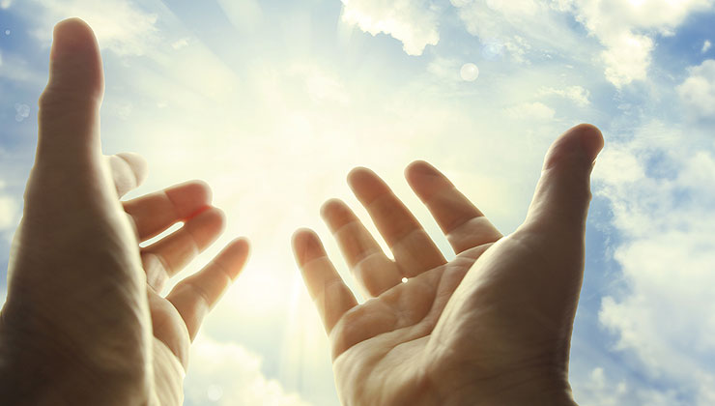
LORD
LORD
Seek the LORD while He may be found, Call upon Him while He is near. – Isaiah 55:6
Let us search out and examine our ways, And turn back to the LORD; Let us lift our hearts and hands To God in heaven. – Lamentations 3:40-41
turn
heart
back
lift
heart
Notes:
We are in a place where He extends His patience waiting for our simple rise back to Him. To relinquish this opportunity severs one’s destiny with eternity. God is near each listening (surely everyone of us), intimately, as the current grace of life prevails upon all, - before judgment. Consider your heart and the extent it has to humbly open to Him.

Slide 25
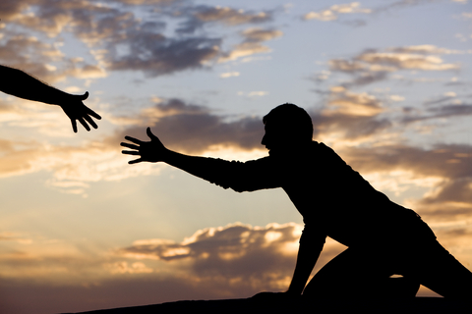
Search me, O God, and know my heart; Try me, and know my anxieties; And see if there is any wicked way in me, And lead me in the way everlasting. – Psalms 139:23-24
Search me, O God, and know my heart; Try me, and know my anxieties; And see if there is any wicked way in me, And lead me in the way everlasting. – Psalms 139:23-24
Search me, O God, and know my heart; Try me, and know my anxieties; And see if there is any wicked way in me, And lead me in the way everlasting. – Psalms 139:23-24
Search me
God
heart
know my heart
Notes:
In rising back to God one must plea for His guidance over human arrogance. Petitioning God for help in our struggles is part of the hope we embrace. To be humble is to admit faults requesting this guidance.

Slide 26
Seek good and not evil, That you may live; So the LORD God of hosts will be with you, As you have spoken. – Amos 5:14
life
death
Seek good and not evil, That you may live; So the LORD God of hosts will be with you, As you have spoken. – Amos 5:14
Seek good and not evil, That you may live; So the LORD God of hosts will be with you, As you have spoken. – Amos 5:14
Seek good and not evil
Therefore humble yourselves under the mighty hand of God, that He may exalt you in due time, casting all your care upon Him, for He cares for you. – 1st Peter 5:6-7
Beloved, let us love one another, for love is of God; and everyone who loves is born of God and knows God. He who does not love does not know God, for God is love. – 1st John 4:7-8
Beloved, let us love one another, for love is of God; and everyone who loves is born of God and knows God. He who does not love does not know God, for God is love. – 1st John 4:7-8
Therefore humble yourselves under the mighty hand of God, that He may exalt you in due time, casting all your care upon Him, for He cares for you. – 1st Peter 5:6-7
Therefore humble yourselves under the mighty hand of God, that He may exalt you in due time, casting all your care upon Him, for He cares for you. – 1st Peter 5:6-7
Beloved, let us love one another, for love is of God; and everyone who loves is born of God and knows God. He who does not love does not know God, for God is love. – 1st John 4:7-8
LORD
LORD
God
God
God
God
God
God
God
God
God
God
God
God
God
Notes:
Evil is and must be identified for goodness to prosper. To love is to imitate God. Trust in Him is praise due.

Slide 27
Evil men do not understand justice, But those who seek the LORD understand all. – Proverbs 28:5
Evil men do not understand justice, But those who seek the LORD understand all. – Proverbs 28:5
seek
LORD
LORD
Notes:
Any moment of time in space has glorious sense for those returning to what His majesty holds. True gratefulness for His mercy under grace renders wise sympathetic souls. The wisdom of God has no equal.

Slide 28
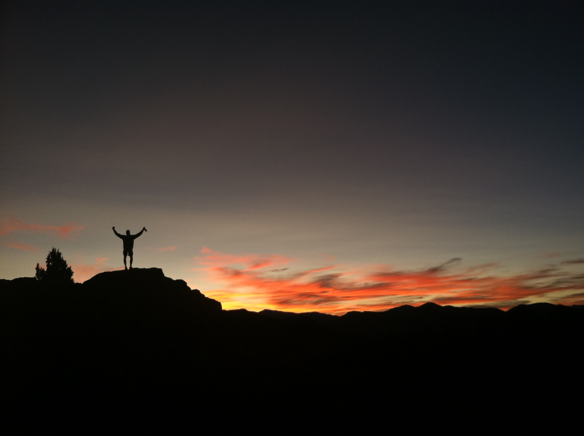
And you will seek Me and find Me, when you search for Me with all your heart. – Jeremiah 29:13
And you will seek Me and find Me, when you search for Me with all your heart. – Jeremiah 29:13
seek
seek
all
Notes:
God can be found by all those who genuinely seek Him out. Most assuredly, God will be found by all those who use all of their might to know Him.

Slide 29
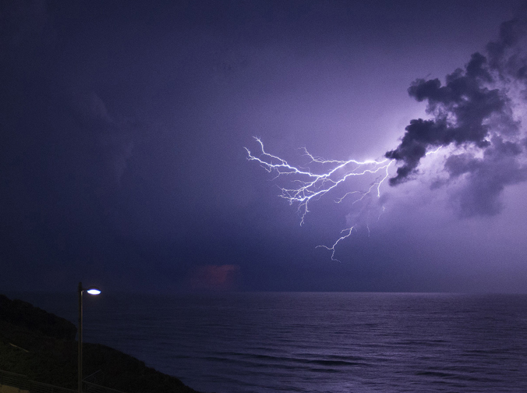
seek
Let all those who seek You rejoice and be glad in You; And let those who love Your salvation say continually, "Let God be magnified!" – Psalm 70:4
Let all those who seek You rejoice and be glad in You; And let those who love Your salvation say continually, "Let God be magnified!" – Psalm 70:4
love
Notes:
Is love on the horizon of your heart? As God increases in one’s life, the self is lessened in the light of His mercy. He magnifies endless power through eternal love.

Slide 30
You are all sons of light and sons of the day. We are not of the night nor of darkness. Therefore let us not sleep, as others do, but let us watch and be sober. For those who sleep, sleep at night, and those who get drunk are drunk at night. But let us who are of the day be sober, putting on the breastplate of faith and love, and as a helmet the hope of salvation. – 1st Thessalonians 5:5-8
You are all sons of light and sons of the day. We are not of the night nor of darkness. Therefore let us not sleep, as others do, but let us watch and be sober. For those who sleep, sleep at night, and those who get drunk are drunk at night. But let us who are of the day be sober, putting on the breastplate of faith and love, and as a helmet the hope of salvation. – 1st Thessalonians 5:5-8
watch
light
light
light
light
light
light
light
light
be sober
light
faith
love
hope
Notes:
As sons of light we incorporate His ways as our protection from that which would destroy our single sense of mind. Anything goes is not, and has never been, the rule of law. He asks that we stay in His light keeping our wits about us. Darkness is a slide well enough left alone; Light has no comparison in its’ dark essence.

Slide 31
For you were once darkness, but now you are light in the Lord. Walk as children of light (for the fruit of the Spirit is in all goodness, righteousness, and truth), finding out what is acceptable to the Lord. – Ephesians 5:8-10
For you were once darkness, but now you are light in the Lord. Walk as children of light (for the fruit of the Spirit is in all goodness, righteousness, and truth), finding out what is acceptable to the Lord. – Ephesians 5:8-10
Walk
light
fruit of the Spirit is in all goodness, righteousness, and truth
finding out
what
is acceptable
to the Lord
Notes:
To fully live in His light we must become alive to His will and bear those fruits accordingly. Each of us needs to know what is acceptable to the Lord for our own sake. His will is for us to stand on goodness filled with righteousness in truth.

Slide 32
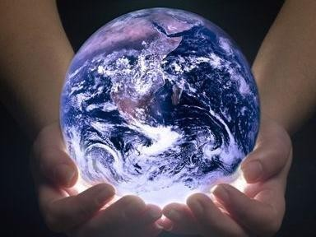
In the morning sow your seed, And in the evening do not withhold your hand; For you do not know which will prosper, Either this or that, Or whether both alike will be good. – Ecclesiastes 11:6
In the morning sow your seed, And in the evening do not withhold your hand; For you do not know which will prosper, Either this or that, Or whether both alike will be good. – Ecclesiastes 11:6
In the morning sow your seed, And in the evening do not withhold your hand; For you do not know which will prosper, Either this or that, Or whether both alike will be good. – Ecclesiastes 11:6
hand
Notes:
He instructs us to never give up, morning noon or night, and always remain ready to engage in pursuit of more goodness. Endurance is a test of God. For the diligent, His will is that they prosper.

Slide 33
hand
Whatever your hand finds to do, do it with your might; for there is no work or device or knowledge or wisdom in the grave where you are going. – Ecclesiastes 9:10
Whatever your hand finds to do, do it with your might; for there is no work or device or knowledge or wisdom in the grave where you are going. – Ecclesiastes 9:10
Whatever your hand finds to do, do it with your might; for there is no work or device or knowledge or wisdom in the grave where you are going. – Ecclesiastes 9:10
Notes:
This test the Lord has us all under will expose the true nature of who we are. The path we walk declares the destiny we will inherit. With all of our might is what makes the presence of goodness rise above the darkness.

Slide 34
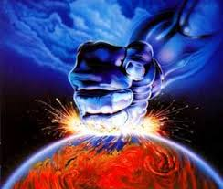
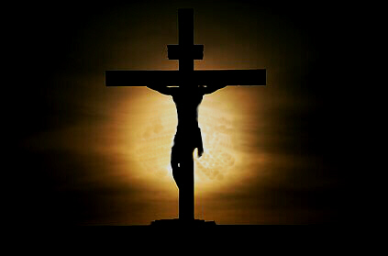
"Truly, these times of ignorance God overlooked, but now commands all men everywhere to repent, because He has appointed a day on which He will judge the world in righteousness by the Man whom He has ordained. He has given assurance of this to all by raising Him from the dead." – Acts 17:30-31
"Truly, these times of ignorance God overlooked, but now commands all men everywhere to repent, because He has appointed a day on which He will judge the world in righteousness by the Man whom He has ordained. He has given assurance of this to all by raising Him from the dead." – Acts 17:30-31
Jesus Christ
raising Him from the dead
raising Him from the dead
Notes:
God’s own judgment will befall upon us all, based on each of our responses to His offering which exposed eternal sacrifice in love. Jesus Christ is the standard for life rising from the earth. It is by His revealing sacrifice, for us, that we now enjoy direct relationship with God. His life calls us to rise from the death of our sinfulness to join with Him in the light of His truths.

Slide 35
If then you were raised with Christ, seek those things which are above, where Christ is, sitting at the right hand of God. Set your mind on things above, not on things on the earth. – Colossians 3:1-2
If then you were raised with Christ, seek those things which are above, where Christ is, sitting at the right hand of God. Set your mind on things above, not on things on the earth. – Colossians 3:1-2
seek
are above
Christ
Christ
mind
of
mind
of
Notes:
We must never forget to consider the mind of Christ, nor neglect the meditations from above. For all that is good rises from the dust of the past. Is His truth tied to the strings of your heart?

Slide 36
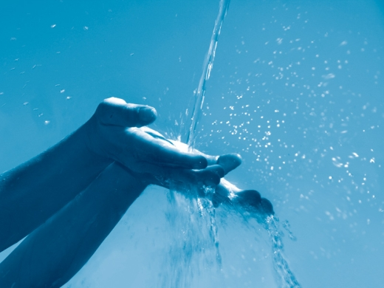
For whatever is born of God overcomes the world. And this is the victory that has overcome the world -- our faith. – 1st John 5:4
For whatever is born of God overcomes the world. And this is the victory that has overcome the world -- our faith. – 1st John 5:4
For whatever is born of God overcomes the world. And this is the victory that has overcome the world -- our faith. – 1st John 5:4
Only let your conduct be worthy of the gospel of Christ, so that whether I come and see you or am absent, I may hear of your affairs, that you stand fast in one spirit, with one mind striving together for the faith of the gospel, … – Philippians 1:27
Only let your conduct be worthy of the gospel of Christ, so that whether I come and see you or am absent, I may hear of your affairs, that you stand fast in one spirit, with one mind striving together for the faith of the gospel, … – Philippians 1:27
mind
mind of Christ
mind of Christ
of
faith
faith
faith
faith
faith
faith
faith
faith
faith
Christ
in
one spirit
stand fast in one spirit
Test all things; hold fast what is good. – 1st Thessalonians 5:21
Test all things; hold fast what is good. – 1st Thessalonians 5:21
hold fast
faith
Notes:
To overcome the world we must be bathed in His sacrifice. Never to say goodbye is of an unending faith.
The world and all that is in it can not deliver the vision of eternal life where true life begins. God looks for individuals to be wise rather than careless.

Slide 37
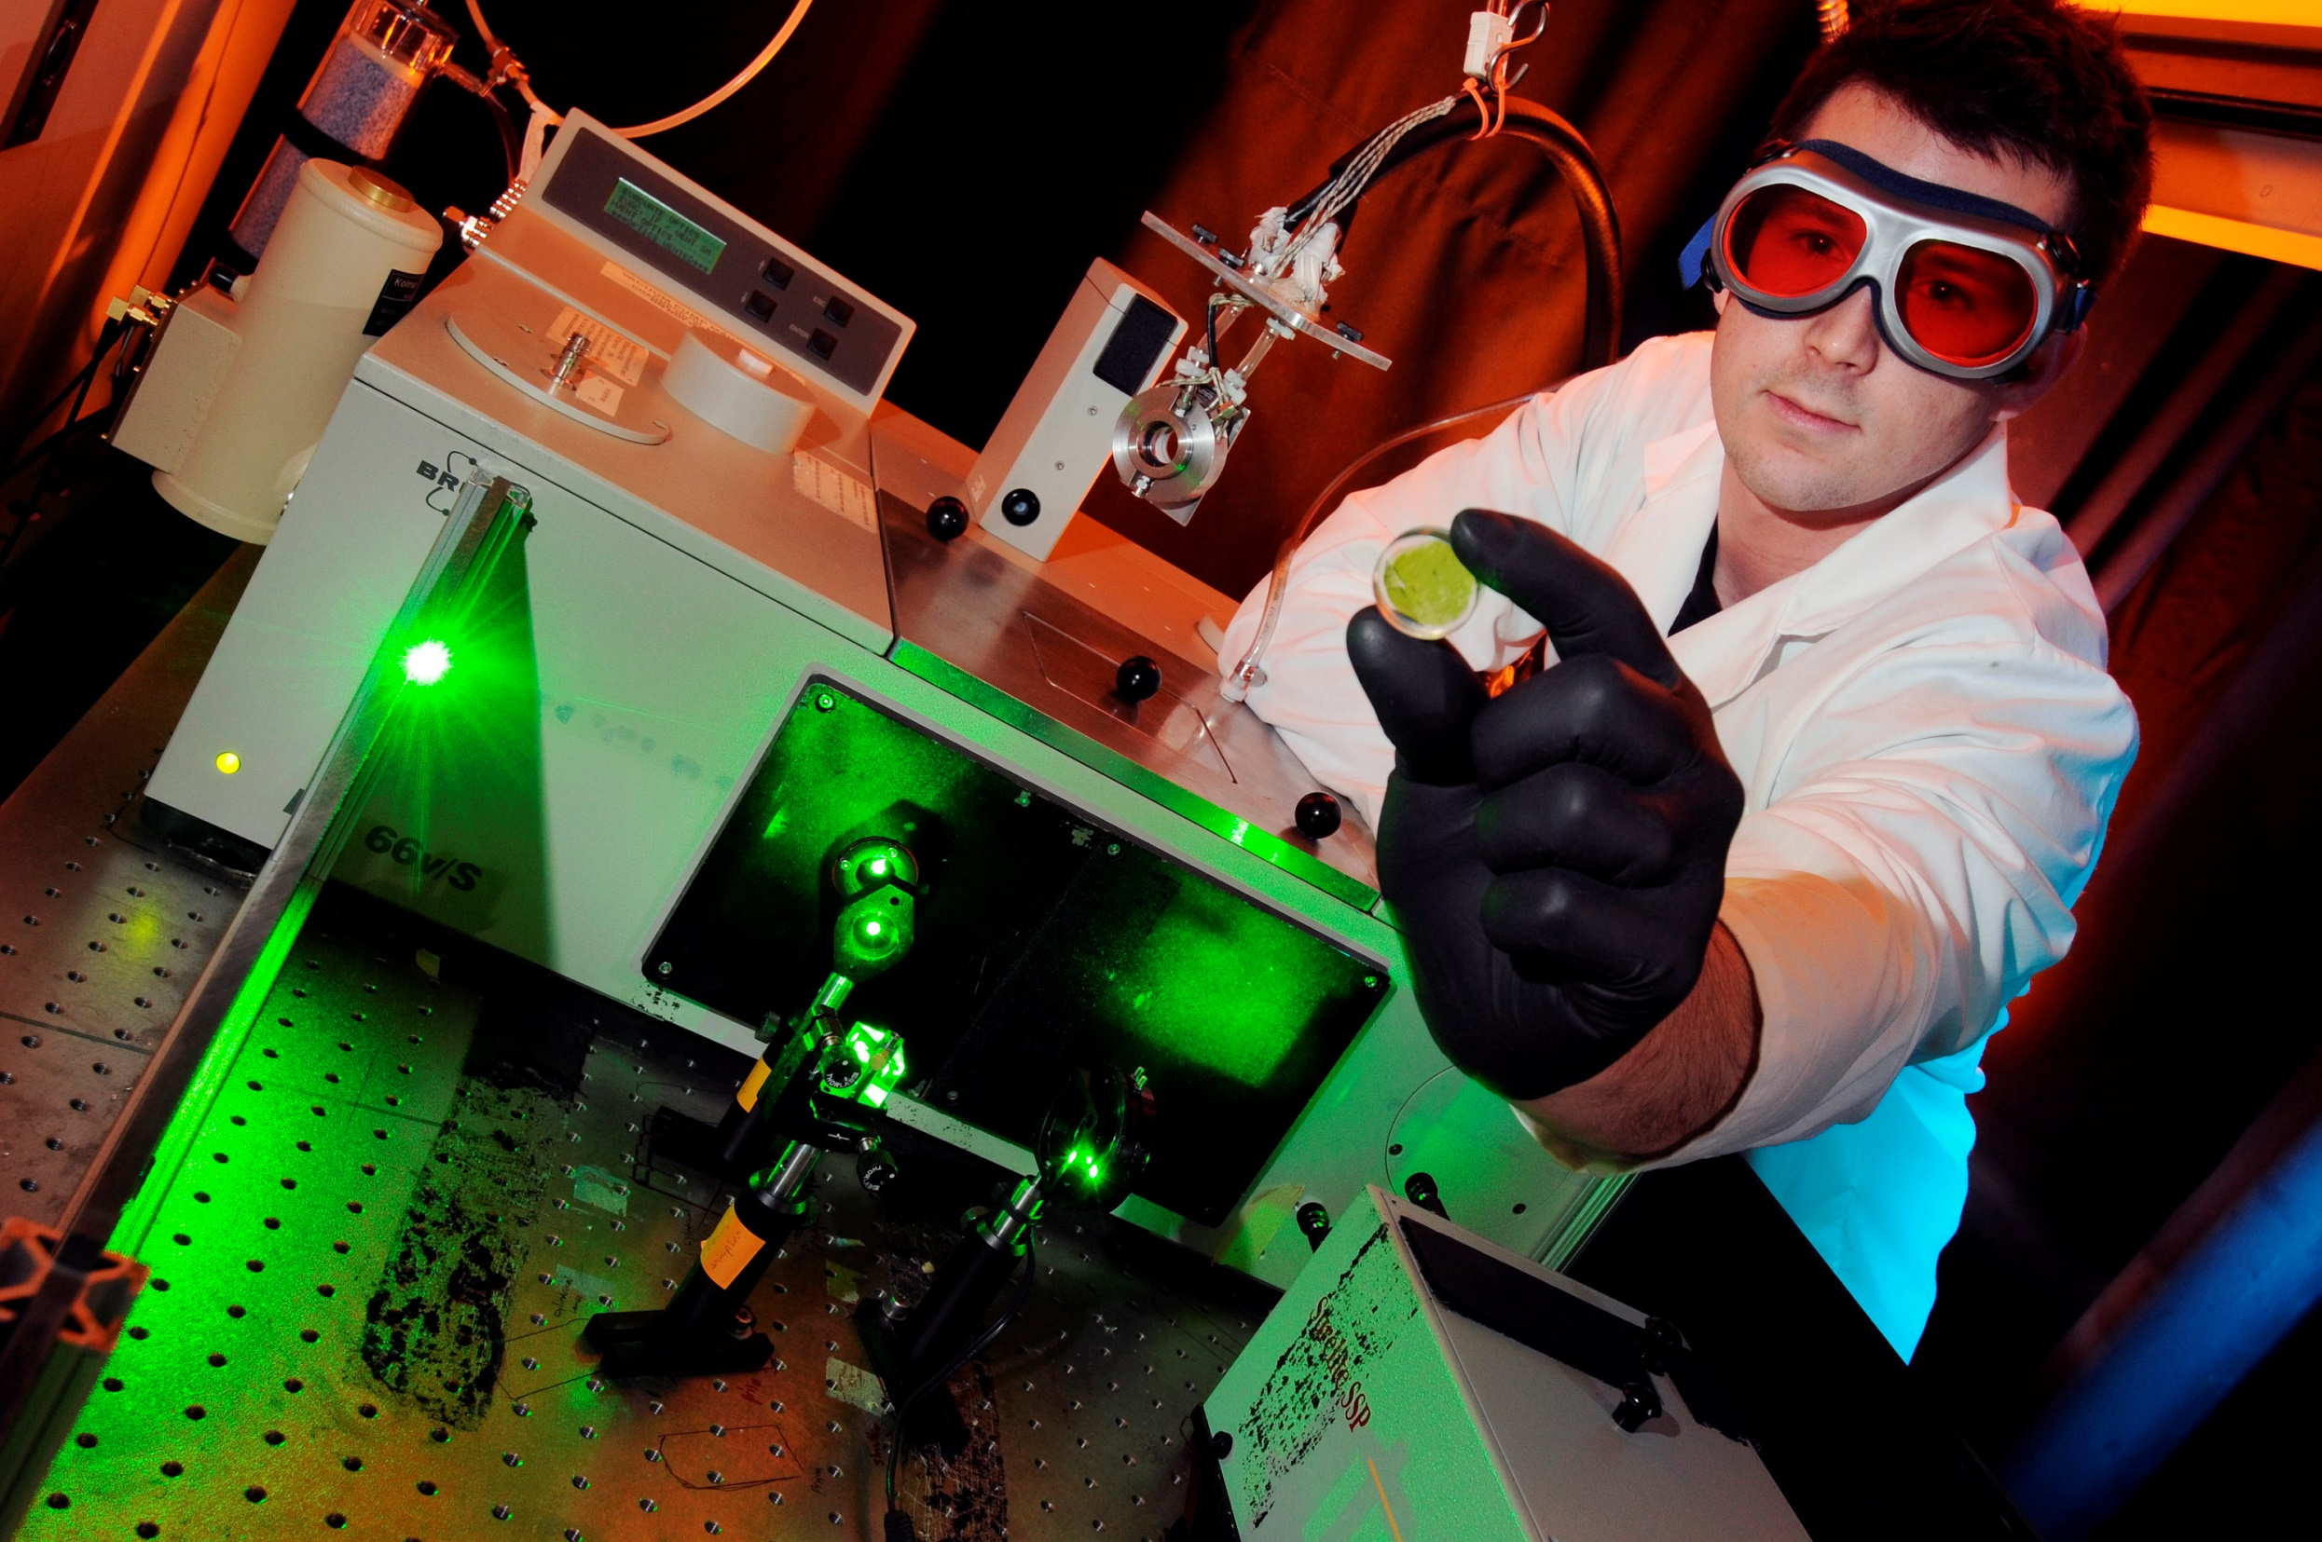
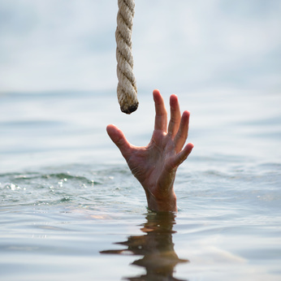
→ Take hold of instruction and do not let go
→ Things of the Spirit of God are spiritually discerned
→ If one draws near to God, He will draw near to you
→ Doubters receive nothing asked for in prayer
→ Lift our hearts to God in heaven
→ Let God lead you in the way everlasting
→ Seek good and not evil
→ Cast all one’s cares upon the Lord
→ Love is a prerequisite to know God
→ Seeking God with one’s all will find Him
→ Faith, love, and hope lead to salvation
→ Day or night never give up on good works
→ Set your mind on things above, not of the earth
We hope to be rescued by His grace

Slide 38
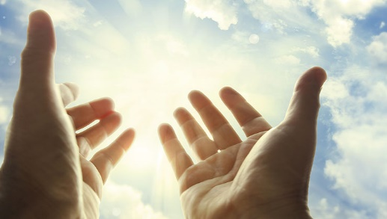
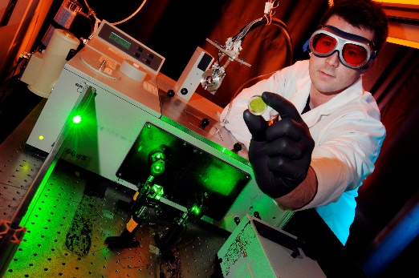

Slide 39
Notes:
The deepest of all darkness can only hide nothing. Darkness has no place to endure.

Slide 40
Please visit http://www.LoveFromGod.com to explore further
Ronald Bert Channel on
Notes:
Eternity never ends.

