Slide 2
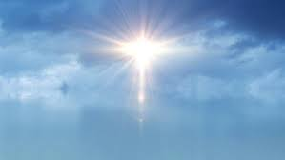
Righteousness
1
Ron Bert
January 6, 2019

Slide 3
For thus says the LORD, Who created the heavens, Who is God, Who formed the earth and made it, Who has established it, Who did not create it in vain, Who formed it to be inhabited: "I am the LORD, and there is no other. I have not spoken in secret, In a dark place of the earth; I did not say to the seed of Jacob, 'Seek Me in vain'; I, the LORD, speak righteousness, I declare things that are right. — Isaiah 45:18-19
thus says the LORD
created the
heavens
formed the
● created the heavens
● formed the earth and made it
● did not create it in vain
● formed it to be inhabited
● I am the LORD, and there is no other
● I have not spoken in secret
● I, the LORD, speak righteousness
● I declare things that are right
earth and made it
thus says the LORD
did not create it in vain
formed
it to be inhabited
I am the LORD, and
there is no other
I have not spoken in
secret
I, the LORD, speak righteousness
I declare
things that are right

Slide 4
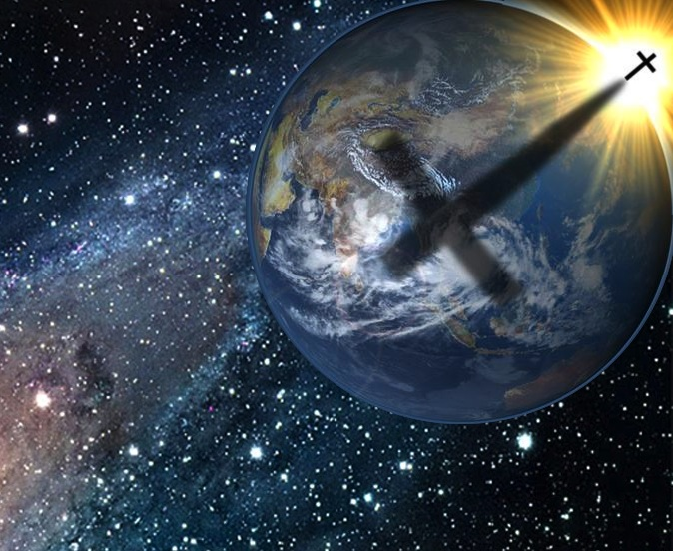
Thus says the LORD: "Keep justice, and do righteousness, For My salvation is about to come, And My righteousness to be revealed. — Isaiah 56:1
thus says the LORD
Keep justice
do righteousness
righteous
righteous
My righteousness to be revealed

Slide 5
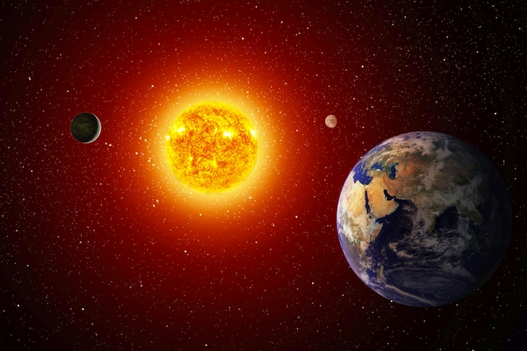
The sinners in Zion are afraid; Fearfulness has seized the hypocrites: "Who among us shall dwell with the devouring fire? Who among us shall dwell with everlasting burnings?" He who walks righteously and speaks uprightly, He who despises the gain of oppressions, Who gestures with his hands, refusing bribes, Who stops his ears from hearing of bloodshed, And shuts his eyes from seeing evil: — Isaiah 33:14-15
devouring fire
→ who walks righteously
→ speaks uprightly
→ despises the gain of oppressions
→ gestures with his hands, refusing bribes
→ stops his ears from hearing of bloodshed
→ shuts his eyes from seeing evil
shall dwell with
righteous
virtuous
righteousness
honesty
who walks righteously
ess
n
righteous
integrity
speaks uprightly
despises the
gain of oppressions
murderous thoughts
gestures with
his hands, refusing bribes
stops his
self-control
ears from hearing of bloodshed
shuts
his eyes from seeing evil

Slide 6
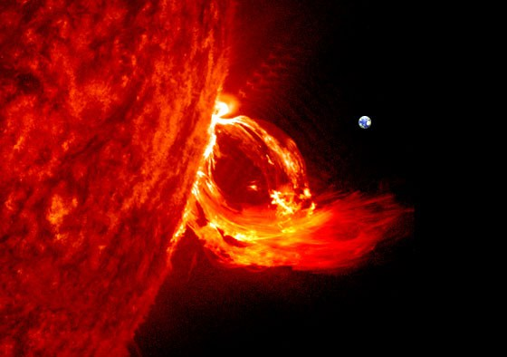
Riches do not profit in the day of wrath, But righteousness delivers from death. The righteousness of the blameless will direct his way aright, But the wicked will fall by his own wickedness. The righteousness of the upright will deliver them, But the unfaithful will be caught by their lust. When a wicked man dies, his expectation will perish, And the hope of the unjust perishes. The righteous is delivered from trouble, And it comes to the wicked instead. — Proverbs 11:4-8
righteous
man
righteousness
man
righteous

Slide 7
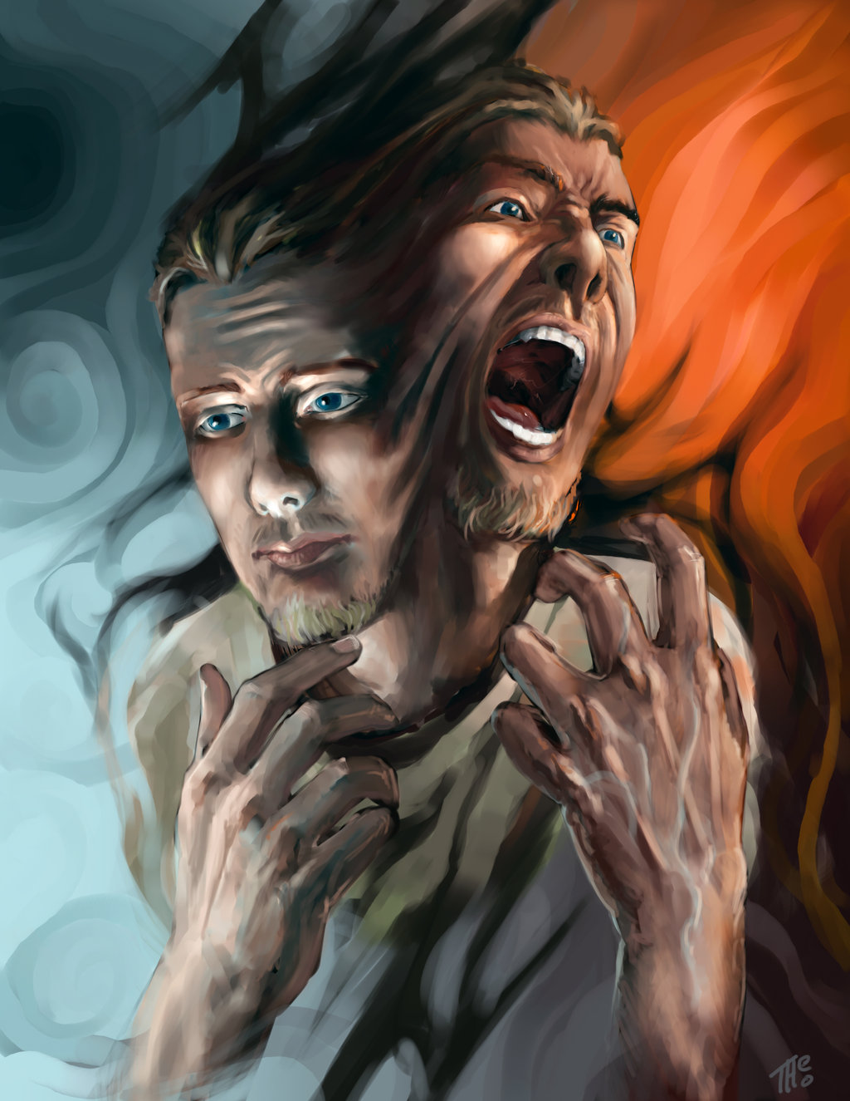
A righteous man hates lying, But a wicked man is loathsome and comes to shame. Righteousness guards him whose way is blameless, But wickedness overthrows the sinner. — Proverbs 13:5-6
A righteous man hates lying
righteous
man
Righteous
s
d
i
Righteous lips
l

Slide 8
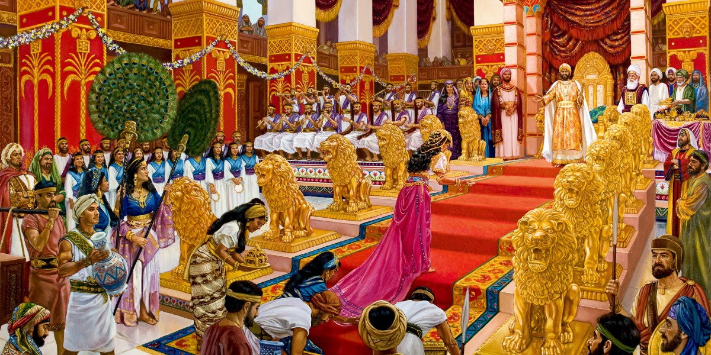
It is an abomination for kings to commit wickedness, For a throne is established by righteousness. Righteous lips are the delight of kings, And they love him who speaks what is right. — Proverbs16:12-13
righteous
established by righteousness
righteous
Righteous lips
speaks what is right
Notes:
s

Slide 9
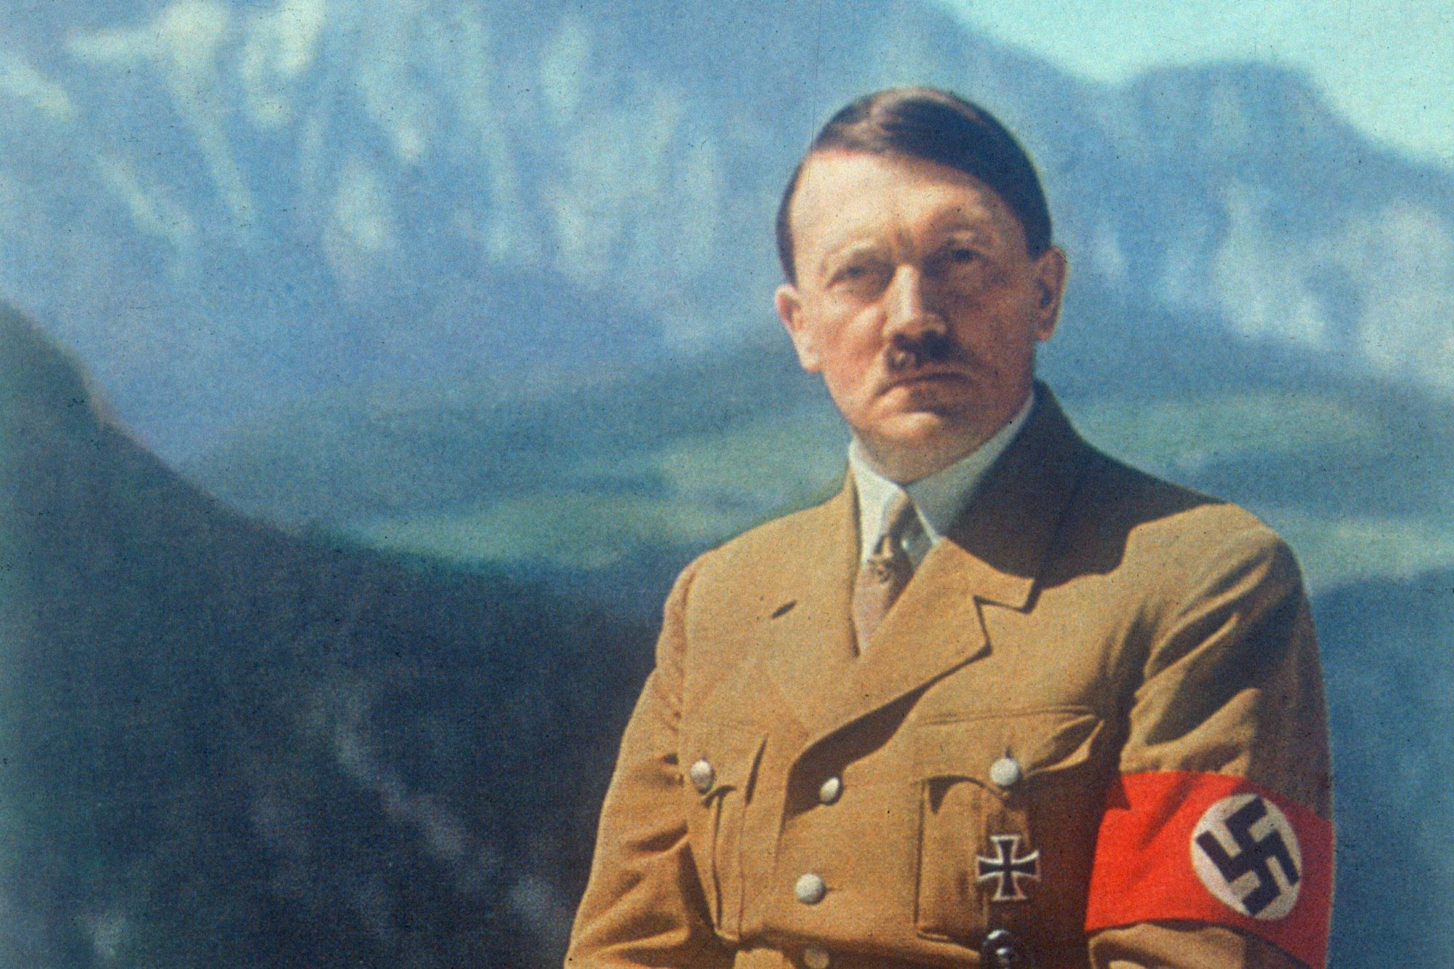
When the righteous are in authority, the people rejoice; But when a wicked man rules, the people groan. — Proverbs 29:2
righteous

Slide 10
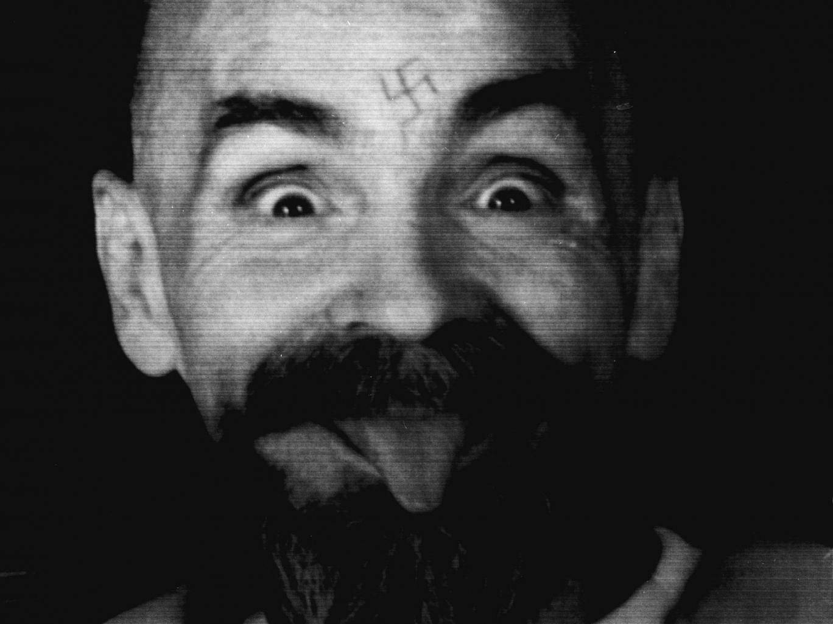
Righteousness exalts a nation, But sin is a reproach to any people. — Proverbs 14:34

Slide 11
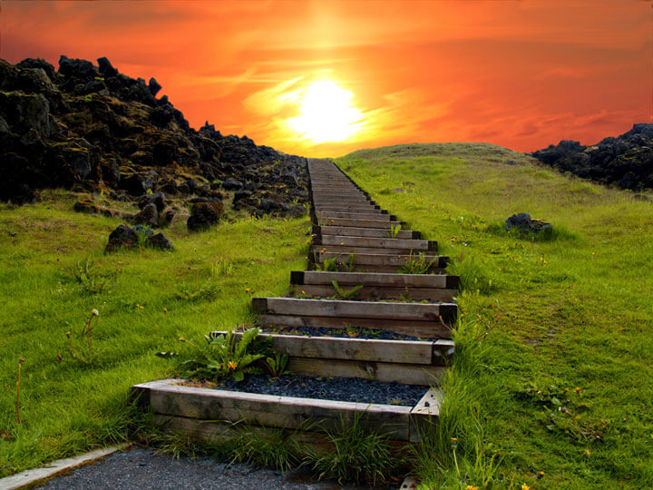
Who is wise? Let him understand these things. Who is prudent? Let him know them. For the ways of the LORD are right; The righteous walk in them, But transgressors stumble in them. — Hosea 14:9
LORD
know them
the ways
LORD
right
LORD
in
walk in them

Slide 12
Sow for yourselves righteousness; Reap in mercy; Break up your fallow ground, For it is time to seek the LORD, Till He comes and rains righteousness on you. — Hosea 10:12
LORD
seek the LORD, Till He comes
LORD

Slide 13
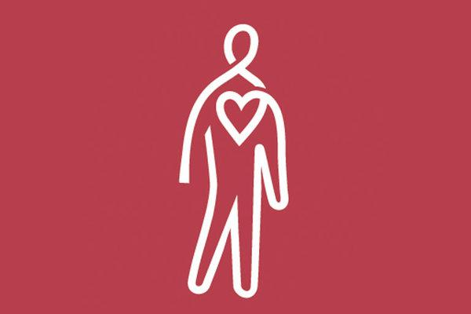
Every way of a man is right in his own eyes, But the LORD weighs the hearts. To do righteousness and justice Is more acceptable to the LORD than sacrifice. A haughty look, a proud heart, And the plowing of the wicked are sin. — Proverbs 21:2-4
To do righteousness
LORD
LORD
and justice

Slide 14
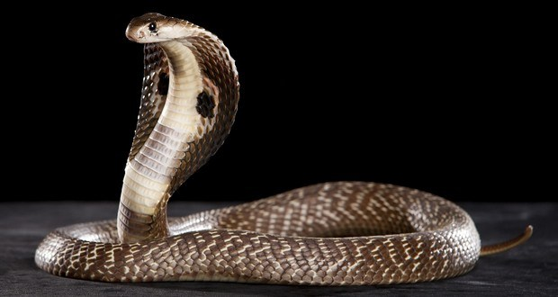
As it is written: "There is none righteous, no, not one; There is none who understands; There is none who seeks after God. They have all turned aside; They have together become unprofitable; There is none who does good, no, not one. Their throat is an open tomb; With their tongues they have practiced deceit; The poison of asps is under their lips; Whose mouth is full of cursing and bitterness." — Romans 3:10-14
none righteous

Slide 15
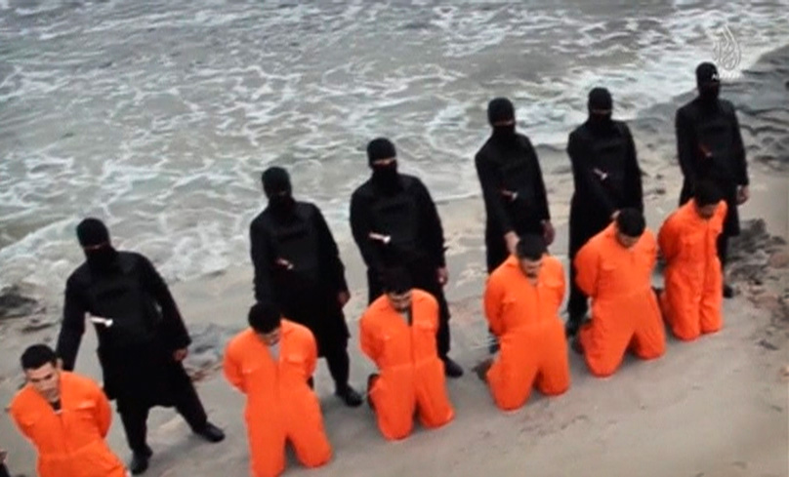
"Their feet are swift to shed blood; Destruction and misery are in their ways; And the way of peace they have not known. There is no fear of God before their eyes." Now we know that whatever the law says, it says to those who are under the law, that every mouth may be stopped, and all the world may become guilty before God. — Romans 3:15-19
no fear of God
all
guilty before God

Slide 16
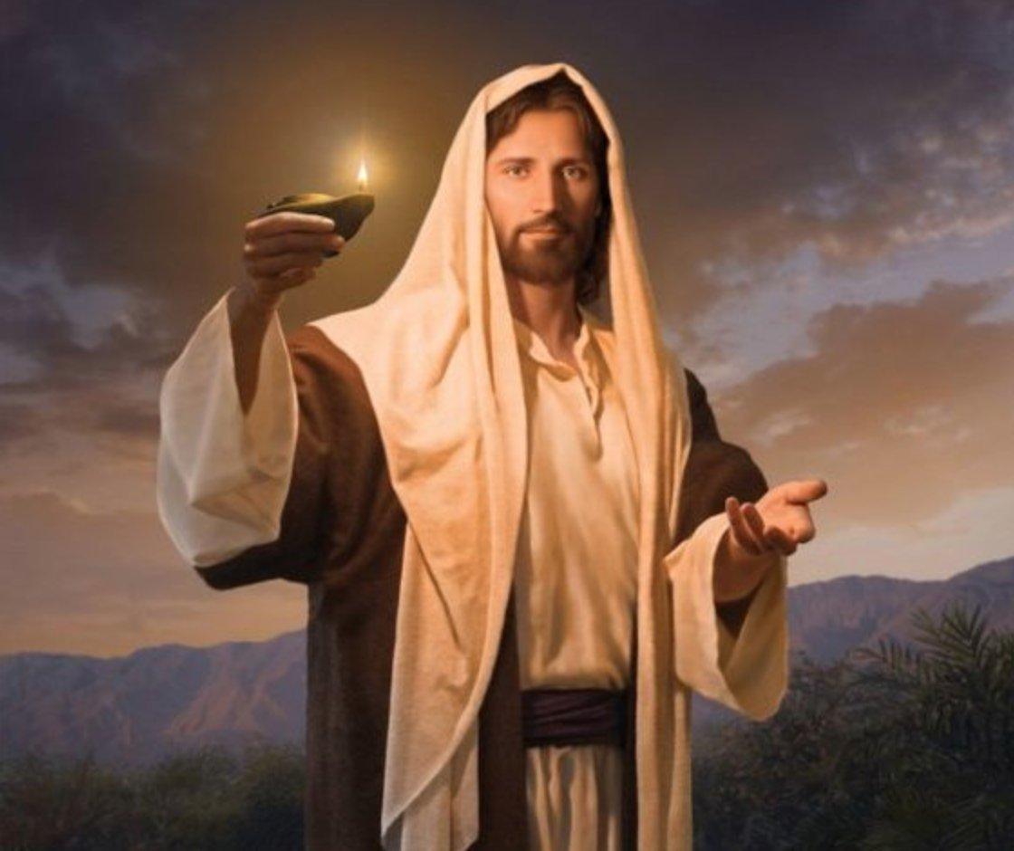
Therefore by the deeds of the law no flesh will be justified in His sight, for by the law is the knowledge of sin. But now the righteousness of God apart from the law is revealed, being witnessed by the Law and the Prophets, even the righteousness of God, through faith in Jesus Christ, to all and on all who believe. For there is no difference; — Romans 3:20-22
in
righteousness of God
revealed
faith = believe
in
through faith in Jesus Christ
faith
faith
Jesus Christ
believe
believe
no difference
no difference

Slide 17
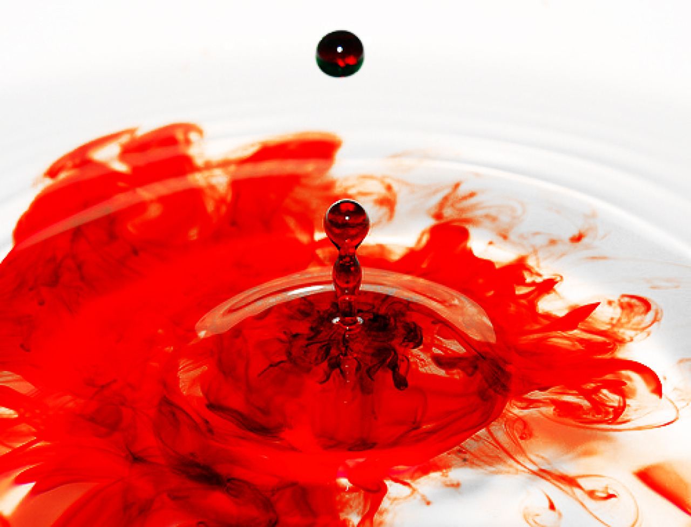
… for all have sinned and fall short of the glory of God, being justified freely by His grace through the redemption that is in Christ Jesus, whom God set forth as a propitiation by His blood, through faith, to demonstrate His righteousness, because in His forbearance God had passed over the sins that were previously committed, … — Romans 3:23-25
justified freely
by His grace
through
redemption
ajustified freely by His grace
through redemption in Christ Jesus
apropitiation by His blood, through faith
to demonstrate His righteousness
in Christ Jesus
in
propitiation by His blood,
through faith
to demonstrate His
faith = believe
righteousness

Slide 18
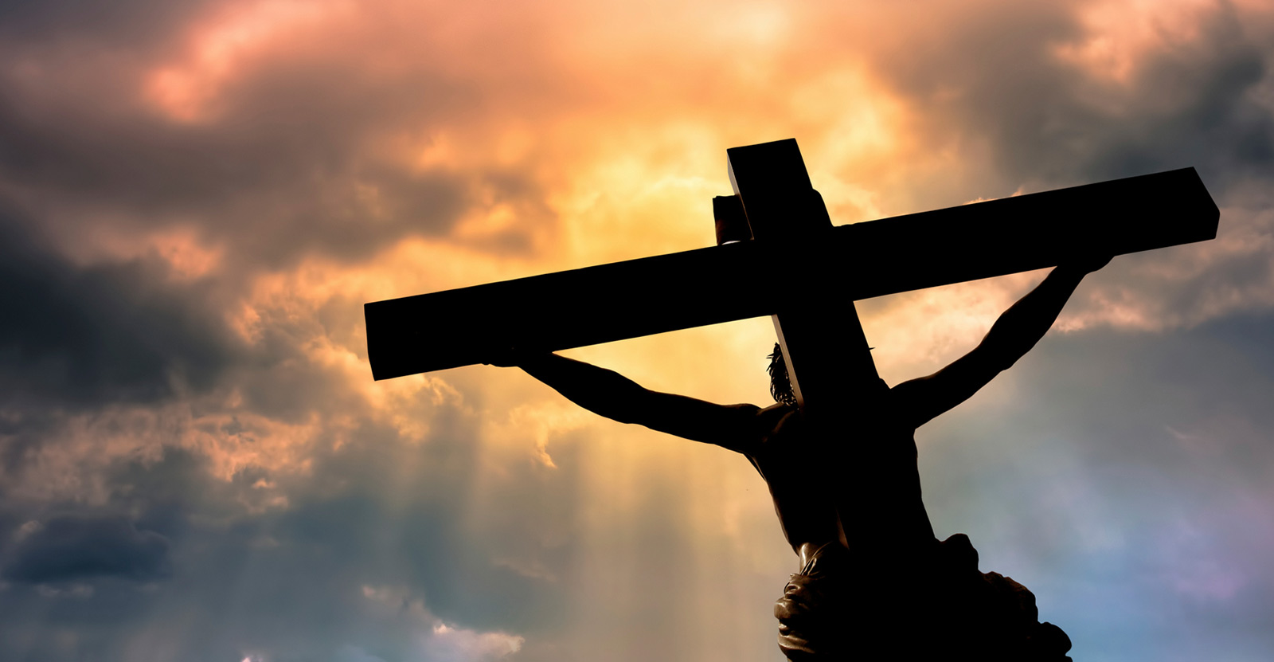
… to demonstrate at the present time His righteousness, that He might be just and the justifier of the one who has faith in Jesus. — Romans 3:26
to demonstrate
His righteousness
His righteousness
just and the justifier
faith in Jesus
in

Slide 19
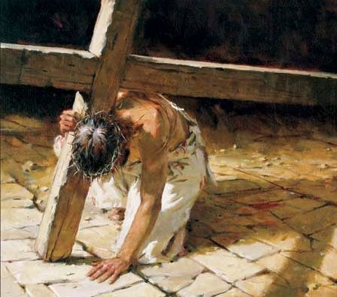
For He made Him who knew no sin to be sin for us, that we might become the righteousness of God in Him. — 2nd Corinthians 5:21
For He made Him who knew no sin to be sin for us, that we might become the righteousness of God in Him. — 2nd Corinthians 5:21
we might
in

Slide 20
For I am not ashamed of the gospel of Christ, for it is the power of God to salvation for everyone who believes, for the Jew first and also for the Greek. For in it the righteousness of God is revealed from faith to faith; as it is written, "The just shall live by faith." — Romans 1:16-17
gospel of Christ
God
God
in
For in it
righteousness of God is revealed
God

Slide 21
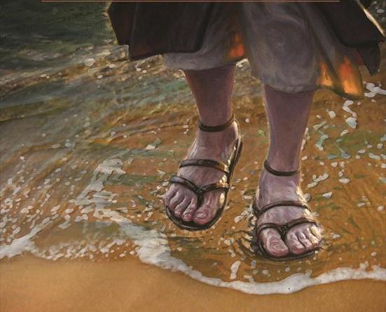
For what the law could not do in that it was weak through the flesh, God did by sending His own Son in the likeness of sinful flesh, on account of sin: He condemned sin in the flesh, that the righteous requirement of the law might be fulfilled in us who do not walk according to the flesh but according to the Spirit. — Romans 8:3-4
God
Spirit
Spirit
in
in us who
to the Spirit
Spirit
Spirit

Slide 22
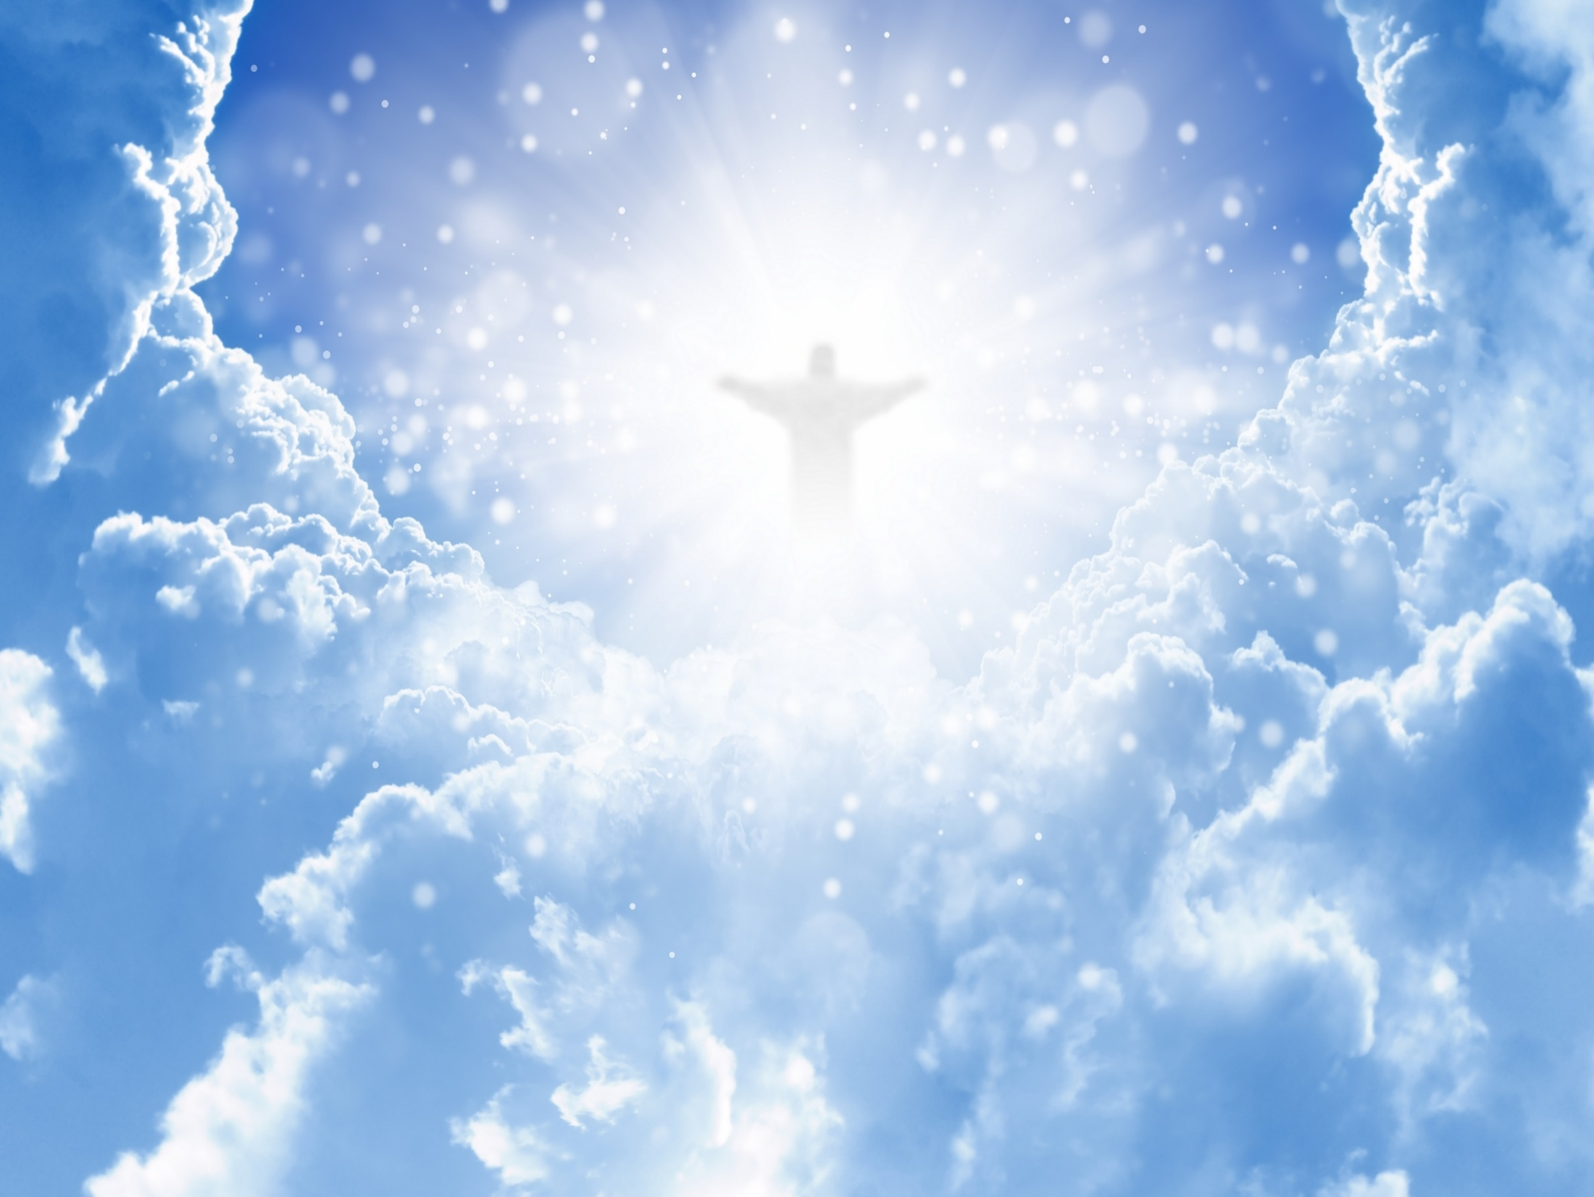
For those who live according to the flesh set their minds on the things of the flesh, but those who live according to the Spirit, the things of the Spirit. For to be carnally minded is death, but to be spiritually minded is life and peace. — Romans 8:5-6
Spirit
Spirit
Spirit

Slide 23
… for the kingdom of God is not eating and drinking, but righteousness and peace and joy in the Holy Spirit. For he who serves Christ in these things is acceptable to God and approved by men. Therefore let us pursue the things which make for peace and the things by which one may edify another. — Romans 14:17-19
in
righteousness and peace and joy
Spirit
the Holy Spirit

Slide 24
Do not be deceived: "Evil company corrupts good habits." Awake to righteousness, and do not sin; for some do not have the knowledge of God. I speak this to your shame. — 1st Corinthians 15:33-34
Awake to righteousness
knowledge of God

Slide 25
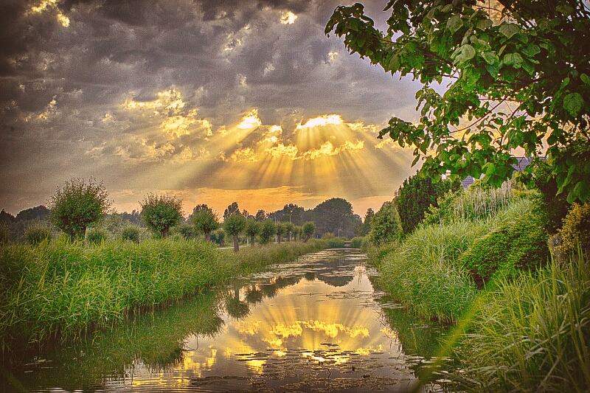
→ The Lord openly speaks righteous truth
→ The righteous speak uprightly refusing bribes
→ The righteous wish no harm exercising self-control
→ Righteousness delivers from death
→ A throne is established by righteousness
→ The righteous walk in the ways of the Lord
→ The Lord desires us to be righteousness and just
→ Righteousness of God is revealed in Jesus Christ
→ Righteousness of God for us is in Christ
→ The gospel is the power of God to salvation
→ Christ fulfilled the righteous requirement of the law
→ Spiritually minded is life and peace
→ Awake to righteousness in the knowledge of God
Dedication to His Word draws out the brilliance of a soul
Notes:
Dedication to His Word draws out the brilliance of a soul.

Slide 27
Righteousness
2
Ron Bert
January 27, 2019

Slide 28
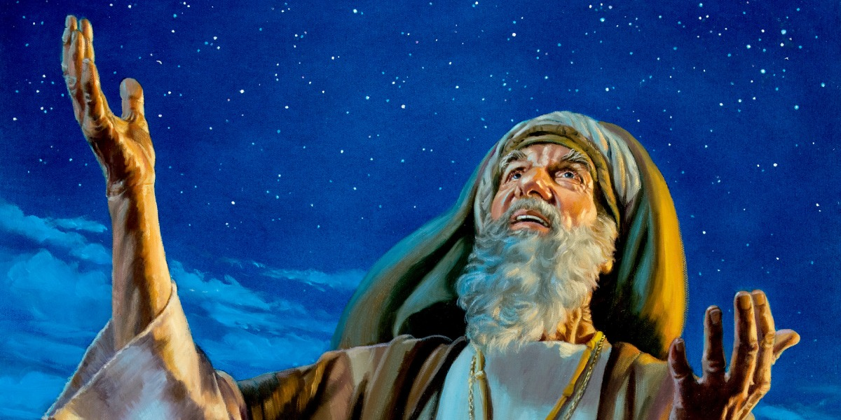
For the promise that he would be the heir of the world was not to Abraham or to his seed through the law, but through the righteousness of faith. — Romans 4:13
faith = believe
ALL
righteousness of faith
righteousness
righteousness

Slide 29
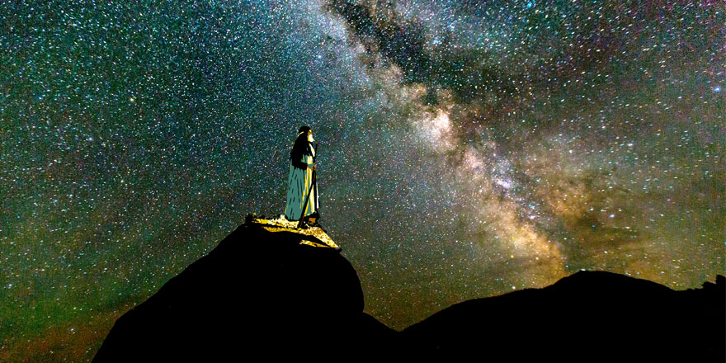
He did not waver at the promise of God through unbelief, but was strengthened in faith, giving glory to God, and being fully convinced that what He had promised He was also able to perform. And therefore "it was accounted to him for righteousness." — Romans 4:20-22
X
in faith
in
fully convinced
righteousness
righteousness

Slide 30
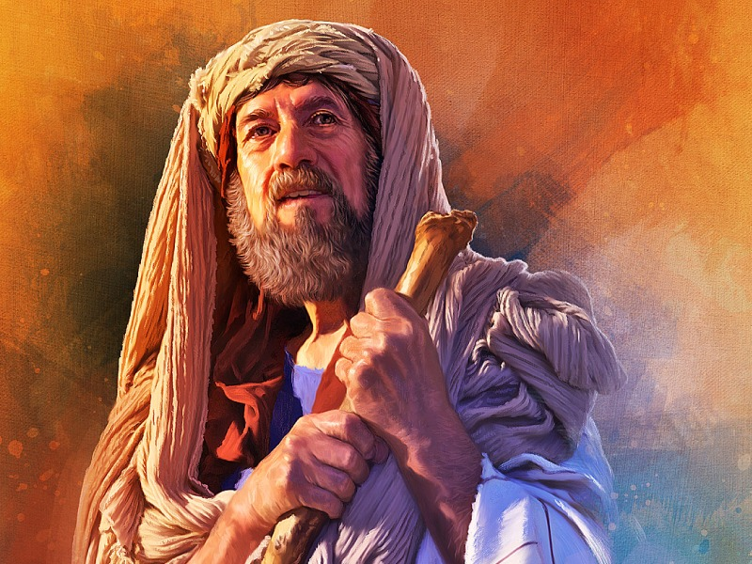
… just as Abraham "believed God, and it was accounted to him for righteousness." — Galatians 3:6
believed God
believed God
righteousness
righteousness
believed God = righteousness

Slide 31
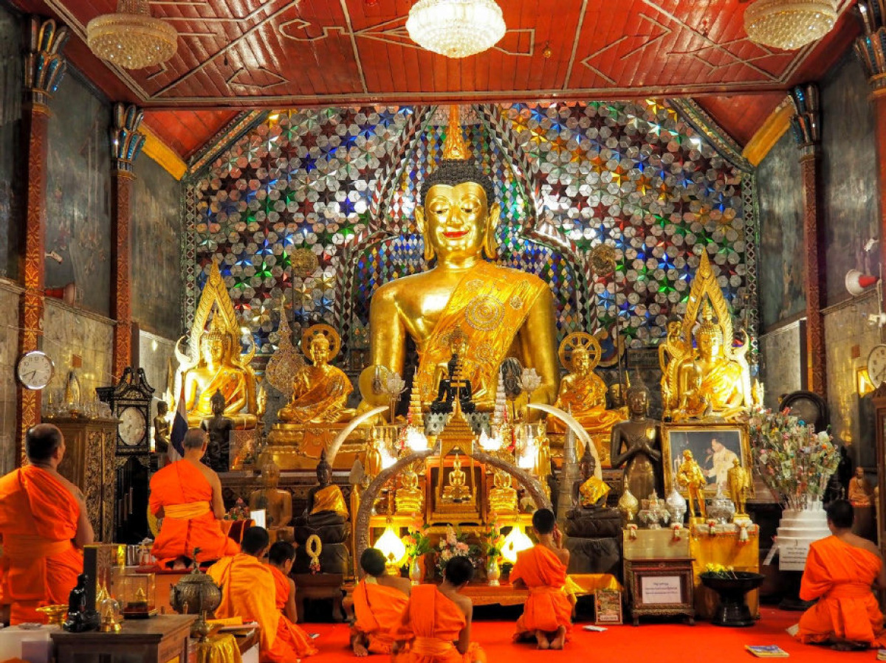
For I bear them witness that they have a zeal for God, but not according to knowledge. For they being ignorant of God's righteousness, and seeking to establish their own righteousness, have not submitted to the righteousness of God. For Christ is the end of the law for righteousness to everyone who believes. — Romans 10:2-4
zeal
God
not according
to knowledge
Christ
Ignorant of God's righteousness
God's
ignorant of God's righteousness
◦ God zeal not according to knowledge
◦ ignorant of God's righteousness
◦ seeking their own righteousness
◦ not submitted to God's righteousness ◦ Christ ends the law for righteousness
to everyone who believes
seeking
their own
righteousness
not submitted to
s
Christ
righteousness
end
the law for righteousness
Christ
to everyone who believes
believes

Slide 32
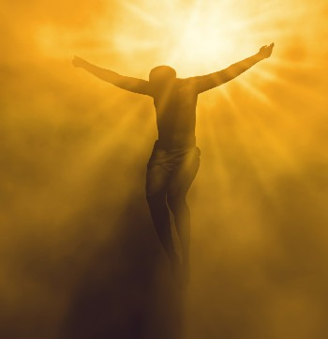
For Moses writes about the righteousness which is of the law, "The man who does those things shall live by them." But the righteousness of faith speaks in this way, "Do not say in your heart, 'Who will ascend into heaven?'" (that is, to bring Christ down from above) — Romans 10:5-6
Christ
righteousness of faith
of faith
of faith
higher knowledge than can be known
judging hearts
Christ

Slide 33
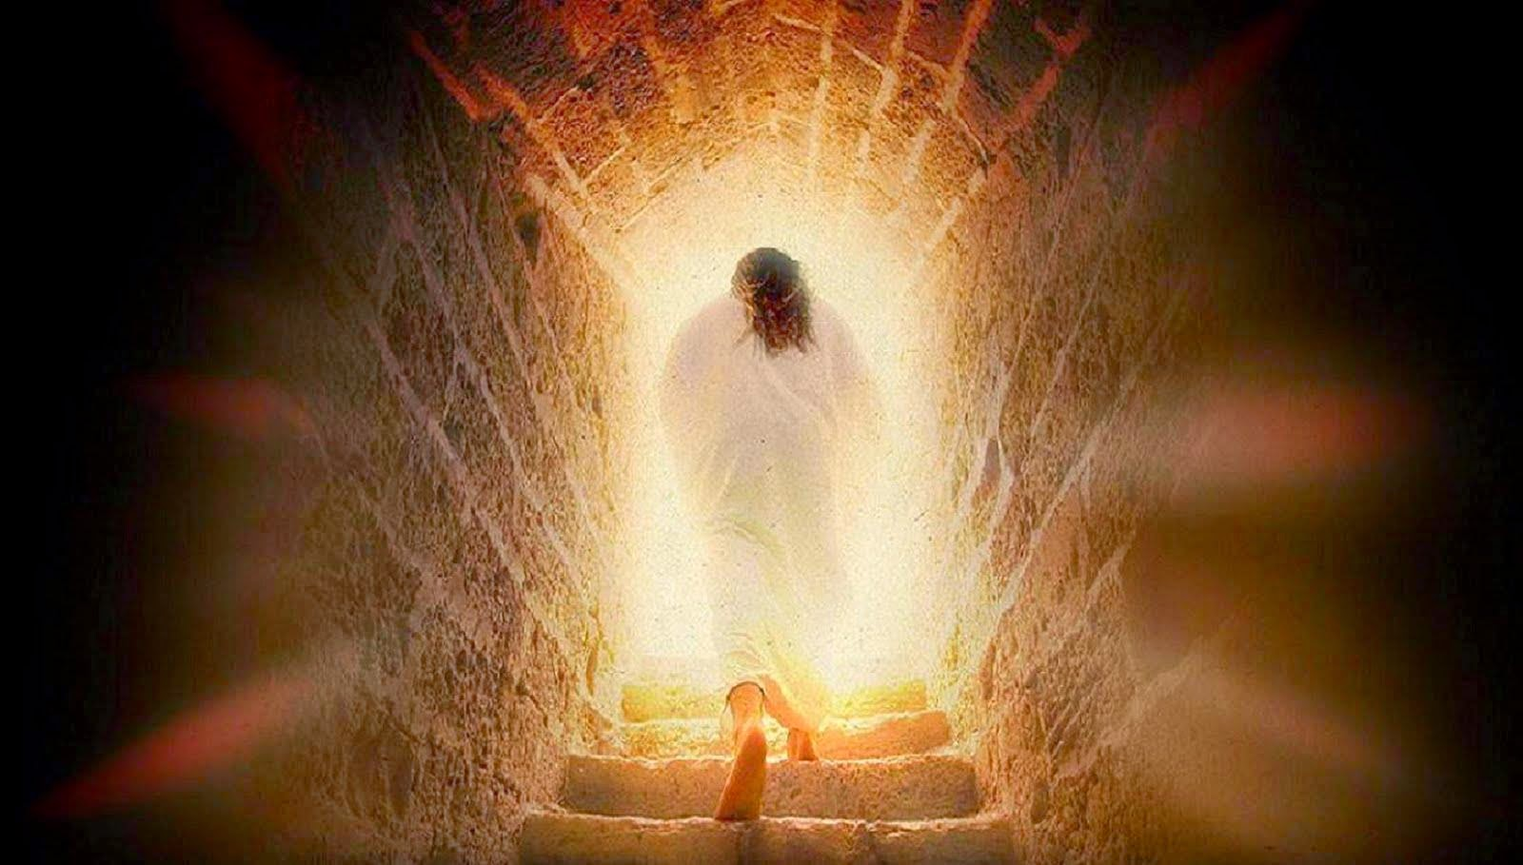
… or," 'Who will descend into the abyss?'" (that is, to bring Christ up from the dead). But what does it say? "The word is near you, in your mouth and in your heart" (that is, the word of faith which we preach): that if you confess with your mouth the Lord Jesus and believe in your heart that God has raised Him from the dead, you will be saved. — Romans 10:7-9
depths of misunderstanding
Christ
But what does it say?
Christ
of faith
confess
in
Jesus
believe in your heart

Slide 34
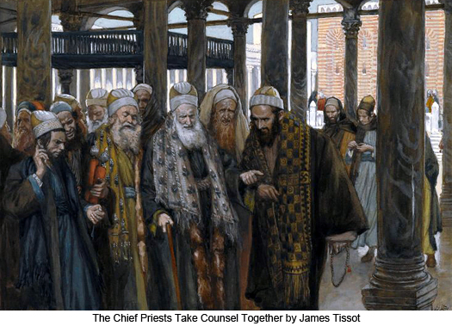
You have become estranged from Christ, you who attempt to be justified by law; you have fallen from grace. For we through the Spirit eagerly wait for the hope of righteousness by faith. For in Christ Jesus neither circumcision nor uncircumcision avails anything, but faith working through love. — Galatians 5:4-6
e
Christ
a
t
heart
eagerly wait for the hope
hope
hope
righteousness by faith
faith
h
faith working through love
r
love

Slide 35
For with the heart one believes unto righteousness, and with the mouth confession is made unto salvation. — Romans 10:10
heart
believes
heart
righteousness
mouth
confess
righteousness

Slide 36
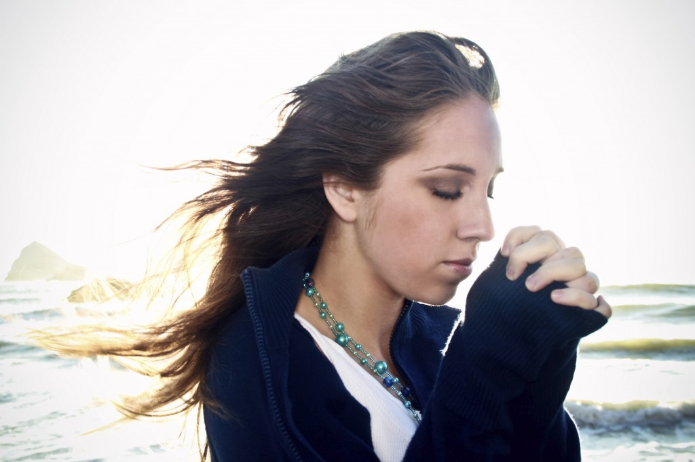
Blessed are those who keep justice, And he who does righteousness at all times! — Psalms 106:3
honesty
righteousness
righteousness

Slide 37
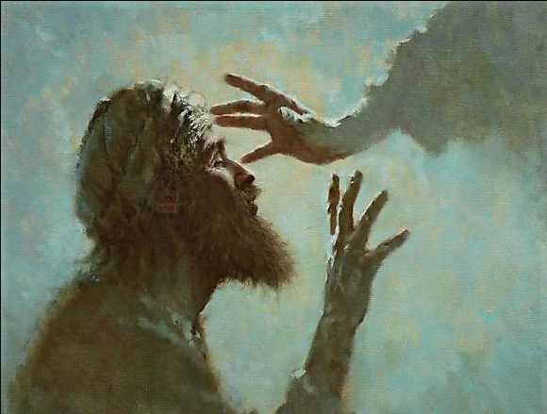
[A Psalm of David.] LORD, who may abide in Your tabernacle? Who may dwell in Your holy hill? He who walks uprightly, And works righteousness, And speaks the truth in his heart; He who does not backbite with his tongue, Nor does evil to his neighbor, Nor does he take up a reproach against his friend; — Psalms 15:1-3
● who walks uprightly
● works righteousness
● speaks the truth in his heart
● does not backbite with his tongue
● Nor does evil to his neighbor
● Nor reproaches his friend
in
Who may dwell in
who walks uprightly
works
righteousness
speaks the truth
in his heart
does not
backbite with his tongue
Nor
does evil to his neighbor
Nor
es
reproach
his friend

Slide 38
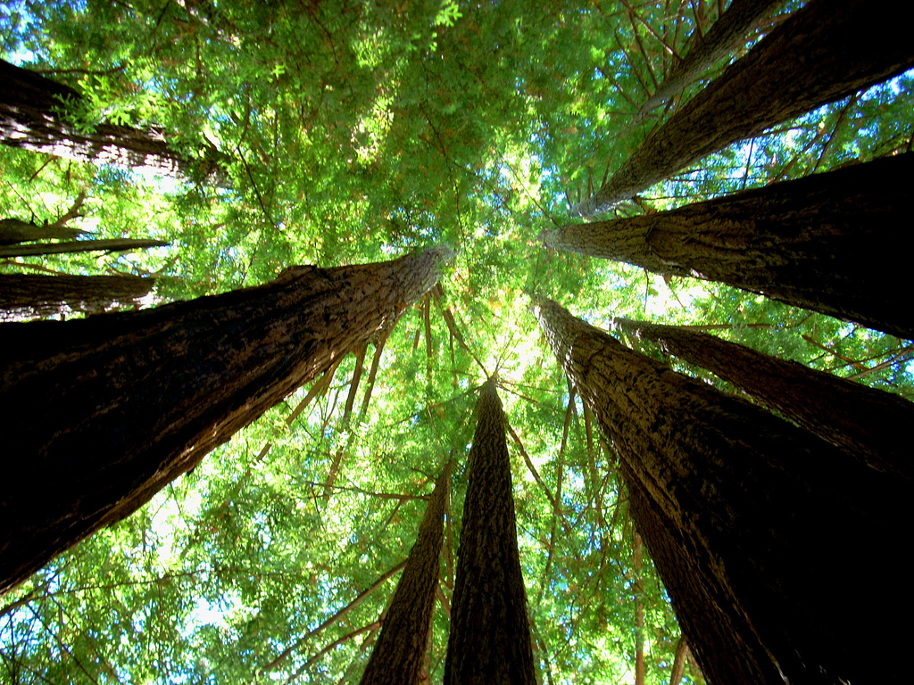
In whose eyes a vile person is despised, But he honors those who fear the LORD; He who swears to his own hurt and does not change; He who does not put out his money at usury, Nor does he take a bribe against the innocent. He who does these things shall never be moved. — Psalms 15:4-5
In
❼
❽
LORD
❾
does not change
❿
LORD
⓫

Slide 39
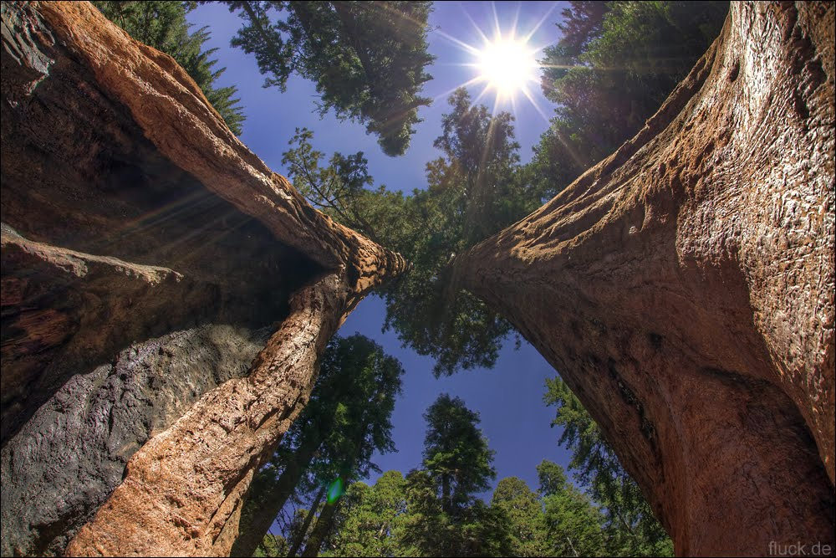
"And now, Israel, what does the LORD your God require of you, but to fear the LORD your God, to walk in all His ways and to love Him, to serve the LORD your God with all your heart and with all your soul, and to keep the commandments of the LORD and His statutes which I command you today for your good?" — Deuteronomy 10:12-13
fear
LORD
walk
all
love
serve
LORD
LORD
all
LORD
all
keep
LORD

Slide 40
He has shown you, O man, what is good; And what does the LORD require of you But to do justly, To love mercy, And to walk humbly with your God? — Micah 6:8
LORD
LORD
to do justly
To
to do justly
To love mercy
walk humbly with God
honesty
love mercy
walk humbly
compassion
with
God
subserviently

Slide 41
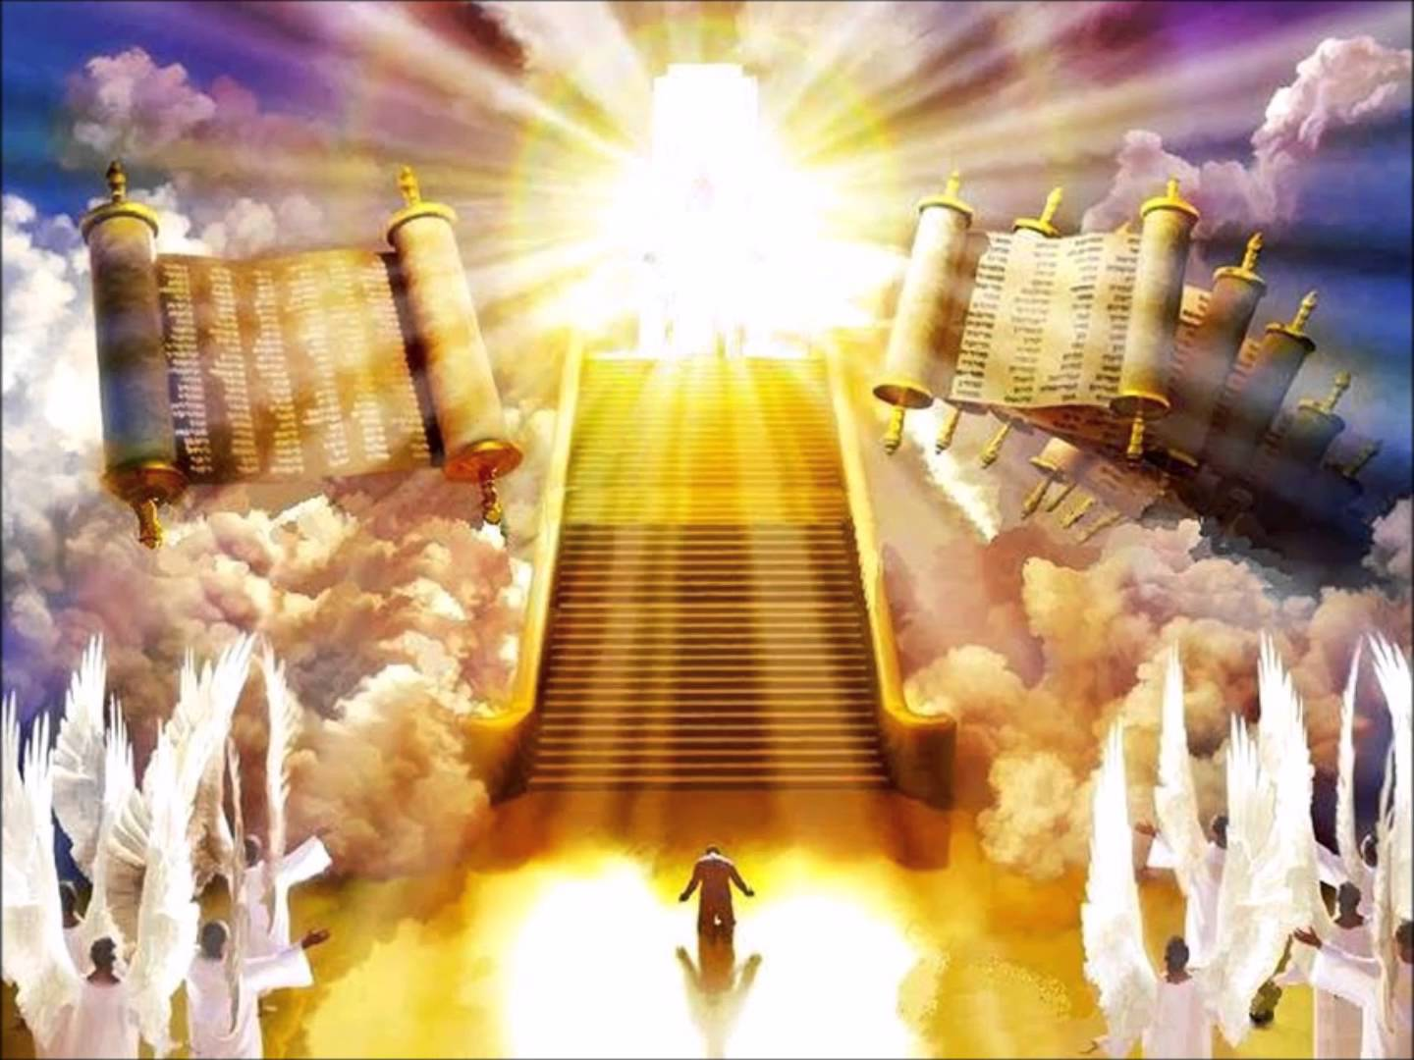
For the LORD is righteous, He loves righteousness; His countenance beholds the upright. — Psalms 11:7
LORD
LORD
upright

Slide 42
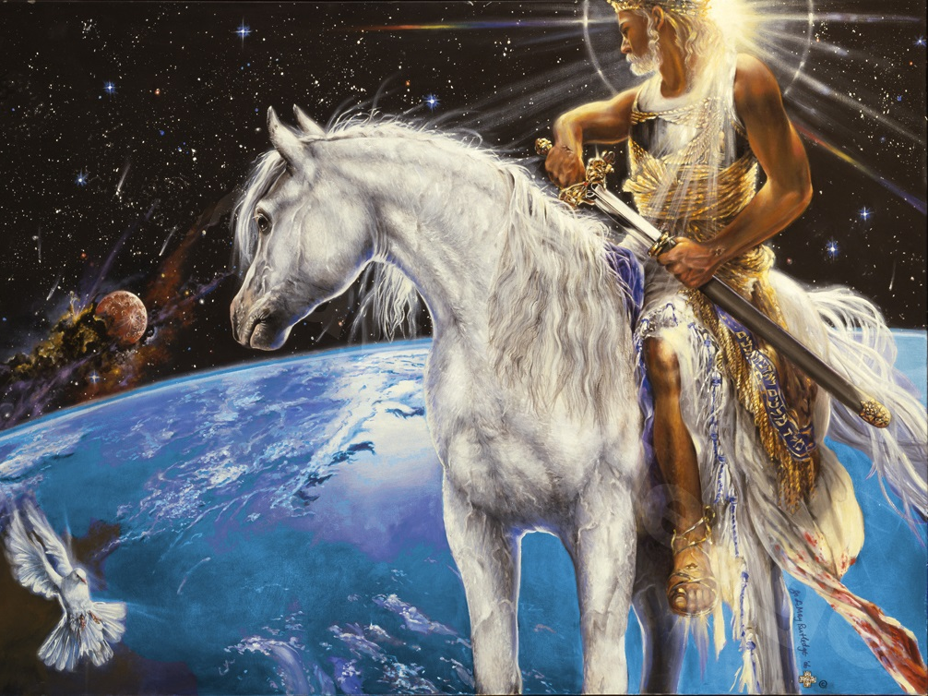
Keep your tongue from evil, And your lips from speaking deceit. Depart from evil and do good; Seek peace and pursue it. The eyes of the LORD are on the righteous, And His ears are open to their cry. — Psalms 34:13-15
Keep
do good
peace
Seek peace
pursue it
peace
LORD

Slide 43
For where envy and self-seeking exist, confusion and every evil thing are there. But the wisdom that is from above is first pure, then peaceable, gentle, willing to yield, full of mercy and good fruits, without partiality and without hypocrisy. Now the fruit of righteousness is sown in peace by those who make peace. — James 3:16-18
judging others
peace
submitting to His will
righteousness
in
righteousness is sown in peace
righteousness
peace

Slide 44
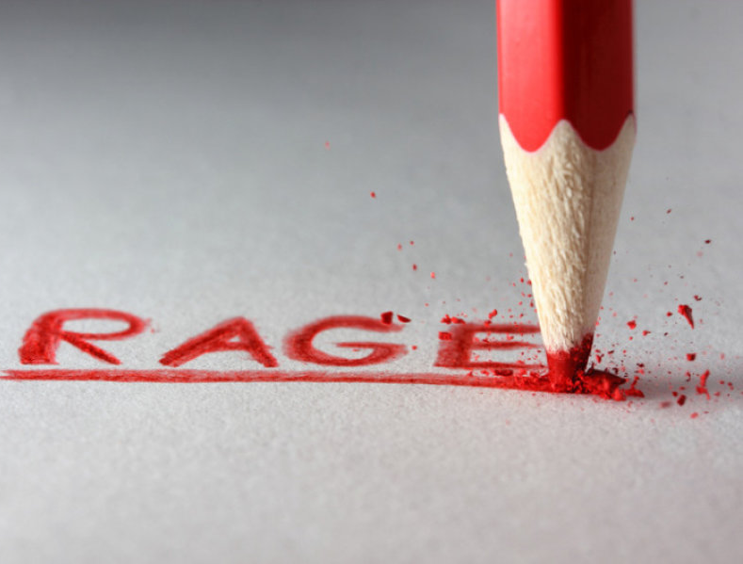
So then, my beloved brethren, let every man be swift to hear, slow to speak, slow to wrath; for the wrath of man does not produce the righteousness of God. — James 1:19-20
righteousness
righteousness

Slide 45
"But seek first the kingdom of God and His righteousness, and all these things shall be added to you." — Matthew 6:33
seek first
His righteousness
righteousness
righteousness

Slide 46
Blessed are those who hunger and thirst for righteousness, For they shall be filled. — Matthew 5:6
righteousness
righteousness

Slide 47
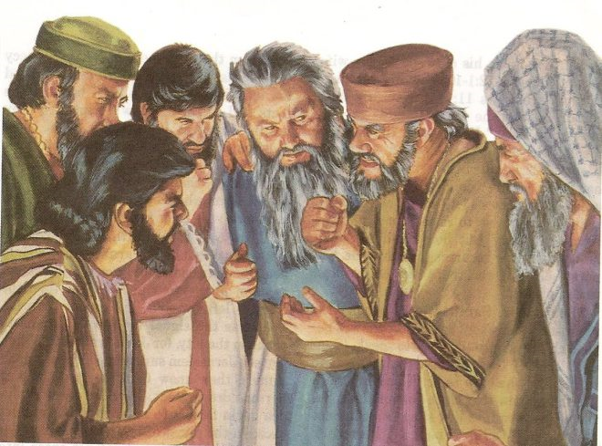
"For I say to you, that unless your righteousness exceeds the righteousness of the scribes and Pharisees, you will by no means enter the kingdom of heaven. You have heard that it was said to those of old, 'You shall not murder, and whoever murders will be in danger of the judgment.'" — Matthew 5:20-21
your righteousness exceeds
righteousness
righteousness
scribes
Pharisees
in danger
in
in danger
in danger
in danger

Slide 48
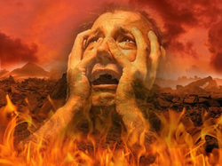
"But I say to you that whoever is angry with his brother without a cause shall be in danger of the judgment. And whoever says to his brother, 'Raca!' shall be in danger of the council. But whoever says, 'You fool!' shall be in danger of hell fire." — Matthew 5:22
in
in danger
in
in danger
in
in danger
in danger
in danger

Slide 49
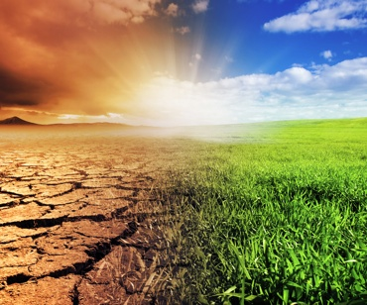
Flee also youthful lusts; but pursue righteousness, faith, love, peace with those who call on the Lord out of a pure heart. — 2nd Timothy 2:22
pursue righteousness
pursue
faith, love, peace

Slide 50
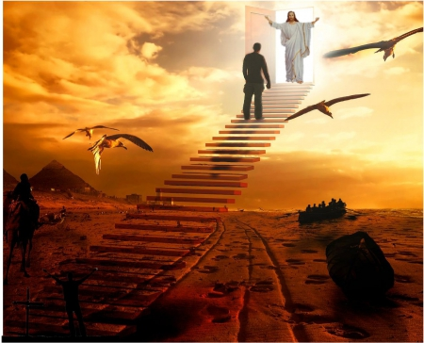
Yet indeed I also count all things loss for the excellence of the knowledge of Christ Jesus my Lord, for whom I have suffered the loss of all things, and count them as rubbish, that I may gain Christ and be found in Him, not having my own righteousness, which is from the law, but that which is through faith in Christ, the righteousness which is from God by faith; — Philippians 3:8-9
Yet indeed I also count all things loss for the excellence of the knowledge of Christ Jesus my Lord, for whom I have suffered the loss of all things, and count them as rubbish, that I may gain Christ and be found in Him, not having my own righteousness, which is from the law, but that which is through faith in Christ, the righteousness which is from God by faith; — Philippians 3:8-9
excellence of the knowledge
Christ
not
my own righteousness
that which is through faith
in Christ, the righteousness which is
from God by faith
in
Christ
Notes:
In the desert of life, what is really important?

Slide 51
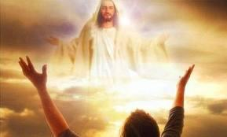
… that I may know Him and the power of His resurrection, and the fellowship of His sufferings, being conformed to His death, if, by any means, I may attain to the resurrection from the dead. — Philippians 3:10-11
may know Him
power of His resurrection
o
n
death
no death
attain to the resurrection
from the dead

Slide 52
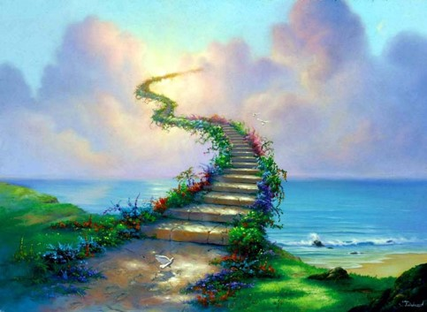
In the way of righteousness is life, And in its pathway there is no death. — Proverbs 12:28
no death
guards the path
guards the path

Slide 53
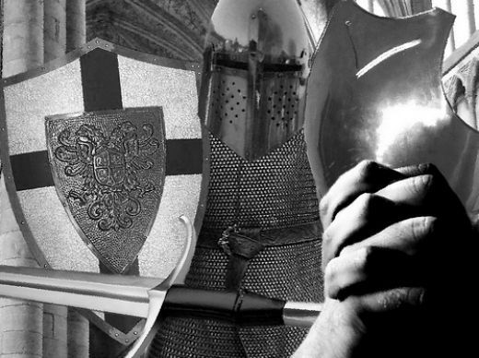
If you seek her as silver, And search for her as for hidden treasures; Then you will understand the fear of the LORD, And find the knowledge of God. For the LORD gives wisdom; From His mouth come knowledge and understanding; He stores up sound wisdom for the upright; He is a shield to those who walk uprightly; He guards the paths of justice, And preserves the way of His saints. — Proverbs 2:4-8
understand
love
hope
understand
faith
salvation
find the knowledge of God
righteousness
LORD gives wisdom
faith
understand
truth
guards the path
Word of God
gospel of peace

Slide 54
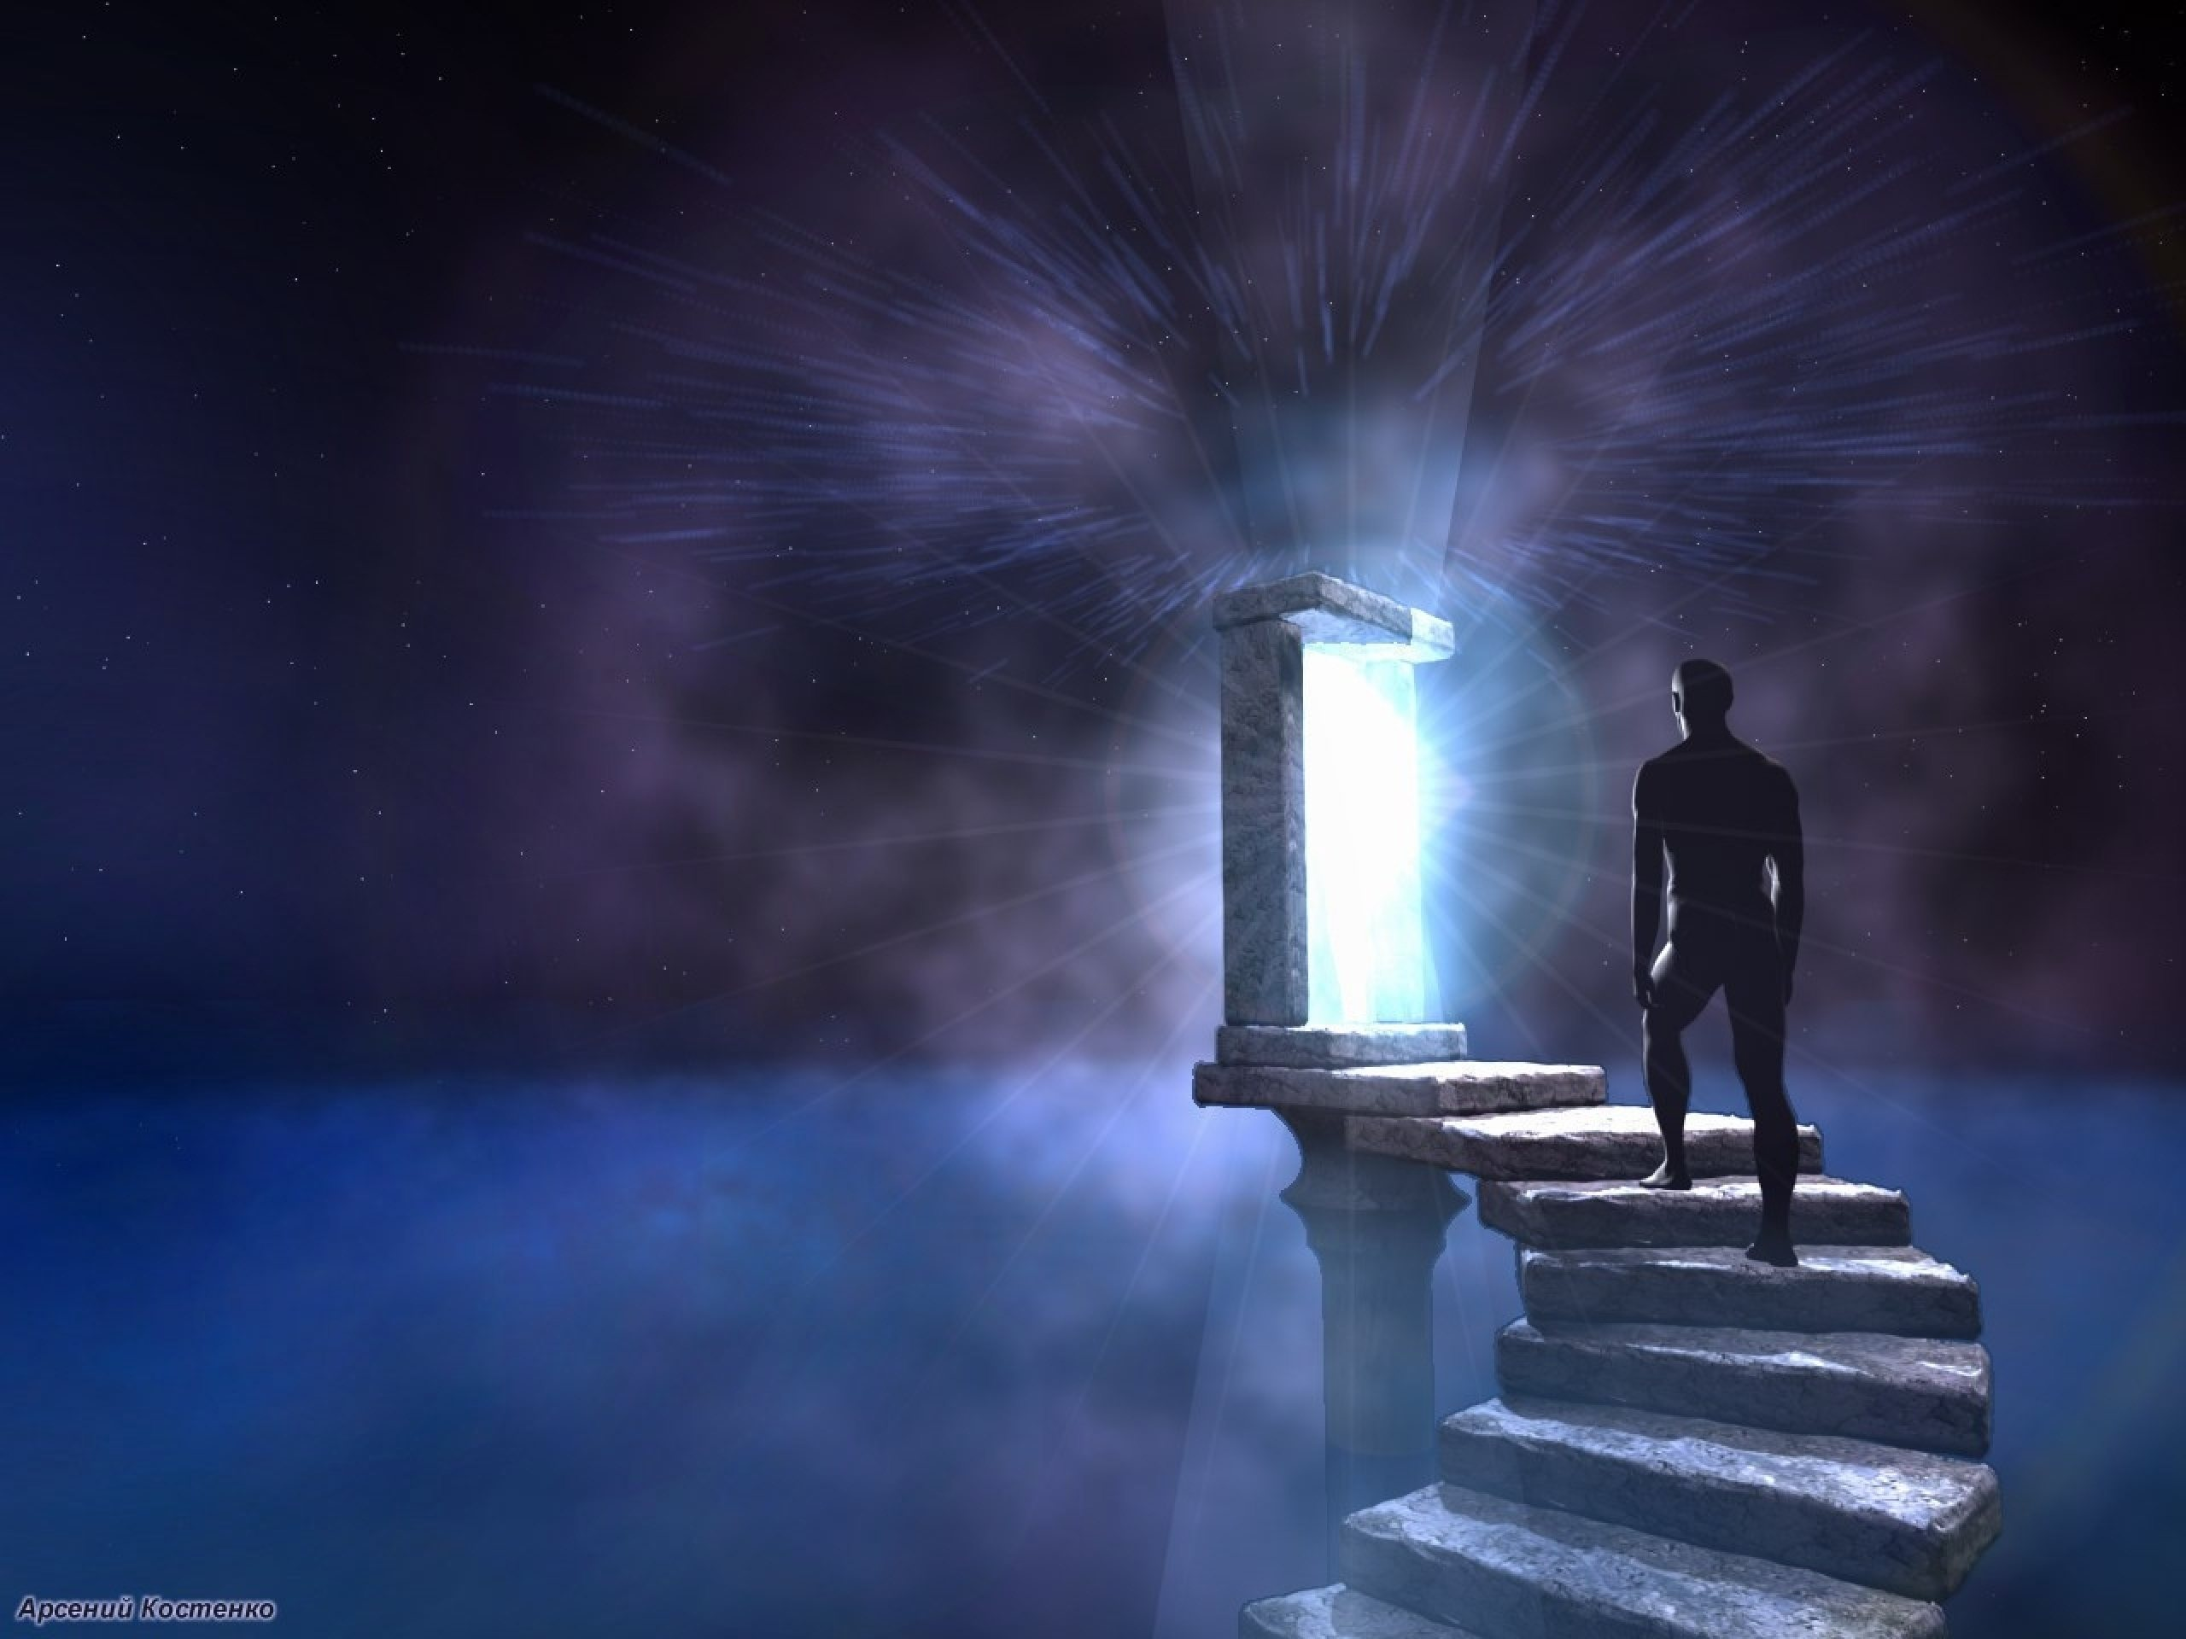
Then you will understand righteousness and justice, Equity and every good path. When wisdom enters your heart, And knowledge is pleasant to your soul, Discretion will preserve you; Understanding will keep you, To deliver you from the way of evil, From the man who speaks perverse things, From those who leave the paths of uprightness To walk in the ways of darkness; Who rejoice in doing evil, And delight in the perversity of the wicked; — Proverbs 2:9-14
understand righteousness
understand
To deliver you from the way of evil
upright

Slide 55
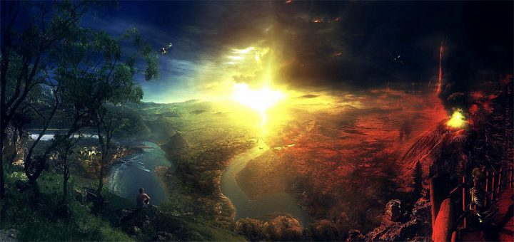
Whose ways are crooked, And who are devious in their paths; To deliver you from the immoral woman, From the seductress who flatters with her words, Who forsakes the companion of her youth, And forgets the covenant of her God. For her house leads down to death, And her paths to the dead; None who go to her return, Nor do they regain the paths of life - So you may walk in the way of goodness, And keep to the paths of righteousness. — Proverbs 2:15-20
devious in
their paths
walk in
the way of
goodness
keep to
the paths of
righteousness
devious in
their paths
forgets the
covenant
of God
forgets the
covenant
of
God
forgets
keep
walk in
the way of
goodness
keep to
the paths
of
righteousness

Slide 56
→ The promise is through the righteousness of faith
→ Belief is an integral part of righteousness
→ Christ is the end for righteous law for believers
→ Righteousness of faith is in the here and now
→ Righteousness by faith has hope working in love
→ Righteousness dwells in a believing heart
→ The Lord is watching the righteous
→ The fruit of righteousness is sown in peace
→ Seeking God’s righteousness adds to one’s own
→ Righteousness does not include murderous anger
→ Righteousness comes from God by faith in Christ
→ The way of righteousness is life with no death
→ To understand righteousness wisdom is required
Righteous works are a soul’s greatest light
peace
Notes:
Righteous works are a soul’s greatest light

Slide 58
Righteousness
3
Ron Bert
February 3, 2019

Slide 59
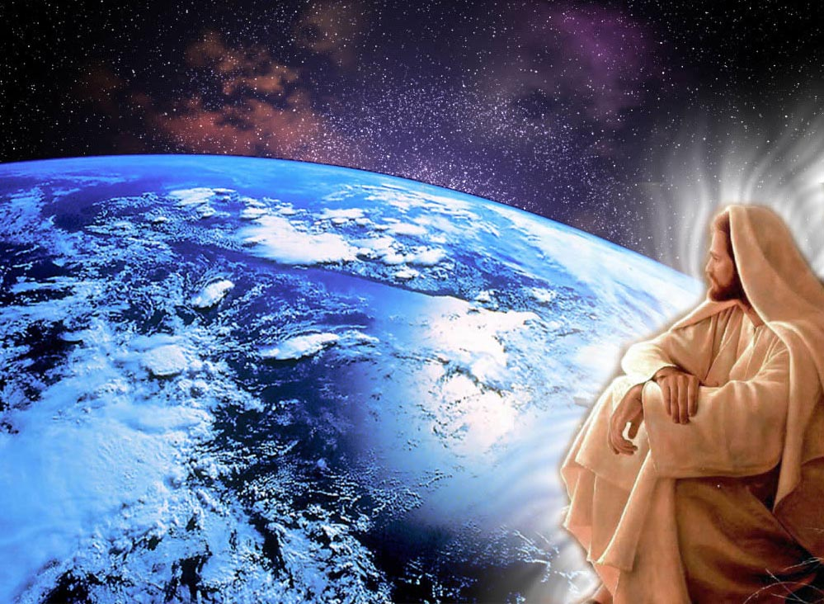
"Truly, these times of ignorance God overlooked, but now commands all men everywhere to repent, because He has appointed a day on which He will judge the world in righteousness by the Man whom He has ordained. He has given assurance of this to all by raising Him from the dead." — Acts 17:30-31
He will judge the
Jesus Christ
in
righteousness
world in righteousness
righteousness

Slide 60
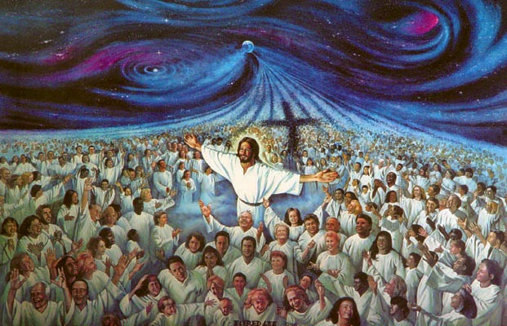
Do you not know that to whom you present yourselves slaves to obey, you are that one's slaves whom you obey, whether of sin leading to death, or of obedience leading to righteousness? But God be thanked that though you were slaves of sin, yet you obeyed from the heart that form of doctrine to which you were delivered. — Romans 6:16-17
righteousness
sin leading to
death
obedience leading to
righteousness
God
righteousness
righteousness
righteousness
righteousness
from the heart
righteousness

Slide 61
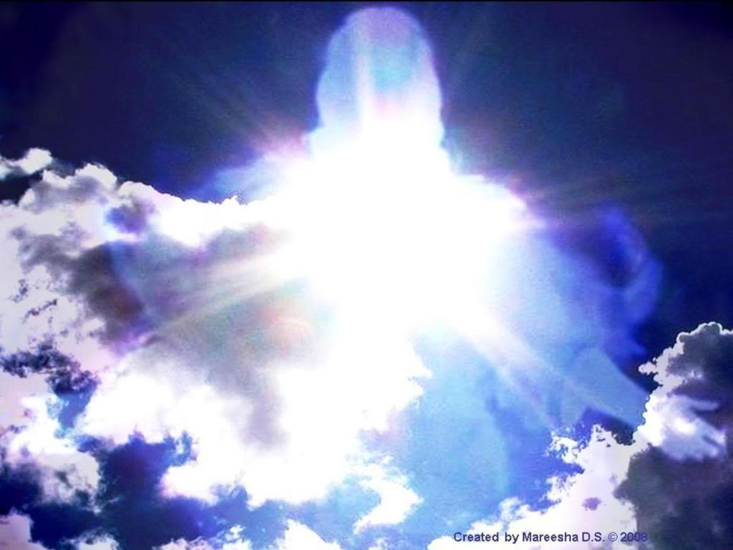
And having been set free from sin, you became slaves of righteousness. I speak in human terms because of the weakness of your flesh. For just as you presented your members as slaves of uncleanness, and of lawlessness leading to more lawlessness, so now present your members as slaves of righteousness for holiness. For when you were slaves of sin, you were free in regard to righteousness — Romans 6:18-20
free from sin
you
righteousness
slaves of righteousness
you
you
you
righteousness
for holiness
you
you
righteousness

Slide 62
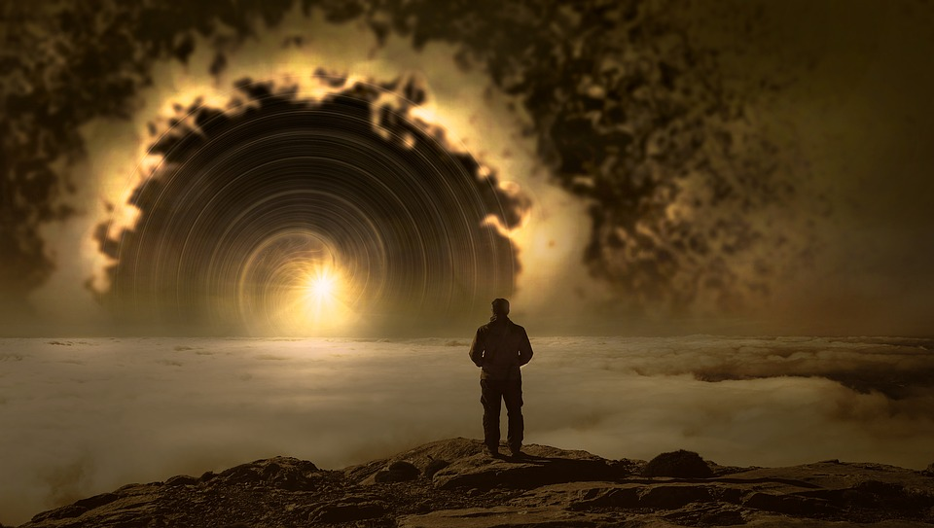
What fruit did you have then in the things of which you are now ashamed? For the end of those things is death. But now having been set free from sin, and having become slaves of God, you have your fruit to holiness, and the end, everlasting life. For the wages of sin is death, but the gift of God is eternal life in Christ Jesus our Lord. — Romans 6:21-23
you
you
life
death
in
gift of God is eternal life in Christ

Slide 63
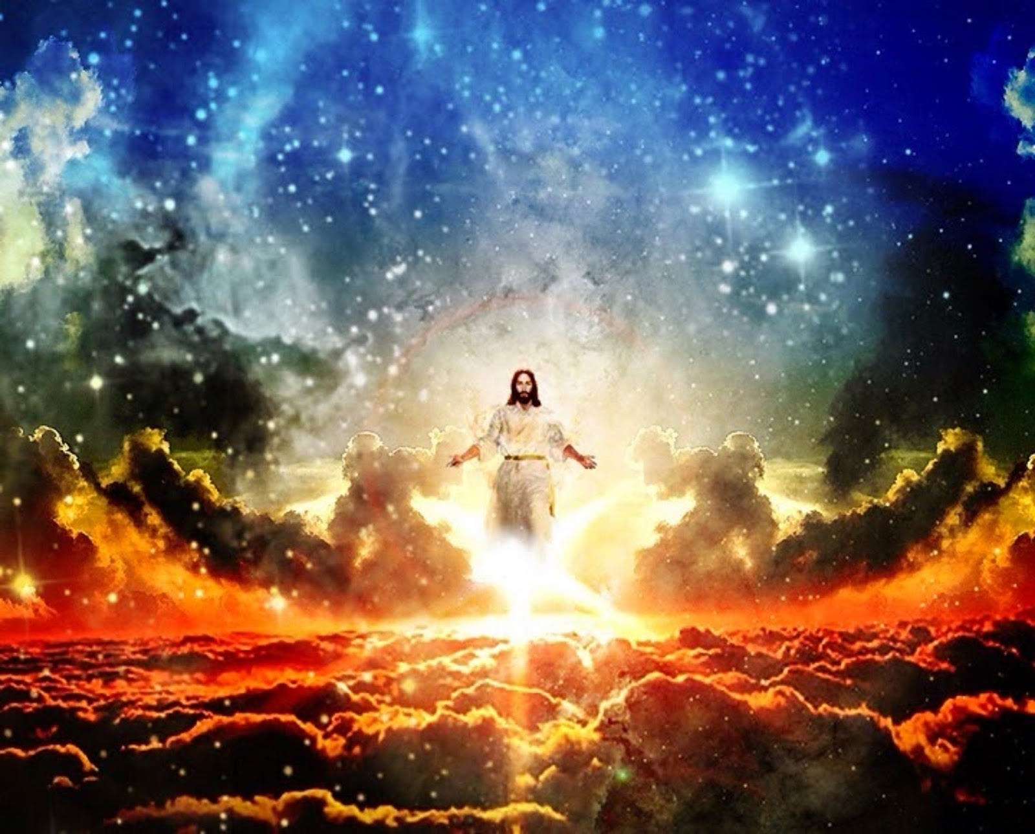
And now, little children, abide in Him, that when He appears, we may have confidence and not be ashamed before Him at His coming. If you know that He is righteous, you know that everyone who practices righteousness is born of Him. — 1st John 2:28-29
abide
in
in Him
practice righteousness
you
practice
righteousness
righteousness is born
of Him

Slide 64
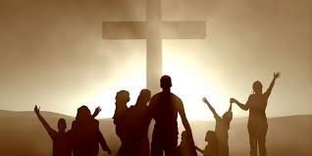
In this the children of God and the children of the devil are manifest: Whoever does not practice righteousness is not of God, nor is he who does not love his brother. For this is the message that you heard from the beginning, that we should love one another, not as Cain who was of the wicked one and murdered his brother. And why did he murder him? Because his works were evil and his brother's righteous. — 1st John 3:10-12
practice righteousness
works
evil
righteous

Slide 65
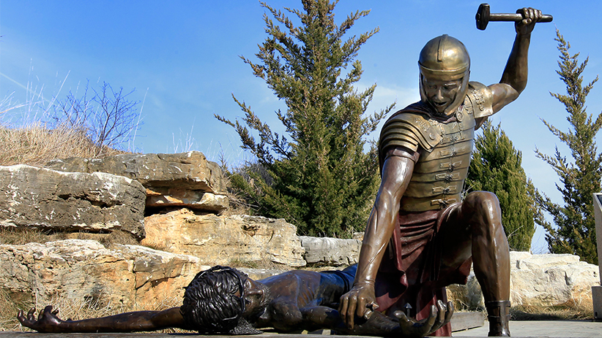
Do not marvel, my brethren, if the world hates you. We know that we have passed from death to life, because we love the brethren. He who does not love his brother abides in death. Whoever hates his brother is a murderer, and you know that no murderer has eternal life abiding in him. By this we know love, because He laid down His life for us. And we also ought to lay down our lives for the brethren. — 1st John 3:13-16
from death to life
who does not love
in
abides in death
in
in
hates
is a murderer
He laid down His life for us

Slide 66
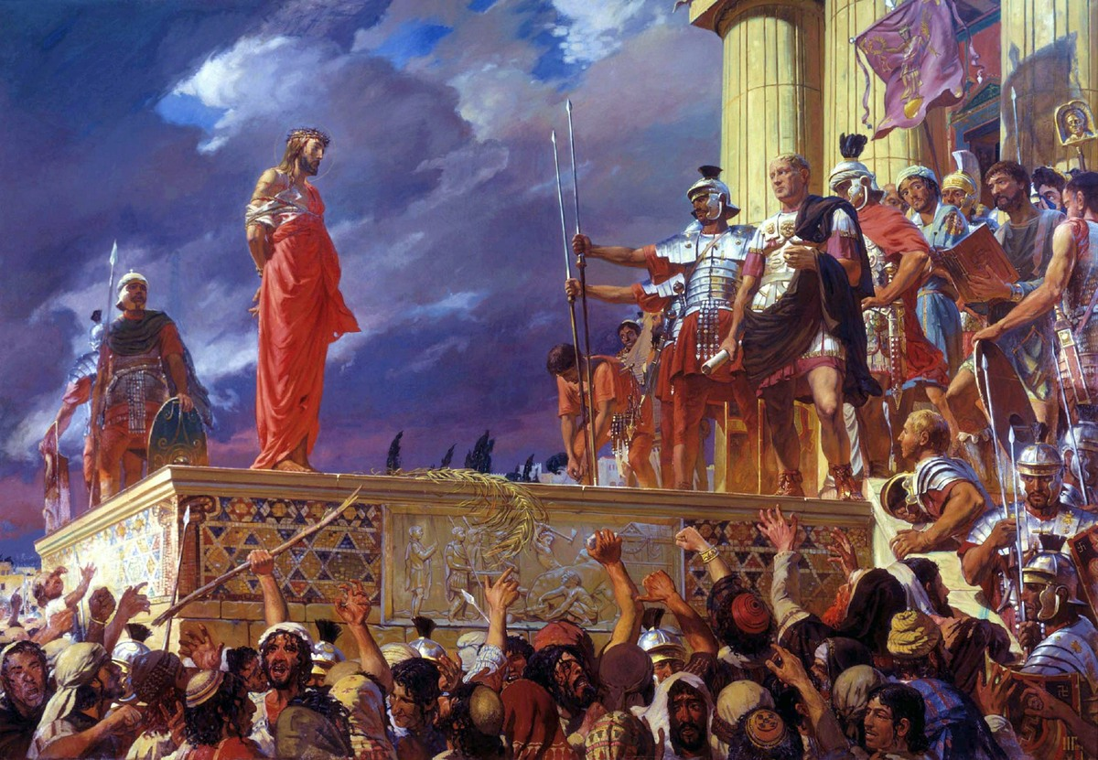
For to this you were called, because Christ also suffered for us, leaving us an example, that you should follow His steps: "Who committed no sin, Nor was deceit found in His mouth"; who, when He was reviled, did not revile in return; when He suffered, He did not threaten, but committed Himself to Him who judges righteously; — 1st Peter 2:21-23
Christ
an example
follow
righteous
in
He
committed Himself
righteous

Slide 67
… who Himself bore our sins in His own body on the tree, that we, having died to sins, might live for righteousness -- by whose stripes you were healed. For you were like sheep going astray, but have now returned to the Shepherd and Overseer of your souls. — 1st Peter 2:24-25
l
o
love
live for
righteousness
righteous
healed
return
ve

Slide 68
Finally, all of you be of one mind, having compassion for one another; love as brothers, be tenderhearted, be courteous; not returning evil for evil or reviling for reviling, but on the contrary blessing, knowing that you were called to this, that you may inherit a blessing. — 1st Peter 3:8-9
love
one mind
love
knowing
call

Slide 69
For "He who would love life And see good days, Let him refrain his tongue from evil, And his lips from speaking deceit. Let him turn away from evil and do good; Let him seek peace and pursue it. For the eyes of the LORD are on the righteous, And His ears are open to their prayers; But the face of the LORD is against those who do evil." — 1st Peter 3:10-12
love
righteous
turn away from evil
seek peace
righteous

Slide 70
But even if you should suffer for righteousness' sake, you are blessed. "And do not be afraid of their threats, nor be troubled." But sanctify the Lord God in your hearts, and always be ready to give a defense to everyone who asks you a reason for the hope that is in you, with meekness and fear; having a good conscience, that when they defame you as evildoers, those who revile your good conduct in Christ may be ashamed. — 1st Peter 3:14-16
righteousness
righteous
righteousness
in
sanctify the Lord God in
your hearts
in
hope that is in you
hope

Slide 71
But when the kindness and the love of God our Savior toward man appeared, not by works of righteousness which we have done, but according to His mercy He saved us, through the washing of regeneration and renewing of the Holy Spirit, whom He poured out on us abundantly through Jesus Christ our Savior, that having been justified by His grace we should become heirs according to the hope of eternal life. — Titus 3:4-7
mercy
righteousness
mercy
He saved us
through Jesus Christ
grace
hope

Slide 72
But God, who is rich in mercy, because of His great love with which He loved us, even when we were dead in trespasses, made us alive together with Christ (by grace you have been saved), and raised us up together, and made us sit together in the heavenly places in Christ Jesus, that in the ages to come He might show the exceeding riches of His grace in His kindness toward us in Christ Jesus. — Ephesians 2:4-7
in
mercy
rich in mercy
grace
great love
grace
in
His grace in
in
kindness
kindness toward us in Christ Jesus

Slide 73
For by grace you have been saved through faith, and that not of yourselves; it is the gift of God, not of works, lest anyone should boast. For we are His workmanship, created in Christ Jesus for good works, which God prepared beforehand that we should walk in them. — Ephesians 2:8-10
grace
faith
we are His workmanship
in
Christ Jesus
faith
works
works
walk
in
in them

Slide 74
But do you want to know, O foolish man, that faith without works is dead? Was not Abraham our father justified by works when he offered Isaac his son on the altar? Do you see that faith was working together with his works, and by works faith was made perfect? — James 2:20-22
faith
works
works
faith
works
faith

Slide 75
And the Scripture was fulfilled which says, "Abraham believed God, and it was accounted to him for righteousness." And he was called the friend of God. You see then that a man is justified by works, and not by faith only. — James 2:23-24
believed
accounted
for righteousness
you
you
a man is justified by
works, and not by faith only
works
faith

Slide 76
But now you yourselves are to put off all these: anger, wrath, malice, blasphemy, filthy language out of your mouth. Do not lie to one another, since you have put off the old man with his deeds, and have put on the new man who is renewed in knowledge according to the image of Him who created him, … — Colossians 3:8-10
put off all these
you
put on the new man
renewed
in
in knowledge
image

Slide 77
… where there is neither Greek nor Jew, circumcised nor uncircumcised, barbarian, Scythian, slave nor free, but Christ is all and in all. Therefore, as the elect of God, holy and beloved, put on tender mercies, kindness, humility, meekness, longsuffering; — Colossians 3:11-12
put on

Slide 78
… bearing with one another, and forgiving one another, if anyone has a complaint against another; even as Christ forgave you, so you also must do. But above all these things put on love, which is the bond of perfection. And let the peace of God rule in your hearts, to which also you were called in one body; and be thankful. — Colossians 3:13-15
must do
love
put on love
peace
let the peace of
in
God rule in your hearts
be thankful

Slide 79
Let the word of Christ dwell in you richly in all wisdom, teaching and admonishing one another in psalms and hymns and spiritual songs, singing with grace in your hearts to the Lord. — Colossians 3:16
in
word of Christ dwell in you
word of Christ
in
in all wisdom
in
in
hearts to the Lord

Slide 80
But of Him you are in Christ Jesus, who became for us wisdom from God -- and righteousness and sanctification and redemption -- that, as it is written, "He who glories, let him glory in the LORD." — 1st Corinthians 1:30-31
in Christ Jesus
in
glory in the LORD
in Christ Jesus
for us wisdom from God
● righteousness
● sanctification
● redemption
for us wisdom from
in
God
righteousness
sanctification
redemption
glory in the LORD

Slide 81
Nevertheless we, according to His promise, look for new heavens and a new earth in which righteousness dwells. Therefore, beloved, looking forward to these things, be diligent to be found by Him in peace, without spot and blameless; — 2nd Peter 3:13-14
His promise
righteousness dwells
looking forward
be diligent to be found
in
peace

Slide 82
→ He will judge the world in righteousness
→ Obedience leads to righteousness
→ Called to be slaves of righteousness for holiness
→ The fruit of holiness’ end is everlasting life
→ Who practices righteousness is born of Him
→ Hate excludes one from eternal life
→ Christ is our example of righteousness
→ If suffering for righteousness one is blessed
→ Grace saves us through faith
→ Belief, faith in God, is accounted for righteousness
→ Put off the old man, renewed in His knowledge
→ Put on love which is the bond of perfection
→ Wisdom from God is righteousness to His glory
The song of His love is for our return
Notes:
The song of His love is for our return

Slide 84
Please visit http://www.LoveFromGod.com to explore further
Ronald Bert Channel on
Notes:
Eternity never ends.

