Slide 2
Repentance
aka: Repent, Repent, Repent
Ron Bert
May 24, 2020

Slide 3
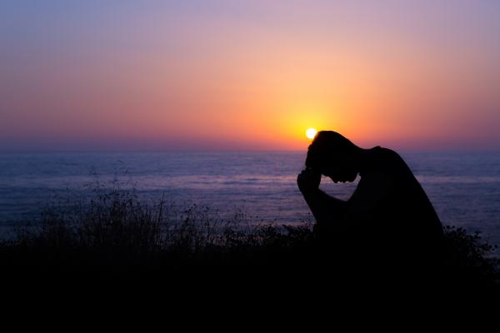
He who covers his sins will not prosper, But whoever confesses and forsakes them will have mercy. — Proverbs 28:13
hides
covet
thieves
lies
sins
confesses and forsakes
Repent
. .
Notes:
Confessing and forsaking sin is rooted through repentance.

Slide 4
Repent

Slide 5
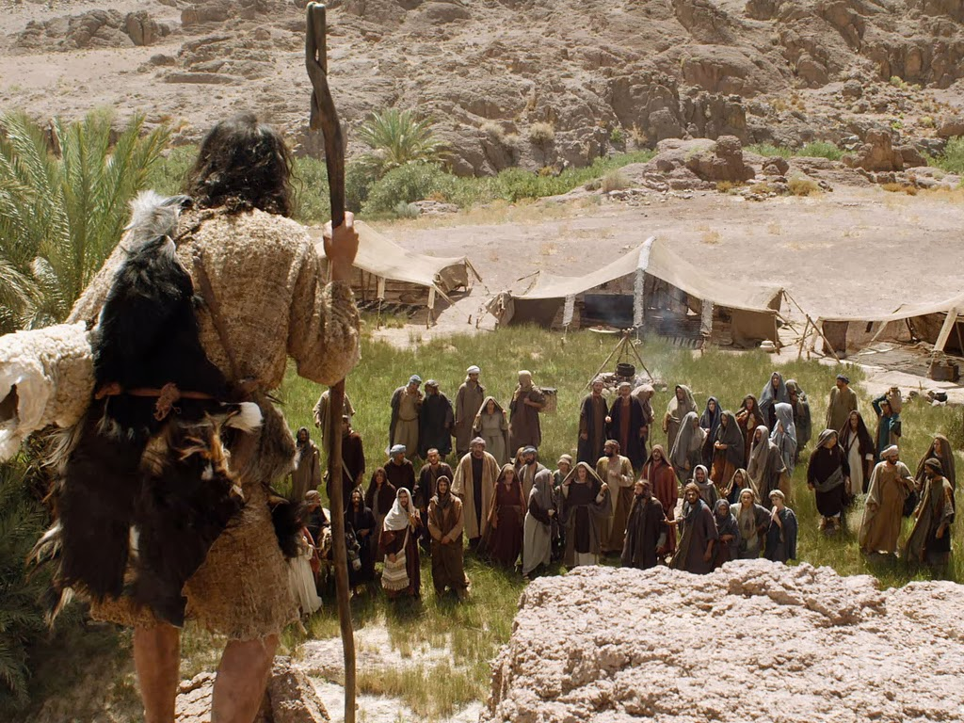
In those days John the Baptist came preaching in the wilderness of Judea, and saying, "Repent, for the kingdom of heaven is at hand!" — Matthew 3:1-2
In those days John the Baptist came preaching in the wilderness of Judea, and saying, "Repent, for the kingdom of heaven is at hand!" — Matthew 3:1-2
John
John
wilderness
wilderness
Repent
Repent
Repent
Notes:
God prepared the way for all to know repentance is on an individual level. In many ways, the world is a renegade planet in rebellion among the vast wilderness of stars. God has touched us with a call to return. All points of compass, it is the wild wild earth.

Slide 6
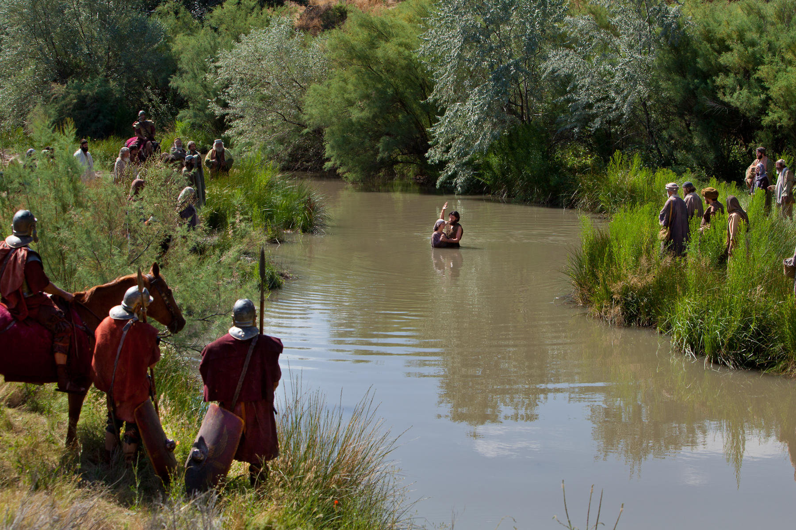
John came baptizing in the wilderness and preaching a baptism of repentance for the remission of sins. — Mark 1:4
John
wilderness
baptism of repentance for the
remission of sins
remission of sins
Notes:
The world is a wilderness of good plagued with evil deeds. God has delivered a means to free oneself from earthly bondage.

Slide 7
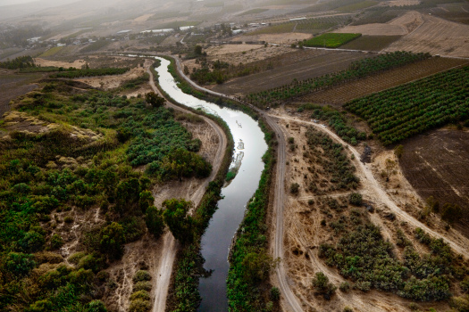
And he went into all the region around the Jordan, preaching a baptism of repentance for the remission of sins, … — Luke 3:3
preaching
into all the region
into all the region
preaching
baptism of repentance for the
remission of sins
remission of sins
Notes:
Preaching has been no foreigner to mankind. Since days of old promoters have tried their best to influence people for better or worse. It is what is genuine that has lasting effects.

Slide 8
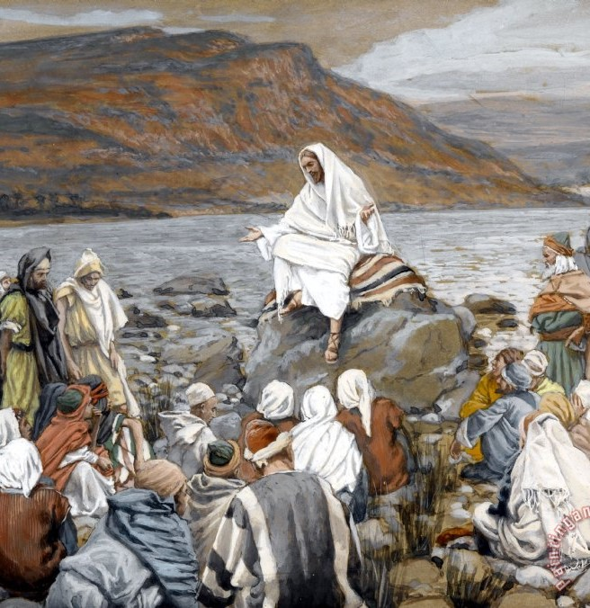
Now after John was put in prison, Jesus came to Galilee, preaching the gospel of the kingdom of God, and saying, "The time is fulfilled, and the kingdom of God is at hand. Repent, and believe in the gospel." — Mark 1:14-15
Jesus
preaching
Repent
in
Repent, and believe in
Repent
Repent, and believe in
the gospel
the gospel
good news
Notes:
To believe in the gospel is to hear the truth of God and trust He has come upon us.

Slide 9
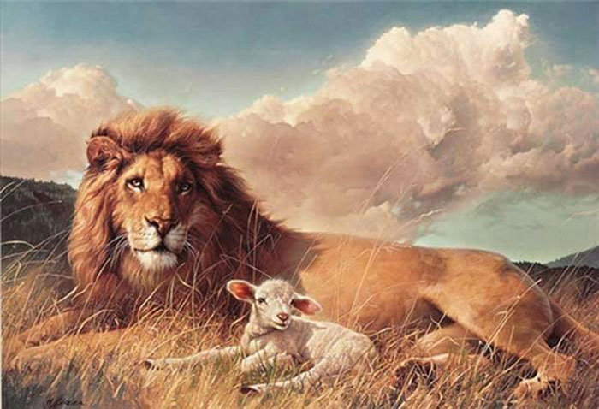
From that time Jesus began to preach and to say, "Repent, for the kingdom of heaven is at hand." — Matthew 4:17
From that time Jesus began to preach and to say, "Repent, for the kingdom of heaven is at hand." — Matthew 4:17
Jesus
Repent
near
Notes:
The power of God is with us.

Slide 10
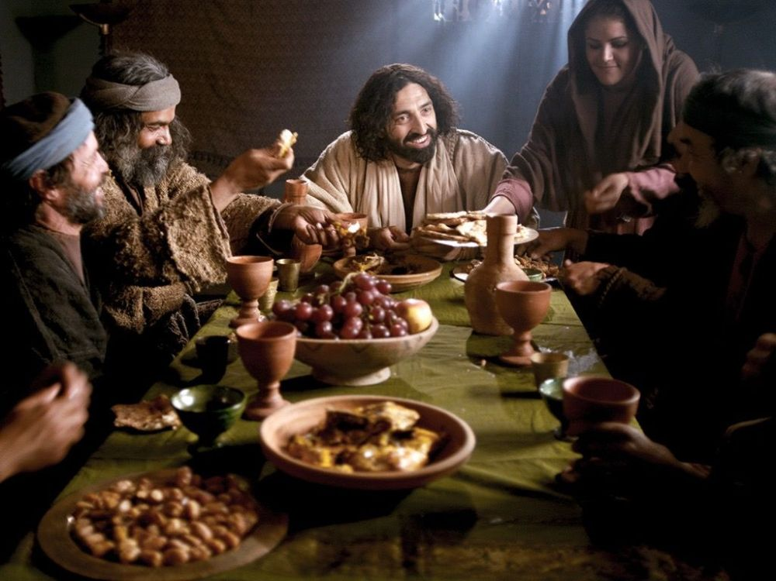
And when the scribes and Pharisees saw Him eating with the tax collectors and sinners, they said to His disciples, "How is it that He eats and drinks with tax collectors and sinners?" When Jesus heard it, He said to them, "Those who are well have no need of a physician, but those who are sick. I did not come to call the righteous, but sinners, to repentance." — Mark 2:16-17
attitudes of superiority
scribes and Pharisees
. .
Anger and contempt
righteous
righteous
righteous
Notes:
For those that do not believe, they need the most help, which is needed for all. Pride is a stealthy sin exalting the self above God Himself. It is a travesty when those in power only endorse themselves excluding others. True love is absent from proud hearts.

Slide 11
As it is written: "There is none righteous, no, not one;" — Romans 3:10
attitudes of superiority
And when the scribes and Pharisees saw Him eating with the tax collectors and sinners, they said to His disciples, "How is it that He eats and drinks with tax collectors and sinners?" When Jesus heard it, He said to them, "Those who are well have no need of a physician, but those who are sick. I did not come to call the righteous, but sinners, to repentance." — Mark 2:16-17
righteous
sinners
sinners, to
sinners
repentance
repentance
repentance

Slide 12
Jesus answered and said to them, "Those who are well have no need of a physician, but those who are sick. I have not come to call the righteous, but sinners, to repentance." — Luke 5:31-32
come to call
. .
sinners
sinners, to
sinners
repentance
Notes:
We are all sinners in need of His healing word.

Slide 13
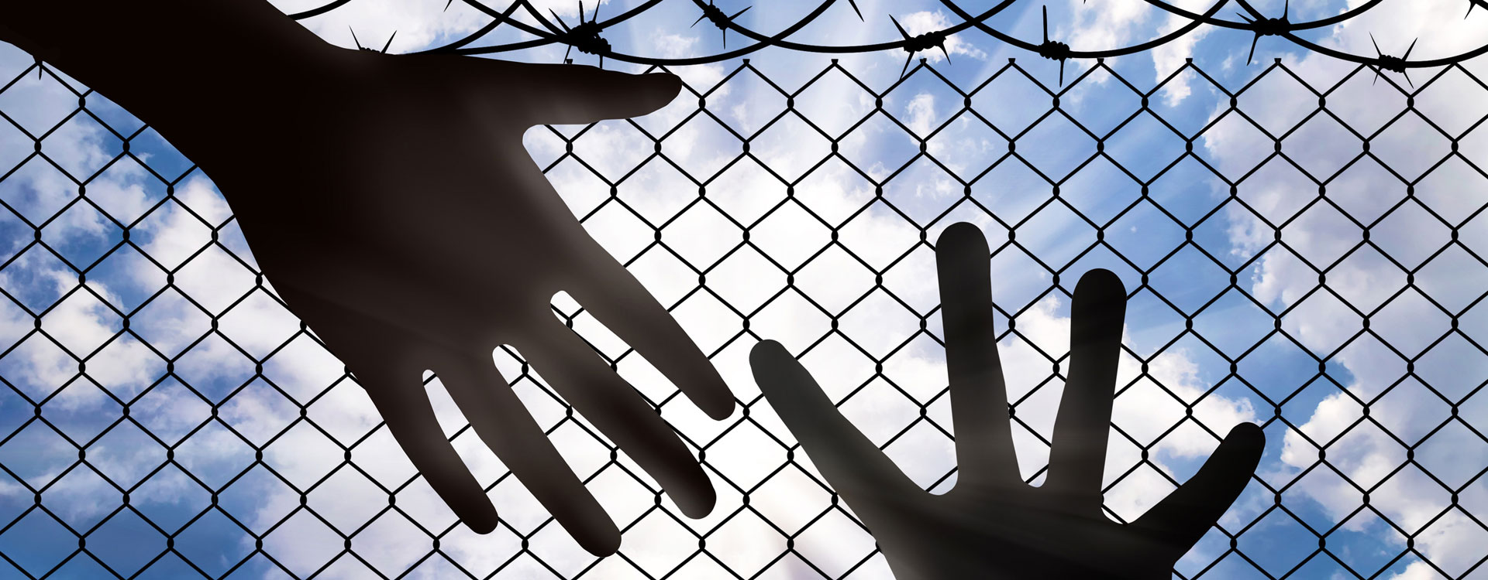
"But go and learn what this means: 'I desire mercy and not sacrifice.' For I did not come to call the righteous, but sinners, to repentance." — Matthew 9:13
'I desire mercy and not
mercy
'I desire mercy and not sacrifice.'
mercy
sacrifice.'
sinners, to
repentance
Notes:
One cannot buy entrance into God’s Kingdom, but doors open when one sees others over the self in compassion, and love of life. In so many ways, condemning others condemns one’s self.

Slide 14
For judgment is without mercy to the one who has shown no mercy. Mercy triumphs over judgment. — James 2:13
For judgment is without mercy to the one who has shown no mercy. Mercy triumphs over judgment. — James 2:13
mercy
'I desire mercy and not sacrifice.'
Love

Slide 15
"I tell you, no; but unless you repent you will all likewise perish." — Luke 13:3
repent
repent
repent
perish
Notes:
Many curves are on the path to our accent back to heaven.

Slide 16
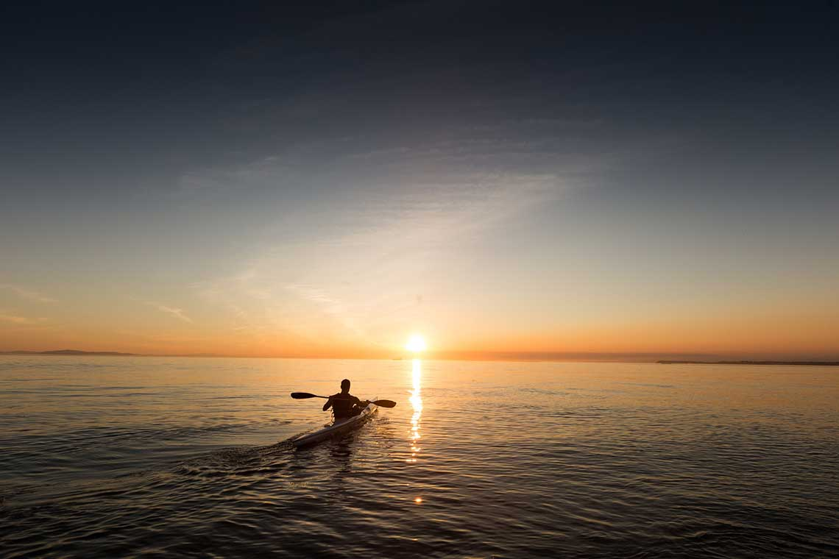
"Therefore bear fruits worthy of repentance, …" — Matthew 3:8
repentance
repent
repentance
Notes:
Repentance should come before the sunset of our lives.

Slide 17
Then He said to them, "Thus it is written, and thus it was necessary for the Christ to suffer and to rise from the dead the third day, and that repentance and remission of sins should be preached in His name to all nations, beginning at Jerusalem. " — Luke 24:46-47
waning
remission of sins
shrinking
lessening
decrease
reduction
repentance
remission of
sins
Notes:
To partake in the remission of sins, one must come to Jesus with a contrite heart, asking for forgiveness.

Slide 18
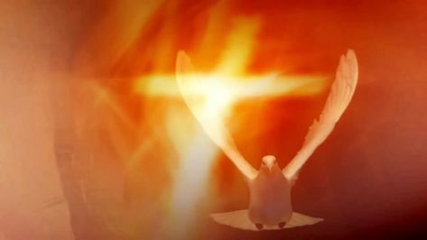
Then Peter said to them, "Repent, and let every one of you be baptized in the name of Jesus Christ for the remission of sins; and you shall receive the gift of the Holy Spirit. — Acts 2:38
Repent
gift of the Holy Spirit
baptized in the name of Jesus
remission of sins
baptized in the name of Jesus
receive the gift of
gift of
. .
the Holy Spirit
the Holy Spirit
Holy Spirit
. .
Notes:
To receive the gift of forgiveness of sins. one must observe His command to come and obey, in submission to His will.

Slide 19
For godly sorrow produces repentance leading to salvation, not to be regretted; but the sorrow of the world produces death. — 2nd Corinthians 7:10
godly
godly sorrow
godly
. .
repentance
world
world
repentance
Notes:
To ponder upon the goodness of God naturally internalizes better qualities. To mourn over what one does not have, in earthly possessions, destroys peace and advances corruption.

Slide 20
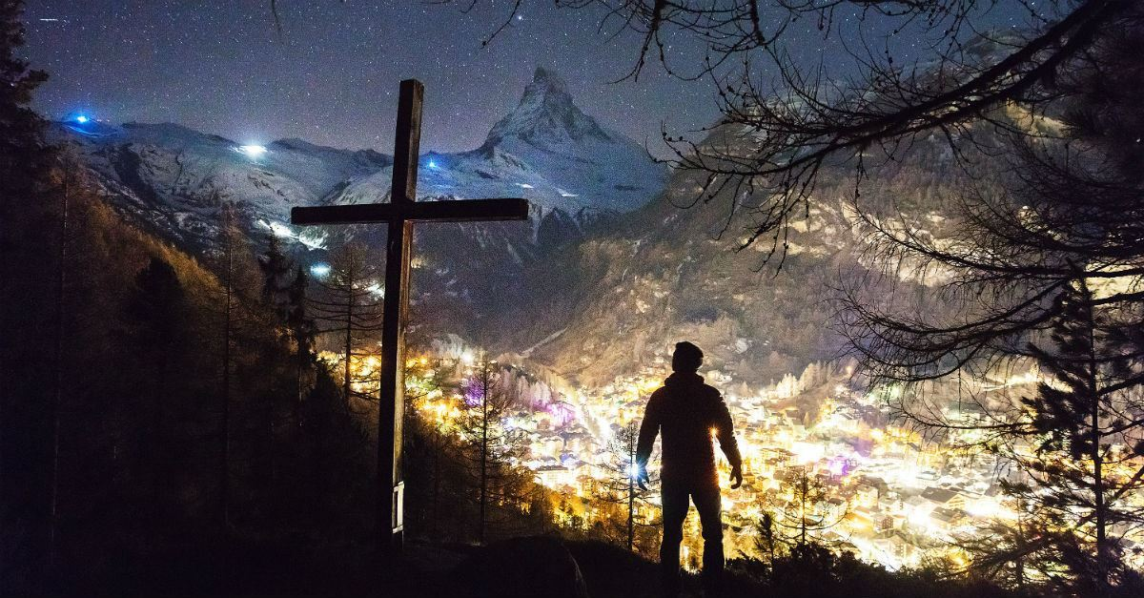
Or do you despise the riches of His goodness, forbearance, and longsuffering, not knowing that the goodness of God leads you to repentance? — Romans 2:4
God
goodness of God
God
God
. .
repentance
Notes:
Love of God take precedence over the highest of all mountains, deepest of all wells, and anything created and or perceived.

Slide 21
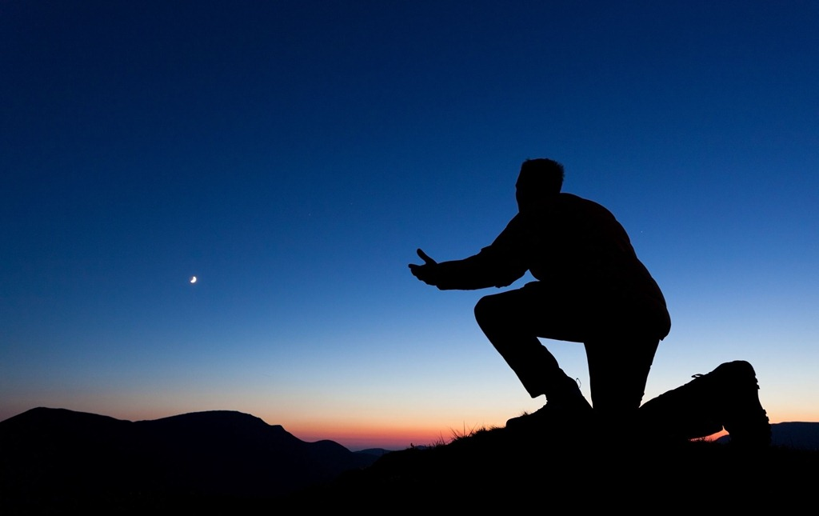
"Repent therefore of this your wickedness, and pray God if perhaps the thought of your heart may be forgiven you. For I see that you are poisoned by bitterness and bound by iniquity." — Acts 8:22-23
forgive
God
poisoned by bitterness
. .
forgive
Notes:
Hope is crucial to our faith as it renders peace in the sanctuary of His love. Forgiving others lifts our spirt to touch the sky.

Slide 22
"… if My people who are called by My name will humble themselves, and pray and seek My face, and turn from their wicked ways, then I will hear from heaven, and will forgive their sin and heal their land." — 2nd Chronicles 7:14
humble
humble
pray
seek
pray
seek
turn
turn
forgive their sin
forgive
forgive their sin
Notes:
To be godly goes hand in hand with a humble heart seeking Him in prayer, turning from past bad behaviors.

Slide 23
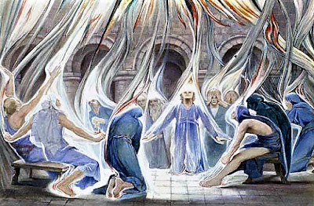
When they heard these things they became silent; and they glorified God, saying, "Then God has also granted to the Gentiles repentance to life." — Acts 11:18
repentance
life
repentance to life
repentance
repentance to life
Notes:
All souls are special to God as He has explained carefully how He wills all peoples to come to Him. Repentance is a sort of reckoning with God.

Slide 24
"... how I kept back nothing that was helpful, but proclaimed it to you, and taught you publicly and from house to house, testifying to Jews, and also to Greeks, repentance toward God and faith toward our Lord Jesus Christ." — Acts 20:20-21
repentance
God
faith
repentance
repentance
faith
Lord Jesus Christ
Notes:
Repentance and faith is how one establishes a relationship with God.

Slide 25
Truly, these times of ignorance
God overlooked, but now commands all men everywhere to repent

Slide 26
"Therefore, since we are the offspring of God, we ought not to think that the Divine Nature is like gold or silver or stone, something shaped by art and man's devising. Truly, these times of ignorance God overlooked, but now commands all men everywhere to repent, because He has appointed a day on which He will judge the world in righteousness by the Man whom He has ordained. He has given assurance of this to all by raising Him from the dead." — Acts 17:29-31
Truly, these times of ignorance
God overlooked, but now commands all men everywhere to repent
now commands all
now commands all
men everywhere to repent
repent
men everywhere to repent
repent
Notes:
It is God’s command that all should repent. If life is important enough, then sacrificing in acknowledgement to Him, is a small price to pay for heaven’s happiness upon waves of bliss.

Slide 27
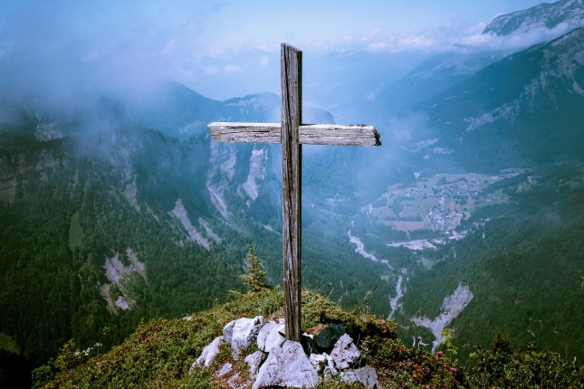
The Lord is not slack concerning His promise, as some count slackness, but is longsuffering toward us, not willing that any should perish but that all should come to repentance. — 2nd Peter 3:9
repentance
all should
all should
come to repentance
repent
repentance
come to repentance
Notes:
God watches from the highest mountaintops. It doesn’t matter what valley one comes to find oneself in, God wants us to see the birds and come to our senses, in the music of His truth.

Slide 28
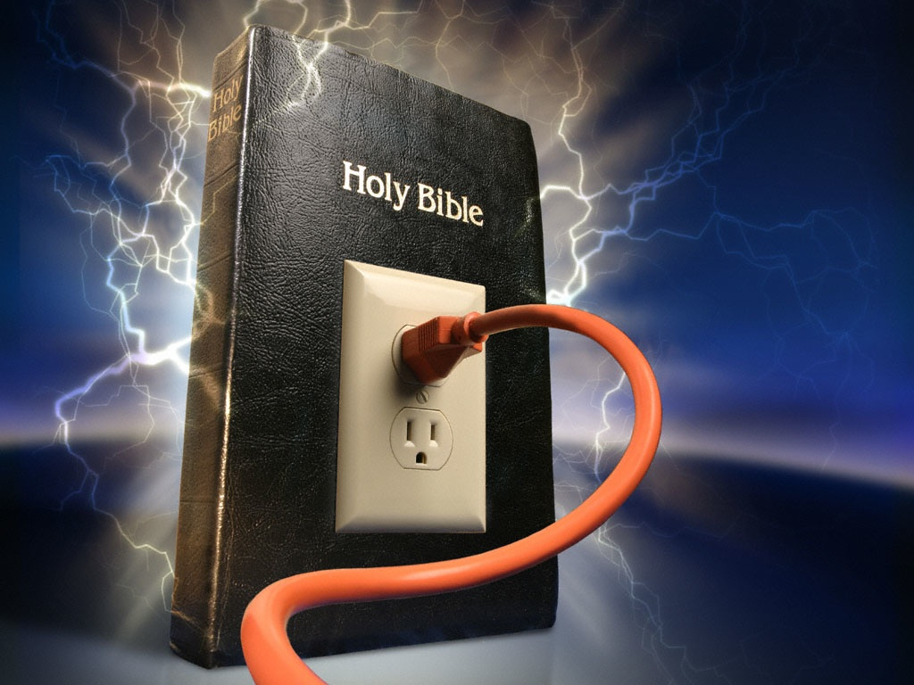
Therefore, leaving the discussion of the elementary principles of Christ, let us go on to perfection, not laying again the foundation of repentance from dead works and of faith toward God, of the doctrine of baptisms, of laying on of hands, of resurrection of the dead, and of eternal judgment. — Hebrew 6:1-2
foundation of repentance
repent
repentance
foundation of repentance
repent
Notes:
As they say, “dial or plug in,” as get with the truth. Living is either distant or close in one’s commitment to God.

Slide 29
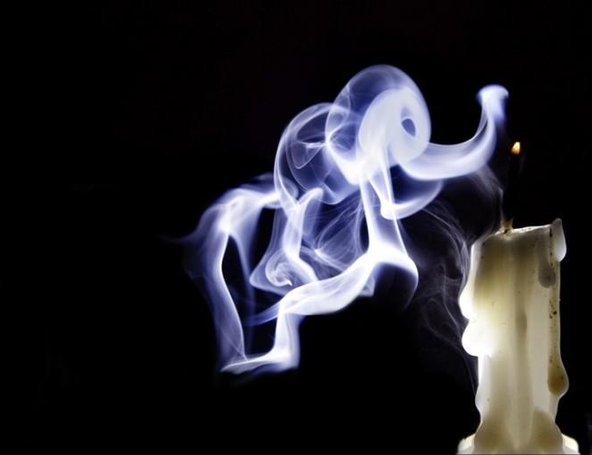
"Remember therefore from where you have fallen; repent and do the first works, or else I will come to you quickly and remove your lampstand from its place -- unless you repent." — Revelation 2:5
Remember
Remember
repent
Notes:
Small things can become very big if not put to rest. Rest is what Christ offers when one has a heart of devotion.

Slide 30
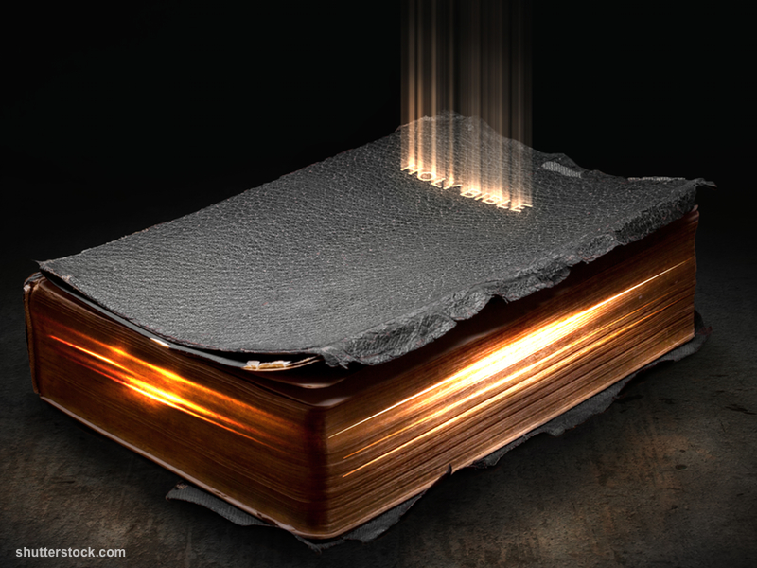
"Remember therefore how you have received and heard; hold fast and repent. Therefore if you will not watch, I will come upon you as a thief, and you will not know what hour I will come upon you." — Revelation 3:3
Remember
Remember
Remember
hold fast
. .
repent
repent
Notes:
What one desires the most is what one holds on to at all cost. Depth of character endures many fires on the path to eternity.

Slide 31
Remember
know the truth
hold fast
repent

Slide 32
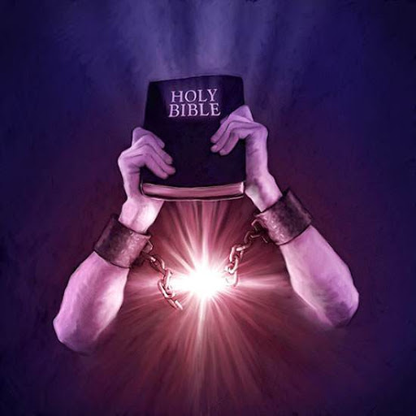
And a servant of the Lord must not quarrel but be gentle to all, able to teach, patient, in humility correcting those who are in opposition, if God perhaps will grant them repentance, so that they may know the truth, and that they may come to their senses and escape the snare of the devil, having been taken captive by him to do his will. — 2nd Timothy 2:24-26
servant of the Lord
not
servant
servant of the Lord: ● able to teach
● not quarrel ● gentle to all ● patient
→ in humility correcting
those who are in opposition
↓
if God perhaps will
grant them repentance
know the truth, come to their senses ↑ escape the snare of the devil
quarrel
gentle to all
able to
teach
patient
in humility correcting
those who are in opposition
if God
perhaps will
grant them repentance
know the truth
know the truth,
come to their senses
escape the snare of the devil
Notes:
To know the truth and coming to one’s senses is the best medicine in warding off the poisons of mankind.

Slide 33
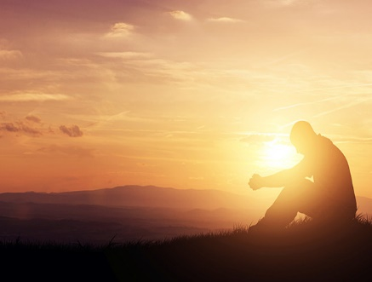
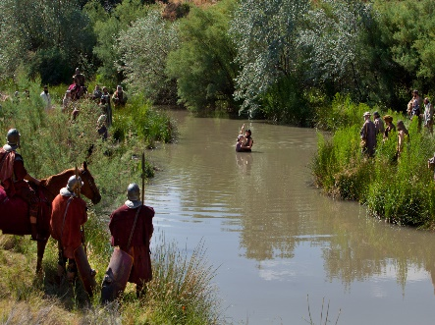
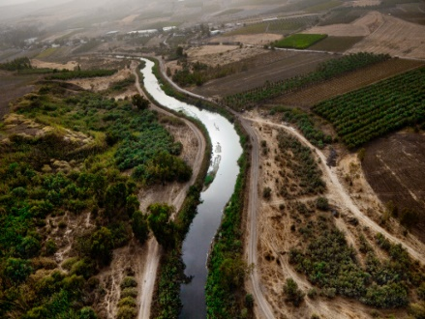
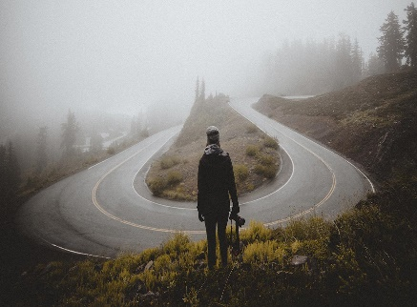
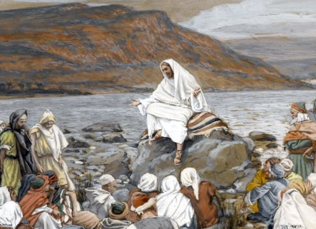
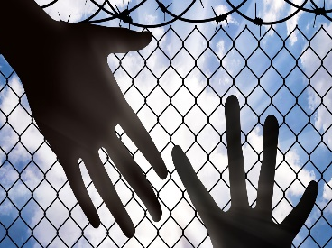
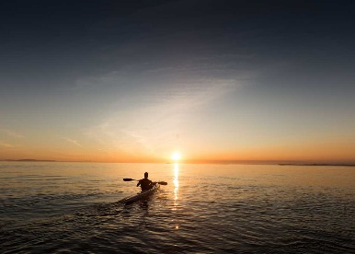
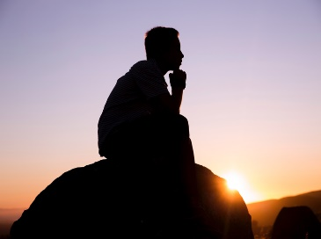
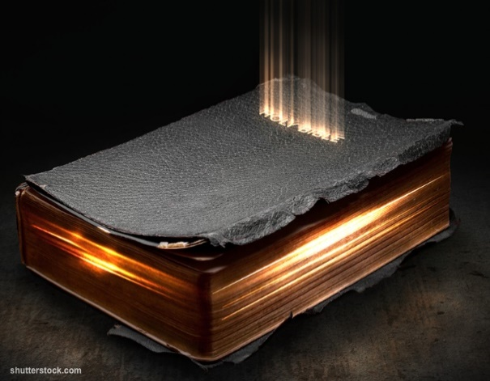

Slide 34
→ Confessing and forsaking sins brings mercy
→ John preached a baptism of repentance
→ Jesus came to call sinners to repentance
→ Unless we repent we will likewise perish
→ We need to bear noble fruits worthy of repentance
→ Repent and be baptized is the call of His church
→ Godly sorrow brings repentance/leads to salvation
→ Repent that one may be forgiven of wickedness
→ Humble seeking Him turning from sin are healed
→ Repentance and faith in Christ is God’s will
→ God commands all men everywhere to repent
→ He wills none should perish but come to repentance
→ Without repentance His blessings will vanish
Repentance is a sign of coming back to the ways of God
Notes:
Repentance is a sign of coming back to the ways of God

Slide 36
Please visit http://www.LoveFromGod.com to explore further
Ronald Bert Channel on
Notes:
Eternity never ends.

