Slide 2
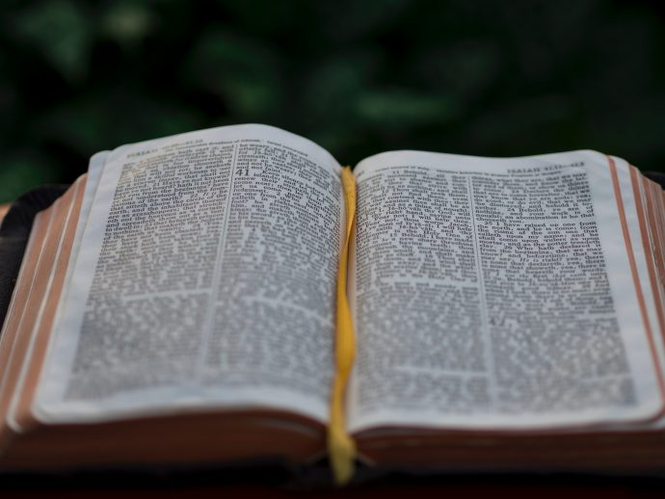
Receiving
Ron Bert
August 19, 2018

Slide 3
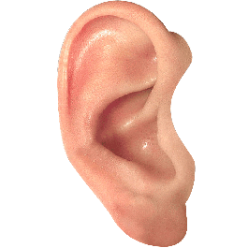
My son, if you receive my words, And treasure my commands within you, So that you incline your ear to wisdom, And apply your heart to understanding; Yes, if you cry out for discernment, And lift up your voice for understanding, If you seek her as silver, And search for her as for hidden treasures; Then you will understand the fear of the LORD, And find the knowledge of God. — Proverbs 2:1-5
receive
receive my words
receive my words
receive
search
search
find
find

Slide 4
Receive my instruction, and not silver, And knowledge rather than choice gold; For wisdom is better than rubies, And all the things one may desire cannot be compared with her. — Proverbs 8:10-11
Receive my instruction
receive
receive
gold
wisdom
rubies wisdom gold
rubies
desire

Slide 5
Listen to counsel and receive instruction, That you may be wise in your latter days. There are many plans in a man's heart, Nevertheless the LORD'S counsel -that will stand. — Proverbs 19:20-21
Listen
receive
receive
temporary
plans in a man's heart
permanent

Slide 6
"But you shall receive power when the Holy Spirit has come upon you; and you shall be witnesses to Me in Jerusalem, and in all Judea and Samaria, and to the end of the earth." — Acts 1:8
receive power
receive
Holy Spirit
receive

Slide 7
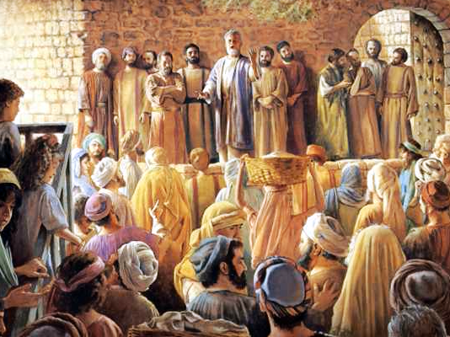
Then Peter said to them, "Repent, and let every one of you be baptized in the name of Jesus Christ for the remission of sins; and you shall receive the gift of the Holy Spirit. — Acts 2:38
Repent
baptized
receive
remission of sins
remission of sins
receive the gift
receive

Slide 8
"To Him all the prophets witness that, through His name, whoever believes in Him will receive remission of sins." — Acts 10:43
receive
remission of sins
remission of sins
receive

Slide 9
"I have shown you in every way, by laboring like this, that you must support the weak. And remember the words of the Lord Jesus, that He said, 'It is more blessed to give than to receive.'" — Acts 20:35
receive
give
receive
give

Slide 10
For you did not receive the spirit of bondage again to fear, but you received the Spirit of adoption by whom we cry out, "Abba, Father." — Romans 8:15
receive
receive
Spirit
received the Spirit of adoption
receive
Spirit

Slide 11
But the natural man does not receive the things of the Spirit of God, for they are foolishness to him; nor can he know them, because they are spiritually discerned. — 1st Corinthians 2:14
the natural man
receive
Spirit
receive

Slide 12
But I fear, lest somehow, as the serpent deceived Eve by his craftiness, so your minds may be corrupted from the simplicity that is in Christ. For if he who comes preaches another Jesus whom we have not preached, or if you receive a different spirit which you have not received, or a different gospel which you have not accepted--you may well put up with it! — 2nd Corinthians 11:3-4
preaches another Jesus
preaches another Jesus
receive
receive
a different spirit
a different spirit
a different gospel
a different gospel
Tolerate

Slide 13
As we have said before, so now I say again, if anyone preaches any other gospel to you than what you have received, let him be accursed. — Galatians 1:9
other gospel
other gospel
receive
receive

Slide 14
Christ has redeemed us from the curse of the law, having become a curse for us (for it is written, "Cursed is everyone who hangs on a tree"), that the blessing of Abraham might come upon the Gentiles in Christ Jesus, that we might receive the promise of the Spirit through faith. — Galatians 3:13-14
In Christ Jesus
Christ Jesus
receive
receive the promise
receive
promise
Spirit through faith
through faith

Slide 15
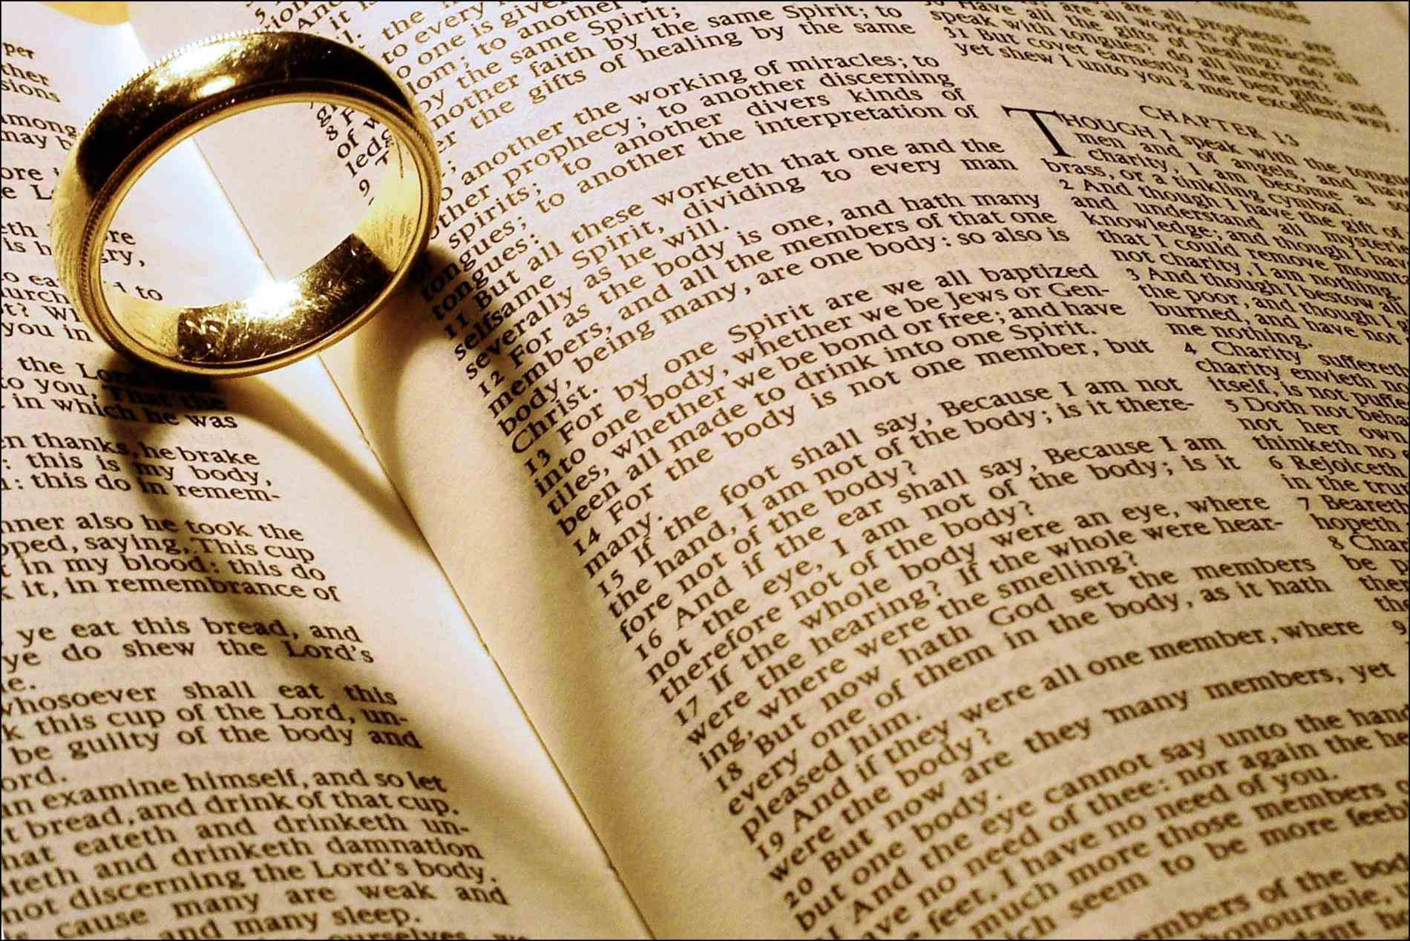
… not with eyeservice, as men-pleasers, but as bondservants of Christ, doing the will of God from the heart, with goodwill doing service, as to the Lord, and not to men, knowing that whatever good anyone does, he will receive the same from the Lord, whether he is a slave or free. — Ephesians 6:6-8
Lord
receive
receive
receive
from the Lord

Slide 16
And for this reason He is the Mediator of the new covenant, by means of death, for the redemption of the transgressions under the first covenant, that those who are called may receive the promise of the eternal inheritance. — Hebrews 9:15
And for this reason He is the Mediator of the new covenant, by means of death, for the redemption of the transgressions under the first covenant, that those who are called may receive the promise of the eternal inheritance. — Hebrews 9:15
receive
those who are called may receive
receive

Slide 17
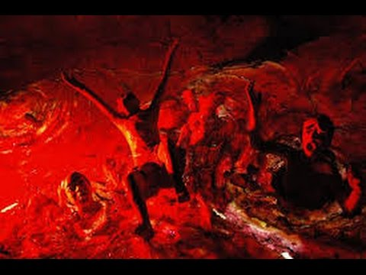
For if we sin willfully after we have received the knowledge of the truth, there no longer remains a sacrifice for sins, … — Hebrews 10:26
receive
receive

Slide 18
For you have need of endurance, so that after you have done the will of God, you may receive the promise: — Hebrews 10:36
need of endurance
receive
after
obedience
receive
promise

Slide 19
By faith Abraham obeyed when he was called to go out to the place which he would receive as an inheritance. And he went out, not knowing where he was going. — Hebrews 11:8
faith
receive
receive

Slide 20
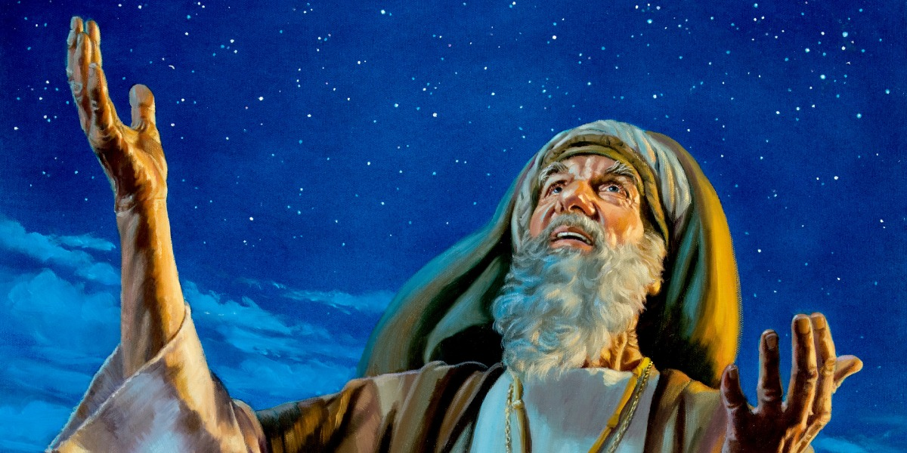
And all these, having obtained a good testimony through faith, did not receive the promise, … — Hebrews 11:39
receive
receive

Slide 21
Therefore, since we are receiving a kingdom which cannot be shaken, let us have grace, by which we may serve God acceptably with reverence and godly fear. — Hebrews 12:28
receive
receive
have grace
serve God

Slide 22
You ask and do not receive, because you ask amiss, that you may spend it on your pleasures. — James 4:3
receive
receive
ask amiss

Slide 23
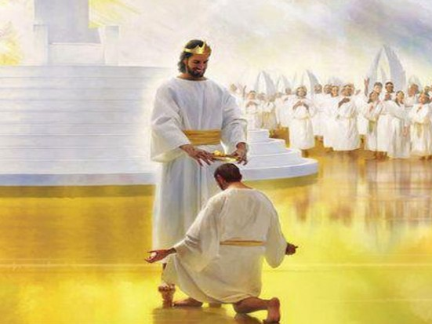
Blessed is the man who endures temptation; for when he has been approved, he will receive the crown of life which the Lord has promised to those who love Him. — James 1:12
receive
receive
receive
life
promise

Slide 24
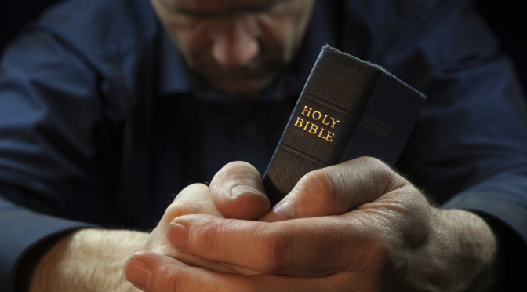
Therefore lay aside all filthiness and overflow of wickedness, and receive with meekness the implanted word, which is able to save your souls. — James 1:21
receive
the
receive
word
word
receive the word = save your souls
save your souls

Slide 25
Whoever transgresses and does not abide in the doctrine of Christ does not have God. He who abides in the doctrine of Christ has both the Father and the Son. If anyone comes to you and does not bring this doctrine, do not receive him into your house nor greet him; for he who greets him shares in his evil deeds. — 2nd John 1:9-11
in the doctrine of Christ
does not bring this doctrine
receive
not receive
receive
in

Slide 26
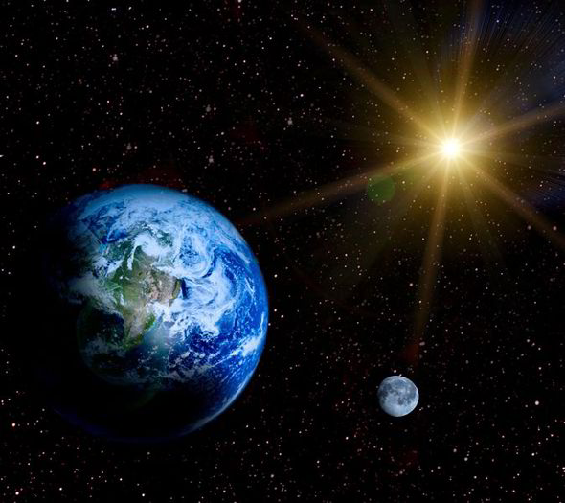
And I heard another voice from heaven saying, "Come out of her, my people, lest you share in her sins, and lest you receive of her plagues. — Revelation 18:4
receive
receive

Slide 27
If any of you lacks wisdom, let him ask of God, who gives to all liberally and without reproach, and it will be given to him. But let him ask in faith, with no doubting, for he who doubts is like a wave of the sea driven and tossed by the wind. For let not that man suppose that he will receive anything from the Lord; — James 1:5-7
God
faith
ask in
faith
faith
receive
receive

Slide 28
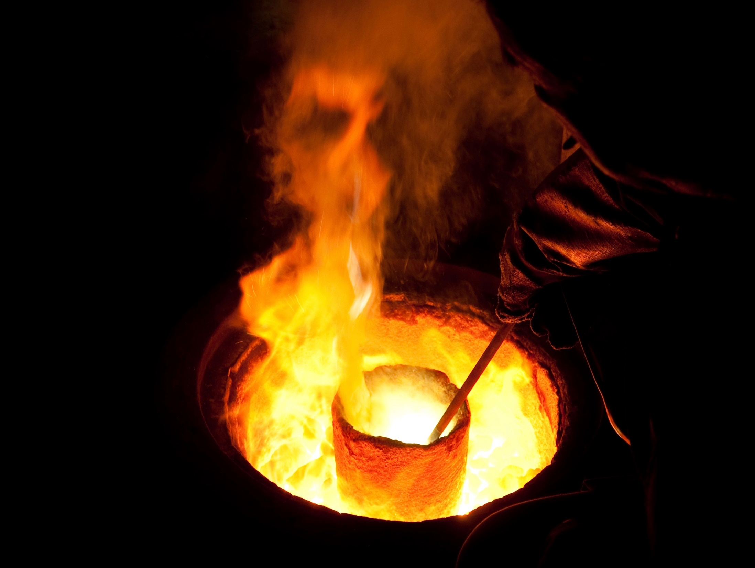
In this you greatly rejoice, though now for a little while, if need be, you have been grieved by various trials, that the genuineness of your faith, being much more precious than gold that perishes, though it is tested by fire, may be found to praise, honor, and glory at the revelation of Jesus Christ, whom having not seen you love. Though now you do not see Him, yet believing, you rejoice with joy inexpressible and full of glory, receiving the end of your faith--the salvation of your souls. — 1st Peter 1:6-9
In this you greatly rejoice, though now for a little while, if need be, you have been grieved by various trials, that the genuineness of your faith, being much more precious than gold that perishes, though it is tested by fire, may be found to praise, honor, and glory at the revelation of Jesus Christ, whom having not seen you love. Though now you do not see Him, yet believing, you rejoice with joy inexpressible and full of glory, receiving the end of your faith--the salvation of your souls. — 1st Peter 1:6-9
ie
genuine
faith
receive
praise
honor
Jesus Christ
genuine faith
● praises
● honors
● glories with joy
→ of love in Jesus Christ
love
s
in
with joy
receive
s
glor
of
s

Slide 29
Therefore receive one another, just as Christ also received us, to the glory of God. — Romans 15:7
Christ
receive
receive one another
receive
Christ
Christ

Slide 30
For we must all appear before the judgment seat of Christ, that each one may receive the things done in the body, according to what he has done, whether good or bad. — 2nd Corinthians 5:10
Christ
judgment
receive
receive
receive

Slide 31
If anyone's work which he has built on it endures, he will receive a reward. — 1st Corinthians 3:14
receive
reward
reward

Slide 32
→ Treasure His word that commands life
→ No value can be placed on proper instructions
→ The Holy Spirit delivers the heart of truth
→ Baptism’s seal is for the remission of sins
→ Gift of the Holy Spirt is the grace of forgiveness
→ He calls for giving hearts in loving submission
→ Only a humble keen spirit receives God’s truths
→ Through faith Christ frees us from curse of death
→ Goodwill in His service to Him pleases Him
→ He calls to rise from sin to an eternal inheritance
→ Serve God in the grace He has given
→ Exercising the implanted word is able to save a soul
→ Expect nothing if doubting but be thankful in faith
Embrace the freedom He delivers to those that love Him

Slide 34
Please visit http://www.LoveFromGod.com to explore further
Ronald Bert Channel on
Notes:
Eternity never ends.

