Slide 2
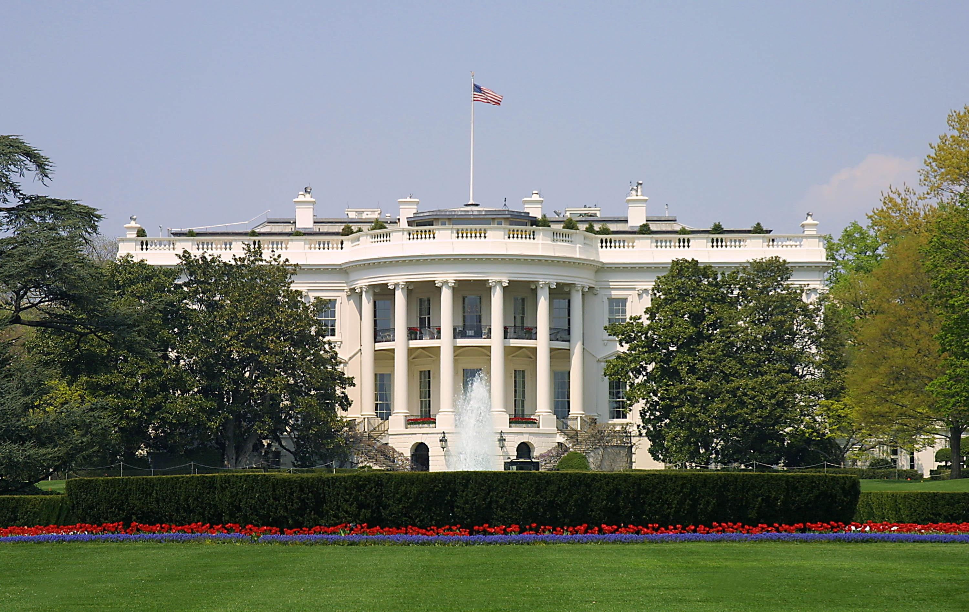
Presidential Quotes
Ron Bert
9
August 19, 2018

Slide 3
16. Abraham Lincoln (1861-1865)
Part 3

Slide 4
“My friends I now leave, not knowing when, or whether ever, I may return, with a task before me greater than that which rested upon Washington. Without the assistance of that Divine Being, who ever attended him, I cannot succeed. With that assistance, I cannot fail.”
assistance of
Divine
I cannot fail

Slide 5
What then shall we say to these things? If God is for us, who can be against us? — Romans 8:31

Slide 6
“May the Almighty grant that the cause of truth, justice, and humanity, shall in no wise suffer at my hands.”

Slide 7
“Four score and seven years ago our fathers brought forth on this continent, a new nation, conceived in Liberty, and dedicated to the proposition that all men are created equal.”

Slide 8
“When we were the political slaves of King George, and wanted to be free, we called the maxim that "all men are created equal" a self-evident truth; but now when we have grown fat, and have lost all dread of being slaves ourselves, we have become so greedy to be masters that we call the same maxim "a self-evident lie" The fourth of July has not quite dwindled away; it is still a great day-for burning fire-crackers!!!”
political slaves
all men
created equal
self-evident truth
all men created equal = self-evident truth

Slide 9
“It is to deny, what the history of the world tells us is true, to suppose that men of ambition and talents will not continue to spring up amongst us. And, when they do, they will as naturally seek the gratification of their ruling passion, as others have so done before them.”
all men created equal = self-evident truth
Power Mongers

Slide 10
Woe to those who are wise in their own eyes, And prudent in their own sight! — Isaiah 5:21

Slide 11
“It is the eternal struggle between these two principles - right and wrong. They are the two principles that have stood face to face from the beginning of time and will ever continue to struggle. It is the same spirit that says, "You work and toil and earn bread, and I'll eat it."
captivity
work and toil

Slide 12
“Now what is Judge Douglas’ Popular Sovereignty? It is, as a principle, no other than that, if one man chooses to make a slave of another man, neither that other man nor anybody else has a right to object.”
rule

Slide 13
"He who kidnaps a man and sells him, or if he is found in his hand, shall surely be put to death." — Exodus 21:16

Slide 14
“One section of our country believes slavery is right, and ought to be extended, while the other believes it is wrong, and ought not to be extended.”

Slide 15
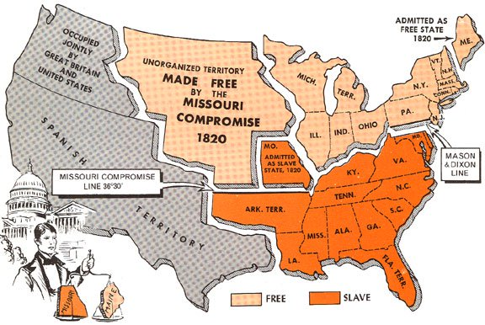
“Repeal the Missouri Compromise (1820) - repeal all compromises - repeal the Declaration of Independence (1776) - repeal all past history, you still cannot repeal human nature. It still will be the abundance of man's heart, that slavery extension is wrong; and out of the abundance of his heart, his mouth will continue to speak.”
“Repeal the Missouri Compromise (1820) - repeal all compromises - repeal the Declaration of Independence (1776) - repeal all past history, you still cannot repeal human nature. It still will be the abundance of man's heart, that slavery extension is wrong; and out of the abundance of his heart, his mouth will continue to speak.”
slavery
is wrong

Slide 16
Jesus answered them, "Most assuredly, I say to you, whoever commits sin is a slave of sin. And a slave does not abide in the house forever, but a son abides forever. Therefore if the Son makes you free, you shall be free indeed." — John 8:34-36
"A good man out of the good treasure of his heart brings forth good; and an evil man out of the evil treasure of his heart brings forth evil. For out of the abundance of the heart his mouth speaks." — Luke 6:45

Slide 17
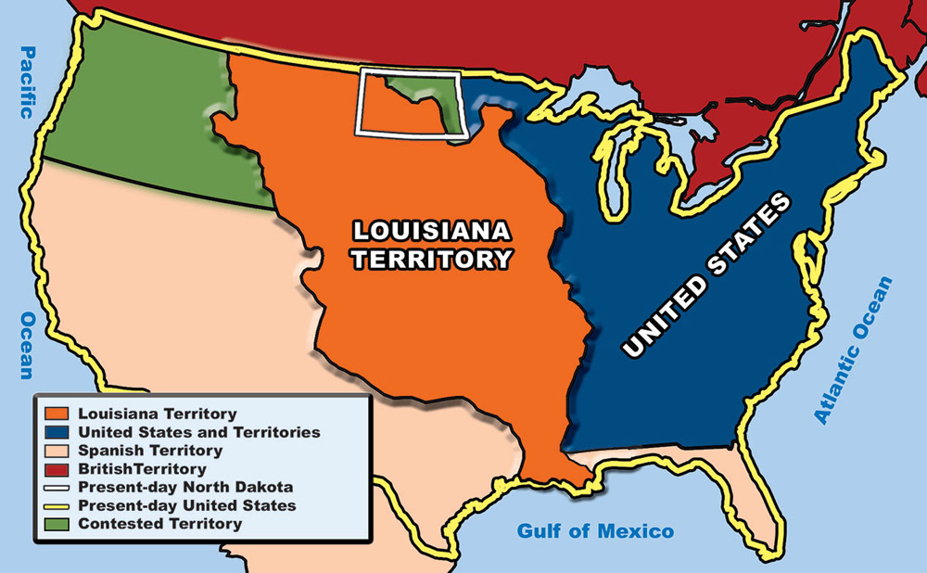
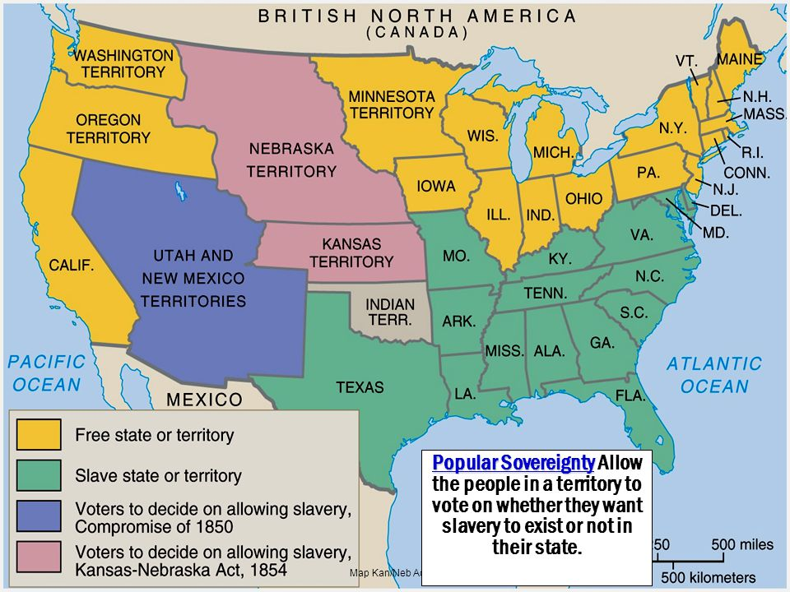
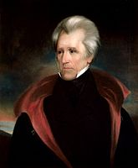
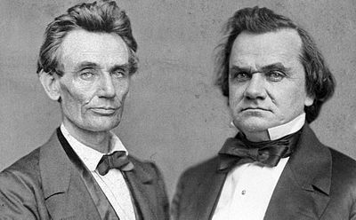
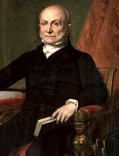
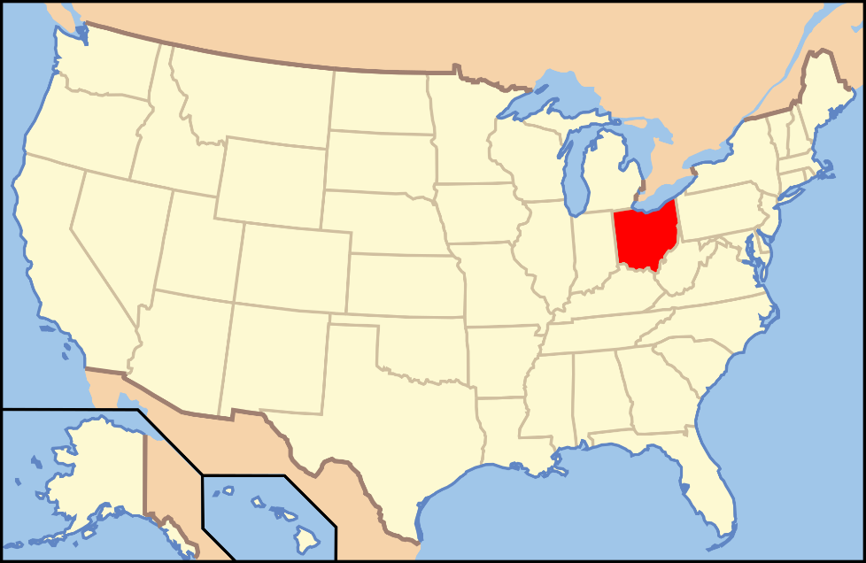
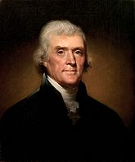
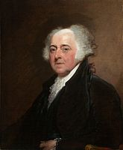
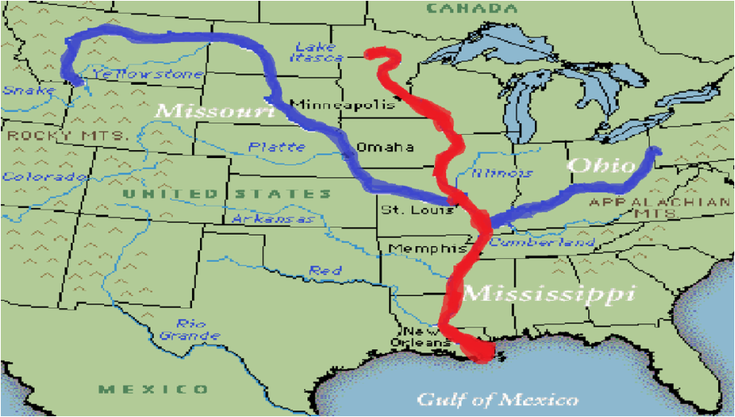
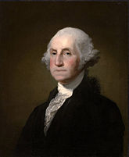
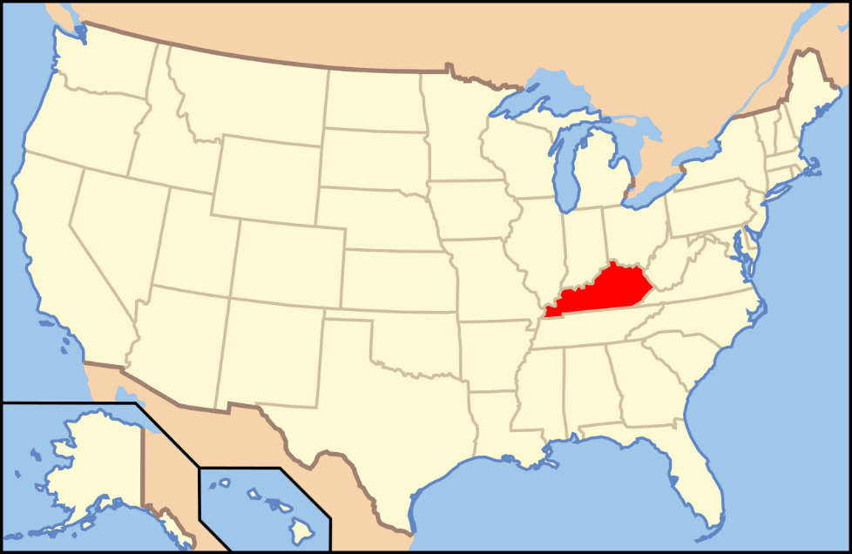
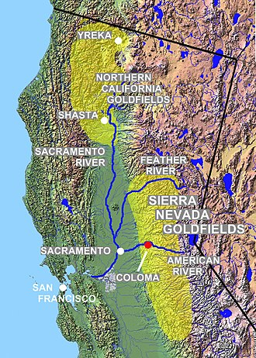
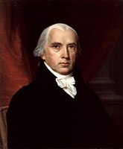
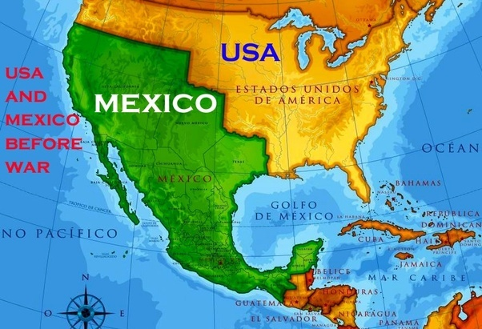
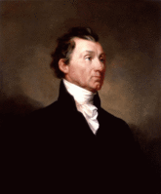
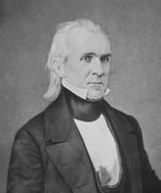
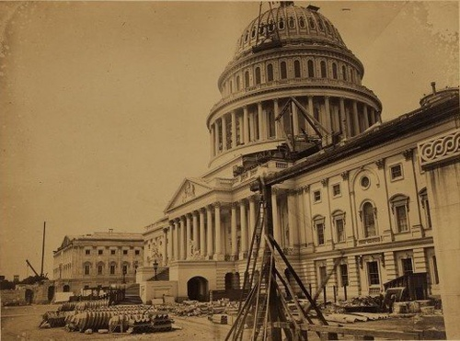
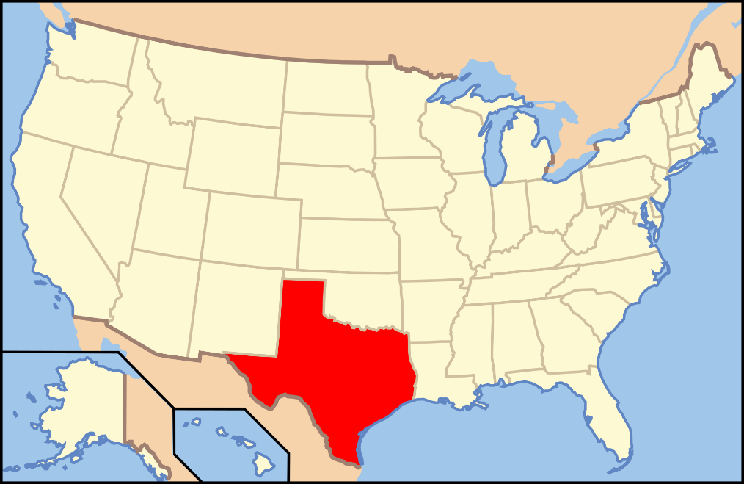
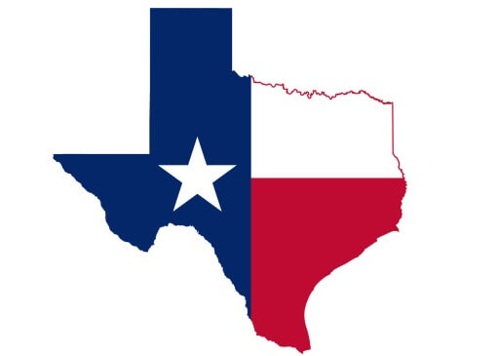
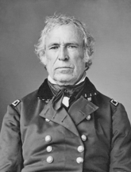
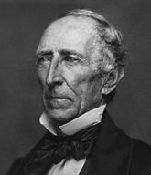
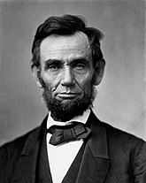
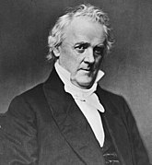
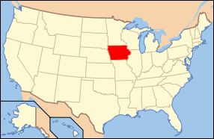
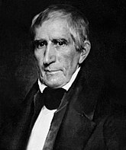
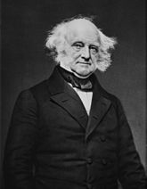
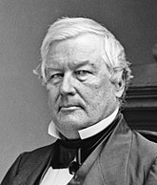
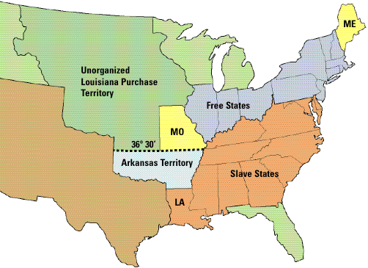
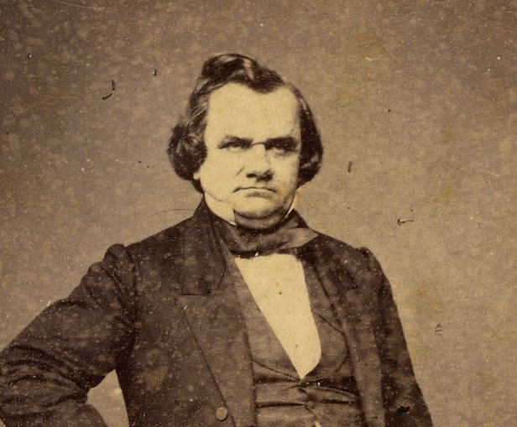
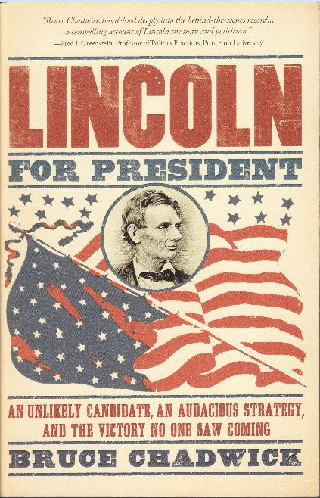
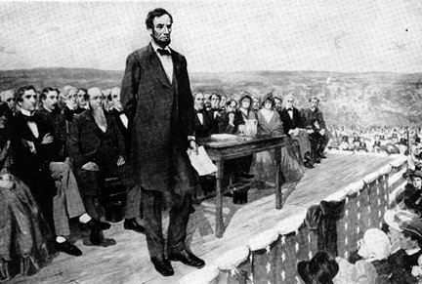
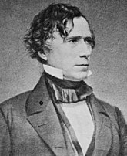
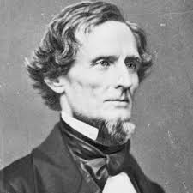
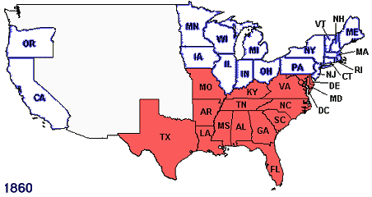
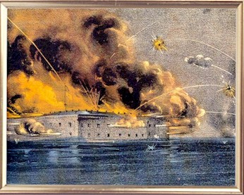
July 4,1776
April 12,1861
July 13,1787
1856
1860
1858
1850
1861
1852
1840
1854
1841
1844
1848
1845
1836
1846
March 2,1836
1792
1828
1796
1808
1824
1816
1820
1803
1800
Missouri Compromise Line drawn on Slavery
John Quincy Adams elected 6th President
Thomas Jefferson elected 3rd President
Fugitive Slave Act – Sept 18, 1850 – Makes federal government responsible for returning fugitive slaves
Kentucky joins as slave state
James Monroe elected 5th President
Abraham Lincoln elected 16th President
Northwest Ordinance – No slaves north of Ohio, east of Mississippi
Franklin Pierce elected 14th President
James Madison elected 4th President
Southern states start seceding Dec.1860 - Feb1861
Andrew Jackson elected 7th President
Zachary Taylor elected 12th President
California becomes a free state
Louisiana Purchase starts slave state debates
Ohio enters as free state
Lincoln Douglas Debates
Iowa enters as free state – Dec 28, 1846
John Adams elected 2nd President
Texas Declares Independence from Mexico
Mexican-American War ends – Feb 2nd
Kansas-Nebraska Act – Stephen Douglas repeals the Missouri Compromise
James Polk elected 11th President
U.S. Declares war on Mexico
Jefferson Davis elected Confederate Pres. Feb 18, 1861
John Tyler sworn in as 10th President
President Buchannan fails to admit Kansas a slave state
Last Compromise of 1850 – Allows voters in New Mexico and Utah to decide on slavery
Millard Fillmore assumes presidency as 13th President – July 9
Lincoln declares federal gov. has the power to halt the spread of slavery Feb 27, 1860
William Henry Harrison elected 9th President
Know Nothings – Anti Catholics and Immigrants
Texas enters U.S. as slave state
California Gold discovered – Jan. 24
James Buchanan elected 15th President
Martin Van Buren elected 8th President
Lincoln inaugurated – March 4, 1861
Declaration of Independence

Slide 18
"A house divided against itself cannot stand. I believe this government cannot endure permanently half-slave and half-free. I do not expect the Union to be dissolved - I do not expect the house to fall - but I do expect it will cease to be divided. It will become all one thing or all the other."

Slide 19
"If a kingdom is divided against itself, that kingdom cannot stand. And if a house is divided against itself, that house cannot stand." — Mark 3:24-25

Slide 20
“He [Stephen Douglas] is blowing out the moral lights around us, when he contends that whoever wants slaves has a right to hold them; that he is penetrating, so far as lies in his power, the human soul, and eradicating the light of reason and the love of liberty, when he is in every possible way preparing the public mind, by his vast influence, for making the institution of slavery perpetual and national.”
moral
m
i
light of reason immoral
love of liberty institutions
≠
light of reason
love of liberty
s
institution

Slide 21
“Senator [Stephen] Douglas is of world-wide renown. All the anxious politicians of his party, or who have been of his party for years past, have been looking upon him as certainly, at no distant day, to be the President of the United States. They have seen in his round, jolly, fruitful face, post offices, land offices, marshalships, and cabinet appointments, chargeships and foreign missions, bursting and sprouting out in wonderful exuberance ready to be laid hold of by their greedy hands.”

Slide 22
“I am naturally anti-slavery. If slavery is not wrong, nothing is wrong. I cannot remember when I did not so think, and feel. And yet I have never understood that the Presidency conferred upon me an unrestricted right to act officially upon this judgment and feeling.”

Slide 23
"For if you remain completely silent at this time, relief and deliverance will arise for the Jews from another place, but you and your father's house will perish. Yet who knows whether you have come to the kingdom for such a time as this?" — Esther 4:14

Slide 24
“One eighth of the whole population were colored slaves, not distributed generally over the Union, but localized in the Southern part of it. These slaves constituted a peculiar and powerful interest. All knew that this interest was, somehow, the cause of the war.”

Slide 25
We must settle this question now -- whether in a free government the minority have the right to break it up whenever they choose. If we fail, it will go far to prove the incapability of the people to govern themselves.”

Slide 26
“No state, upon its own mere motion, can lawfully get out of the Union. Plainly, the central idea of secession, is the essence of anarchy.”

Slide 27
“I would rather be assassinated than see a single star removed from the American flag.”

Slide 28
“I appeal to all loyal citizens to favor, facilitate and aid this effort to maintain the honor, the integrity, and the existence of our National Union, and the perpetuity of popular government; and to redress wrongs already long enough endured.”
citizens
f
e
in
honor
r
maintain
integrity
e
c
ty
free citizens maintaining
society honor and integrity
=
and
i
e
g
s
o
Notes:
`

Slide 29
“Our political problem now is "Can we, as a nation, continue together permanently forever--half slave, and half free?" The problem is too mighty for me. May God, in his mercy, superintend the solution.”

Slide 30
Therefore humble yourselves under the mighty hand of God, that He may exalt you in due time, casting all your care upon Him, for He cares for you. — 1st Peter 5:6 -7

Slide 31
“We want, and must have, a national policy, as to slavery, which deals with it as being wrong.”

Slide 32
There is neither Jew nor Greek, there is neither slave nor free, there is neither male nor female; for you are all one in Christ Jesus. — Galatians 3:28

Slide 34
Presidential Quotes
Ron Bert
9½
August 26, 2018

Slide 35
16. Abraham Lincoln (1861-1865)
Part 4

Slide 36
“That on the first day of January, in the year of our Lord one thousand eight hundred and sixty-three, all persons held as slaves within any state or designated part of a State, the people whereof shall then be in rebellion against the United States, shall be then, thence forward, and forever free...”

Slide 37
“Relying, as I do, upon the Almighty Power, and encouraged as I am by these resolutions which you have just read, with the support which I receive from Christian men, I shall not hesitate to use all the means at my control to secure the termination of this rebellion, and will hope for success.”
Relying, as I do

Slide 38
“And upon this act [Emancipation Proclamation] ... I invoke ... the gracious favor of Almighty God.”

Slide 39
“You dislike the emancipation proclamation; and, perhaps, would have it retracted. You say it is unconstitutional - I think differently.”

Slide 40
“We seek not to overthrow the constitution, but to overthrow those who would pervert it.”

Slide 41
Yes, and all who desire to live godly in Christ Jesus will suffer persecution. But evil men and impostors will grow worse and worse, deceiving and being deceived. — 2nd Timothy 3:12 -13

Slide 42
“Now we are engaged in a great civil war, testing whether that nation, or any nation so conceived and so dedicated, can long endure.”

Slide 43
“We have, as all will agree, a free Government, where every man has a right to be equal with every other man. In this great struggle, this form of Government and every form of human right is endangered if our enemies succeed.”

Slide 44
“Let all Americans - let all lovers of liberty everywhere - join in the great and good work. If we do this, we shall not only have saved the Union; but we shall have so saved it, as to make, and to keep it, forever worthy of the saving.”

Slide 45
For we are His workmanship, created in Christ Jesus for good works, which God prepared beforehand that we should walk in them. — Ephesians 2:10

Slide 46
“We shall meanly lose or nobly save the last hope of earth.”

Slide 47
Let all bitterness, wrath, anger, clamor, and evil speaking be put away from you, with all malice. And be kind to one another, tenderhearted, forgiving one another, just as God in Christ forgave you. — Ephesians 4:31-32

Slide 48
... that there should be no schism in the body, but that the members should have the same care for one another. And if one member suffers, all the members suffer with it; or if one member is honored, all the members rejoice with it. — 1st Corinthians 12:25-26

Slide 49
“My dream is of a place and a time where America will once again be seen as the last best hope of earth.”

Slide 50
For I know the thoughts that I think toward you, says the LORD, thoughts of peace and not of evil, to give you a future and a hope. Then you will call upon Me and go and pray to Me, and I will listen to you. And you will seek Me and find Me, when you search for Me with all your heart. — Jeremiah 29:11-13

Slide 51
But those who wait on the LORD Shall renew their strength; They shall mount up with wings like eagles, They shall run and not be weary, They shall walk and not faint. — Isaiah 40:31

Slide 52
Let love be without hypocrisy. Abhor what is evil. Cling to what is good. Be kindly affectionate to one another with brotherly love, in honor giving preference to one another; not lagging in diligence, fervent in spirit, serving the Lord; rejoicing in hope, patient in tribulation, continuing steadfastly in prayer; — Romans 12:9-12
● Let love be without hypocrisy
● Abhor what is evil
● Cling to what is good
● Be kindly affectionate to one another
● giving preference to one another
● not lagging in diligence
● fervent in spirit, serving the Lord
● rejoicing in hope
● patient in tribulation
● continuing steadfastly in prayer
Let love be without hypocrisy
Abhor
what is evil
Cling to what is good
Be kindly affectionate to one another
giving
preference to one another
not
lagging in diligence
fervent in spirit,
serving the Lord
rejoicing in hope
patient in tribulation
continuing
steadfastly in prayer

Slide 53
Now may the God of hope fill you with all joy and peace in believing, that you may abound in hope by the power of the Holy Spirit. — Romans 15:13
in
in
power of the Holy Spirit

Slide 54
“I will either be America's greatest president or its last.”

Slide 55
My people are destroyed for lack of knowledge. Because you have rejected knowledge, I also will reject you from being priest for Me; Because you have forgotten the law of your God, I also will forget your children. — Hosea 4:6

Slide 56
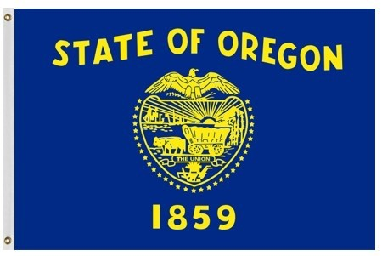
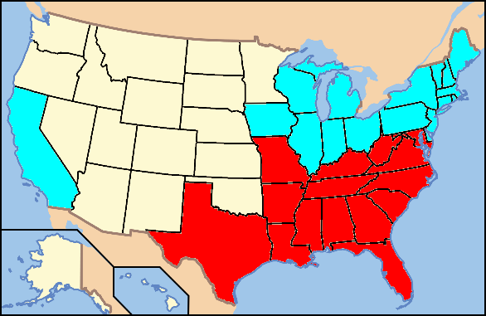
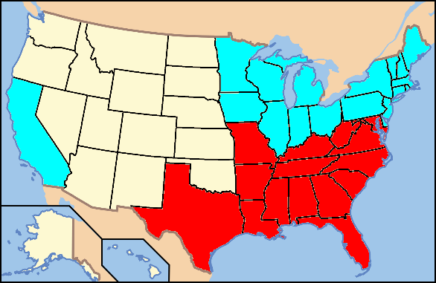
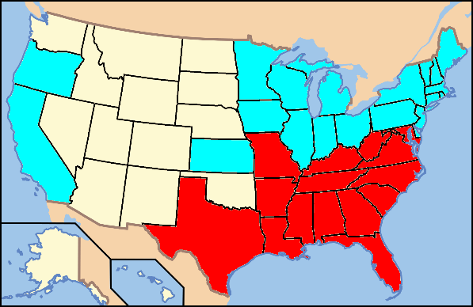
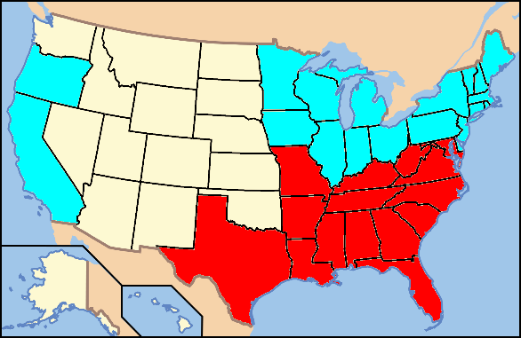
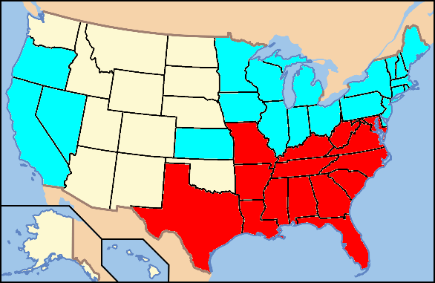
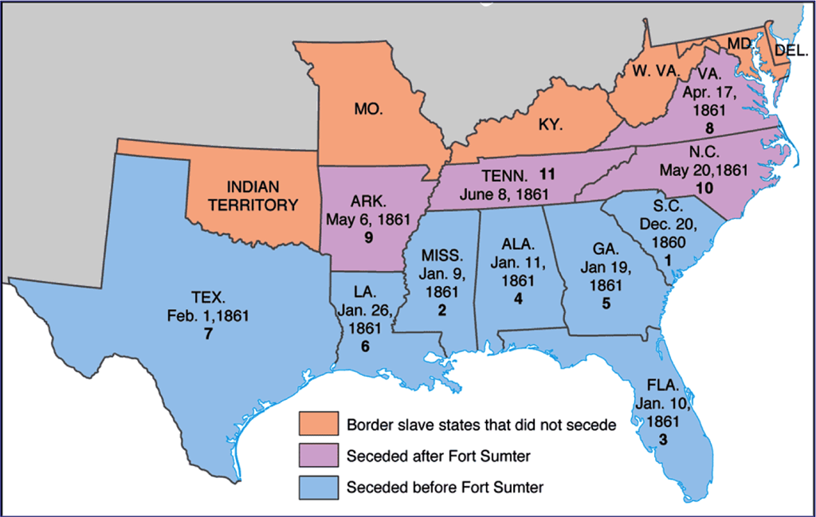
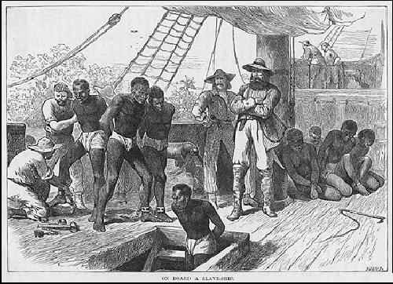
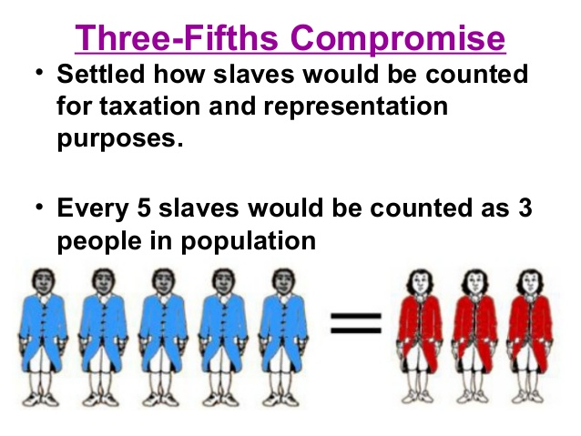
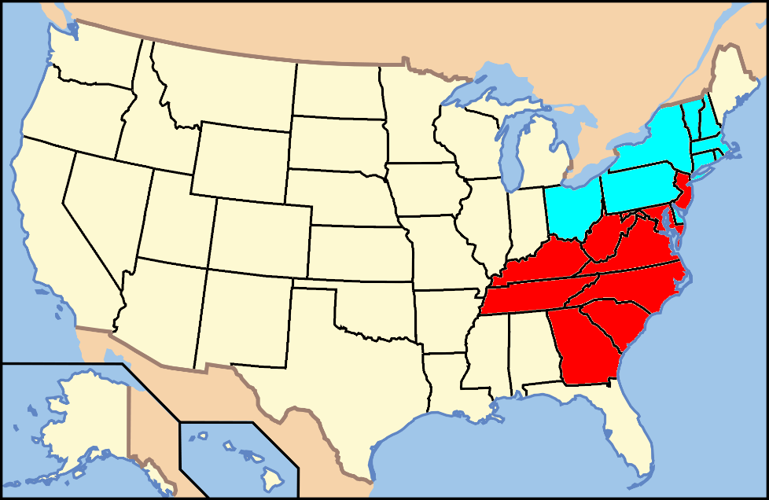
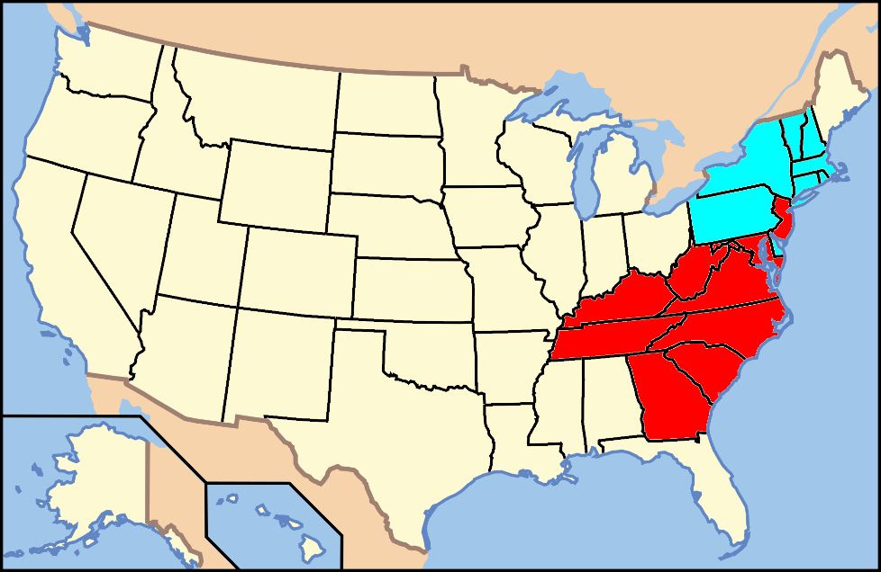
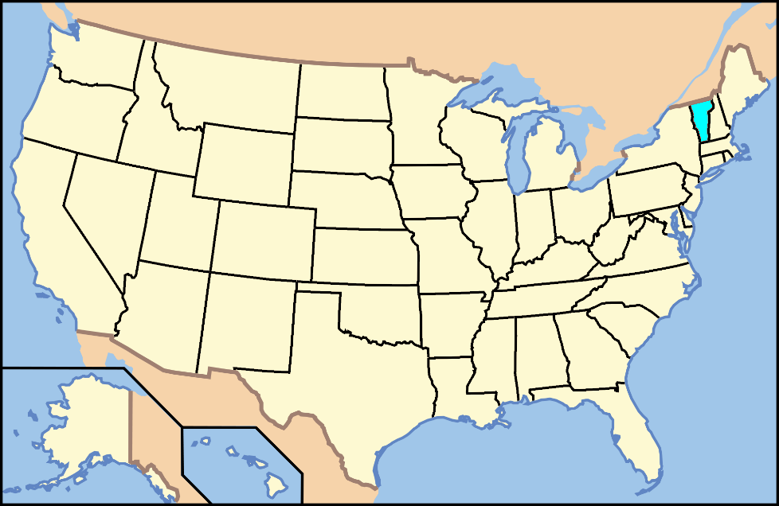
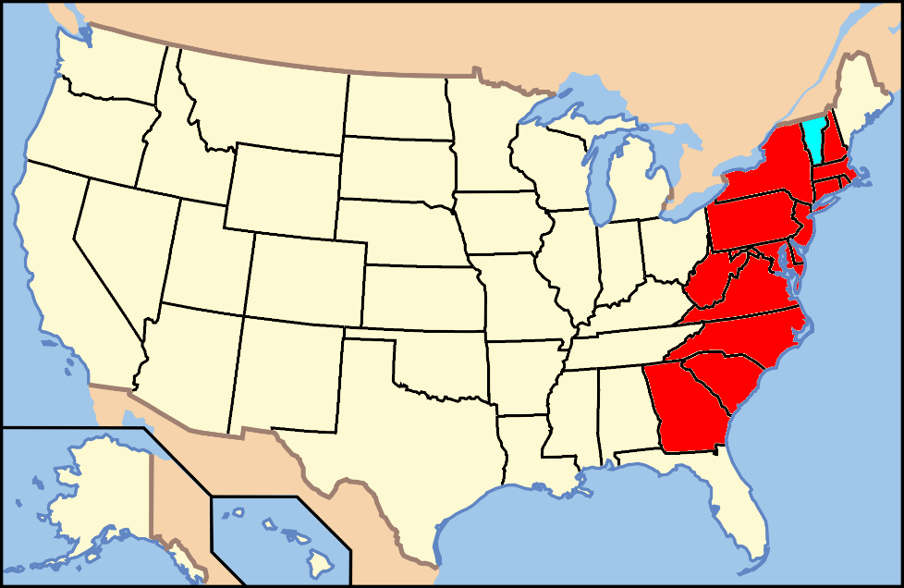
July 4,1776
Quick Summary
Behold, the nations are as a drop in a bucket, And are counted as the small dust on the scales; Look, He lifts up the isles as a very little thing. — Isaiah 40:15
1799
April 12,1861
1865
1857
1861
1866
1864
1863
1860
1850
1858
1856
1846
1854
1841
1852
1844
1845
1796
1840
1848
1859
1808
1836
1792
1812
1837
1819
1818
1817
1816
1803
1820
1804
July 13,1787
1828
1788
1824
1800
1821
1791
1827
1784 - Connecticut and Rhode Island for gradual abolition
1783 - New Hampshire announces gradual abolition
Thomas Jefferson elected 3rd President
Vermont joins the Union as a free state. First state admitted after the 13 original states signed Constitution; #14
First to ratify U.S. Constitution; 1788-89 Abolition societies established in Dover and Wilmington
Vermont joins the Union as a free state. First state admitted after the 13 original states signed Constitution; #14
John Quincy Adams elected 6th President
Emancipation Proclamation Pres. Abraham Lincoln decrees that all slaves in Rebel territory are free on January 1, 1863
Louisiana Purchase starts slave state debates
Purchased from France (Napoleon) for 15 million
23,054,152 people including 3,200,600 slaves or 14%. Slaves not so much in north, but 58% in S.C. & 51% in Mississippi
Republican Party (Whigs) forms on anti-slavery platform opposing Democratic Party policies
Abraham Lincoln elected 16th President – 1st Republican to win the US Presidency.
Jefferson Davis elected Confederate President February 18, 1861
James Monroe elected 5th President
Northwest Ordinance No slaves north of Ohio River - east of Mississippi; outlawed slavery in the new territories
Franklin Pierce elected 14th President
1783 - Massachusetts abolishes slavery and grants voting rights to blacks and Natives
Andrew Jackson elected 7th President
1780 - Pennsylvania 1st state to abolish slavery / gradual abolition
Kentucky joins as slave state; #15
Fugitive Slave Act of 1793 – is modified and strengthened; makes Fed. Gov. responsible for returning fugitive slaves
Federalist Papers 54 - James Madison questions morality of slaves as property
Southern states start seceding December 1860 – February 1861
August 20, 1866 President Johnson formally declared the end of the war
United States Bans Slave Trade. Importing African slaves is outlawed, but smuggling continues
The 2nd Continental Congress resolves "that NO slaves be imported into any of the thirteen United Colonies."
Zachary Taylor elected 12th President
Many National Leaders are slave owners
California becomes a free state; #31
New Jersey's state legislature announces a gradual emancipation act
Three-Fifths Compromise – Representation in Congress due to uncounted non-voting slaves and taxation purposes
Iowa enters as free state – Dec 28th, 1846; # 29
December 6, Slavery Abolished The 13th Amendment to the United States Constitution outlaws slavery
April 14, 1865 Abraham Lincoln assassinated
April 9, 1865 American Civil War Ends at Appomattox Courthouse where General Robert E. Lee surrenders his army to General Ulysses S. Grant
Lincoln Douglas Debates
November 6, 1865 The last Confederate surrender when the warship CSS Shenandoah surrendered at Liverpool, England
April 15, 1865 Democrat Andrew Johnson is sworn in. Does not give protection to former slaves and later acquitted from impeachment by one vote
Mississippi joins as slave state, #20
Alabama joins as slave state, #22
Illinois joins as free state, #21
Mexican-American War ends – Feb 2nd
Kansas-Nebraska Act – Stephen Douglas repeals the Missouri Compromise
James Polk elected 11th President
Wisconsin joins as free state, #30
Supreme Court rules in Scott v. Sandford that blacks are not U.S. citizens
U.S. Declares war on Mexico
John Tyler sworn in as 10th President
President Buchannan fails to admit Kansas a slave state
Last Compromise of 1850 – Allows voters in New Mexico and Utah to decide on slavery
Millard Fillmore assumes presidency as 13th President – July 9
Lincoln declares Federal Gov. has the power to halt the spread of slavery Feb 27, 1860
Texas Declares Independence from Mexico
Martin Van Buren elected 8th President
Gradual slavery emancipation
in New York
William Henry Harrison elected 9th President
Know Nothings – Anti Catholics and Immigrants
Tennessee joins as slave state; #16
James Madison elected 4th President
California Gold discovered – Jan. 24
The state of New York abolishes slavery
Indiana joins as free state, #19
James Buchanan elected 15th President
Minnesota joins as free state, #32
Missouri Compromise Line drawn on Slavery
Congress defines the slave trade as piracy
Missouri joins as slave state, #24
Texas enters U.S. as slave state; #28
Florida joins as slave state
Arkansas joins as slave state, #25
Maine joins as free state, #23
Louisiana joins as slave state, #18
Lincoln inaugurated – March 4, 1861
John Adams elected 2nd President
Ohio joins as free state; # 17
Lincoln reelected as President
Oregon joins as free state, #33
Nevada joins as a free state October 31, 1864
Michigan joins as free state, #26
Kansas joins as free state - January 29th, #34
Declaration of Independence
Northwest Ordinance No Slaves N. Ohio
Congress Ends Slave Trade
Importing slaves/outlawed
Missouri Compromise
Louisiana Purchase
Slave Trade as Piracy
Fugitive Slave Act
Last Compromise
War with Mexico
MO Comp. repealed
Blacks not U.S. citizens
Fort Sumter

Slide 60
→ Without God’s assistance, all is lost
→ All men created equal should be a self-evident truth
→ Talent and power can mix toward a bad outcome
→ Slavery of others denies service in God
→ No mortal home can stand where slaves are made of
→ Greed is the seed spawning corruption in all that it is
→ Human bondage darkens the light of all to be free
→ Undivided justice is found in the unity truth brings
→ Pray as we might to have peace in God’s will for man
→ In rebellion, men selfishly turn to lust of the flesh
→ Regard for people is God’s call to respect Him
→ Evil long desires the bondage of men with no hope
→ Freedom is worth saving where there is love of God
In God man’s true heart is found
Notes:
In God man’s true heart is found

Slide 62
Please visit http://www.LoveFromGod.com to explore further
Ronald Bert Channel on
Notes:
Eternity never ends.

