Slide 2
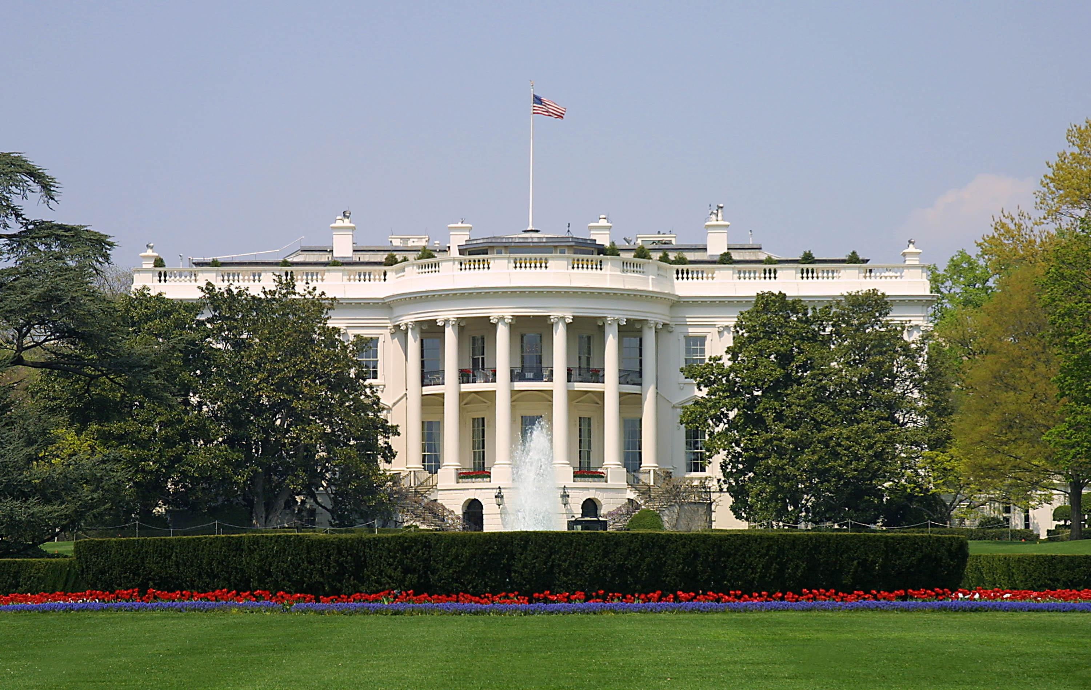
Presidential Quotes
Ron Bert
8
July 28, 2018

Slide 3
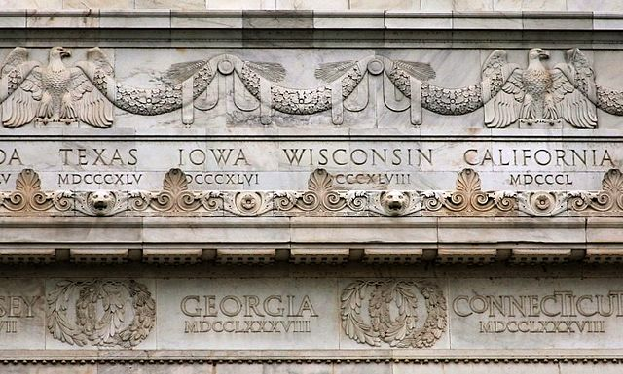
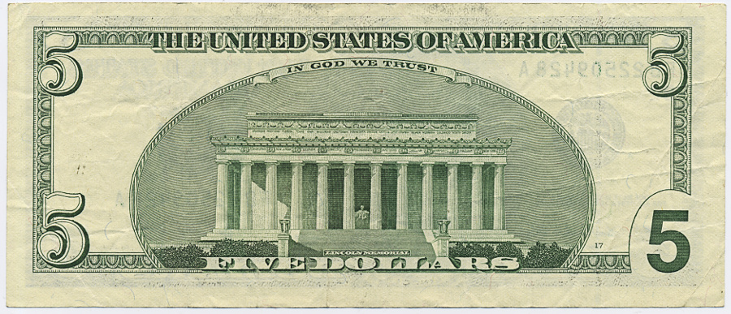
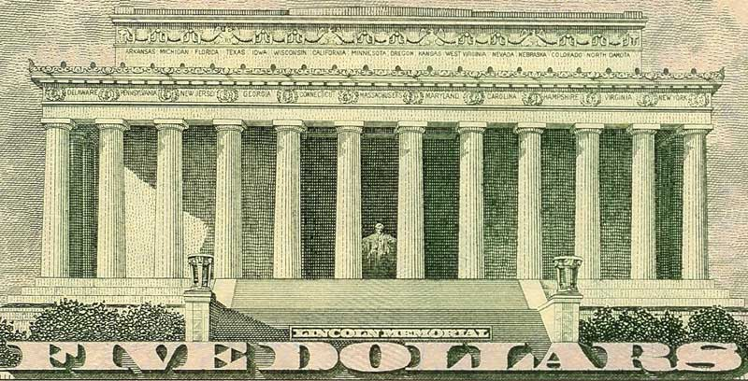
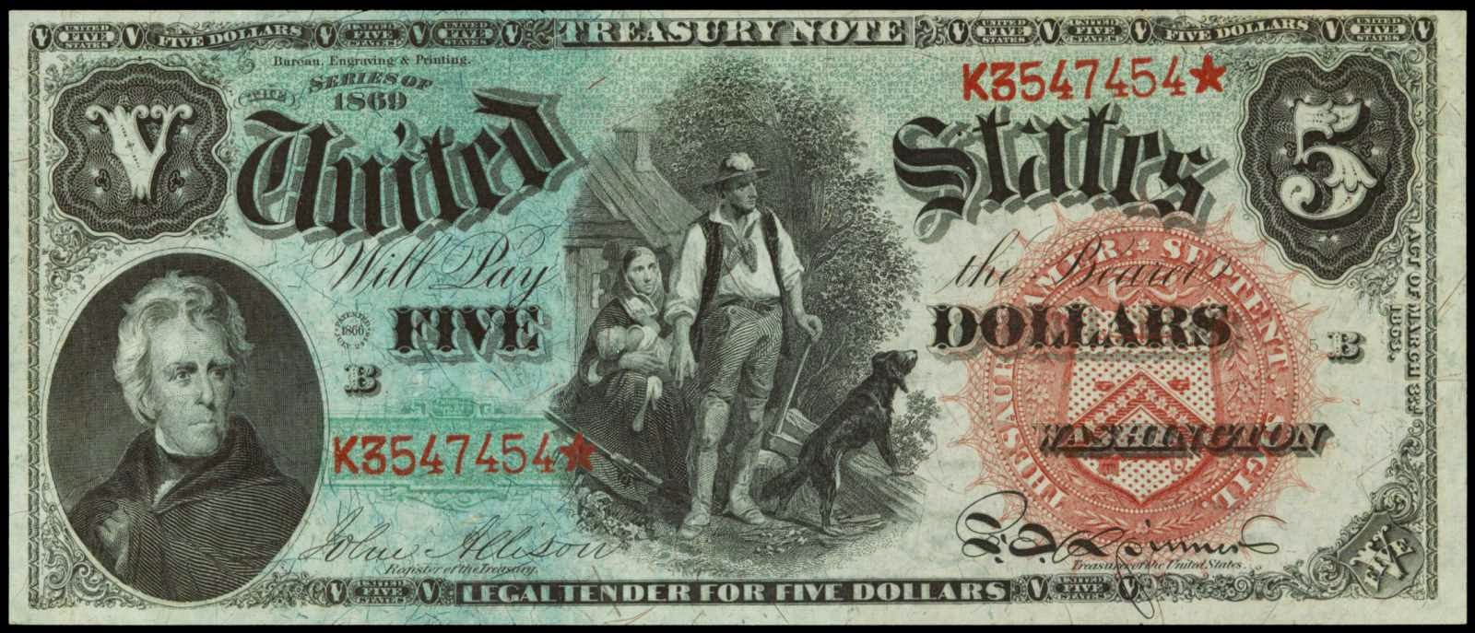
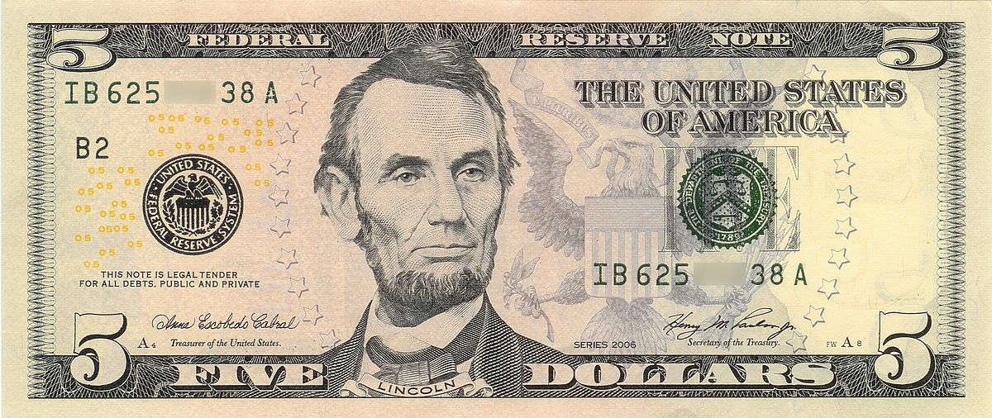
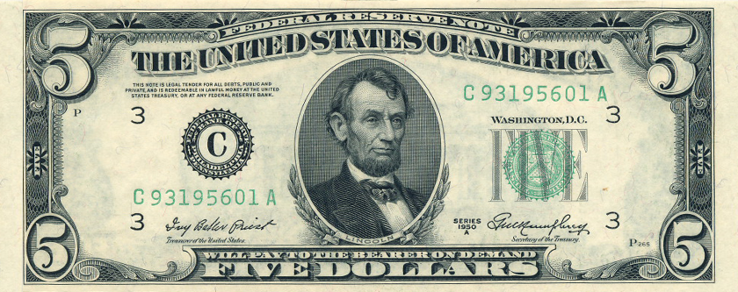
16. Abraham Lincoln (1861-1865)
Part 1

Slide 4
“The Bible is not my book and Christianity is not my religion. I could never give assent to the long complicated statements of Christian dogma.”
agreement

Slide 5
“I have never united myself to any church because I found difficulty in giving my assent without mental reservation to the long, complicated statements of Christian doctrine which characterize the articles of belief and the usual confession of faith.”

Slide 6
“That I am not a member of any Christian Church, is true; but I have never denied the truth of the Scriptures; and I have never spoken with intentional disrespect of religion in general, or of any denomination of Christians in particular.”

Slide 7
“When I do good, I feel good. When I do bad, I feel bad. That’s my religion.”

Slide 8
“When any church will inscribe over its altar, as its sole qualification for membership, the Savior's condensed statement of the substance of both law and Gospel, 'Thou shalt love the lord thy God with all thy heart, and with all thy soul and thy neighbor as thyself' that church will I join with all my heart and all my soul.”

Slide 9
“The highest art is always the most religious, and the greatest artist is always a devout person.”

Slide 10
“I can see how it might be possible for a man to look down upon the earth and be an atheist, but I cannot conceive how a man could look up into the heavens and say there is no God.”

Slide 11
“Is not God in the height of heaven? And see the highest stars, how lofty they are!” — Job 22:12

Slide 12
“Surely God would not have created such a being as man, with an ability to grasp the infinite, to exist only for a day! No, no, man was made for immortality.”

Slide 13
“I am for liberty of conscience in its noblest, broadest, and highest sense. But I cannot give liberty of conscience to the pope and his followers, the papists, so long as they tell me, through all their councils, theologians, and canon laws that their conscience orders them to burn my wife, strangle my children, and cut my throat when they find their opportunity.”
liberty of conscience

Slide 14
“If the American people could learn what I know of the fierce hatred of the priests of Rome against our institutions, our schools, our most sacred rights, and our so dearly bought liberties, they would drive them out as traitors!”

Slide 15
“I see a very dark cloud on America's horizon, and that cloud is coming from Rome.”

Slide 16
“I know there is a God, and that He hates injustice and slavery. I see the storm coming, and I know that His hand is in it. If He has a place and work for me - and I think He has - I believe I am ready.”

Slide 17
“We live in the midst of alarms; anxiety beclouds the future; we expect some new disaster with each newspaper we read.”

Slide 18
“It is a sin to be silent when it is your duty to protest.”
“He who sees cruelty and does nothing about it is himself cruel.”

Slide 19
Therefore, to him who knows to do good and does not do it, to him it is sin. — James 4:17

Slide 20
Do not be overcome by evil, but overcome evil with good. — Romans 12:21

Slide 21
“Let none falter who thinks he is right, and we may succeed. But if, after all, we shall fail, be it so: we still shall have the proud consolation of saying to our consciences, and to the departed shade of our country's freedom, that the cause approved of our judgment and adored of our hearts, in disaster, in chains, in torture, in death, we never faltered in defending.”
never falter

Slide 22
But sanctify the Lord God in your hearts, and always be ready to give a defense to everyone who asks you a reason for the hope that is in you, with meekness and fear; — 1st Peter 3:15

Slide 23
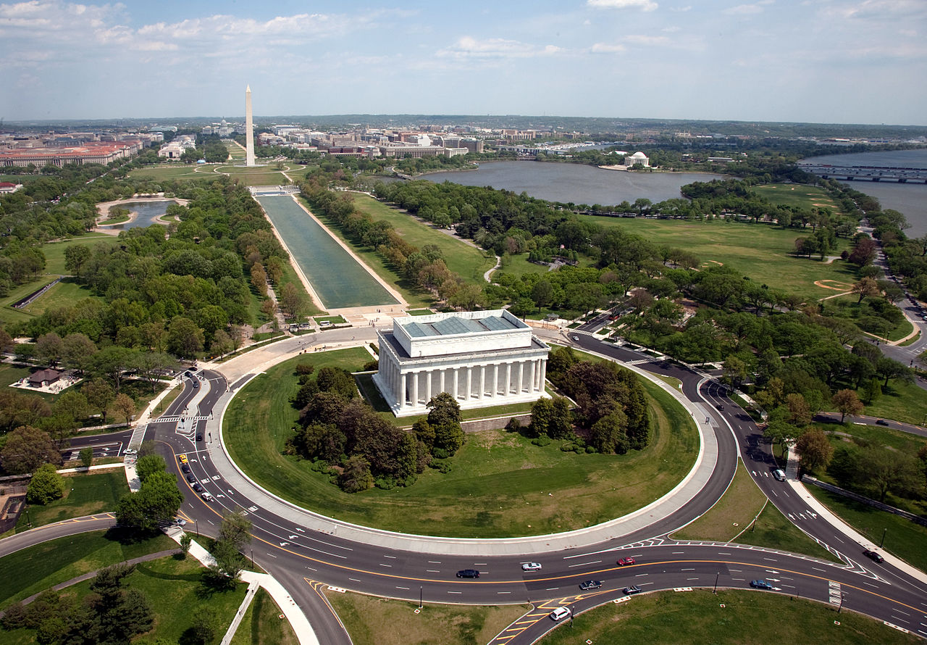

Slide 24
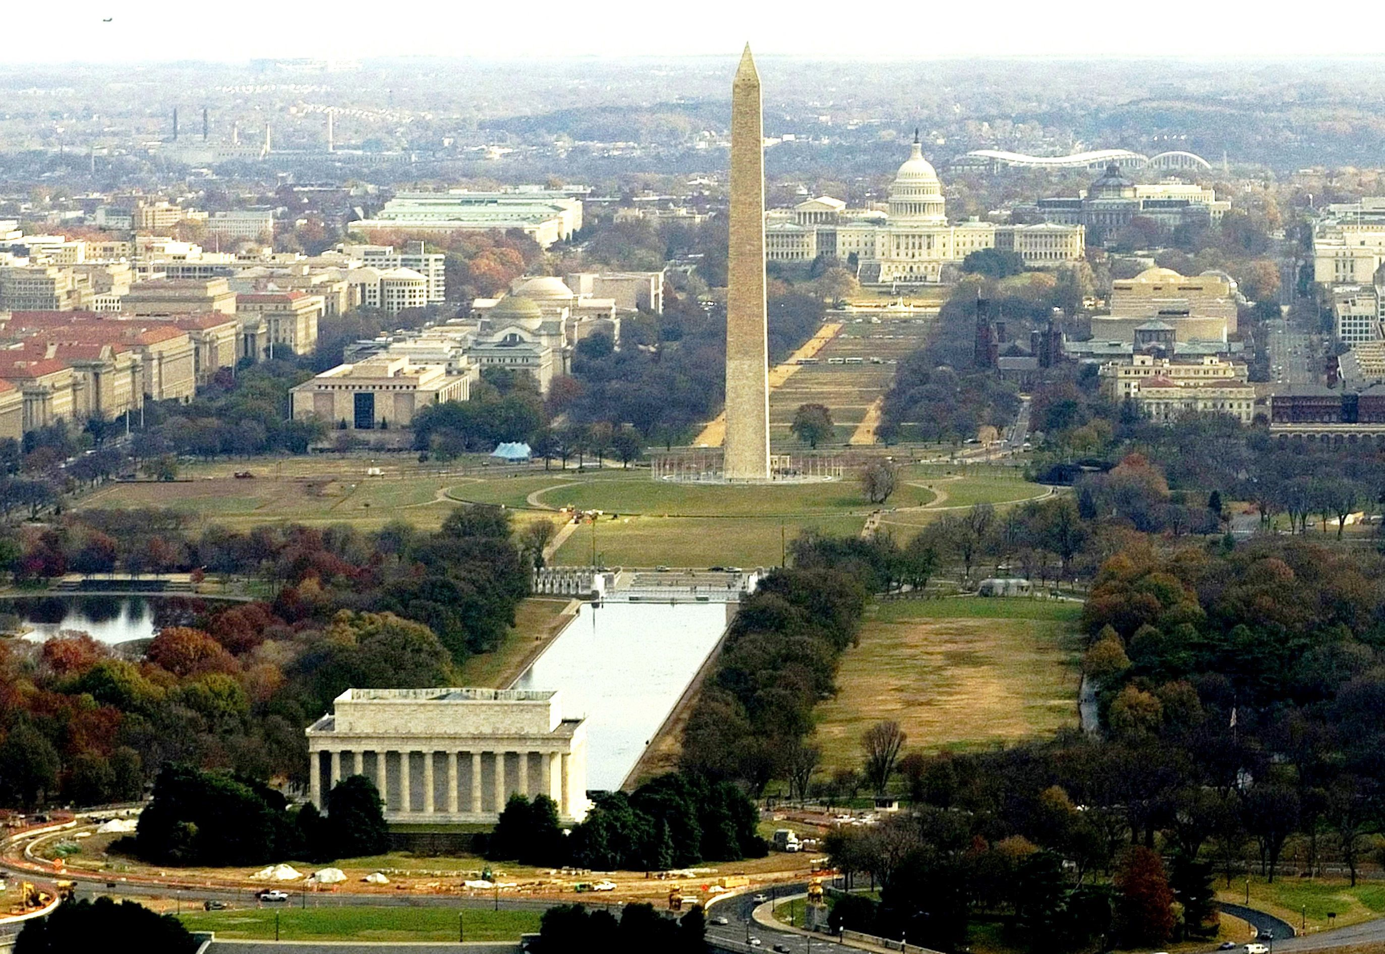

Slide 25
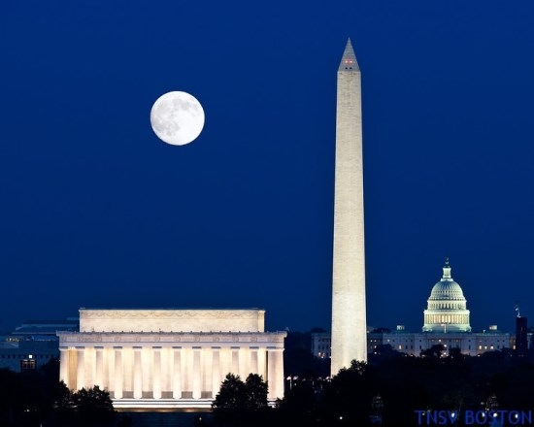

Slide 26
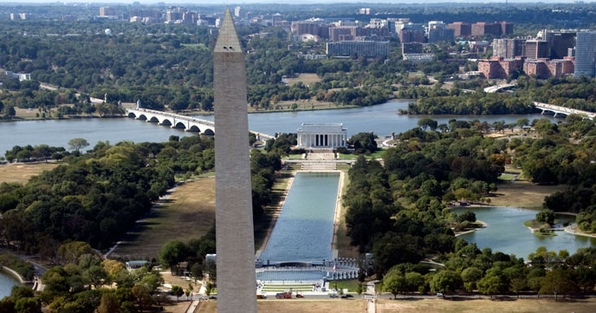

Slide 27
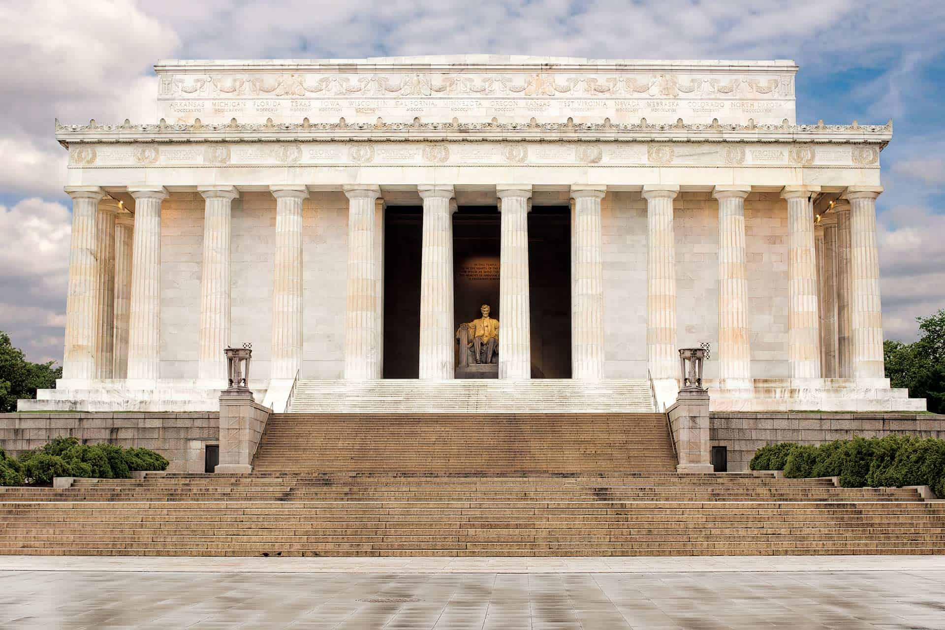

Slide 28
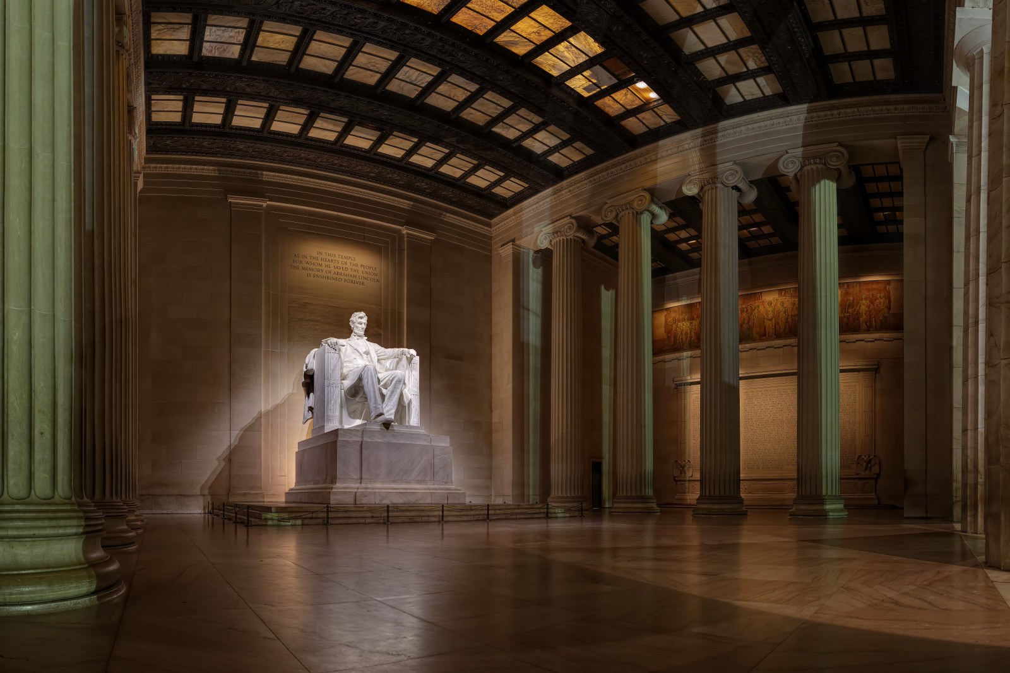

Slide 29
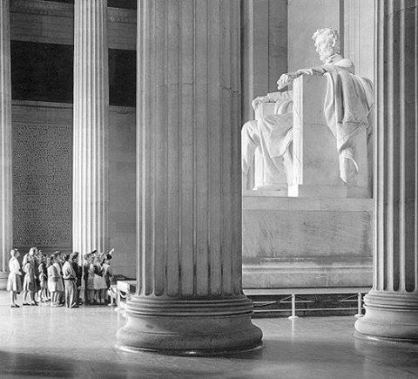

Slide 31
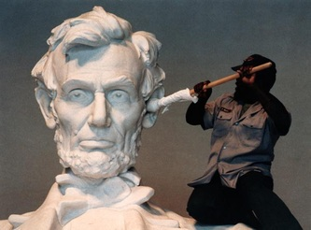
"But I say to you who hear: Love your enemies, do good to those who hate you, bless those who curse you, and pray for those who spitefully use you." — Luke 6:27-28

Slide 32
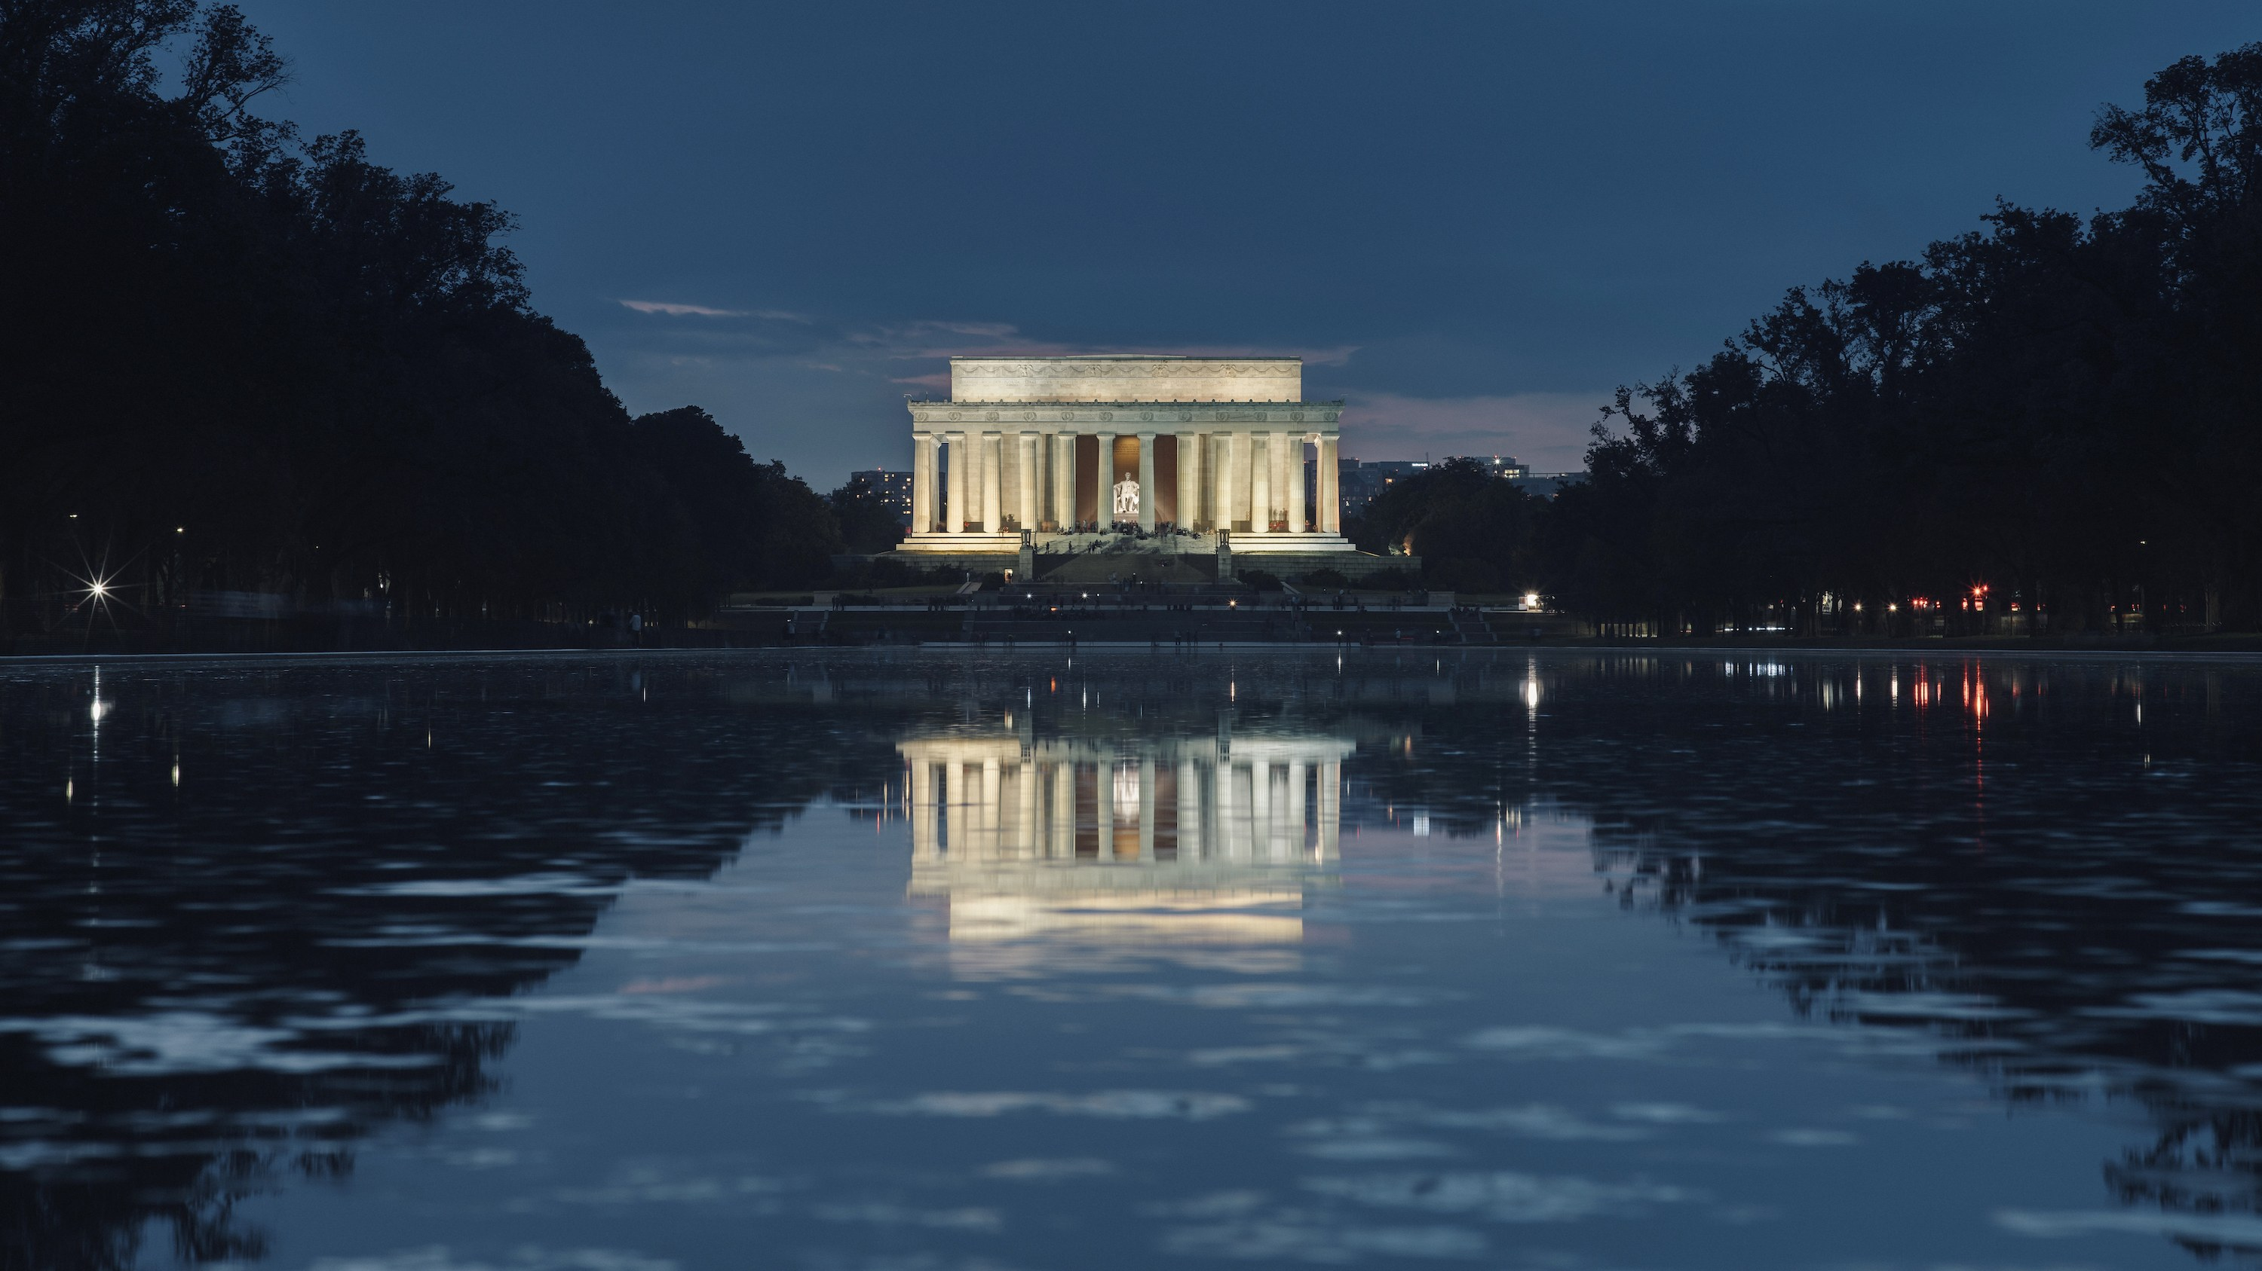
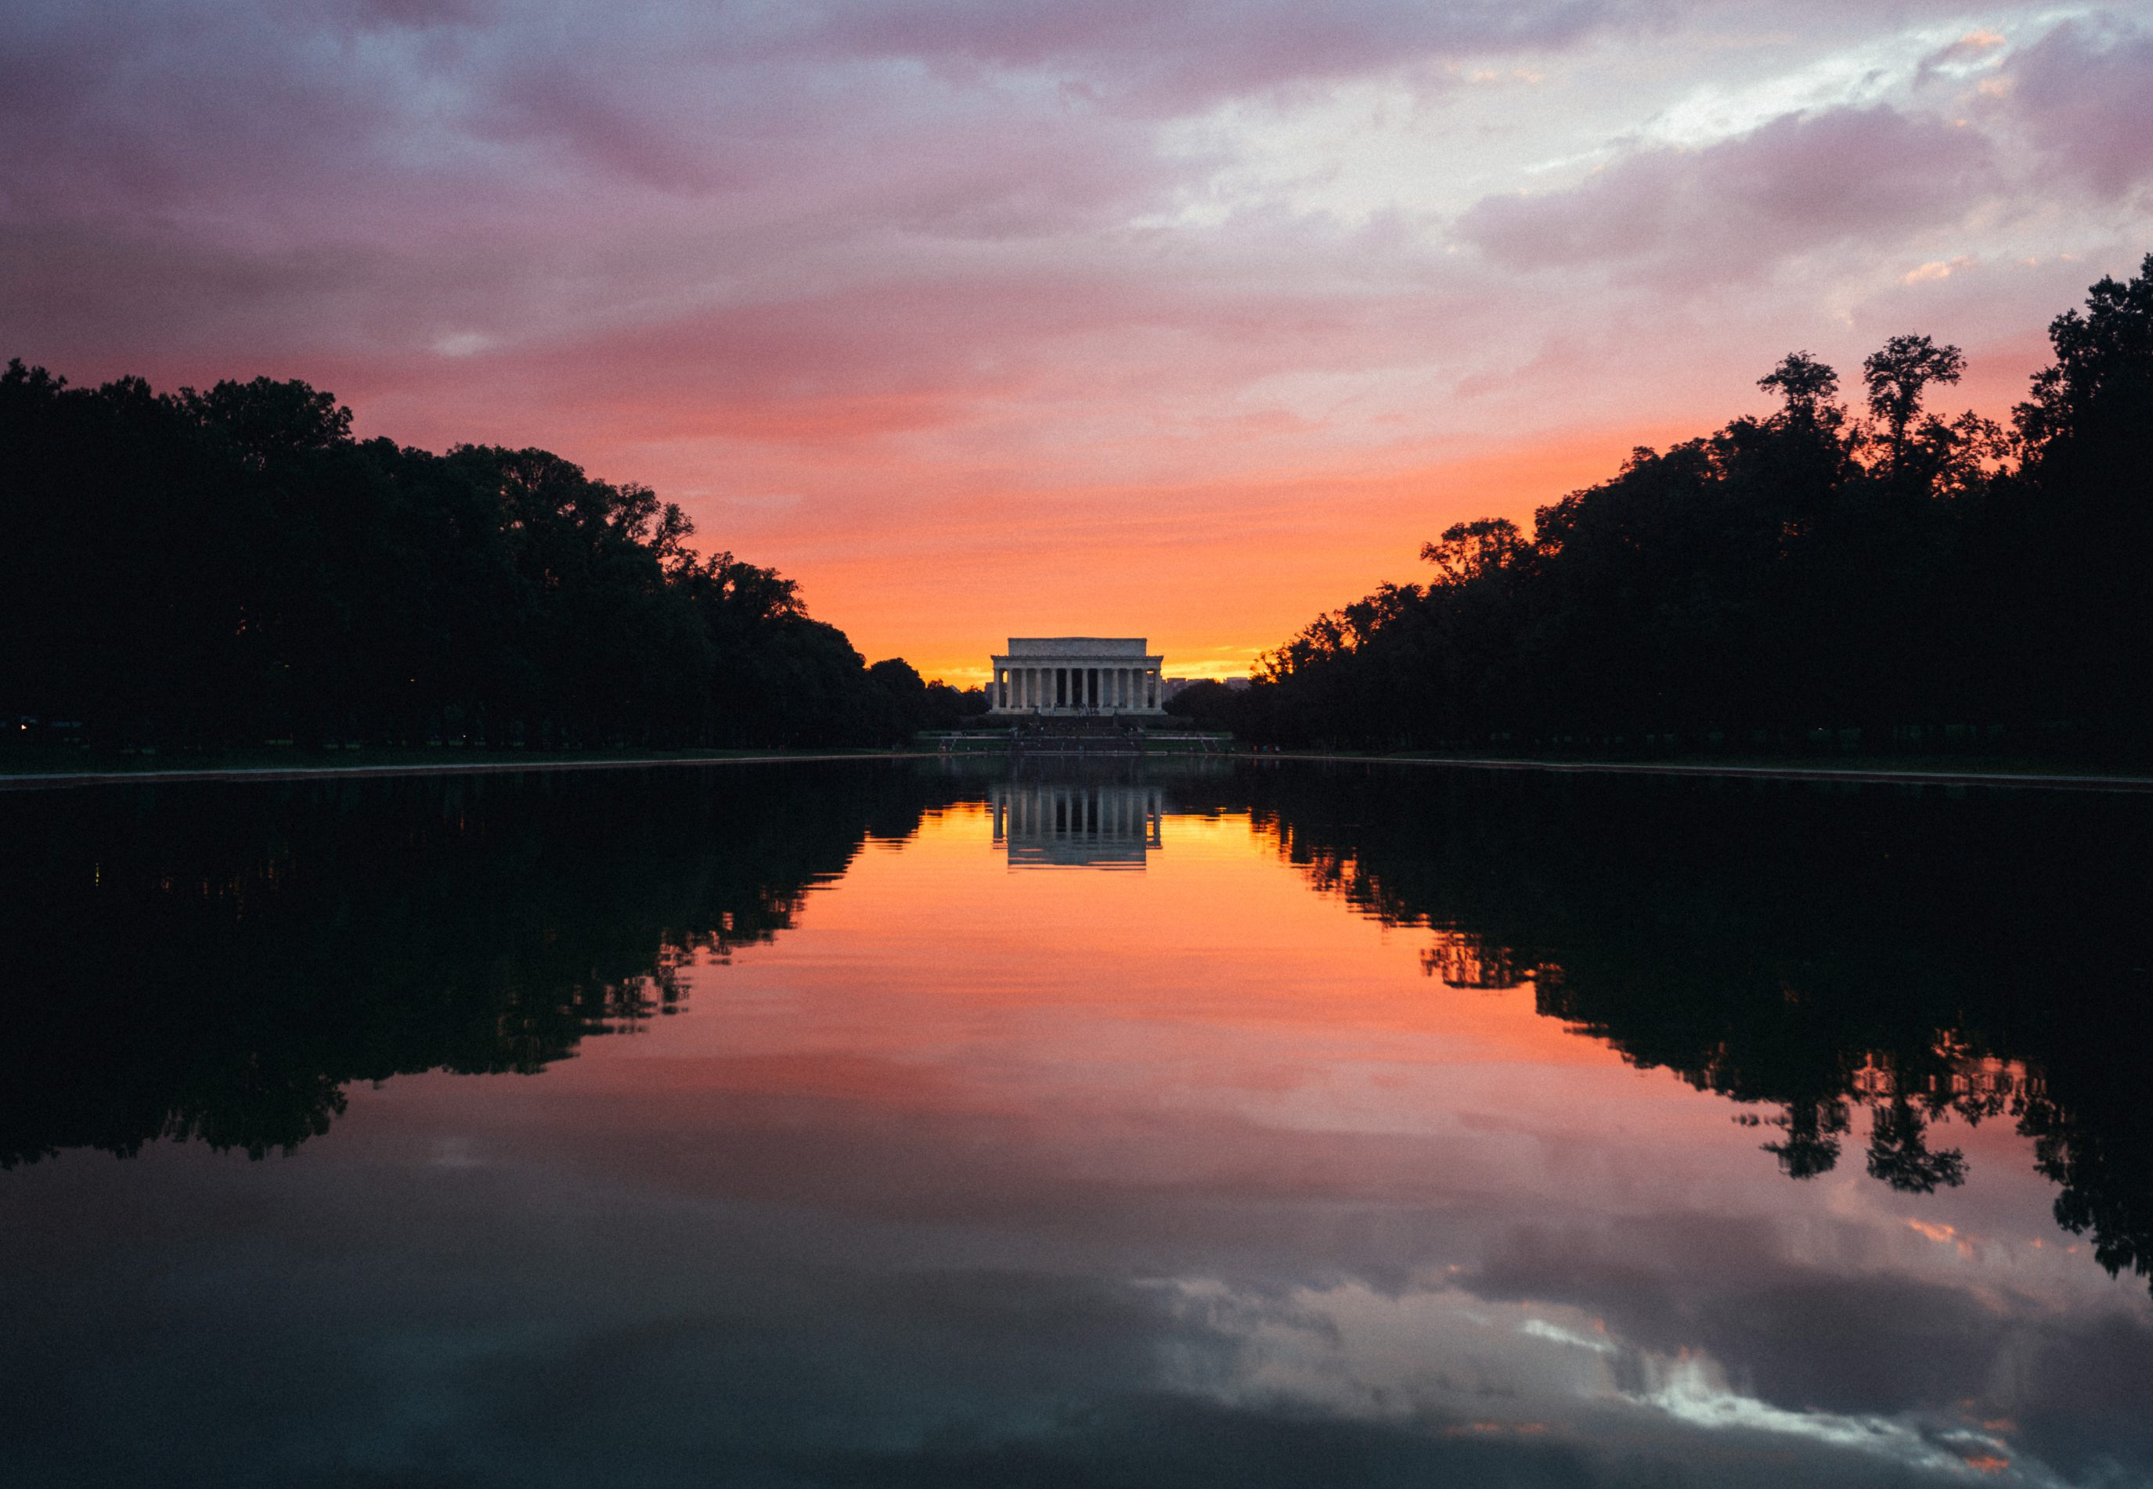

Slide 34
Presidential Quotes
Ron Bert
8½
August 12, 2018

Slide 35
“Near eighty years ago we began by declaring that all men are created equal; but now from that beginning we have run down to the other declaration, that for SOME men to enslave OTHERS is a "sacred right of self-government." These principles cannot stand together. They are as opposite as God and mammon; and whoever holds to the one, must despise the other.”
Equality
Elitism
cannot stand together
Part 2
16. Abraham Lincoln (1861-1865)

Slide 36
"No one can serve two masters; for either he will hate the one and love the other, or else he will be loyal to the one and despise the other. You cannot serve God and mammon." — Matthew 6:24

Slide 37
“As a nation, we began by declaring that 'all men are created equal.' We now practically read it 'all men are created equal, except negroes.' When the Know-Nothings get control, it will read 'all men are created equal, except negroes, and foreigners, and Catholics.' When it comes to this I should prefer emigrating to some country where they make no pretense of loving liberty – to Russia, for instance, where despotism can be taken pure, and without the base alloy of hypocrisy.”
men
t
?
ate
statesmen or despots
loving liberty or base of hypocrisy
or
or
s
s
loving liberty
despot
s
base
of hypocrisy

Slide 38
“In 1841 you and I had together a tedious low-water trip, on a Steam Boat from Louisville to St. Louis. You may remember, as I well do, that from Louisville to the mouth of the Ohio there were, on board, ten or a dozen slaves, shackled together with irons. That sight was a continual torment to me; and I see something like it every time I touch the Ohio, or any other slave-border.”

Slide 39
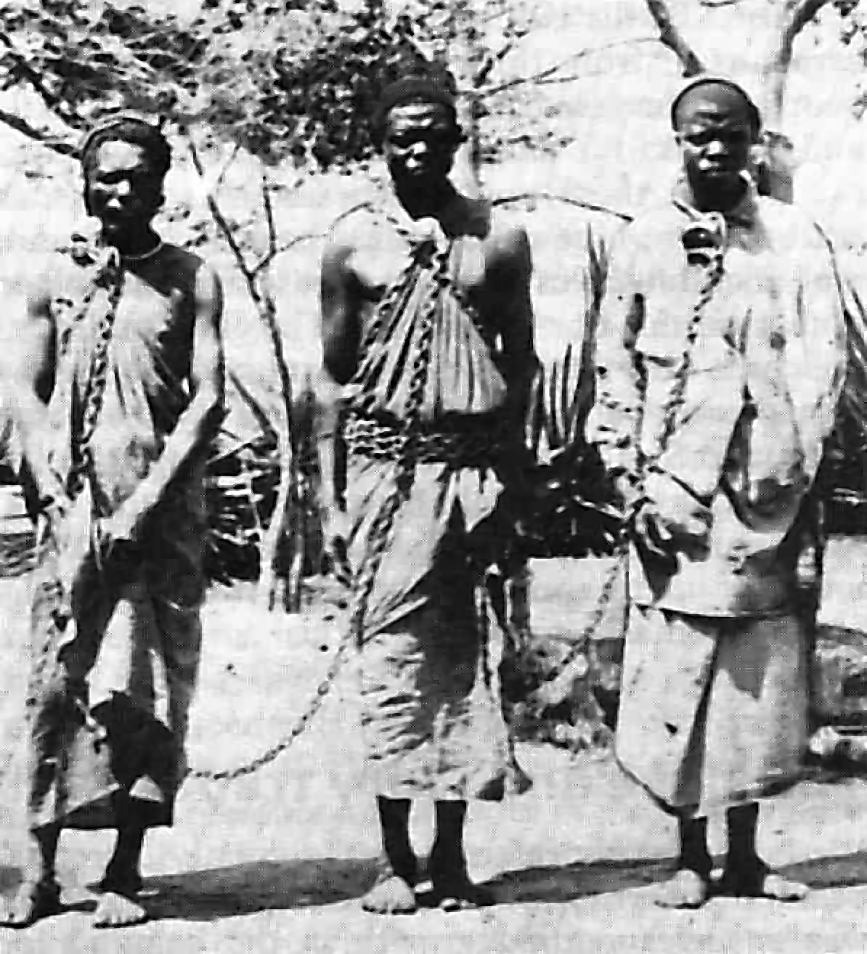
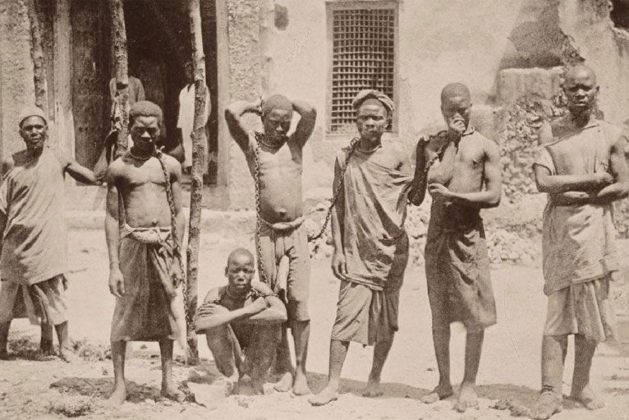
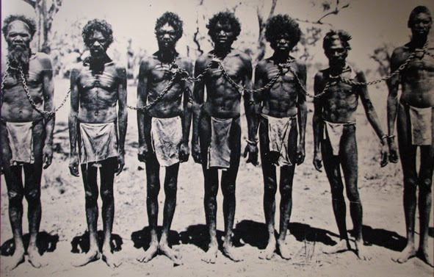
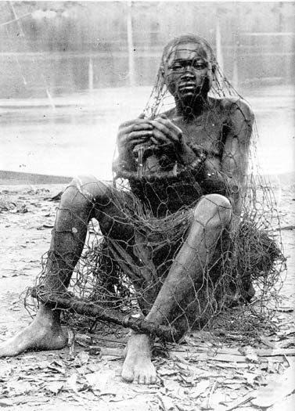
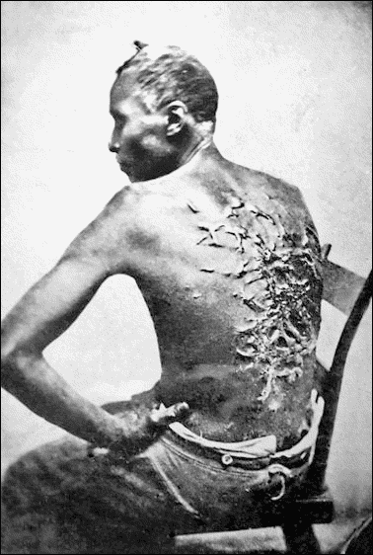
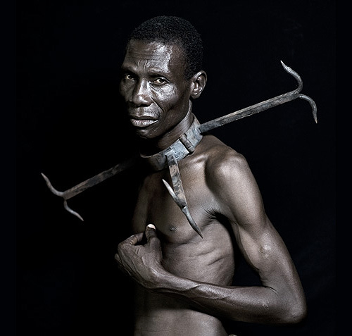
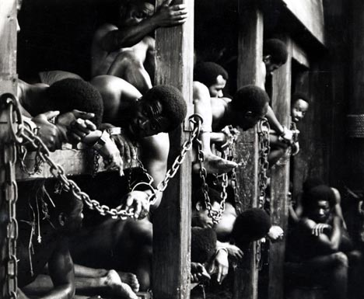
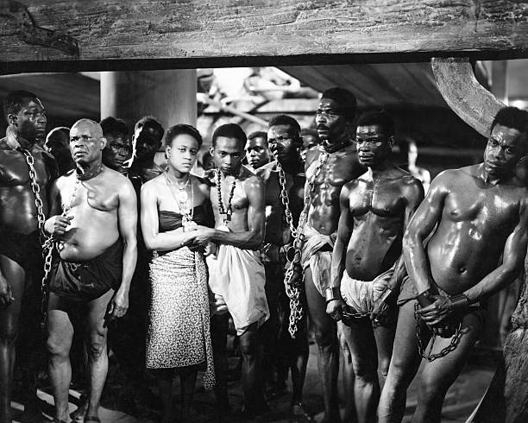
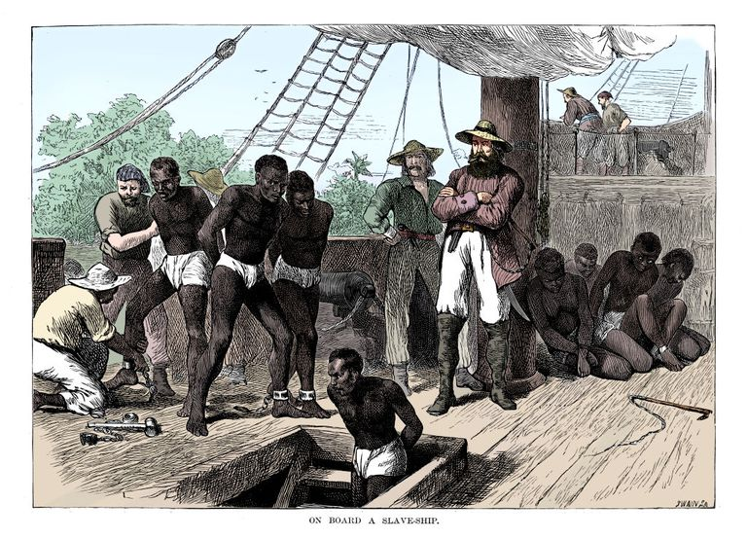
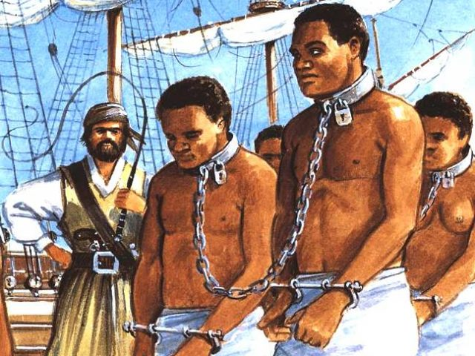

Slide 40
“The Bible says somewhere that we are desperately selfish. I think we would have discovered that fact without the Bible.”

Slide 41
“The heart is deceitful above all things, And desperately wicked; Who can know it?” — Jeremiah 17:9

Slide 42
“Our progress in degeneracy appears to me to be pretty rapid.”

Slide 43
“We have been the recipients of the choicest bounties of Heaven; we have been preserved these many years in peace and prosperity; we have grown in numbers, wealth, and power as no other nation has ever grown. But we have forgotten God. We have forgotten the gracious hand which preserved us in peace and multiplied and enriched and strengthened us, and we have vainly imagined, in the deceitfulness of our hearts, …”
“… that all these blessings were produced by some superior wisdom and virtue of our own. Intoxicated with unbroken success, we have become too self-sufficient to feel the necessity of redeeming and preserving grace, too proud to pray to the God that made us. It behooves us, then, to humble ourselves before the offended Power, to confess our national sins, and to pray for clemency and forgiveness.”
forgotten God
pray to
God
confess
sins
pray for
forgiveness

Slide 44
“I know that the Lord is always on the side of the right. But it is my constant anxiety and prayer that I and this nation should be on the Lord's side.”
“I know that the Lord is always on the side of the right. But it is my constant anxiety and prayer that I and this nation should be on the Lord's side.”
“Sir, my concern is not whether God is on our side; my greatest concern is to be on God’s side, for God is always right.”
“Sir, my concern is not whether God is on our side; my greatest concern is to be on God’s side, for God is always right.”
“I do not boast that God is on my side, I humbly pray that I am on God's side.”
“I do not boast that God is on my side, I humbly pray that I am on God's side.”
“Don't pray that God's on our side, pray that we're on his side.”
“Don't pray that God's on our side, pray that we're on his side.”

Slide 45
"For he who is not against us is on our side. — Mark 9:40
"For he who is not against us is on side. — Mark 9:40
God’s
God’s
God’s
God’s
God’s
God’s
God’s
God’s
God’s

Slide 46
“Faith is not believing that God can, but that God will.”

Slide 47
Your kingdom come. Your will be done On earth as it is in heaven. — Matthew 6:10

Slide 48
“Freedom is not the right to do what we want, but what we ought.”
Freedom
Freedom
responsibility
what we ought
Citizenship
Duty

Slide 49
Therefore, to him who knows to do good and does not do it, to him it is sin. — James 4:17
Freedom

Slide 50
“Freedom is the natural condition of the human race, in which the Almighty intended men to live. Those who fight the purpose of the Almighty will not succeed. They always have been, they always will be beaten.”
Freedom

Slide 51
Stand fast therefore in the liberty by which Christ has made us free, and do not be entangled again with a yoke of bondage. — Galatians 5:1
What then shall we say to these things? If God is for us, who can be against us? — Romans 8:31

Slide 52
“The only assurance of our nation's safety is to lay our foundation in morality and religion.”
only assurance
nation's foundation in
safety morality & religion
=
nation's
safety
foundation in
morality
religion

Slide 53
Let us diligently apply the means, never doubting that a just God, in his own good time, will give us the rightful result.”

Slide 54
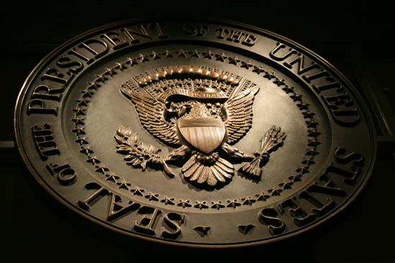
→ The truest religion holds love of God; neighbor/self
→ Heaven shows the sure sight of God
→ Man was created for immortality
→ Roman Catholic church subverted the USA’s unity
→ It is a sin not to dutifully pursue goodness
→ Hypocrisy has no honor of another’s freedom
→ Mankind is desperately selfish advancing degeneracy
→ Forgetting God leads to the demise of a people
→ God is always right
→ Faith is knowing God will
→ Freedom/innate to our creation by God’s own image
→ Who deny others freedom goes against God’s will
→ Only morality & religion insures national safety
People remain free where God is Glorified
Notes:
People remain free where God is Glorified

Slide 56
Please visit http://www.LoveFromGod.com to explore further
Ronald Bert Channel on
Notes:
Eternity never ends.

