Slide 2
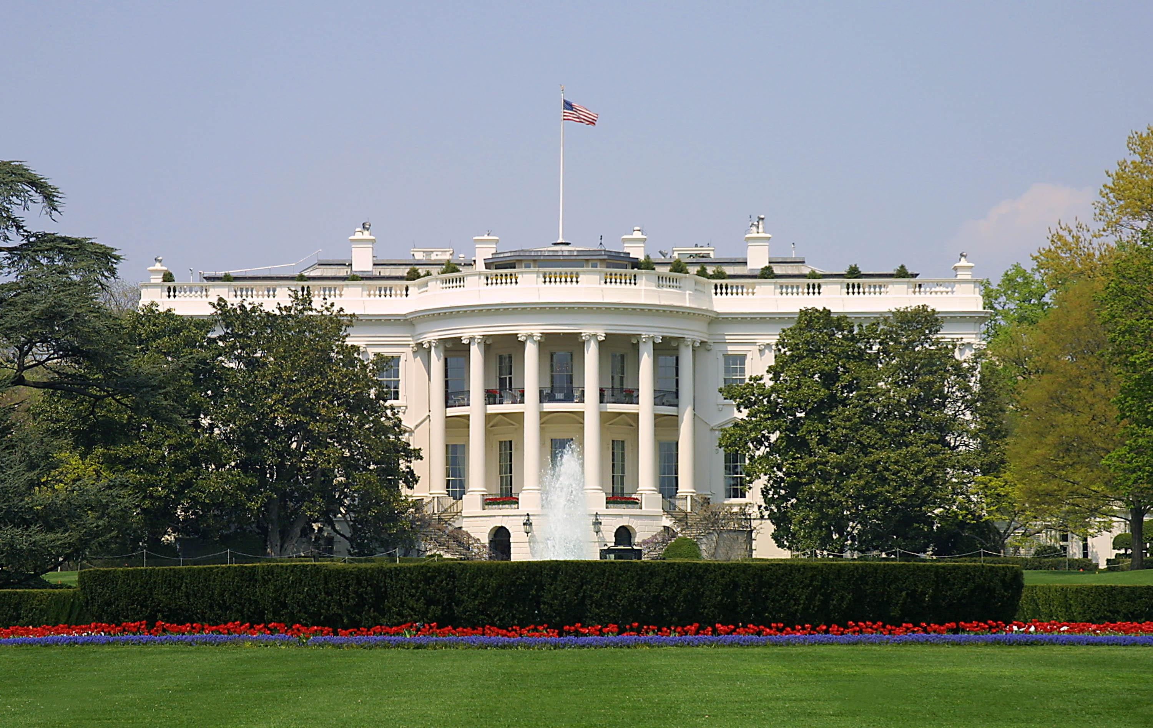
Presidential Quotes
Ron Bert
6
April 29, 2017

Slide 3
9. William Henry Harrison (1841)

Slide 4
"We admit of no government by divine right, believing that so far as power is concerned the Beneficent Creator has made no distinction amongst men; that all are upon an equality, and that the only legitimate right to govern is an express grant of power from the governed."

Slide 5
"I deem the present occasion sufficiently important and solemn to justify me in expressing to my fellow-citizens a profound reverence for the Christian religion and a thorough conviction that sound morals, religious liberty, and a just sense of religious responsibility are essentially connected with all true and lasting happiness; ….”
true and lasting happiness:
● sound morals
● religious liberty
● sense of religious responsibility
sound morals
religious
liberty
sense of religious
responsibility
true and lasting
happiness;

Slide 6
… and to that good Being who has blessed us by the gifts of civil and religious freedom, who watched over and prospered the labors of our fathers and has hitherto preserved to us institutions far exceeding in excellence those of any other people, let us unite in fervently commending every interest of our beloved country in all future time."
unite in fervently commending

Slide 7
Therefore I exhort first of all that supplications, prayers, intercessions, and giving of thanks be made for all men, for kings and all who are in authority, that we may lead a quiet and peaceable life in all godliness and reverence. For this is good and acceptable in the sight of God our Savior, who desires all men to be saved and to come to the knowledge of the truth. — 1st Timothy 2:1-4

Slide 8
“I believe and I say it is true Democratic feeling, that all the measures of the Government are directed to the purpose of making the rich richer and the poor poorer.”

Slide 9
“There is nothing more corrupting, nothing more destructive of the noblest and finest feelings of our nature, than the exercise of unlimited power.”

Slide 10
“Conscience, that vicegerent of God in the human heart, whose "still small voice" the loudest revelry cannot drown.”
earthly representative

Slide 11
Your ears shall hear a word behind you, saying, "This is the way, walk in it," Whenever you turn to the right hand or whenever you turn to the left. — Isaiah 30:21

Slide 12
“The strongest of all governments is that which is most free.”

Slide 13
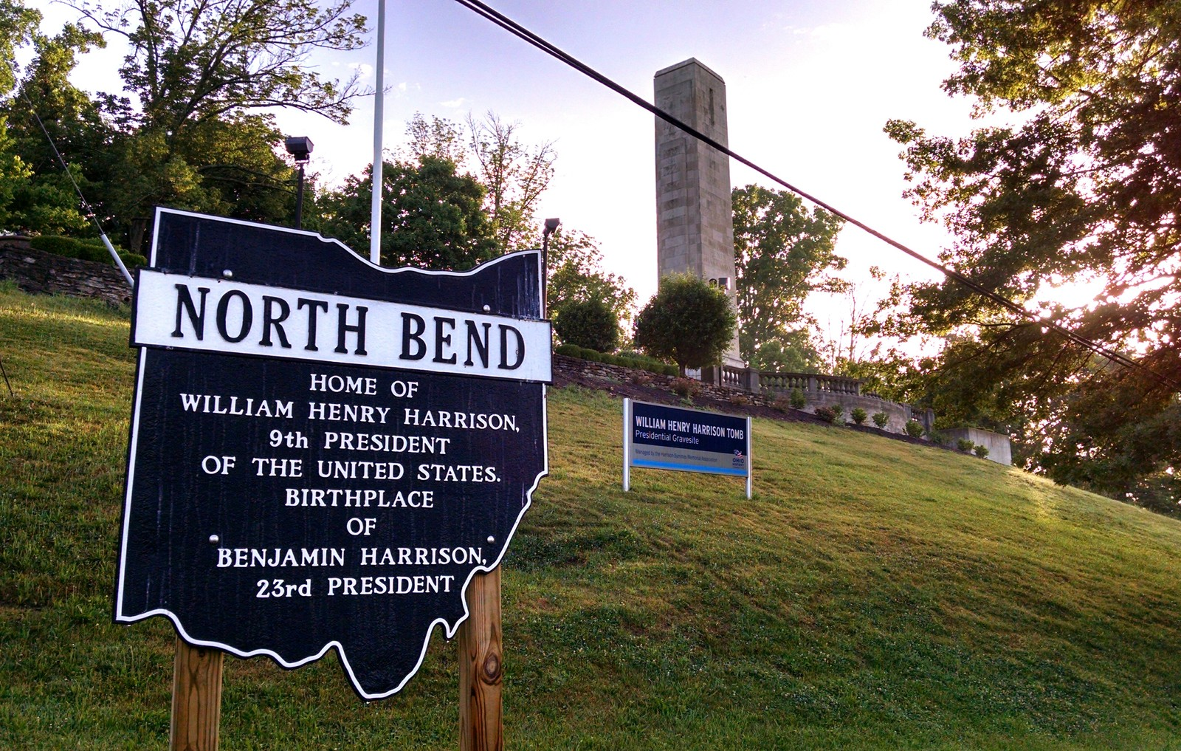
Notes:
Mt. Nebo in North Bend, Ohio, with its wide view of the Ohio River and of the corners of three states—Ohio, Indiana and Kentucky.

Slide 14
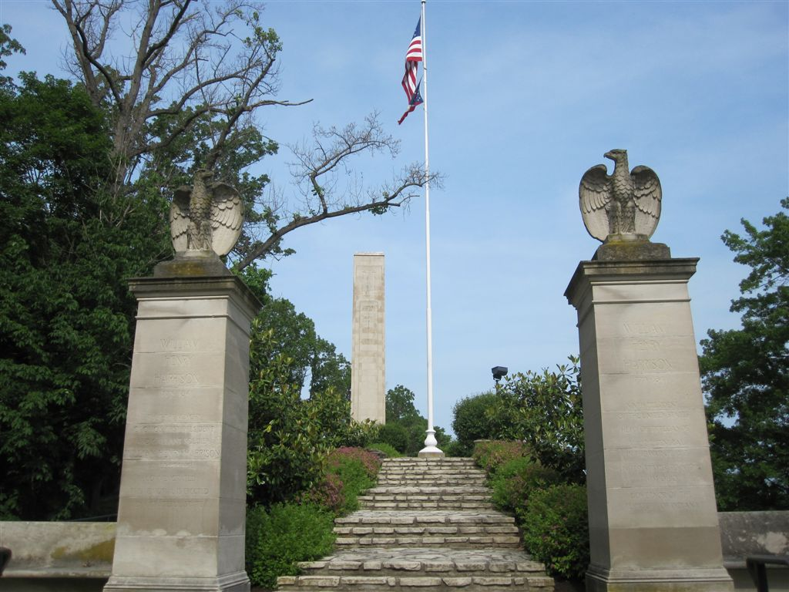

Slide 15
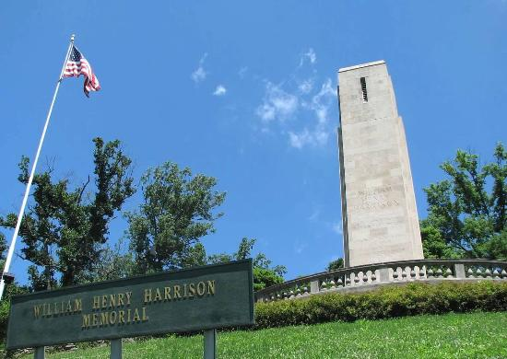

Slide 16
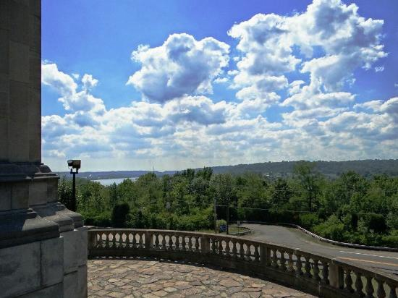

Slide 17
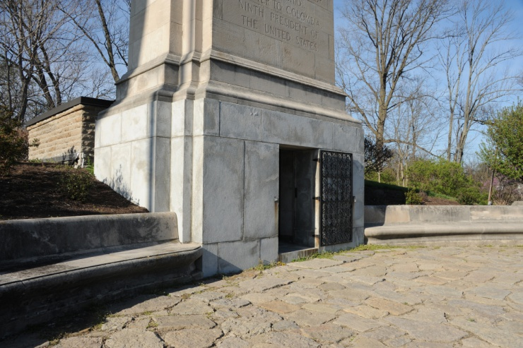
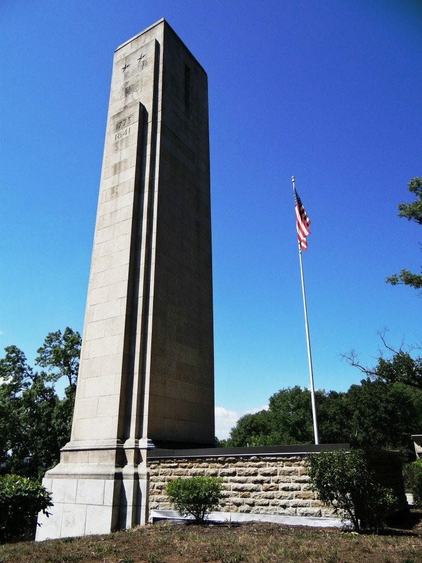

Slide 18
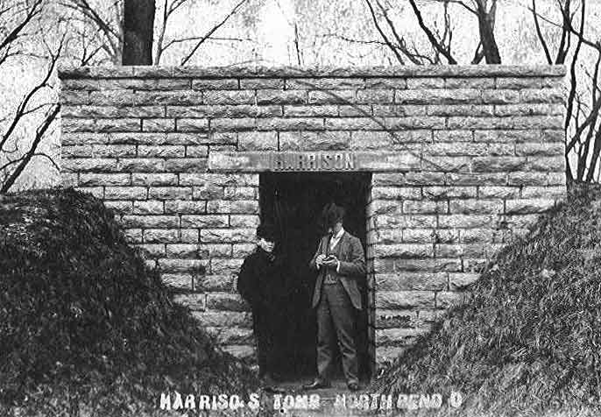

Slide 19
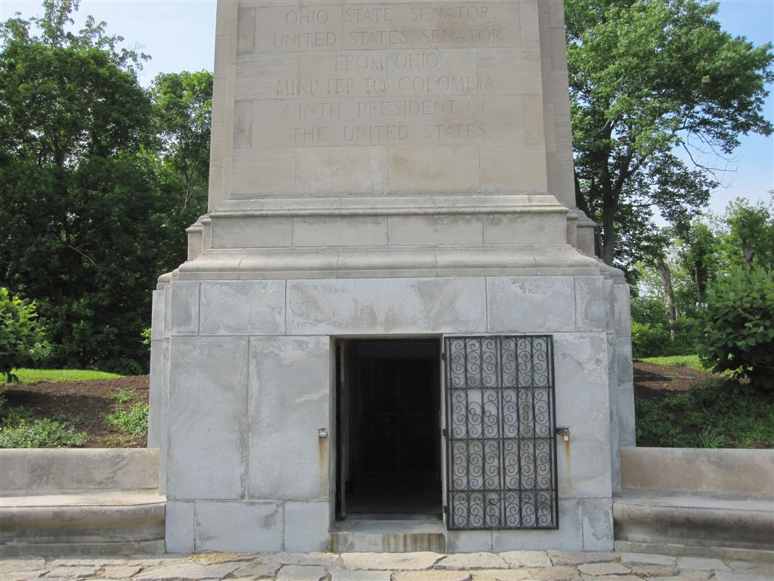
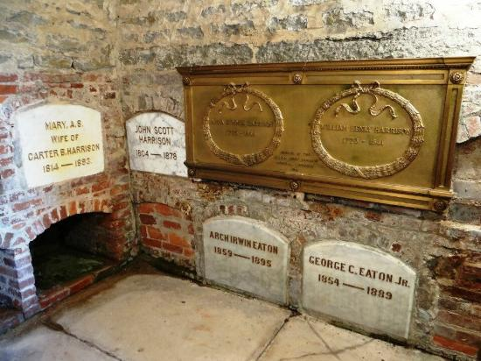
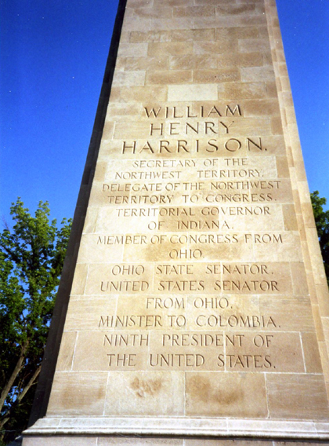

Slide 20
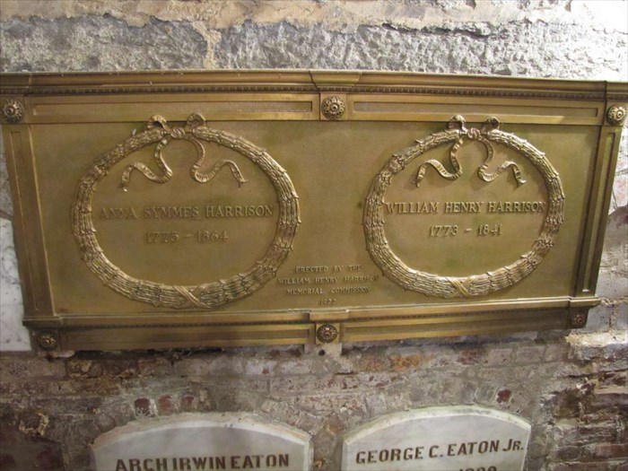

Slide 21
10. John Tyler (1841-1845)
Notes:
Richmond, VA

Slide 22
“Let it be henceforth proclaimed to the world that man's conscience was created free; that he is no longer accountable to his fellow man for his religious opinions, being responsible therefore only to his God.”

Slide 23
“The United States have adventured upon a great and noble experiment, which is believed to have been hazarded in the absence of all previous precedent - that of total separation of Church and State. No religious establishment by law exists among us. The conscience is left free from all restraint and each is permitted to worship his Maker after his own judgement.”
proposed

Slide 24
“. . . The offices of the Government are open alike to all. No tithes are levied to support an established Hierarchy, nor is the fallible judgment of man set up as the sure and infallible creed of faith. . . . Such is the great experiment which we have tried, and . . . our system of free government would be imperfect without it.”

Slide 25
“Our form of government can no longer be considered an experiment in politics. Crowned with success, it stands forth an example to the world and exhibits the proudest triumph of reason and philosophy.”

Slide 26
“If we find ourselves increasing beyond example in numbers, in strength, in wealth, in knowledge, in everything which promotes human and social happiness, let us ever remember our dependence for all these on the protection and merciful dispensations of Divine Providence.”

Slide 27
And we know that all things work together for good to those who love God, to those who are the called according to His purpose. — Romans 8:28

Slide 28
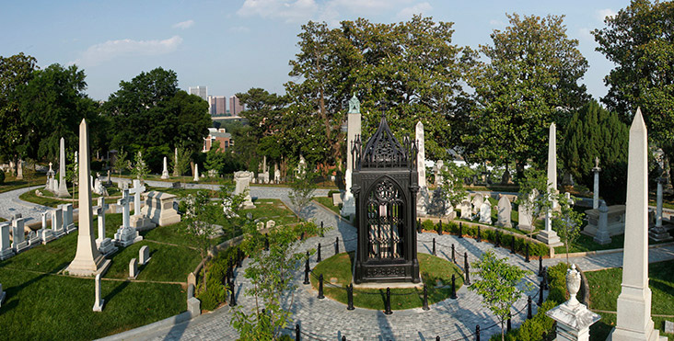
Notes:
Richmond, VA – Hollywood Cemetery

Slide 29
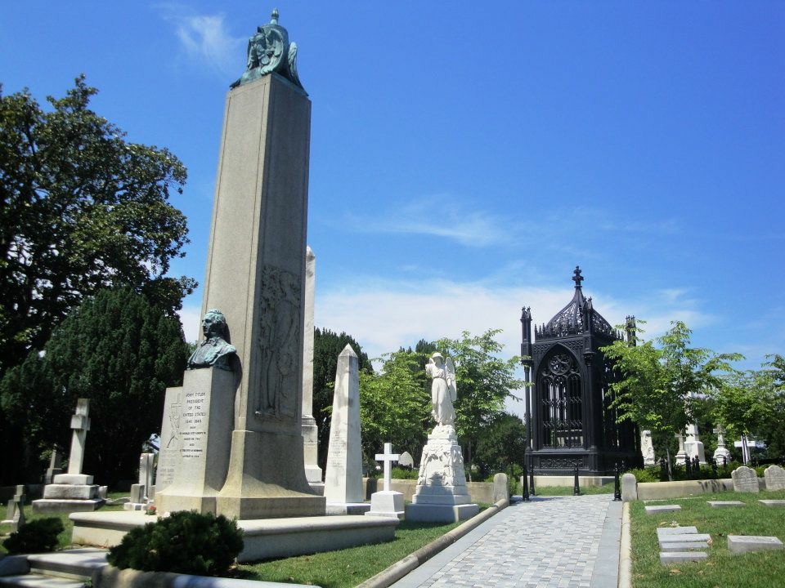
X

Slide 30
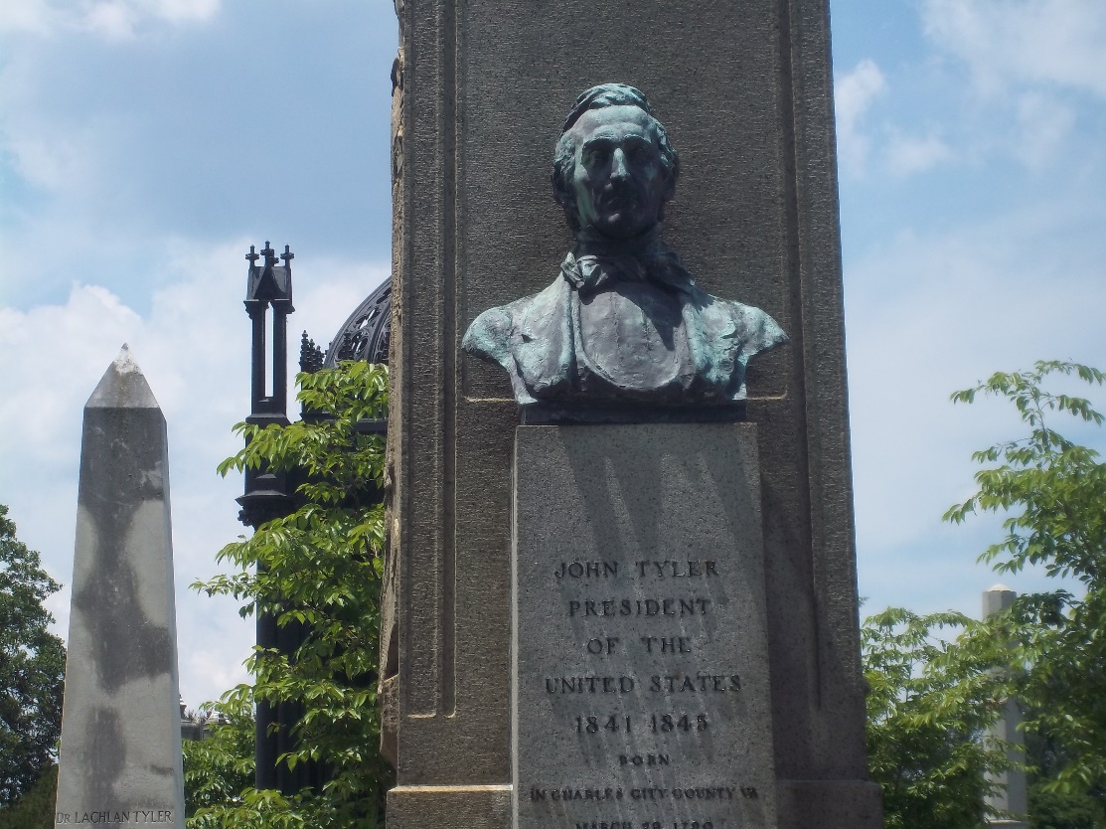

Slide 31
11. James K. Polk (1845-1849)
Notes:
Tennessee State Capitol, Nashville, TN

Slide 32
“Under the blessings of Divine Providence ... It becomes us in humility to make our devout acknowledgments to the Supreme Ruler of the Universe for the inestimable civil and religious blessings with which we are favored.”

Slide 33
“Under the benignant providence of Almighty God the representatives of the States and of the people are again brought together to deliberate for the public good. The gratitude of the nation to the sovereign arbiter of all human events should be commensurate with the boundless blessings which we enjoy. Peace, plenty, and contentment reign throughout our borders, and our beloved country presents a sublime moral spectacle to the world.”

Slide 34
“Thank God, under our Constitution there was no connection between Church and State, and that in my action as President of the United States I recognized no distinction of creeds in my appointments office.”

Slide 35
“There are four great measures for my administration - a reduction of tariff, an independent treasury, settlement of the Oregon boundary and acquisition of California.”

Slide 36
“There is more selfishness and less principle among members of Congress than I had any conception of, before I became President of the U.S.”

Slide 37
“The passion for office among members of Congress is very great, if not absolutely disreputable, and greatly embarrasses the operations of the Government. They create offices by their own votes and then seek to fill them themselves.”

Slide 38
"Woe to you lawyers! For you have taken away the key of knowledge. You did not enter in yourselves, and those who were entering in you hindered." — Luke 11:52

Slide 39
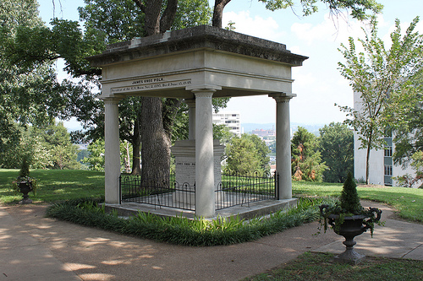
Notes:
Tennessee State Capitol, Nashville, TN

Slide 40
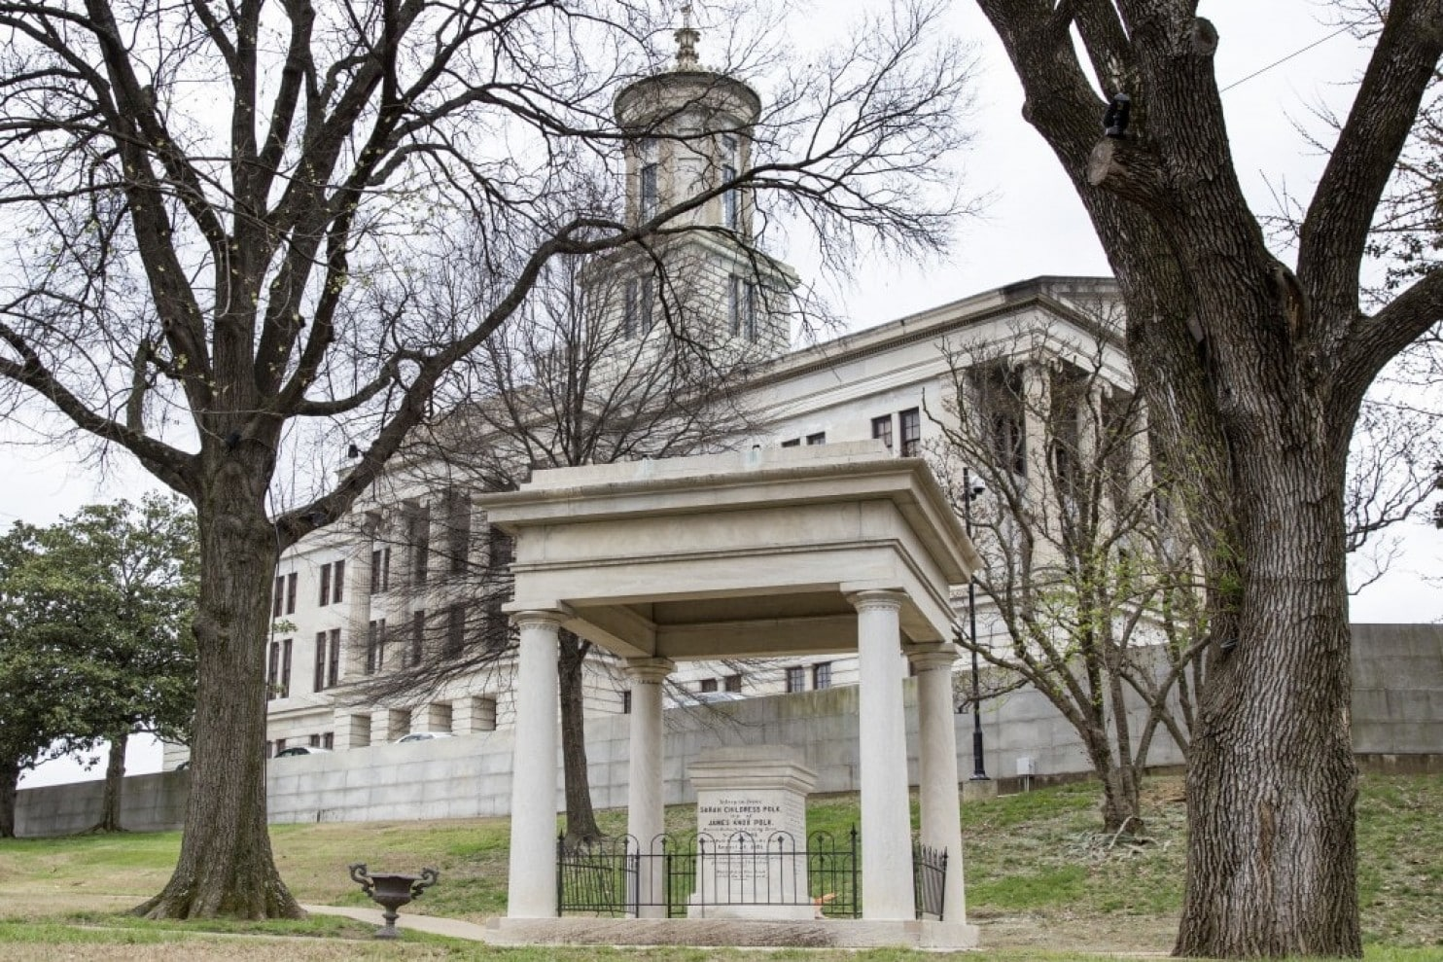

Slide 41
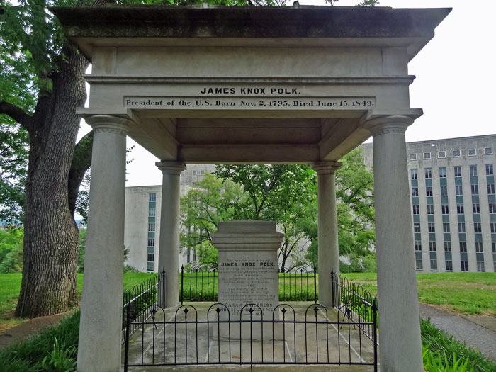

Slide 42
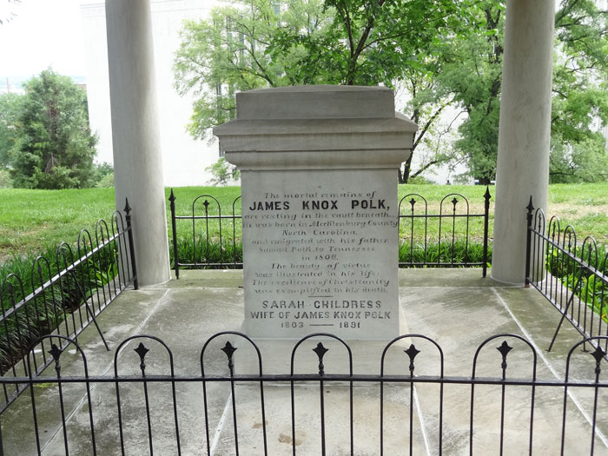

Slide 43
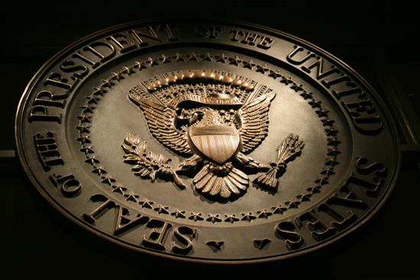
→ No earthly government is of a divine right
→ Happiness = by sound morals/religious liberty & duty
→ Let us eagerly praise our unity under God’s blessings
→ Governments/man selectively enhance the rich few
→ Unlimited power often corrupts one’s noblest nature
→ Conscience, God regarded, differentiates good & bad
→ Freedoms highest responsibility is to God
→ No United States laws establish religious preference
→ The USA is founded on reason and philosophy
→ Never forget merciful blessings of Divine Providence
→ Keep devout acknowledgement of God’s blessings
→ Working together as one people exposes godliness
→ Thirst for power & selfish vices invade the noble
Governments without regard for God exalt criminality
Notes:
Governments without regard for God exalt criminality

Slide 45
Please visit http://www.LoveFromGod.com to explore further
Ronald Bert Channel on
Notes:
Eternity never ends.

