Slide 2
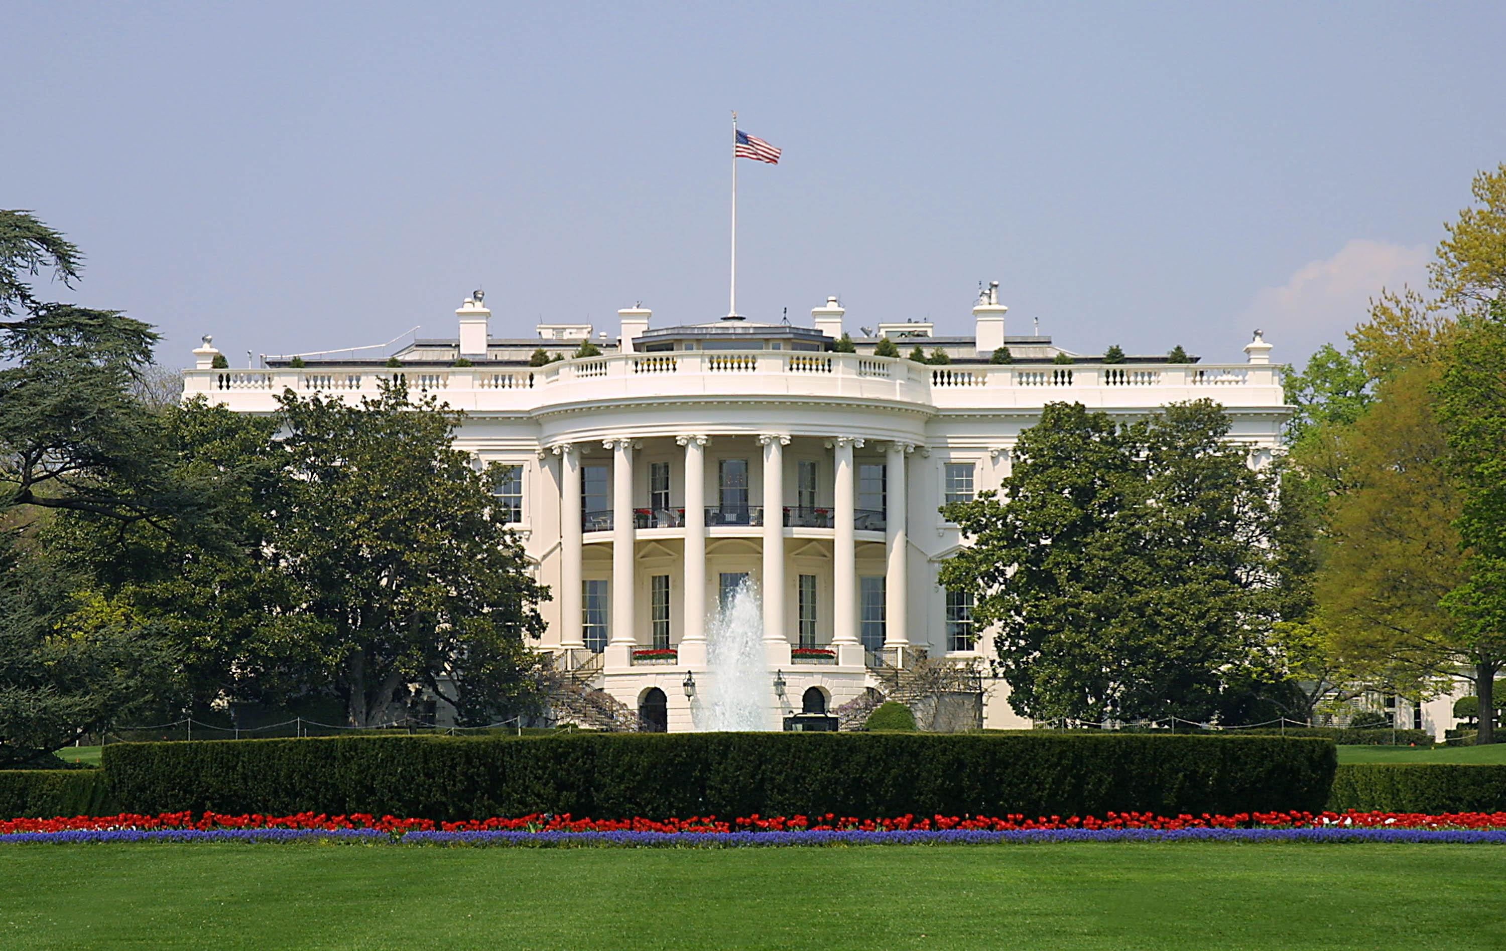
Presidential Quotes
Ron Bert
5
April 15, 2018

Slide 3
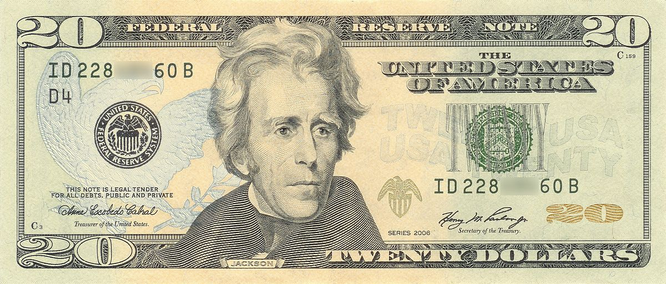
7. Andrew Jackson (1829-1837)

Slide 4
“That book [Bible], sir, is the Rock on which our Republic rests.”

Slide 5
“As long as our government is administered for the good of the people, and is regulated by their will; as long as it secures to us the rights of person and property, liberty of conscience, and of the press, it will be worth defending.”
worth defending
● rights of person and property
● liberty of conscience
└ and of press
rights of person and property
liberty of conscience
and of
press
worth defending

Slide 6
“From the earliest ages of history to the present day there have never been thirteen millions of people associated in one political body who enjoyed so much freedom and happiness as the people of these United States. You have no longer any cause to fear dangers from abroad ... It is from within, among yourselves - from cupidity, from corruption, from disappointed ambition and inordinate thirst for power - that factions will be formed and liberty endangered ...”
y
endangered liberty is from within:
● cupidity (greedy meanness)
● corruption
● disappointed ambition
● inordinate thirst for power
reed
an
ness
g
from within
is from within
greedy meanness
cupidity
cupidity
corruption
disappointed ambition
corruption
disappointed ambition
thirst for power
inordinate thirst for power
me
liberty
endangered

Slide 7
And He said, "What comes out of a man, that defiles a man. For from within, out of the heart of men, proceed evil thoughts, adulteries, fornications, murders, thefts, covetousness, wickedness, deceit, lewdness, an evil eye, blasphemy, pride, foolishness. All these evil things come from within and defile a man." — Mark 7:20-23

Slide 8
“Every man is equally entitled to protection by law. But when the laws undertake to add... artificial distinctions, to grant titles, gratuities, and exclusive privileges — to make the rich richer and the potent more powerful — the humble members of society — the farmers, mechanics, and laborers, who have neither the time nor the means of securing like favors to themselves, have a right to complain of the injustice of their government.”

Slide 9
“But you must remember, my fellow-citizens, that eternal vigilance by the people is the price of liberty, and that you must pay the price if you wish to secure the blessing.”

Slide 10
“I am one of those who do not believe that a national debt is a national blessing, but rather a curse to a republic; inasmuch as it is calculated to raise around the administration a moneyed aristocracy dangerous to the liberties of the country.”

Slide 11
“The bold effort the present (central) bank had made to control the government ... are but premonitions of the fate that await the American people should they be deluded into a perpetuation of this institution or the establishment of another like it.”
Federal Reserve

Slide 12
“You are a den of vipers. I intend to rout you out and by the Eternal God I will rout you out. If the people only understood the rank injustice of our money and banking system, there would be a revolution before morning.”

Slide 13
“I weep for the liberty of my country when I see at this early day of its successful experiment that corruption has been imputed to many members of the House of Representatives, and the rights of the people have been bartered for promises of office.”

Slide 14
“It is to be regretted that the rich and powerful too often bend the acts of government to their own selfish purposes.”

Slide 15
“Finally, it is my most fervent prayer to that Almighty Being before whom I now stand, and who has kept us in His hands from the infancy of our Republic unto the present day, that He will so overrule all my intentions and actions and inspire the hearts of my fellow-citizens that we may be preserved from dangers of all kinds and continue forever a united and happy people.”

Slide 16
Confess your trespasses to one another, and pray for one another, that you may be healed. The effective, fervent prayer of a righteous man avails much. — James 5:16

Slide 17
“Go to the Scriptures... the joyful promises it contains will be a balsam to all your troubles.”

Slide 18
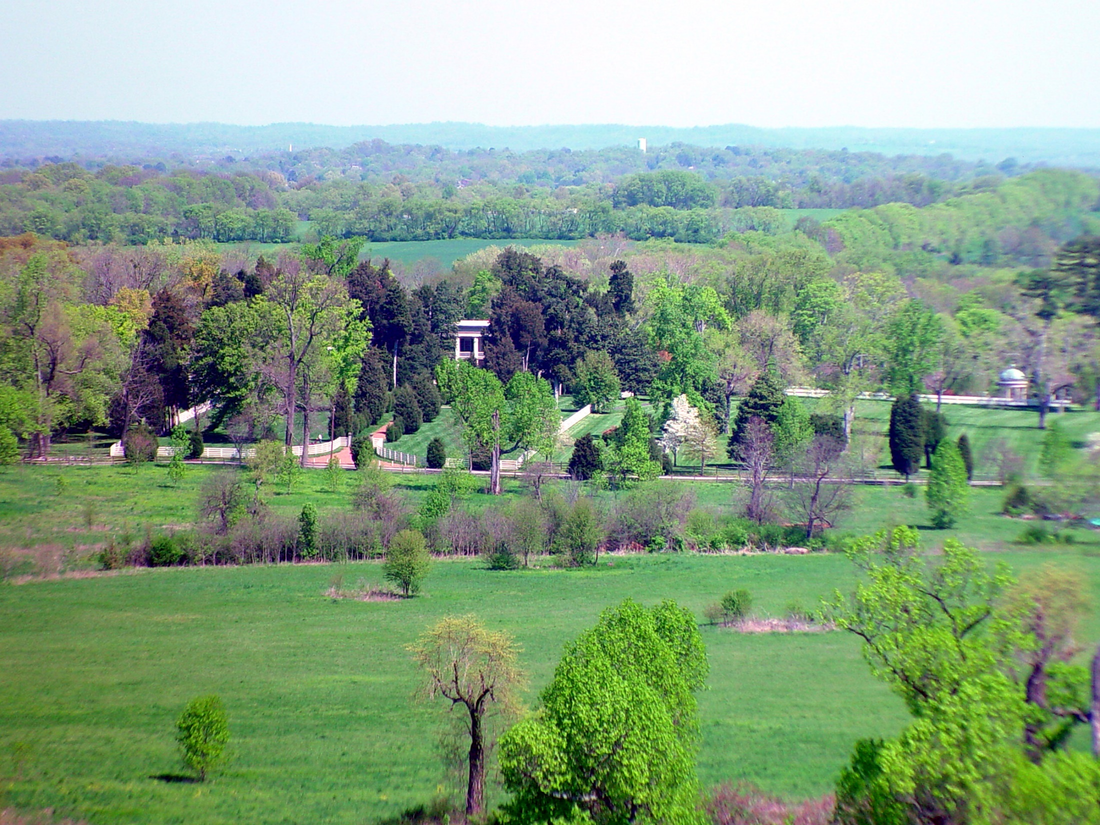
"The field is the world, the good seeds are the sons of the kingdom, but the tares are the sons of the wicked one. The enemy who sowed them is the devil, the harvest is the end of the age, and the reapers are the angels. Therefore as the tares are gathered and burned in the fire, so it will be at the end of this age. The Son of Man will send out His angels, and they will gather out of His kingdom all things that offend, and those who practice lawlessness, and will cast them into the furnace of fire. There will be wailing and gnashing of teeth." — Matthew 13:38-42
"Then the righteous will shine forth as the sun in the kingdom of their Father. He who has ears to hear, let him hear! Again, the kingdom of heaven is like treasure hidden in a field, which a man found and hid; and for joy over it he goes and sells all that he has and buys that field. Again, the kingdom of heaven is like a merchant seeking beautiful pearls, who, when he had found one pearl of great price, went and sold all that he had and bought it." — Matthew 13:43-46

Slide 20
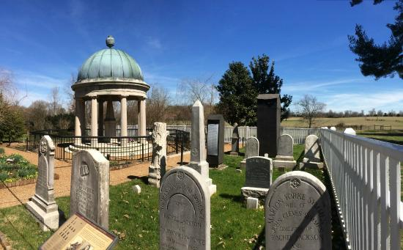
X

Slide 21
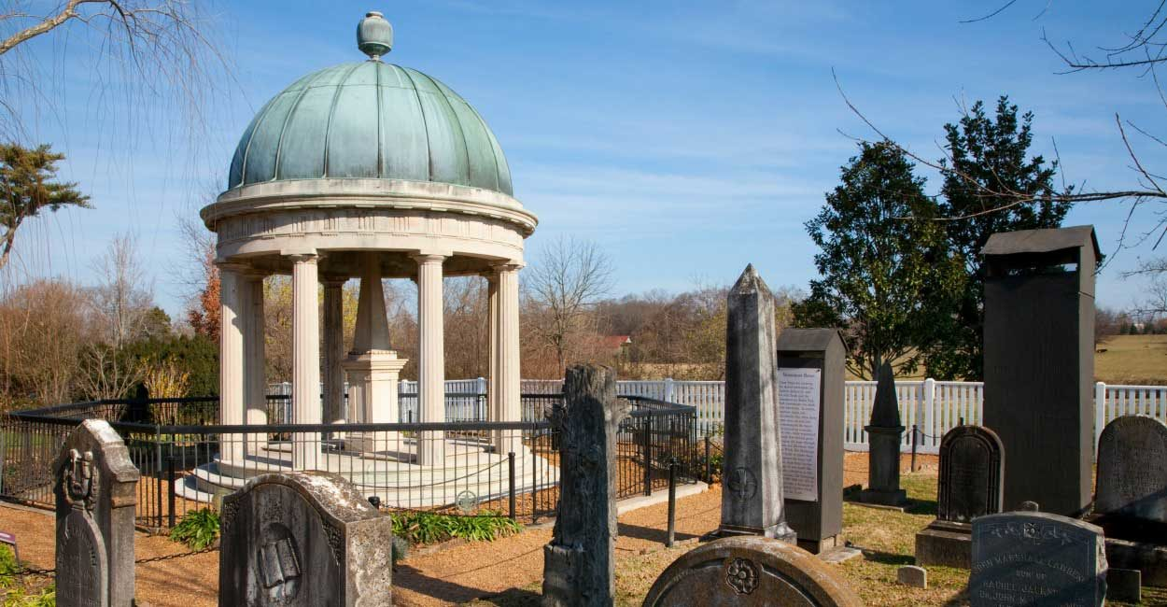

Slide 22
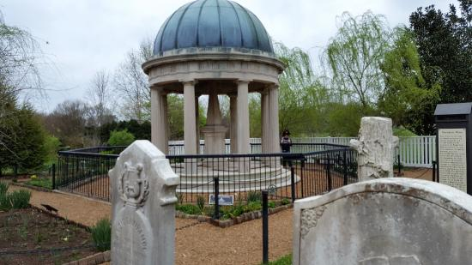
X

Slide 23
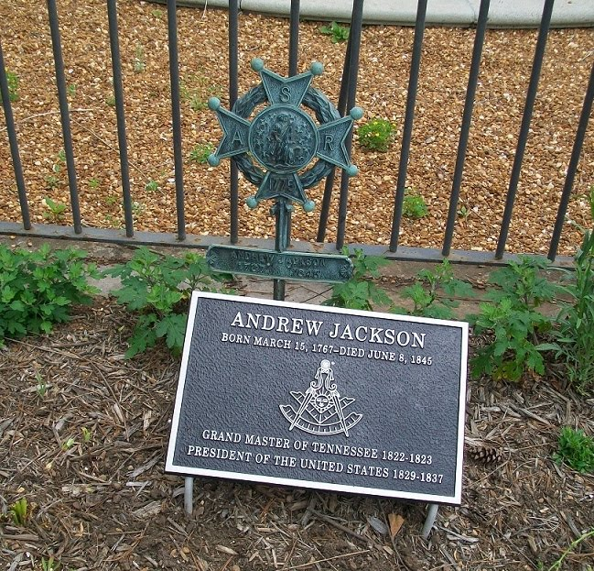
X

Slide 24
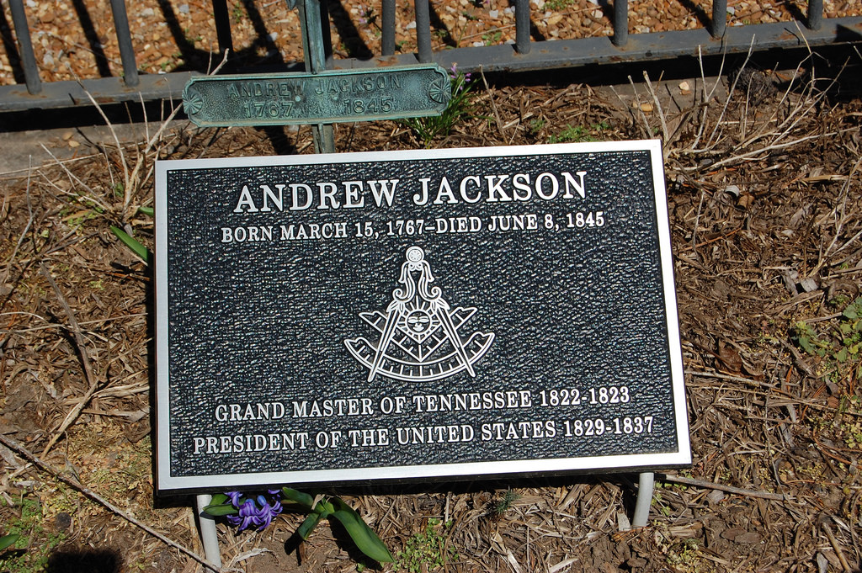
X

Slide 25
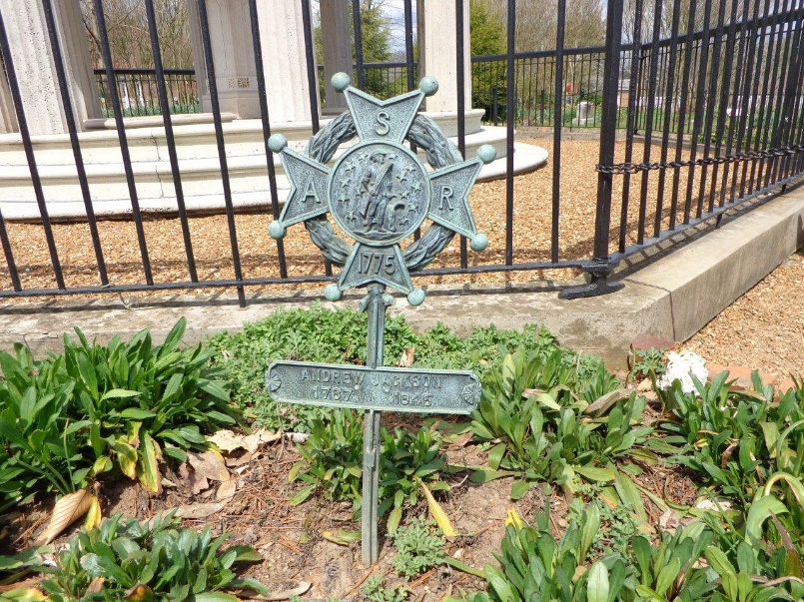

Slide 26
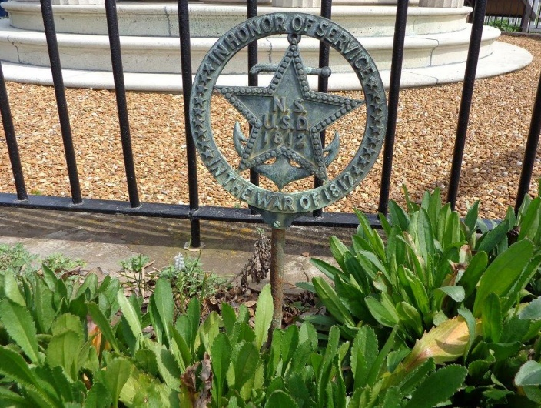

Slide 27
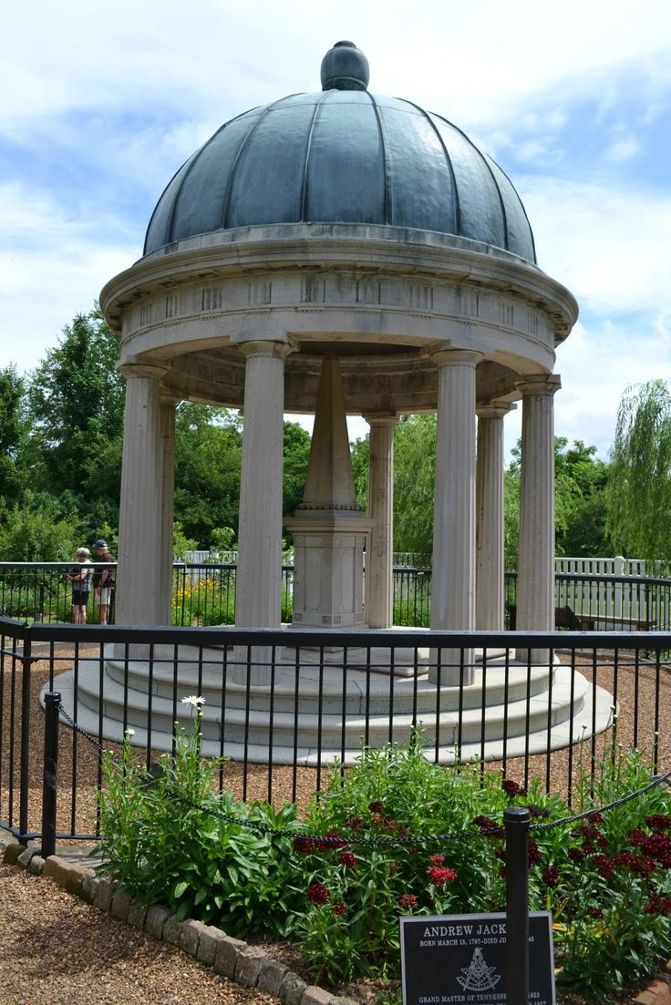

Slide 28
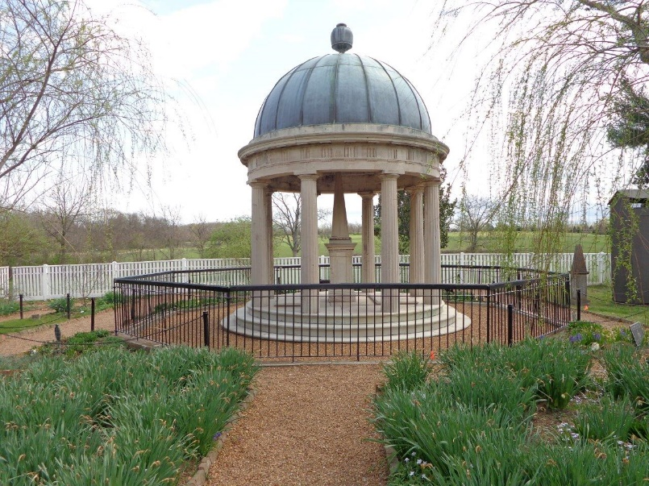

Slide 29
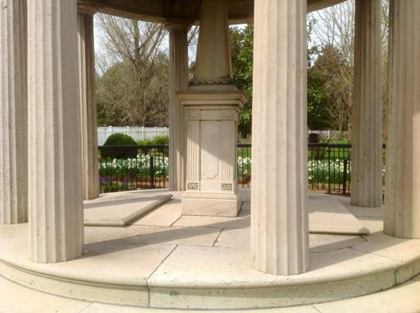

Slide 30
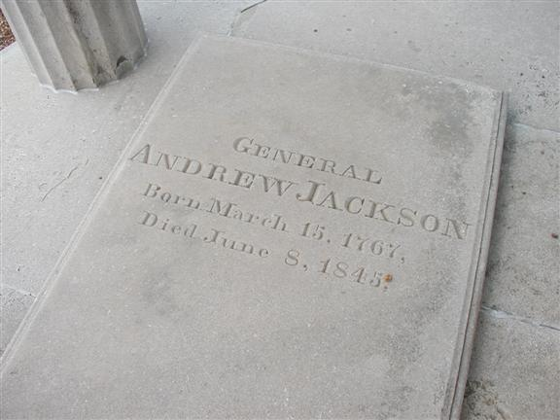

Slide 31
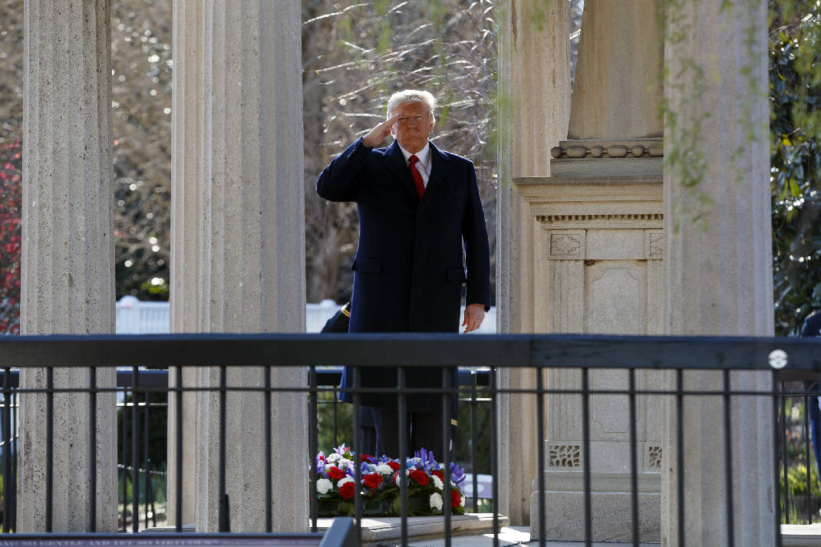

Slide 32
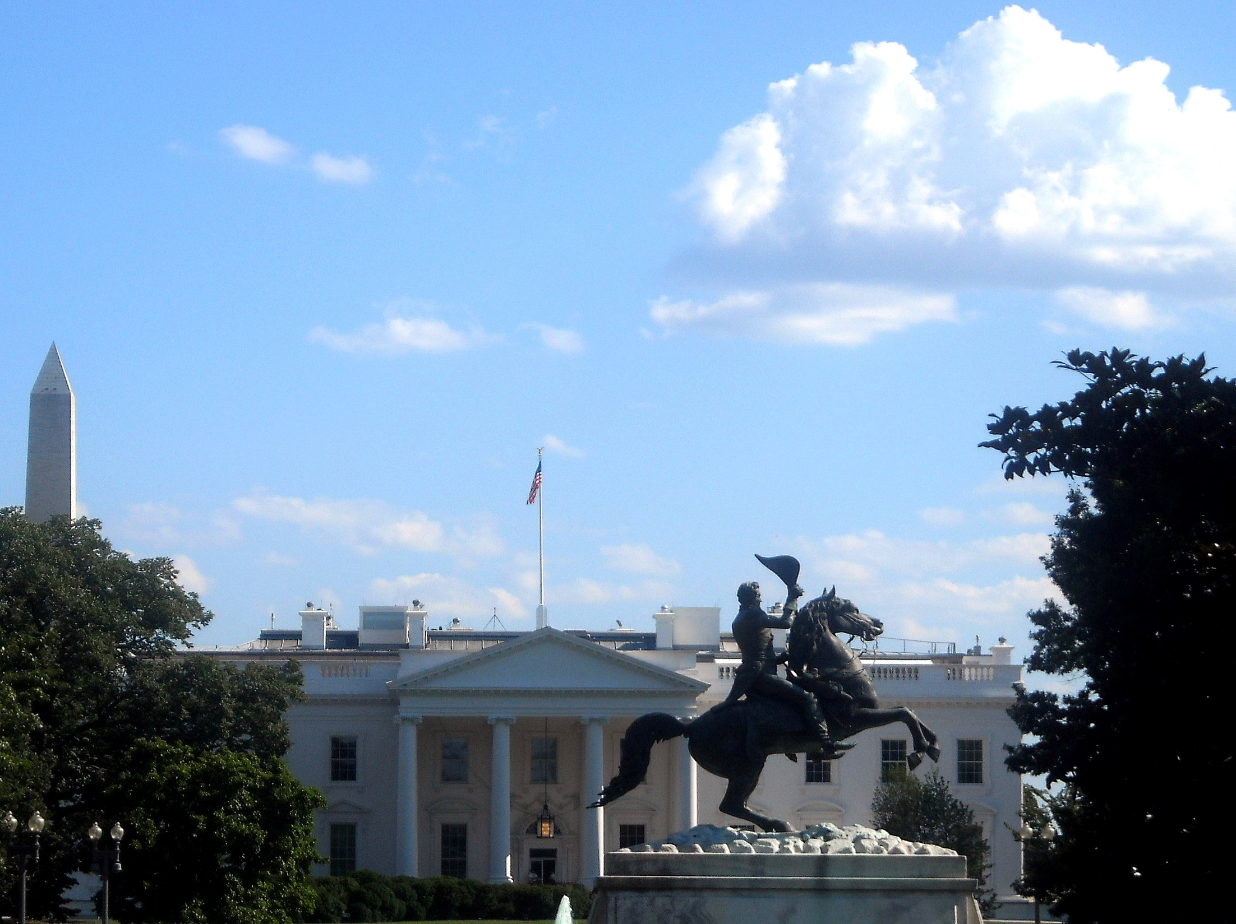

Slide 33
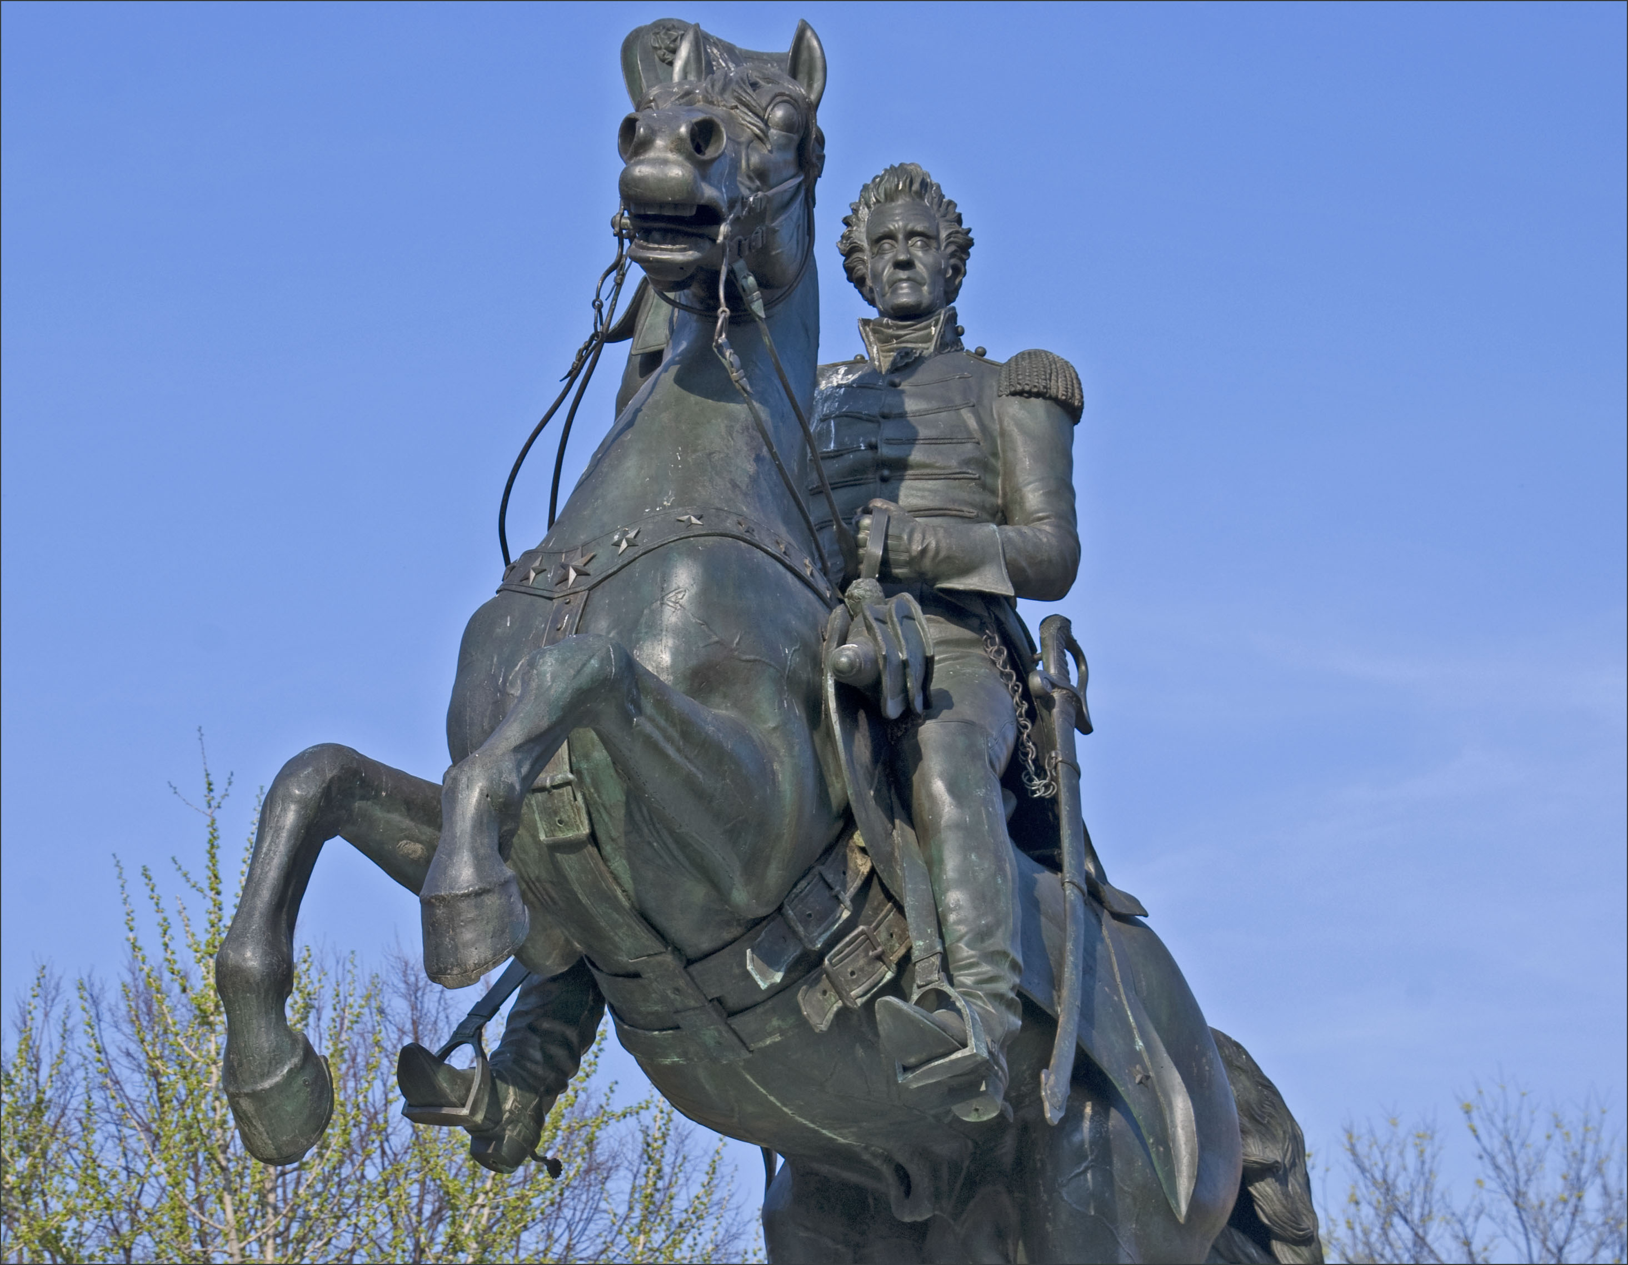

Slide 34
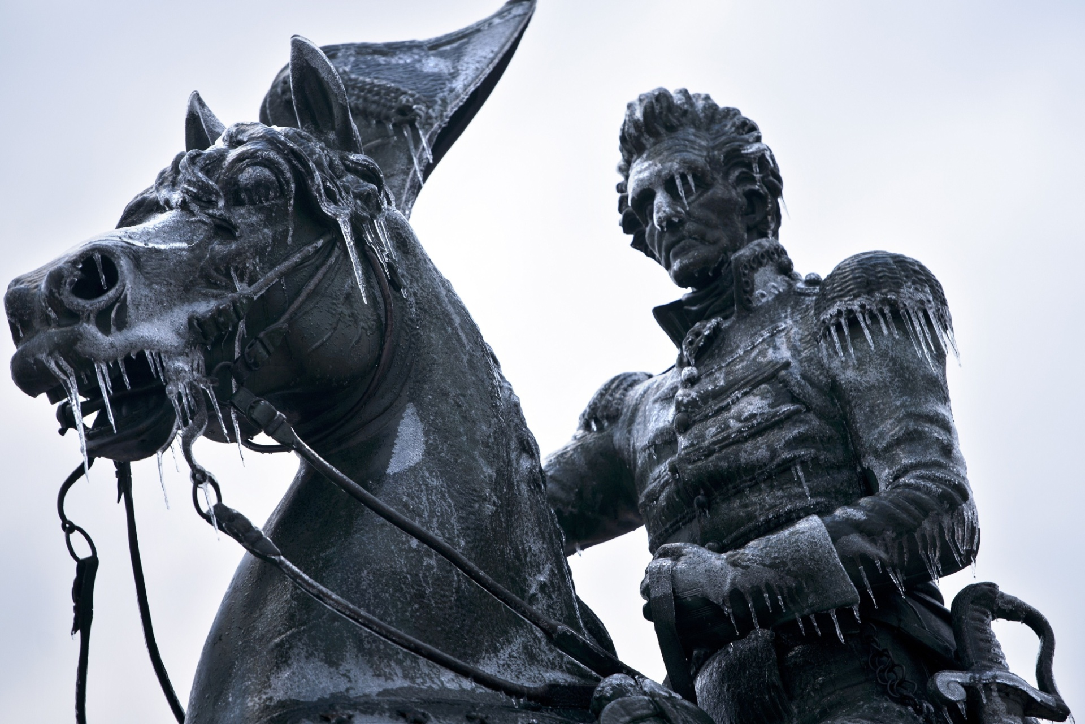
Therefore, since all these things will be dissolved, what manner of persons ought you to be in holy conduct and godliness, … 2ndPeter 3:11

Slide 35
8. Martin Van Buren (1837-1841)

Slide 36
"There is a power in public opinion in this country-and I thank God for it: for it is the most honest and best of all powers-which will not tolerate an incompetent or unworthy man to hold in his weak or wicked hands the lives and fortunes of his fellow-citizens."

Slide 37
Therefore submit to God. Resist the devil and he will flee from you. — James 4:7

Slide 38
“The less government interferes with private pursuits, the better for general prosperity.”

Slide 39
"All forms of religion have united for the first time to diffuse charity and piety, because for the first time in the history of nations all have been totally untrammeled and absolutely free."

Slide 40
Railroad carriages are pulled at the enormous speed of fifteen miles per hour by engines which, in addition to endangering life and limb of passengers, roar and snort their way through the countryside, setting fire to the crops, scaring the livestock, and frightening women and children. The Almighty certainly never intended that people should travel at such break-neck speed.

Slide 41
The Lord is not slack concerning His promise, as some count slackness, but is longsuffering toward us, not willing that any should perish but that all should come to repentance. — 2nd Peter 3:9

Slide 42
“I only look to the gracious protection of the Divine Being whose strengthening support I humbly solicit, and whom I fervently pray to look down upon us all. May it be among the dispensations of His Providence to bless our beloved country with honors and with length of days; may her ways beways of pleasantness, and all her paths be peace.”

Slide 43
“It affords me sincere pleasure to be able to apprise you of the entire removal of the Cherokee Nation of Indians to their new homes west of the Mississippi.”

Slide 44
Be sober, be vigilant; because your adversary the devil walks about like a roaring lion, seeking whom he may devour. — 1st Peter 5:8
“To the Lord our God belong mercy and forgiveness, though we have rebelled against Him.” — Daniel 9:9

Slide 45
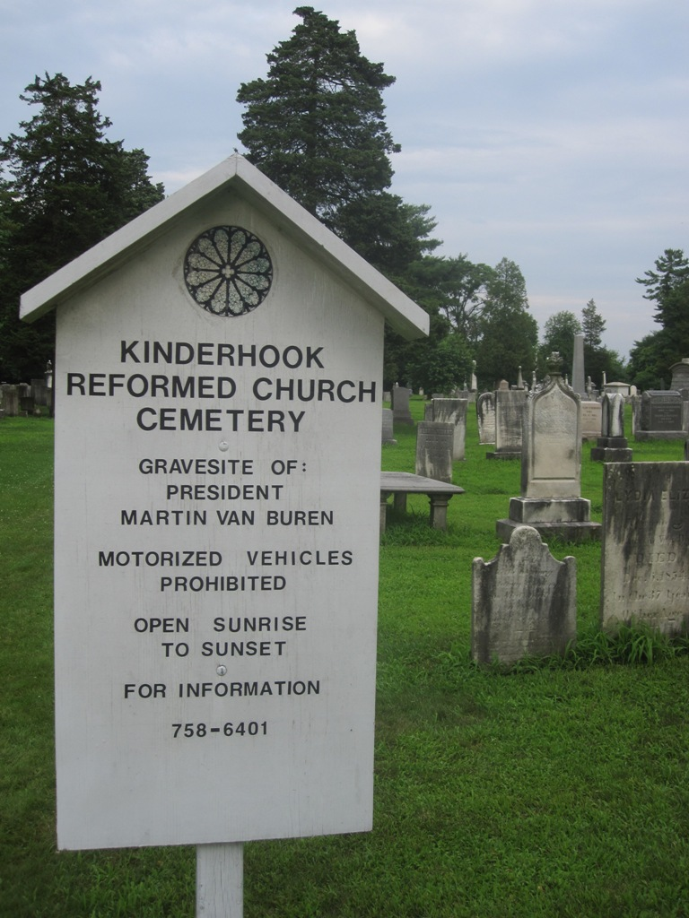
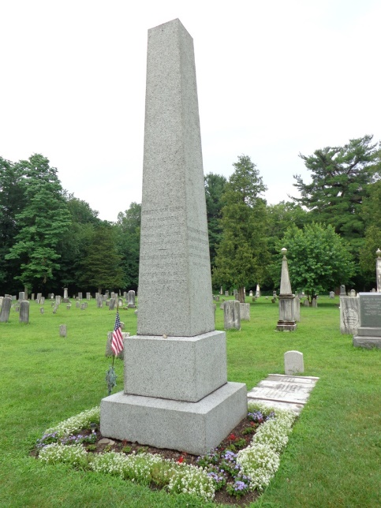
“The atonement of Jesus Christ is the only remedy and rest for my soul.”
"Blessed are those who mourn, For they shall be comforted." — Matthew 5:4

Slide 46
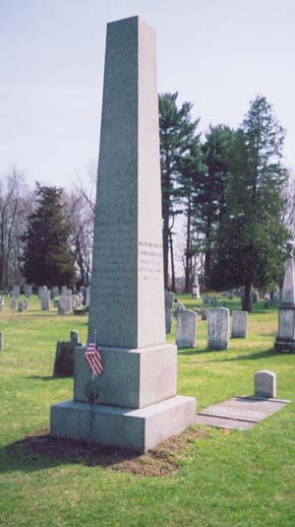
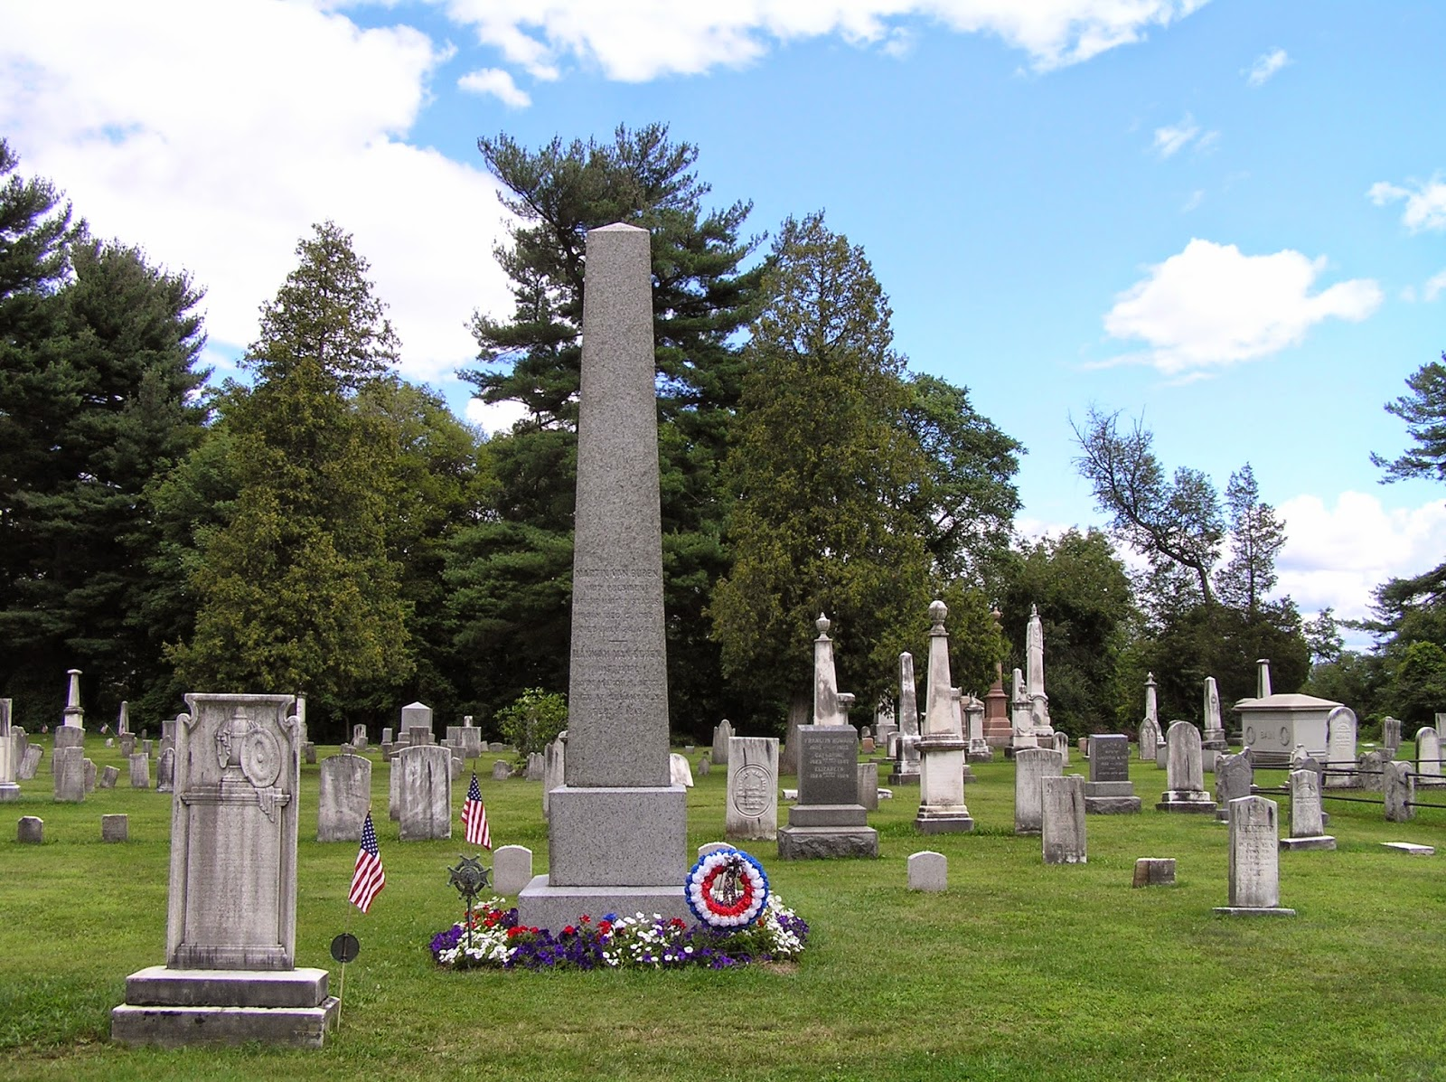
X

Slide 47
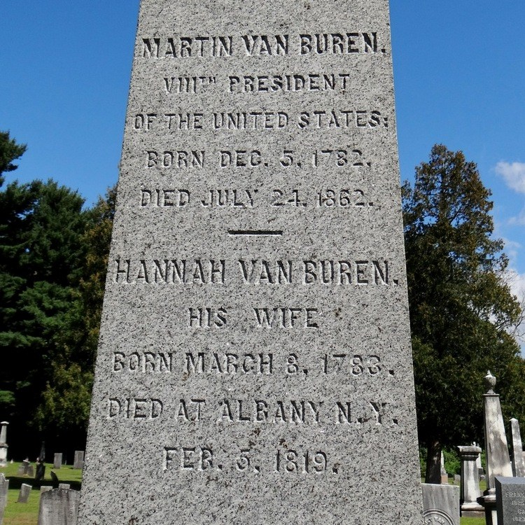
X

Slide 49
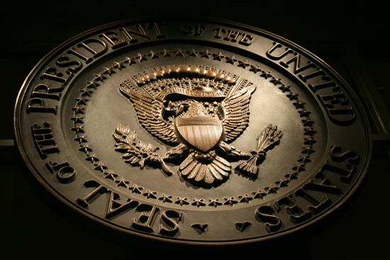
→ The Bible holds values that built America’s Republic
→ Civil rights & liberty of conscious is worth defending
→ In-house corruption & abuse of power defeats all
→ Pompous elitists steal social tranquility
→ National debt imprisons liberty to servitude
→ Federal banking shackles honest business
→ Bribes and scheming politicians sour nobility
→ Pray God He protects us uniting our rejoicing hearts
→ It is scripture that frees a soul from troubles
→ Public opinion impacts accountability on who govern
→ Traditions and opinions can blur clear truth
→ Ignorance and bigotry embrace mortal mistakes
→ Atonement in Christ is a soul’s only real rest
His Forgiveness humbles all genuine hearts
Notes:
His Forgiveness humbles all genuine hearts

Slide 51
Please visit http://www.LoveFromGod.com to explore further
Ronald Bert Channel on
Notes:
Eternity never ends.

