Slide 2
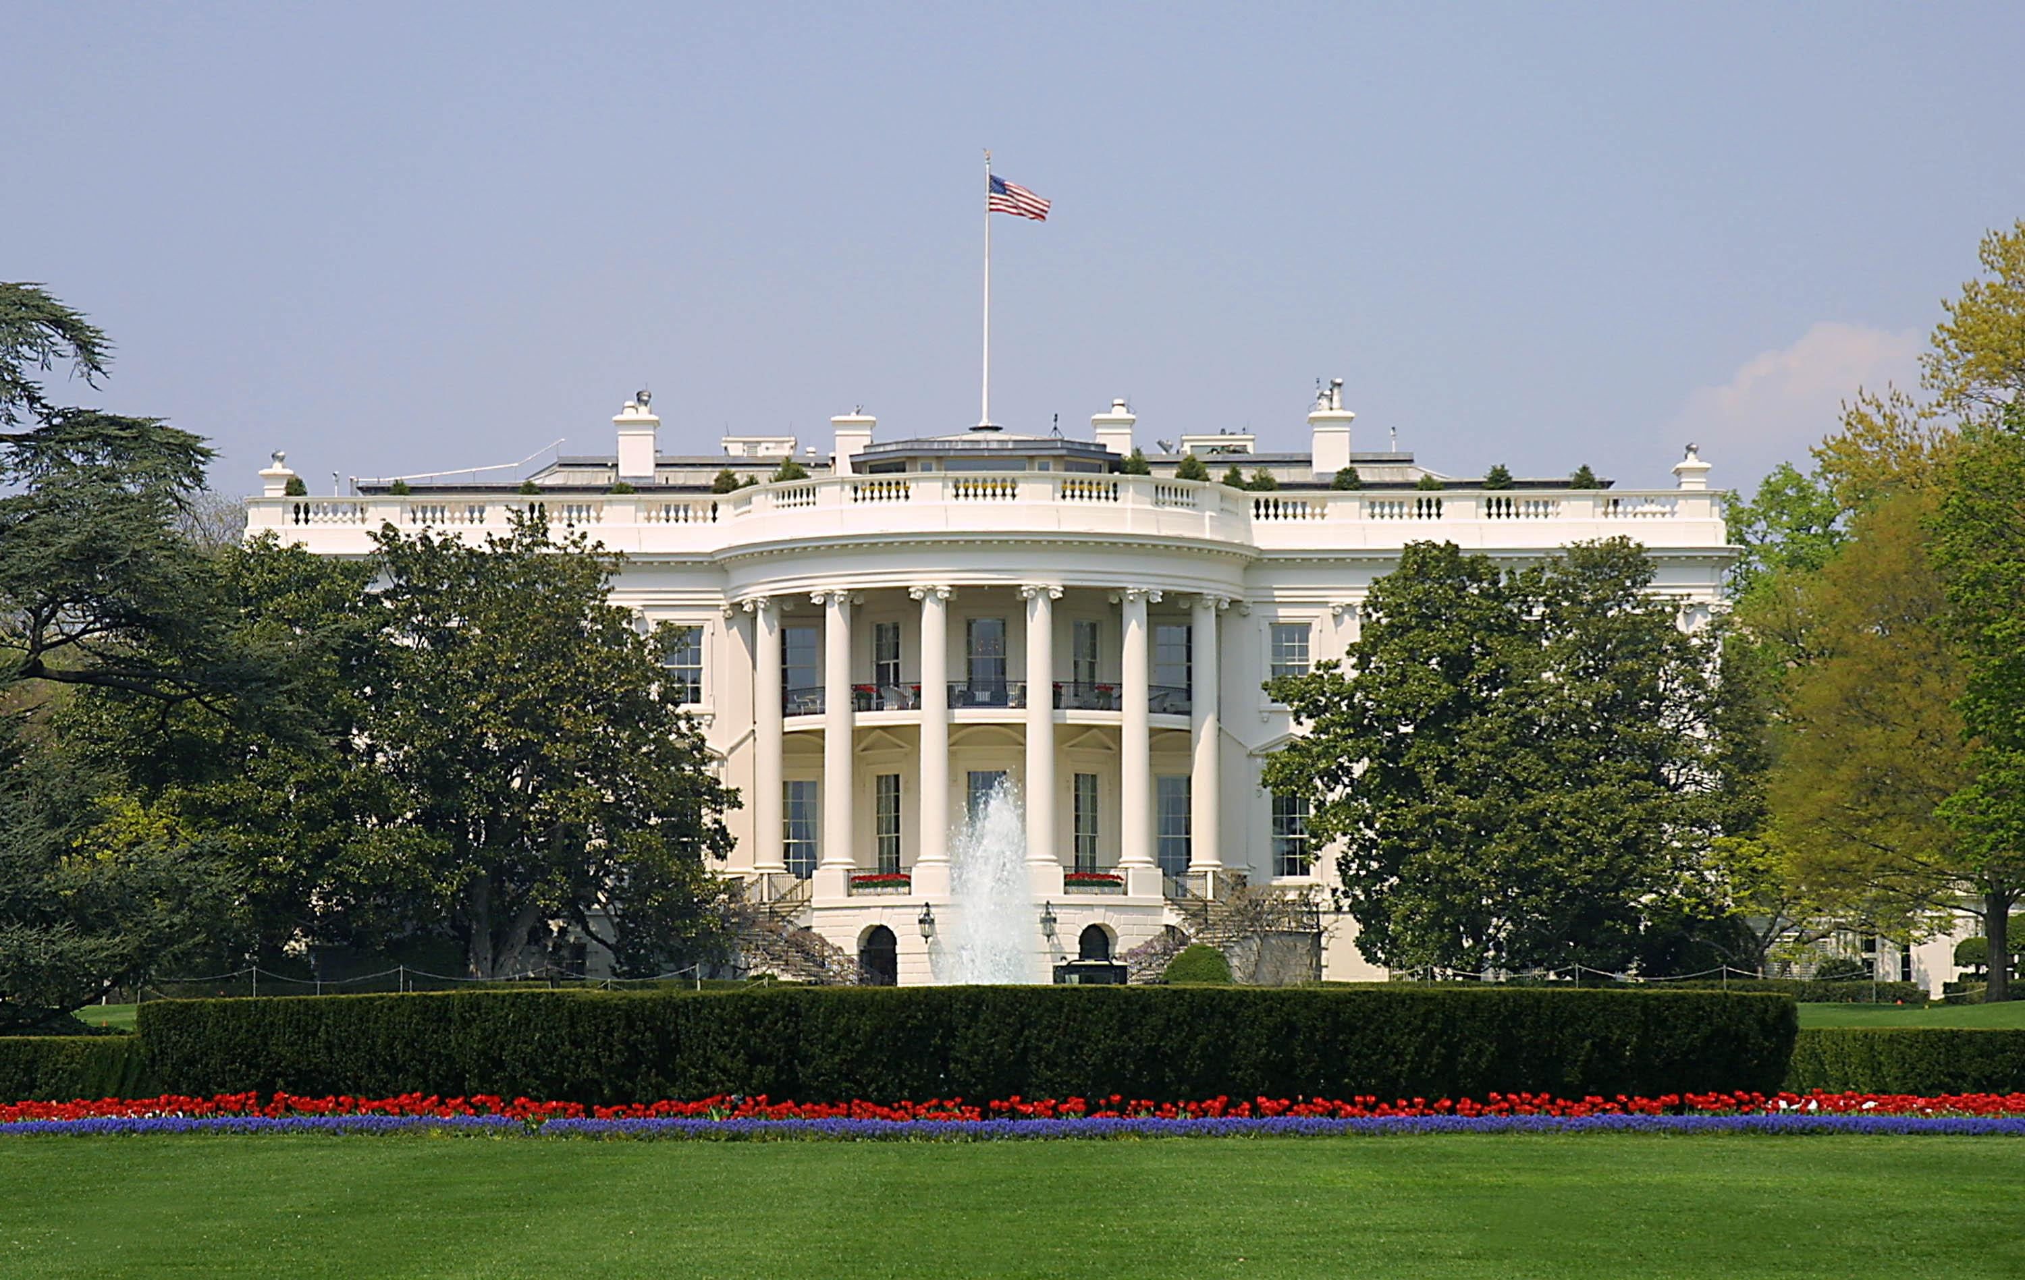
Presidential Quotes
Ron Bert
4
March 18, 2018

Slide 3
5. James Monroe (1817-1825)

Slide 4
“The best form of government is that which is most likely to prevent the greatest sum of evil.”

Slide 5
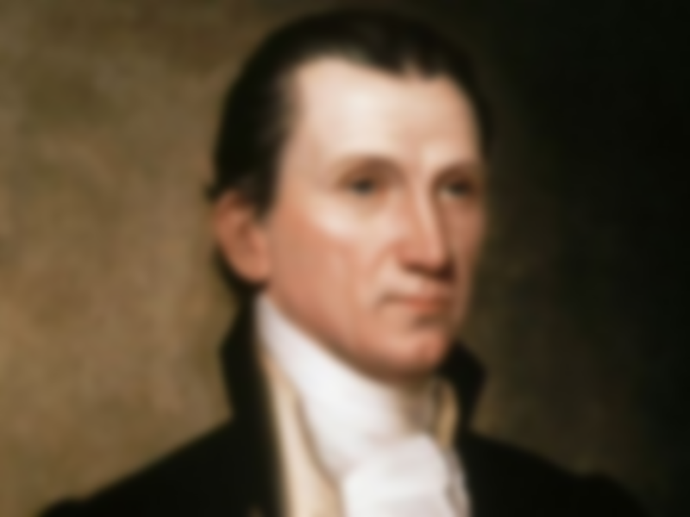
There is a price tag on human liberty. That price is the willingness to assume the responsibilities of being free men. Payment of this price is a personal matter with each of us. ”
What then? Shall we sin because we are not under law but under grace? Certainly not! Do you not know that to whom you present yourselves slaves to obey, you are that one's slaves whom you obey, whether of sin leading to death, or of obedience leading to righteousness? — Romans 6:15-16
Payment
personal
matter

Slide 6
“Before any man can be considered as a member of civil society, he must be considered as a subject of the Governor of the Universe. And to the same Divine Author of every good and perfect gift we are indebted for all those privileges and advantages, religious as well as civil, which are so richly enjoyed in this favored land.”
subject

Slide 7
During the darkest days of the Revolutionary War, the Continental Congress and George Washington - I call him the first George W. - (laughter and applause) - urged citizens to pray and to give thanks and to ask for God's protection.”
pray
give thanks
ask for God’s protection

Slide 8
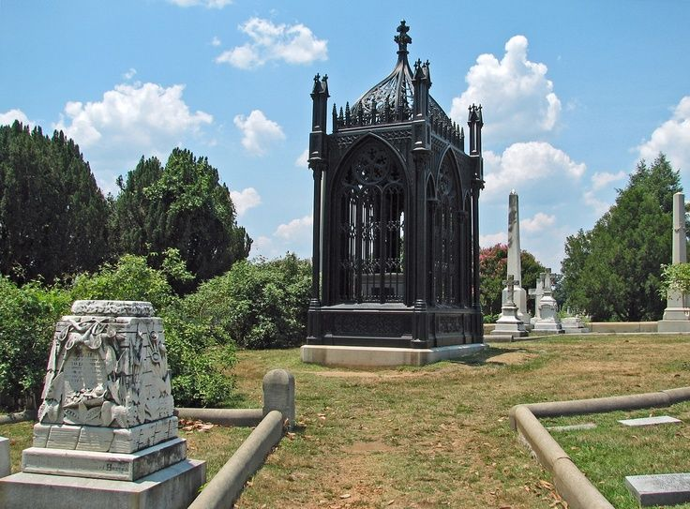
Remember how short my time is; For what futility have You created all the children of men? What man can live and not see death? Can he deliver his life from the power of the grave? Selah — Psalms 89:47-48
Remember
Remember

Slide 9
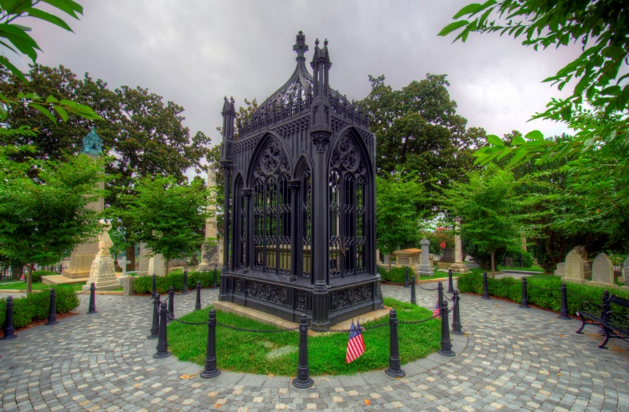
Remember
Remember your Creator before the silver cord is loosed, Or the golden bowl is broken, Or the pitcher shattered at the fountain, Or the wheel broken at the well. — Ecclesiastes 12:6
Remember

Slide 10
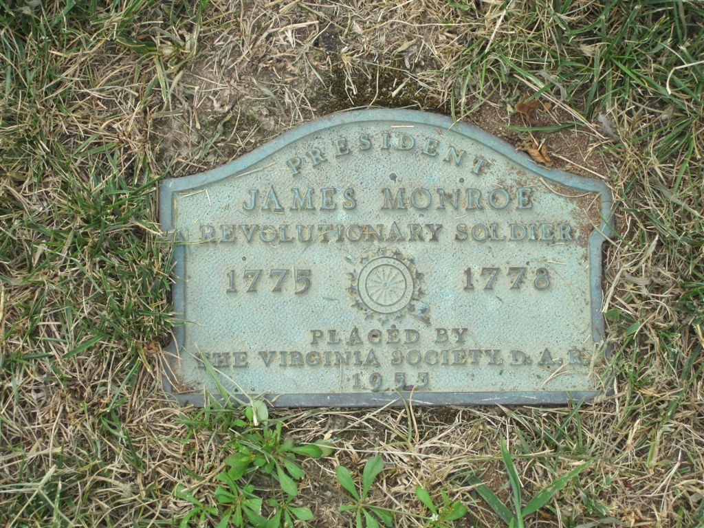
Remember the former things of old, For I am God, and there is no other; I am God, and there is none like Me, — Isaiah 46:9
Remember
Remember

Slide 11
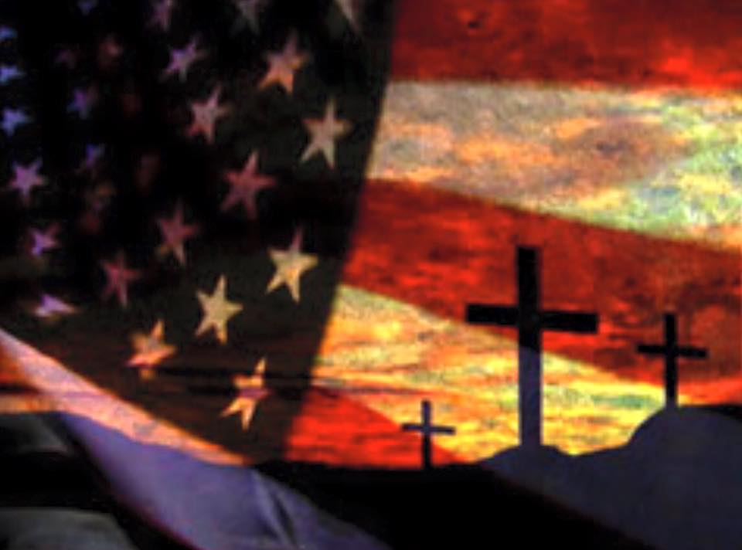
"Remember therefore how you have received and heard; hold fast and repent. Therefore if you will not watch, I will come upon you as a thief, and you will not know what hour I will come upon you." — Revelation 3:3
Remember

Slide 12
6. John Quincy Adams (1825-1829)

Slide 13
“The highest glory of the American Revolution was this: it connected in one indissoluble bond the principles of civil government with the principles of Christianity.”
unseparable
Personal Accountability

Slide 14
“Is it not that in the chain of human events, the birthday of a nation is indissolubly linked with the birthday of the Savior? That it forms a leading event in the progress of the Gospel dispensation? Is it not that the Declaration of Independence first organized the social compact on the foundation of the Redeemer’s mission upon earth? That it laid the cornerstone of human government upon the first precepts of Christianity?”
human government
precepts of Christianity

Slide 15
Righteousness exalts a nation, But sin is a reproach to any people. — Proverbs 14:34

Slide 16
“The first and almost the only book deserving of universal attention is the Bible. I speak as a man of the world to men of the world; and I say to you, Search the Scriptures! The Bible is the book of all others, to be read at all ages, and in all conditions of human life; not to be read once or twice or thrice through, and then laid aside, but to be read in small portions of one or two chapters every day, and never to be intermitted, unless by some overruling necessity.”
Search the Scriptures
to be read
every day

Slide 17
These were more fair-minded than those in Thessalonica, in that they received the word with all readiness, and searched the Scriptures daily to find out whether these things were so. — Acts 17:11

Slide 18
“The Bible contains the revelation of the will of God. It contains the history of the creation of the world, and of mankind.”

Slide 19
“The Sermon on the Mount commands me to lay up for myself treasures, not upon earth, but in Heaven. My hopes of a future life are all founded upon the Gospel of Christ.”
hope

Slide 20
“There are three points of doctrine the belief of which forms the foundation of all morality. The first is the existence of God; the second is the immortality of the human soul; and the third is a future state of rewards and punishments. Suppose it possible for a man to disbelieve either of these three articles of faith and that man will have no conscience, he will have no other law than that of the tiger or the shark. The laws of man may bind him in chains or may put him to death, but they never can make him wise, virtuous, or happy.”
foundation of all morality
the existence of God
the immortality of the human soul
a future state of rewards
→ foundation of all morality
● the existence of God
● the immortality of the human soul
● a future state of rewards & punishments
punishments
wise
virtuous
happy

Slide 21
Do not be deceived: "Evil company corrupts good habits." — 1st Corinthians 15:33

Slide 22
“THE Gospel of Christ not only differs from all other systems of religion in the superior excellence of the truths it reveals, but also in the directions it gives for the propagation of its doctrines. Other systems seek to advance themselves by invoking the aid of the secular power, and by forcing men, against their convictions, to accept a theory repugnant to their views. They have thus succeeded in thronging their temples with hypocritical worshippers, bound to their altars through fear and slavish dread. …”
“… This principle is directly expressed in the text and its connection. The teaching of the Savior has been violated, however, even by his professed followers; and, in the name of the meek and lowly Jesus, men have gone forth with proscription, oppression, and persecution, to advance their own opinions, and crush out that liberty of thought, and those rights of conscience vouchsafed to man by his Maker, and the free exercise of which is alone compatible with his personal accountability.”
“… These systems, in order to maintain themselves, find it necessary to proscribe and persecute all who differ from them, either in their articles of belief or mode of worship. But the Gospel of Christ, though it is the infallible truth of God, expressly prohibits a resort to any such measures for its advancement. It not only teaches its adherents to utterly abandon the use of carnal weapons for its propagation, but it also charges them not to proscribe those who may differ in their views or mode of worship. …”
personal accountability

Slide 23
But even if we, or an angel from heaven, preach any other gospel to you than what we have preached to you, let him be accursed. As we have said before, so now I say again, if anyone preaches any other gospel to you than what you have received, let him be accursed. — Galatians 1:8-9

Slide 24
“...he [Muhammad] declared undistinguishing and exterminating war, as a part of his religion, against all the rest of mankind...The precept of the Koran is, perpetual war against all who deny, that Mahomet is the prophet of God.”

Slide 25
“Of all persecuted sects, the Baptists stand forth as most prominent, simply and only because they aim at a more complete and thorough reform than any others ever attempted. They teach that Christ's kingdom is not of this world; that the church is not a national, political, or provincial establishment; but a congregation of holy men, separated from the world by the receiving of the Holy Spirit.”

Slide 26
Jesus answered, "My kingdom is not of this world. If My kingdom were of this world, My servants would fight, so that I should not be delivered to the Jews; but now My kingdom is not from here." — John 18:36

Slide 27
Then Peter said to them, "Repent, and let every one of you be baptized in the name of Jesus Christ for the remission of sins; and you shall receive the gift of the Holy Spirit." — Acts 2:38
receive the gift
of the Holy Spirit
Repent
baptized in the name
of Jesus
Repent
baptized in the name =
of Jesus Christ
Christ
remission
of sins
remission
of sins
receive the gift
of
the Holy Spirit

Slide 28
“Power always thinks it has a great soul and vast views beyond the comprehension of the weak, and that it is doing God’s service when it is violating all His laws.”

Slide 29
“They taught that the church of which Jesus is the Head, was a spiritual organization, composed not of those who came into it by hereditary descent, but of those who were born of the Spirit. But, there has been a departure from these principles; and organizations now exist, under the designation of Christian churches, …”
“… which aim to unite the church and the world, and introduce the impious, and ungodly, and profane, into Christ's kingdom – thus reversing his declaration, that his "kingdom is not of this world." Against this innovation Baptists strenuously protest. We announce, then, as the Second Feature of the reform in which Baptists are engaged, THE RESTORATION OF THE SPIRITUALITY OF CHRIST'S KINGDOM.”

Slide 30
Beware lest anyone cheat you through philosophy and empty deceit, according to the tradition of men, according to the basic principles of the world, and not according to Christ. — Colossians 2:8

Slide 31
The wicked flee when no one pursues, But the righteous are bold as a lion. Because of the transgression of a land, many are its princes; But by a man of understanding and knowledge Right will be prolonged. — Proverbs 28:1-2

Slide 32
“The Lord saw fit to lead me some time by simple faith — a childlike dependence on the Word of God. And then, when I was emptied of self, I was filled with glory and with God. For the first time in my life, my soul was continually satisfied. My need was all supplied. Oh, the fullness of Jesus! …”
“… Oh, how I have been led to loathe myself; and how I have sunk in self-abasement at the foot of the cross, completely overwhelmed with a view of self. And oh, how sweet to have Jesus take me, and wash me in his own precious blood, and realize that I am cleansed. Oh, how fully Jesus does save. …”
“… My greatest desire now, is to live for Jesus; to glorify him by my looks, my actions, my walk, and even the tones of my voice. I am led to see my own weakness more and more each day, and this leads me to look to Jesus each moment. And when, in view of my vileness, I am led to exclaim: “Every moment, Lord, I need, The merit of Thy death,” I can, by divine grace, triumphantly add : “Every moment, Lord, I have The merit of Thy death.” I am, indeed, A poor sinner, and nothing at all, But Jesus Christ is my all in all.”
“…. I love to have the will of God done; and as long as he sees fit to keep me here, I am willing to stay. Surely, I am a wonderful “miracle of grace.” The Lord has indeed done great things for me, whereof I am glad. I have often thought I was a poor, unworthy creature, but I have never known my unworthiness as I know it now. …”
“… I was saved, fully saved from sin. Years have passed since I received from the Lord the blessing I sought of him — entire sanctification. During that time, oh, what a change has taken place in me. I am no longer the desponding, unhappy creature I was. I do not now grow weary of life. …”

Slide 33
I have been crucified with Christ; it is no longer I who live, but Christ lives in me; and the life which I now live in the flesh I live by faith in the Son of God, who loved me and gave Himself for me. — Galatians 2:20

Slide 34
“Heaven has given to every human being the power of controlling his passions, and if he neglects or loses it, the fault is his own, and he must be answerable for it.”

Slide 35
“Whenever vanity and gaiety, a love of pomp and dress, furniture, equipage, buildings, great company, expensive diversions, and elegant entertainments get the better of the principles and judgments of men and women, there is no knowing where they will stop, nor into what evils, natural, moral, or political, they will lead us.”

Slide 36
No temptation has overtaken you except such as is common to man; but God is faithful, who will not allow you to be tempted beyond what you are able, but with the temptation will also make the way of escape, that you may be able to bear it. — 1st Corinthians 10:13

Slide 37
“It was the special purpose of Christ's appearance upon earth to bring immortality to light.”
“If your actions inspire others to dream more, learn more, do more and become more, you are a leader.”

Slide 38
... but has now been revealed by the appearing of our Savior Jesus Christ, who has abolished death and brought life and immortality to light through the gospel, ... — 2nd Timothy 1:10

Slide 39
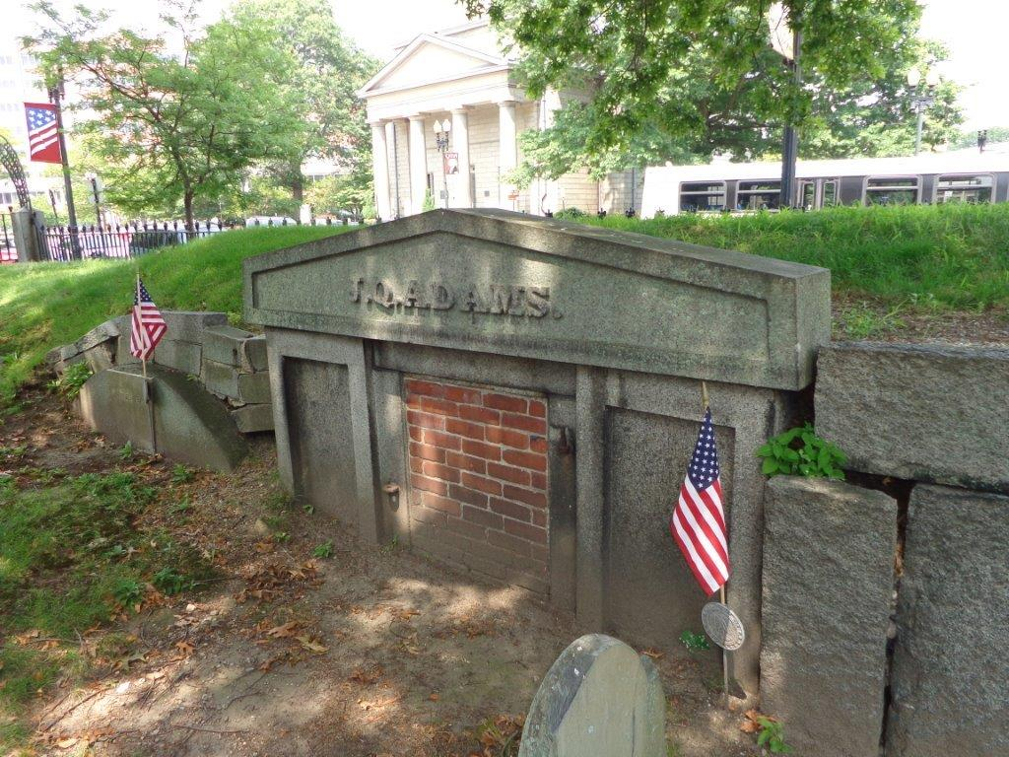
X

Slide 40
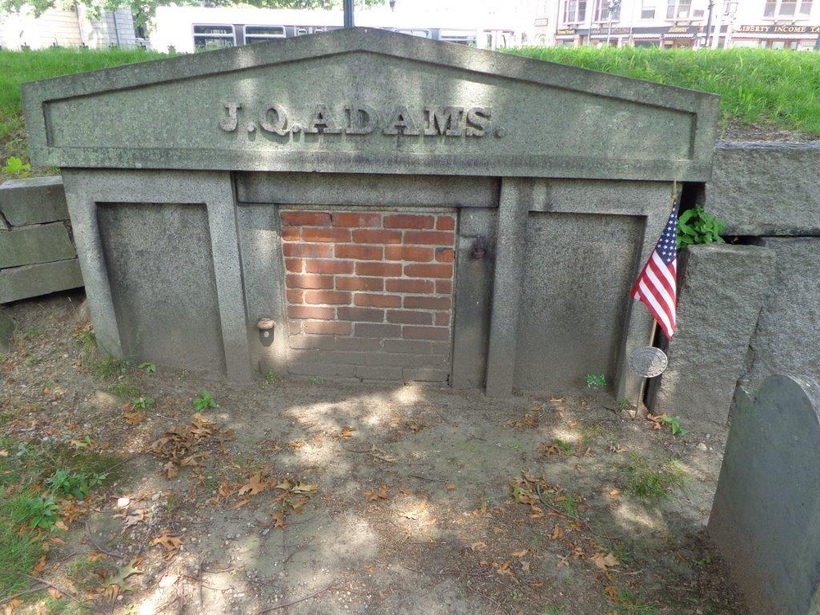

Slide 41
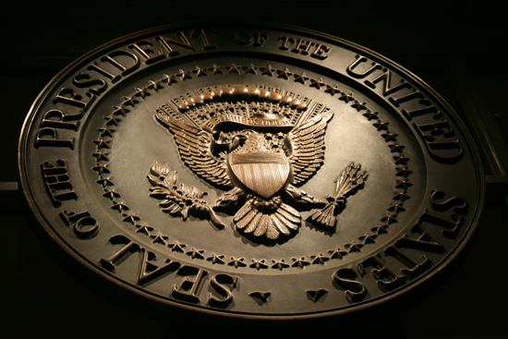
→ The Bible is the best book for the revival of humanity
→ Morality is set up by God’s existence and immortality
→ Coming judgment of good and bad tempers decency
→ False religion employs the secular to enforce tyranny
→ Opinions of man violate God’s call for godly morality
→ God’s congregation = those receiving the Holy Spirit
→ Power blinds those from seeing the meek’s wisdom
→ Christ’s kingdom holds those born of spirit
→ Self-Control is heaven’s test all must answer to
→ Salvation from sin comes by following Jesus
→ The Bible holds values that built America’s Republic
→ Bribes and scheming politicians sour nobility
→ Pray God He protects us uniting our rejoicing hearts
Hearts are filled by what they desire
Notes:
Hearts are filled by which they desire

Slide 43
Please visit http://www.LoveFromGod.com to explore further
Ronald Bert Channel on
Notes:
Eternity never ends.

