Slide 2
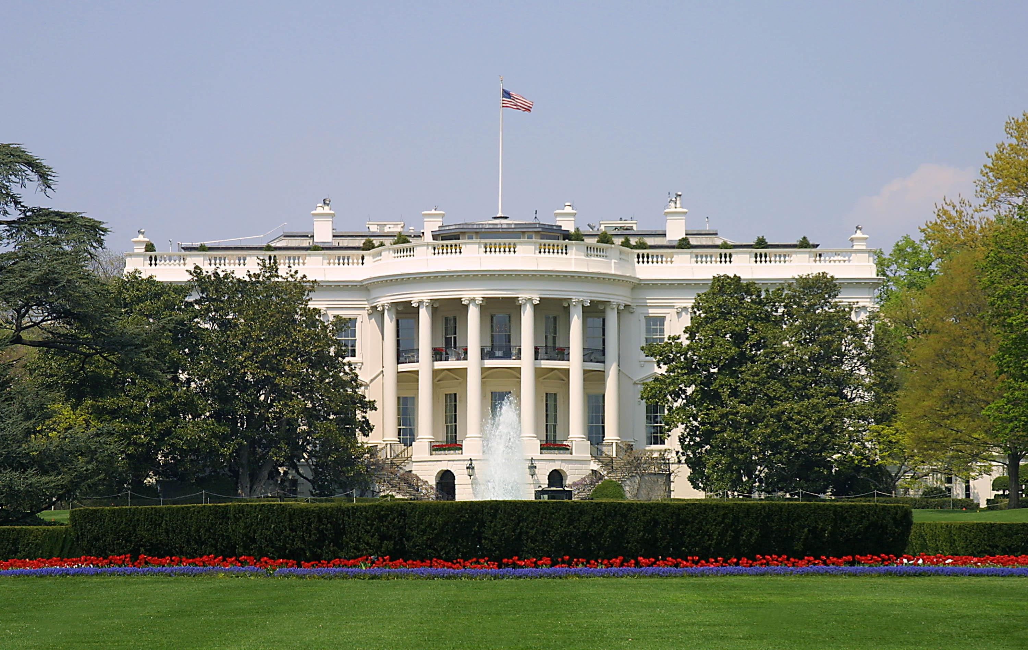
Presidential Quotes
Ron Bert
31
March 1, 2020

Slide 3
38. Gerald Ford (1974-1977)

Slide 4
“Without God there could be no American form of government, nor an American way of life.”
way of life
way of life

Slide 5
“The Declaration [of Independence] was not a protest against government, but against the excess of government. It prescribed the proper role of government, to secure the rights of individuals and to effect their safety and happiness. In modern society, no individual can do this alone. So government is not a necessary evil but a necessary good.”
government is
government is
a necessary good
a necessary good

Slide 6
For rulers are not a terror to good works, but to evil. Do you want to be unafraid of the authority? Do what is good, and you will have praise from the same. For he is God's minister to you for good. But if you do evil, be afraid; for he does not bear the sword in vain; for he is God's minister, an avenger to execute wrath on him who practices evil. — Romans 13:3-4
not a terror to good
not a terror to good

Slide 7
“A government big enough to give you everything you want is a government big enough to take from you everything you have.”

Slide 8
"For they bind heavy burdens, hard to bear, and lay them on men's shoulders; but they themselves will not move them with one of their fingers." — Matthew 23:4

Slide 9
“This is an hour of history that troubles our minds and hurts our hearts.”
heart
heart

Slide 10
“I do believe, with all my heart and mind and spirit, that I, not as President but as a humble servant of God, will receive justice without mercy if I fail to show mercy.”
heart
mercy
mercy
mercy
mercy

Slide 11
For judgment is without mercy to the one who has shown no mercy. Mercy triumphs over judgment. — James 2:13
mercy
mercy

Slide 12
“Now, therefore, I, Gerald R. Ford, President of the United States, pursuant to the pardon power conferred upon me by Article II, Section 2, of the Constitution, have granted and by these presents do grant a full, free, and absolute pardon unto Richard Nixon for all offenses against the United States which he, Richard Nixon, has committed or may have committed or taken part in during the period from January 20, 1969 through August 9, 1974.”
absolute pardon
absolute pardon

Slide 13
When He saw their faith, He said to him, "Man, your sins are forgiven you." And the scribes and the Pharisees began to reason, saying, "Who is this who speaks blasphemies? Who can forgive sins but God alone?" But when Jesus perceived their thoughts, He answered and said to them, "Why are you reasoning in your hearts? Which is easier, to say, 'Your sins are forgiven you,' or to say, 'Rise up and walk'?" — Luke 5:20-23
Who can forgive
Who can forgive

Slide 14
"But that you may know that the Son of Man has power on earth to forgive sins" -- He said to the man who was paralyzed, "I say to you, arise, take up your bed, and go to your house." Immediately he rose up before them, took up what he had been lying on, and departed to his own house, glorifying God. And they were all amazed, and they glorified God and were filled with fear, saying, "We have seen strange things today!" — Luke 5:24-26
power on earth to forgive sins
power on earth to forgive sins

Slide 15
“I believe that truth is the glue that holds government together, not only our Government but civilization itself. That bond, though strained, is unbroken at home and abroad. In all my public and private acts as your President, I expect to follow my instincts of openness and candor with full confidence that honesty is always the best policy in the end. My fellow Americans, our long national nightmare is over. Our Constitution works; our great Republic is a government of laws and not of men. Here the people rule. But there is a higher Power, by whatever name we honor Him, who ordains not only righteousness but love, not only justice but mercy.”
truth is the glue
truth is the glue
a higher Power
a higher Power
ordains
righteousness
ordains
righteousness
love
justice
mercy
love
justice
mercy

Slide 16
“America now is stumbling through the darkness of hatred and divisiveness. Our values, our principles, and our determination to succeed as a free and democratic people will give us a torch to light the way. And we will survive and become the stronger - not only because of a patriotism that stands for love of country, but a patriotism that stands for love of people.”

Slide 17
“It feels like getting a back massage from the Grim Reaper: one must get comfortable with the most horrifying things in the world.”

Slide 18
And have no fellowship with the unfruitful works of darkness, but rather expose them. — Ephesians 5:11

Slide 19
“We cannot stand still or slip backwards. We must go forward now together.”

Slide 20
But Jesus said to him, "No one, having put his hand to the plow, and looking back, is fit for the kingdom of God." — Luke 9:62
is fit
is fit
accountable

Slide 21
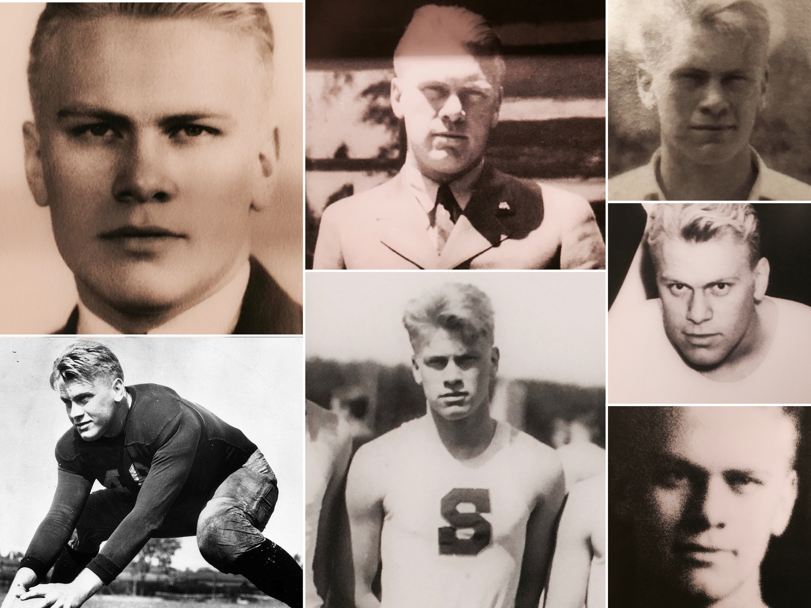
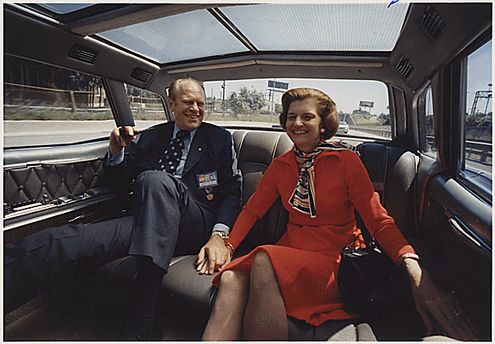

Slide 22
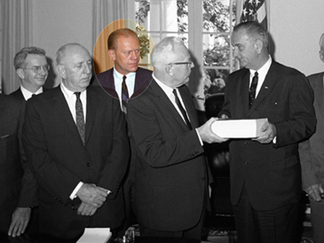

Slide 23
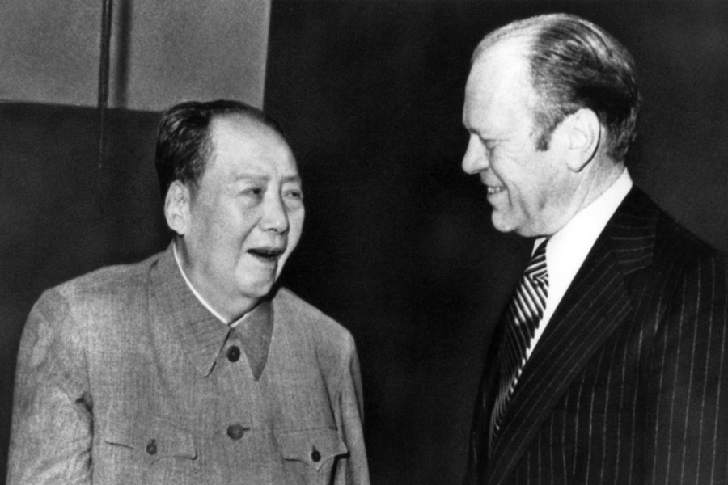

Slide 24
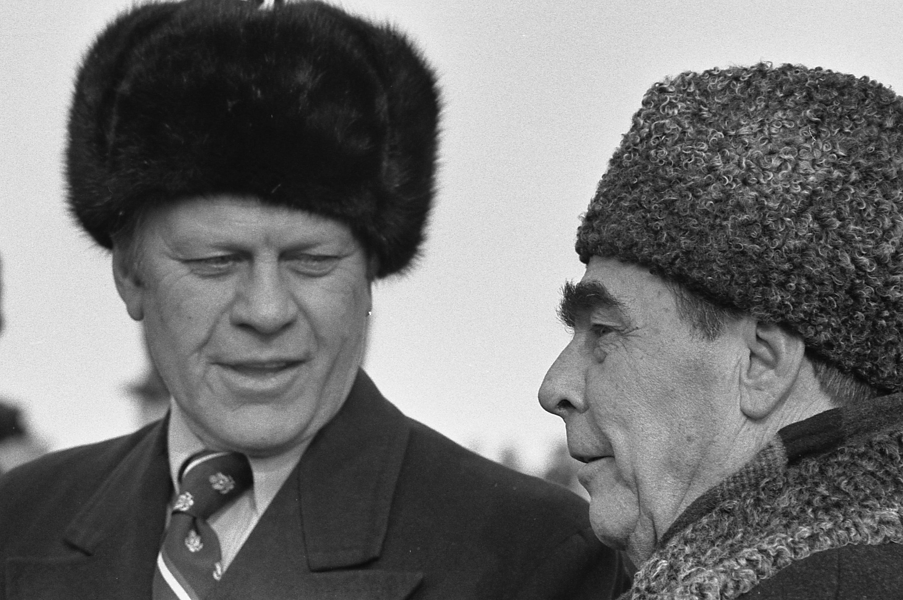

Slide 25
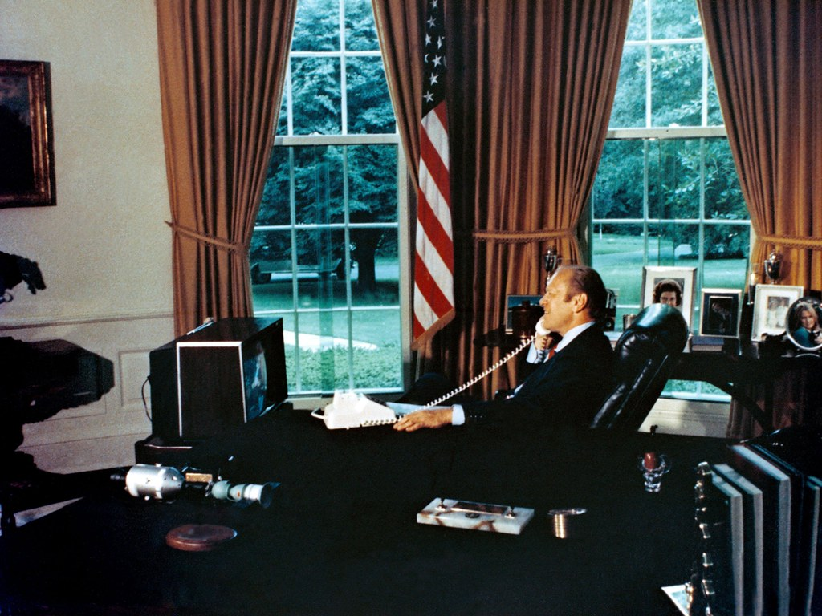

Slide 27
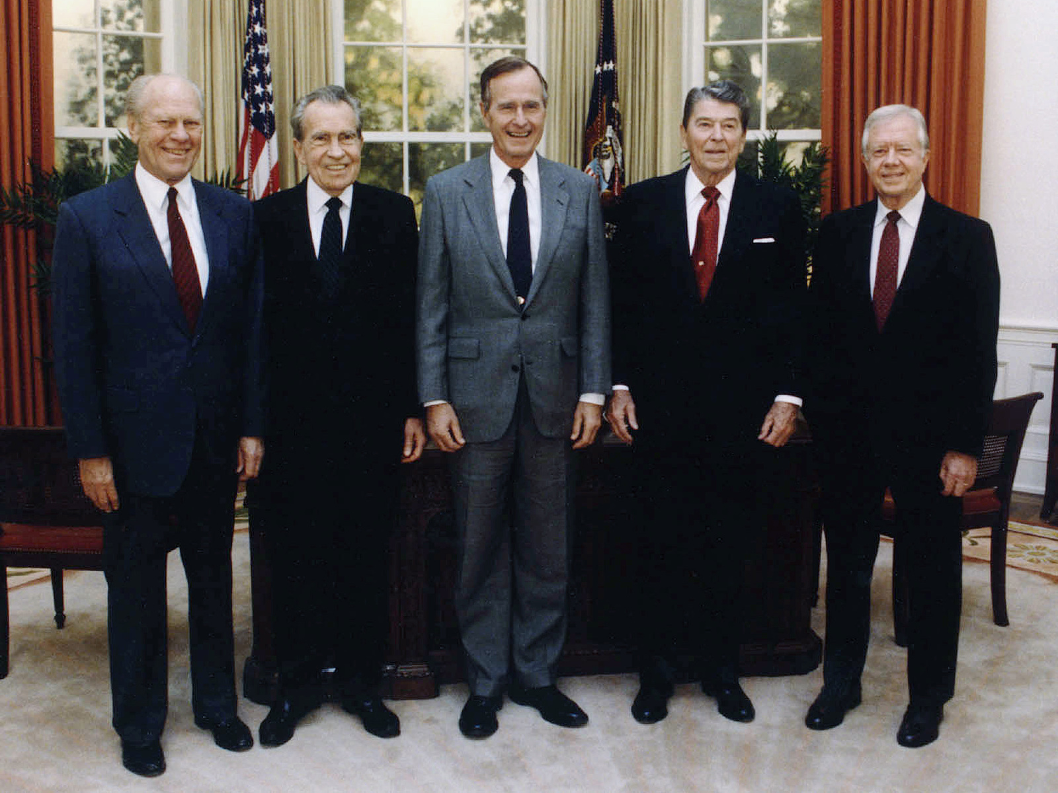

Slide 28
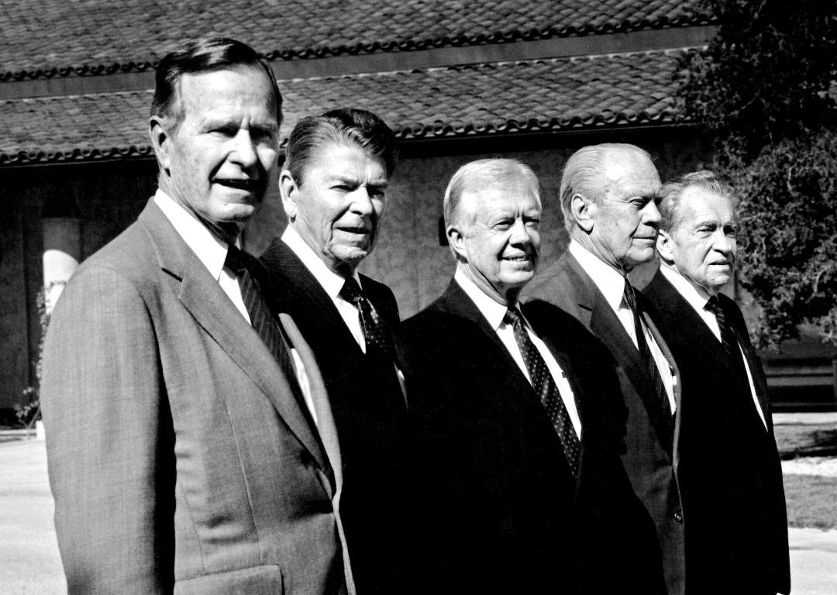

Slide 29
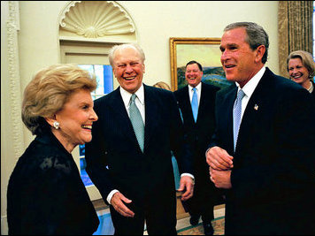

Slide 30
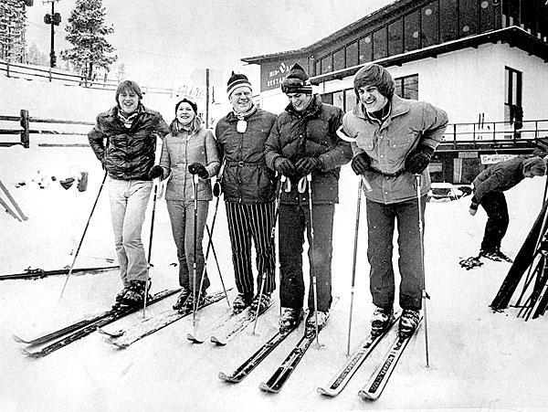
Notes:
Vail, Colorado

Slide 31
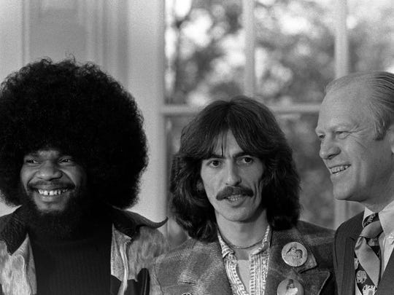
Notes:
Billy Preston & George Hrrison

Slide 33
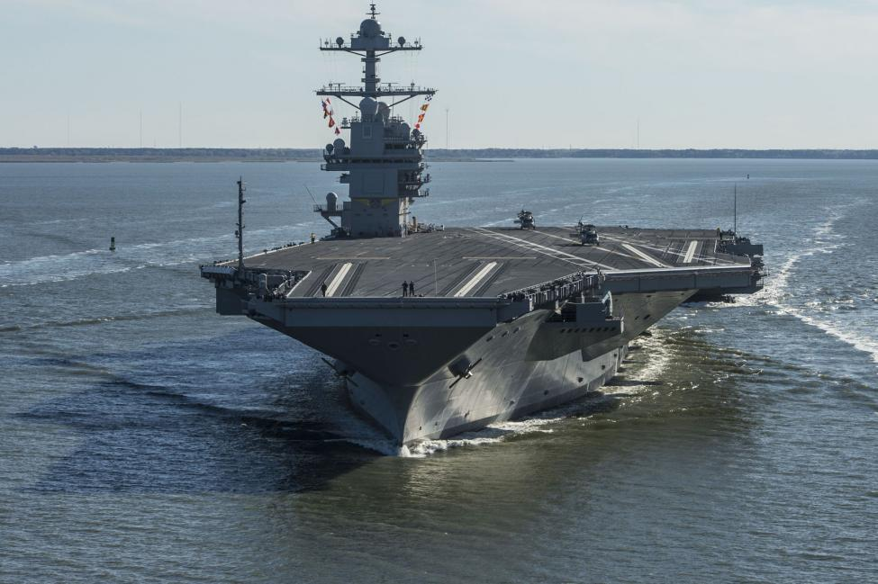

Slide 34
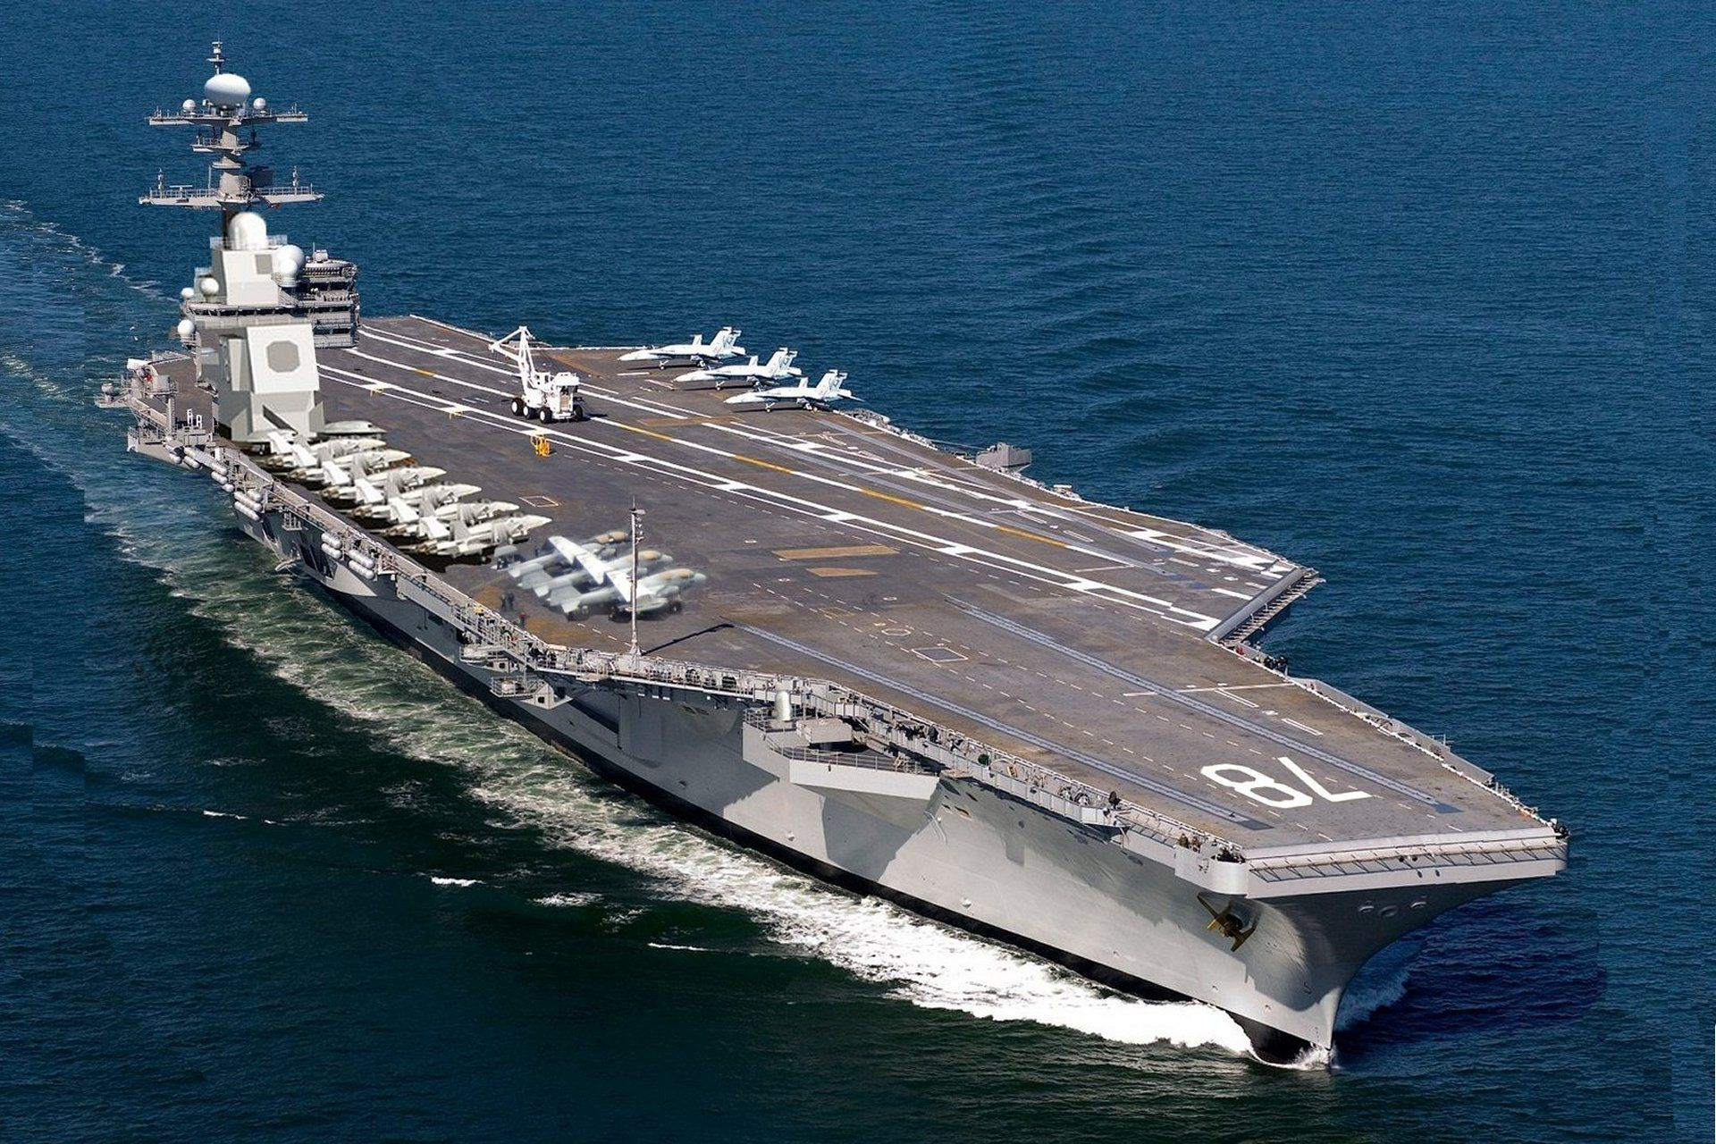

Slide 35
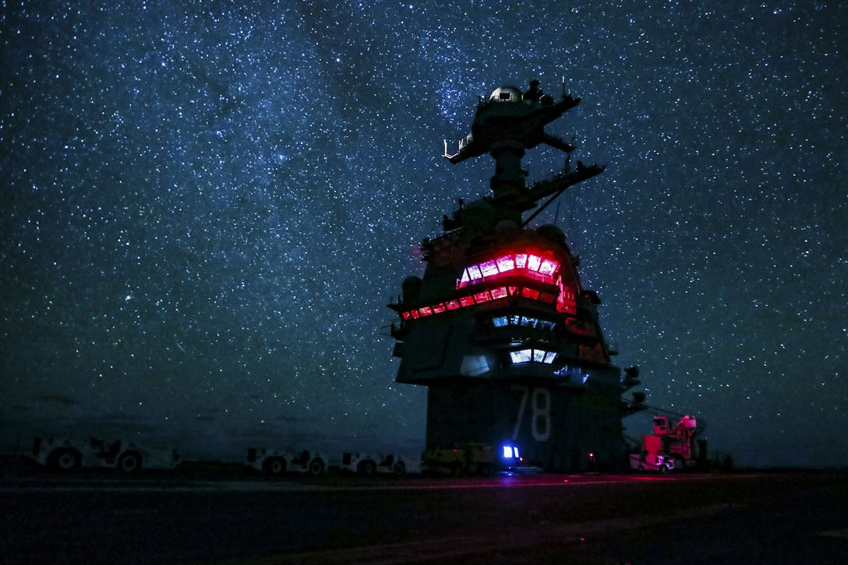

Slide 36
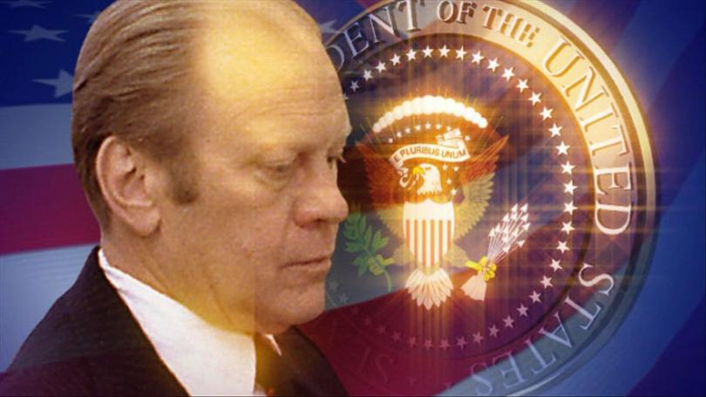

Slide 37
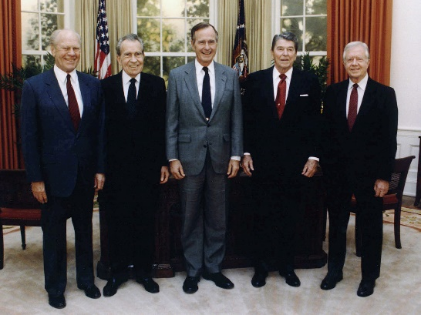
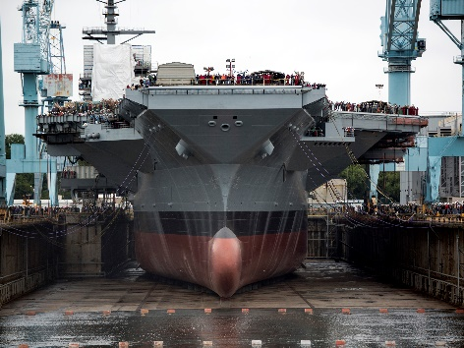

Slide 40
Presidential Quotes
Ron Bert
31½
March 22, 2020

Slide 41
Part 2
38. Gerald Ford (1974-1977)

Slide 42
“History and experience tell us that moral progress comes not in comfortable and complacent times, but out of trial and confusion.”

Slide 43
“For millions of men and women, the church has been the hospital for the soul, the school for the mind and the safe depository for moral ideas.”
the church
hospital
the church:
• hospital for the soul
• school for the mind
• safe depository for moral ideas
for the soul
school for the
mind
safe depository for
moral ideas

Slide 44
“There are no adequate substitutes for father, mother, and children bound together in a loving commitment to nurture and protect. No government, no matter how well-intentioned, can take the place of the family in the scheme of things.”
no
no
substitutes for
substitutes for
family
family

Slide 45
“It's the quality of the ordinary, the straight, the square, that accounts for the great stability and success of our nation. It's a quality to be proud of. But it's a quality that many people seem to have neglected.”
worker
moral
straight
honest
straight
success of our nation
success of our nation
neglected

Slide 46
What is crooked cannot be made straight, And what is lacking cannot be numbered. — Ecclesiastes 1:15
straight

Slide 47
“In the two centuries that have passed since 1776, millions upon millions of Americans have worked and taken up arms when necessary to make that dream a reality. We can be extremely proud of what they have accomplished. Today, we are the world's oldest republic. We are at peace. Our Nation and our way of life endure. We are free.”
republic
republic

Slide 48
“For nearly two hundred years, our nation has derived its strength from the diversity of its people and of their beliefs. That strength has been greatly enhanced by [the Islamic] religious heritage.”

Slide 49
“My commitment to the security and future of Israel is based upon basic morality as well as enlightened self-interest. Our role in supporting Israel honors our own heritage.”

Slide 50
Therefore, as we have opportunity, let us do good to all, especially to those who are of the household of faith. — Galatians 6:10

Slide 51
“Let us remember that our national unity is a most priceless asset.”
unity
unity

Slide 52
“But the separation of church and state, although a fundamental principle to which I fully subscribe, was never intended in my view to separate public morality from public policy.
never intended
never intended
to separate public morality
to separate public morality
from public policy
from public policy

Slide 53
“I believe that prayer in public schools should be voluntary. It is difficult for me to see how religious exercises can be a requirement in public schools, given our Constitutional requirement of separation of church and state. I feel that the highly desirable goal of religious education must be principally the responsibility of church and home. I do not believe that public education should show any hostility toward religion, and neither should it inhibit voluntary participation, if it does not interfere with the educational process.”
“I believe that prayer in public schools should be voluntary. It is difficult for me to see how religious exercises can be a requirement in public schools, given our Constitutional requirement of separation of church and state. I feel that the highly desirable goal of religious education must be principally the responsibility of church and home. I do not believe that public education should show any hostility toward religion, and neither should it inhibit voluntary participation, if it does not interfere with the educational process.”
not
not
show any hostility
show any hostility

Slide 54
“The length of one's days matters less than the love of one's family and friends.”

Slide 55
"The fear of the LORD is the beginning of wisdom, And the knowledge of the Holy One is understanding. For by me your days will be multiplied, And years of life will be added to you. If you are wise, you are wise for yourself, And if you scoff, you will bear it alone." — Proverbs 9:10-12
despise

Slide 56
“I remain convinced that pardoning Nixon was the right thing to do.”

Slide 57
Repay no one evil for evil. Have regard for good things in the sight of all men. If it is possible, as much as depends on you, live peaceably with all men. — Romans 12:17-18

Slide 58
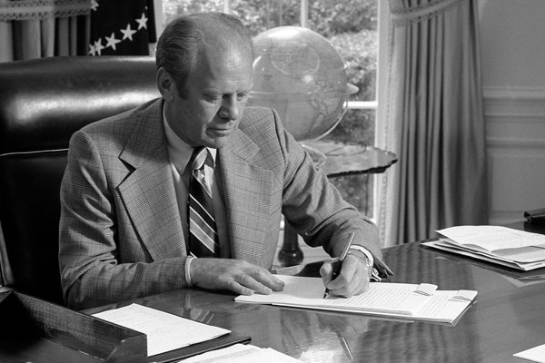
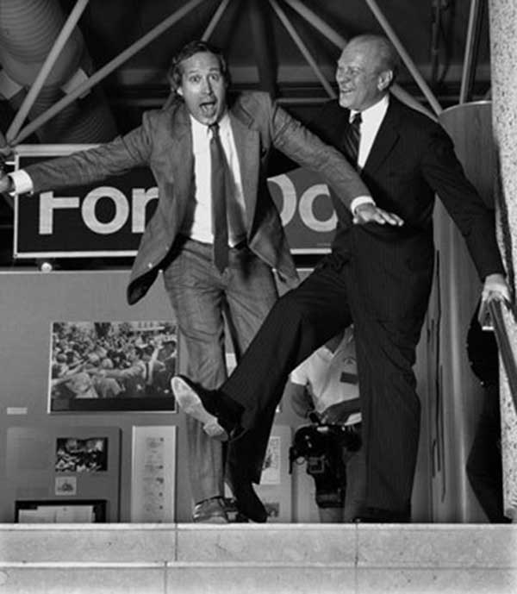
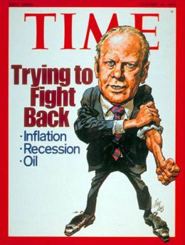

Slide 59
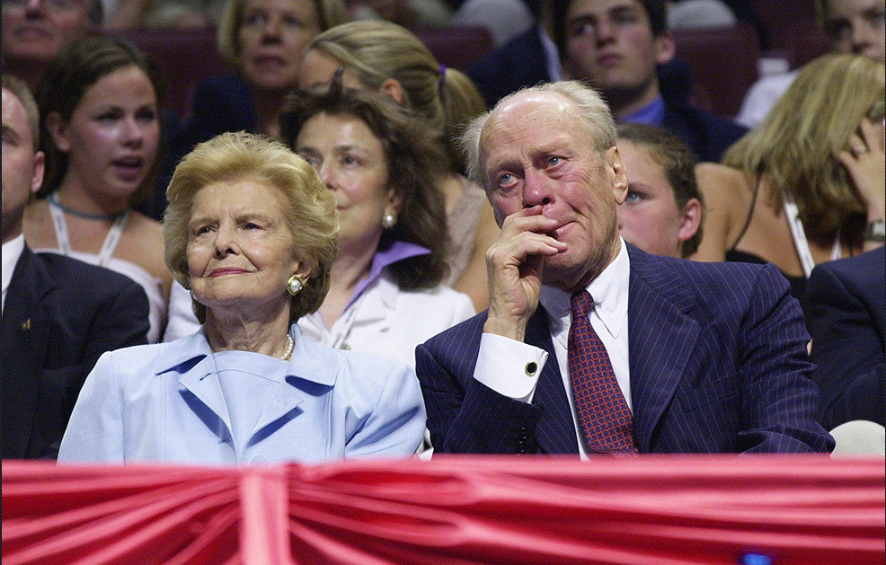
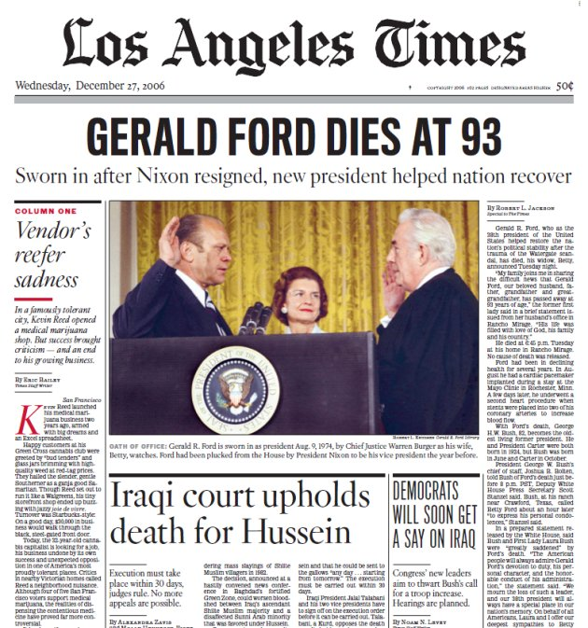

Slide 60
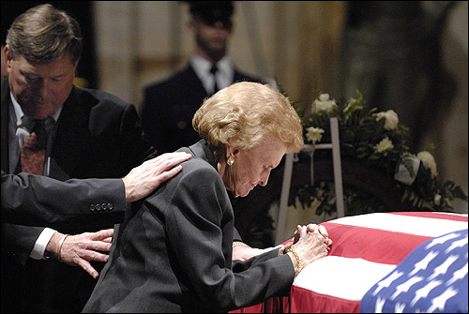

Slide 62
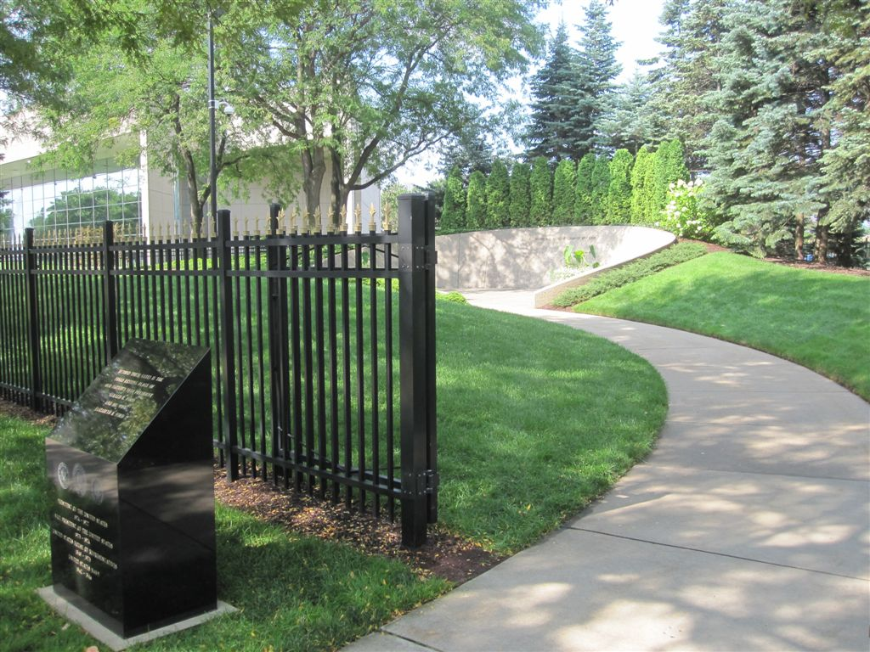

Slide 63
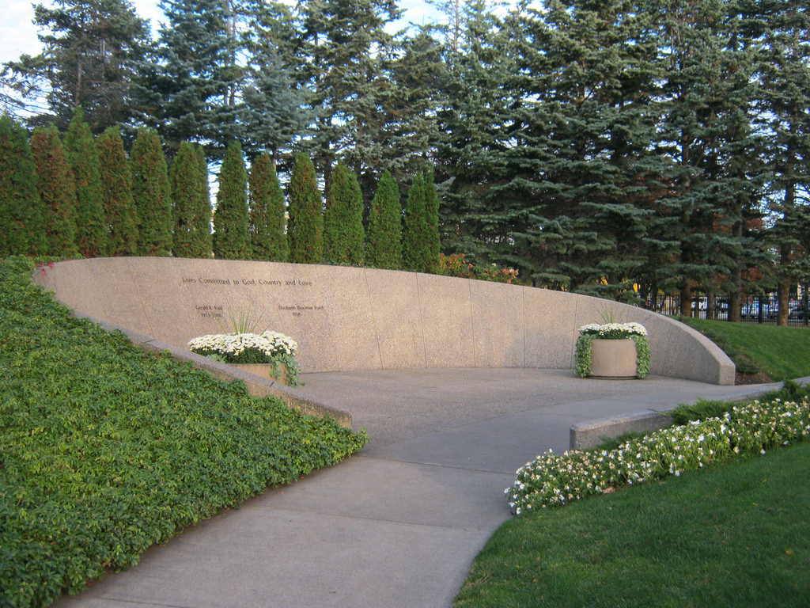

Slide 64
Married for 58 years

Slide 65
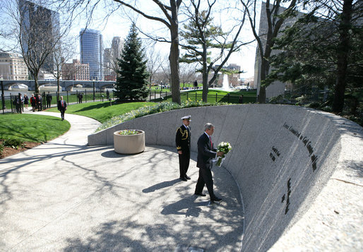
Grand Rapids, MI
President Bush
Notes:
Grand Rapids, Michigan

Slide 66
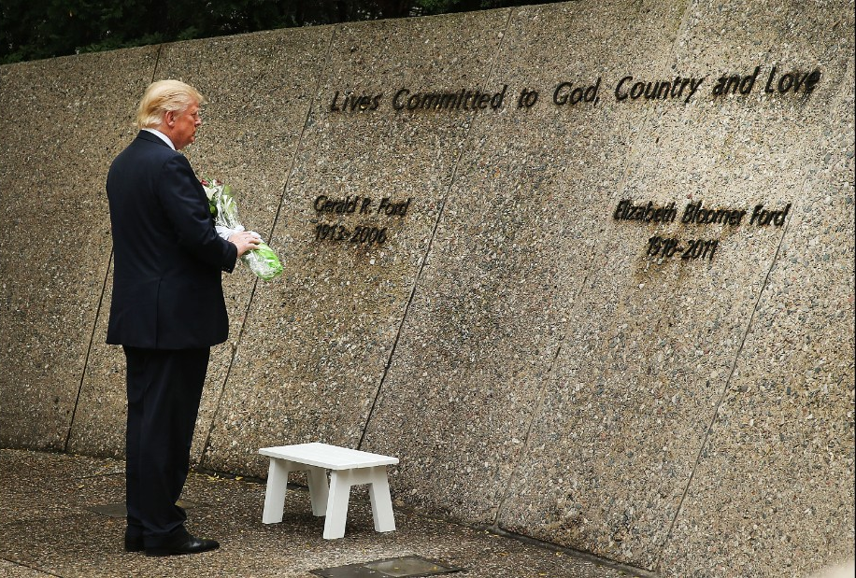

Slide 67
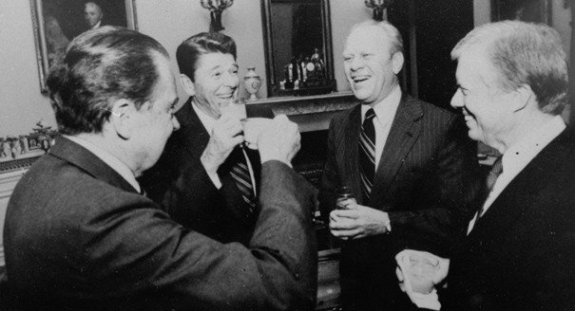
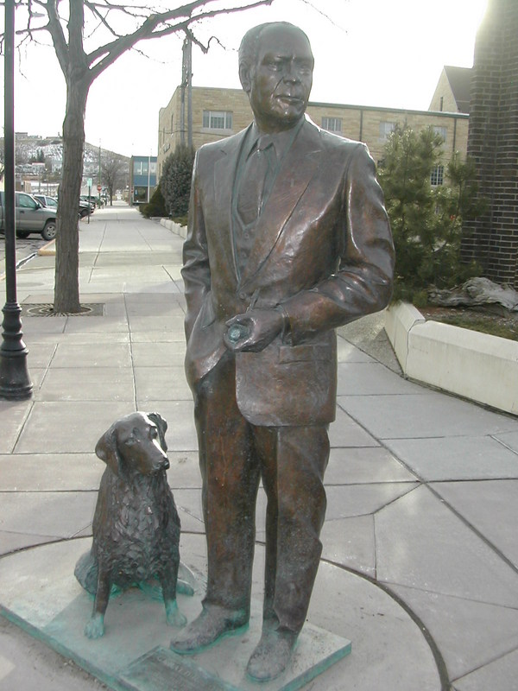
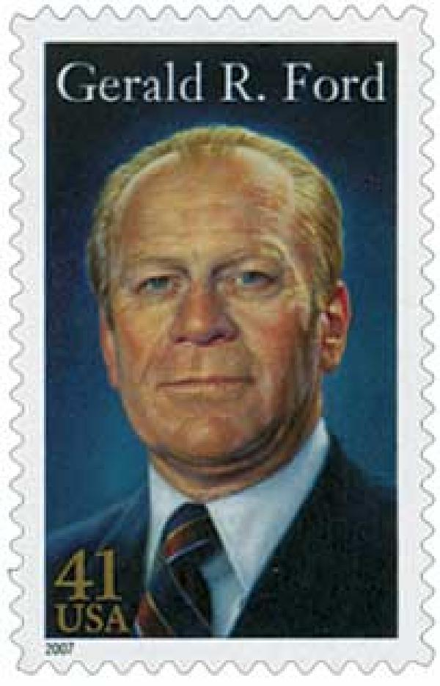

Slide 68
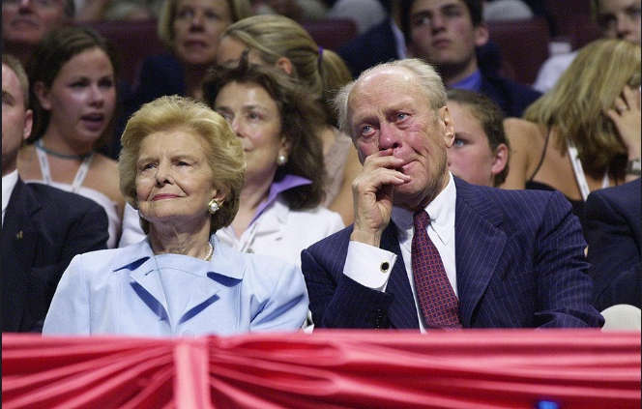
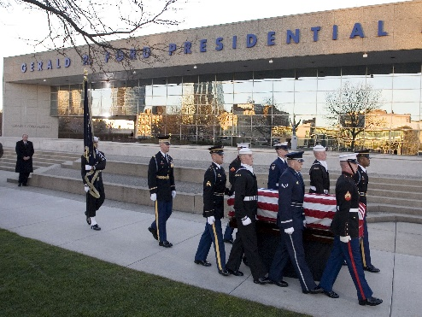
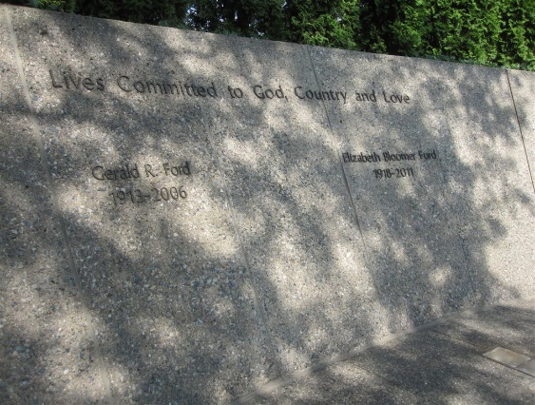
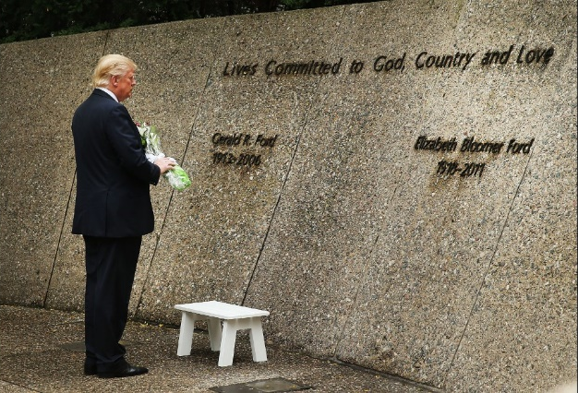

Slide 69
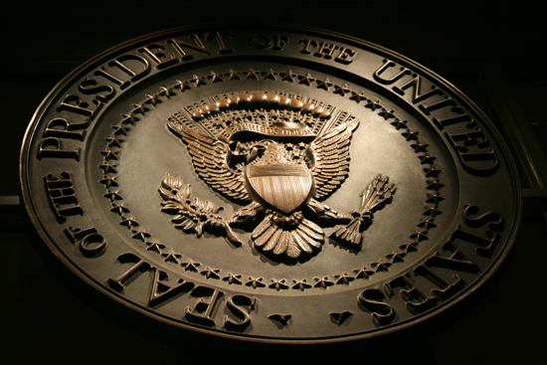
→ God forms the foundation for American life
→ Pain exposes endurance where mercy questions
→ Only God can truly forgive sins
→ Without honest truth no hope could endure
→ Only in the light of His love darkness is defeated
→ Darkness cannot be overcome if ignored
→ Establishing good character takes extreme effort
→ Nations only find might in the godly over rebellious
→ It is our duty to stand with faithful God fearing souls
→ Without moral social consensus unity is all but lost
→ Dooming is public policy absent of public morality
→ Love is the one breath that is remembered
→ Forgiveness is what emboldens a people
Troubled times call for honest hearts
Notes:
Troubled times call for honest hearts

Slide 71
Please visit http://www.LoveFromGod.com to explore further
Ronald Bert Channel on
Notes:
Eternity never ends.

