Slide 2
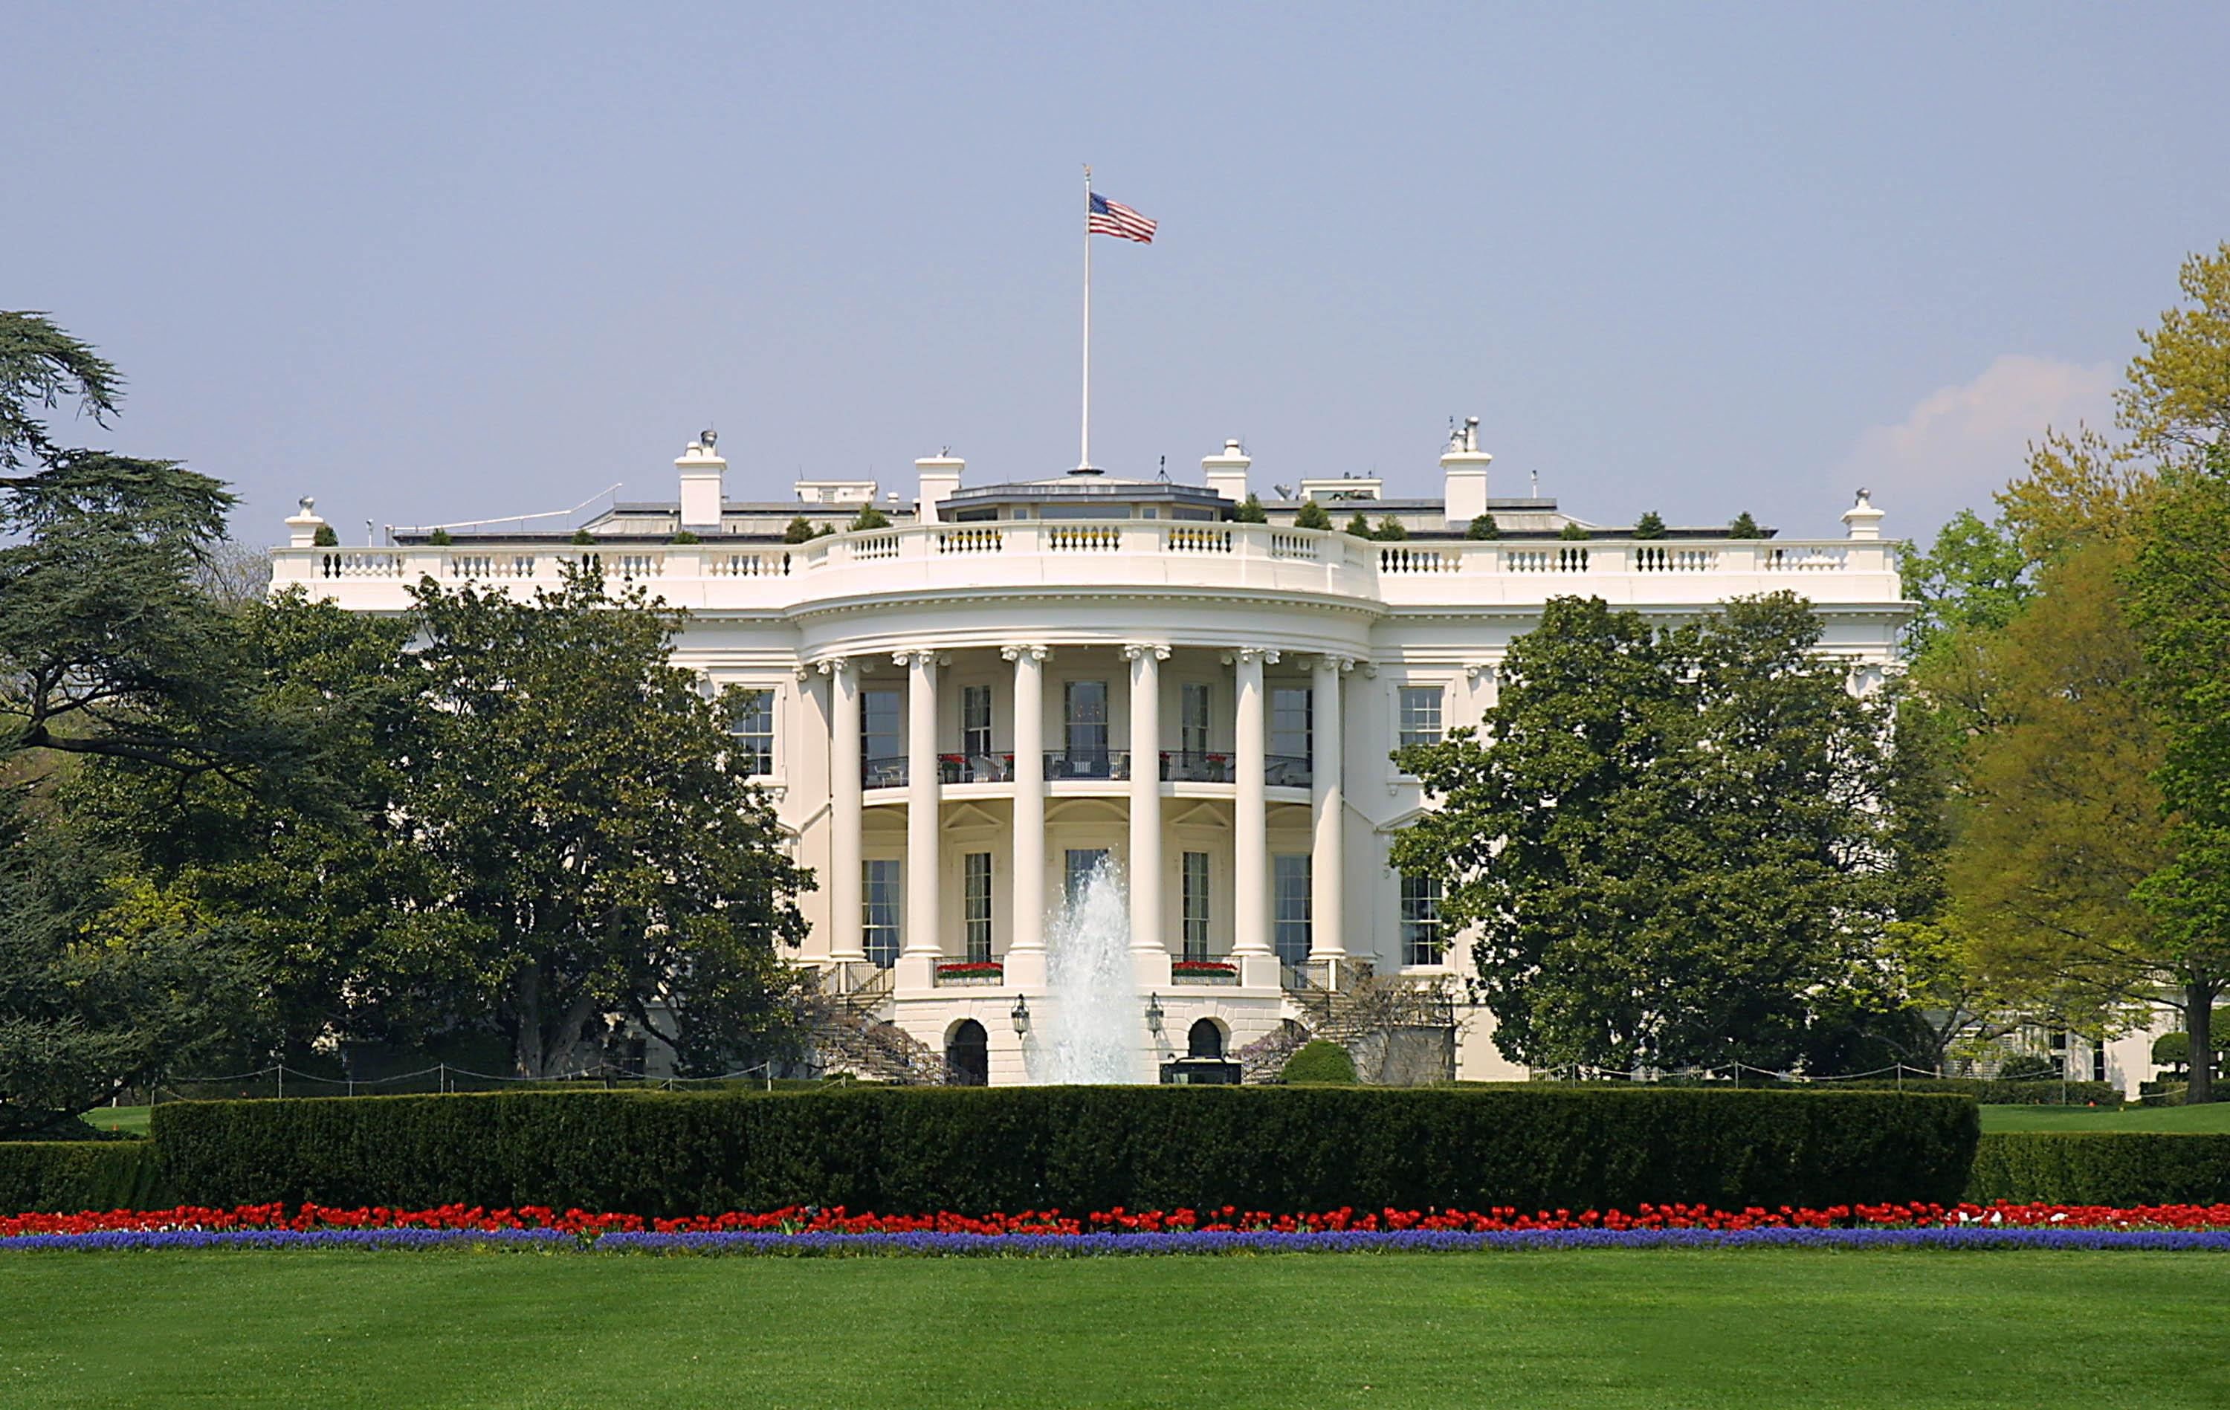
Presidential Quotes
Ron Bert
30
January 26, 2020

Slide 3
Part 1
37. Richard Nixon (1969-1974)

Slide 4
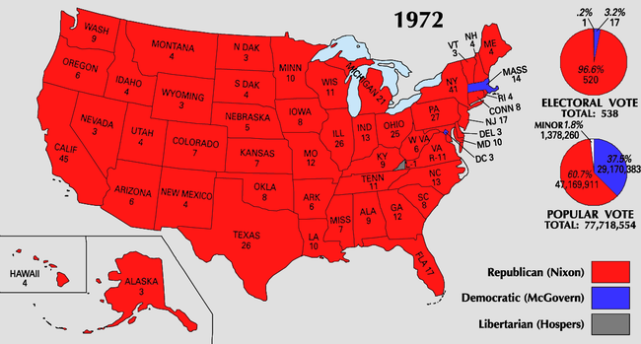
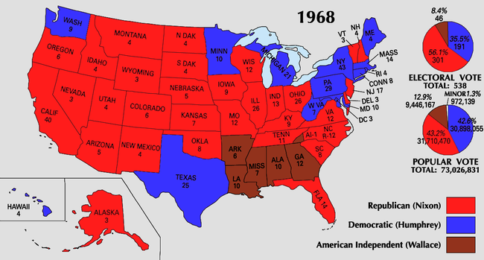

Slide 5
“Life isn't meant to be easy. It's hard to take being on the top - or on the bottom. I guess I'm something of a fatalist. You have to have a sense of history, I think, to survive some of these things ... Life is one crisis after another.”
. .

Slide 6
“People react to fear, not love; they don't teach that in Sunday School, but it's true.”

Slide 7
"But take heed to yourselves, lest your hearts be weighed down with carousing, drunkenness, and cares of this life, and that Day come on you unexpectedly. "For it will come as a snare on all those who dwell on the face of the whole earth. "Watch therefore, and pray always that you may be counted worthy to escape all these things that will come to pass, and to stand before the Son of Man." — Luke 21:34-36
snare on all
Watch therefore

Slide 9
Love has been perfected among us in this: that we may have boldness in the day of judgment; because as He is, so are we in this world. There is no fear in love; but perfect love casts out fear, because fear involves torment. But he who fears has not been made perfect in love. — 1st John 4:17-18
no fear in love

Slide 10
“Communism denies God, enslaves men, and destroys justice.”

Slide 11
“Capitalism works better than it sounds, while socialism sounds better than it works.”

Slide 12
“The Soviet Union began by banishing God. The United States began as a community of people who wanted to worship God as they chose. … Man does not live by bread alone. Those in the United States whose desire to create a strictly secular society is as strong as Lenin's was should study this Cold War lesson closely. Communism was defeated by an alliance spearheaded by 'one nation under God.'”
banishing God
strictly secular society
Communism
Communism
one nation under God

Slide 13
But Jesus answered him, saying, "It is written, 'Man shall not live by bread alone, but by every word of God.'" — Luke 4:4

Slide 14
Bear one another's burdens, and so fulfill the law of Christ. — Galatians 6:2

Slide 15
“As you know, the separation of church and state is not subject to discussion or alteration. Under our Constitution no church or religion can be supported by the U.S. Government. We maintain freedom of religion so that an American can either worship in the church of his choice or choose to go to no church at all.”
freedom of religion
worship

Slide 16
Jesus this song you wrote, The words are sticking in my throat, Peace on Earth, Hear it every Christmas time, But hope and history won't rhyme, So what's it worth? This peace on Earth.
hopelessness
Bitterness
won't rhyme
in God

Slide 17
And suddenly there was with the angel a multitude of the heavenly host praising God and saying: "Glory to God in the highest, And on earth peace, goodwill toward men!" — Luke 2:13-14

Slide 18
"Do not think that I came to bring peace on earth. I did not come to bring peace but a sword." — Matthew 10:34

Slide 19
“When the strongest nation in the world can be tied up for years in a war with no end in sight, when the richest nation in the world can't manage its own economy, when the nation with the greatest tradition of the rule of law is plagued by unprecedented lawlessness, and when the President of the United States cannot travel abroad or to any major city at home without fear of a hostile demonstration - then it's time for new leadership for the United States of America.”
war with no end
can't manage its own economy
lawlessness
time for new
leadership

Slide 20
Alas, sinful nation, A people laden with iniquity, A brood of evildoers, Children who are corrupters! They have forsaken the LORD, They have provoked to anger The Holy One of Israel, They have turned away backward. — Isaiah 1:4

Slide 21
“What we have done with the American Indian is its way as bad as what we imposed on the Negroes. We took a proud and independent race and virtually destroyed them. We have to find ways to bring them back into decent lives in this country.”
bring them back

Slide 22
“The man of thought who will not act is ineffective; the man of action who will not think is dangerous.”
Hides
not act
Thoughtless Impulsive
not think

Slide 23
Therefore, to him who knows to do good and does not do it, to him it is sin. — James 4:17

Slide 24
The heart of the prudent acquires knowledge, And the ear of the wise seeks knowledge. — Proverbs 18:15
. .
wise

Slide 25
Wisdom is the principal thing; Therefore get wisdom. And in all your getting, get understanding. — Proverbs 4:7
Wisdom
depth of character
understanding

Slide 26
"There is nothing that enters a man from outside which can defile him; but the things which come out of him, those are the things that defile a man." — Mark 7:15

Slide 27
“The student who invades an administration building, roughs up a dean, rifles the files and issues 'non-negotiable demands' may have some of his demands met by a permissive university administration. But the greater his 'victory' the more he will have undermined the security of his own rights.”

Slide 28
Remember those who rule over you, who have spoken the word of God to you, whose faith follow, considering the outcome of their conduct. — Hebrews 13:7
Let every soul be subject to the governing authorities. For there is no authority except from God, and the authorities that exist are appointed by God.. — Romans 13:1

Slide 29
"And because lawlessness will abound, the love of many will grow cold." — Matthew 24:12

Slide 30
“There is an international disease which feeds on the notion that if you have a cause to defend, you can use any means to further your cause, since the end justifies the means. As an international community, we must oppose this notion, whether it be in Canada, in the United States, or anywhere else. No cause justifies violence as long as the system provides for change by peaceful means.”

Slide 31
“A man who has never lost himself in a cause bigger than himself has missed one of life's mountaintop experiences. Only in losing himself does he find himself. Only then does he discover all the latent strengths he never knew he had and which otherwise would have remained dormant.”

Slide 32
“Until he has been part of a cause larger than himself, no man is truly whole.”

Slide 33
"For whoever desires to save his life will lose it, but whoever loses his life for My sake and the gospel's will save it. — Mark 8:35

Slide 34
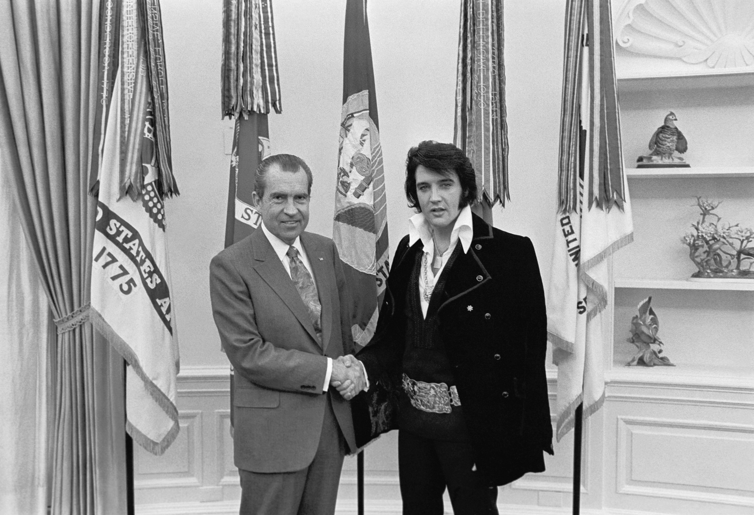

Slide 35
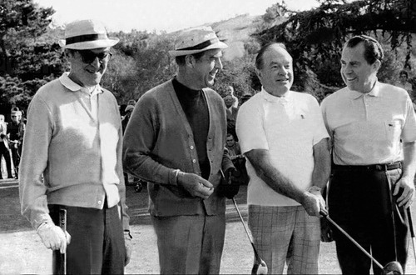

Slide 36
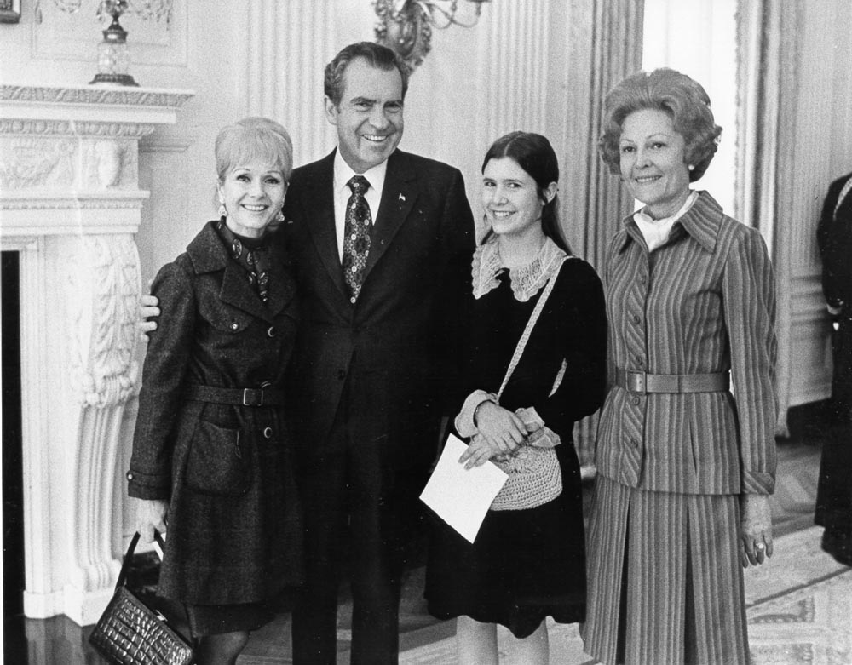

Slide 37
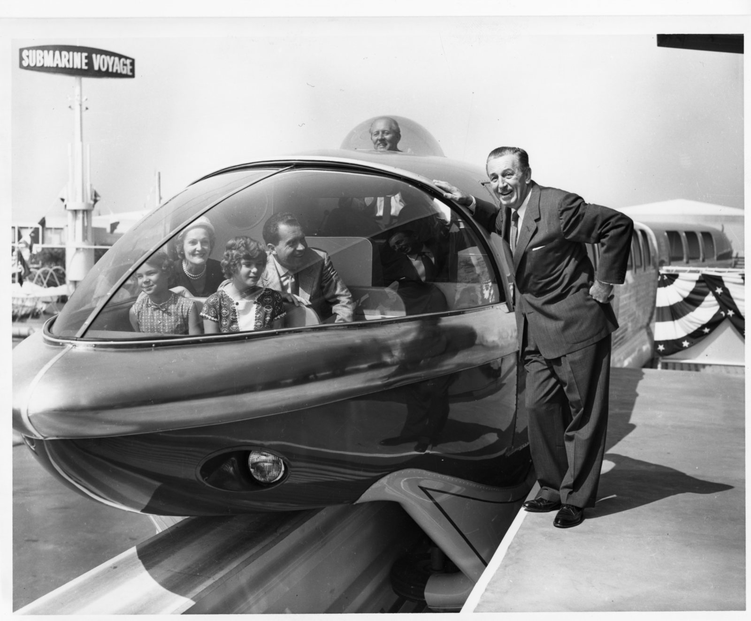

Slide 38
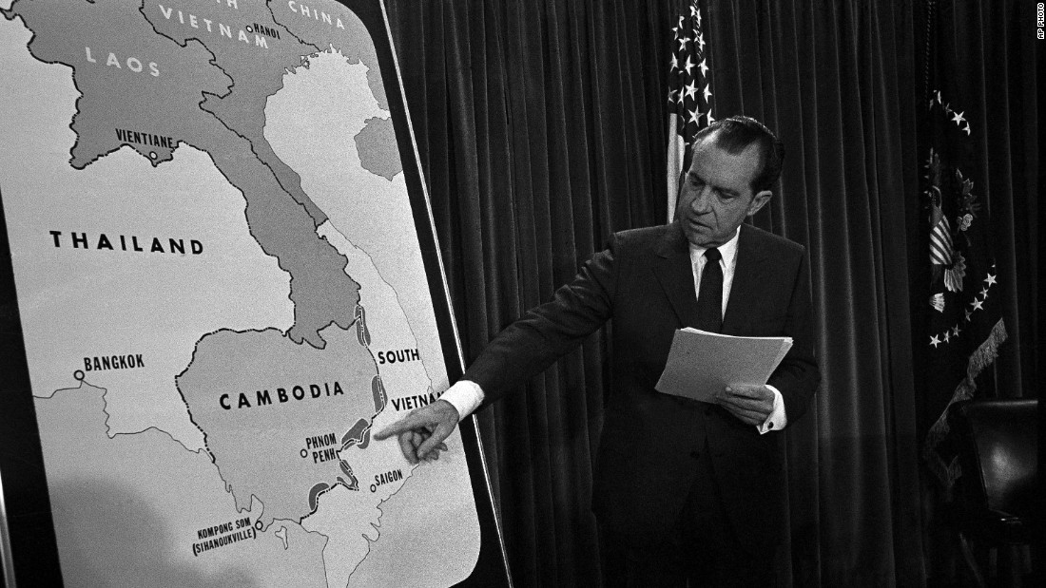

Slide 39
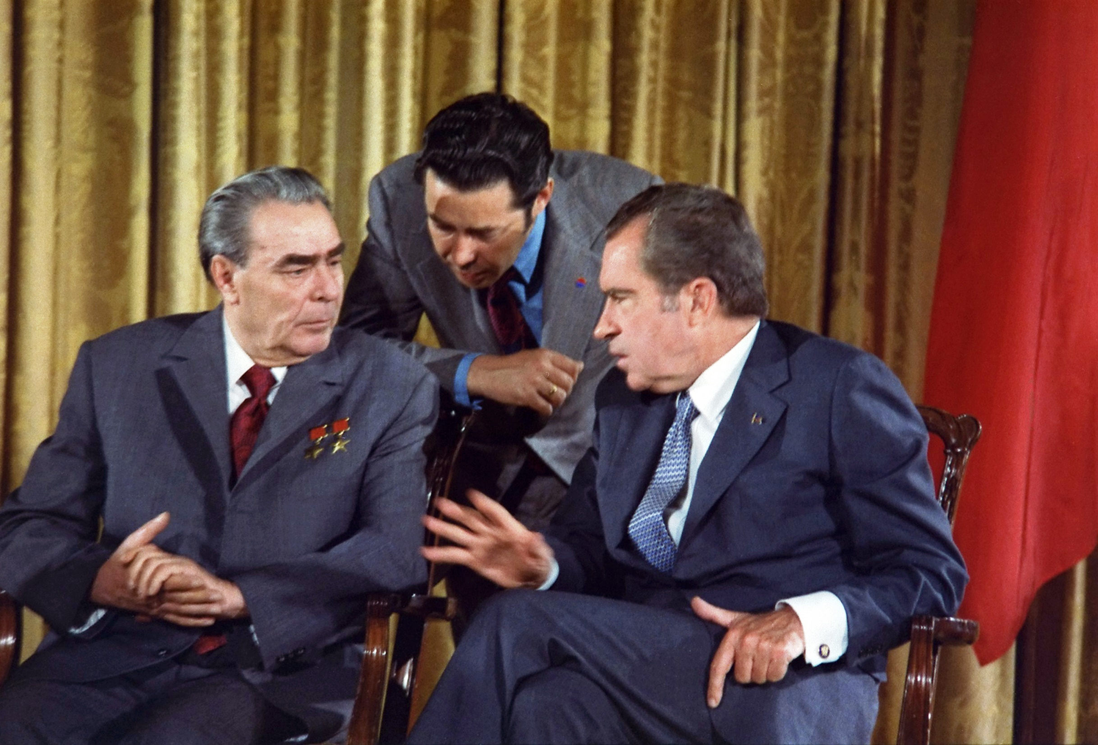

Slide 40
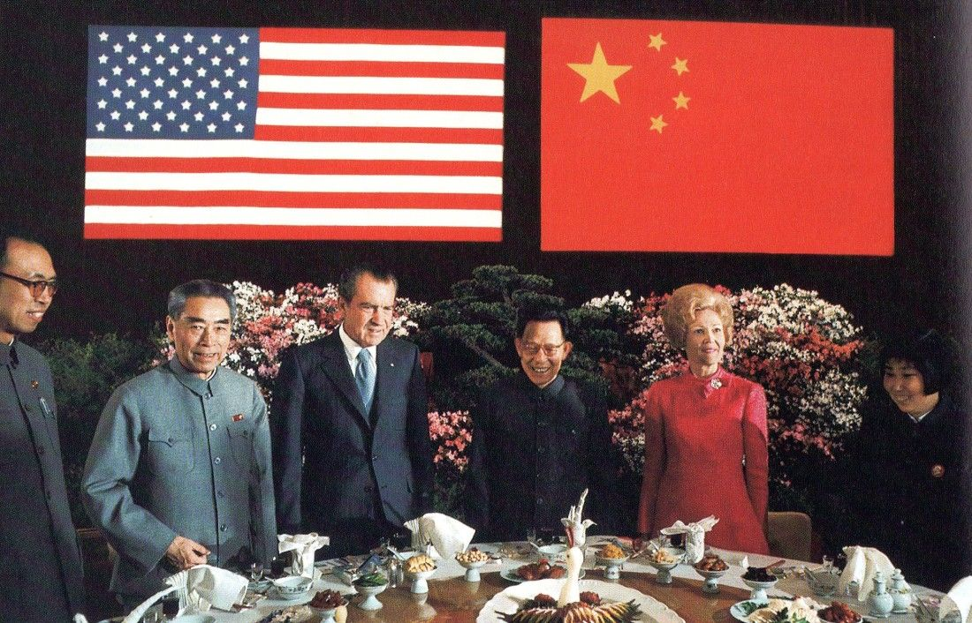

Slide 41
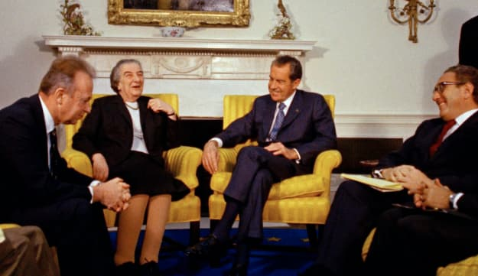
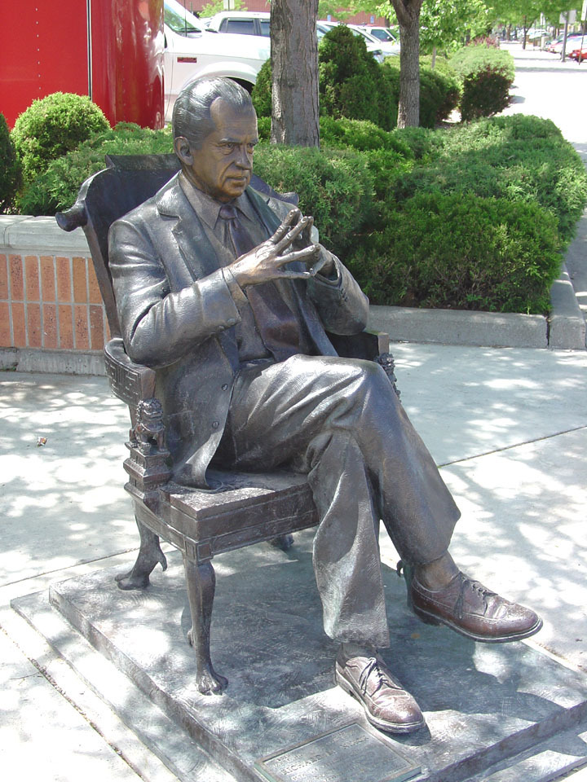

Slide 42
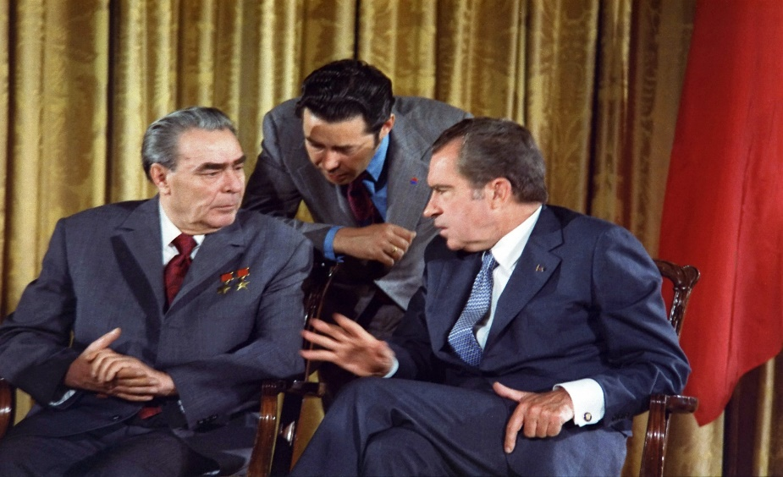

Slide 45
Presidential Quotes
Ron Bert
30½
February 2, 2020

Slide 46
Part 2
37. Richard Nixon (1969-1974)

Slide 47
“With all the power that a president has, the most important thing to bear in mind is this: You must not give power to a man unless, above everything else, he has character. Character is the most important qualification the president of the United States can have.”
Character
Character

Slide 48
He who walks with integrity walks securely, But he who perverts his ways will become known. — Proverbs 10:9
integrity
uprightness
honesty
truthfulness

Slide 49
“Before we become too arrogant with the most deadly of the seven deadly sins, the sin of pride, let us remember that the two great wars of this century, wars which cost twenty million dead, were fought between Christian nations praying to the same God.”
. .
seven deadly sins
truthfulness
unfaithful
?
. .
Christian nations praying

Slide 50
1. Lust 2. Gluttony 3. Greed 4. Sloth 5. Wrath 6. Envy 7. Pride

Slide 51
Therefore the Lord said: "Inasmuch as these people draw near with their mouths And honor Me with their lips, But have removed their hearts far from Me, And their fear toward Me is taught by the commandment of men, … — Isaiah 29:13
X
Self-seeking

Slide 52
“Never be too proud to go onto your knees before God.”

Slide 53
Pride goes before destruction, And a haughty spirit before a fall. — Proverbs 16:18

Slide 54
“In the long term we can hope that religion will change the nature of man and reduce conflict. But history is not encouraging in this respect. The bloodiest wars in history have been religious wars.
hope
hope
arrogance
religious
ideologies

Slide 55
wars and fights
Where do wars and fights come from among you? Do they not come from your desires for pleasure that war in your members? You lust and do not have. You murder and covet and cannot obtain. You fight and war. Yet you do not have because you do not ask. You ask and do not receive, because you ask amiss, that you may spend it on your pleasures. — James 4:1-3
desires for pleasure
lust
wars and fights
desires for pleasure
lust
murder and covet
murder and covet
hate
want

Slide 56
“To a crisis of the spirit, we need an answer of the spirit. To find that answer, we need only look within ourselves. When we listen to the better angels of our nature, we find that they celebrate the simple things, the basic things -- such as goodness, decency, love, kindness. Greatness comes in simple trappings.”
crisis of
the spirit
spirit
look within our spirit
listen to find the simple things
Greatness comes in:
• goodness
• decency
• love
• kindness
look within
. .
the simple things
listen to
our
find
• goodness
• decency
• love
• kindness
the simple things
goodness
decency
love
kindness
Greatness
comes in
Notes:
To neglect good and kind decent loving emotions is to be a barren vessel.

Slide 57
"But the hour is coming, and now is, when the true worshipers will worship the Father in spirit and truth; for the Father is seeking such to worship Him. God is Spirit, and those who worship Him must worship in spirit and truth." — John 4:23-24
Goodness • Decency • Love • Kindness •
Bullets of Truth
in
. .
self
lies

Slide 58
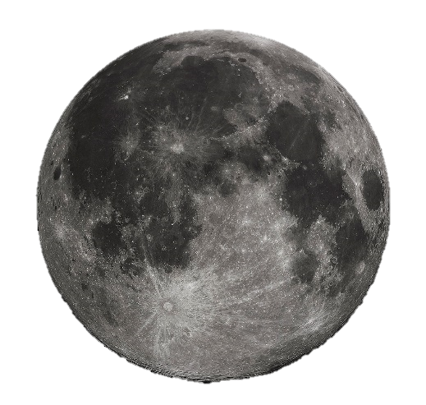
“For years politicians have promised the Moon. I'm the first one to be able to deliver it.”

Slide 59
“For one priceless moment in the whole history of man, all of the people on this earth are truly one. One in their pride at what you have done, one in our prayers that you will return safely to earth.”
one
in
. .
one in our prayers
one
`

Slide 60
Finally, all of you be of one mind, having compassion for one another; love as brothers, be tenderhearted, be courteous; — 1st Peter 3:8
. .
one mind
one
● compassion
● love
● tenderhearted
● courteous
compassion
one
love
tenderhearted
courteous

Slide 61
“Let us begin by committing ourselves to the truth to see it like it is, and tell it like it is, to find the truth, to speak the truth, and to live the truth.”
to the truth
. .
truth
truth
truth
truth
truth

Slide 62
to
to speak
to live
to

Slide 63
"And you shall know the truth, and the truth shall make you free." — John 8:32
know
free

Slide 64
“There may be some truth in that if the Arabs have some complaints about my policy towards Israel, they have to realize that the Jews in the U. S. control the entire information and propaganda machine, the large newspapers, the motion pictures, radio and television, and the big companies, and there is a force that we have to take into consideration.”

Slide 65
“Look at the Justice Department, it's full of Jews ... The lawyers in government are damn Jews.”

Slide 66
“The Jews are irreligious, atheistic, immoral bunch of b#!@&%.”
“The Jews are just a very aggressive and abrasive and obnoxious personality.”
“The Jewish cabal is out to get me.”

Slide 67
… have you not shown partiality among yourselves, and become judges with evil thoughts? — James 2:4
… but if you show partiality, you commit sin, and are convicted by the law as transgressors. — James 2:9
prejudice
Notes:
There is no unity in prejudice, only hate that divides peace of heart.

Slide 68
"Have I not commanded you? Be strong and of good courage; do not be afraid, nor be dismayed, for the LORD your God is with you wherever you go." — Joshua 1:9

Slide 69
What then shall we say to these things? If God is for us, who can be against us? — Romans 8:31

Slide 70
“I want a G#!d@* strong statement on marijuana, I mean one that just tears the a#! out of them. You know, its a funny thing, every one of the b#!@&% that are out for legalizing marijuana is Jewish.”

Slide 71
Let no corrupt word proceed out of your mouth, but what is good for necessary edification, that it may impart grace to the hearers. — Ephesians 4:29

Slide 72
“The jawbone of an a#! is just as dangerous a weapon today as in Sampson's time.”

Slide 73
“Look, people get drunk ... People chase girls. And the point is, it's a hell of a lot better for them to get drunk than to take drugs. It's better to chase girls than boys.”

Slide 74
Even so the tongue is a little member and boasts great things. See how great a forest a little fire kindles!. — James 3:5

Slide 75
A wise man fears and departs from evil, But a fool rages and is self-confident. — Proverbs 14:16

Slide 76
A fool vents all his feelings, But a wise man holds them back. If a ruler pays attention to lies, All his servants become wicked. — Proverbs 29:11-12

Slide 77
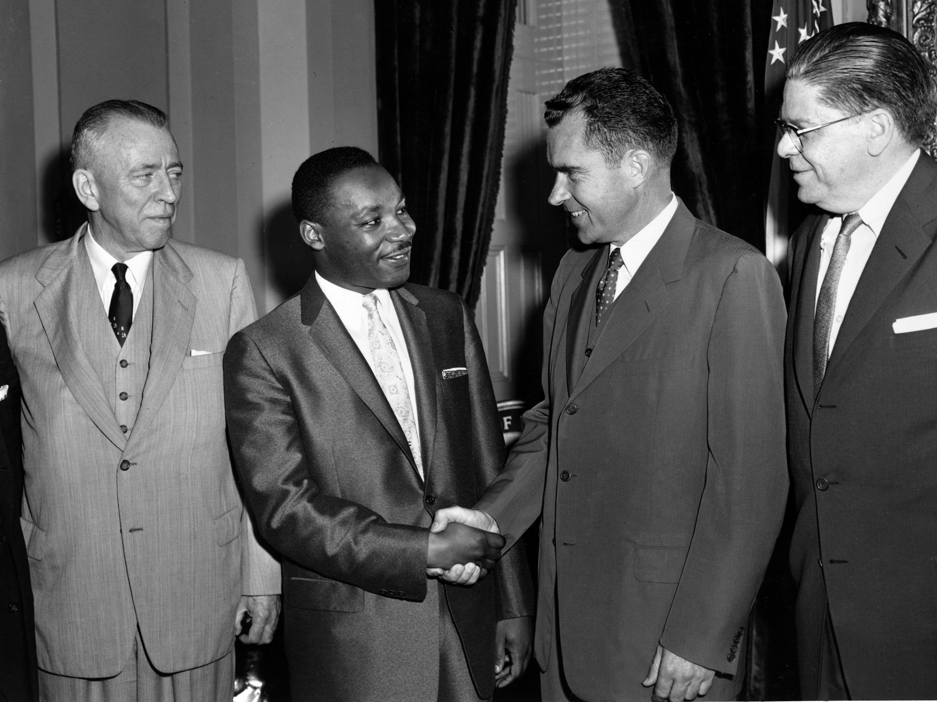

Slide 78
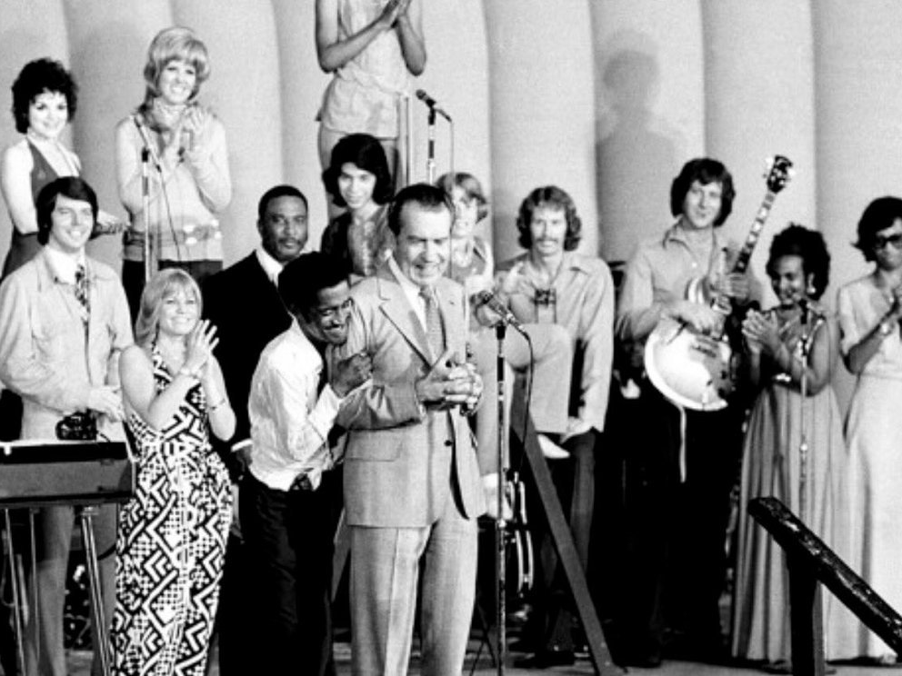

Slide 79
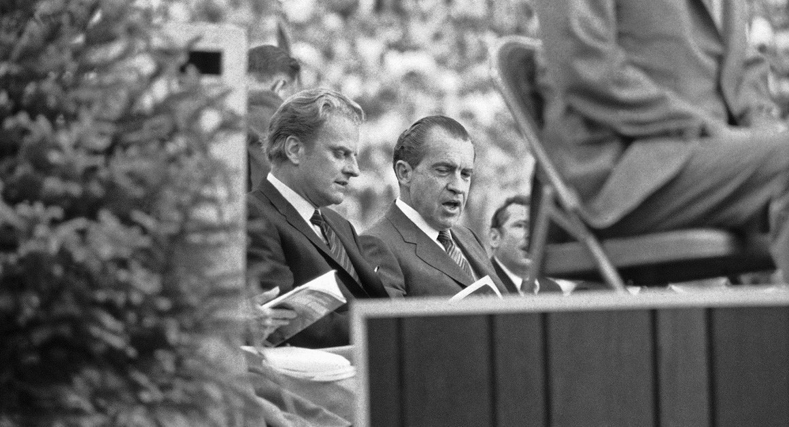

Slide 80
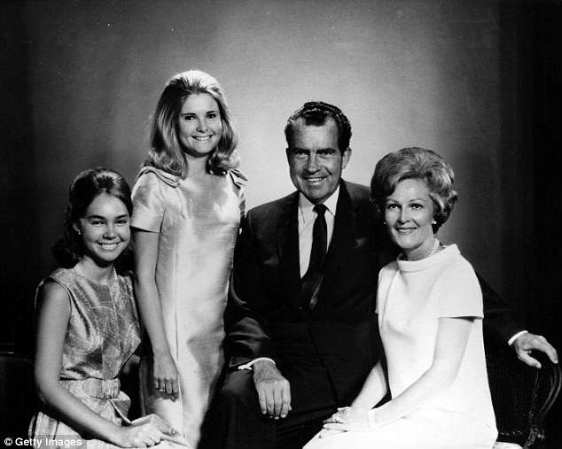
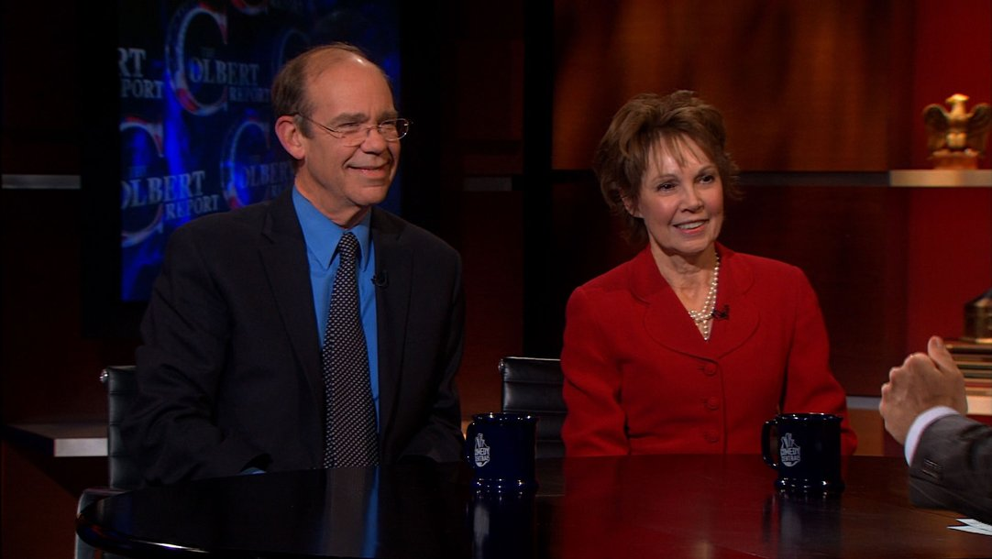
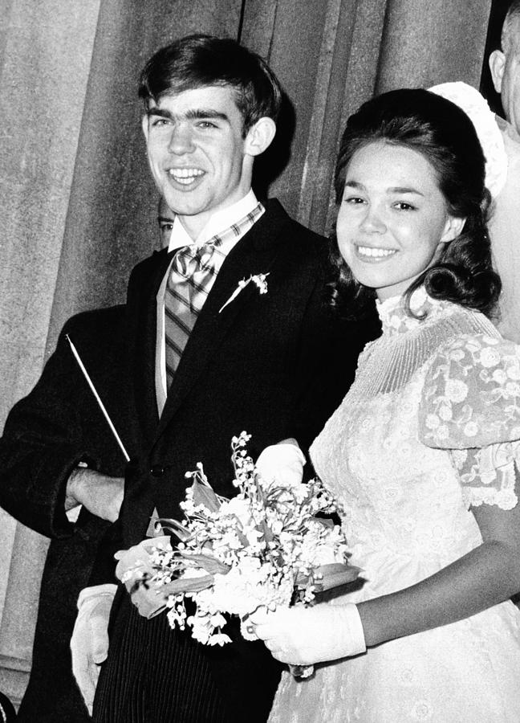
Notes:
Julie and David Eisenhower are married. Older in 2010.

Slide 81
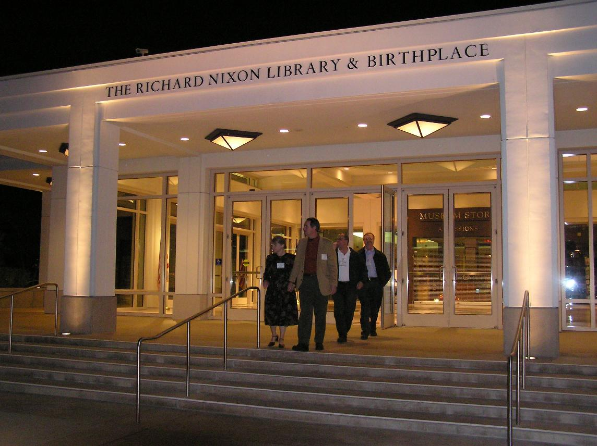

Slide 83
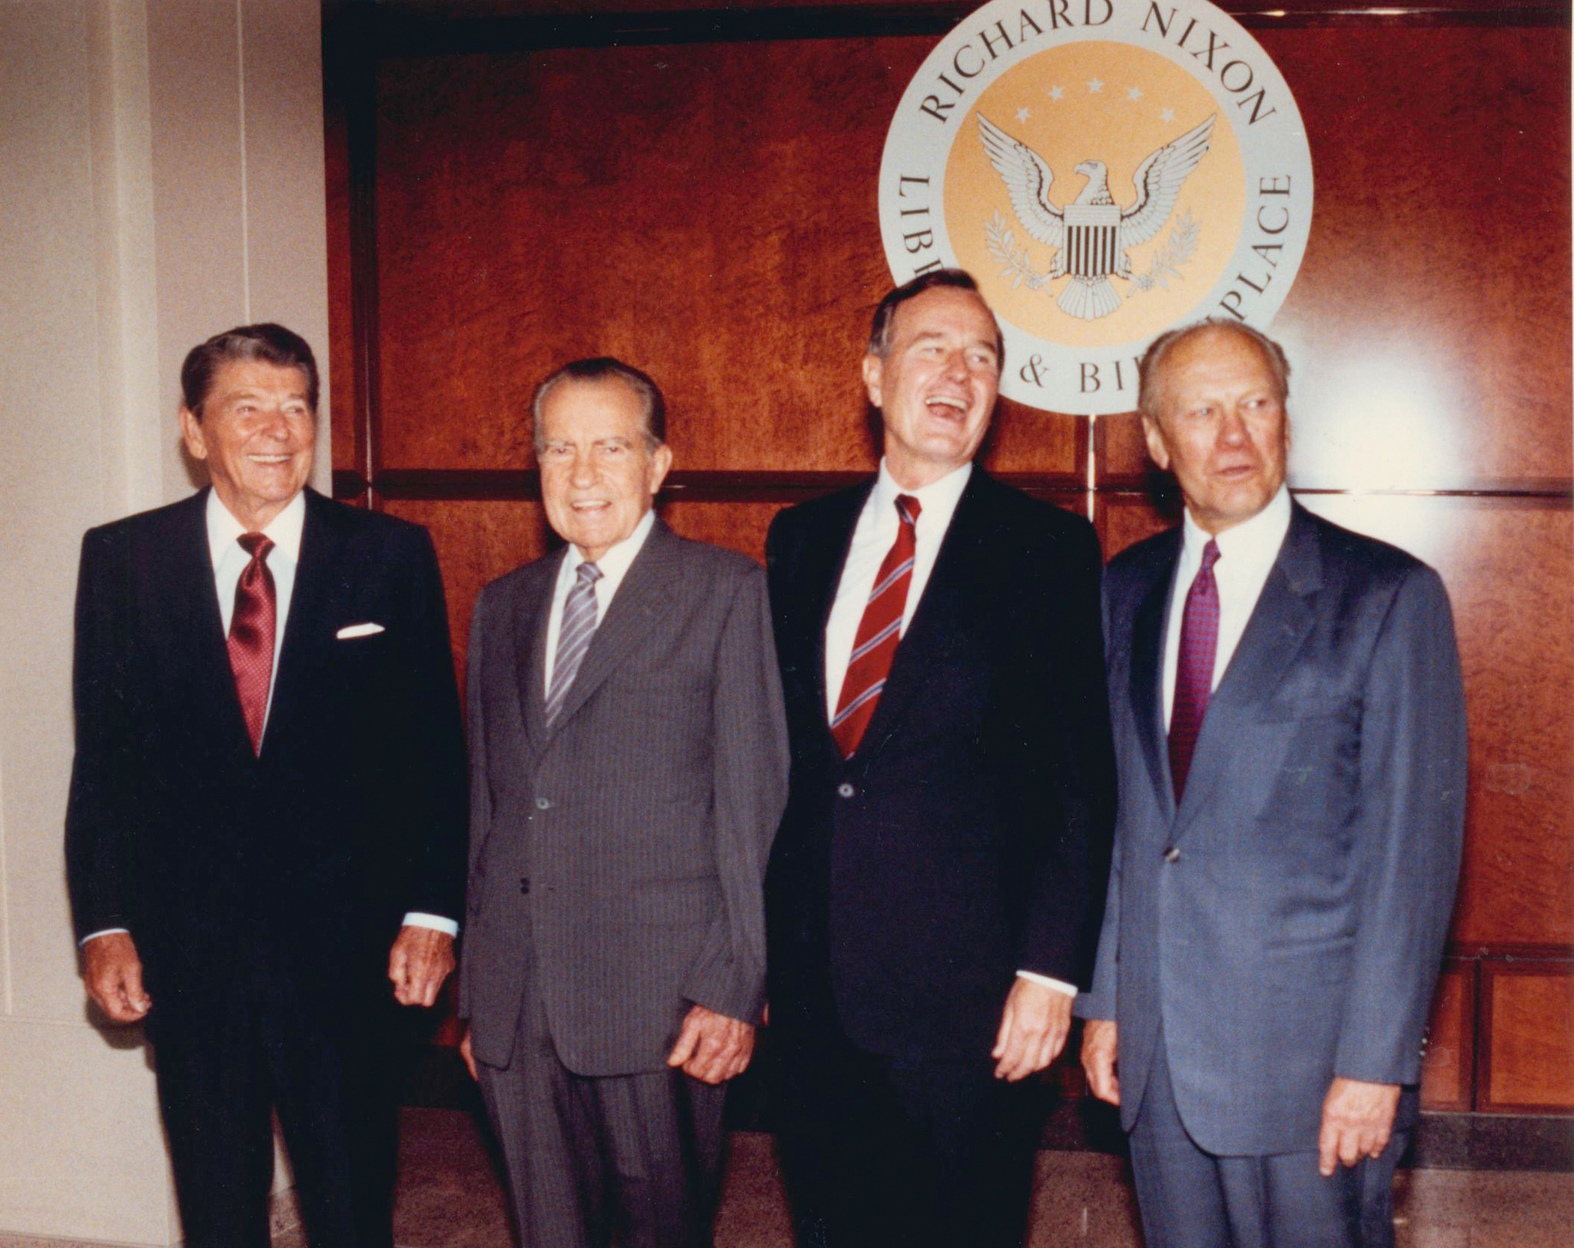

Slide 86
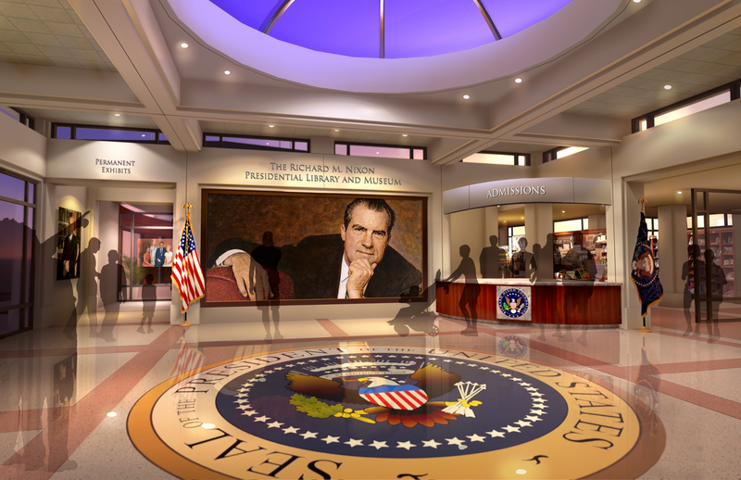

Slide 87
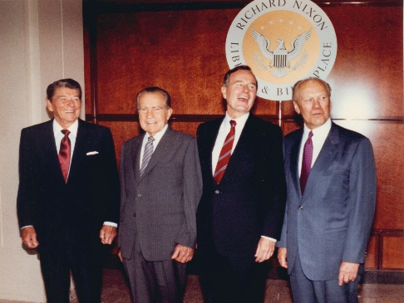
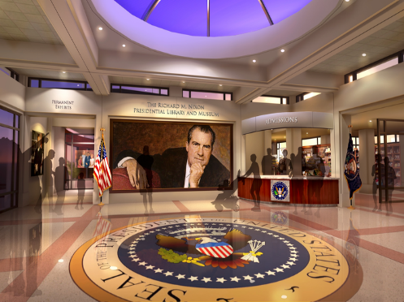

Slide 88
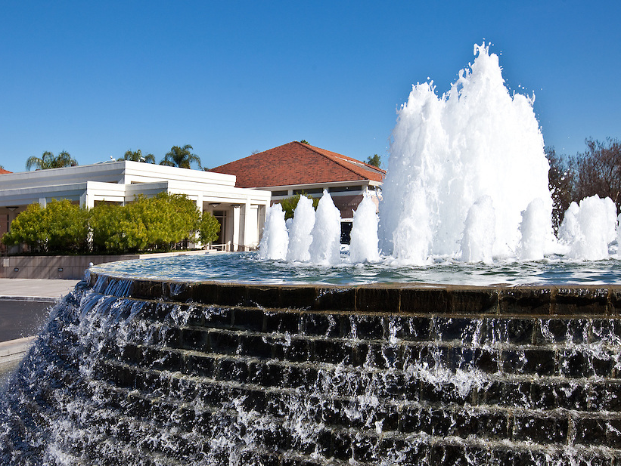

Slide 90
Presidential Quotes
Ron Bert
30¾
February 23, 2020

Slide 91
Part 3
37. Richard Nixon (1969-1974)

Slide 92
“I don't mind the homosexuality. I understand it. Nevertheless, g#!d@*, I don't think you glorify it on public television, homosexuality, even more than you glorify whores. We all know we have weaknesses. But, g#!d@*it, what do you think that does to kids? You know what happened to the Greeks! Homosexuality destroyed them. Sure, Aristotle was a homo. We all know that. So was Socrates.”
Homosexuality destroyed them

Slide 93
Do you not know that the unrighteous will not inherit the kingdom of God? Do not be deceived. Neither fornicators, nor idolaters, nor adulterers, nor homosexuals, nor sodomites, nor thieves, nor covetous, nor drunkards, nor revilers, nor extortioners will inherit the kingdom of God. — 1st Corinthians 6:9-10

Slide 94
Neither:
● fornicators ● thieves
● idolaters ● covetous
● adulterers ● drunkards
● homosexuals ● sodomites
● revilers ● extortioners
will inherit the kingdom of God

Slide 95
God, of course, is the greatest philosopher of all.

Slide 96
For in Him dwells all the fullness of the Godhead bodily; and you are complete in Him, who is the head of all principality and power. — Colossians 2:9-10

Slide 97
“I know you heard what you thought I said, but what I said isn't what I meant.”

Slide 98
Therefore you are inexcusable, O man, whoever you are who judge, for in whatever you judge another you condemn yourself; for you who judge practice the same things. But we know that the judgment of God is according to truth against those who practice such things. And do you think this, O man, you who judge those practicing such things, and doing the same, that you will escape the judgment of God? — Romans 2:1-3
judgment of God is according to truth

Slide 99
“I didn't do anything wrong and I promise to never do it again.”
ø
EXCUSES
Notes:
The dishonest usually come up with excuses after lying about something or caught in a misbehavior.

Slide 100
Well, I screwed it up real good, didn't I?
Notes:
Humble hearts cut through all previous arrogance, and what God waits for.

Slide 101
“What a strange creature man is that he fouls his own nest”

Slide 102
Like a bird that wanders from its nest Is a man who wanders from his place. — Proverbs 27:8

Slide 103
These are grumblers, complainers, walking according to their own lusts; and they mouth great swelling words, flattering people to gain advantage — Jude 1:16

Slide 104
“I have never been a quitter. To leave office before my term is completed is opposed to every instinct in my body. But as president I must put the interests of America first Therefore, I shall resign the presidency effective at noon tomorrow.”
first

Slide 105
“I let the American people down, and I have to carry that burden for the rest of my life. My political life is over. I will never again have an opportunity to serve in any official position. Maybe I can give a little advice from time to time.”

Slide 106
“My own view is that taping of conversations for historical purposes was a bad decision on the part of all the presidents. I don't think Kennedy should have done it. I don't think Johnson should have done it, and I don't think we should have done it.”

Slide 107
“I played by the rules of politics as I found them.”

Slide 108
For those who live according to the flesh set their minds on the things of the flesh, but those who live according to the Spirit, the things of the Spirit. For to be carnally minded is death, but to be spiritually minded is life and peace. — Romans 8:5-6

Slide 109
“No president in history has been more vilified or was more vilified during the time he was President than Lincoln. Those who knew him, his secretaries, have written that he was deeply hurt by what was said about him and drawn about him, but on the other hand, Lincoln had the great strength of character never to display it, always able to stand tall and strong and firm no matter how harsh or unfair the criticism might be. These elements of greatness, of course, inspire us all today.”
great strength of character
able to stand

Slide 110
And not only that, but we also glory in tribulations, knowing that tribulation produces perseverance; and perseverance, character; and character, hope. — Romans 5:3-4
hope
↑
character
↑
perseverance
↑
tribulations
tribulations
perseverance
character
hope

Slide 111
“Defeat doesn't finish a man, quitting does. A man is not finished when he's defeated. He's finished when he quits.”

Slide 112
For you have need of endurance, so that after you have done the will of God, you may receive the promise: — Hebrews 10:36
need of endurance

Slide 113
“Never let your head hang down. Never give up and sit down and grieve. Find another way. And don't pray when it rains if you don't pray when the sun shines.”
pray
unceasingly
pray

Slide 114
“You must never give up. You must remember that you have to take risks in order to achieve anything and sometimes you will suffer defeat. But the mark of any individual is to recover from defeat and disappointment and go on and give it his best shot.”
recover
defeat and disappointment

Slide 115
For a righteous man may fall seven times And rise again, But the wicked shall fall by calamity. — Proverbs 24:16

Slide 116
“Remember, always give your best. Never get discouraged. Never be petty. Always remember, others may hate you. But those who hate you don't win unless you hate them. And then you destroy yourself.”
always give your
• always give your best
• Never get discouraged
• Never be petty
→ others may hate you
they win if you hate them
then you destroy yourself
best
Never get discouraged
i
Never be petty
others may hate you
th
e
you
win
y
hate them
then
f
you destroy yourself

Slide 117
“If we succeed, it will not be because of what we have, but it will be because of what we are; not because of what we own, but, rather because of what we believe.”
. .
we believe

Slide 118
"Do not lay up for yourselves treasures on earth, where moth and rust destroy and where thieves break in and steal; but lay up for yourselves treasures in heaven, where neither moth nor rust destroys and where thieves do not break in and steal. For where your treasure is, there your heart will be also." — Matthew 6:19-21

Slide 119
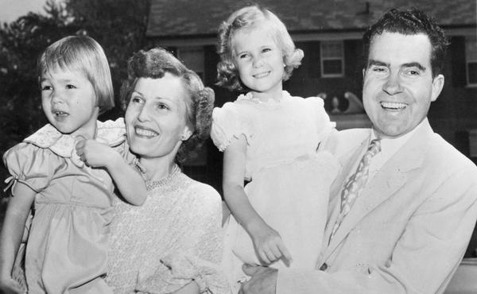

Slide 120
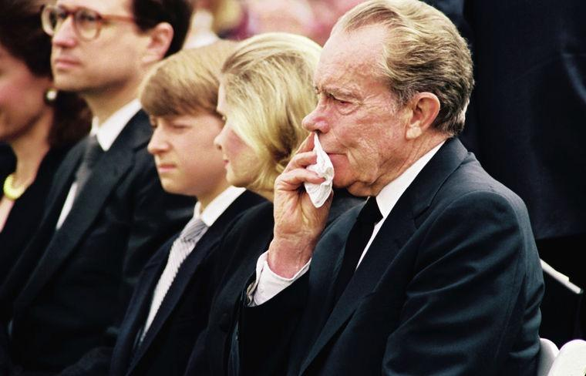
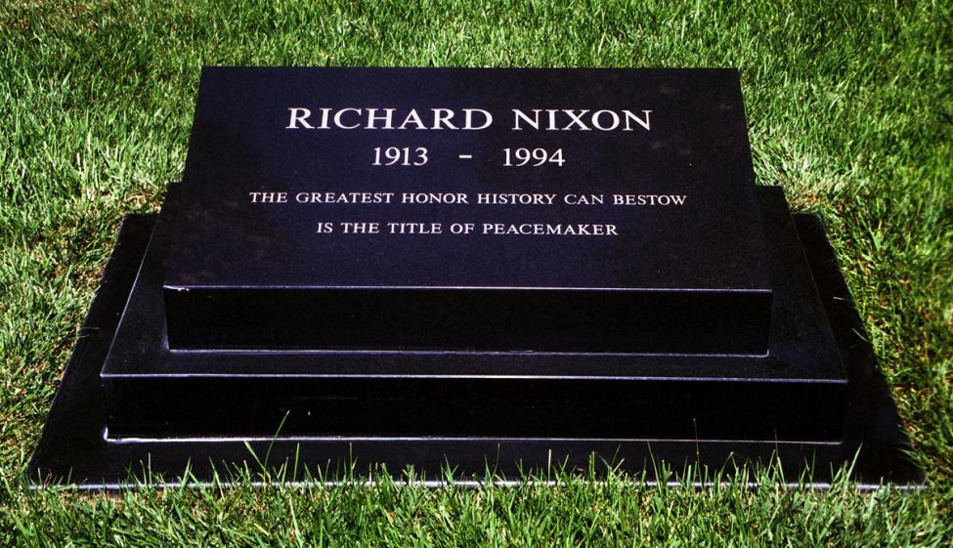
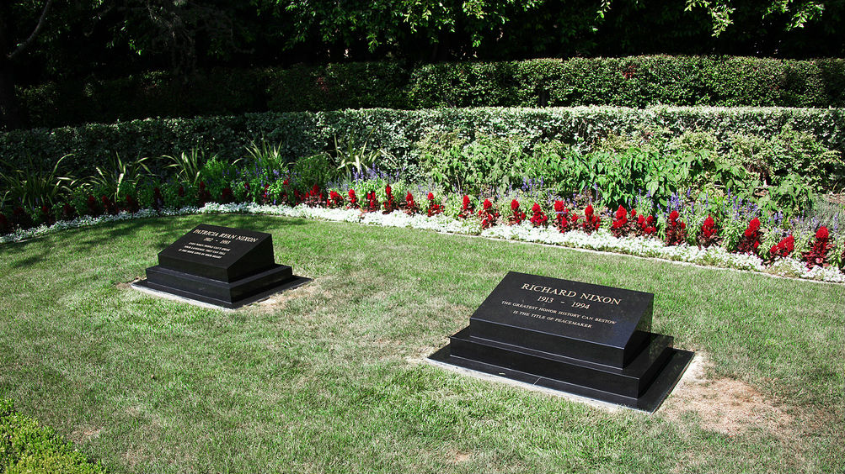
Married for 53 years
June 22, 1993
April 22, 1994

Slide 121
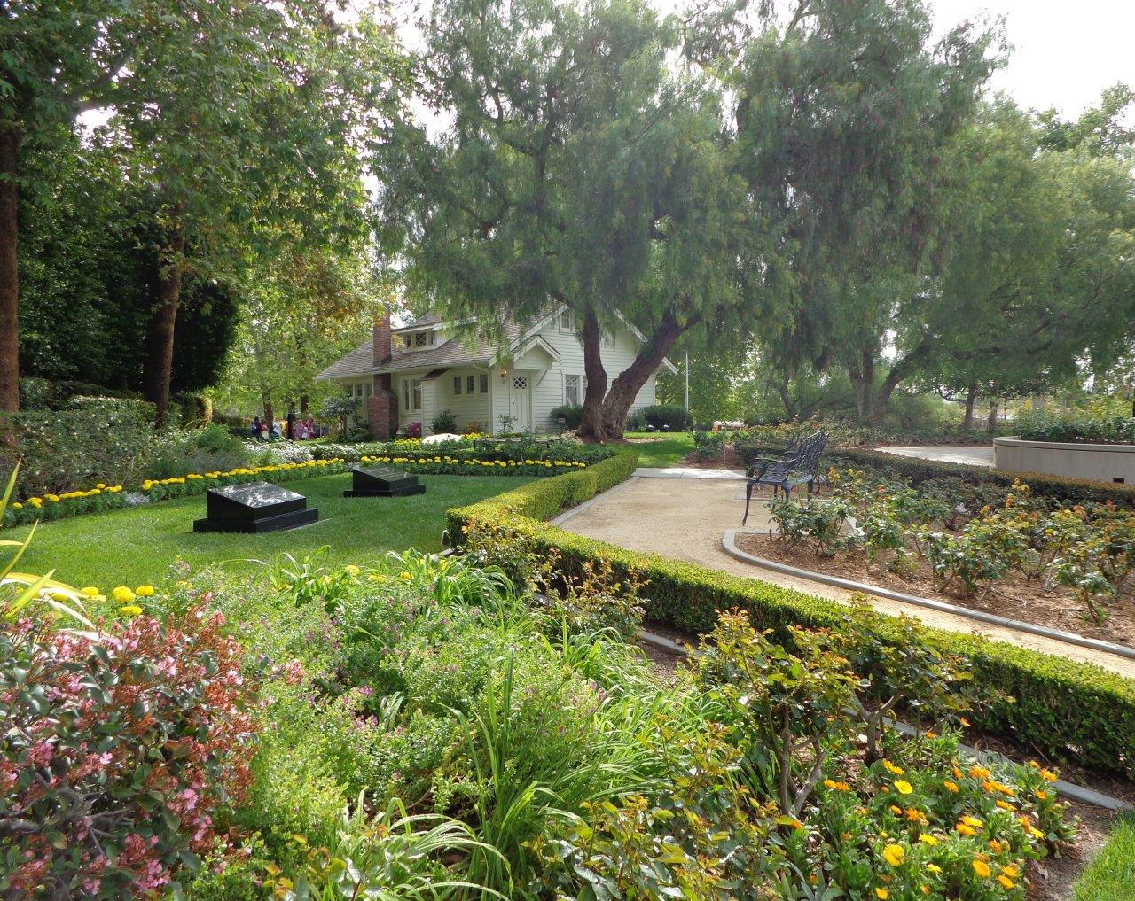

Slide 123
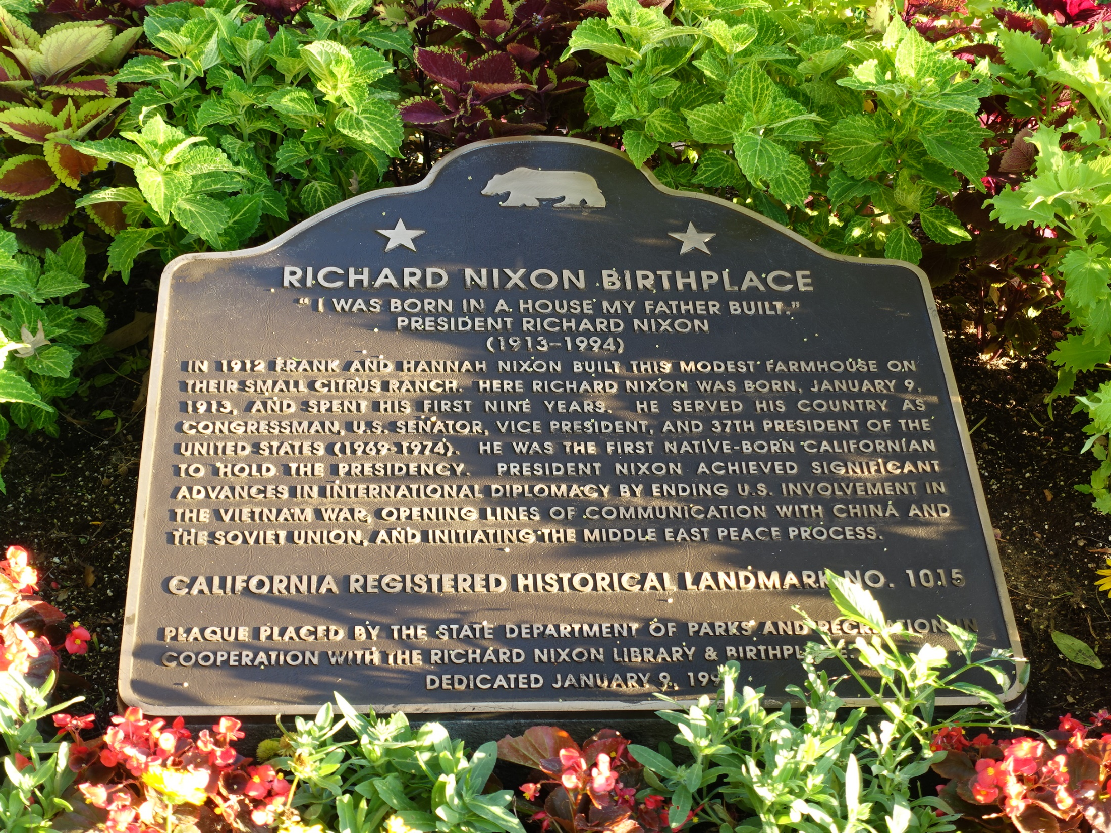

Slide 124
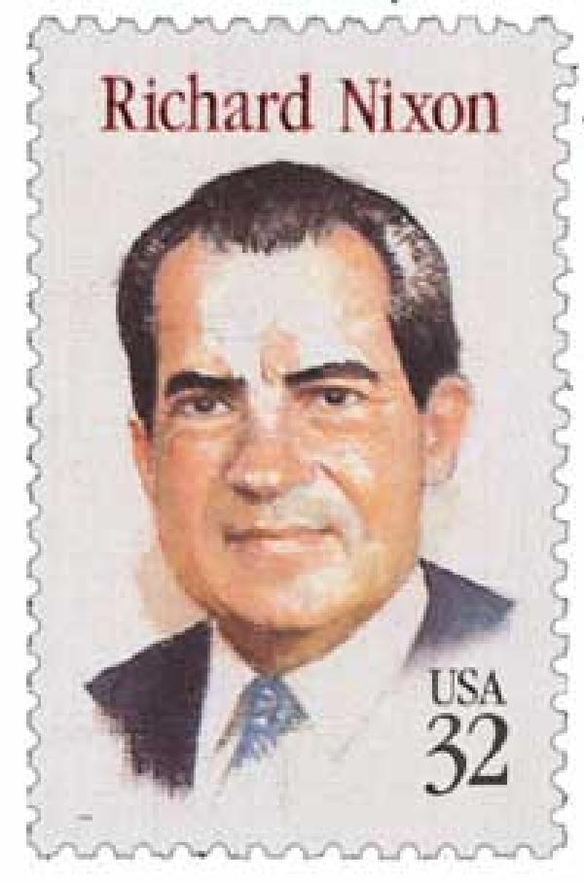
For there is no more remembrance of the wise than of the fool forever, Since all that now is will be forgotten in the days to come. And how does a wise man die? As the fool! — Ecclesiastes 2:16
For in death there is no remembrance of You; In the grave who will give You thanks? — Psalms 6:5
The dead do not praise the LORD, Nor any who go down into silence. — Psalms 115:17
Notes:
Freedom comes to those who truly believe.

Slide 125
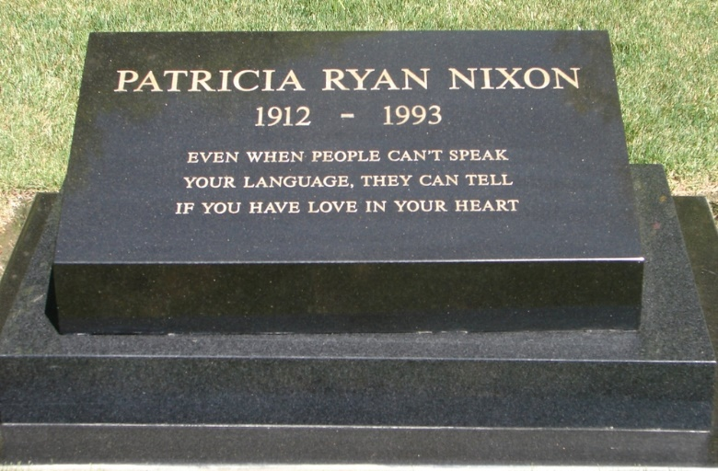

Slide 126
→ In this world fear plagues all peace
→ The greatest test of faith comes to free spirits
→ Corrupt leadership creates a hostile people
→ Violence consumes those who perpetuate it
→ Only by submitting to God is one made whole
→ Power’s greatest abuse is lack of character
→ Wars among men are fought for greed, not for God
→ Schizophrenia is symptomatic of insecure paranoids
→ Fools speak what wisdom does not declare
→ God is more than man can explain
→ Endurance is the character of greatness
→ Hate is murder of the self
→ Faith supersedes all that is material
Genuine magnificence comes with no tricks
Notes:
Genuine magnificence comes with no tricks

Slide 128
Please visit http://www.LoveFromGod.com to explore further
Ronald Bert Channel on
Notes:
Eternity never ends.

