Slide 2
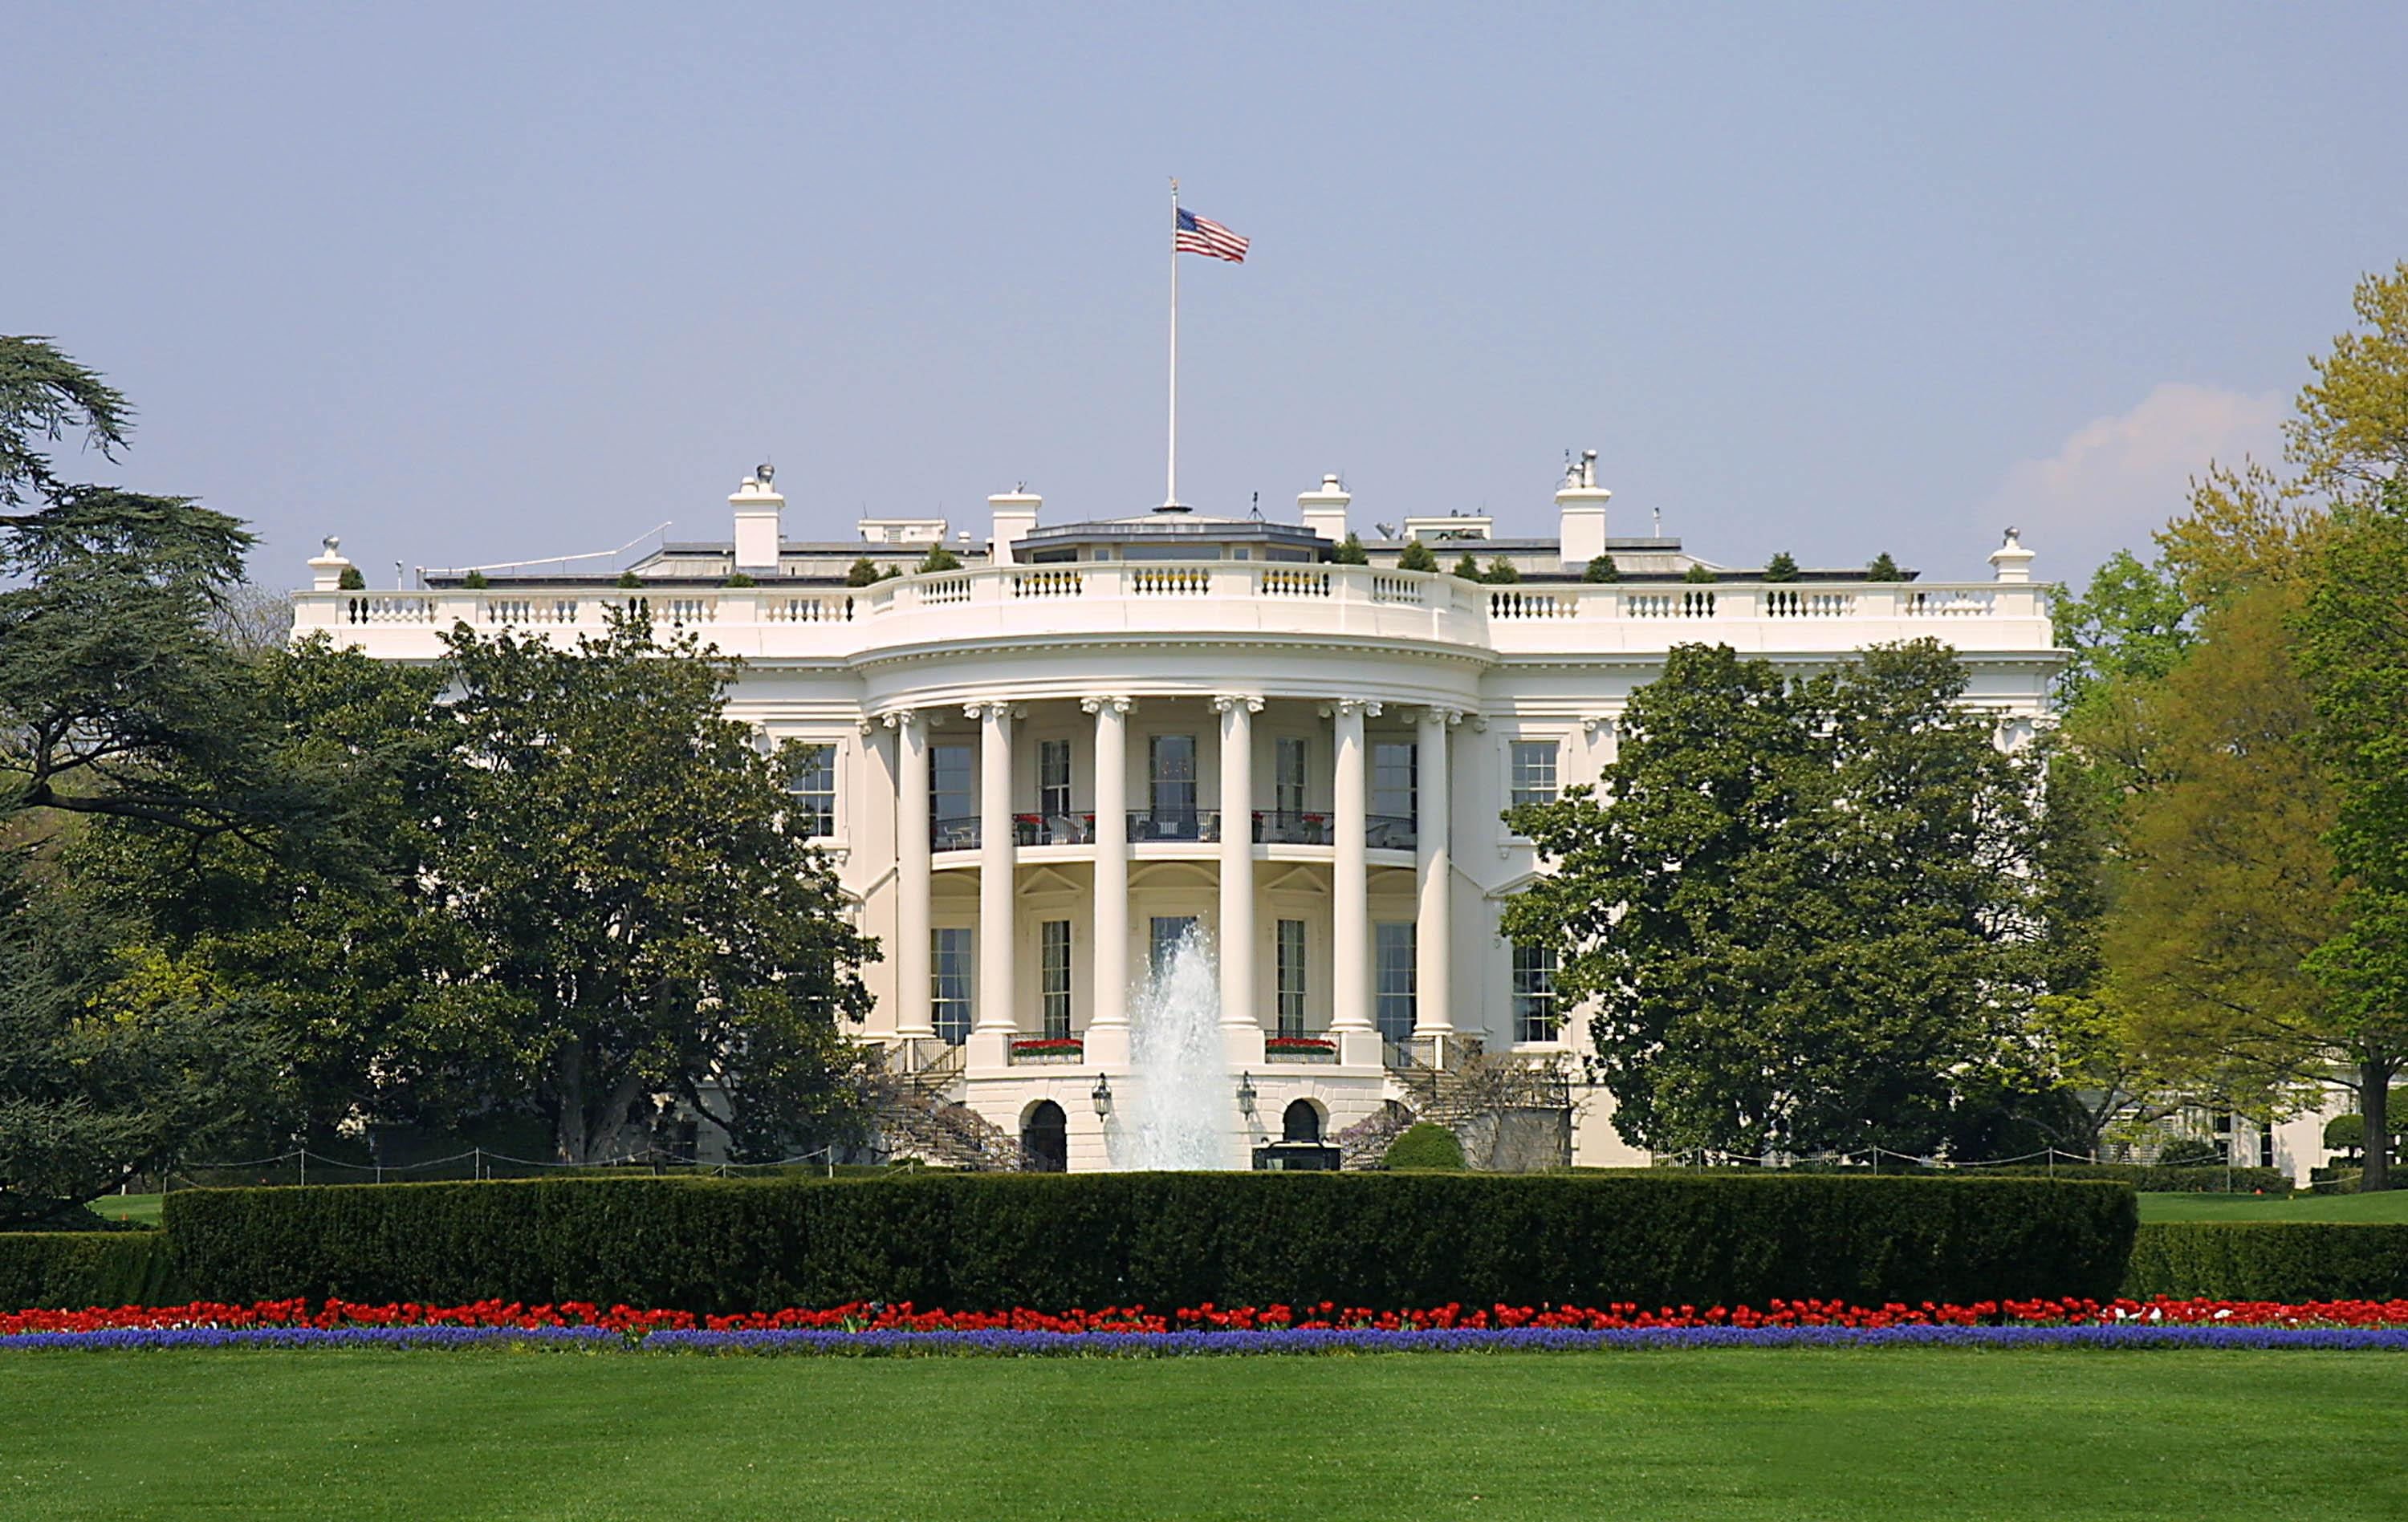
Presidential Quotes
Ron Bert
3
February 18, 2018

Slide 3
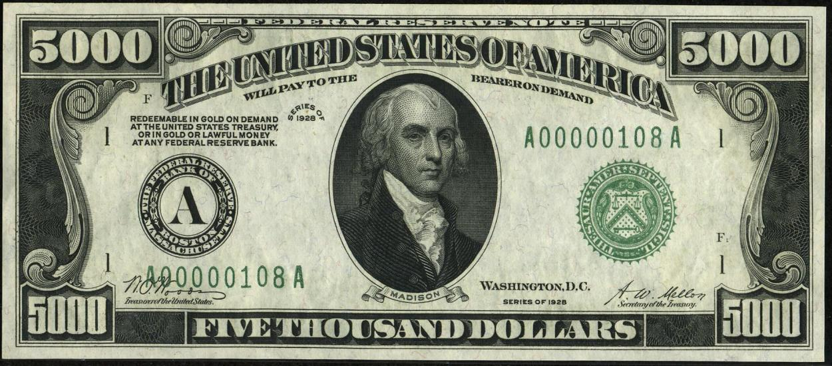
4. James Madison (1809-1817)

Slide 4
“We have staked the whole future of American civilization not on the power of government, far from it. We have staked the whole of our political institutions upon the capacity of mankind for self-government, upon the capacity of each and all of us to govern ourselves according to the commandments of God. The future and success of America is not in this Constitution, but in the laws of God upon which this Constitution is founded.”
future of
civilization
govern ourselves
according to the commandments of God

Slide 5
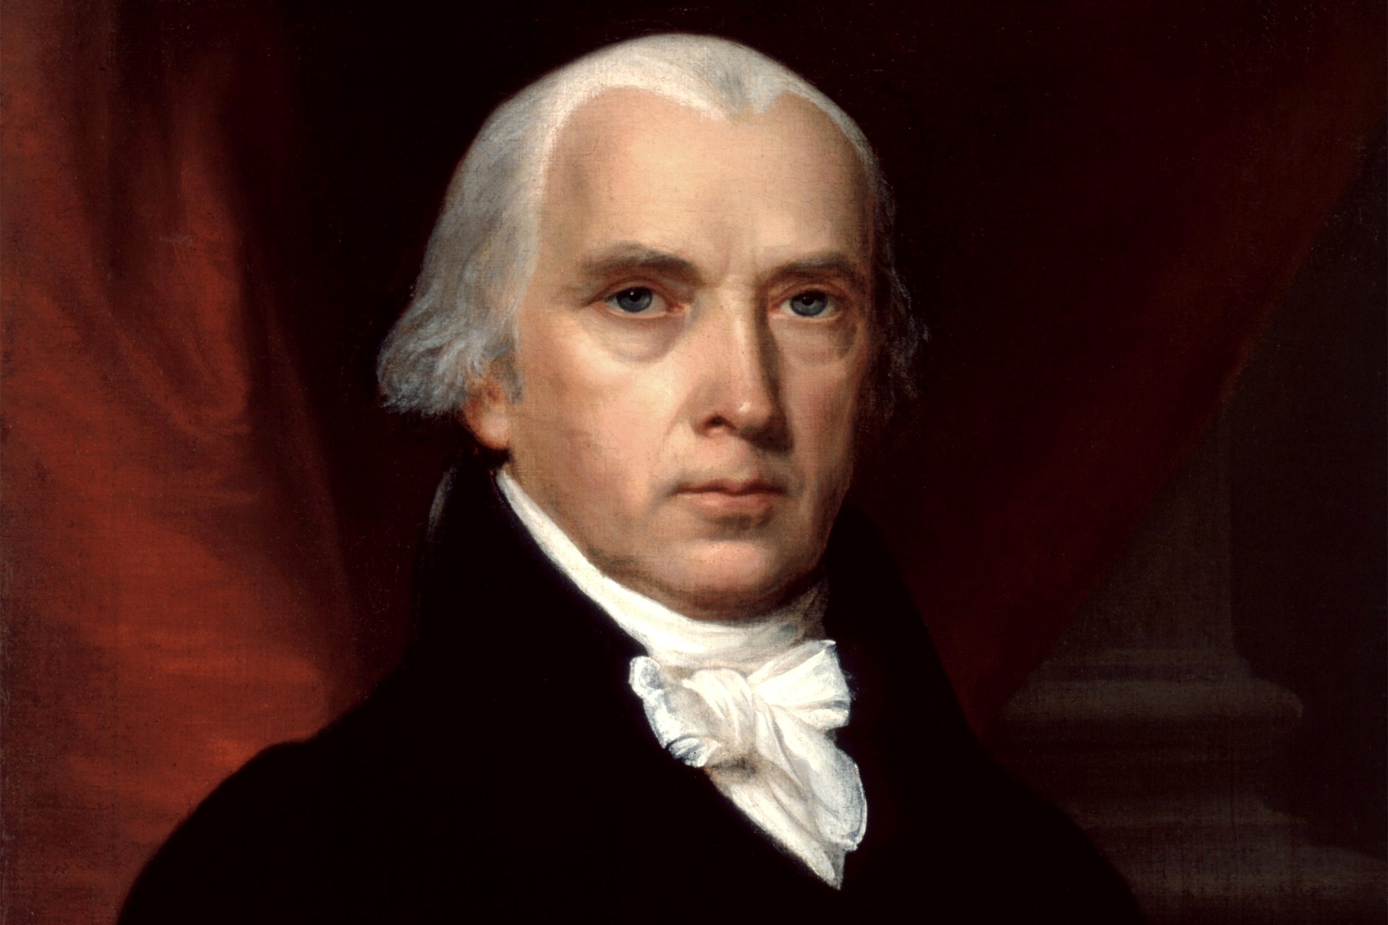
"If you do well, will you not be accepted? And if you do not do well, sin lies at the door. And its desire is for you, but you should rule over it." — Genesis 4:7
sin
rule over

Slide 6
“Religion is the basis and foundation of Government”
"All Scripture is given by inspiration of God, and is profitable for doctrine, for reproof, for correction, for instruction in righteousness, ..." — 2nd Timothy 3:16
PRICIPLES
MORALS
Belief in answerability to goodness
Faith
Civil order

Slide 7
“It is the duty of every man to render to the Creator such homage ... Before any man can be considered as a member of Civil Society, he must be considered as a subject of the Governor of the Universe...”
duty
duty
respect
duty

Slide 8
“We hold it for a fundamental and undeniable truth, that Religion or the duty which we owe to our Creator and the Manner of discharging it, can be directed only by reason and conviction, not by force or violence.”
duty which we owe
duty
knowledge
wisdom
belief
duty
intimidation
threats

Slide 9
“The Religion then of every man must be left to the conviction and conscience of every man; and it is the right of every man to exercise it as these may dictate. This right is in its nature an unalienable right. It is unalienable; because the opinions of men, depending only on the evidence contemplated by their own minds, cannot follow the dictates of other men: It is unalienable also; because what is here a right towards men, is a duty towards the Creator. ”
on the evidence
evidence
evidence
evidence
evidence
evidence
evidence
evidence
evidence
own minds
duty
duty

Slide 10
"But without faith it is impossible to please Him, for he who comes to God must believe that He is, and that He is a rewarder of those who diligently seek Him." — Hebrews 11:6
diligently seek

Slide 11
“Cursed be all that learning that is contrary to the cross of Christ.”
learning

Slide 12
“Whilst we assert for ourselves a freedom to embrace, to profess and observe the Religion which we believe to be of divine origin, we cannot deny equal freedom to those whose minds have not yet yielded to the evidence which has convinced us. If this freedom be abused, it is an offense against God, not against man: To God, therefore, not to man, must an account of it be rendered.”
i
t
l
o
Christianity
h
Religion
ri
i
n
y
t
submit
not yet yielded to the evidence
y
the
evidence
evidence
evidence
evidence
evidence
evidence
evidence
evidence
evidence
on
s
is
sed
a
Christianity is the only Religion based on evidence
an
C
b

Slide 13
“Religion and government will both exist in greater purity, the less they are mixed together.”

Slide 14
The civil rights of none, shall be abridged on account of religious belief or worship, nor shall any national religion be established, nor shall the full and equal rights of conscience be in any manner, or on any pretext infringed. ”
Freedom of Conscience

Slide 15
“No religious Test shall ever be required as a Qualification to any Office or public Trust under the United States.”

Slide 16
“That liberal catholic and equitable way of thinking as to the rights of Conscience, which is one of the Characteristics of a free people and so strongly marks the People of your province is but little known among the Zealous adherents to our Hierarchy. We have it is true some persons in the Legislature of generous Principles both in Religion & Politicks but number, not merit, you know, is necessary to carry points there. ….”
Self - seeking
Zealous adherents to
politicians
our Hierarchy

Slide 17
“… Besides, the Clergy are a numerous and powerful body, have great influence at home by reason of their connection with & dependence on the Bishops and Crown and will naturally employ all their art & Interest to depress their rising Adversaries; for such they must consider dissenters who rob them of the good will of the people and may in` time endanger their livings & security. … Religious bondage shackles and debilitates the mind and unfits it for every noble enterprise, every expanded prospect.”
Followers of Christ
Adversaries
Greed
$
Domination of man over man

Slide 18
"... But if you have bitter envy and self-seeking in your hearts, do not boast and lie against the truth. This wisdom does not descend from above, but is earthly, sensual, demonic. For where envy and self-seeking exist, confusion and every evil thing are there ..." — James 3:14-16
Therefore, as the elect of God, holy and beloved, put on tender mercies, kindness, humility, meekness, longsuffering; bearing with one another, and forgiving one another, if anyone has a complaint against another; even as Christ forgave you, so you also must do. But above all these things put on love, which is the bond of perfection. And let the peace of God rule in your hearts, to which also you were called in one body; and be thankful. — Colossians 3:12-15
"… But the wisdom that is from above is first pure, then peaceable, gentle, willing to yield, full of mercy and good fruits, without partiality and without hypocrisy. Now the fruit of righteousness is sown in peace by those who make peace." — James 3:17-18
put on
"Who is wise and understanding among you? Let him show by good conduct that his works are done in the meekness of wisdom. ..." — James 3:13
must do
LOVE
be thankful

Slide 19
“During almost fifteen centuries has the legal establishment of Christianity been on trial. What has been its fruits? More or less, in all places, pride and indolence in the clergy; ignorance and servility in the laity; in both, superstition, bigotry, and persecution.”
Mankind
Christianity on trial:
clergy = pride and indolence
laity = ignorance and servility
in both
superstition, bigotry, and persecution
:
Leaders
=
Superiority & inactivity
Christianity
on trial
Believers
=
unfamiliarity & sucking up
laziness
pride and indolence
↓
clergy
ignorance and servility
brownnosing
falsehoods
prejudices
flock
laity
in both
superstition,
torments
bigotry, and
persecution

Slide 20
But if you bite and devour one another, beware lest you be consumed by one another! — Galatians 5:15

Slide 21
“The purpose of separation of church and state is to keep forever from these shores the ceaseless strife that has soaked the soil of Europe in blood for centuries.”
ceaseless strife

Slide 22
“Who does not see that the same authority which can establish Christianity, in exclusion of all other Religions, may establish with the same ease any particular sect of Christians, in exclusion of all other Sects?”
Presbyterian
Baptist
Episcopalian
Lutheran
Protestant
Quaker
Exaltation of man or God?
rejection
Mormon
Jehovah Witness
Church of Christ
in
in exclusion
Christians
Christians in exclusion
Catholic
Methodist

Slide 23
The belief in a God All Powerful wise and good, is so essential to the moral order of the world and to the happiness of man, that arguments which enforce it cannot be drawn from too many sources nor adapted with too much solicitude to the different characters and capacities impressed with it. ”
The belief in a God All Powerful wise and good, is so essential to the moral order of the world and to the happiness of man, that arguments which enforce it cannot be drawn from too many sources nor adapted with too much solicitude to the different characters and capacities impressed with it. ”
fragmentation
too many sources
convoluted
different characters

Slide 24
Now the purpose of the commandment is love from a pure heart, from a good conscience, and from sincere faith, … — 1st Timothy 1:5

Slide 25
… let us draw near with a true heart in full assurance of faith, having our hearts sprinkled from an evil conscience and our bodies washed with pure water. Let us hold fast the confession of our hope without wavering, for He who promised is faithful. And let us consider one another in order to stir up love and good works, not forsaking the assembling of ourselves together, as is the manner of some, but exhorting one another, and so much the more as you see the Day approaching. — Hebrews 10:22-25
draw near with a true heart
in
faith
draw near with a true heart
● in faith
● from an evil conscience
● bodies washed with pure water
● hold fast our hope
● consider one another in love and good works
● not forsaking the assembling of ourselves
● exhorting one another
draw near with a true heart
from an evil conscience
bodies washed
with pure water
hold fast
our hope
consider one another in
love
and good works
not forsaking the assembling
of ourselves
exhorting one another

Slide 26
“We are free today substantially, but the day will come when our Republic will be an impossibility. It will be an impossibility because wealth will be concentrated in the hands of a few. A Republic cannot stand upon bayonets, and when the day comes when the wealth of the nation will be in the hands of a few, then we must rely upon the wisdom of the best elements in the country to readjust the laws of the nations to the changed conditions.”
X

Slide 27
“History records that the money changers have used every form of abuse, intrigue, deceit, and violent means possible to maintain their control over governments by controlling money and it's issuance.”

Slide 28
“Enlightened statesmen will not always be at the helm.”
“If men were angels, no government would be necessary.”
“If Tyranny and Oppression come to this land, it will be in the guise of fighting a foreign enemy.”

Slide 29
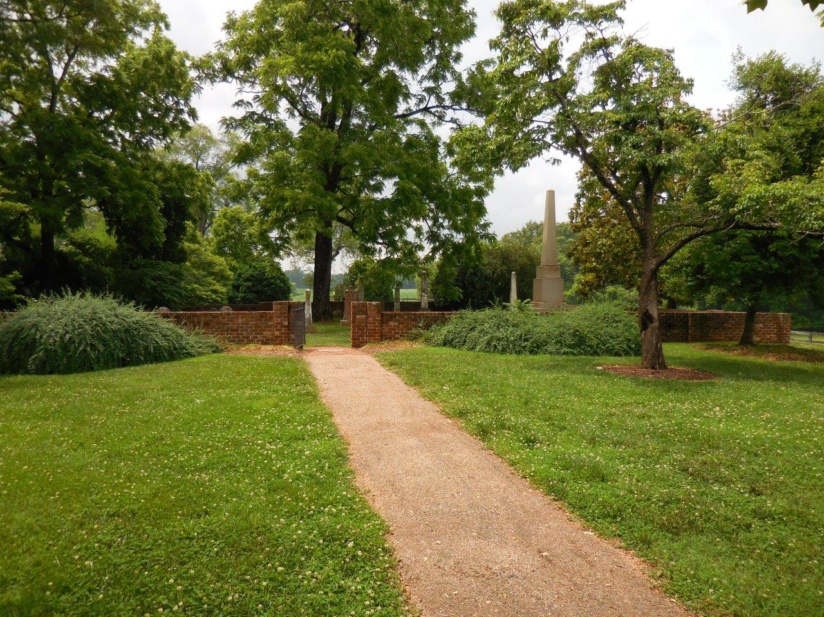
Beloved, do not believe every spirit, but test the spirits, whether they are of God; because many false prophets have gone out into the world. By this you know the Spirit of God: Every spirit that confesses that Jesus Christ has come in the flesh is of God, and every spirit that does not confess that Jesus Christ has come in the flesh is not of God. And this is the spirit of the Antichrist, which you have heard was coming, and is now already in the world. — 1st John 4:1-3

Slide 30
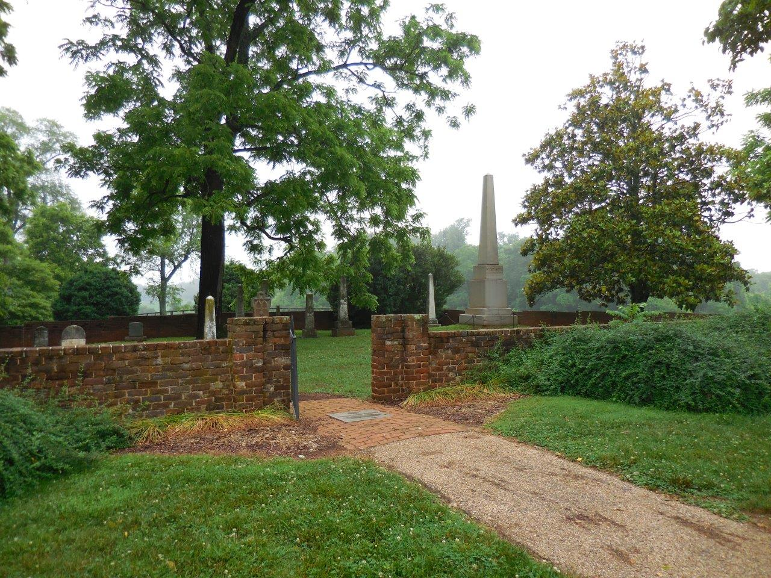

Slide 31
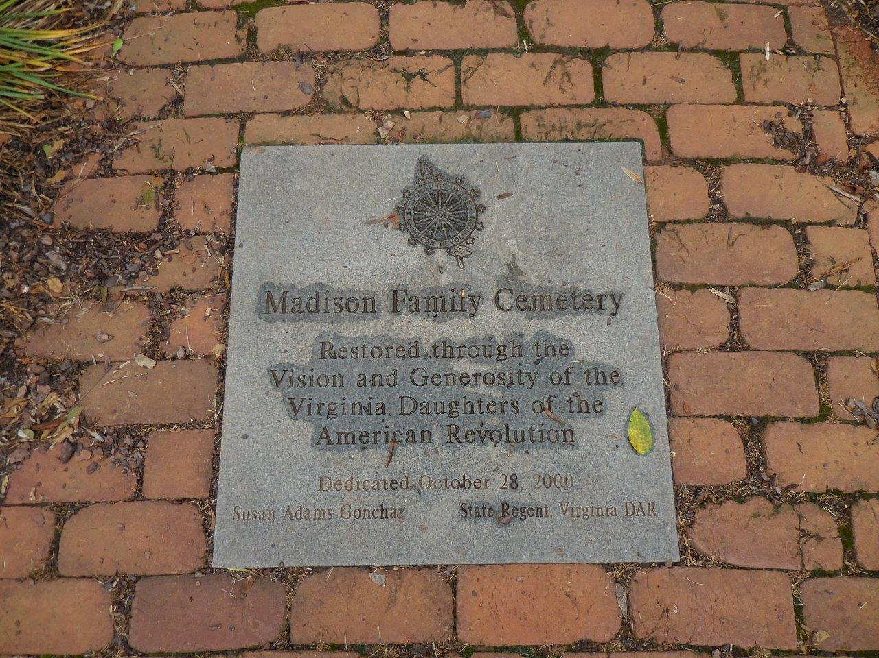

Slide 32
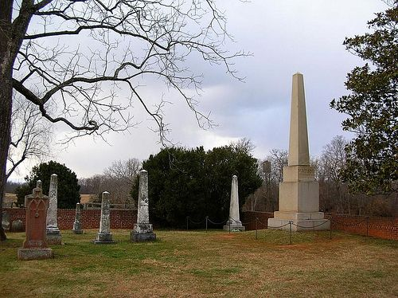

Slide 33
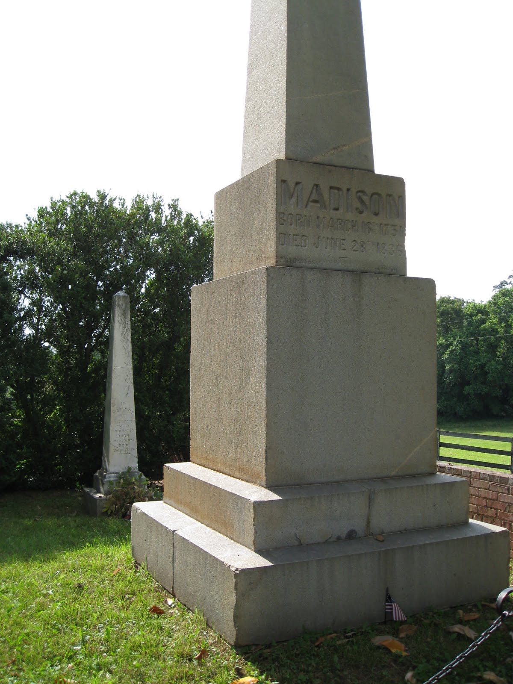
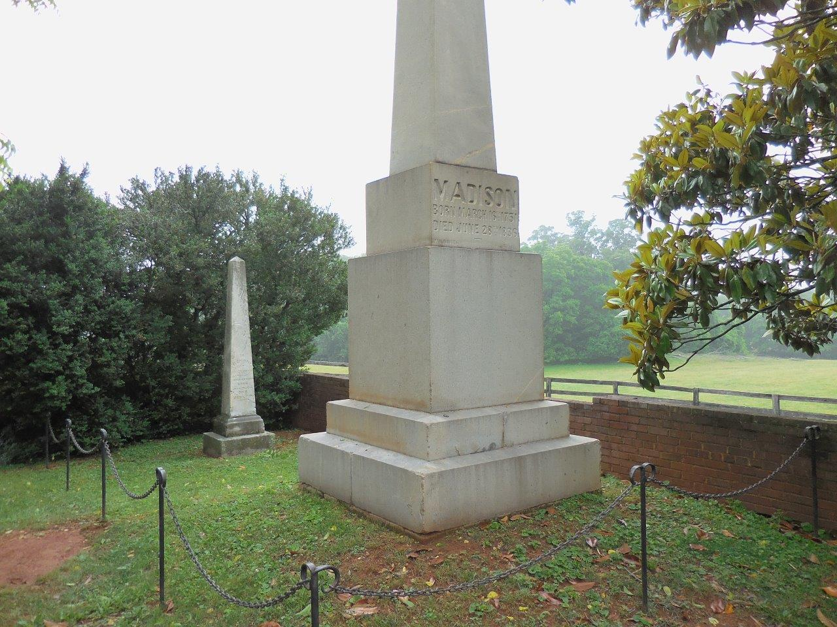
So also is the resurrection of the dead. The body is sown in corruption, it is raised in incorruption. It is sown in dishonor, it is raised in glory. It is sown in weakness, it is raised in power. It is sown a natural body, it is raised a spiritual body. There is a natural body, and there is a spiritual body. — 1st Corinthians 15:42-44

Slide 34
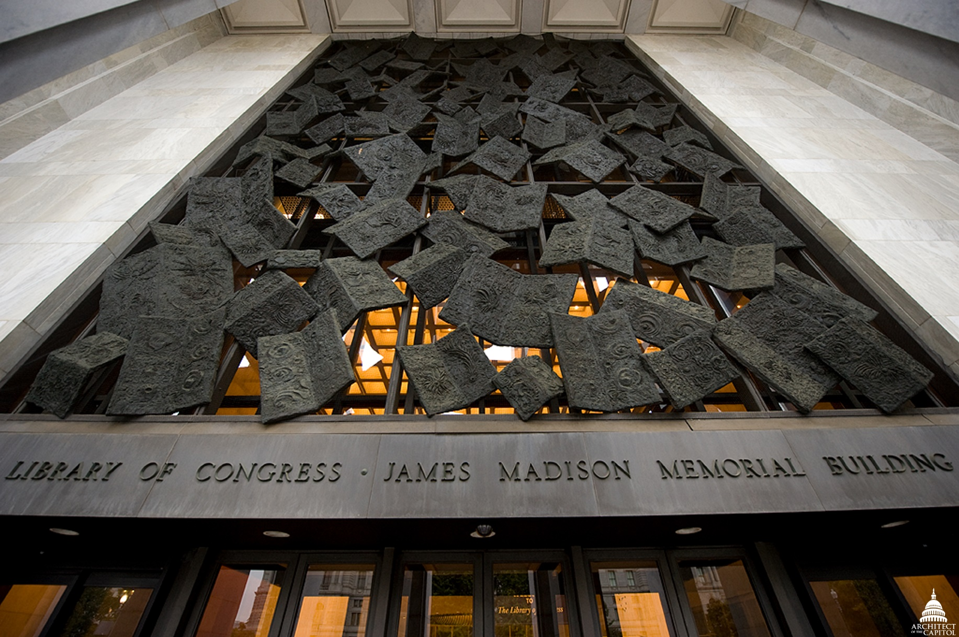
Behold, I tell you a mystery: We shall not all sleep, but we shall all be changed -- in a moment, in the twinkling of an eye, at the last trumpet. For the trumpet will sound, and the dead will be raised incorruptible, and we shall be changed. For this corruptible must put on incorruption, and this mortal must put on immortality. So when this corruptible has put on incorruption, and this mortal has put on immortality, then shall be brought to pass the saying that is written: "Death is swallowed up in victory." — 1st Corinthians 15:51-54

Slide 35
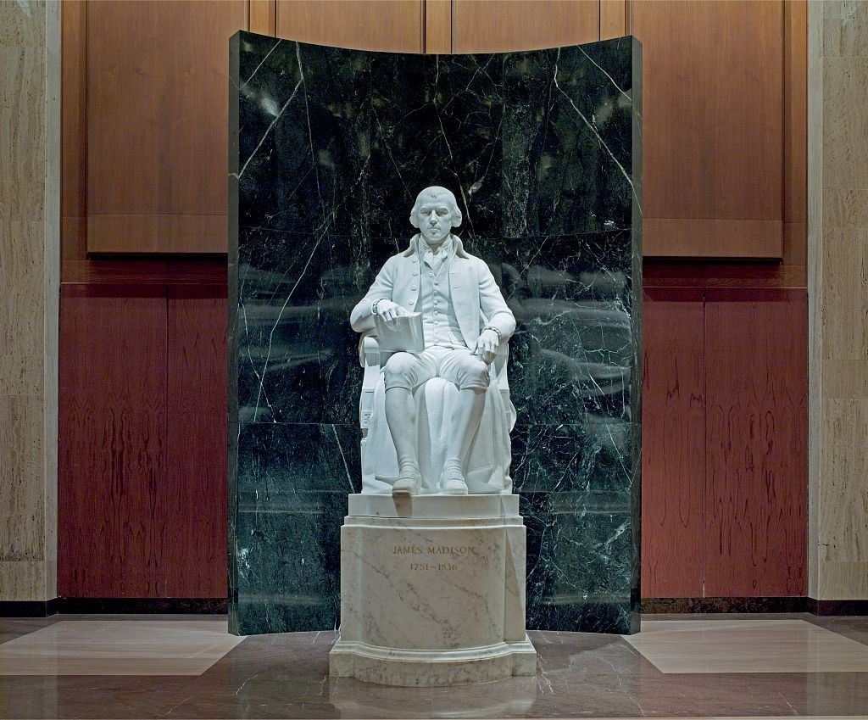
Beloved, now we are children of God; and it has not yet been revealed what we shall be, but we know that when He is revealed, we shall be like Him, for we shall see Him as He is. And everyone who has this hope in Him purifies himself, just as He is pure. — 1st John 3:2-3

Slide 36
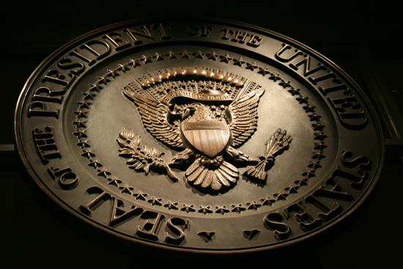
→ Souls following the commands of God = Citizens
→ Religion is the basis and foundation of Government
→ Duty to God is what makes a Civil Society
→ Each person is responsible for their own religion
→ Cursed is teachings contrary to the cross of Christ
→ It is a right and obligation for man to account to God
→ No religious test shall be instituted for public service
→ Religious bondage shackles and debilitates the mind
→ Separation/church/state is to stop religious carnage
→ Christianity is at risk of splitting into separate Sects
→ Belief in a God/essential to moral order & happiness
→ Coming is when the rich few will abolish the republic
→ Good leaders will not always lead us
Freedom is not a license to sin
Notes:
Freedom is not a license to sin

Slide 38
Please visit http://www.LoveFromGod.com to explore further
Ronald Bert Channel on
Notes:
Eternity never ends.

