Slide 2
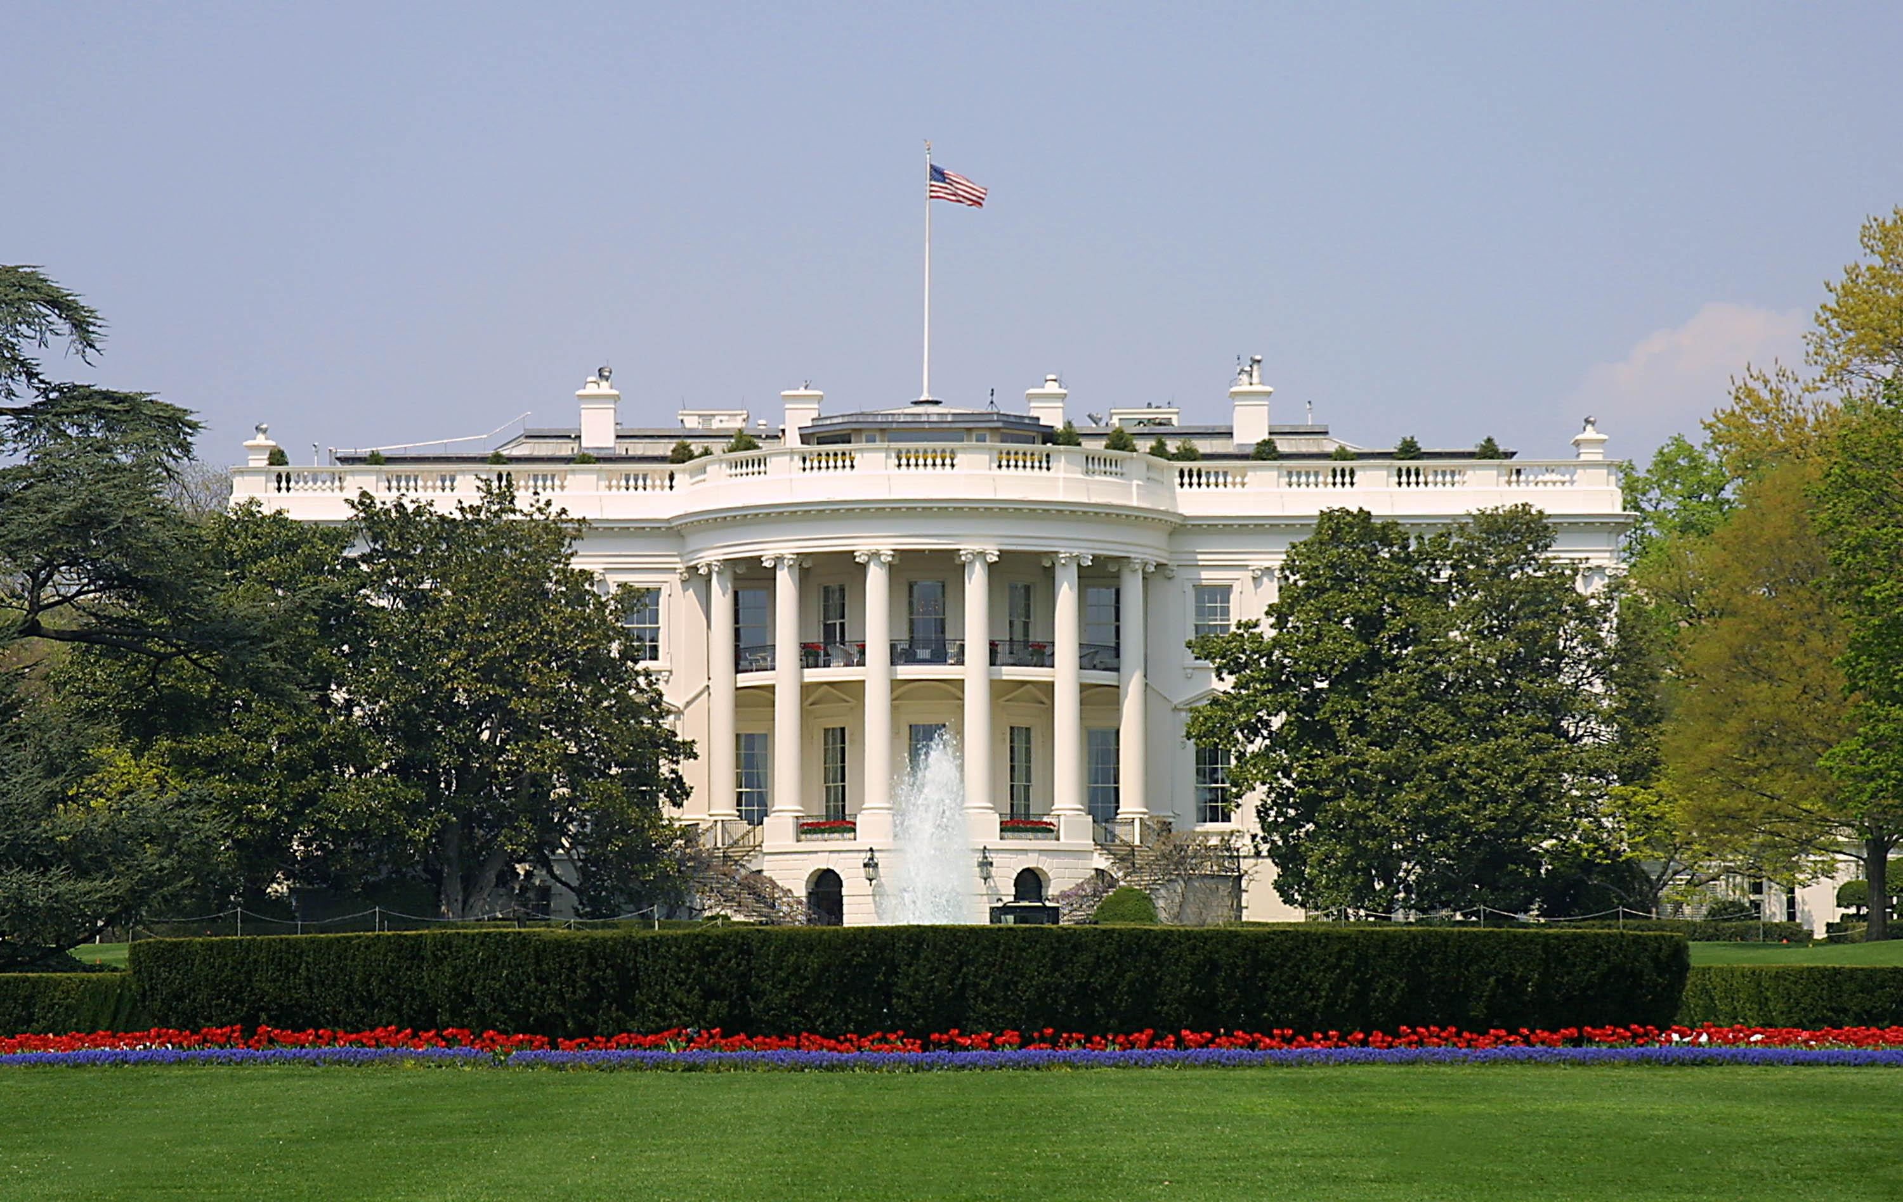
Presidential Quotes
Ron Bert
29
December 29, 2019

Slide 3
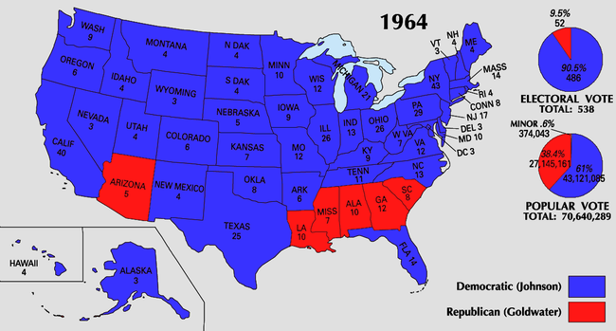
Part 1
36. Lyndon B. Johnson (1963-1969)

Slide 4
“I am going to build the kind of nation that President Roosevelt hoped for, President Truman worked for, and President Kennedy died for.”

Slide 5
“You might say that Lyndon Johnson is a cross between a Baptist preacher and a cowboy.”

Slide 6
“John F. Kennedy was the victim of the hate that was a part of our country. It is a disease that occupies the minds of the few but brings danger to the many.”
victim of the hate

Slide 7
"If the world hates you, you know that it hated Me before it hated you." — John 15:18

Slide 8
The LORD is in His holy temple, The LORD'S throne is in heaven; His eyes behold, His eyelids test the sons of men. The LORD tests the righteous, But the wicked and the one who loves violence His soul hates. — Psalms 11:4-5
test
tests
His soul
soul

Slide 9
“Justice requires us to remember that when any citizen denies his fellow, saying, 'His color is not mine,' or 'His beliefs are strange and different,' in that moment he betrays America, though his forebears created this nation.”
prejudice

Slide 10
“Emancipation was a proclamation, but not a fact.”

Slide 11
“The law cannot save those who deny it but neither can the law serve any who do not use it. The history of injustice and inequality is a history of disuse of the law.”
deny it
do not use it
disregard
disuse

Slide 12
But the natural man does not receive the things of the Spirit of God, for they are foolishness to him; nor can he know them, because they are spiritually discerned. — 1st Corinthians 2:14
not receive

Slide 13
Therefore, to him who knows to do good and does not do it, to him it is sin. — James 4:17

Slide 14
“The men who have guided the destiny of the United States have found the strength for their tasks by going to their knees. This private unity of public men and their God is an enduring source of reassurance for the American people.”
prayer

Slide 15
“Our society is illuminated by the spiritual insights of the Hebrew prophets. America and Israel have a common love of human freedom, and they have a common faith in a democratic way of life. ... Most, if not all of you, have very deep ties with the land and with the people of Israel, as I do; for my Christian faith sprang from yours. The Bible stories are woven into my childhood memories as the gallant struggle of modern Jews to be free of persecution is also woven into our souls.”
free of persecution

Slide 16
“In our home there was always prayer – aloud, proud and unapologetic.”

Slide 17
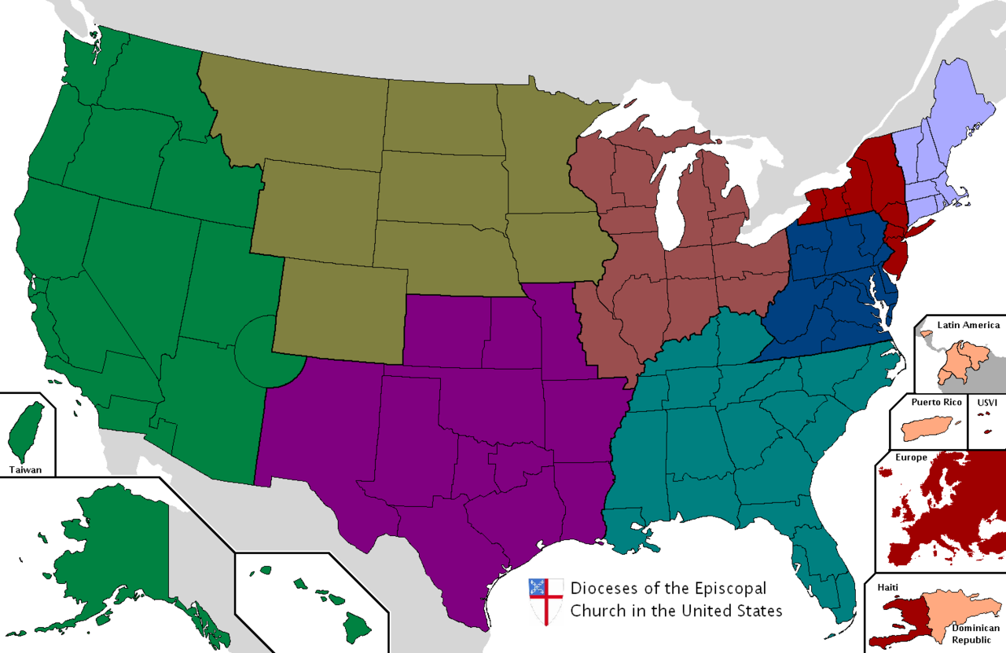
“Greater love hath no man than to attend the Episcopal Church with his wife.”
X
X
Roman Catholic Church
Denomination divided into 9 provinces
Episcopal
Founded: 1785
Church of England
Church

Slide 18
"Greater love has no one than this, than to lay down one's life for his friends." — John 15:13

Slide 19
“The noblest search is the search for excellence.”

Slide 20
“Doing the right thing is not the problem. Knowing what the right thing is, that's the challenge.”

Slide 21
“Above the pyramid on the great seal of the United States it says in Latin: "God has favored our undertaking." God will not favor everything that we do. It is rather our duty to divine His will.”
our duty

Slide 22
“Art is a nation's most precious heritage; for it is in our works of art that we reveal to ourselves and to others the inner vision which guides us as a nation. And where there is no vision, the people perish.”
Morals
?
LAW

Slide 23
Where there is no revelation, the people cast off restraint; But happy is he who keeps the law. — Proverbs 29:18
vision
Word of God
perish

Slide 24
“I believe in the American tradition of separation of church and state which is expressed in the First Amendment to the Constitution. By my office - and by personal conviction - I am sworn to uphold that tradition.”
tradition

Slide 25
“The separation of church and state is a source of strength, but the conscience of our nation does not call for separation between men of state and faith in the Supreme Being.”
“The separation of church and state is a source of strength, but the conscience of our nation does not call for separation between men of state and faith in the Supreme Being.”
not call for separation

Slide 26
“We need to remember that the separation of church and state must never mean the separation of religious values from the lives of public servants. ... If we who serve free men today are to differ from the tyrants of this age, we must balance the powers in our hands with God in our hearts.”
separation of church and state
separation of church and state:
→ never mean
separation of religious values
from lives of public servants
↓
free with God in our hearts
never mean
separation
of religious values
from
lives
of public servants
free
free
from the tyrants
God
in
with God in our hearts
God in our hearts

Slide 27
“This nation, this generation, in this hour has man's first chance to build a Great Society, a place where the meaning of man's life matches the marvels of man's labor.”
Great Society
life
labor

Slide 28
The sleep of a laboring man is sweet, Whether he eats little or much; But the abundance of the rich will not permit him to sleep. There is a severe evil which I have seen under the sun: Riches kept for their owner to his hurt. — Ecclesiastes 5:12-13

Slide 29
“At the desk where I sit, I have learned one great truth. The answer for all our national problems - the answer for all the problems of the world - come to a single word. That word is ‘education.’”
education

Slide 30
Take firm hold of instruction, do not let go; Keep her, for she is your life. — Proverbs 4:13

Slide 31
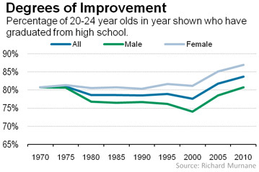
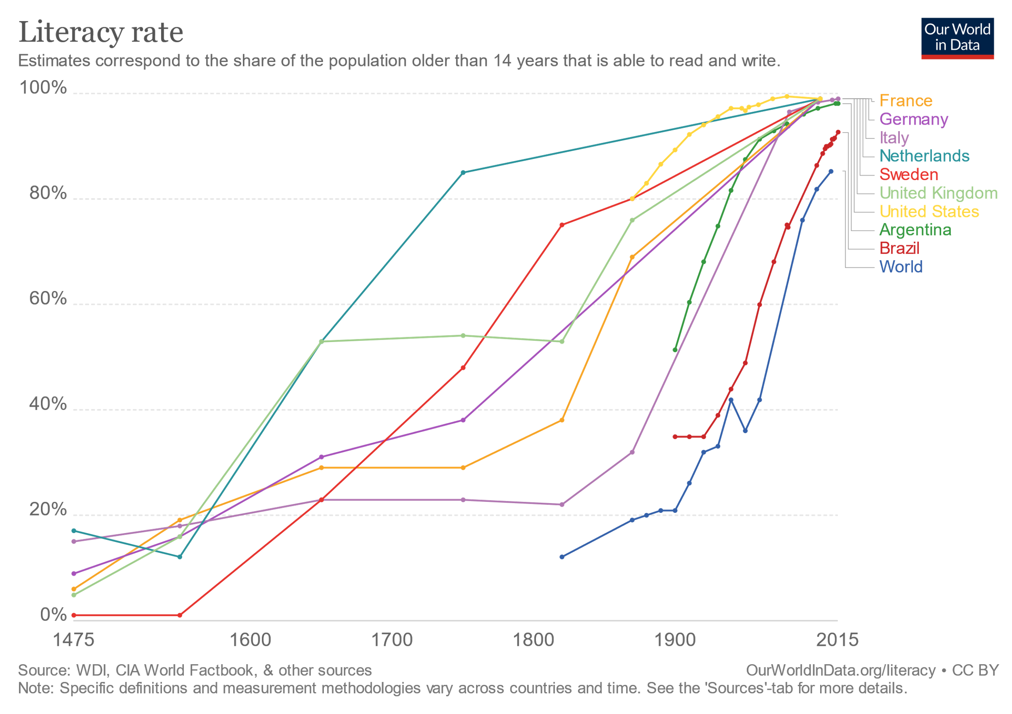
“Today, 8 million adult Americans, more than the entire population of Michigan, have not finished 5 years of school. Nearly 20 million have not finished 8 years of school. Nearly 54 million - more than one-quarter of all America - have not even finished high school.”

Slide 32
“'Human history, ' H.G. Wells once wrote, 'becomes more and more a race between education and catastrophe.' You and I cannot be indifferent to the outcome of that race. We care deeply about the winner. Because we do care so deeply about the winner, that is why we are all in the East Room of the White House today.”
a race
between education and catastrophe

Slide 33
Therefore my people have gone into captivity, Because they have no knowledge; Their honorable men are famished, And their multitude dried up with thirst. — Isaiah 5:13

Slide 34
“This Congress did more to uplift education, more to attack disease in this country and around the world, and more to conquer poverty than any other session in all American history, and what more worthy achievements could any person want to have? For it was the Congress that was more true than any other Congress to Thomas Jefferson's belief that: 'The care of human life and happiness is the first and only legitimate objective of good Government.'”
“This Congress did more to uplift education, more to attack disease in this country and around the world, and more to conquer poverty than any other session in all American history, and what more worthy achievements could any person want to have? For it was the Congress that was more true than any other Congress to Thomas Jefferson's belief that: 'The care of human life and happiness is the first and only legitimate objective of good Government.'”

Slide 35
Beloved, I pray that you may prosper in all things and be in health, just as your soul prospers. — 3rd John 1:2

Slide 36
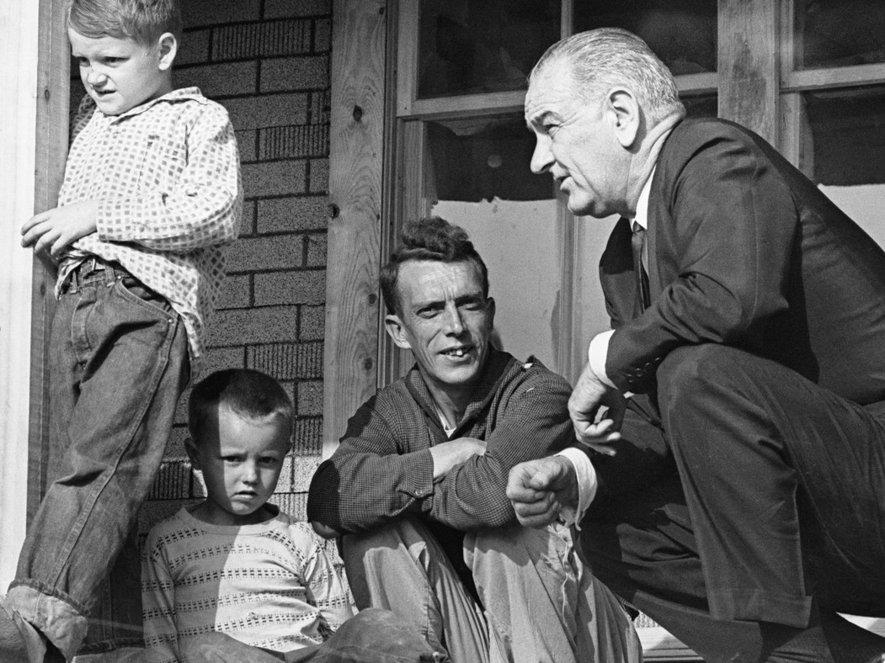

Slide 37
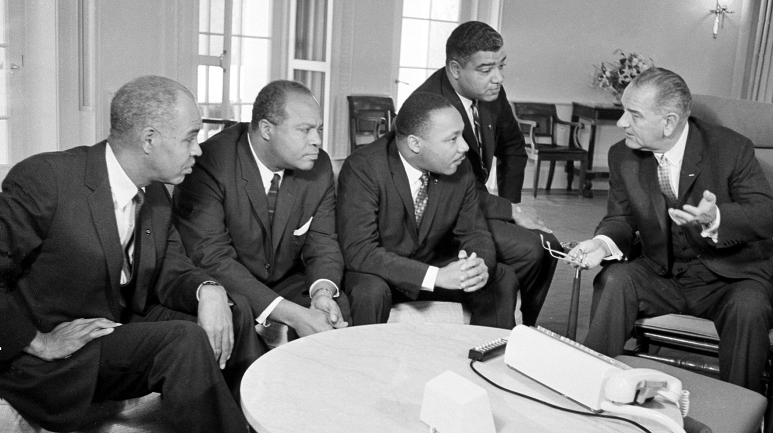

Slide 38
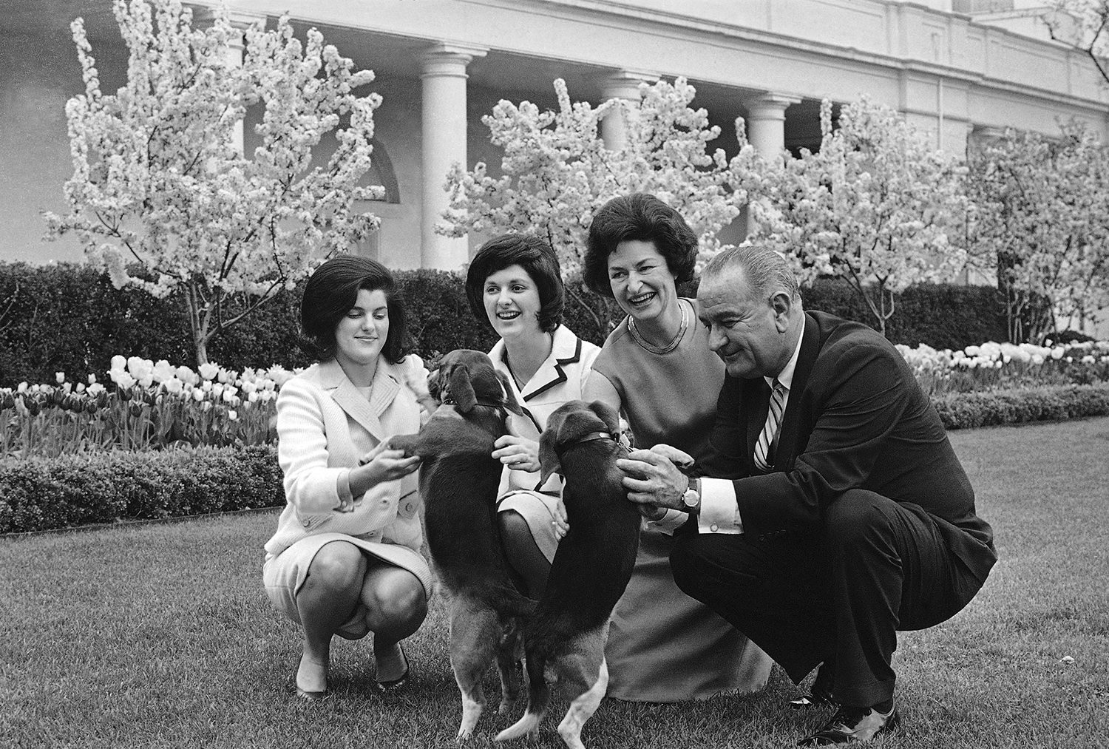
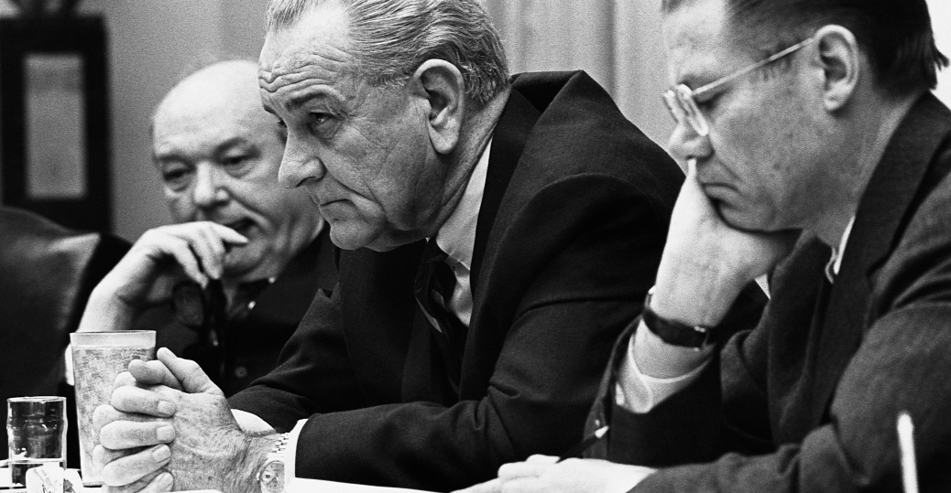

Slide 39
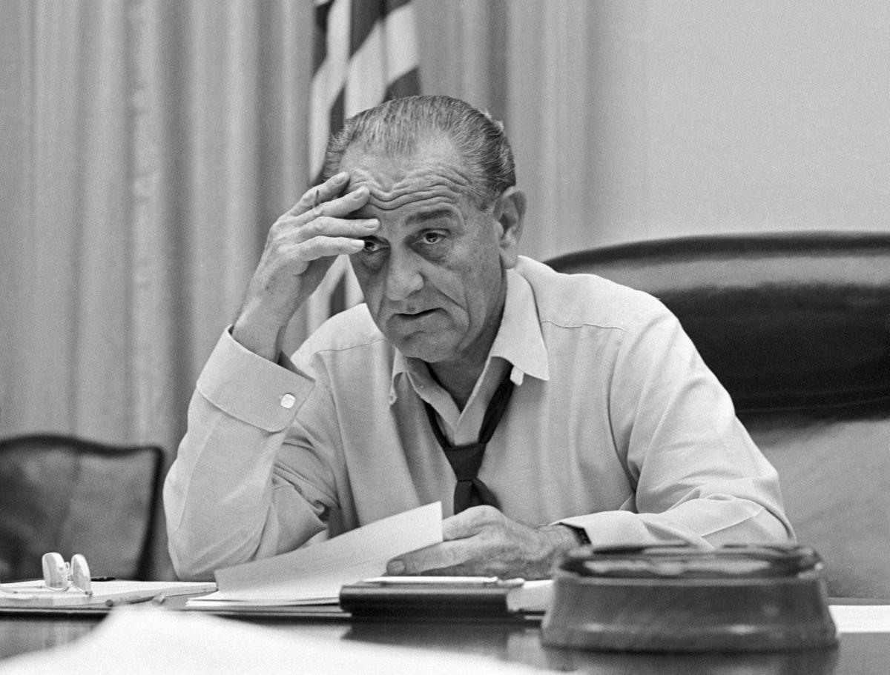

Slide 40
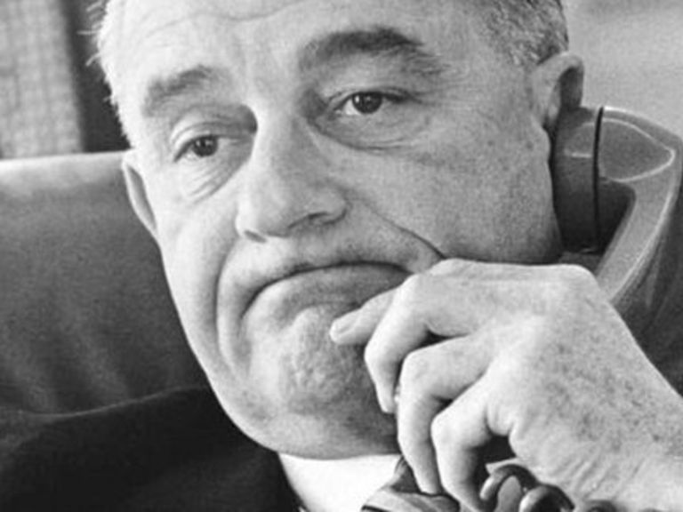

Slide 41
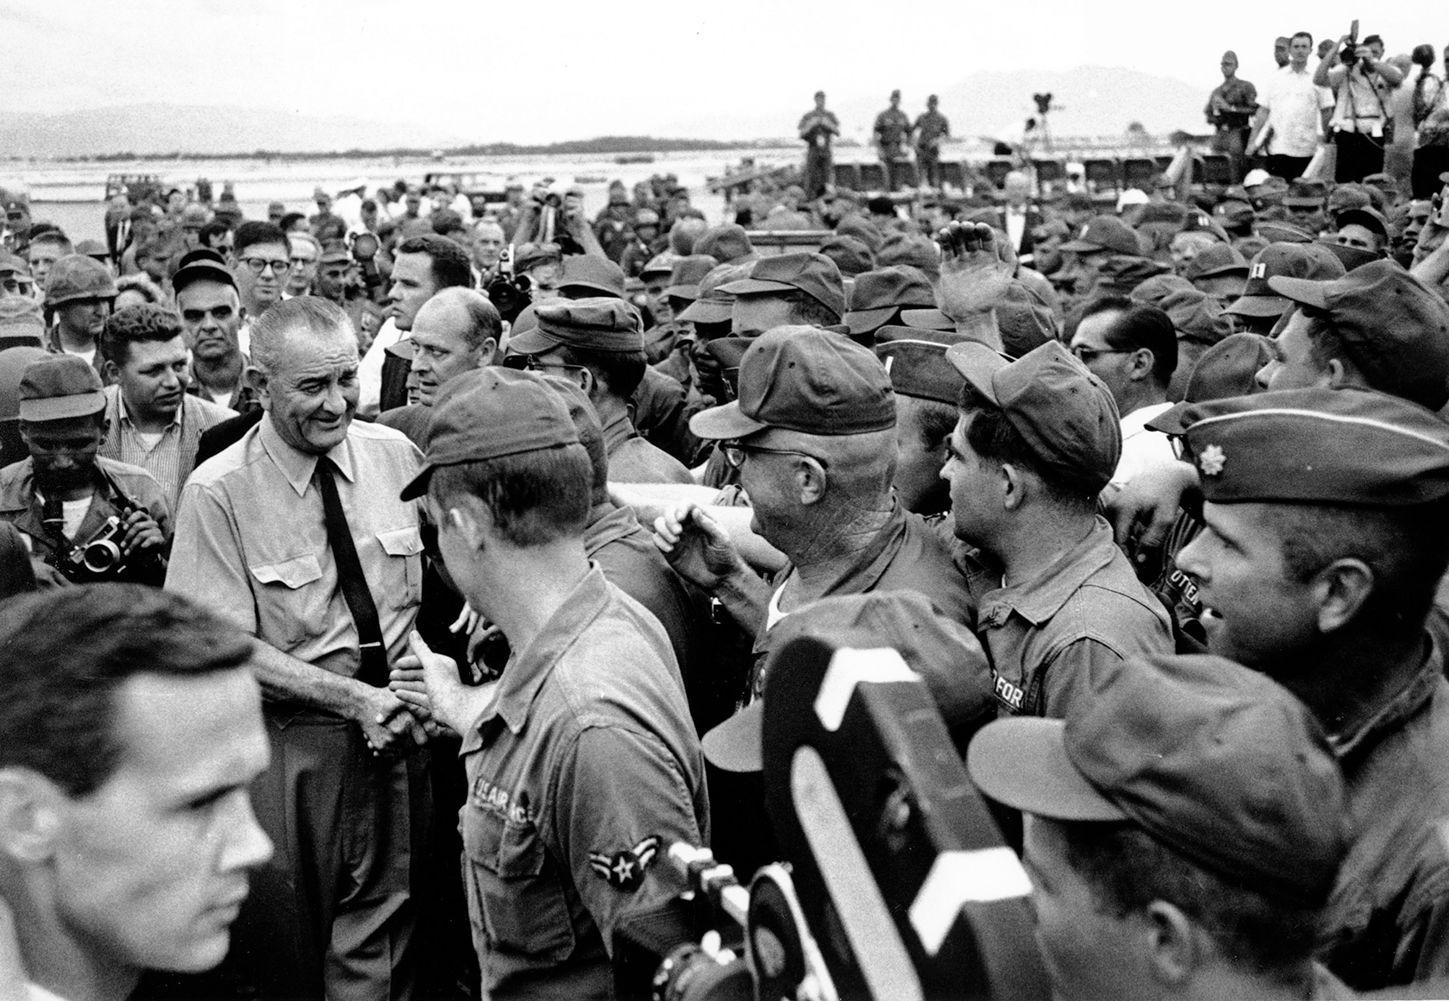

Slide 42
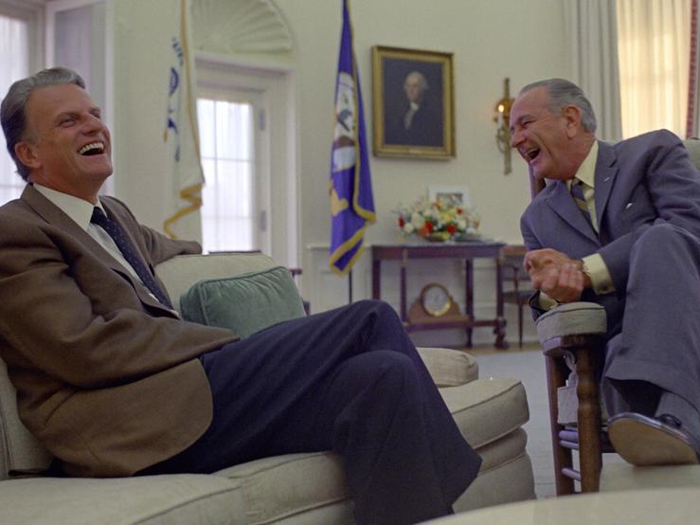

Slide 43
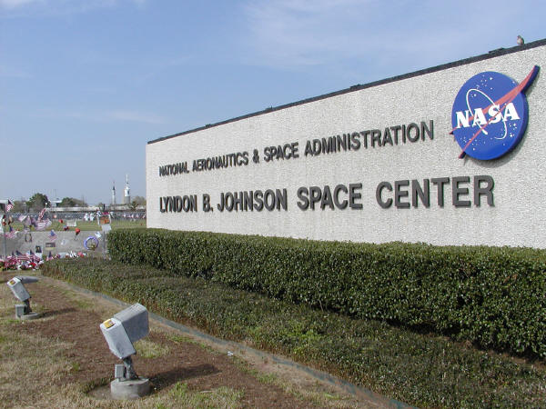

Slide 45
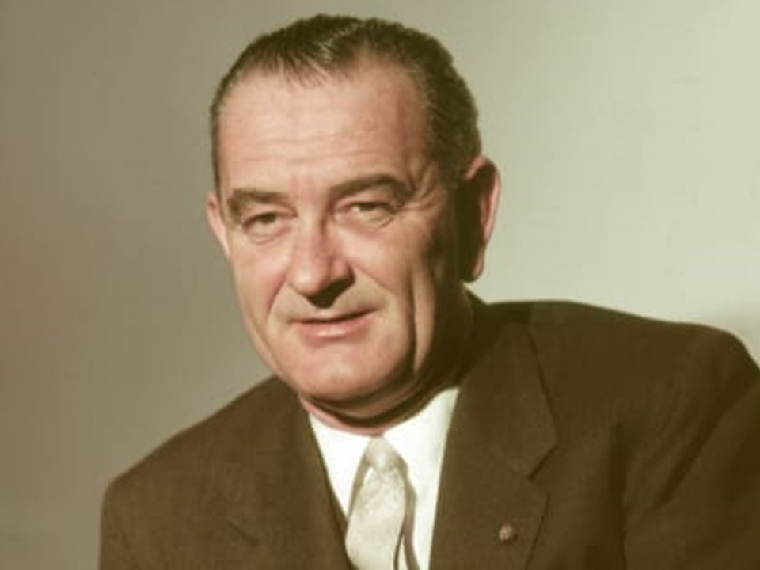

Slide 46
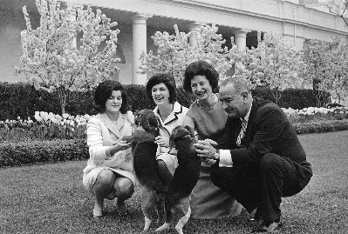
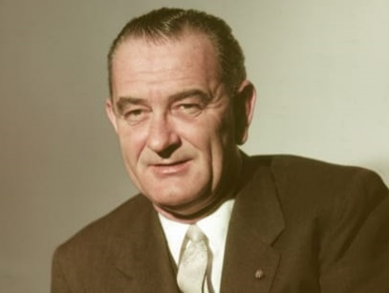
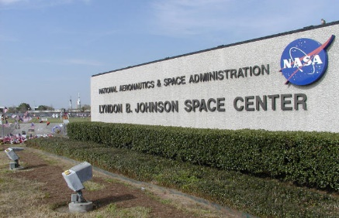
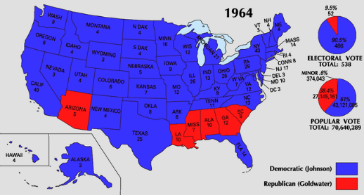

Slide 49
Presidential Quotes
Ron Bert
29½
January 5, 2020

Slide 50
Part 2
36. Lyndon B. Johnson (1963-1969)

Slide 51
“The family is the corner stone of our society. More than any other force it shapes the attitude, the hopes, the ambitions, and the values of the child. And when the family collapses it is the children that are usually damaged. When it happens on a massive scale the community itself is crippled.”
family collapses
community itself is crippled

Slide 52
He who finds a wife finds a good thing, And obtains favor from the LORD. — Proverbs 18:22

Slide 53
God sets the solitary in families; He brings out those who are bound into prosperity; But the rebellious dwell in a dry land. — Psalms 68:6
individual

Slide 54
“This administration here and now declares unconditional war on poverty.”

Slide 55
“I believe that the essence of government lies with unceasing concern for the welfare and dignity and decency and innate integrity of life for every individual. I don't like to say this and wish I didn't have to add these words to make it clear but I will regardless of color, creed, ancestry, sex or age.”
concern
life for every individual

Slide 56
“Nothing comes free. Nothing. Not even good, especially not good.”

Slide 57
“But if future generations are to remember us more with gratitude than with sorrow, we must achieve more than just the miracles of technology. We must also leave them a glimpse of the world as God really made it, not just as it looked when we got through with it.”
remember
God
God

Slide 58
“'All men are created equal’, 'government by consent of the governed’, 'give me liberty or give me death’. Well, those are not just clever words, or those are not just empty theories.”

Slide 59
“In the years since then, those four freedoms – freedom of speech, freedom of worship, freedom from want, and freedom from fear - have stood as a summary of our aspirations for the American Republic and for the world.”
four freedoms
❶
of speech
❷
of worship
❸
from want
❹
from fear
summary of our aspirations
Notes:
Franklin D. Roosevelt (1933-1945) stated 4 freedoms

Slide 60
“Free speech, free press, free religion, the right of free assembly, yes, the right of petition ... well, they are still radical ideas.”
radical ideas:
• Free speech
• free press
• free religion
• right of free assembly
• right of petition
Free speech
free press
free religion
right of free
assembly
right of
petition
radical ideas

Slide 61
Death and life are in the power of the tongue, And those who love it will eat its fruit. — Proverbs 18:21

Slide 62
So then, my beloved brethren, let every man be swift to hear, slow to speak, slow to wrath; for the wrath of man does not produce the righteousness of God. — James1:19-20

Slide 63
“I believe we can continue the Great Society while we fight in Vietnam.”

Slide 64
“Boys, it is just like the Alamo. Somebody should have by God helped those Texans. I'm going to Vietnam.”

Slide 65
“If we quit Vietnam, tomorrow we'll be fighting in Hawaii, and next week we'll have to fight in San Francisco.”

Slide 66
Receive one who is weak in the faith, but not to disputes over doubtful things. — Romans 14:1

Slide 67
“Every old man complains of the growing depravity of the world, of the petulance and insolence of the rising generation. He recounts the decency and regularity of former times, and celebrates the discipline and sobriety of the age in which his youth was passed; a happy age which is now no more to be expected, since confusion has broken in upon the world, and thrown down all the boundaries of civility and reverence.”
immorality
grouchiness
disrespect

Slide 68
Do not hasten in your spirit to be angry, For anger rests in the bosom of fools. Do not say, "Why were the former days better than these?" For you do not inquire wisely concerning this. — Ecclesiastes 7:9-10

Slide 69
“There is nothing that exasperates people more than a display of superior ability or brilliance in conversation. They seem pleased at the time, but their envy makes them curse the conversationalist in their heart.”

Slide 70
Again, I saw that for all toil and every skillful work a man is envied by his neighbor. This also is vanity and grasping for the wind. — Ecclesiastes 4:4
Notes:
Jealousy and envy tear down the heights all can aspire to be. When we want more than applaud, what is stolen are the mountains that build greatness itself.

Slide 71
“Nothing is more despicable than the old age of a passionate man. When the vigor of youth fails him, and his amusements pall with frequent repetition, his occasional rage sinks by decay of strength into peevishness; that peevishness, for want of novelty and variety, becomes habitual; the world falls off from around him, and he is left, as Homer expresses it, to devour his own heart in solitude and contempt.”
darken
HELL

Slide 72
Pursue peace with all people, and holiness, without which no one will see the Lord: looking carefully lest anyone fall short of the grace of God; lest any root of bitterness springing up cause trouble, and by this many become defiled; — Hebrews 12:14-15
anger
?
Pursue peace
fall short
root of bitterness

Slide 73
“He that in the latter part of his life too strictly inquires what he has done, can very seldom receive from his own heart such an account as will give him satisfaction.”

Slide 74
“Light at the end of the tunnel? We don't even have a tunnel; we don't even know where the tunnel is.”

Slide 75
“Our most tragic error may have been our inability to establish a rapport and a confidence with the press and television with the communication media. I don't think the press has understood me.”

Slide 76
“If one morning I walked on top of the water across the Potomac River, the headline that afternoon would read: 'President Can't Swim.'”

Slide 77
“Faith builds, cynicism destroys.”

Slide 78
Help, LORD, for the godly man ceases! For the faithful disappear from among the sons of men. They speak idly everyone with his neighbor; With flattering lips and a double heart they speak. May the LORD cut off all flattering lips, And the tongue that speaks proud things, … — Psalms 12:1-3

Slide 79
“I'm tired. I'm tired of feeling rejected by the American people. I'm tired of waking up in the middle of the night worrying about the war.”

Slide 80
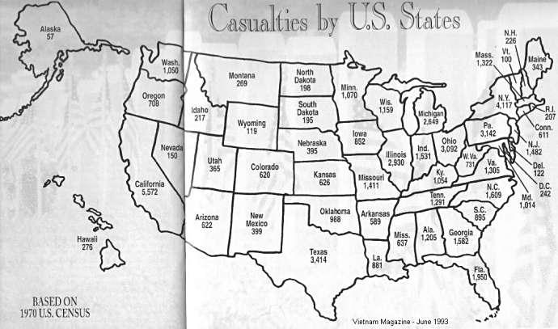
“The last thing I wanted to do was to be a wartime President.”

Slide 81
“What we won when all of our people united just must not now be lost in suspicion, distrust, selfishness, and politics among any of our people. Accordingly, I shall not seek, and I will not accept, the nomination of my party for another term as your President.”

Slide 82
Where there is no counsel, the people fall; But in the multitude of counselors there is safety. — Proverbs 11:14

Slide 83
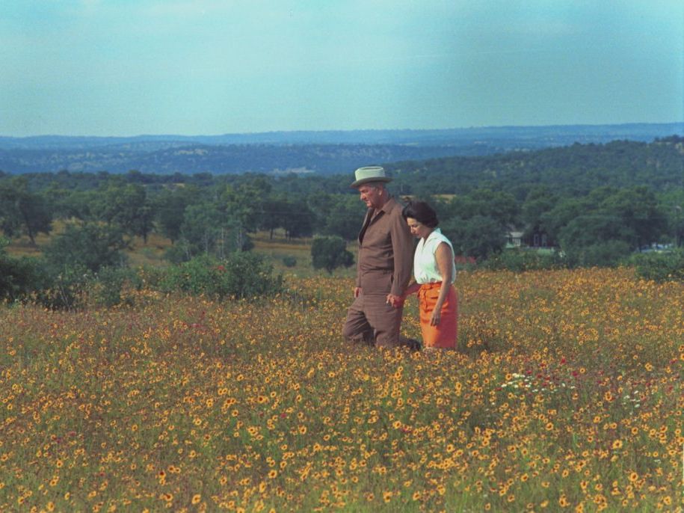
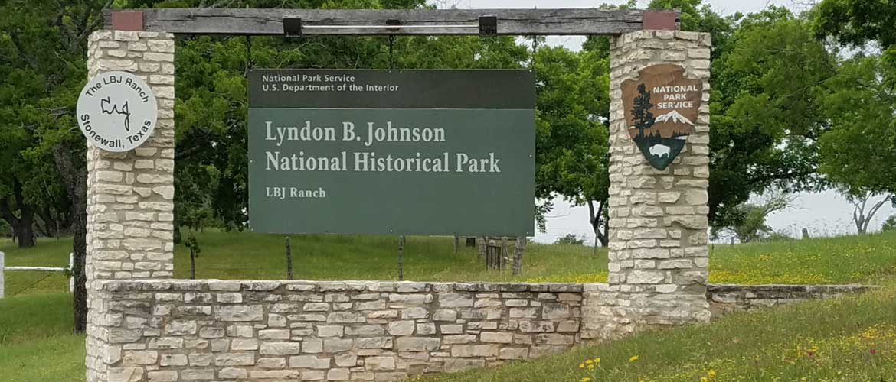

Slide 84
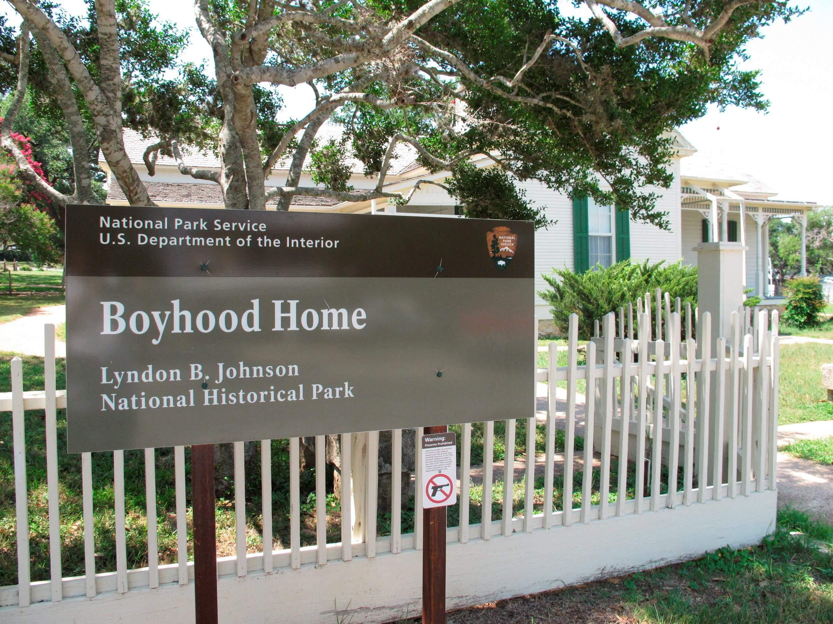

Slide 85
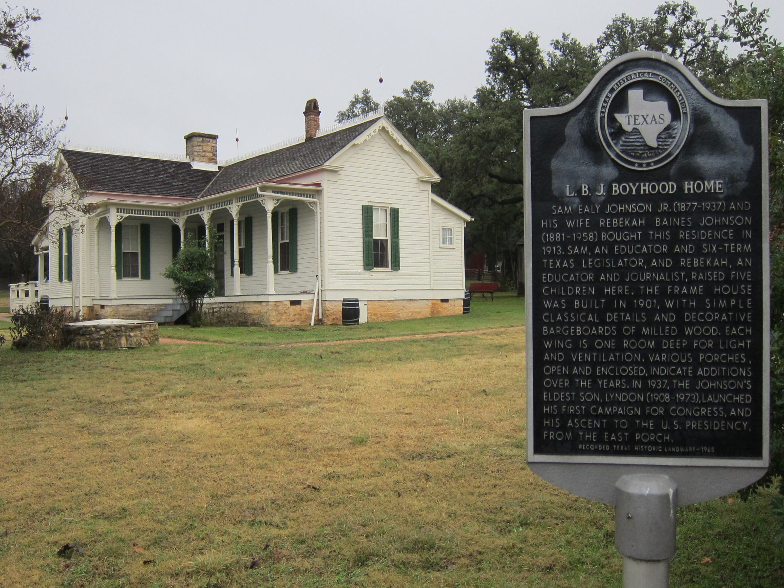

Slide 86
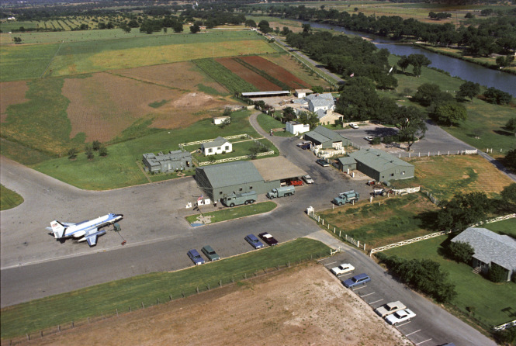
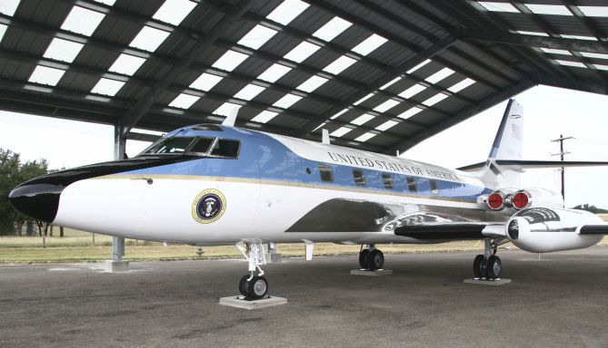

Slide 87
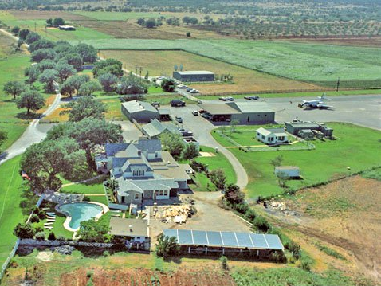

Slide 88
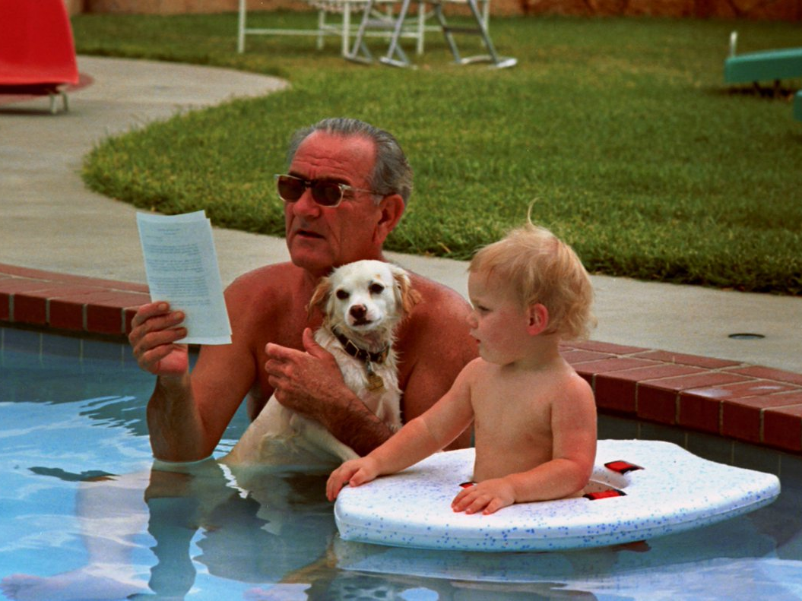

Slide 89
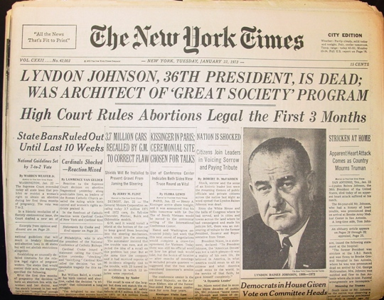

Slide 91
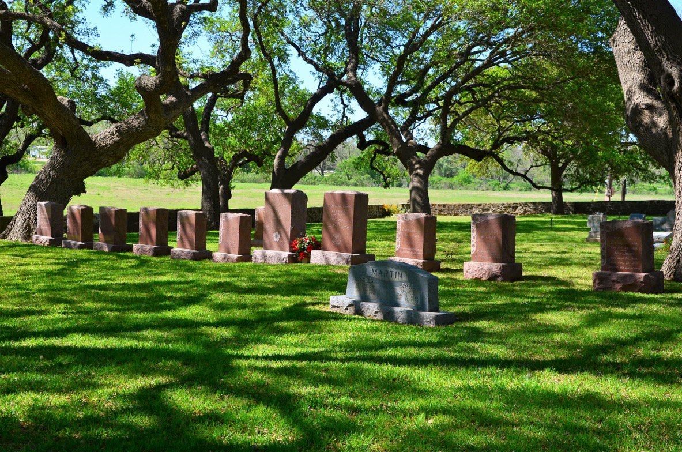

Slide 92
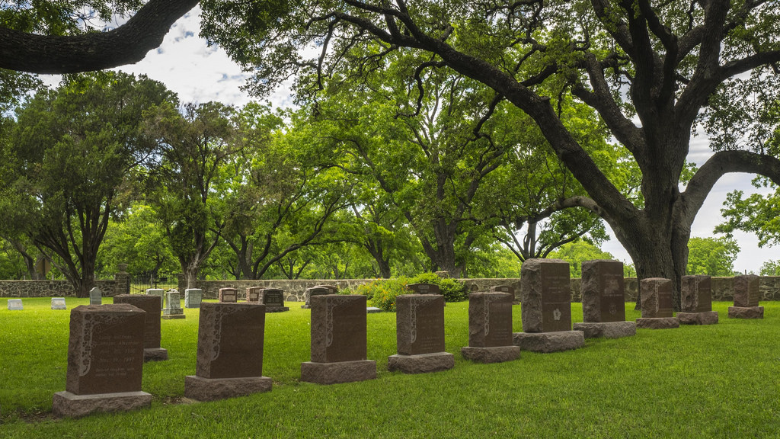

Slide 93
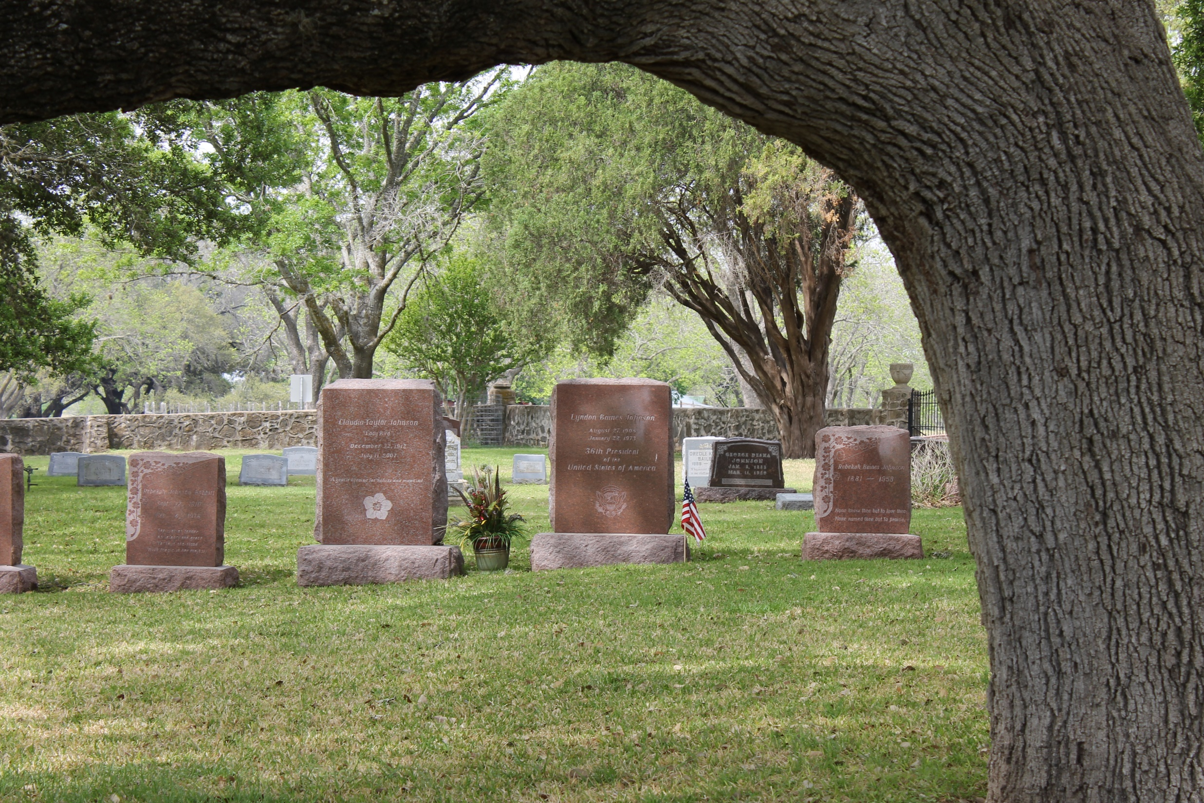

Slide 94
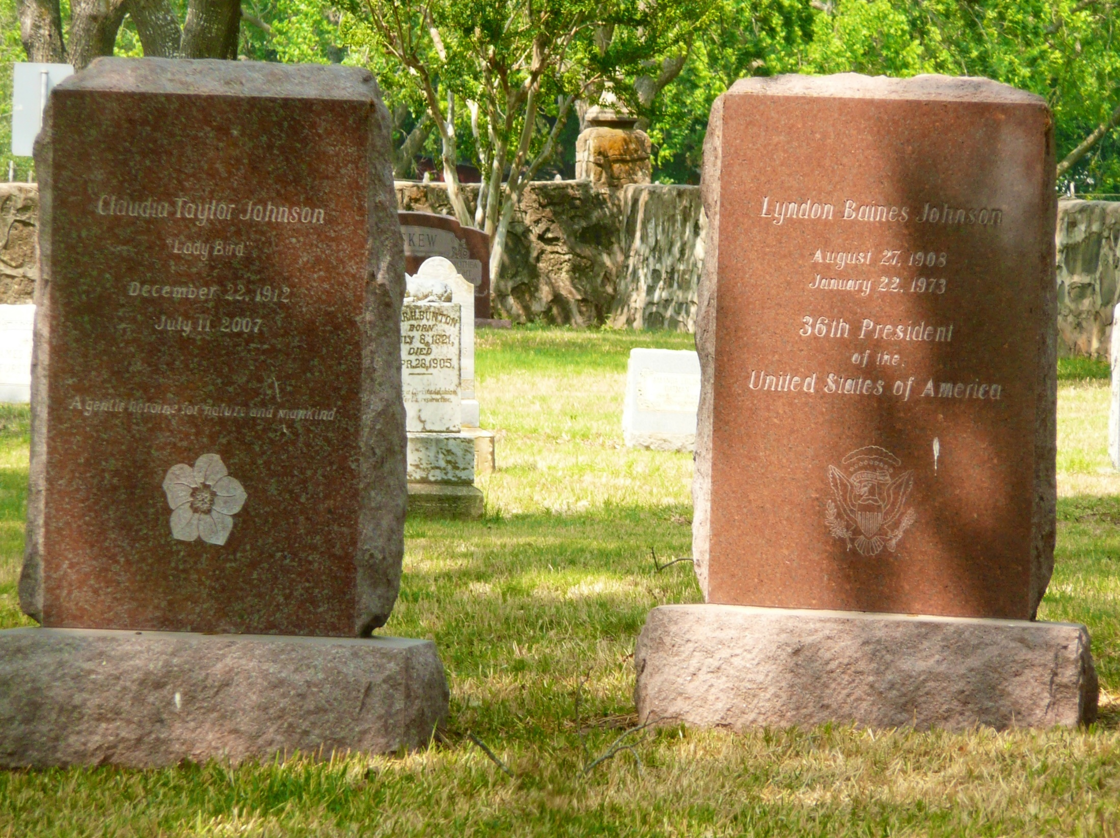

Slide 95
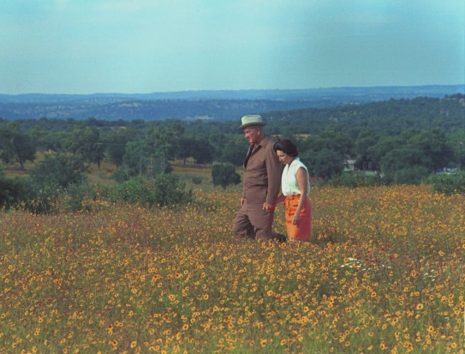
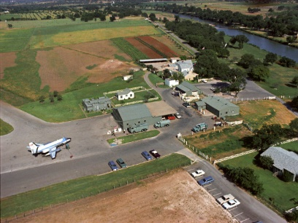
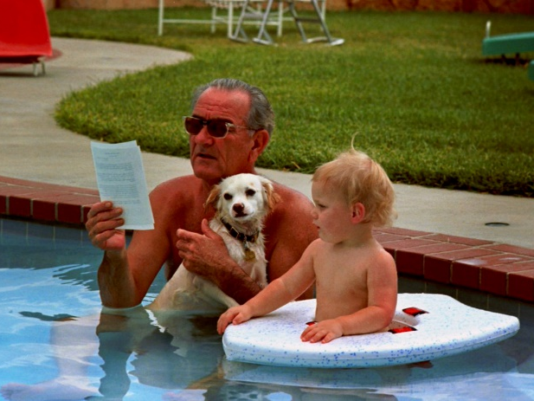
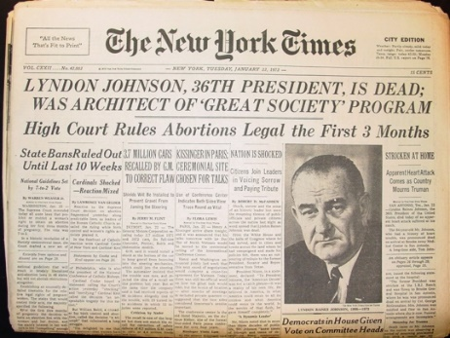
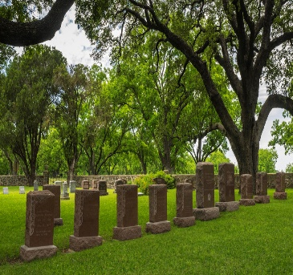
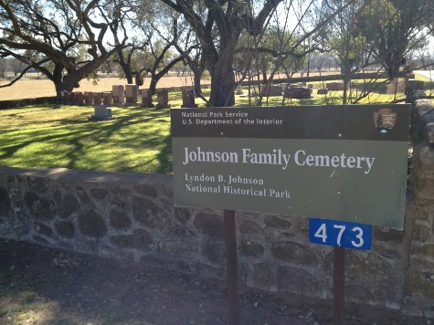

Slide 96
→ Promises are often made from over inflated egos
→ A misconception that only a few hold hatful hearts
→ Hypocrites pray one day then curse the next
→ Knowledge without understanding blurs truth
→ American ideals build from duty to God & His word
→ Faithful separate from public service is destructive
→ Without adequate education oblivion looms
→ What unites a people is tight bonded families
→ History contains the wealth of basic truisms
→ Contempt for those capable drives jealous hearts
→ Bitter hearts die alone void of welcoming truth
→ Obsessive arguing over truth leaves just empty truth
→ Faith builds heaven’s ladder while hate carves a pit
Disgust can kill the heart of a servant
Notes:
Disgust can kill the heart of a servant

Slide 98
Please visit http://www.LoveFromGod.com to explore further
Ronald Bert Channel on
Notes:
Eternity never ends.

