Slide 2
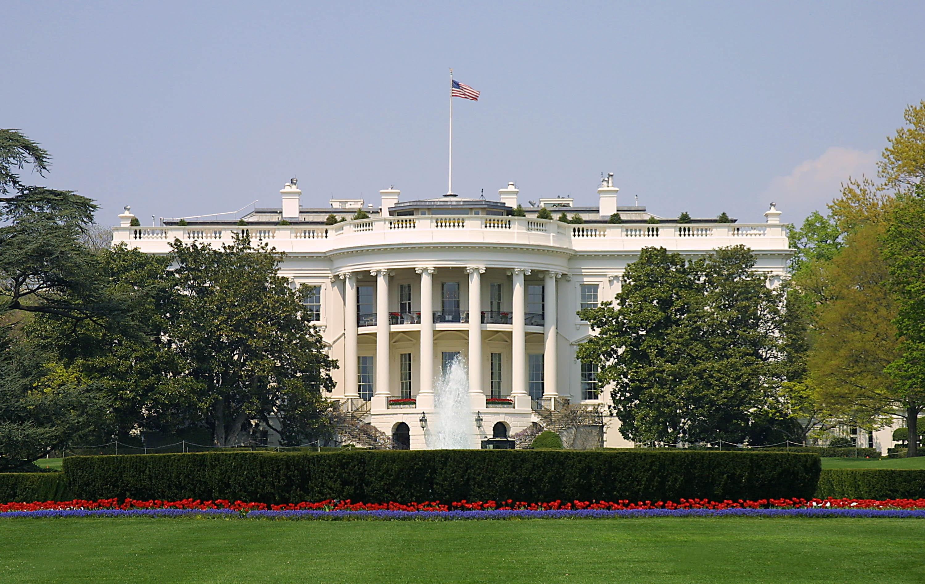
Presidential Quotes
Ron Bert
26
October 6, 2019

Slide 3
Part 1
34. Dwight D. Eisenhower (1953-1961)
Notes:
Parents were Jehovah's witnesses
Baptized into the Presbyterian church Feb 1953, only president to do so.
Under God in pelage of allegiance
In God we trust on money.
Formed NASA in 1958
Had a stroke and heart attack while in office.

Slide 4
“Forces of good and evil are massed and armed and opposed as rarely before in history. Freedom is pitted against slavery; lightness against the dark ... In the final choice, a soldier's pack is not so heavy a burden as a prisoner's chains.”
Freedom is pitted against slavery
dark
lightness against the dark
light

Slide 5
“We face a hostile ideology global in scope, atheistic in character, ruthless in purpose and insidious in method.”
global in scope
atheistic in character
ruthless in purpose
insidious in method
in
global
in scope
atheistic in character
in
Evil
ruthless in purpose
in
insidious in method
in

Slide 6
“How far have we come in man's long pilgrimage from darkness toward light? Are we nearing the light-a day of freedom and of peace for all mankind? Or are the shadows of another night closing in upon us?”
long pilgrimage
toward light
HOPE
peace for all mankind

Slide 7
"And this is the condemnation, that the light has come into the world, and men loved darkness rather than light, because their deeds were evil. For everyone practicing evil hates the light and does not come to the light, lest his deeds should be exposed." — John 3:19-20
everyone practicing
evil hates

Slide 8
“This is a long tough road we have to travel. The men that can do things are going to be sought out just as surely as the sun rises in the morning. Fake reputations, habits of glib and clever speech, and glittering surface performance are going to be discovered.”
Fake
to be discovered

Slide 9
“The hope of the world is that wisdom can arrest conflict between brothers. I believe that war is the deadly harvest of arrogant and unreasoning minds. And I find grounds for this belief in the wisdom literature of Proverbs. It says in effect this: Panic strikes like a storm and calamity comes like a whirlwind to those who hate knowledge and ignore their God.”
arrogant and unreasoning minds
hate
knowledge
ignore their God

Slide 10
“When your terror comes like a storm, And your destruction comes like a whirlwind, When distress and anguish come upon you. Then they will call on me, but I will not answer; They will seek me diligently, but they will not find me. Because they hated knowledge And did not choose the fear of the LORD, …” — Proverbs 1:27-29

Slide 11
“Before all else, we seek, upon our common labor as a nation, the blessings of Almighty God.”

Slide 12
“Give us, we pray, the power to discern clearly right from wrong, and allow all our words and actions to be governed thereby, and by the laws of this land. Especially we pray that our concern shall be for all the people regardless of station, race, or calling.”
pray
be governed
laws
for all

Slide 13
Therefore lay aside all filthiness and overflow of wickedness, and receive with meekness the implanted word, which is able to save your souls. But be doers of the word, and not hearers only, deceiving yourselves.. — James 1:21-22
But be doers

Slide 14
“We the people, elect leaders not to rule but to serve.”
to serve

Slide 15
“Personal prayer, it seems to me, is one of the simplest necessities of life, as basic to the individual as sunshine, food and water-and at times, of course, more so. By prayer I mean an effort to get in touch with the Infinite. We know that our prayers are imperfect. Of course they are. We are imperfect human beings. A thousand experiences have convinced me beyond room of doubt that prayer multiplies the strength of the individual and brings within the scope of his capabilities almost any conceivable objective.”
Personal prayer
necessities of life
prayer multiplies
the strength of the individual

Slide 16
Likewise the Spirit also helps in our weaknesses. For we do not know what we should pray for as we ought, but the Spirit Himself makes intercession for us with groanings which cannot be uttered. — Romans 8:26

Slide 17
“Without God there could be no American form of government, nor an American way of life. Recognition of the Supreme Being is the first, the most basic, expression of Americanism. Thus, the founding fathers of America saw it, and thus with God’s help, it will continue to be.”
no
Without God
way of life
FAITH

Slide 18
“Our government makes no sense unless it is founded on a deeply held religious belief - and I don't care what it is.”
government
founded on
belief

Slide 19
“If we make ourselves worthy of America's ideals, if we do not forget that our nation was founded on the premise that all men are creatures of God's making, the world will come to know that it is free men who carry forward the true promise of human progress and dignity.”
if
we do not forget
all men are creatures of God's
making

Slide 20
"Behold, all souls are Mine; The soul of the father As well as the soul of the son is Mine; The soul who sins shall die." — Ezekiel 18:4

Slide 21
“The spirit of man is more important than mere physical strength, and the spiritual fiber of a nation than its wealth. The Bible is endorsed by the ages. Our civilization is built upon its words. In no other book is there such a collection of inspired wisdom, reality, and hope.”
spirit
more
important than mere physical
The Bible:
endorsed by the ages
civilization built upon it
• inspired wisdom
• reality
• hope
strength
The Bible
The Bible
endorsed by the ages
civilization
built upon it
inspired wisdom
reality
hope

Slide 22
For bodily exercise profits a little, but godliness is profitable for all things, having promise of the life that now is and of that which is to come. — 1st Timothy 4:8
godliness

Slide 23
“In the highest sense the Bible is to us the unique repository of eternal spiritual truths.”
the Bible
eternal spiritual truths

Slide 24
“The teaching of their ancient belief is filled with truth for the present day. Its profound sense of justice, nation to nation, man to man, is an essential part of every religious and social order. The health of our society depends upon a deep and abiding respect for the basic commandments of the God of Israel.”
truth for the present day
every religious
order
God of Israel

Slide 25
“We have never stopped sin by passing laws; and in the same way, we are not going to take a great moral ideal and achieve it merely by law.”
sin
moral ideal

Slide 26
“What the church should be telling the worker is that the first demand religion makes on him is that he should be a good workman. If he is a carpenter he should be a competent carpenter. Church by all means on Sundays-but what is the use of church if at the very center of life a man defrauds his neighbor and insults God by poor craftsmanship.”
be a good workman

Slide 27
Bondservants, obey in all things your masters according to the flesh, not with eyeservice, as men-pleasers, but in sincerity of heart, fearing God. And whatever you do, do it heartily, as to the Lord and not to men, knowing that from the Lord you will receive the reward of the inheritance; for you serve the Lord Christ. — Colossians 3:22-24
to the Lord and not to men

Slide 28
For we are His workmanship, created in Christ Jesus for good works, which God prepared beforehand that we should walk in them. — Ephesians 2:10
His workmanship
created in Christ Jesus for good
in
works

Slide 29
“This is what I found out about religion: It gives you courage to make the decisions you must make in a crisis, and then the confidence to leave the result to a higher Power. Only by trust in God can a man carrying responsibility find repose.”
religion
courage
confidence
Only by trust in God
rest

Slide 30
Trust in the LORD with all your heart, And lean not on your own understanding; In all your ways acknowledge Him, And He shall direct your paths. Do not be wise in your own eyes; Fear the LORD and depart from evil. — Proverbs 3:5-7
all
all

Slide 31
"Come to Me, all you who labor and are heavy laden, and I will give you rest. Take My yoke upon you and learn from Me, for I am gentle and lowly in heart, and you will find rest for your souls." — Matthew 11:28-29
all

Slide 32
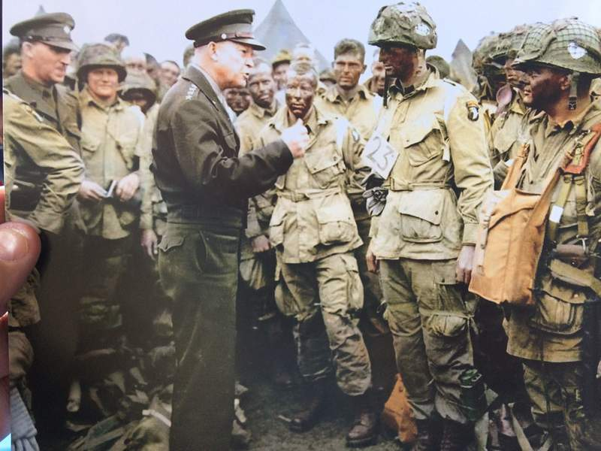
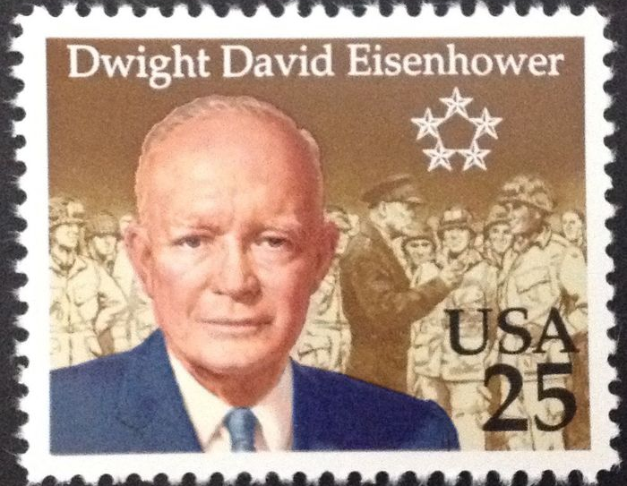

Slide 33
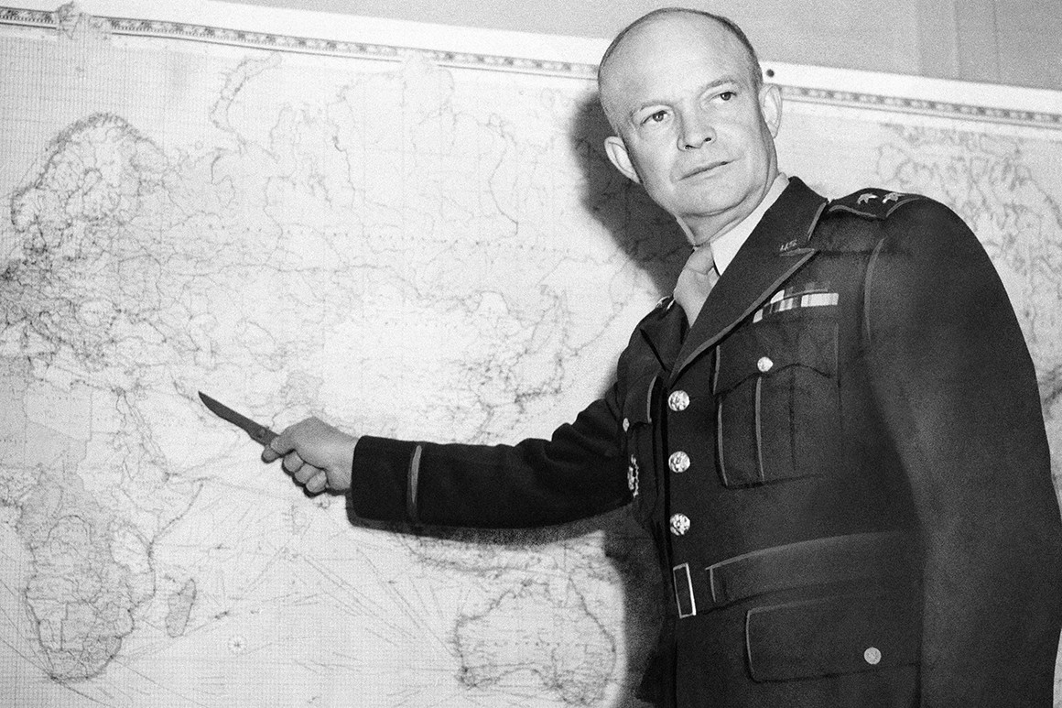
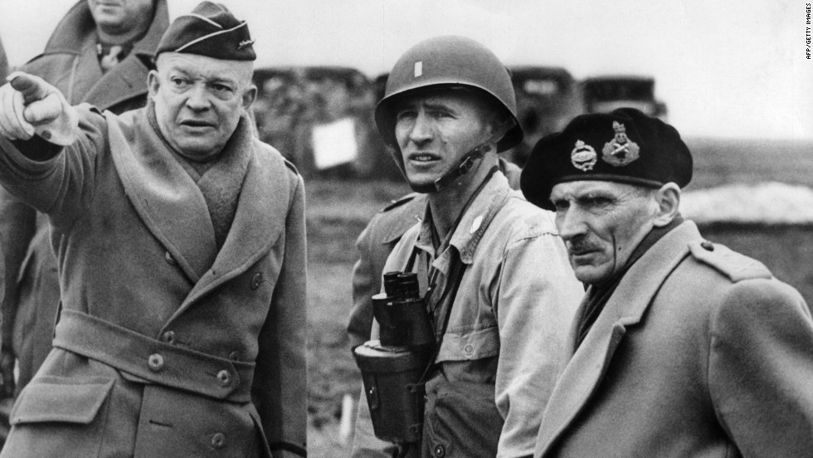
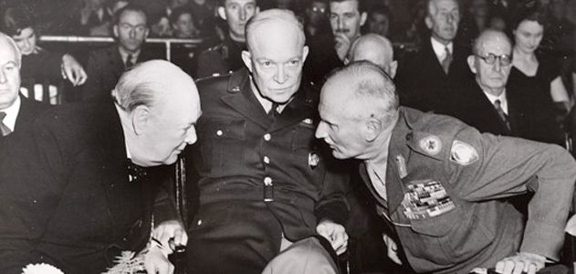
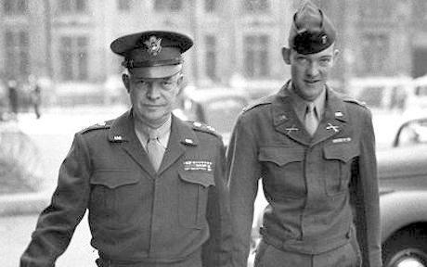

Slide 34
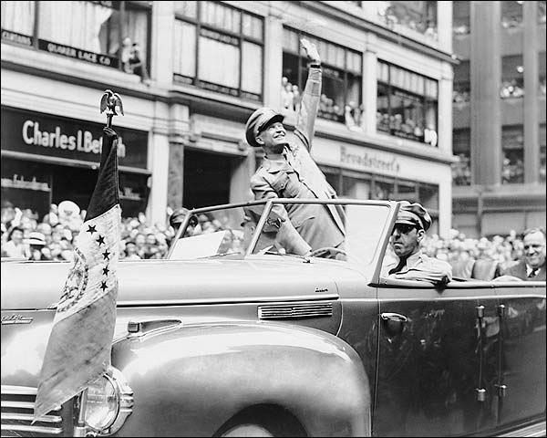
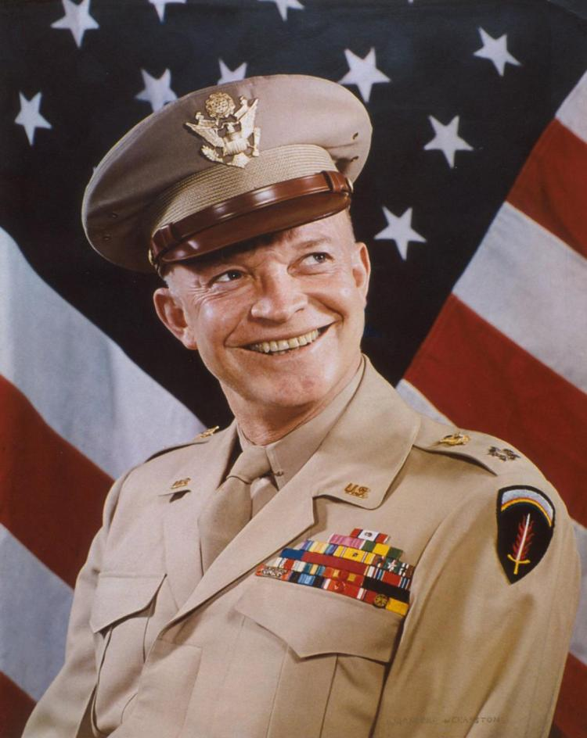

Slide 35
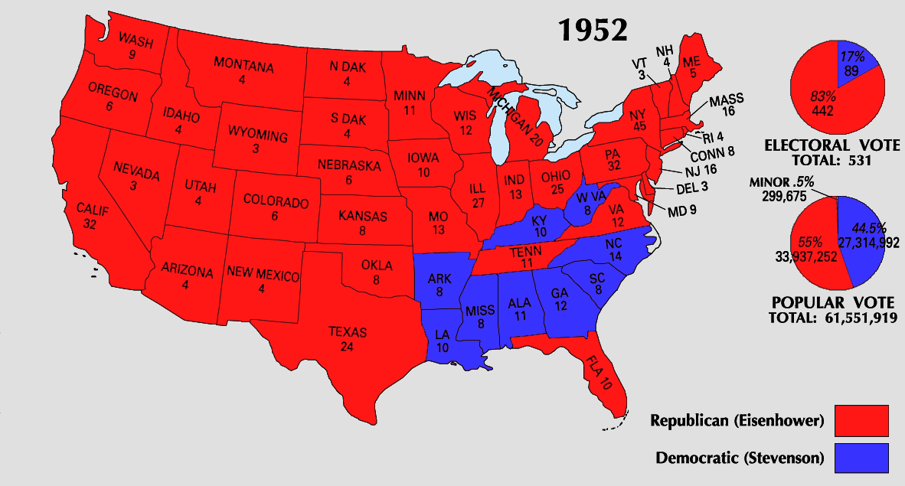

Slide 36
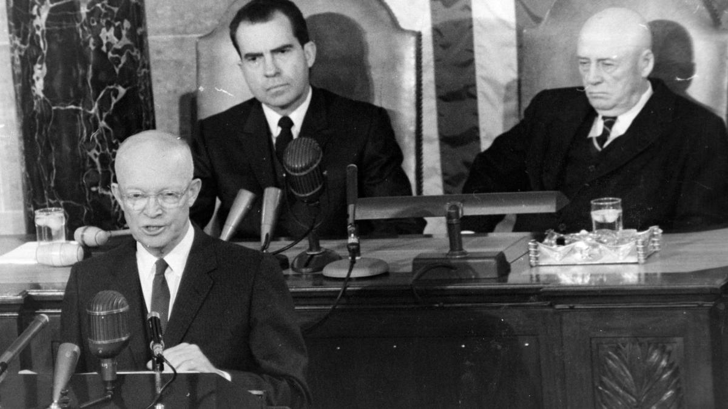

Slide 37
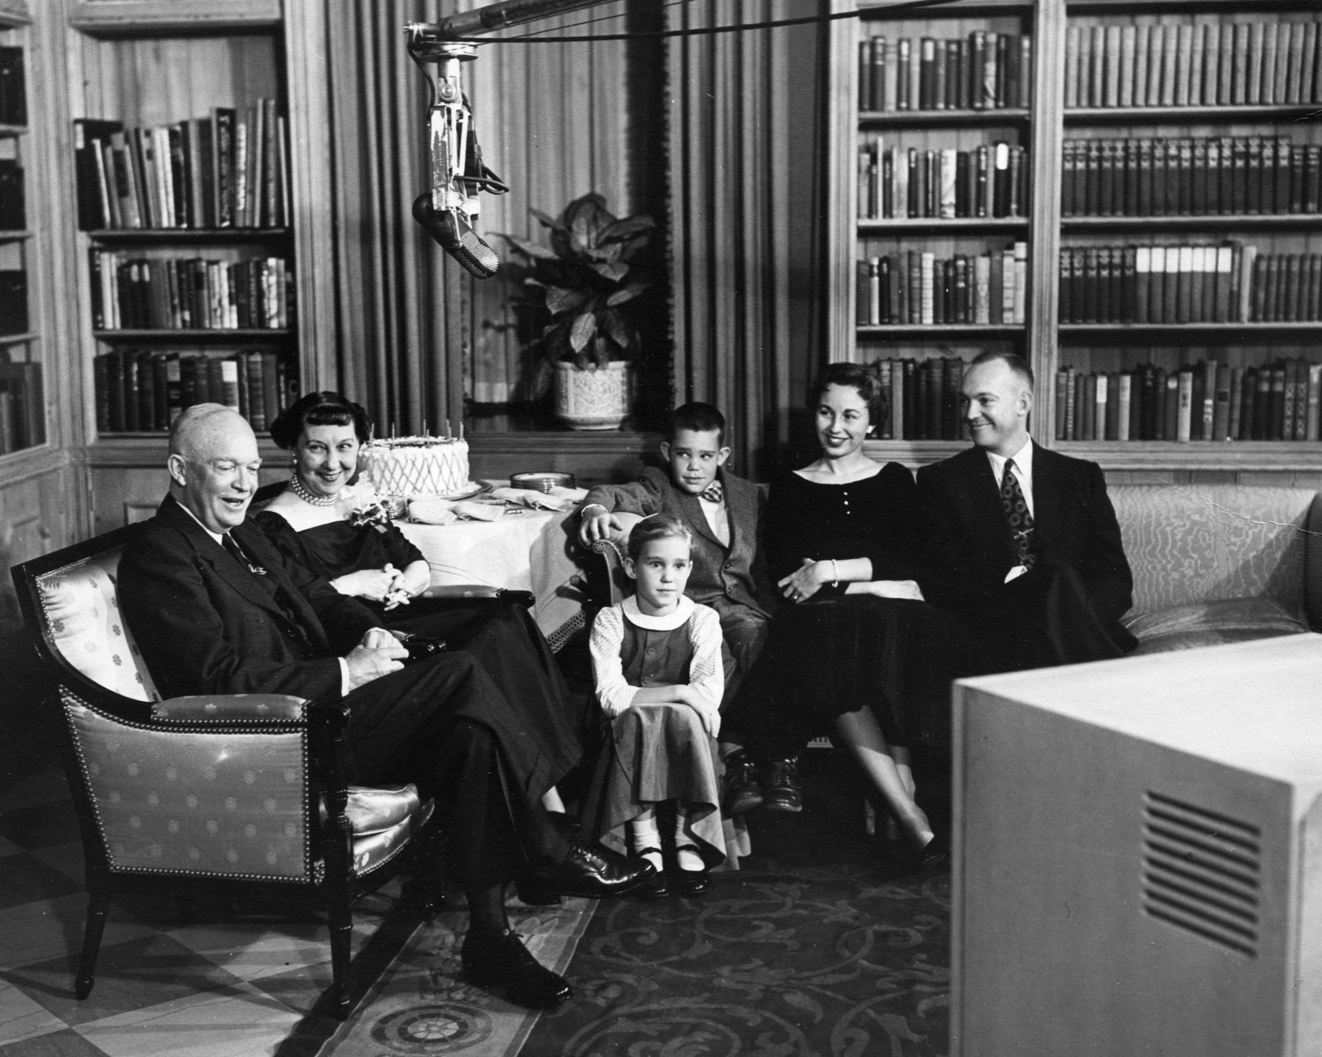

Slide 38
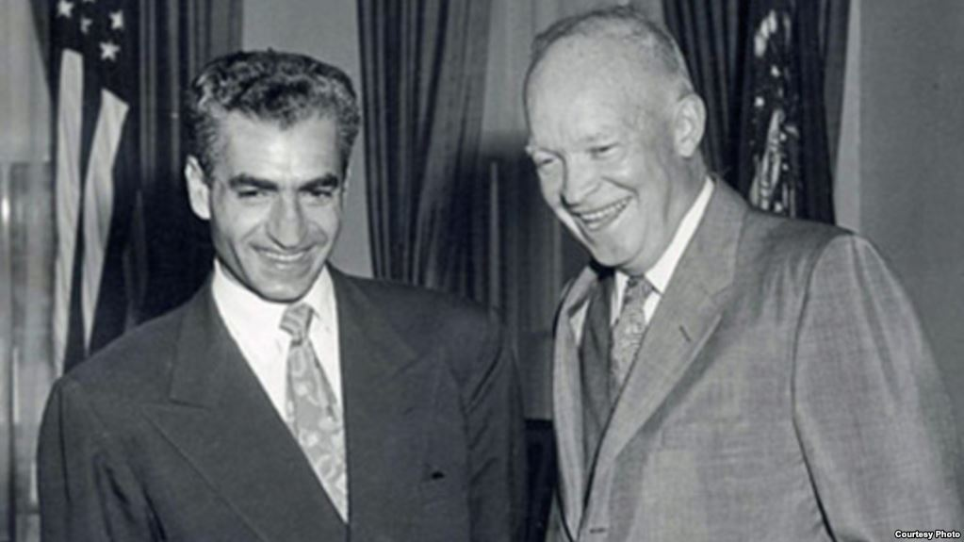
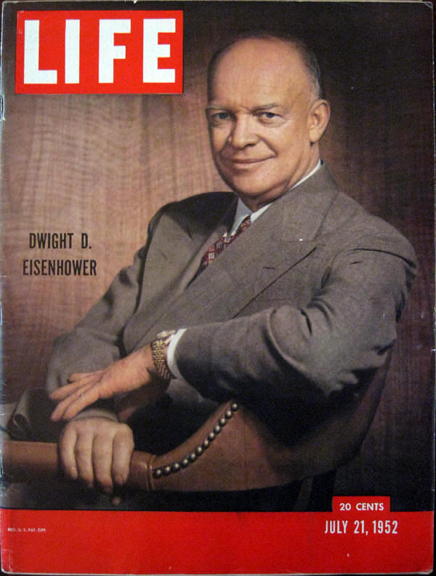
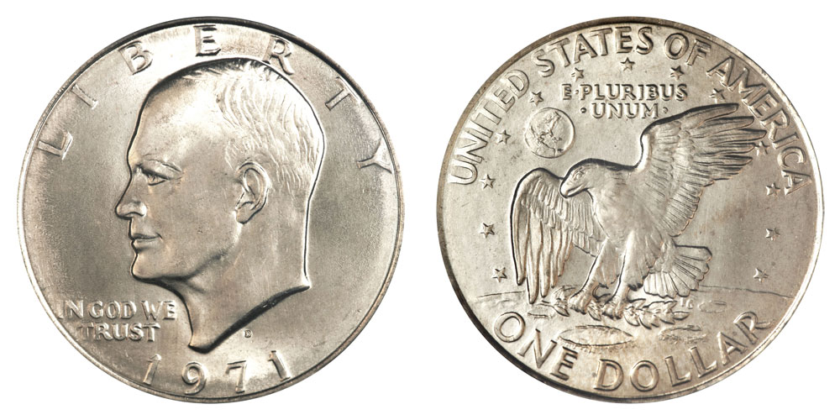

Slide 39
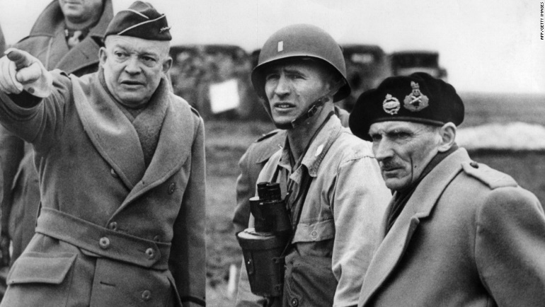
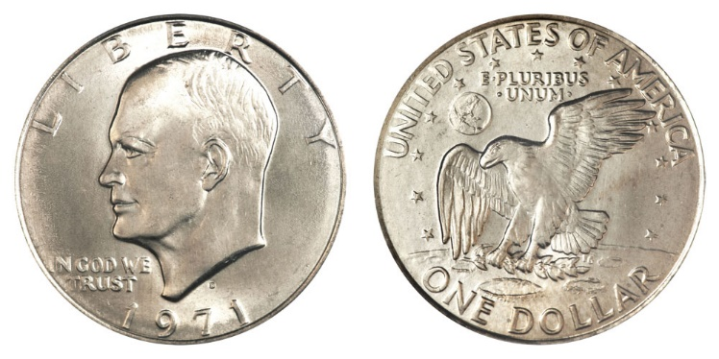

Slide 41
Presidential Quotes
Ron Bert
26½
October 27, 2019

Slide 42
Part 2
34. Dwight D. Eisenhower (1953-1961)

Slide 43
“There are three stages of life: youth, maturity, and 'My, you're looking good!'”

Slide 44
“The past sharpens perspective, warns against pitfalls, and helps to point the way.”

Slide 45
As iron sharpens iron, So a man sharpens the countenance of his friend. — Proverbs 27:17

Slide 46
“Freedom has its life in the hearts, the actions, the spirit of men and so it must be daily earned and refreshed - else like a flower cut from its life-giving roots, it will wither and die.”
must be daily earned

Slide 47
For He knows our frame; He remembers that we are dust. As for man, his days are like grass; As a flower of the field, so he flourishes. For the wind passes over it, and it is gone, And its place remembers it no more. — Psalms 103:14-16

Slide 48
But the mercy of the LORD is from everlasting to everlasting On those who fear Him, And His righteousness to children's children, To such as keep His covenant, And to those who remember His commandments to do them. — Psalms 103:17-18
heritage
such as keep
remember
do them

Slide 49
“The qualities of a great man are vision, integrity, courage, understanding, the power of articulation, and profundity of character.”
profoundness
perceptiveness
insightfulness
understanding
wisdom

Slide 50
“Only our individual faith in freedom can keep us free.”
individual faith

Slide 51
“May the light of freedom, coming to all darkened lands, flame brightly - until at last the darkness is no more.”

Slide 52
"I have come as a light into the world, that whoever believes in Me should not abide in darkness. And if anyone hears My words and does not believe, I do not judge him; for I did not come to judge the world but to save the world. He who rejects Me, and does not receive My words, has that which judges him -- the word that I have spoken will judge him in the last day." — John 12:46-48
I have come as a light into the world
the word that I have spoken will judge

Slide 53
“But we know that freedom cannot be served by the devices of the tyrant. As it is an ancient truth that freedom cannot be legislated into existence, so it is no less obvious that freedom cannot be censored into existence. And any who act as if freedoms defenses are to be found in suppression and suspicion and fear confess a doctrine that is alien to America.”
of the tyrant
truth
ancient truth
if
if freedoms defenses
truth
found in suppression
suspicion
in
fear
X

Slide 54
Then Jesus said to those Jews who believed Him, "If you abide in My word, you are My disciples indeed. And you shall know the truth, and the truth shall make you free." — John 8:31-32
truth

Slide 55
“To have a free, peaceful and prosperous world we must be ever stronger particularly in the spiritual things. ... It is American belief in decency and justice and progress and the value of individual liberty because of the rights conferred on each of us by our Creator that will carry us through. ... There must be something in the heart as well as the head.”
rights conferred on each of us
by our Creator

Slide 56
“We are so proud of our guarantees of freedom in thought and speech and worship, that, unconsciously, we are guilty of one of the greatest errors that ignorance can make - we assume our standard of values is shared by all other humans in the world.”
freedom
in
thought
speech
worship

Slide 57
“As we peer into society's future, we -- you and I, and our government -- must avoid the impulse to live only for today, plundering for our own ease and convenience the precious resources of tomorrow. We cannot mortgage the material assets of our grandchildren without risking the loss also of their political and spiritual heritage. We want democracy to survive for all generations to come, not to become the insolvent phantom of tomorrow.”
spiritual heritage
X
shadow

Slide 58
“It is not a struggle merely of economic theories, or forms of government or of military power. At issue is the true nature of man. Either man is the creature whom the psalmist described as a little lower than the angels ... or man is a soulless, animated machine to be enslaved, used and consumed by the state for its own glorification. It is, therefore, a struggle which goes to the roots of the human spirit, and its shadow falls across the long sweep of man's destiny.”
true nature of man:
true nature of
a soulless
animated machine
to be enslaved
used and consumed
by the state
↓
for its own
glorification
man
a little lower
than the
a little lower
than the angels
angels
a soulless
animated
machine
to be enslaved
used and consumed
by the state
for its own
glorification

Slide 59
When I consider Your heavens, the work of Your fingers, The moon and the stars, which You have ordained, What is man that You are mindful of him, And the son of man that You visit him? For You have made him a little lower than the angels, And You have crowned him with glory and honor. — Psalms 8:3-5

Slide 60
“Every gun that is made, every warship launched, every rocket fired signifies in the final sense, a theft from those who hunger and are not fed, those who are cold and are not clothed. This world in arms is not spending money alone. It is spending the sweat of its laborers, the genius of its scientists, the hopes of its children. This is not a way of life at all in any true sense. Under the clouds of war, it is humanity hanging on a cross of iron.”
humanity hanging on a cross of iron

Slide 61
“The cost of one modern heavy bomber is this: a modern brick school in more than 30 cities ... We pay for a single fighter with a half million bushels of wheat. We pay for a single destroyer with new homes that could have housed more than 8,000 people.”

Slide 62
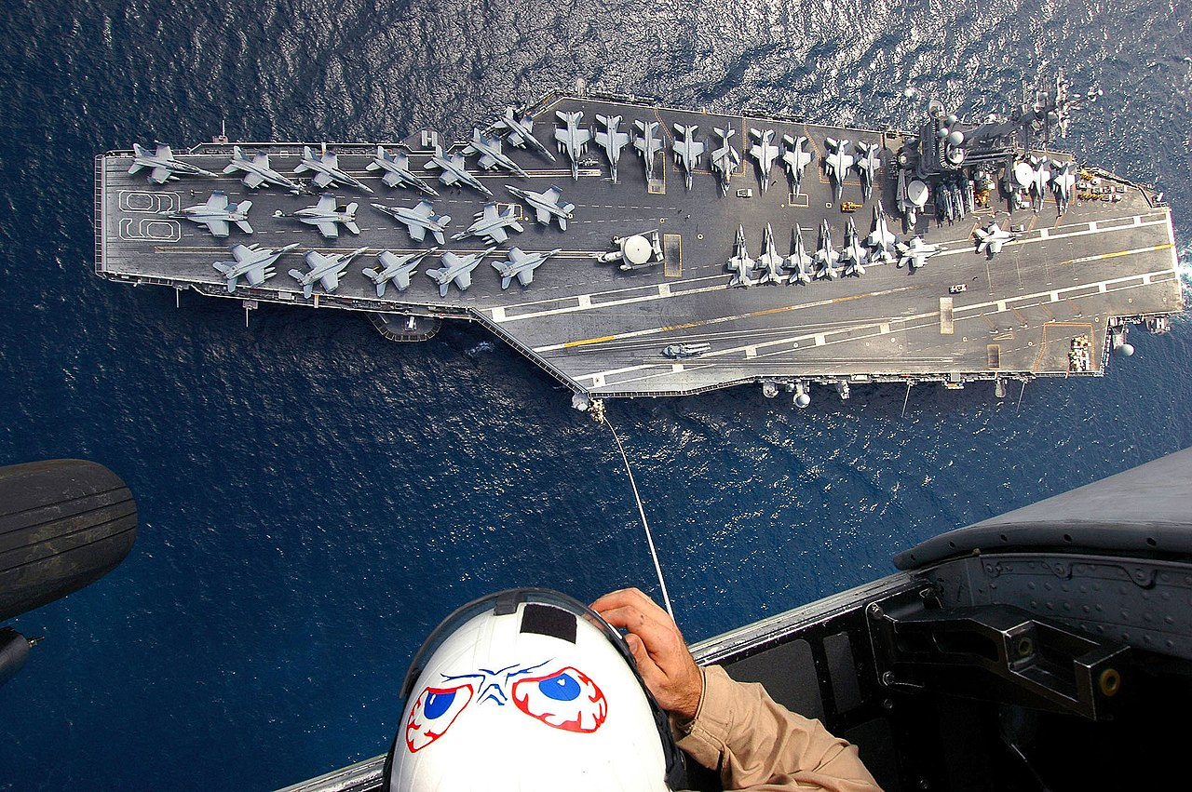

Slide 63
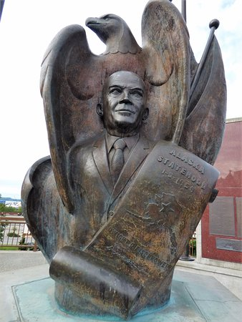
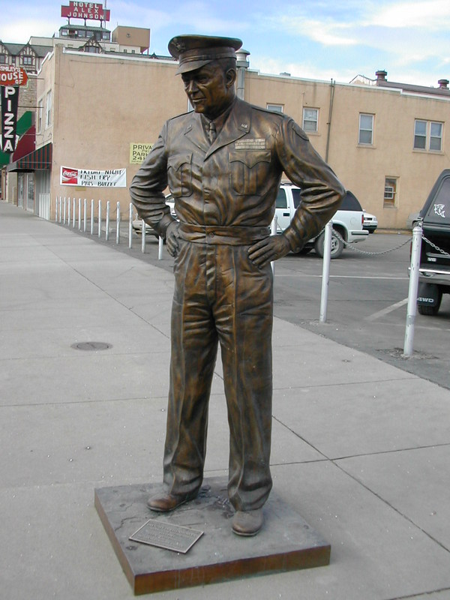
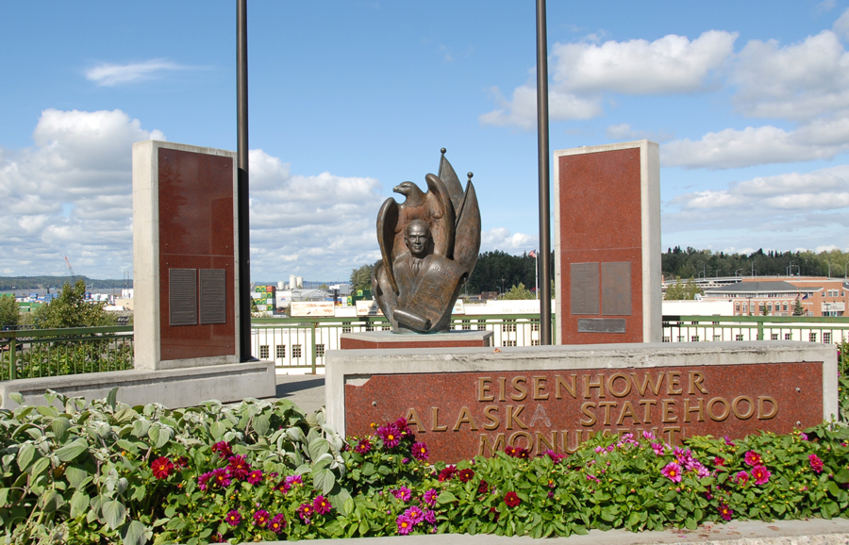
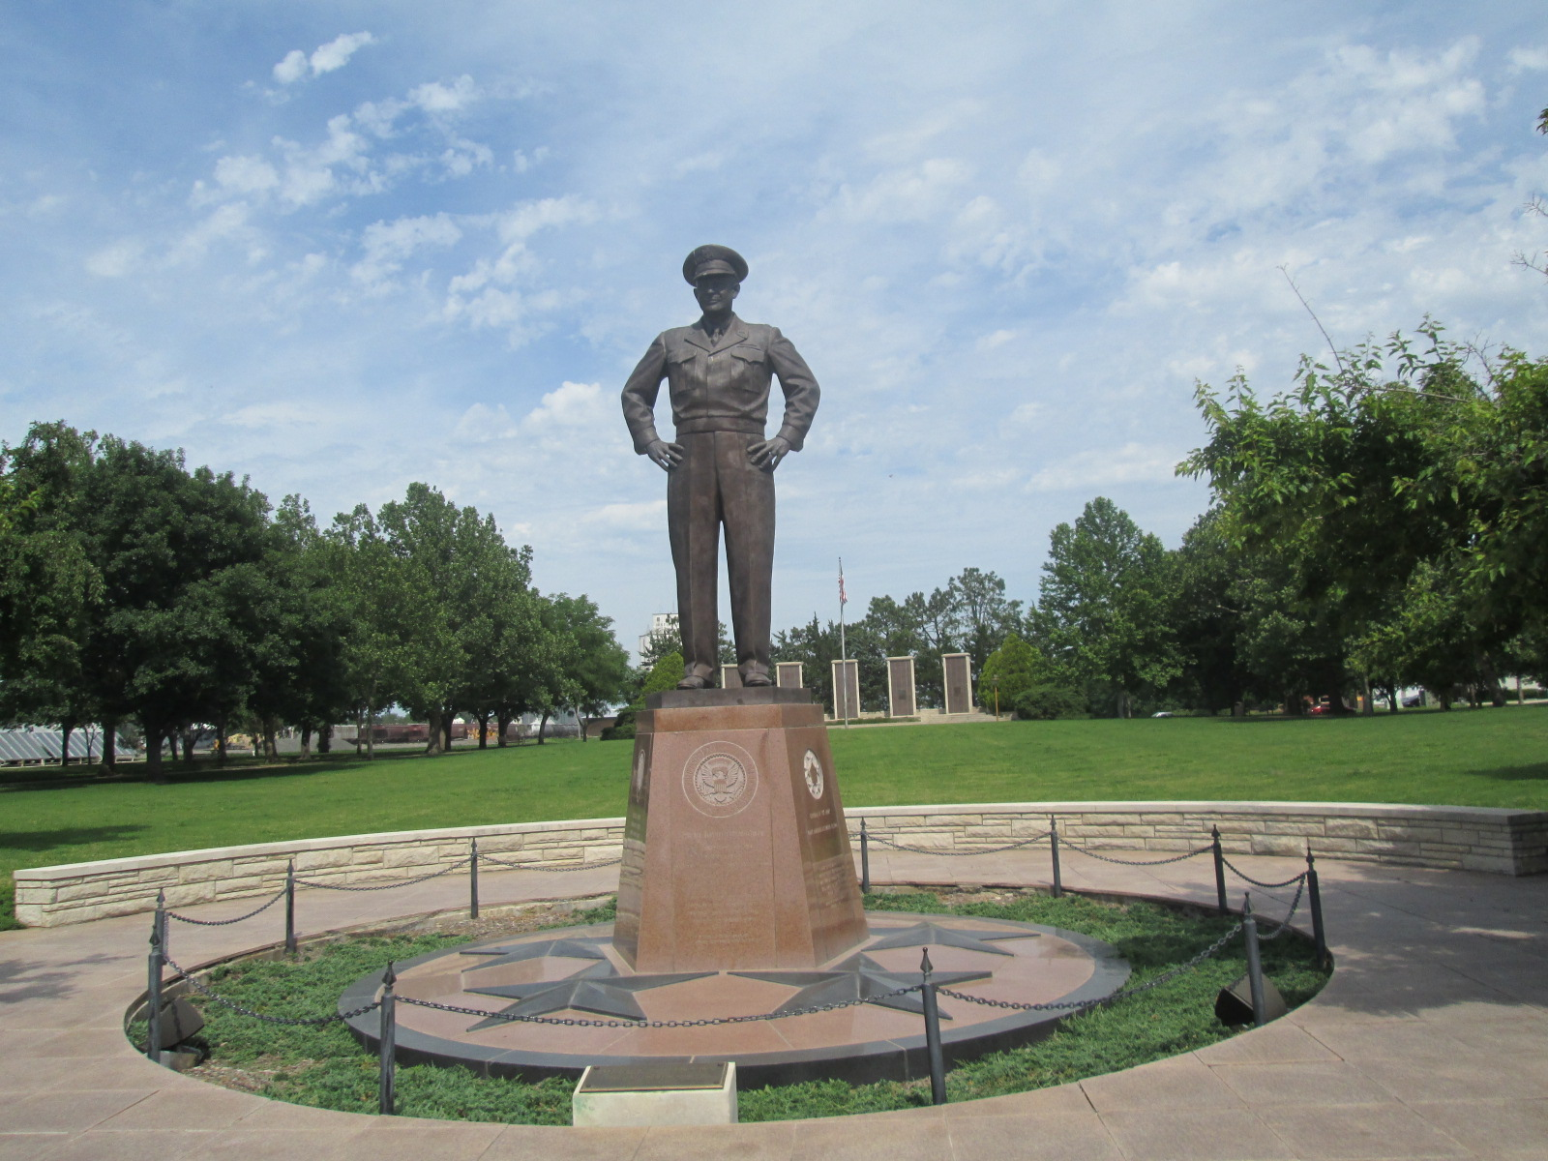

Slide 64
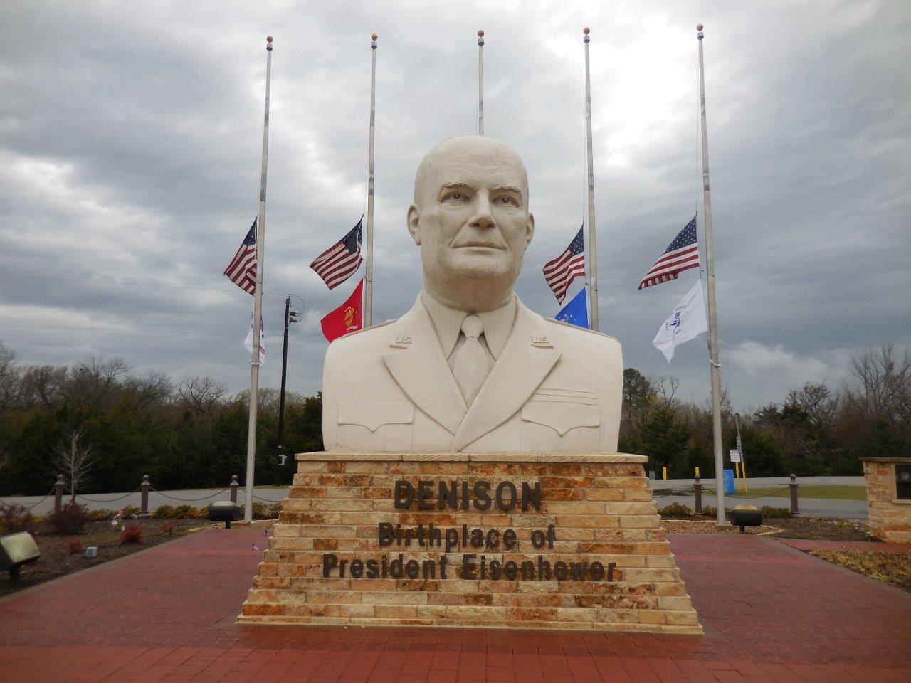

Slide 65
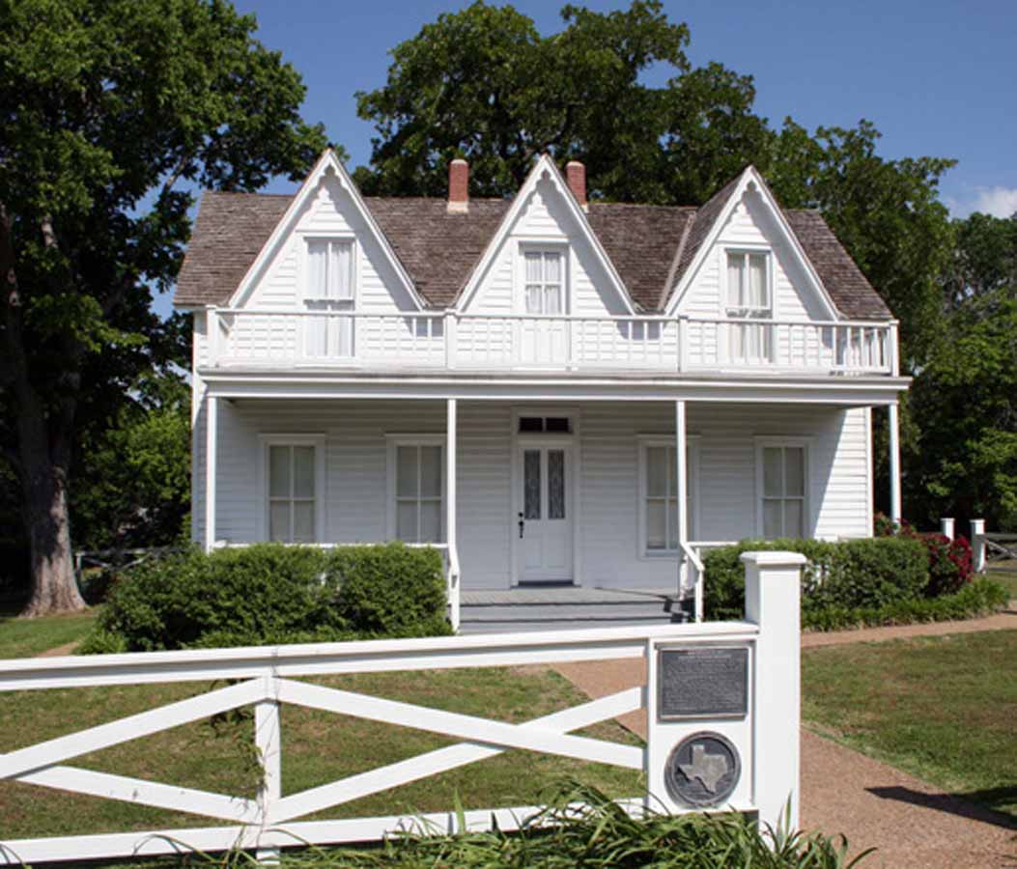

Slide 66
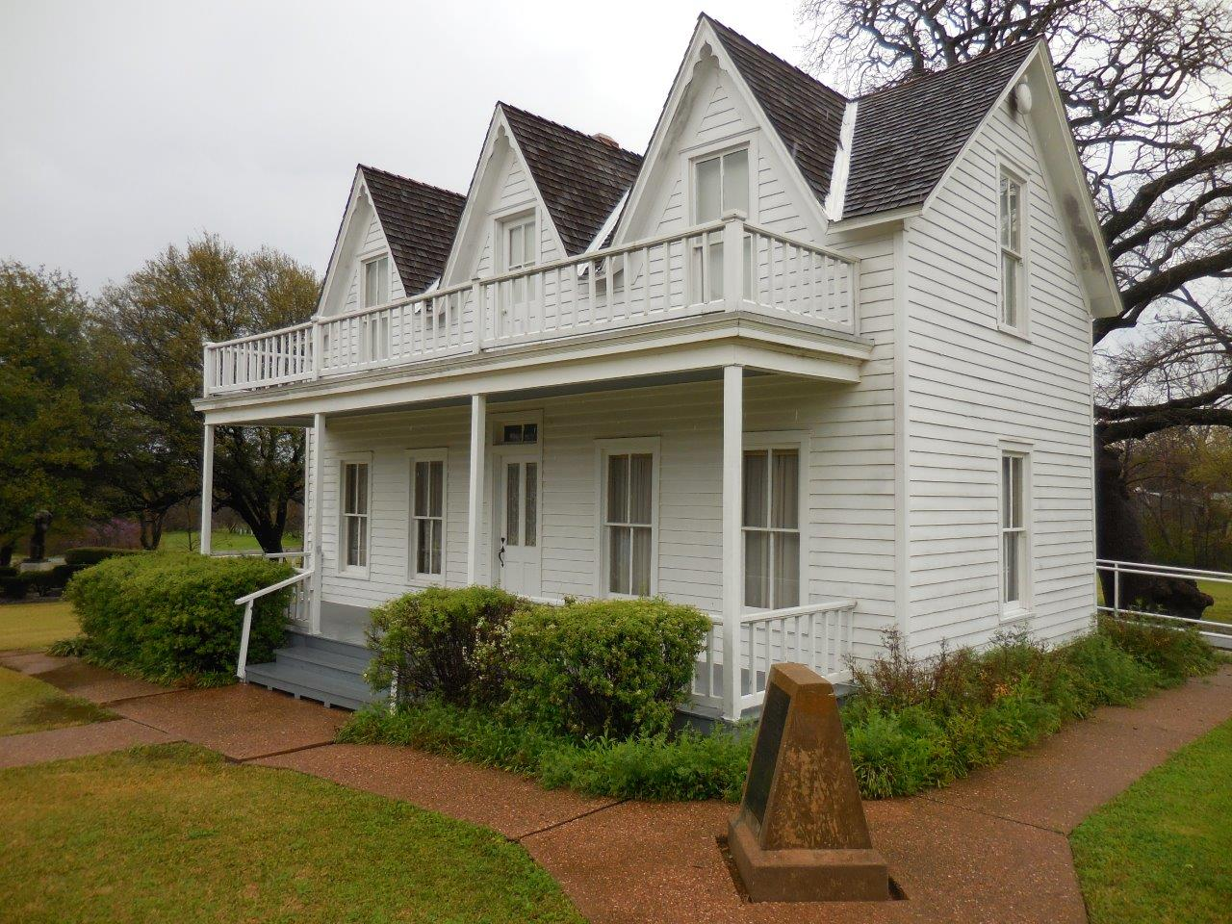

Slide 67
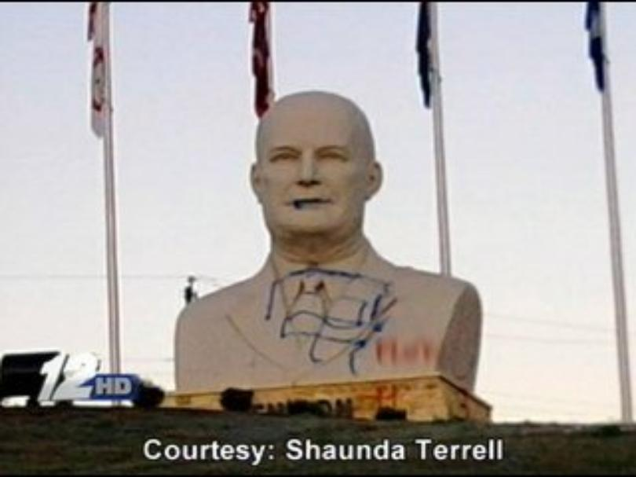

Slide 68
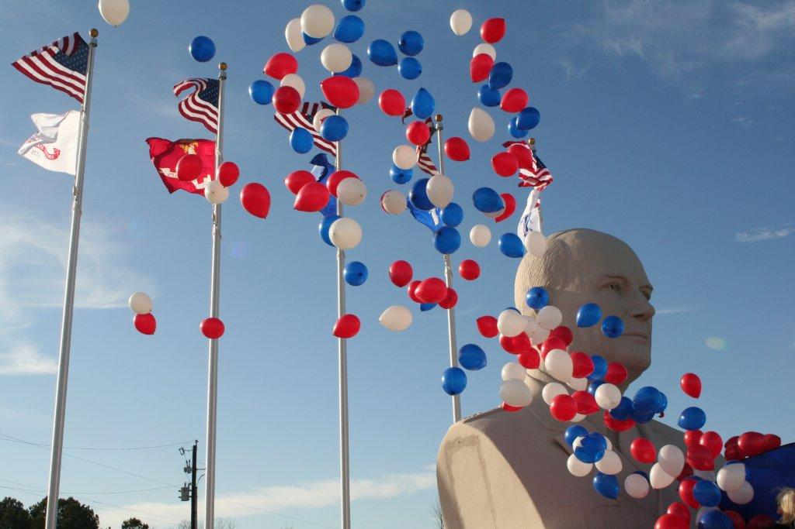

Slide 69
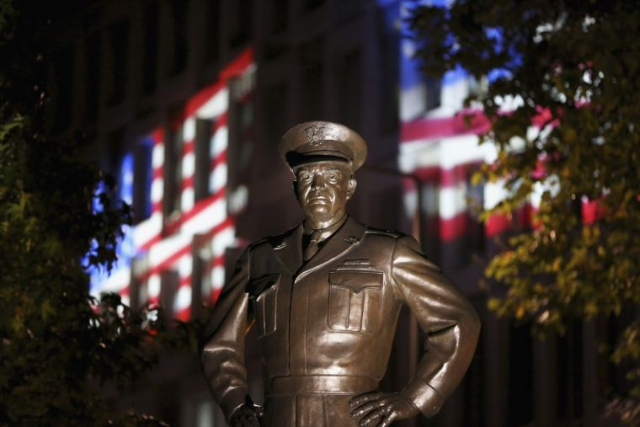

Slide 70
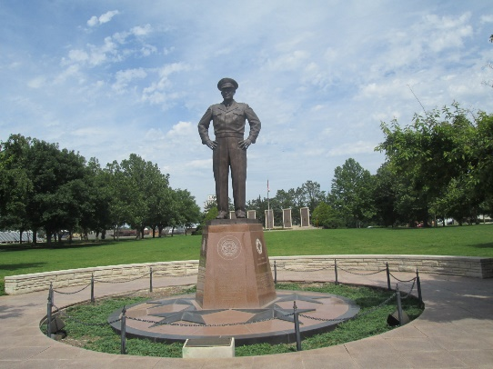

Slide 71
→ The great battle is freedom from slavery
→ Hating knowledge and despising God brings defeat
→ One must pray to distinguish between right & wrong
→ The Bible holds timeless wisdom, reality, & hope
→ Societies heath is dependent upon adherence to God
→ Trust in God is the only sane way to peace
→ Truths of the past delivers wisdom in the present
→ Greatness is found in the gauge of good character
→ The light of God’s truth is found in His word
→ Passion to pursue the will of God strengthens people
→ Values like grasping water can shift as sand blows
→ Impulsive greed steals the birthright of our children
→ The cost of war enslaves the whole world
The canvas of life is spewn with challenges to return to Him
Notes:
The canvas of life is spewn with challenges to return to Him

Slide 73
Please visit http://www.LoveFromGod.com to explore further
Ronald Bert Channel on
Notes:
Eternity never ends.

