Slide 2
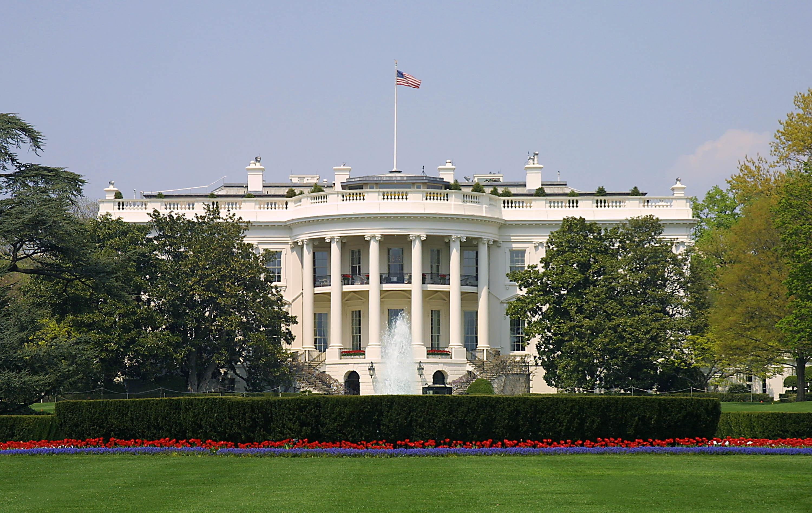
Presidential Quotes
Ron Bert
25
September 1, 2019

Slide 3
Part 1
33. Harry S. Truman (1945-1953)

Slide 4
“Work Hard. Do your best. Keep your word. Never get too big for your britches. Trust in God. Have no fear; and Never forget a friend.”
in
Trust in God

Slide 5
In the morning sow your seed, And in the evening do not withhold your hand; For you do not know which will prosper, Either this or that, Or whether both alike will be good. — Ecclesiastes 11:6

Slide 6
“This Nation was established by men who believed in God. ... You will see the evidence of this deep religious faith on every hand.”
in
believed in God

Slide 7
“We believe that all men are created equal because they are created in the image of God.”
in
created in the image of God

Slide 8
“The fundamental basis of this Nation’s law was given to Moses on the Mount. The fundamental basis of our Bill of Rights comes from the teachings which we get from Exodus and St. Matthew, from Isaiah and St. Paul … If we don’t have a proper fundamental moral background, we will finally end up with a totalitarian government which does not believe in the rights for anybody except the State!”
If we don’t
fundamental moral background
oppressive
totalitarian

Slide 9
Remember the former things of old, For I am God, and there is no other; I am God, and there is none like Me, … — Isaiah 46:9

Slide 10
“We are profoundly grateful for the blessings bestowed upon us: the preservation of our freedom, so dearly bought and so highly prized; our opportunities for human welfare and happiness, so limitless in their scope; our material prosperity, so far surpassing that of earlier years; and our private spiritual blessings, so deeply cherished by all. For these we offer fervent thanks to God.”
fervent thanks to God

Slide 11
And whatever you do in word or deed, do all in the name of the Lord Jesus, giving thanks to God the Father through Him. — Colossians 3:17

Slide 12
“We must never forget that this country was founded by men who came to these shores to worship God as they pleased. Catholics, Jews, and Protestants, all came here for this great purpose. They did not come here to do as they pleased - but to worship God as they pleased, and that is an important distinction.”
be lawless
be reverent
important distinction

Slide 13
“The true foundation of the brotherhood of humankind is belief in the knowledge that God is the Father of humankind. For us, therefore, brotherhood is not only a generous impulse but also a divine command.”
God is the Father
brotherhood
a divine command

Slide 14
But now, O LORD, You are our Father; We are the clay, and You our potter; And all we are the work of Your hand. — Isaiah 64:8
Honor all people. Love the brotherhood. Fear God. Honor the king. — 1st Peter 2:17

Slide 15
“Religious and racial persecution is moronic at all times, perhaps the most idiotic of human stupidities.”

Slide 16
“Divine Providence has played a great part in our history. I have the feeling that God has created us and brought us to our present position of power and strength for some great purpose. It is not given to us to know fully what that purpose is, but I think we may be sure of one thing, and that is that our country is intended to do all it can, in cooperating with other nations to help created peace and preserve peace in the world. It is given to defend the spiritual values - the moral code - against the vast forces of evil that seek to destroy them.”
peace in the world
in
defend
moral code

Slide 17
“I do not believe there is a problem in this country or the world today which could not be settled if approached through the teaching of the Sermon on the Mount.”

Slide 18
“A person who is fundamentally honest doesn't need a code of ethics. The Ten Commandments and the Sermon on the Mount are all the ethical code anybody needs.”

Slide 19
“But all of us - at home, at war, wherever we may be - are within the reach of God's love and power. We can all pray. We all should pray. We should ask the fulfillment of God’s will. We should ask for courage, wisdom, for the quietness of soul which comes alone to them who place their lives in His hands.”
pray
Peace going beyond understanding
courage, wisdom, for the quietness

Slide 20
But what does it say? "The word is near you, in your mouth and in your heart" (that is, the word of faith which we preach): — Romans 10:8
If any of you lacks wisdom, let him ask of God, who gives to all liberally and without reproach, and it will be given to him. — James 1:5

Slide 21
“Beware of the guy praying loudest in the amen corner.”

Slide 22
"For they bind heavy burdens, hard to bear, and lay them on men's shoulders; but they themselves will not move them with one of their fingers. But all their works they do to be seen by men. They make their phylacteries broad and enlarge the borders of their garments. They love the best places at feasts, the best seats in the synagogues, greetings in the marketplaces, and to be called by men, 'Rabbi, Rabbi.' But you, do not be called 'Rabbi'; for One is your Teacher, the Christ, and you are all brethren." — Matthew 23:4-8
"For they bind heavy burdens, hard to bear, and lay them on men's shoulders; but they themselves will not move them with one of their fingers. But all their works they do to be seen by men. They make their phylacteries broad and enlarge the borders of their garments. They love the best places at feasts, the best seats in the synagogues, greetings in the marketplaces, and to be called by men, 'Rabbi, Rabbi.' But you, do not be called 'Rabbi'; for One is your Teacher, the Christ, and you are all brethren." — Matthew 23:4-8
all their works they do to be
seen by men

Slide 23
“Selfishness and greed, individual or national, cause most of our troubles.”

Slide 24
“We worship money instead of honor.”

Slide 25
For the love of money is a root of all kinds of evil, for which some have strayed from the faith in their greediness, and pierced themselves through with many sorrows. — 1st Timothy 6:10

Slide 26
“One of the difficulties with all our institutions is the fact that we've emphasized the reward instead of the service.”
service

Slide 27
“I think there is an immense shortage of Christian charity among so-called Christians.”

Slide 28
“We must remember that the test of our religious principles lies not just in what we say, not only in our prayers, not even in living blameless lives - but in what we do for others.”
religious principles:
• in what we say
• in our prayers
• in living blameless lives
in what we do for others
religious principles
in
in what we say
in
in our prayers
in
in living blameless lives
in
what we do
in what we do for others
Notes:
Service is often challenged when sinfulness rules

Slide 29
And He sat down, called the twelve, and said to them, "If anyone desires to be first, he shall be last of all and servant of all." — Mark 9:35
servant of all

Slide 30
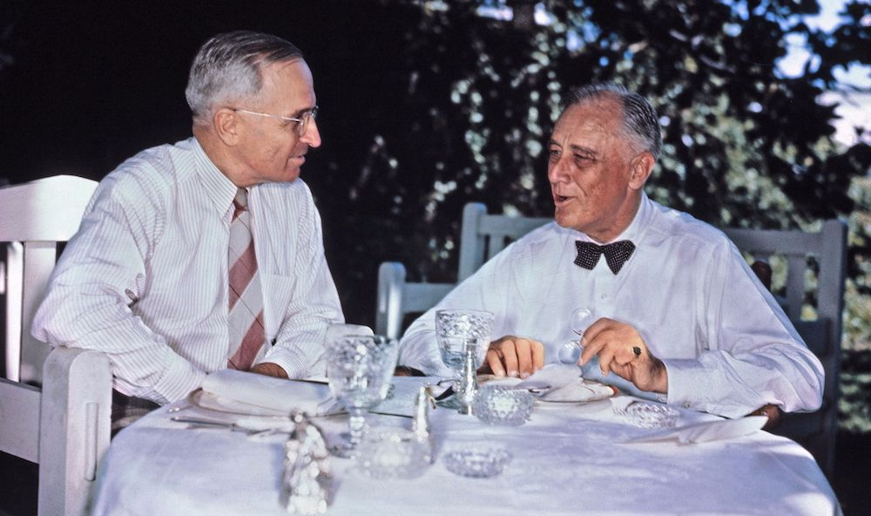
Notes:
After FDR
Martial Plan to rebuild Europe
Truman Doctrine to repel communism
Civil rights

Slide 31
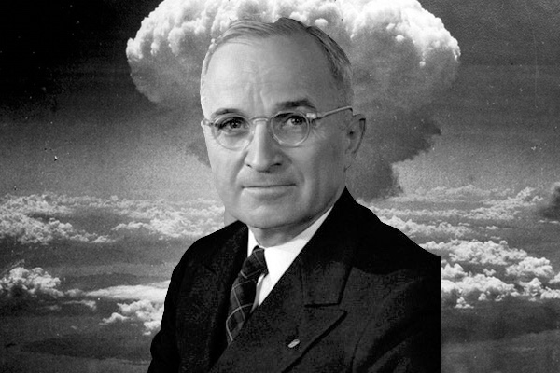

Slide 32
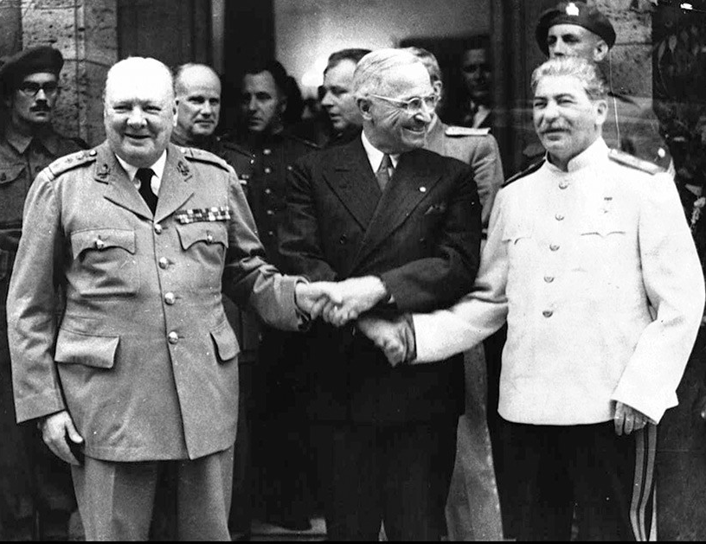
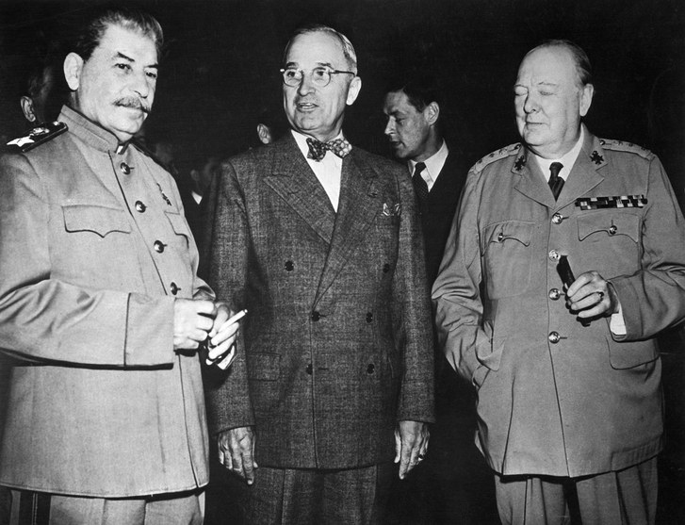

Slide 33
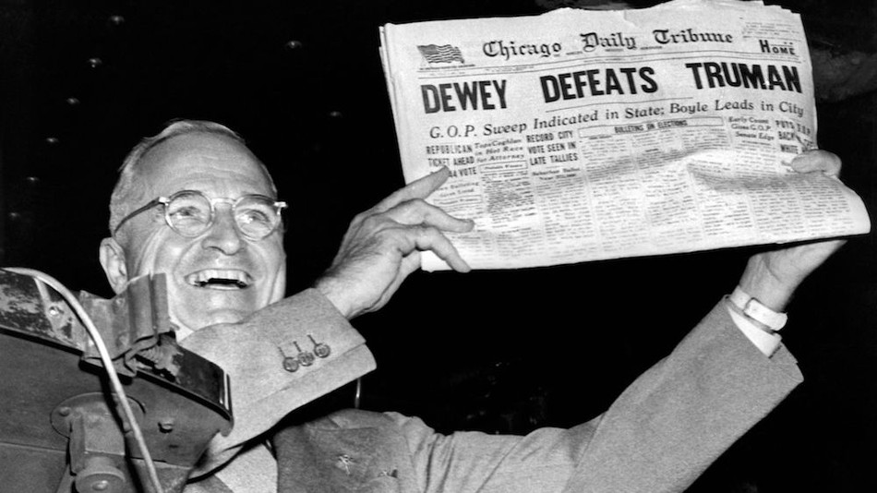
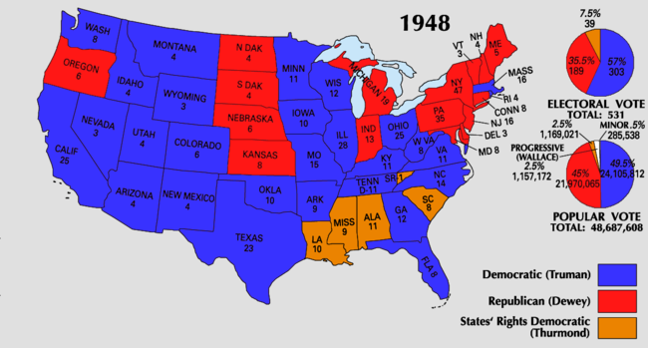
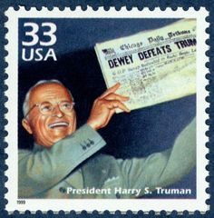

Slide 34
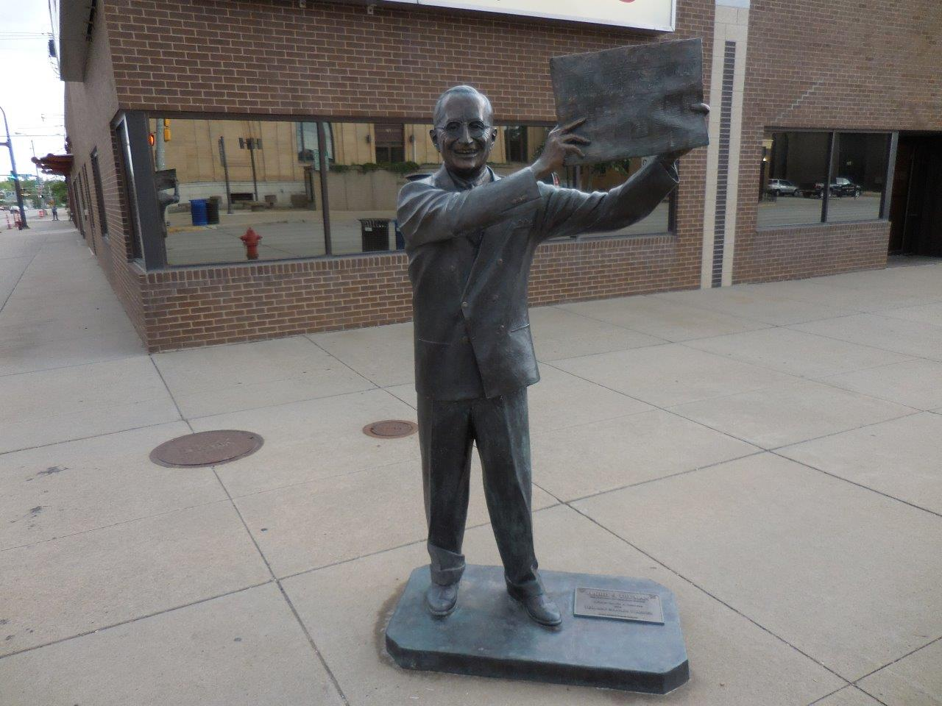
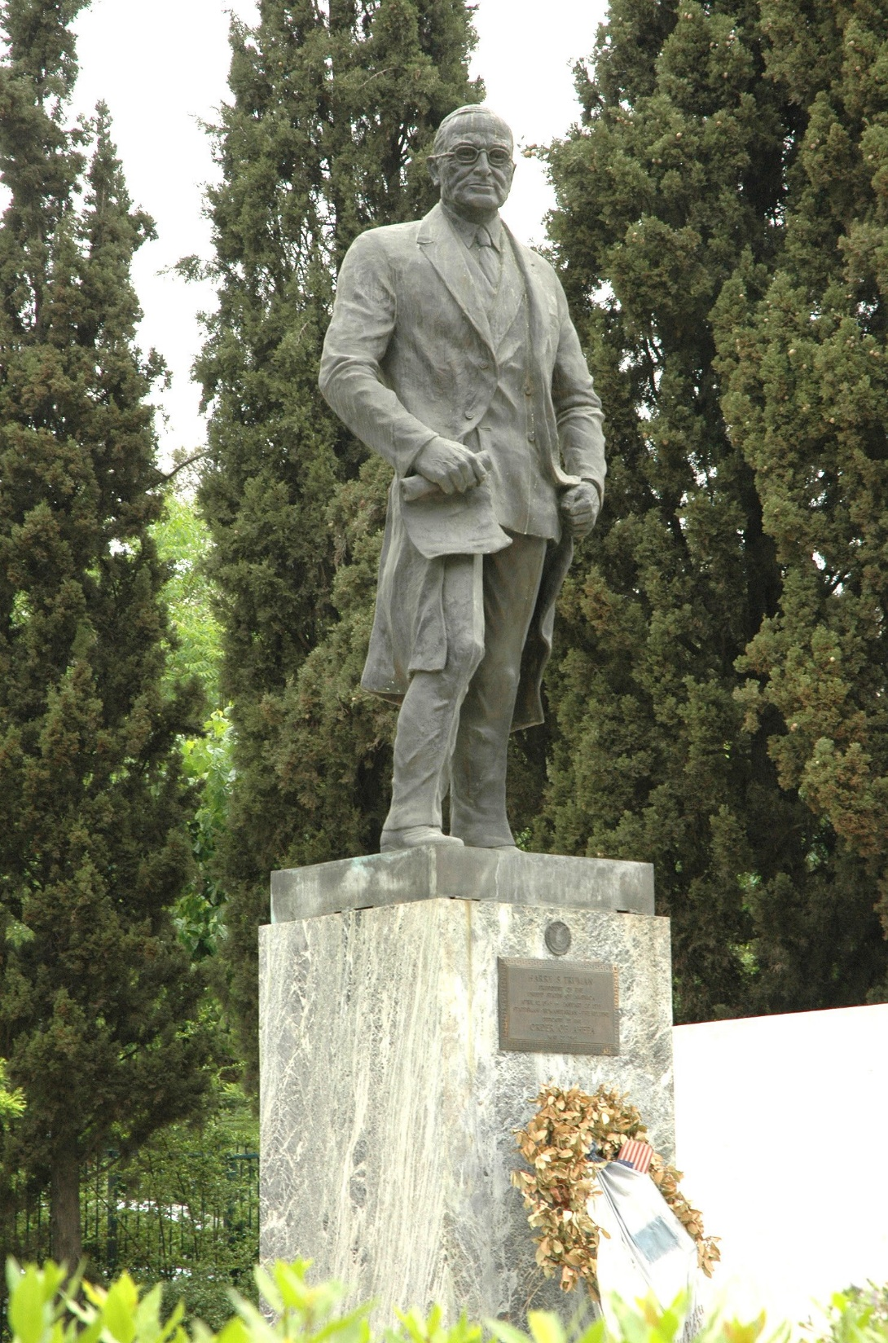

Slide 35
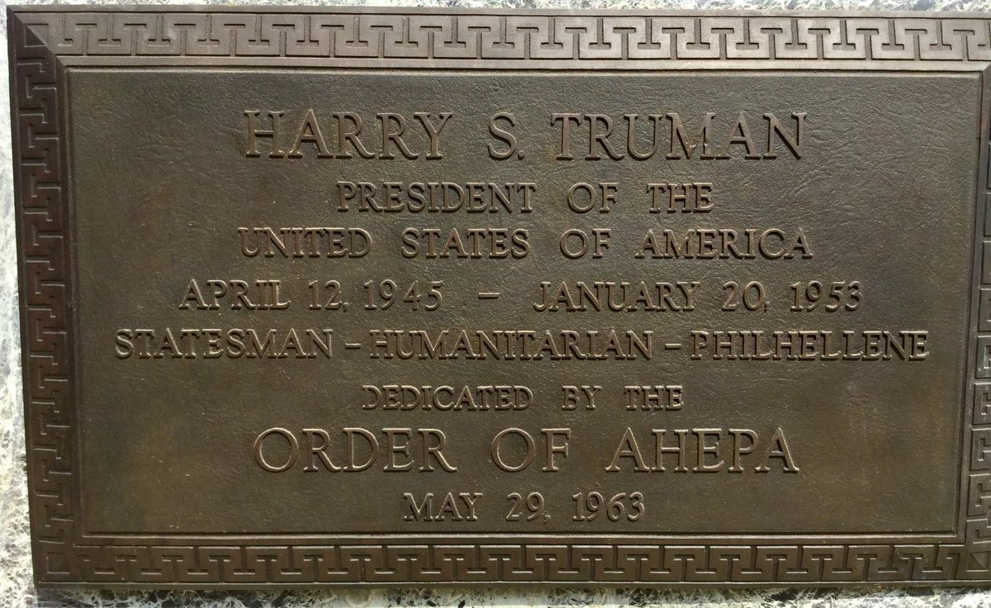
Notes:
Some historians believe that the Cold War between the United States and Russia began on March 12, 1947 (65 years ago today). It was on that day that President Harry S. Truman gave a speech outlining a policy that became known as the "Truman Doctrine".
In the speech, delivered to both houses of Congress, Truman stated that the United States would support Greece and Turkey with economic and military aid to prevent their takeover by the Soviet Union in an effort to stop the spread of post-World War 2 communism.

Slide 36
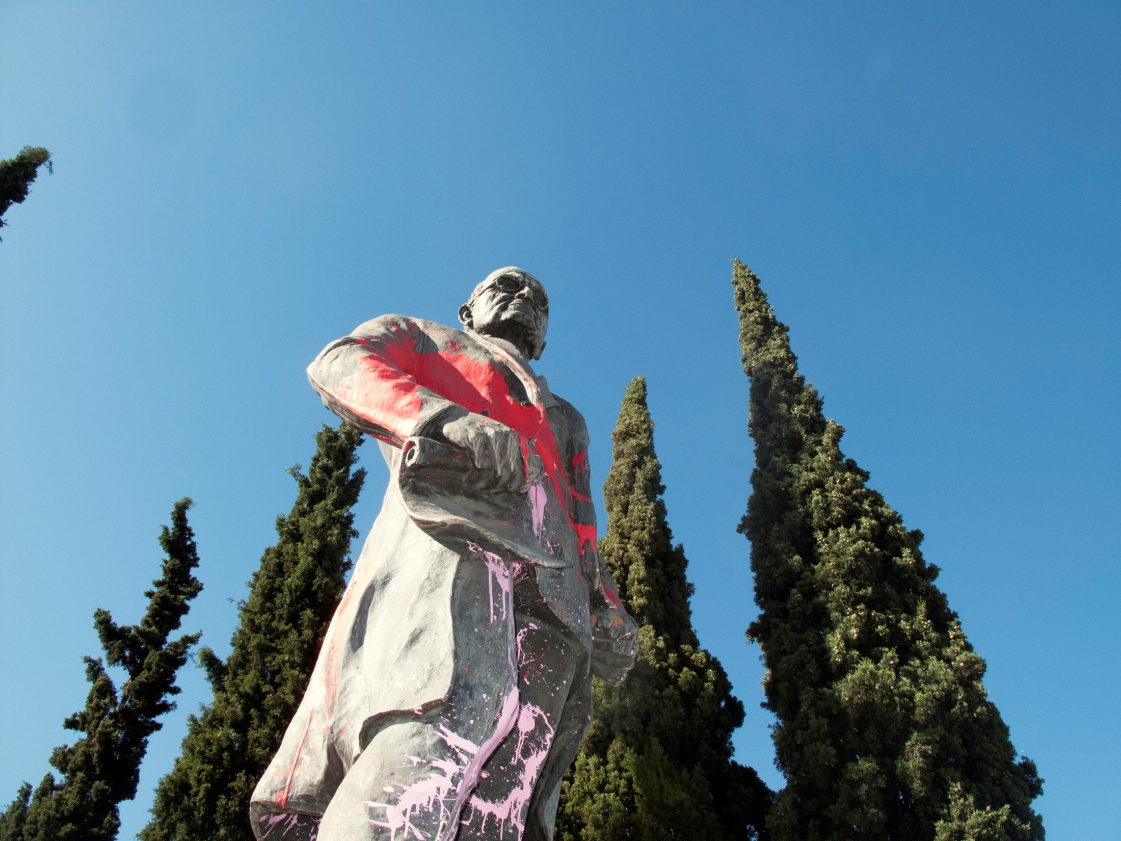

Slide 37
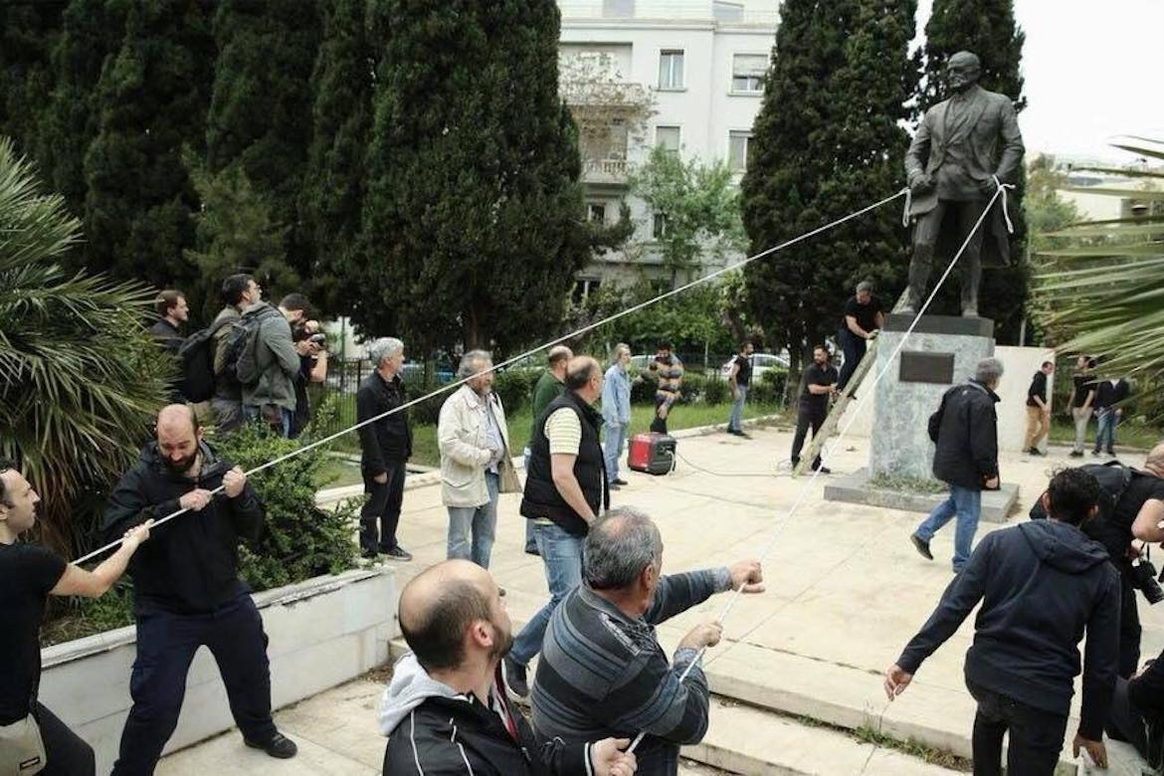

Slide 38
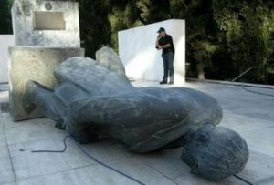

Slide 39
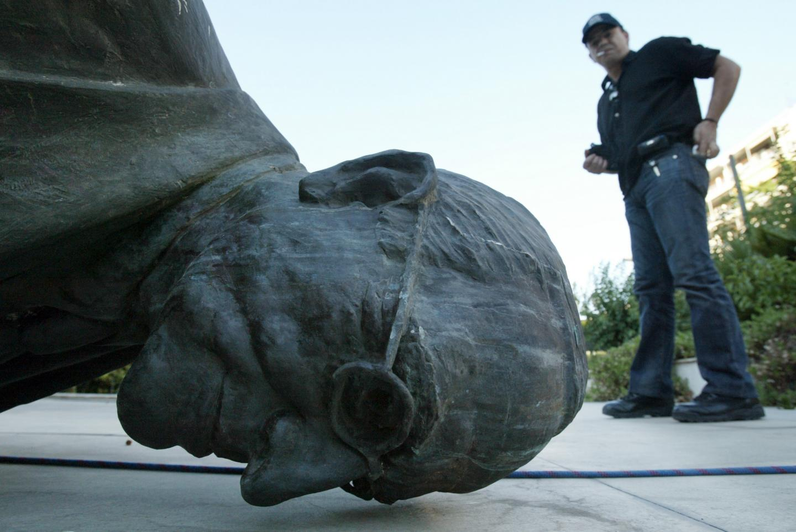

Slide 40
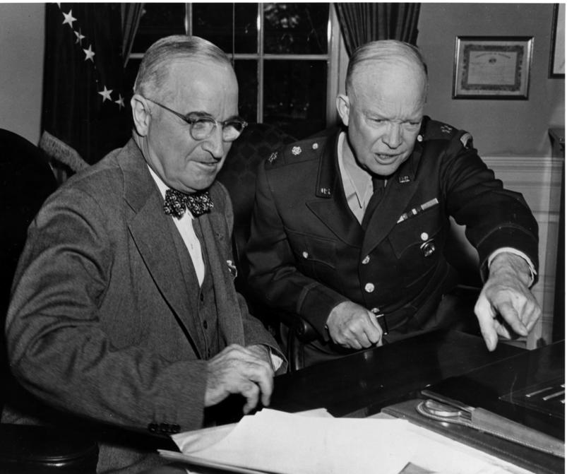
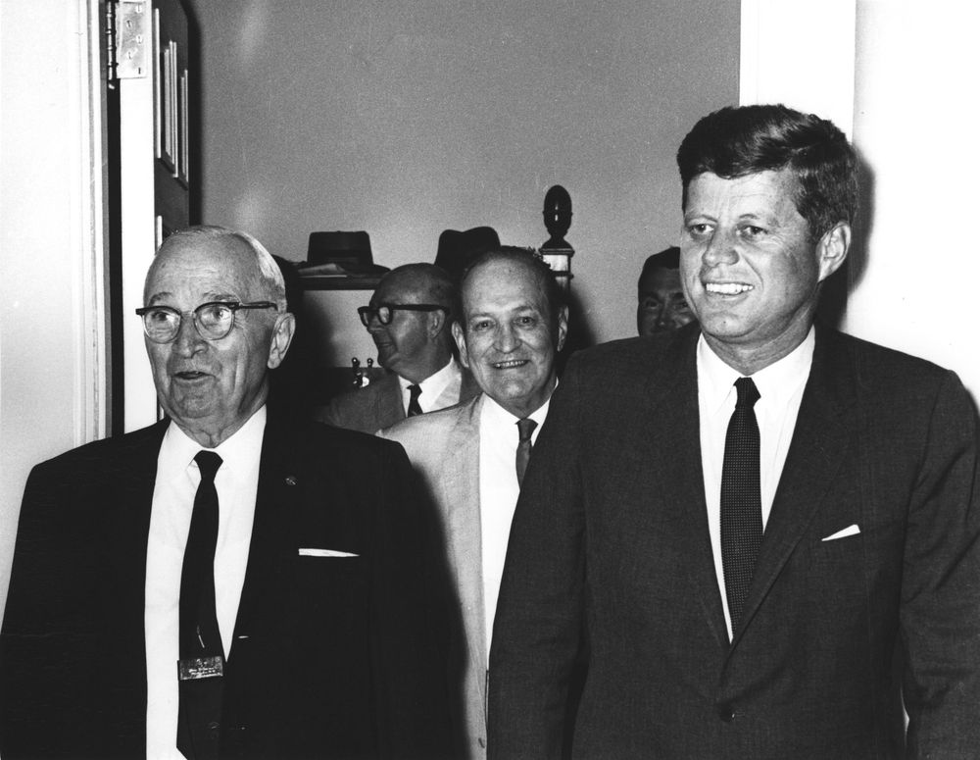

Slide 41
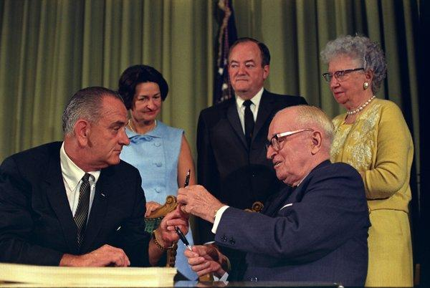
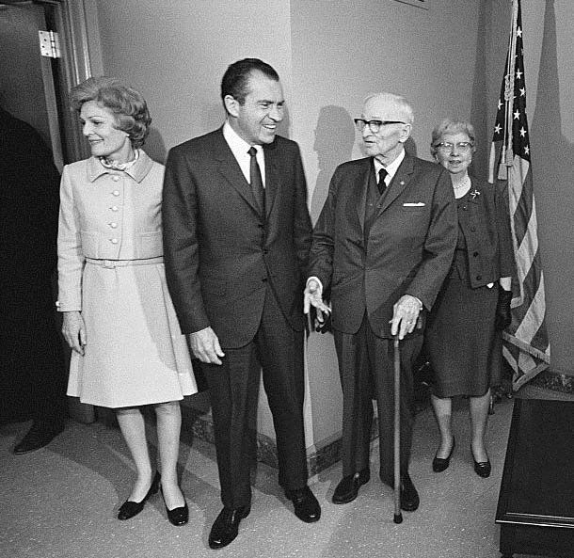

Slide 42
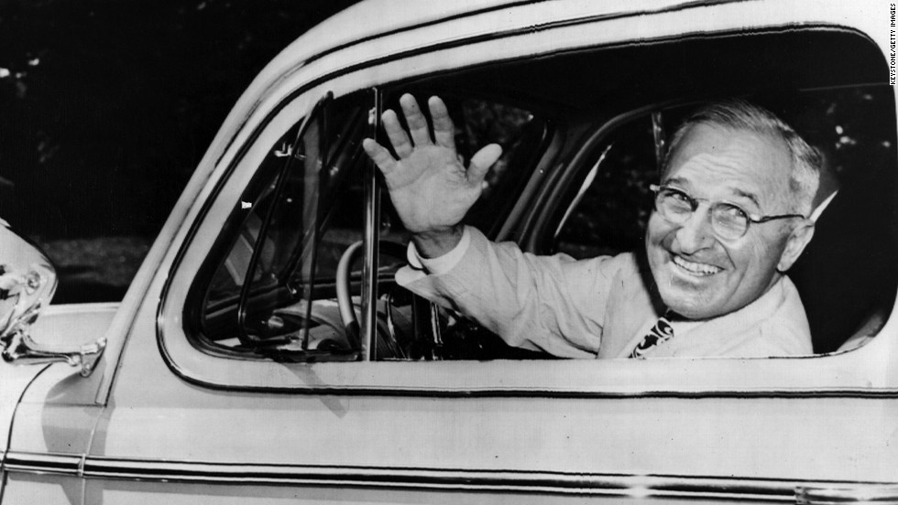

Slide 43
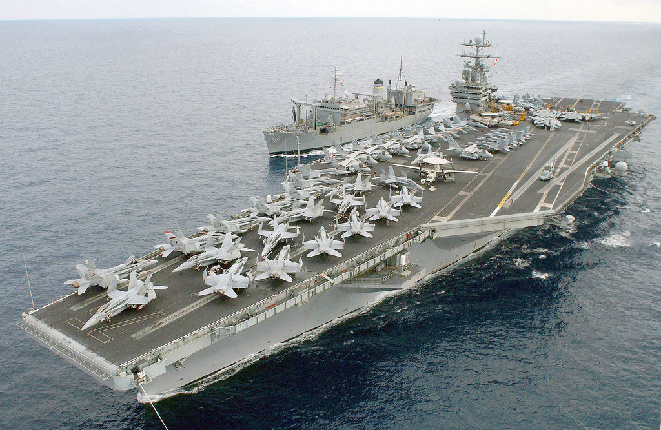

Slide 44
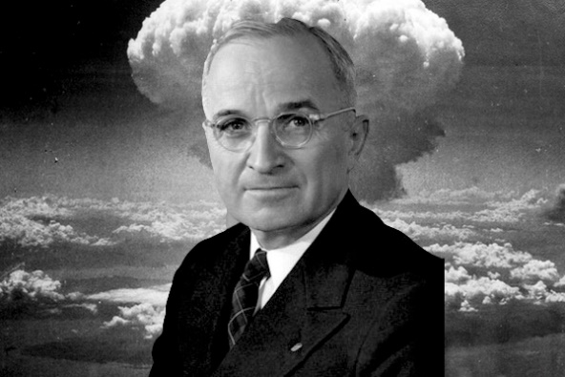
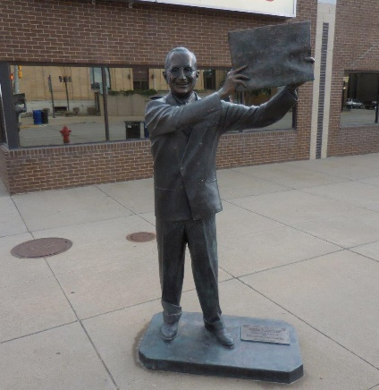
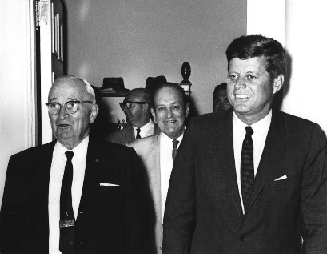
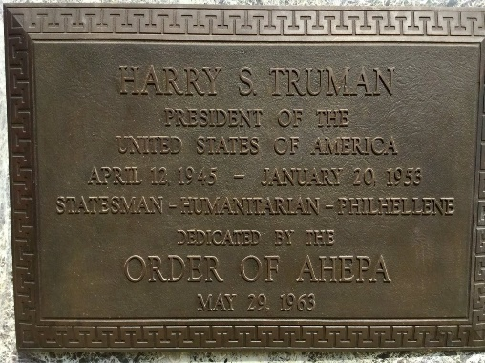

Slide 46
Presidential Quotes
Ron Bert
25½
September 29, 2019

Slide 47
Part 2
33. Harry S. Truman (1945-1953)

Slide 48
“We have gone a long way toward civilization and religious tolerance, and we have a good example in this country. Here the many Protestant denominations, the Catholic Church and the Greek Orthodox Church do not seek to destroy one another in physical violence just because they do not interpret every verse of the Bible in exactly the same way. Here we now have the freedom of all religions, and I hope that never again will we have a repetition of religious bigotry, as we have had in certain periods of our own history. There is no room for that kind of foolishness here.”
religious bigotry
foolishness

Slide 49
But even if our gospel is veiled, it is veiled to those who are perishing, whose minds the god of this age has blinded, who do not believe, lest the light of the gospel of the glory of Christ, who is the image of God, should shine on them. — 2nd Corinthians 4:3-4
Christ
image of God
shine

Slide 50
"Do not judge according to appearance, but judge with righteous judgment." — John 7:24

Slide 51
“Of course, there are dangers in religious freedom and freedom of opinion. But to deny these rights is worse than dangerous, it is absolutely fatal to liberty. The external threat to liberty should not drive us into suppressing liberty at home. Those who want the government to regulate matters of the mind and spirit are like men who are so afraid of being murdered that they commit suicide to avoid assassination.”
religious freedom and freedom of opinion
Global dictatorships
external threat to liberty
not
not
suppressing liberty at home
so afraid
schizophrenia
murder
suicide
assassination

Slide 52
“There are always a lot of people so afraid of rocking the boat that they stop rowing. We can never get ahead that way.”

Slide 53
The wicked flee when no one pursues, But the righteous are bold as a lion. — Proverbs 28:1

Slide 54
“When even one American - who has done nothing wrong - is forced by fear to shut his mind and close his mouth - then all Americans are in peril.”

Slide 55
“A man cannot have character unless he lives within a fundamental system of morals that creates character.”

Slide 56
“I found that the men and women who got to the top were those who did the jobs they had in hand, with everything they had of energy and enthusiasm and hard work.”
with everything

Slide 57
Let love be without hypocrisy. Abhor what is evil. Cling to what is good. Be kindly affectionate to one another with brotherly love, in honor giving preference to one another; not lagging in diligence, fervent in spirit, serving the Lord; — Romans 12:9-11
Let love be without hypocrisy. Abhor what is evil. Cling to what is good. Be kindly affectionate to one another with brotherly love, in honor giving preference to one another; not lagging in diligence, fervent in spirit, serving the Lord; — Romans 12:9-11
"You shall love the LORD your God with all your heart, with all your soul, and with all your strength." — Deuteronomy 6:5
fervent in spirit
purpose

Slide 58
“The human race has reached a turning point. Man has opened the secrets of nature and mastered new powers. If he uses them wisely, he can reach new heights of civilization. If he uses them foolishly, they may destroy him. Man must create the moral and legal framework for the world which will insure that his new powers are used for good and not for evil.”
knowledge
secrets of nature
wisdom
create the moral
used for good and not for evil

Slide 59
“We must build a new world, a far better world - one in which the eternal dignity of man is respected.”
eternal
respected

Slide 60
“Nothing is more important in our national life than the welfare of our children.”
“In the long view, no nation is any healthier than its children.”

Slide 61
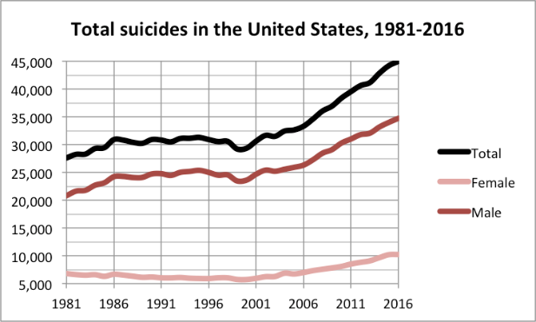
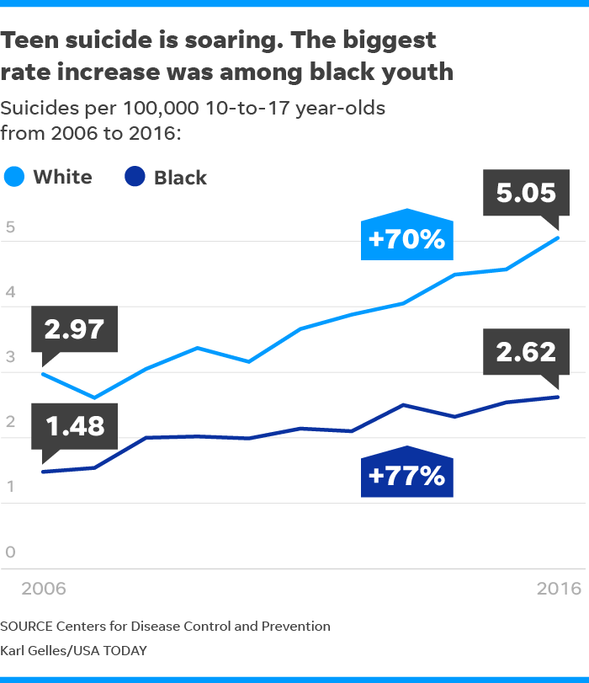
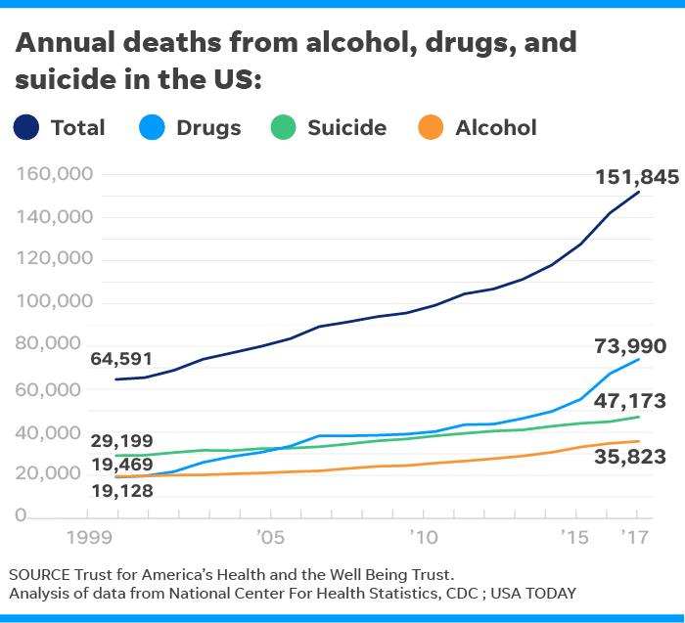
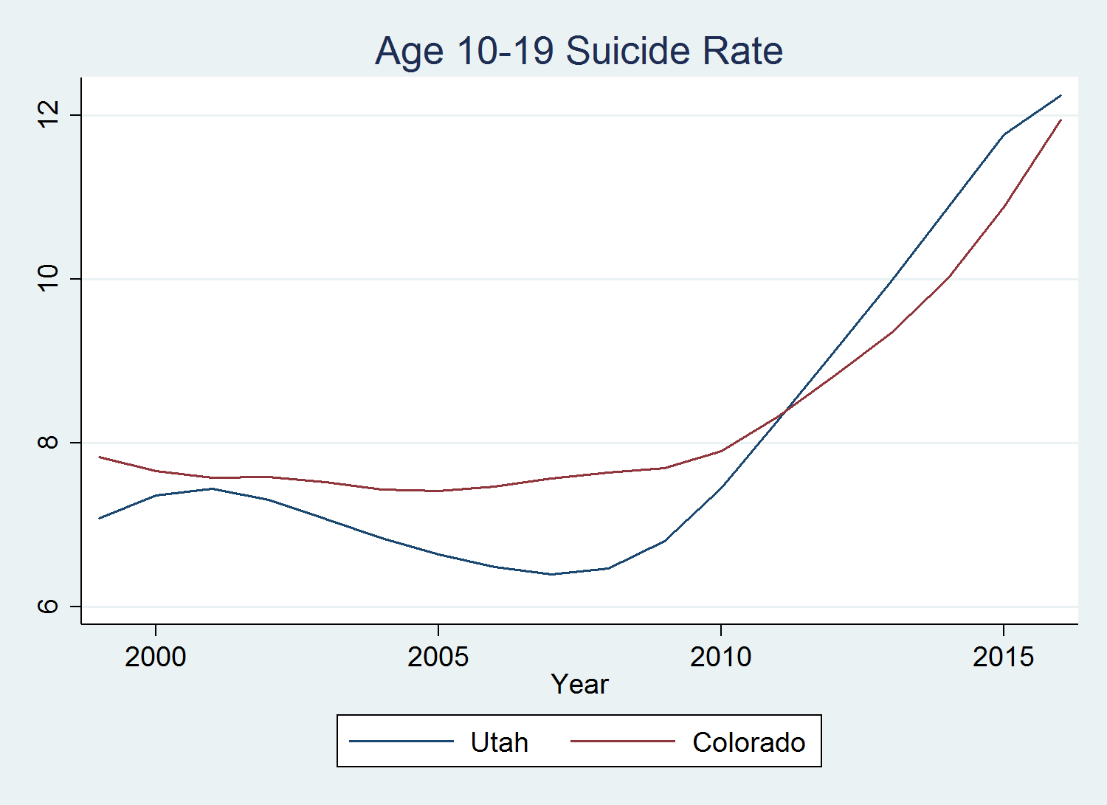
Suicide is the 10th leading cause of death in the US for all ages
Every day, approximately 123 Americans die by suicide
There is one death by suicide in the US every 12 minutes
Suicide takes the lives of over 44,965 Americans every year
Suicide is the 2nd leading cause of death in the world for those aged 15-24 years
Nearly 800,000 people die by suicide in the world each year, which is roughly one death every 40 seconds Source(CDC)

Slide 62
“Mama and Papa are more to blame (for delinquency) than the kids; parents should stay home and raise their children and spend less time in taverns.”

Slide 63
“Some day we'll awake, have a reformation of the heart, teach our kids honor and kill a few sex psychologists, put boys in high schools with men teachers (not sissies), close all the girls' finishing schools, shoot all the efficiency experts and become a nation of God's people once more.”
God's people once more

Slide 64
For this is good and acceptable in the sight of God our Savior, who desires all men to be saved and to come to the knowledge of the truth. For there is one God and one Mediator between God and men, the Man Christ Jesus, … — 1st Timothy 2:3-5
God desires all men to be saved
to come to the knowledge
of the truth
↓
one God and one Mediator
between God and men
the Man Christ Jesus
God
desires all men to be saved
to
come to the knowledge
of the
truth
one God and
one Mediator
between God and
men
the Man Christ Jesus
Christ Jesus

Slide 65
“When you have to deal with a beast, you have to treat him as a beast. It is most regrettable but nevertheless true.”
sin

Slide 66
“If you don't like the heat, get out of the kitchen.”

Slide 67
“When the decision is up before you - and on my desk I have a motto which says ‘The buck stops here’ - the decision has to be made.”

Slide 68
“Everybody is headed for the same place, and they are headed on the same train, and under the same engineer.”

Slide 69
"Enter by the narrow gate; for wide is the gate and broad is the way that leads to destruction, and there are many who go in by it. Because narrow is the gate and difficult is the way which leads to life, and there are few who find it." — Matthew 7:13-14

Slide 71
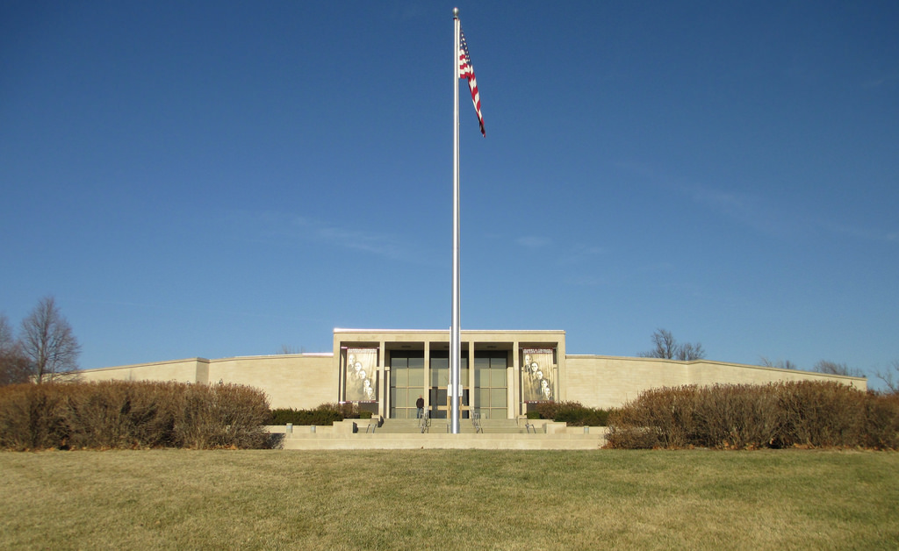

Slide 72
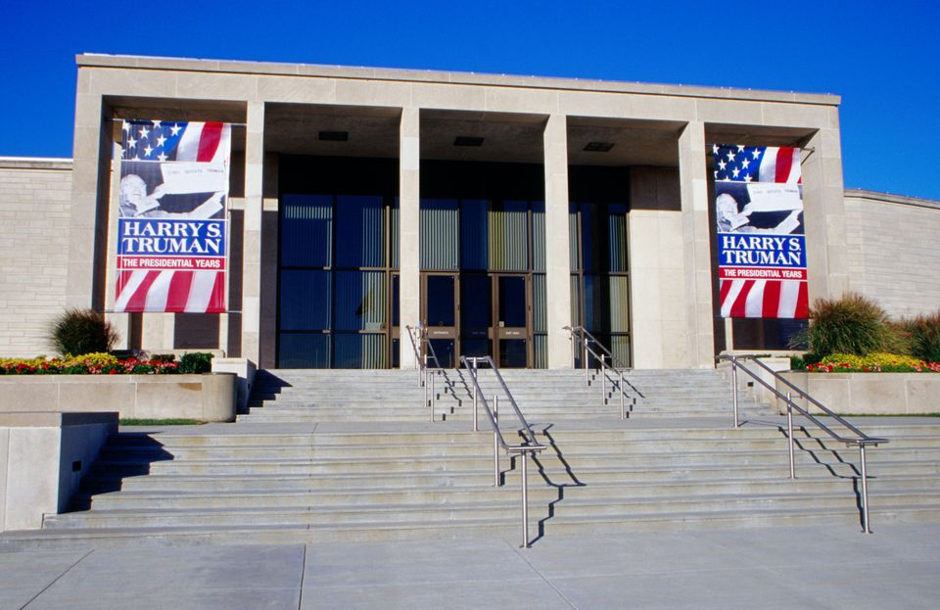

Slide 73
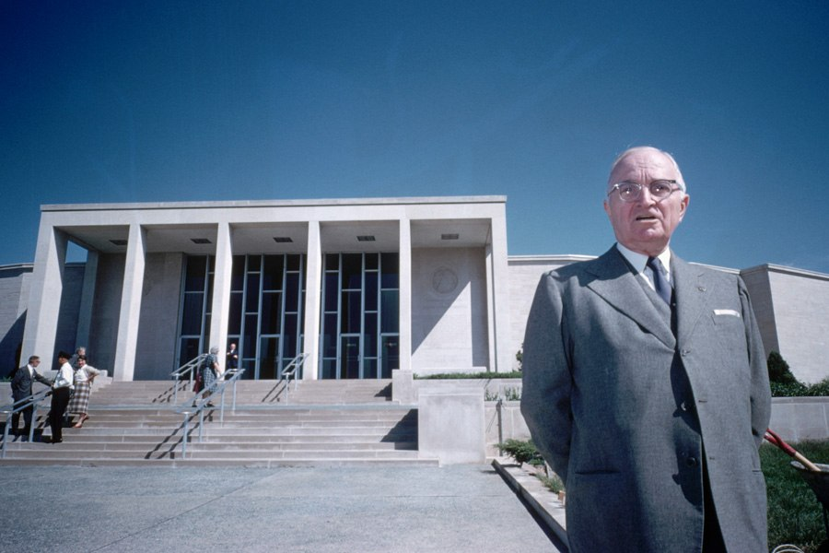

Slide 74
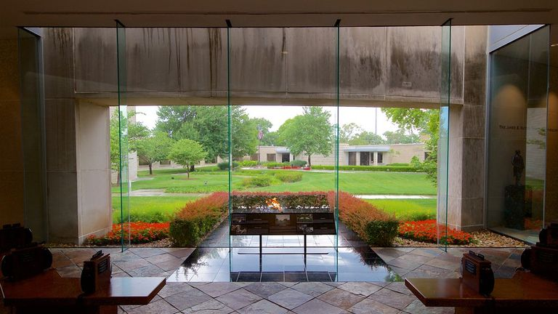

Slide 75
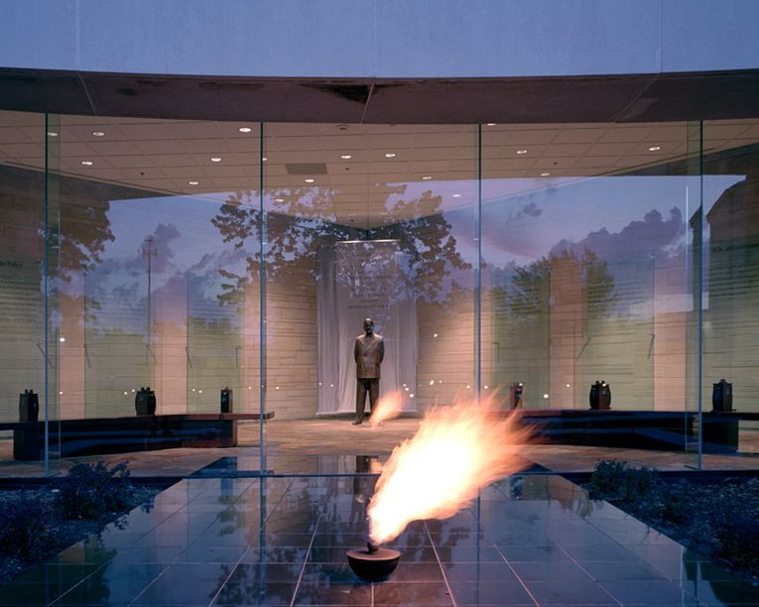
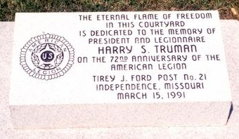

Slide 76
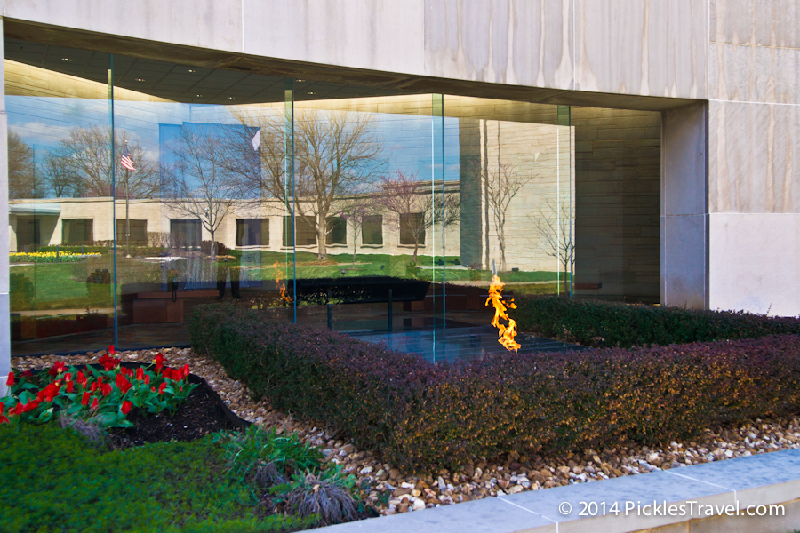

Slide 77
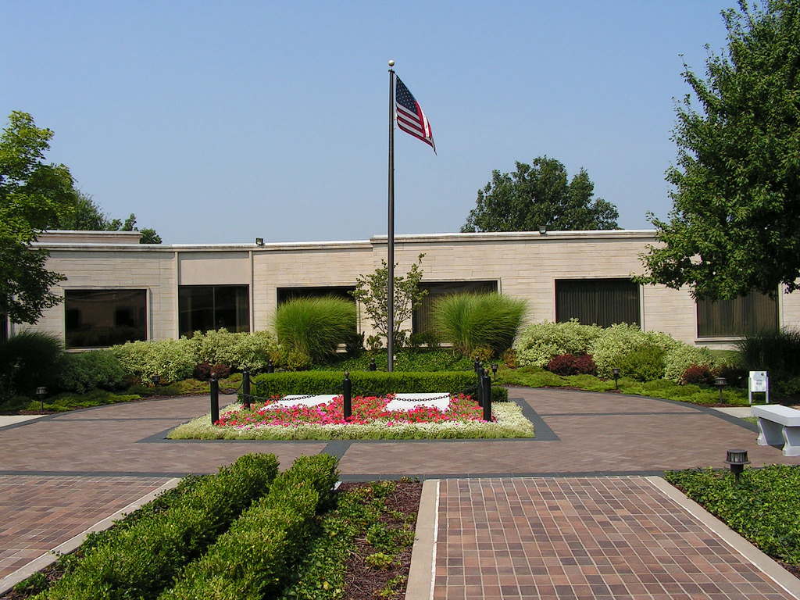

Slide 78
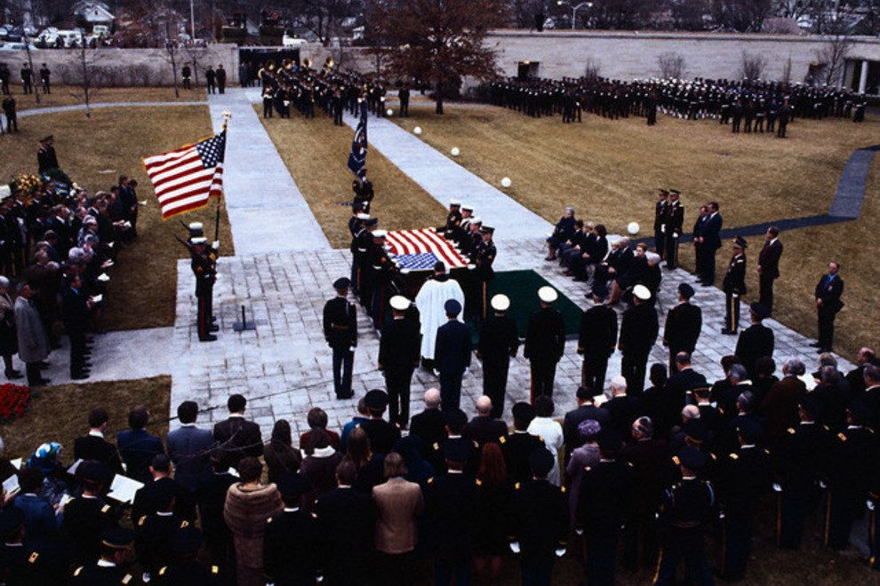

Slide 79
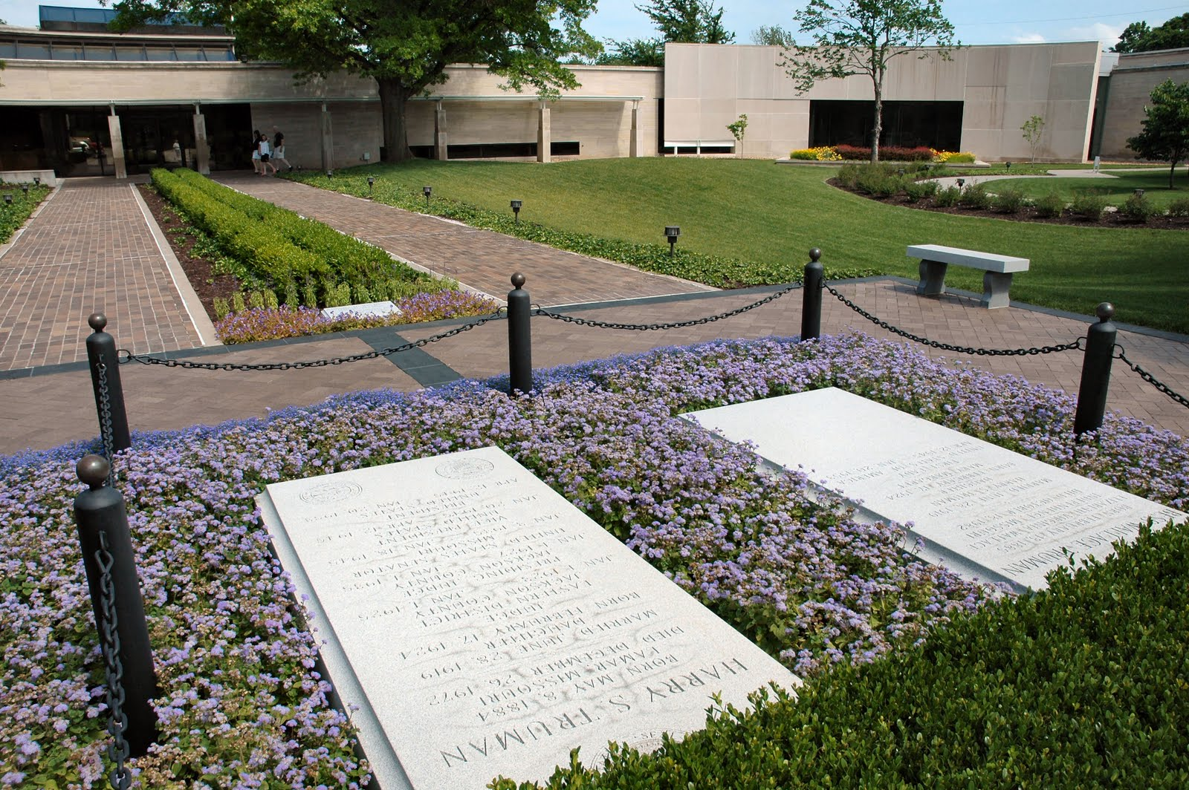
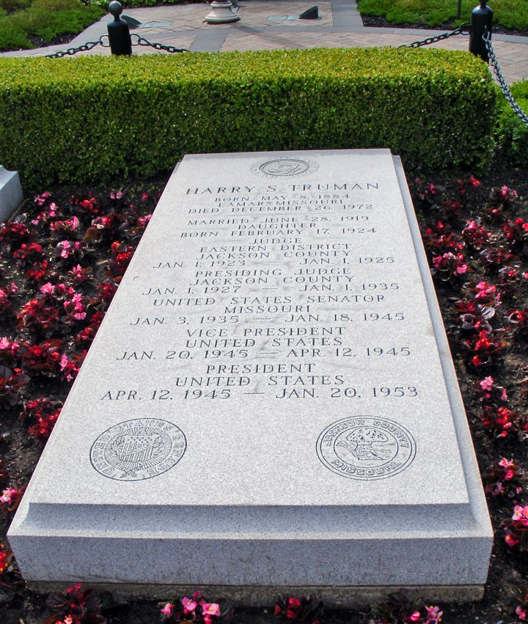

Slide 80
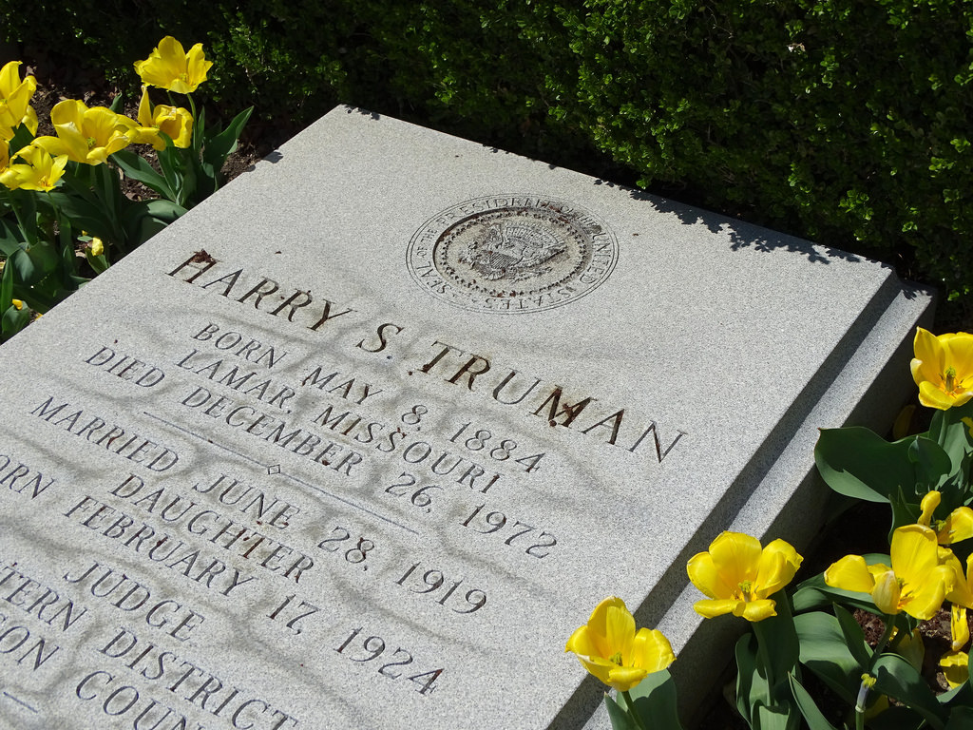

Slide 81
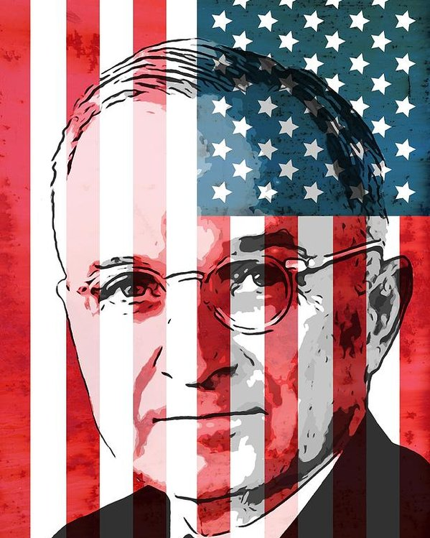

Slide 82
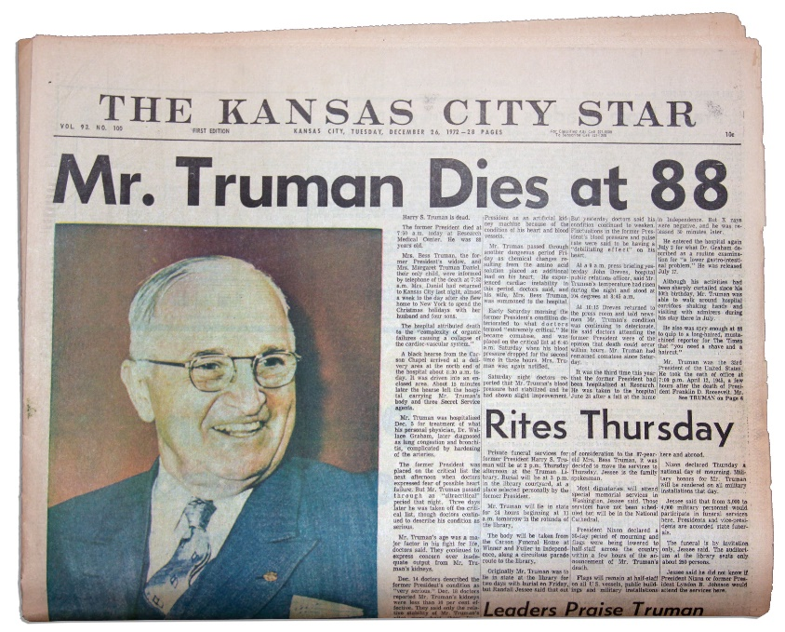
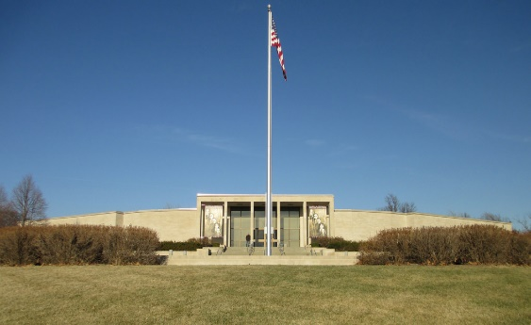
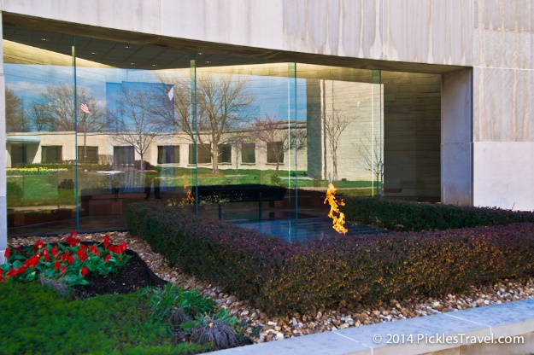
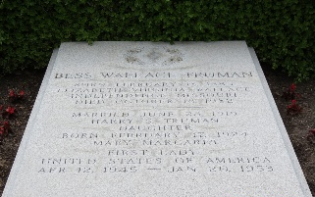
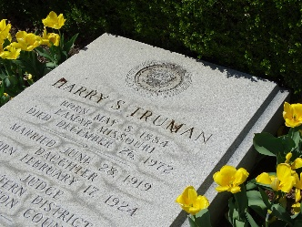

Slide 83
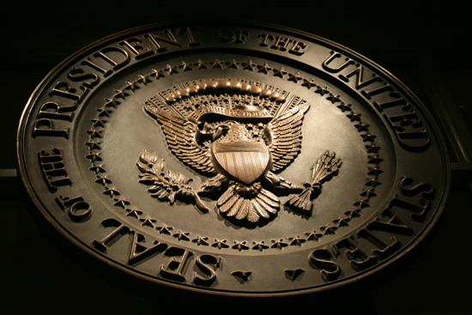
→ Human life is in God’s own image free to itself
→ This country was established to worship God
→ Mankind’s unity is in faith of God’s divine commands
→ Ethical code and morals are found in the Bible
→ Selfishness and greed is the root of all troubles
→ The core of religion is in what we do for others
→ Paranoid regulation of mind & spirit is schizophrenia
→ Silencing independence of thought will kill America
→ Zeal and endless commitment leads to the top
→ Without responsible adults our children are lost
→ Bickering opinions lack devotion to the ways of God
→ Endurance is no game for the faint hearted
→ In God there is only one heaven
It has never been easy to stand by a principle
Notes:
It has never been easy to stand by a principle

Slide 85
Please visit http://www.LoveFromGod.com to explore further
Ronald Bert Channel on
Notes:
Eternity never ends.

