Slide 1
↻

Slide 2
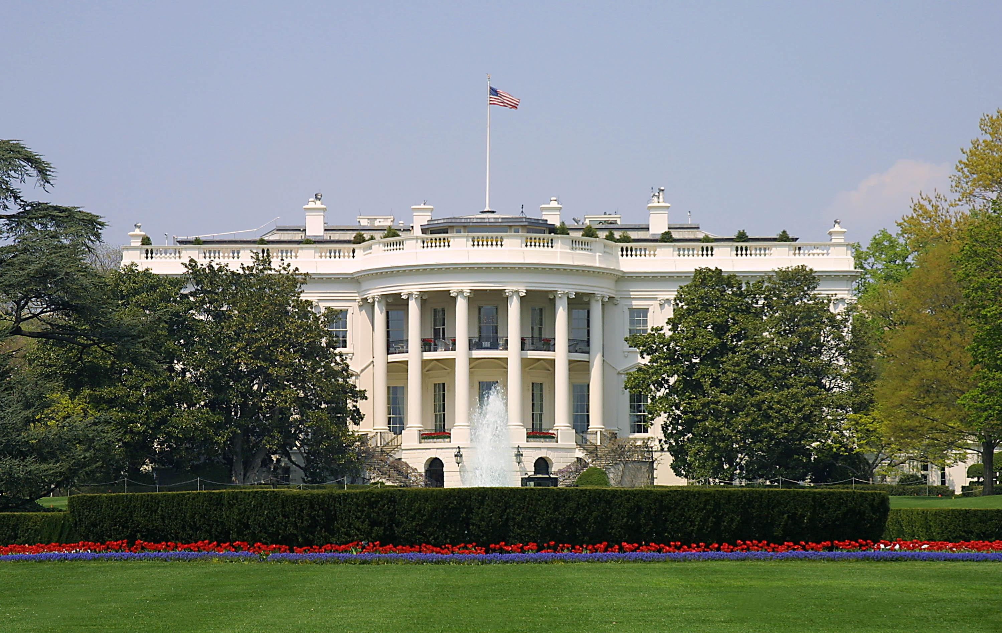
Presidential Quotes
Ron Bert
23
July 7, 2019

Slide 3
Part 1
31. Herbert Hoover (1929-1933)
Notes:
Hover’s father died when he was 6, mom at 10. Lived with Quaker uncle in Oregon
FDR wanted Hoover to run for President in 1920 and promised to back him all the way. Instead FDR ran against Harding as the democratic vice president nominee with Cox.
Stanford graduate mining engineer. Made millions in silver mines. Spoke Chinese fluently.
Hoover the humanitarian who organized and fed Belgium during World War 1.
Known as the landslide president, in and out.
No SS, no Federal Reserve deposit protection, raised tariffs to exacerbate global depression. Pulled money out of the free market. Thought citizens should aid and not the government. He did pass and introduce laws to allow FDR to take credit for some policies in FDRs “New Deal.”
Chicken in every pot, car in every backyard
Appointed Secretary of commerce under Harding and Coolidge
Never elected to any office other than President
Started Home loans for common people. Said it was a crisis in credit.
1932 Made half
Called Eisenhower and MacArthur to stop vets in Washington DC from protesting over 19944 pension bonus. MacArthur burned the camps known as Hooverville's
Tried to run for president 1940
the federal budget available as loans to big business and banks to keep business going. Fundamental recovery plan of the New Deal.
3 volume book published 50 years after His death “Freedom Betrayed”

Slide 4
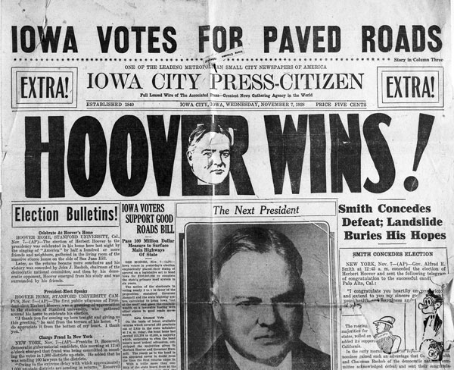

Slide 5
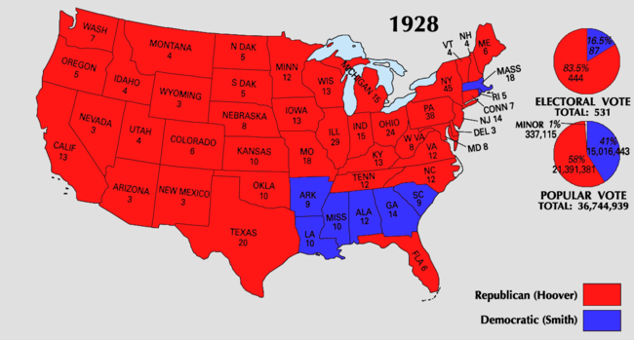

Slide 6
“The study of the Bible is a post-graduate course in the richest library of human experience.”
upper-education

Slide 7
“The whole inspiration of our civilization springs from the teachings of Christ and the lessons of the prophets. To read the Bible for these fundamentals is a necessity of American life.”
Christ
necessity of American life

Slide 8
The earth is the LORD'S, and all its fullness, The world and those who dwell therein. — Psalms 24:1

Slide 9
“There is no other book so various as the Bible, nor one so full of concentrated wisdom. Whether it be of law, business, morals ... he who seeks for guidance ... may look inside its covers and find illumination ...”
Bible
concentrated wisdom
look inside
illumination

Slide 10
“We are indebted to the Book of books (Bible) for our national ideals and institution. Their preservation rests in adhering to it's precepts.”
Book of books
Bible

Slide 11
“It [freedom] is a thing of the spirit. Men must be free to worship, to think, to hold opinions, to speak without fear. They must be free to challenge wrong and oppression with the surety of justice.”
free to challenge
wrong

Slide 12
And have no fellowship with the unfruitful works of darkness, but rather expose them. — Ephesians 5:11

Slide 13
“I come of Quaker stock. My ancestors were persecuted for their beliefs. Here they sought and found religious freedom. By blood and conviction I stand for religious tolerance both in act and in spirit.”
religious
tolerance

Slide 14
Then the children of Israel again did evil in the sight of the LORD, and served the Baals and the Ashtoreths, the gods of Syria, the gods of Sidon, the gods of Moab, the gods of the people of Ammon, and the gods of the Philistines; and they forsook the LORD and did not serve Him. — Judges 10:6
Then the children of Israel again did evil in the sight of the LORD, and served the Baals and the Ashtoreths, the gods of Syria, the gods of Sidon, the gods of Moab, the gods of the people of Ammon, and the gods of the Philistines; and they forsook the LORD and did not serve Him. — Judges 10:6
"God is Spirit, and those who worship Him must worship in spirit and truth.". — John 4:24
truth
spirit and truth
did not serve Him

Slide 15
“Our social and economic system cannot march toward better days unless it is inspired by things of the Spirit. It is here that the higher purposes of individualism must find their sustenance.”
of the Spirit
higher purposes

Slide 16
“A splendid storehouse of integrity and freedom has been bequeathed to us by our forefathers. In this day of confusion, of peril to liberty, our high duty is to see that this storehouse is not robbed of its contents.”
X
integrity and freedom
integrity
confusion
peril
duty
robbed

Slide 17
For you, brethren, have been called to liberty; only do not use liberty as an opportunity for the flesh, but through love serve one another. — Galatians 5:13
serve

Slide 18
“Freedom conceives that the mind and spirit of man can be free only if he is free to pattern his own life, to develop his own talents, free to earn, to spend, to save, to acquire property as the security of his old age and his family.”
Freedom
Freedom only if:
• free to pattern own life
• to develop own talents
• free to earn, to spend, to save
• to acquire property
as the security of old age
family
only
if
free to pattern
own life
to develop
own talents
free to
earn, to spend, to save
to acquire
property
as the security of
old
age
family

Slide 19
“Being a politician is a poor profession. Being a public servant is a noble one.”
servant

Slide 20
As each one has received a gift, minister it to one another, as good stewards of the manifold grace of God. — 1st Peter 4:10

Slide 21
“Governments know that the life of the world cannot be saved if the soul of the world is allowed to be lost.”
Christ
saved
soul
lost

Slide 22
“When there is a lack of honor in government, the morals of the whole people are poisoned.”

Slide 23
“No public man can be just a little crooked. There is no such thing as a no-man's land between honesty and dishonesty.”

Slide 24
“Beware of false prophets, who come to you in sheep's clothing, but inwardly they are ravenous wolves.” — Matthew 7:15
"But let your 'Yes' be 'Yes,’ and your 'No,' 'No.' For whatever is more than these is from the evil one." — Matthew 5:37

Slide 25
“Our strength lies in spiritual concepts. It lies in public sensitivities to evil. Our greatest danger is not from invading armies. Our dangers are that we may commit suicide from within by complaisance with evil, or by public tolerance of scandalous behavior.”
in
strength lies in spiritual
danger
suicide from within
complaisance with evil
tolerance of scandalous behavior

Slide 26
Woe to those who call evil good, and good evil; Who put darkness for light, and light for darkness; Who put bitter for sweet, and sweet for bitter! — Isaiah 5:20

Slide 27
For if he who comes preaches another Jesus whom we have not preached, or if you receive a different spirit which you have not received, or a different gospel which you have not accepted -- you may well put up with it! — 2nd Corinthians 11:4
truth
different gospel
you may well put up with it

Slide 28
“It is those moral and spiritual qualities which rise alone in free men, which will fulfill the meaning of the word American. And with them will come centuries of further greatness to our country.”

Slide 29
“Our fathers and grandfathers who poured over the Midwest were self-reliant, rugged, God-fearing people of indomitable courage ... They asked only for freedom of opportunity and equal chance. In these conceptions lies the real basis of American democracy. They and their fathers give a genius to American institutions that distinguished our people from any other in the world.”
freedom of opportunity and equal
chance

Slide 30
“While I can make no claim for having introduced the term "rugged individualism," I should be proud to have invented it. It has been used by American leaders for over a half-century in eulogy of those God-fearing men and women of honesty whose stamina and character and fearless assertion of rights led them to make their own way in life.”
truth
honesty
steadfast
stamina
fearless
faith

Slide 31
“I believe not only that religious faith will be victorious, but that it is vital to humankind that it shall be. We may differ in form and particulars in our religious faith. Those are matters that are sacred to each of our inner sanctuaries. It is our privilege to decline to argue them. Their real demonstration is the lives that we live.”
faith
vital to humankind
GOD
relationship
inner sanctuaries
lives that we live

Slide 32
Likewise exhort the young men to be sober-minded, in all things showing yourself to be a pattern of good works; in doctrine showing integrity, reverence, incorruptibility, sound speech that cannot be condemned, that one who is an opponent may be ashamed, having nothing evil to say of you. — Titus 2:6-8
be
be sober-minded:
in all things showing yourself
a pattern of good works
in doctrine
• showing integrity
• reverence
• incorruptibility
• sound speech
sober-minded
in all things showing
yourself
a pattern of good
works
in doctrine
showing integrity
reverence
incorruptibility
sound
speech

Slide 33
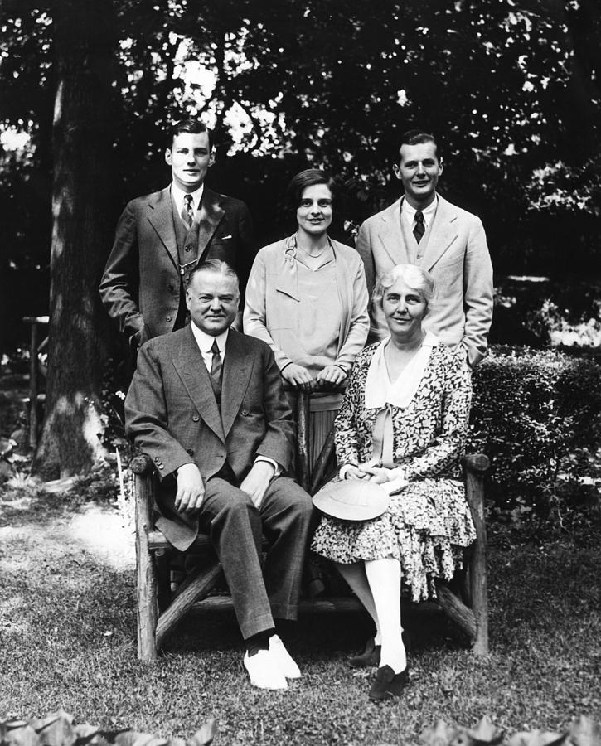
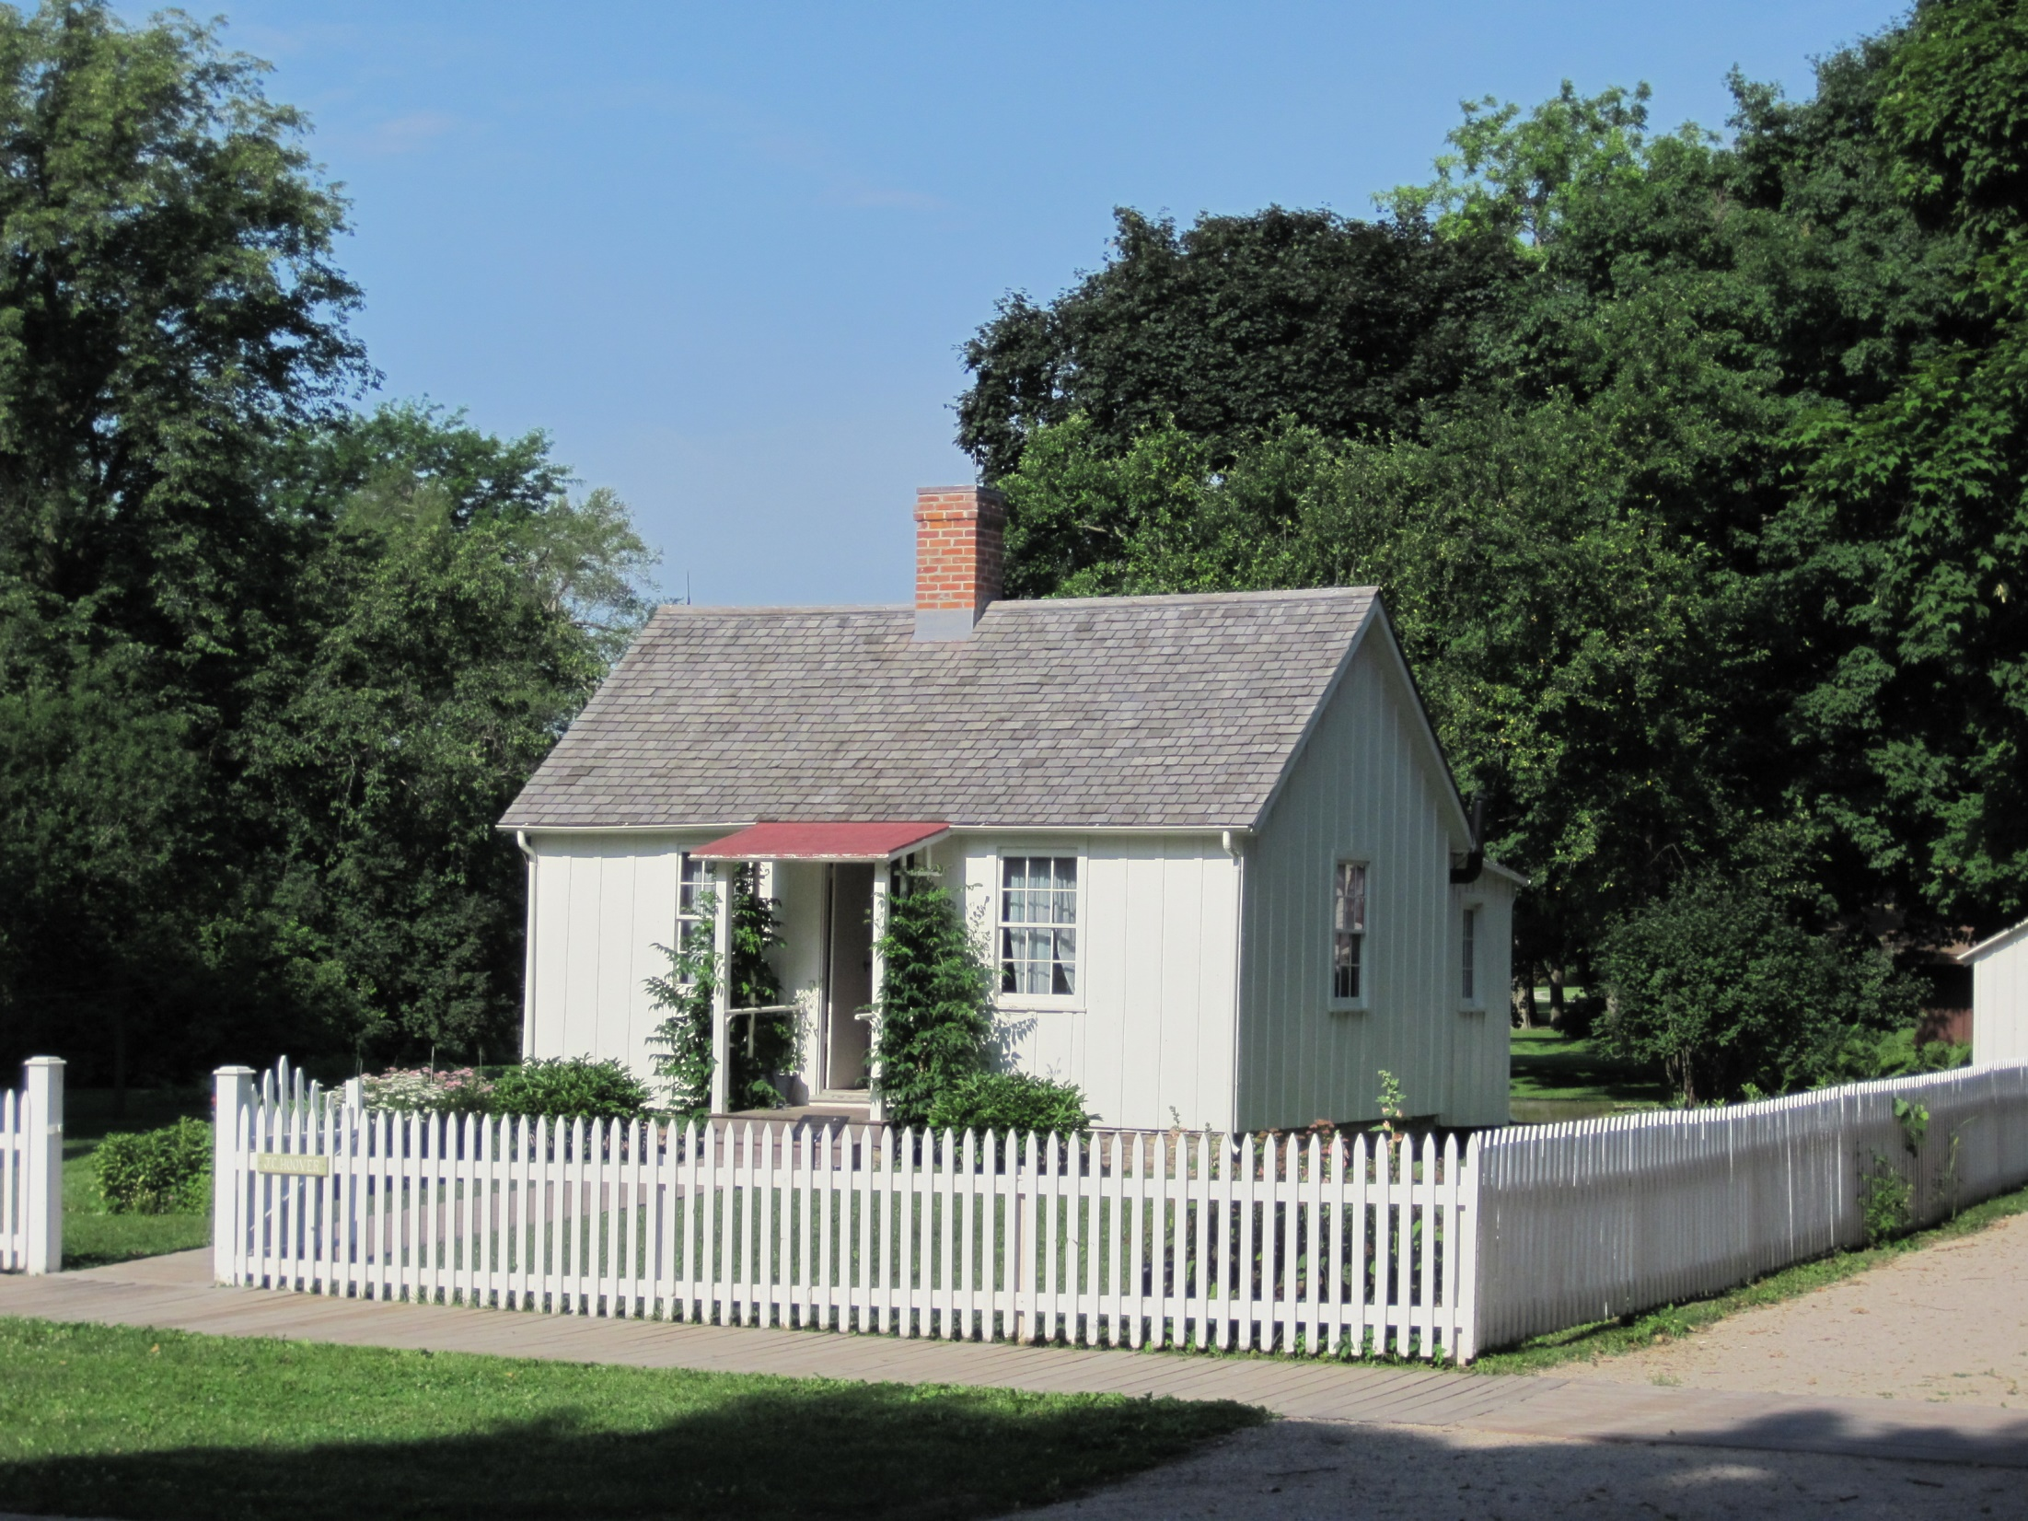
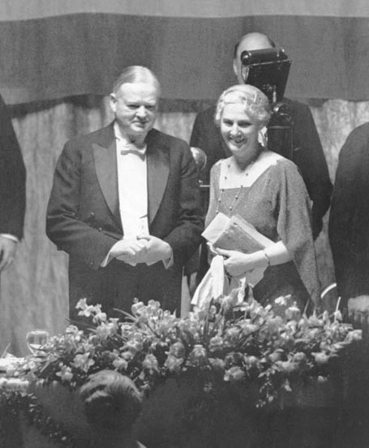
be sober-minded:
in all things showing yourself
a pattern of good works
in doctrine
• showing integrity
• reverence
• incorruptibility
• sound speech
Notes:
In 1898, the year she graduated from Stanford, Hoover cabled a marriage proposal, which she promptly accepted by return wire. Both Herbert and Lou were 24 years old when they married on February 10, 1899, at the home of the bride's parents in Monterey, California.

Slide 34
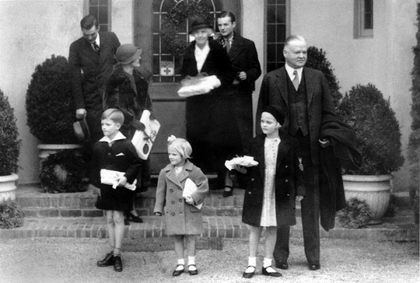

Slide 35
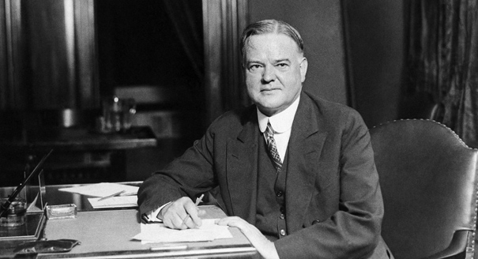
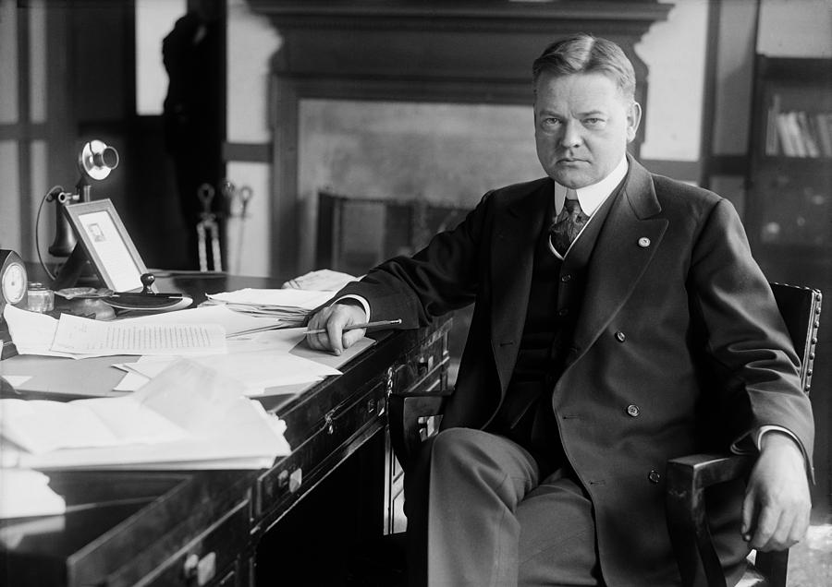

Slide 36
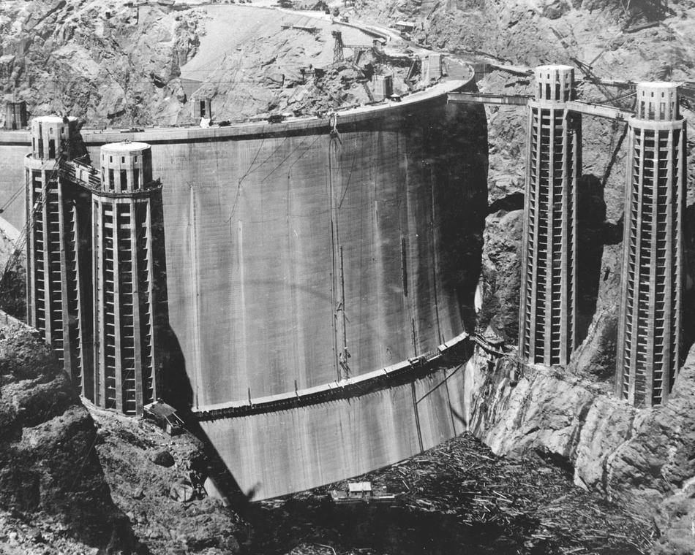
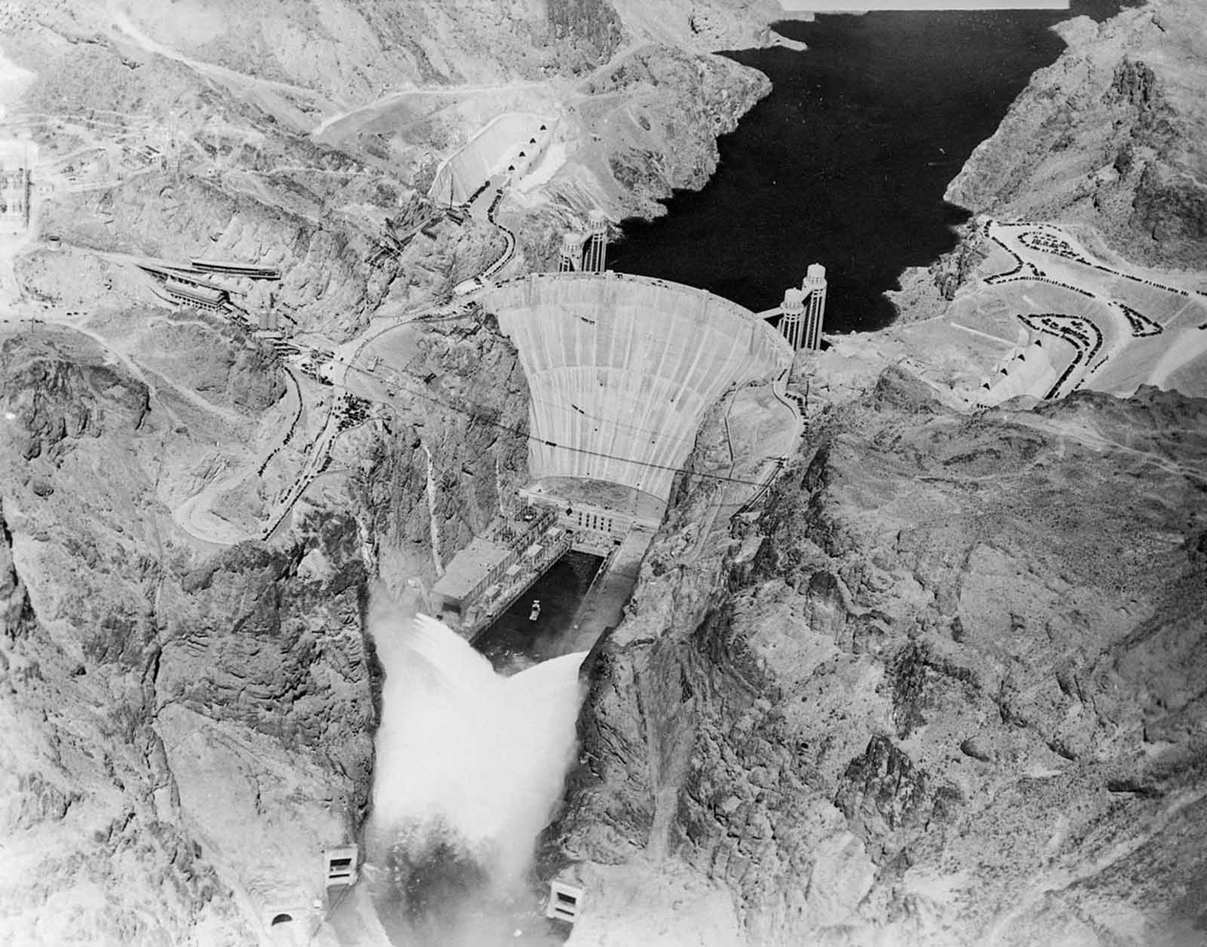
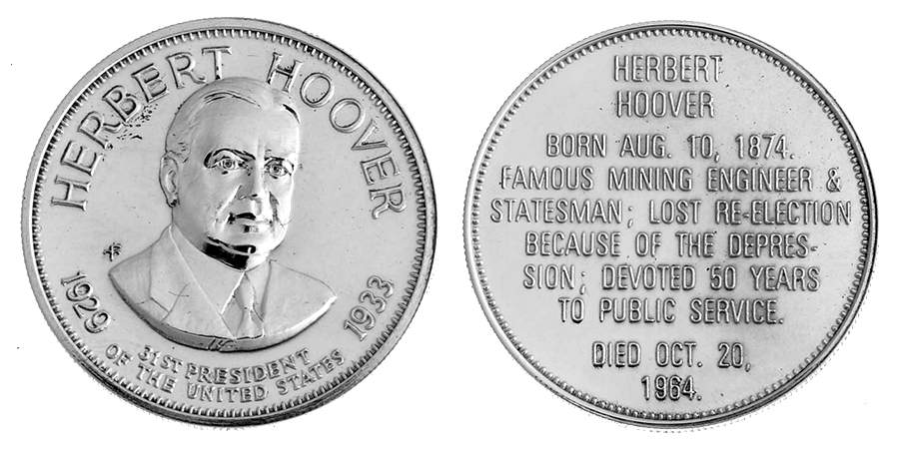
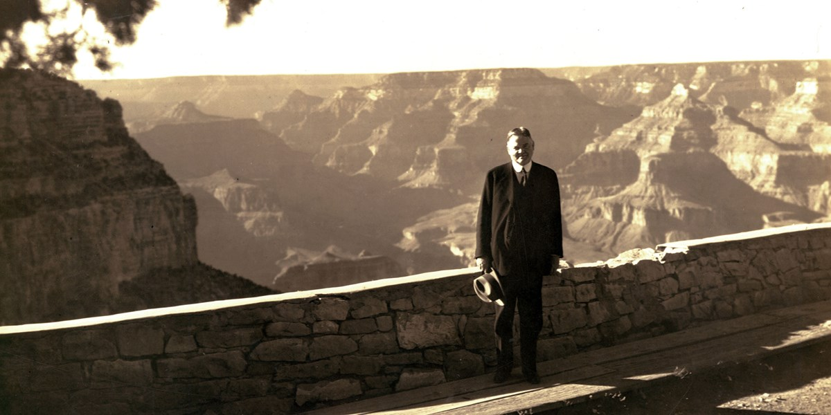
Notes:
Hoover only wentr to Hoover Dam once, in 1932. Franklin changed the name to Boulder but Congress made Hoover the official name

Slide 37
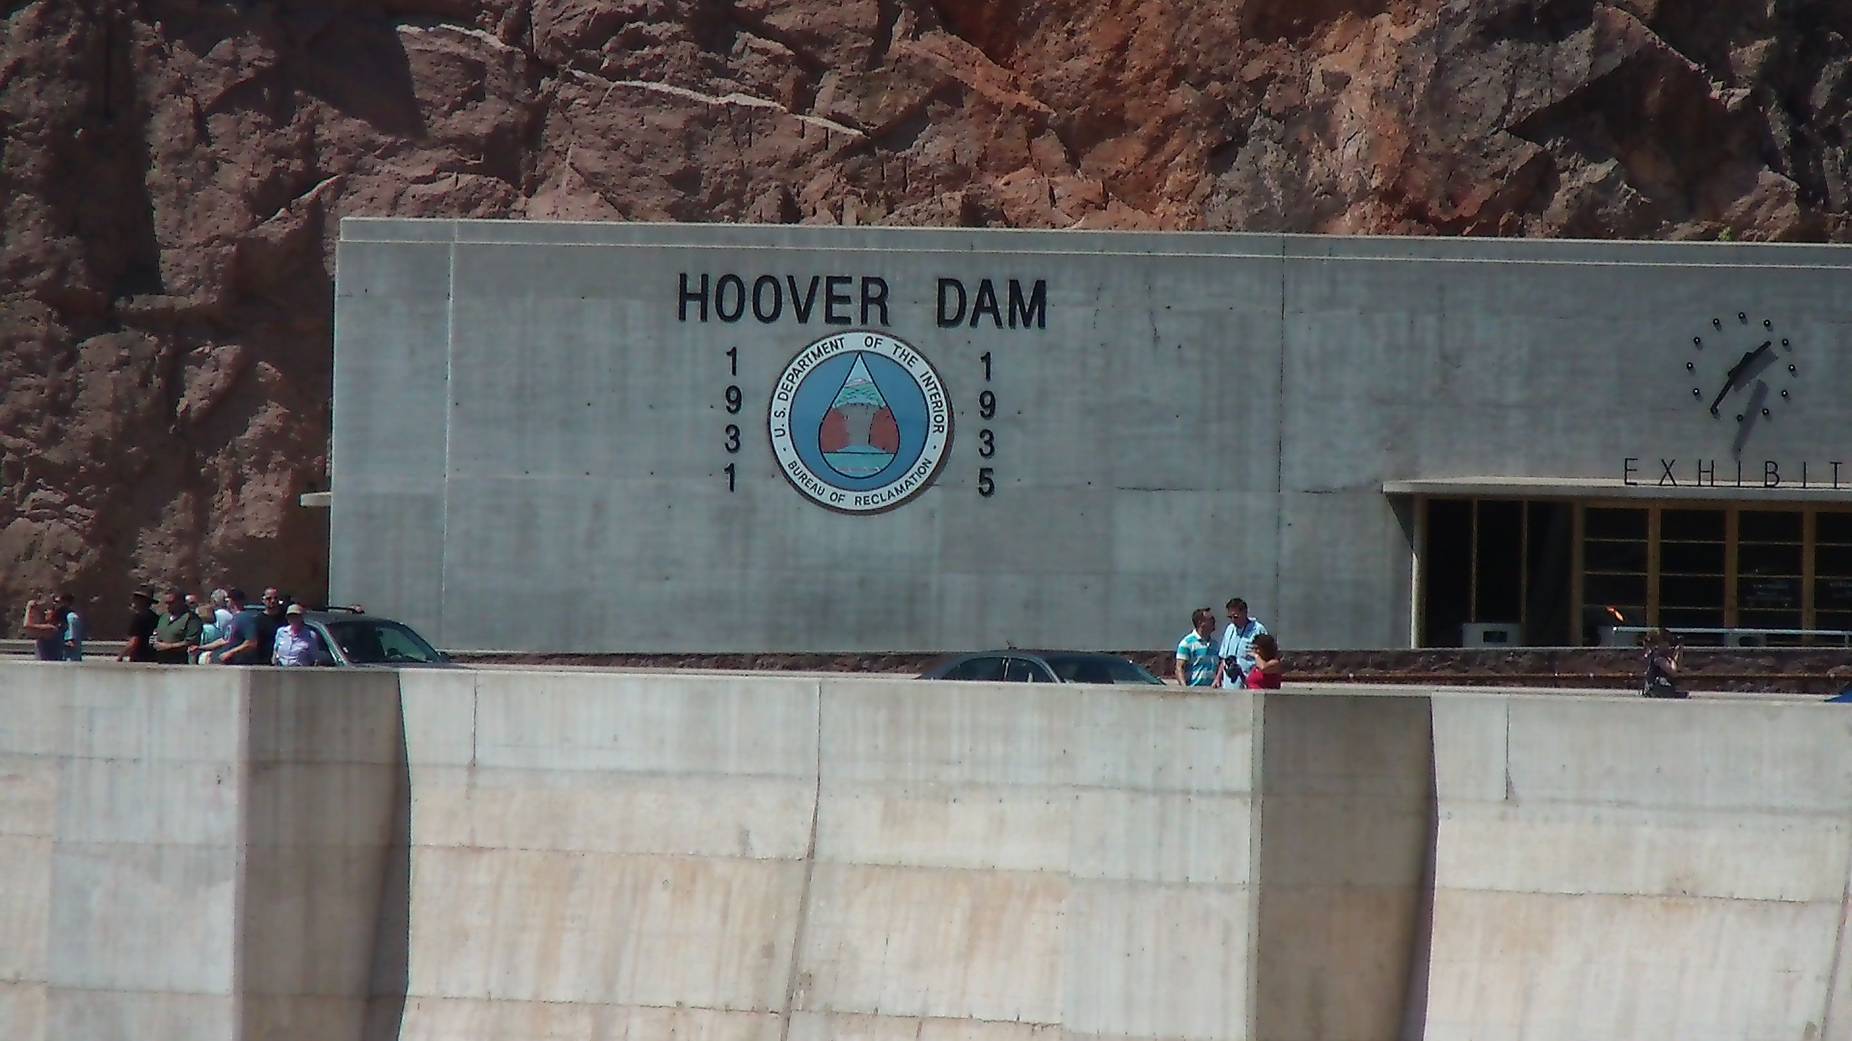

Slide 38
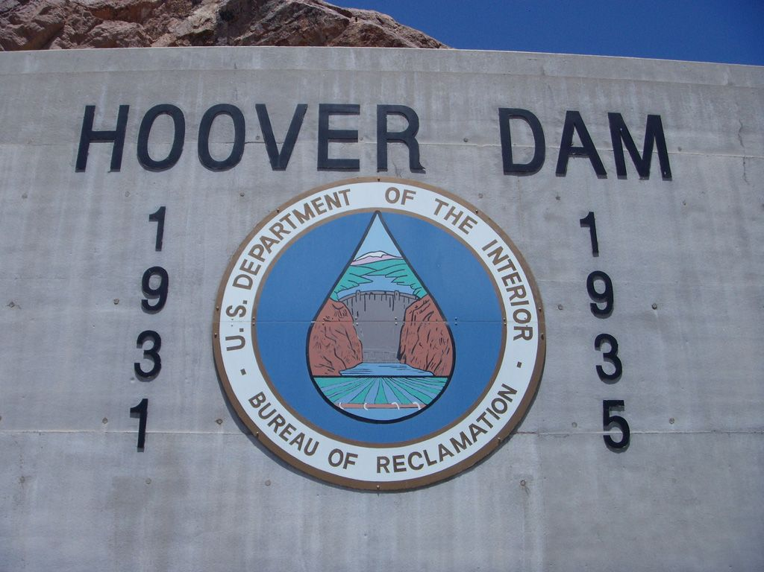

Slide 39
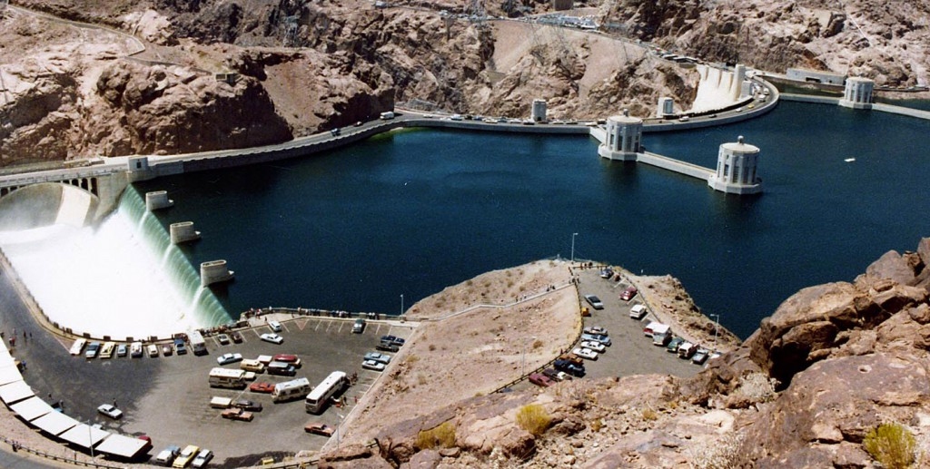

Slide 40
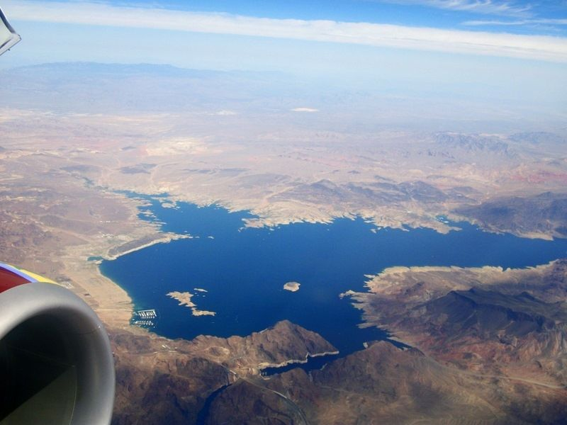

Slide 41
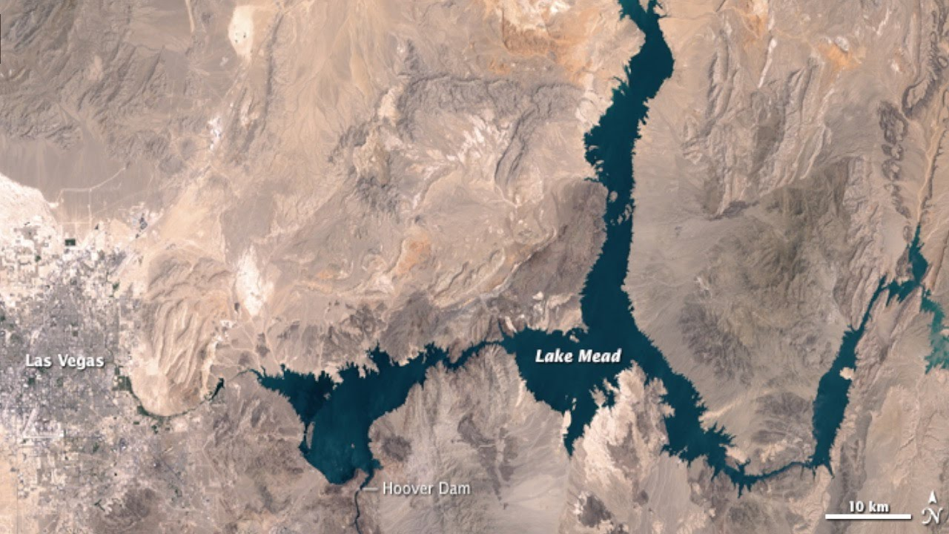

Slide 42
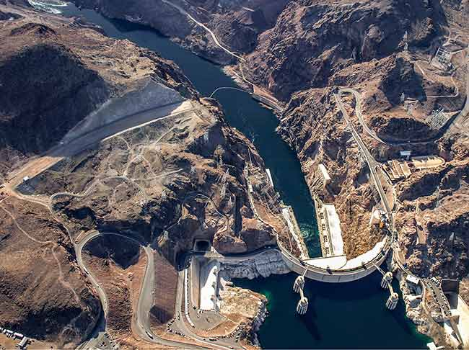

Slide 43
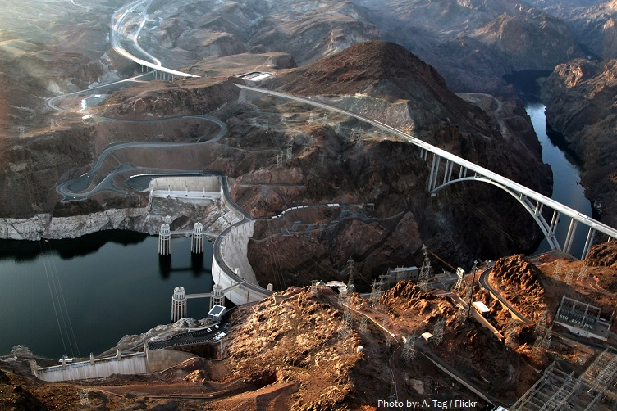
Arizona
Nevada

Slide 44
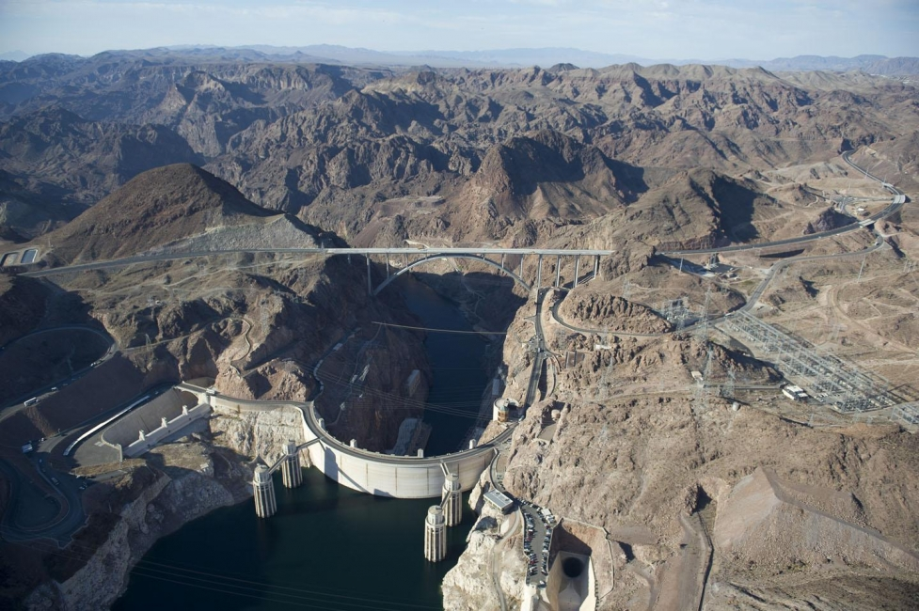

Slide 45
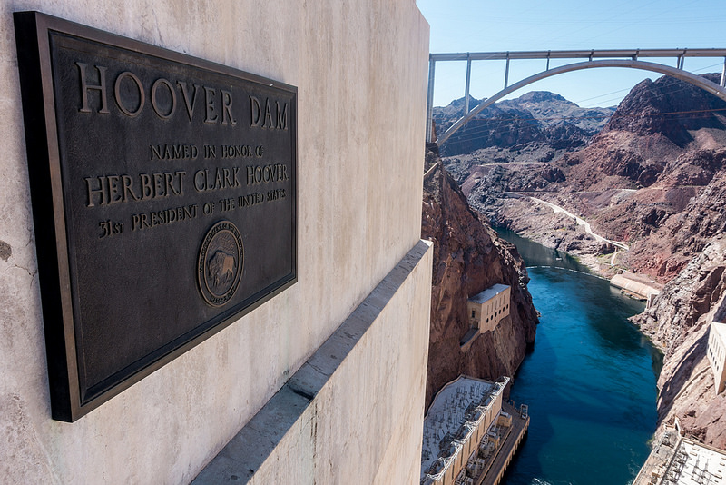

Slide 46
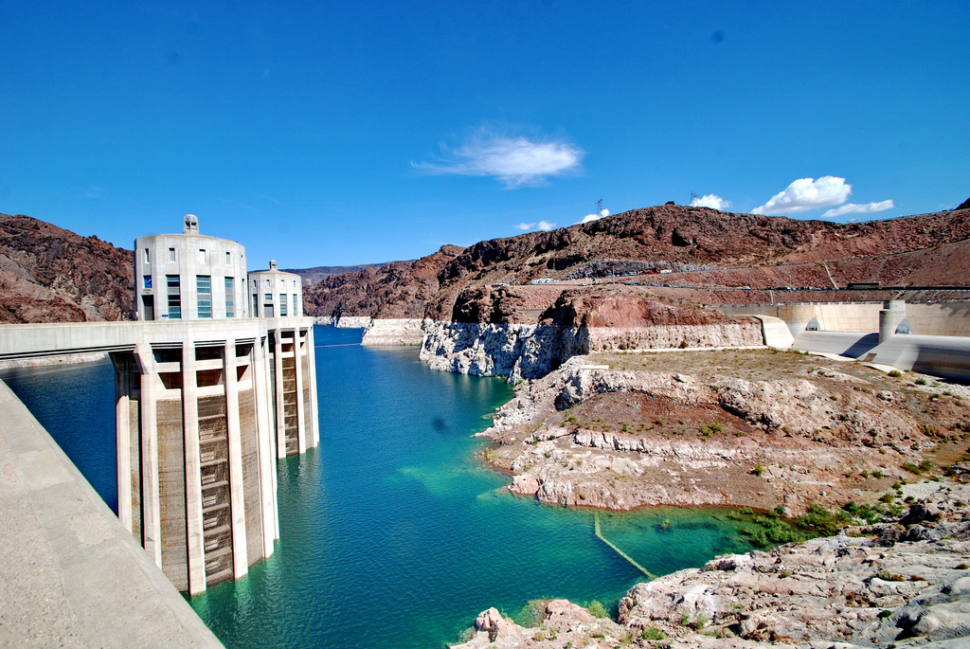

Slide 47
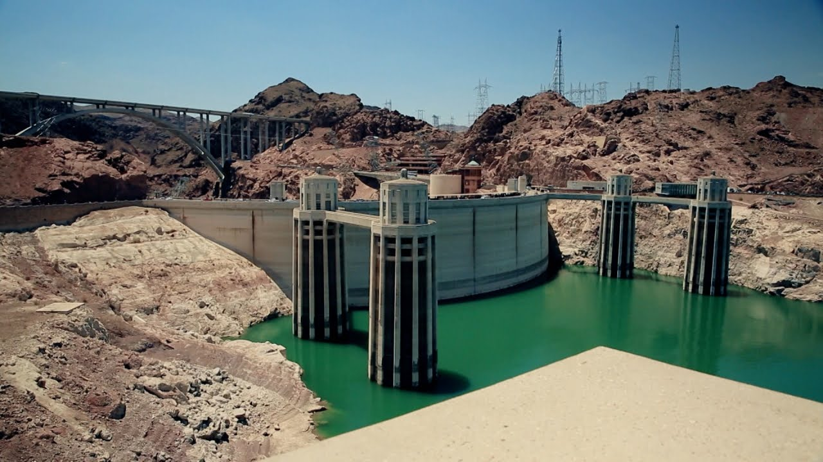

Slide 49
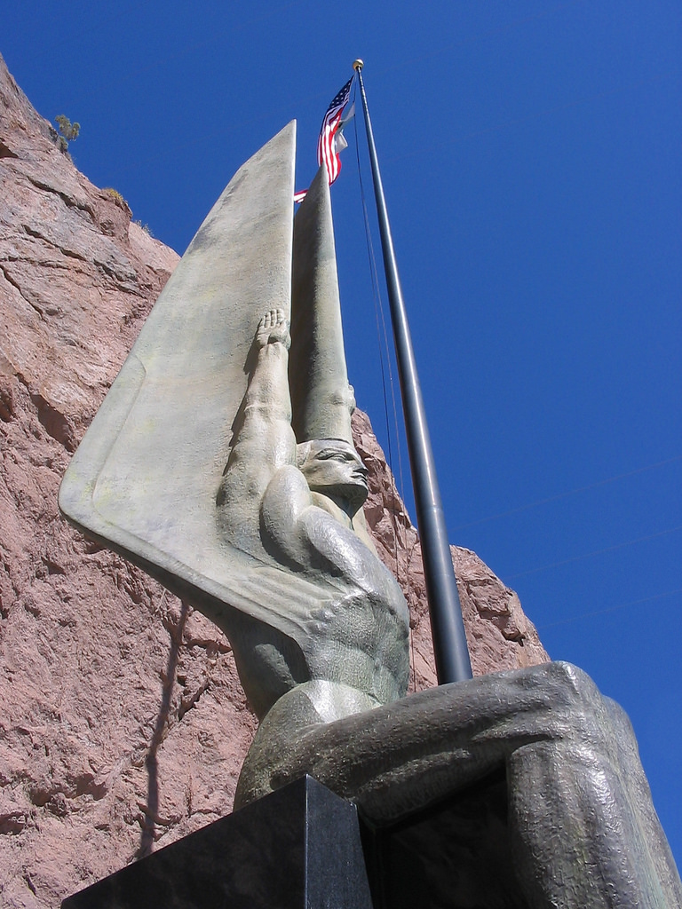
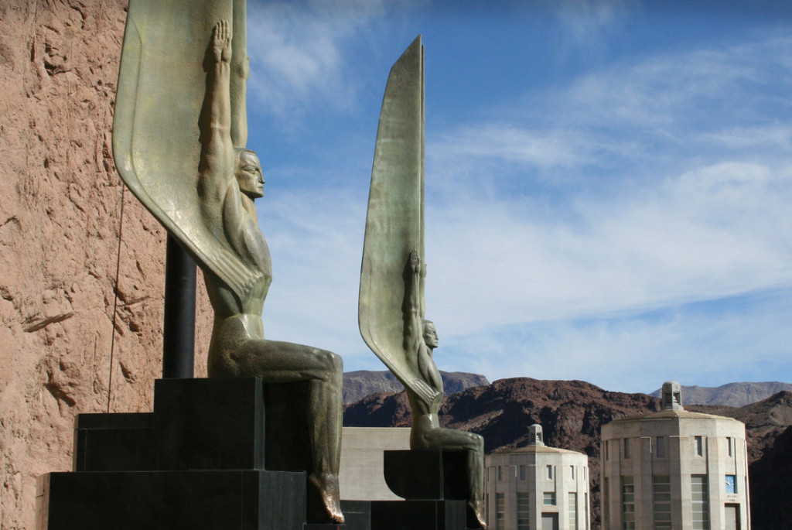
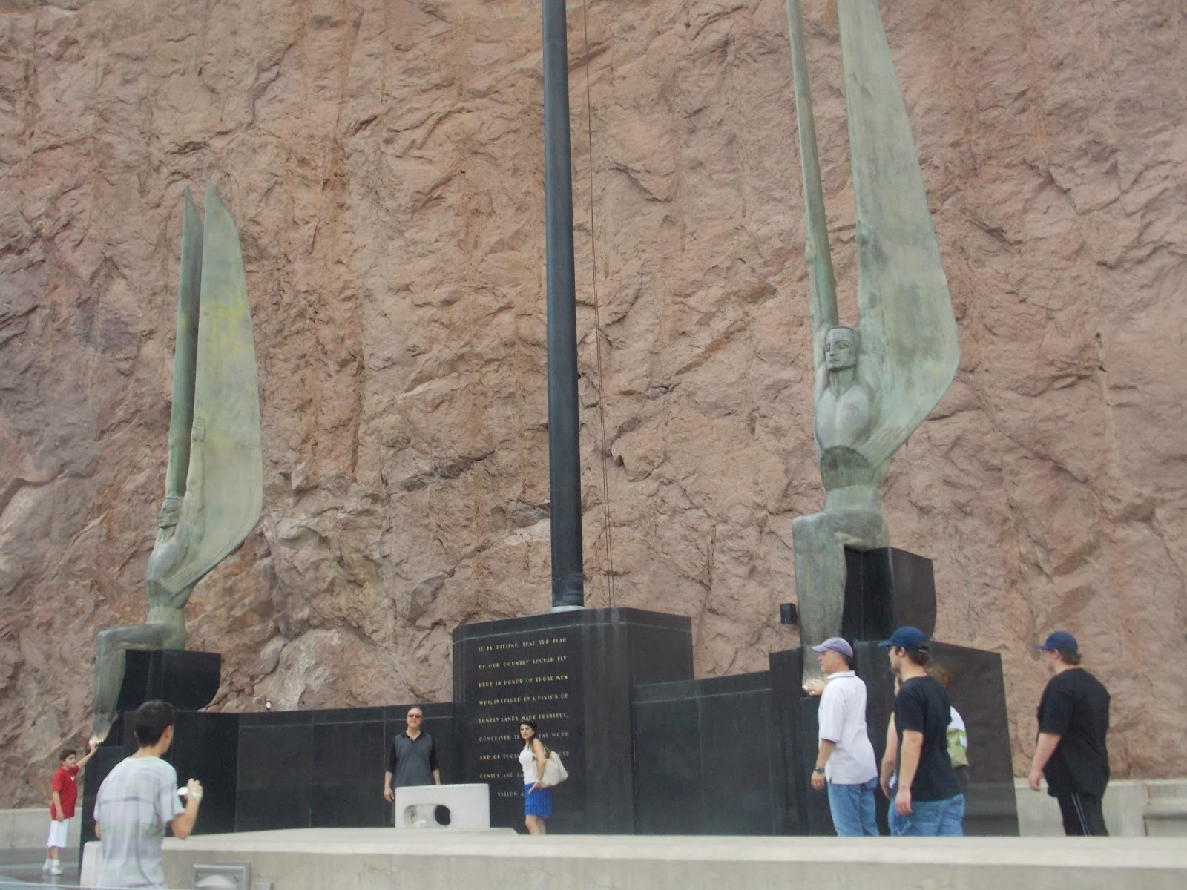
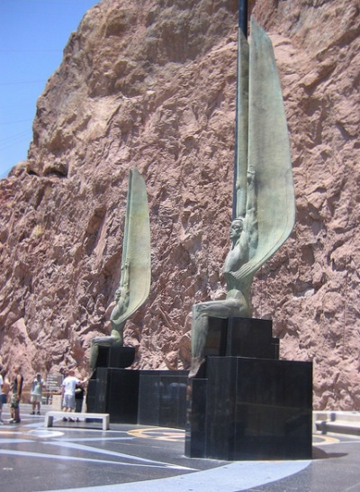

Slide 50
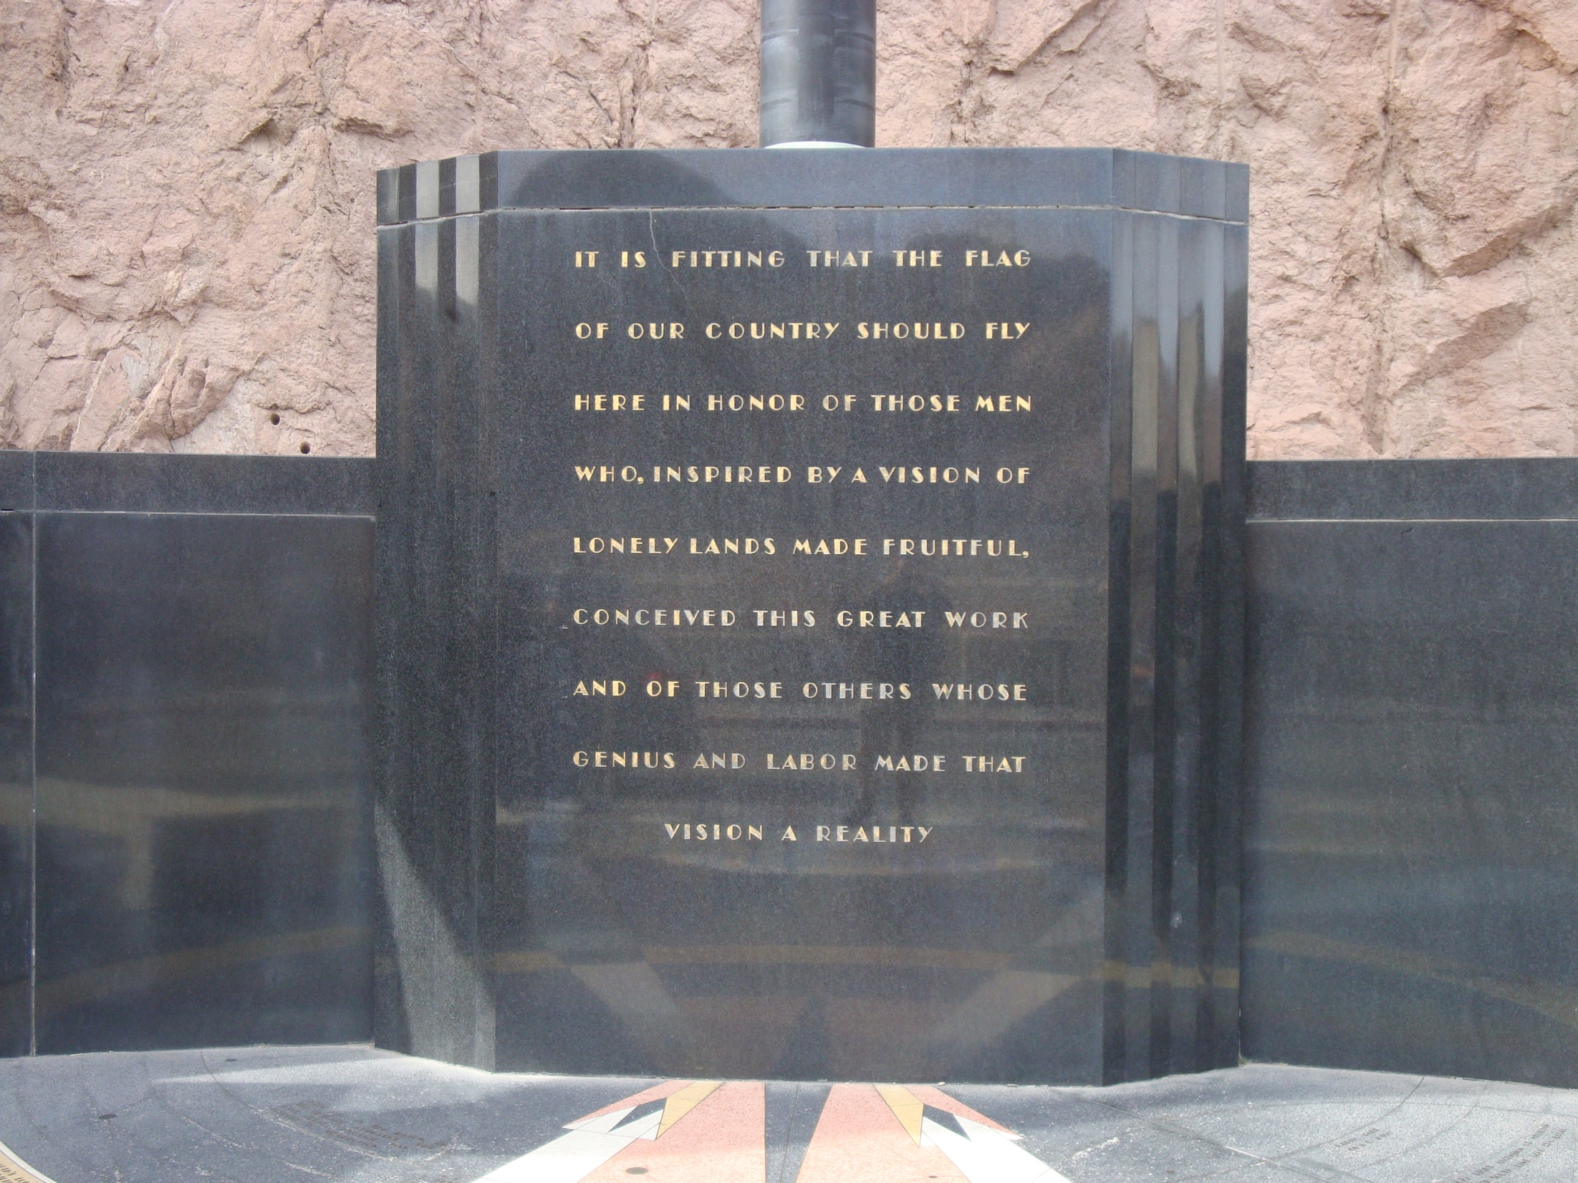
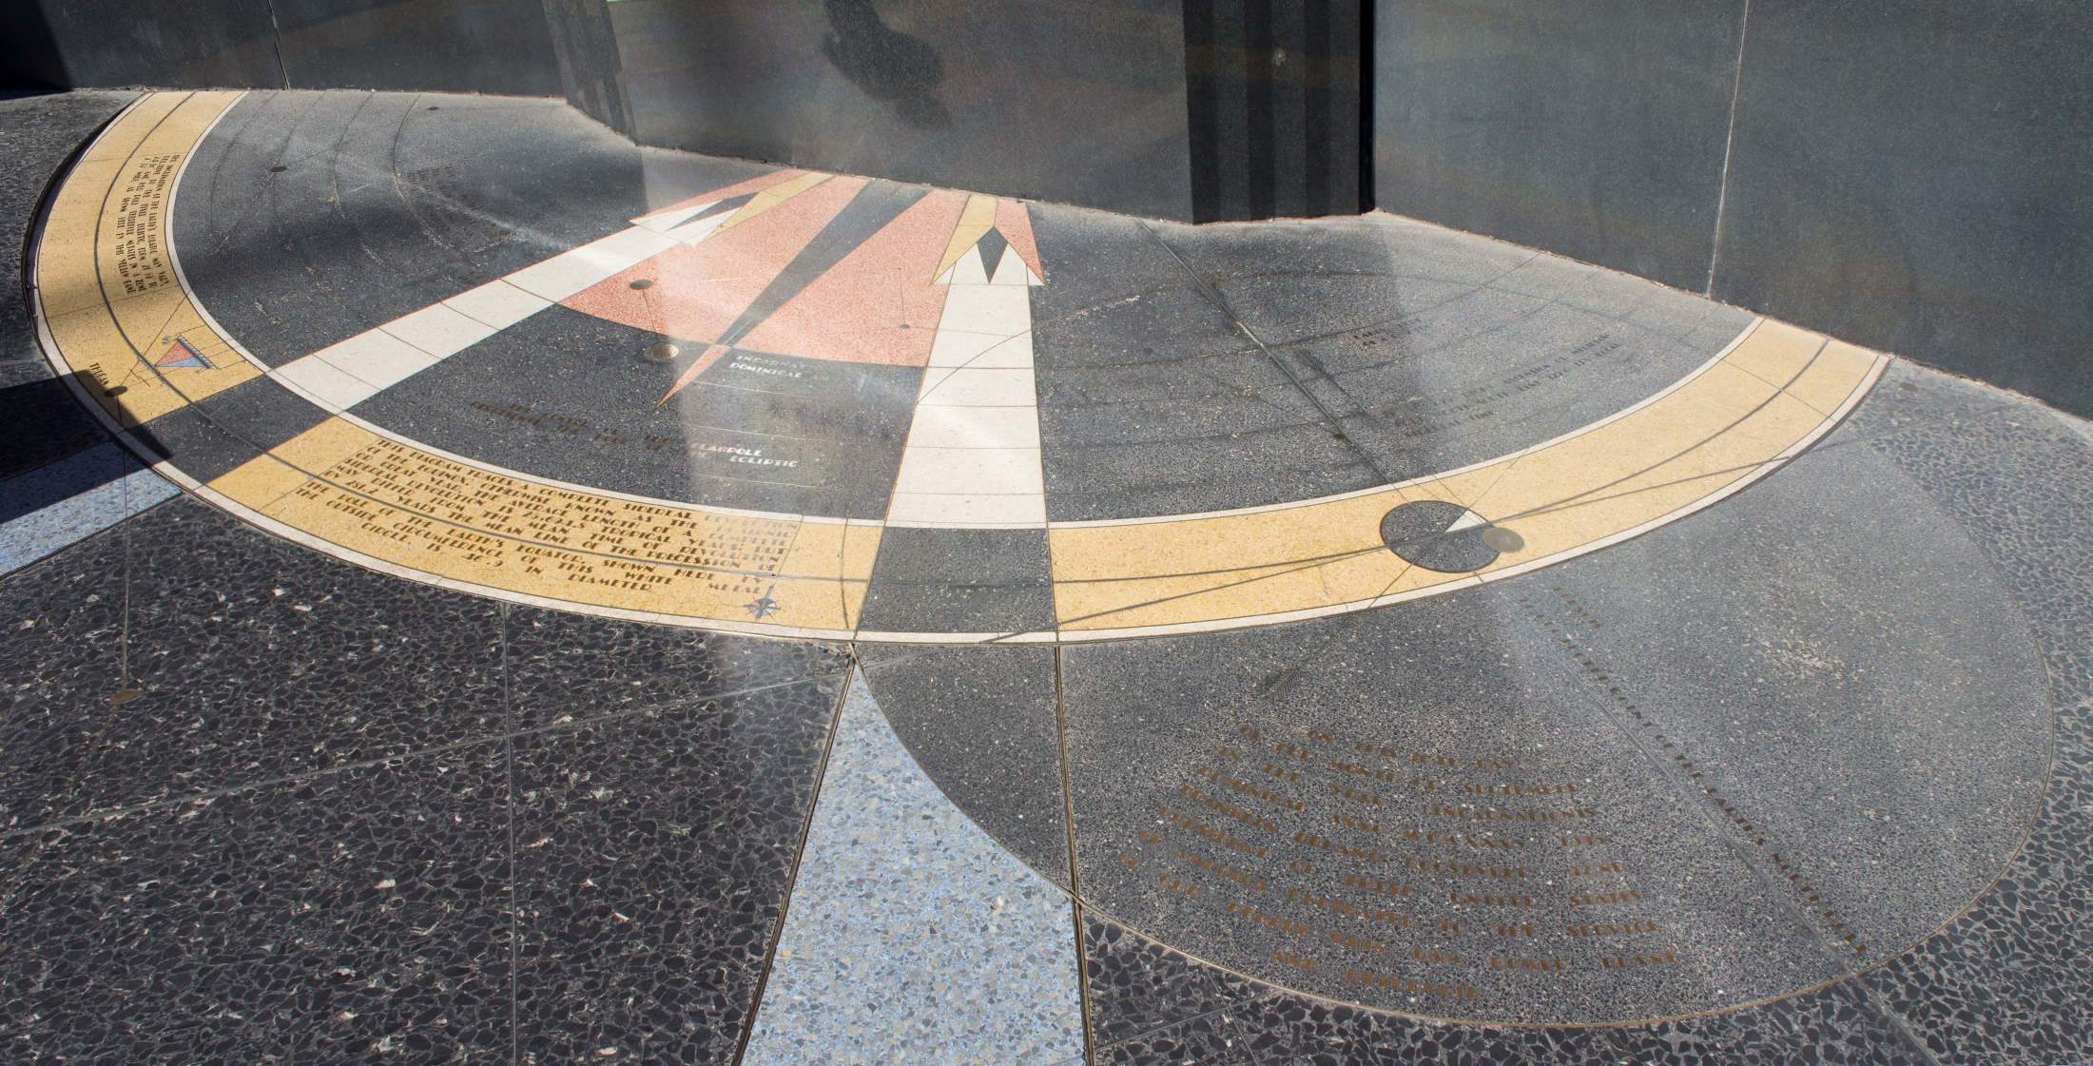

Slide 51
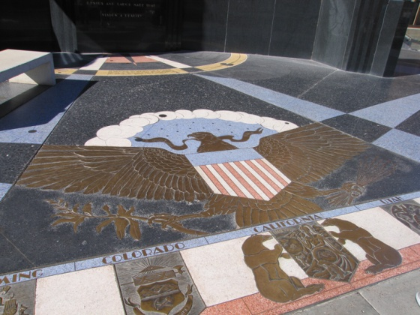

Slide 52
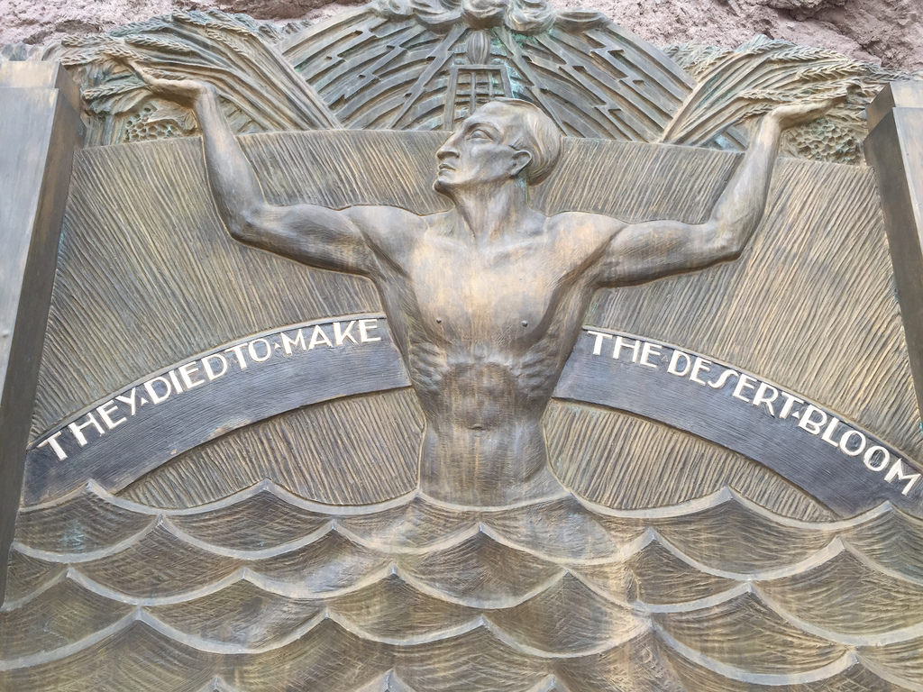

Slide 53
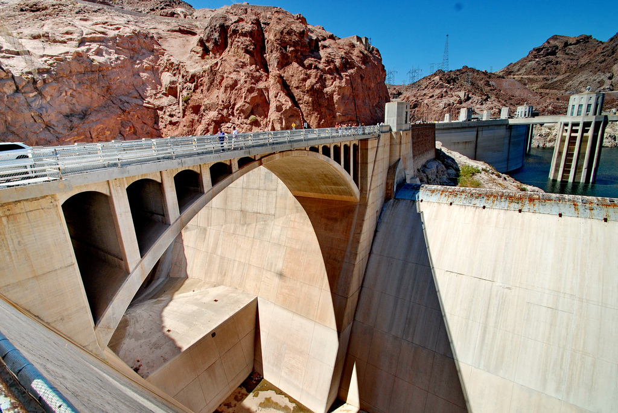

Slide 54
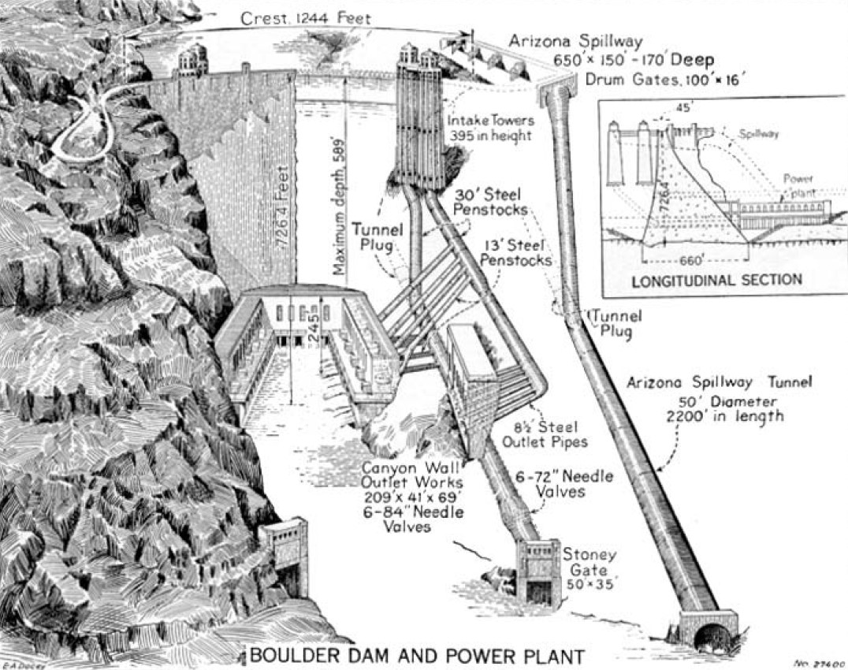

Slide 55
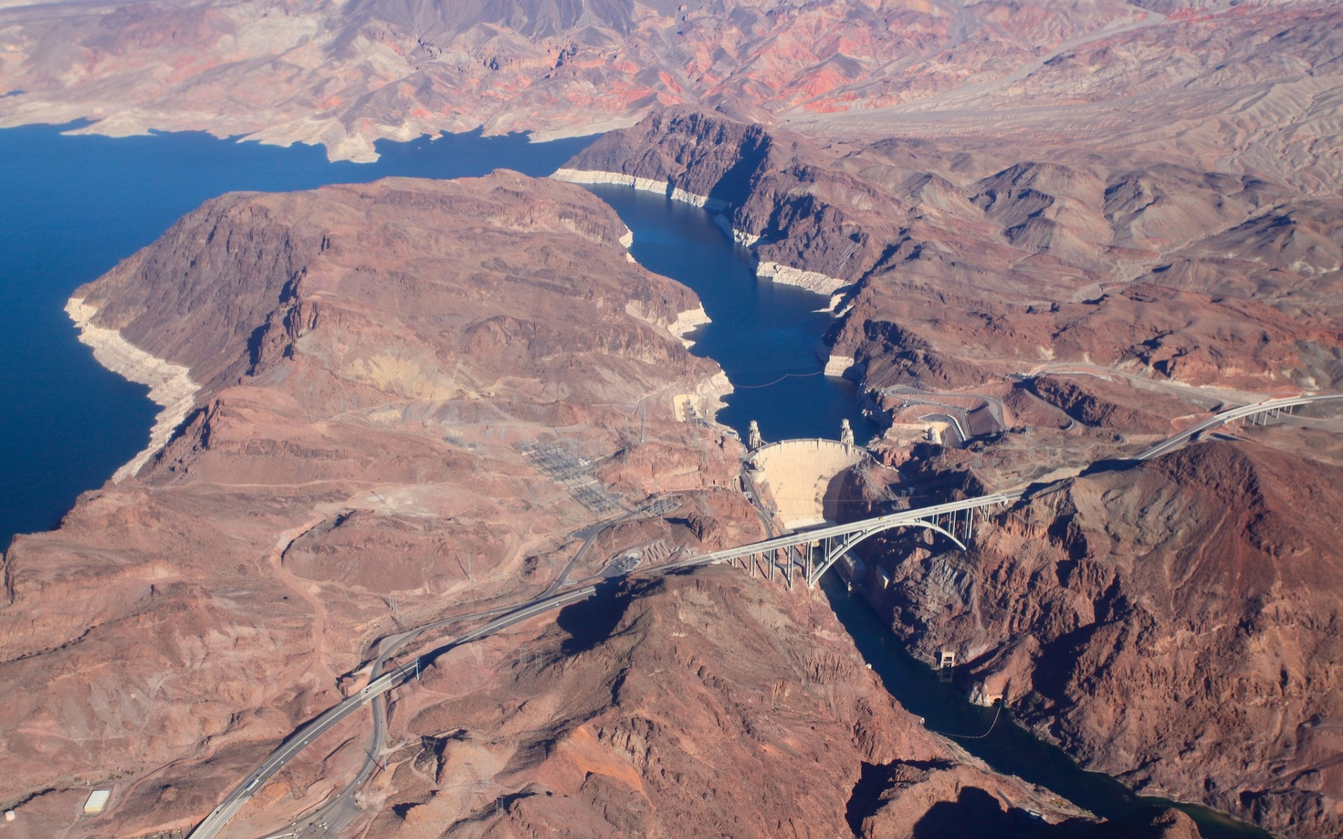

Slide 56
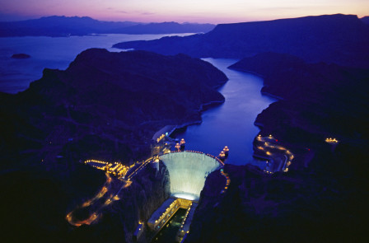

Slide 57
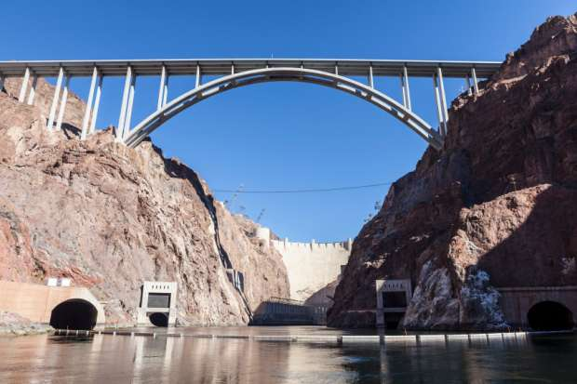
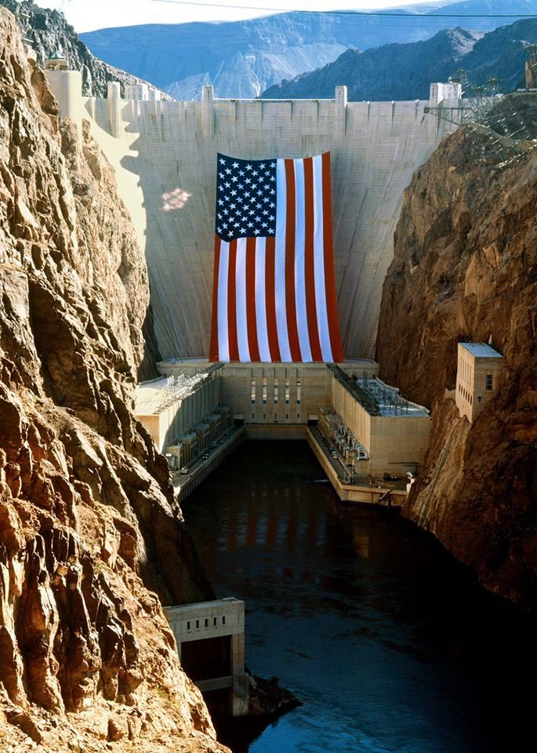
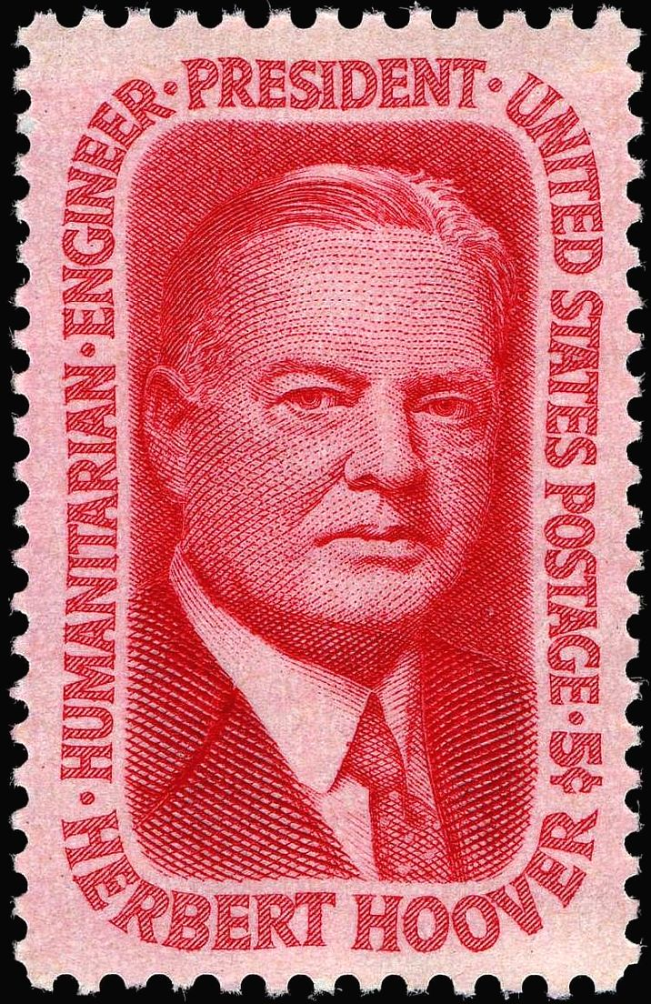

Slide 58
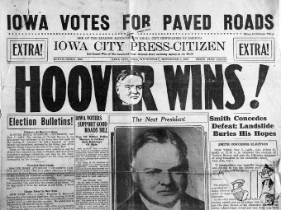
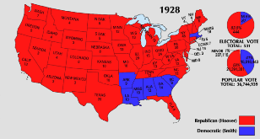
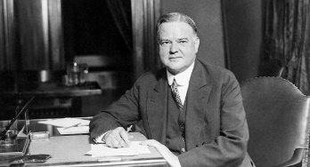
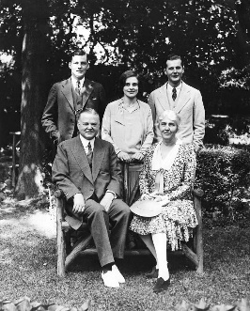
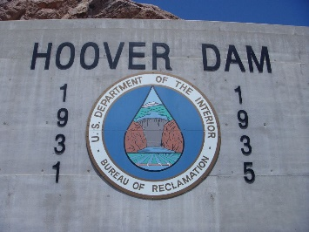
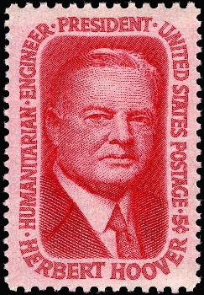
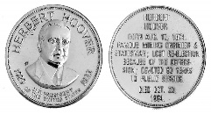
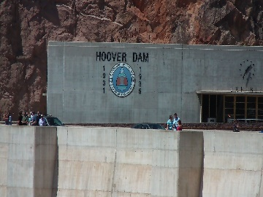
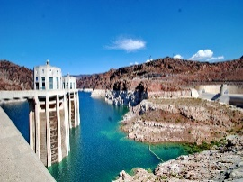
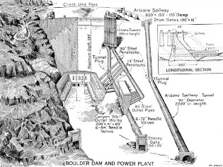
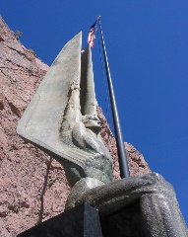

Slide 60
Presidential Quotes
Ron Bert
23½
July 28, 2019

Slide 61
Part 2
31. Herbert Hoover (1929-1933)

Slide 62
“To go fishing is the chance to wash one's soul with pure air, with the rush of the brook, or with the shimmer of sun on blue water. It brings meekness and inspiration from the decency of nature, charity toward tackle-makers, patience toward fish, a mockery of profits and egos, a quieting of hate, a rejoicing that you do not have to decide a darned thing until next week. And it is discipline in the equality of men - for all men are equal before fish.”
wash
love
charity
endurance
patience
quiet
peace
rejoicing

Slide 63
“Lots of people committed crimes during the year who would not have done so if they had been fishing. The increase of crime is among those deprived of the regenerations that impregnate the mind and character of the fisherman.”
spirit

Slide 64
“Next to prayer, Fishing is the most personal relationship of man.”
prayer
prayer

Slide 65
And the prayer of faith will save the sick, and the Lord will raise him up. And if he has committed sins, he will be forgiven. Confess your trespasses to one another, and pray for one another, that you may be healed. The effective, fervent prayer of a righteous man avails much. — James 5:15-16
of
prayer of faith
prayer

Slide 66
“Love what is ahead by loving what has come before.”

Slide 67
For we do not have a High Priest who cannot sympathize with our weaknesses, but was in all points tempted as we are, yet without sin. Let us therefore come boldly to the throne of grace, that we may obtain mercy and find grace to help in time of need. — Hebrews 4:15-16

Slide 68
“Children add to the wonder of being alive.”
Children are the most wholesome part of the race, the sweetest, for they are the freshest from the hand of God.

Slide 69
“If we could have but one generation of properly born, trained, educated, and healthy children, a thousand other problems of government would vanish.”

Slide 70
Train up a child in the way he should go, And when he is old he will not depart from it. — Proverbs 22:6

Slide 71
“National character cannot be built by law. It is the sum of the moral fiber of its individuals.”

Slide 72
“The structure of human betterment cannot be built upon foundations of materialism or business, but upon the bedrock of individual character in free men and women.”
betterment
of individual character

Slide 73
“The imperative need of this nation at all times is the leadership of Uncommon Men or Women.”

Slide 74
“Every collectivist revolution rides in on a Trojan horse of "emergency". It was the tactic of Lenin, Hitler, and Mussolini. In the collectivist sweep over a dozen minor countries of Europe, it was the cry of men striving to get on horseback. And "emergency" became the justification of the subsequent steps. This technique of creating emergency is the greatest achievement that demagoguery attains.”
emergency
emergency
emergency
emergency
exciting desires and prejudices of ordinary people
demagoguery
Notes:
exciting desires and prejudices of ordinary people

Slide 75
But there were also false prophets among the people, even as there will be false teachers among you, who will secretly bring in destructive heresies, even denying the Lord who bought them, and bring on themselves swift destruction. And many will follow their destructive ways, because of whom the way of truth will be blasphemed. — 2nd Peter 2:1-2

Slide 76
“It is a paradox that every dictator has climbed to power on the ladder of free speech. Immediately on attaining power each dictator has suppressed all free speech except his own.”

Slide 77
“Menaced by collectivist trends, we must seek revival of our strength in the spiritual foundations which are the bedrock of our republic. Democracy is the outgrowth of the religious conviction of the sacredness of every human life. On the religious side, its highest embodiment is the Bible; on the political side, the Constitution.”
the Bible
Bible
Bible
the Constitution
Constitution

Slide 78
“Man is still by instinct a predatory animal given to devilish aggression. The discoveries of science have immensely increased productivity of material things. They have increased the standards of living and comfort. They have eliminated infinite drudgery. They have increased leisure. But that gives more time for devilment. The work of science has eliminated much disease and suffering. It has increased the length of life. That, together with increase in productivity, has resulted in vastly increased populations. Also it increased the number of people engaged in devilment.”
science
increased leisure
increased
people
in
devilment

Slide 79
“The heart is deceitful above all things, And desperately wicked; Who can know it?” — Jeremiah 17:9

Slide 80
“I have on numerous occasions, as you know, expressed my sympathy in the establishment of a National Home for the Jews in Palestine and, despite the set-backs caused by the disorders there during the last few years, I have been heartened by the progress which has been made and by the remarkable accomplishments of the Jewish settlers in that country.”

Slide 81
“What the world needs today is a definite, spiritual mobilization of the nations who believe in God against this tide of Red agnosticism. It needs a moral mobilization against the hideous ideas of the police state and human slavery. I suggest that the United Nations should be reorganized without the Communist nations in it. It is a proposal based solely upon moral, spiritual and defense foundations. It is a proposal to redeem the concept of the United Nations to the high purpose for which it was created. It is a proposal for moral and spiritual cooperation of God-fearing free nations. And in rejecting an atheistic other world, I am confident that the Almighty God will be with us.”
agnosticism
distrust
nonbelief
doubt
reservation
moral and spiritual cooperation of God-fearing free
skepticism
uncertainty

Slide 82
Therefore let us pursue the things which make for peace and the things by which one may edify another. — Romans 14:19

Slide 83
“Freedom is the open window through which pours the sunlight of the human spirit and human dignity.”

Slide 84
28
Notes:
Herbert Hoover (standing, left) served in Wilson’s war council.

Slide 85
29
Notes:
With President Harding

Slide 86
30
Notes:
With Calvin Coolidge

Slide 87
31
27
30

Slide 88
32

Slide 90
33

Slide 92
34

Slide 93
37
34
33
31

Slide 94
35

Slide 96
Notes:
Dinner with Hitler 1938, Gandhi 1946

Slide 104
→ The Bible contains fundamentals of civilization
→ One must be free to declare where evils occur
→ Only a spiritual society remains successful
→ A duty of securing freedom is to maintain integrity
→ When leaders lack morals all are damaged
→ Only moral and spiritual qualities ensure greatness
→ Courageous souls build lasting legacies of character
→ Without opportunities for purpose crime advances
→ Wondrous children inspire the hopes of our dreams
→ Individual moral character is the bedrock of society
→ Suppressing free speech is the sign of oppression
→ Better living standards with leisure time increase sin
→ Only a God fearing world will achieve peace
Heaven is only as far away as those many who believe
Notes:
Heaven is only as far away as those many who believe

Slide 105
Please visit http://www.LoveFromGod.com to explore further
Ronald Bert Channel on
Notes:
Eternity never ends.

