Slide 2
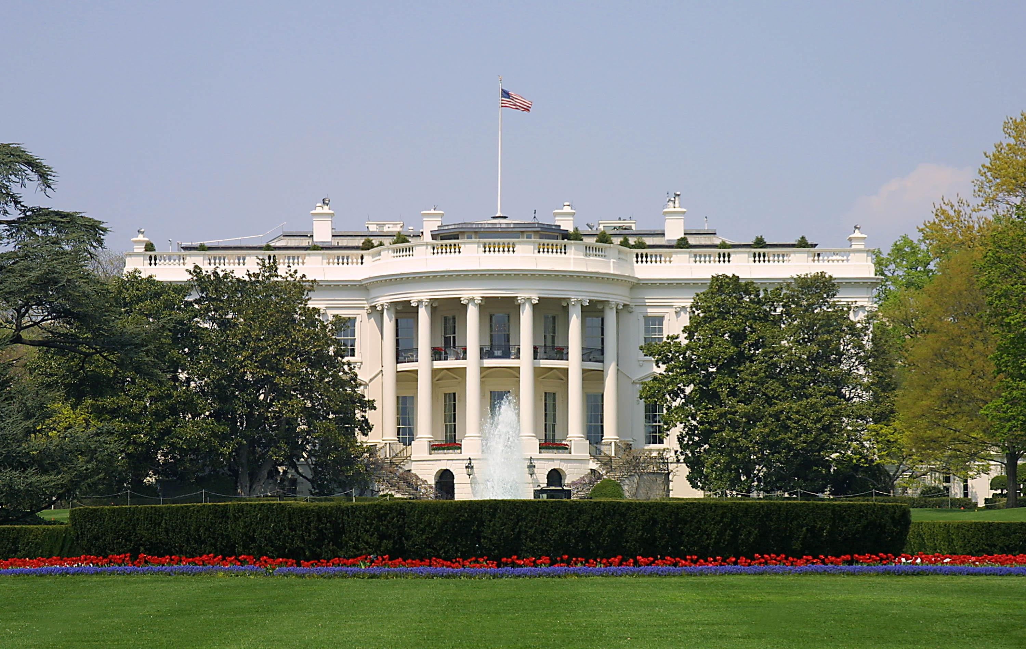
Presidential Quotes
Ron Bert
22
June 23, 2019

Slide 3
29. Warren G. Harding (1921-1923)
Notes:
Harding's campaign for the presidency promised a "return to normalcy." He was elected president on his birthday and inaugurated in 1921, following World War I. After serving as president for less than three years, on August 2, 1923, Harding died unexpectedly of a heart attack while traveling in California.
Warren Harding Lost The White House China In A Poker Game

Slide 4
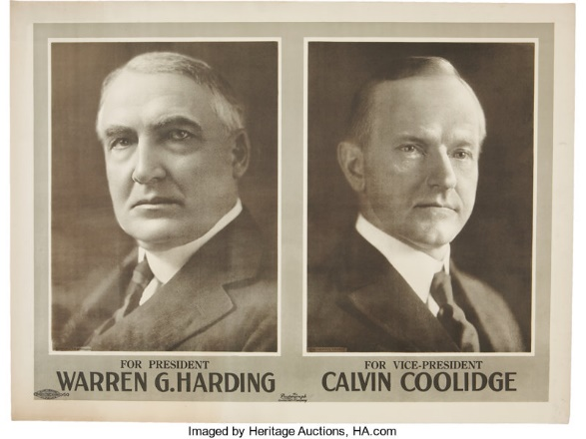

Slide 5
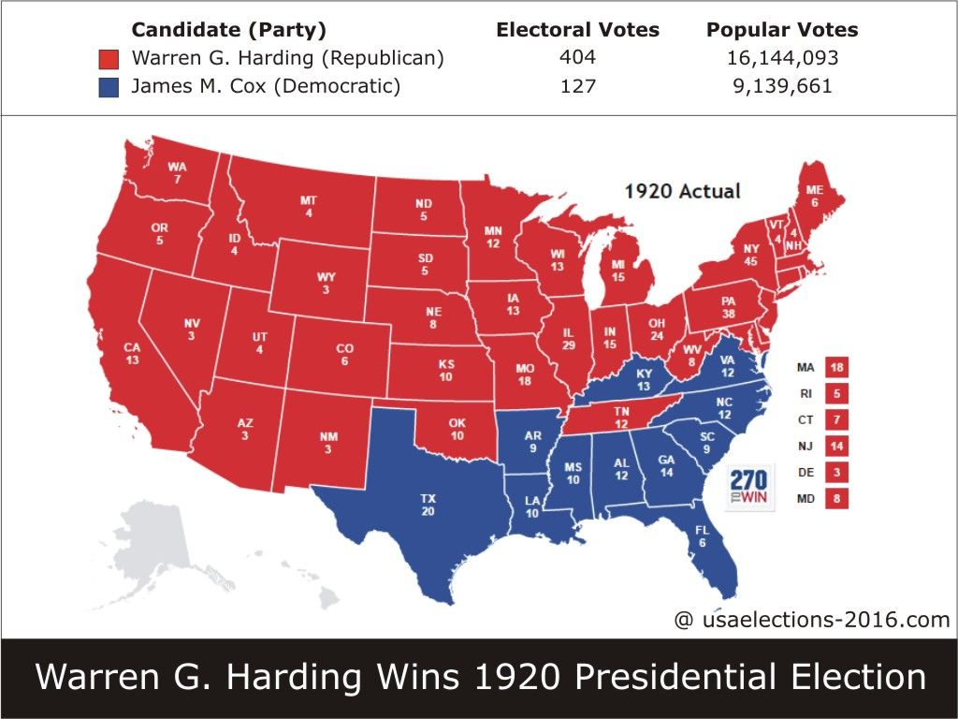

Slide 6
“We need citizens who are less concerned about what their government can do for them, and more concerned about what they can do for the nation.”

Slide 7
“I have been thinking a lot about these things as I have come to the realization of the tremendous responsibilities which rest upon me. It is my conviction that the fundamental trouble with the people of the United States is that they have gotten too far away from Almighty God. I am bound to believe that in a tumultuous age like ours the most important and imperative duty is the reconstruction of humanity to Almighty God.”
far away from Almighty God
reconstruction
Notes:
He ran on the slogan “Americanism”

Slide 8
All we like sheep have gone astray; We have turned, every one, to his own way; And the LORD has laid on Him the iniquity of us all. — Isaiah 53:6
iniquity of us all
iniquity of us all
LORD has laid on Him
iniquity
of us all

Slide 9
“There is something inherently wrong, something out of accord with the ideals of representative democracy, when one portion of our citizenship turns its activities to private gain amid defensive war while another is fighting, sacrificing, or dying for national preservation.”
criminal
profiteering

Slide 10
Indeed the wages of the laborers who mowed your fields, which you kept back by fraud, cry out; and the cries of the reapers have reached the ears of the Lord of Sabaoth. You have lived on the earth in pleasure and luxury; you have fattened your hearts as in a day of slaughter. You have condemned, you have murdered the just; he does not resist you. — James 5:4-6

Slide 11
“I would not be my natural self if I did not utter my consciousness of my limited ability to meet your full expectation or to realize the aspirations within my own breast. But I'll gladly give all that is in me, all of heart, soul, and mind and the fighting love of country, to service in our common cause. I can only pray to the omnipotent God that I may be as worthy in service as I know myself to be faithful in thought and purpose. One cannot give more.”
natural self
all of heart, soul, and mind
in
worthy in service

Slide 12
“It is impossible for one who has studied at all the services of the Hebrew people to avoid the faith that they will one day be restored to their historic national home and there enter on a new and yet greater phase of their contribution to the advance of humanity.”

Slide 13
“There is no relationship here between Church and State. Religious liberty has its unalterable place, along with civil and human liberty, in the very foundation of the Republic. I hold it [religious intolerance] to be a menace to the very liberties which we boast and cherish.”
“I am not fit for this office and never should have been here.”

Slide 14
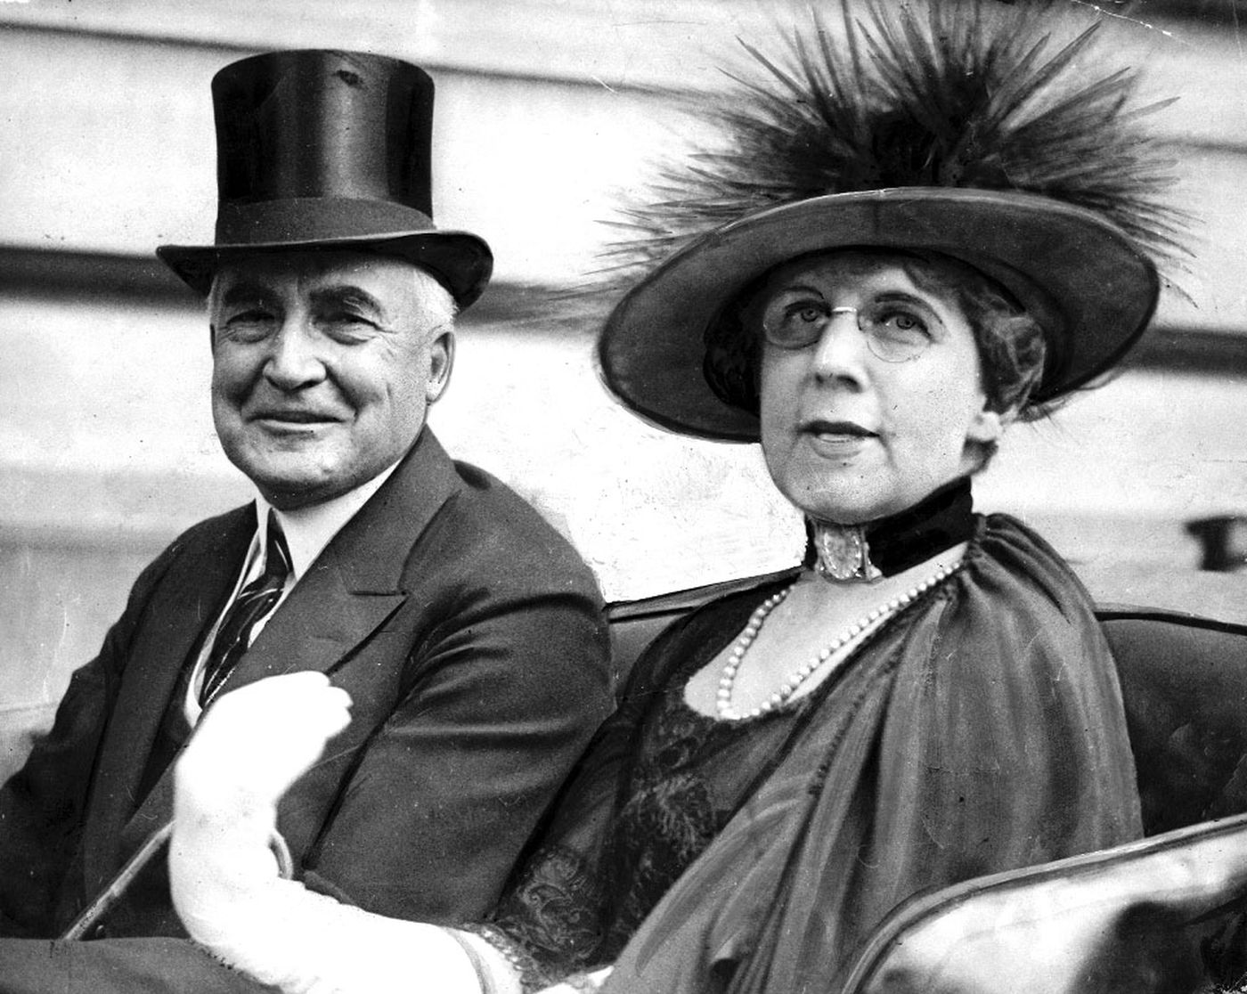
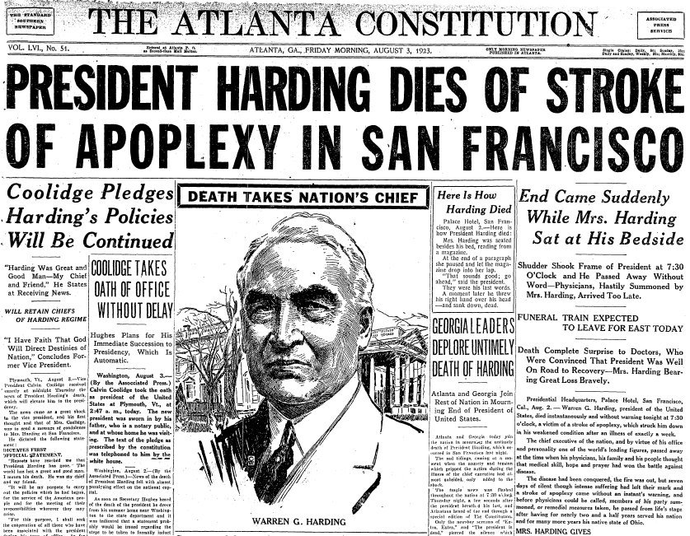
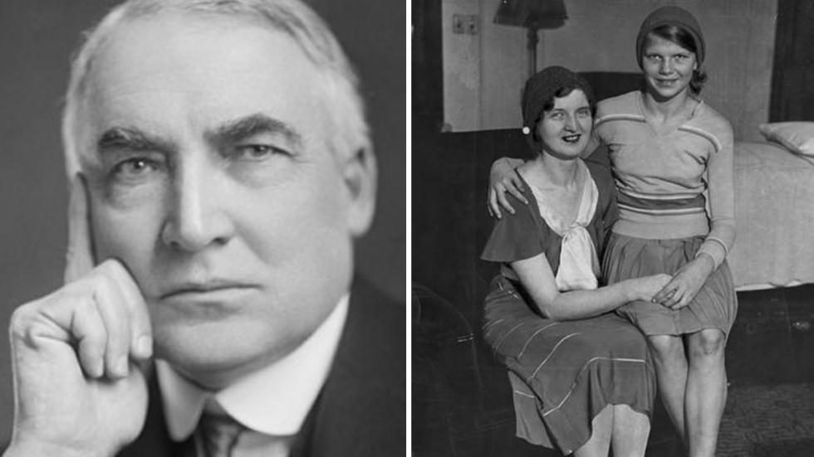
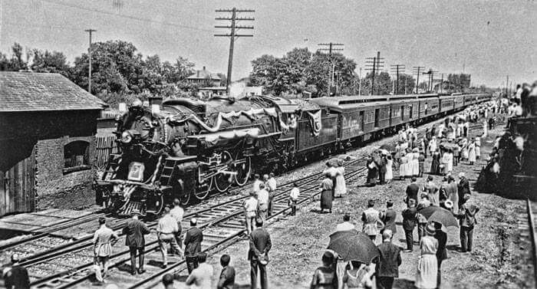
Notes:
Tests confirm 1920s US leader's affair with mistress, who claimed she and Harding had sex in a White House closet; grandson overjoyed by DNA results. Known as the horniest president.
Stroke or heart attack? – Stimulants from doctors or poisoning from wife?
Presidents wife ordered embalming 1 hour after death, refused autopsy.
She destroyed many document in Washington DC office.
President had written many steamy lustful letters.

Slide 15
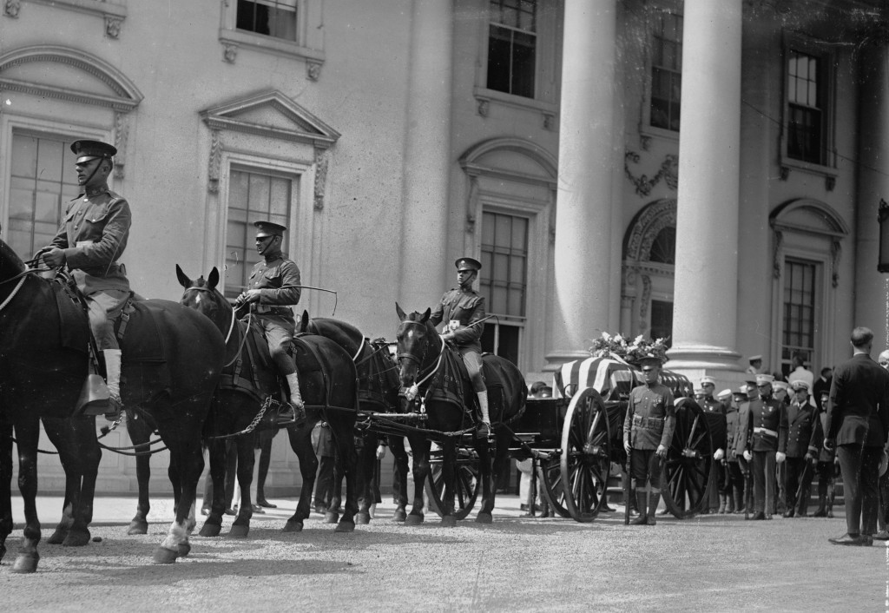

Slide 16
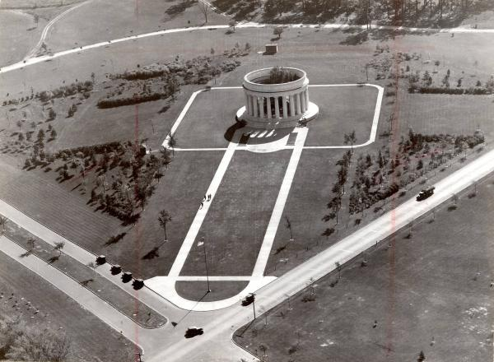

Slide 17
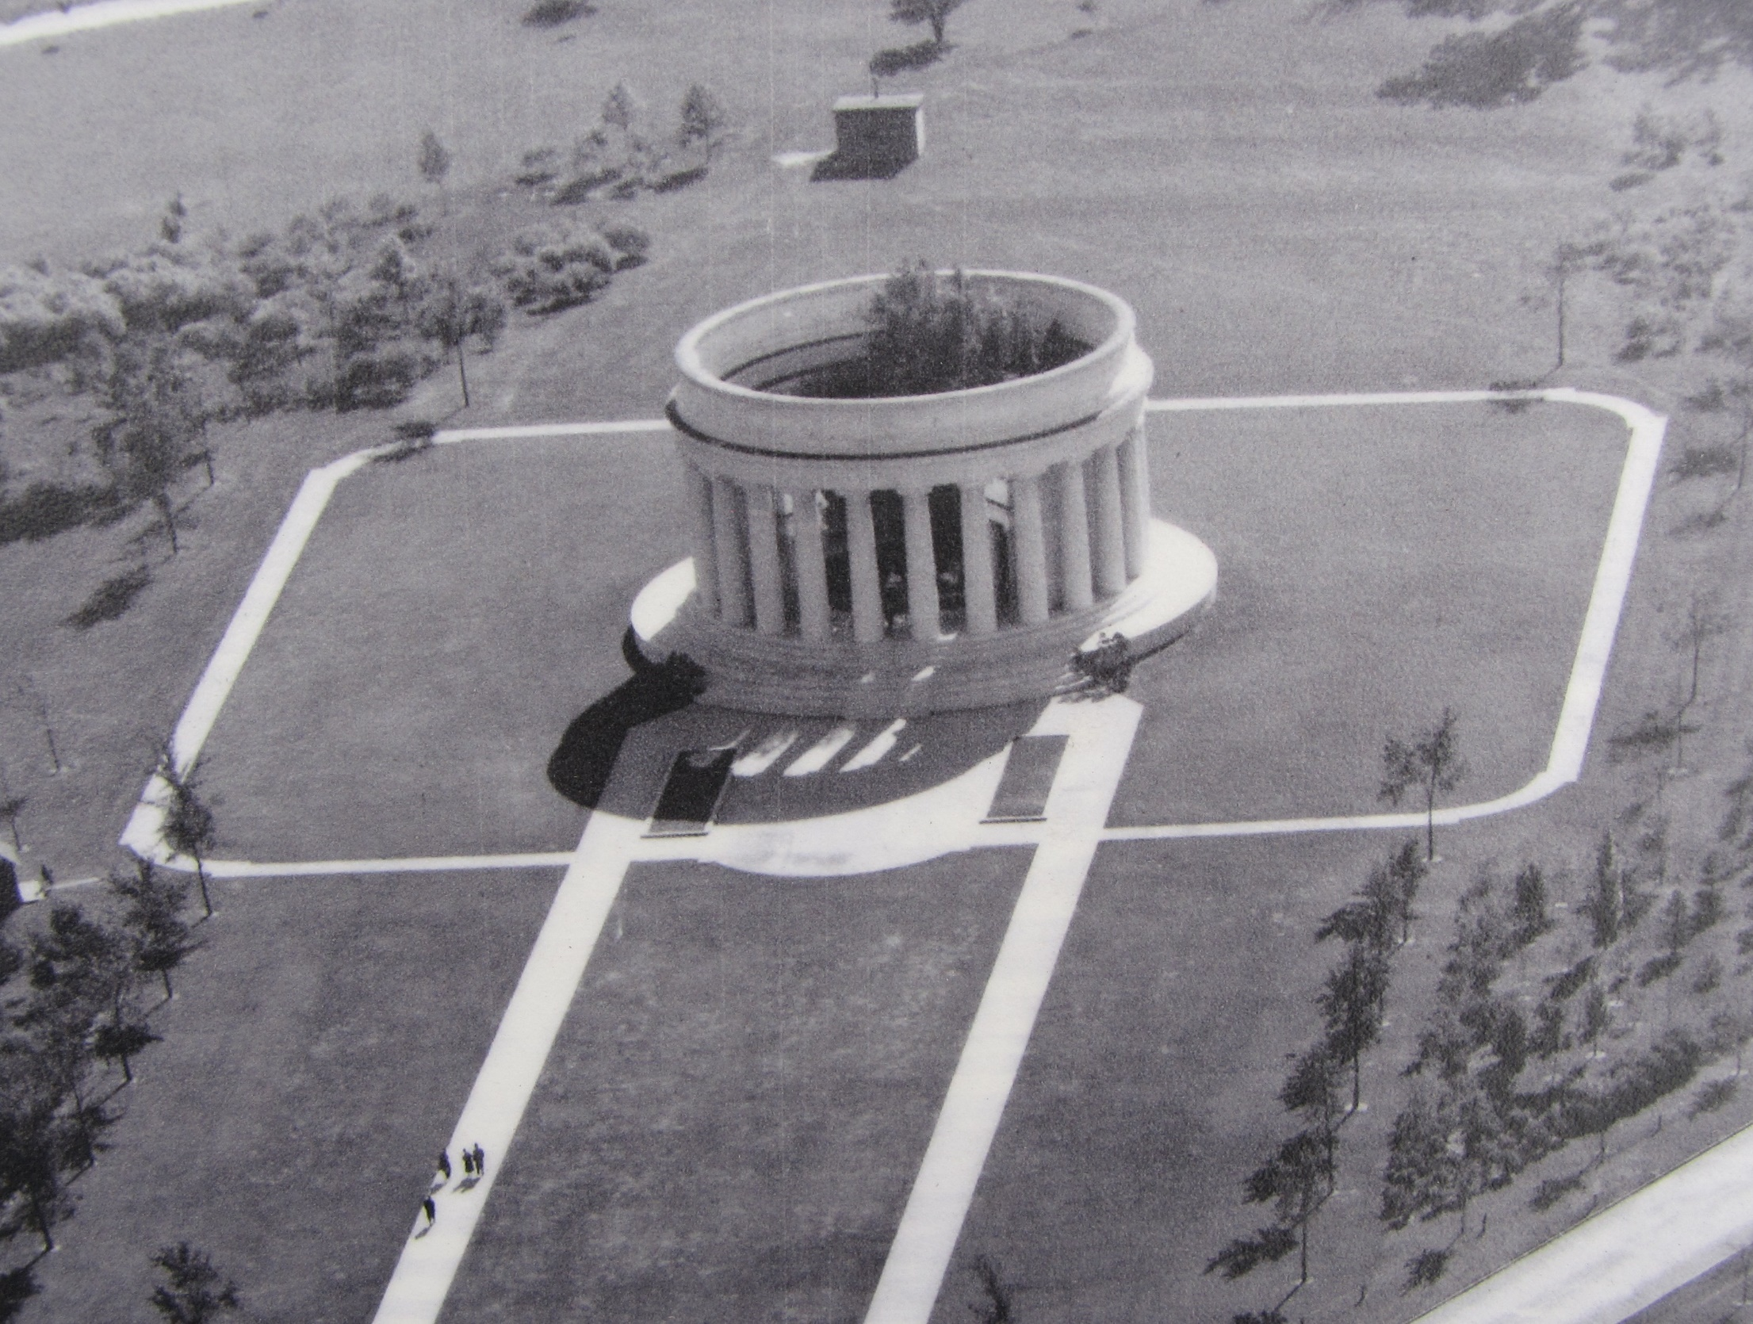

Slide 18
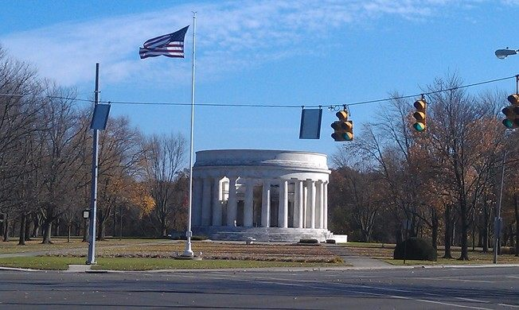

Slide 19
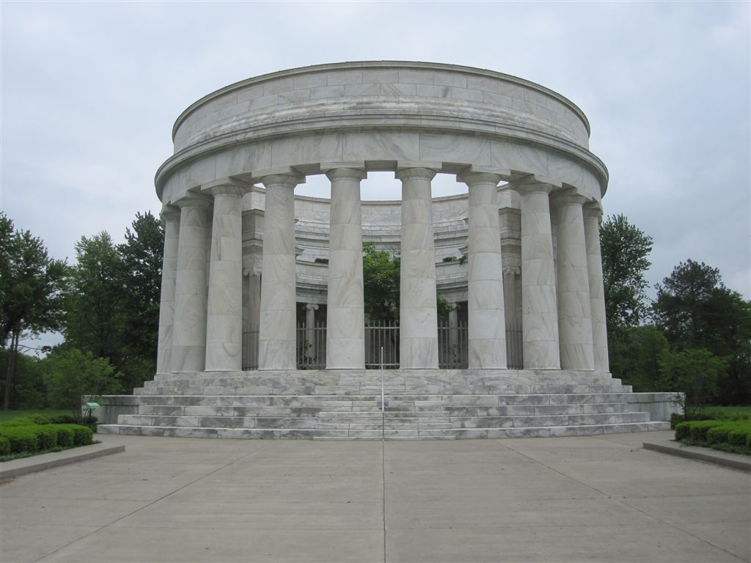
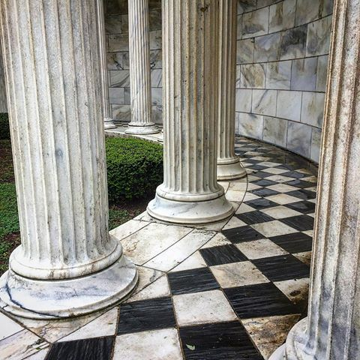
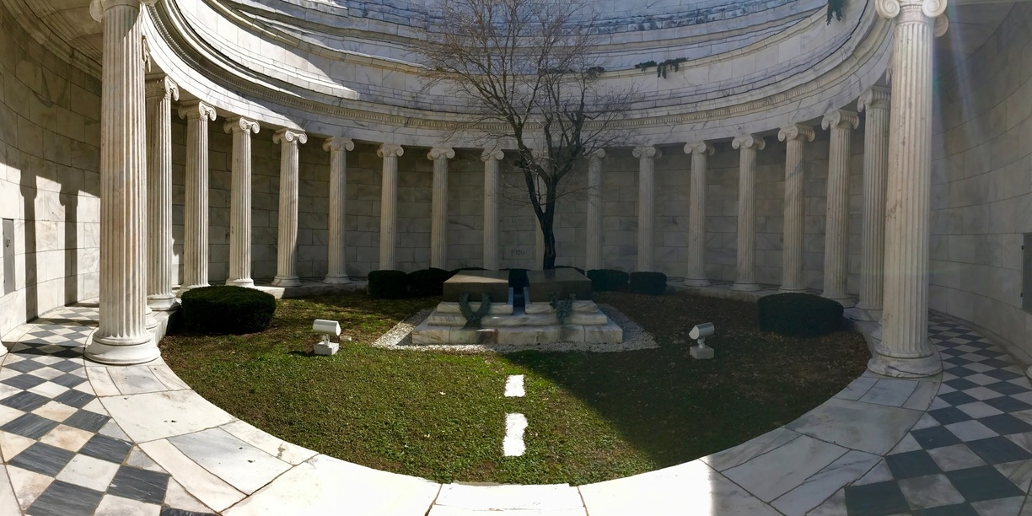

Slide 20
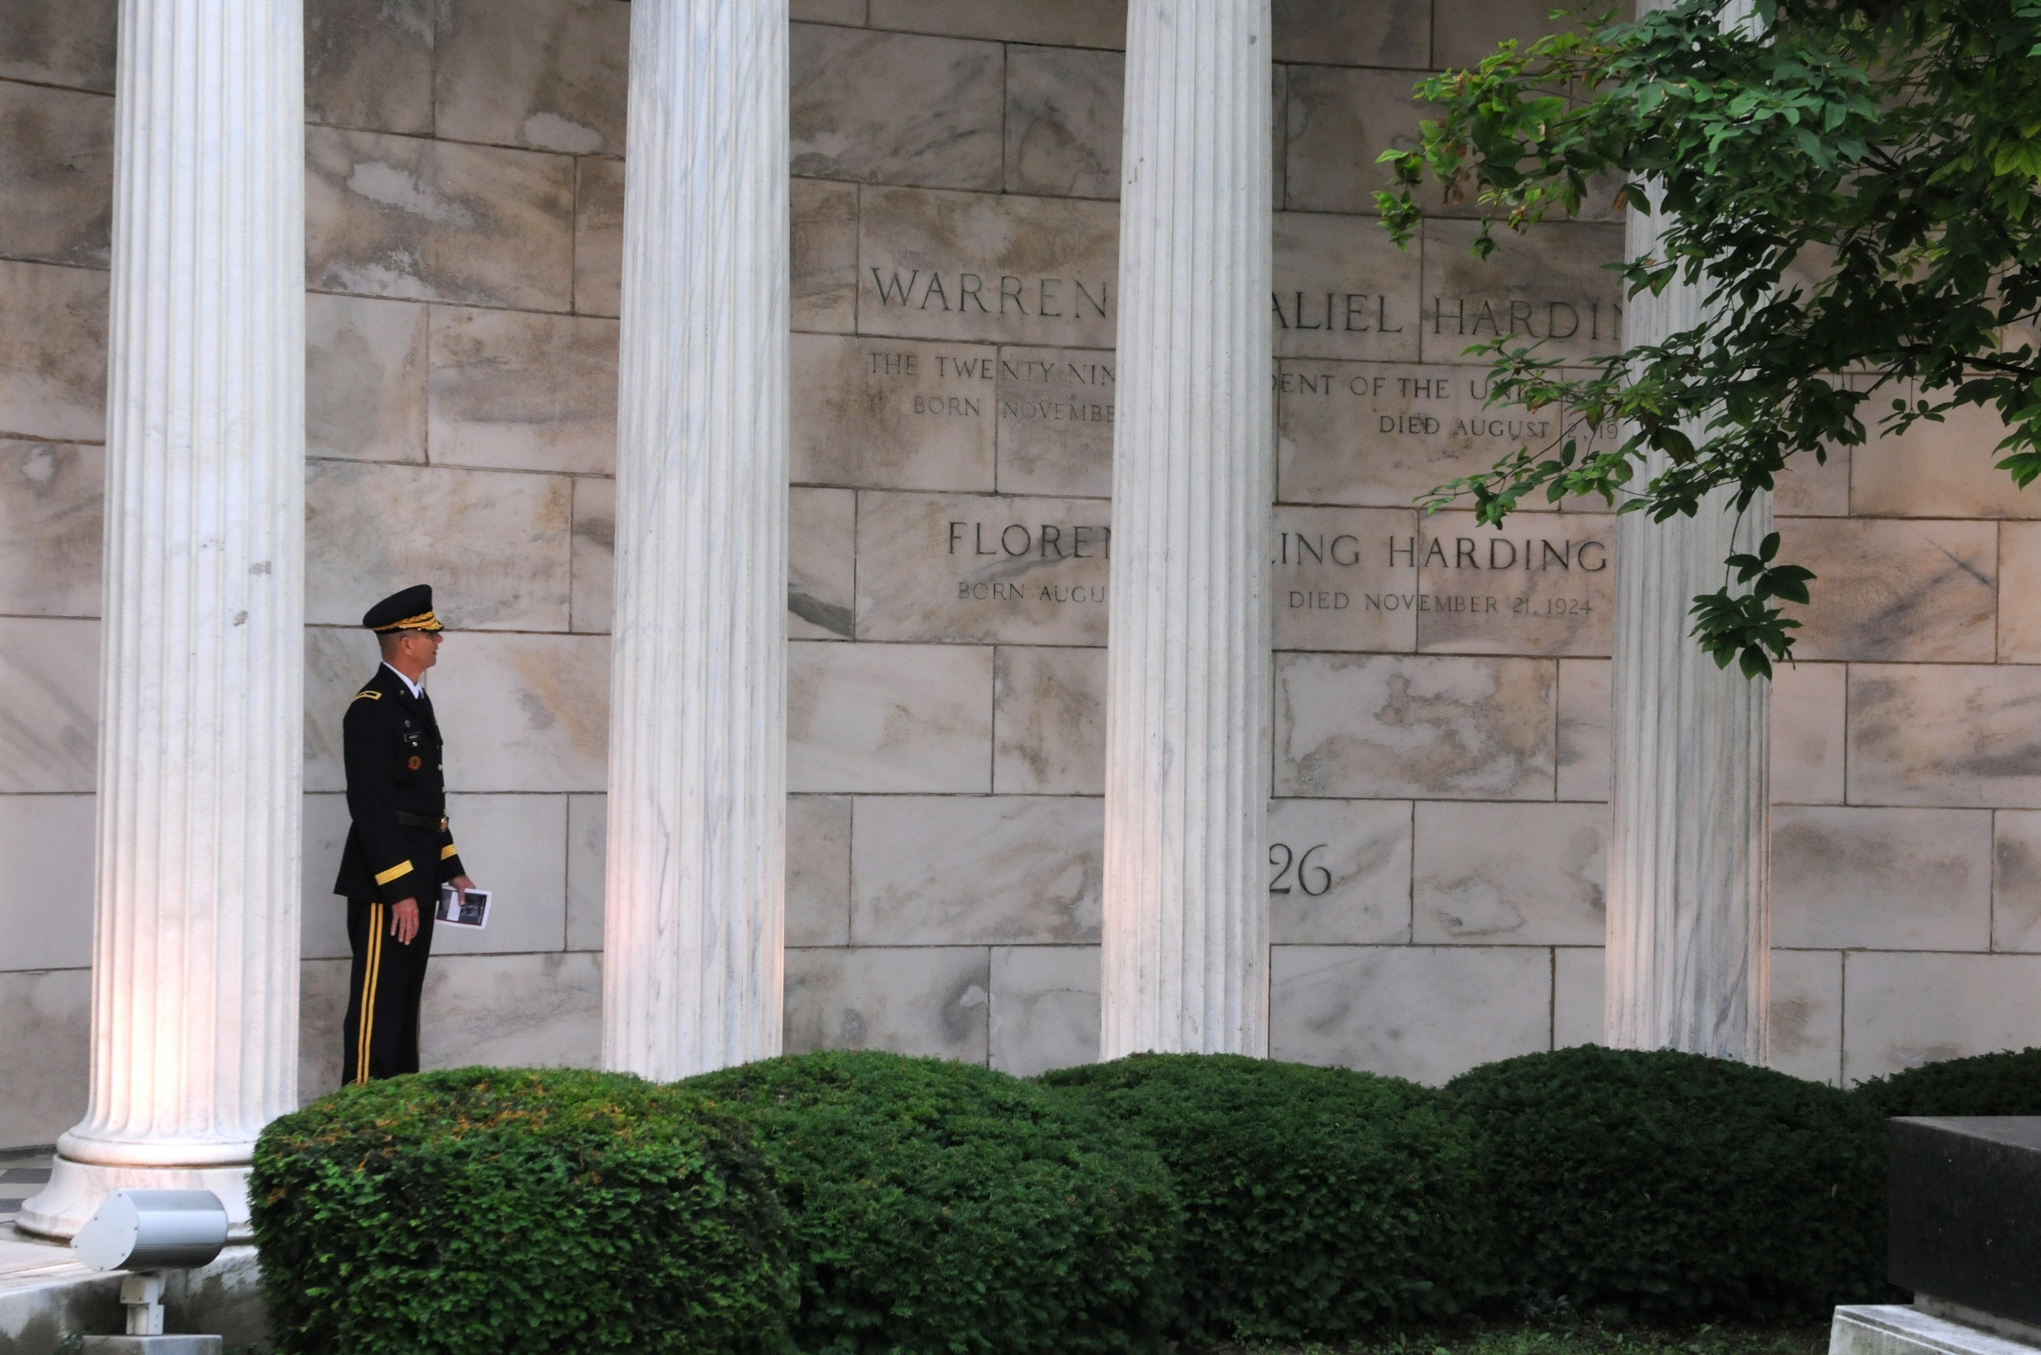
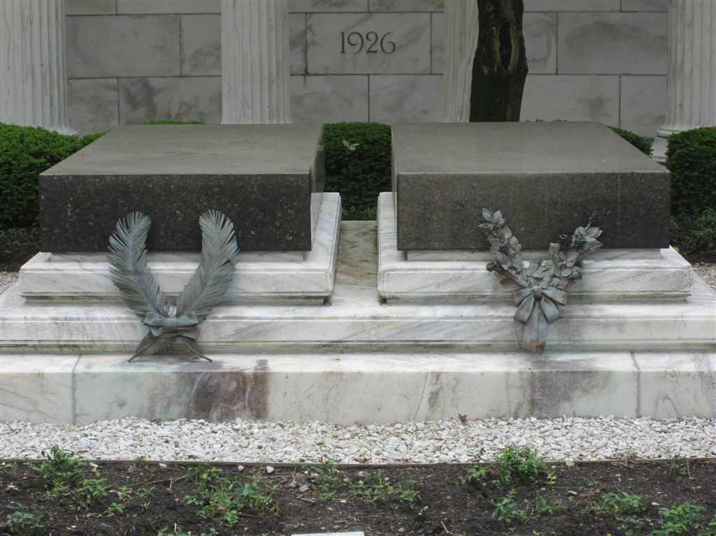

Slide 21
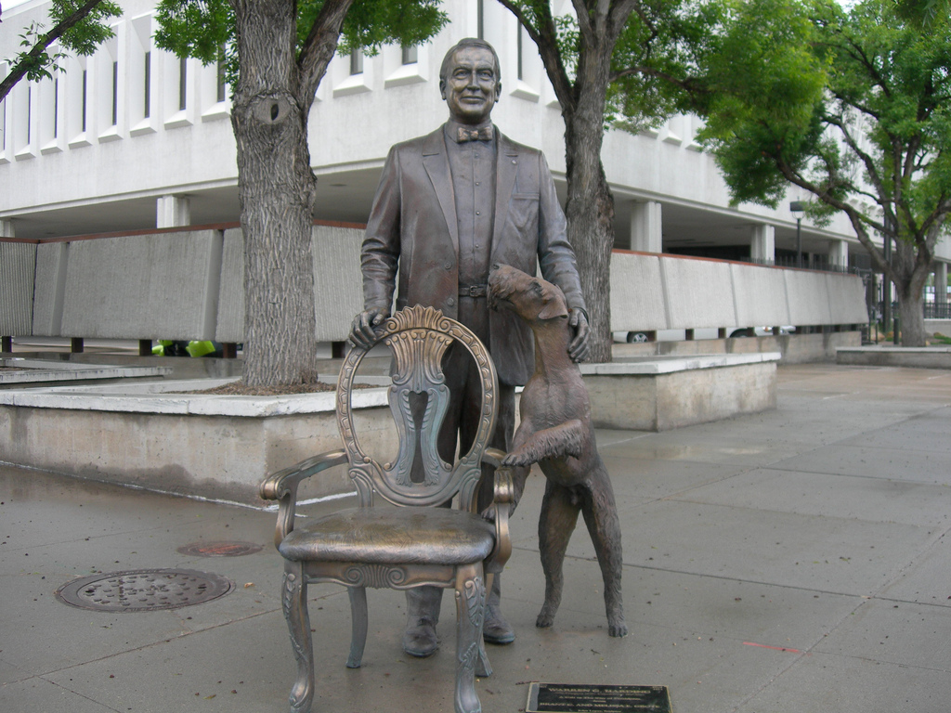
Notes:
Rapid City

Slide 22
30. Calvin Coolidge (1923-1929)
Part 1

Slide 23
“The strength of a country is the strength of its religious convictions.”

Slide 24
“The government of a country never gets ahead of the religion of a country. There is no way by which we can substitute the authority of the law for the virtues of men.”
government of a country
religion of a country
virtues of men
government of a country
authority of the law
ethical morals
virtues
religion of a country
authority of the law
sound civilization
virtues of men

Slide 25
But the fruit of the Spirit is love, joy, peace, longsuffering, kindness, goodness, faithfulness, gentleness, self-control. Against such there is no law. — Galatians 5:22-23

Slide 26
“The strength of our country is the strength of its religious convictions. The foundations of our society and our government rest so much on the teachings of the Bible that it would be difficult to support them if faith in these teachings would cease to be practically universal in our country.”
foundations
rest
on the teachings of the Bible

Slide 27
“Under our institutions the only way to perfect the Government is to perfect the individual citizen. It is necessary to reach the mind and soul of the individual. I know of no way that this can be done save through the influence of religion and education. By religion I do not mean fanaticism or bigotry; by education I do not mean the cant of the schools, but a broad and tolerant faith, loving thy neighbor as thyself, and a training and experience that enables the human mind to see into the heart of things.”
dullness
faith, loving
thy neighbor as thyself

Slide 28
For the commandments, "You shall not commit adultery," "You shall not murder," "You shall not steal," "You shall not bear false witness," "You shall not covet," and if there is any other commandment, are all summed up in this saying, namely, "You shall love your neighbor as yourself." Love does no harm to a neighbor; therefore love is the fulfillment of the law. — Romans 13:9-10
You shall not:
• commit adultery
• murder
• steal
• bear false witness
• covet
You shall love your neighbor as yourself
Love does no harm to a neighbor
love is the fulfillment of the law
Control
You shall
not
commit adultery
lust
anger
murder
steal
bear false witness
thieving
covet
lying
possessiveness
You shall love your
neighbor as yourself
Love does no
harm to a neighbor
love is the
fulfillment of the law
fulfillment of the law
Notes:
Fulfilling God's Law is Clear

Slide 29
“It is hard to see how a great man can be an atheist. Without the sustaining influence of faith in a divine power we could have little faith in ourselves. We need to feel that behind us is intelligence and love. Doubters do not achieve; skeptics do not contribute; cynics do not create. Faith is the great motive power, and no man realizes his full possibilities unless he has the deep conviction that life is eternally important, and that his work, well done, is a part of an unending plan.”
Faith is the great motive power

Slide 30
“It is only when men begin to worship that they begin to grow.”

Slide 31
"But the hour is coming, and now is, when the true worshipers will worship the Father in spirit and truth; for the Father is seeking such to worship Him. — John 4:23

Slide 32
“It has not been my fortune to know very much of Freemasonry, but I have had the great fortune to know many Freemasons and have been able in that way to judge the tree by its fruit. I know of your high ideals. I have seen that you hold your meetings in the presence of the open Bible, and I know that men who observe that formality have high sentiments of citizenship, of worth, and character. That is the strength of our Commonwealth and nation.”
hold
open Bible

Slide 33
"Therefore by their fruits you will know them. Not everyone who says to Me, 'Lord, Lord,' shall enter the kingdom of heaven, but he who does the will of My Father in heaven." — Matthew 7:20-21

Slide 34
“They [the Founding Fathers] were intent upon establishing a Christian commonwealth in accordance with the principle of self-government. They were an inspired body of men. It has been said that God sifted the nations that He might send choice grain into the wilderness ... Who can fail to see it in the hand of Destiny? Who can doubt that it has been guided by a Divine Providence?”
self-government
Lawful citizens

Slide 35
“Our government rests upon religion. It is from that source that we derive our reverence for truth and justice, for equality and liberty, and for the rights of mankind. Unless the people believe in these principles they cannot believe in our government.”
government rests upon
religion
reverence for truth
government rests upon religion
reverence for truth
• justice
• equality
• liberty
• rights of mankind
justice
equality
liberty
rights of
mankind
Notes:
Religious values inspire men of good character

Slide 36
“Our doctrine of equality and liberty and humanity comes from our belief in the brotherhood of man, through the fatherhood of God.”

Slide 37
If someone says, "I love God," and hates his brother, he is a liar; for he who does not love his brother whom he has seen, how can he love God whom he has not seen? And this commandment we have from Him: that he who loves God must love his brother also. — 1st John 4:20-21

Slide 38
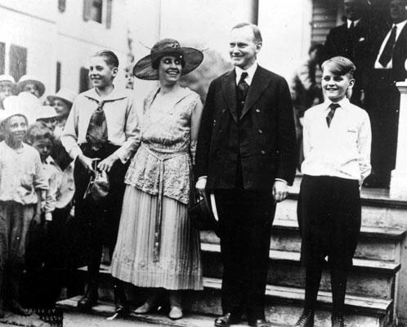

Slide 39
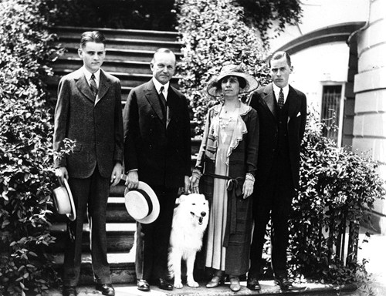

Slide 40
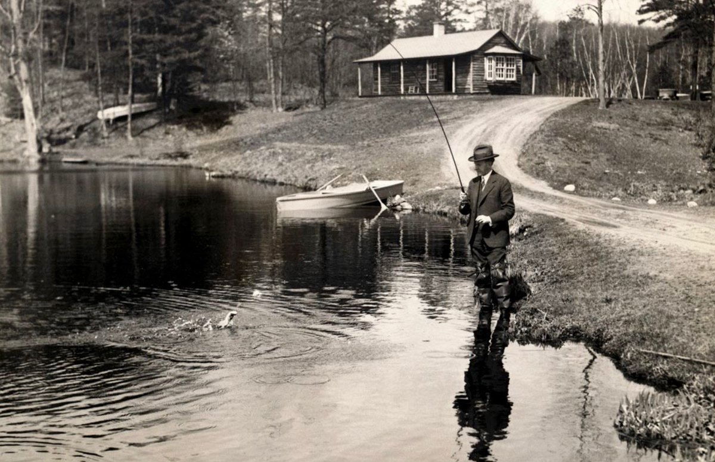

Slide 41
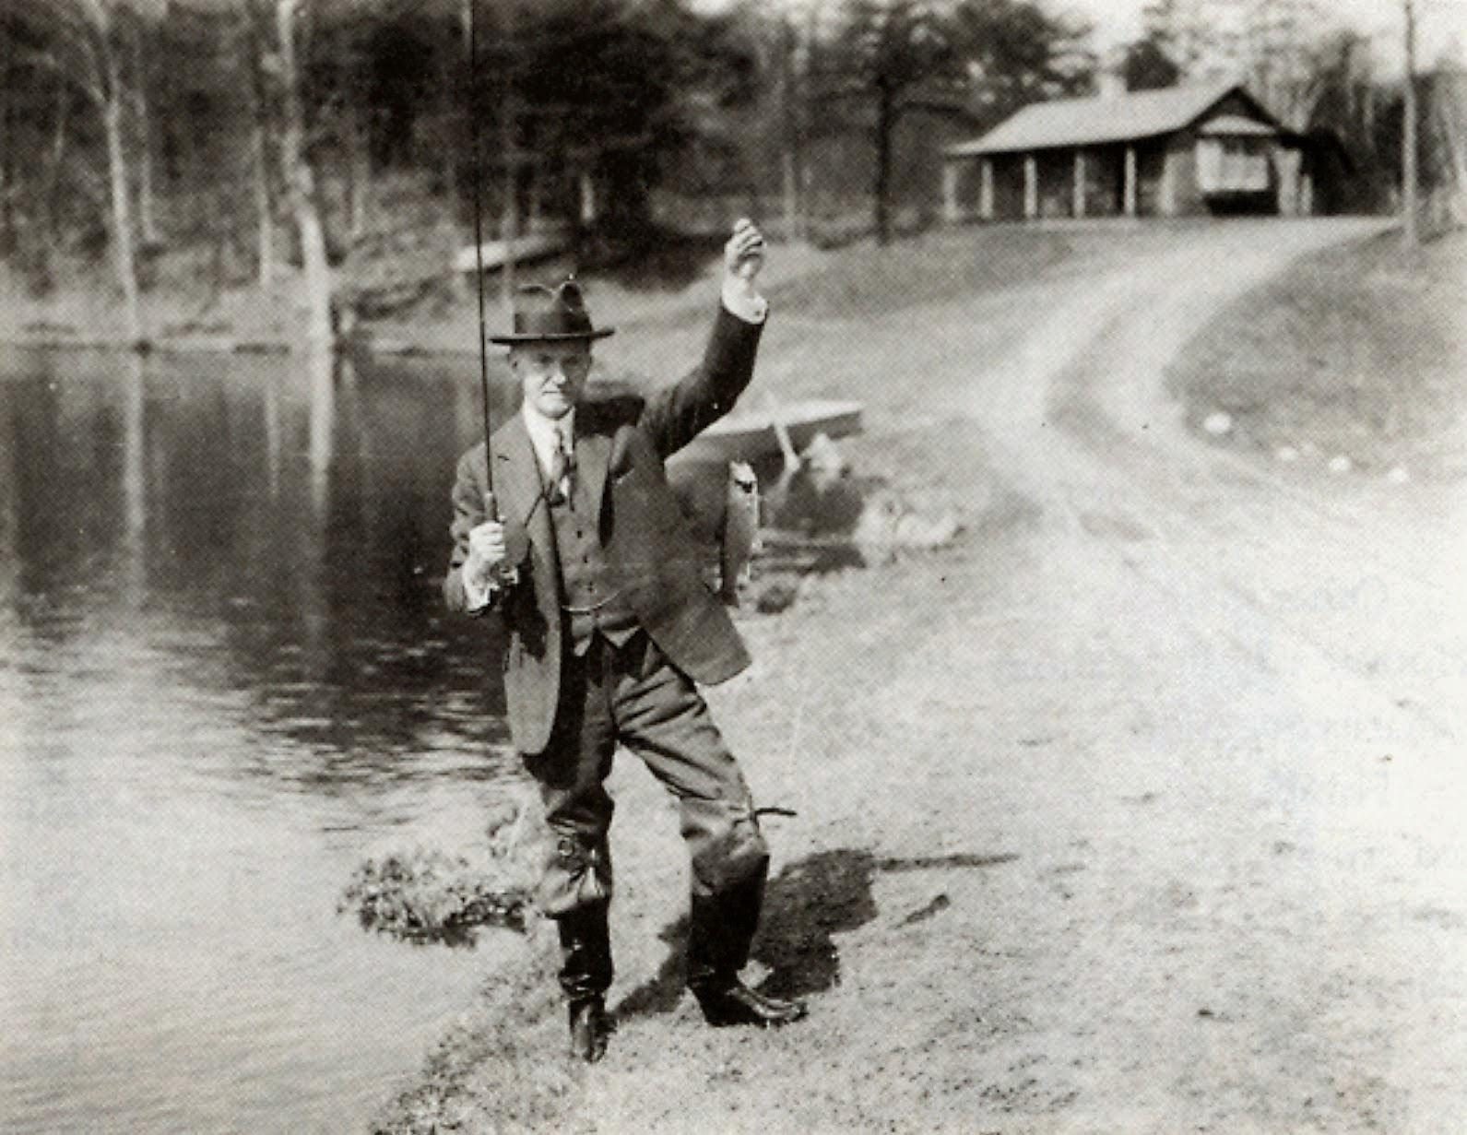
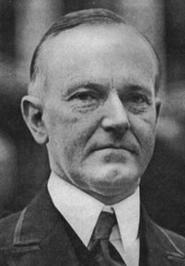
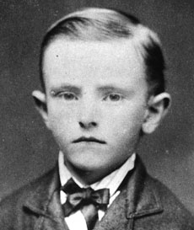

Slide 42
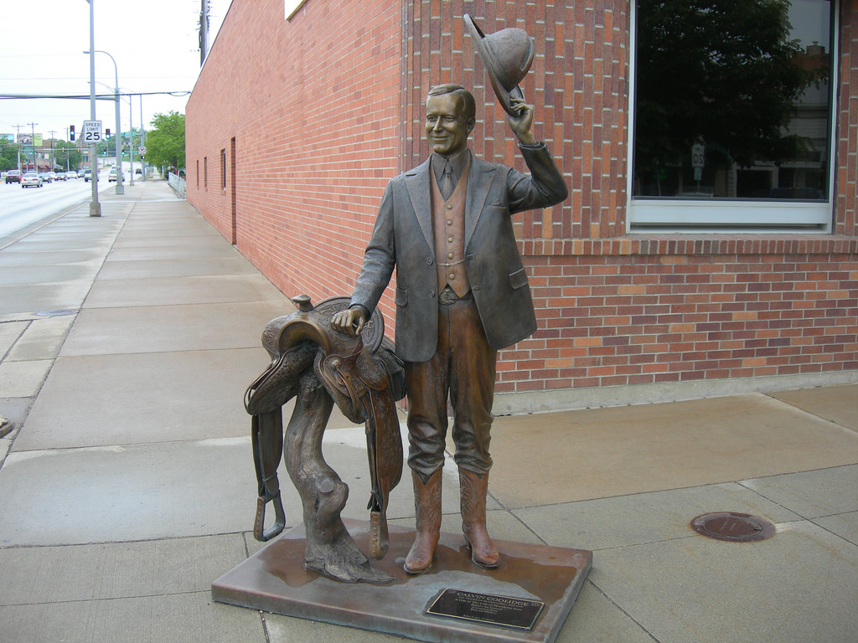

Slide 43
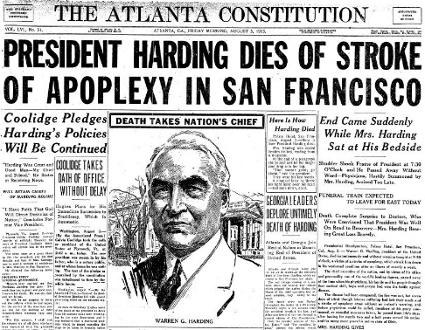
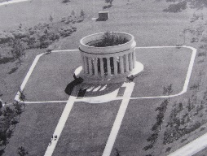
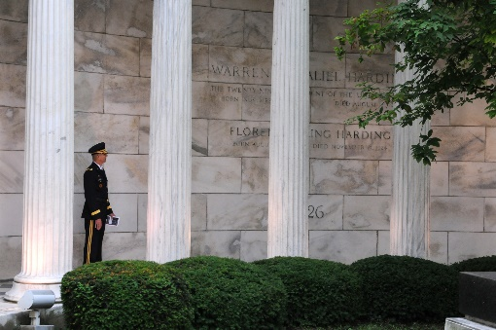
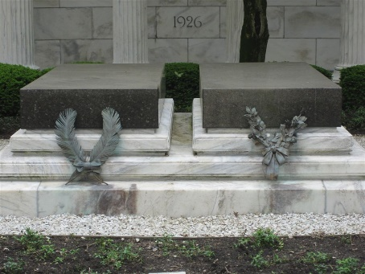
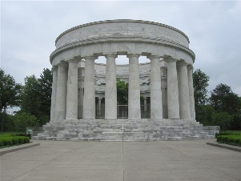
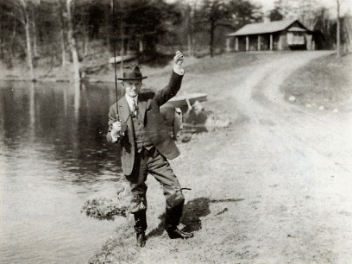

Slide 45
Presidential Quotes
Ron Bert
22½
June 30, 2019

Slide 46
30. Calvin Coolidge (1923-1929)
Part 2

Slide 47
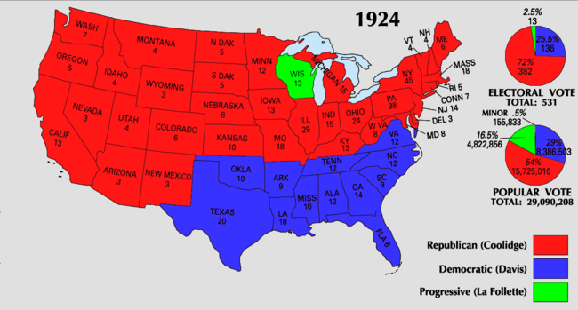

Slide 48
“The danger to America is not in the direction of the failure to maintain its economic position, but in the direction of the failure to maintain its ideals.”
. .
. .

Slide 49
“The American Revolution represented the informed and mature convictions of a great mass of independent, liberty-loving, God-fearing people who knew their rights, and possessed the courage to dare to maintain them.”
courage to
maintain them

Slide 50
“If American democracy is to remain the greatest hope of humanity, it must continue abundantly in the faith of the Bible.”
If
“If American democracy is to remain the greatest hope of humanity, it must continue abundantly in the faith of the Bible.”
“If American democracy is to remain the greatest hope of humanity, it must continue abundantly in the faith of the Bible.”
in
in the faith
Bible

Slide 51
So then faith comes by hearing, and hearing by the word of God. — Romans 10:17

Slide 52
“A wholesome regard for the memory of the great men of long ago is the best assurance to a people of a continuation of great men to come, who shall be able to instruct, to lead, and to inspire. A people who worship at the shrine of true greatness will themselves be truly great.”
memory of
great men of
long ago
to instruct, to lead, and to inspire

Slide 53
For whatever things were written before were written for our learning, that we through the patience and comfort of the Scriptures might have hope. — Romans 15:4

Slide 54
“The Jews themselves, of whom a considerable number were already scattered throughout the colonies, were true to the teachings of their prophets. The Jewish faith is predominantly the faith of liberty.”
faith of liberty

Slide 55
“It is not in violence and crime that our greatest danger lies. These evils are so perfectly apparent that they very quickly arouse the moral power of the people for their suppression. A far more serious danger lurks in the shirking of those responsibilities of citizenship, where the evil may not be so noticeable but is more insidious and likely to be more devastating.”
shirking
citizenship
evil
more insidious
more devastating
Notes:
There is plenty of people today that say this is not my country.

Slide 56
When the righteous are in authority, the people rejoice; But when a wicked man rules, the people groan. — Proverbs 29:2

Slide 57
“Unless the people, through unified action, arise and take charge of their government, they will find that their government has taken charge of them. Independence and liberty will be gone, and the general public will find itself in a condition of servitude to an aggregation of organized and selfish interest.”
socialism
fascism

Slide 58
“Restricted immigration is not an offensive but purely a defensive action. It is not adopted in criticism of others in the slightest degree, but solely for the purpose of protecting ourselves. We cast no aspersions on any race or creed, but we must remember that every object of our institutions of society and government will fail unless America be kept American.”

Slide 59
“Life is one darn thing after another.”

Slide 60
No temptation has overtaken you except such as is common to man; but God is faithful, who will not allow you to be tempted beyond what you are able, but with the temptation will also make the way of escape, that you may be able to bear it. — 1st Corinthians 10:13

Slide 61
“In life there is nothing more common than talent and intelligence. What is missing is passion, persistence, commitment, and dedication.”

Slide 62
“Liberty is not collective, it is personal. All liberty is individual liberty.”
“Duty is not collective; it is personal.”

Slide 63
“We do not need more intellectual power, we need more spiritual power. We do not need more of the things that are seen, we need more of the things that are unseen.”
spiritual power

Slide 64
For our light affliction, which is but for a moment, is working for us a far more exceeding and eternal weight of glory, while we do not look at the things which are seen, but at the things which are not seen. For the things which are seen are temporary, but the things which are not seen are eternal. — 2nd Corinthians 4:17-18

Slide 65
“Little progress can be made by merely attempting to repress what is evil. Our great hope lies in developing what is good.”

Slide 66
“There is no surer road to destruction than prosperity without character.”

Slide 67
The integrity of the upright will guide them, But the perversity of the unfaithful will destroy them. — Proverbs 11:3

Slide 68
“Money will not purchase character or good government.”

Slide 69
“In a republic the first rule for the guidance of the citizen is obedience of the law.”

Slide 70
“The words of the President have an enormous weight and ought not to be used indiscriminately.”

Slide 71
“Christmas is not a time nor a season, but a state of mind. To cherish peace and goodwill, to be plenteous in mercy, is to have the real spirit of Christmas. If we think on these things, there will be born in us a Savior and over us will shine a star sending its gleam of hope to the world.”

Slide 72
Lift up your eyes on high, And see who has created these things, Who brings out their host by number; He calls them all by name, By the greatness of His might And the strength of His power; Not one is missing. — Isaiah 40:26

Slide 73
“Whether one traces his Americanism back three centuries to the Mayflower, or three years to the steerage, is not half so important as whether his Americanism of today is real and genuine. No matter by what various crafts we came here, we are all now in the same boat.”
“I do not choose to run for president in 1928.”
we are all now in the same boat
Notes:
Did not like the arrogance that had overcome him and consuming pride. Did not want to be worshipped.

Slide 74
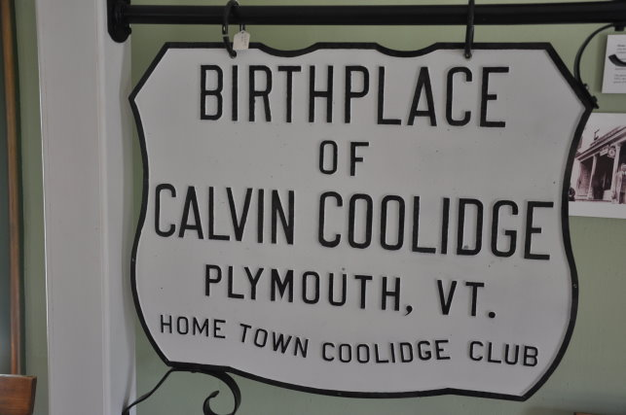

Slide 75
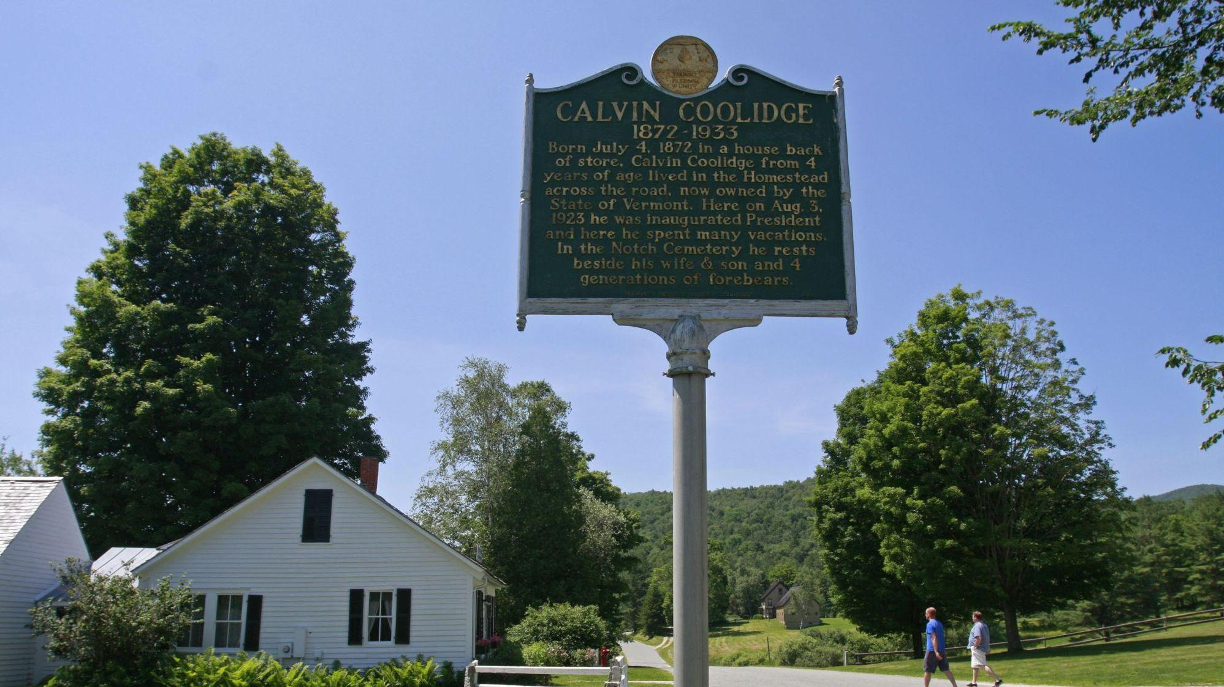

Slide 76
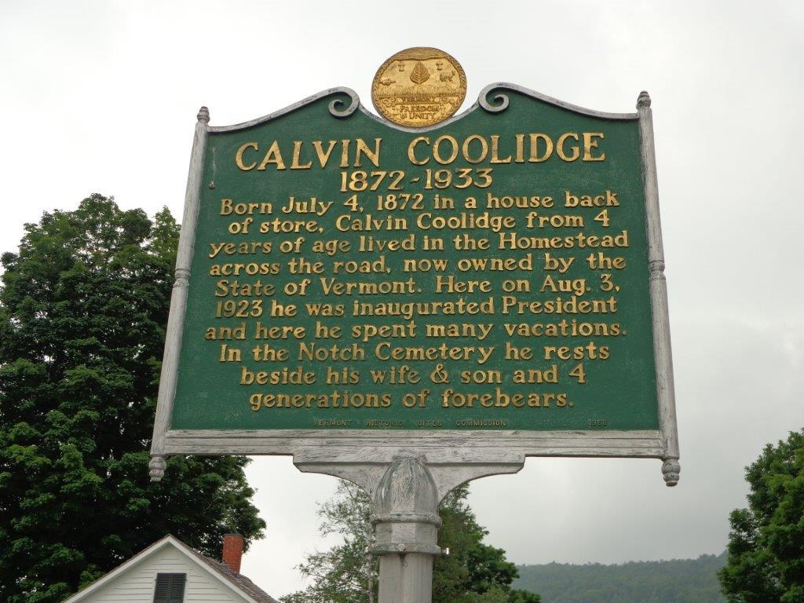

Slide 77
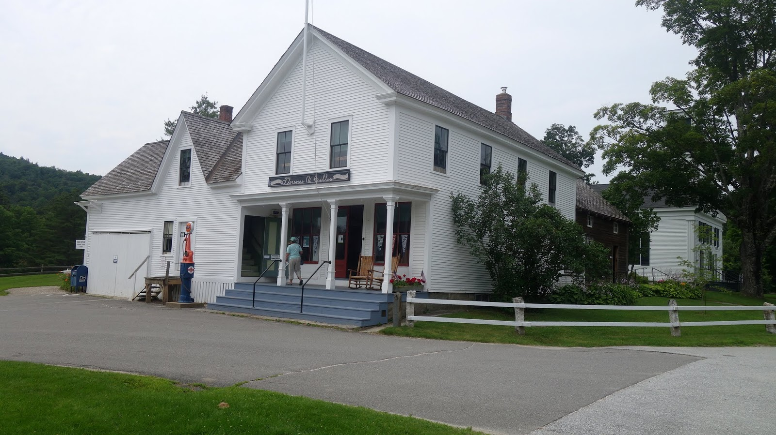

Slide 78
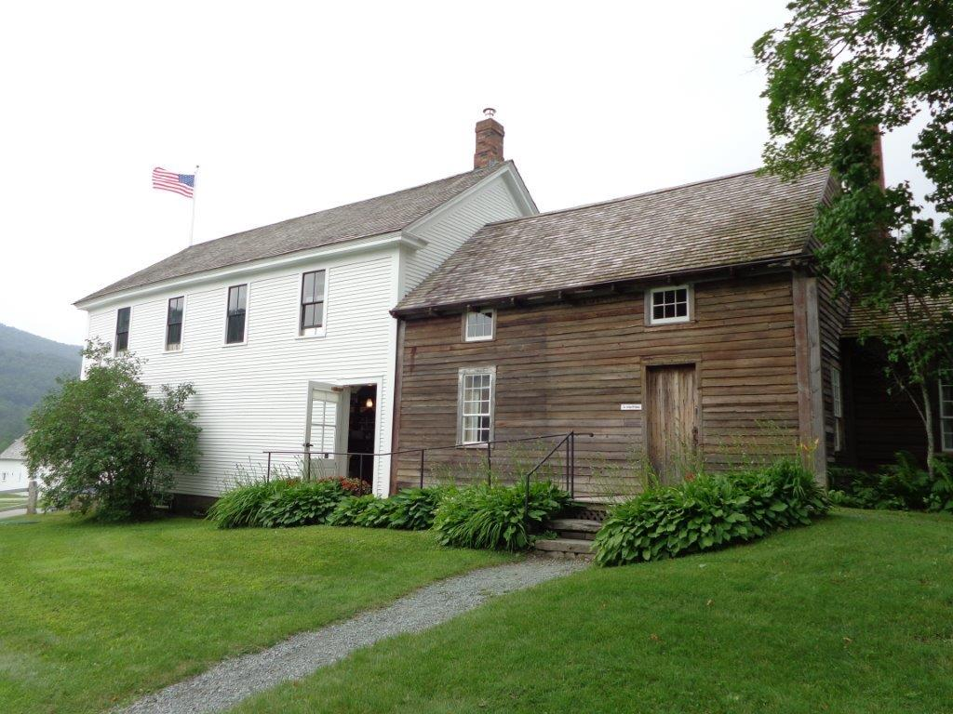

Slide 79
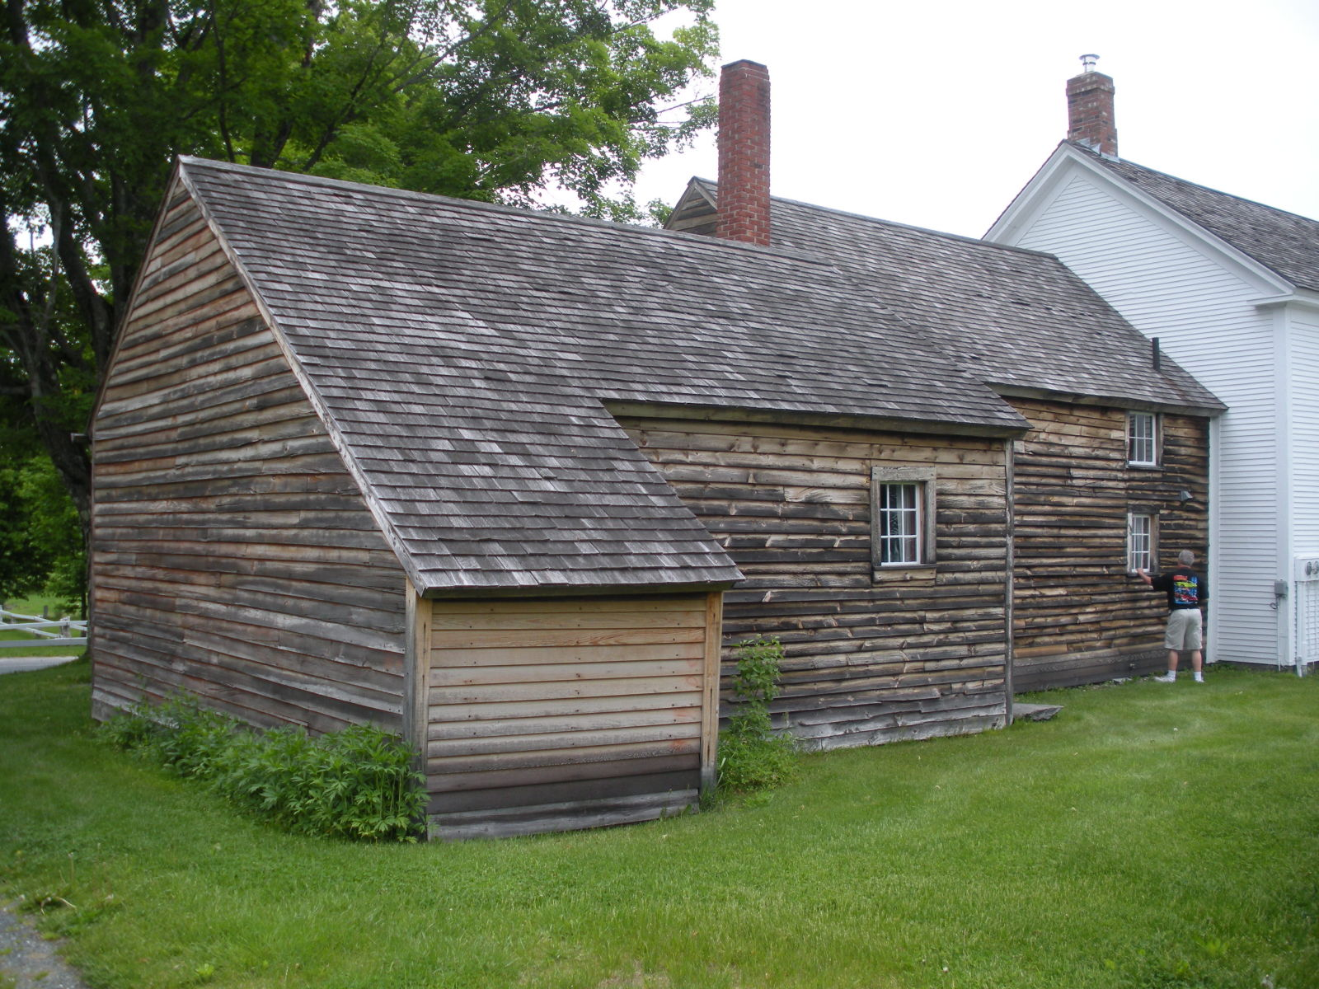

Slide 80
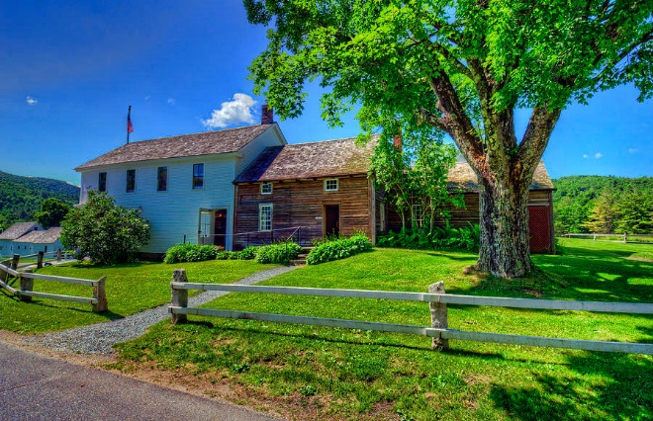

Slide 81
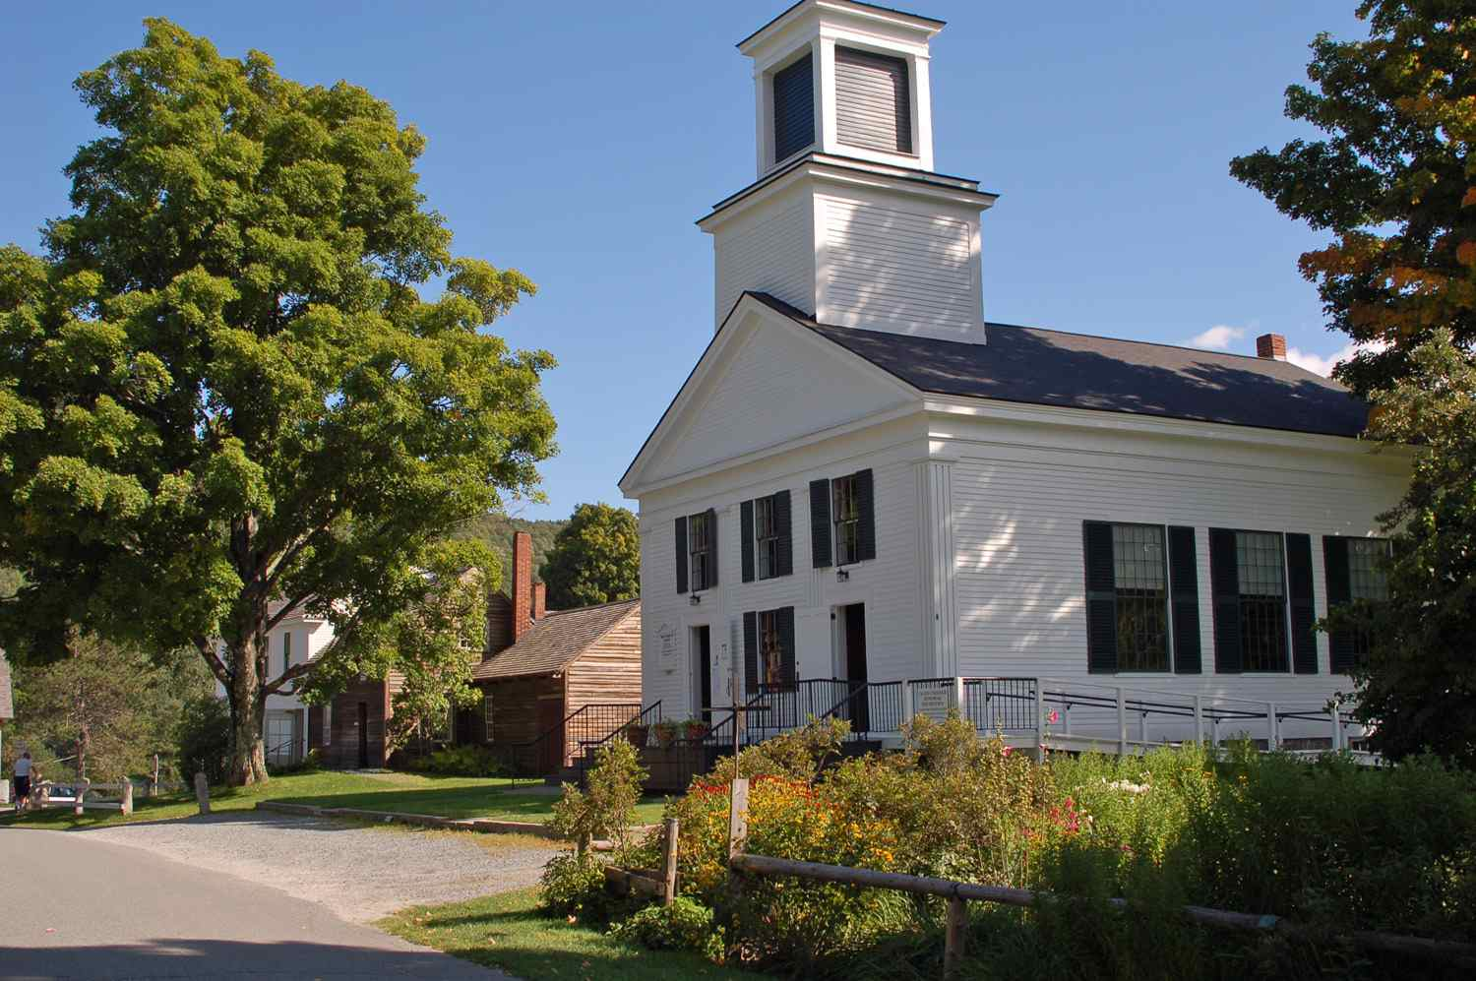

Slide 82
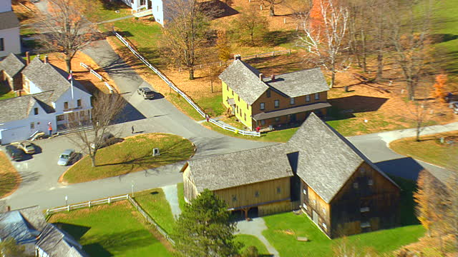

Slide 83
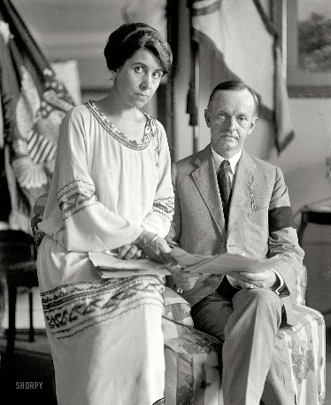
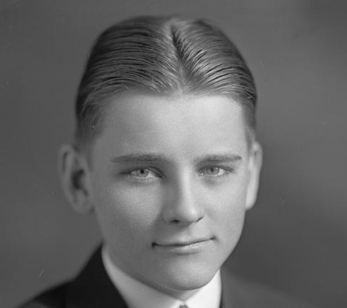
A time to be born, And a time to die; A time to plant, And a time to pluck what is planted; — Ecclesiastes 3:2
Notes:
In July, 1924 Cal was playing tennis. He wore his tennis shoes without socks, and rubbed up a blister. A common enough occurrence. Not worth bothering about. Certainly not worth complaining about.
But this blister was a blood blister, and it became infected. Penicillin and other antibiotics were still a few years in the future. The poison of the infection entered Cal’s bloodstream, and the boy declined rapidly. He was in pain, and delirious with fever that did not respond to the treatment of the day.
President Coolidge. He could do many things, but he could not save his son’s life.
Doctors had been summoned immediately, but every effort they made failed. They could do nothing. The President and First Lady sat with their sick son, but they could do nothing. Cal Junior begged his father to “help him,” after all, he was the President. But the President was helpless. He could do nothing. Within the week (10 days), Cal died.

Slide 84
Notes:
Moved to this house in 1930

Slide 85
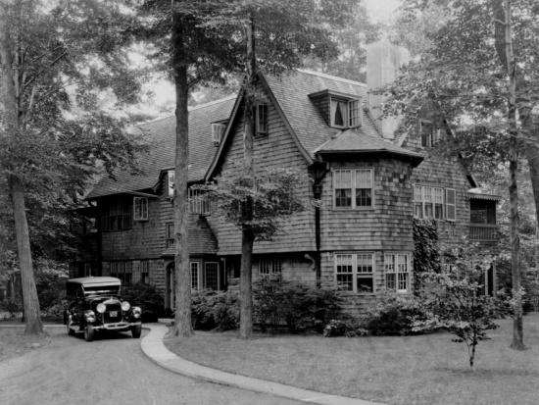

Slide 86
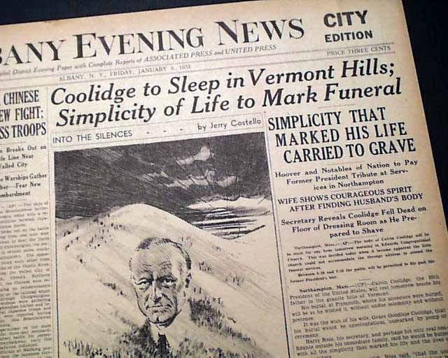

Slide 87
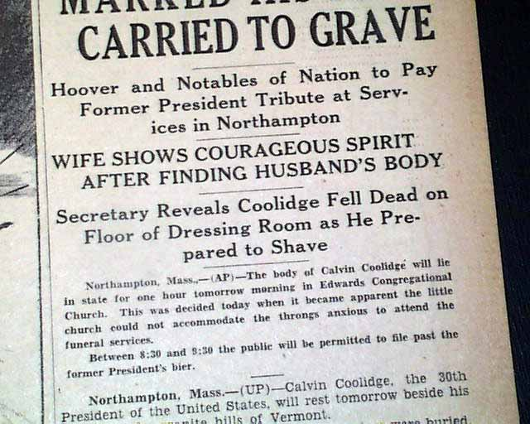

Slide 88
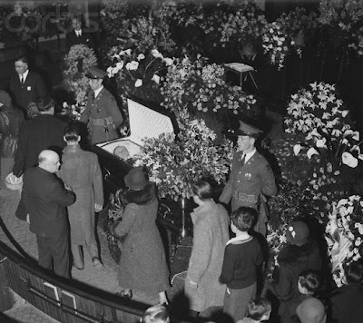
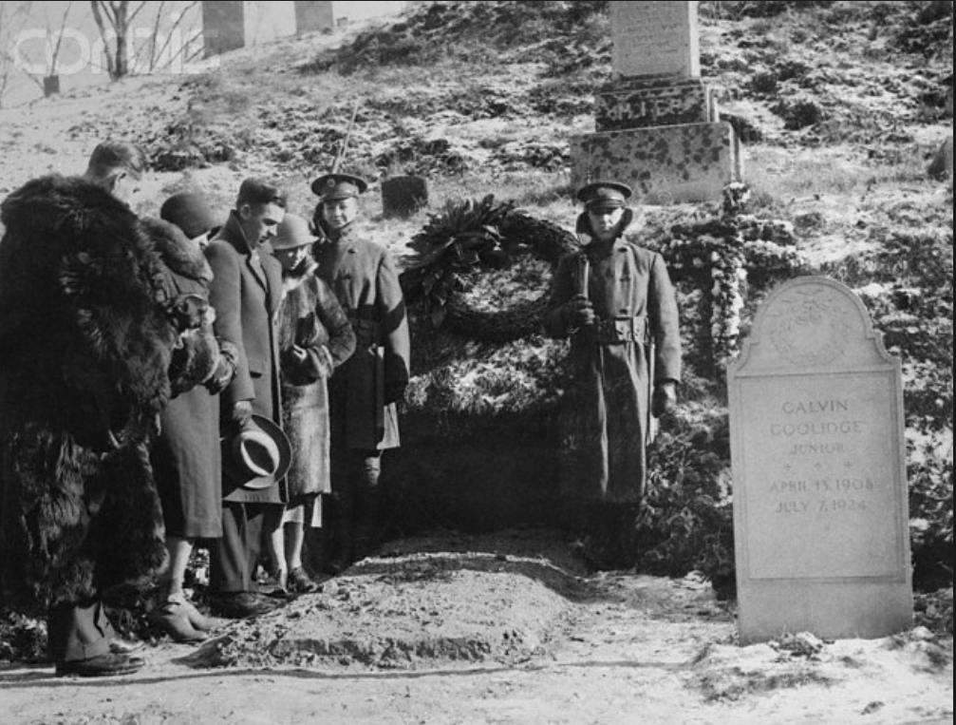

Slide 89
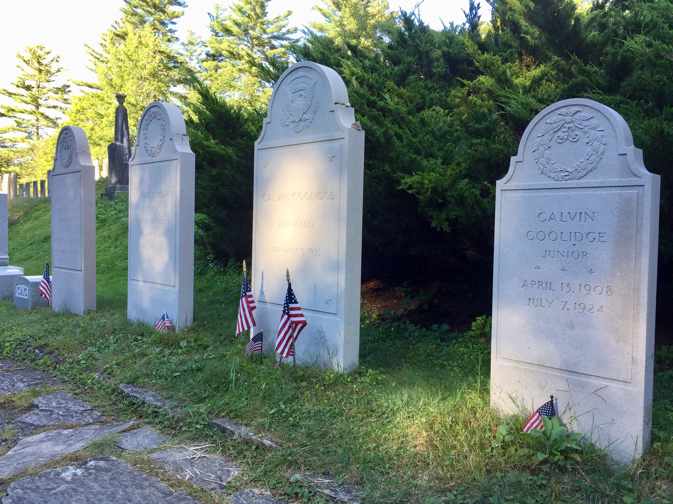

Slide 90
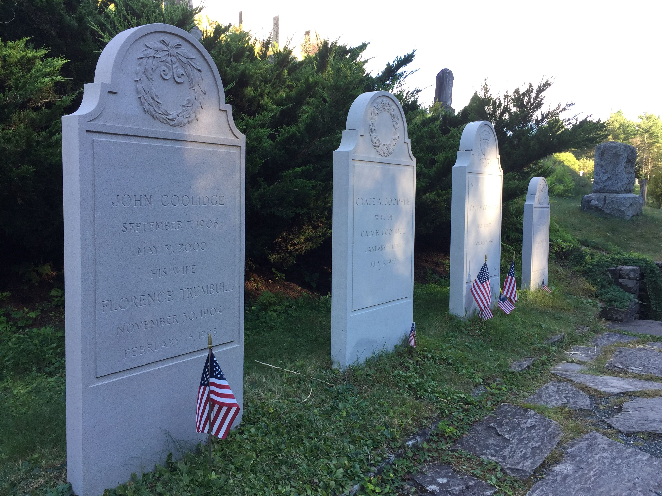
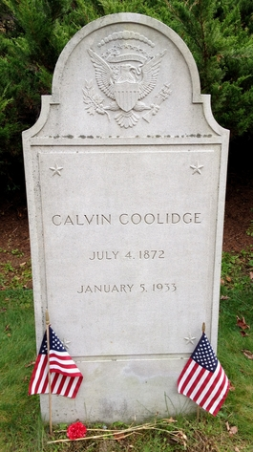

Slide 93
→ Religious intolerance is contrary to the constitution
→ Without holy values our nation has no foundation
→ Without true worship the spirit remains stagnant
→ The power of Christianity founded this country
→ Rulers must cleave to the values of truth and justice
→ Failure to maintain religious ideals with defeat us
→ Remembering the wise gone by ensures social gifts
→ Evil leadership creates a decadent society
→ Regimes dominate where citizens become apathetic
→ Liberty is a personal individual responsibility
→ Spiritual power overshadows mere intellectualism
→ Prosperity without character leads to destruction
→ Unity is combined in being all in the same place
Truth brings to presence God’s own divine nature
Notes:
Truth brings to presence God’s own divine nature

Slide 95
Please visit http://www.LoveFromGod.com to explore further
Ronald Bert Channel on
Notes:
Eternity never ends.

