Slide 2
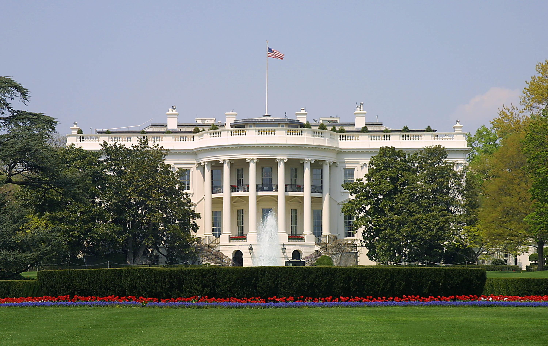
Presidential Quotes
Ron Bert
21
April 28, 2019

Slide 3
28. Woodrow Wilson (1913-1921)
Part 2

Slide 4
“Understanding is the soil in which grow all the fruits of friendship.”

Slide 5
“Friendship is the only cement that will ever hold the world together.”

Slide 6
“Fear God and you need not fear anyone else.”

Slide 7
In God I have put my trust; I will not be afraid. What can man do to me? — Psalms 56:11

Slide 8
“It does not become America that within her borders, where every man is free to follow the dictates of his conscience, men should raise the cry of church against church. To do that is to strike at the very spirit and heart of America.”
free to follow
conscience
Man
Man
church against church

Slide 9
Now I urge you, brethren, note those who cause divisions and offenses, contrary to the doctrine which you learned, and avoid them. For those who are such do not serve our Lord Jesus Christ, but their own belly, and by smooth words and flattering speech deceive the hearts of the simple. — Romans 16:17-18

Slide 10
“War isn’t declared in the name of God; it is a human affair entirely.”

Slide 11
“It is a fearful thing to lead this great peaceful people into war, into the most terrible and disastrous of all wars, civilization itself seeming to be in the balance. But the right is more precious than peace, and we shall fight for the things we have always carried closest to our hearts.”

Slide 12
“Is there any man here or any woman, let me say is there any child here, who does not know that the seed of war in the modern world is industrial and commercial rivalry?”

Slide 13
But those who desire to be rich fall into temptation and a snare, and into many foolish and harmful lusts which drown men in destruction and perdition. For the love of money is a root of all kinds of evil, for which some have strayed from the faith in their greediness, and pierced themselves through with many sorrows. — 1st Timothy 6:9-10

Slide 14
“We live in an age disturbed, confused, bewildered, afraid of its own forces, in search not merely of its road but even of its direction. There are many voices of counsel, but few voices of vision; there is much excitement and feverish activity, but little concert of thoughtful purpose. We are distressed by our own ungoverned, undirected energies and do many things, but nothing long. It is our duty to find ourselves.”
duty to find ourselves

Slide 15
"By your patience possess your souls." — Luke 21:19

Slide 16
“For my part, I am very much more afraid of the man who does a bad thing and does not know it is bad than of the man who does a bad thing and knows it is bad; because I think that in public affairs stupidity is more dangerous than knavery, because it is harder to fight and dislodge.”
dishonesty

Slide 17
Woe to those who call evil good, and good evil; Who put darkness for light, and light for darkness; Who put bitter for sweet, and sweet for bitter! — Isaiah 5:20

Slide 18
“Remember that God ordained that I should be the next president of the United States. Neither you nor any other mortal or mortals could have prevented this.”

Slide 19
Let every soul be subject to the governing authorities. For there is no authority except from God, and the authorities that exist are appointed by God. — Romans 13:1

Slide 20
“The masters of the government of the United States are the combined capitalists and manufacturers of the United States.”

Slide 21
“Government, in it's last analysis, is organized force.”

Slide 22
“I am a most unhappy man. I have unwittingly ruined my country. A great industrial nation is controlled by its system of credit. Our system of credit is concentrated. The growth of the nation, therefore, and all our activities are in the hands of a few men. We have come to be one of the worst ruled, one of the most completely controlled and dominated Governments in the civilized world - no longer a Government by free opinion, no longer a Government by conviction and the vote of the majority, but a Government by the opinion and duress of a small group of dominant men.”

Slide 23
"How can you say, 'We are wise, And the law of the LORD is with us'? Look, the false pen of the scribe certainly works falsehood." — Jeremiah 8:8

Slide 24
“A little group of willful men, representing no opinion but their own, have rendered the great government of the United States helpless and contemptible.”

Slide 25
“There is a very holy and a very terrible isolation for the conscience of every man who seeks to read the destiny in affairs for others as well as for himself, for a nation as well as for individuals. That privacy no man can intrude upon. That lonely search of the spirit for the right perhaps no man can assist.”
invasive power
soul identity

Slide 26
"Enter by the narrow gate; for wide is the gate and broad is the way that leads to destruction, and there are many who go in by it. Because narrow is the gate and difficult is the way which leads to life, and there are few who find it. Beware of false prophets, who come to you in sheep's clothing, but inwardly they are ravenous wolves." — Matthew 7:13-15
difficult is the way
Notes:
The road to heaven is not a cake walk.

Slide 27
“The way to stop financial joyriding is to arrest the chauffeur, not the automobile.”

Slide 28
“Government ought to be all outside and no inside. ... Everybody knows that corruption thrives in secret places, and avoids public places, and we believe it a fair presumption that secrecy means impropriety.”
bad behavior

Slide 29
“The cure for bad politics is the same as the cure for tuberculosis. It is living in the open.”

Slide 30
“Liberty has never come from the government. Liberty has always come from the subjects of the government. The history of liberty is a history of resistance. The history of liberty is a history of the limitation of governmental power, not the increase of it.”

Slide 31
“I would rather belong to a poor nation that was free than to a rich nation that had ceased to be in love with liberty.”

Slide 32
For you, brethren, have been called to liberty; only do not use liberty as an opportunity for the flesh, but through love serve one another. — Galatians 5:13

Slide 33
“The truth is we are all caught in a great economic system which is heartless.”

Slide 35
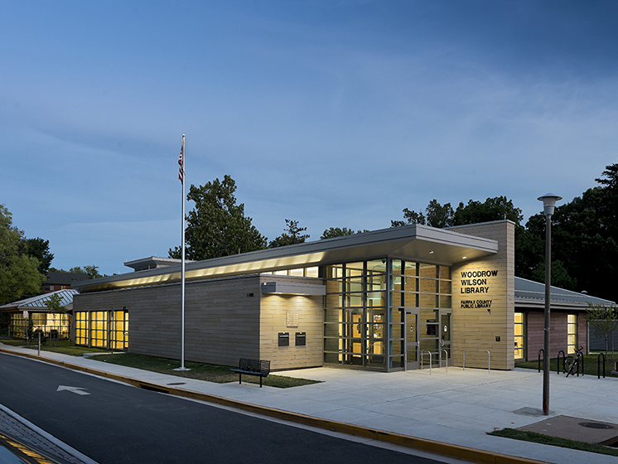

Slide 36
Notes:
Wilson Library Museum, Staunton, Virginia

Slide 37
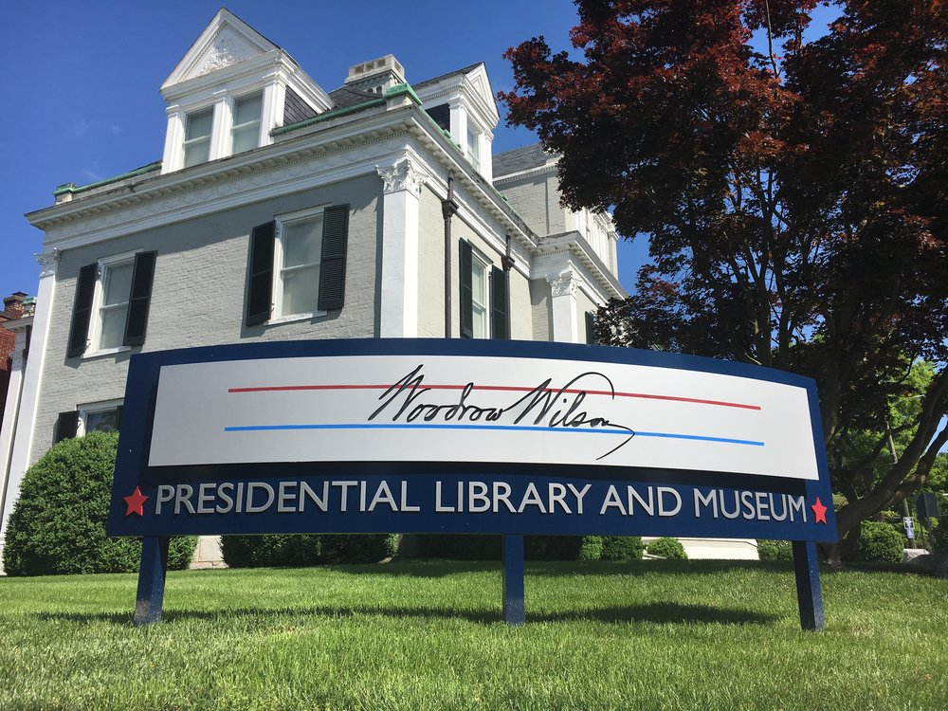
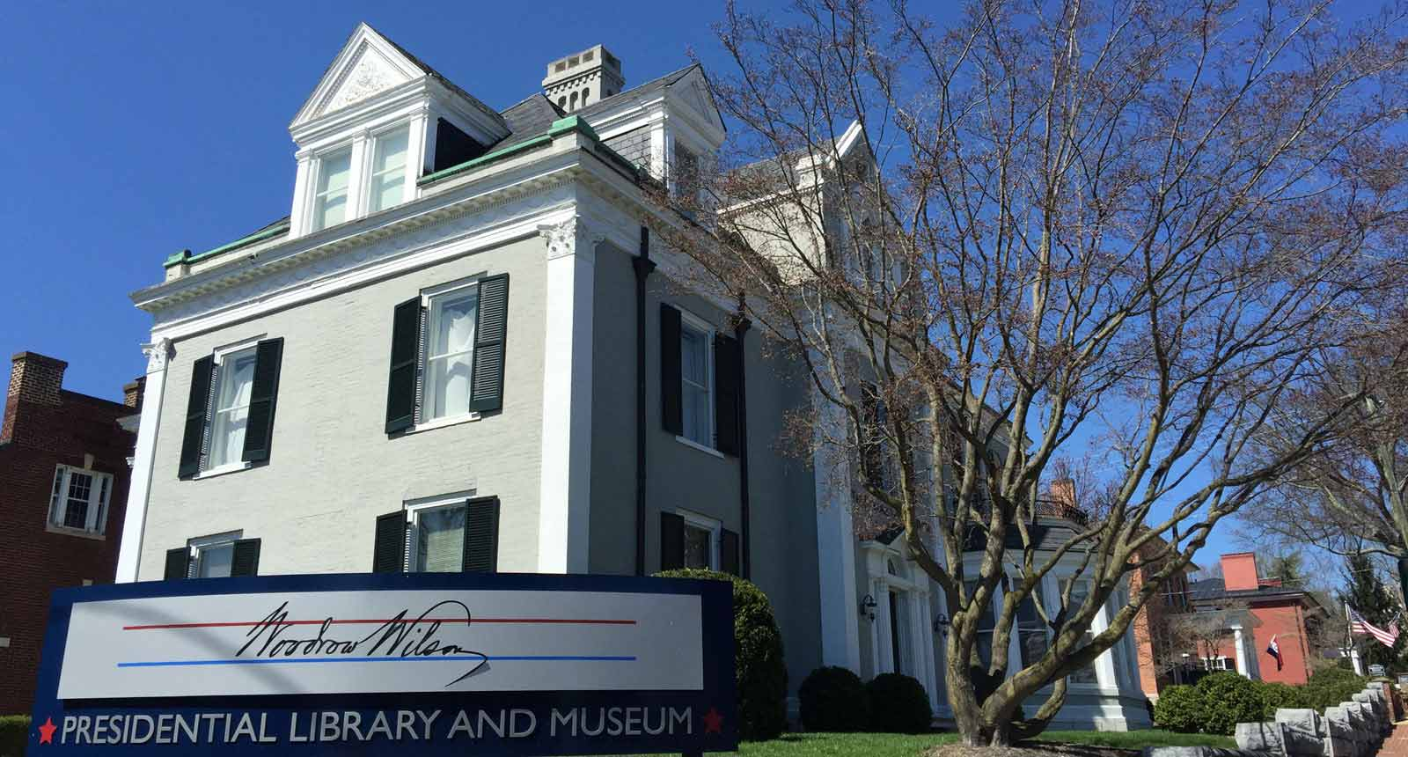

Slide 38
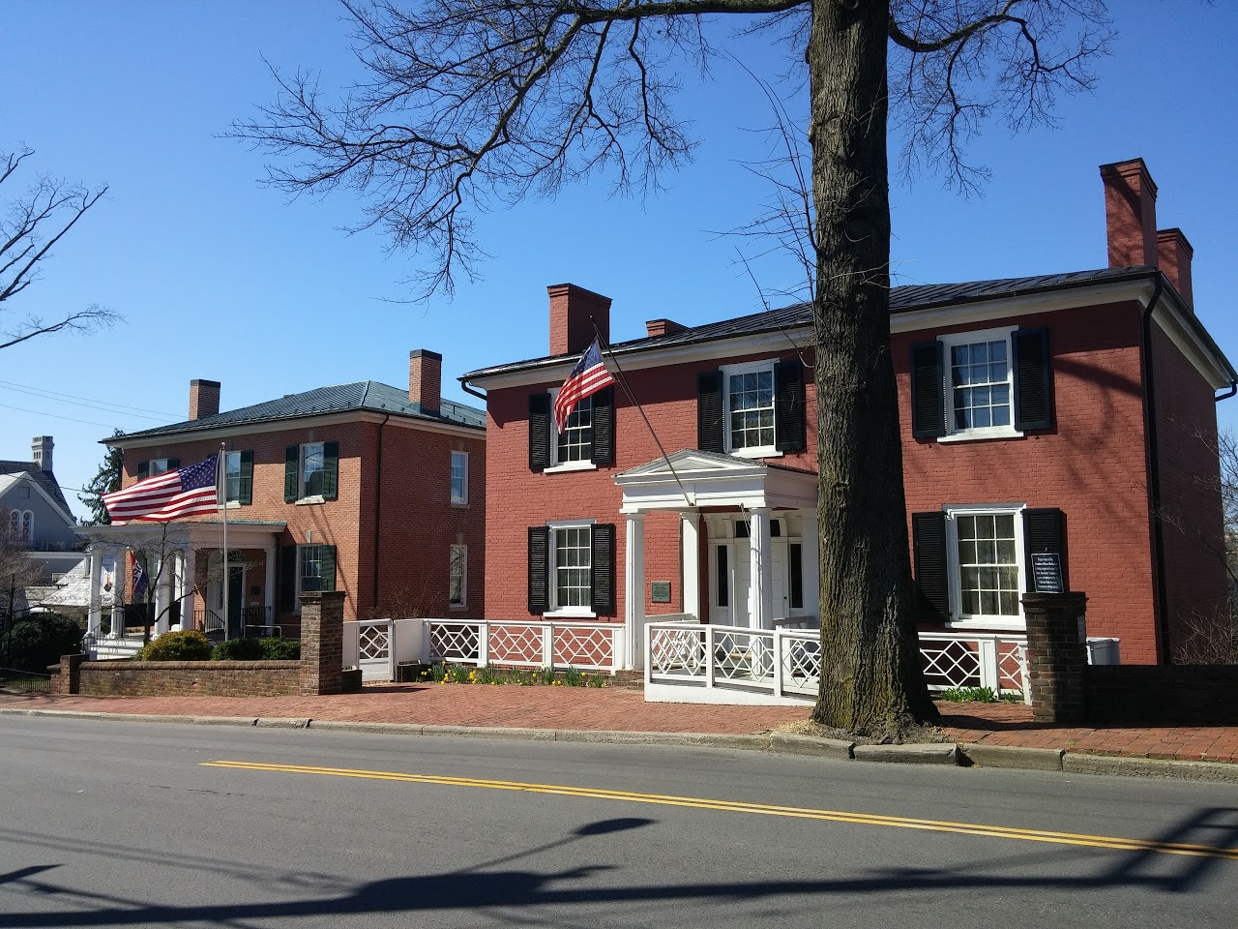

Slide 39
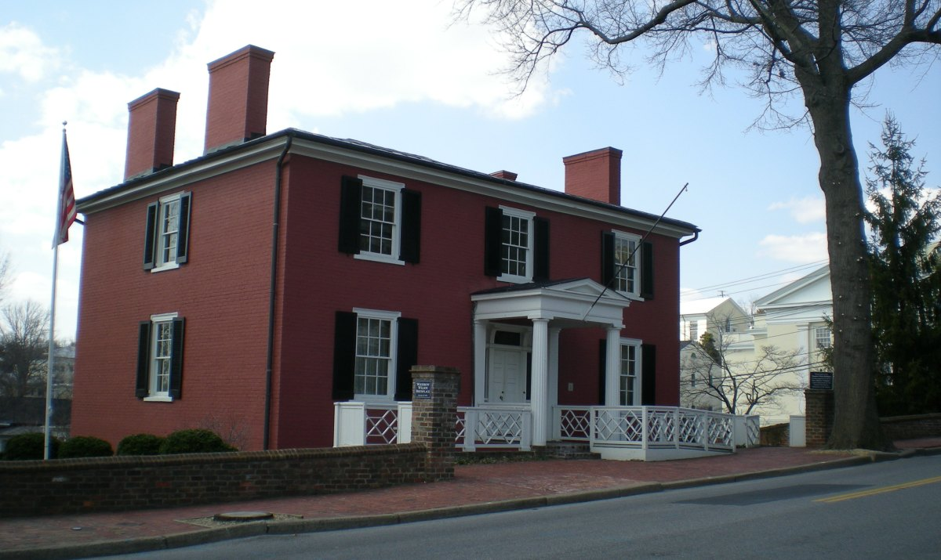
Notes:
Wilson Birthplace

Slide 40
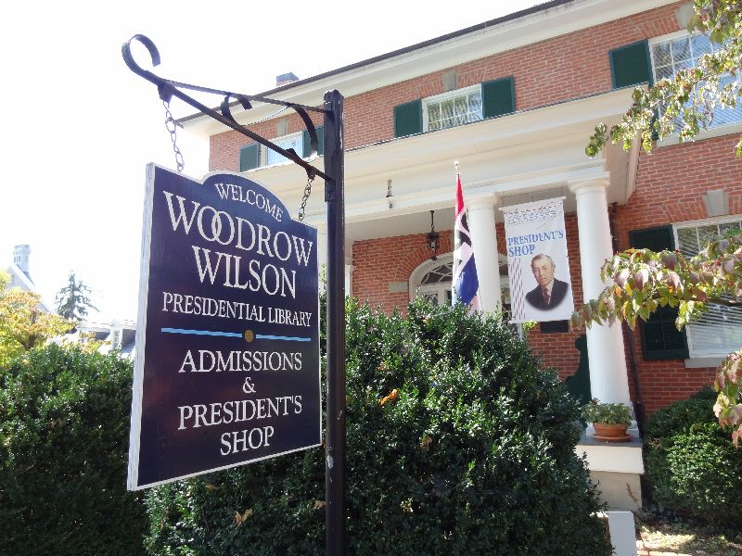

Slide 41
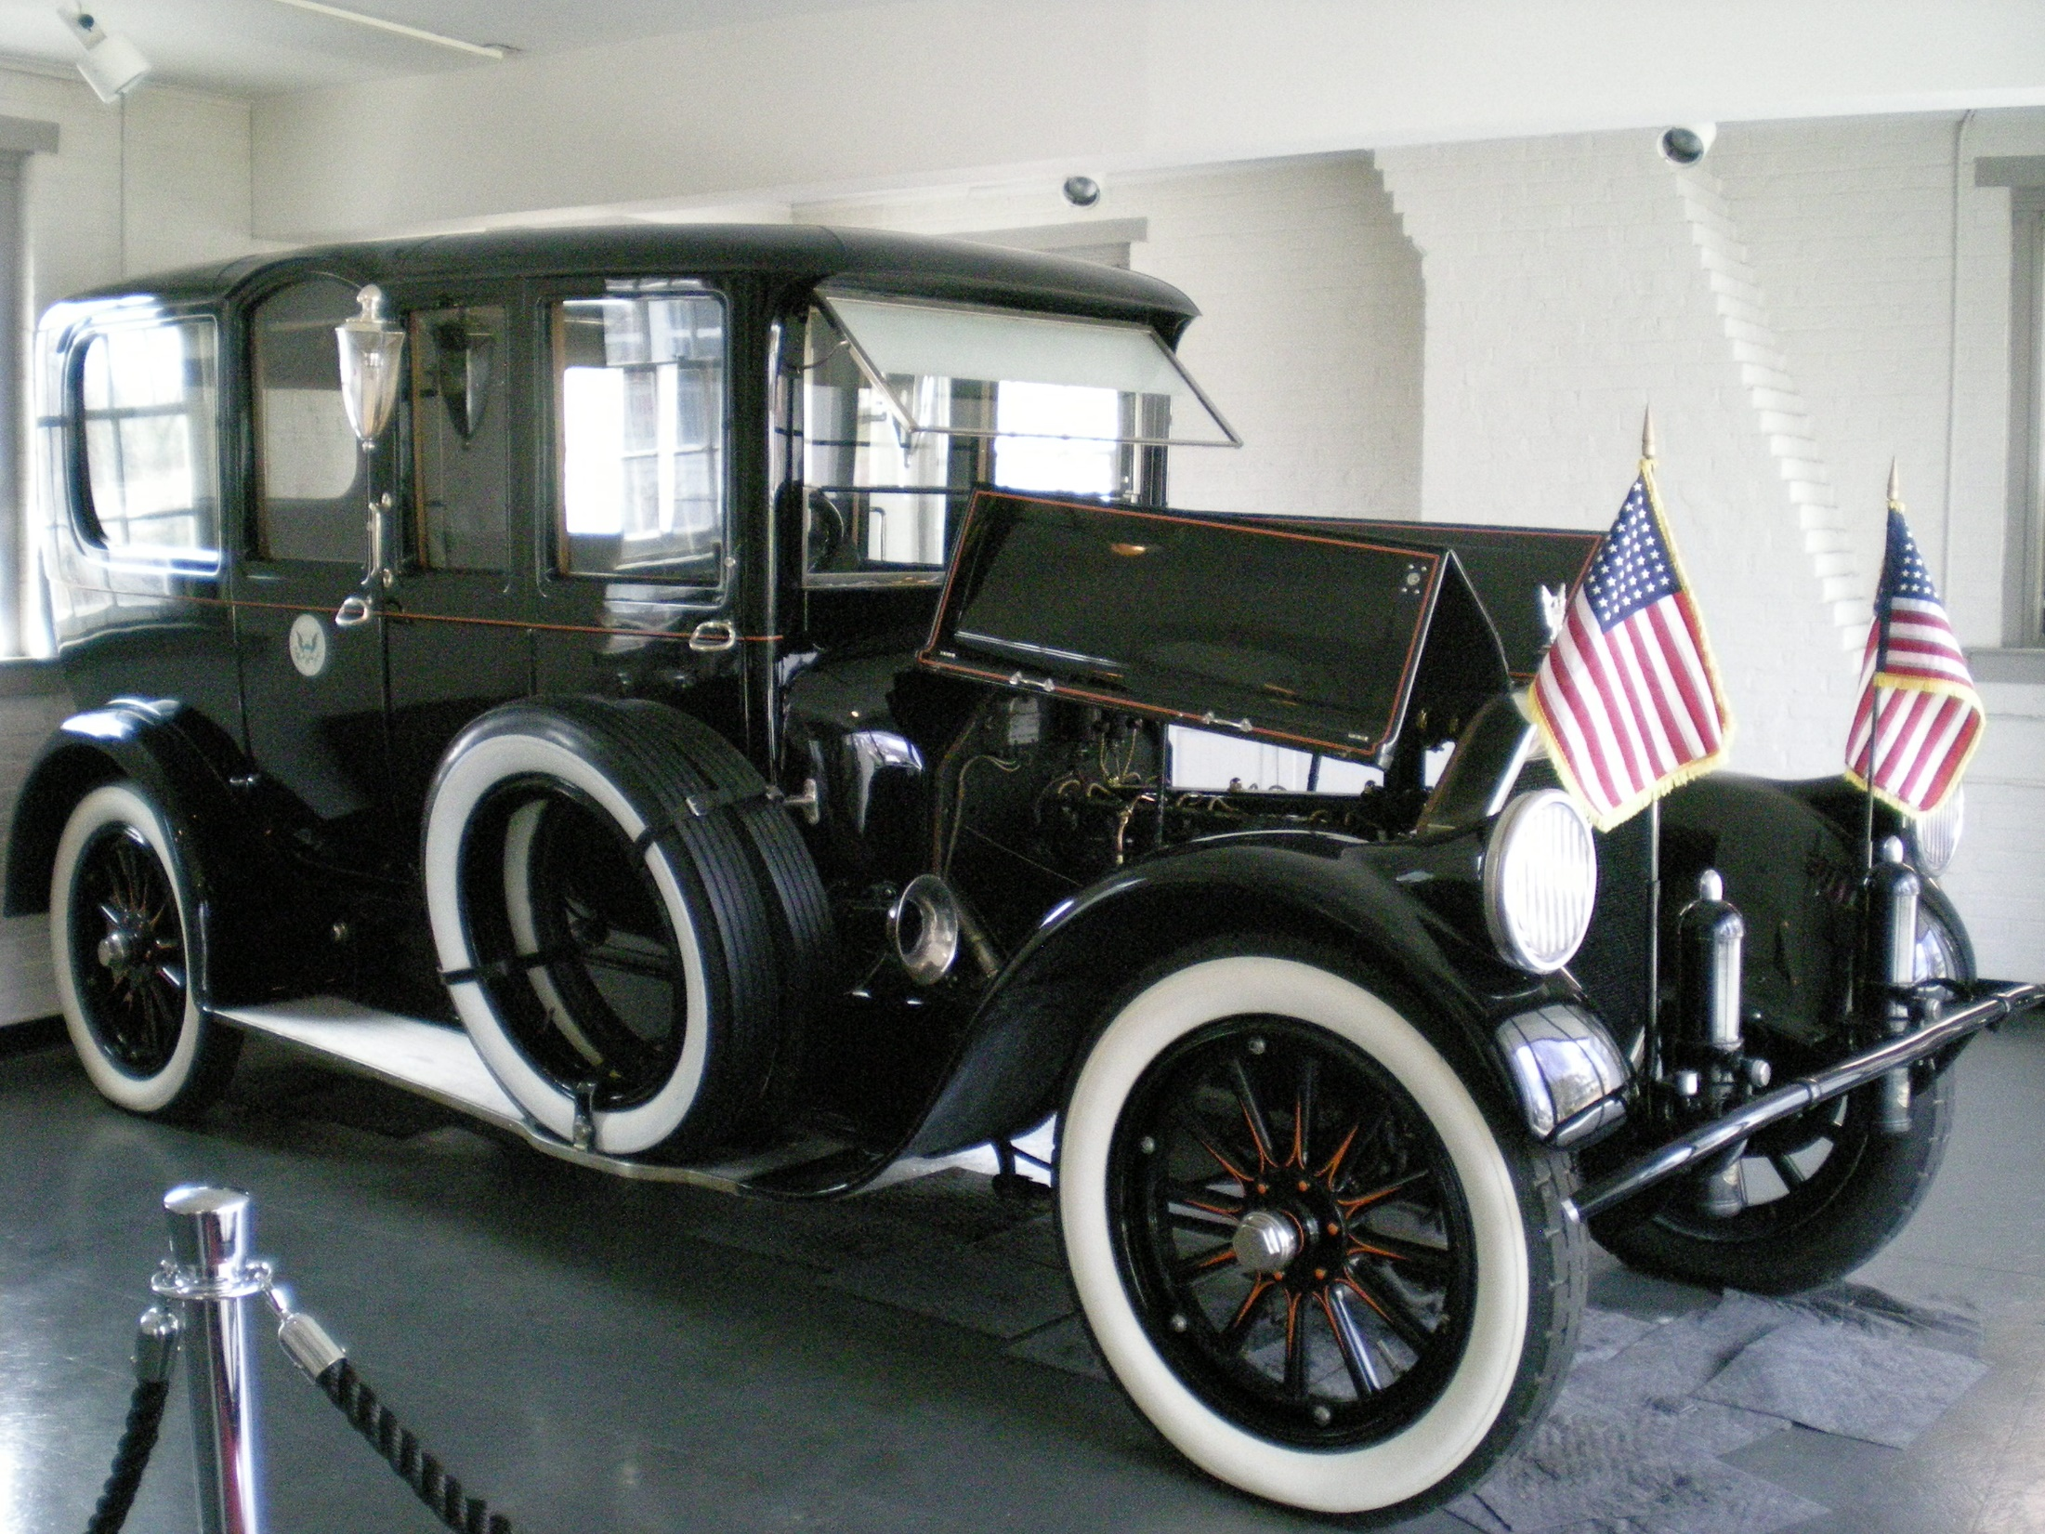
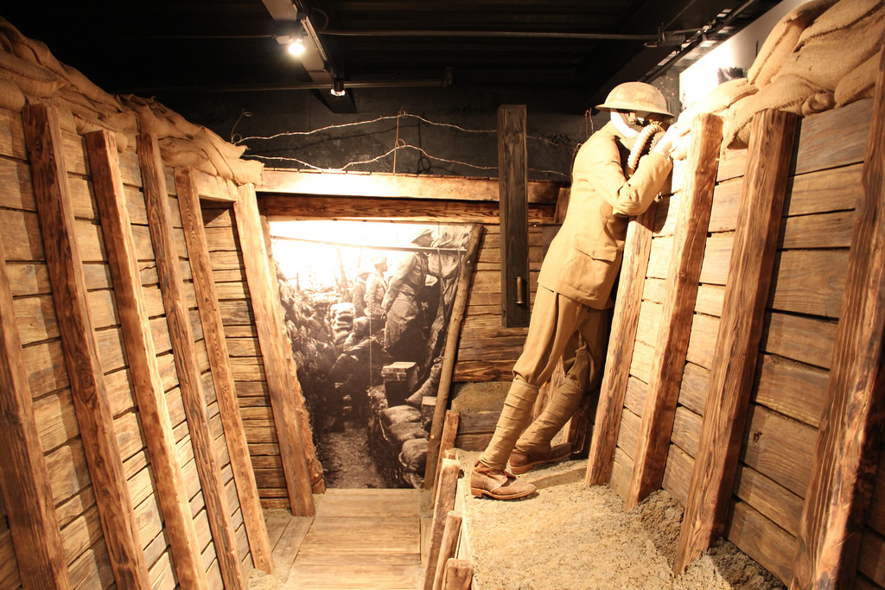

Slide 42
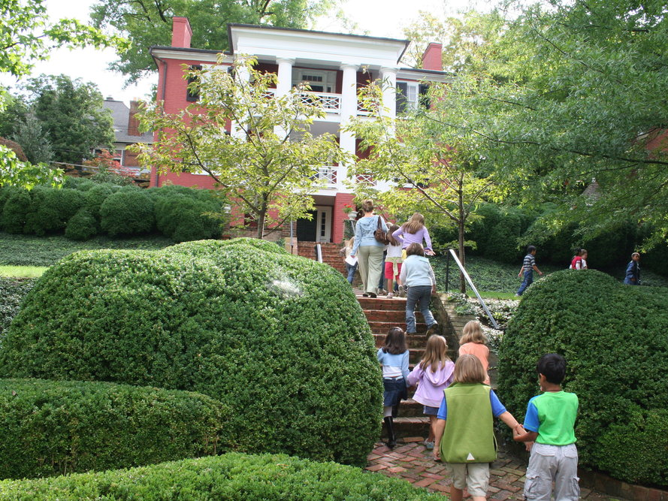
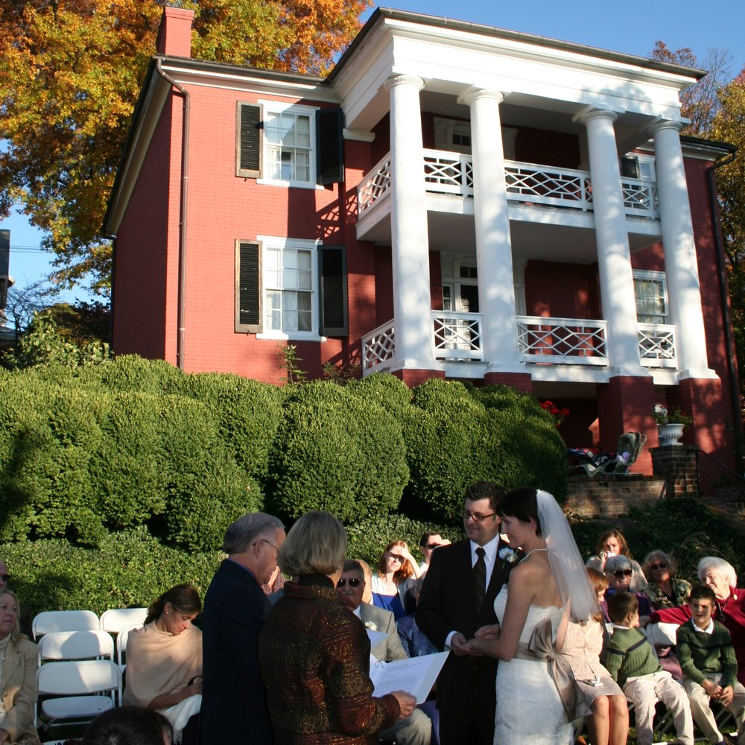

Slide 43
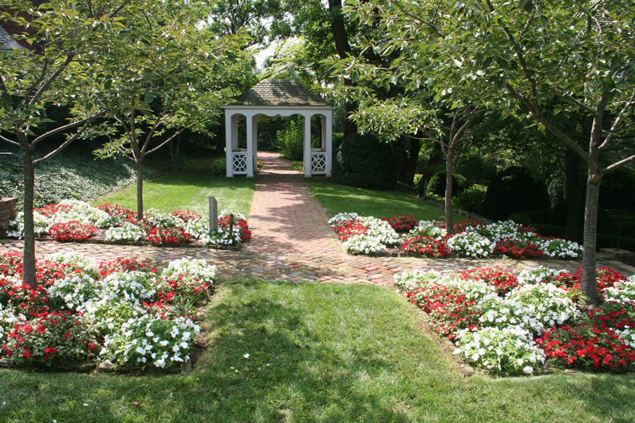
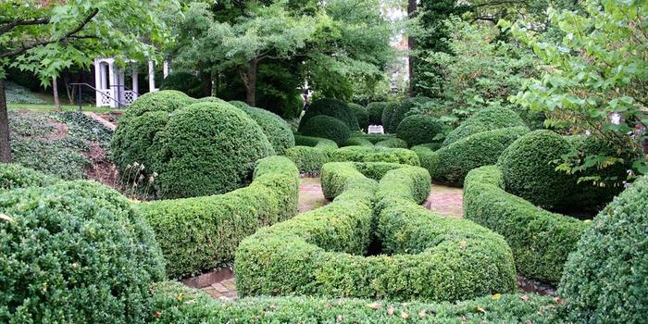

Slide 44
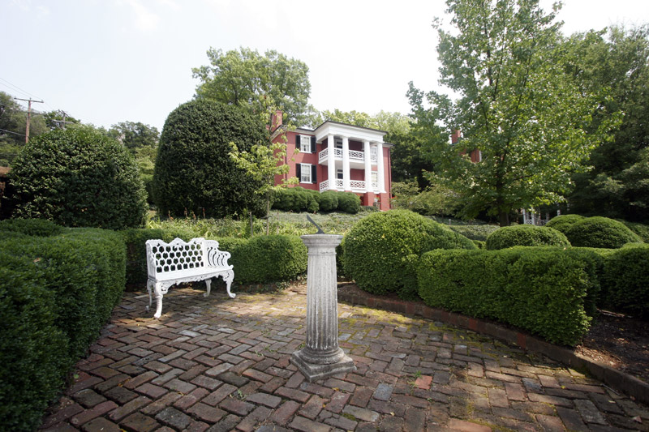

Slide 45
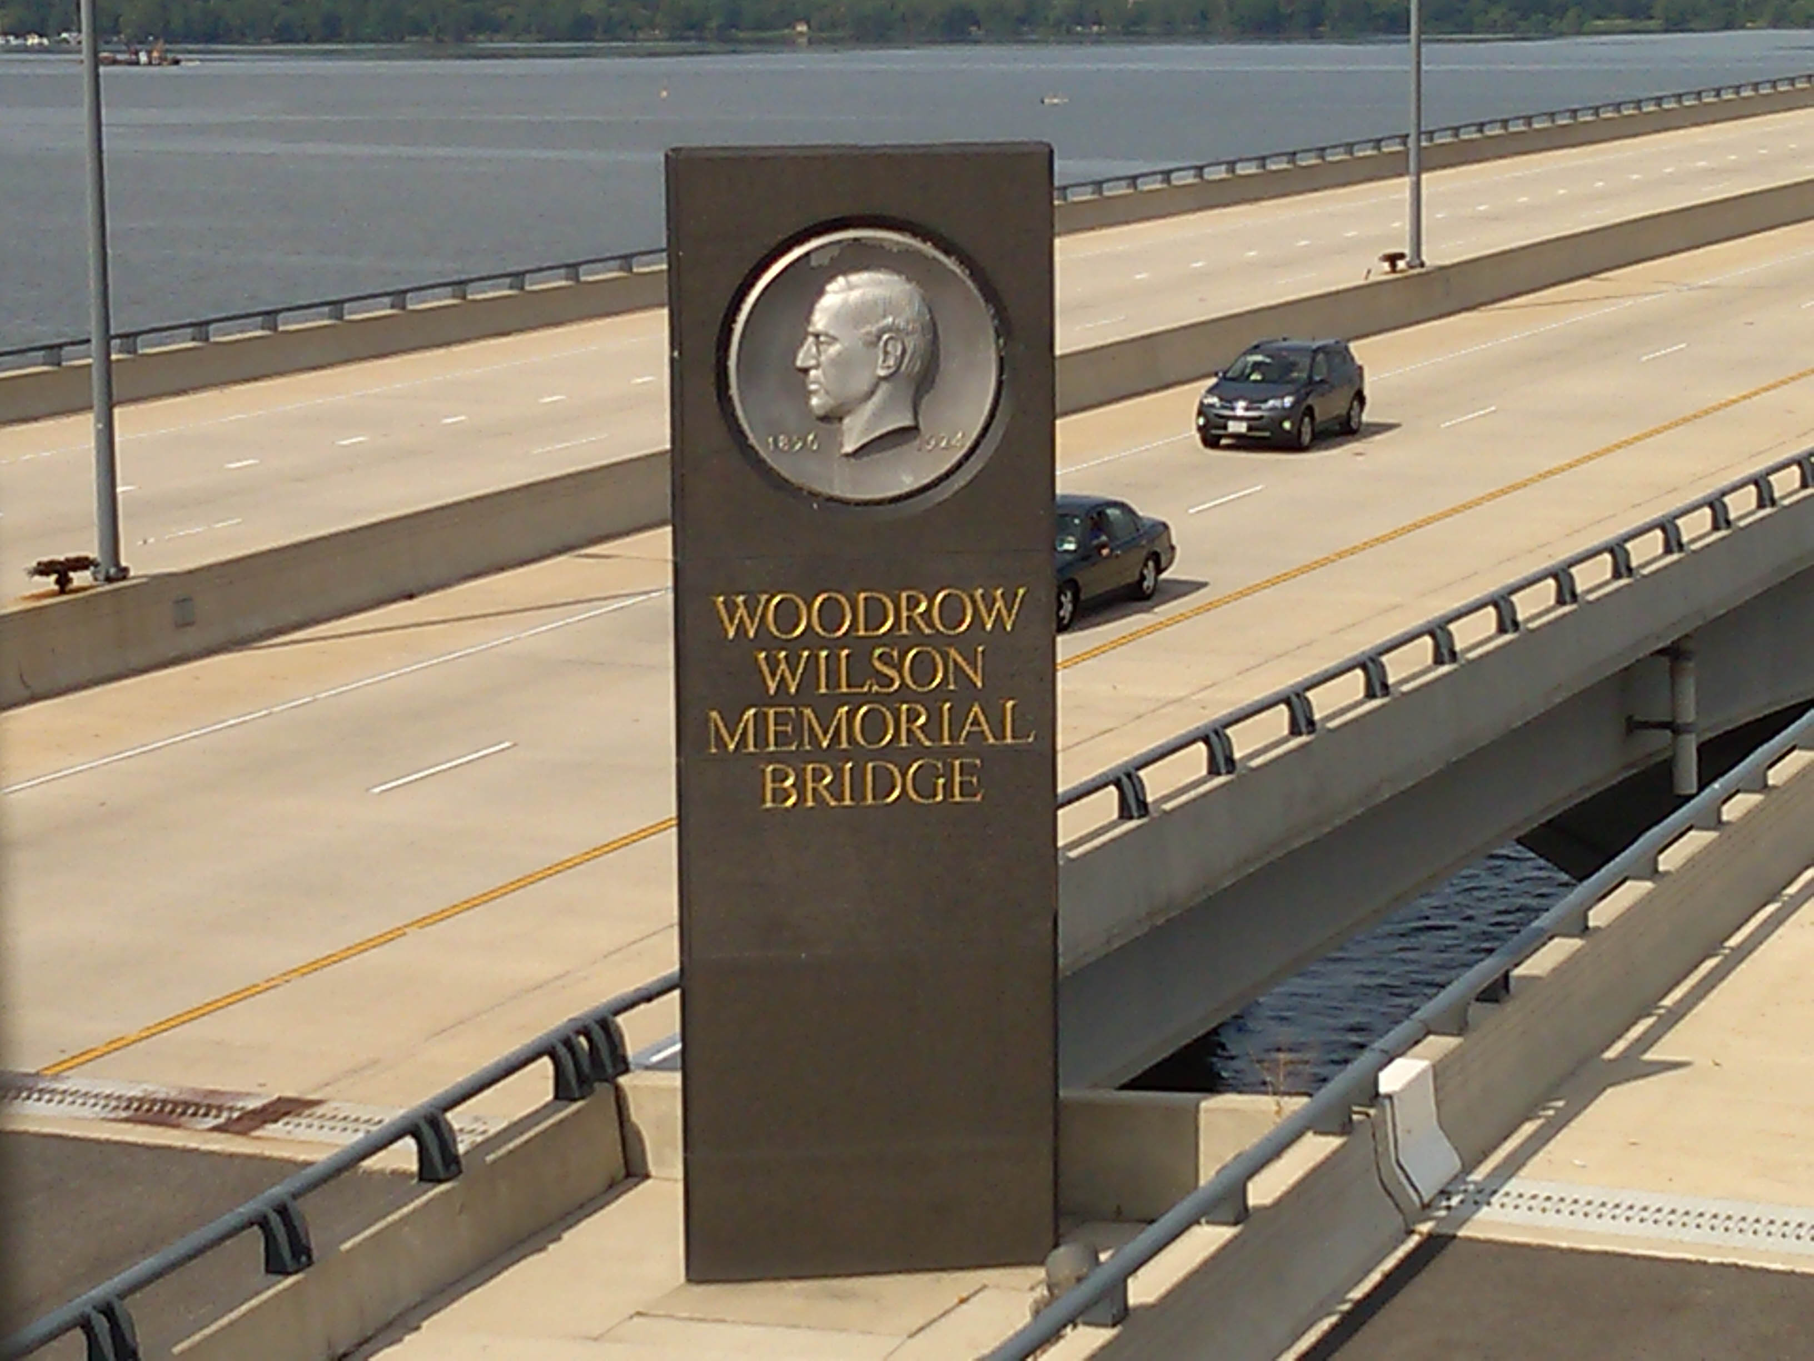
Notes:
Crosses the Potomac River between Virginia and Maryland

Slide 46
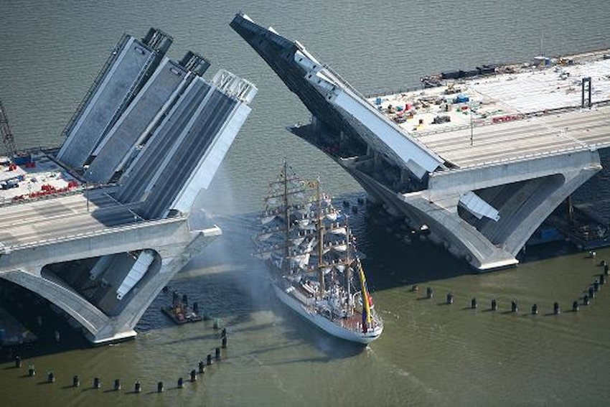

Slide 47
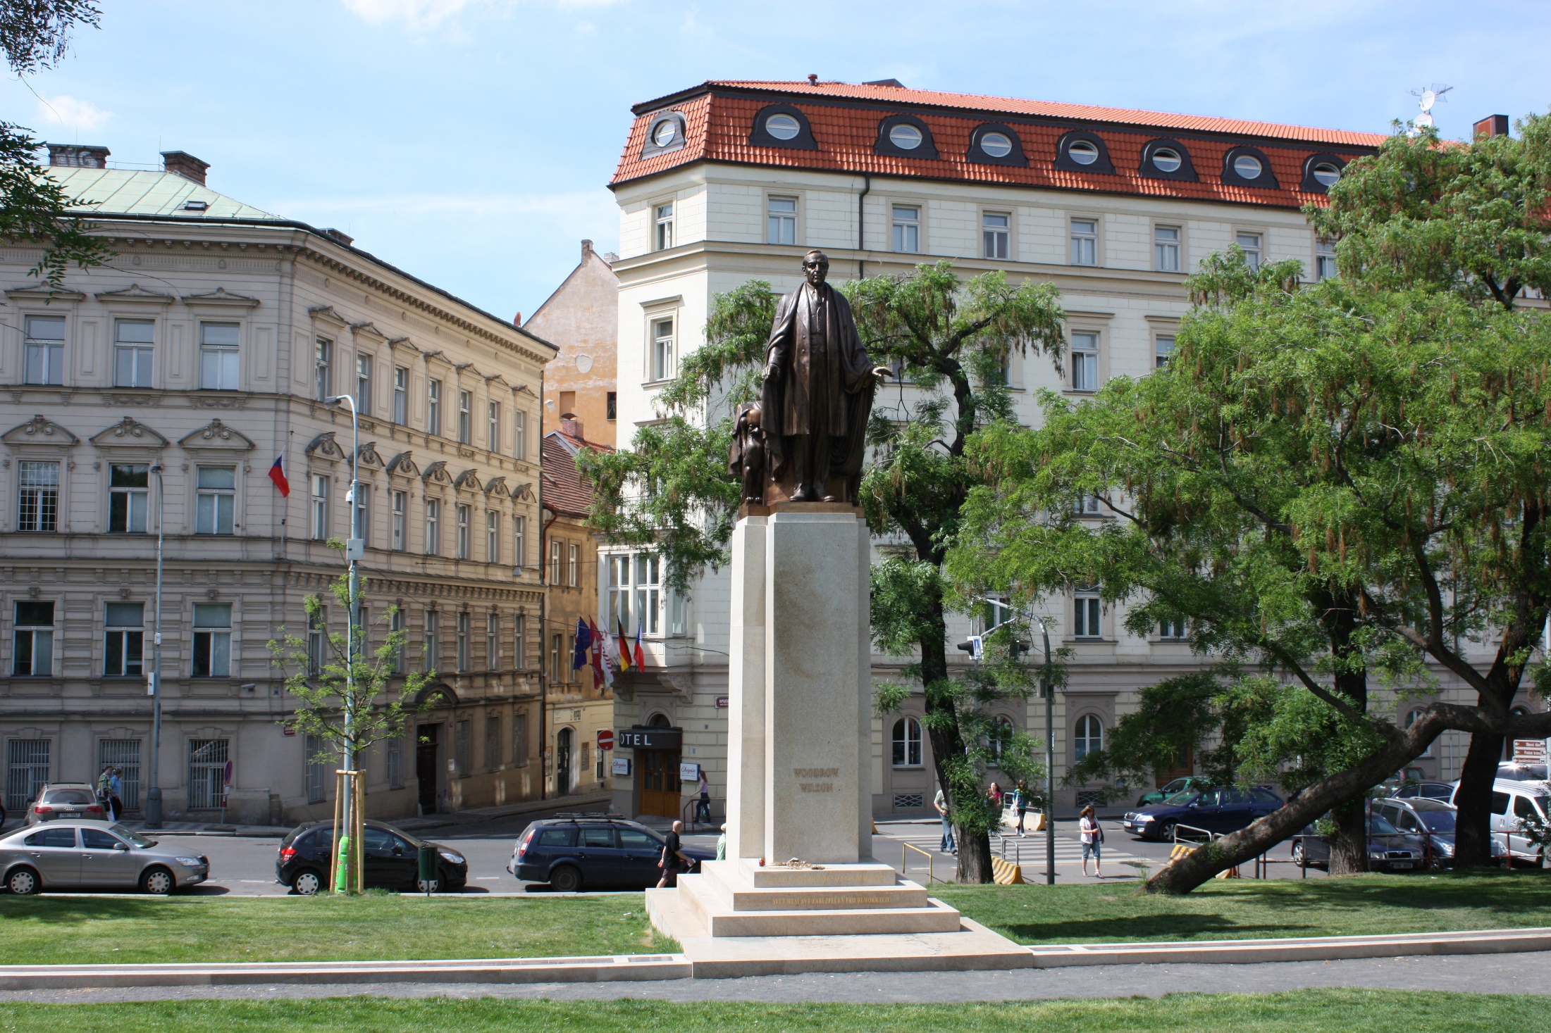

Slide 48
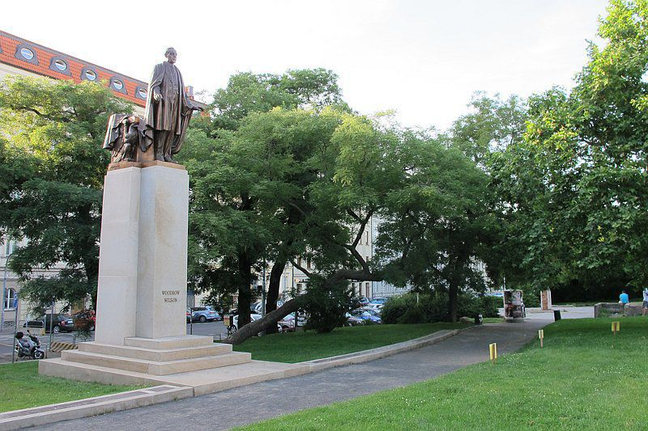
Notes:
Prague, Czech Republic

Slide 49
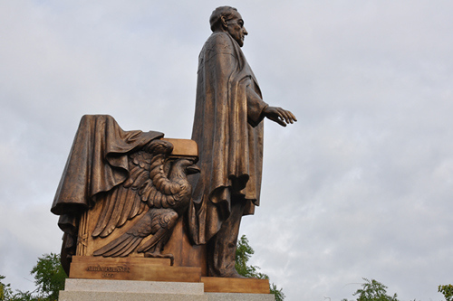

Slide 50
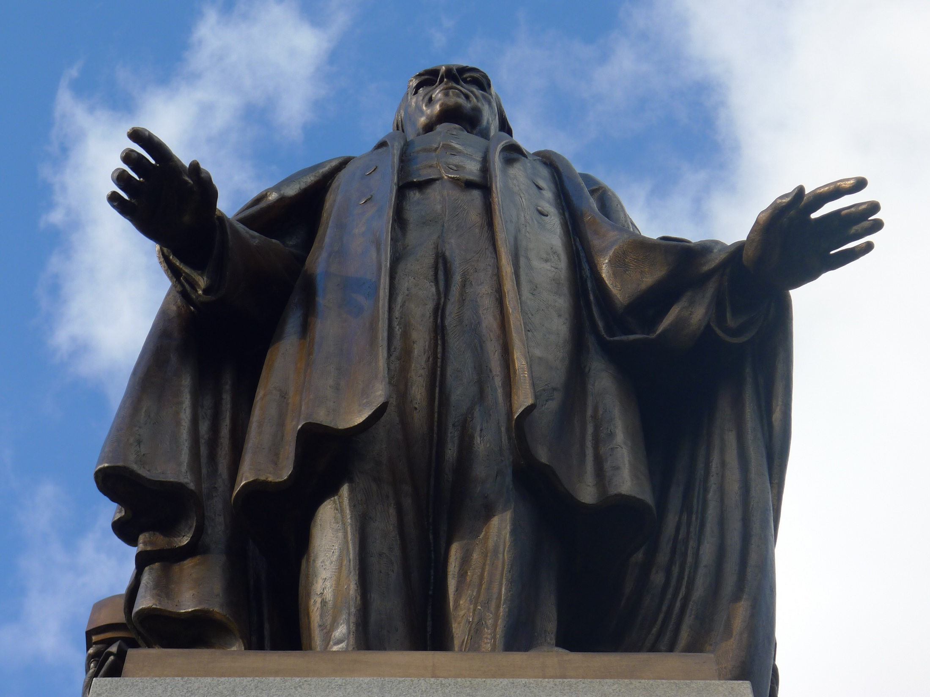

Slide 51
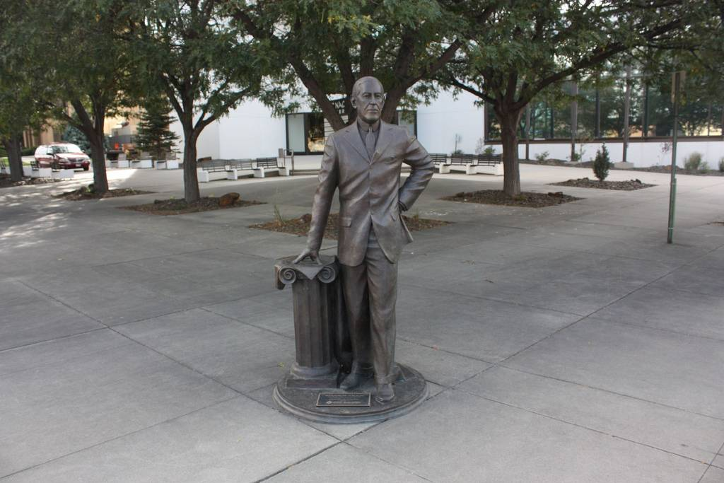
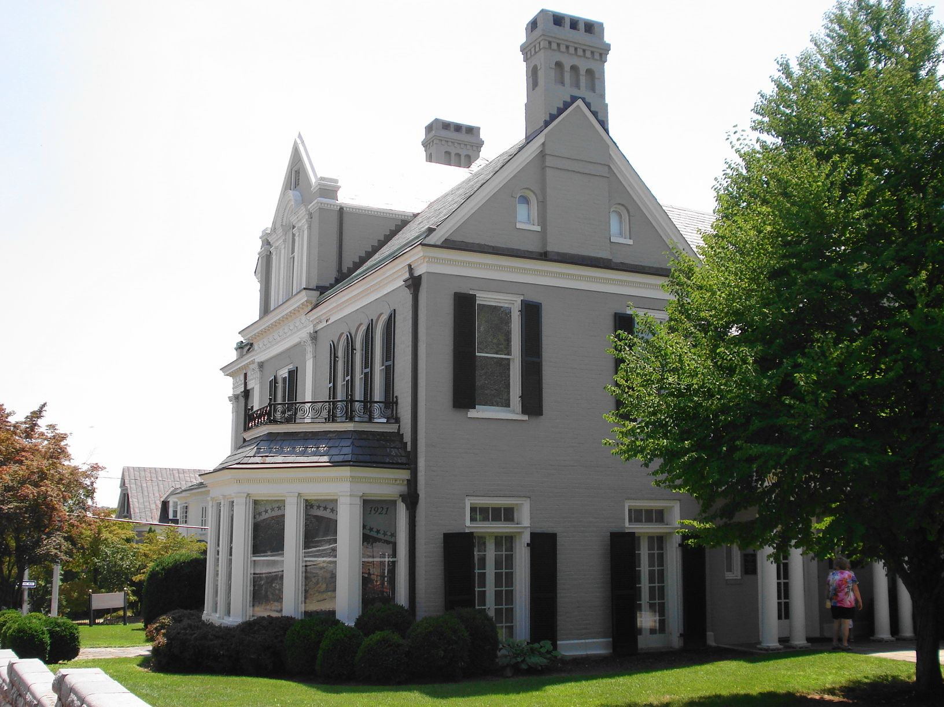

Slide 52
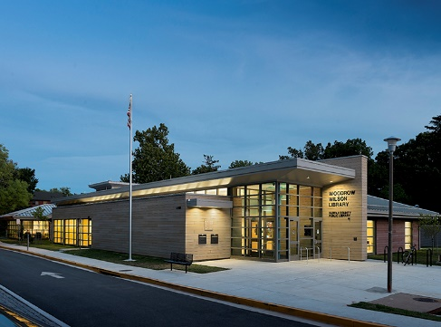
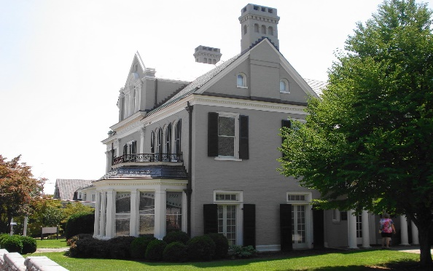
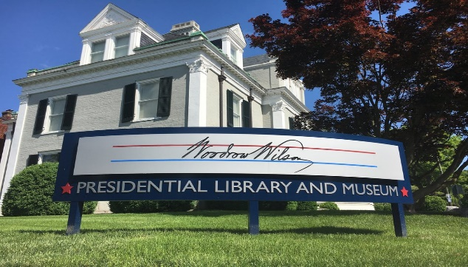
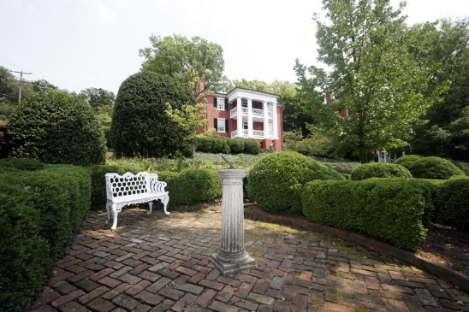
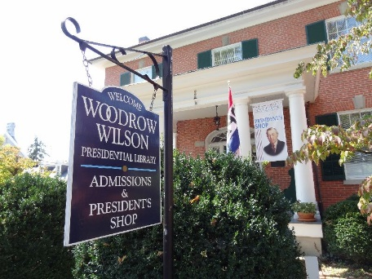
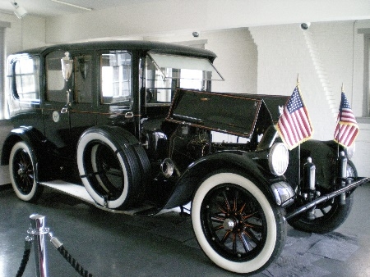

Slide 54
Presidential Quotes
Ron Bert
21½
May 19, 2019

Slide 55
28. Woodrow Wilson (1913-1921)
Part 3

Slide 56
America was established not to create wealth but to realize a vision, to realize an ideal - to discover and maintain liberty among men.

Slide 57
“My urgent advice to you would be, not only always to think first of America, but always, also, to think first of humanity. You do not love humanity if you seek to divide humanity into jealous camps. Humanity can be welded together only by love, by sympathy, by justice, not by jealousy and hatred. I am sorry for the man who seeks to make personal capital out of the passions of his fellowmen. He has lost touch with the ideal of America. For America was created to unite mankind.”
America was created to unite mankind
think first of America
think first of humanity
not
think first of America
think first of humanity
welded by love
by sympathy
by justice
love humanity
divide humanity
jealous camps
welded
godly
by love
by sympathy
by
not love humanity
divide humanity
jealous camps
by jealousy and hatred
lost touch with the ideal
justice
by jealousy and hatred
ungodly
lost touch with the ideal
America was created to unite mankind

Slide 58
For where envy and self-seeking exist, confusion and every evil thing are there. — James 3:16

Slide 59
“A nation which does not remember what it was yesterday, does not know what it is today, nor what it is trying to do. We are trying to do a futile thing if we do not know where we came from or what we have been about.”

Slide 60
"Remember this, and show yourselves men; Recall to mind, O you transgressors. Remember the former things of old, For I am God, and there is no other; I am God, and there is none like Me, …" — Isaiah 46:8-9
w
Recall to mind
d
o
Recall to mind = wisdom
is
m

Slide 61
“America is not a mere body of traders; it is a body of free men. Our greatness is built upon our freedom - is moral, not material. We have a great ardor for gain; but we have a deep passion for the rights of man.”
carnal
spiritual
love

Slide 62
“You have just taken an oath of allegiance to the United States. Of allegiance to whom? Of allegiance to no one, unless it be God. Certainly not of allegiance to those who temporarily represent this great government. You have taken an oath of allegiance to a great ideal, to a great body of principles, to a great hope of the human race.”
allegiance to whom?
God

Slide 63
But Peter and the other apostles answered and said: "We ought to obey God rather than men. — Acts 5:29

Slide 64
“America was born a Christian nation. America was born to exemplify that devotion to the elements of righteousness, which are derived from Holy Scripture. Ladies and gentlemen, I have a very simple thing to ask of you. I ask of every man and woman in this audience that, from this night on, they will realize that part of the destiny of America lies in their daily perusal of this great Book of revelations. (The Bible) That if they would see America free and pure they will make their own spirits free and pure by the baptism of Holy Scripture.”
scrutiny
daily perusal
The Bible
spirits free
baptism of Holy Scripture

Slide 65
These were more fair-minded than those in Thessalonica, in that they received the word with all readiness, and searched the Scriptures daily to find out whether these things were so. — Acts 17:11
searched
daily to find

Slide 66
“If you wish your children to be Christians you must really take the trouble to be Christian yourselves. Those are the only terms upon which the home will work the gracious miracle.”

Slide 67
There is no more subtle dissolvent of morals than sentimentality.
X
feelings over reason
Notes:
FEELING SORRY FOR SINNERS Dissolvent=Dissolving

Slide 68
You therefore, beloved, since you know this beforehand, beware lest you also fall from your own steadfastness, being led away with the error of the wicked; — 2nd Peter 3:17

Slide 69
“There is something better, if possible, that a man can give than his life. That is his living spirit to a service that is not easy, to resist counsels that are hard to resist, to stand against purposes that are difficult to stand against.”
service that is not easy
stand against purposes
difficult to stand against

Slide 70
“The seed of revolution is repression.”

Slide 71
“Business underlies everything in our national life, including our spiritual life. Witness the fact that in the Lord's Prayer, the first petition is for daily bread. No one can worship God or love his neighbor on an empty stomach.”

Slide 72
“Hunger does not breed reform; it breeds madness and all the distemper's that make an ordered life impossible.”

Slide 73
“The fewer the desires, the more peace.”

Slide 74
Where do wars and fights come from among you? Do they not come from your desires for pleasure that war in your members? — James 4:1

Slide 75
“This was not after all a conventional war, a struggle between equally predacious powers; it was a war to end all wars.”

Slide 76
“It must be a peace without victory... Victory would mean peace forced upon the loser, a victor's terms imposed upon the vanquished. It would be accepted in humiliation, under duress, at an intolerable sacrifice, and would leave a sting, a resentment, a bitter memory upon which terms of peace would rest, not permanently, but only as upon quicksand. Only a peace between equals can last.”

Slide 77
“The sum of the whole matter is this - our civilization cannot survive materially unless it be redeemed spiritually. It can be saved only by becoming permeated with the Spirit of Christ, and being made free and happy by practices which spring out of that spirit. Only thus can discontent be driven out and all shadows lifted from the road ahead. ”
saved only by
Spirit of Christ
by practice

Slide 78
For the grace of God that brings salvation has appeared to all men, teaching us that, denying ungodliness and worldly lusts, we should live soberly, righteously, and godly in the present age, looking for the blessed hope and glorious appearing of our great God and Savior Jesus Christ, who gave Himself for us, that He might redeem us from every lawless deed and purify for Himself His own special people, zealous for good works. — Titus 2:11-14
For the grace of God that brings salvation has appeared to all men, teaching us that, denying ungodliness and worldly lusts, we should live soberly, righteously, and godly in the present age, looking for the blessed hope and glorious appearing of our great God and Savior Jesus Christ, who gave Himself for us, that He might redeem us from every lawless deed and purify for Himself His own special people, zealous for good works. — Titus 2:11-14
zealous for good works

Slide 79
“A man's rootage is more important than his leafage.”

Slide 80
“You have the greatest soul, the noblest nature, the sweetest, most loving heart I have ever known, and my love, my reverence, my admiration for you, you have increased in one evening as I should have thought only a lifetime of intimate, loving association could have increased them. You are more wonderful and lovely in my eyes than you ever were before; and my pride and joy and gratitude that you should love me with such a perfect love are beyond all expression, except in some great poem which I cannot write.”

Slide 81
There is no fear in love; but perfect love casts out fear, because fear involves torment. But he who fears has not been made perfect in love. — 1st John 4:18

Slide 82
“I firmly believe in Divine Providence. Without belief in Providence I think I should go crazy. Without God the world would be a maze without a clue.”

Slide 83
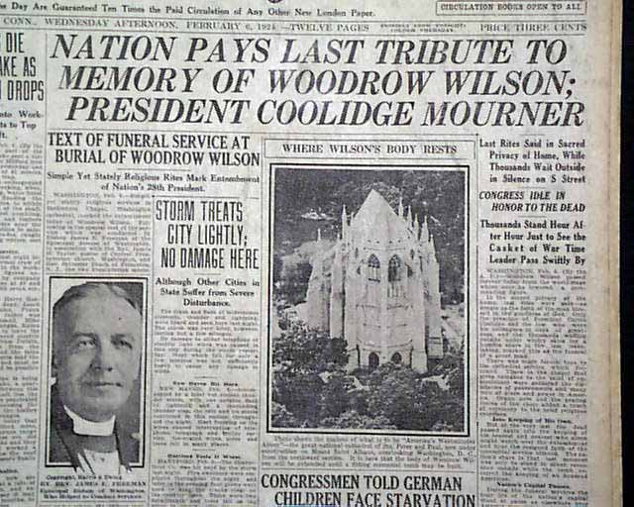

Slide 84
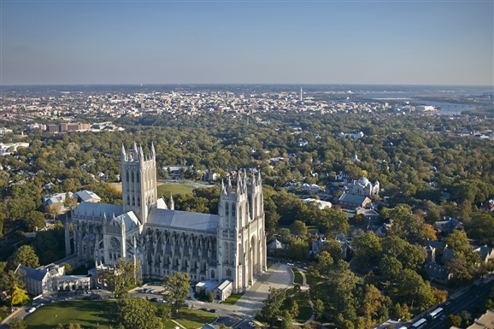
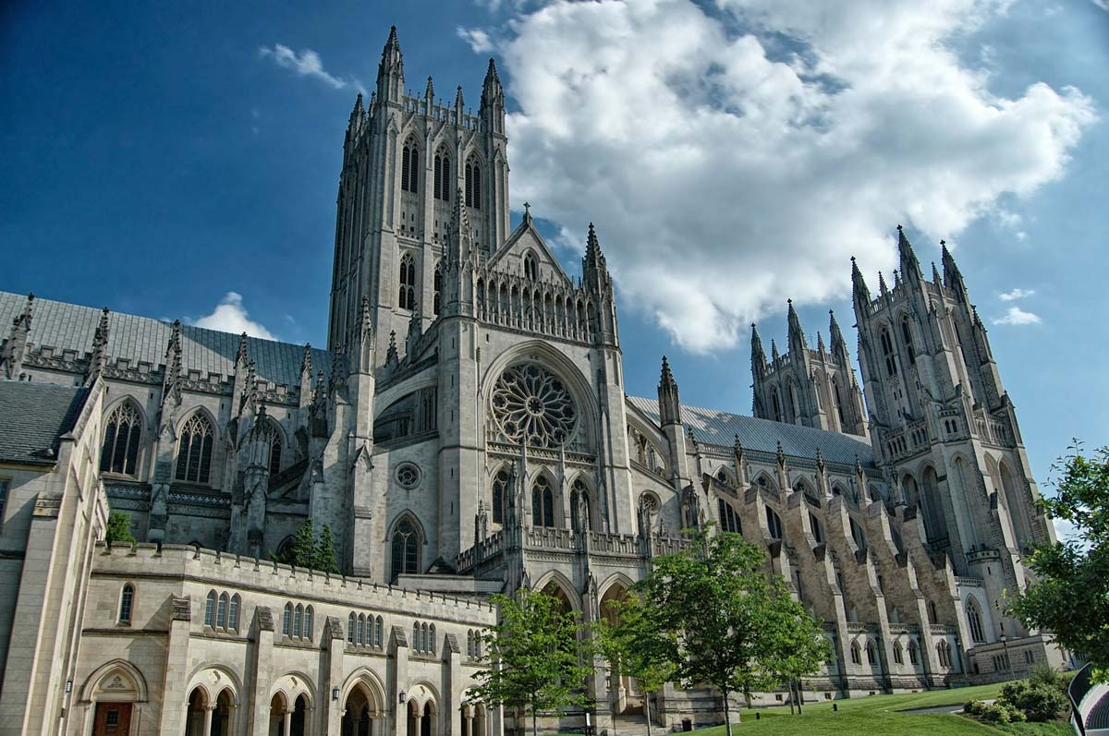
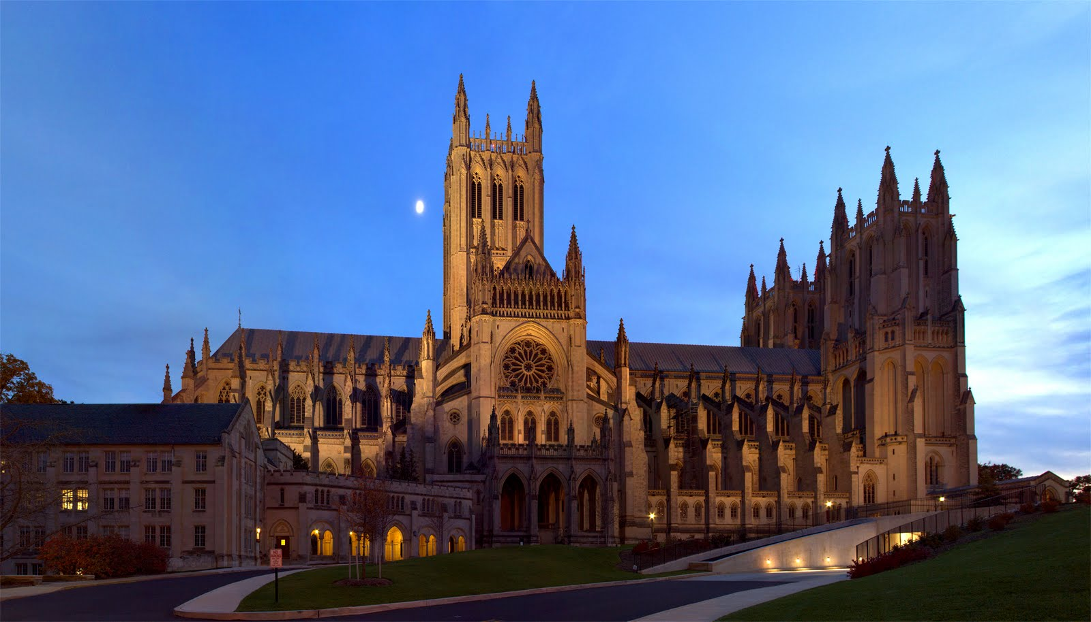
Washington Monument
Notes:
Washington National Cathedral

Slide 85
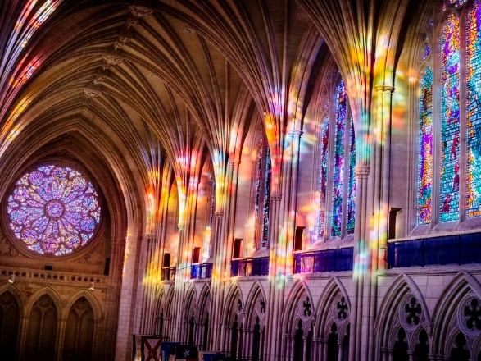

Slide 86
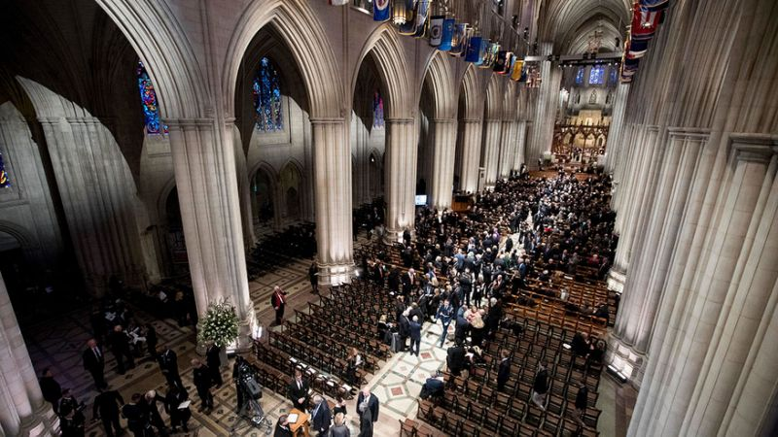
Notes:
G.W. Bush had his funeral here

Slide 87
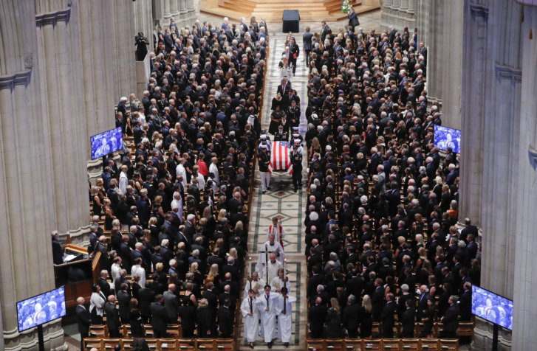
Notes:
and John McCain was honored

Slide 88
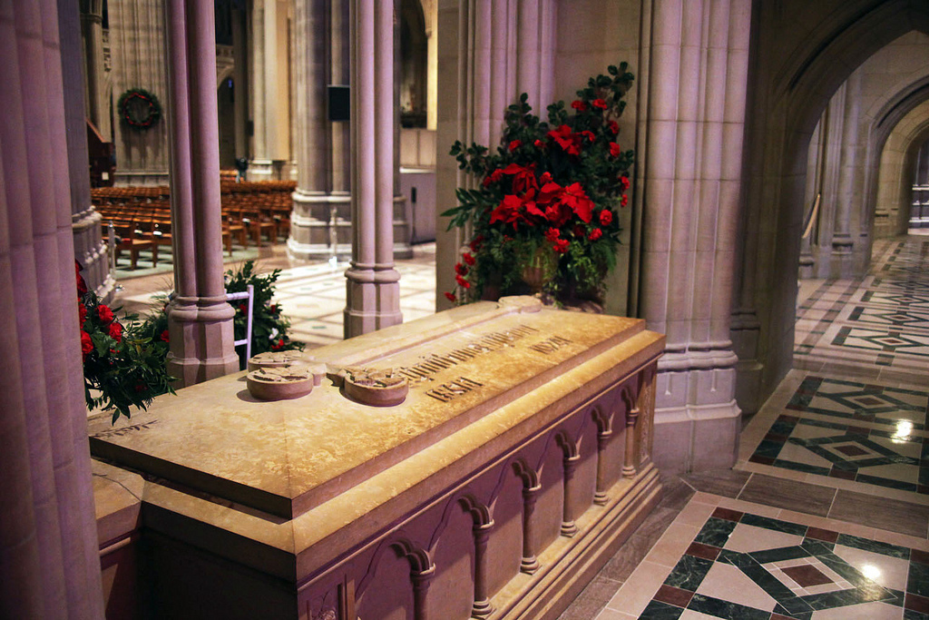
Notes:
Hellen Keller is buried in this cathedral too

Slide 89
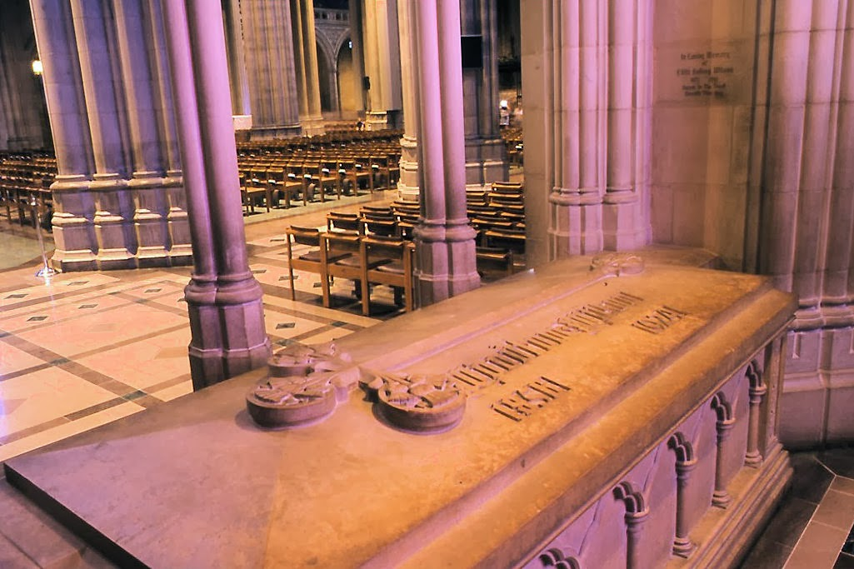

Slide 90
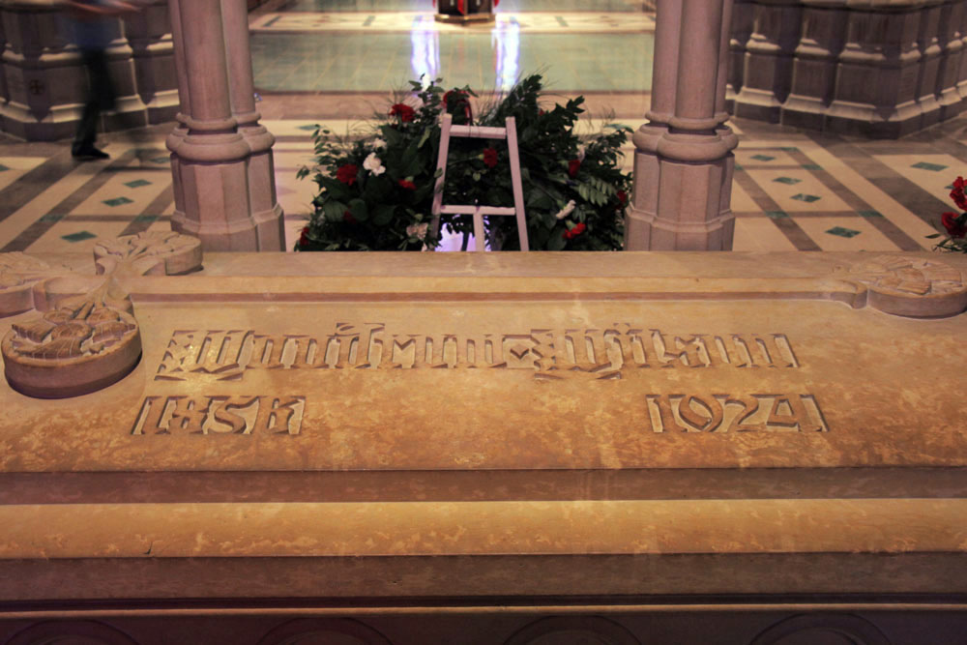

Slide 91
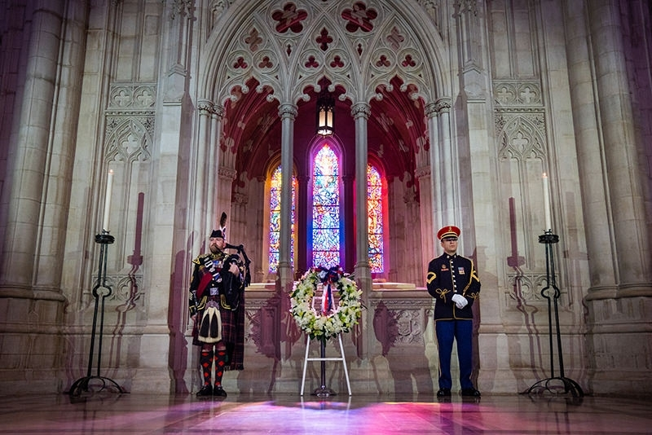

Slide 92
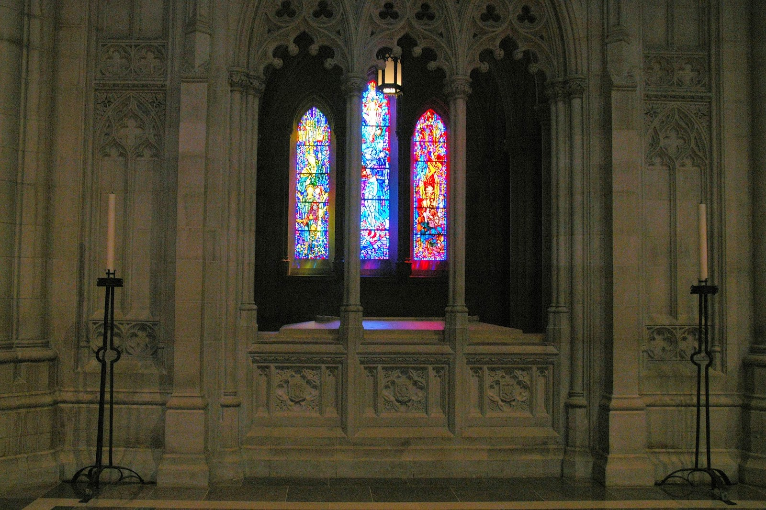

Slide 93
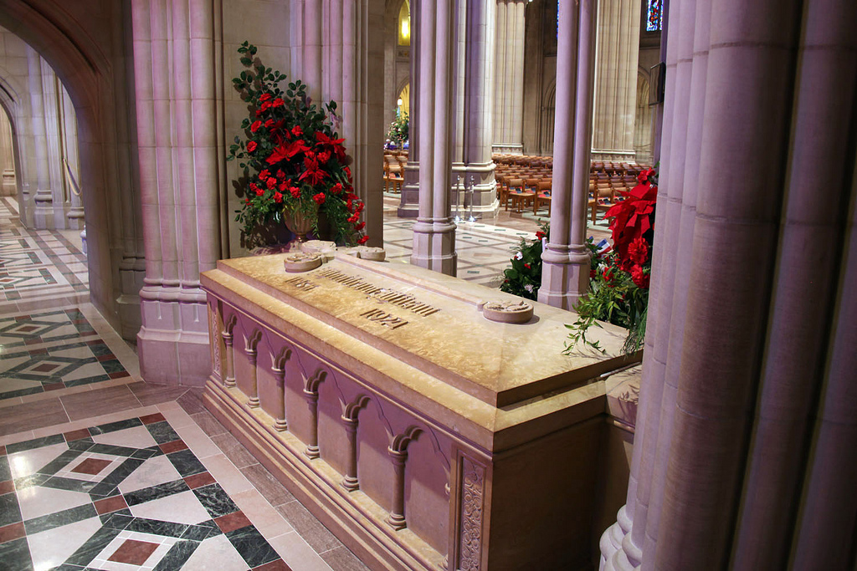

Slide 94
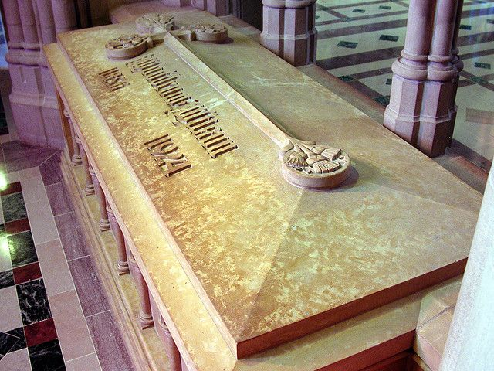

Slide 95
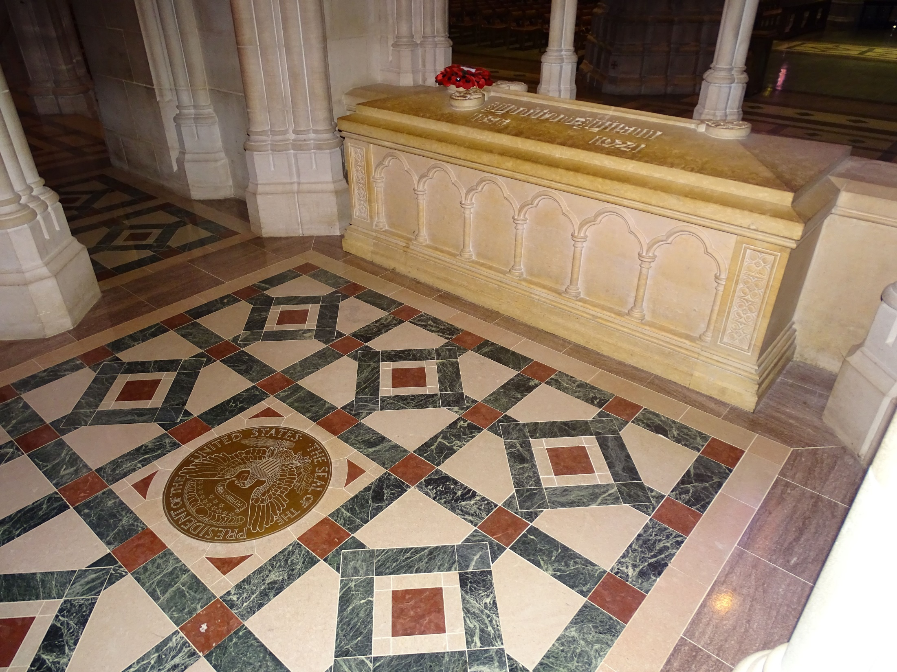

Slide 96
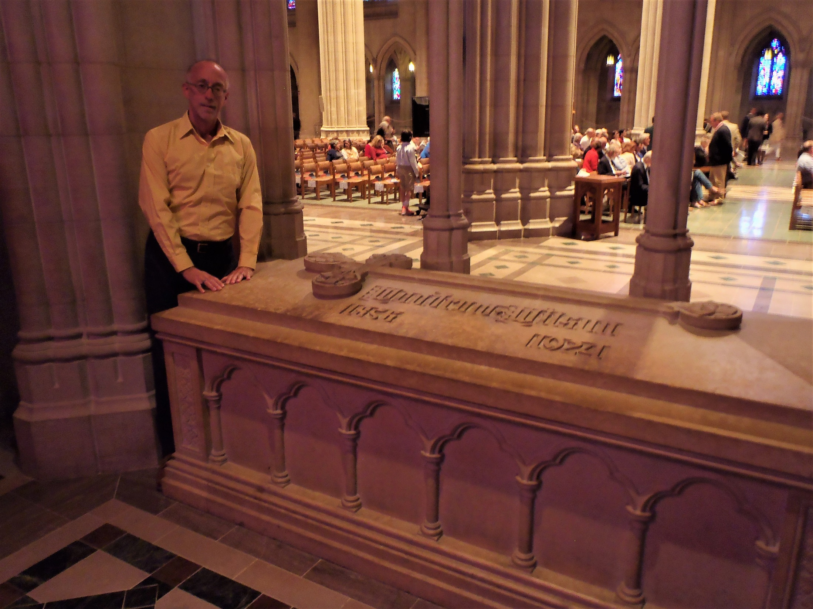
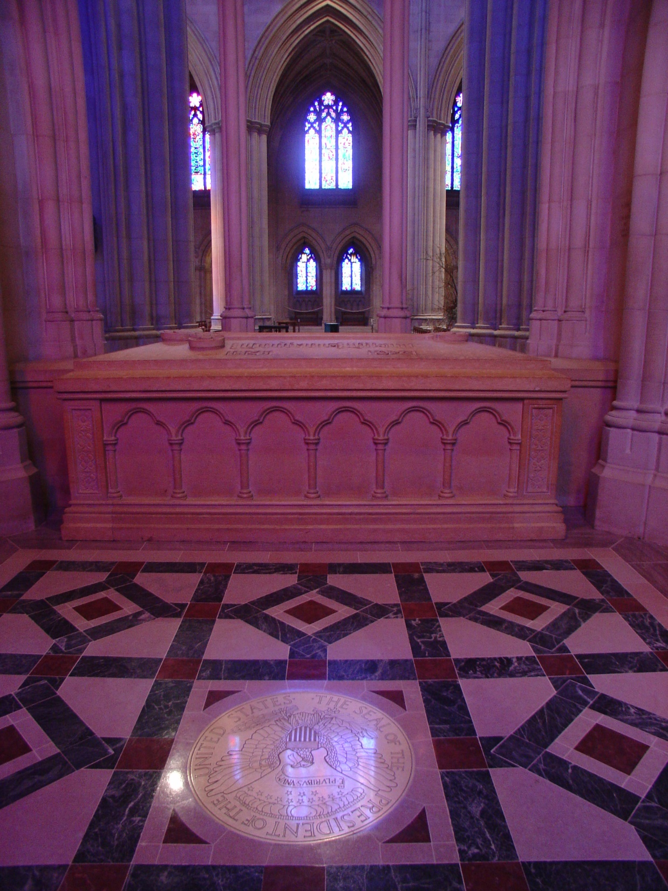
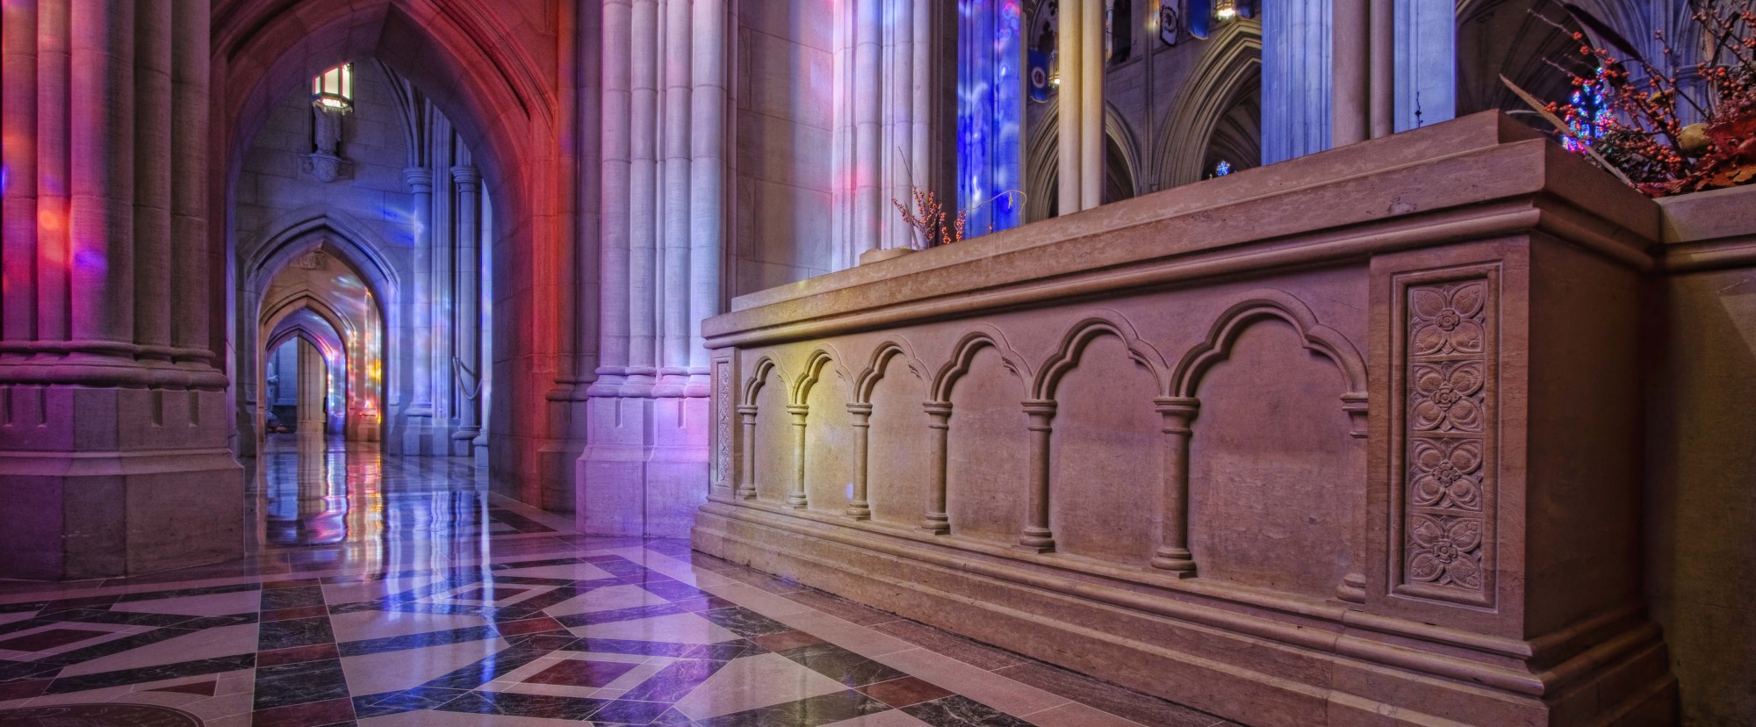

Slide 97
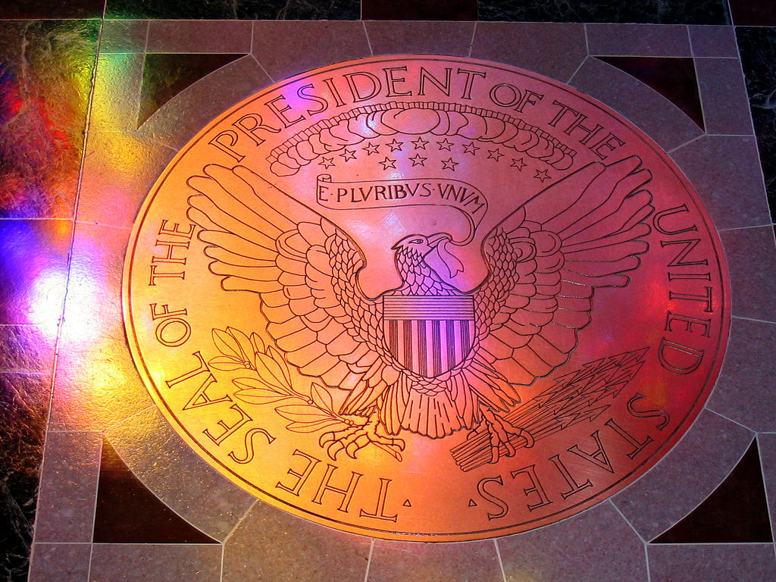

Slide 98
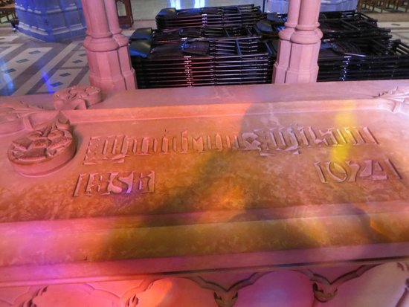

Slide 99
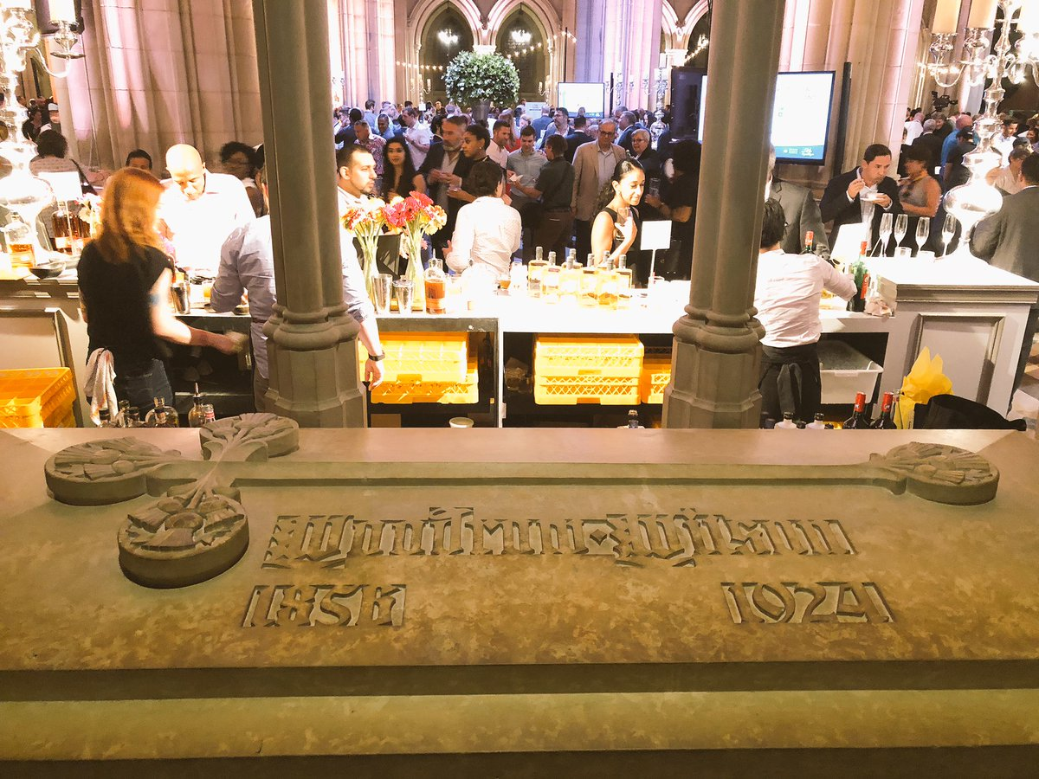
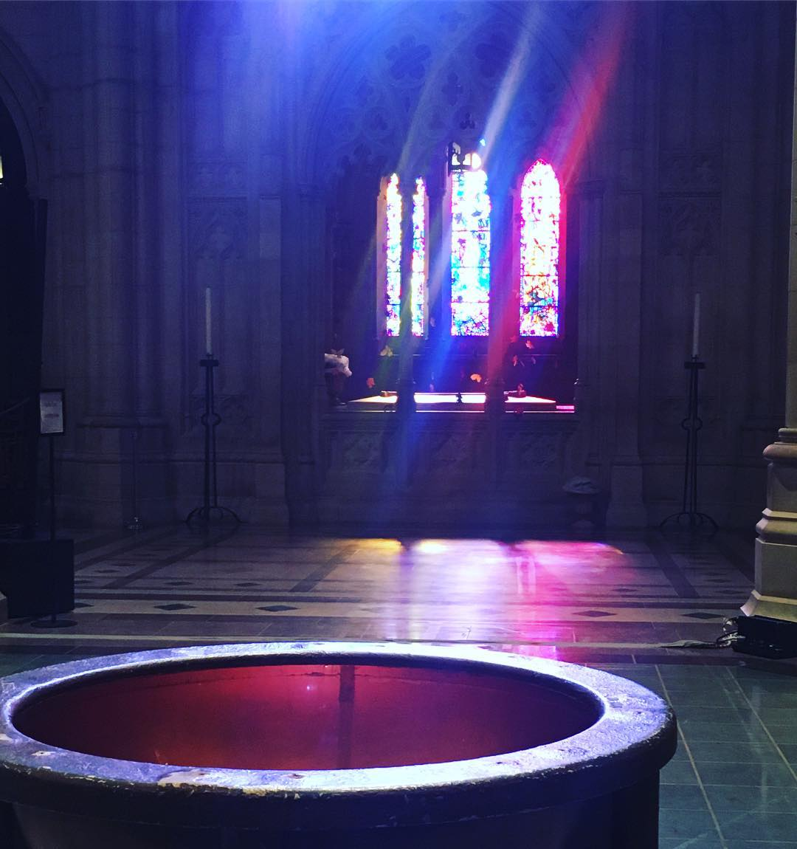

Slide 101
→ Friendship is what holds peoples together
→ With God there is no fear of what man can do
→ War among men is not declared by God, but by men
→ Ignorance of God deepens the persistence of sin
→ Only individuals by themselves can find God
→ Darkness hides in the halls of men’s perceived power
→ Freedom is held in bondage by the greedy
→ Forgetting original ideals leaves no good foundation
→ Allegiance should be to God over man
→ Sympathy for sinners can lead to sin’s acceptance
→ The fewer the desires, the more peace
→ Without God the shadows of man bring destruction
→ Love cannot find extent of expression in its’ pure gift
Torturous conditions carry us in the land of His mercy
Notes:
Torturous conditions carry us in the land of His mercy

Slide 102
Please visit http://www.LoveFromGod.com to explore further
Ronald Bert Channel on
Notes:
Eternity never ends.

