Slide 2
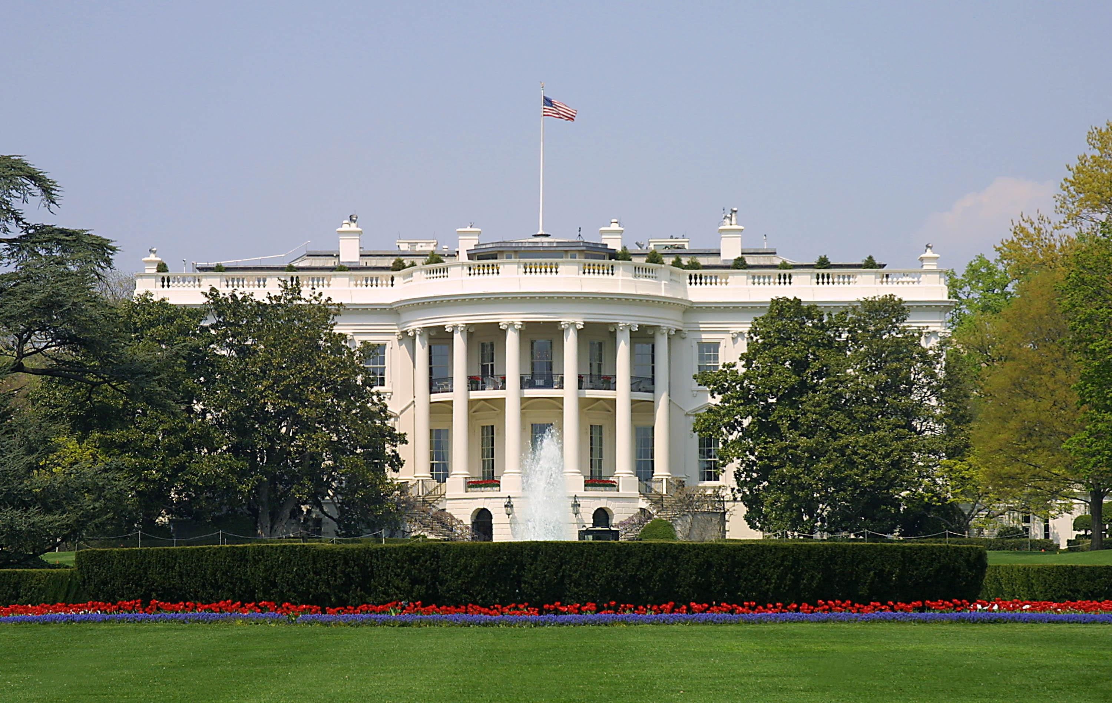
Presidential Quotes
Ron Bert
20
April 7, 2019

Slide 3
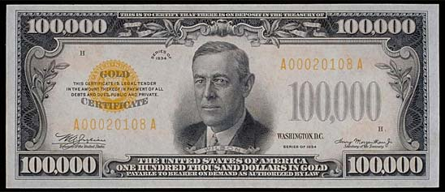
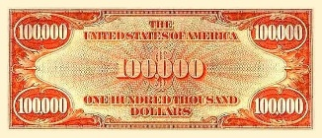
28. Woodrow Wilson (1913-1921)
Part 1
Notes:
He was president of Princeton University, governor of New Jersey, and president of the United States

Slide 4
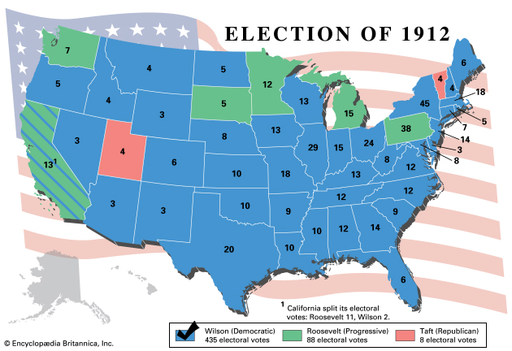
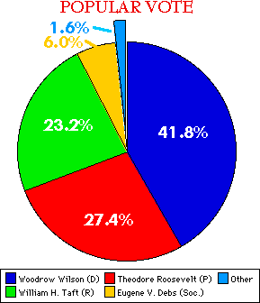

Slide 5
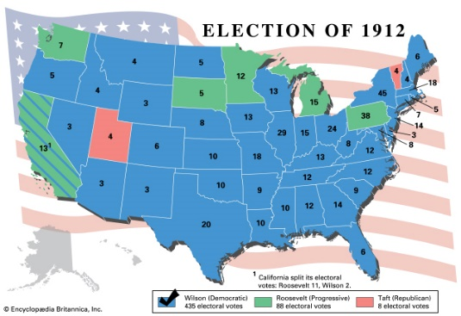
“When you have read the Bible, you know it is the word of God, because it is the key to your heart, your own happiness, and your duty.”

Slide 6
For this reason we also thank God without ceasing, because when you received the word of God which you heard from us, you welcomed it not as the word of men, but as it is in truth, the word of God, which also effectively works in you who believe. — 1st Thessalonians 2:13

Slide 7
“The Bible is the supreme source of revelation of the meaning of life, the nature of God, and the spiritual nature and needs of men. It is the only guide of life which really leads the spirit in the way of peace and salvation. America was born a Christian nation. America was born to exemplify that devotion to the elements of righteousness which are derived from the revelations of Holy Scripture.”

Slide 8
All Scripture is given by inspiration of God, and is profitable for doctrine, for reproof, for correction, for instruction in righteousness, … — 2nd Timothy 3:16

Slide 9
“This book [the Bible] speaks both the voice of God and the voice of humanity, for there is told in it the most convincing of human experience that has ever been written...and those who heed that story will know their strength and happiness and success are all summed up in the exhortation, "Fear God and keep His commandments."

Slide 10
“No people are true Christians who do not think constantly of how they can lift their brother and sister, how they can assist their friends, how they can enlighten mankind, how they can make virtue the rule of conduct in the circle in which they live.”

Slide 11
But whoever has this world's goods, and sees his brother in need, and shuts up his heart from him, how does the love of God abide in him? — 1st John 3:17

Slide 12
“The only way your powers can become great is by exerting them outside the circle of your own narrow, special, selfish interests. And that is the reason of Christianity. Christ came into the world to save others, not to save himself; and no man is a true Christian who does not think constantly of how he can lift his brother, how he can assist his friend, how he can enlighten mankind, how he can make virtue the rule of conduct in the circle in which he lives.”
virtue the rule of conduct

Slide 13
“I am sorry for men who do not read the Bible every day. I wonder why they deprive themselves of the strength and pleasure.”

Slide 14
(… by which, when you read, you may understand my knowledge in the mystery of Christ), … — Ephesians 3:4

Slide 15
“It is the object of learning, not only to satisfy the curiosity and perfect the spirits of ordinary men, but also to advance civilization.”

Slide 16
“Science has won for us a great liberty in the physical world, a liberty from superstitious fear and from disease, a freedom touse nature as a familiar servant; but it has not freed us from ourselves.”
Notes:
TOUSE=WAVING NOISE

Slide 17
“Never for a moment have I had one doubt about my religious beliefs. There are people who believe only so far as they can understand -- that seems to me presumptuous and sets their understanding as the standard of the universe.”
arrogant

Slide 18
“You are not here merely to make a living. You are here in order to enable the world to live more amply, with greater vision, with a finer spirit of hope and achievement. You are here to enrich the world, and you impoverish yourself if you forget the errand.”
service

Slide 19
"Every man shall give as he is able, according to the blessing of the LORD your God which He has given you." — Deuteronomy 16:17

Slide 20
“Life does not consist in thinking, it consists in acting.”

Slide 21
“Work is the keystone of a perfect life. Work and trust in God.”

Slide 22
“Responsibility is proportionate to opportunity.”

Slide 23
“... men are not put into this world to go the path of ease, they are put into this world to go the path of pain and struggle.”

Slide 24
But may the God of all grace, who called us to His eternal glory by Christ Jesus, after you have suffered a while, perfect, establish, strengthen, and settle you. — 1st Peter 5:10

Slide 25
“A fault which humbles a person is of more use to him or her than a good action which puffs him or her up.”

Slide 26
When pride comes, then comes shame; But with the humble is wisdom. — Proverbs 11:2

Slide 27
“The difference between a strong man and a weak one is that the former does not give up after a defeat.”

Slide 28
“If you lose your wealth, you have lost nothing; if you lose your health, you have lost something; but if you lose your character, you have lost everything.”

Slide 29
“No man has ever risen to the stature of spiritual manhood until he has found that it is finer to serve somebody else than it is to serve himself.”

Slide 30
As each one has received a gift, minister it to one another, as good stewards of the manifold grace of God. — 1st Peter 4:10

Slide 31
“No thoughtful man ever came to the end of his life, and had time and a little space of calm from which to look back upon it, who did not know and acknowledge that it was what he had done unselfishly and for others, and nothing else, that satisfied him in the retrospect, and made him feel that he had played the man.”

Slide 32
“There is no higher religion than human service. To work for the common good is the greatest creed.”

Slide 33
“The princes among us are those who forget themselves and serve others.”

Slide 34
"Greater love has no one than this, than to lay down one's life for his friends." — John 15:13

Slide 35
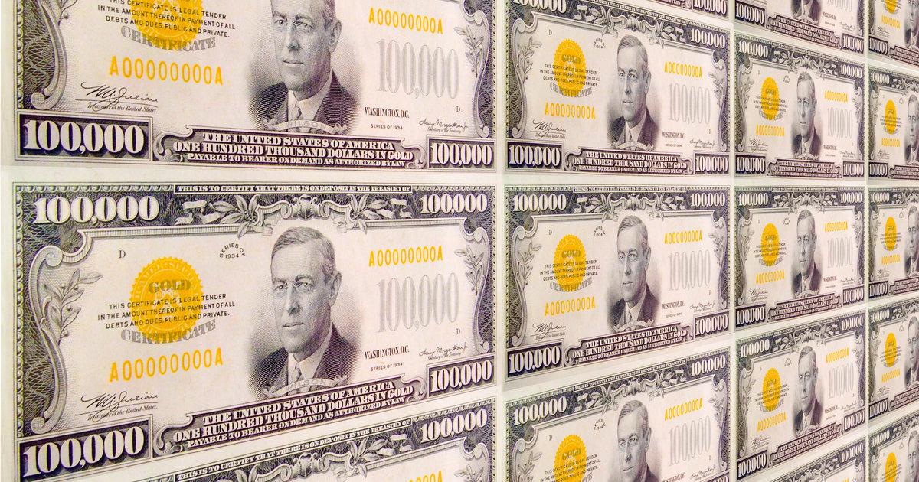

Slide 36
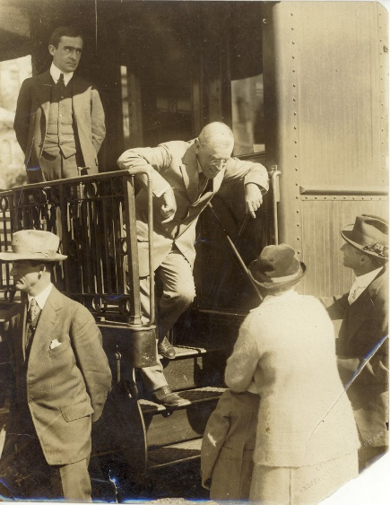
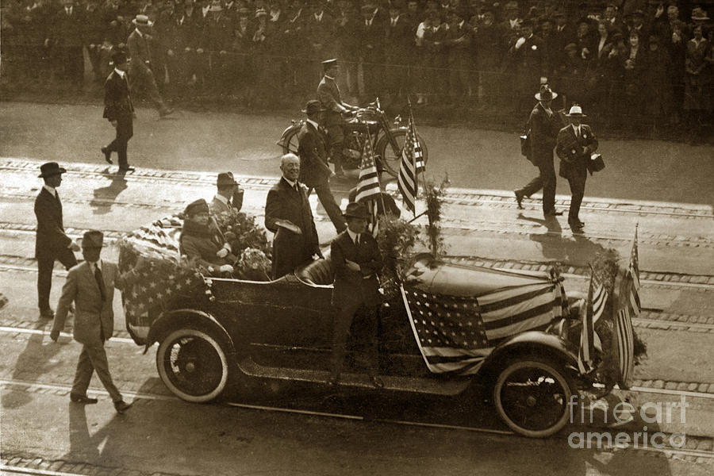

Slide 37
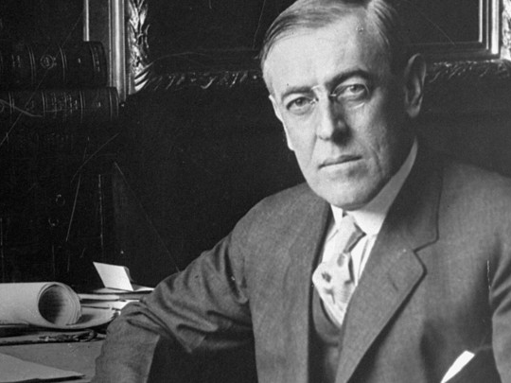

Slide 38
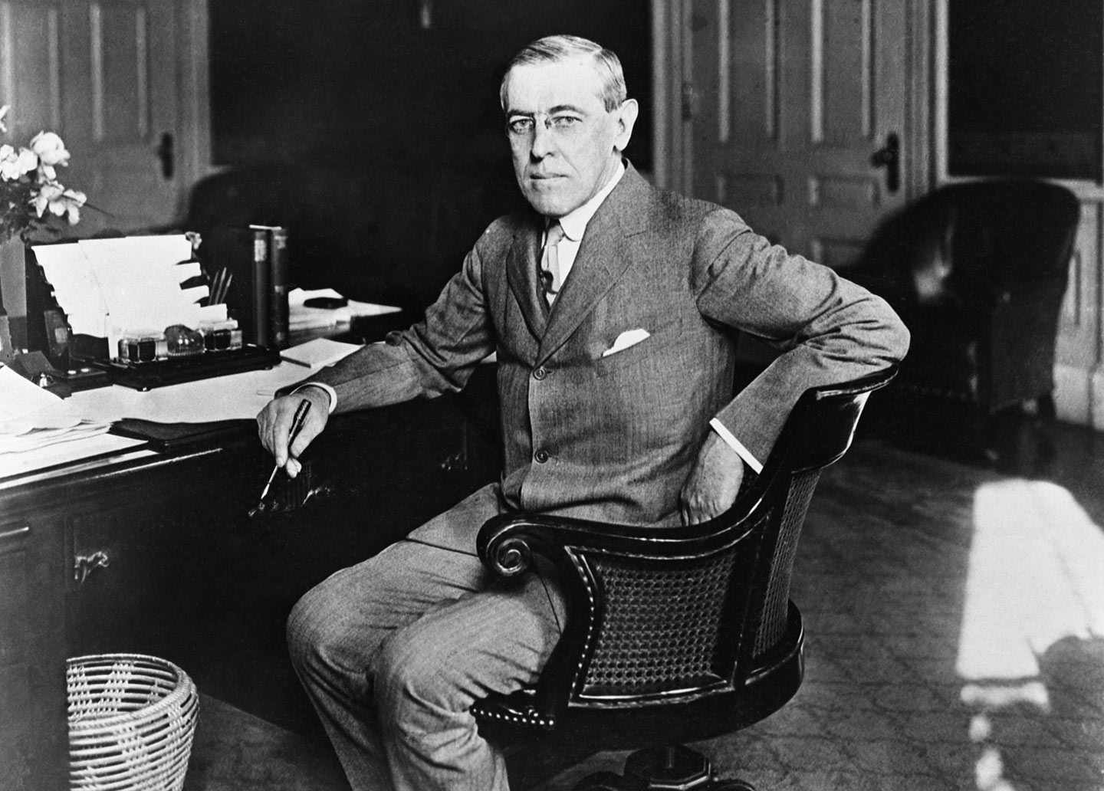

Slide 39
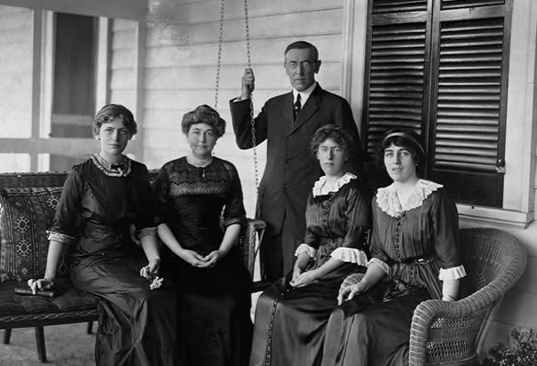
Notes:
Ellen Axson Wilson - She died of Bright's disease at the White House on August 6, 1914. She was buried in Rome, Georgia among her family at Myrtle Hill Cemetery. In December 1915, president Woodrow Wilson married Edith Bolling Galt.

Slide 40
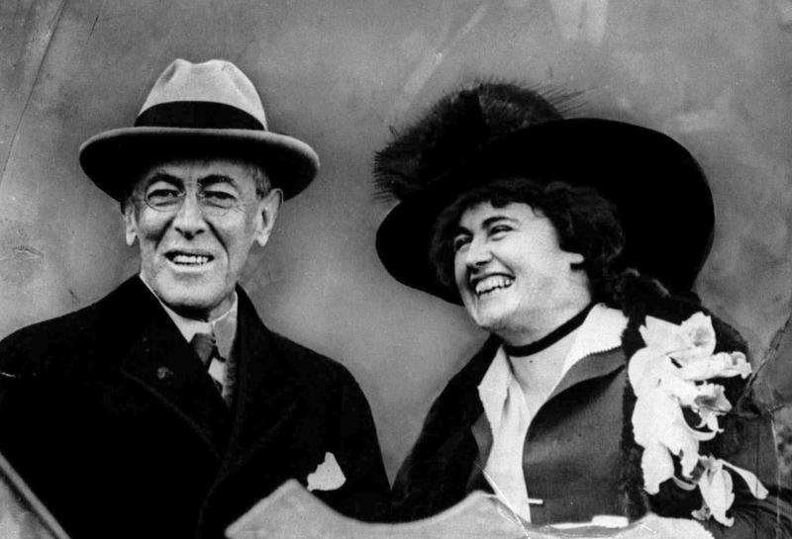
Notes:
Woodrow Wilson marries Edith Bolling Galt. On this day December 18, 1915, President Woodrow Wilson marries Edith Galt in Washington, D.C. The bride was 43 and the groom was 59. It was the second marriage for Wilson, whose first wife died the year before from a kidney ailment.

Slide 41
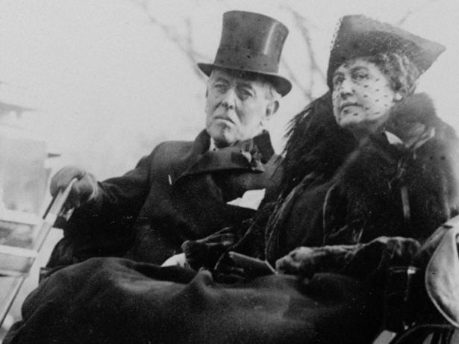

Slide 42
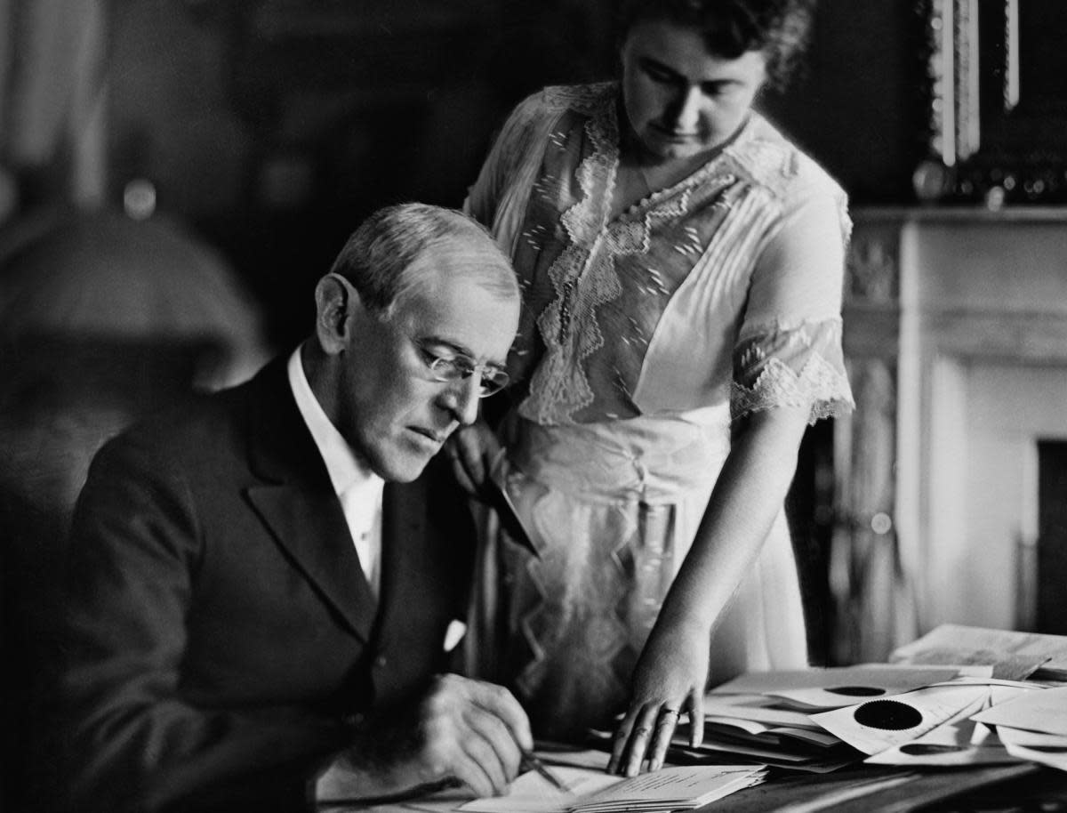
Notes:
President Woodrow Wilson collapsed after addressing a crowd in Pueblo, Colorado, on this day September 25, 1919
For just over a year, Edith Wilson took on the duties of the president, following her husband's stroke.
On the morning of Oct. 2, 1919 Edith found her husband unconscious. He had suffered a massive stroke that left him blind in his left eye and his left side paralyzed.
The extent of Wilson’s disability remained a secret until after his death on Feb. 3, 1924. It was subsequently cited as a rationale for passage of the 25th Amendment, which lays out what should be done if a president is found to be unable to perform the functions of his office.

Slide 43
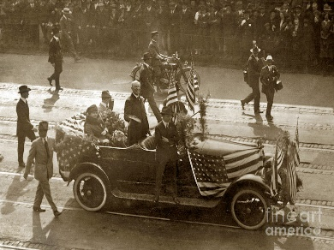
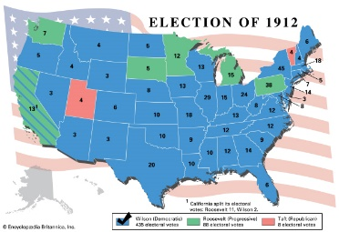

Slide 44
→ The Bible is the key to happiness and duty
→ The Bible is the guide to life and salvation
→ The Bible speaks the voice of God & humanity
→ Intrinsic to Christianity is compassion for others
→ Greatness can only come to through helping
→ The Bible delivers spiritual strength & pleasure
→ The truth of science frees us from superstition
→ True belief goes beyond mere understanding
→ True poverty of spirit comes to the selfish
→ Key to a perfect life is work and trust in God
→ All are challenged to continue the struggle
→ Service to others defines spiritual maturity
→ The greatest retrospect in life is service
Clarity comes to those with noble hearts
Notes:
Clarity comes to those with noble hearts

Slide 46
Please visit http://www.LoveFromGod.com to explore further
Ronald Bert Channel on
Notes:
Eternity never ends.

