Slide 2
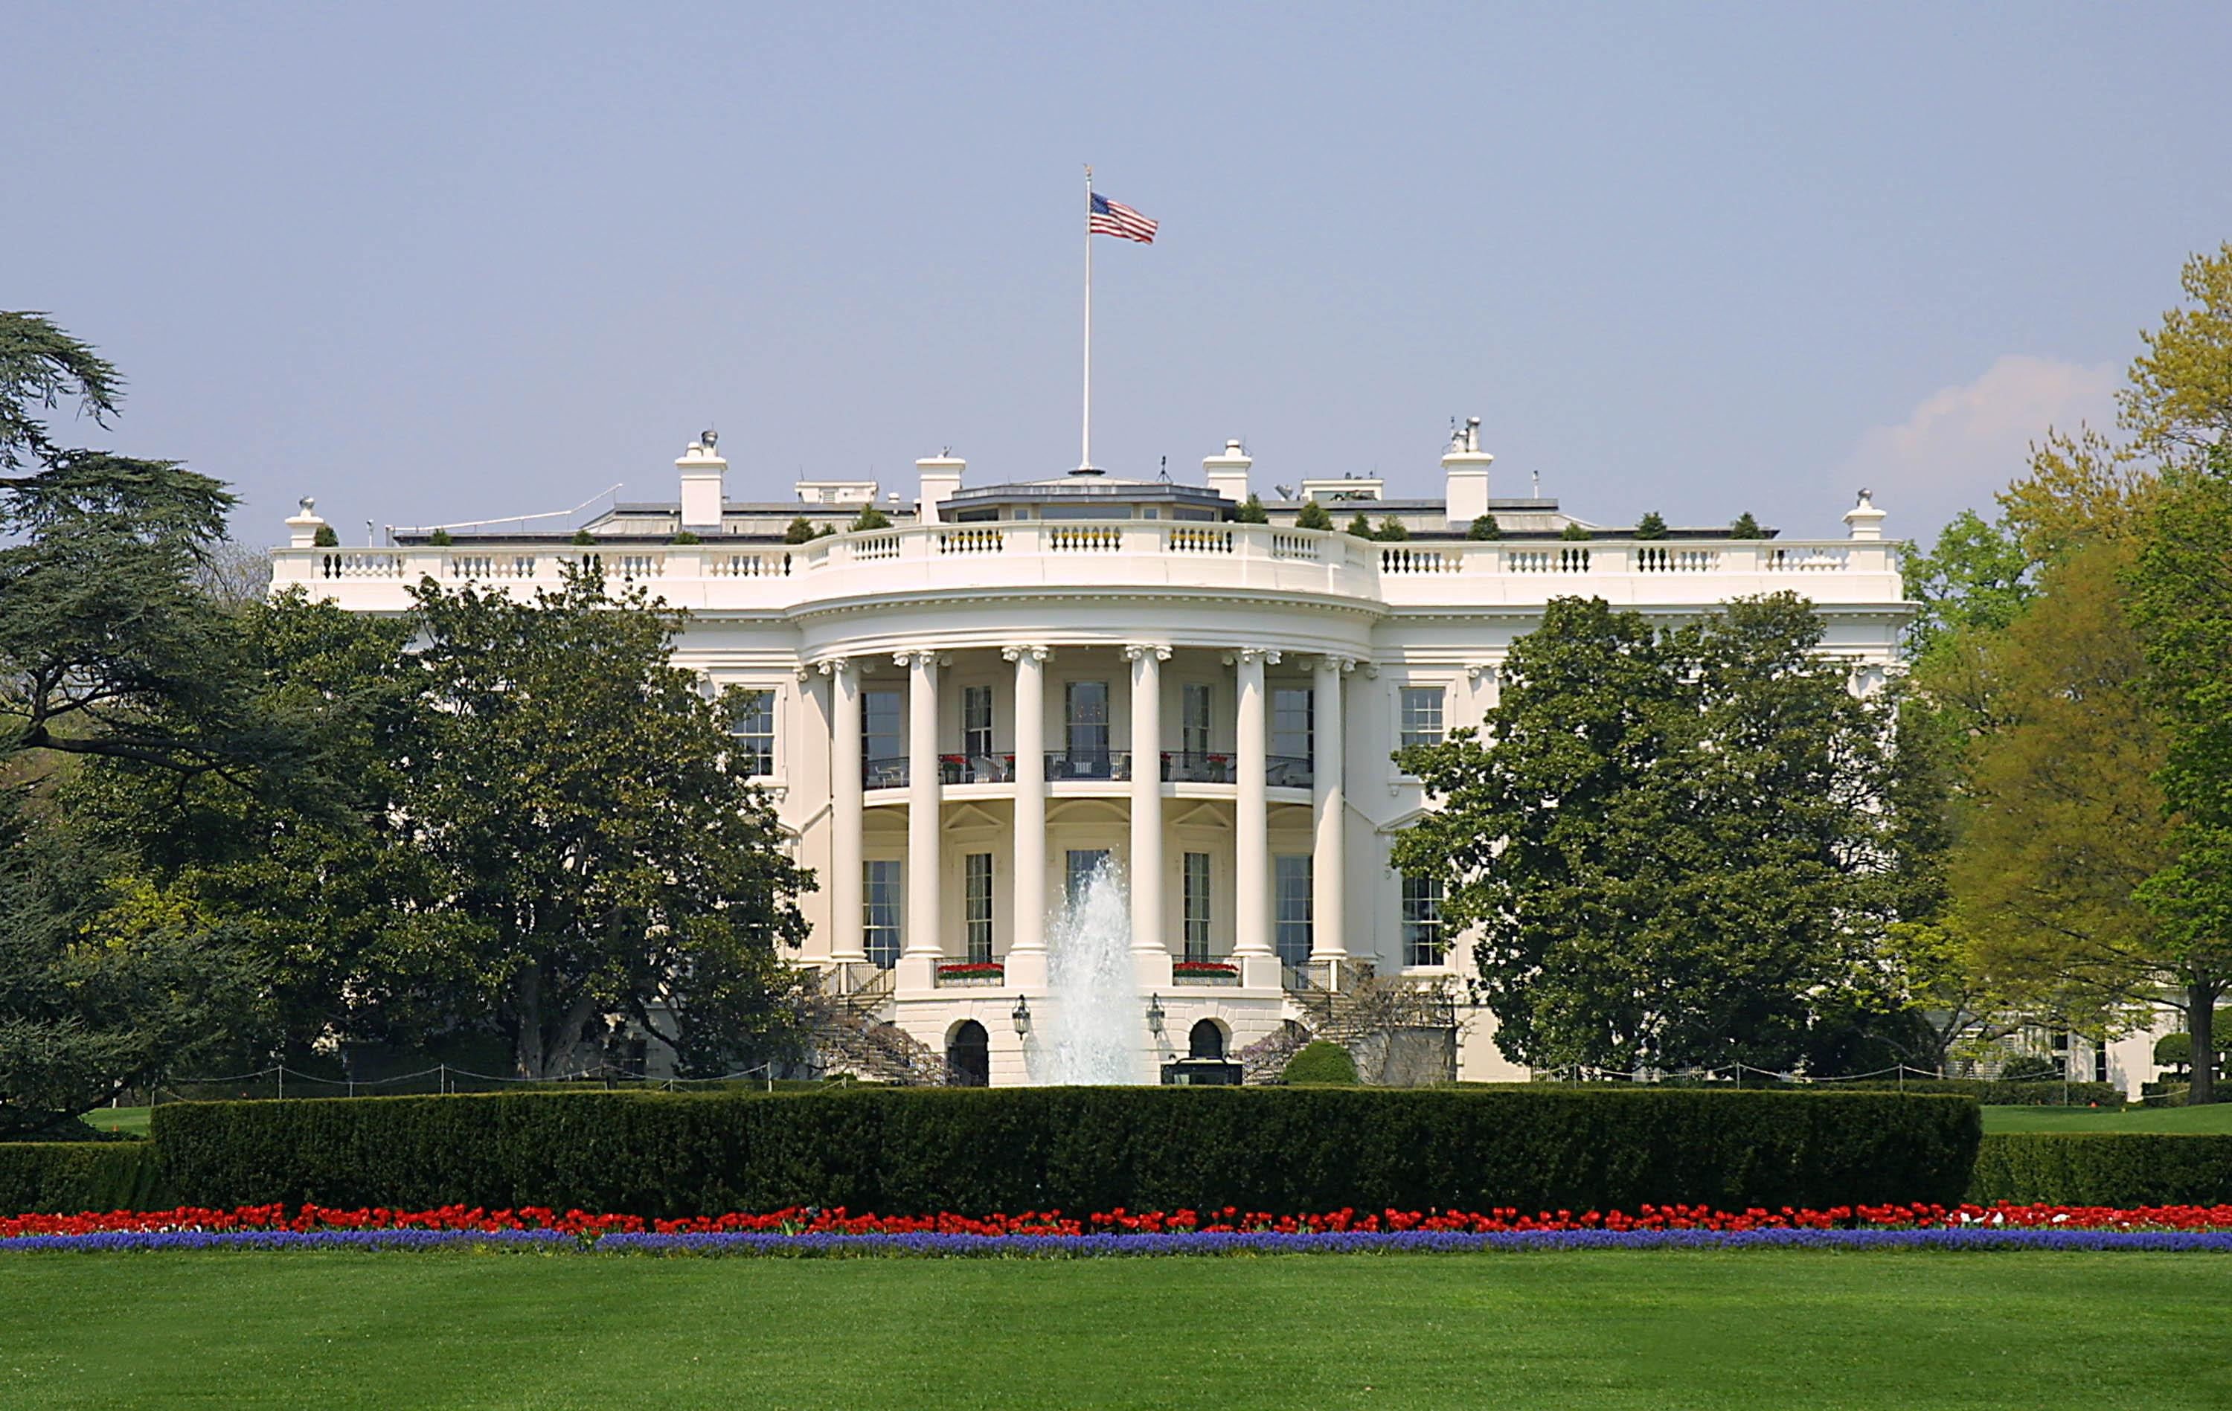
Presidential Quotes
Ron Bert
19
March 24, 2019

Slide 3
26. Theodore Roosevelt (1901-1909)
Part 3

Slide 4
“It is better to be faithful than famous.”

Slide 5
“The joy of living is his who has the heart to demand it. Life is a great adventure, and I want to say to you, accept it in such a spirit.”
joy of living
demand it
in
in such a spirit

Slide 6
“Wide differences of opinion in matters of religious, political, and social belief must exist if conscience and intellect alike are not to be stunted, if there is to be room for healthy growth.”

Slide 7
But the manifestation of the Spirit is given to each one for the profit of all: for to one is given the word of wisdom through the Spirit, to another the word of knowledge through the same Spirit, to another faith by the same Spirit, to another gifts of healings by the same Spirit, to another the working of miracles, to another prophecy, to another discerning of spirits, to another different kinds of tongues, to another the interpretation of tongues. — 1st Corinthians 12:7-10

Slide 8
But one and the same Spirit works all these things, distributing to each one individually as He wills. For as the body is one and has many members, but all the members of that one body, being many, are one body, so also is Christ. — 1st Corinthians 12:11-12

Slide 9
“Freemasonry teaches not merely temperance, fortitude, prudence, justice, brotherly love, relief, and truth, but liberty, equality, and fraternity, and it denounces ignorance, superstition, bigotry, lust tyranny and despotism.”

Slide 10
“I highly venerate the Masonic Institution, under the fullest persuasion that, when its principles are acknowledged and its laws and precepts obeyed, it comes nearest to the Christian religion, in its moral effects and influence, of any institution with which I am acquainted.”
honor

Slide 11
“I hold that in this country there must be complete severance of Church and State; that public moneys shall not be used for the purpose of advancing any particular creed; and therefore that the public schools shall be nonsectarian and no public moneys appropriated for sectarian schools.”

Slide 12
“There is superstition in science quite as much as there is superstition in theology, and it is all the more dangerous because those suffering from it are profoundly convinced that they are freeing themselves from all superstition.”
false notion
fantasy
more dangerous
X
GOD
delusion
Notes:
Atheism in science is a dead science. We serve in a living universe. It is still the land of the living.

Slide 13
“I believe that this Republic will endure for many centuries. If so there will doubtless be among its Presidents Protestants and Catholics, and very probably at some time, Jews. I have consistently tried while President to act in relation to my fellow Americans of Catholic faith as I hope that any future President who happens to be Catholic will act towards his fellow Americans of Protestant faith. Had I followed any other course I should have felt that I was unfit to represent the American people.”

Slide 14
“We fight in honorable fashion for the good of mankind; fearless of the future, unheeding of our individual fates, with unflinching hearts and undimmed eyes; we stand at Armageddon, and we battle for the Lord.”
battle for the Lord

Slide 15
“A churchless community, a community where men have abandoned and scoffed at or ignored their religious needs, is a community on the rapid downgrade.”

Slide 16
And let us consider one another in order to stir up love and good works, not forsaking the assembling of ourselves together, as is the manner of some, but exhorting one another, and so much the more as you see the Day approaching. — Hebrews 10:24-25
consider one another in
order to
stir up love and good
consider one another in order to:
• stir up love and good works
• not forsaking the assembling
• exhorting one another
works
not forsaking the
assembling
bonding
gathering
exhorting one another
encouraging

Slide 17
“We must diligently strive to make our young men decent, God-fearing, law-abiding, honor-loving, justice-doing and also fearless and strong.”

Slide 18
“If a man does not have an ideal and try to live up to it, then he becomes a mean, base and sordid creature, no matter how successful.”
supreme
best-possible
principle
model
ideal
standard
belief
vile
sleezy

Slide 19
“Almost every man who has by his life-work added to the sum of human achievement of which the race is proud, of which our people are proud, almost every such man has based his life-work largely upon the teachings of the Bible.”

Slide 20
“I have often thought that unselfishness combined in one word more of the teachings of the Bible than any other in the language.”
unselfishness
one word
teachings
the Bible

Slide 21
… yet in the church I would rather speak five words with my understanding, that I may teach others also, than ten thousand words in a tongue. — 1st Corinthians 14:19

Slide 22
“He [Lincoln] had mastered it {the Bible] absolutely ... mastered it so that he became almost 'a man of one Book', who knew that Book and who instinctively put into practice what he had been taught therein.”
practice
taught

Slide 23
And do not be conformed to this world, but be transformed by the renewing of your mind, that you may prove what is that good and acceptable and perfect will of God. — Romans 12:2

Slide 24
“Abraham Lincoln - the spirit incarnate of those who won victory in the Civil War - was the true representative of this people, not only for his own generation, but for all time, because he was a man among men.”

Slide 25
“The true Christians are the true citizens, lofty of purpose, resolute in endeavor, ready for a hero's deeds, but never looking down on their task because it is cast in the day of small things; scornful of baseness, awake to their own duties as well as to their rights, following the higher law with reverence, and in this world doing all that in their power lies, so that when death comes they may feel that humanity is in some degree better because they lived.”
purpose
resolute
ready
deeds
task
hate evil
duties
higher law

Slide 26
For our citizenship is in heaven, from which we also eagerly wait for the Savior, the Lord Jesus Christ, who will transform our lowly body that it may be conformed to His glorious body, according to the working by which He is able even to subdue all things to Himself — Philippians 3:20-21

Slide 27
“From the greatest to the smallest, happiness and usefulness are largely found in the same soul, and the joy of life is won in its deepest and truest sense only by those who have not shirked life's burdens.”
joy of life
in
won in
by
not shirked life's burdens

Slide 28
For each one shall bear his own load. — Galatians 6:5

Slide 29
"By your patience possess your souls." — Luke 21:19

Slide 30
“The dreams of golden glory in the future will not come true unless, high of heart and strong of hand, by our own mighty deeds we make them come true.”

Slide 31
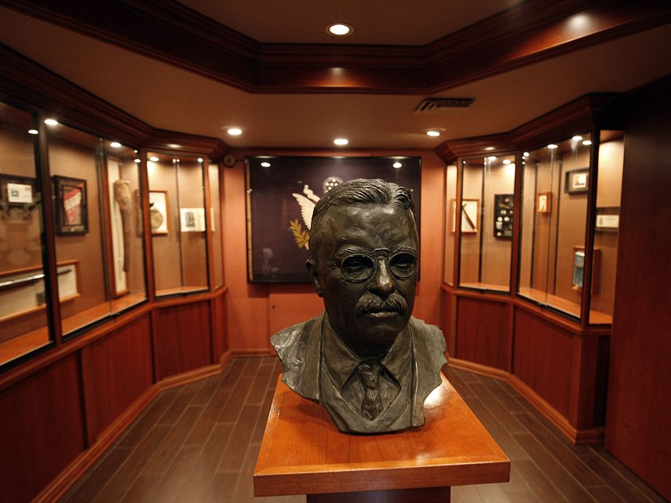

Slide 32
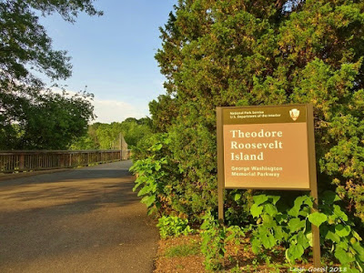
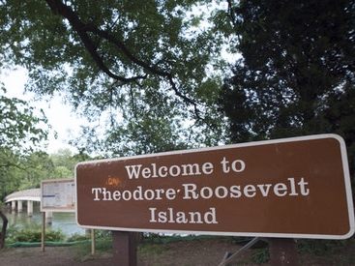
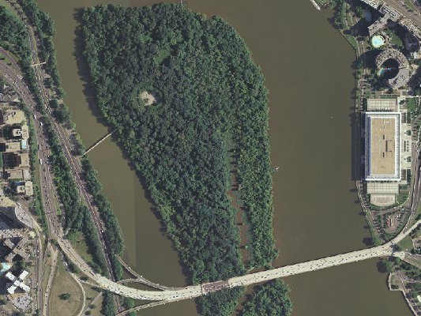

Slide 33
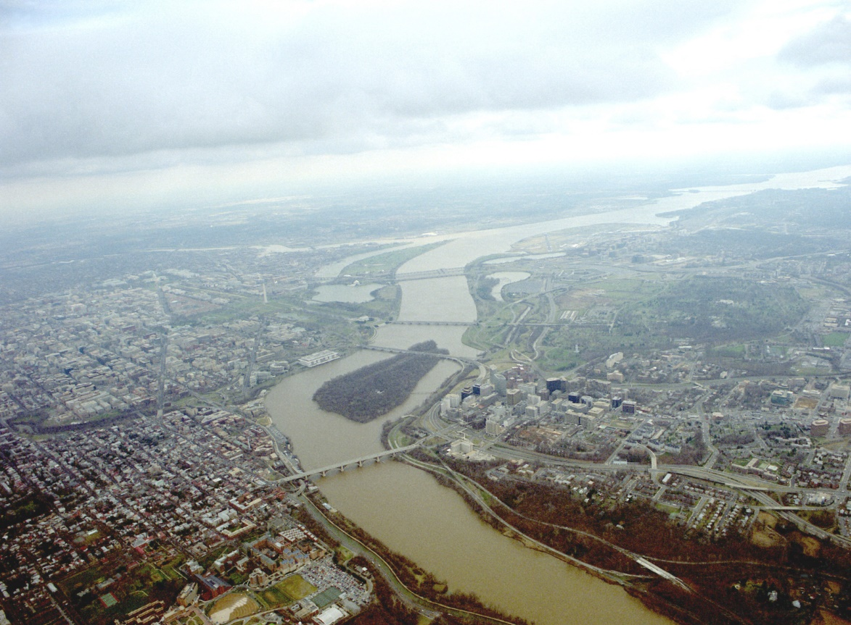
Washington Monument
Jefferson Memorial
Capitol
Washington
Lincoln Memorial
Theodore Roosevelt Island
White House
Arlington
Potomac River

Slide 34
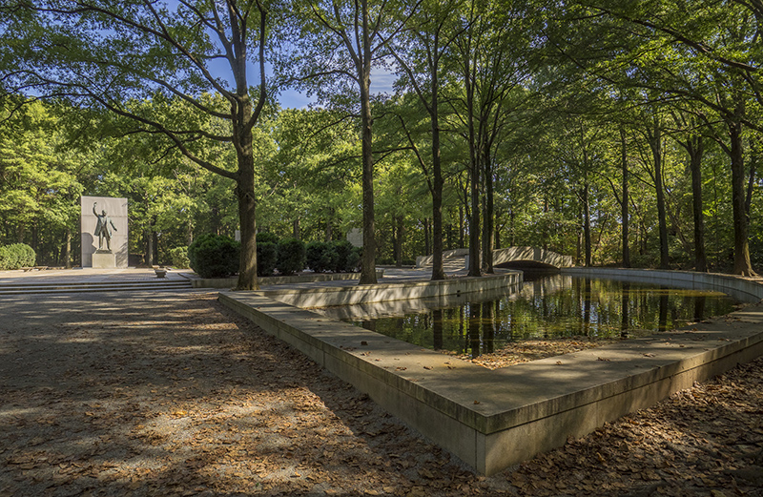

Slide 35
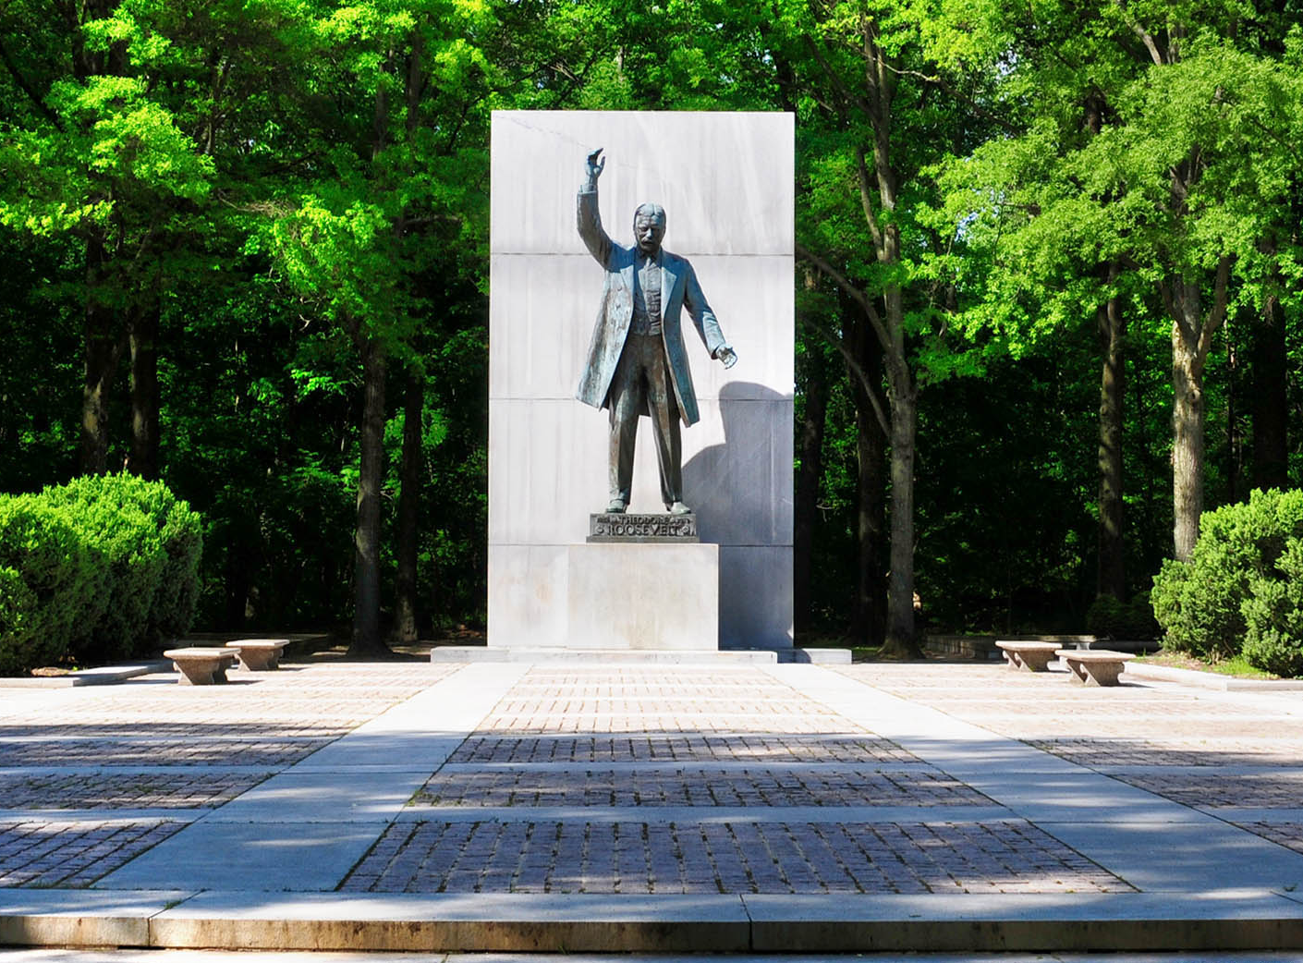
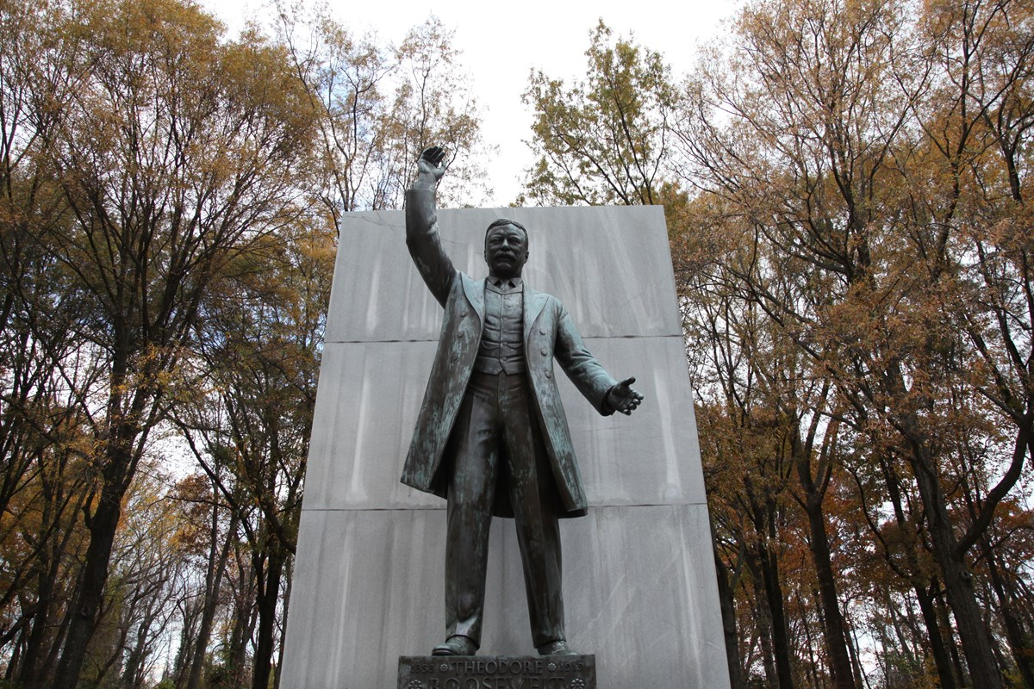

Slide 36
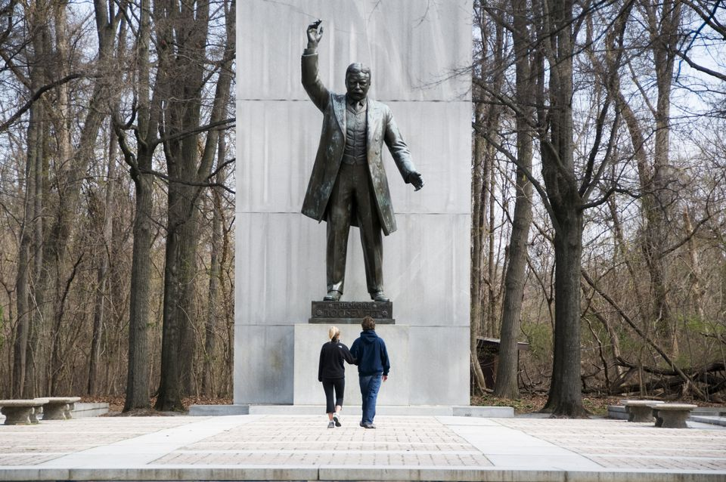

Slide 37
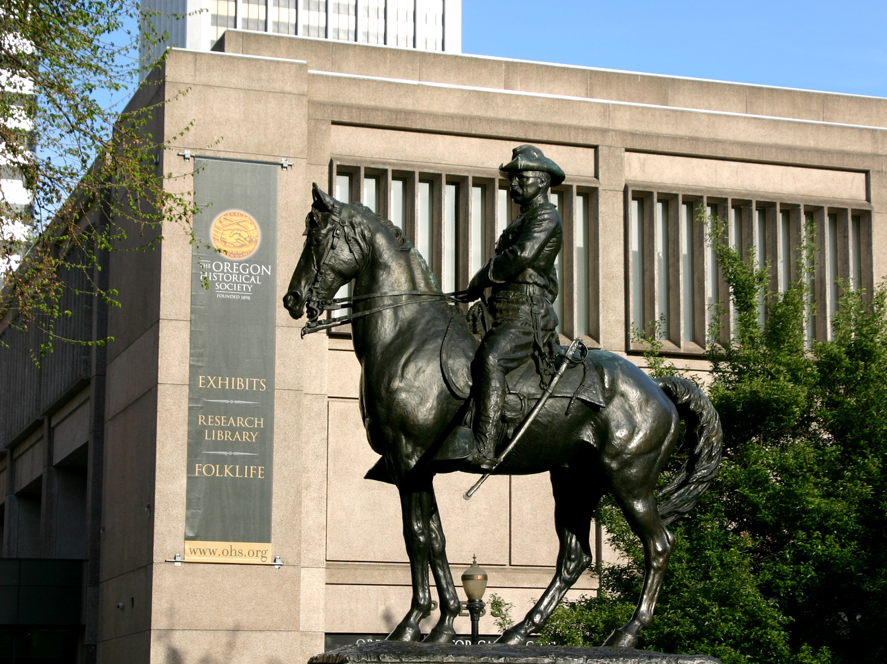
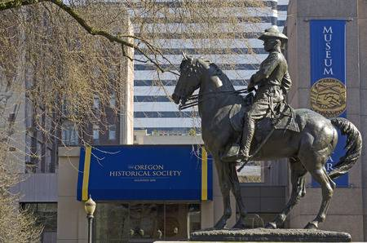
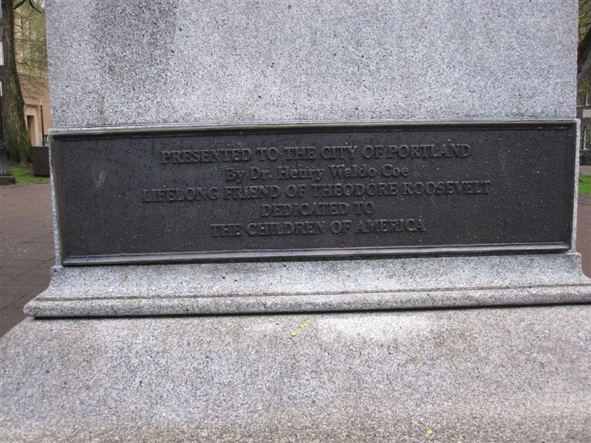

Slide 38
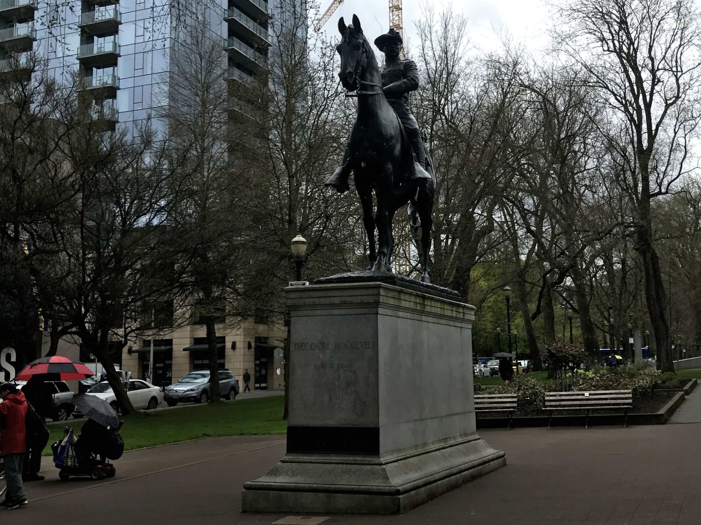

Slide 39
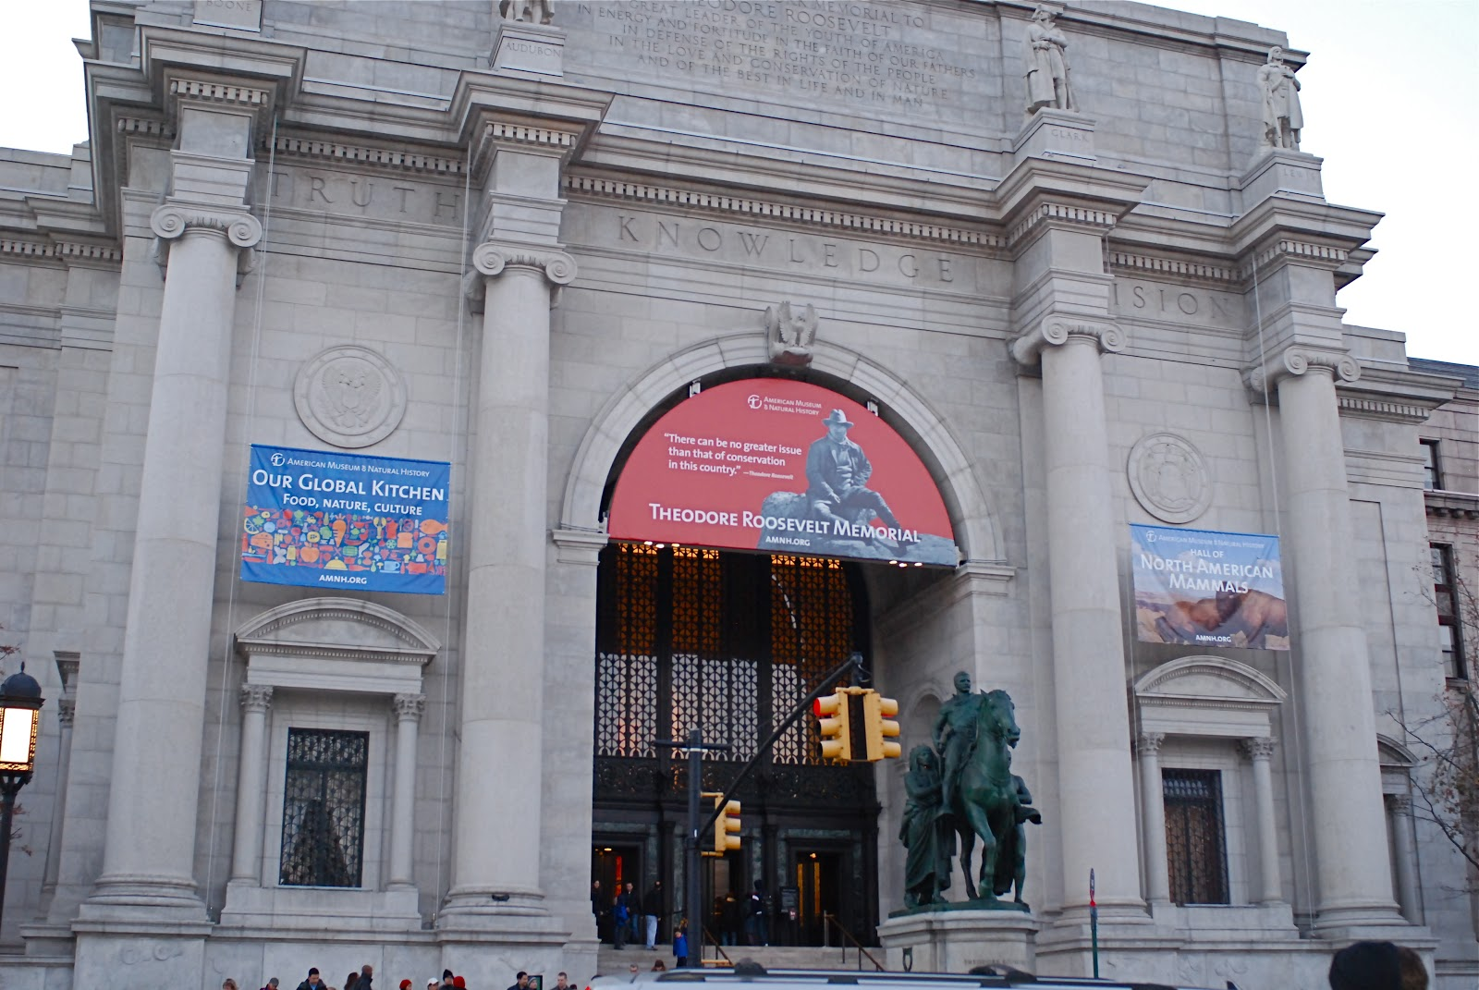
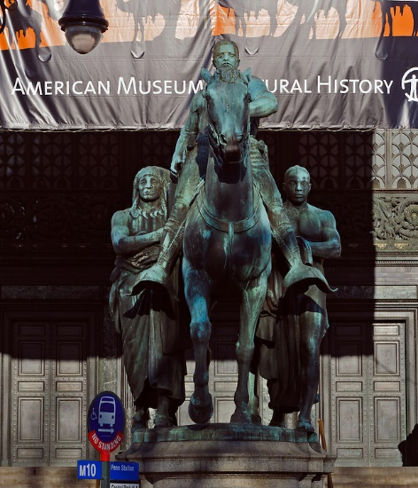
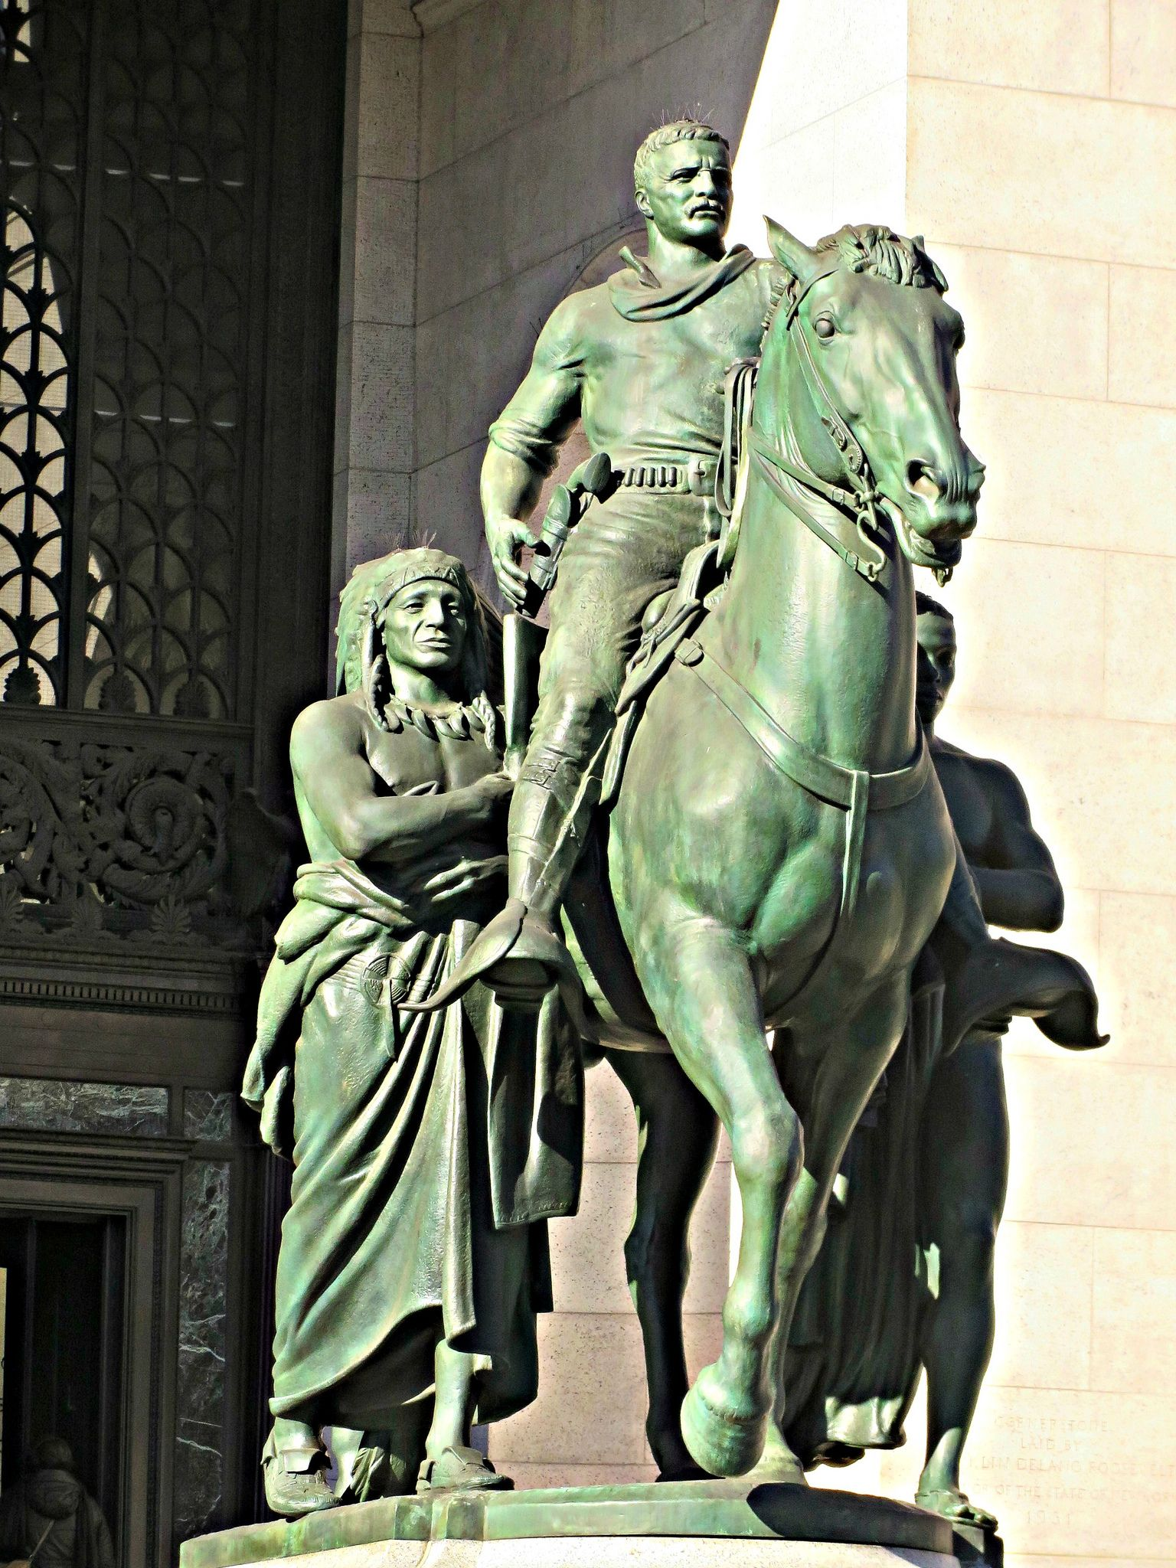
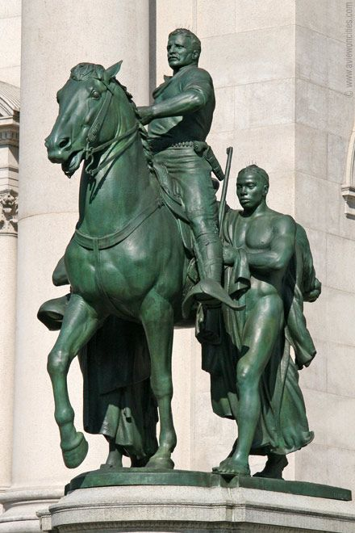
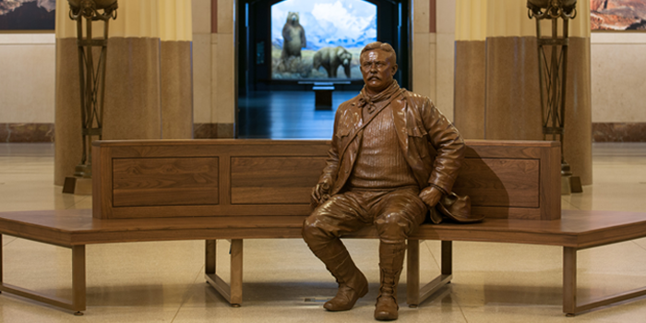

Slide 40
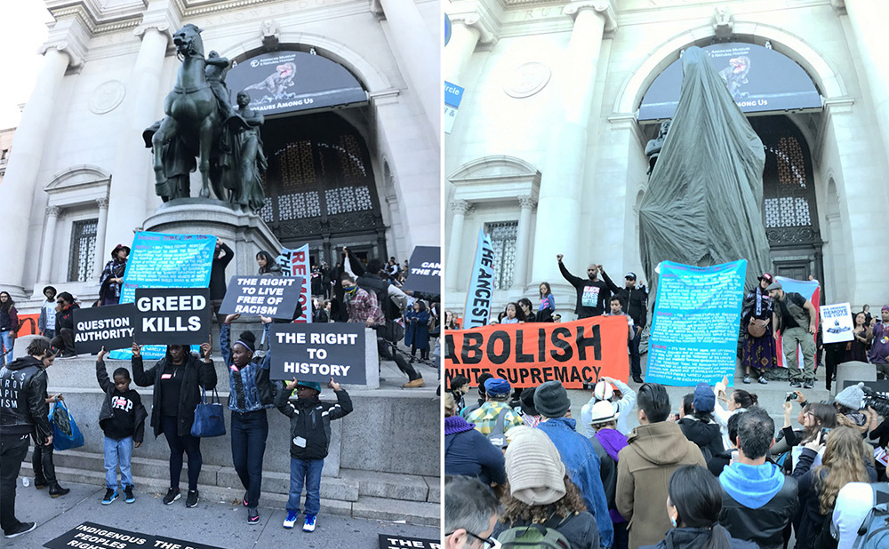
Notes:
Isaiah 59:6

Slide 41
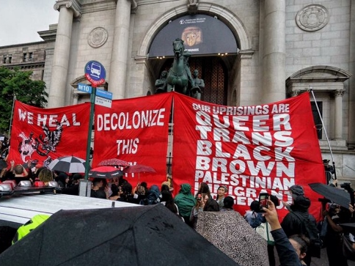

Slide 42
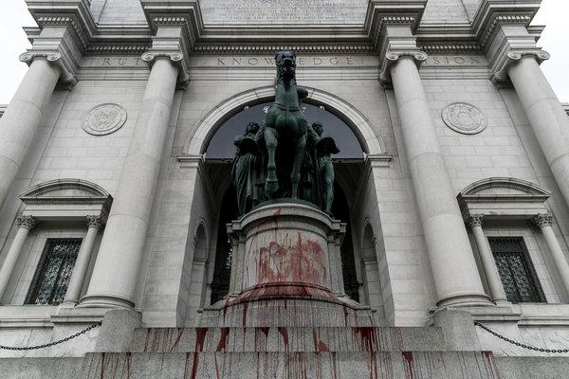

Slide 43
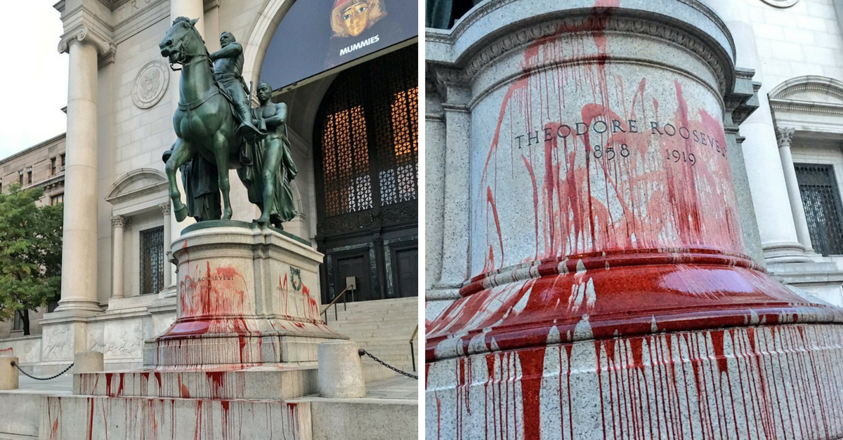
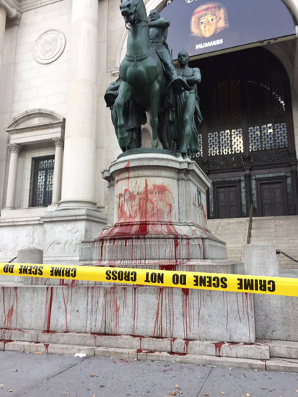

Slide 44
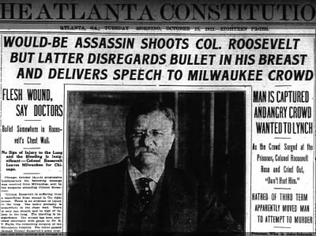
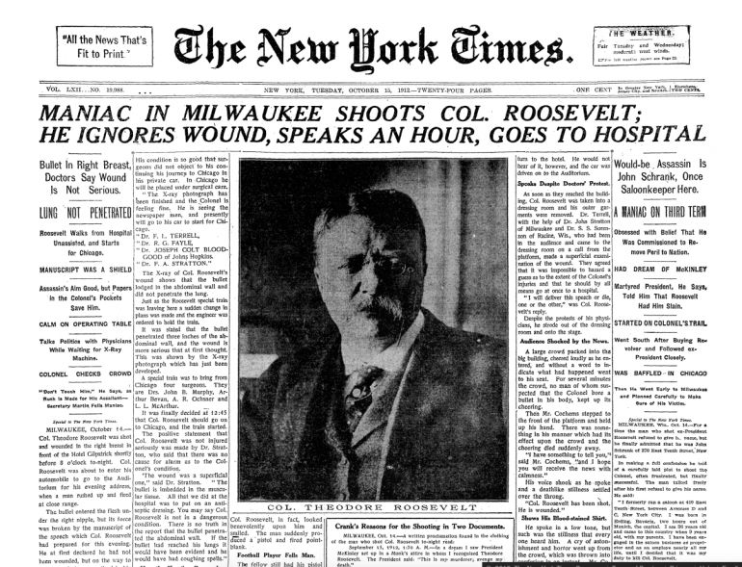
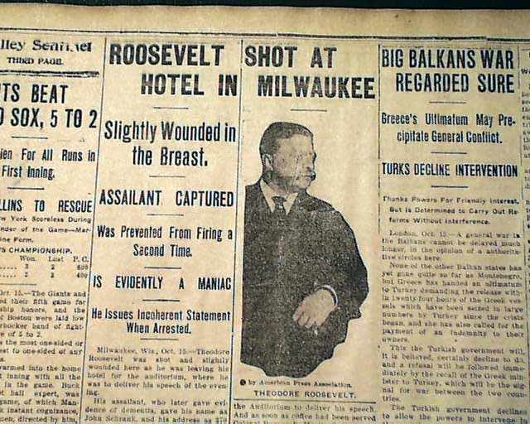
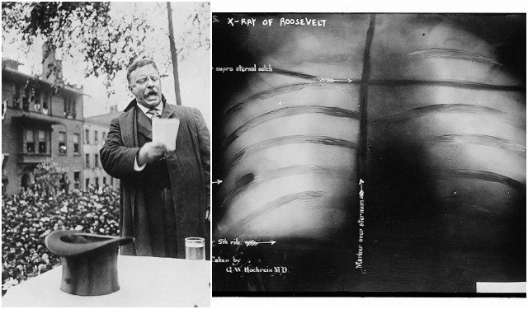
Notes:
Shot in 1912 as he was running for a third term

Slide 45
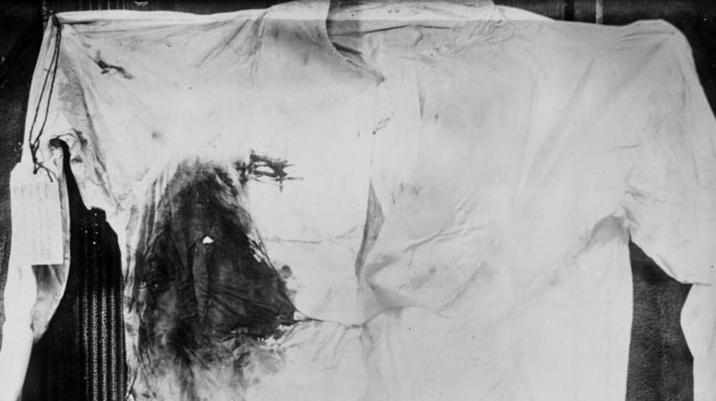
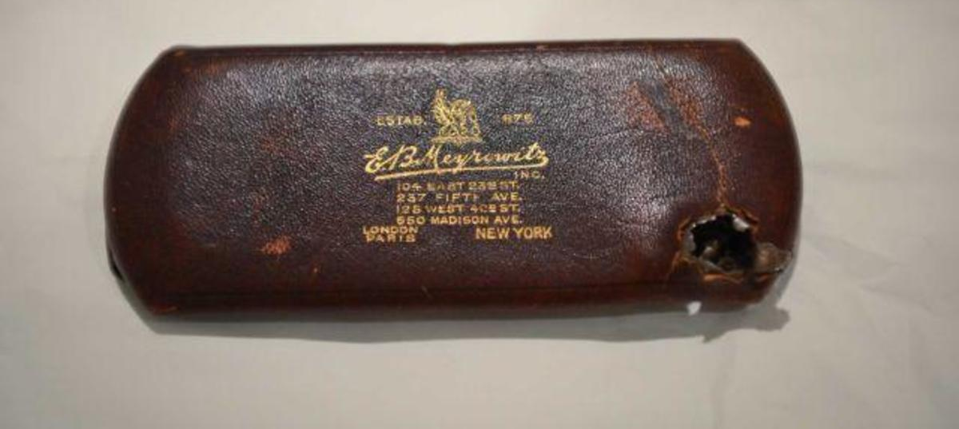
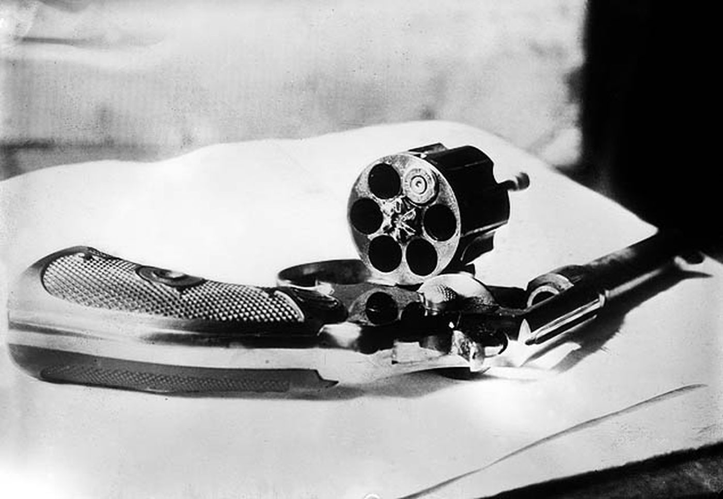
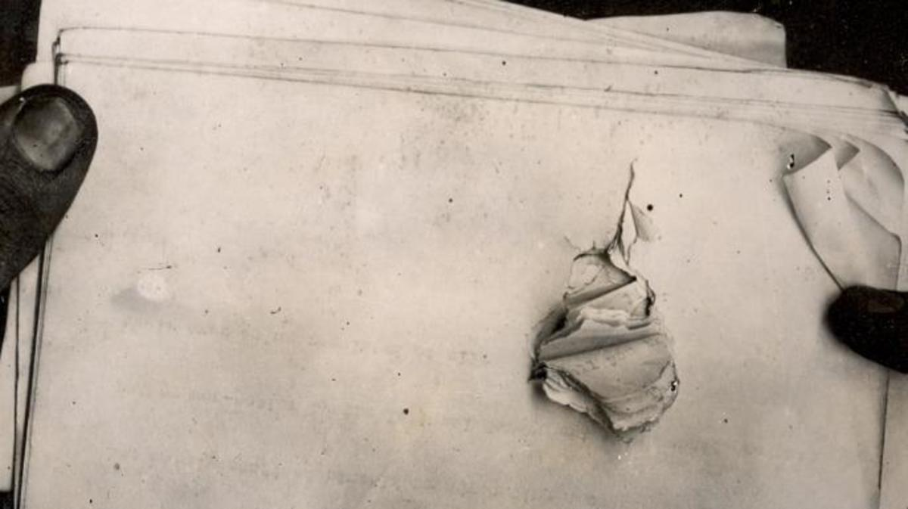
Notes:
.38 caliber revolver

Slide 46
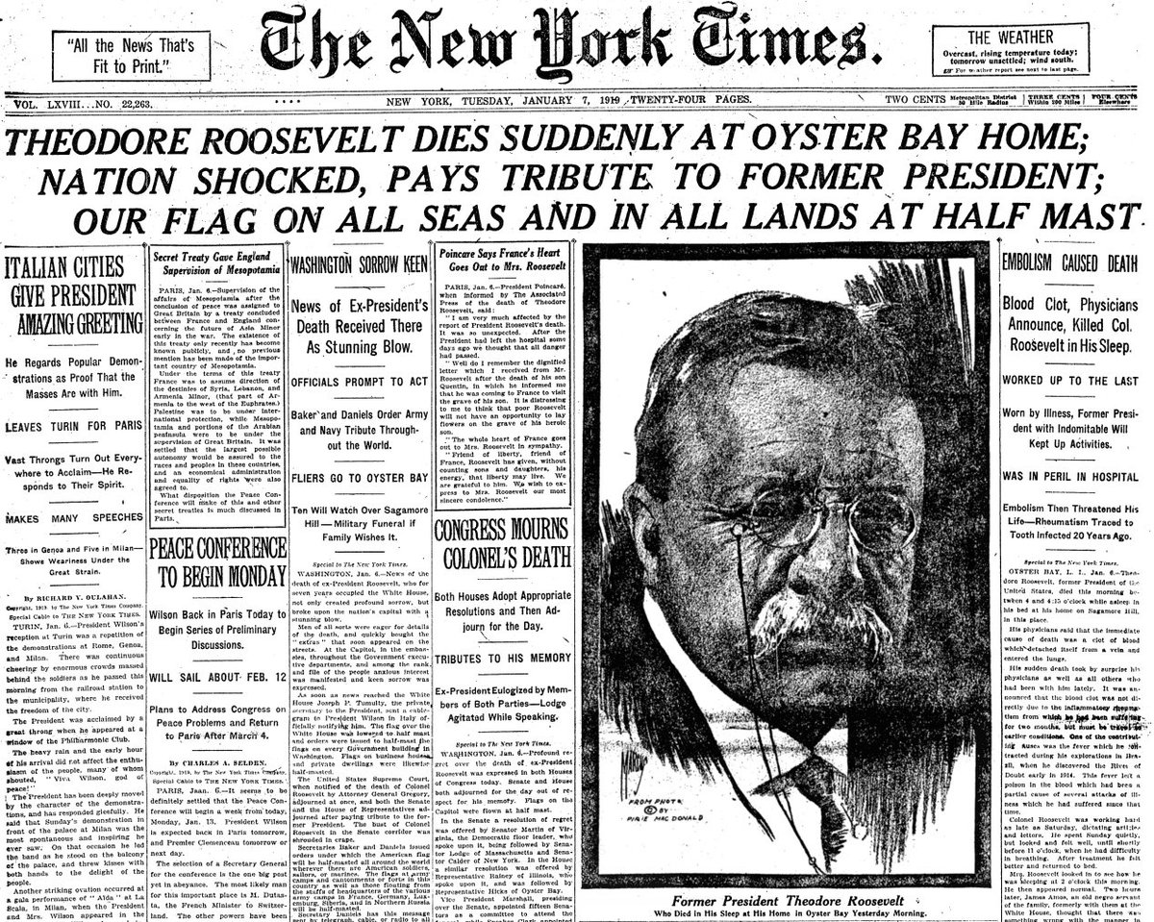

Slide 47
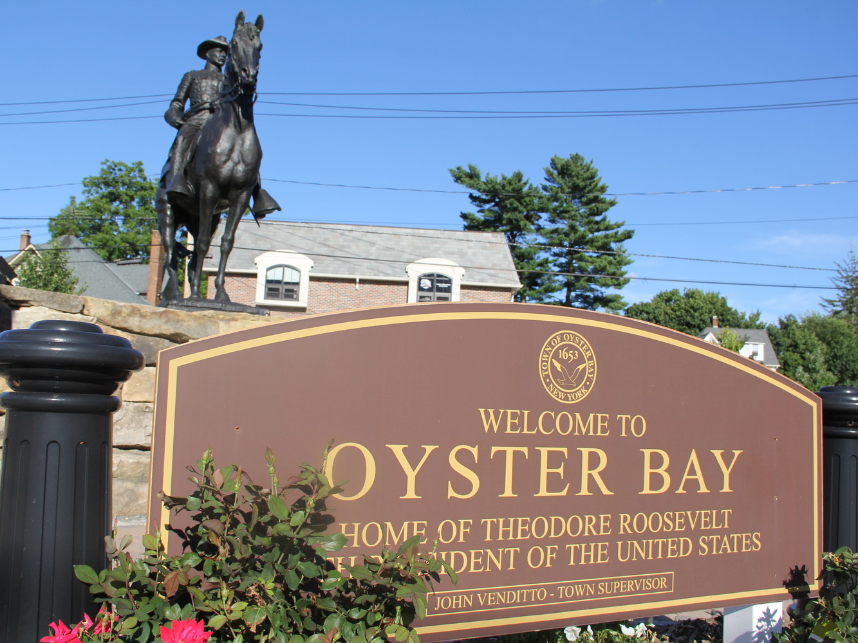

Slide 48
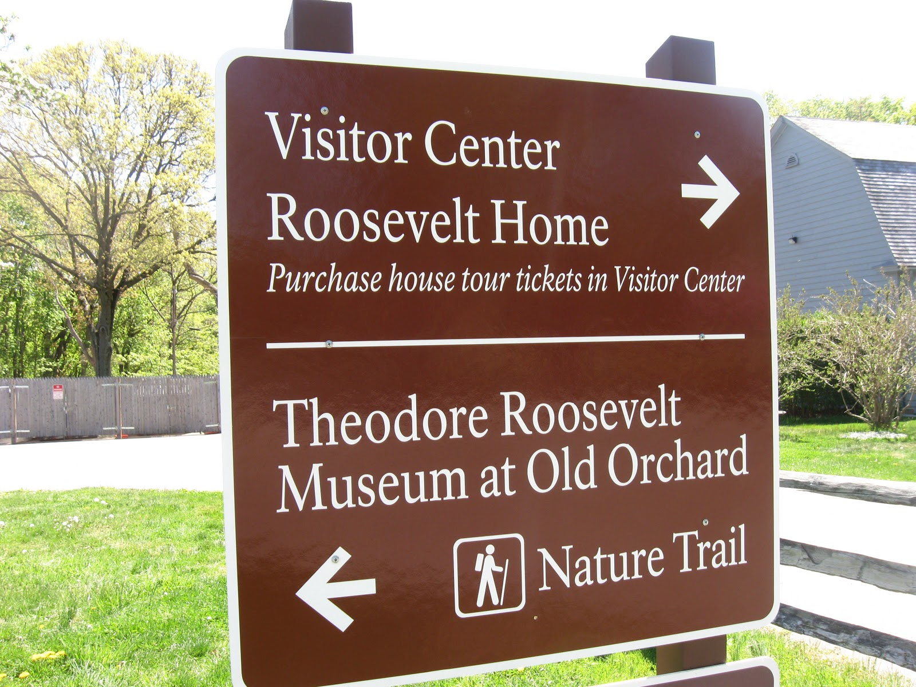
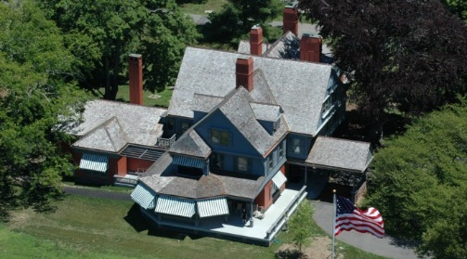

Slide 49
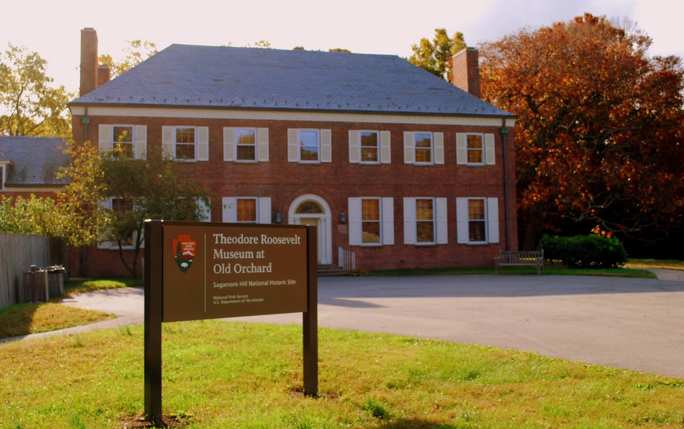

Slide 50
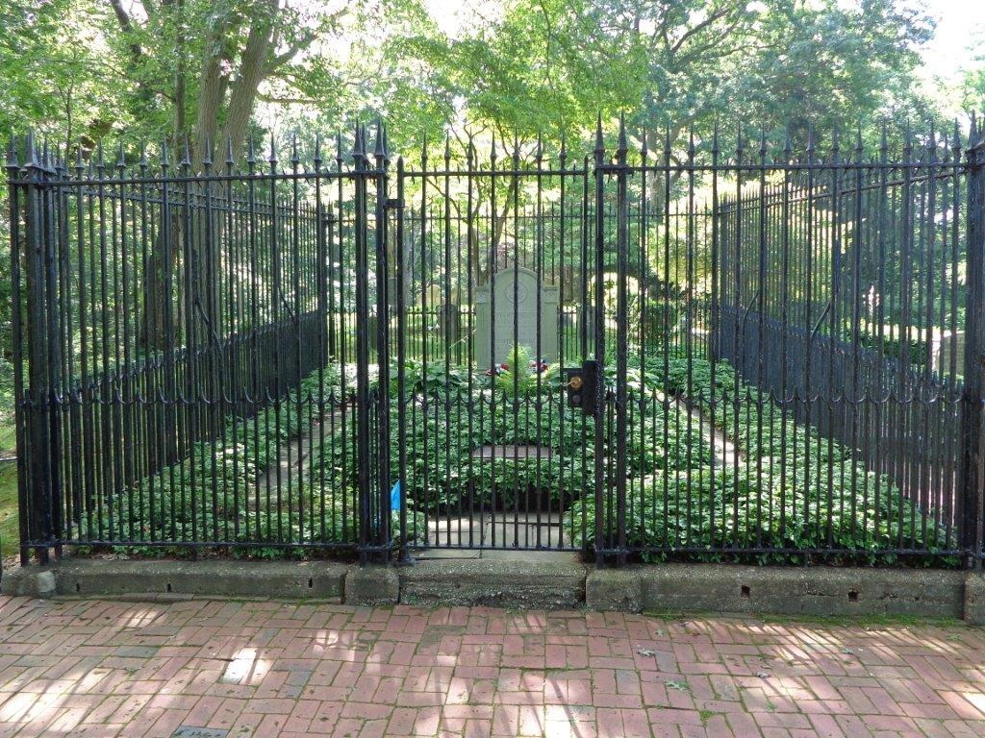

Slide 51
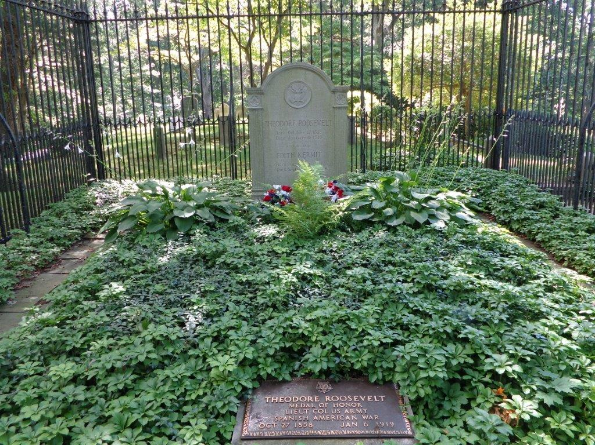

Slide 52
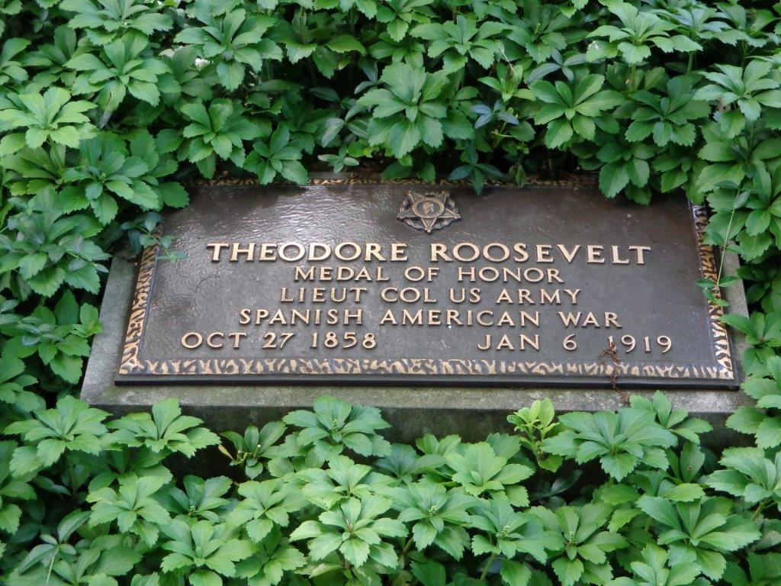
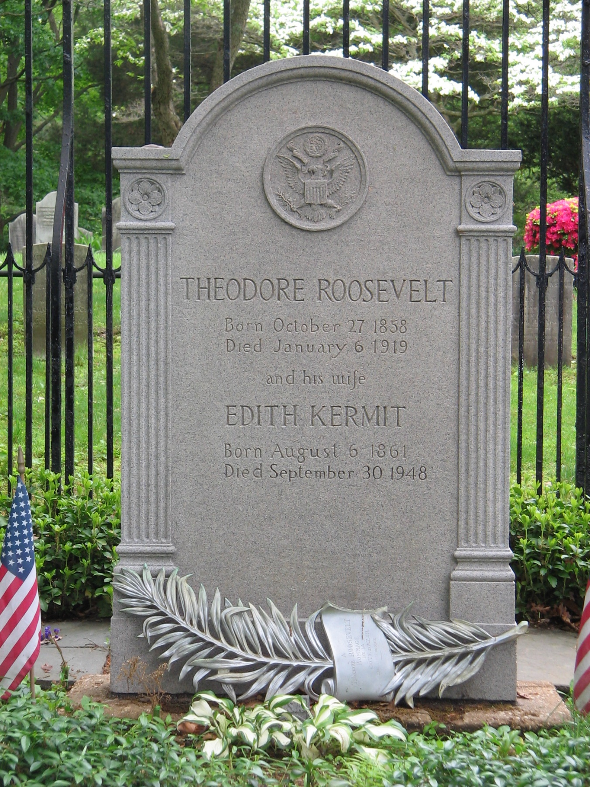

Slide 53
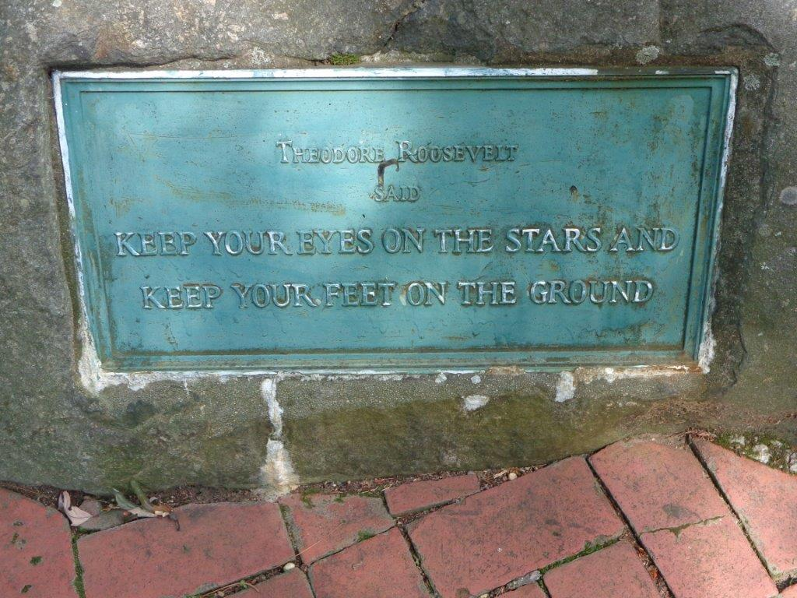
Washington Monument
Jefferson Memorial
Capitol
Washington
Lincoln Memorial
Theodore Roosevelt Island
White House
Arlington
Potomac River

Slide 54
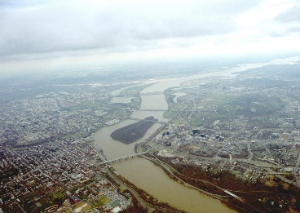
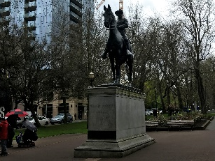
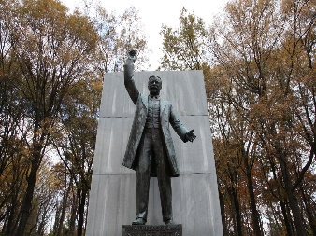
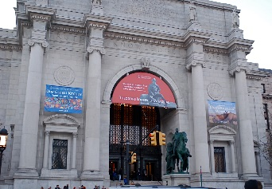
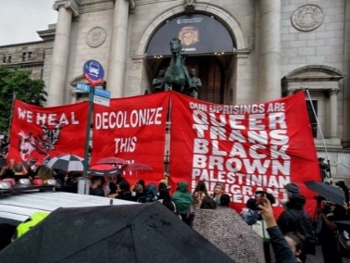
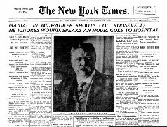
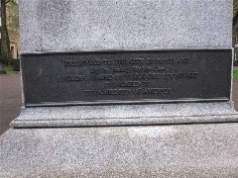
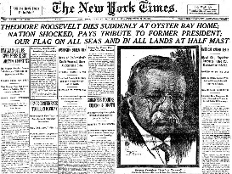

Slide 55
Notes:
North_Dakota_TR_National_Park Scenic_ Theodore Roosevelt National Park

Slide 57
Presidential Quotes
Ron Bert
19½
March 31, 2019

Slide 58
27. William Howard Taft (1909-1913)

Slide 59
“Unless education promotes character making, unless it helps men to be more moral, more just to their fellows, more law abiding, more discriminatingly patriotic and public spirited, it is not worth the trouble taken to furnish it. I do not believe in the divinity of Christ, and there are many other of the postulates of the orthodox creed to which I cannot subscribe.”
predestined salvation
Notes:
False religion compromises true religion.

Slide 60
My people are destroyed for lack of knowledge. Because you have rejected knowledge, I also will reject you from being priest for Me; Because you have forgotten the law of your God, I also will forget your children. — Hosea 4:6

Slide 61
“The underlying principle of Masonry is the fatherhood of God and the brotherhood of man. In this war we are engaging in upholding these principles and our enemies are attacking them.”
Mason
Notes:
Un-scriptural religions many times use partial truths to incorporate their beliefs.

Slide 62
You see then that a man is justified by works, and not by faith only. — James 2:24

Slide 63
“The prosperity of Masonry as a means of strengthening our religion and propagating true brotherly love, is one of the dearest wishes of my heart, which, I trust, will be gratified by the help of the Grand Architect of the Universe.”

Slide 64
“The study of Freemasonry is the study of man as a candidate for a blessed eternity. It furnishes examples of holy living, and displays the conduct which is pleasing and acceptable to God. The doctrines and examples which distinguish the Order are obvious, and suited to every capacity. It is impossible for the most fastidious Mason to misunderstand, however he might slight or neglect them. It is impossible for the most superficial brother to say that he is unable to comprehend the plain precepts and the unanswerable arguments which are furnished by Freemasonry.”
runner
a candidate for a blessed eternity

Slide 65
“The secret of Masonry, like the secret of life, can be known only by those who seek it, serve it, live it. It cannot be uttered; it can only be felt and acted. It is, in fact, an open secret, and each man knows it according to his quest and capacity. Like all things worth knowing, no one can know it for another and no man can know it alone.”
open secret
accountability to God

Slide 66
Do you not know that the unrighteous will not inherit the kingdom of God? Do not be deceived. Neither fornicators, nor idolaters, nor adulterers, nor homosexuals, nor sodomites, nor thieves, nor covetous, nor drunkards, nor revilers, nor extortioners will inherit the kingdom of God. — 1st Corinthians 6:9-10
Neither • fornicators
• nor idolaters
• nor adulterers
• nor homosexuals
• nor sodomites
• nor thieves
• nor covetous
• nor drunkards
• nor revilers
• nor extortioners
Neither
fornicators
nor idolaters
nor adulterers
WARNING
nor homosexuals
nor sodomites
nor thieves
nor covetous
nor
drunkards
nor revilers
nor
extortioners

Slide 67
“The true Mason takes full responsibility for the condition of his character and ever strives for its perfection.”

Slide 68
“The Society or Fraternity of Freemasons is more in the nature of a system of Philosophy or of moral and social virtues taught by symbols, allegories, and lectures based upon fundamental truths, the observance of which tends to promote stability of character, conservatism, morality and good citizenship.”

Slide 69
“Masonry, according to the general acceptation of the term, is an art founded on the principles of geometry, and devoted to the service and convenience of mankind. But Freemasonry, embracing a wider range and having a nobler object in view, namely, the cultivation and improvement of the human mind, may with more propriety be called a science, inasmuch as, availing itself of the terms of the former, it inculcates the principles of the purest morality, though its lessons are for the most part veiled in allegory and illustrated by symbols.”
Mason
service
the human mind
science

Slide 70
“The Masonic system represents a stupendous and beautiful fabric, founded on universal purity, to rule and direct our passions, to have faith and love in God, and charity toward man.”

Slide 71
“The true Mason is the Tiler of the Temple of the Heart.”

Slide 72
Do you not know that you are the temple of God and that the Spirit of God dwells in you? — 1st Corinthians 3:16

Slide 73
“The precepts of the Gospel were universally the obligations of Masonry.”

Slide 74
“We have a government of limited power under the Constitution, and we have got to work out our problems on the basis of law.”

Slide 75
“I love judges, and I love courts. They are my ideals that typify on earth what we shall meet hereafter in heaven under a just God.”
justice

Slide 76
“Rules of conduct which govern men in their relations to one another are being applied in an ever-increasing degree to nations. The battlefield as a place of settlement of disputes is gradually yielding to arbitral courts of justice.”

Slide 77
“The judiciary has fallen to a very low state in this country. I think your part of the country has suffered especially. The federal judges of the South are a disgrace to any country, and I'll be damned if I put any man on the bench of whose character and ability there is the least doubt.”

Slide 78
Then He spoke a parable to them, that men always ought to pray and not lose heart, saying: "There was in a certain city a judge who did not fear God nor regard man. Now there was a widow in that city; and she came to him, saying, 'Get justice for me from my adversary.' And he would not for a while; but afterward he said within himself, 'Though I do not fear God nor regard man,' …" — Luke 18:1-4
"…'yet because this widow troubles me I will avenge her, lest by her continual coming she weary me.'" Then the Lord said, "Hear what the unjust judge said. And shall God not avenge His own elect who cry out day and night to Him, though He bears long with them? I tell you that He will avenge them speedily. Nevertheless, when the Son of Man comes, will He really find faith on the earth?" — Luke 18:5-8

Slide 79
Do not be unequally yoked together with unbelievers. For what fellowship has righteousness with lawlessness? And what communion has light with darkness? — 2nd Corinthians 6:14

Slide 80
“It gives me the greatest pleasure to say, as I do from the bottom of my heart, that never in the history of the country, in any crisis and under any conditions, have our Jewish fellow citizens failed to live up to the highest standards of citizenship and patriotism.”

Slide 81
“Anti-Semitism is a noxious weed that should be cut out. It has no place in America.”

Slide 82
“One cannot always be sure of the truth of what one hears if he happens to be President of the United States.”

Slide 83
Beloved, do not believe every spirit, but test the spirits, whether they are of God; because many false prophets have gone out into the world. — 1st John 4:1

Slide 84
“Politics, when I am in it, makes me sick.”

Slide 85
“The trouble with me is that I like to talk too much.”

Slide 96
→ Better to be faithful than famous
→ Masonic ideals are achieved in Christian morals
→ Blind science may delude one from seeing truth
→ Without religious values society declines rapidly
→ Without ideals men become mean and sordid
→ It is one’s duty to live to improve humanity
→ Education is futile without helping moral character
→ Each man must be accountable for his own godliness
→ Precepts of the Gospel is the temple of the heart
→ Lawful courts reflects the justice God wills for man
→ Judges who lack character damn our country
→ Bigotry and intolerance has no place in America
→ Truth can be uncertain for an American president
Fear and anger steal security found in true worship
Notes:
Fear and anger steal security found in true worship

Slide 98
Please visit http://www.LoveFromGod.com to explore further
Ronald Bert Channel on
Notes:
Eternity never ends.

