Slide 2
Presidential Quotes
Ron Bert
18
February 24, 2019

Slide 3
26. Theodore Roosevelt (1901-1909)
Part 1
Notes:
Gov. NY 1899-1900

Slide 4
“A thorough knowledge of the Bible is worth more than a college education.”
Bible
Bible

Slide 5
“I enter a most earnest plea that in our hurried and rather bustling life of today we do not lose the hold that our forefathers had on the Bible. I wish to see the Bible study as much a matter of course in the secular colleges as in the seminary. No educated man can afford to be ignorant of the Bible, and no uneducated man can afford to be ignorant of the Bible.”
Bible
Bible
Bible study
Bible
in the secular
No educated man
Bible
ignorant of the Bible
no uneducated man
Bible

Slide 6
“It is necessary for the welfare of the nation that men's lives be based on the principles of the Bible. No man, educated or uneducated, can afford to be ignorant of the Bible.”
Bible
Bible
Bible
No man
can afford to be
ignorant of the Bible
Bible

Slide 7
Therefore, my beloved brethren, be steadfast, immovable, always abounding in the work of the Lord, knowing that your labor is not in vain in the Lord. — 1st Corinthians 15:58
in
in the work
action
action
in
in
not in vain
in the Lord
hope
the Lord
hope

Slide 8
Blessed is the man who endures temptation; for when he has been approved, he will receive the crown of life which the Lord has promised to those who love Him. — James 1:12
endures

Slide 9
“There is not in all America a more dangerous trait than the deification of mere smartness unaccompanied by any sense of moral responsibility.”
moral responsibility

Slide 10
“To educate a man in mind and not in morals is to educate a menace to society.”

Slide 11
Do not be deceived: "Evil company corrupts good habits." Awake to righteousness, and do not sin; for some do not have the knowledge of God. I speak this to your shame. — 1st Corinthians 15:33-34
Do not
Awake to righteousness
do
do
do not have the
knowledge of God
not sin
do
do not

Slide 12
“To every man who faces life with real desire to do his part in everything, I appeal for a study of the Bible.”
in
to do his part in
do
everything

Slide 13
Rejoice always, pray without ceasing, in everything give thanks; for this is the will of God in Christ Jesus for you. — 1st Thessalonians 5:16-18
Rejoice always
pray without
→ the will of God in Christ
• Rejoice always
• pray without ceasing
• in everything give thanks
in
ceasing
in everything give thanks
in everything
the will of God in Christ
Notes:
To those that hear God reigns

Slide 14
‘The teachings of the Bible are so interwoven and entwined with our whole civic and social life that it would be literally impossible for us to figure to ourselves what that life would be if these teachings were removed.’
the Bible
what
if these teachings
removed
Notes:
Societies that relinquish Biblical morals quickly reduce to that of chaotic squabbling, to even near anarchic brutal behaviors.

Slide 15
“I believe that the next half century will determine if we will advance the cause of Christian civilization or revert to the horrors of brutal paganism.”
“I believe that the next half century will determine if we will advance the cause of Christian civilization or revert to the horrors of brutal paganism.”
“Darkness can’t catch you if you just keep moving.”
paganism
Worship of creature over creator
Absence of true God
Notes:
Without God societies are confronted with brutal horrors.

Slide 16
“No man is worth his salt who is not ready at all times to risk his well-being, to risk his body, to risk his life, in a great cause.”
life
great
cause

Slide 18
"Salt is good, but if the salt loses its flavor, how will you season it? Have salt in yourselves, and have peace with one another." — Mark 9:50
worth
peace

Slide 19
“The dull, purblind folly of the very rich men, their greed and arrogance, and the corruption in business and politics, have tended to produce a very unhealthy condition.”
slow to see
dumb & blind
rich?
?
greed
arrogance
corruption
Notes:
Treachery by choice remains purposely oblivious to truths that touch heaven itself. When leaders pursue selfish whims, the meek seek a new compass, where glory replaces devouring greed.

Slide 20
“There is no room in this country for hyphenated Americanism. The one absolutely certain way of bringing this nation to ruin, of preventing all possibility of its continuing to be a nation at all, would be to permit it to become a tangle of squabbling nationalities.”
squabbling

Slide 21
“In the long run, the most unpleasant truth is a safer companion than a pleasant falsehood.”

Slide 22
“If you could kick the person in the pants responsible for most of your trouble, you wouldn't sit for a month.”

Slide 23
"Judge not, that you be not judged. For with what judgment you judge, you will be judged; and with the measure you use, it will be measured back to you. And why do you look at the speck in your brother's eye, but do not consider the plank in your own eye? Or how can you say to your brother, 'Let me remove the speck from your eye'; and look, a plank is in your own eye? Hypocrite! First remove the plank from your own eye, and then you will see clearly to remove the speck from your brother's eye." — Matthew 7:1-5
plank in your own eye?

Slide 24
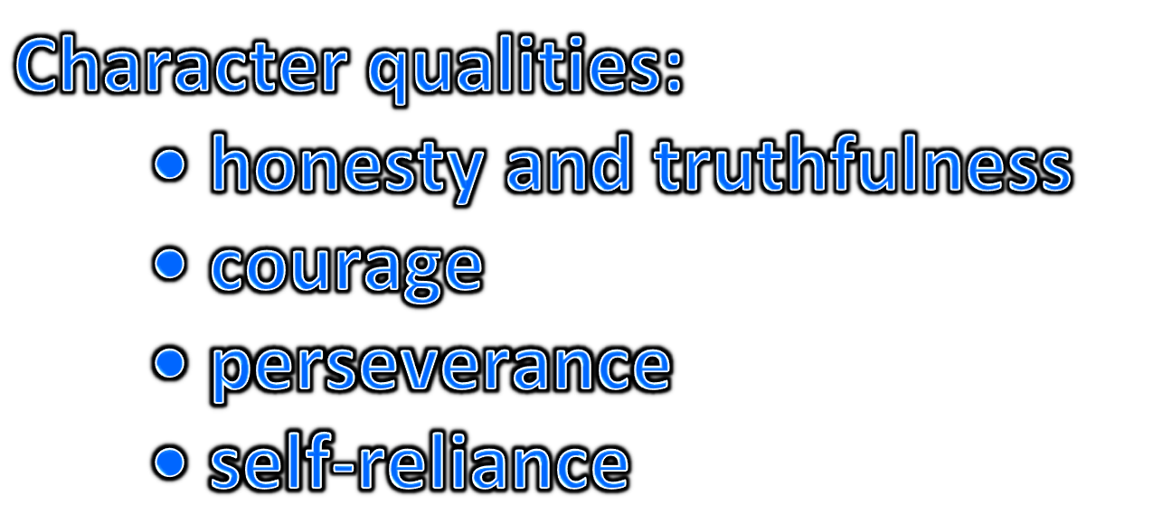
“Character is far more important than intellect in making a man a good citizen or successful at his calling - meaning by character not only such qualities as honesty and truthfulness, but courage, perseverance and self-reliance.”
Character
qualities
honesty and
truthfulness
courage
perseverance
self-reliance

Slide 25
“Knowing what's right doesn't mean much unless you do what's right.”
do
do
do

Slide 26
“The man who really counts in the world is the doer, not the mere critic -- the man who actually does the work, even if roughly and imperfectly, not the man who only talks or writes about how it ought to be done.”
do
do

Slide 27
“The wise and honorable and Christian thing to do is to treat each black man and each white man (or any person) on his merits as a man, giving him no more and no less than he is worthy to have.”
do
impartial

Slide 28
For the Scripture says, "You shall not muzzle an ox while it treads out the grain," and, "The laborer is worthy of his wages." — 1st Timothy 5:18

Slide 29
“Speak softly and carry a big stick; you will go far.”

Slide 30
So then, my beloved brethren, let every man be swift to hear, slow to speak, slow to wrath; — James 1:19

Slide 31
“It is no use to preach to [children] if you do not act decently yourself.”

Slide 32
“There can be nothing in the world more beautiful than the Yosemite, the groves of the giant sequoias and redwoods, the Canyon of the Colorado, the Canyon of the Yellowstone, the Three Tetons; and our people should see to it that they are preserved for their children and their children's children forever, with their majestic beauty all unmarred.”

Slide 33
“Rarely has any people enjoyed greater prosperity than we are now enjoying. For this we render heartfelt and solemn thanks to the Giver of Good; and we seek to praise Him - not by words only -but by deeds, by the way in which we do our duty to ourselves and to our fellow men.”
thanks
Give
praise Him
our duty

Slide 34
Thus also faith by itself, if it does not have works, is dead. — James 2:17

Slide 35
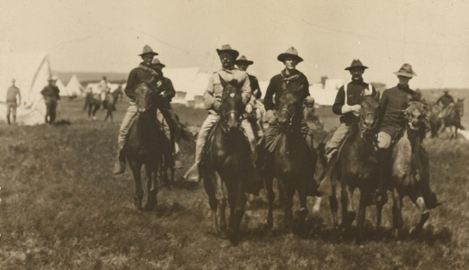
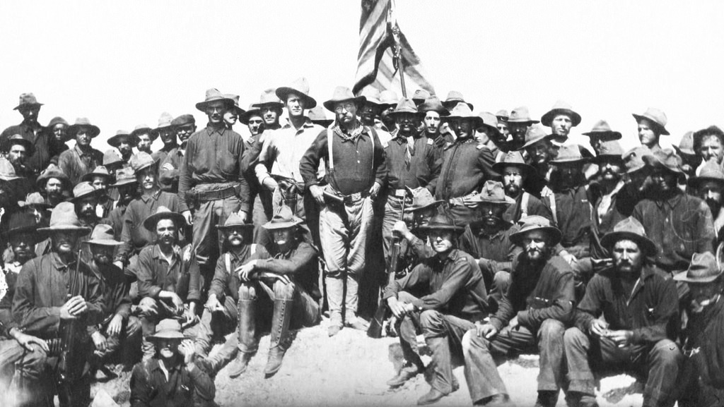
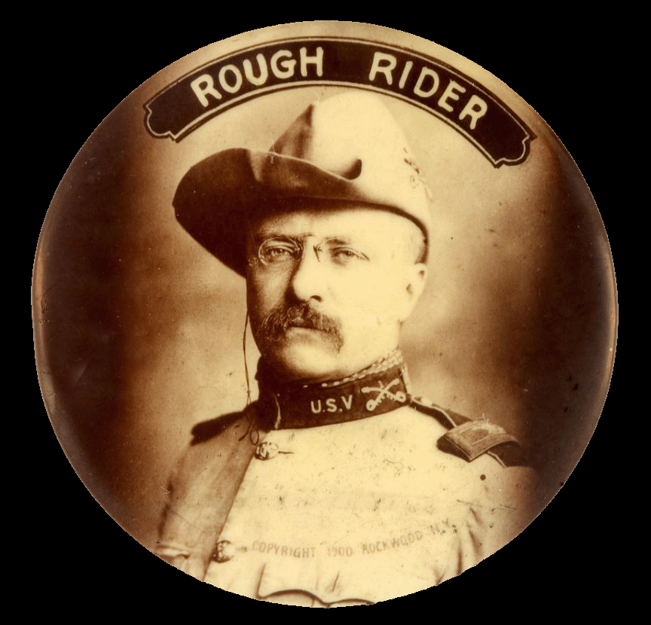
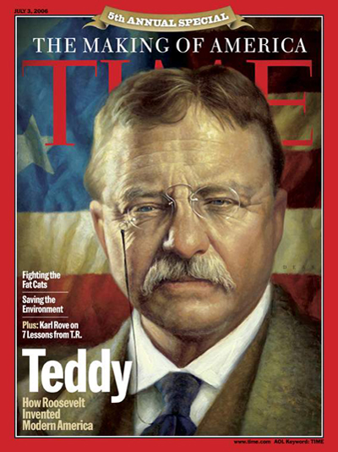
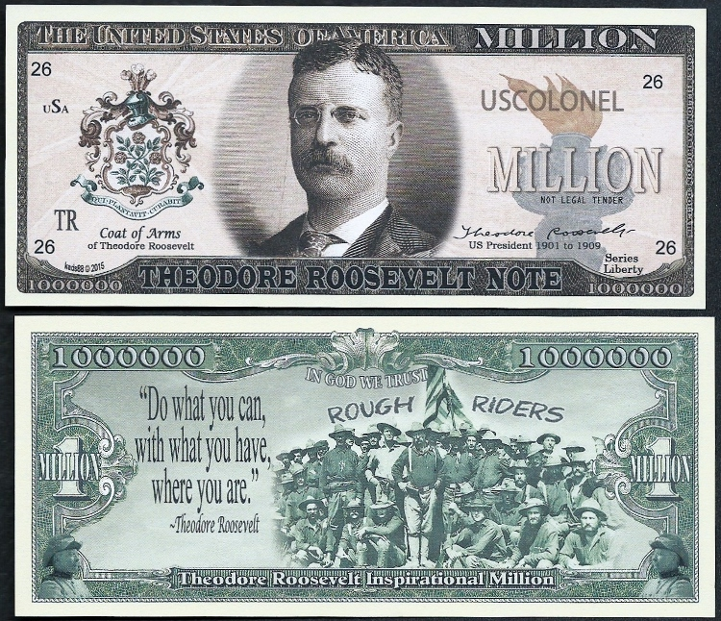
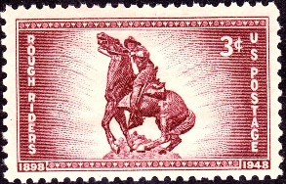
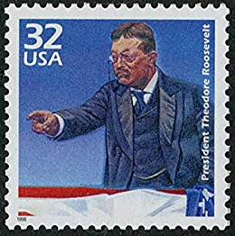
Notes:
Courageously charged San Juan Hill

Slide 36
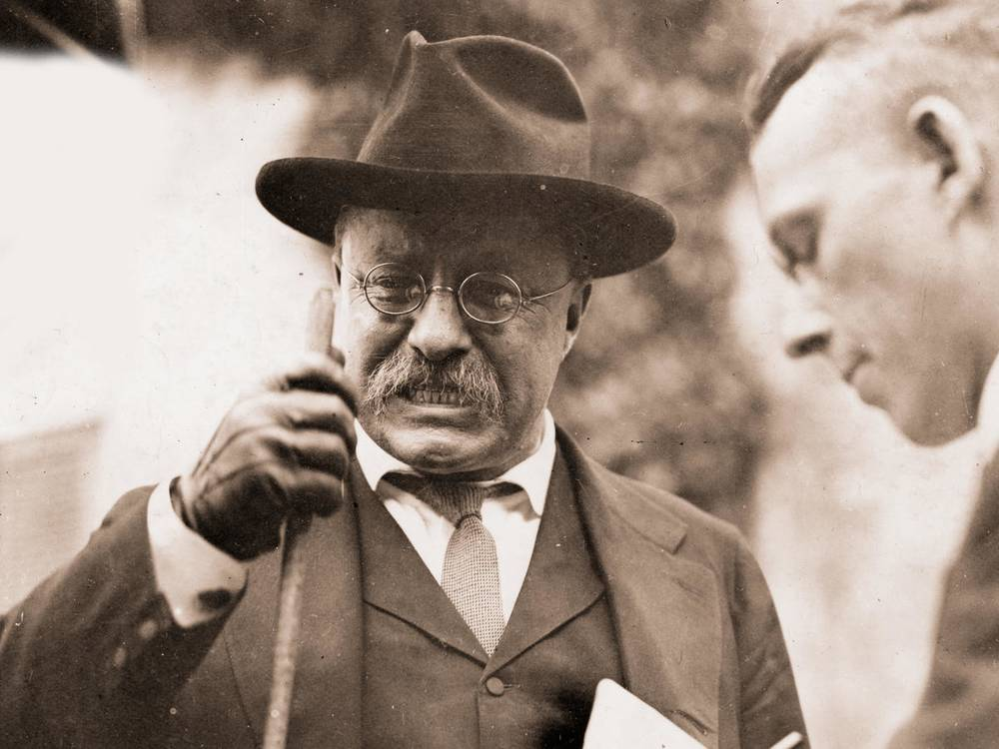
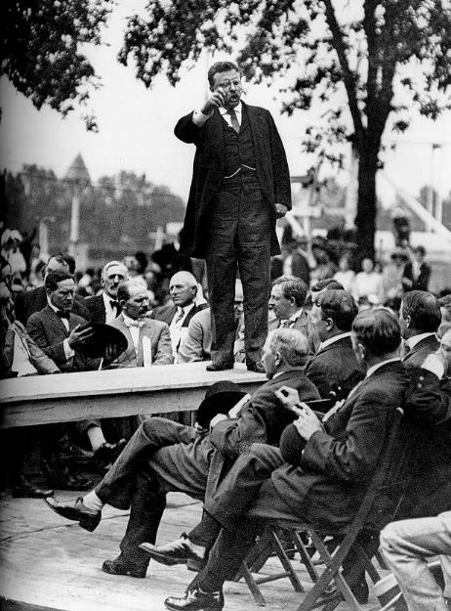
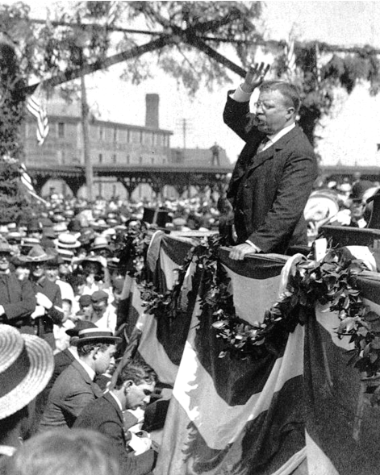
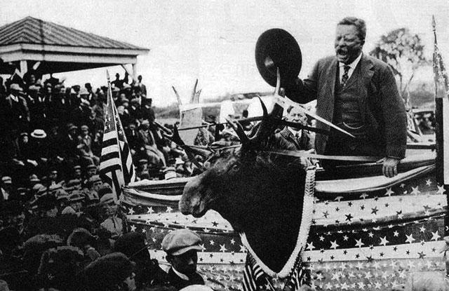
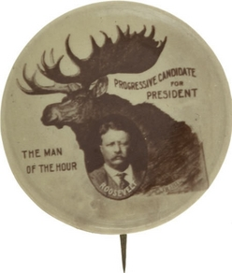
Notes:
Ran on the progressive platform, symbolized by a moose

Slide 37
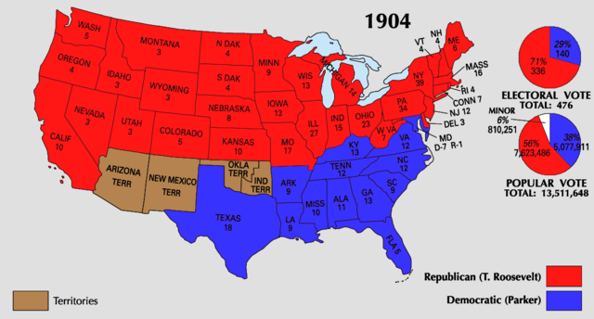

Slide 38
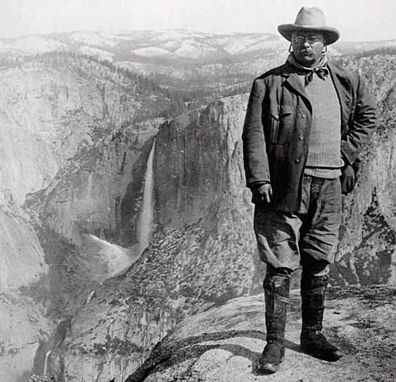
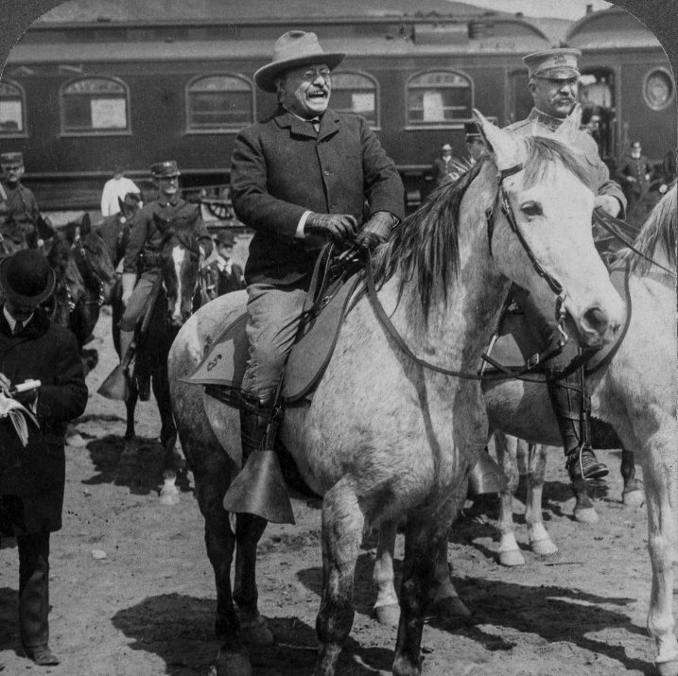

Slide 39
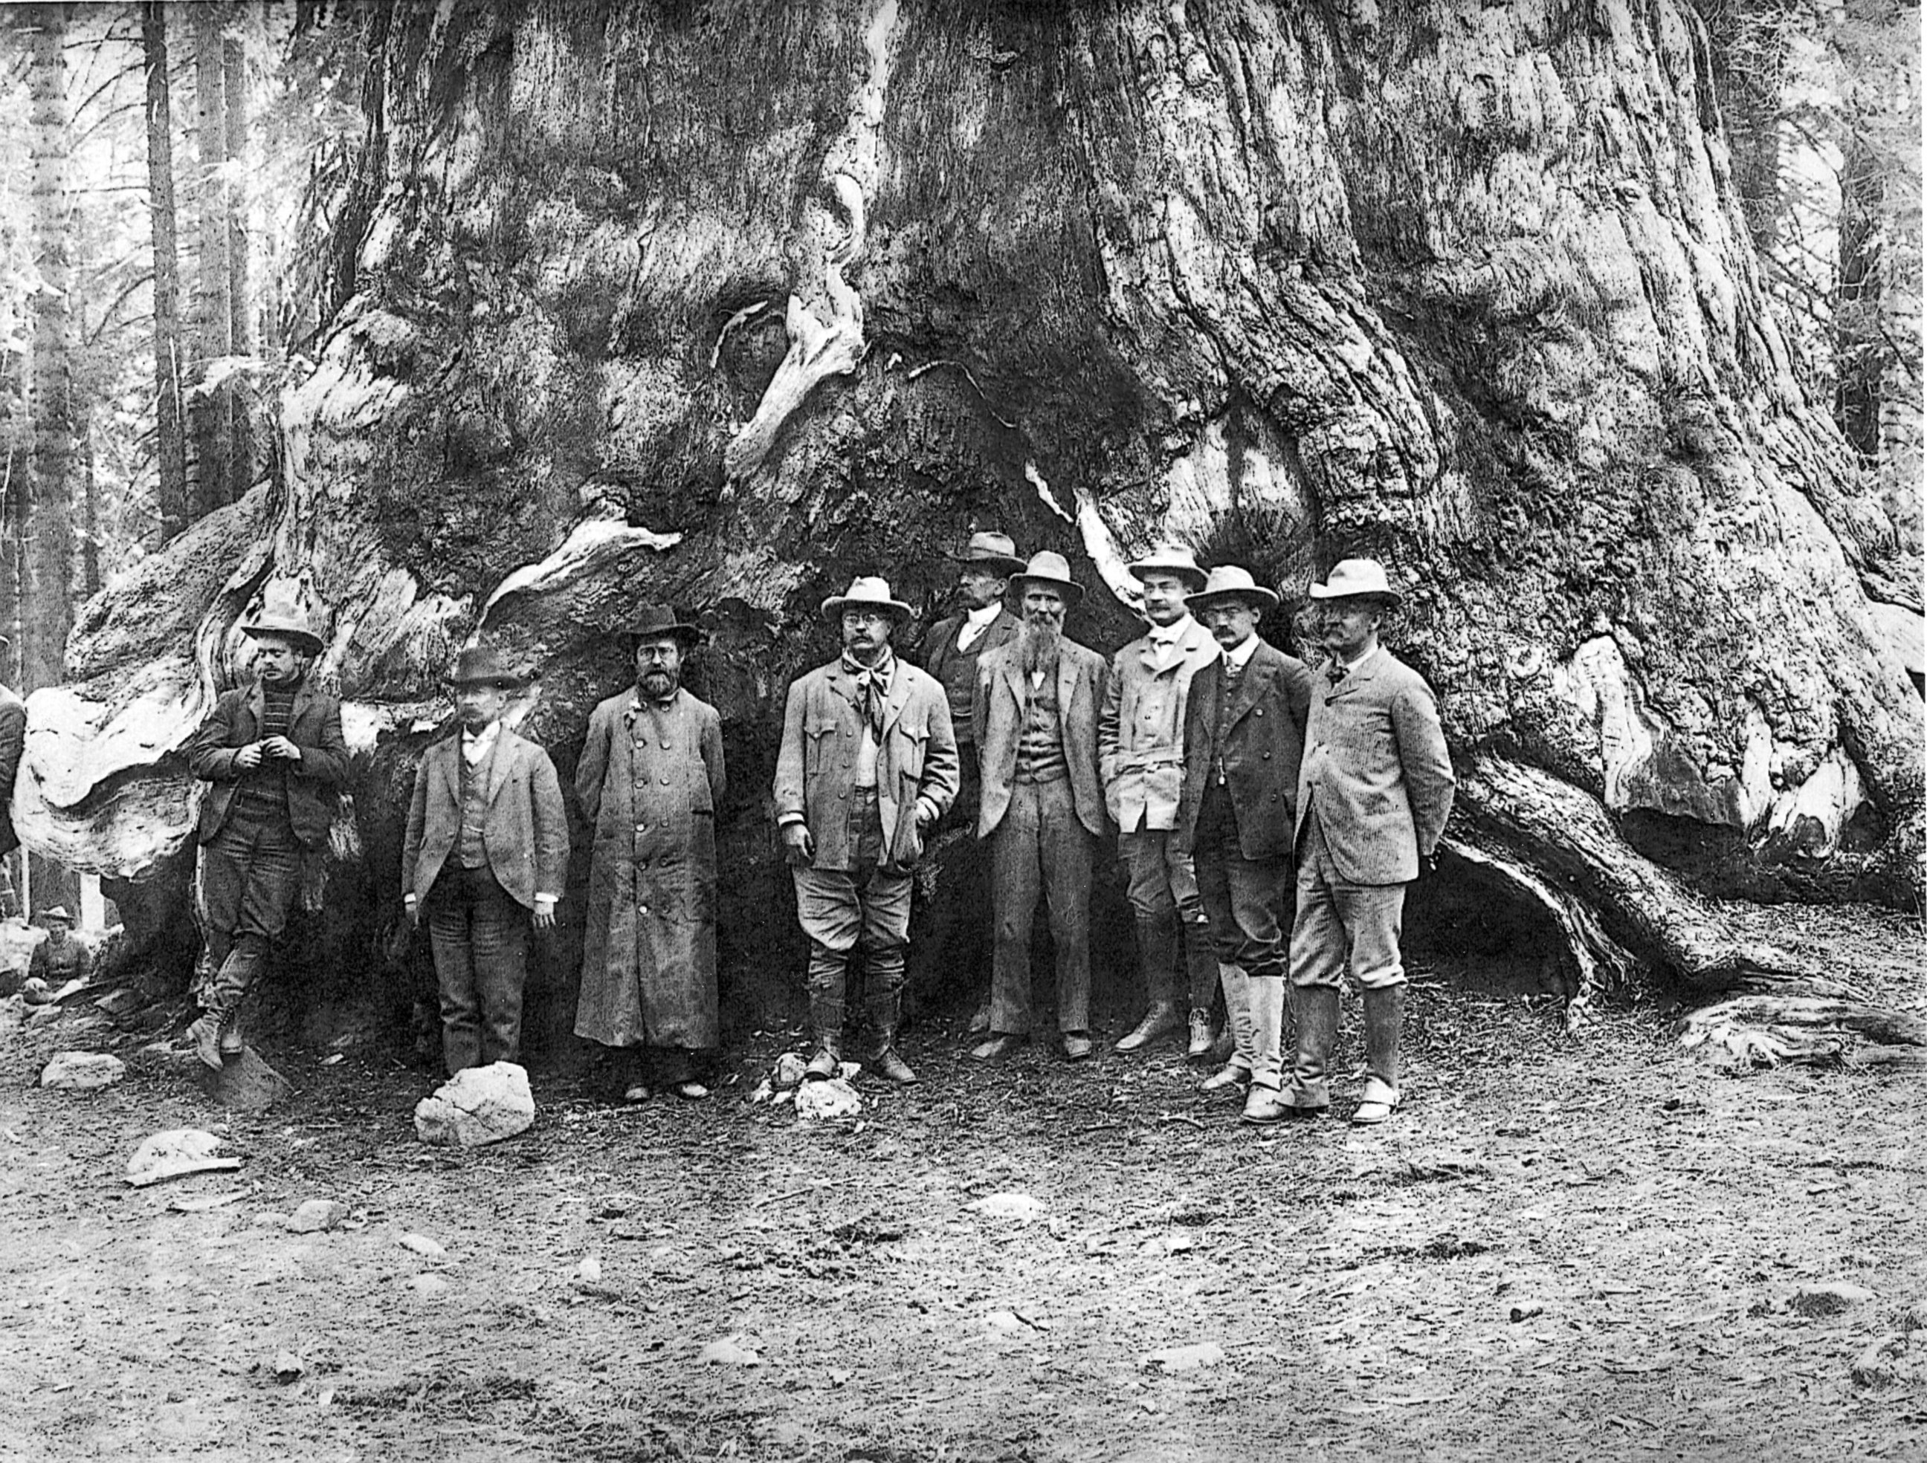

Slide 40
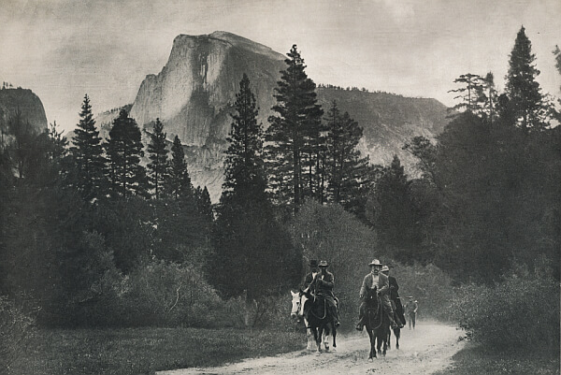

Slide 41
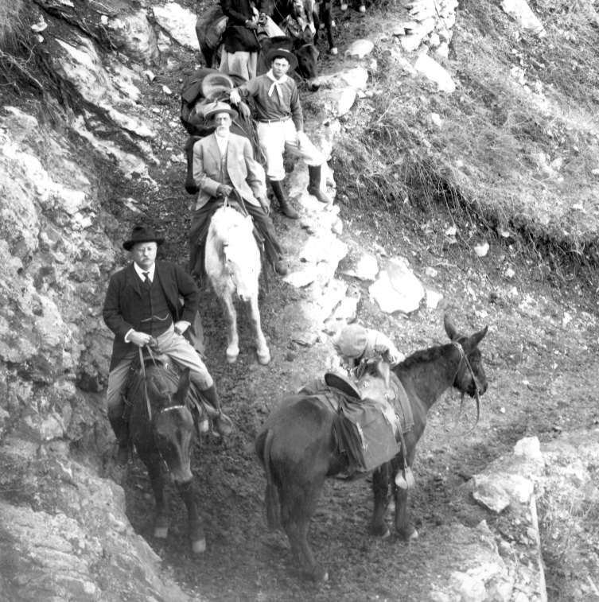
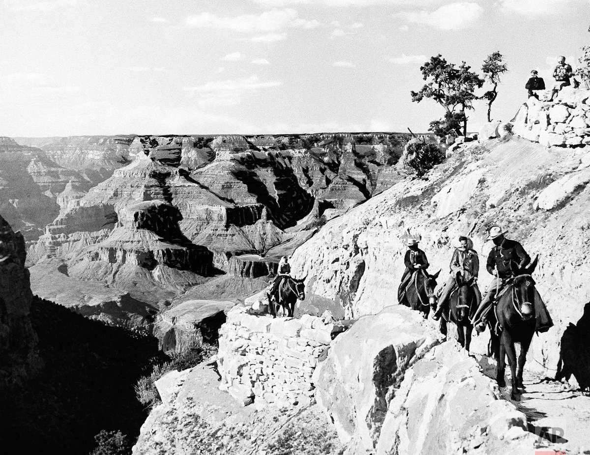
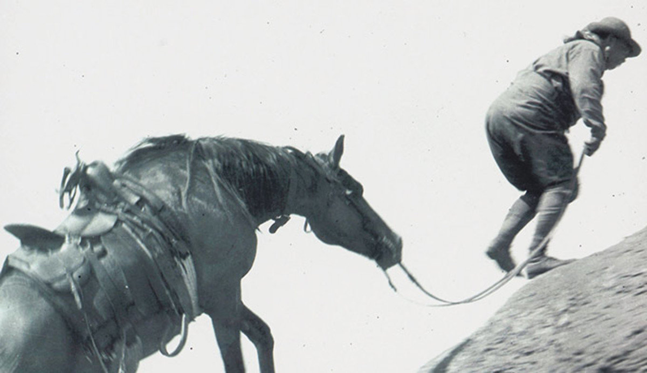

Slide 42
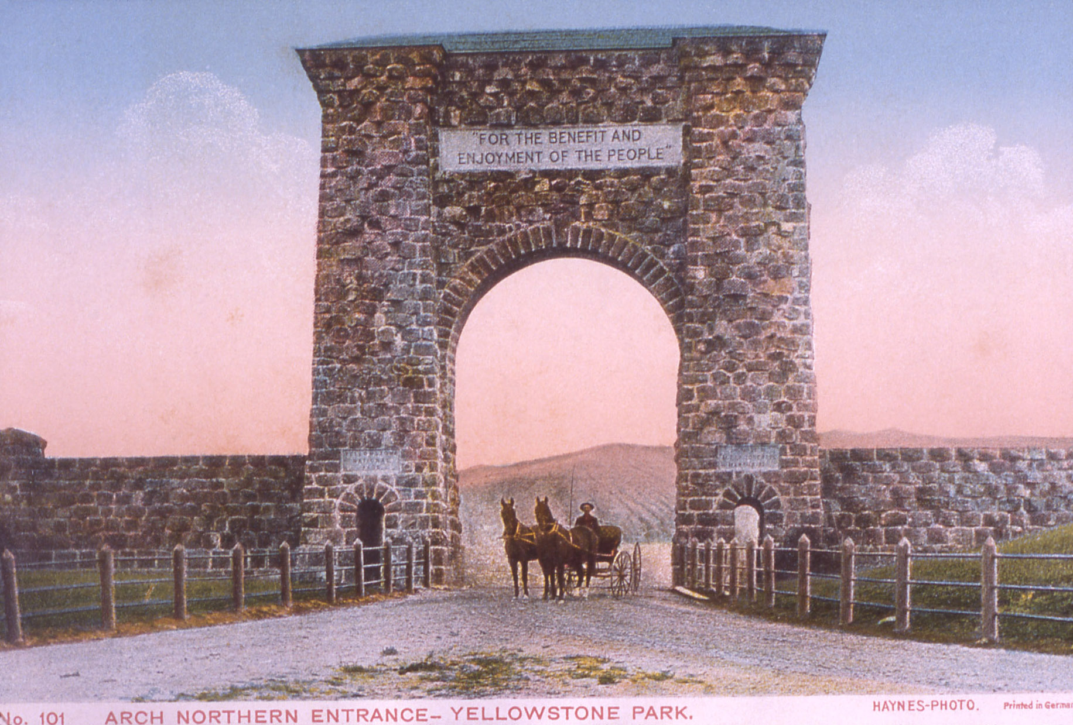

Slide 43
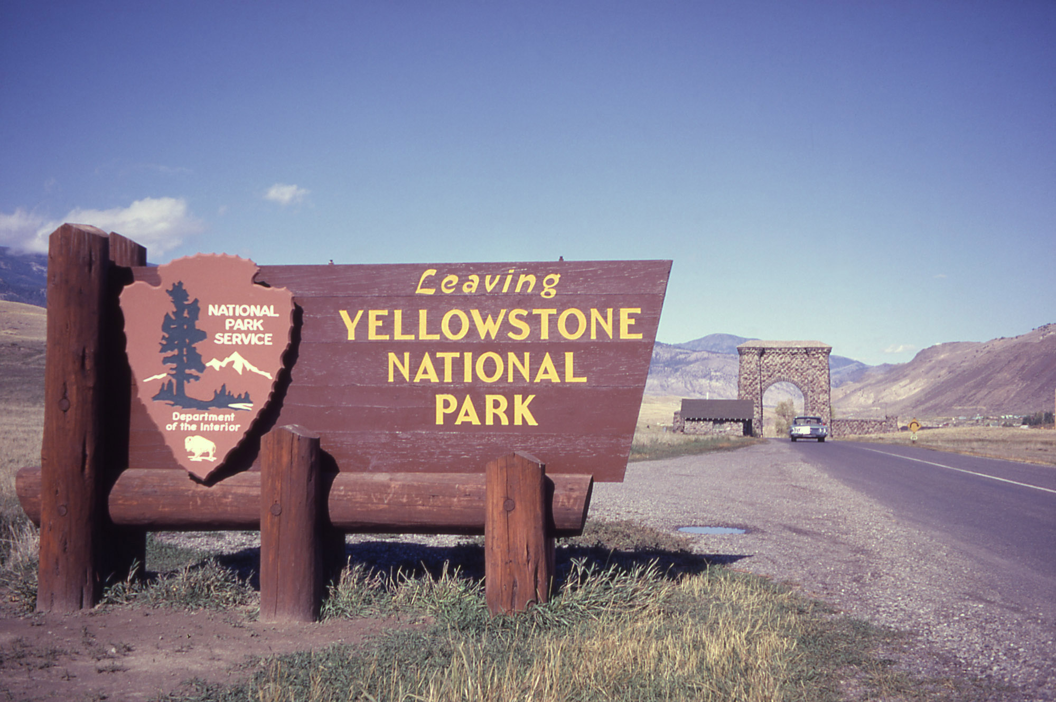

Slide 44
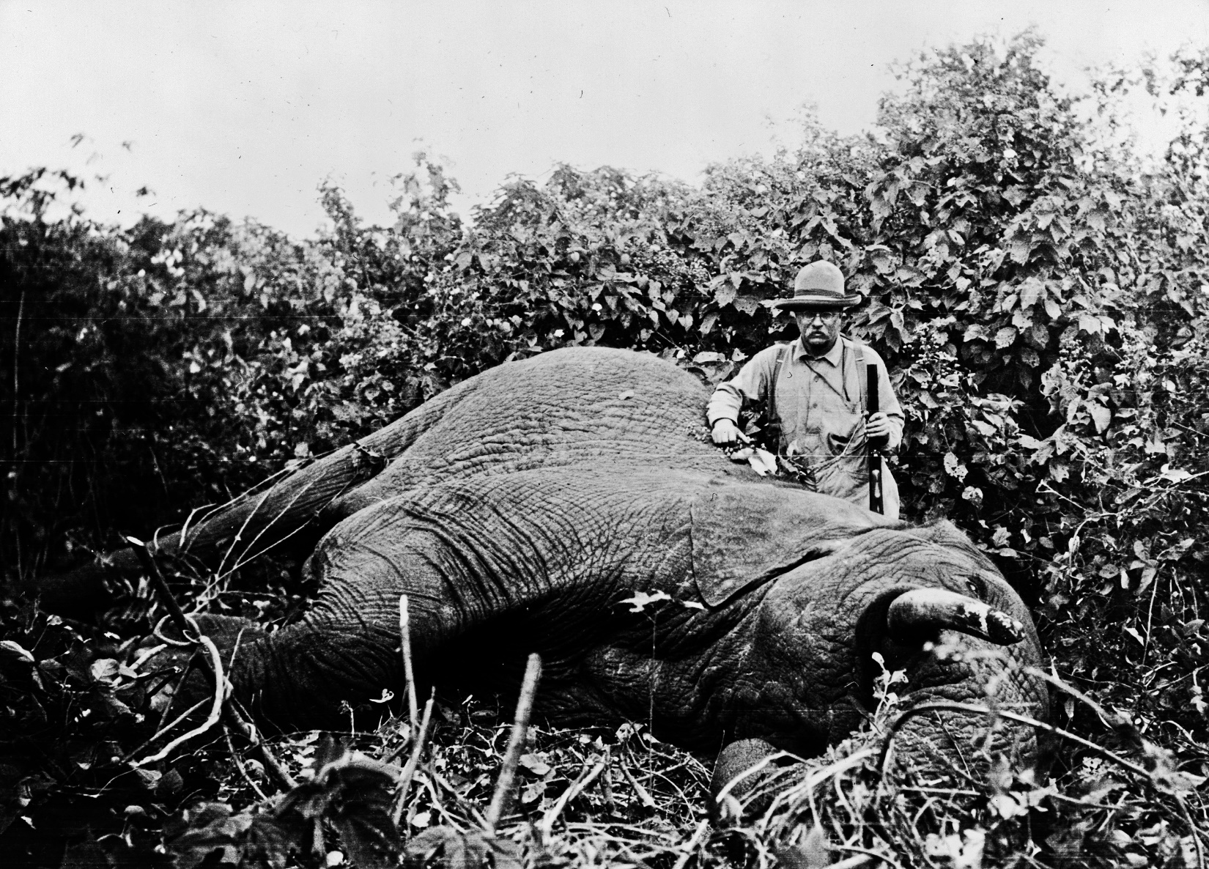
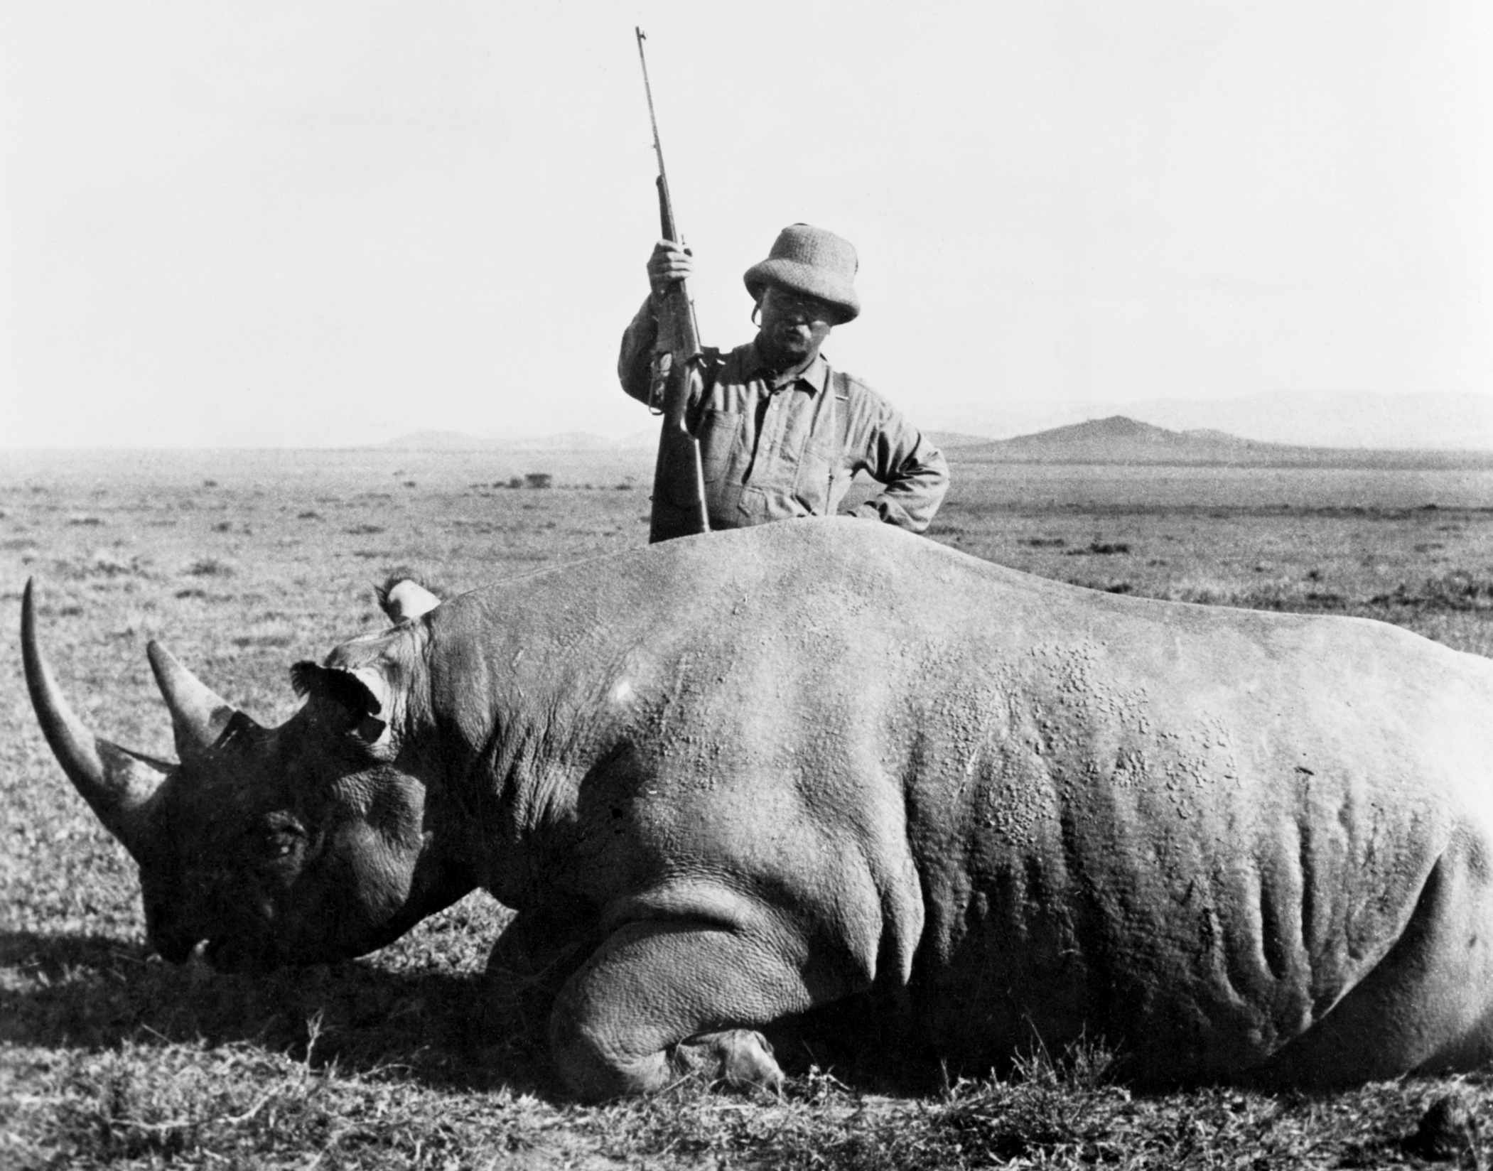
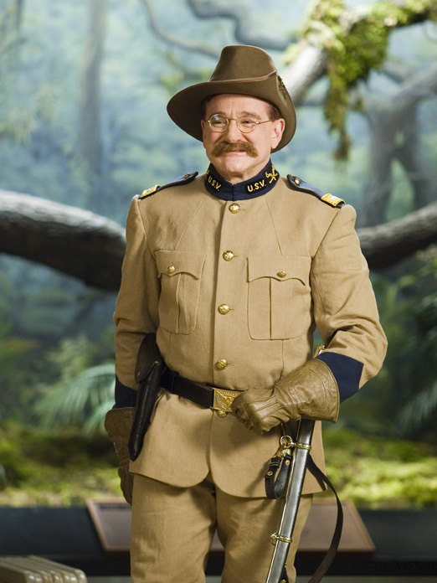

Slide 45
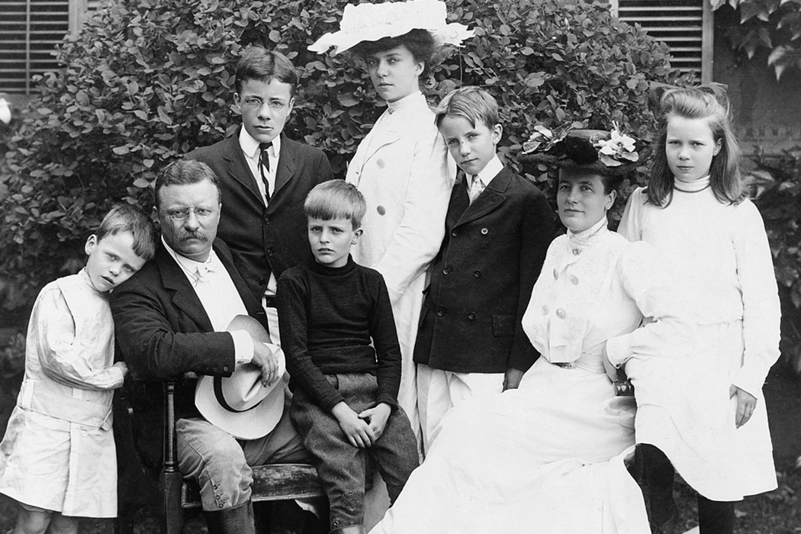
Notes:
Had 5 children with 2nd wife. Studied at Harvard and Columbia law, joined NY assembly, when 1st wife and mother died on the same day, valentines day (Feb 14, 1864) just two days after his daughter was born, went off to Dakoda’s to start a new for two years. Came back to NY politics and join forces in the Spanish American war where he went from private to coronel leading the charge on San Juan Hill. 4 time decorated for bravery. Took office youngest president at 42.
Quintin, (roller skates & snakes in White House) – Pillow fights - his youngest son died in WW1 as an aviator over France shot down by the Germans. Six months later Teddy died at 60 in his sleep.
“Darkness can’t catch you if you just keep moving.”
1906 Food and drug administration.

Slide 46
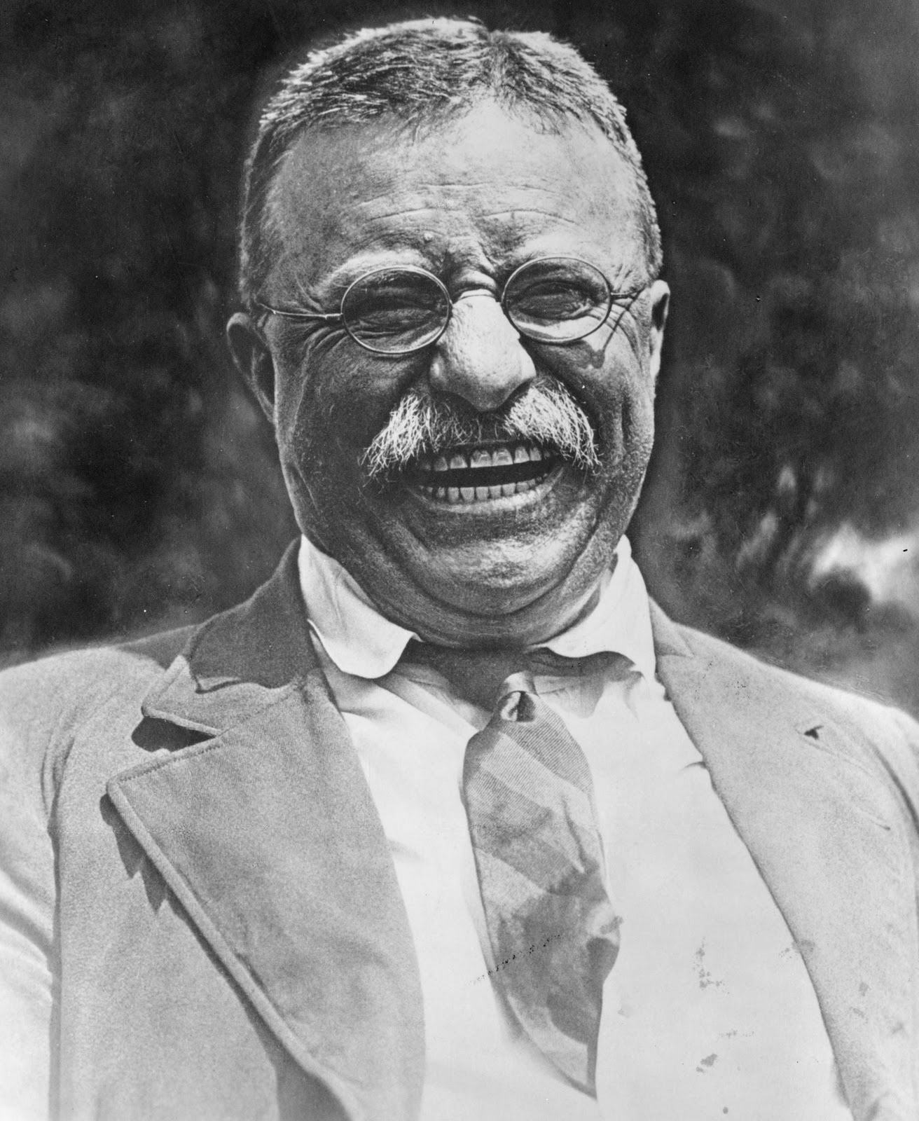
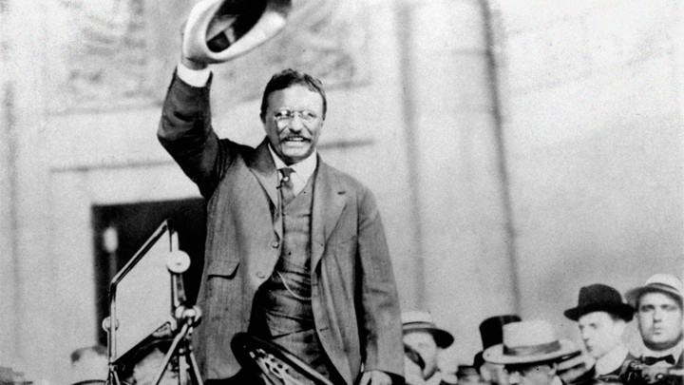
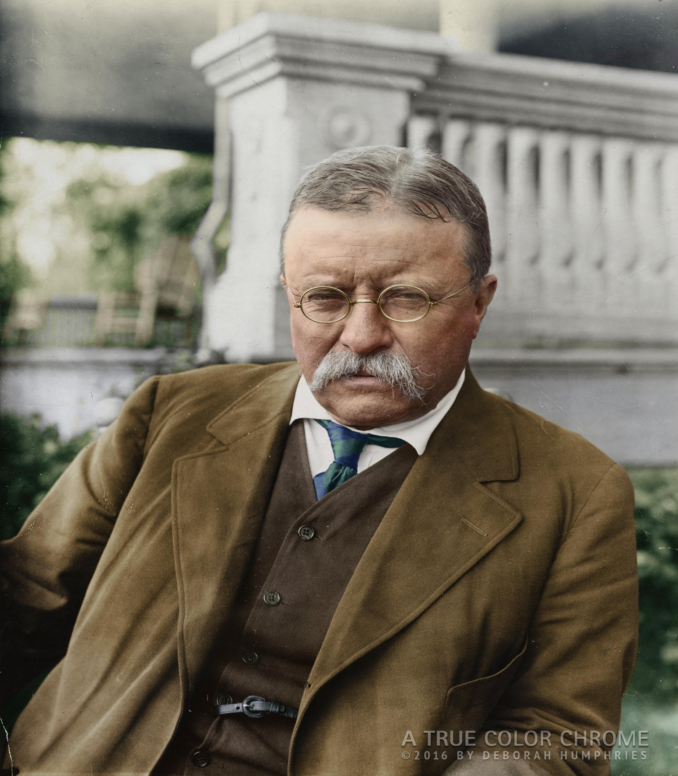

Slide 47
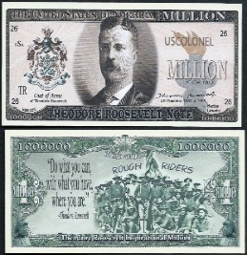
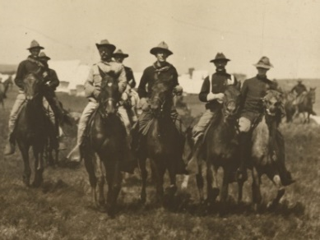
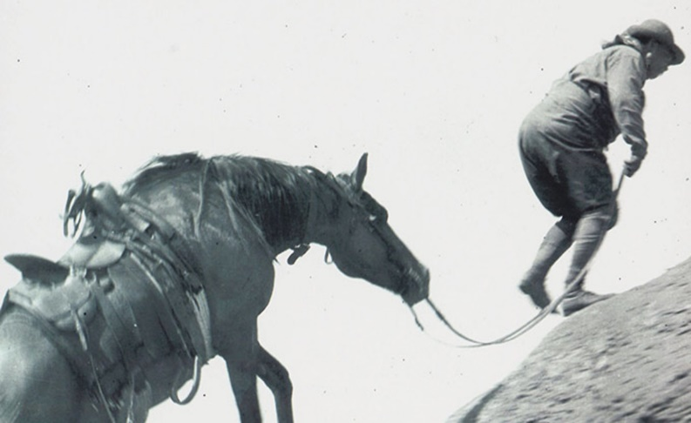
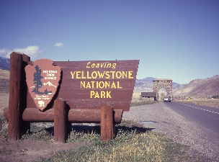

Slide 48
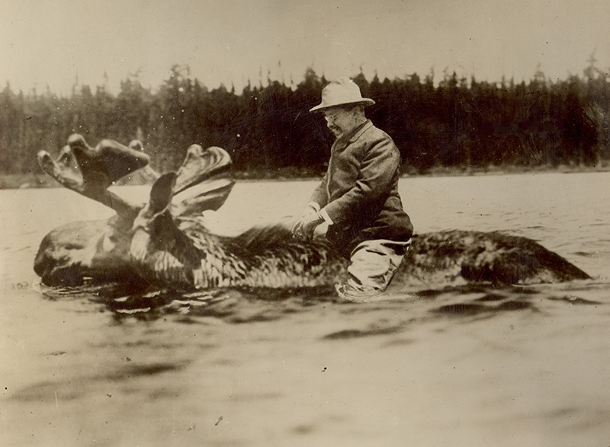

Slide 50
Presidential Quotes
Ron Bert
18½
March 3, 2019

Slide 51
26. Theodore Roosevelt (1901-1909)
Part 2

Slide 52
“The worst lesson that can be taught to a man is to rely upon others and to whine over his sufferings.”
owner
emotional
moaner
groaner
moaner groaner emotional owner
outer person
Notes:
Each of us owns our own emotional needs and or blessings with perhaps, perceived curses, as tragedies confront all. Cursed are all who fall away from God. We have all encountered that person who incessantly complains about all whom they know. Never satisfied, their unapologetic hearts demanding service upon false accusations of being abandoned, has an unceasing harp. Woe is imprinted as their first name. I call them moaners, groaners, emotional owners.

Slide 53
… that He would grant you, according to the riches of His glory, to be strengthened with might through His Spirit in the inner man, — Ephesians 3:16
u
y
His rich glory
strengthen us mightily
through His Spirit
rich
His
glory
strengthen
l
s
might
through His Spirit
i
Notes:
It is welcome to be in the presence of the faithful elderly. Though raked over decades of tribulations, they cling to a steadfast and confident faith sharing their peacefulness as an example. Shedding fears and unfilled desires comes only to the faithful, through years of accumulated wisdom.

Slide 54
“Nobody cares how much you know, until they know how much you care.”

Slide 55
Let each of you look out not only for his own interests, but also for the interests of others. — Philippians 2:4

Slide 56
“With a great moral issue involved, neutrality does not serve righteousness; for to be neutral between right and wrong is to serve wrong.”
apathy
is to serve wrong

Slide 57
Therefore, to him who knows to do good and does not do it, to him it is sin. — James 4:17

Slide 58
"It may be that 'the voice of the people is the voice of God' in fifty one cases out of a hundred, but in the remaining forty nine it is quite as likely to be the voice of the devil, of, what is still worse, the voice of a fool.”
conscience
spite

Slide 59
The fool has said in his heart, "There is no God." They are corrupt, They have done abominable works, There is none who does good. — Psalms 14:1

Slide 60
“The longer I live the more I think of the quality of fortitude... men who fall, pick themselves up and stumble on, fall again, and are trying to get back up when they die.”

Slide 61
For a righteous man may fall seven times And rise again, But the wicked shall fall by calamity. — Proverbs 24:16

Slide 62
“Life brings sorrows and joys alike. It is what a man does with them - not what they do to him - that is the true test of his mettle.”
sorrows and joys
test of his mettle
courage
grit
mettle
spirit
nerve
determination
resolve

Slide 63
“There are dreadful moments when death comes very near those we love, even if for the time being it passes by. But life is a great adventure, and the worst of all fears is the fear of living.”
life is a
life is a great adventure
great adventure
worst
=
is the fear of living

Slide 64
For God has not given us a spirit of fear, but of power and of love and of a sound mind. — 2nd Timothy 1:7

Slide 65
“Probably the greatest harm done by vast wealth is the harm that we of moderate means do ourselves when we let the vices of envy and hatred enter deep into our own natures.”
greatest harm
envy
envy
envy
hatred
our own
Notes:
If the light in us dwells in dark thoughts, how dark we become if these wicked things illuminate our hearts. Freedom is not found in the shadows.

Slide 66
“Envy is as evil a thing as arrogance.”
envy

Slide 67
“The foes from whom we pray to be delivered are our own passions, appetites, and follies; and against these there is always need that we should war.”
pray
be delivered
our own

Slide 68
“These international bankers and Rockefeller Standard Oil interests control the majority of newspapers and the columns of these papers to club into submission or drive out of public office officials who refuse to do the bidding of the powerful corrupt cliques which compose the invisible government.”
drive out
corrupt cliques
invisible government
Notes:
Life has become more a circus than a standing civilization.

Slide 69
“Happiness lies not in the mere possession of money; it lies in the joy of achievement, in the thrill of creative effort. The joy and moral stimulation of work must no longer be forgotten in the mad chase of evanescent profits.”
“Happiness lies not in the mere possession of money; it lies in the joy of achievement, in the thrill of creative effort. The joy and moral stimulation of work must no longer be forgotten in the mad chase of evanescent profits.”

Slide 70
The sleep of a laboring man is sweet, Whether he eats little or much; But the abundance of the rich will not permit him to sleep. — Ecclesiastes 5:12

Slide 71
I know that nothing is better for them than to rejoice, and to do good in their lives, and also that every man should eat and drink and enjoy the good of all his labor - it is the gift of God. — Ecclesiastes 3:12-13

Slide 72
“The only time you really live fully is from thirty to sixty. The young are slaves to dreams; the old servants of regrets. Only the middle-aged have all their five senses in the keeping of their wits.”
repentance

Slide 73
“We demand that big business give the people a square deal; in return we must insist that when any one engaged in big business honestly endeavors to do right he shall himself be given a square deal.”
a square deal

Slide 74
“When I say I believe in a square deal I do not mean to give every man the best hand. If the cards do not come to any man, or if they do come, and he has not got the power to play them, that is his affair. All I mean is that there shall be no crookedness in the dealing.”
no crookedness

Slide 75
“There is not one among us in whom a devil does not dwell; at some time, on some point, that devil masters each of us ... It is not having been in the Dark House, but having left it, that counts.”
but having left it, that counts

Slide 76
… and be renewed in the spirit of your mind, and that you put on the new man which was created according to God, in true righteousness and holiness. — Ephesians 4:23-24
inner
in
in true
righteousness and holiness

Slide 77
“At some time in our lives a devil dwells within us, causes heartbreaks, confusion and troubles, then dies.”
Notes:
Winston Churchill’s famous 9 word speech. – “Never give up,” 3 times.

Slide 78
“Thank God for the iron in the blood of our fathers.”

Slide 79
As iron sharpens iron, So a man sharpens the countenance of his friend. — Proverbs 27:17

Slide 80
“No nation deserves to exist if it permits itself to lose the stern and virile virtues; and this without regard to whether the loss is due to the growth of a heartless and all-absorbing commercialism, to prolonged indulgence in luxury and soft, effortless ease, or to the deification of a warped and twisted sentimentality.”
lose
valiant
self-centered greed
slothful apathetic laziness
bleeding hearts
Notes:
Surely we live in disgusting times when sin is glorified and societal norms demand acceptance of despicableness, with open loving arms, or be subject to the condemnation and ostracization of ungodly men. Lies are repeated as truth evades the children. Without God and His declared ways of uprightness and decency, any country or people soon find themselves at the door of oblivion. With loss of virtues comes self-centered greed, slothful apathetic laziness, and bleeding hearts demanding justice for the unjust. A society that reduces to habitually claiming “not guilty’ looses its ability to rule. All are punished when punishment has no enforcement in the unending spirals of crooked and immoral lawyers.

Slide 81
“There is need of a sound body, and even more need of a sound mind. But above mind and above body stands character - the sum of those qualities which we mean when we speak of a man's force and courage, of his good faith and sense of honor.”
“There is need of a sound body, and even more need of a sound mind. But above mind and above body stands character - the sum of those qualities which we mean when we speak of a man's force and courage, of his good faith and sense of honor.”
character
good faith
sense of honor

Slide 82
“Laws are essential emanations from the self-poised character of God; they radiate from the sun to the circling edge of creation. Verily, the mighty Lawgiver hath subjected himself unto laws.”
Laws are
commanding
confident
from
controlled
balanced
God

Slide 83
“No people on earth have more cause to be thankful than ours, and this is said reverently, in no spirit of boastfulness in our own strength, but with the gratitude to the Giver of good who has blessed us.”
be thankful

Slide 84
Rejoice always, pray without ceasing, in everything give thanks; for this is the will of God in Christ Jesus for you. — 1st Thessalonians 5:16-18
Rejoice always
pray without
→ the will of God in Christ
• Rejoice always
• pray without ceasing
• in everything give thanks
in
give thanks
ceasing
in everything give thanks
in everything
the will of God in Christ

Slide 85
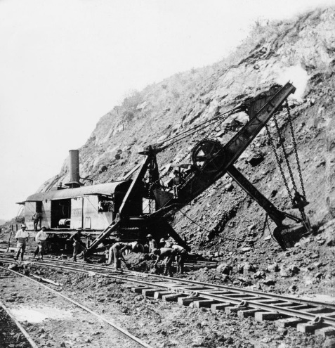
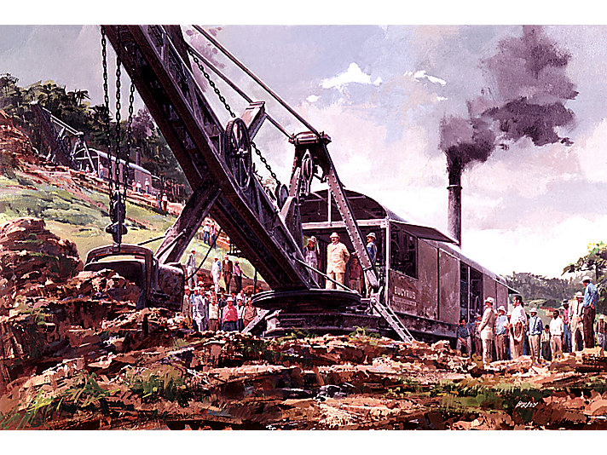
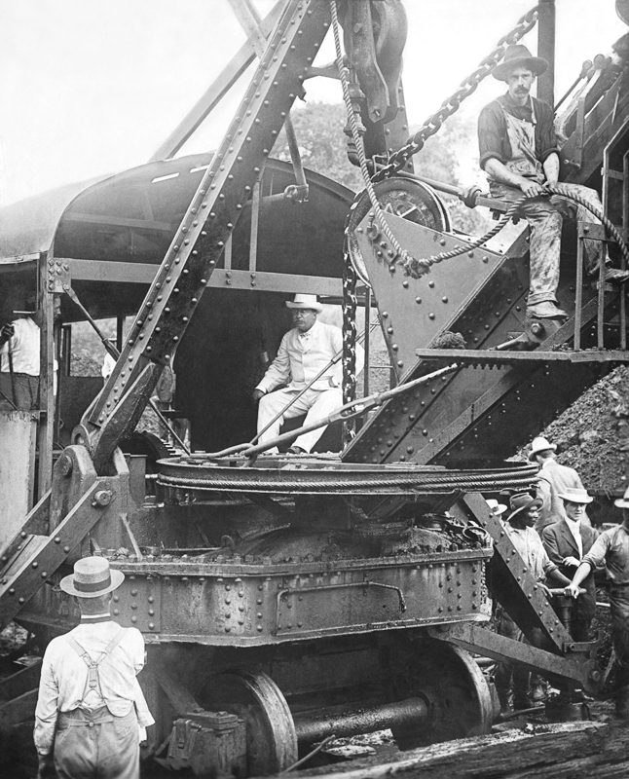
Notes:
5,600 Americans died building the Panama canal

Slide 86
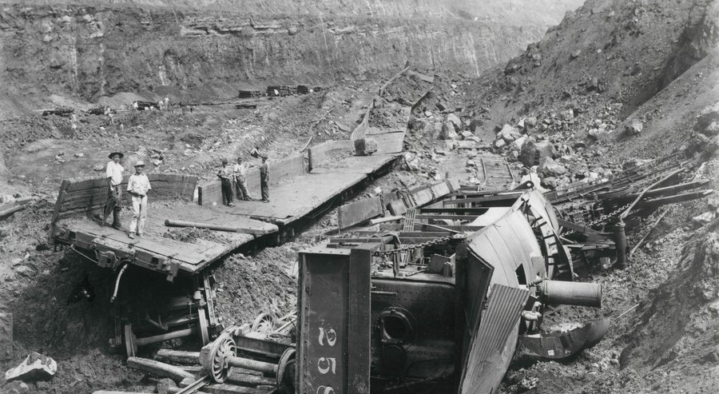

Slide 88
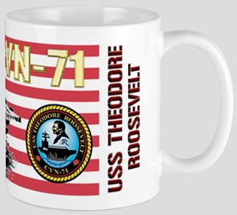
Notes:
Teddy was a heavy coffee drinker

Slide 89
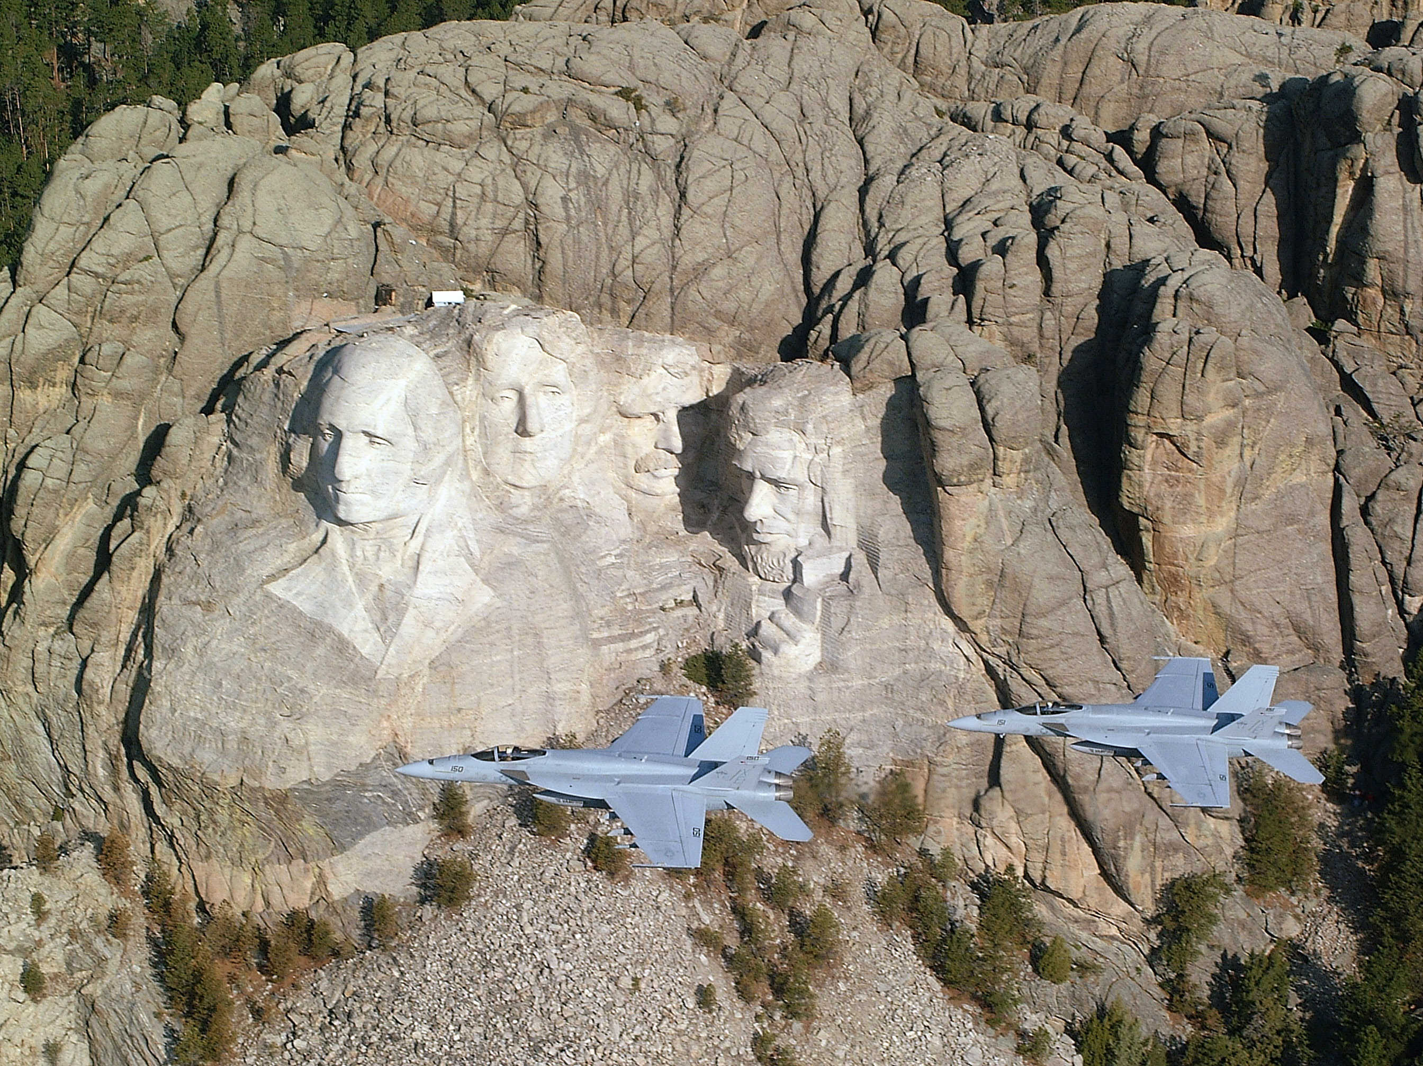

Slide 90
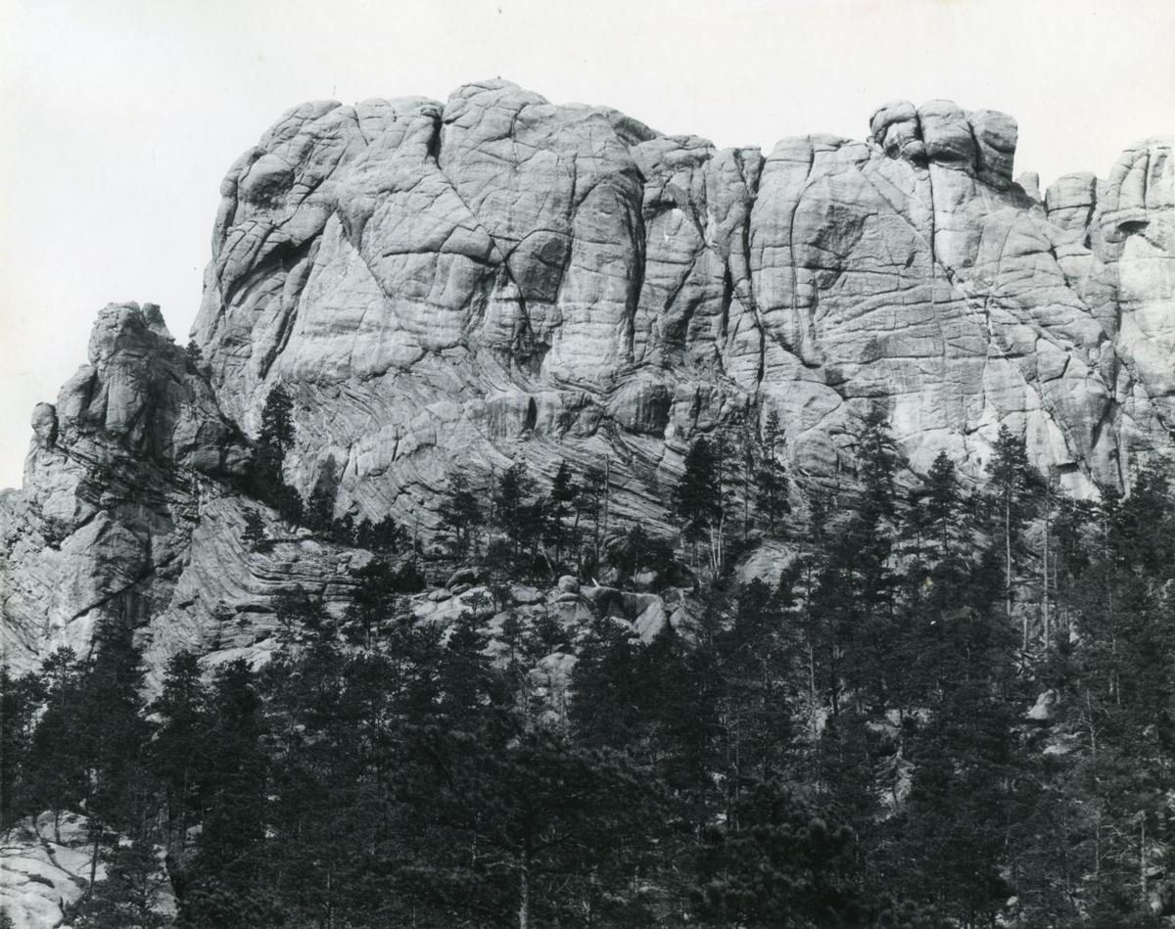
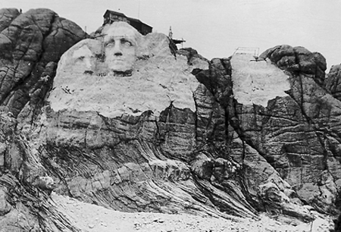
Notes:
October 4, 1927 starts the carving

Slide 91
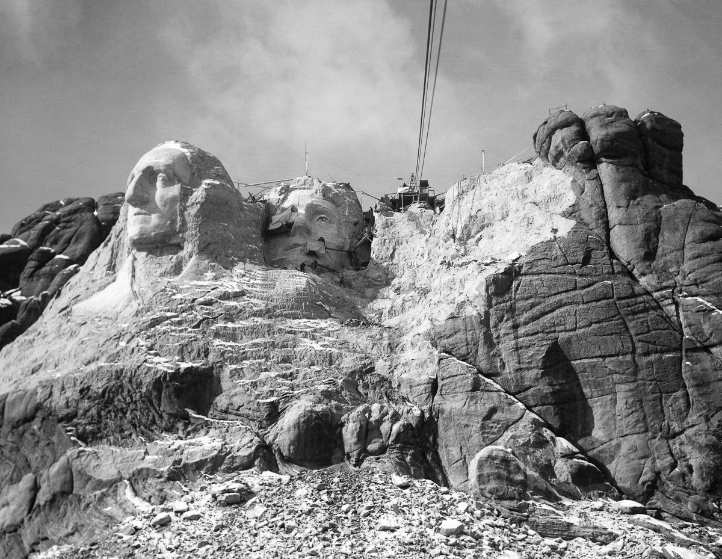

Slide 92
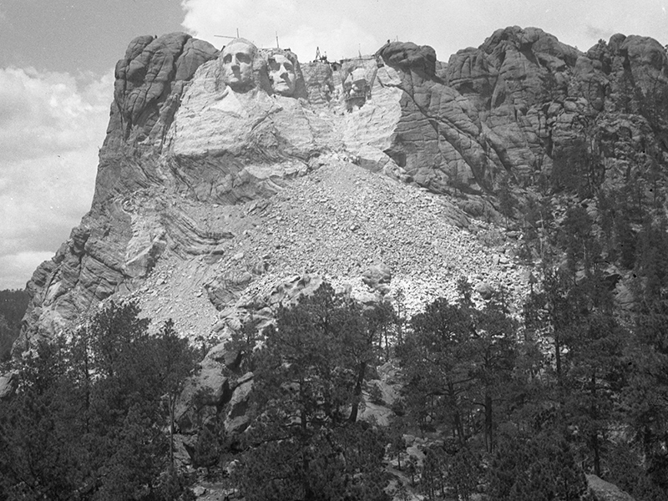
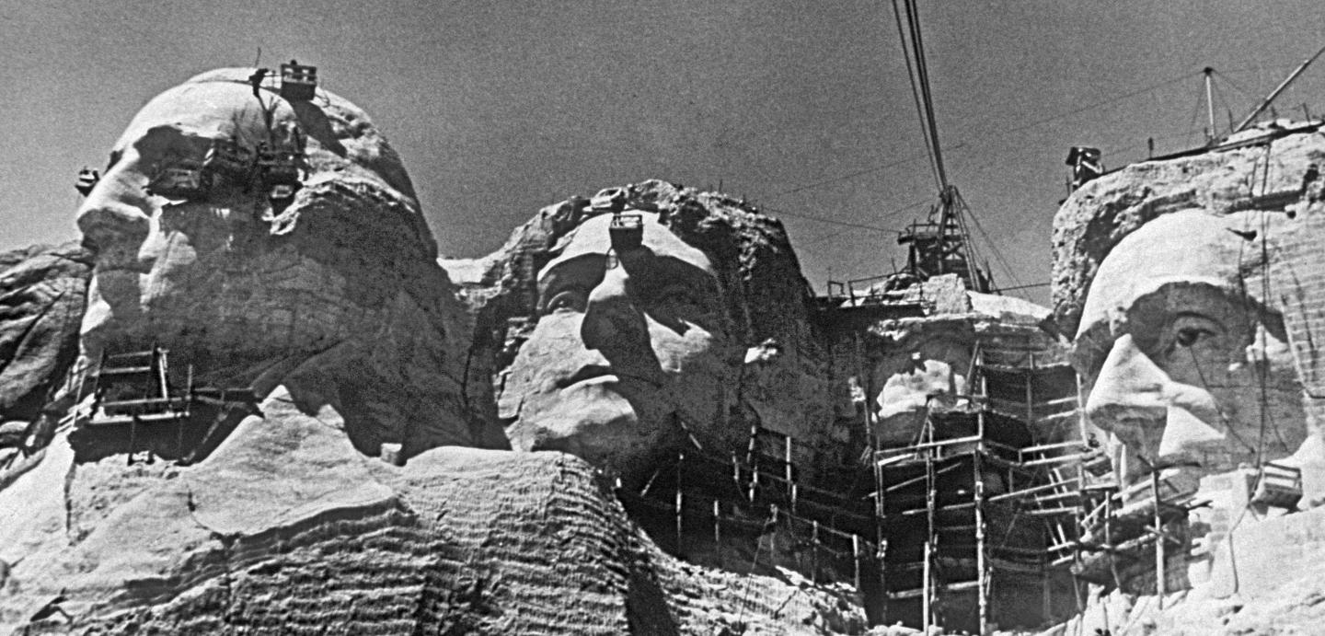

Slide 93
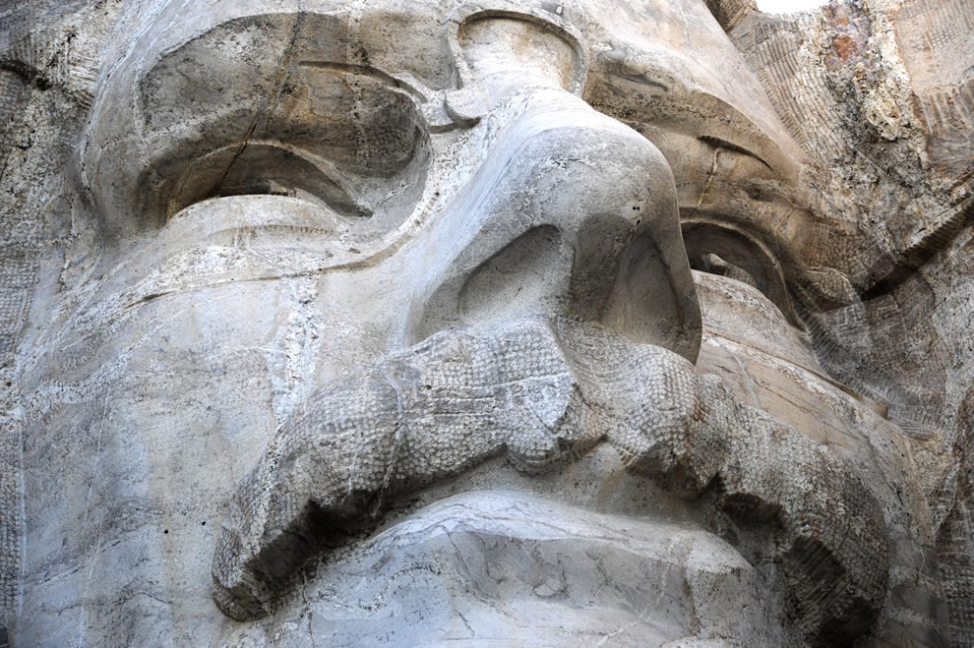

Slide 94
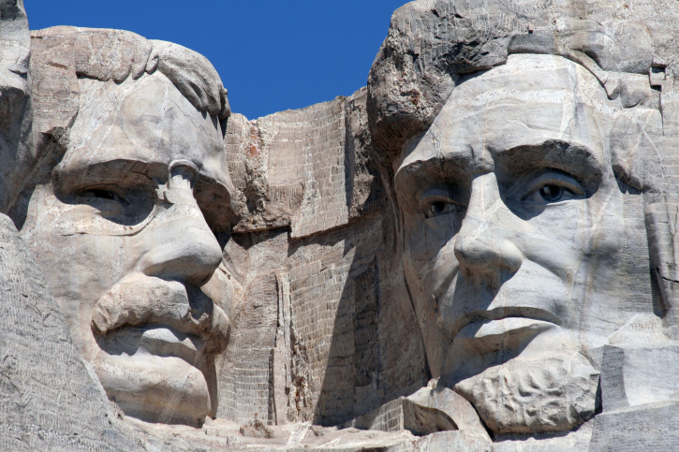
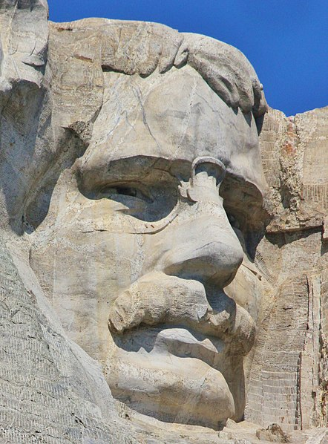

Slide 95
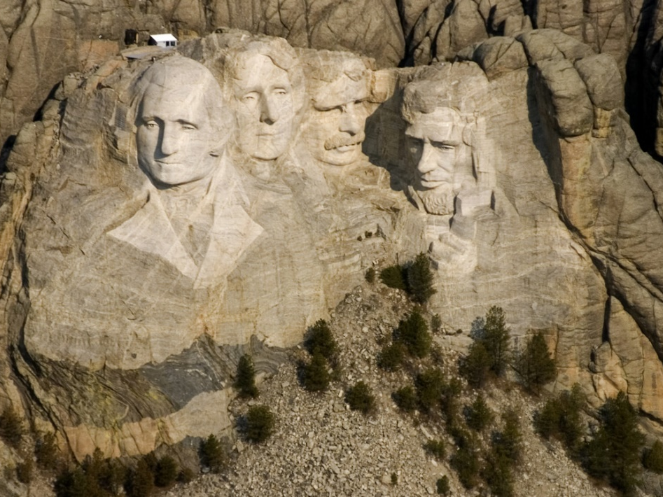
Notes:
Teddy Roosevelt, icon of Mt, Rushmore

Slide 96
Notes:
In 1902 he refused to kill a cub bear while on a hinting trip in Miss.

Slide 98
→ The Bible is worth more than secular education
→ People lacking Bible morals are a social menace
→ Without Christian values brutal horrors will prevail
→ Rich corrupted arrogant men have polluted politics
→ Character is more important than intellect
→ Holding one’s tongue banking on wisdom succeeds
→ Nature’s majesty should be preserved for the future
→ Whiners lack courage to stand in God’s given life
→ Knowledge without compassion is indifference
→ The voice of a fool mingles lower than a devil
→ Fear of life halts the adventure of living
→ True happiness lies in the joy of achievement
→ Every employed man deserves a fair square deal
A Person is valued by what they give, not what they take
Notes:
A Person is valued by what they give, not what they take

Slide 100
Please visit http://www.LoveFromGod.com to explore further
Ronald Bert Channel on
Notes:
Eternity never ends.

