Slide 2
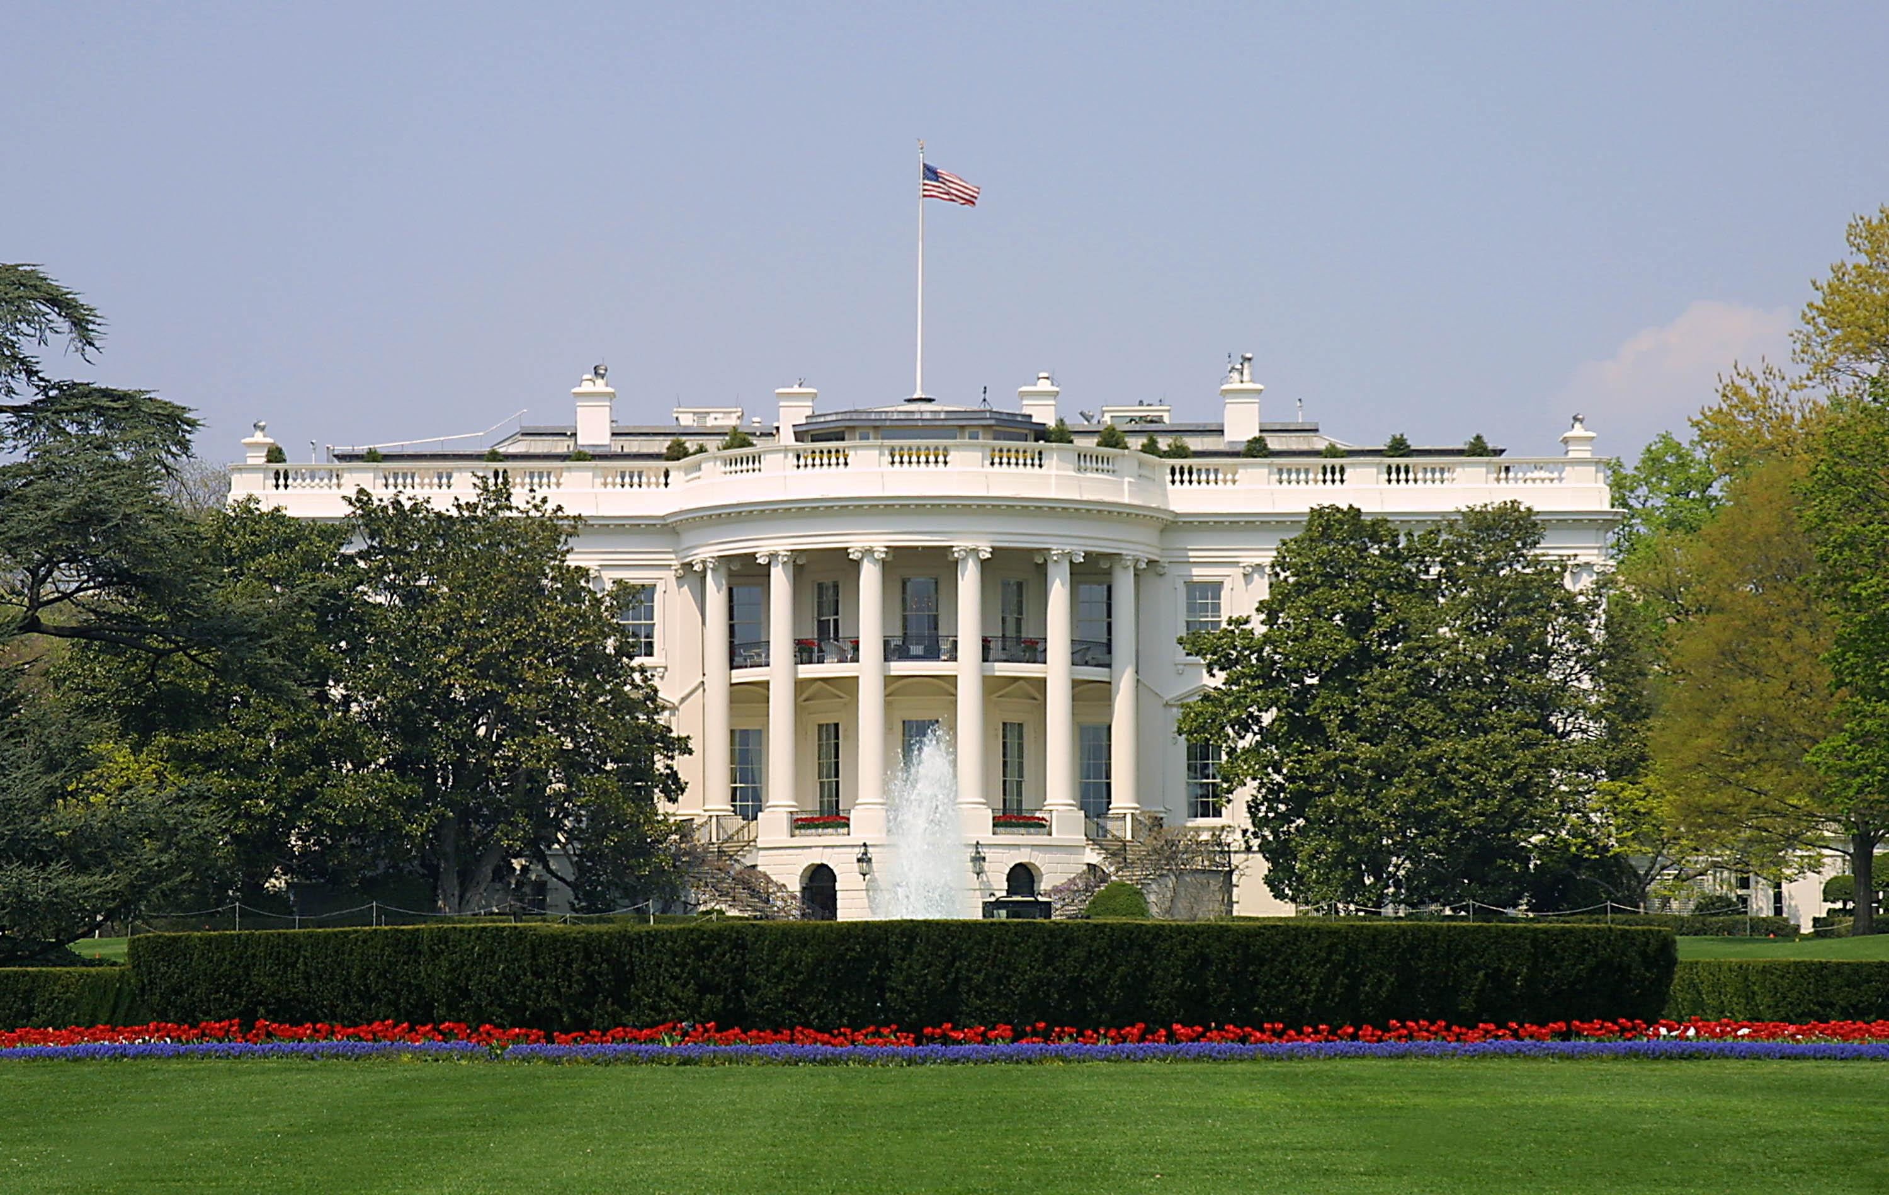
Presidential Quotes
Ron Bert
17
February 3, 2019

Slide 3
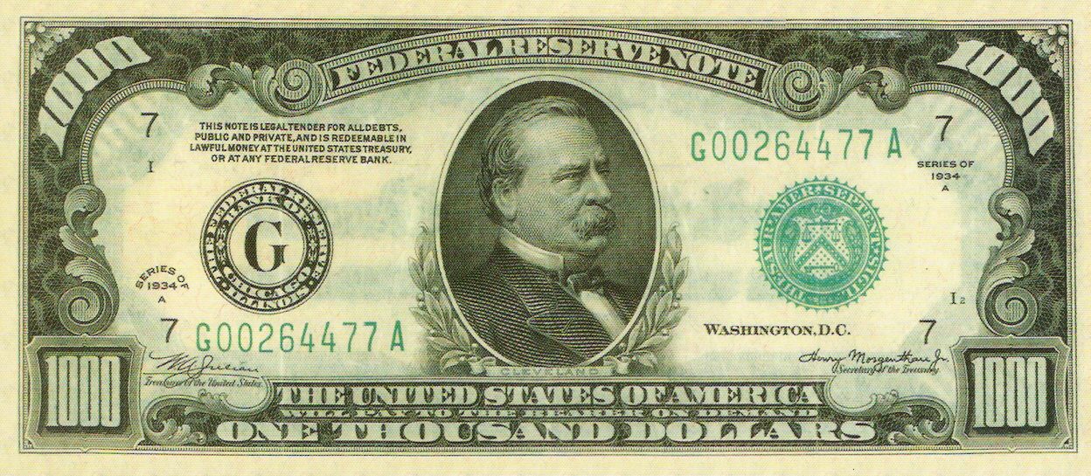
24. Grover Cleveland (1893-1897)
22.

Slide 4
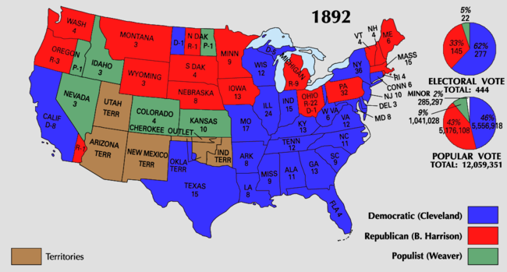

Slide 5
“I know there is a Supreme Being who rules the affairs of men and whose goodness and mercy have always followed the American people, and I know He will not turn from us now if we humbly and reverently seek His powerful aid.”
. .
seek

Slide 6
No temptation has overtaken you except such as is common to man; but God is faithful, who will not allow you to be tempted beyond what you are able, but with the temptation will also make the way of escape, that you may be able to bear it. — 1st Corinthians 10:13
trust

Slide 7
“The friendliness and charity of our countrymen can always be relied upon to relieve their fellow citizens in misfortune. This has been repeatedly and quite lately demonstrated. Federal aid in such cases encourages the expectation of paternal care on the part of the Government and weakens the sturdiness of our national character, while it prevents the indulgence among our people of that kindly sentiment and conduct which strengthens the bonds of a common brotherhood.”
Federal aid
weakens
kindly sentiment

Slide 8
Pure and undefiled religion before God and the Father is this: to visit orphans and widows in their trouble, and to keep oneself unspotted from the world. — James 1:27

Slide 9
“I know that human prejudice - especially that growing out of race and religion - is cruelly inveterate and lasting.”
Wicca
Muslim
prejudgment
Catholic
human prejudice
race and religion
Red
White
Mixture
Yellow
Brown
Black
deep-rooted
Mormon
Baptist
Buddhist

Slide 10
"Do not judge according to appearance, but judge with righteous judgment." — John 7:24
"I can of Myself do nothing. As I hear, I judge; and My judgment is righteous, because I do not seek My own will but the will of the Father who sent Me." — John 5:30
It is not good to show partiality to the wicked, Or to overthrow the righteous in judgment. — Proverbs 18:5
hear
favoritism
partiality
I do not seek
overthrow
seek
My own
lawlessness
the will of the
Father
Notes:
Partiality

Slide 11
“A government for the people must depend for its success on the intelligence, the morality, the justice, and the interest of the people themselves.”
government
government success depends on:
• intelligence
• morality
• justice
• interest of the people
depend
s
success
on
≠ ignorance
intelligence
morality
≠ wickedness
justice
interest of
≠ lies
the people
≠ loss

Slide 12
“We will not forget that Liberty has made her home here, nor shall her chosen altar be neglected ... A stream of light shall pierce the darkness of ignorance and mans oppression until Liberty enlightens the world.”
darkness of ignorance
mans oppression

Slide 13
“Above all, tell the truth.”

Slide 14
“These are days of special perplexity and depression, and the path of public duty is unusually rugged.”

Slide 15
“Communism is a hateful thing and a menace to peace and organized government; but the communism of combined wealth and capital, the outgrowth of overweening cupidity and selfishness, which insidiously undermines the justice and integrity of free institutions, is not less dangerous than the communism of oppressed poverty and toil, which, exasperated by injustice and discontent, attacks with wild disorder the citadel of rule.”
communism of combined wealth
mean greed
injustice
CRIME
attacks
disorder
Decency

Slide 16
“As we view the achievements of aggregated capital, we discover the existence of trusts, combinations, and monopolies, while the citizen is struggling far in the rear or is trampled to death beneath an iron heel.

Slide 17
Corporations, which should be the carefully constrained creatures of the law and the servants of the people, are fast becoming the people's masters.”

Slide 18
… with goodwill doing service, as to the Lord, and not to men, knowing that whatever good anyone does, he will receive the same from the Lord, whether he is a slave or free. And you, masters, do the same things to them, giving up threatening, knowing that your own Master also is in heaven, and there is no partiality with Him. — Ephesians 6:7-9
giving up threatening

Slide 19
“The ship of democracy, which has weathered all storms, may sink through the mutiny of those on board.”

Slide 20
"Son of man, when a land sins against Me by persistent unfaithfulness, I will stretch out My hand against it; I will cut off its supply of bread, send famine on it, and cut off man and beast from it. Even if these three men, Noah, Daniel, and Job, were in it, they would deliver only themselves by their righteousness," says the Lord GOD. — Ezekiel 14:13-14
deliver only
by their righteousness

Slide 21
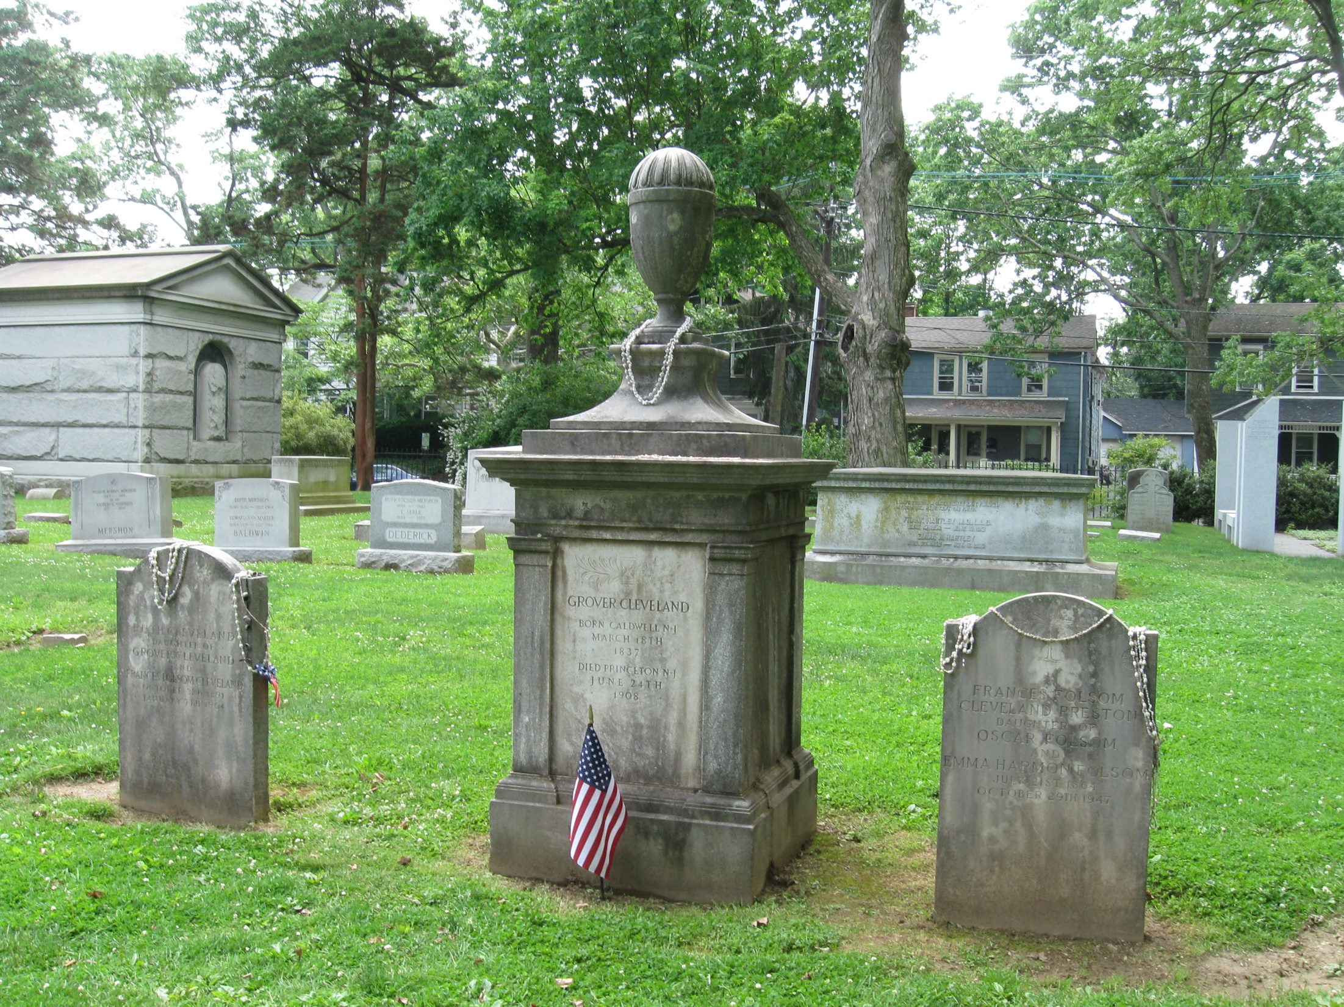
Princeton Cemetery, Princeton, NJ

Slide 22
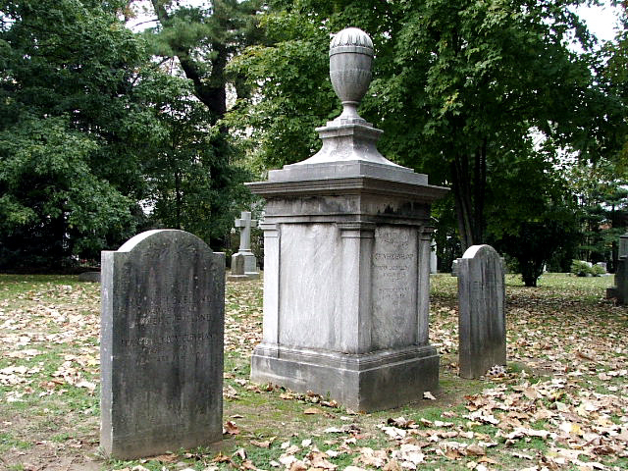

Slide 23
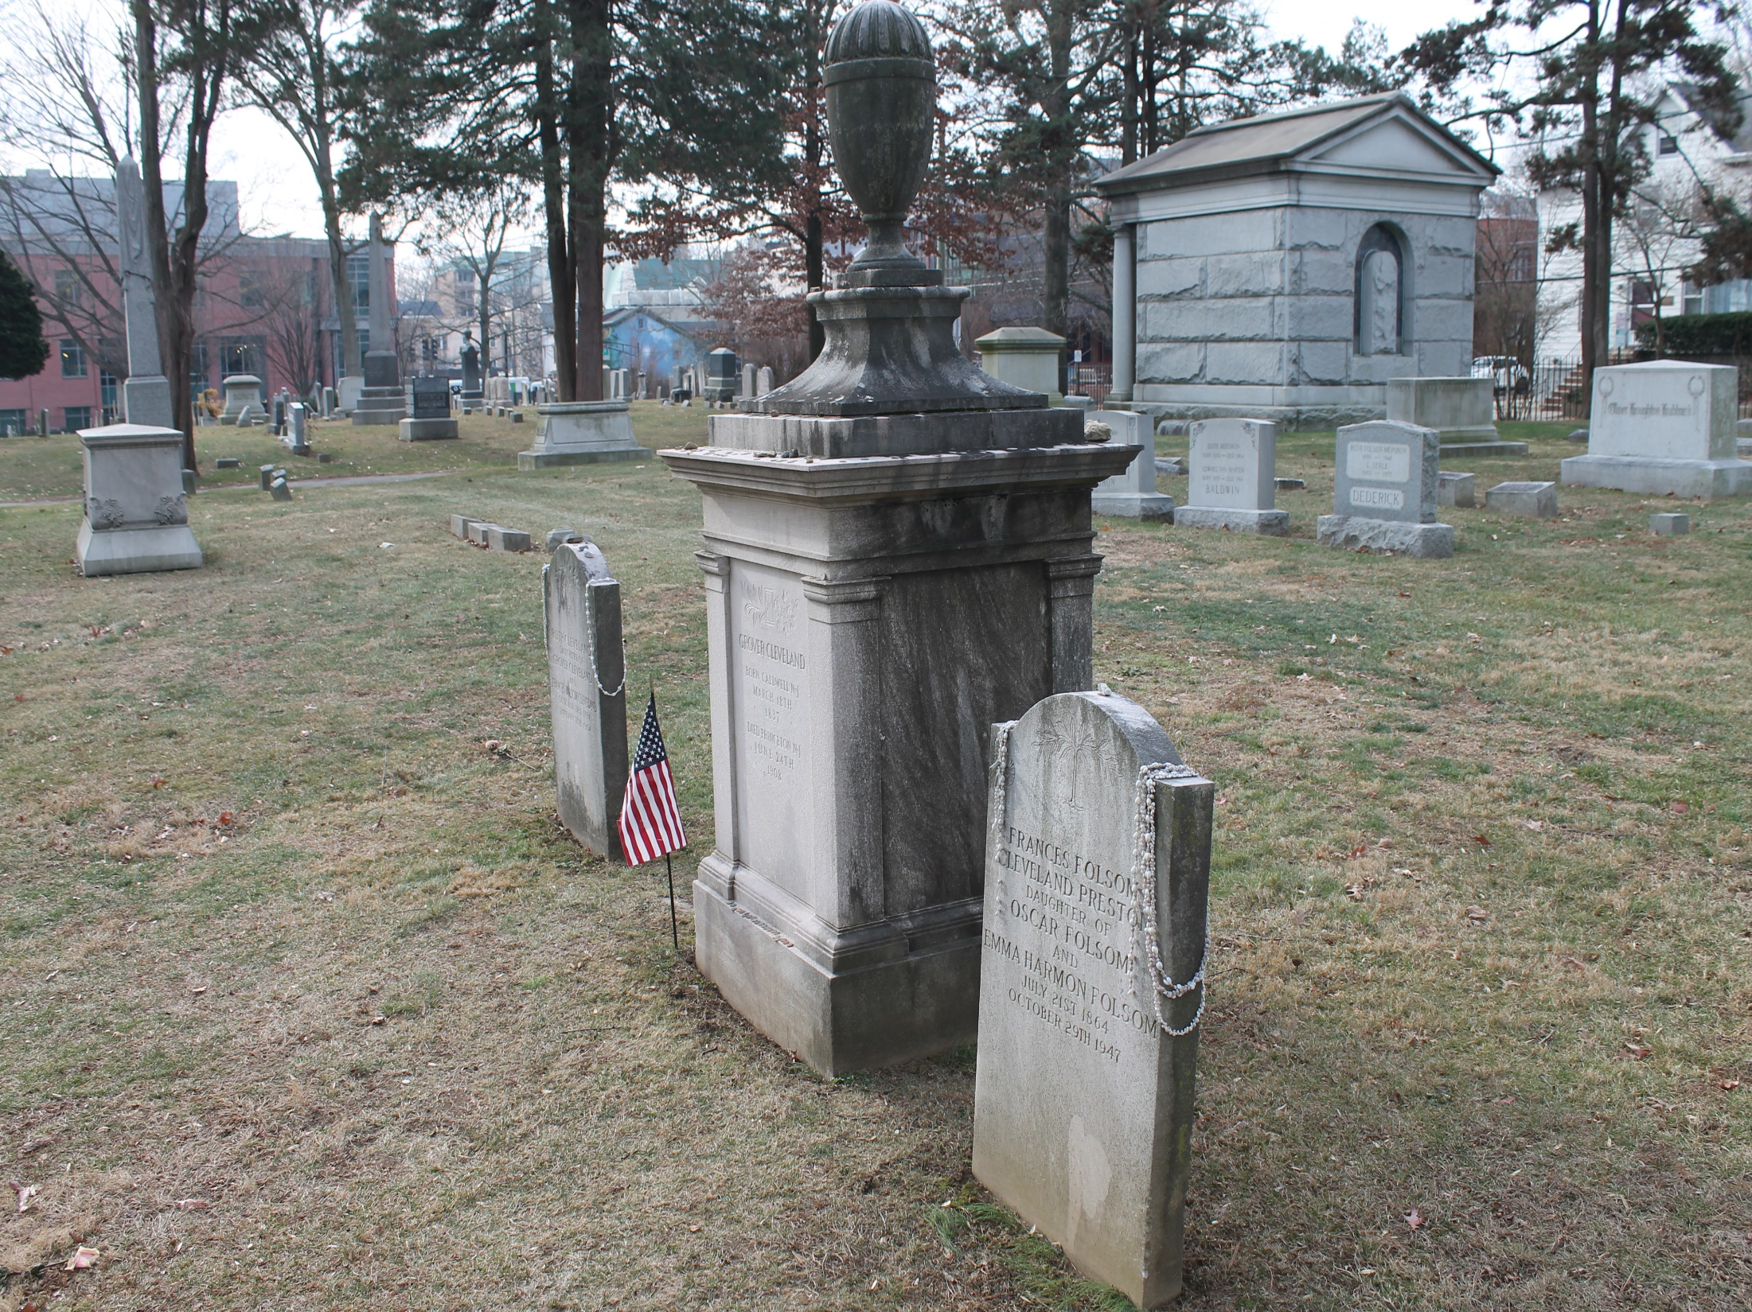

Slide 24
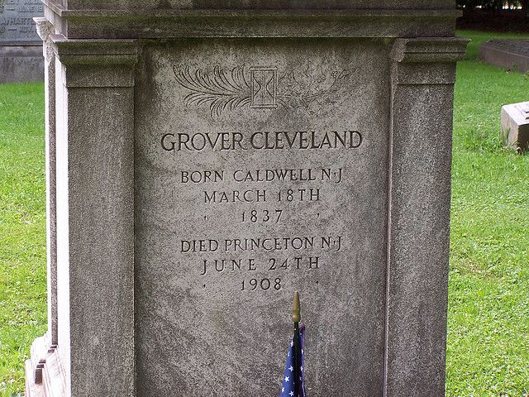

Slide 25
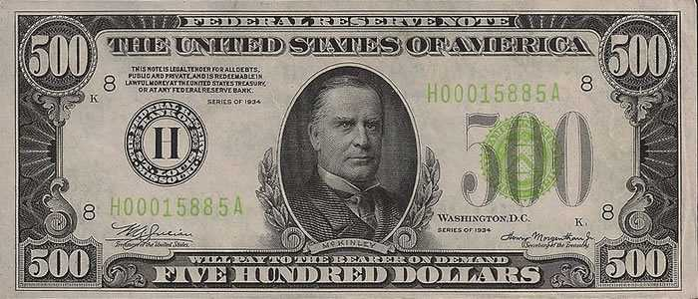
25. William McKinley (1897-1901)
Notes:
On February 15, 1898, the USS Maine was sunk on an official visit to Havana. President McKinley attempted to prevent war and endeavored to persuade the Spanish government to adopt a conciliatory policy with the Cuban insurrectionists. On April 20, Congress adopted a resolution declaring war against Spain. A peace protocol ended hostilities on August 12, 1898. Under the peace treaty signed at Paris on December 10, 1898,
Fought in the Civil war starting as a private ending with rank of Major.
Elected governor of Ohio 1891
1st Candidate to run a presidential campaign for republican nomination. 1st to speak to a black audience in Florida.
William McKinley (1897-1901) 1st president to ride in a car. Led the Spanish/American, freed Cuba, and gained control over Guam, Puerto Rico, & Philippines. The United States annexed the independent Republic of Hawaii in 1898 and it became a United States territory. Machine age was changing economy. He established gold standard once for all to keep value in our money. Assassinated 1901. Mt. McKinley was renamed back to Mt. Denali by President Obama. Lost only two daughters, one as an infant, and 5 year old. Wife heavily depressed rest of life and developed epileptic fits. Congress then approved protection of the president by the Secret Service (Originally formed to battle currency fraud by Lincoln the morning of his assassination).

Slide 26
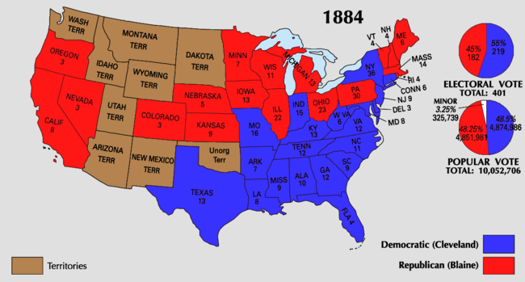
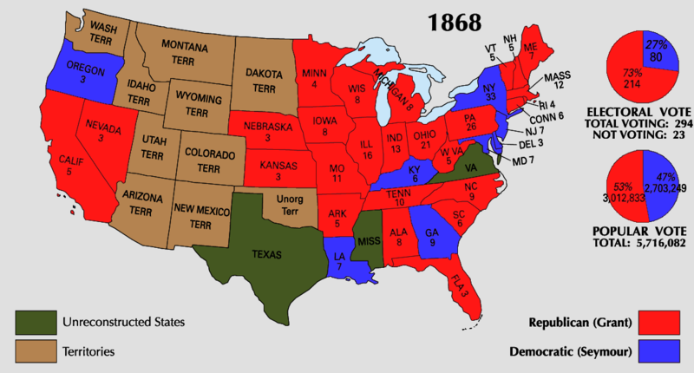
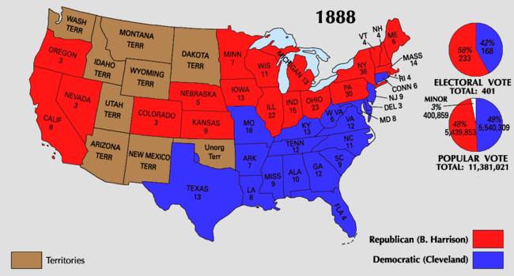
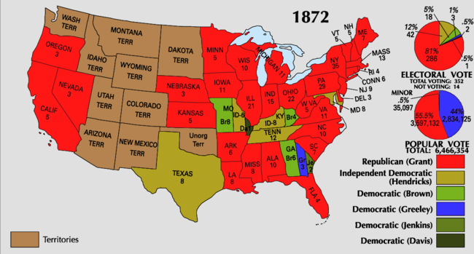
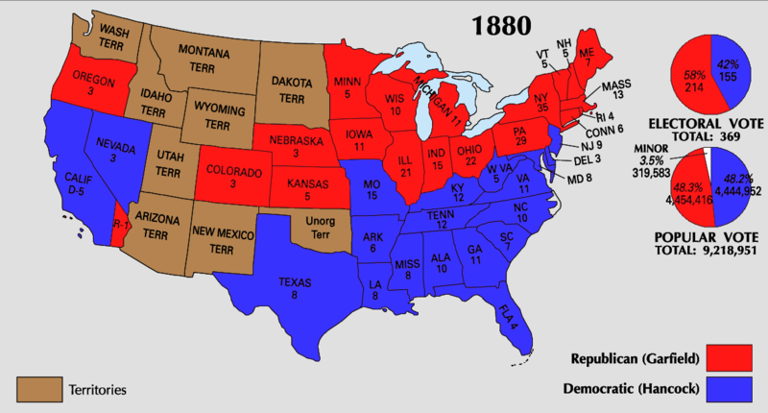
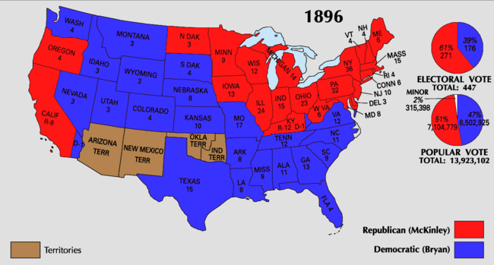
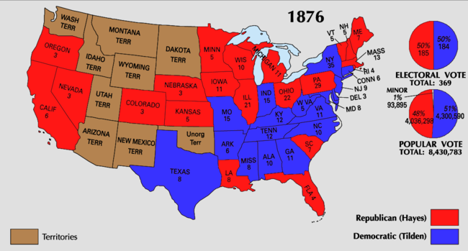
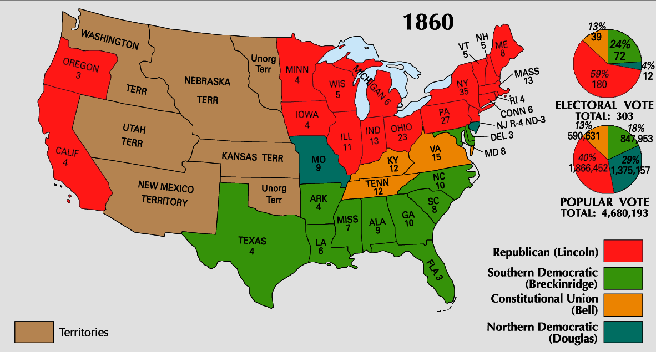
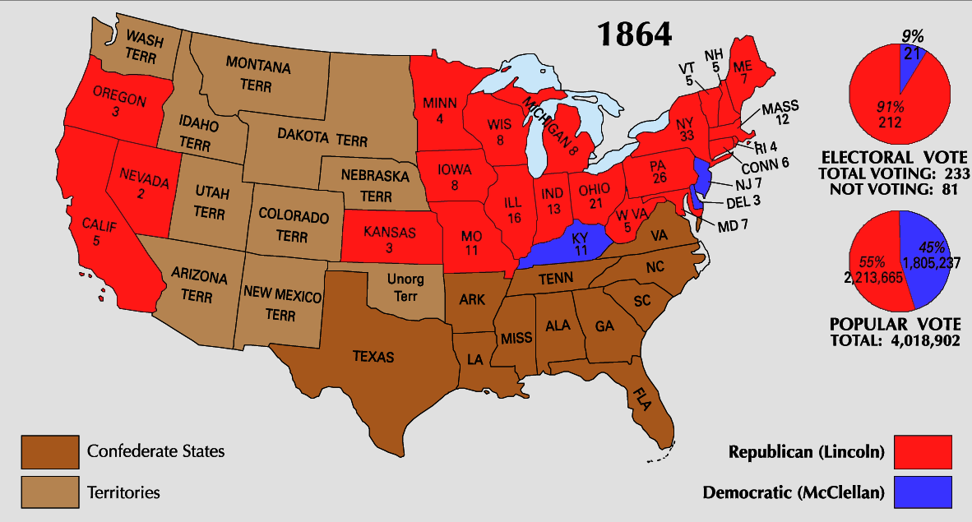

Slide 27
“That's all a man can hope for during his lifetime - to set an example - and when he is dead, to be an inspiration for history.”

Slide 28
Praise the LORD! Blessed is the man who fears the LORD, Who delights greatly in His commandments. His descendants will be mighty on earth; The generation of the upright will be blessed. — Psalms 112:1-2
generation of the upright
be blessed

Slide 29
“I went down on my knees and prayed to Almighty God for light and guidance and one night late it came to me this way. We could not leave (the Philippines) to themselves - they were unfit for self-government - and they would soon have anarchy and misrule over there worse than Spain's was. There was nothing left for us to do but take them all and educate the Filipinos, and uplift and Christianize them.”

Slide 30
And He said to them, "Go into all the world and preach the gospel to every creature. He who believes and is baptized will be saved; but he who does not believe will be condemned." — Mark 16:15-16

Slide 31
“Our faith teaches that there is no safer reliance than upon the God of our fathers who has so singularly favored the American people in every national trial and who will not forsake us so long as we obey His commandments and walk humbly in His footsteps.”
so long as
we obey
in

Slide 32
“The more profoundly we study this wonderful Book, and the more closely we observe its divine precepts, the better citizens we will become and the higher will be our destiny as a nation.”

Slide 33
“Our earnest prayer is that God will graciously vouchsafe prosperity, happiness, and peace to all our neighbors, and like blessings to all the peoples and powers of the earth.”
grant
to all our neighbors
of the earth

Slide 34
Finally, all of you be of one mind, having compassion for one another; love as brothers, be tenderhearted, be courteous; not returning evil for evil or reviling for reviling, but on the contrary blessing, knowing that you were called to this, that you may inherit a blessing. — 1st Peter 3:8-9
not returning evil for evil

Slide 35
“By the blessings of heaven I mean to live and die, please God, in the faith of my mother.”

Slide 36
For if we live, we live to the Lord; and if we die, we die to the Lord. Therefore, whether we live or die, we are the Lord’s. — Romans 14:8

Slide 37
“The path of progress is seldom smooth. New things are often found hard to do. Our fathers found them so. We find them so. But are we not made better for the effort and sacrifice?”

Slide 38
And He said to me, "My grace is sufficient for you, for My strength is made perfect in weakness." Therefore most gladly I will rather boast in my infirmities, that the power of Christ may rest upon me. — 2nd Corinthians 12:9

Slide 39
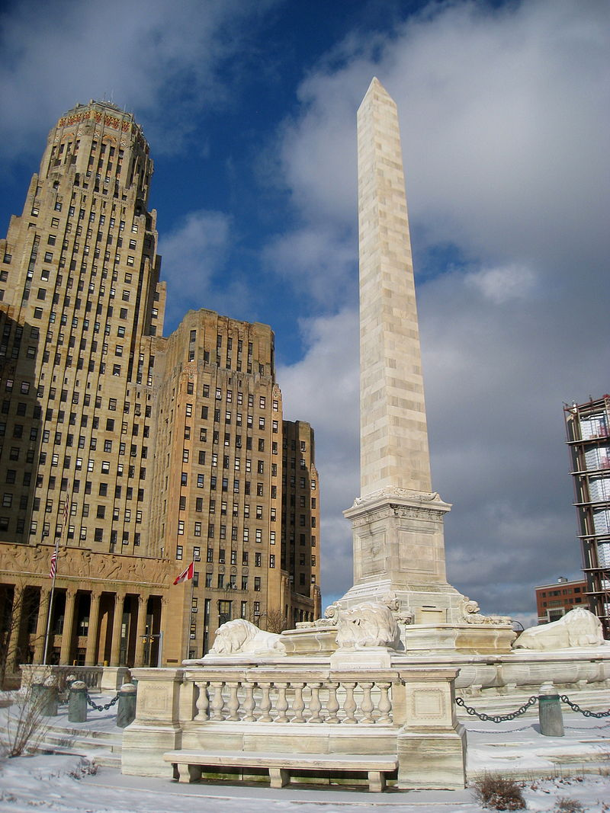
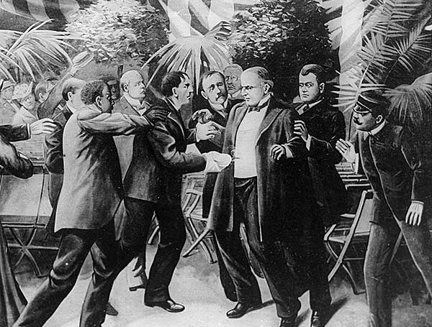
Notes:
On September 6, 1901, William McKinley, the 25th President of the United States, was shot on the grounds of the Pan-American Exposition at the Temple of Music in Buffalo, New York. He was shaking hands with the public when Leon Czolgosz, an anarchist, shot him twice in the abdomen. 6 months into 2nd term.
Died on Sept 14, 1901 as a result of initial injury and subsequent infection)
The McKinley Monument is a 96-foot (29 m) tall obelisk in Niagara Square, Buffalo, New York.

Slide 40
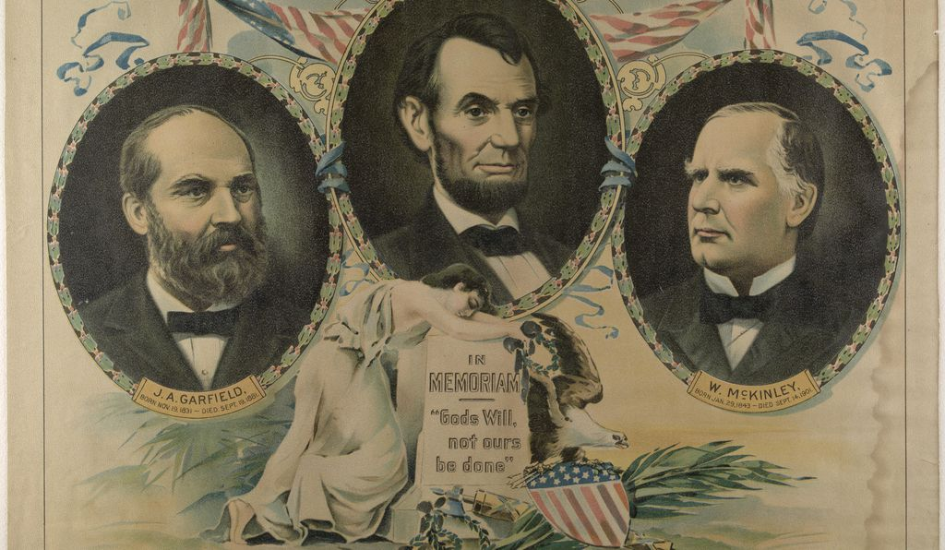
16
25
20
Notes:
Lincoln signed the secret service into law the morning of his assassination. It was not to protect the president but to investigate the misappropriation of funds. 4 assassinations and 4 deaths in office, 1 out 5 presidents die in office.

Slide 41
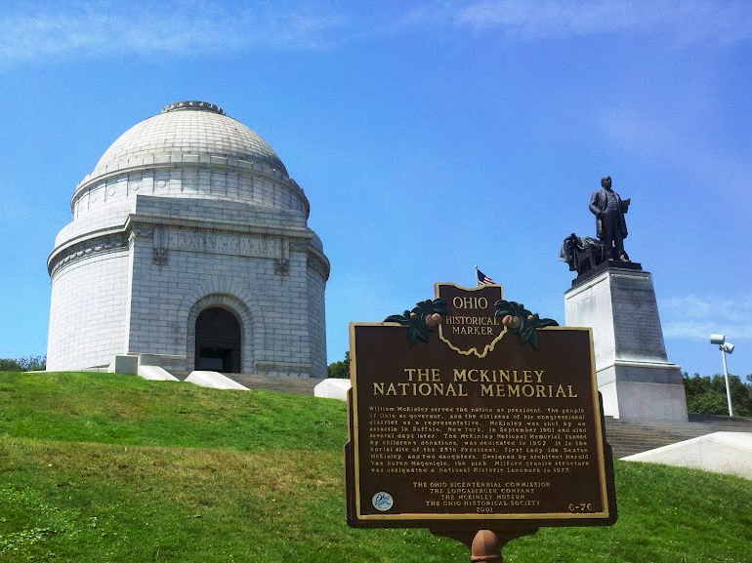
Notes:
The McKinley National Memorial in Canton, Ohio. 21+ aches.

Slide 42
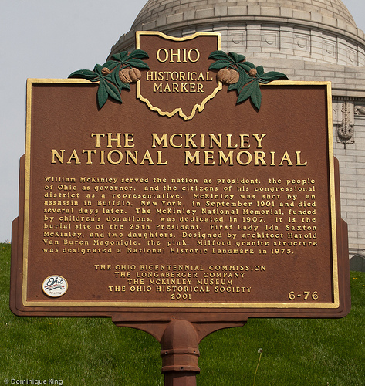

Slide 43
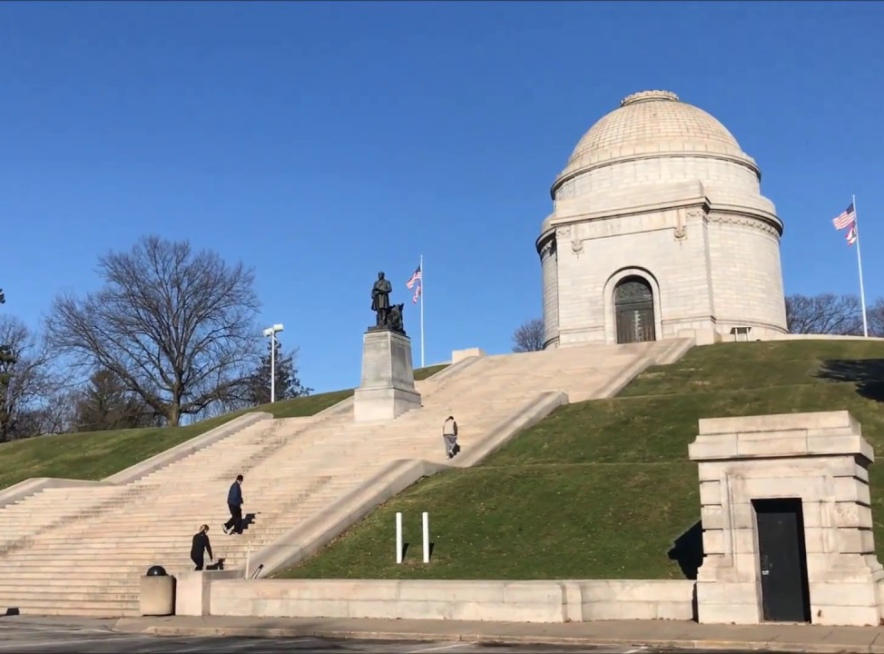
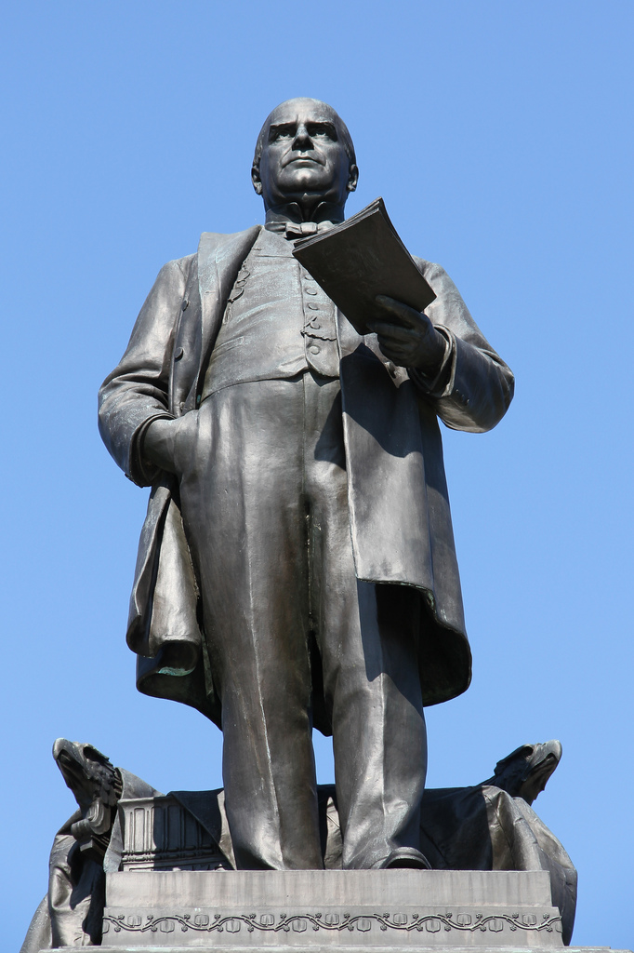

Slide 44
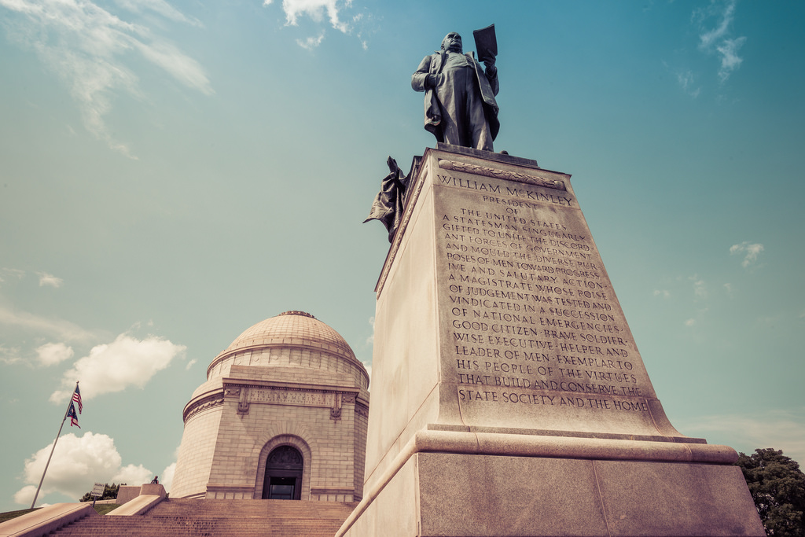

Slide 45
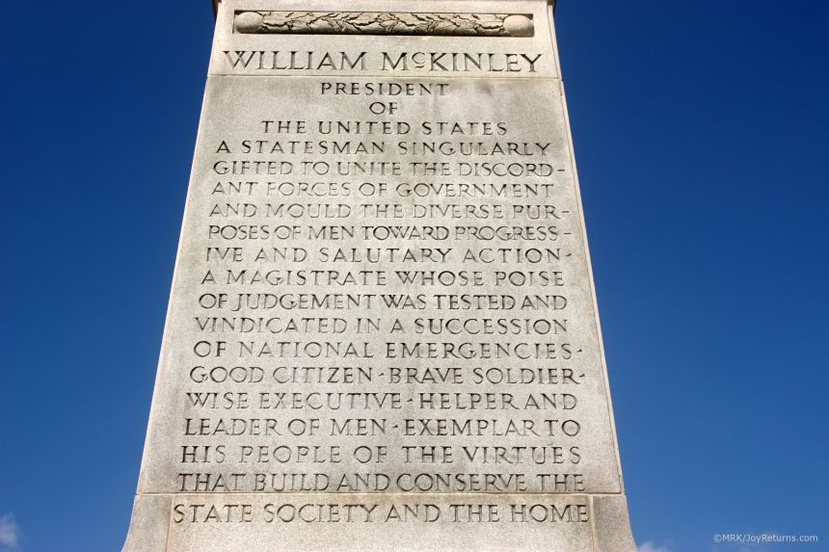

Slide 46
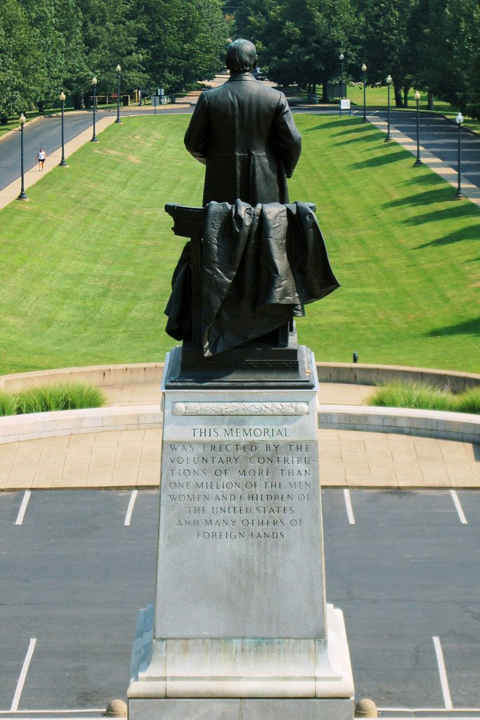

Slide 47
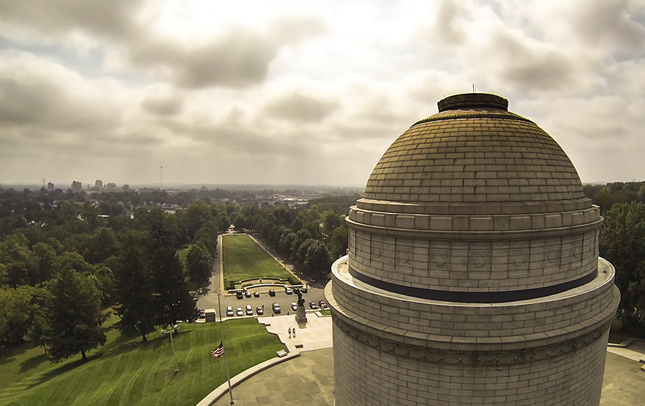
Notes:
Canton. Ohio

Slide 48
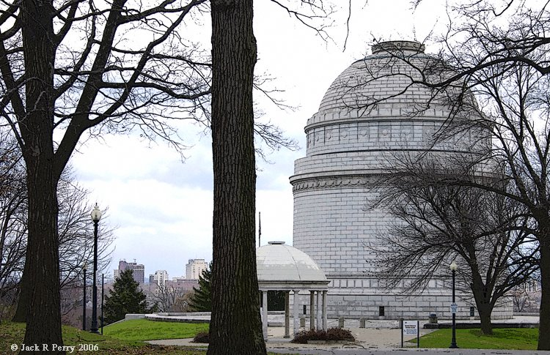

Slide 49
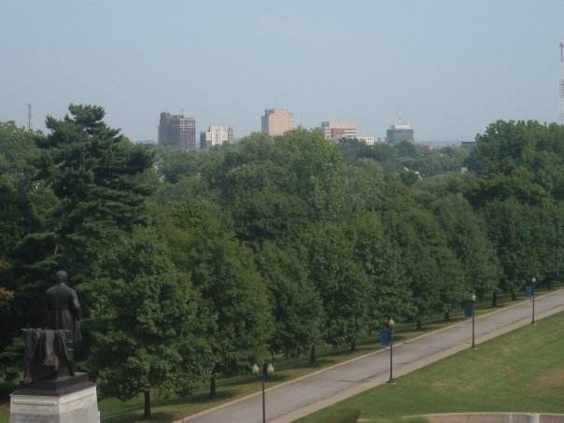

Slide 50
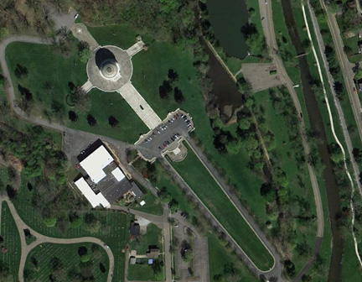
Notes:
22 acres

Slide 51
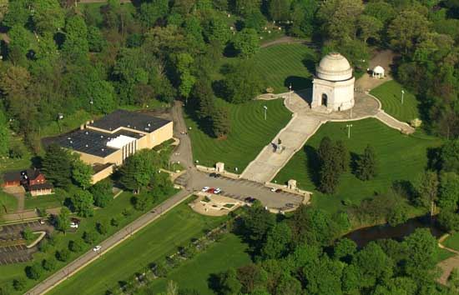

Slide 52
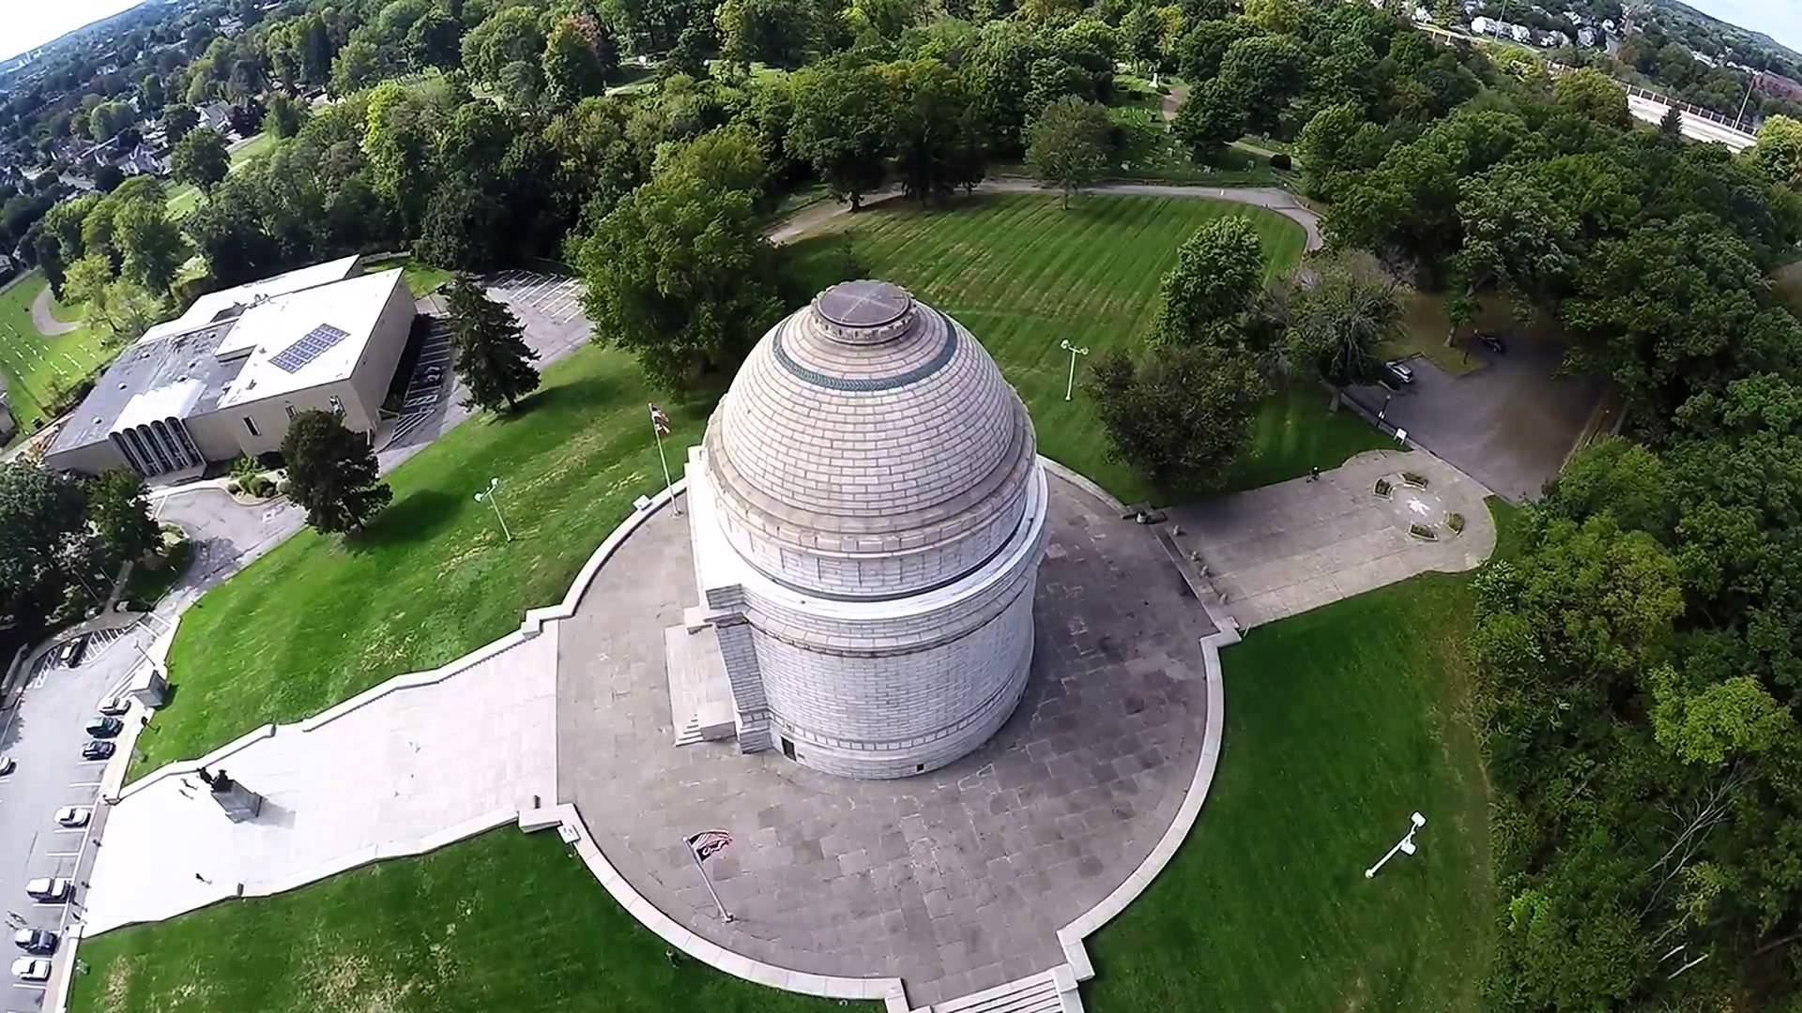
Notes:
Canton, Ohio

Slide 53
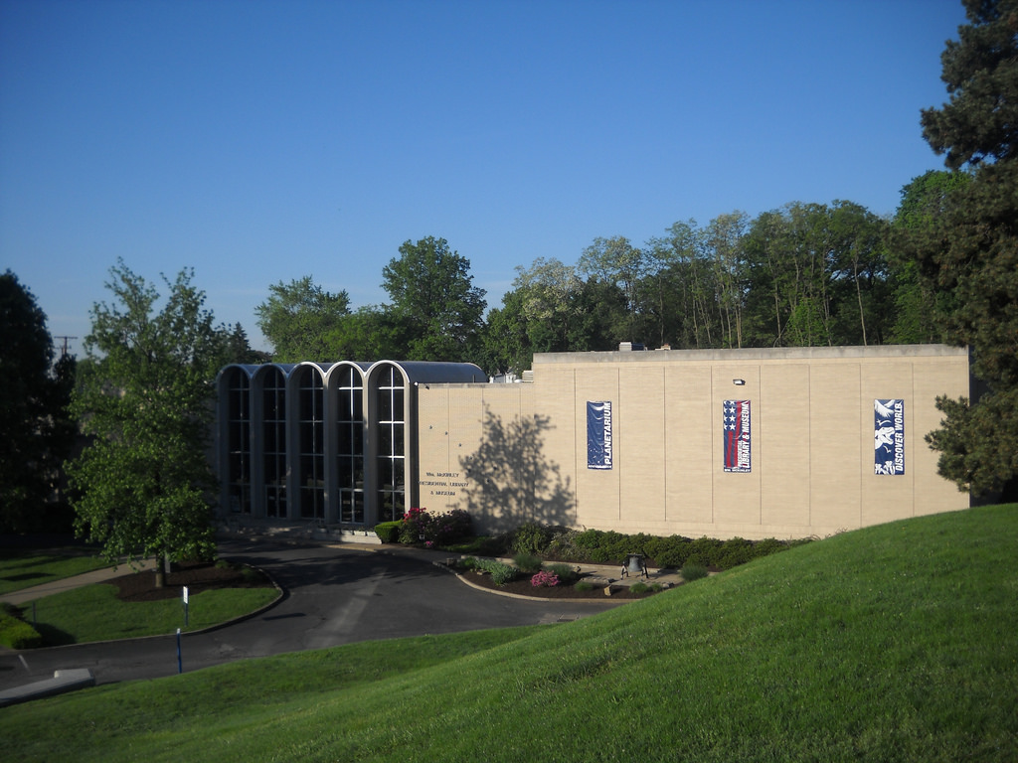

Slide 54
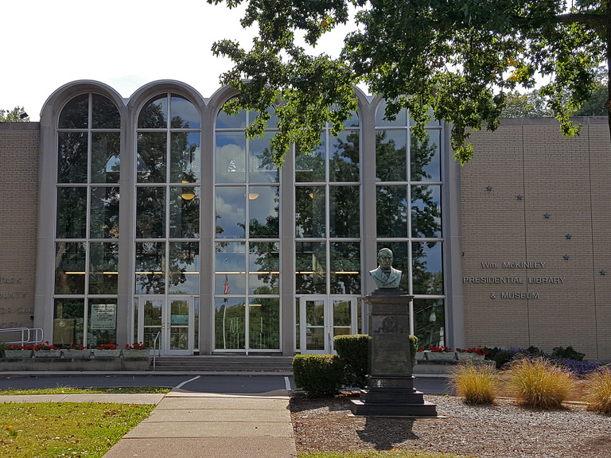

Slide 55
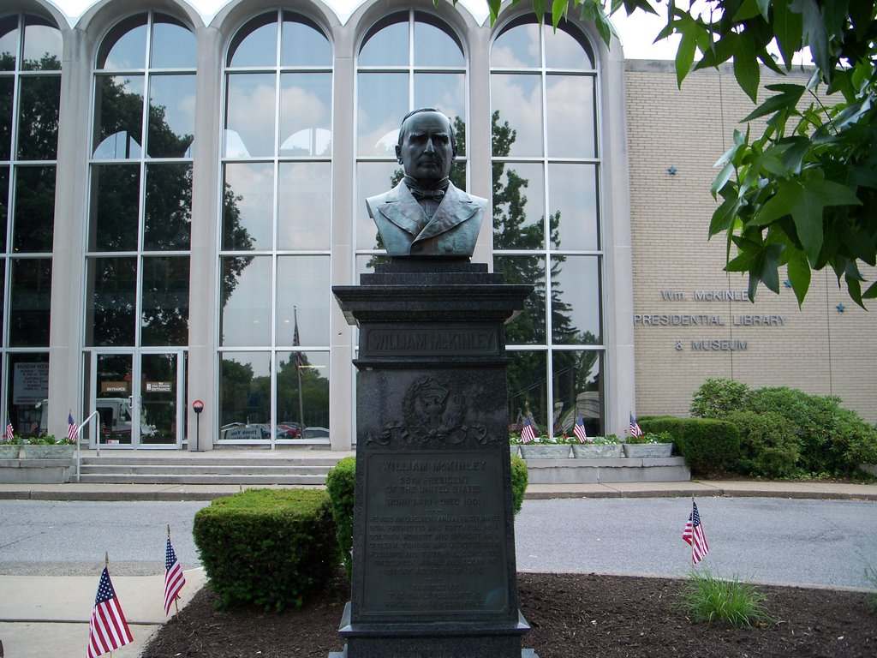

Slide 56
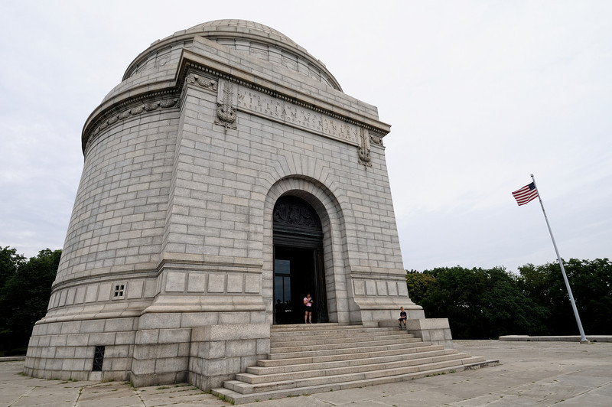

Slide 57
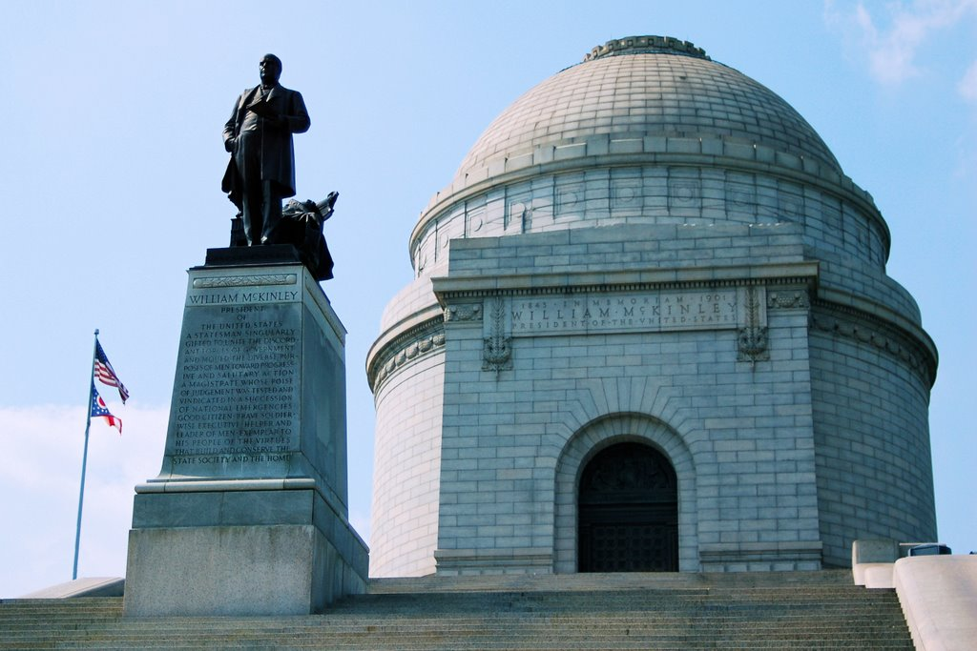

Slide 58
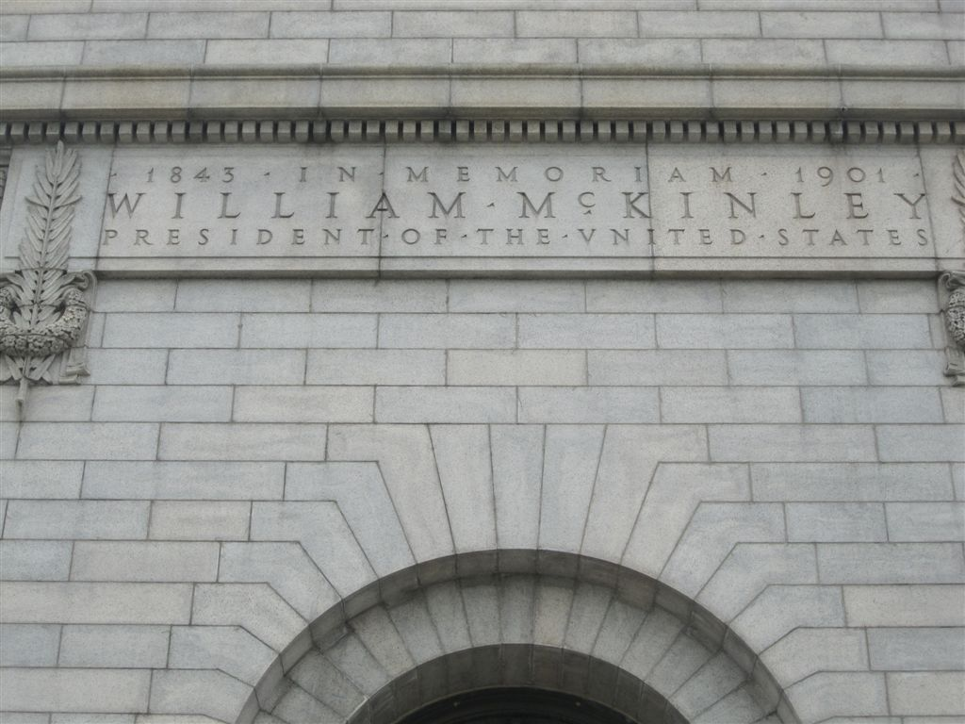

Slide 59
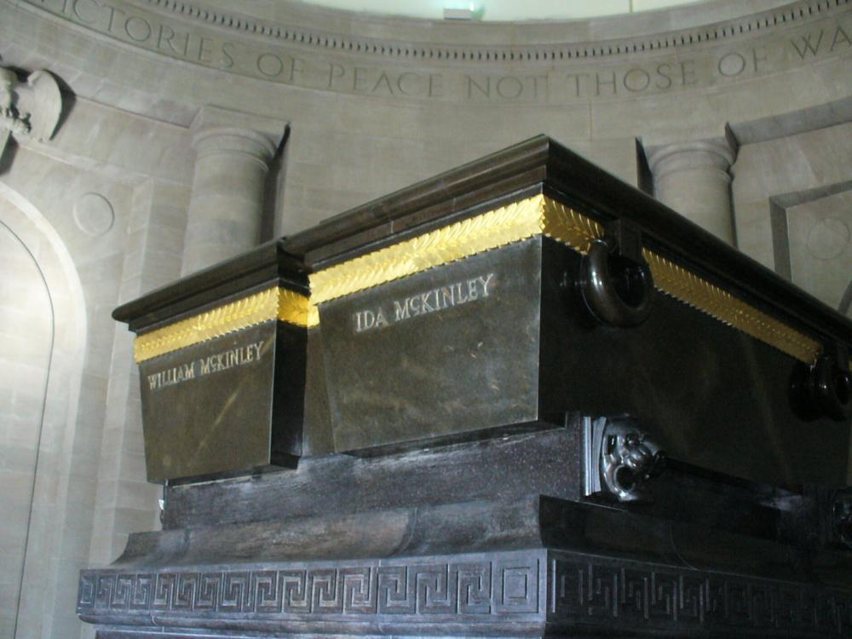

Slide 60
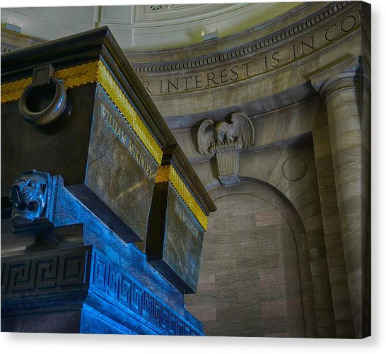
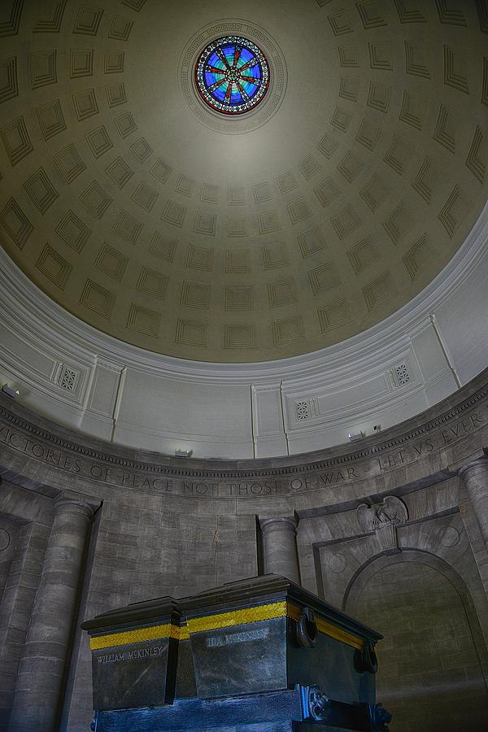
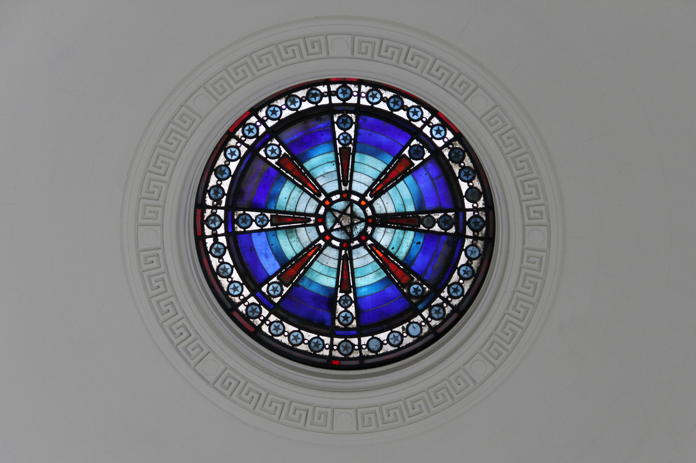

Slide 61
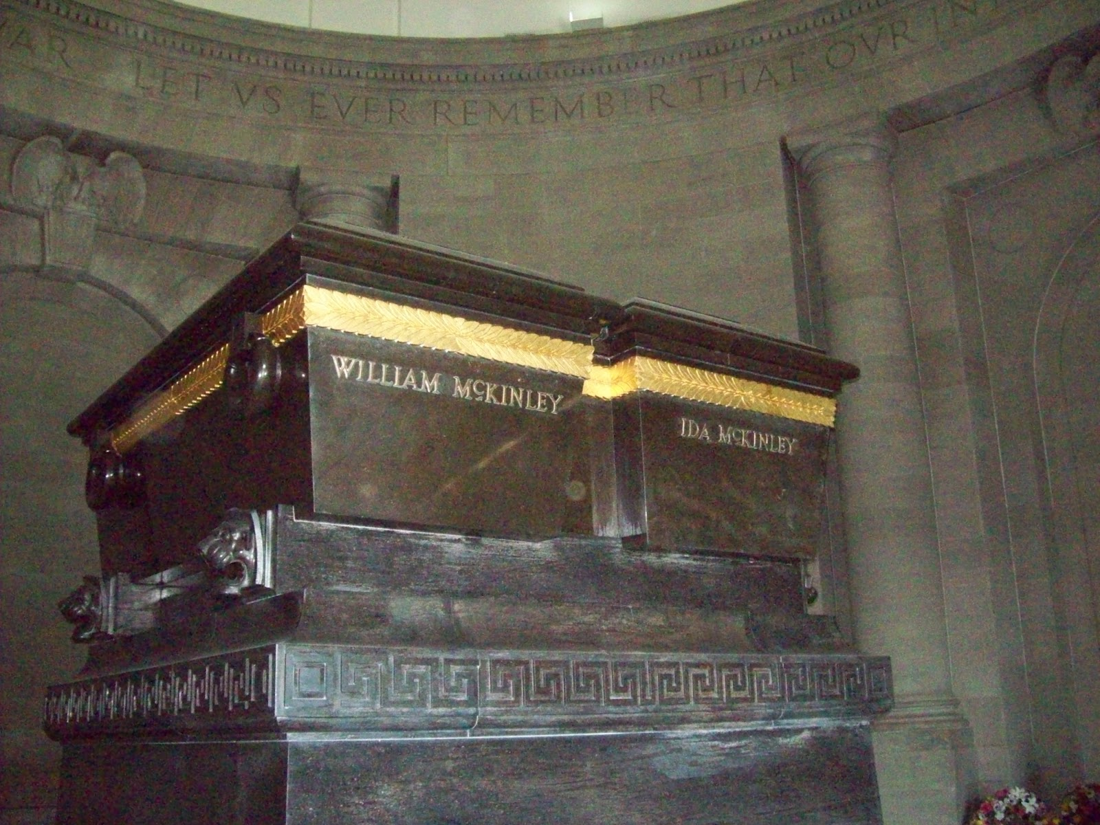

Slide 62
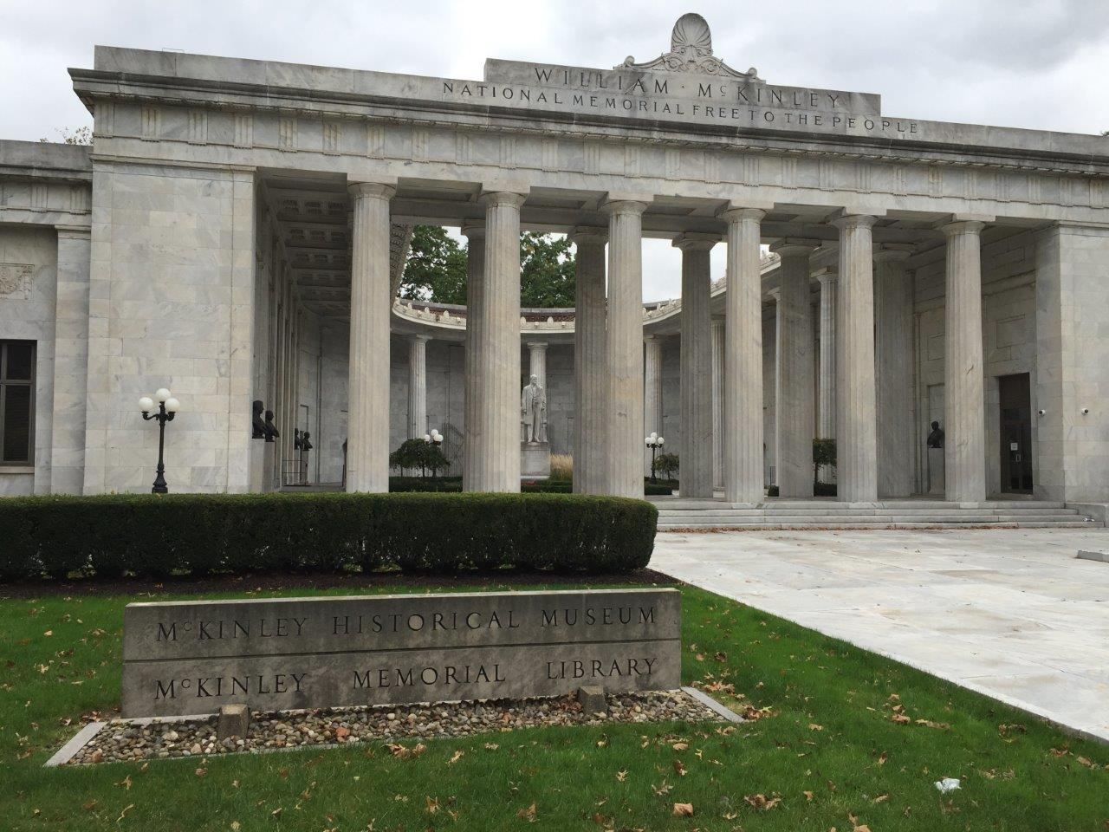
Notes:
Niles, Ohio

Slide 63
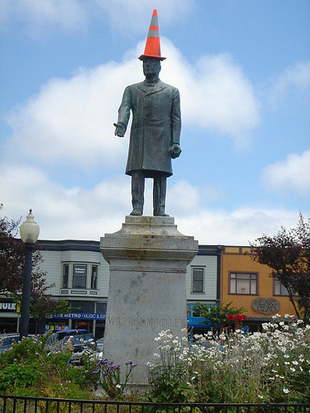
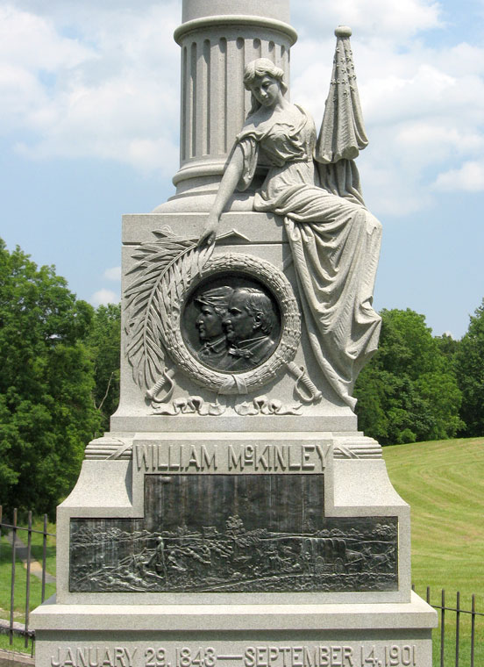
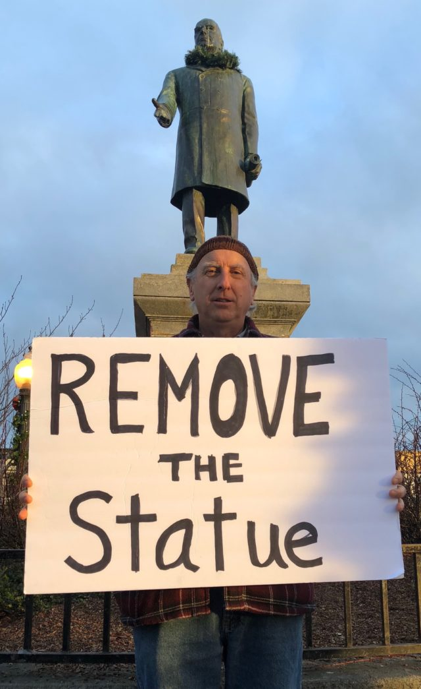
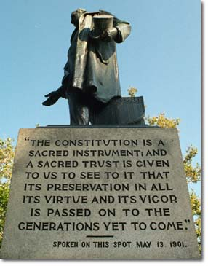
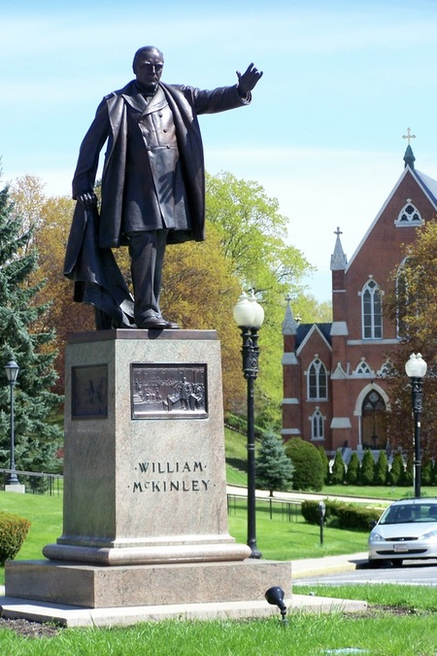
Notes:
Arcata, California, … Blamed for strict immigration laws which killed millions of Filipinos. Leader of a colonial empire …

Slide 64
→ The providence of God blesses the faithful
→ Godliness involves taking care of your own
→ Prejudice is a monster that destroys decency
→ Safeguarding a moral régime is an intelligent public
→ Liberty is the light of God
→ Oppressive institutions defeat peaceful public order
→ Rule disregarding respect for freedom invites ruin
→ Legacy is a matter the goodness one lives by
→ Reverent integrity blesses future generations
→ We are commanded by God to share His knowledge
→ Humble faith brings God’s favor upon a people
→ Power of prayer applies when hearts are genuine
→ In weakness strength is found
Falling away from God’s commands weakens all who disobey
Notes:
Falling away from God’s commands weakens all who disobey

Slide 66
Please visit http://www.LoveFromGod.com to explore further
Ronald Bert Channel on
Notes:
Eternity never ends.

