Slide 2
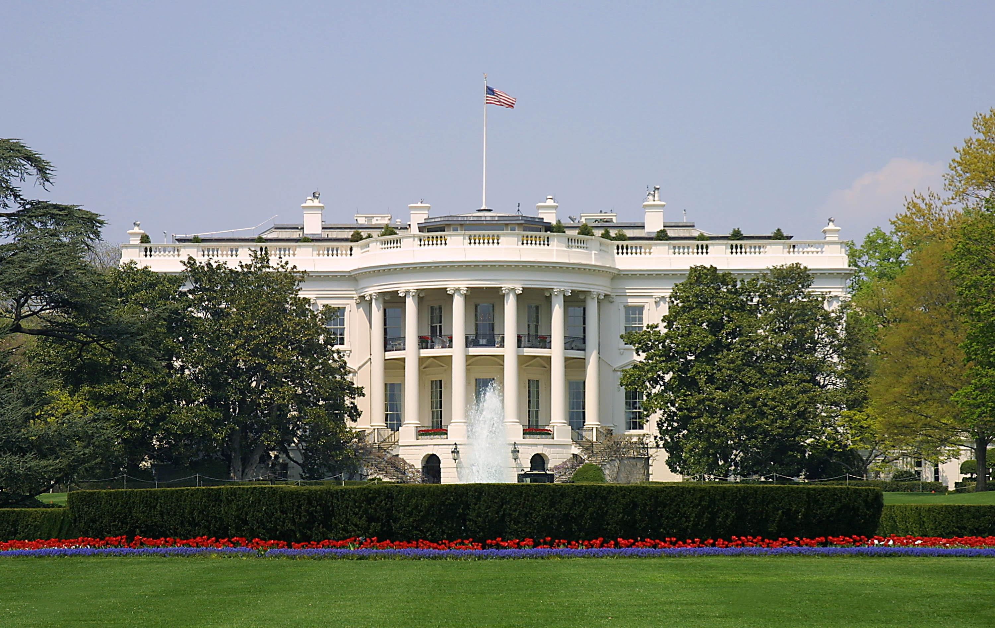
Presidential Quotes
Ron Bert
16
January 27, 2019

Slide 3
21. Chester Arthur (1881-1885)
Notes:
Son of a abolitionist Baptist minister. Quarter-master supply general. Collector of the Port of New York customs funds collector. He made $50K a year in a time where people made $500 a year. Corrupted on the take New York (polite) politician, until he became president. Ordered remodel of the White House via Tiffany of New York. No federal income tax. Business favors to become government jobs; spoils system. He became a reformer an initiated civil service reform for qualifications. Ceased pay for position policies. Obsessed with clothes and parties and cigars. Worked from 10:00AM to 4:00PM. Kidney disease, died 2 years offer left office. Assassin of Garfield screamed, “Now Arthur will be president.” Modernized navy, steel ships, colleges. President when Brooklyn Bridge opened, at ceremony. Lawyer. Masters degree at 21.

Slide 4
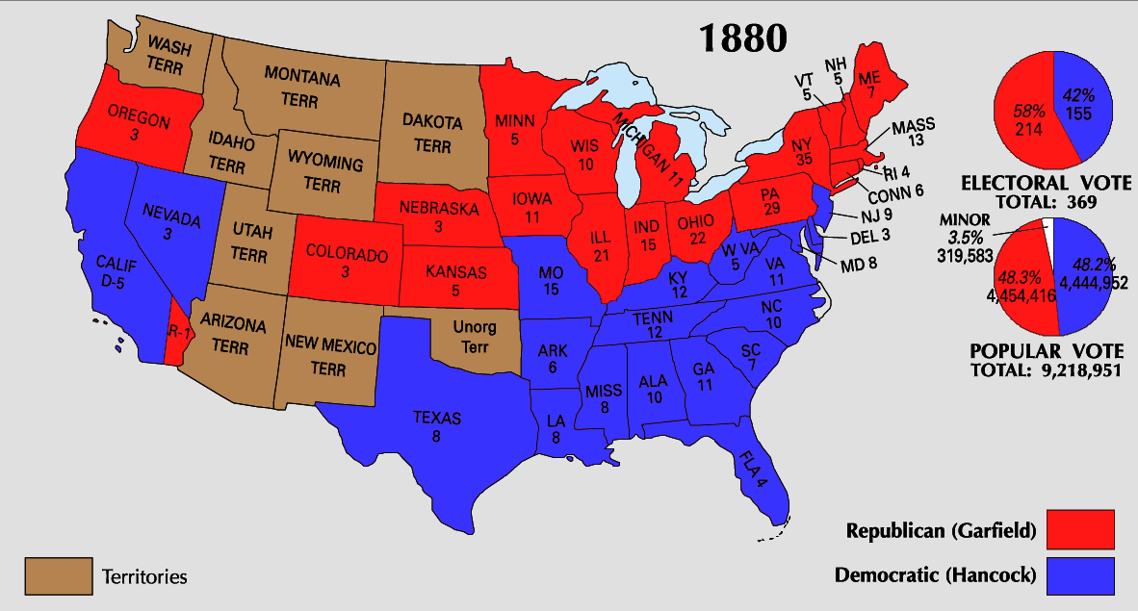

Slide 6
“I may be president of the United States, but my private life is nobody's damned business.”

Slide 7
“If it were not for the reporters, I would tell you the truth.”

Slide 8
For wisdom is better than rubies, And all the things one may desire cannot be compared with her. "I, wisdom, dwell with prudence, And find out knowledge and discretion. The fear of the LORD is to hate evil; Pride and arrogance and the evil way And the perverse mouth I hate." — Proverbs 8:11-13
find out knowledge
Pride and arrogance
evil way

Slide 9
“The health of the people is of supreme importance. All measures looking to their protection against the spread of contagious diseases and to the increase of our sanitary knowledge for such purposes deserve attention of Congress.”
contagious diseases

Slide 10
“Where you stand depends where you sit.”

Slide 11
For if there should come into your assembly a man with gold rings, in fine apparel, and there should also come in a poor man in filthy clothes, and you pay attention to the one wearing the fine clothes and say to him, "You sit here in a good place," and say to the poor man, "You stand there," or, "Sit here at my footstool," have you not shown partiality among yourselves, and become judges with evil thoughts? — James 2:2-4
For if there should come into your assembly a man with gold rings, in fine apparel, and there should also come in a poor man in filthy clothes, and you pay attention to the one wearing the fine clothes and say to him, "You sit here in a good place," and say to the poor man, "You stand there," or, "Sit here at my footstool," have you not shown partiality among yourselves, and become judges with evil thoughts? — James 2:2-4

Slide 12
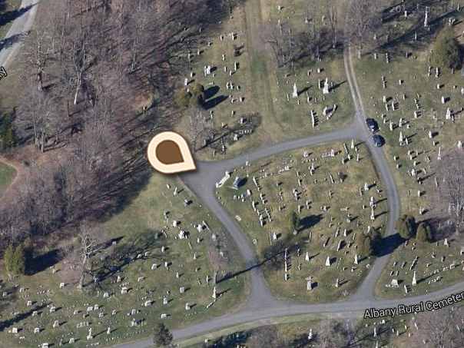
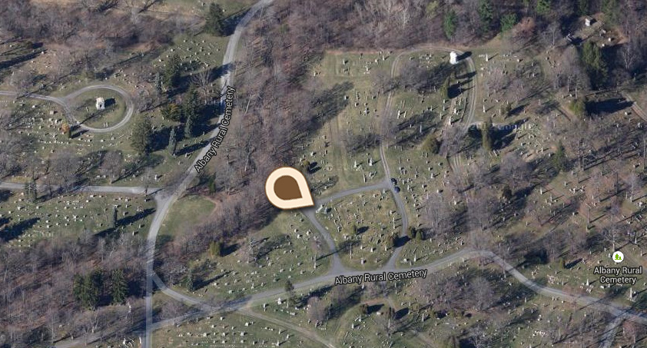
Albany Rural Cemetery. Menands, Albany County, New York

Slide 13
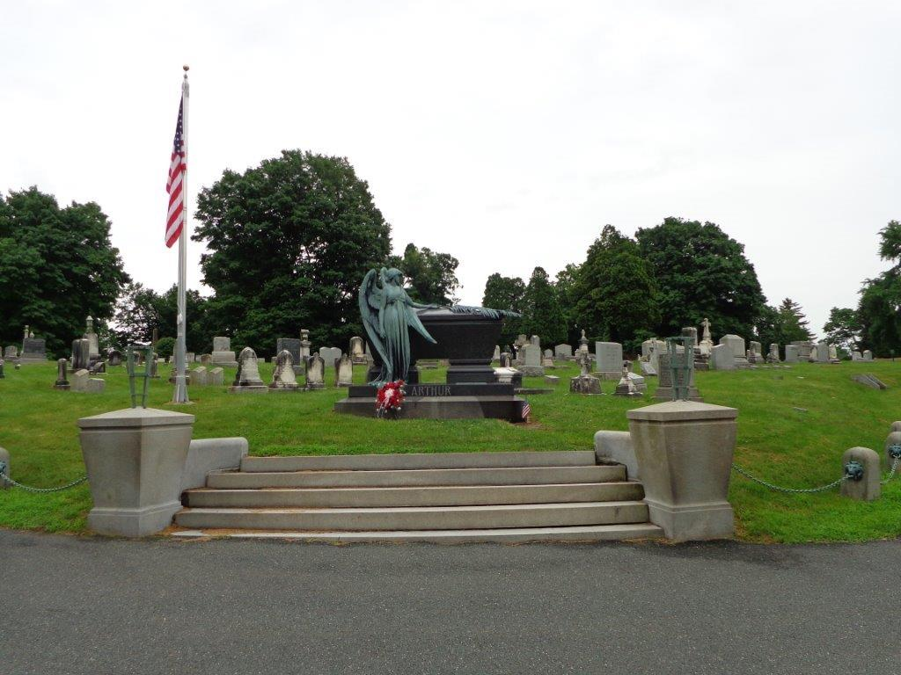

Slide 14
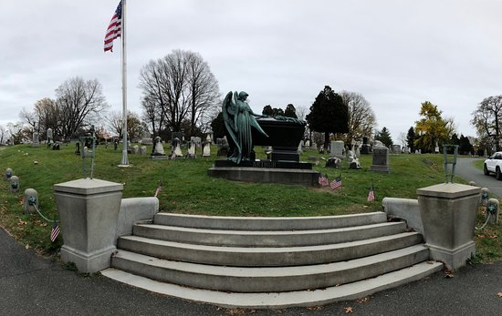

Slide 15
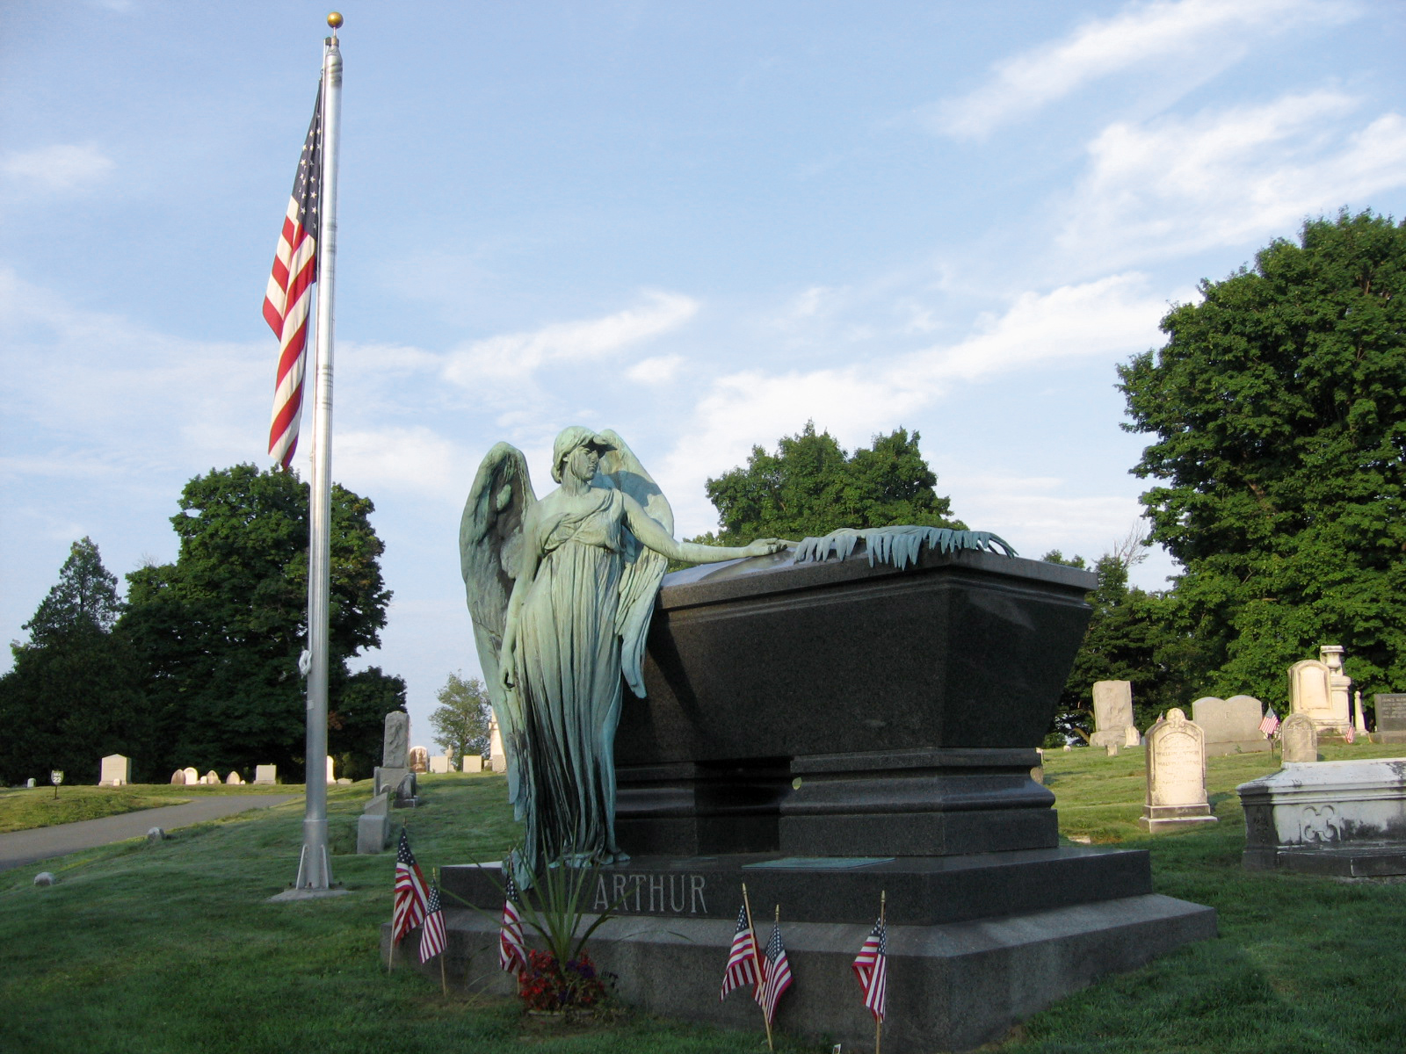

Slide 16
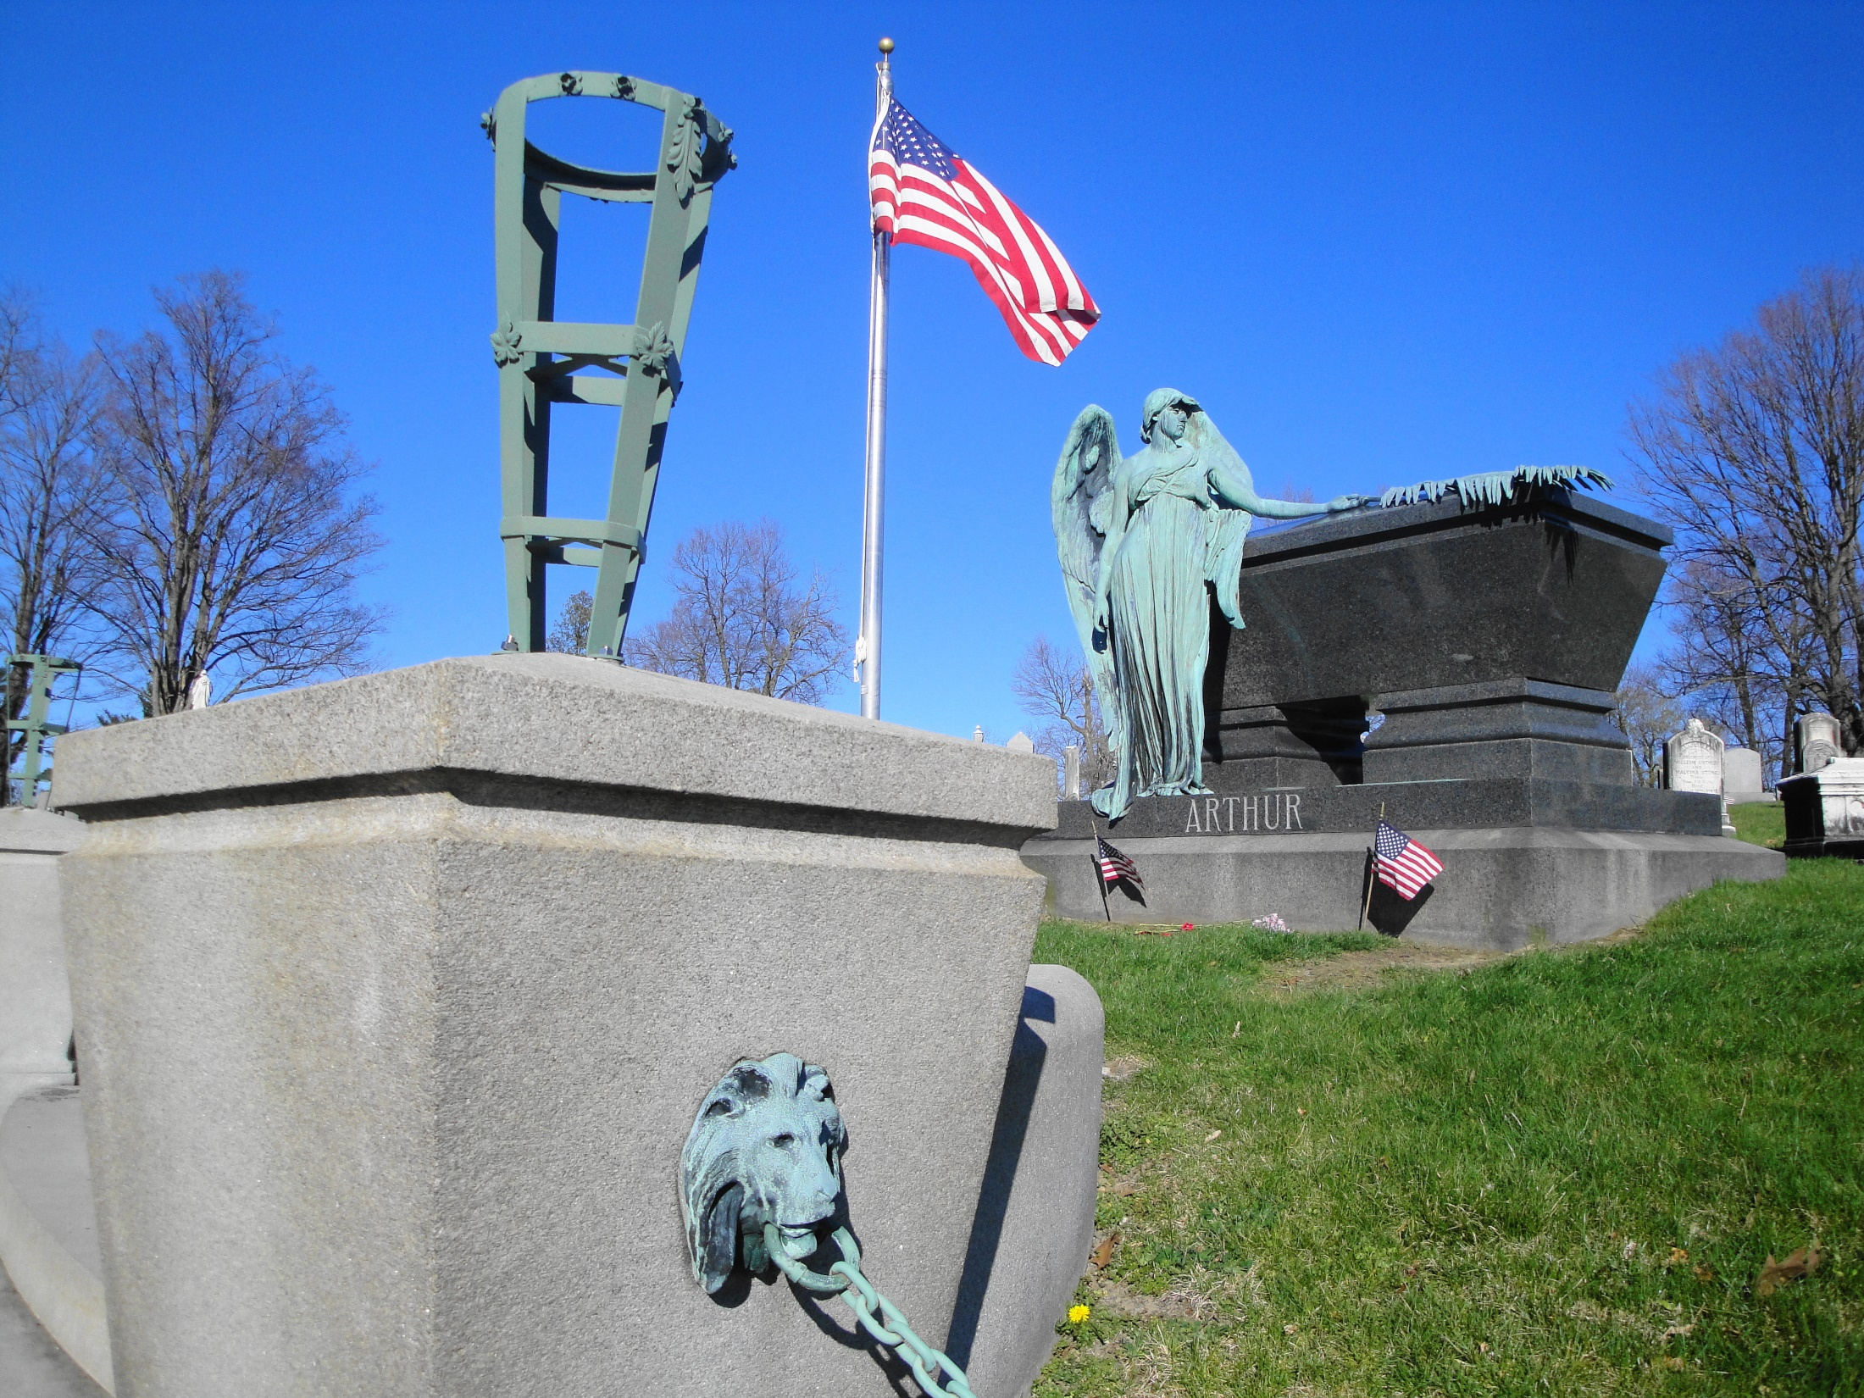
X

Slide 17
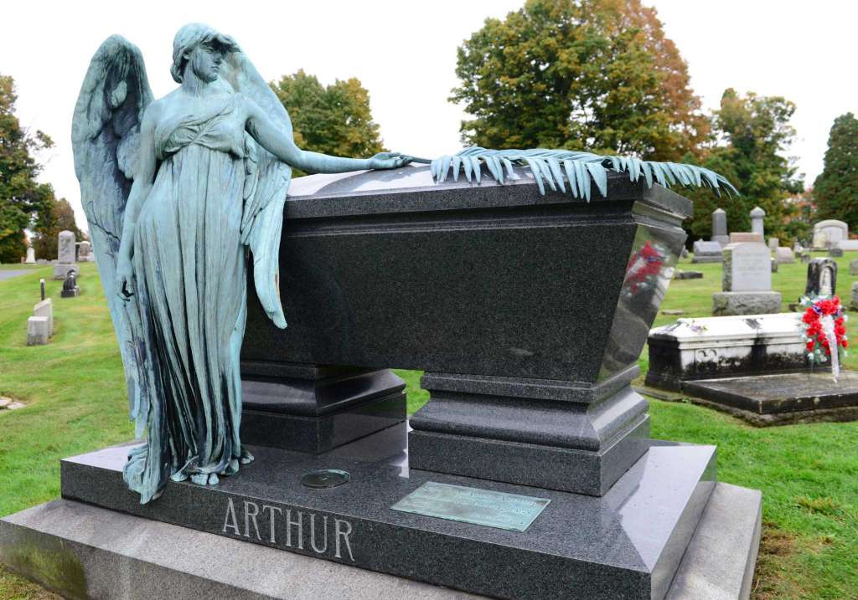

Slide 18
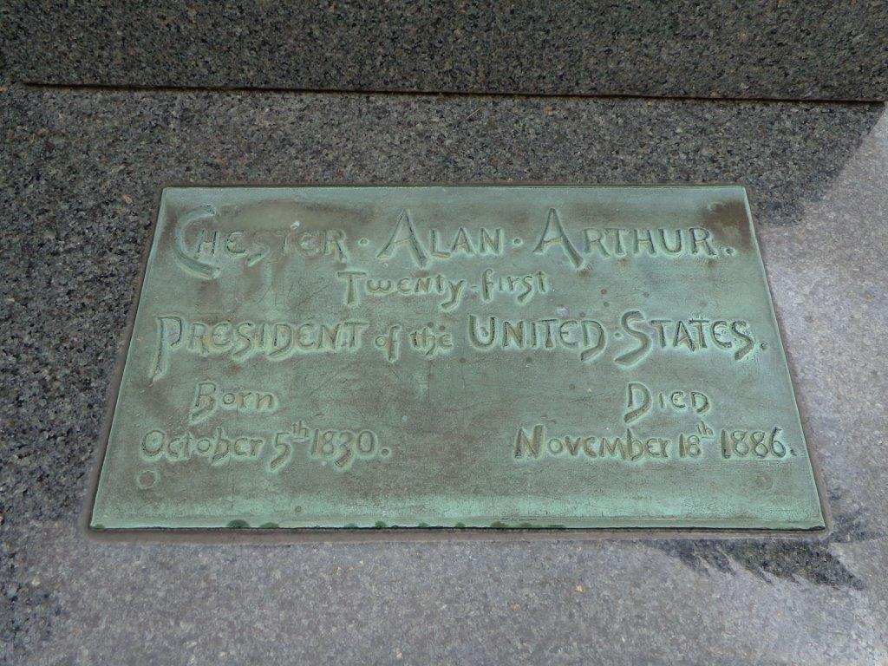
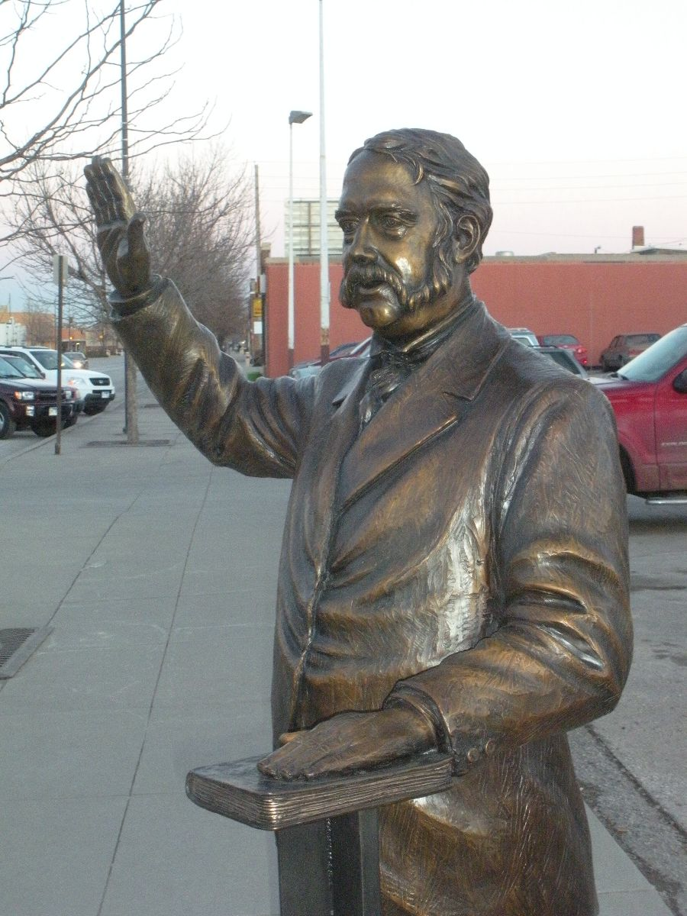
56

Slide 19
22. Grover Cleveland (1885-1889)
24.
Notes:
Father was a Presbyterian minister. 300 lbs. Ran on non-corruption. Honesty. Fiscal conservative. Reform element. Never went to college, but studied law. Smear campaign on his Buffalo-illegitimate child. He admits it and his honesty is respected, became President. Married in office at White House, 21 year old while he was 49. Established gold standard. Mouth cancer like Grant had. Kept cancer secret. Cancer was taboo. Railroad failing, business failing.

Slide 20
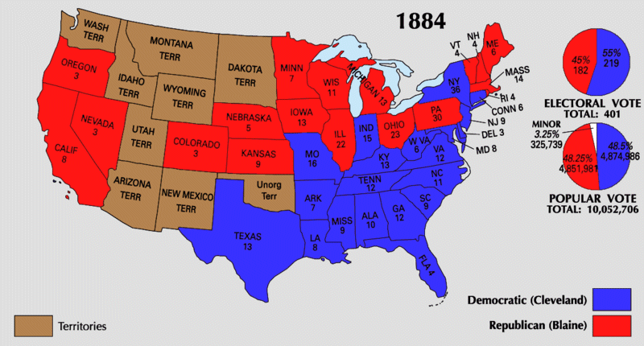

Slide 21
“Though the people support the government; the government should not support the people.”
Notes:
Farmers bailout.

Slide 22
“Once the coffers of the federal government are opened to the public, there will be no shutting them again.”

Slide 23
“Sensible and responsible women do not want to vote. The relative positions to be assumed by man and woman in the working out of our civilization were assigned long ago by a higher intelligence than ours.”

Slide 24
And I do not permit a woman to teach or to have authority over a man, but to be in silence. — 1st Timothy 2:12

Slide 25
“All must admit that the reception of the teachings of Christ results in the purest patriotism, in the most scrupulous fidelity to public trust, and in the best type of citizenship.”
teachings of Christ
Christ
conscientious
loyalty
in
in the best type
Notes:
conscientious

Slide 26
For our citizenship is in heaven, from which we also eagerly wait for the Savior, the Lord Jesus Christ, who will transform our lowly body that it may be conformed to His glorious body, according to the working by which He is able even to subdue all things to Himself. — Philippians 3:20
may be conformed

Slide 27
“And let us not trust to human effort alone, but humbly acknowledging the power and goodness of Almighty God, who presides over the destiny of nations, and who has at all times been revealed in our country's history, let us invoke His aid and His blessings upon our labors.”
summon
beseech
beg
pray
appeal

Slide 28
“The appointing power of the Pope is treated as a public trust, and not as a personal perquisite.”
public welfare
spiritual advantage

Slide 29
Thus says the LORD: "Cursed is the man who trusts in man And makes flesh his strength, Whose heart departs from the LORD. — Jeremiah 17:5

Slide 30
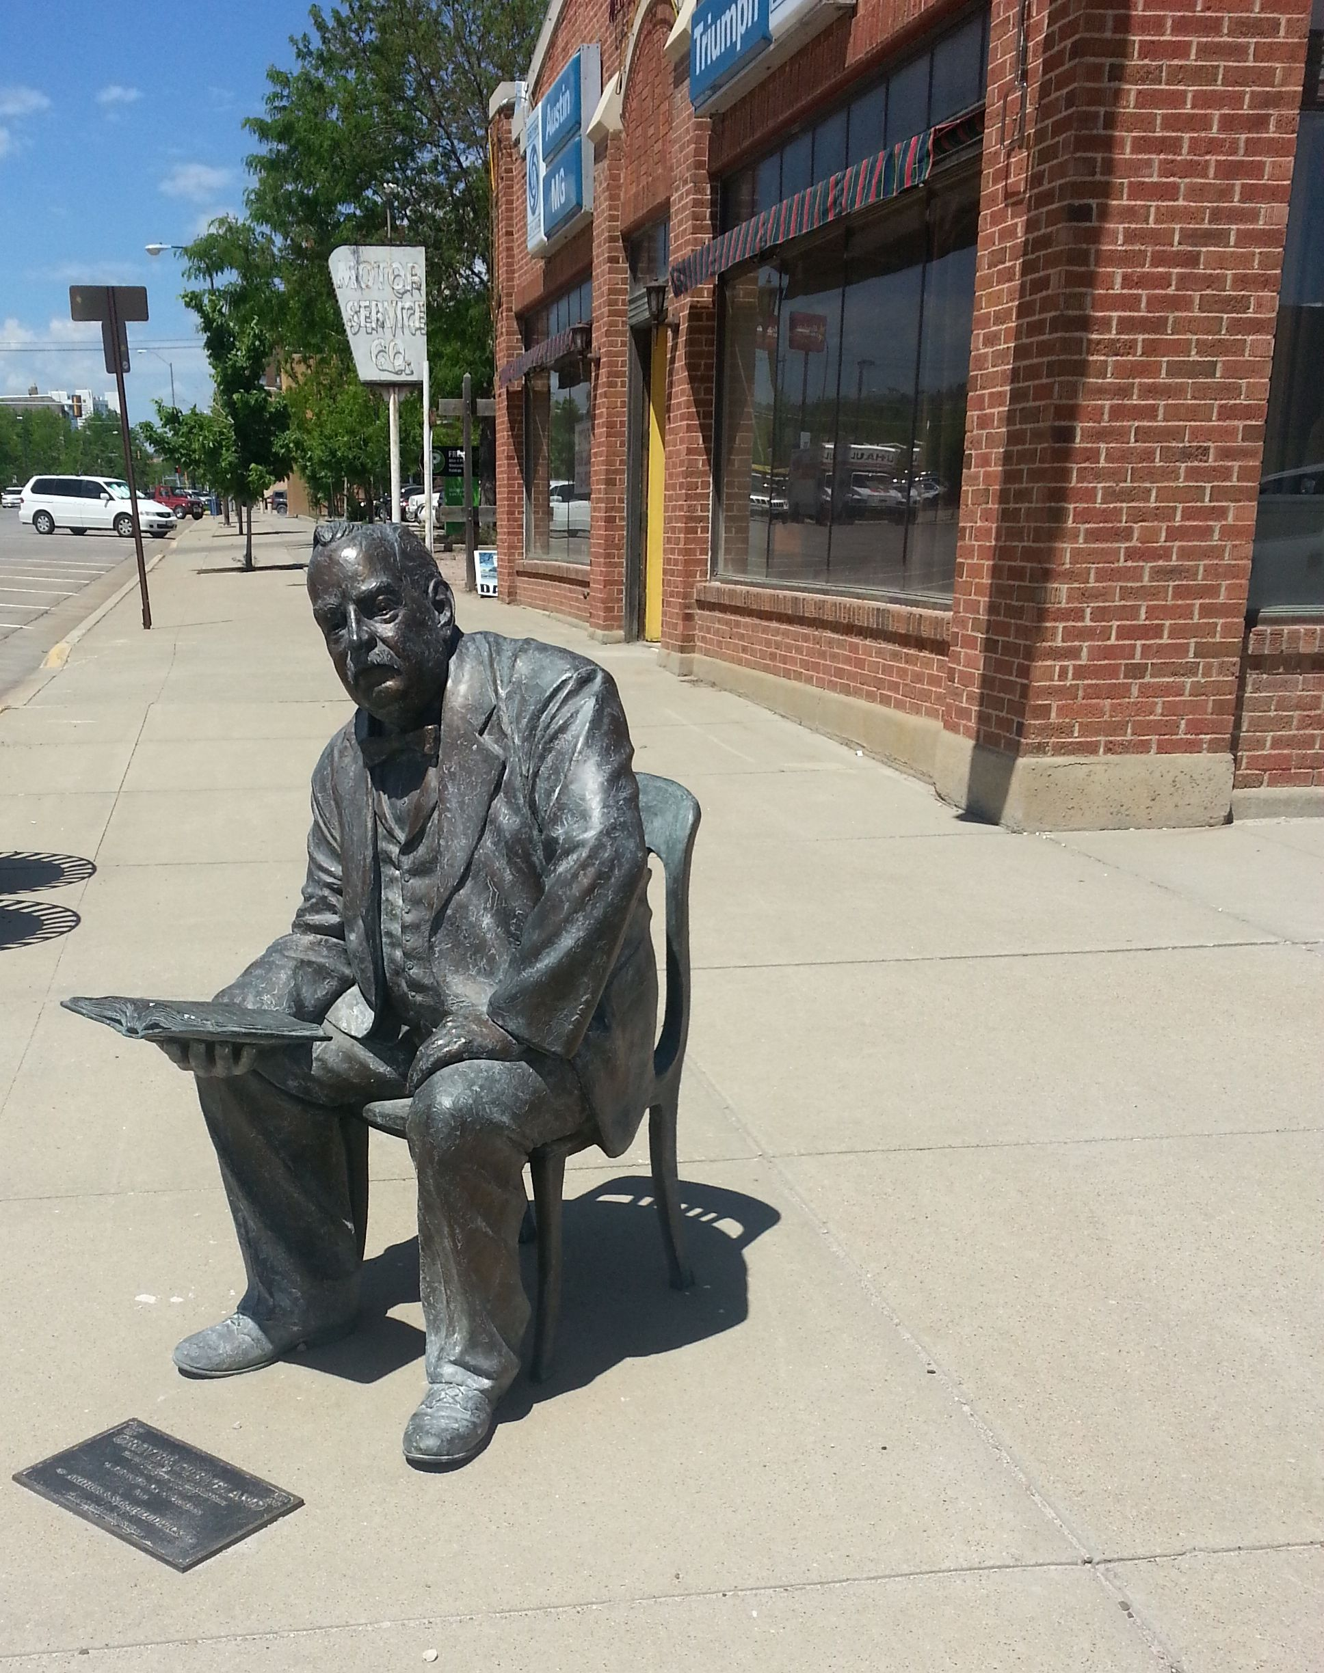
Notes:
Rapid City

Slide 31
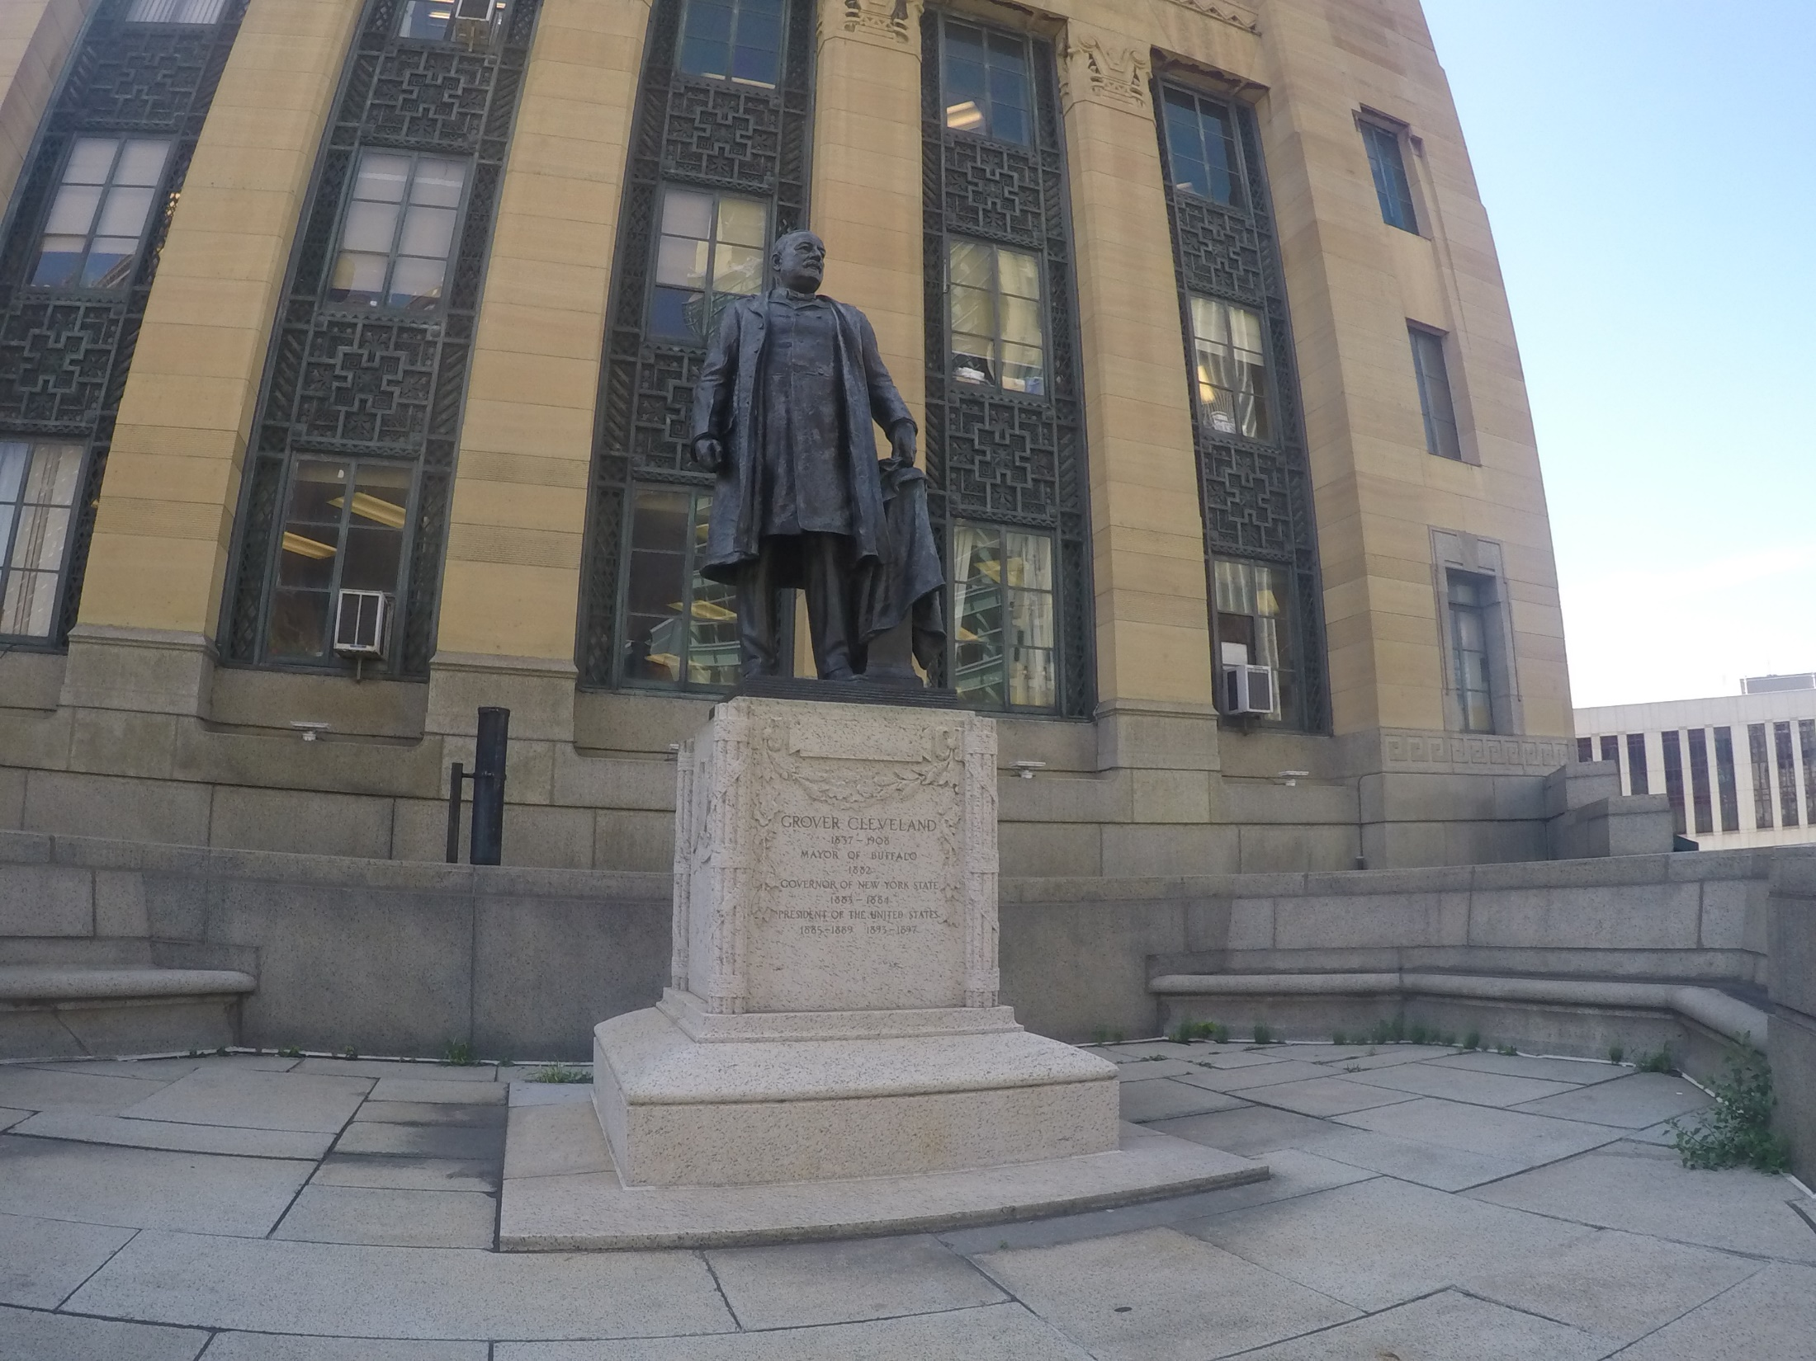
Notes:
Buffalo, NY City Hall

Slide 32
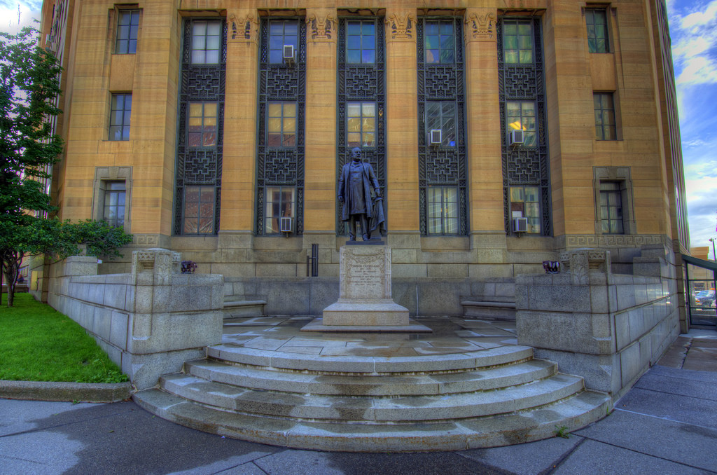

Slide 33
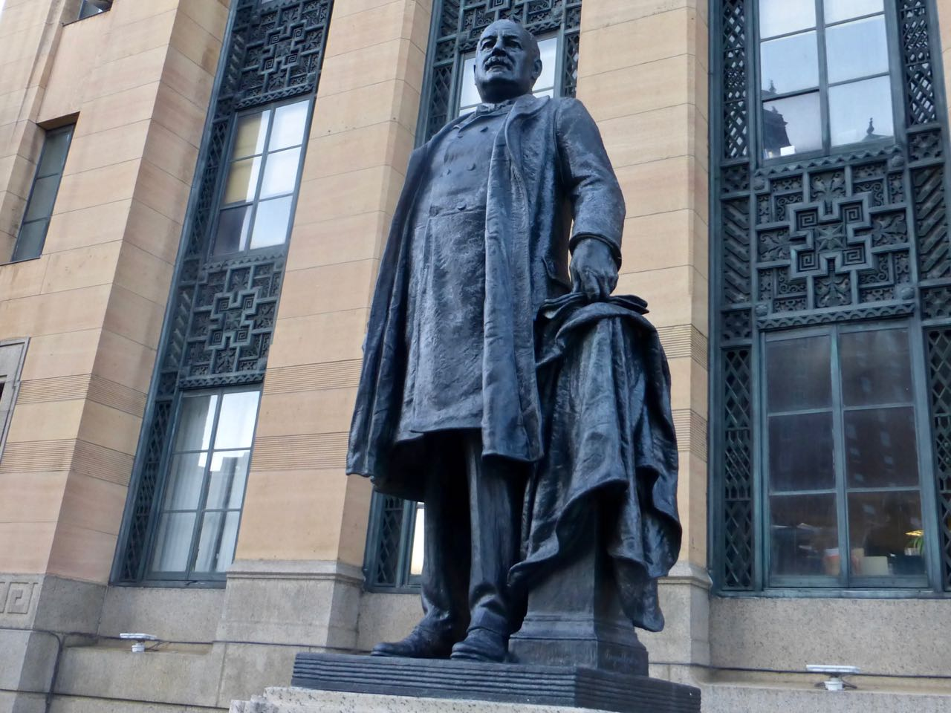
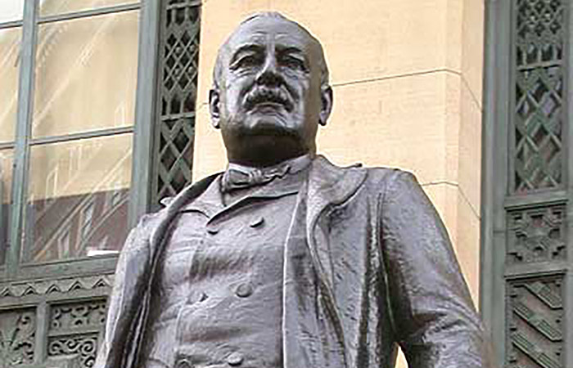
Notes:
Groundbreaking for City Hall was held on September 16, 1929. The building was completed November 10, 1931. The building was dedicated July 1, 1932

Slide 34
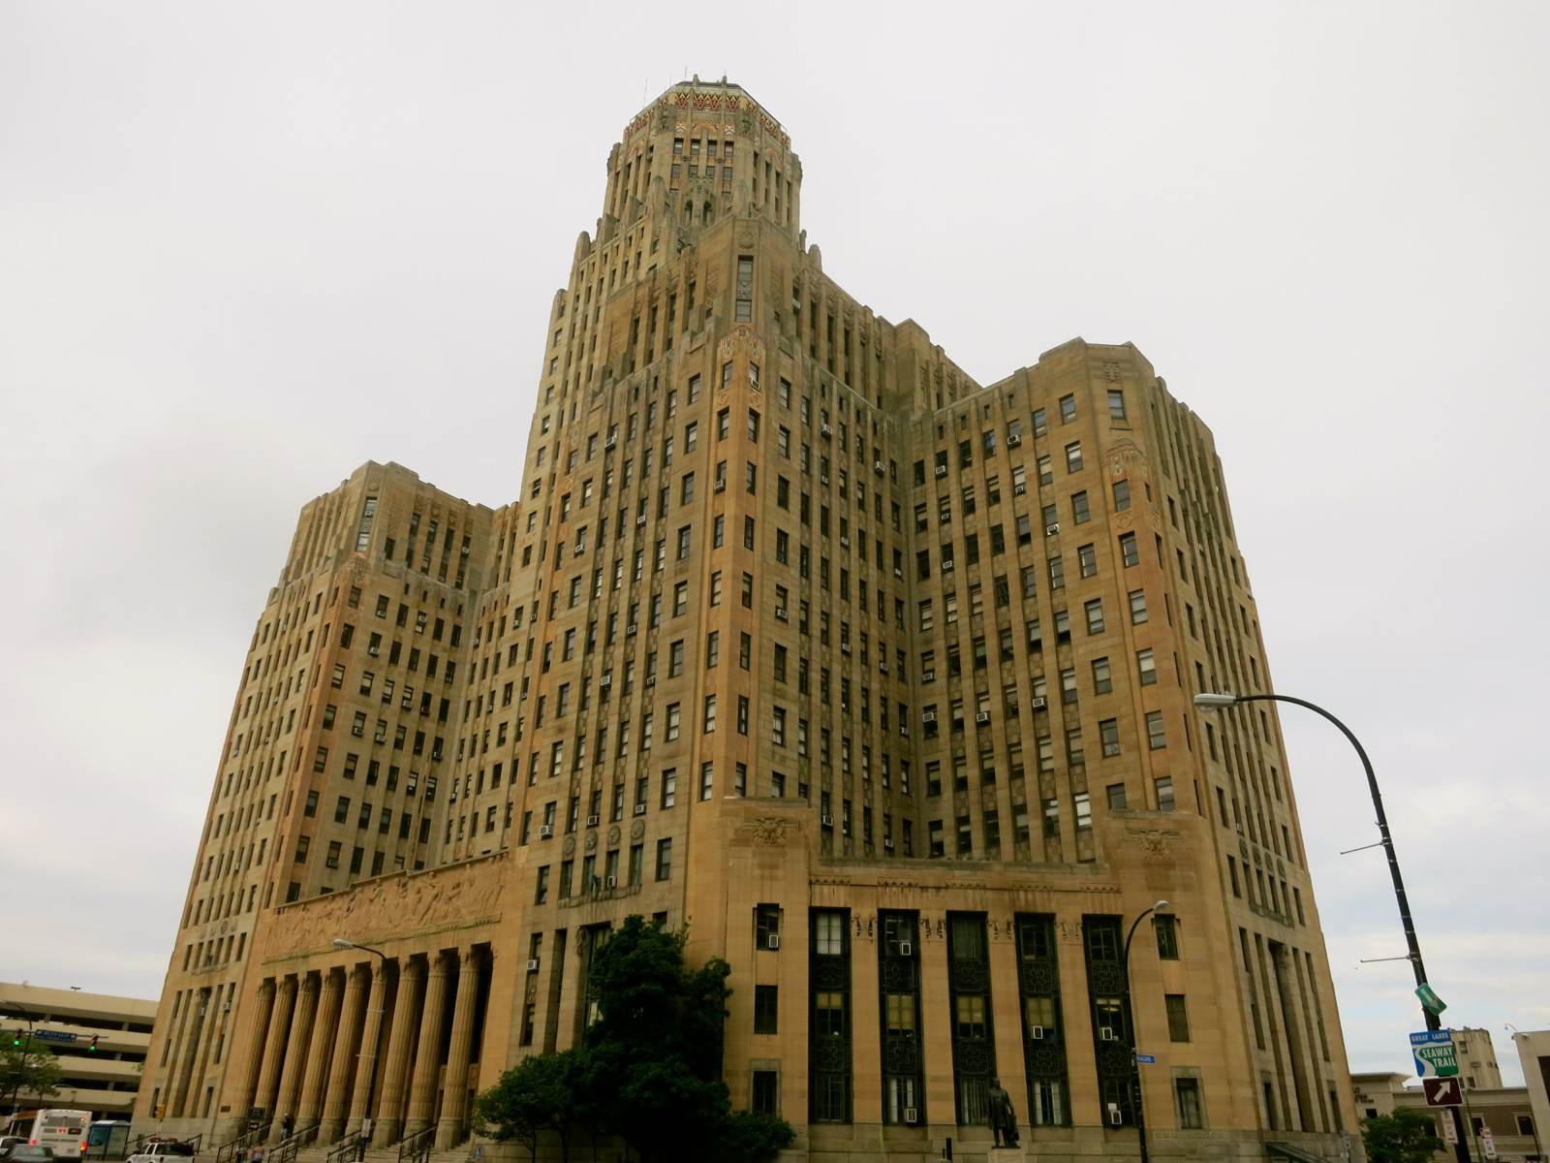

Slide 35
Lake Erie
Niagara Falls
Notes:
Millard Fillmore other statue

Slide 36
23. Benjamin Harrison (1889-1893)
Notes:
1st President to have audio recording on an Edison drum. Sherman Anti-trust act. Religious, duty oriented. Hard worker. Ran on being a family man. Earned a reputation of frank and boring. Racial violence is increasing. Admits 6 states while president. Conservationist creating national forests including Yosemite. Wife died 2 weeks before 1888 elections. Had 2 possums and a goat as pets in the White House.
1st Wife died 2 weeks before 1888 elections. Mary Dimmick ‘Lord” Harrison was the second wife of the 23rd United States president Benjamin Harrison. She was nearly 25 years younger than Harrison, and was the niece of his first wife.

Slide 37
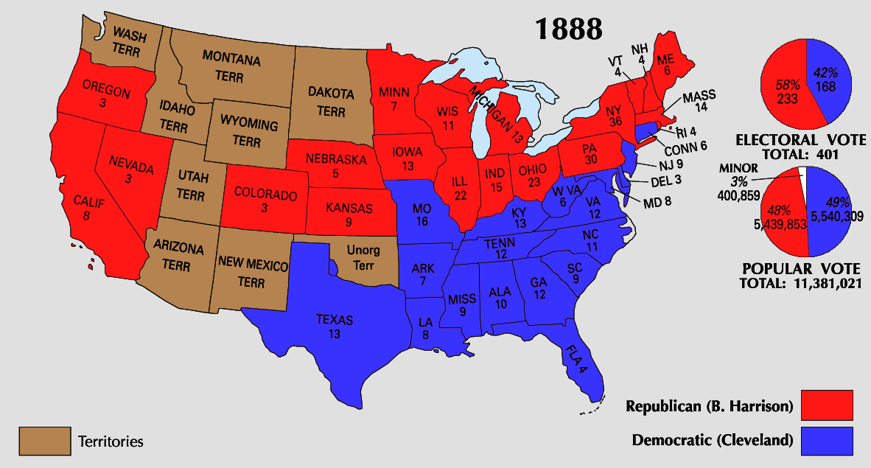

Slide 38
“If you take out your statutes, your constitution, your family life, all that is taken from the sacred book, what would there be left to bind society together?”
laws
ideals
statutes
constitution
love
family life
is
sacred book
bind society together
?

Slide 39
“God forbid that the day should ever come when, in the American mind, the thought of man as a consumer shall submerge the old American thought of man as a creature of God, endowed with unalienable rights.”
christmas
material
consumer
sink
creature of God
spirit
passover
Christ

Slide 40
"Nevertheless I have this against you, that you have left your first love. Remember therefore from where you have fallen; repent and do the first works, or else I will come to you quickly and remove your lampstand from its place -- unless you repent." — Revelation 2:4-5
left your first
love

Slide 41
“Have you not learned that not stocks or bonds or stately houses, or products of the mill or field are our country? It is a spiritual thought that is in our minds.”
our country?
spiritual
in
in our minds

Slide 42
“The evil works from a bad center both ways. It demoralizes those who practice it and destroys the faith of those who suffer by it in the efficiency of the law as a safe protector.”
evil
demoralizes
destroys
faith
faith
law
Abortion

Slide 43
"I will punish the world for its evil, And the wicked for their iniquity; I will halt the arrogance of the proud, And will lay low the haughtiness of the terrible." — Isaiah 13:11
When the righteous rejoice, there is great glory; But when the wicked arise, men hide themselves. — Proverbs 28:12

Slide 44
“We Americans have no commission from God to police the world.”

Slide 45
“Lincoln had faith in time, and time has justified his faith.”

Slide 46
“I'd rather have a bullet inside of me than to be living in constant dread of one.”

Slide 47
So then, my beloved brethren, let every man be swift to hear, slow to speak, slow to wrath; for the wrath of man does not produce the righteousness of God. — James 1:19-20
wrath of man

Slide 48
“Prayer steadies one when he is walking in slippery places - even if things asked for are not given.”
Prayer steadies one

Slide 49
Now this is the confidence that we have in Him, that if we ask anything according to His will, He hears us. — 1st John 5:14
according to His will

Slide 50
“The bud of victory is always in the truth.”
victory
in
in the truth

Slide 51
“Great lives never go out, they go on.”

Slide 52
For whatever is born of God overcomes the world. And this is the victory that has overcome the world -- our faith. — 1st John 5:4
our faith

Slide 53
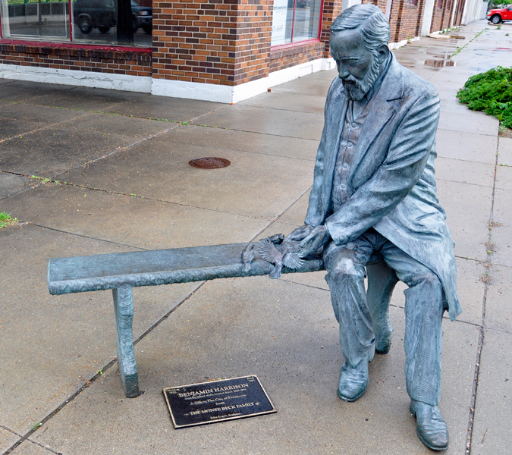
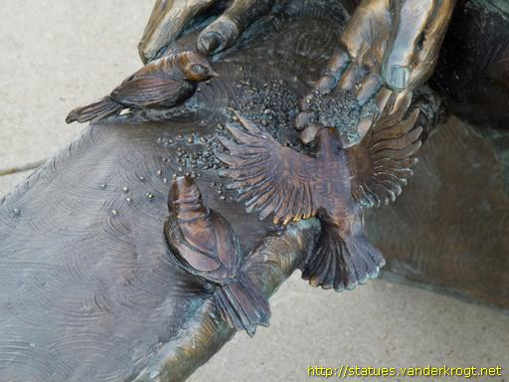

Slide 54
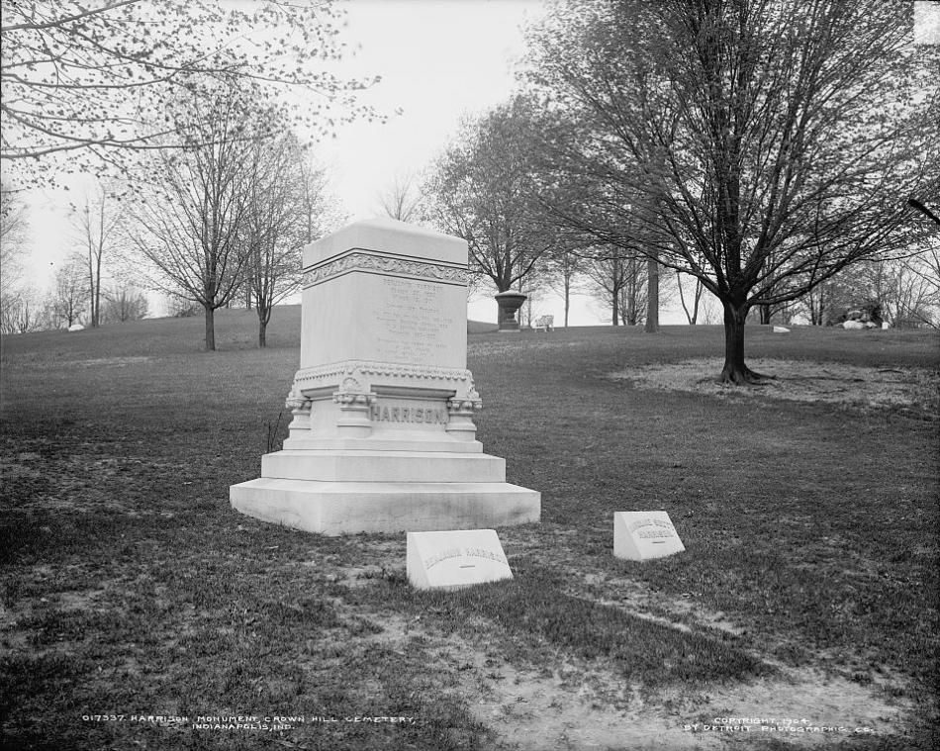
Crown Hill Funeral Home and Cemetery, Indianapolis, IN
Notes:
Crown Hill Funeral Home and Cemetery, Indianapolis, IN

Slide 55
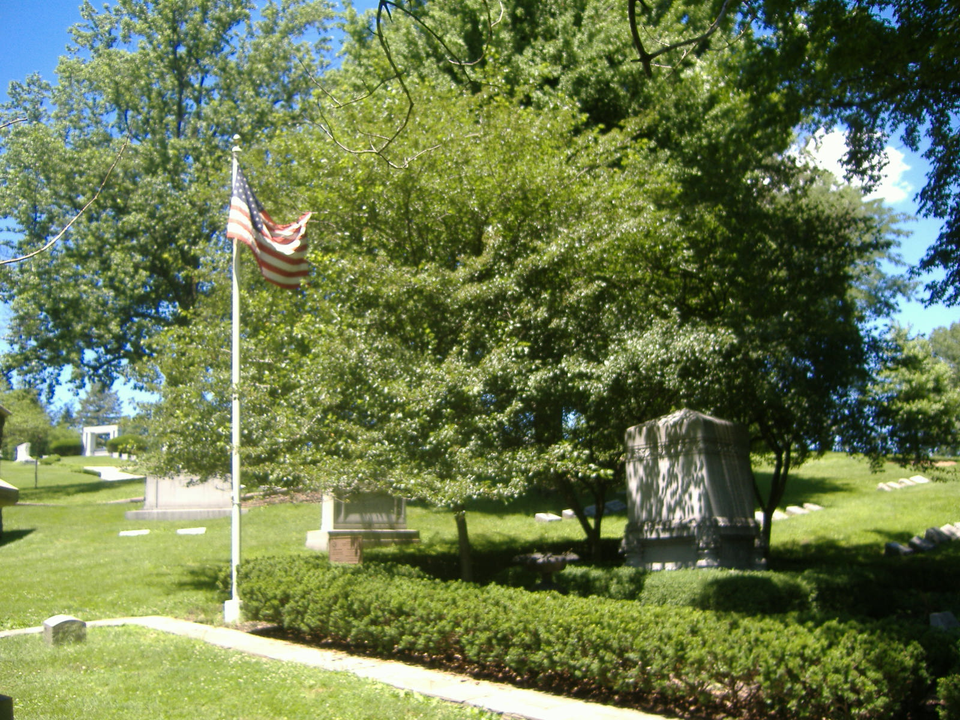

Slide 56
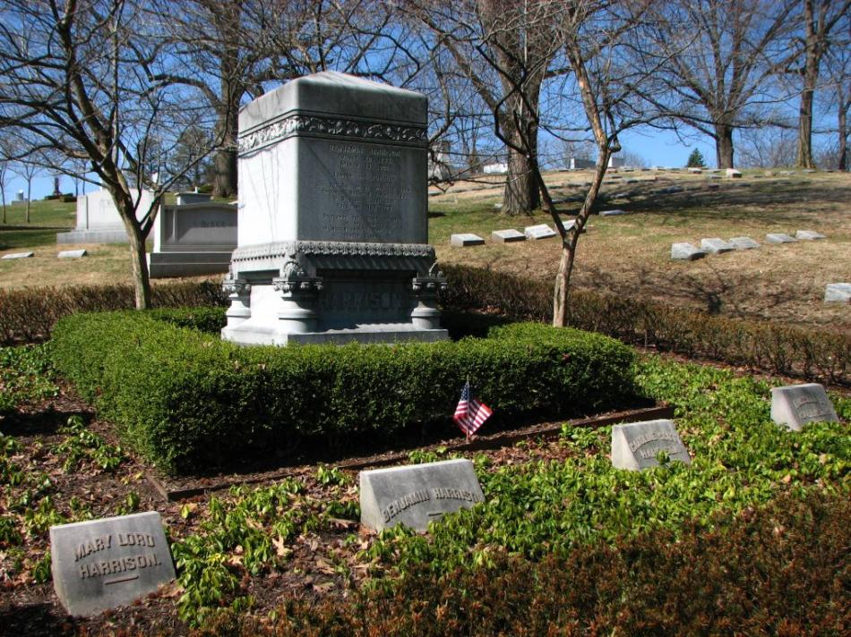
Notes:
1st Wife died 2 weeks before 1888 elections. Mary Dimmick ‘Lord” Harrison was the second wife of the 23rd United States president Benjamin Harrison. She was nearly 25 years younger than Harrison, and was the niece of his first wife.

Slide 57
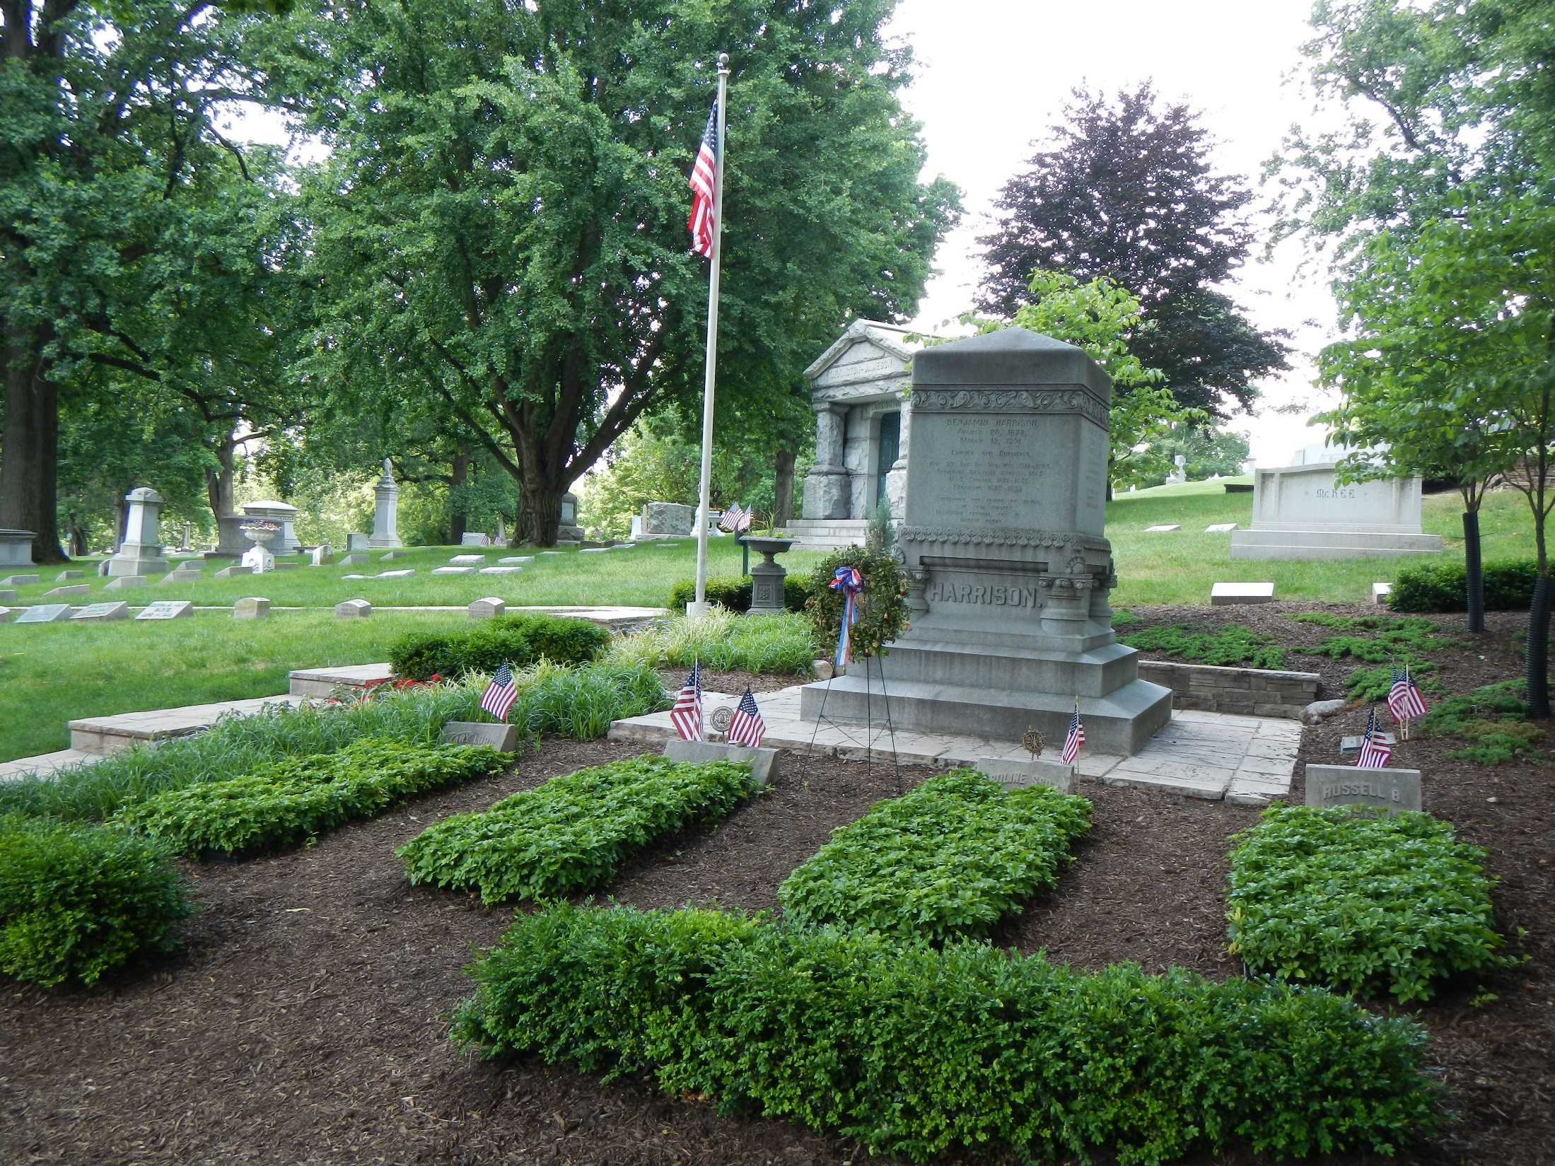

Slide 59
→ Liars keep justice hidden in the “service” of all
→ Arrogance reveals one’s clear lack of kind service
→ Unity is found through care for one another
→ Reception of Christ uncovers the highest citizenship
→ Trust should be in the power and goodness of God
→ Greed and thirst for power betrays public trust
→ The Bible’s sacred truths bind society together
→ Our countries greatest value is found in spirituality
→ Evil destroys both itself and part of those it touches
→ Hope for civility is a prelude to civilization
→ Boldly tempting fate can invite unwanted calamities
→ Unanswered prayers divulge the depths of faith
→ Truth is a prize worth nurturing
Struggles set the course as life is
Notes:
Struggles set the course as life is

Slide 61
Please visit http://www.LoveFromGod.com to explore further
Ronald Bert Channel on
Notes:
Eternity never ends.

