Slide 2
Presidential Quotes
Ron Bert
15
December 30, 2018

Slide 3
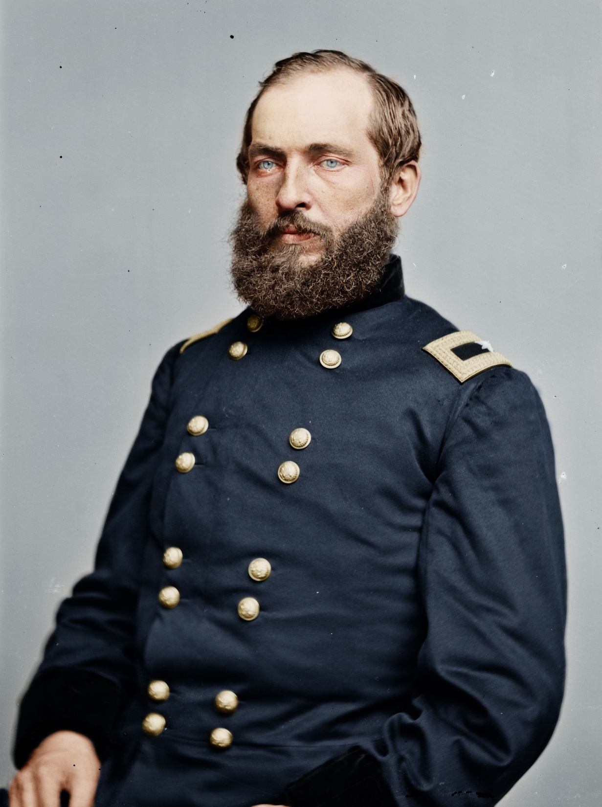
20. James A. Garfield (1881)

Slide 4
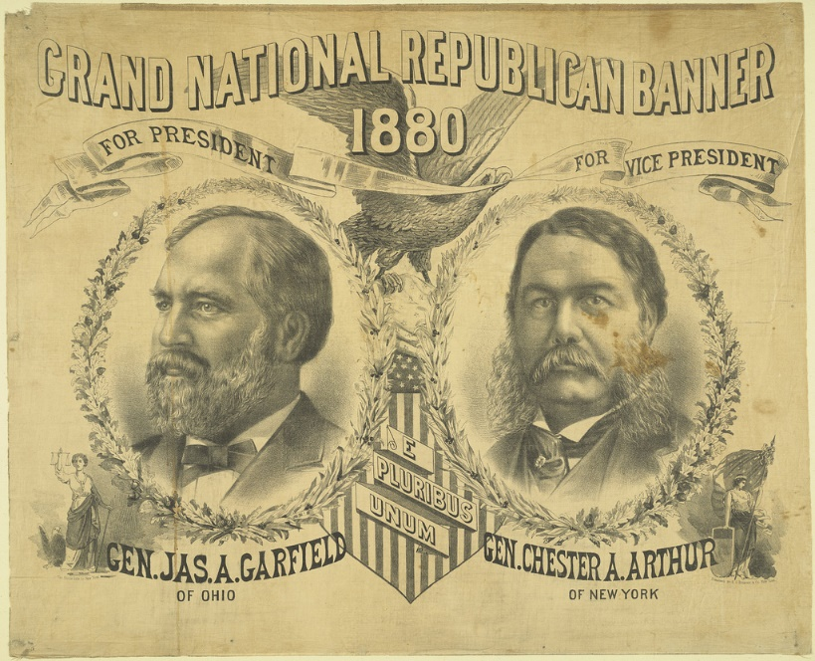

Slide 5
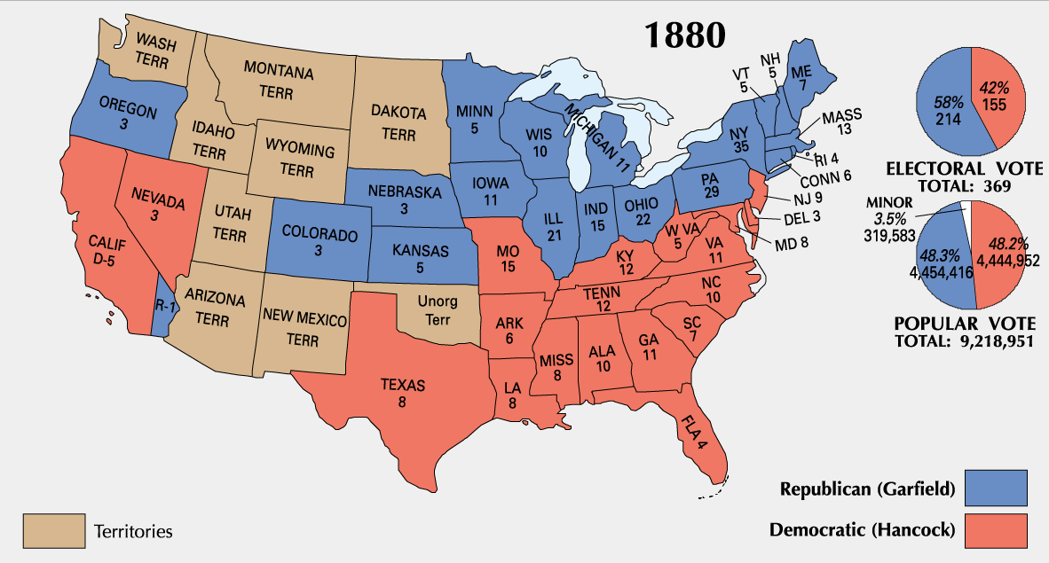
1880 Election Results

Slide 6
“Now more than ever the people are responsible for the character of their Congress. If that body be ignorant, reckless, and corrupt, it is because the people tolerate ignorance, recklessness, and corruption. If it be intelligent, brave, and pure, it is because the people demand these high qualities to represent them in the national legislature. . . . If the next centennial does not find us a great nation . . . it will be because those who represent the enterprise, the culture, and the morality of the nation do not aid in controlling the political forces.”
in
do not aid in

Slide 7
These are wells without water, clouds carried by a tempest, for whom is reserved the blackness of darkness forever. For when they speak great swelling words of emptiness, they allure through the lusts of the flesh, through lewdness, the ones who have actually escaped from those who live in error. While they promise them liberty, they themselves are slaves of corruption; for by whom a person is overcome, by him also he is brought into bondage. — 2nd Peter 2:17-19

Slide 8
“There are men and women who make the world better just by being the kind of people they are. They have the gift of kindness or courage or loyalty or integrity. It really matters very little whether they are behind the wheel of a truck or running a business or bringing up a family. They teach the truth by living it.”
kindness
courage
loyalty
integrity

Slide 9
… for when Gentiles, who do not have the law, by nature do the things in the law, these, although not having the law, are a law to themselves, who show the work of the law written in their hearts, their conscience also bearing witness, and between themselves their thoughts accusing or else excusing them) — Romans 2:14-15
in
written in their hearts
law of conscience

Slide 10
“The truth will set you free, but first it will make you miserable.”

Slide 11
"And you shall know the truth, and the truth shall make you free." — John 8:32

Slide 12
“Next in importance to freedom and justice is popular education, without which neither freedom nor justice can be permanently maintained.”

Slide 13
My people are destroyed for lack of knowledge. Because you have rejected knowledge, I also will reject you from being priest for Me; Because you have forgotten the law of your God, I also will forget your children. — Hosea 4:6

Slide 14
“If there is one thing upon this earth that mankind love and admire better than another, it is a brave man, - it is the man who dares to look the devil in the face and tell him he is a devil.”

Slide 15
Then David said to the Philistine, "You come to me with a sword, with a spear, and with a javelin. But I come to you in the name of the LORD of hosts, the God of the armies of Israel, whom you have defied. — 1st Samuel 17:45

Slide 16
“I believe in God, and I trust myself in His hands.”

Slide 17
Show Your marvelous lovingkindness by Your right hand, O You who save those who trust in You From those who rise up against them. — Psalms 17:7

Slide 18
“Men are tending to materialism. Houses, lands, and worldly goods attract their attention, and as a mirage lure them on to death. Christianity, on the other hand leads only the natural body to death, and for the spirit, it points out a house not built with hands, eternal in the heavens... Let me urge you to follow Him, not as the Nazarene, the Man of Galilee, the carpenter's son, but as the ever living spiritual person, full of love and compassion, who will stand by you in life and death and eternity.”

Slide 19
"In My Father's house are many mansions; if it were not so, I would have told you. I go to prepare a place for you. And if I go and prepare a place for you, I will come again and receive you to Myself; that where I am, there you may be also." — John 14:2-3

Slide 20
“The return to solid values is always hard... Distress, panic, and hard times have marked our pathway in returning to solid values.”

Slide 21
And He said to them, "Take heed and beware of covetousness, for one's life does not consist in the abundance of the things he possesses." — Luke 12:15

Slide 22
“The divorce between Church and State ought to be absolute. It ought to be so absolute that no Church property anywhere, in any state or in the nation, should be exempt from equal taxation; for if you exempt the property of any church organization, to that extent you impose a tax upon the whole community.”

Slide 23
“The sin of slavery is one of which it may be said that without the shedding of blood there is no remission.”

Slide 24
And according to the law almost all things are purified with blood, and without shedding of blood there is no remission. Therefore it was necessary that the copies of the things in the heavens should be purified with these, but the heavenly things themselves with better sacrifices than these. For Christ has not entered the holy places made with hands, which are copies of the true, but into heaven itself, now to appear in the presence of God for us; — Hebrews 9:22-24

Slide 25
“There are times in the history of men and nations, when they stand so near the vale that separates mortals from the immortals, time from eternity, and men from their God, that they can almost hear the beatings, and feel the pulsations of the heart of the Infinite.”

Slide 26
Draw near to God and He will draw near to you. Cleanse your hands, you sinners; and purify your hearts, you double-minded. — James 4:8
But what does it say? "The word is near you, in your mouth and in your heart" (that is, the word of faith which we preach): — Romans 10:8

Slide 27
“Most human organizations that fall short of their goals do so not because of stupidity or faulty doctrines, but because of internal decay and rigidification.”
bondage
shackles

Slide 28
“We are apt to be deluded into false security by political catch-words, devised to flatter rather than instruct.”

Slide 29
But know this, that in the last days perilous times will come: For men will be lovers of themselves, lovers of money, boasters, proud, blasphemers, disobedient to parents, unthankful, unholy, unloving, unforgiving, slanderers, without self-control, brutal, despisers of good, traitors, headstrong, haughty, lovers of pleasure rather than lovers of God, … — 2nd Timothy 3:1-4

Slide 30
“Coercion is the basis of every law in the universe, -- human or divine. A law is not law without coercion behind it.”
force

Slide 31
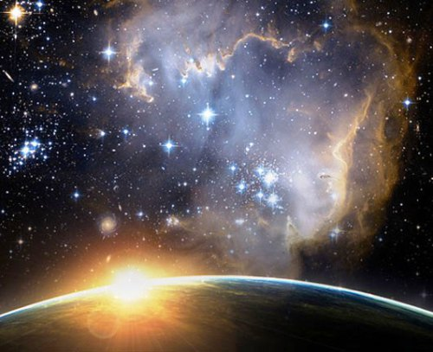
In the beginning God created the heavens and the earth. — Genesis 1:1
Time
↓
Force
↓
Action
↓
↑
Space
↑
Matter

Slide 32
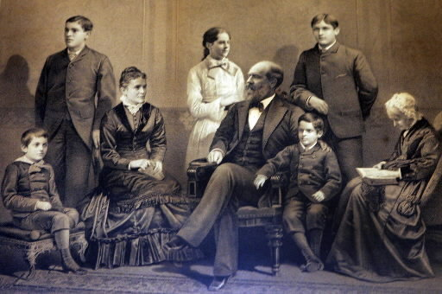
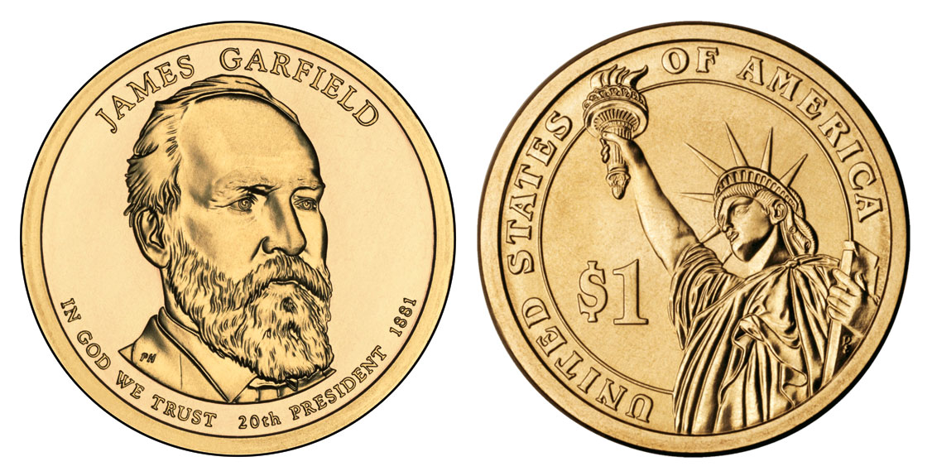
Notes:
The Garfield Children. James and Lucretia Garfield had seven children, five of whom survived into adulthood to make a lasting impact on their country. The passing of the Garfield's first and last children at ages three and one, respectively, brought tragedy to the family that affected both James and Lucretia deeply.

Slide 33
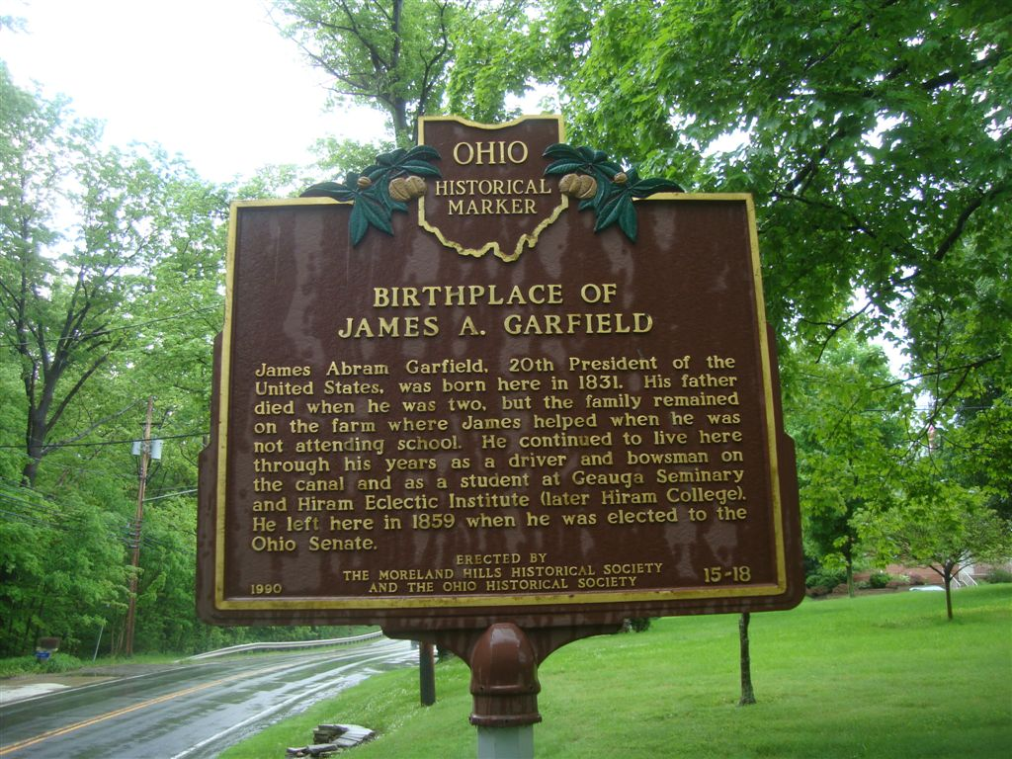

Slide 34
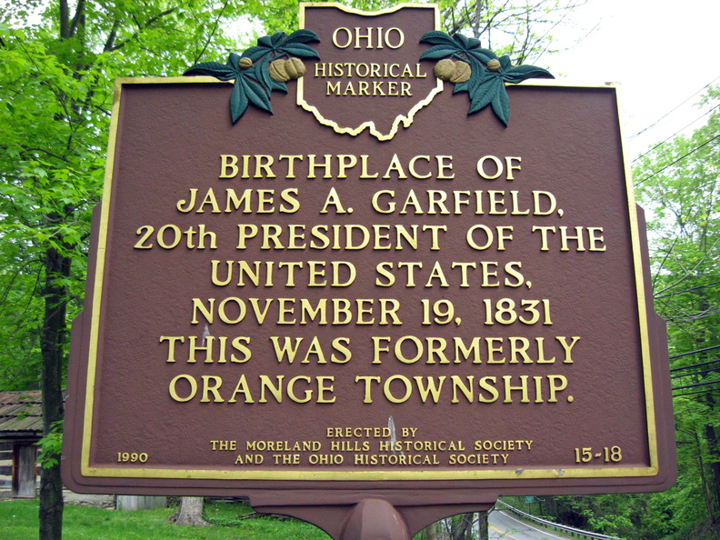

Slide 36
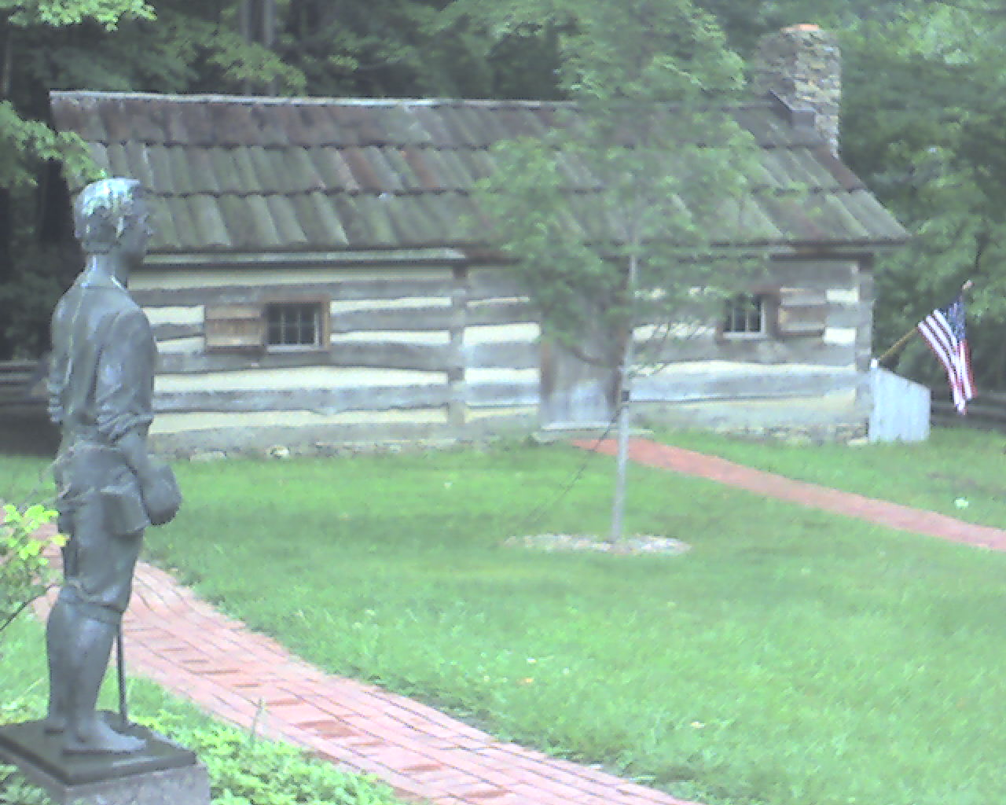

Slide 37
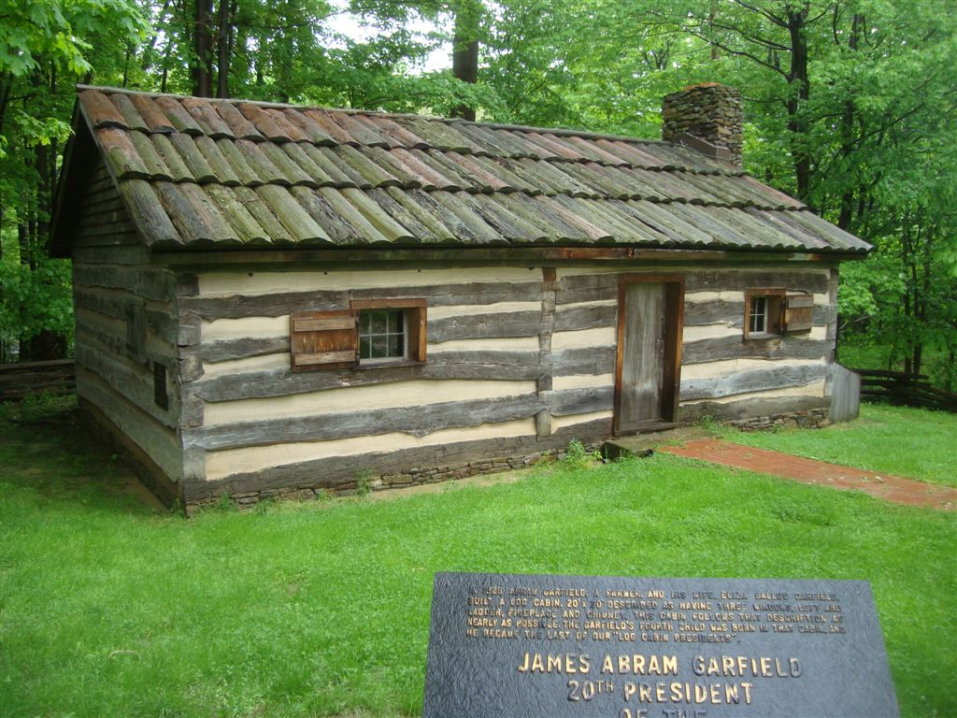

Slide 38
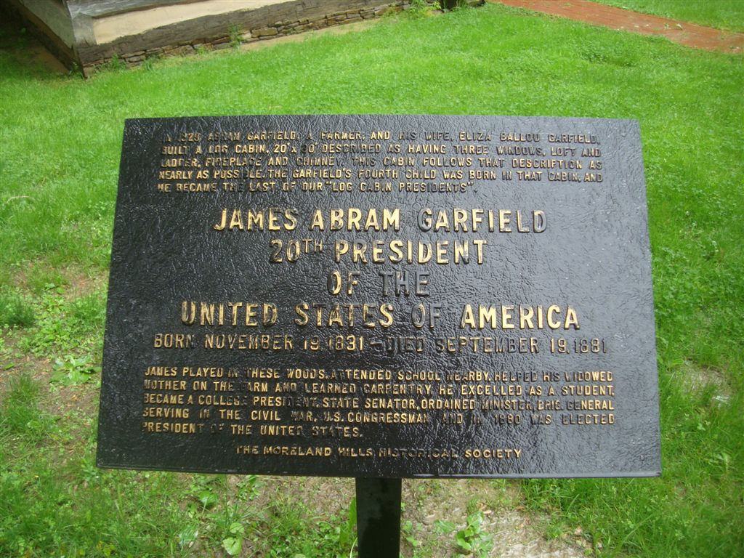

Slide 39
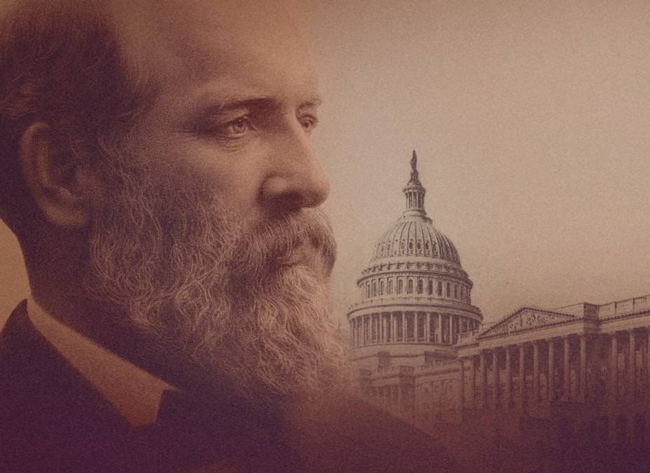
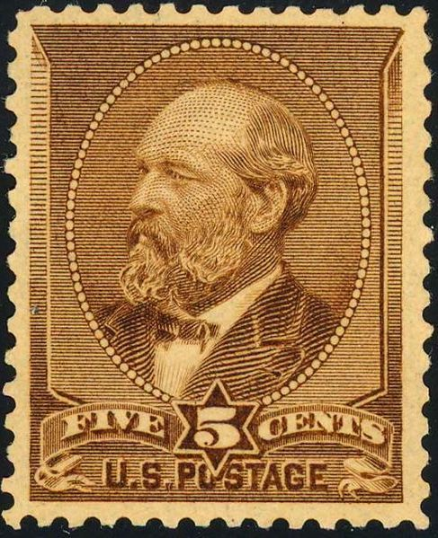

Slide 41
Presidential Quotes
Ron Bert
15½
January 6, 2019

Slide 42
20. James A. Garfield (1881)
Part 2
Notes:
Not only was he the first president to be both righty and lefty, but it was said he could write a sentence in Latin with one hand and write it in Greek with the other hand. - Ambidextrous

Slide 43
“The world's history is a divine poem, of which the history of every nation is a canto, and every man a word. Its strains have been pealing along down the centuries, and though there have been mingled the discords of warring cannon and dying men, yet to the Christian philosopher and historian - the humble listener - there has been a Divine melody running through the song which speaks of hope and halcyon days to come.”
EAR
heaven
untroubled

Slide 44
You will keep him in perfect peace, Whose mind is stayed on You, Because he trusts in You. — Isaiah 26:3

Slide 45
“It would be unjust to our people and dangerous to our institutions to apply any portion of revenues of the nation or of the States to the support of sectarian schools.”

Slide 46
“Science is the literature of God written on the stars - the trees -the rocks - and more important because of its marked utilitarian character.”
God
Dependable

Slide 47
For since the creation of the world His invisible attributes are clearly seen, being understood by the things that are made, even His eternal power and Godhead, so that they are without excuse, ... — Romans 1:20

Slide 48
“God reigns, and the Government at Washington still lives!”
God reigns
God reigns

Slide 49
God reigns over the nations; God sits on His holy throne. — Psalms 47:8
God reigns

Slide 50
“A nation is not worthy to be saved if, in the hour of its fate, it will not gather up all its jewels of manhood and life, and go down into the conflict however bloody and doubtful, resolved on measureless ruin or complete success.”
FAITH
complete success

Slide 51
“Whatever I may believe in theology, I do not believe in the doctrine of vicarious atonement in politics.”
FAKES
secondhand substitution
hypocrites
half-hearted
substitute reparation
proxy apology
Notes:
substitute reparation

Slide 52
“History is but the unrolled scroll of prophecy.”

Slide 53
“But for we could not know right from wrong. All things most desirable for man's welfare ... are to be found portrayed in it.”
right from wrong
God’s Word
in
in it

Slide 54
What shall we say then? Is the law sin? Certainly not! On the contrary, I would not have known sin except through the law. For I would not have known covetousness unless the law had said, "You shall not covet." — Romans 7:7

Slide 55
“I am receiving what I suppose to be the usual number of threatening letters on the subject. Assassination can be no more guarded against than death by lightning; it is best not to worry about either.”

Slide 56
"Therefore do not worry about tomorrow, for tomorrow will worry about its own things. Sufficient for the day is its own trouble." — Matthew 6:34
"And do not fear those who kill the body but cannot kill the soul. But rather fear Him who is able to destroy both soul and body in hell." — Matthew 10:28
in

Slide 57
“If wrinkles must be written on our brows, let them not be written upon the heart. The spirit should never grow old.”

Slide 58
My son, give me your heart, And let your eyes observe my ways. — Proverbs 23:26
Commitment
How can a young man cleanse his way? By taking heed according to Your word. — Psalms 119:9
taking heed

Slide 59
Flee also youthful lusts; but pursue righteousness, faith, love, peace with those who call on the Lord out of a pure heart. But avoid foolish and ignorant disputes, knowing that they generate strife. — 2nd Timothy 2:22-23
pursue:
∙ righteousness
∙ faith
∙ love
∙
→ with a pure heart call
pursue
righteousness
faith
love
peace
with
call
a
peace
pure heart
avoid foolish
ignorant disputes
→

Slide 60
Pursue peace with all people, and holiness, without which no one will see the Lord: — Hebrews 12:14
peace

Slide 61
At that time the disciples came to Jesus, saying, "Who then is greatest in the kingdom of heaven?" Then Jesus called a little child to Him, set him in the midst of them, and said, "Assuredly, I say to you, unless you are converted and become as little children, you will by no means enter the kingdom of heaven." — Matthew 18:1-3
Envy
Jealousy
COMPARE
Greed
loving pure hearts
Notes:
Envy Greed Jealousy

Slide 62
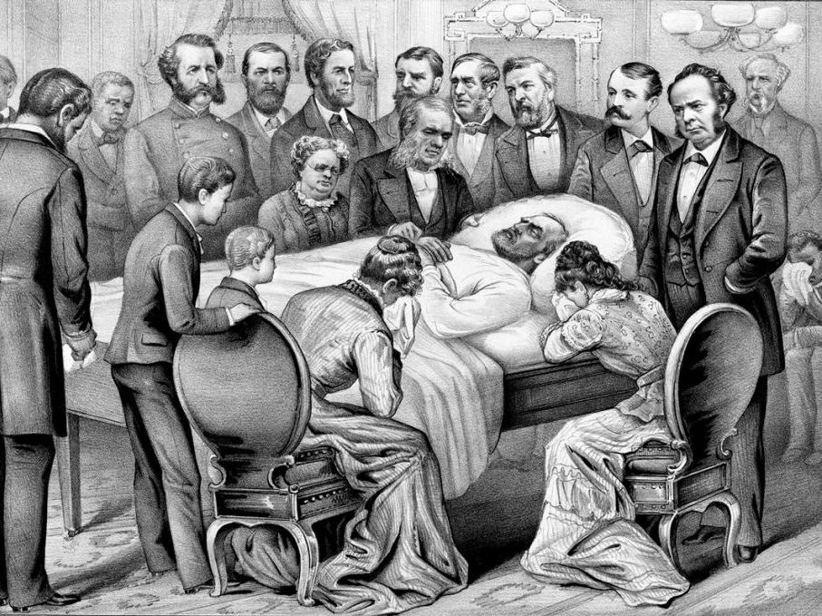
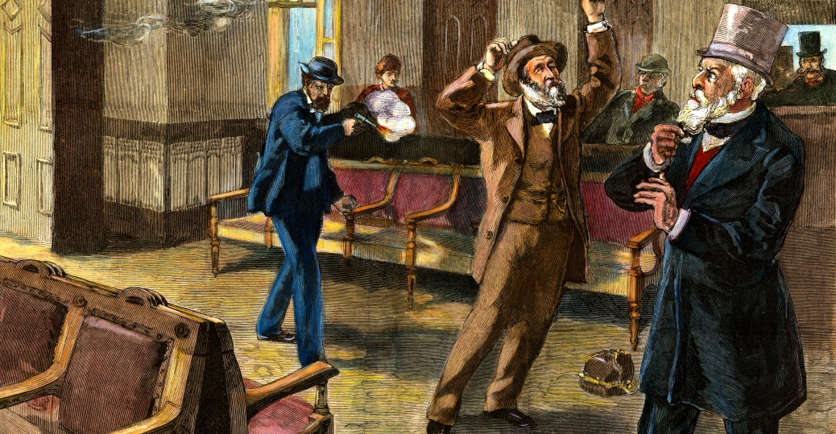
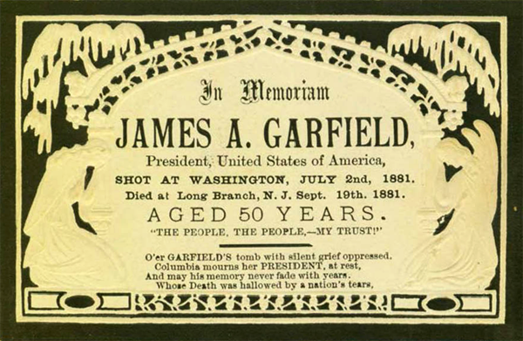
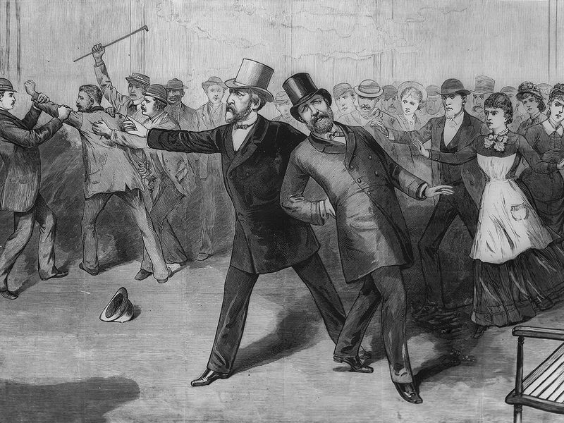
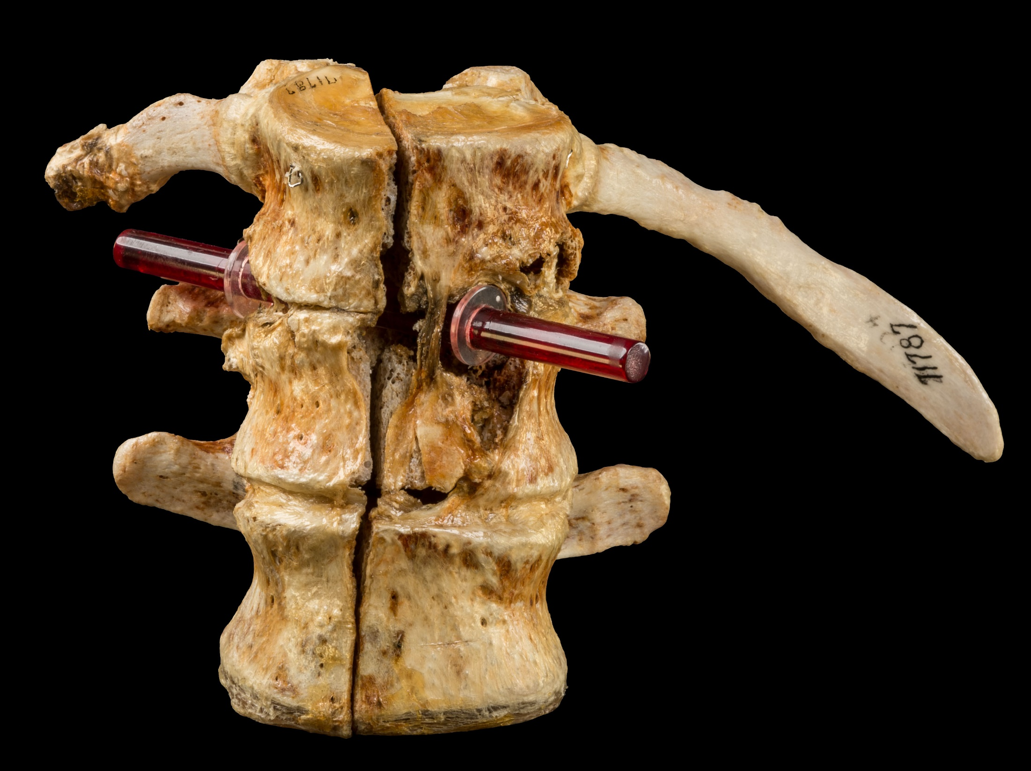
80 days on his deathbed
Shot July 2nd 1881
Baltimore Washington DC train station
Notes:
4 months in office shot at train station Baltimore Washington DC, 80 days on his deathbed – Pre-germs knowledge, doctors probe with fingers at train station for bullet.

Slide 63
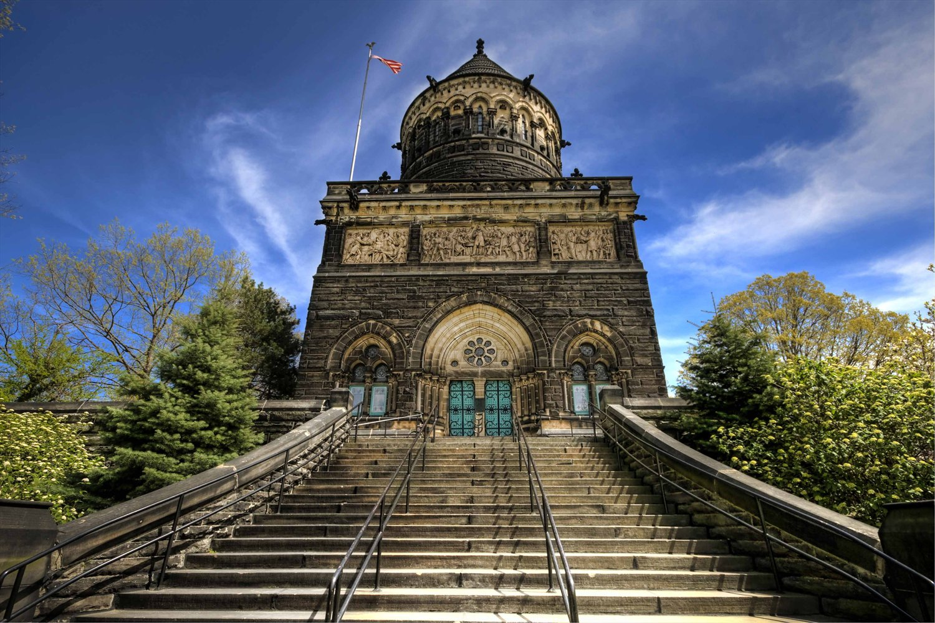
Notes:
The Garfield Monument stands 180 feet tall and is constructed of Berea Sandstone. Around the exterior of the balcony are five, terra cotta panels by Casper Bubel, with over 110 figures all life size, depicting Garfield’s life and death.

Slide 64
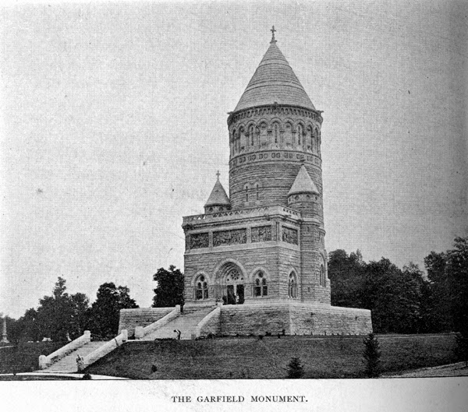

Slide 65
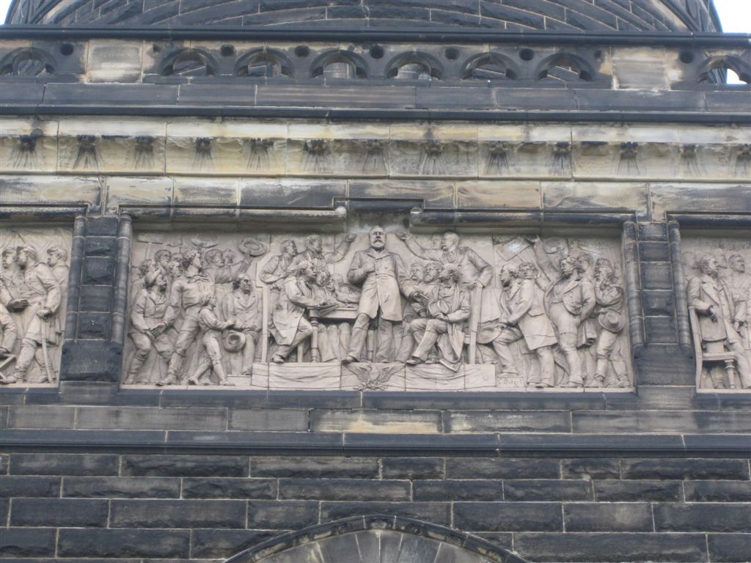

Slide 66
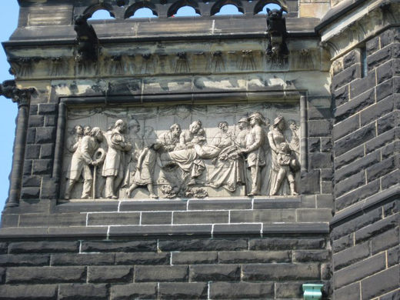

Slide 67
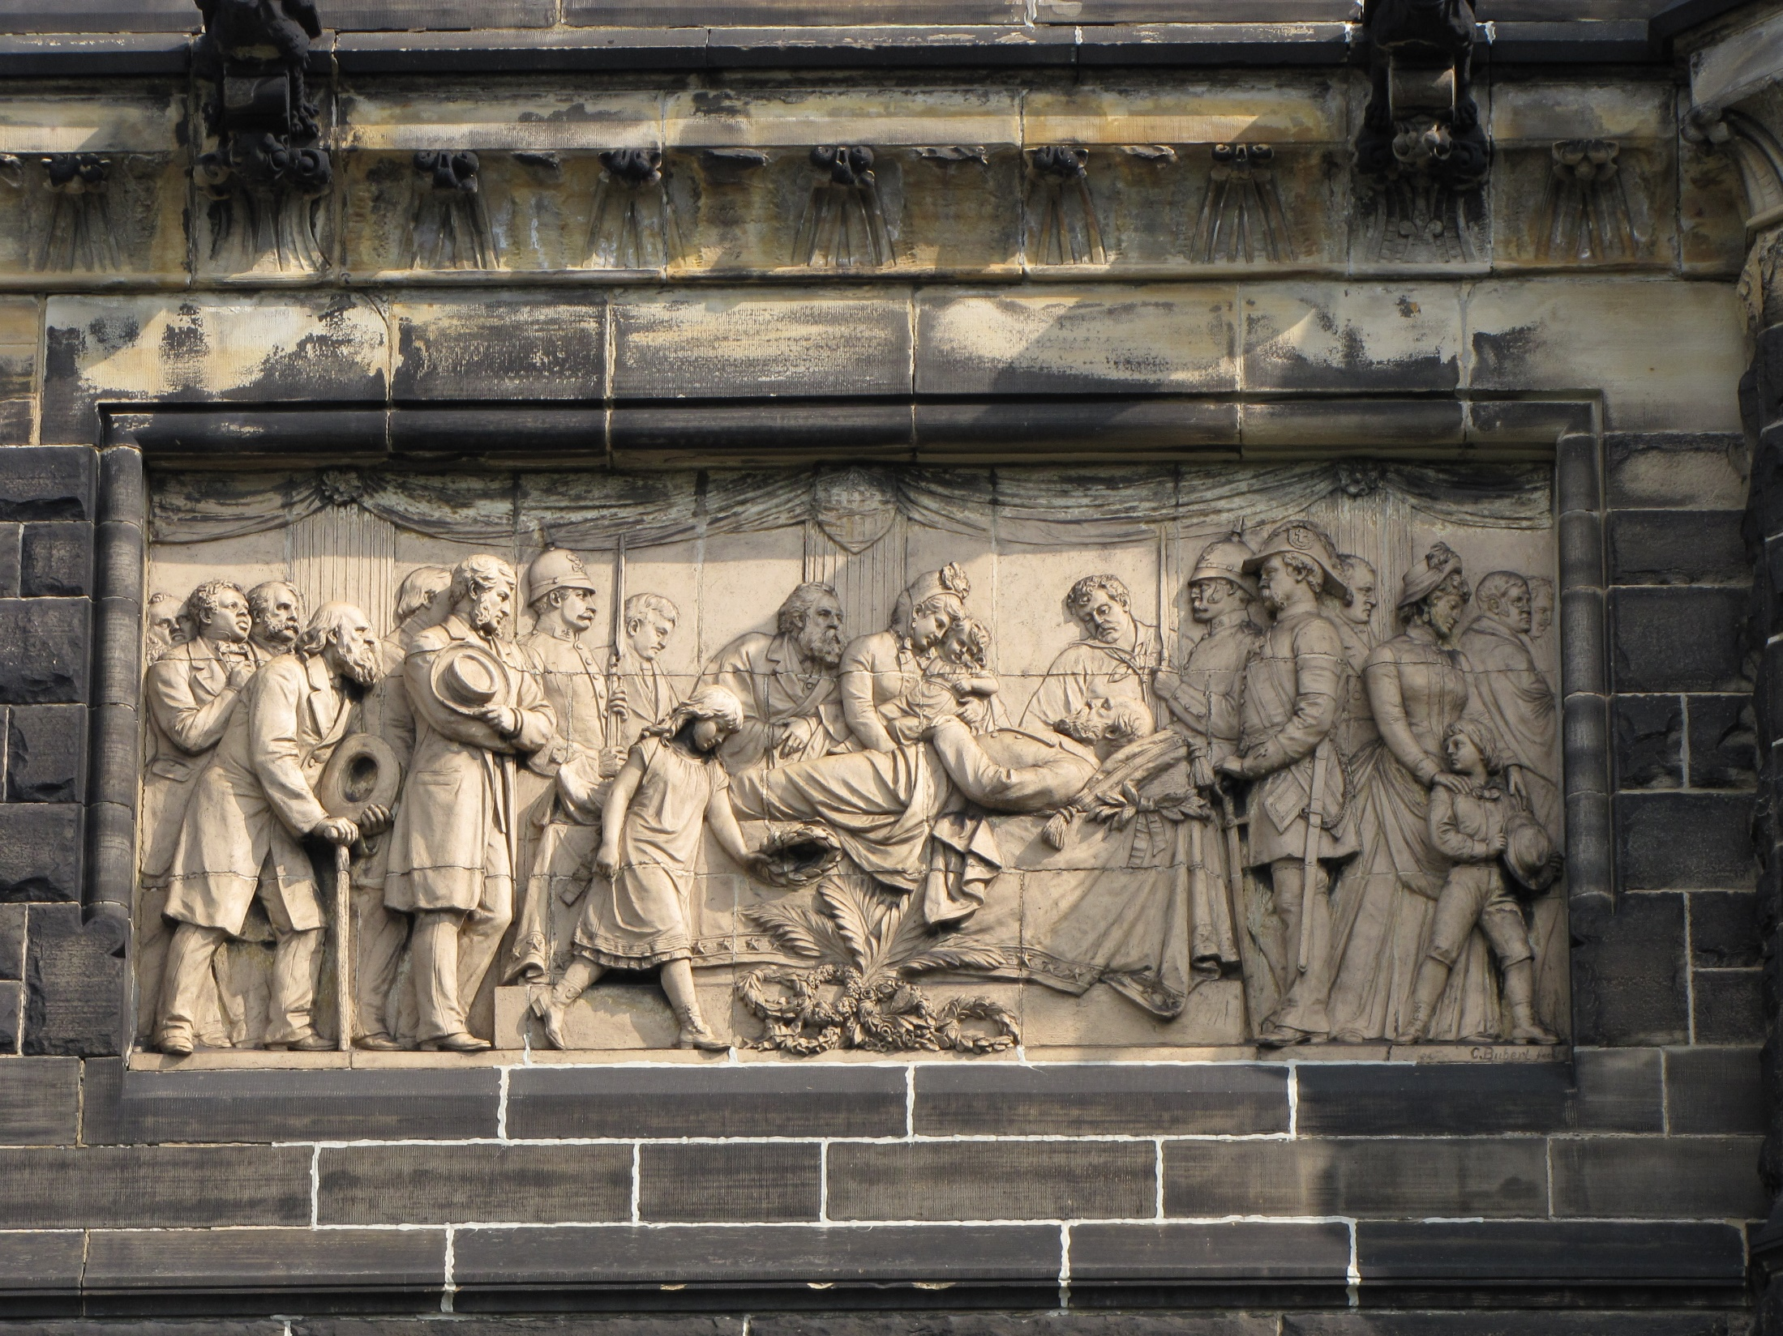

Slide 69
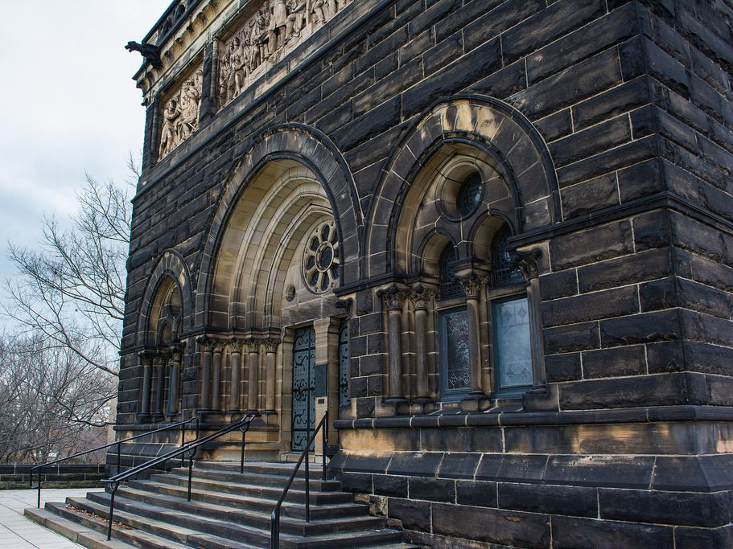
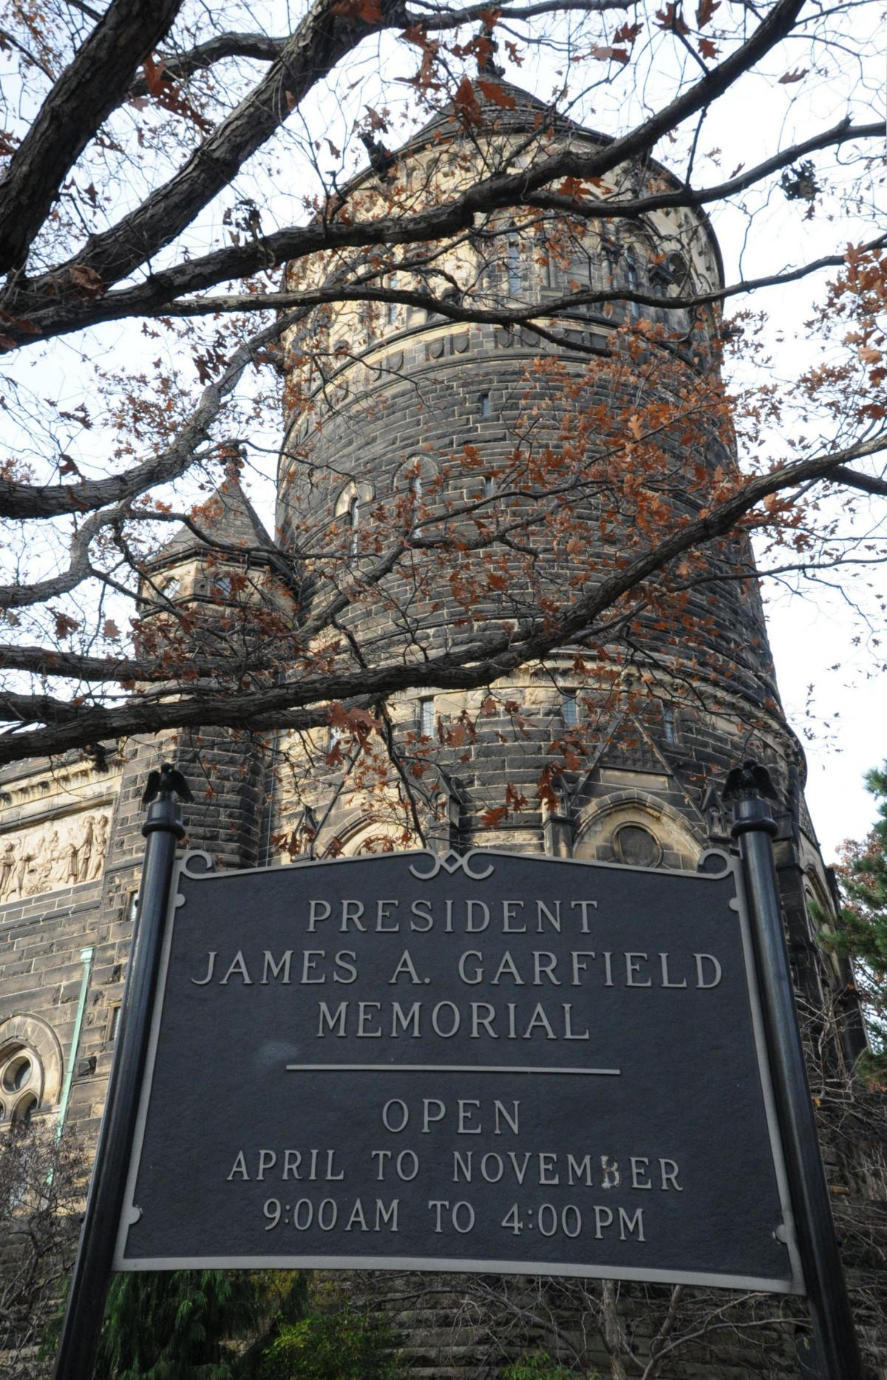
“… but lay up for yourselves treasures in heaven, where neither moth nor rust destroys and where thieves do not break in and steal.” — Matthew 6:20
Notes:
On May 12, 2014 a thief(s) stole 2 dozen spoons in a break-in (Broke window) – An empty whiskey bottle and two cigarette butts were found.

Slide 70
Notes:
Lakeside Cemetery, Cleveland Ohio

Slide 71
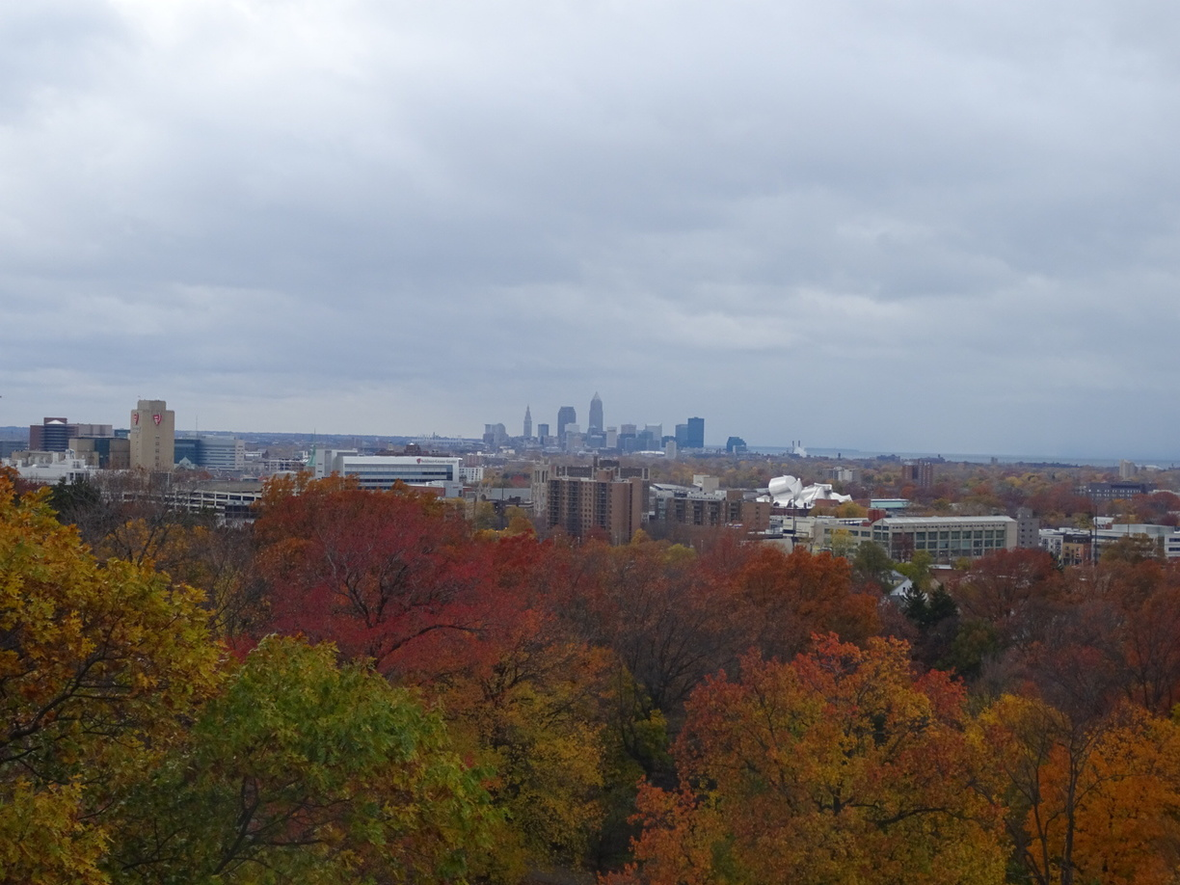
Notes:
Cleveland, Ohio

Slide 72
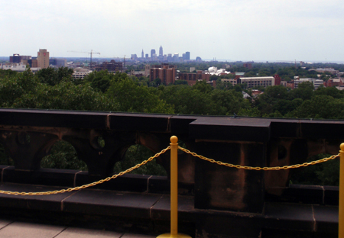

Slide 74
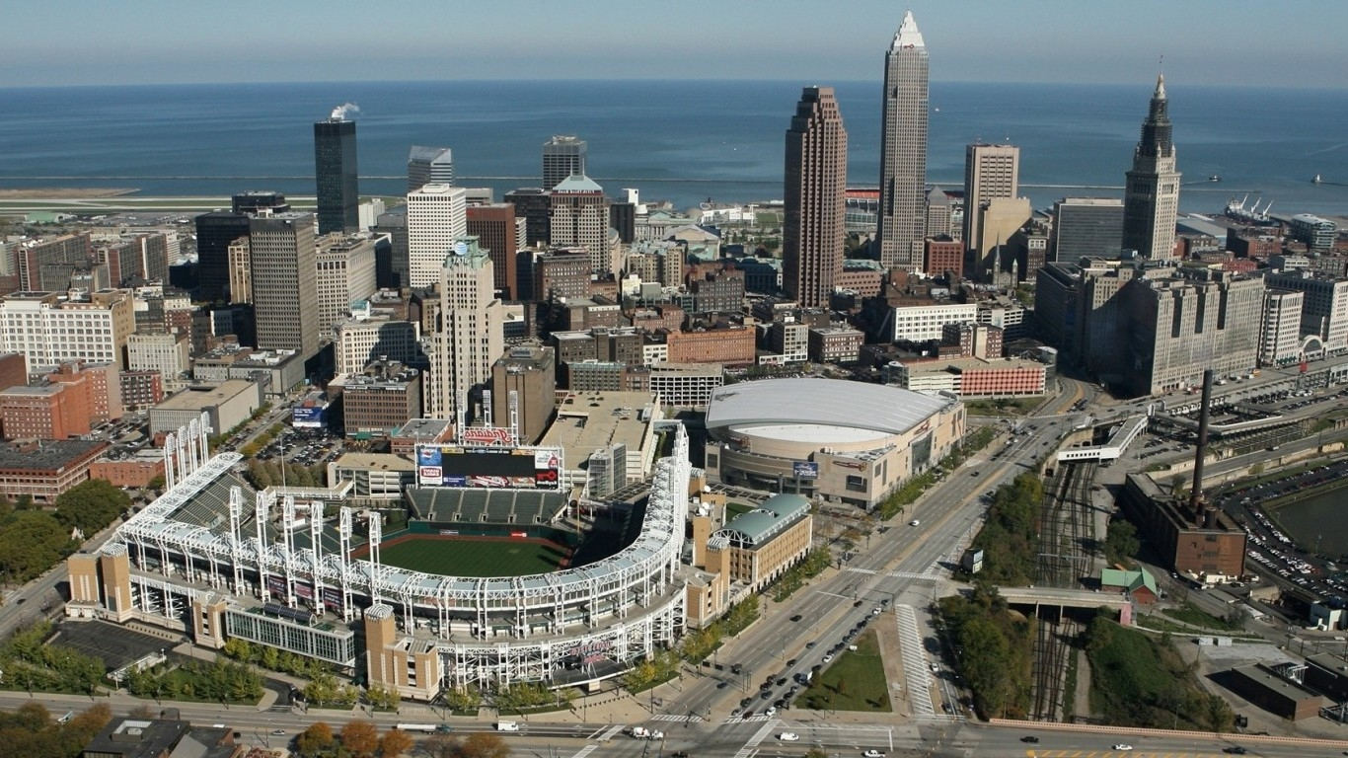
Lake Erie
Cleveland, Ohio

Slide 75
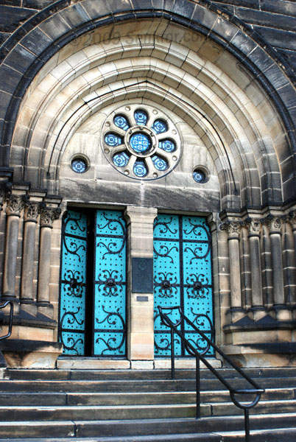

Slide 76
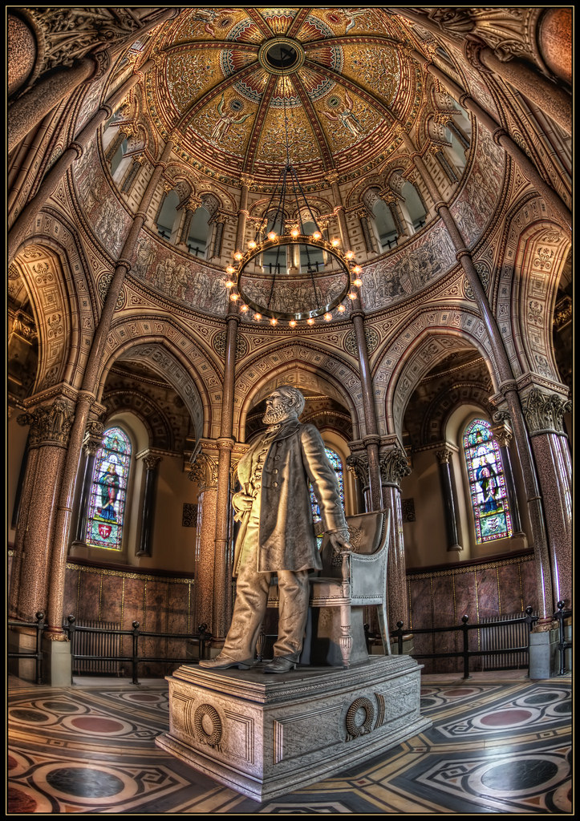
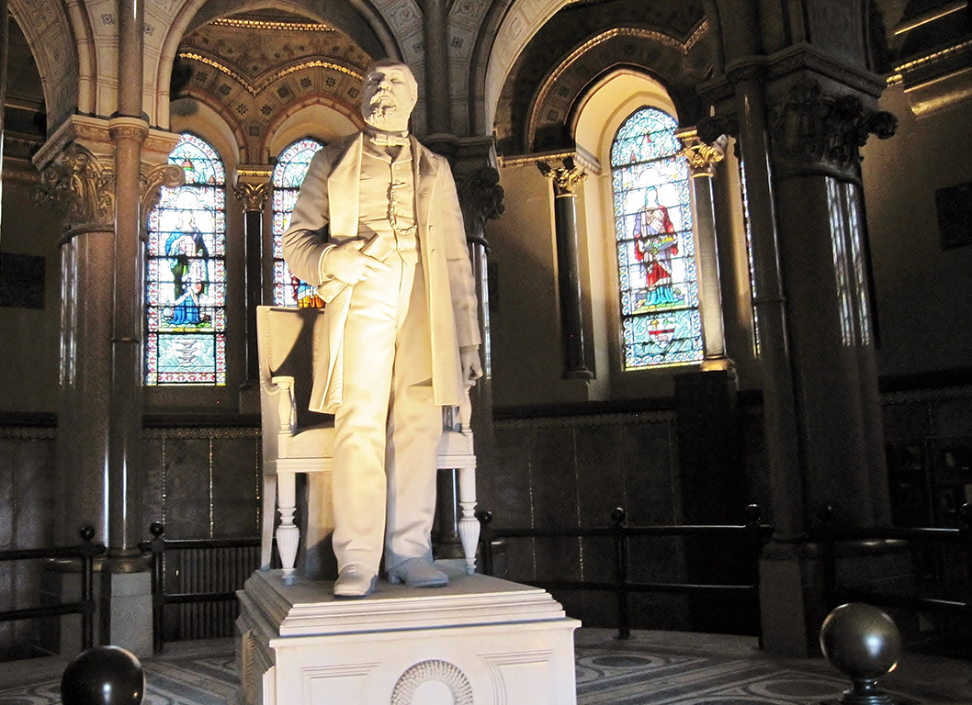

Slide 77
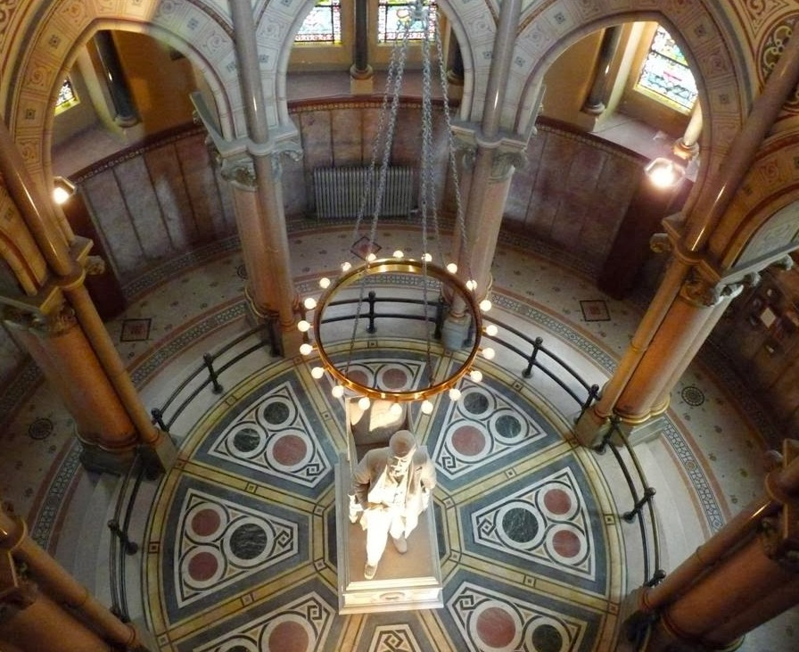

Slide 78
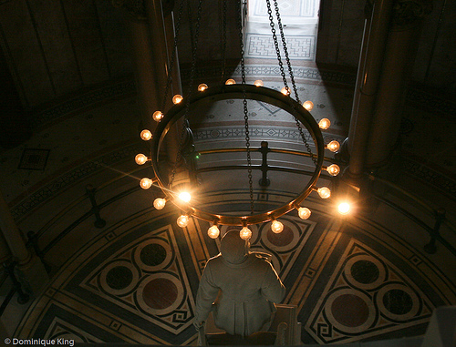
In 1879, Cleveland became the first city to be lighted by electricity
Notes:
Memorial dedicated on Memorial Day1890

Slide 79
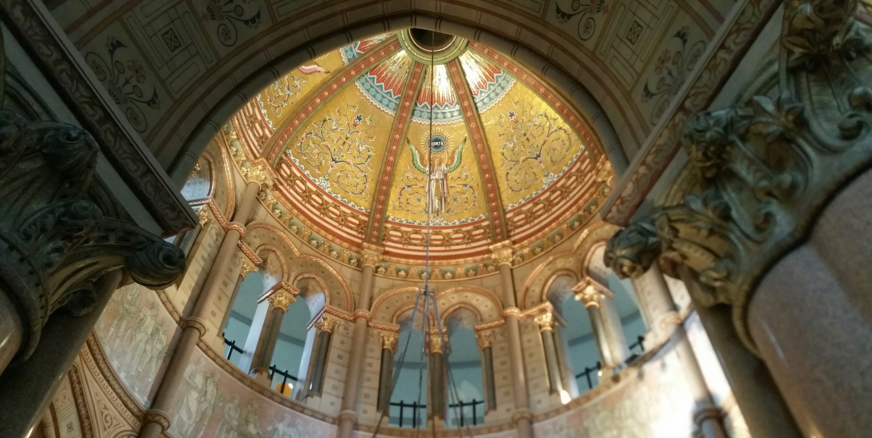

Slide 80
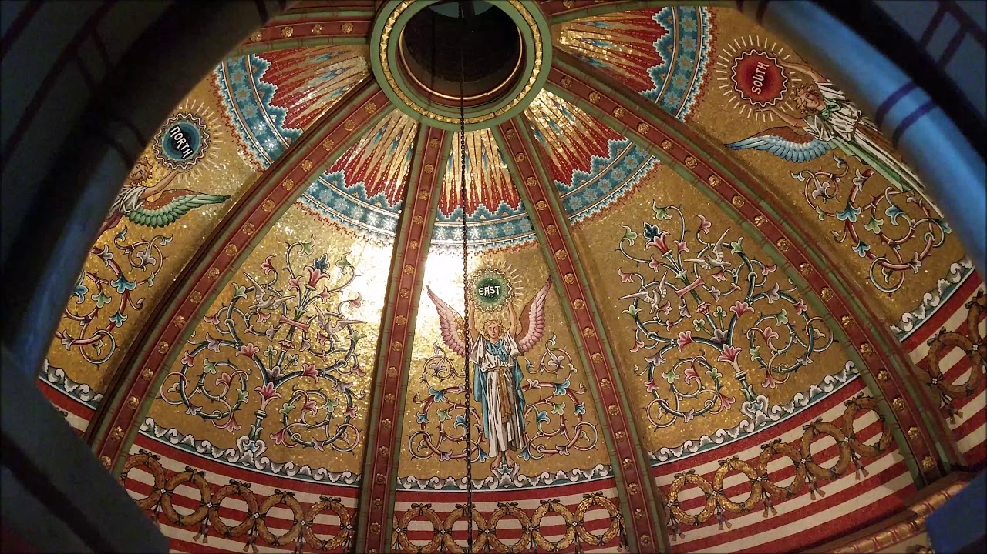

Slide 81
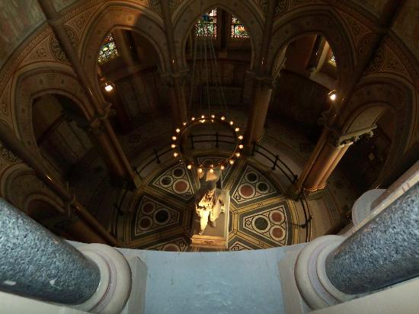
X

Slide 82
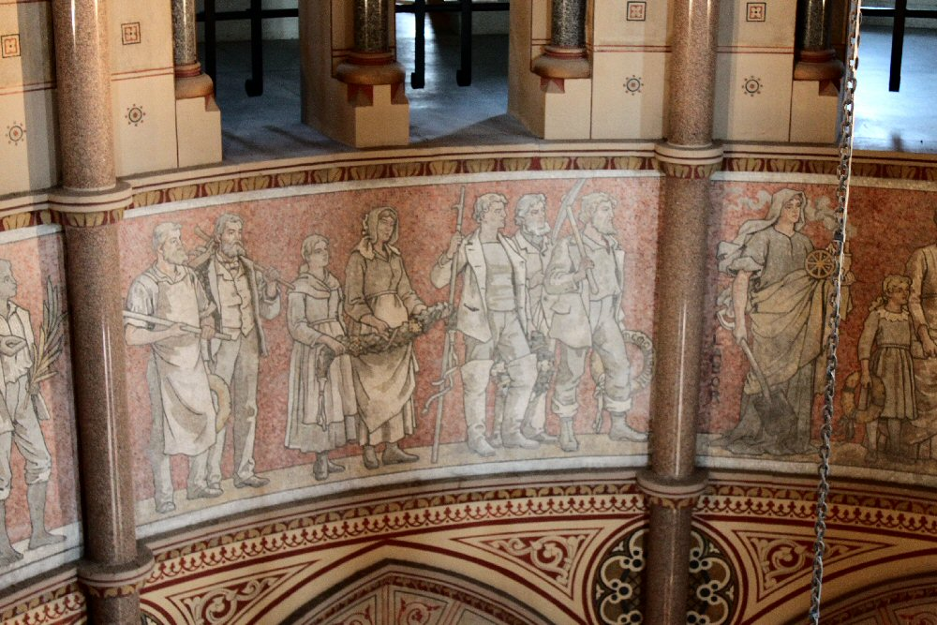

Slide 83
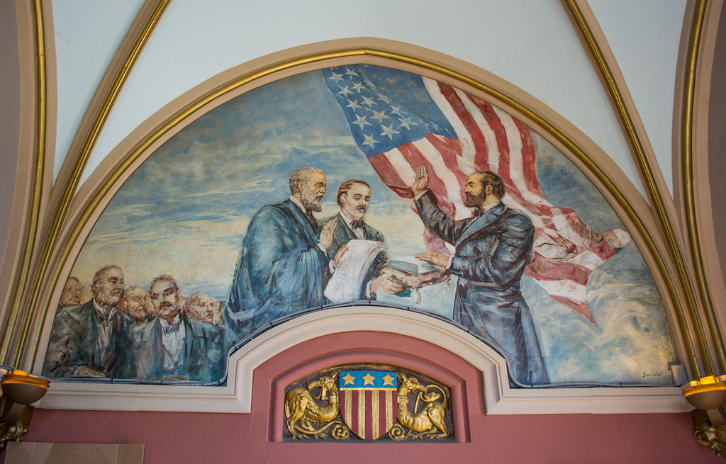

Slide 84
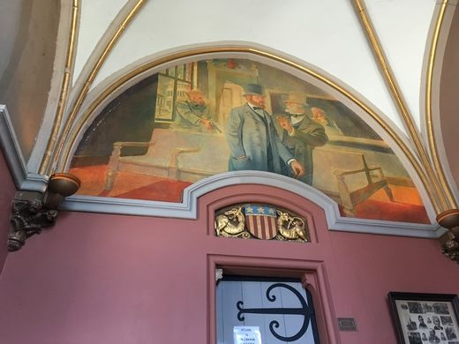

Slide 85
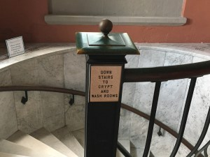

Slide 87
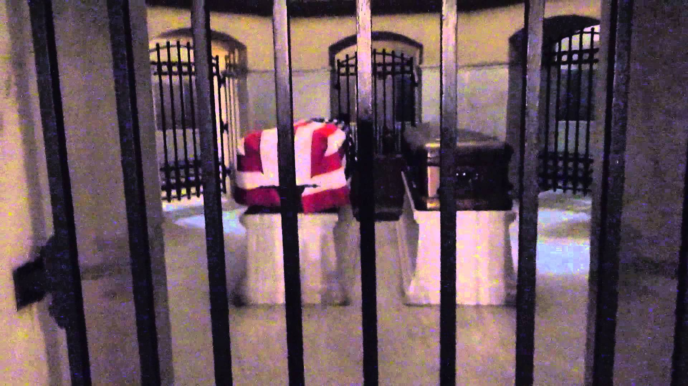

Slide 88
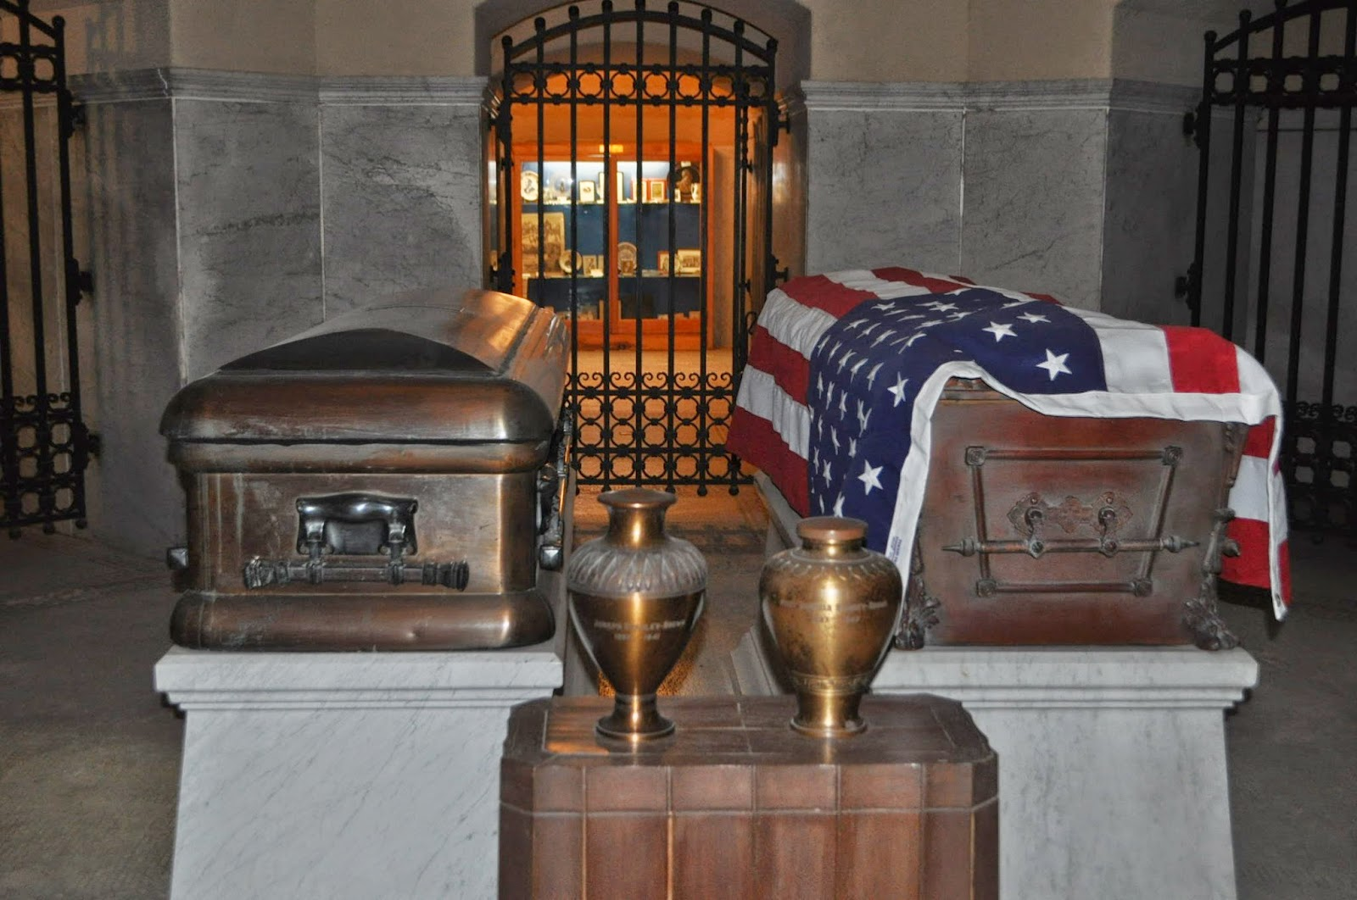
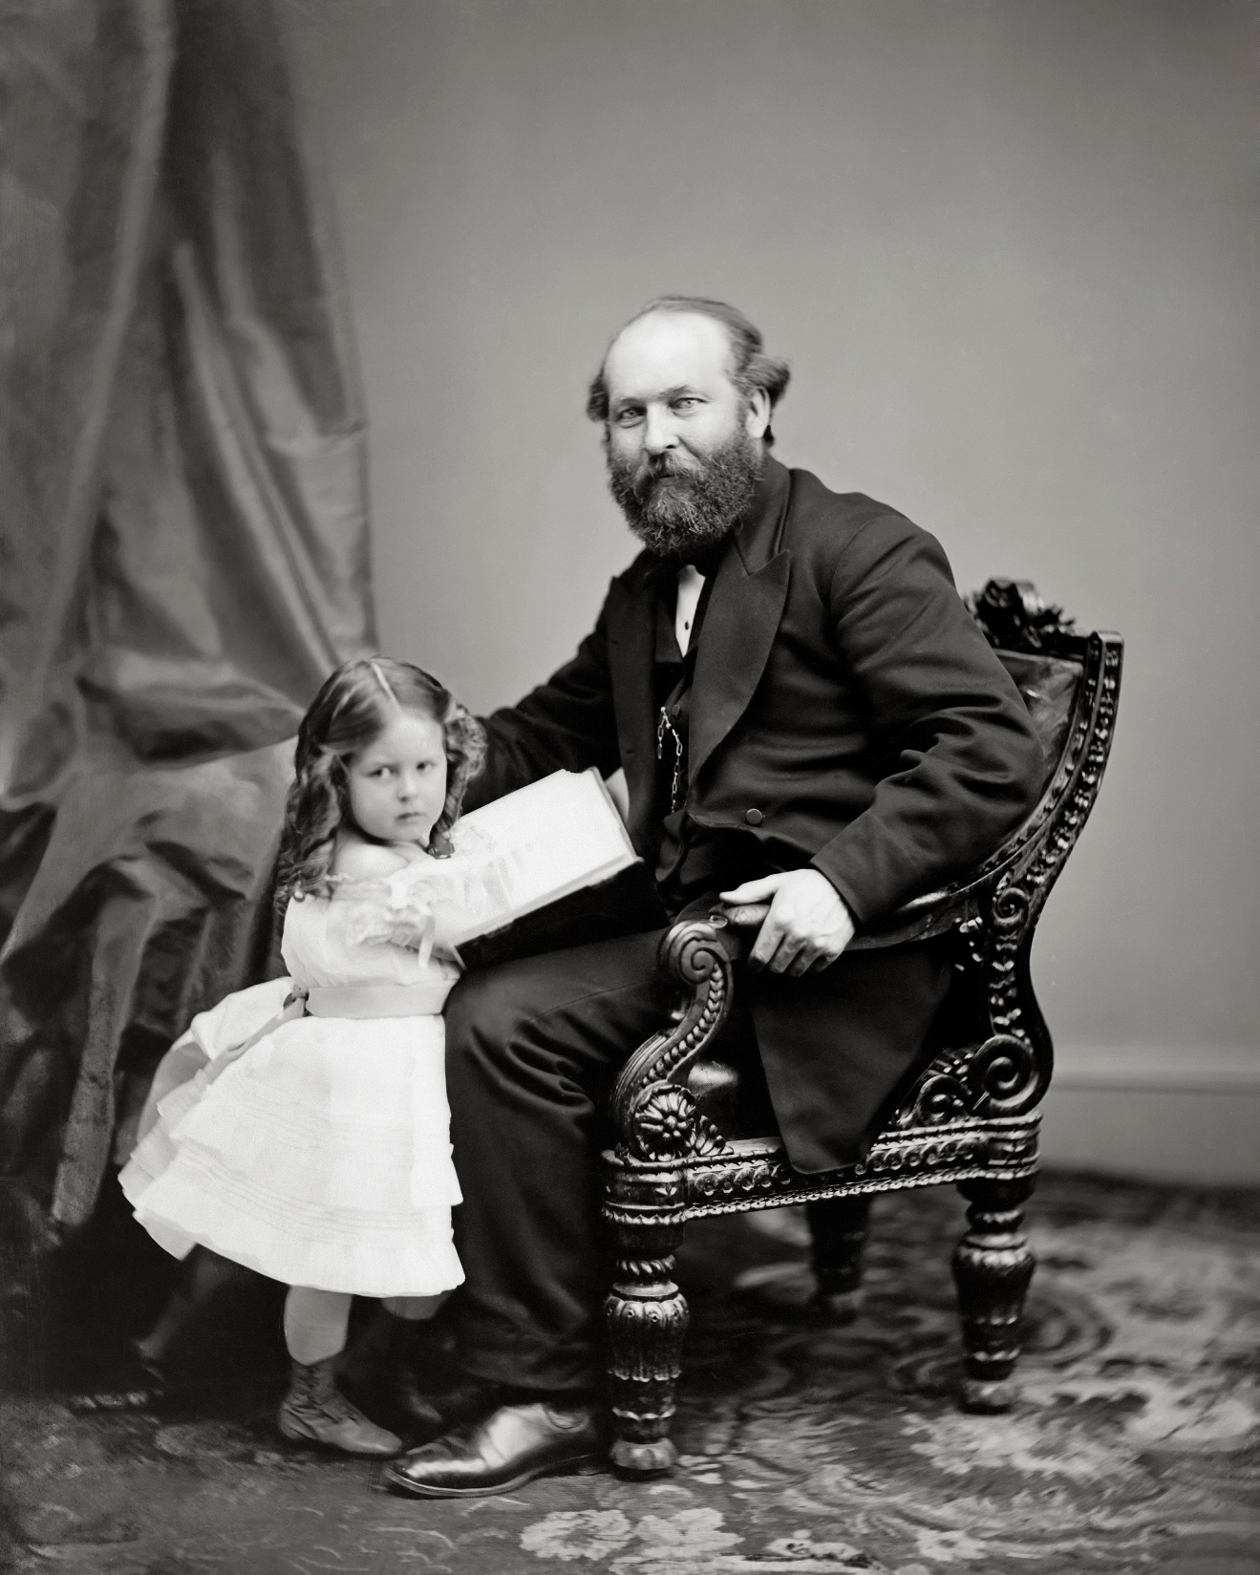
Notes:
Erns include President Garfield’s daughter and husband Joe Brown.
Joseph Stanley Brown served as private secretary to the twentieth President of the United States, James A. Garfield. He would completely devote himself to Garfield, as seen when Garfield asked "What can I do for you?" at their first meeting, prompting Brown to respond, " "It's not what you can do for me, but what I can do for you, sir. " Brown would serve as Garfield's secretary during his brief presidency, controlling the office-seekers that ran rampant due to the spoils system, which Garfield's vice president Chester Arthur would eventually reform.[1] He married President Garfield's daughter Mary "Mollie" Garfield in 1888.

Slide 89
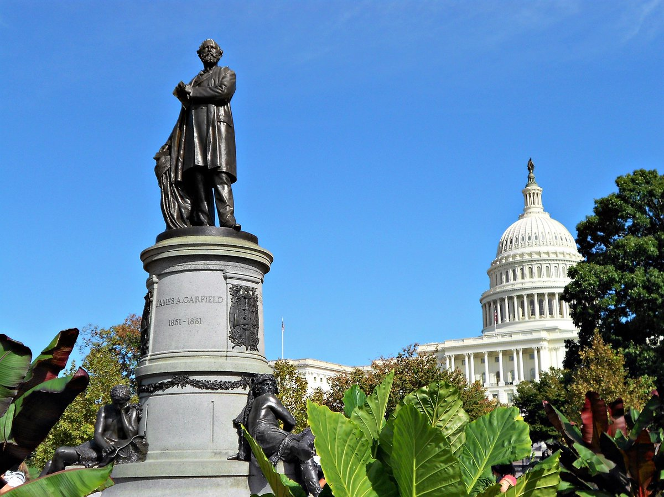

Slide 90
→ Quality of our leaders reflects the public’s senses
→ Kindness is what makes the world better
→ Truth is not always easy to digest as one finds it
→ Education is crucial to maintain freedom and justice
→ Bravery is what encourages people in the face of evil
→ To follow God is to find Life over death in Christ
→ A return to solid values causes social hardships
→ Closeness to God enlightens intimacy with decency
→ Who listens to God hears His songs of hope & peace
→ All that God has made has inborn utilitarian value
→ Nations lacking devoted courage fall to those who do
→ Right and wrong reveals what is best in living
→ A child’s heart maintains a spirit of innocence
Great men never live as long as we would want
Notes:
Great men never live as long as we would want.

Slide 91
Please visit http://www.LoveFromGod.com to explore further
Ronald Bert Channel on
Notes:
Eternity never ends.

