Slide 2
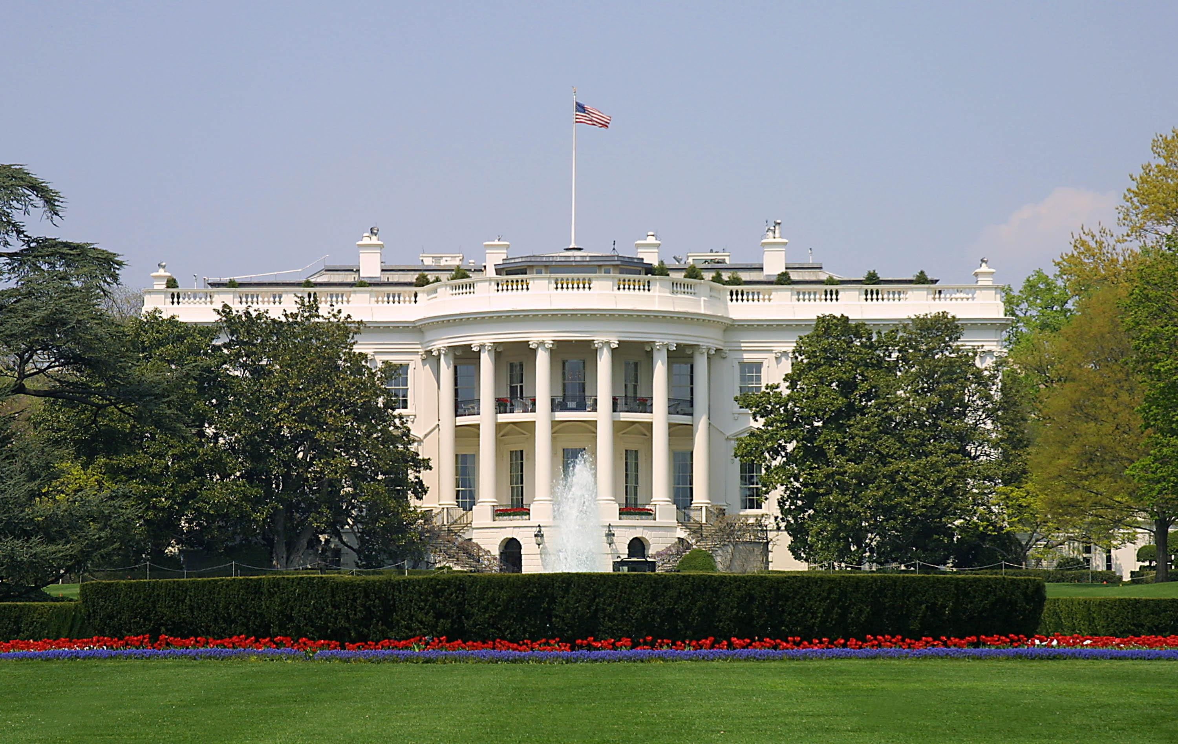
Presidential Quotes
Ron Bert
14
December 16, 2018

Slide 3
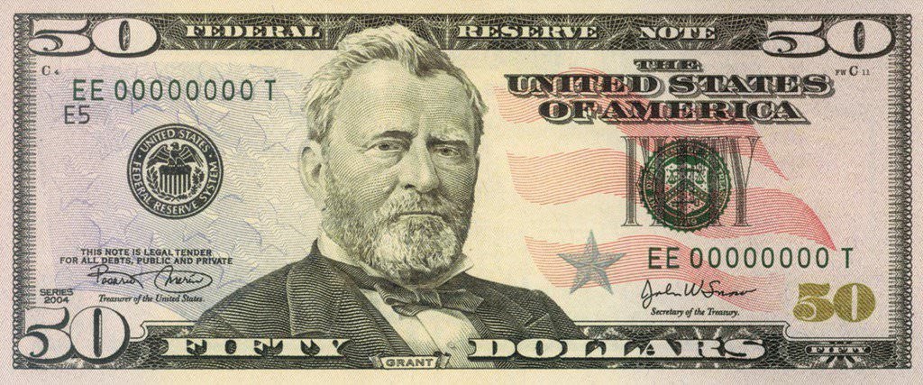
18. Ulysses S. Grant (1869-1877)

Slide 4
“Hold fast to the Bible as the sheet anchor of your liberties. Write its precepts in your hearts, practice them in your lives.”
Hold fast to the Bible

Slide 5
"Remember therefore how you have received and heard; hold fast and repent. Therefore if you will not watch, I will come upon you as a thief, and you will not know what hour I will come upon you." — Revelation 3:3
hold fast
repent
watch

Slide 6
“Hold fast to the Bible. To the influence of this Book we are indebted for all the progress made in true civilization and to this we must look as our guide in the future.”
Hold fast to the Bible
Bible
in
in true civilization
guide
guide
in
in the future
Notes:
This country was built upon the freedom of religion, not its’ absence.

Slide 7
"To give light to those who sit in darkness and the shadow of death, To guide our feet into the way of peace." — Luke 1:79
To guide
guide
way of peace

Slide 8
“As soon as slavery fired upon the flag it was felt, we all felt, even those who did not object to slaves, that slavery must be destroyed. We felt that it was a stain to the Union that men should be bought and sold like cattle.”
a stain

Slide 9
“If we are to have another contest in the near future of our national existence, I predict that the dividing line will not be Mason and Dixon's but between patriotism and intelligence on the one side, and superstition, ambition and ignorance on the other.”
ambition
ignorance
superstition
honor
loyalty
greed
patriotism
intelligence
freedom
bondage
GODLY
unawareness
knowledge wisdom
UNGODLY
patriotism
intelligence
fear
superstition
ambition
ignorance

Slide 10
This I say, therefore, and testify in the Lord, that you should no longer walk as the rest of the Gentiles walk, in the futility of their mind, having their understanding darkened, being alienated from the life of God, because of the ignorance that is in them, because of the blindness of their heart; — Ephesians 4:17-18
no longer walk
no longer walk in:
• futility of mind
• understanding darkened
• alienated from the life of God
because of ignorance in them
blindness of heart
in
futility of
mind
understanding darkened
alienated from the life of God
because of
ignorance
in
them
blindness of
heart

Slide 11
“God gave us Lincoln and Liberty, let us fight for both.”
Truth
Freedom

Slide 12
“Let us labor for the security of free thought, free speech, pure morals, unfettered religious sentiments, and equal rights and privileges for all men, irrespective of nationality, color, or religion;.... leave the matter of religious teaching to the family altar, the church, and the private school, supported entirely by private contribution. Keep church and state forever separate.”

Slide 13
“Encourage free schools and resolve that not one dollar appropriated for their support shall be appropriated to the support of any sectarian schools. Resolve that neither the state nor nation, nor both combined, shall support institutions of learning other than those sufficient to afford every child growing up in the land of opportunity of a good common school education, unmixed with sectarian, pagan, or atheistical dogmas. Leave the matter of religion to the family altar, the church and the private school supported entirely by private contributions. Keep the church and state forever separate.”
“Encourage free schools and resolve that not one dollar appropriated for their support shall be appropriated to the support of any sectarian schools. Resolve that neither the state nor nation, nor both combined, shall support institutions of learning other than those sufficient to afford every child growing up in the land of opportunity of a good common school education, unmixed with sectarian, pagan, or atheistical dogmas. Leave the matter of religion to the family altar, the church and the private school supported entirely by private contributions. Keep the church and state forever separate.”
atheistical dogmas

Slide 14
“Labor disgraces no man; unfortunately, you occasionally find men who disgrace labor.”

Slide 15
He who is slothful in his work Is a brother to him who is a great destroyer. — Proverbs 18:9

Slide 16
“Whatever there is of greatness in the United States, or indeed in any other country, is due to labor. The laborer is the author of all greatness and wealth. Without labor there would be no government, no leading class, and nothing to preserve.”

Slide 17
Whatever your hand finds to do, do it with your might; for there is no work or device or knowledge or wisdom in the grave where you are going. — Ecclesiastes 9:10

Slide 18
“In 1850, I believe, the church property in the United States, which paid no tax, amounted to $87 million. In 1900, without a check, it is safe to say, this property will reach a sum exceeding $3 billion. I would suggest the taxation of all property equally, whether church or corporation, exempting only the last resting place of the dead and possibly, with proper restrictions, church edifices.”
Notes:
I’m not sure where all the laws apply or when the gray line is used to benefit the individual over glorifying God. Looking at google maps shows churches on every corner claimed by many residential households. The extent of the den of thieves only God knows. Concerning separation of state and government, it should remain established to protect true worshippers from bondage to that which should rather uphold them. Our government was established to protect religion, not to eliminate it. Certainly it is a fine line when wolves use religion as a means to establish human doctrine over that of practicing God’s word. Bad apples and greedy self-seeking souls destroy the desire of many to seek Him, in assemblies where He is truly worshipped. Pray God He brings to our senses truth above what man has done.

Slide 19
“The most confident critics are generally those who know the least about the matter criticized.”

Slide 20
Also it is not good for a soul to be without knowledge, And he sins who hastens with his feet. — Proverbs 19:2

Slide 21
“My failures have been errors in judgment, not of intent.”

Slide 22
“Two commanders on the same field are always one too many.”

Slide 23
"Do not call anyone on earth your father; for One is your Father, He who is in heaven. And do not be called teachers; for One is your Teacher, the Christ. But he who is greatest among you shall be your servant." — Matthew 23:9-11

Slide 24
So the scribe said to Him, "Well said, Teacher. You have spoken the truth, for there is one God, and there is no other but He. And to love Him with all the heart, with all the understanding, with all the soul, and with all the strength, and to love one's neighbor as oneself, is more than all the whole burnt offerings and sacrifices." Now when Jesus saw that he answered wisely, He said to him, "You are not far from the kingdom of God." But after that no one dared question Him." — Mark 12:32-34
one God

Slide 27
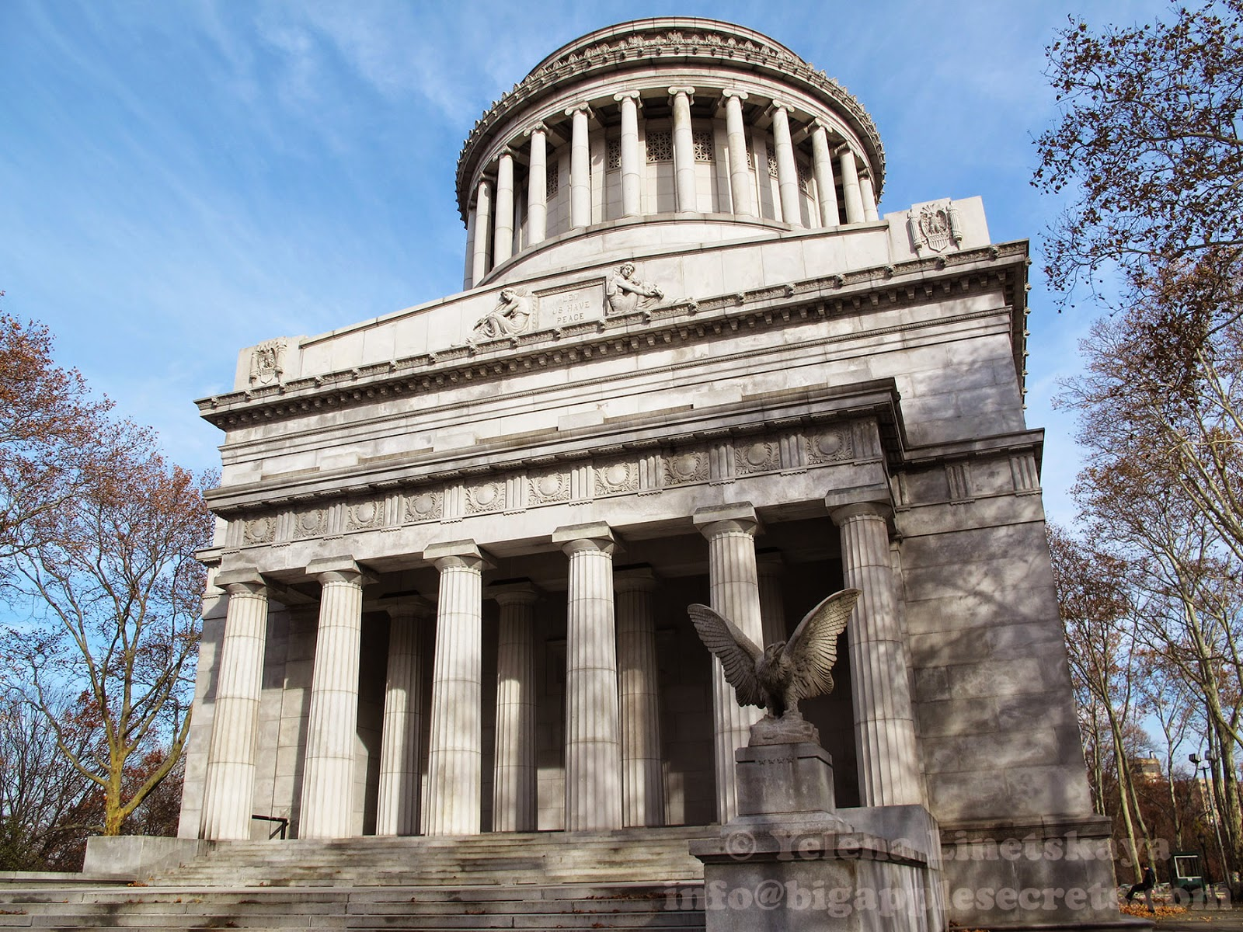

Slide 28
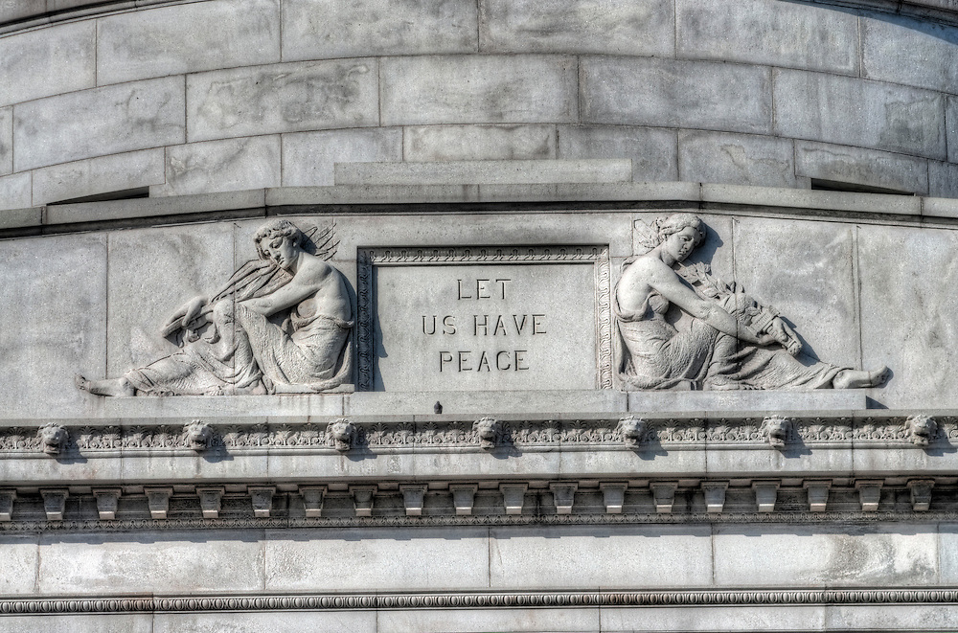

Slide 29
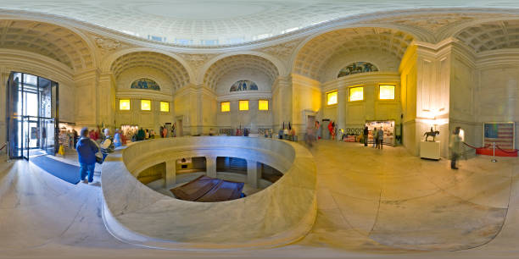

Slide 30
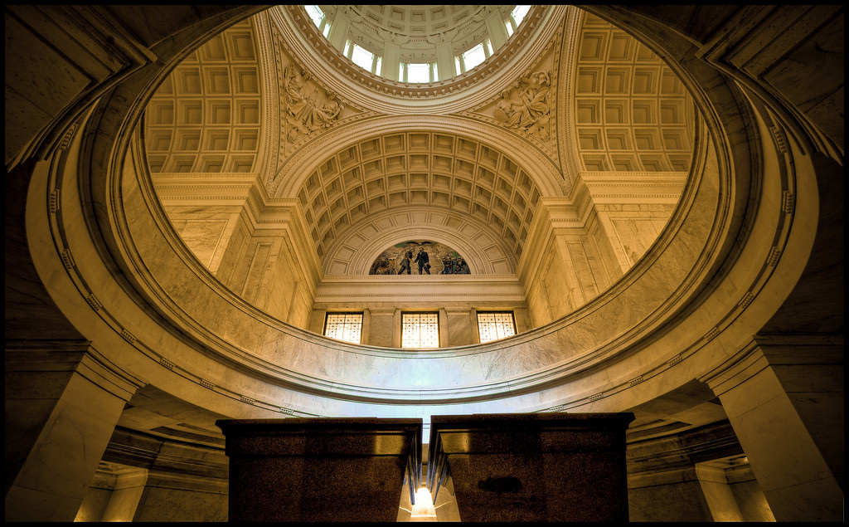

Slide 31
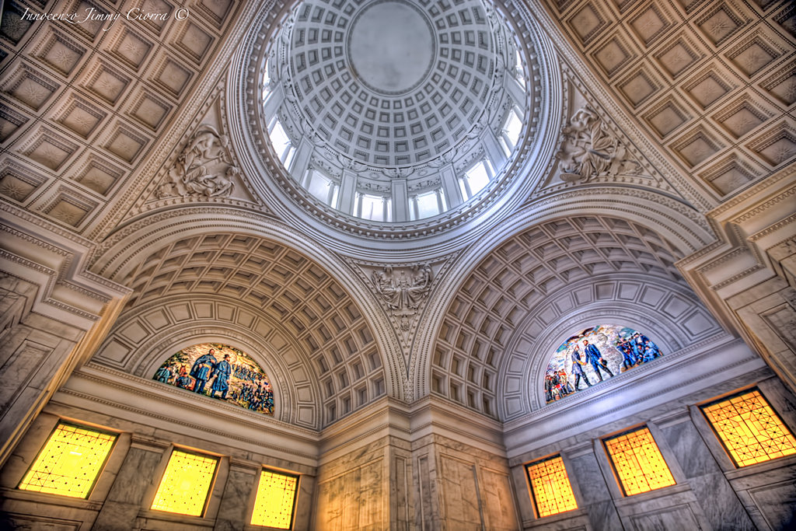
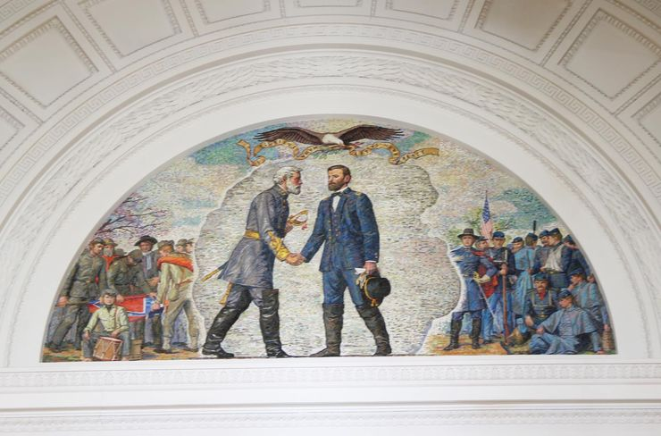

Slide 32
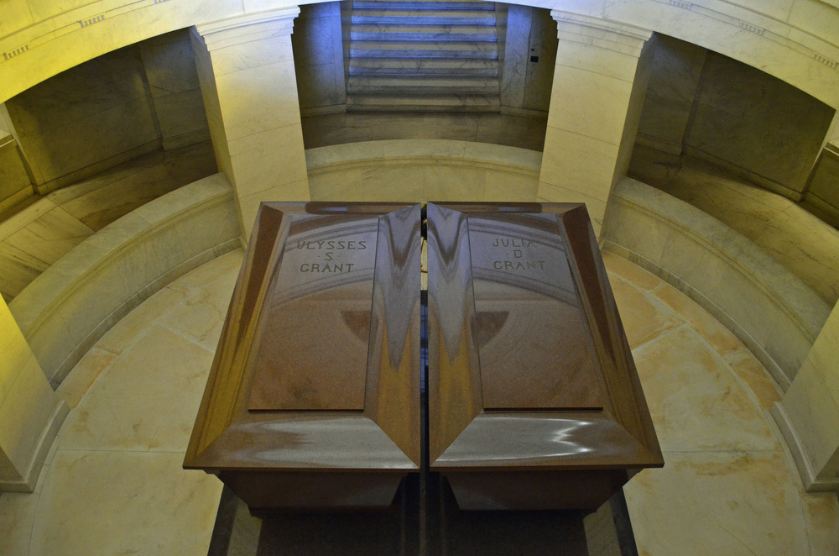

Slide 33
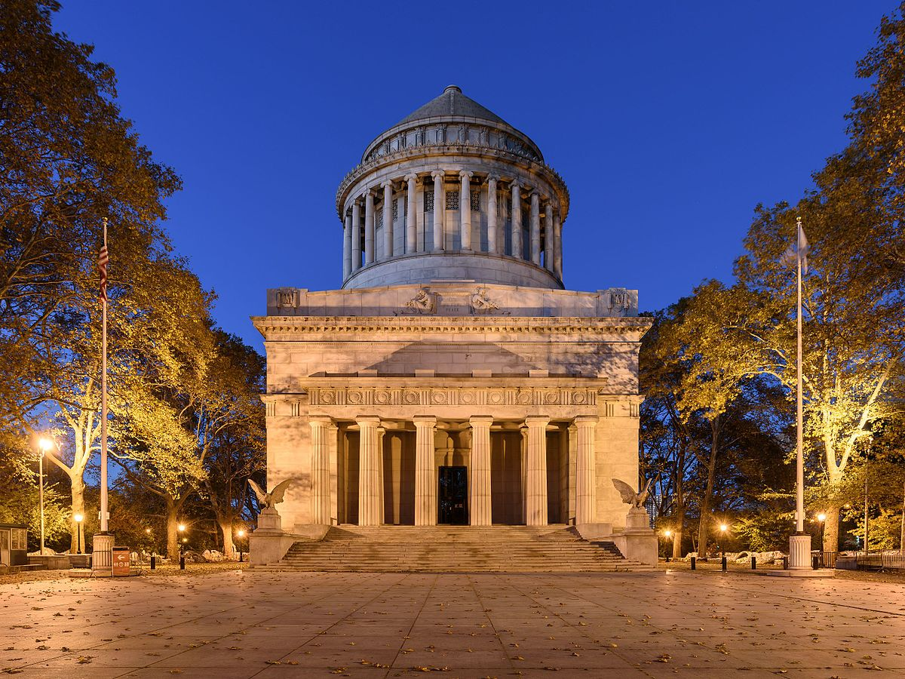
The wind goes toward the south, And turns around to the north; The wind whirls about continually, And comes again on its circuit. — Ecclesiastes 1:6
Notes:
The winds of time swirl upon the age of man.

Slide 35
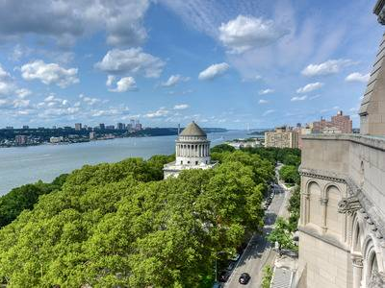
North

Slide 36
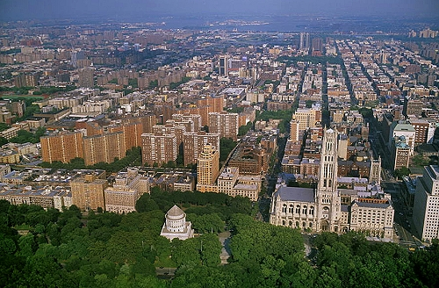
East

Slide 37
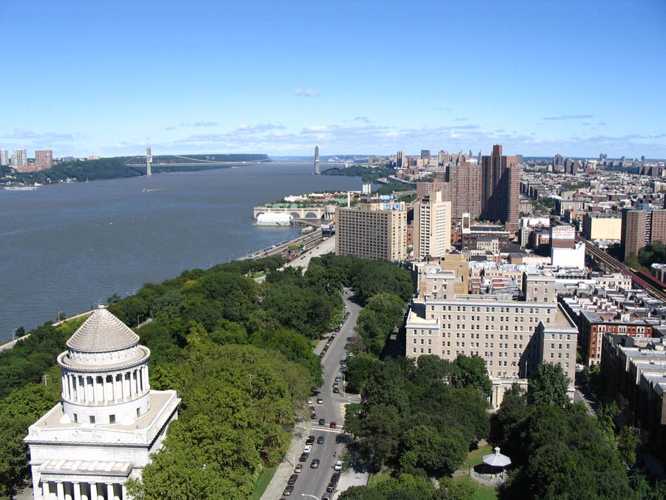
George Washington

Slide 38
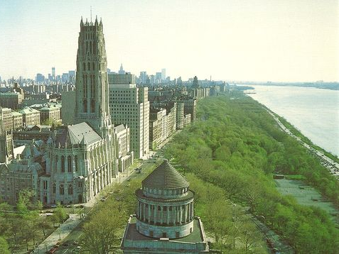
Hudson
South

Slide 40
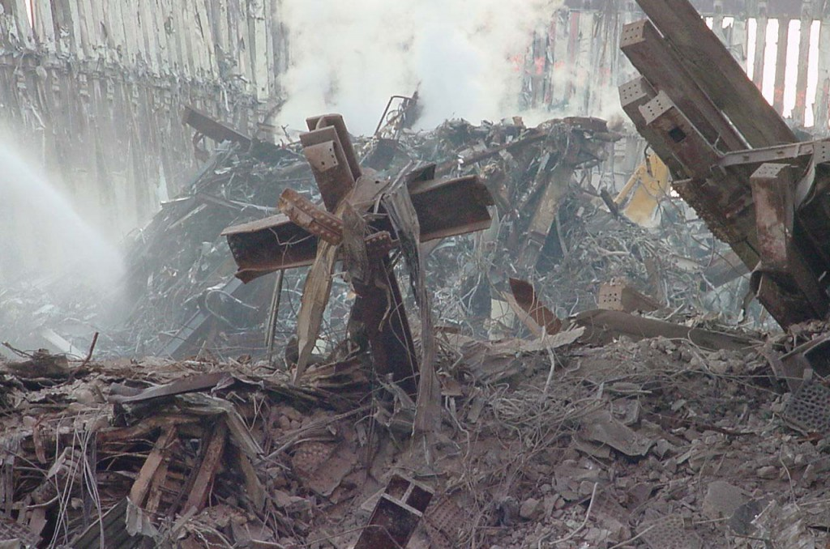

Slide 41
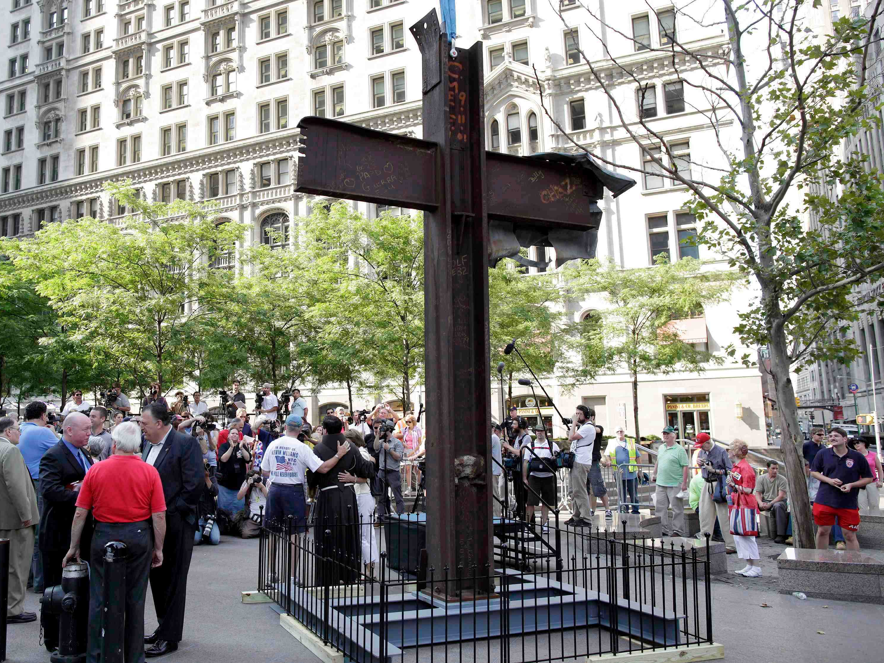

Slide 42
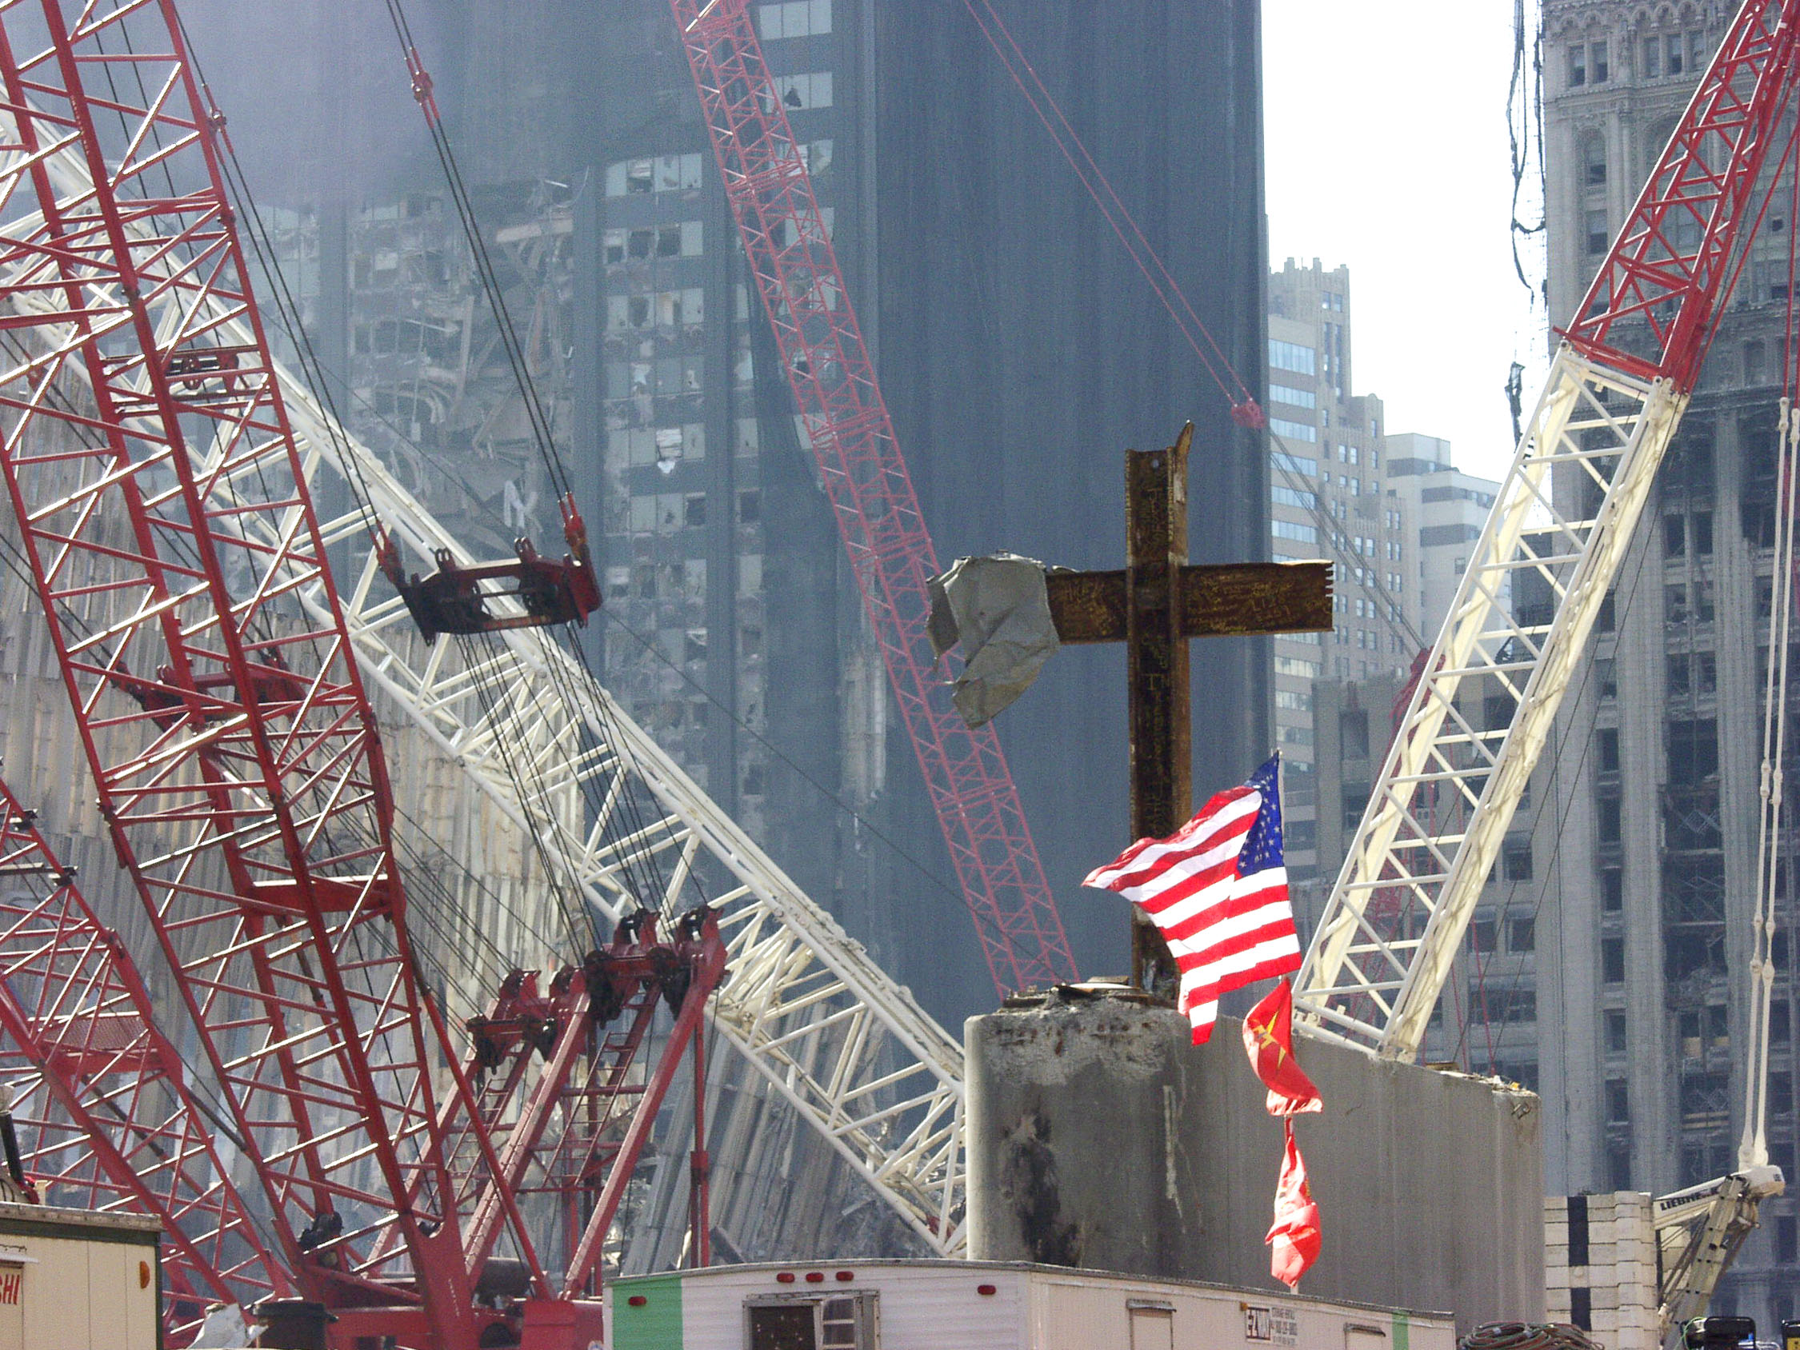

Slide 43
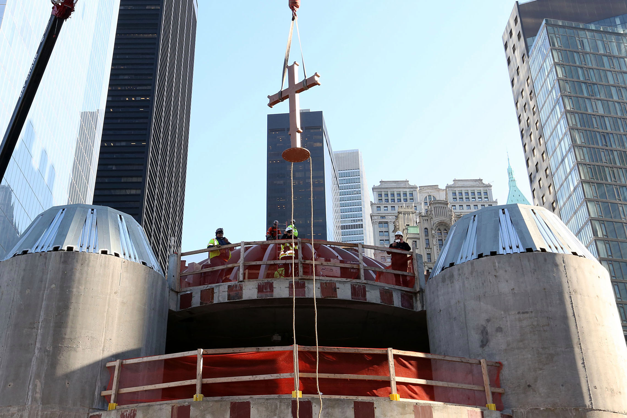
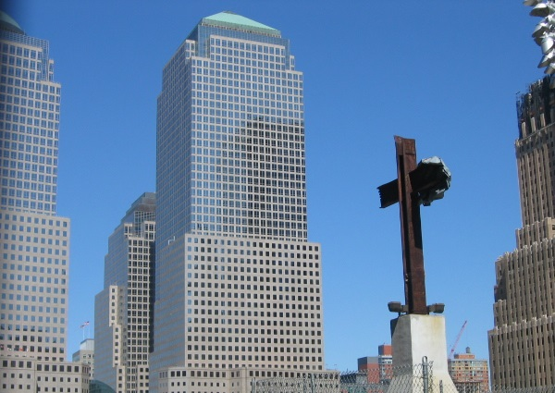

Slide 45
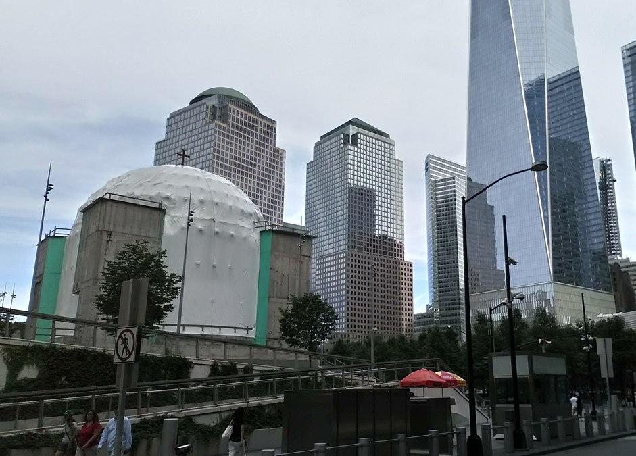

Slide 47
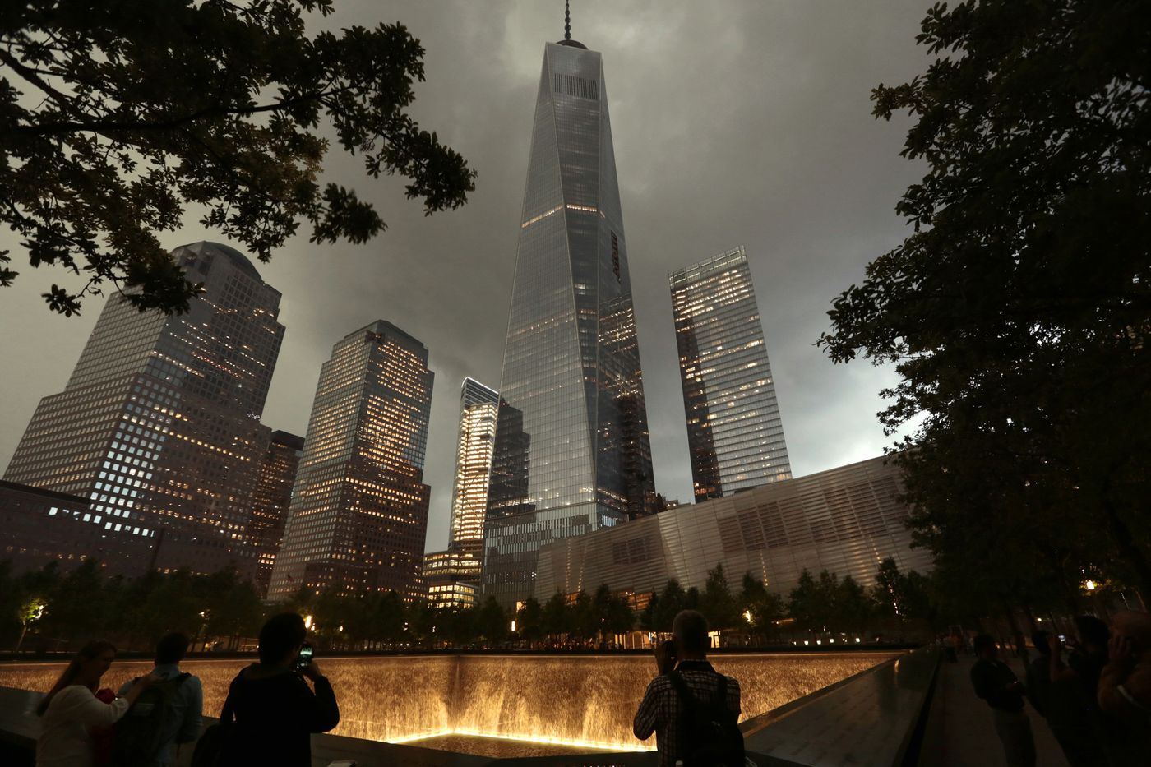

Slide 48
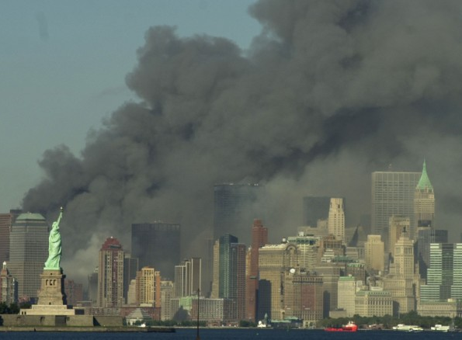
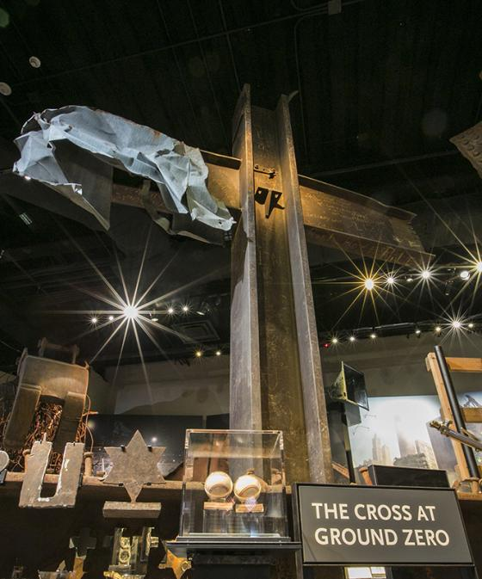
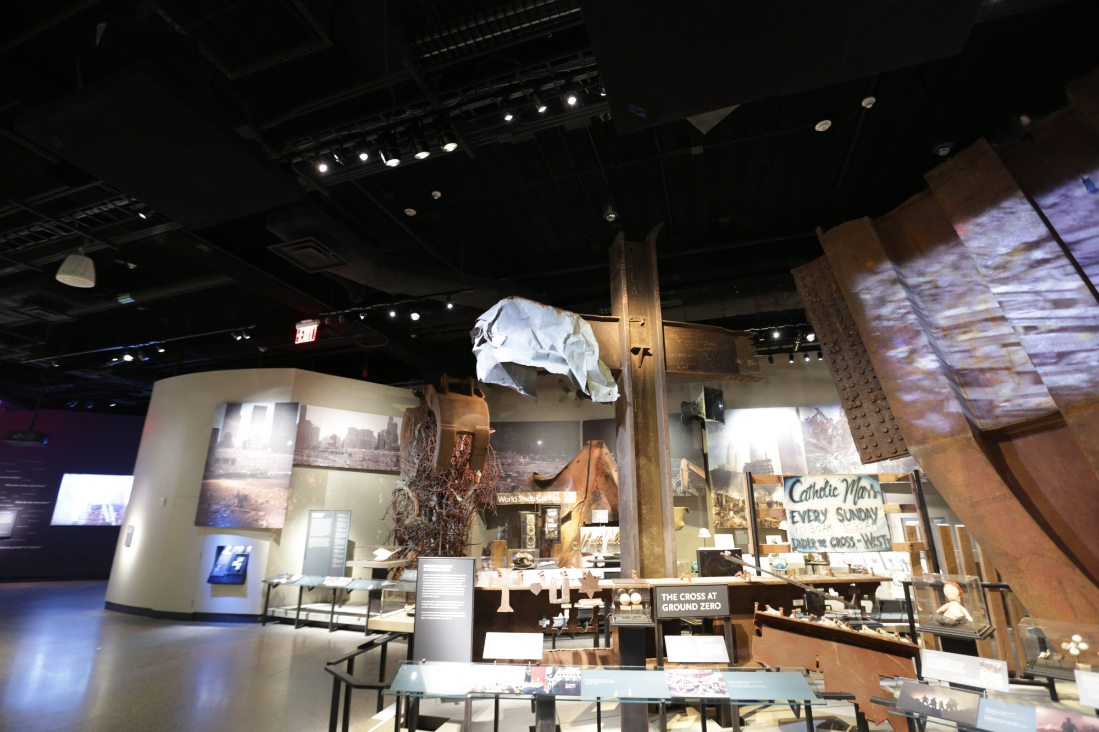

Slide 49
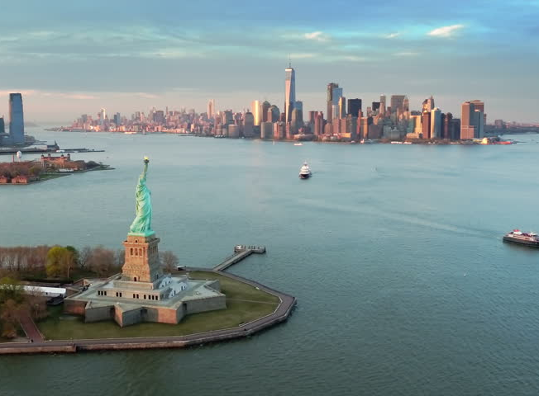

Slide 51
Presidential Quotes
Ron Bert
14½
December 23, 2018

Slide 52
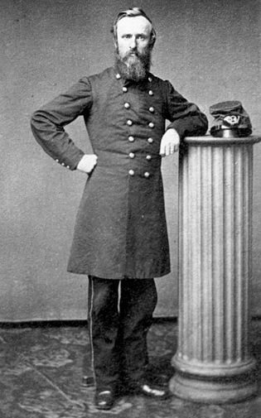
19. Rutherford B. Hayes (1877-1881)

Slide 53
“Every age has its temptations, its weaknesses, its dangers. Ours is in the line of the snobbish and the sordid.”
sordid
Nasty
Sleezy
Repugnant
Foul
Filthy
Wretched
Disreputable

Slide 54
“Free government cannot long endure if property is largely in a few hands, and large masses of people are unable to earn homes, education, and a support in old age.”

Slide 55
“Crimes increase as education, opportunity, and property decrease. Whatever spreads ignorance, poverty and, discontent causes crime. ... Criminals have their own responsibility, their own share of guilt, but they are merely the hand. ... Whoever interferes with equal rights and equal opportunities is in some real degree, responsible for the crimes committed in the community.”

Slide 56
"The Pharisee stood and prayed thus with himself, 'God, I thank You that I am not like other men --extortioners, unjust, adulterers, or even as this tax collector." — Luke 18:11
But the Scripture has confined all under sin, that the promise by faith in Jesus Christ might be given to those who believe. — Galatians 3:22
… for all have sinned and fall short of the glory of God, — Romans 3:23

Slide 57
“Abolish plutocracy if you would abolish poverty. As millionaires increase, pauperism grows. The more millionaires, the more paupers.”
government by the wealthy
plutocracy

Slide 58
“Shall the railroads govern the country, or shall the people govern the railroads? Shall the interest of railroad kings be chiefly regarded, or shall the interest of the people be paramount?”

Slide 59
“Wars will remain while human nature remains. I believe in my soul in cooperation, in arbitration; but the soldier's occupation we cannot say is gone until human nature is gone.”

Slide 60
"And you will hear of wars and rumors of wars. See that you are not troubled; for all these things must come to pass, but the end is not yet." — Matthew 24:6

Slide 61
“Nothing brings out the lower traits of human nature like office-seeking. Men of good character and impulses are betrayed by it into all sorts of meanness.”

Slide 62
A righteous man who falters before the wicked Is like a murky spring and a polluted well. — Proverbs 25:26

Slide 63
“These semi-traitors [Union generals who were not hostile to slavery] must be watched. -- Let us be careful who become army leaders in the reorganized army at the end of this Rebellion. The man who thinks that the perpetuity of slavery is essential to the existence of the Union, is unfit to be trusted. The deadliest enemy the Union has is slavery -- in fact, its only enemy.”

Slide 64
“It is now true that this is God's Country, if equal rights - a fair start and an equal chance in the race of life are everywhere secured to all.”

Slide 65
“Conscience is the authentic voice of God to you.”

Slide 66
So when they continued asking Him, He raised Himself up and said to them, "He who is without sin among you, let him throw a stone at her first." And again He stooped down and wrote on the ground. Then those who heard it, being convicted by their conscience, went out one by one, beginning with the oldest even to the last. And Jesus was left alone, and the woman standing in the midst. — John 8:7-9
convicted
by their conscience

Slide 67
…who show the work of the law written in their hearts, their conscience also bearing witness, and between themselves their thoughts accusing or else excusing them) — Romans 2:15
conscience
thoughts accusing or else excusing

Slide 68
… having faith and a good conscience, which some having rejected, concerning the faith have suffered shipwreck, … — 1st Timothy 1:19
good conscience
rejected

Slide 69
… speaking lies in hypocrisy, having their own conscience seared with a hot iron, … — 1st Timothy 4:2

Slide 70
But we have renounced the hidden things of shame, not walking in craftiness nor handling the word of God deceitfully, but by manifestation of the truth commending ourselves to every man's conscience in the sight of God. — 2nd Corinthians 4:2
evil
in
holiness
in

Slide 71
“We all agree that neither the Government nor political parties ought to interfere with religious sects. It is equally true that religious sects ought not to interfere with the Government or with political parties. We believe that the cause of good government and the cause of religion suffer by all such interference.”

Slide 72
“The religion of the Bible is the best in the world. I see the infinite value of religion. Let it be always encouraged. A world of superstition and folly have grown up around its forms and ceremonies. But the truth in it is one of the deep sentiments in human nature.”
the Bible
best in the world
human traditions
in
truth in it

Slide 73
… and consider that the longsuffering of our Lord is salvation - as also our beloved brother Paul, according to the wisdom given to him, has written to you, as also in all his epistles, speaking in them of these things, in which are some things hard to understand, which untaught and unstable people twist to their own destruction, as they do also the rest of the Scriptures. — 2nd Peter 3:15-16
unstable people twist

Slide 74
“I hope you will be benefitted by your churchgoing. Where the habit does not Christianize, it generally civilizes. That is reason enough for supporting churches, if there were no higher.”
regarding God
religion
Christianize
civilizes
Christianize = civilizes

Slide 75
“Have been reading "Genesis" several Sundays, not as a Christian reads for "spiritual consolation," "instruction," etc., not as an infidel reads to carp and quarrel and criticize, but as one who wishes to be informed and furnished in the earliest and most wonderful of all literary productions. The literature of the Bible should be studied as one studies Shakespeare, for illustration and language, for its true pictures of man and woman nature, for its early historical record.”
Christianize = civilizes
should be studied
true pictures of man and woman

Slide 76
“The gloomy theology of the orthodox -- the Calvinists -- I do not, I cannot believe. Many of the notions -- nay, most of the notions -- which orthodox people have of the divinity of the Bible, I disbelieve. I am so nearly infidel in all my views, that too, in spite of my wishes, that none but the most liberal doctrines can command my assent.”
predestination
chosen

Slide 77
Whoever transgresses and does not abide in the doctrine of Christ does not have God. He who abides in the doctrine of Christ has both the Father and the Son. If anyone comes to you and does not bring this doctrine, do not receive him into your house nor greet him; for he who greets him shares in his evil deeds. — 2nd John 1:9-11
obedience
in
abides in
doctrine of Christ

Slide 78
“The best religion the world has ever known is the religion of the Bible. It builds up all that is good.”
best religion
Bible
builds up all that is good

Slide 79
“Partisanship should be kept out of the pulpit. ... The blindest of partisans are preachers. All politicians expect and find more candor, fairness, and truth in politicians than in partisan preachers. They are not replied to -- no chance to reply to them. ... The balance wheel of free institutions is free discussion. The pulpit allows no free discussion.”
prejudice

Slide 80
For if there should come into your assembly a man with gold rings, in fine apparel, and there should also come in a poor man in filthy clothes, and you pay attention to the one wearing the fine clothes and say to him, "You sit here in a good place," and say to the poor man, "You stand there," or, "Sit here at my footstool,“ have you not shown partiality among yourselves, and become judges with evil thoughts? — James 2:2-4
Everyone proud in heart is an abomination to the LORD; Though they join forces, none will go unpunished. In mercy and truth Atonement is provided for iniquity; And by the fear of the LORD one departs from evil. — Proverbs 16:5

Slide 81
“As friends go it is less important to live.”

Slide 82
Better to go to the house of mourning Than to go to the house of feasting, For that is the end of all men; And the living will take it to heart. — Ecclesiastes 7:2

Slide 83
“There is a great deal of strength in Garfield's life and struggles as a self-made man. ... From poverty and obscurity, by labor at all avocations, he became a great scholar, a statesman, a major general, a Senator, a Presidential candidate.... The truth is, no man ever started so low that accomplished so much in all our history. Not Franklin or Lincoln even.”

Slide 84
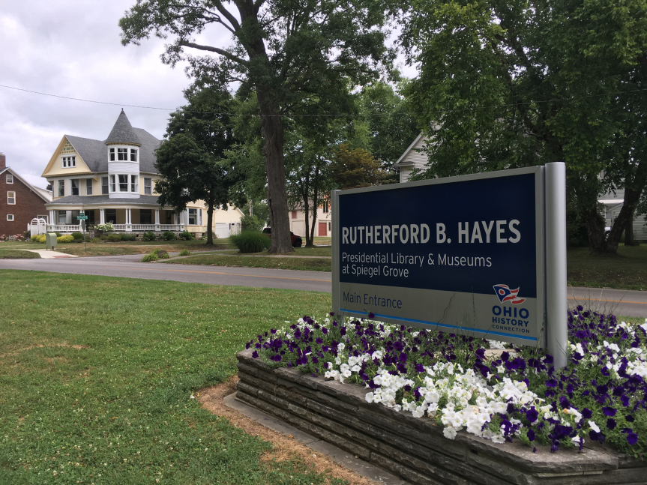
Notes:
1st Presidential Library

Slide 86
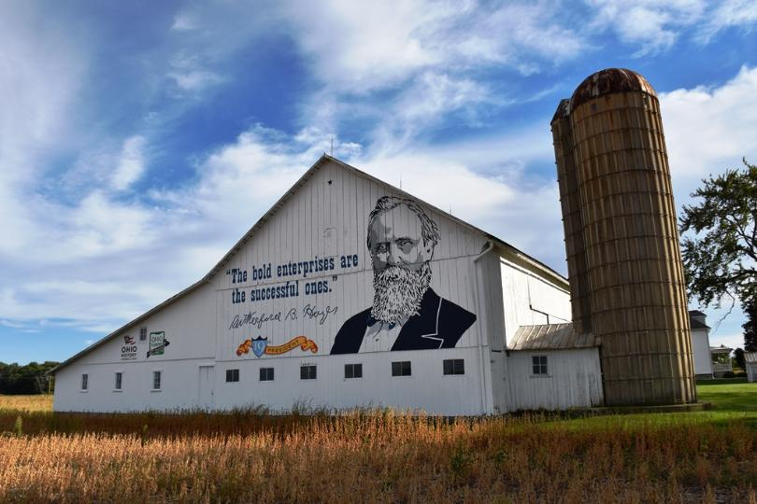
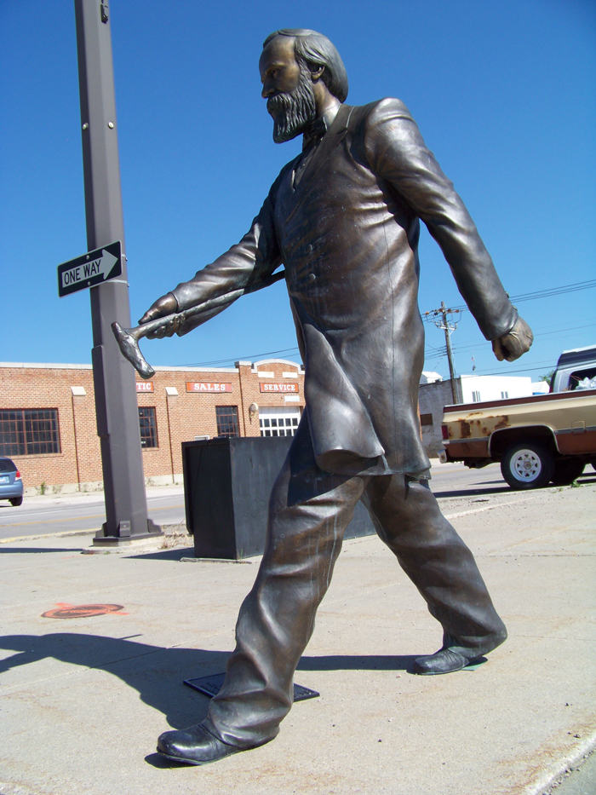

Slide 87
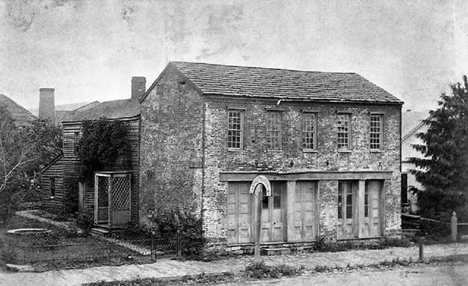
Notes:
Burned down in 1910

Slide 88
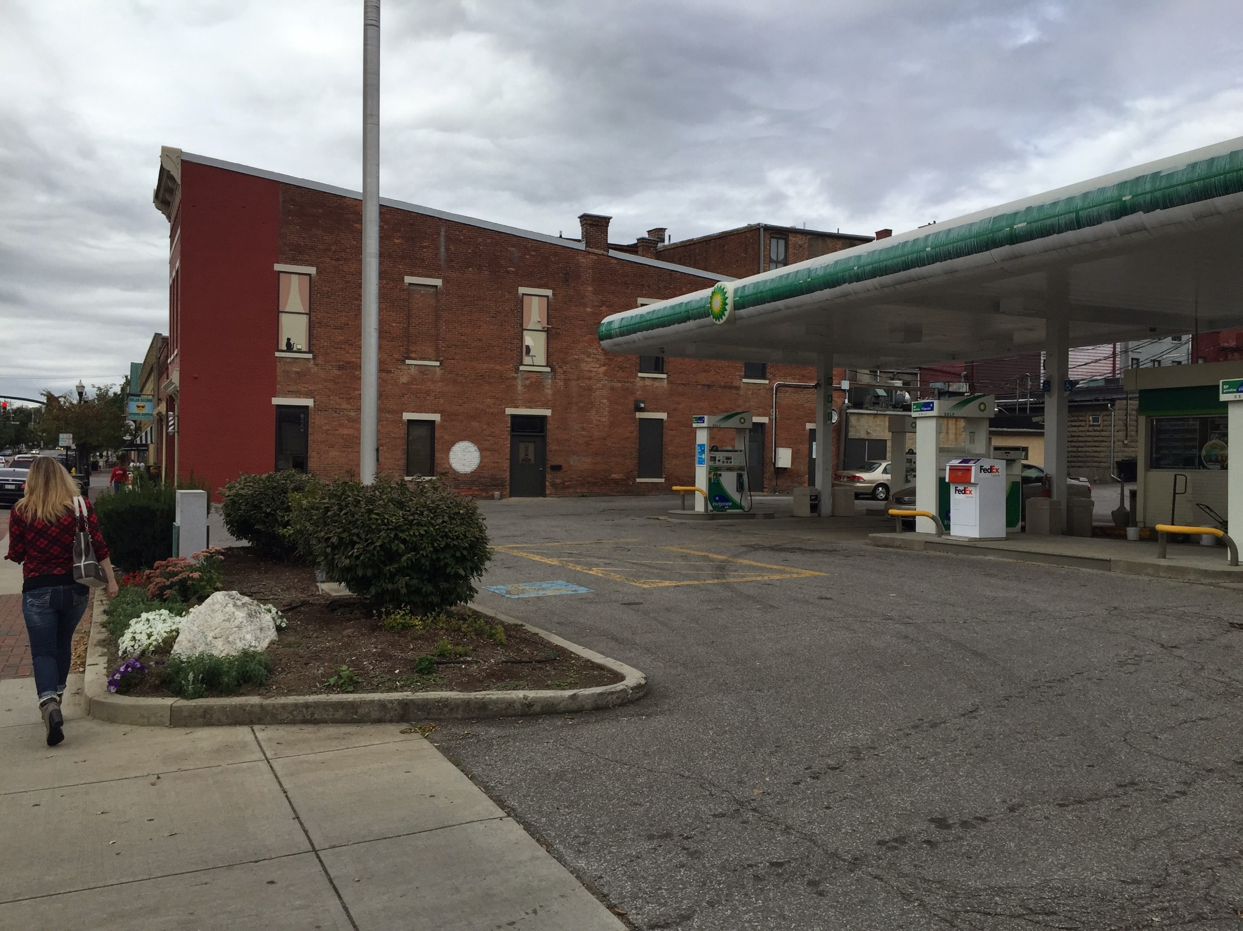

Slide 89
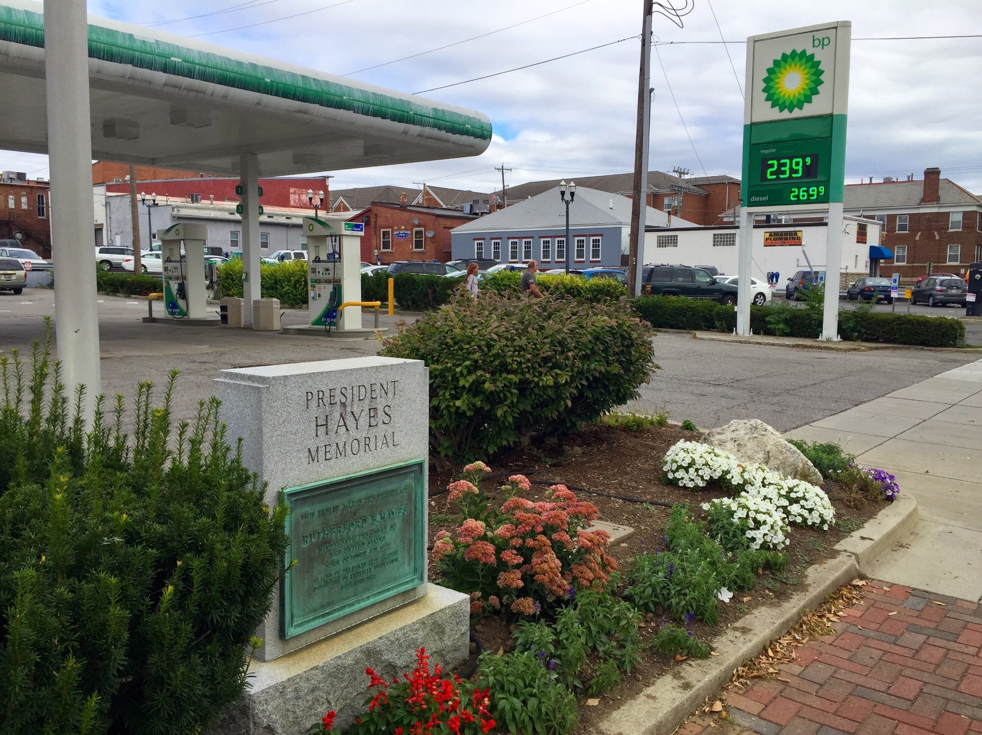

Slide 90
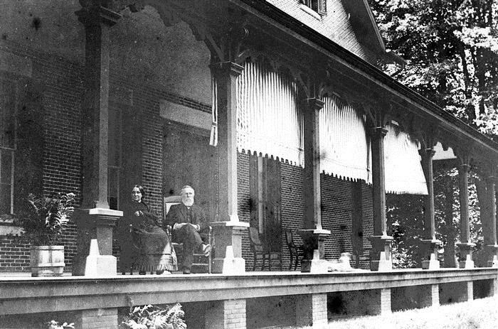

Slide 91
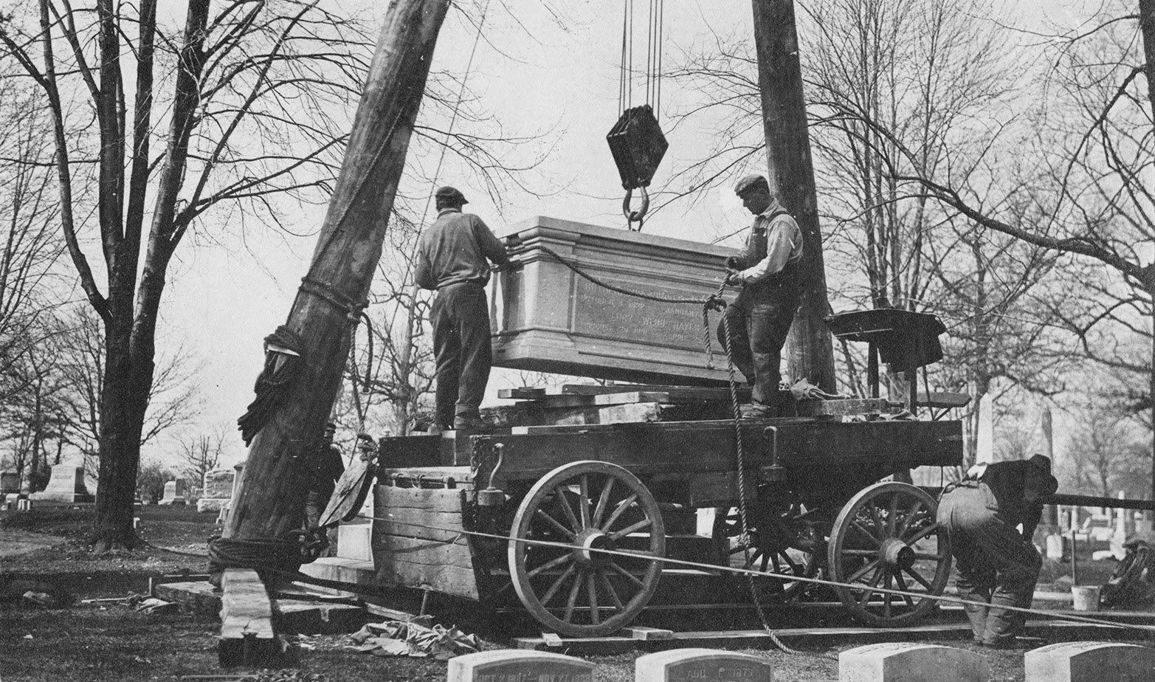

Slide 92
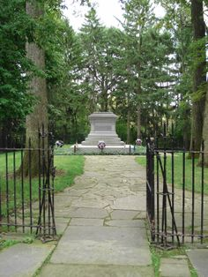
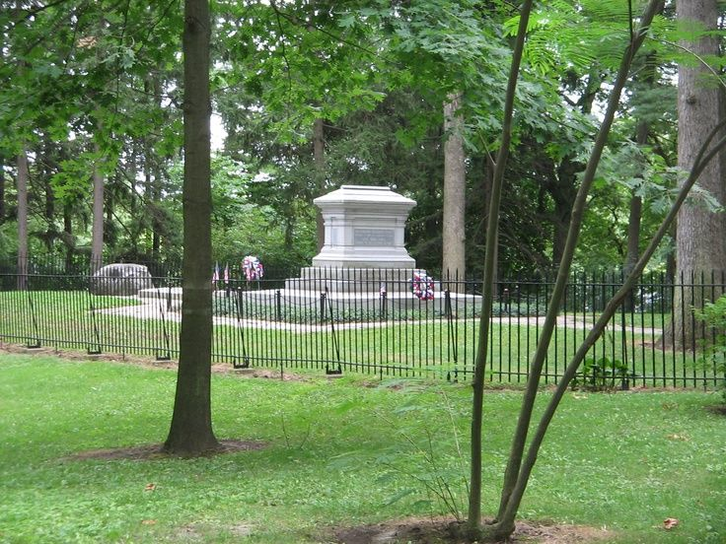
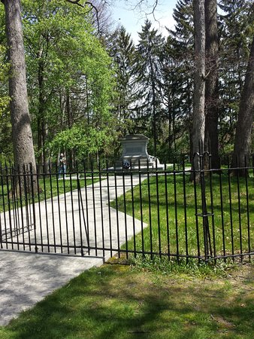
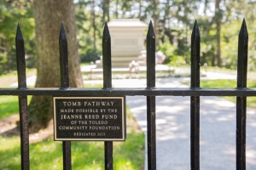
Notes:
Fremont, Ohio

Slide 93
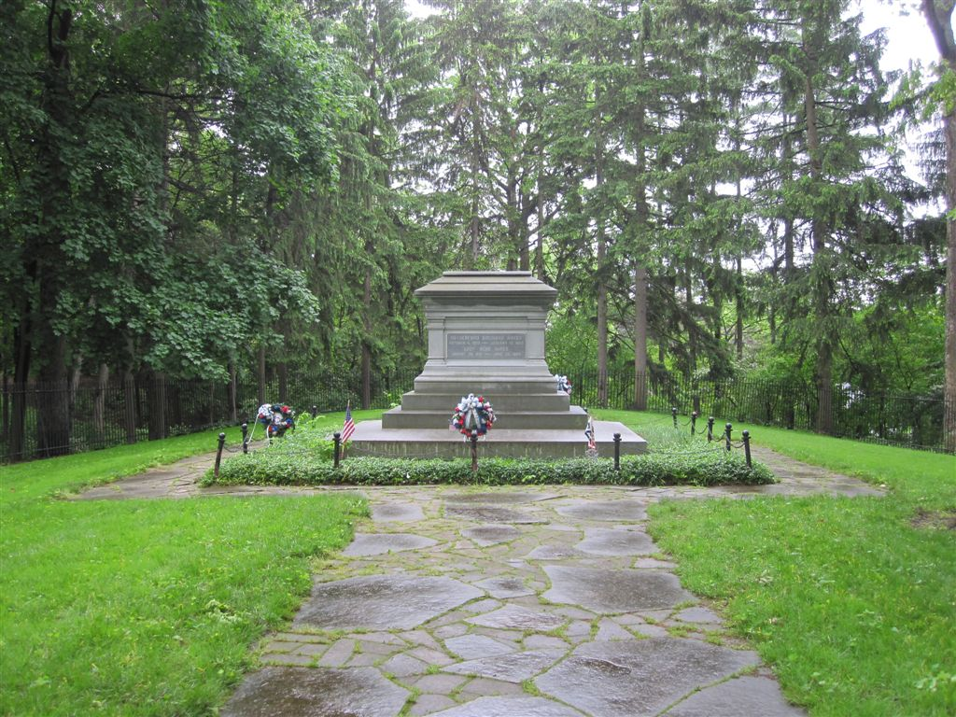

Slide 94
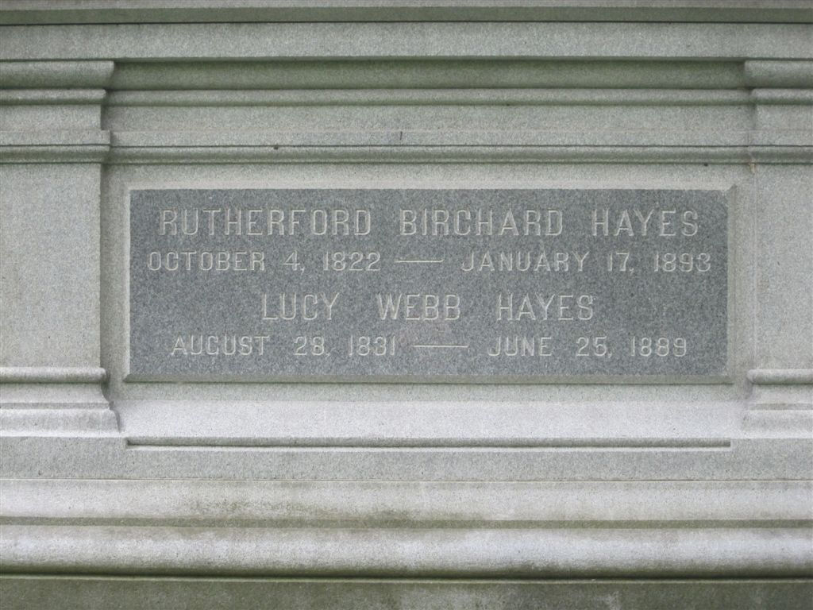

Slide 95
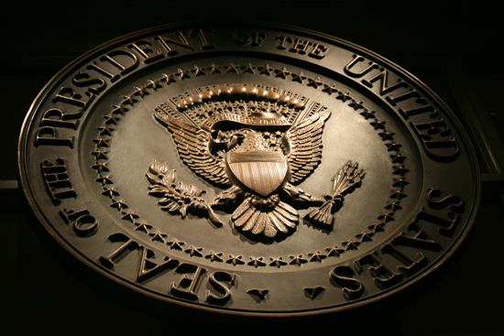
→ The Bible is the anchor and guide of true civilization
→ Contrast lies amid cautious loyal & ignorant fanatics
→ Free thought & religious duty builds our nation
→ Let public education remain free of all bias
→ Labor is the cement that builds a nations security
→ Religious bodies should not remain tax exempt?
→ Free government cannot exist under wealthy tyranny
→ Crime avalanches where education suffers
→ When rich dominate the poor, injustice screams out
→ Natural human nature is selfishness promoting evils
→ Conscience is the authentic voice of God to you
→ Cause of government & religion is best served apart
→ Bible exclusively expresses the infinite values of God
The crushed cry over the steps of tyranny
Notes:
The crushed cry over the steps of tyranny.

Slide 97
Please visit http://www.LoveFromGod.com to explore further
Ronald Bert Channel on
Notes:
Eternity never ends.

