Slide 2
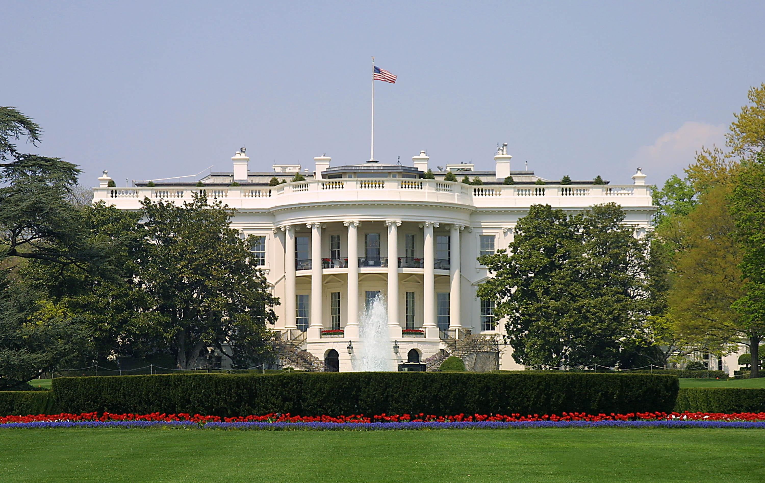
Presidential Quotes
Ron Bert
13
November 25, 2018

Slide 3
16. Abraham Lincoln (1861-1865)
Part 11

Slide 4
“The best thing about the future is that it comes one day at a time.”

Slide 5
"Therefore do not worry about tomorrow, for tomorrow will worry about its own things. Sufficient for the day is its own trouble." — Matthew 6:34

Slide 6
“Surely He intends some great good to follow this mighty convulsion which no mortal could make, and no mortal could stay.”

Slide 7
I wrote to you in my epistle not to keep company with sexually immoral people. Yet I certainly did not mean with the sexually immoral people of this world, or with the covetous, or extortioners, or idolaters, since then you would need to go out of the world. But now I have written to you not to keep company with anyone named a brother, who is sexually immoral, or covetous, or an idolater, or a reviler, or a drunkard, or an extortioner - not even to eat with such a person. — 1st Corinthians 5:9-11
would need to go out of the world

Slide 8
Submitted to the Sec. of War. - “On principle I dislike an oath which requires a man to swear he has not done wrong. It rejects the Christian principle of forgiveness on terms of repentance. I think it is enough if the man does no wrong hereafter.”
forgiveness
on terms of repentance
no wrong hereafter

Slide 9
Afterward Jesus found him in the temple, and said to him, "See, you have been made well. Sin no more, lest a worse thing come upon you." — John 5:14
Sin no more

Slide 10
“The Union is much older than the Constitution. It was formed in fact, by the Articles of Association in 1774. It was matured and continued by the Declaration of Independence in 1776.”

Slide 11
Two are better than one, Because they have a good reward for their labor. For if they fall, one will lift up his companion. But woe to him who is alone when he falls, For he has no one to help him up. Again, if two lie down together, they will keep warm; But how can one be warm alone? Though one may be overpowered by another, two can withstand him. And a threefold cord is not quickly broken. — Ecclesiastes 4:9-12
a threefold cord is not quickly broken

Slide 12
“Do I not destroy my enemies when I make them my friends?”

Slide 13
Therefore if your enemy is hungry, feed him; If he is thirsty, give him drink; For in so doing you will heap coals of fire on his head. — Romans 12:20

Slide 14
"We are not enemies, but friends. We must not be enemies. Though passion may have strained, it must not break our bonds of affection. The mystic chords of memory, stretching from every battle-field, and patriot grave, to every living heart and hearth-stone, all over this broad land, will yet swell the chorus of the Union, when again touched, as surely they will be, by the better angels of our nature.”
holiness
our nature

Slide 15
“I do the very best I can, I mean to keep going. If the end brings me out all right, then what is said against me won't matter. If I'm wrong, ten angels swearing I was right won't make a difference.”

Slide 16
“With the fearful strain that is on me night and day, if I did not laugh I should die.”

Slide 17
A merry heart does good, like medicine, But a broken spirit dries the bones. — Proverbs 17:22
heart
heart

Slide 18
Even in laughter the heart may sorrow, And the end of mirth may be grief. — Proverbs 14:13
heart
heart

Slide 19
Sorrow is better than laughter, For by a sad countenance the heart is made better. — Ecclesiastes 7:3
Sorrow
heart
Sorrow

Slide 20
For in much wisdom is much grief, And he who increases knowledge increases sorrow. — Ecclesiastes 1:18
Sorrow

Slide 21
“In this sad world of ours sorrow comes to all and it often comes with bitter agony. Perfect relief is not possible except with time. You cannot now believe that you will ever feel better. But this is not true. You are sure to be happy again. Knowing this, truly believing it will make you less miserable now. I have had enough experience to make this statement.”

Slide 22
“In order to win a man to your cause, you must first reach his heart, the great high road to his reason.”
cause
his heart
the
his heart
his reason
life
his reason
salvation
the cause
senses

Slide 23
Every way of a man is right in his own eyes, But the Lord weighs the hearts. — Proverbs 21:2
heart
eyes
heart

Slide 24
Trust in the LORD with all your heart, And lean not on your own understanding; In all your ways acknowledge Him, And He shall direct your paths. — Proverbs 3:5-6
heart
lean
heart

Slide 25
For it is the God who commanded light to shine out of darkness, who has shone in our hearts to give the light of the knowledge of the glory of God in the face of Jesus Christ. — 2nd Corinthians 4:6
hearts
shine
in
hearts
heart
knowledge
in
in the face of Jesus Christ

Slide 26
But sanctify the Lord God in your hearts, and always be ready to give a defense to everyone who asks you a reason for the hope that is in you, with meekness and fear; ... — 1st Peter 3:15
sanctify the Lord
in
hearts
one
one is
for the hope
is
in

Slide 27
Jesus answered and said to him, "Most assuredly, I say to you, unless one is born again, he cannot see the kingdom of God." — John 3:3
one is
see

Slide 28
“He has a right to criticize, who has a heart to help.”

Slide 29
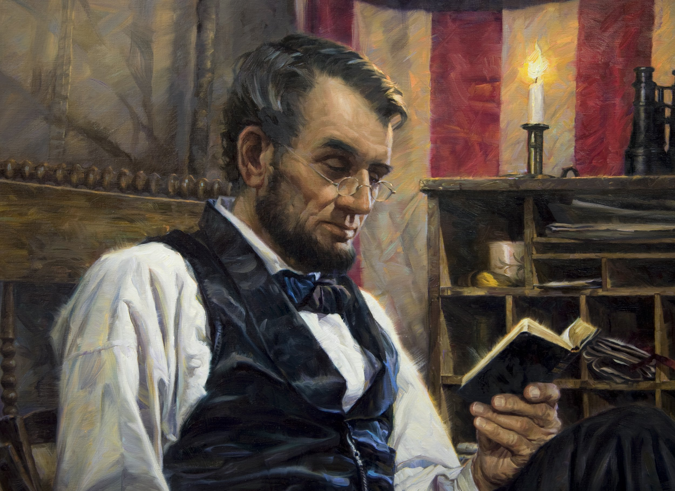
“Here in my heart, my happiness, my house. Here inside the lighted window is my love, my hope, my life. Peace is my companion on the pathway winding to the threshold. Inside this portal dwells new strength in the security, serenity, and radiance of those I love above life itself. Here two will build new dreams -- dreams that tomorrow will come true. The world over, these are the thoughts at eventide when footsteps turn ever homeward. In the haven of the hearthside is rest and peace and comfort.”
my
my
my
inside the light
my
my
hope
my
my
r
in
above
hope for peace
dreams that tomorrow will come true
fo
peace
Notes:
Great men have always had dreams that outlive the times.

Slide 30
"Behold, I stand at the door and knock. If anyone hears My voice and opens the door, I will come in to him and dine with him, and he with Me." — Revelation 3:20
Through wisdom a house is built, And by understanding it is established; By knowledge the rooms are filled With all precious and pleasant riches. — Proverbs 24:3-4
wisdom
is built
understanding
established
knowledge

Slide 31
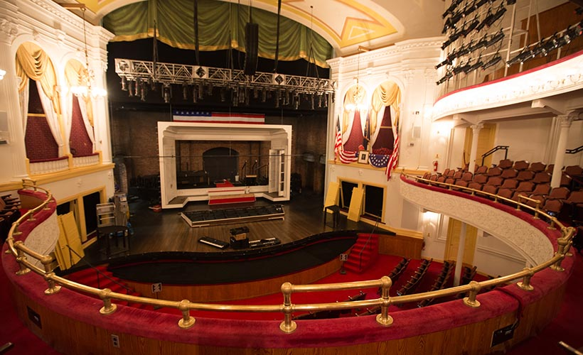

Slide 32
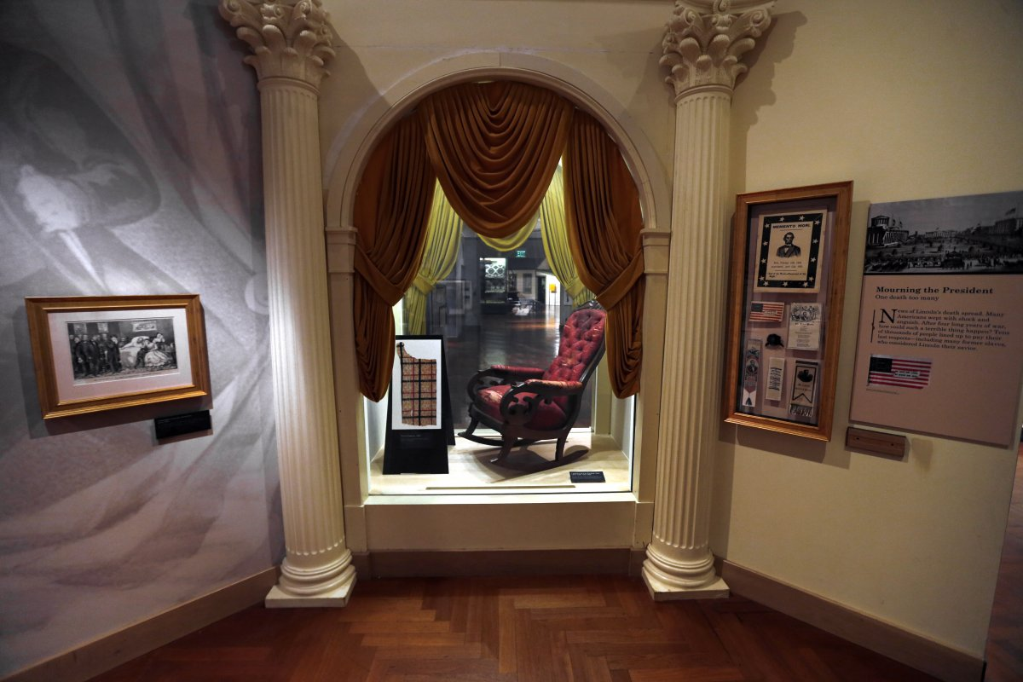

Slide 33
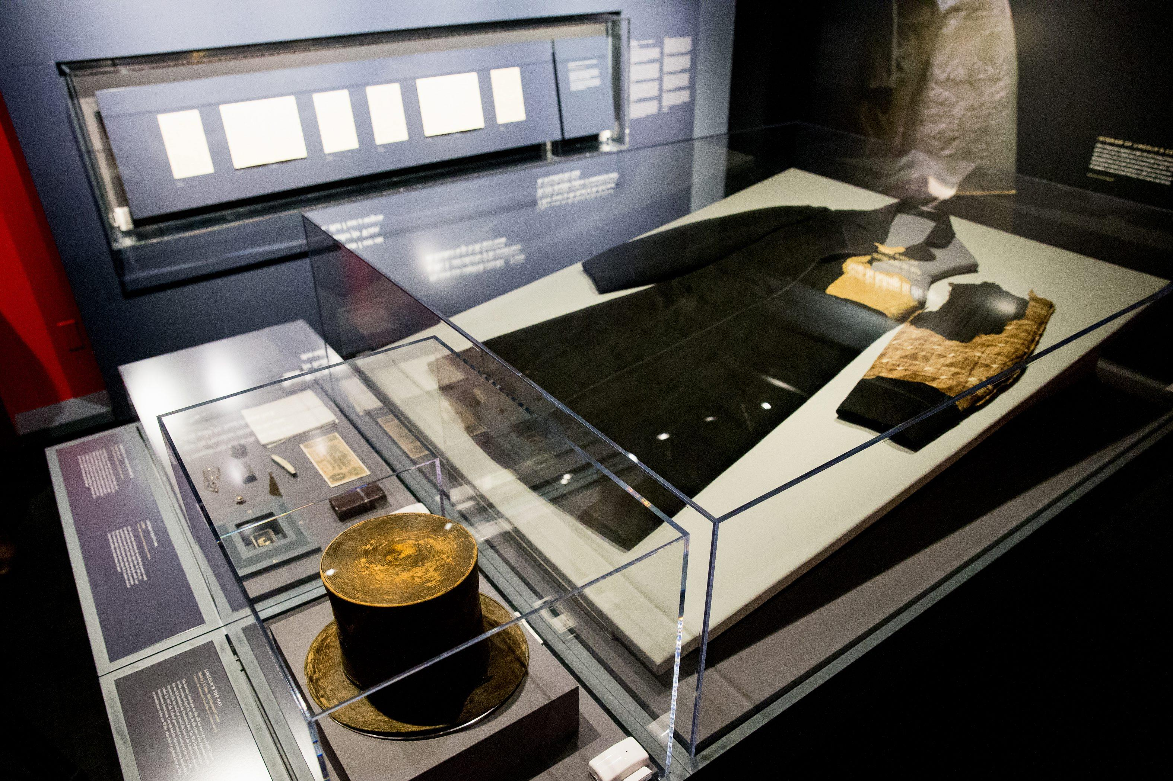

Slide 34
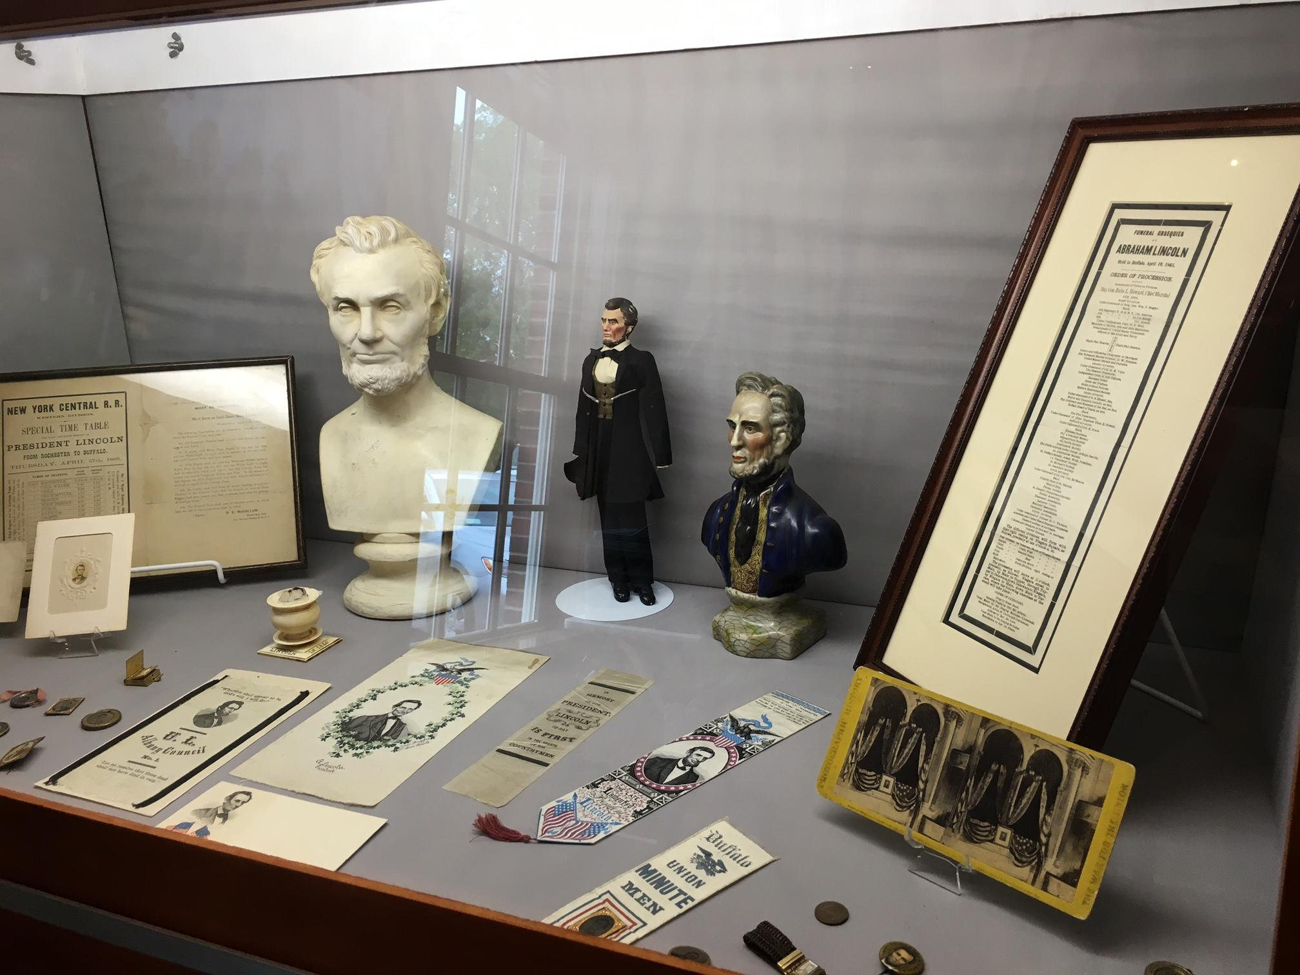

Slide 35
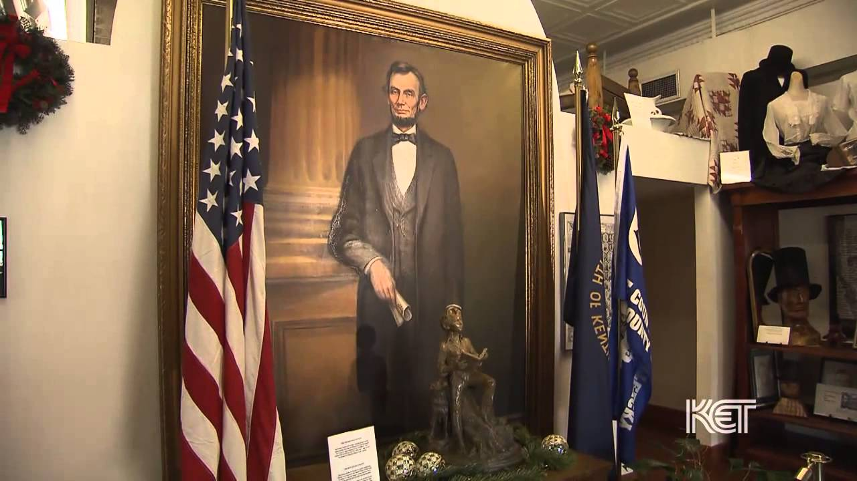

Slide 36
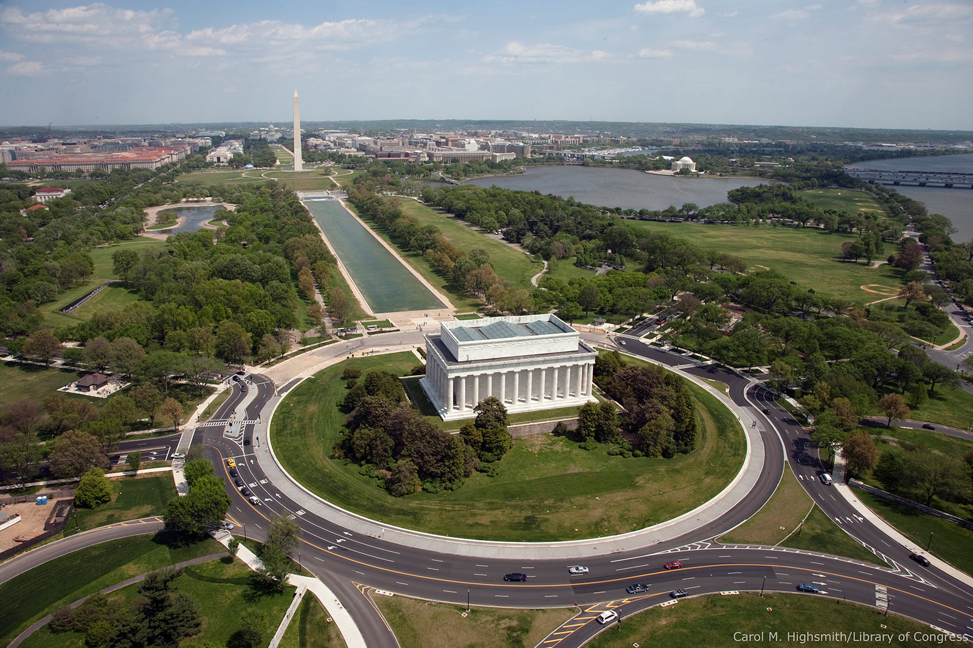

Slide 37
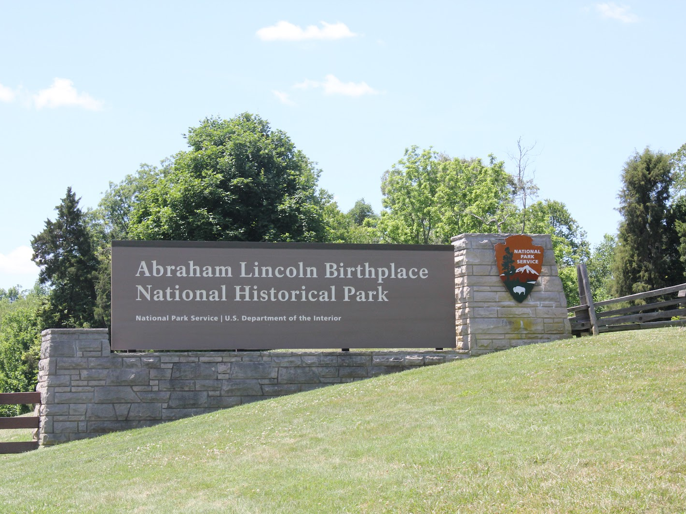

Slide 38
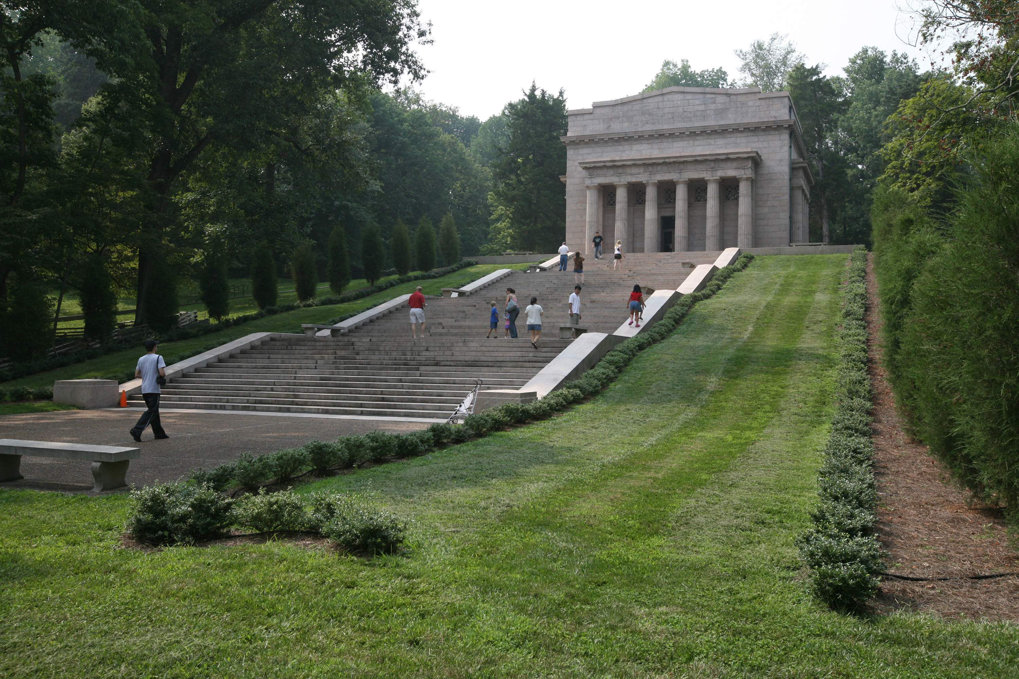

Slide 39
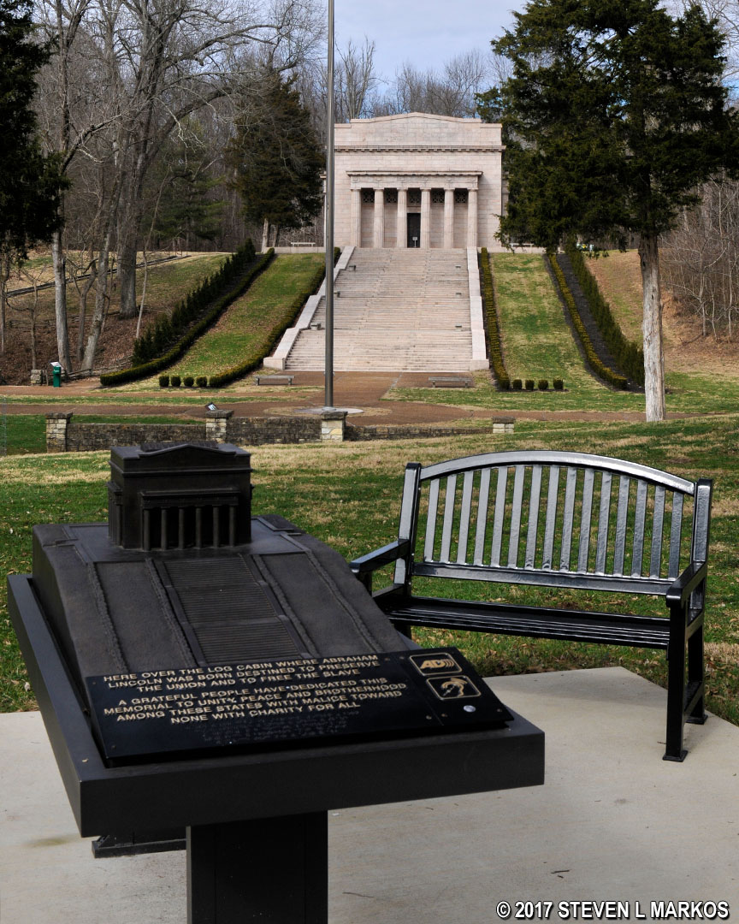

Slide 40
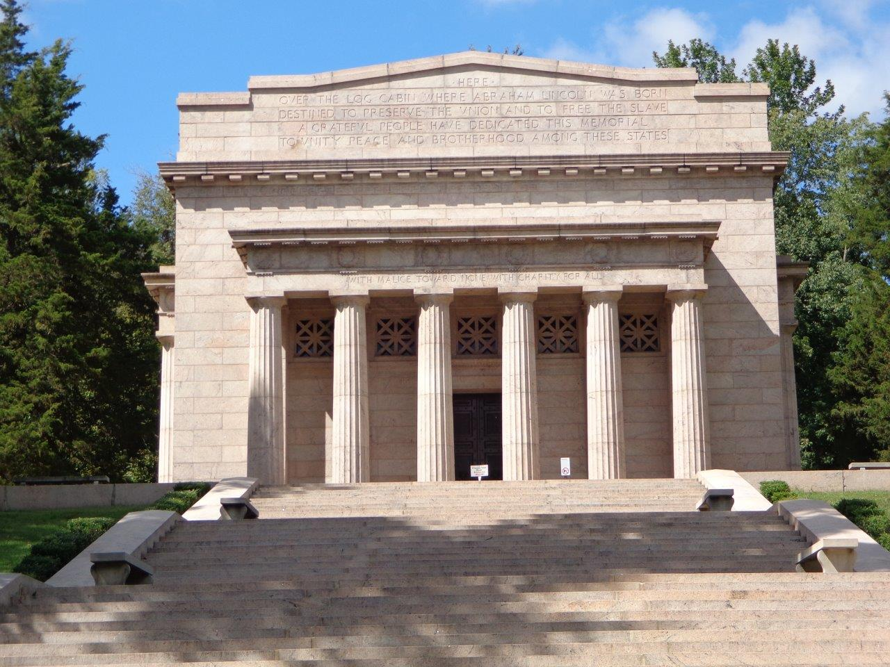

Slide 41
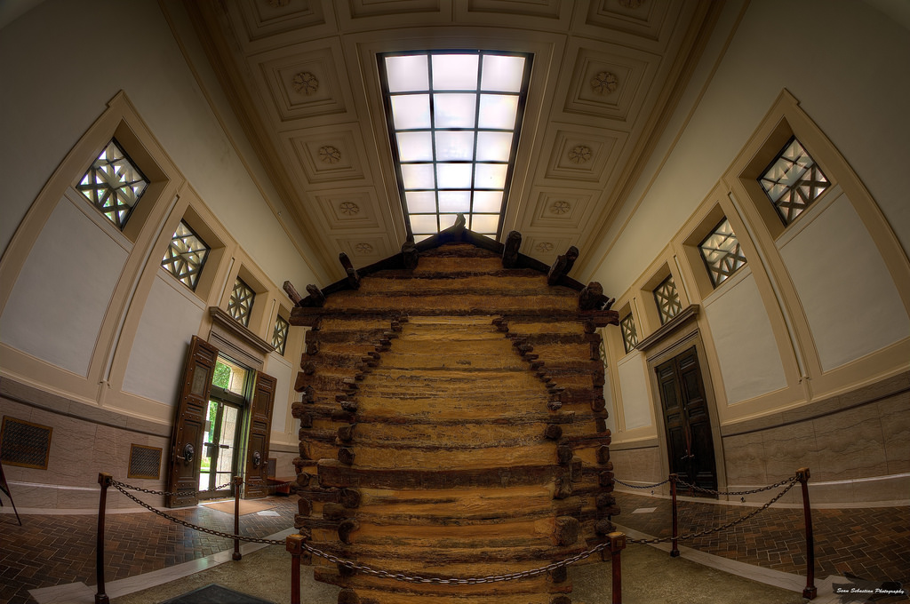

Slide 42
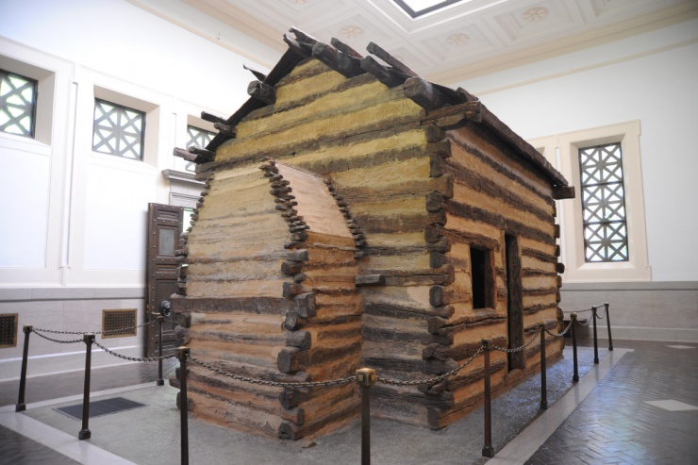

Slide 43
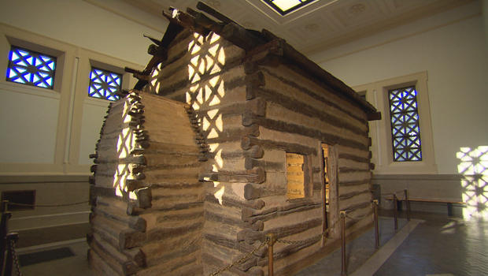

Slide 44
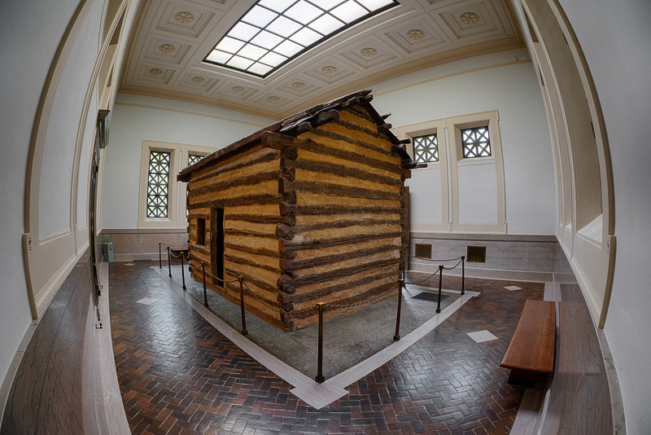

Slide 47
Notes:
Knob Creek Lincoln’s boyhood creek

Slide 48
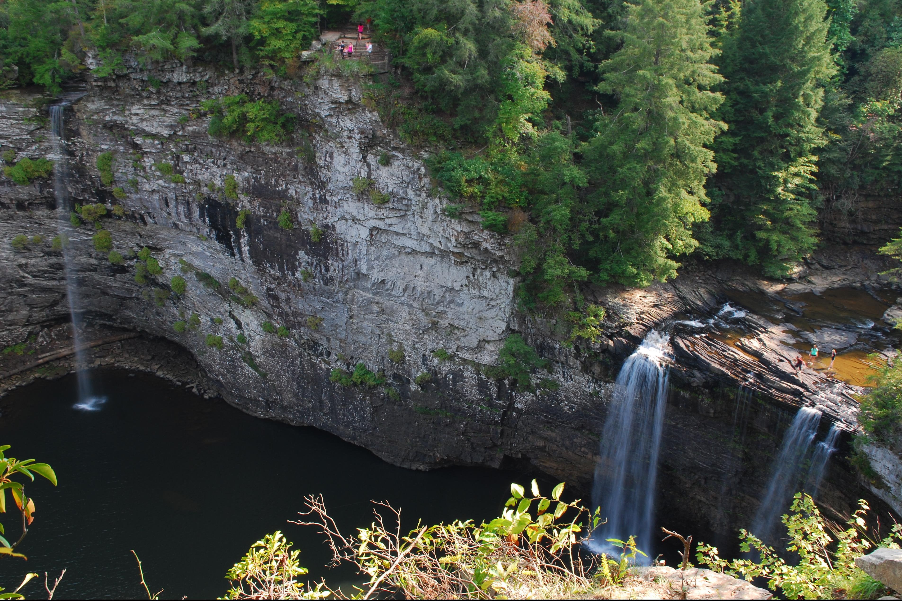

Slide 51
Presidential Quotes
Ron Bert
13½
December ??, 2018

Slide 52
16. Abraham Lincoln (1861-1865)
Part 12

Slide 53
“Character is like a tree and reputation like a shadow. The shadow is what we think of it; the tree is the real thing.”
Character

Slide 54
A good name is better than precious ointment, And the day of death than the day of one's birth; — Ecclesiastes 7:1

Slide 55
"Either make the tree good and its fruit good, or else make the tree bad and its fruit bad; for a tree is known by its fruit. — Matthew 12:33

Slide 56
For if anyone is a hearer of the word and not a doer, he is like a man observing his natural face in a mirror; for he observes himself, goes away, and immediately forgets what kind of man he was. — James 1:23-24

Slide 57
Listen to counsel and receive instruction, That you may be wise in your latter days. There are many plans in a man's heart, Nevertheless the LORD'S counsel-that will stand. — Proverbs 19:20-21

Slide 58
“You can fool all the people some of the time, and some of the people all the time, but you cannot fool all the people all the time.”

Slide 59
Some men's sins are clearly evident, preceding them to judgment, but those of some men follow later. — 1st Timothy 5:24

Slide 60
“I could write shorter sermons but when I get started I’m too lazy to stop.”

Slide 61
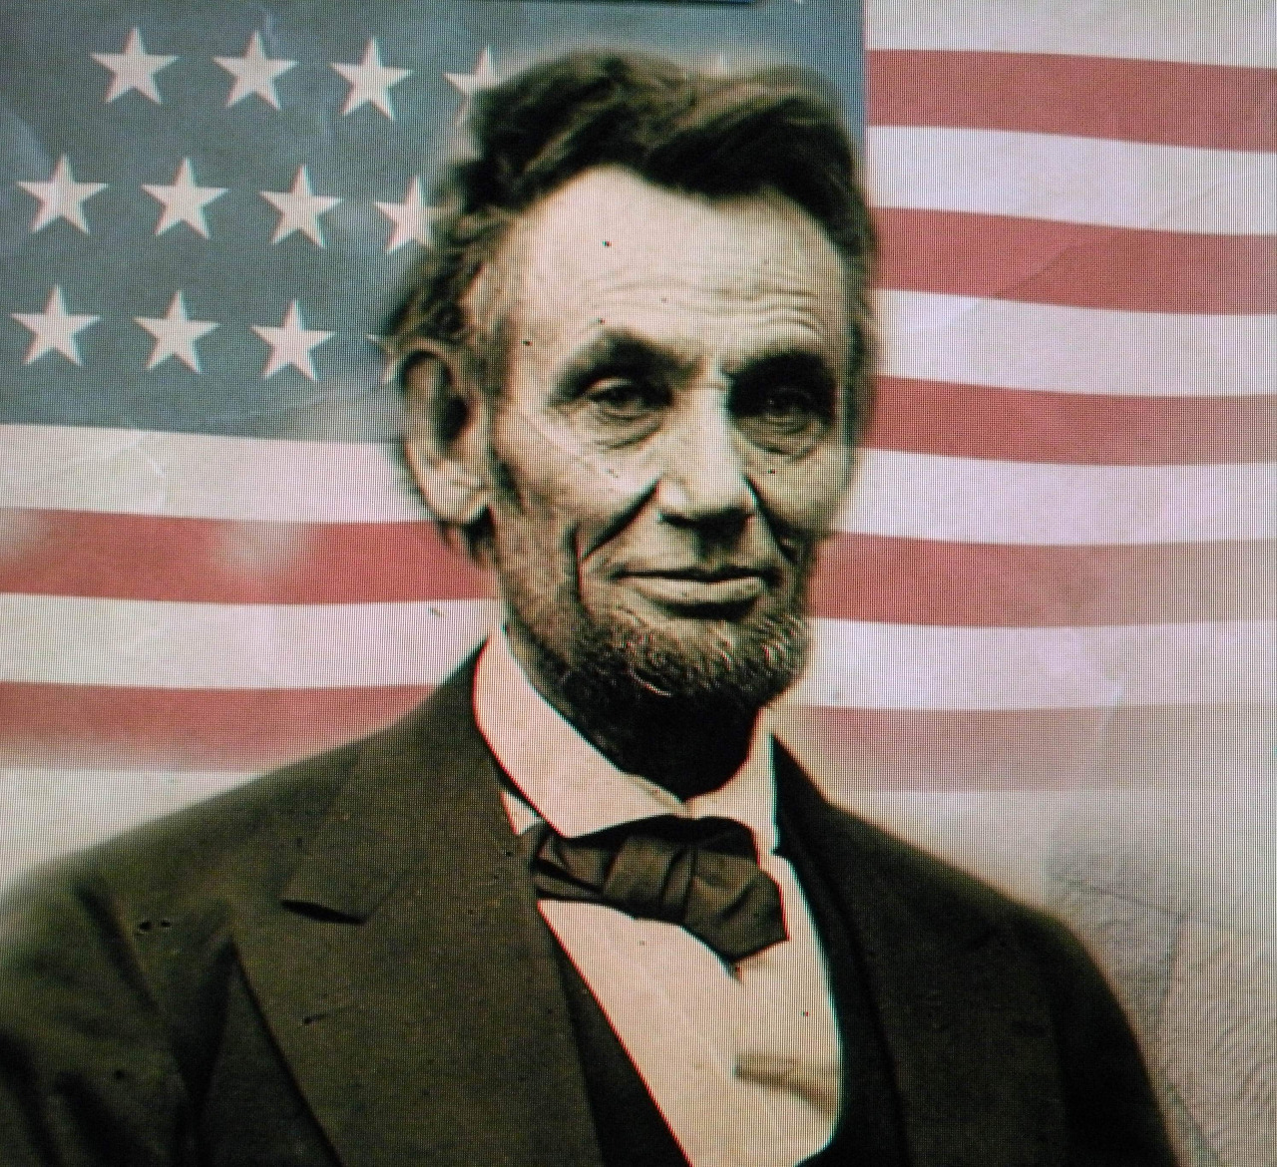
“I have endured a great deal of ridicule without much malice, and have received a great deal of kindness not quite free from ridicule."

Slide 62
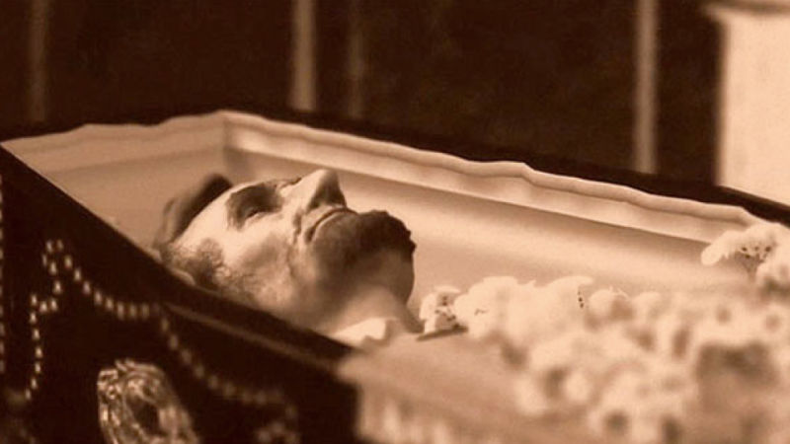

Slide 63
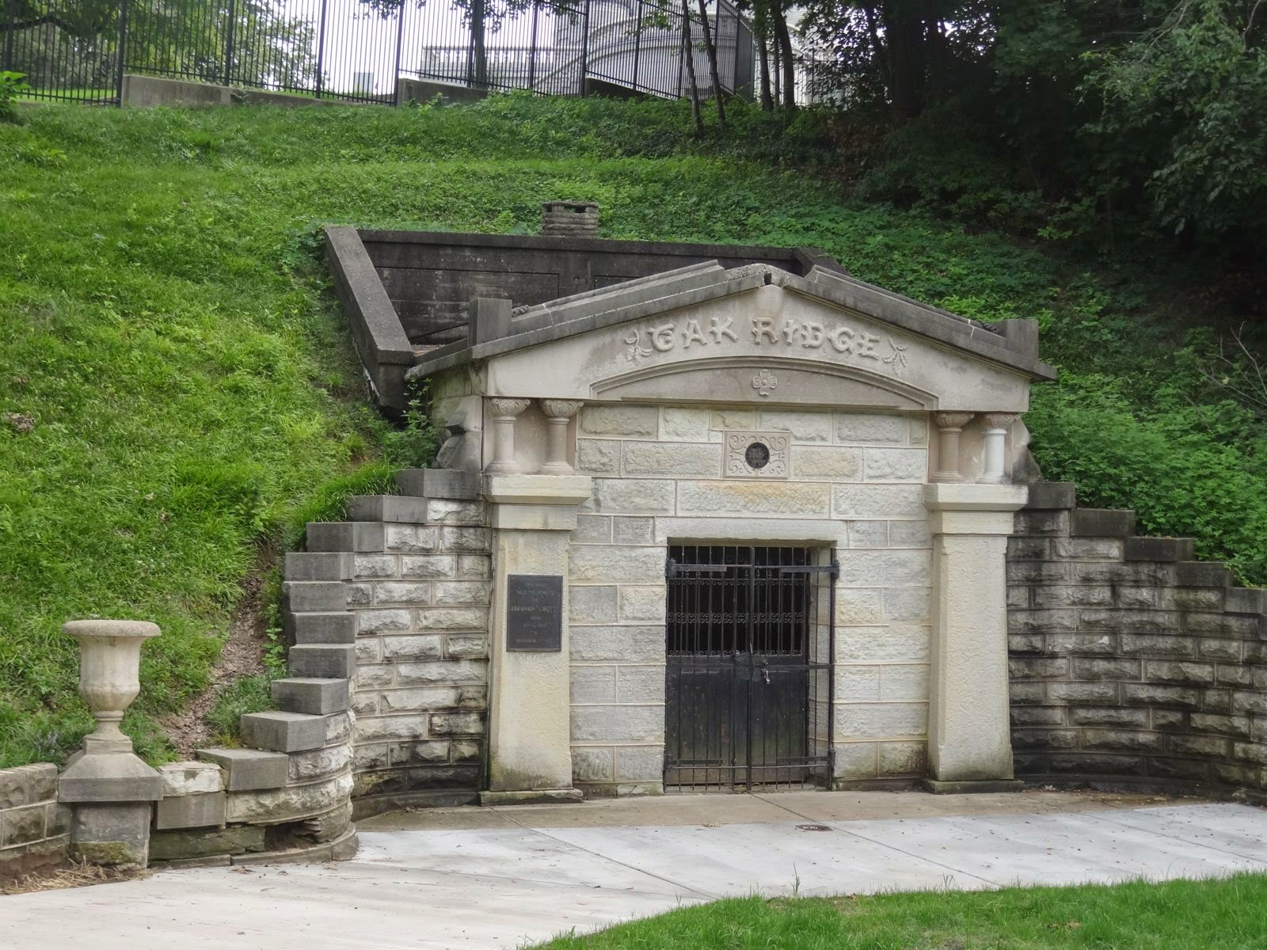

Slide 64
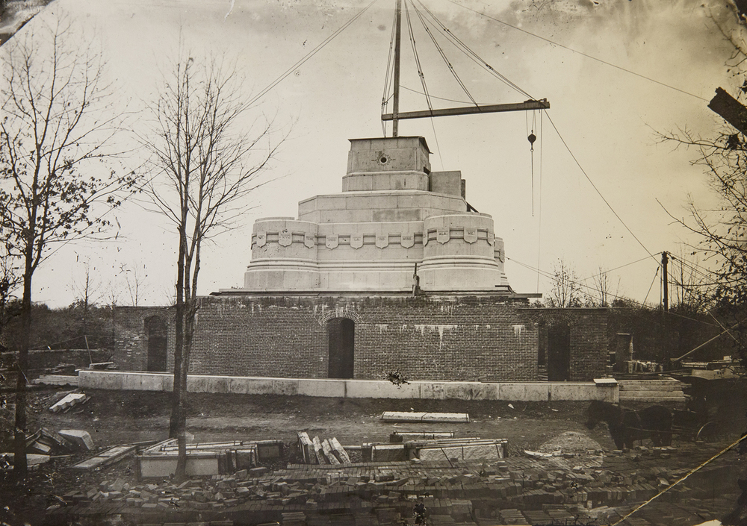

Slide 65
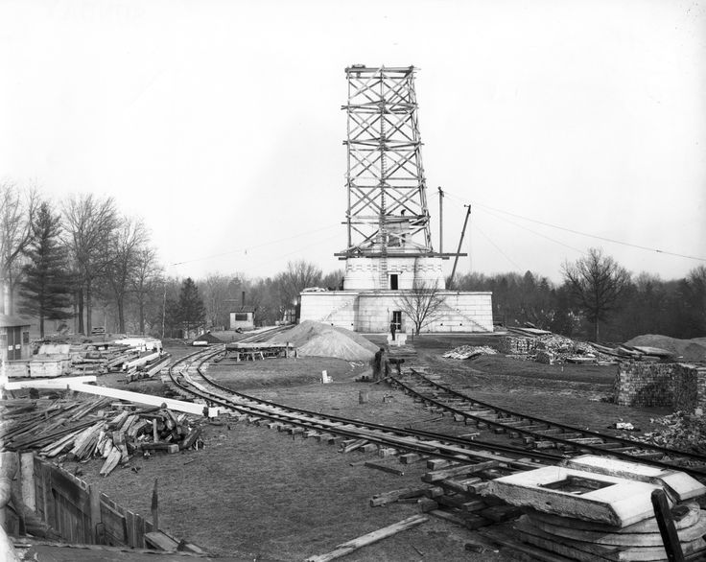

Slide 66
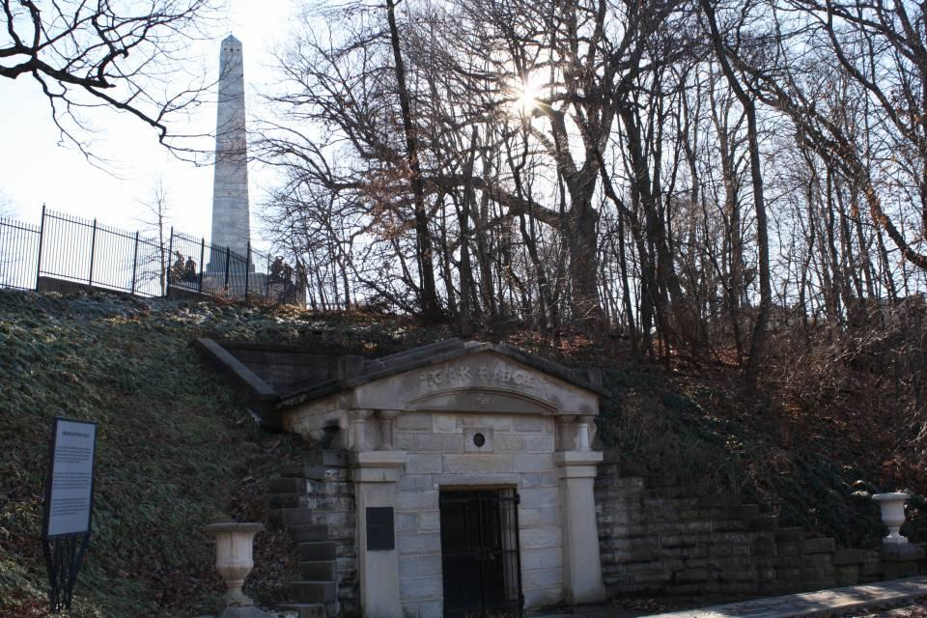
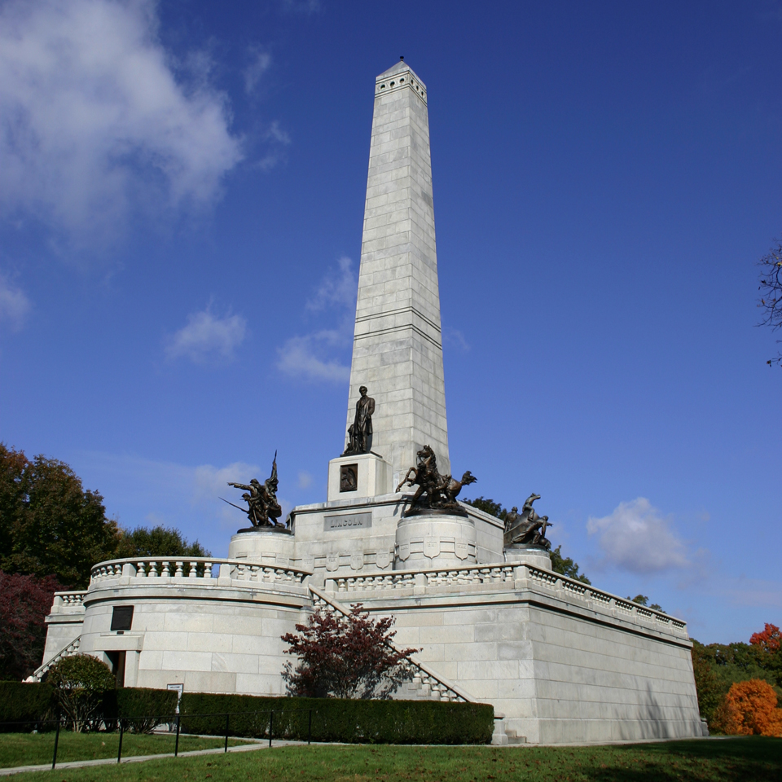

Slide 67
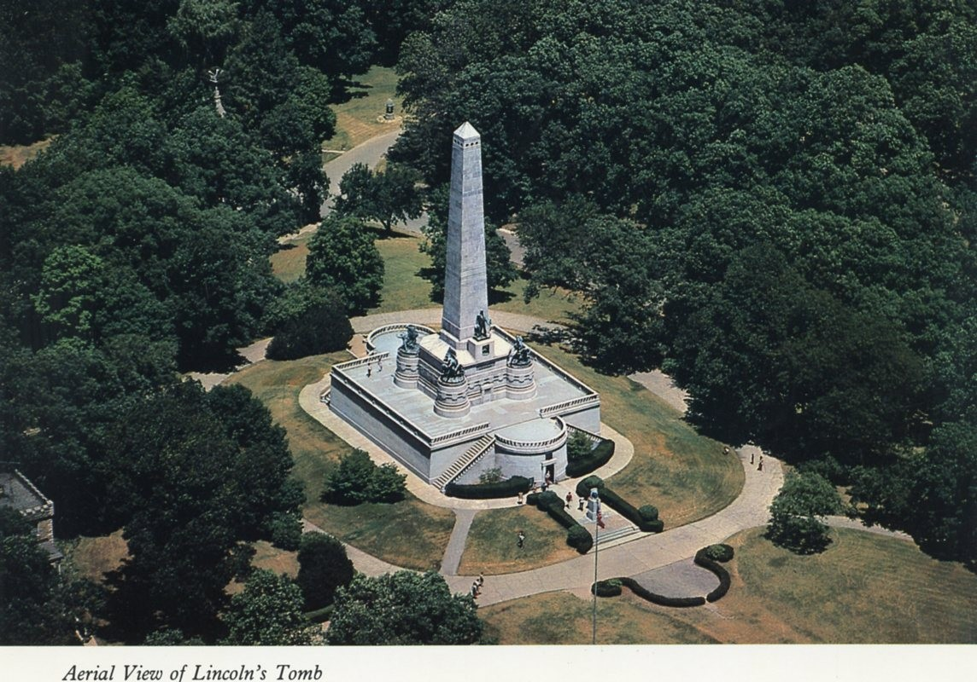

Slide 68
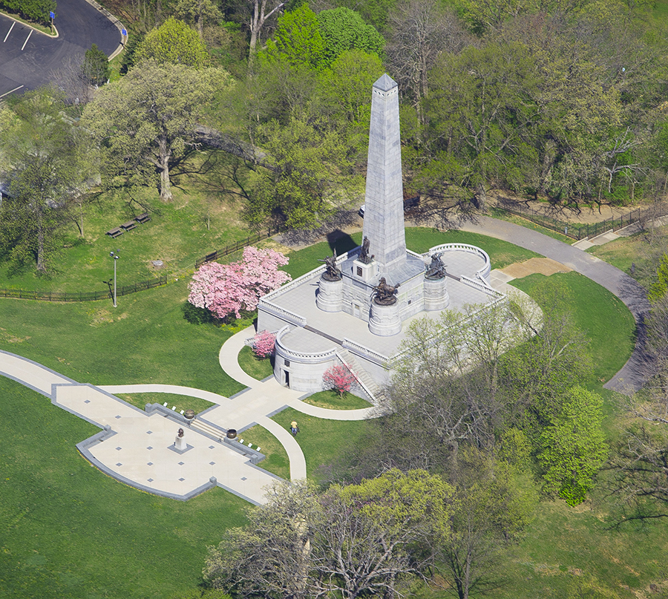

Slide 69
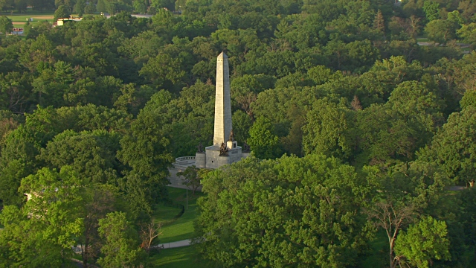

Slide 70
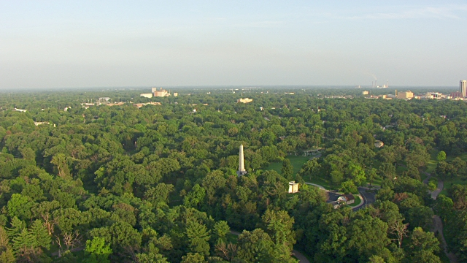

Slide 71
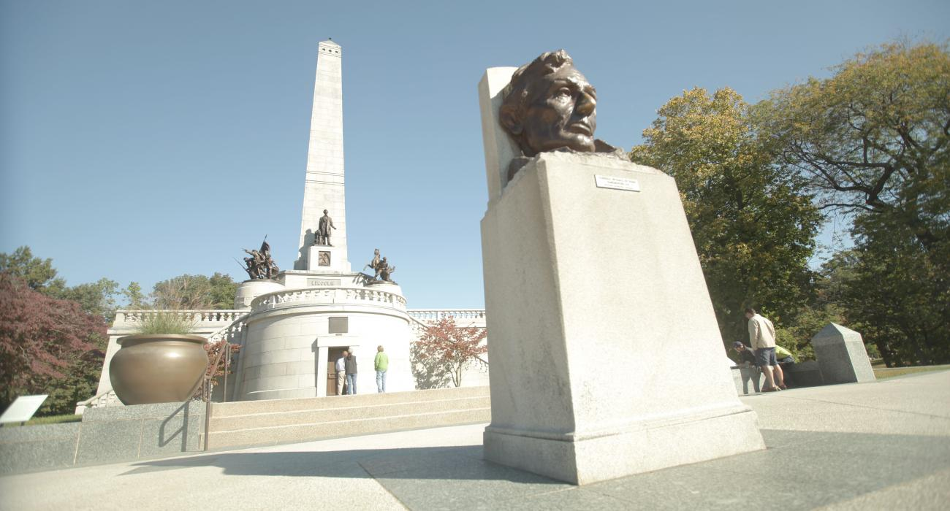

Slide 72
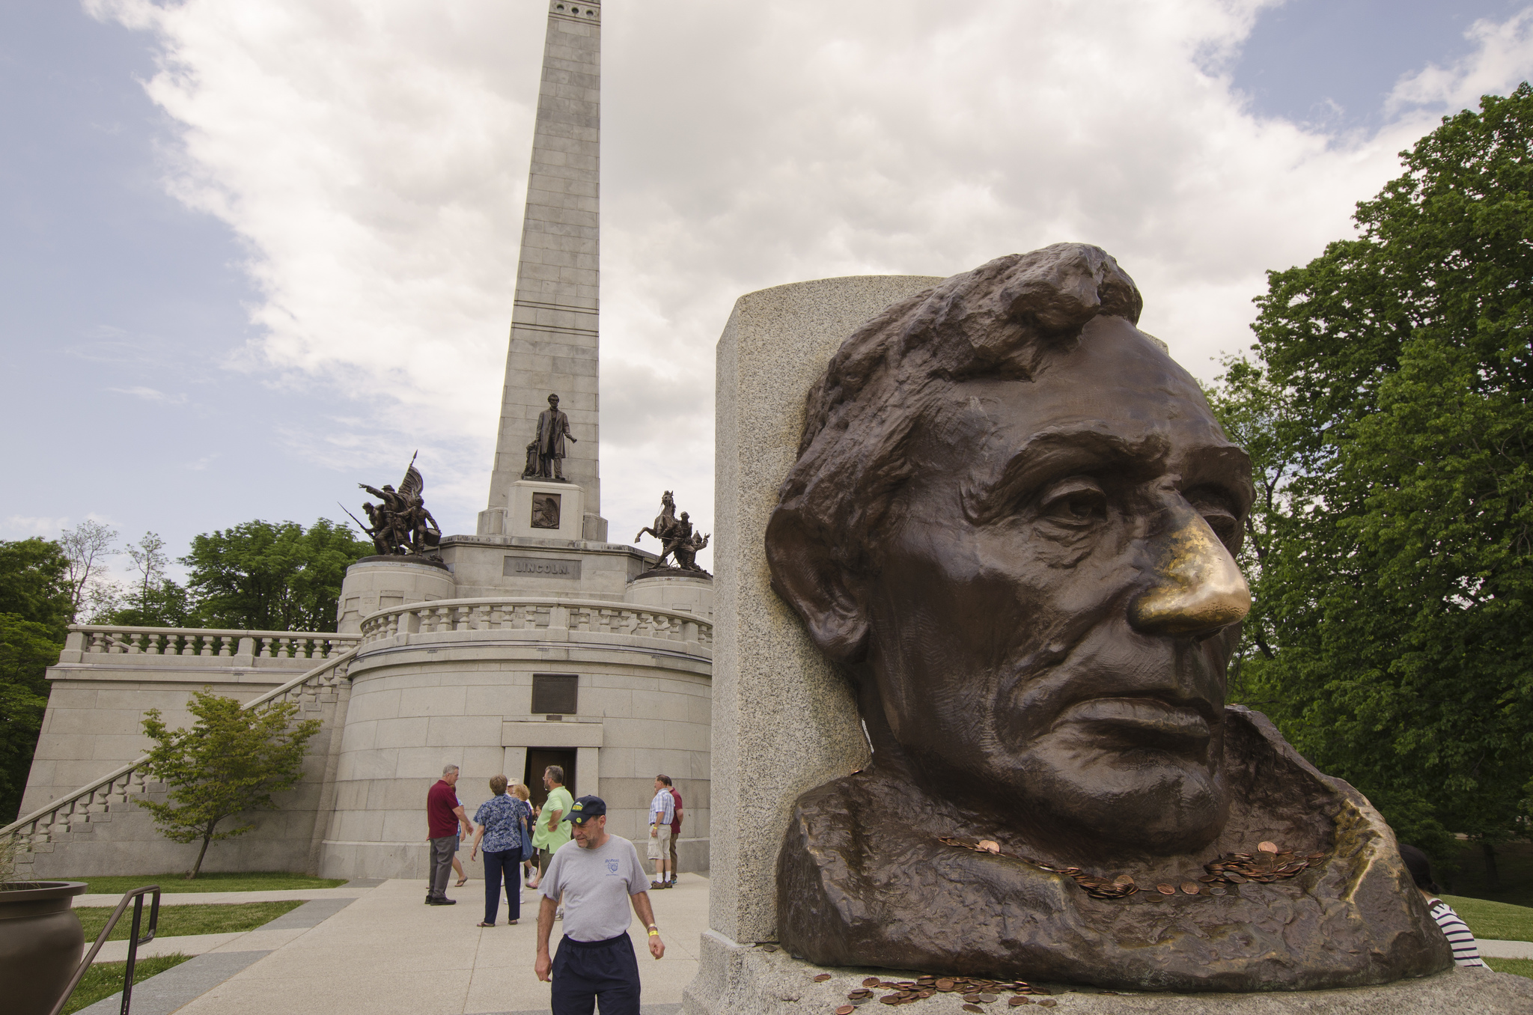

Slide 73
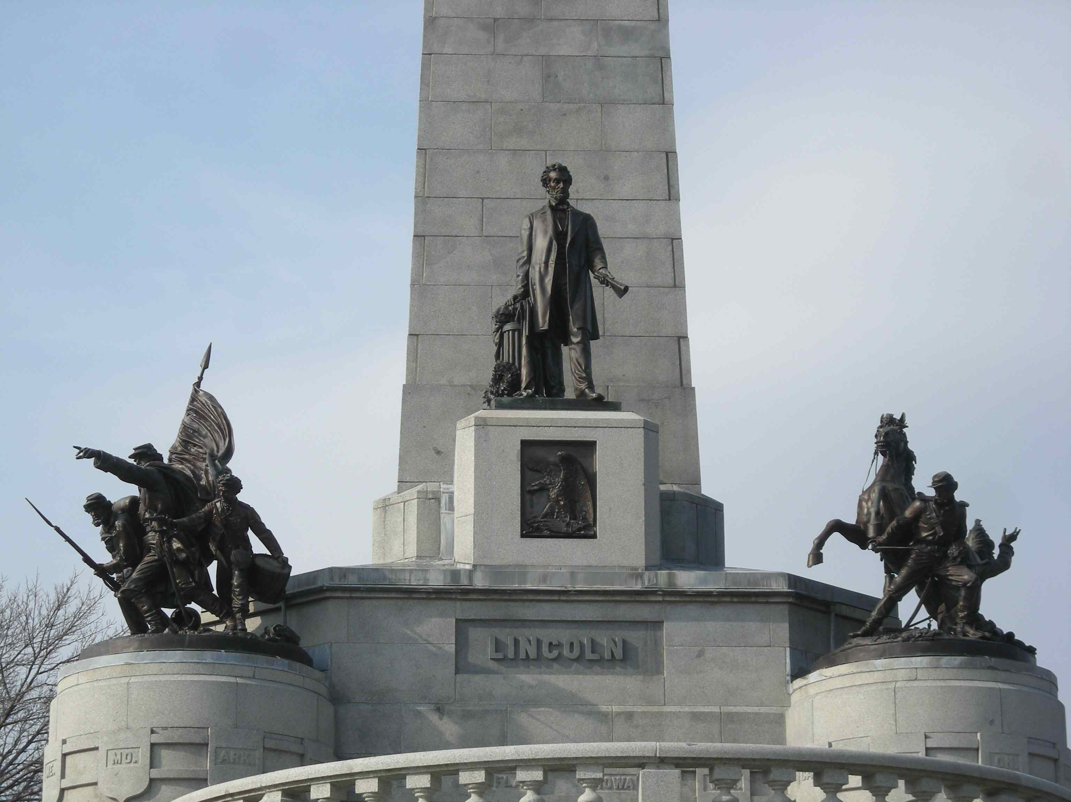

Slide 74
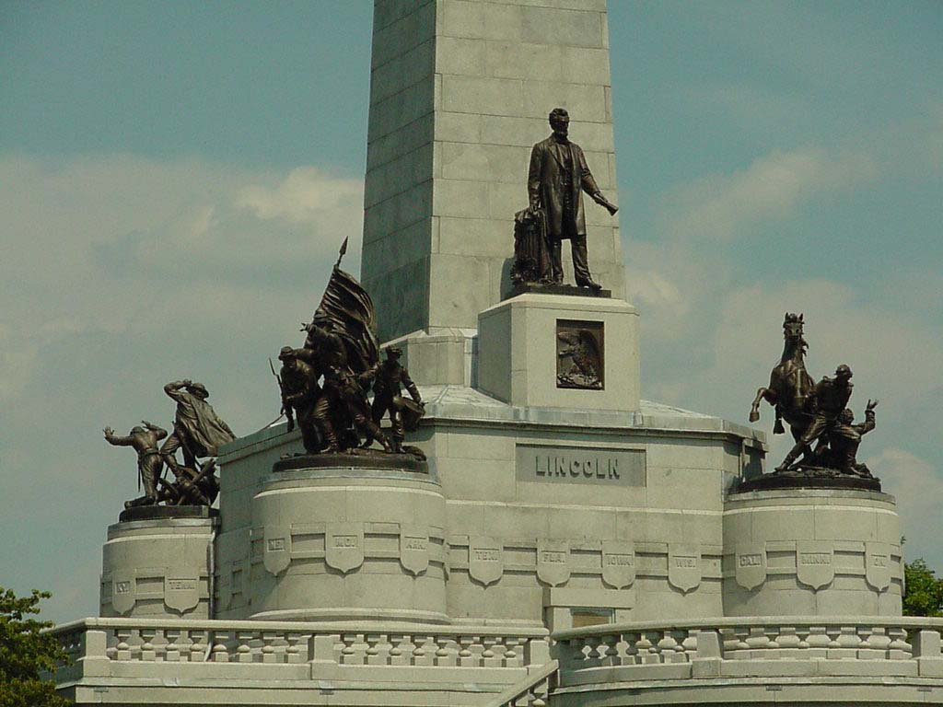

Slide 75
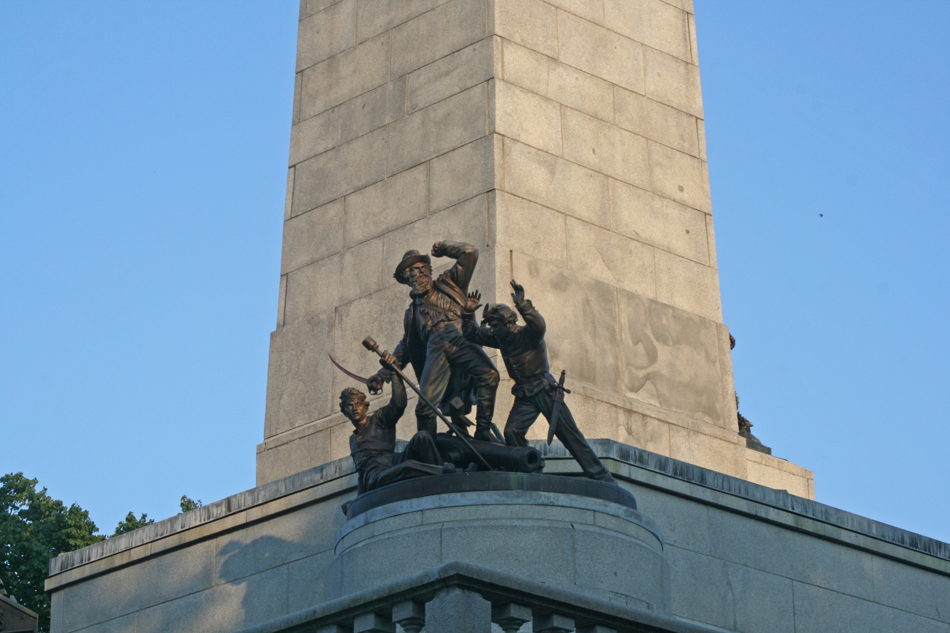

Slide 76
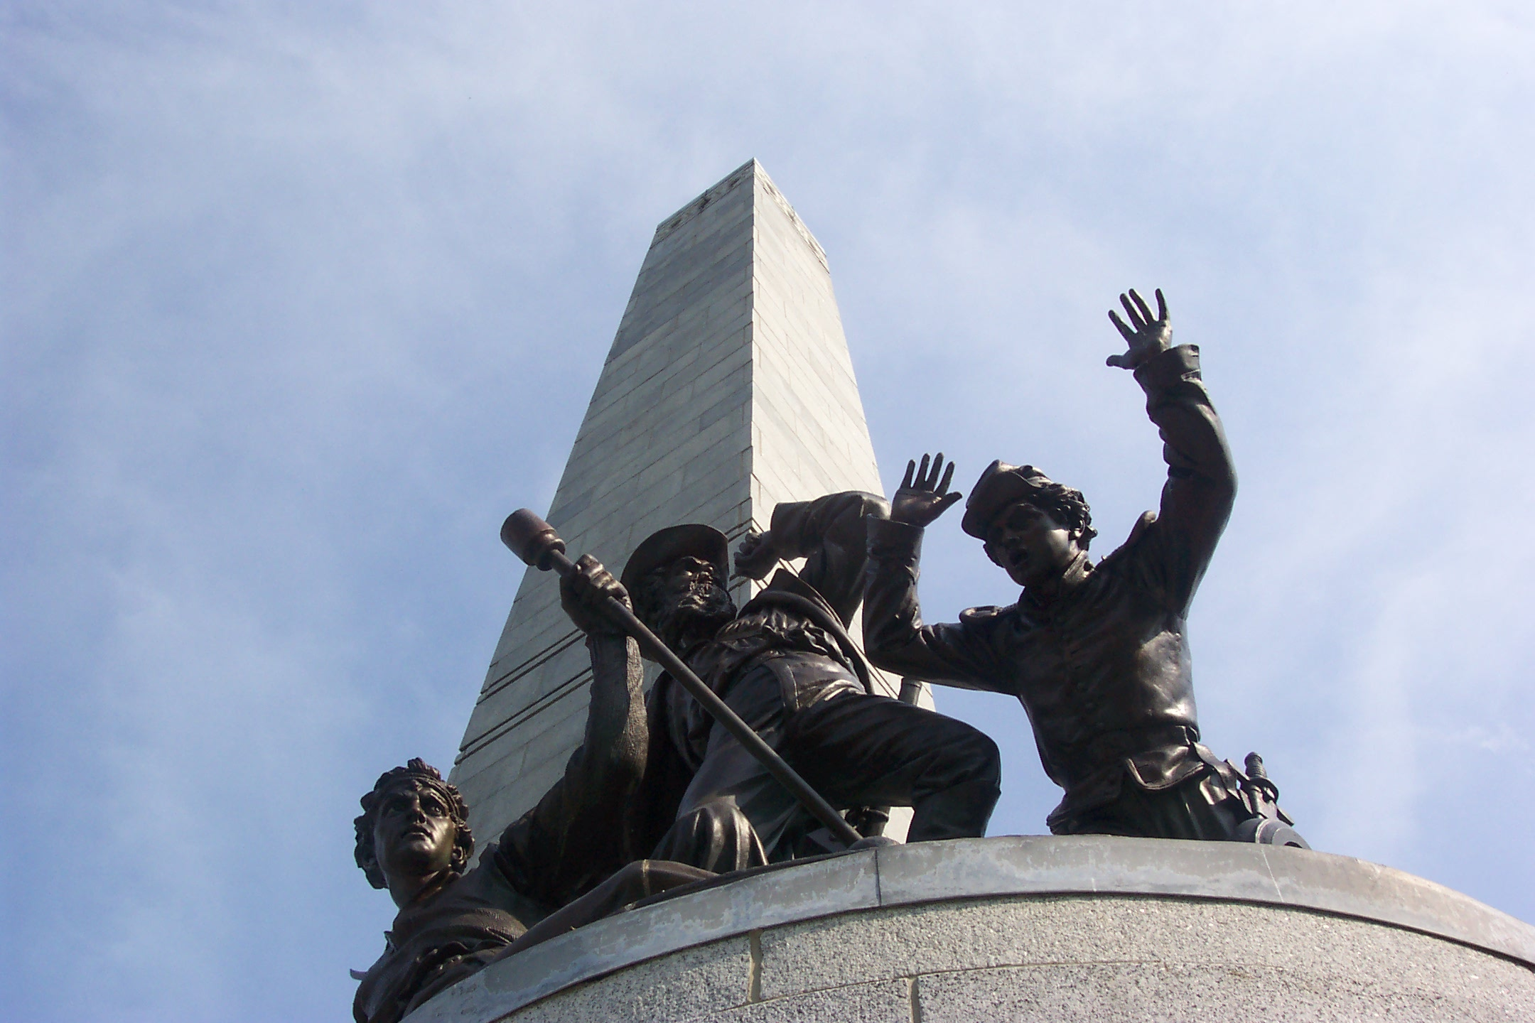
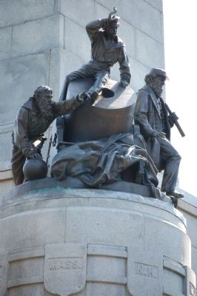

Slide 77
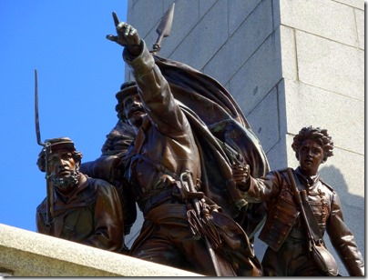
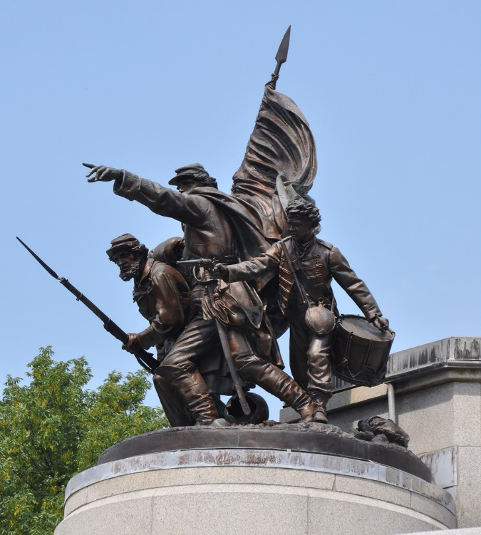
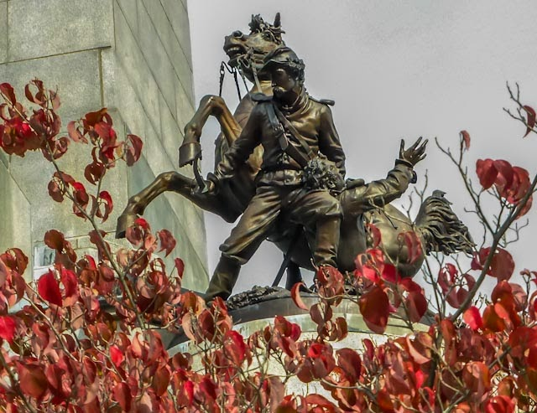

Slide 78
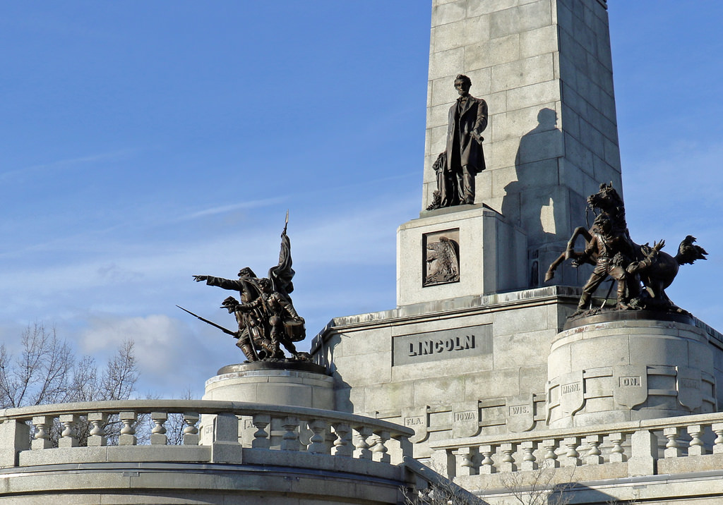
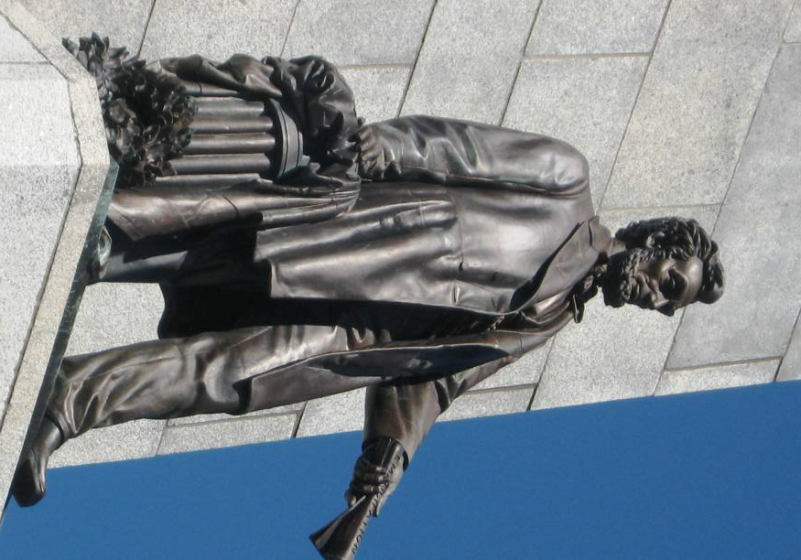

Slide 79
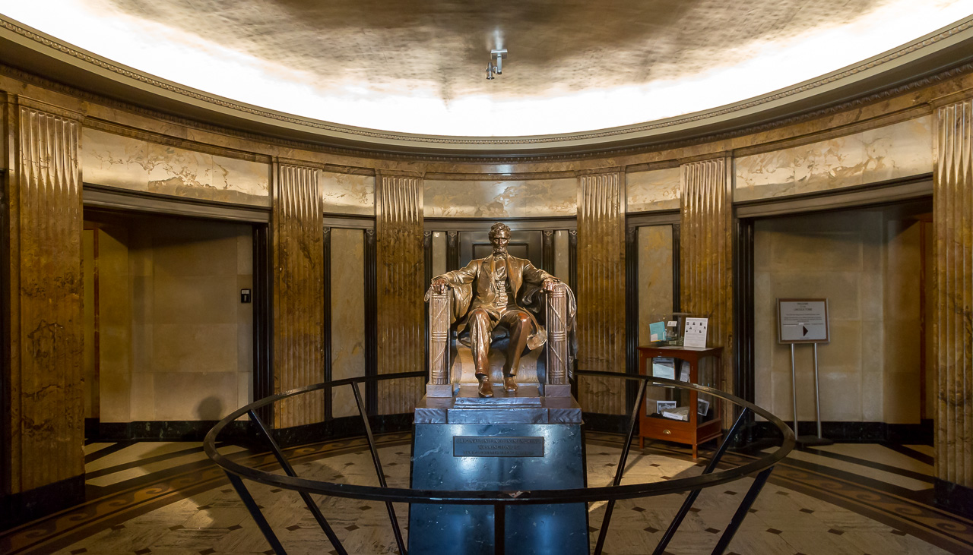

Slide 81
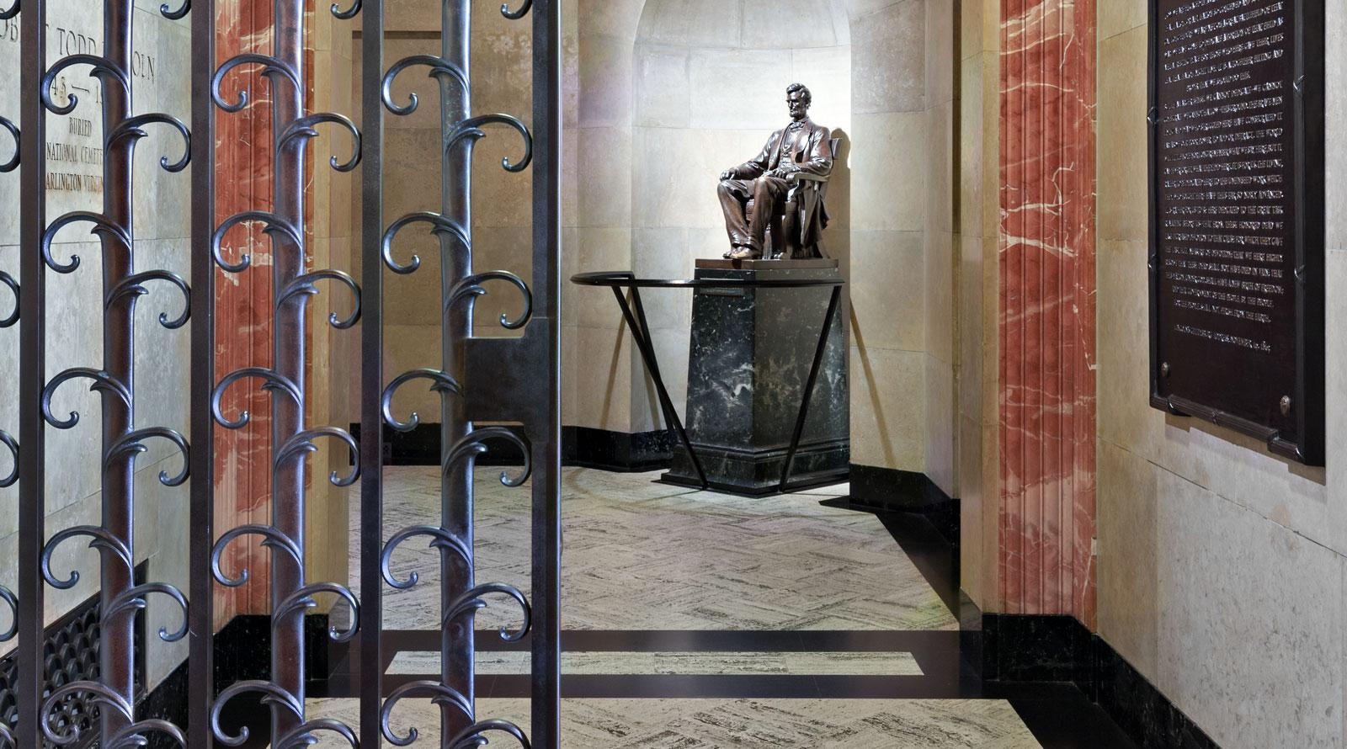

Slide 82
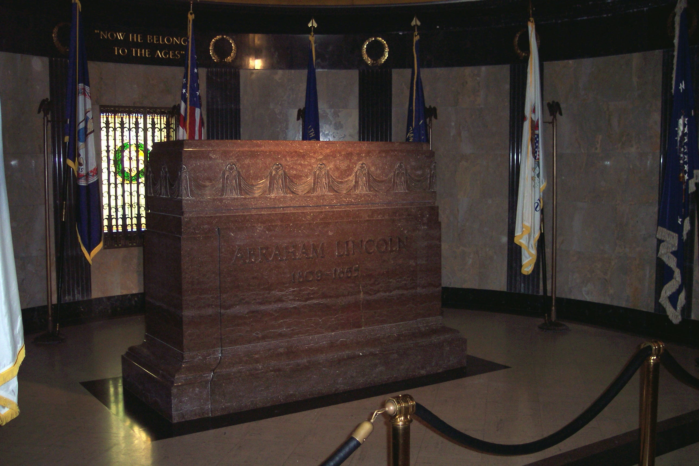

Slide 83
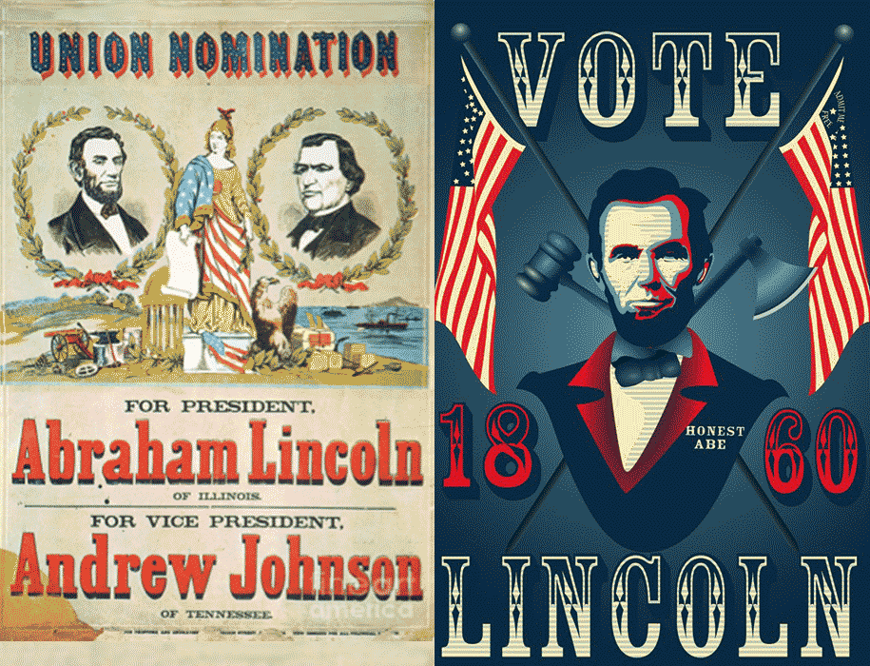
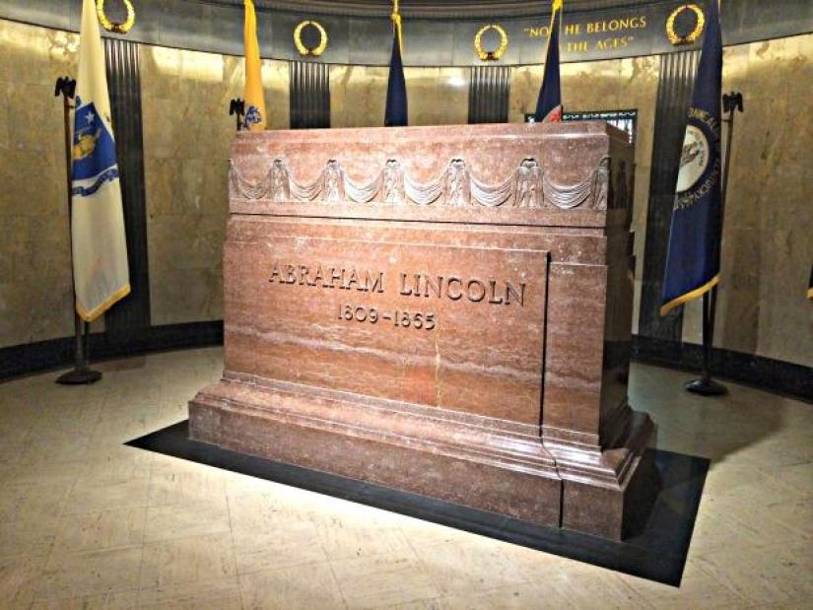

Slide 84
17. Andrew Johnson (1865-1869)

Slide 85
“I have been almost overwhelmed by the announcement of the sad event [Lincoln's assassination] which has so recently occurred. I feel incompetent to perform duties so important and responsible as those which have been so unexpectedly thrown upon me.”

Slide 86
"If I am shot at, I want no man to be in the way of the bullet."

Slide 87
“Let us look forward to the time when we can take the flag of our country and nail it below the Cross, and there let it wave as it waved in the olden times, and let us gather around it and inscribed for our motto: 'Liberty and Union, one and inseparable, now and forever,' and exclaim, 'Christ first, our country next!'”

Slide 88
“The life of a republic lies certainly in the energy, virtue, and intelligence of its citizens.”

Slide 89
Do you have faith? Have it to yourself before God. Happy is he who does not condemn himself in what he approves. But he who doubts is condemned if he eats, because he does not eat from faith; for whatever is not from faith is sin. — Romans 14:22-23

Slide 90
"My right side is paralyzed. I need no doctor. I can overcome my own troubles."

Slide 91
And He said to me, "My grace is sufficient for you, for My strength is made perfect in weakness." Therefore most gladly I will rather boast in my infirmities, that the power of Christ may rest upon me. — 2nd Corinthians 12:9

Slide 92
“There are some who lack confidence in the integrity and capacity of the people to govern themselves. To all who entertain such fears I will most respectfully say that I entertain none . . . If man is not capable, and is not to be trusted with the government of himself, is he to be trusted with the government of others . . . Who, then, will govern? The answer must be, Man for we have no angels in the shape of men, as yet, who are willing to take charge of our political affairs.”

Slide 93
“It is our sacred duty to transmit unimpaired to our posterity the blessings of liberty which were bequeathed to us by the founders of the Republic.”

Slide 94
“Tyranny and despotism can be exercised by many, more rigorously, more vigorously, and more severely, than by one.”

Slide 95
If a ruler pays attention to lies, All his servants become wicked. — Proverbs 29:12

Slide 96
"Slavery exists. It is black in the South, and white in the North."

Slide 97
"Let them impeach and be damned."

Slide 98
“I have performed my duty to my God, my country, and my family. I have nothing to fear in approaching death. To me it is the mere shadow of God's protecting wing . . . Here I will rest in quiet and peace beyond the reach of calumny's poisoned shaft, the influence of envy and jealous enemies, where treason and traitors or State backsliders and hypocrites in church can have no peace.”
lies
schemers
phonies

Slide 99
"And then many will be offended, will betray one another, and will hate one another. Then many false prophets will rise up and deceive many. And because lawlessness will abound, the love of many will grow cold. But he who endures to the end shall be saved." — Matthew 24:10-13

Slide 100
And let the peace of God rule in your hearts, to which also you were called in one body; and be thankful. — Colossians 3:15

Slide 101
... and the peace of God, which surpasses all understanding, will guard your hearts and minds through Christ Jesus. — Philippians 4:7

Slide 102
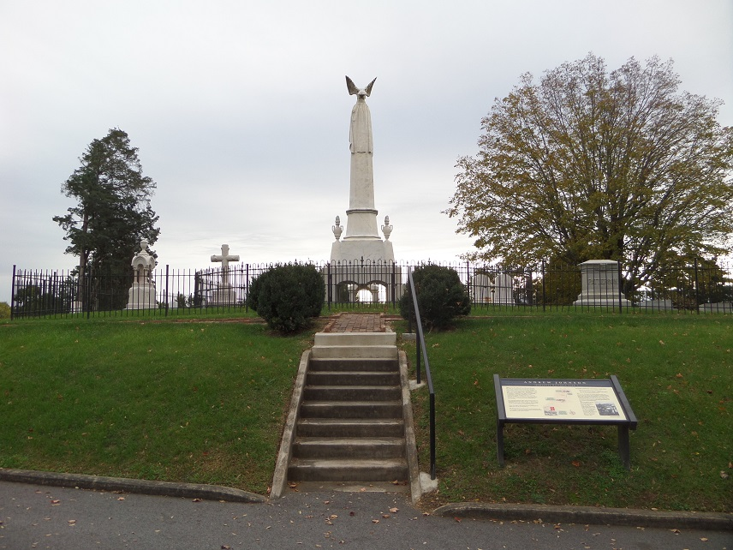

Slide 103
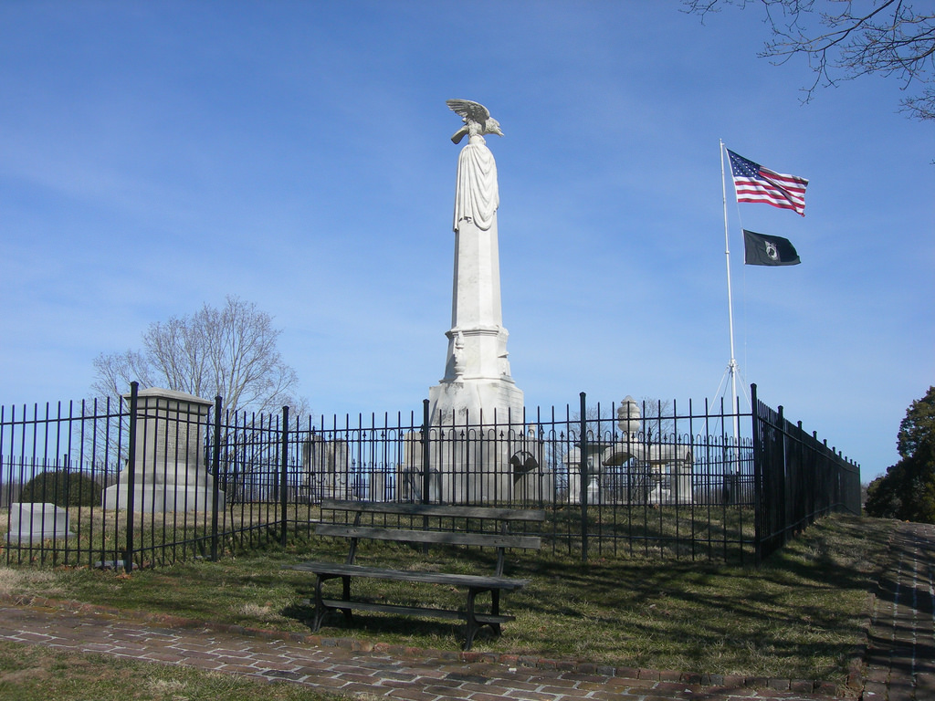

Slide 104
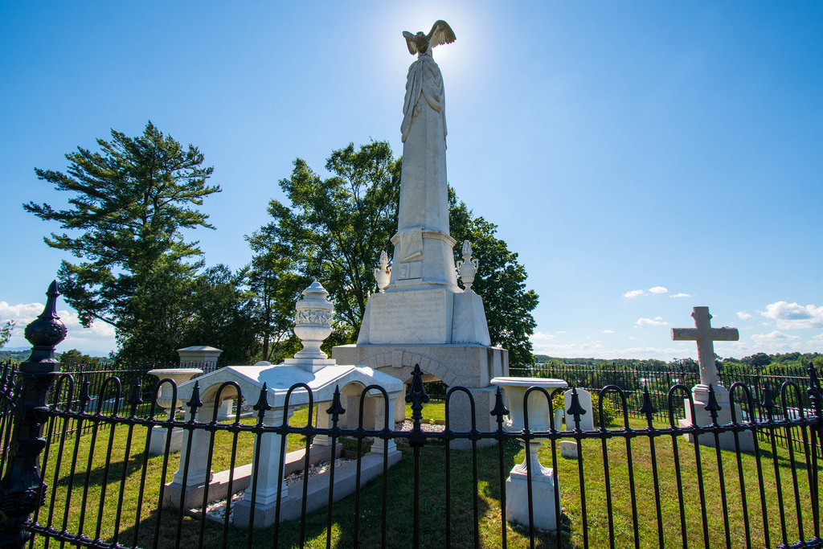

Slide 106
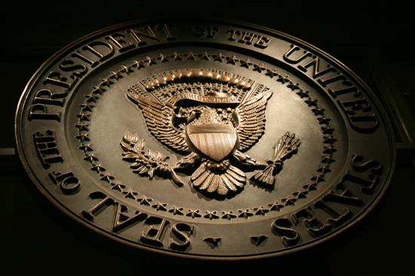
→ Living one day at a time enhances endurance
→ Once recognized, one should flea habitual sinfulness
→ Sympathy for enemies increases godliness
→ Each of us is accountable to God for who we are
→ Laughter cuts the piercing pains of living
→ Sorrow deepens sober understanding
→ Only hearts open to God can reach higher truths
→ Owning lifelong instruction bolsters elderly wisdom
→ When Christ comes first all else will follow
→ Tranquil lives call for common virtuous knowledge
→ Only men of noble character are able to lead
→ Ongoing slavery comes by those unjustly dominating
→ Peace through thankfulness draws one to the divine
Hearts deepen when God is made supreme
Notes:
Hearts deepen when God is made supreme.

Slide 107
Please visit http://www.LoveFromGod.com to explore further
Ronald Bert Channel on
Notes:
Eternity never ends.

