Slide 2
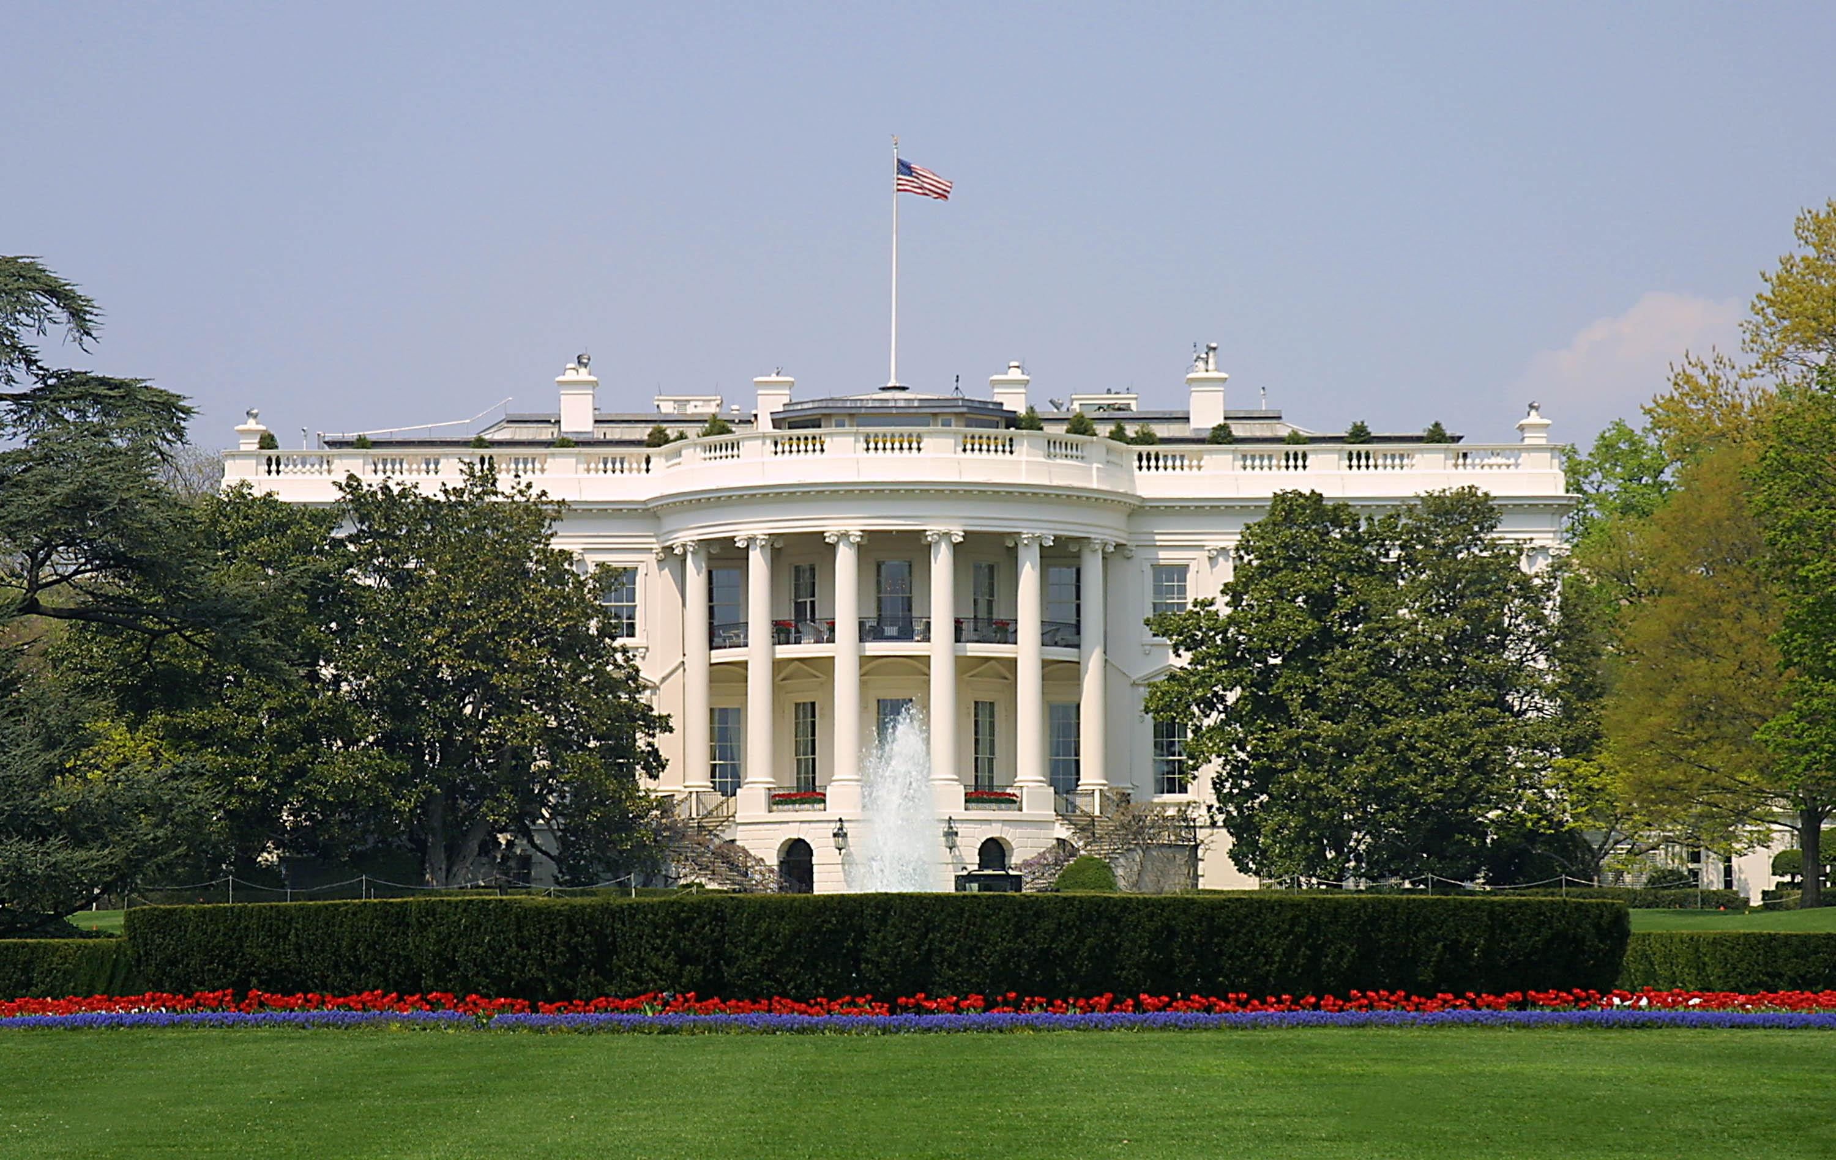
Presidential Quotes
Ron Bert
12
November 4, 2018

Slide 3
16. Abraham Lincoln (1861-1865)
Part 9

Slide 4
“When I left Springfield [to become President] I asked the people to pray for me. I was not a Christian. When I buried my son, the severest trial of my life, I was not a Christian. But when I went to Gettysburg and saw the graves of thousands of our soldiers, I then and there consecrated myself to Christ.”
pray for me

Slide 5
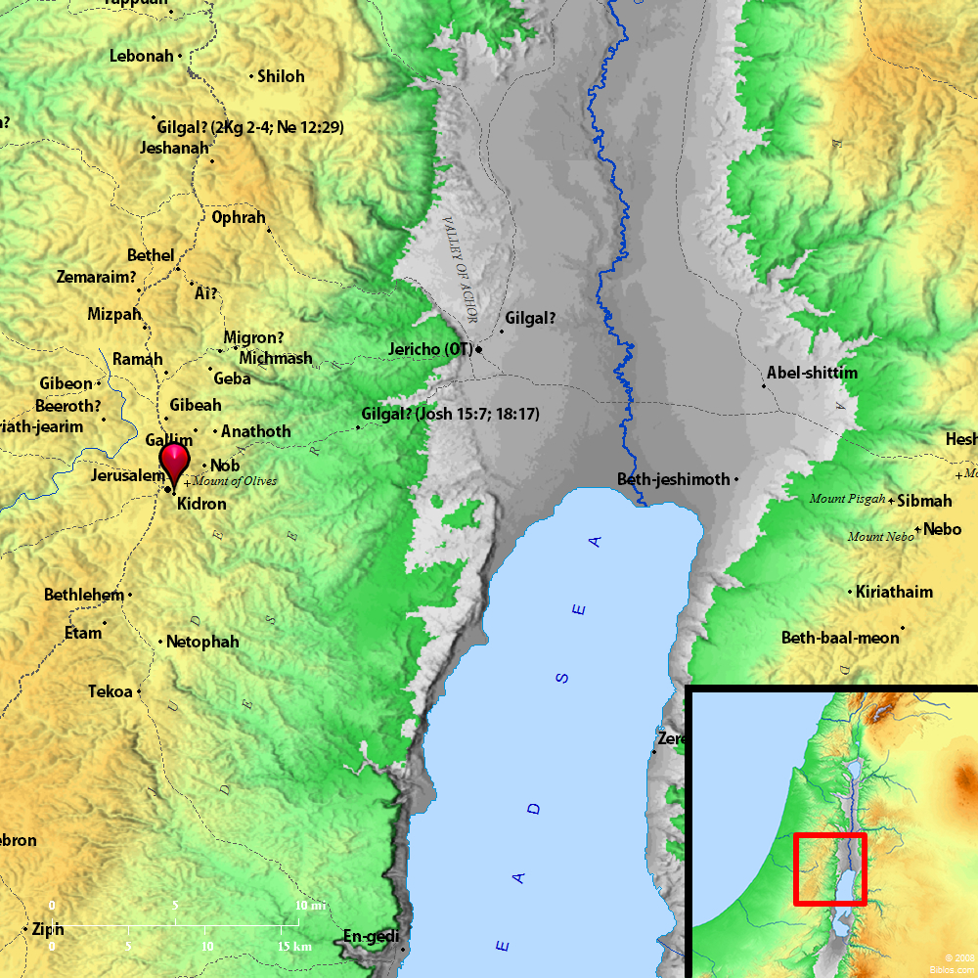
“Young man, if God gives me four years more to rule this country, I believe it will become what it ought to be - what its Divine Author intended it to be - no longer one vast plantation for breeding human beings for the purpose of lust and bondage. But it will become a new Valley of Jehoshaphat, where all the nations of the earth will assemble together under one flag, worshipping a common God, and they will celebrate the resurrection of human freedom.”
Valley of Jehoshaphat
"YAHWEH has judged"
Notes:
"YAHWEH has judged" in Hebrew = Jehoshaphat

Slide 6
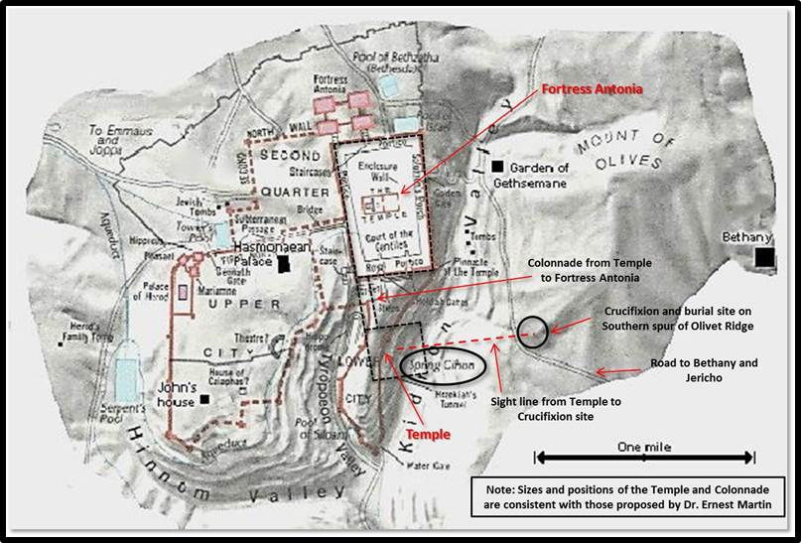

Slide 8
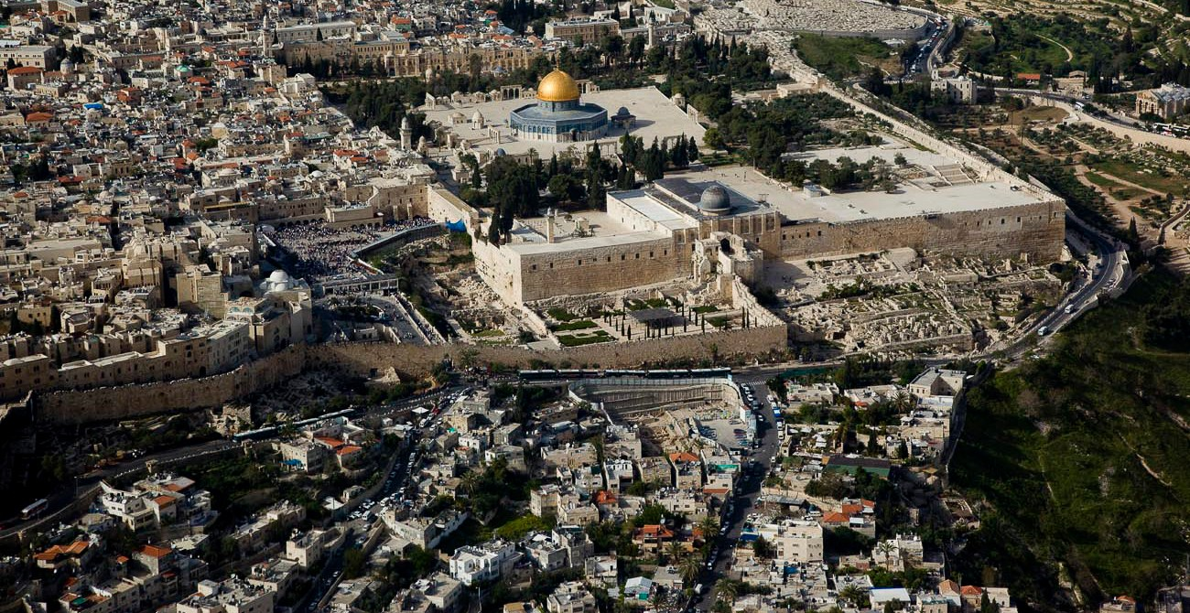

Slide 9
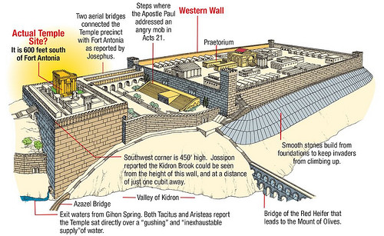

Slide 10
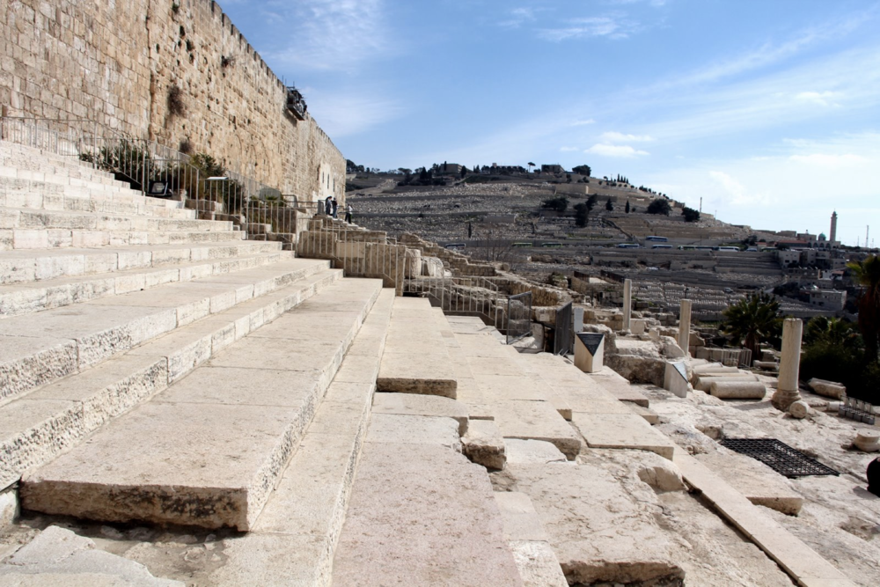
Then as He went out of the temple, one of His disciples said to Him, "Teacher, see what manner of stones and what buildings are here!" And Jesus answered and said to him, "Do you see these great buildings? Not one stone shall be left upon another, that shall not be thrown down." — Mark 13:1-2

Slide 11
For all that is in the world - the lust of the flesh, the lust of the eyes, and the pride of life - is not of the Father but of the world. — 1st John 2:16

Slide 12
"Let the nations be wakened, and come up to the Valley of Jehoshaphat; For there I will sit to judge all the surrounding nations." — Joel 3:12

Slide 13
“And having thus chosen our course, without guile, and with pure purpose, let us renew our trust in God, and go forward without fear, and with manly hearts.”
treachery
in
trust in God

Slide 14
For God has not given us a spirit of fear, but of power and of love and of a sound mind. — 2nd Timothy 1:7

Slide 15
“But I must add that the U.S. government must not, as by this order, undertake to run the churches. When an individual, in a church or out of it, becomes dangerous to the public interest, he must be checked; but let the churches, as such take care of themselves. It will not do for the U.S. to appoint Trustees, Supervisors, or other agents for the churches.”
government must not
run the churches
Notes:
Lincoln was more apt to say that government should not interfere with churches than to remove churches from influencing government, to the contrary, that churches should influence the goodness to be had in government. With contemporary delusions we have lost sight that it was churches government was to protect for the betterment of government. Lincoln would summarize wisdom proclaiming that we need faith more than government, and if there was something to be removed from social presence, it would be government and not the courageous outspoken faithful. Without the calls of truth being louder than the scheming of many big little godless politicians, freedom is devoured in the shadow of lies. Separation of church and state was to put church above government, not below it, to be outlawed by the immoral.

Slide 16
“God bless the Methodist Church - bless all the churches - and blessed be God, Who, in this our great trial, giveth us the churches.”
Assembly of the holy

Slide 17
“The written word may be man's greatest invention. It allows us to converse with the dead, the absent, and the unborn.”

Slide 18
Your word is a lamp to my feet And a light to my path. — Psalms 119:105
… by which, when you read, you may understand my knowledge in the mystery of Christ), — Ephesians 3:4

Slide 19
“I am profitably engaged in reading the Bible. Take all of this Book upon reason that you can, and the balance by faith, and you will live and die a better man (When a skeptic expressed surprise to see him reading a Bible).”
examine
by faith
live and die a better man

Slide 20
“If we believe the Bible, we must accept the fact that, in the old days, God and his angels came to humans in their sleep and made themselves known in dreams.”

Slide 21
God, who at various times and in various ways spoke in time past to the fathers by the prophets, ... — Hebrews 1:1

Slide 22
“In regard to this Great Book, I have but to say, it is the best gift God has given to man. All the good the Savior gave to the world was communicated through this book. But for it we could not know right from wrong. All things most desirable for man's welfare, here and hereafter, are to be found portrayed in it.”
Great Book
it is the best gift
God has given to man

Slide 23
“All things desirable to men are contained in the Bible.”

Slide 24
“The judgments of the Lord are true and righteous altogether.”

Slide 25
The fear of the LORD is clean, enduring forever; The judgments of the LORD are true and righteous altogether. — Psalms 19:9

Slide 26
“The good old maxims of the Bible are applicable, and truly applicable to human affairs, and in this as in other things, we may say here that he who is not for us is against us; he would gathereth not with us scattereth.”

Slide 27
"He who is not with Me is against Me, and he who does not gather with Me scatters abroad." — Matthew 12:30
Christ
with Me
"For he who is not against us is on our side." — Mark 9:40
Notes:
Truly, he who is against Christian principles goes against the will of God Himself.

Slide 28
… in flaming fire taking vengeance on those who do not know God, and on those who do not obey the gospel of our Lord Jesus Christ. These shall be punished with everlasting destruction from the presence of the Lord and from the glory of His power, … — 2nd Thessalonians 1:8-9
… in flaming fire taking vengeance on those who do not know God, and on those who do not obey the gospel of our Lord Jesus Christ. These shall be punished with everlasting destruction from the presence of the Lord and from the glory of His power, … — 2nd Thessalonians 1:8-9
who do not know God
who do not obey
gospel of our Lord Jesus Christ
Notes:
Certainly this is not a very popular scripture for the most who practice lawlessness.

Slide 29
“If there is anything that links the human to the divine, it is the courage to stand by a principle when everybody else rejects it.”

Slide 30
“I can only say that I have acted upon my best convictions, without selfishness or malice, and that by the help of God I shall continue to do so.”
by the help of God
continue to do

Slide 31
Commit your works to the LORD, And your thoughts will be established. — Proverbs 16:3
Brethren, I do not count myself to have apprehended; but one thing I do, forgetting those things which are behind and reaching forward to those things which are ahead, I press toward the goal for the prize of the upward call of God in Christ Jesus.— Philippians 3:13-14
SIN
FAITH
In His Presence

Slide 32
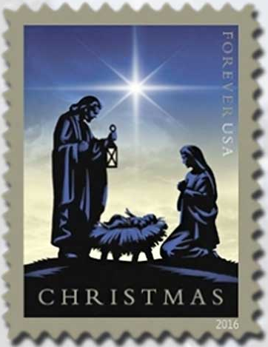
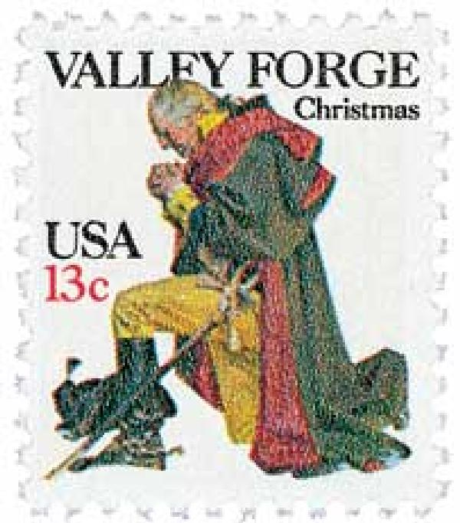
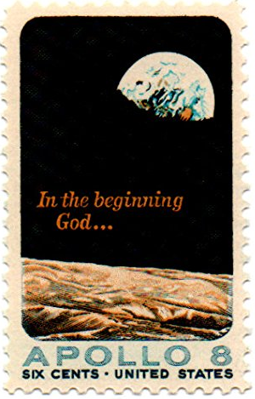
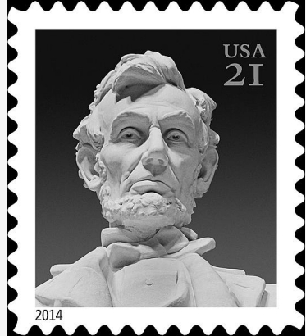
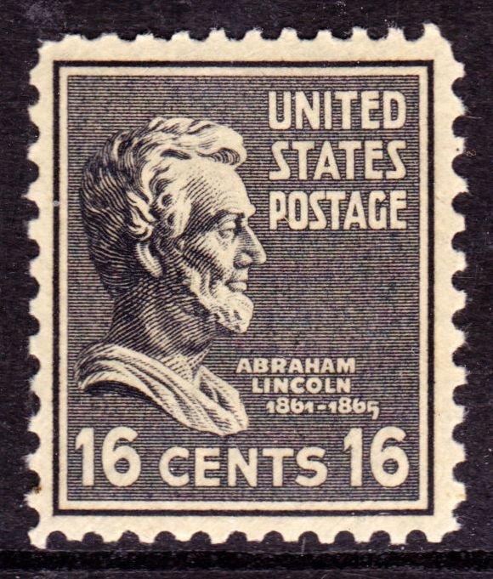
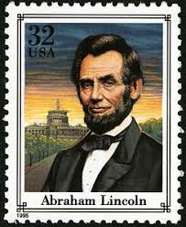
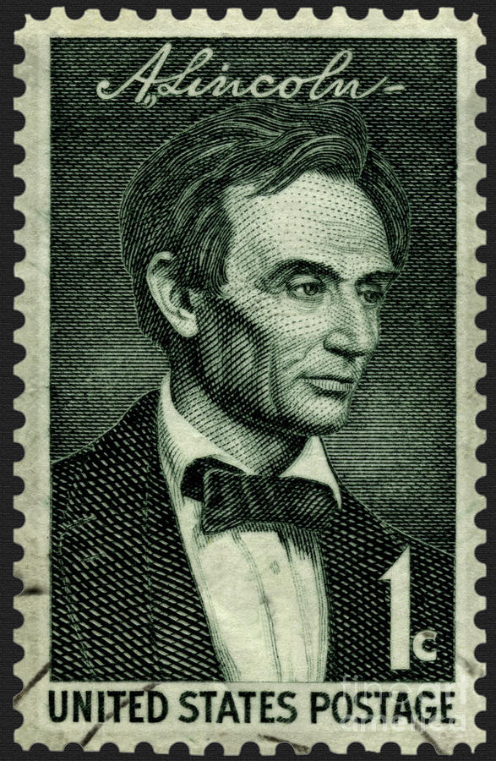
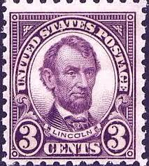
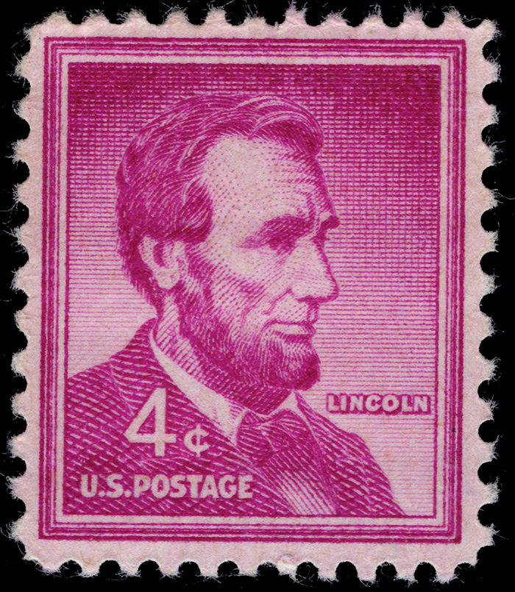
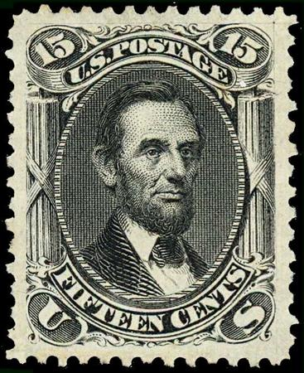
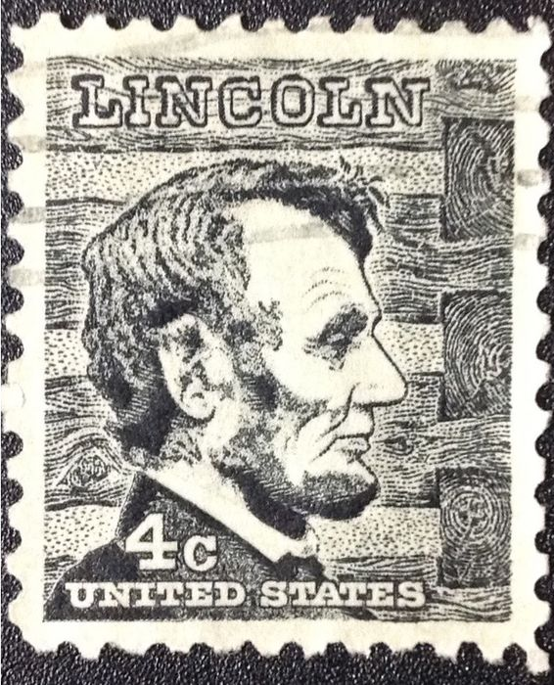
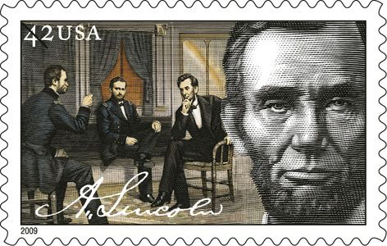
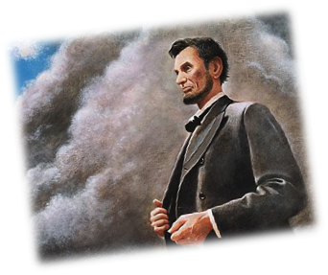
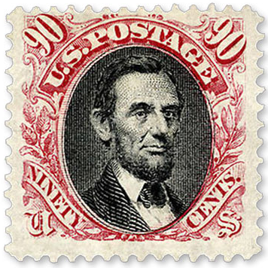
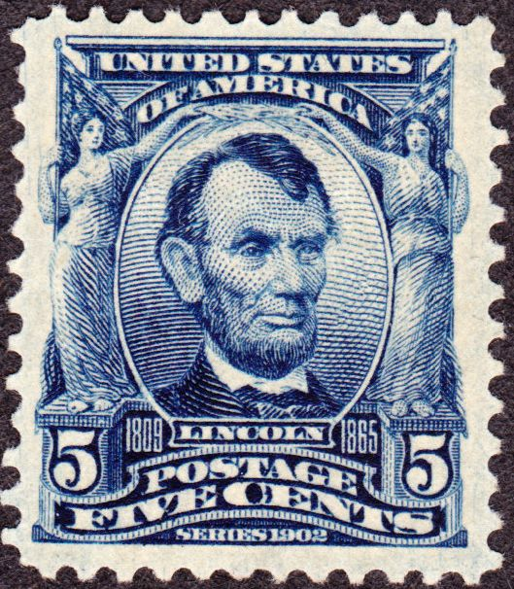
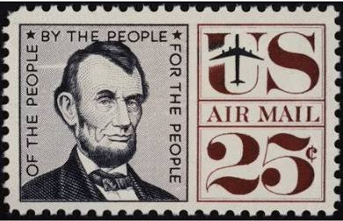
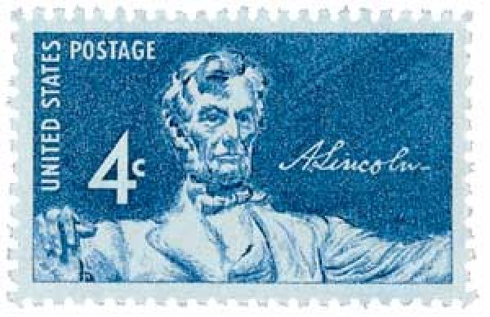
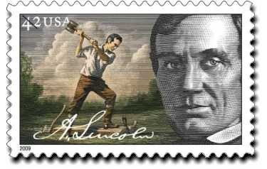
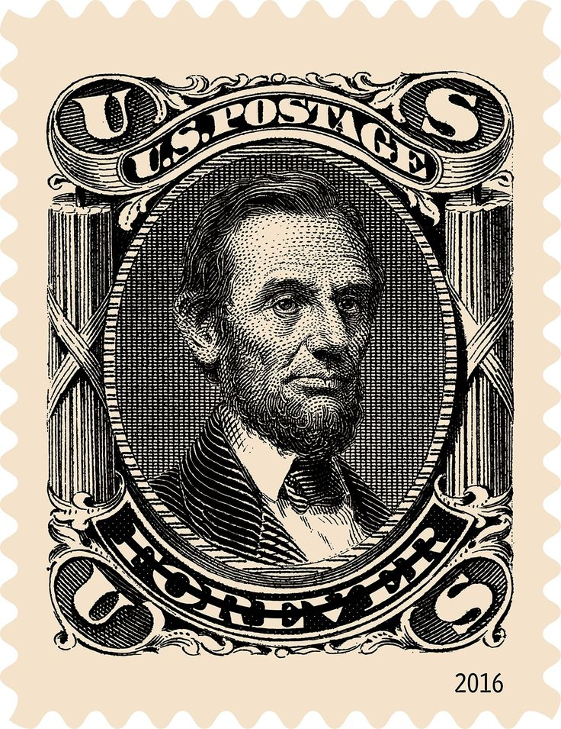
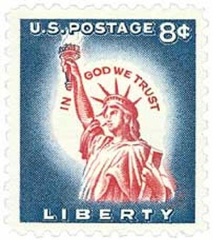
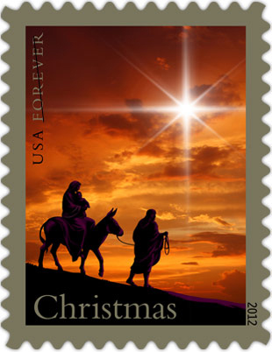
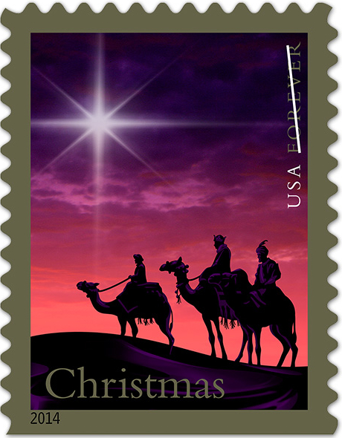
Notes:
Abraham Lincoln left an indelible stamp on the cloudy shores of our times. Let us awake to his call to stand in the courage of fortunate belief in a true and faithful God.

Slide 34
Presidential Quotes
Ron Bert
12½
November 11, 2018

Slide 35
16. Abraham Lincoln (1861-1865)
Part 10

Slide 36
“I have had so many evidences of [God's] direction, so many instances when I have been controlled by some other power than my own will, that I cannot doubt that this power comes from above.”

Slide 37
... as His divine power has given to us all things that pertain to life and godliness, through the knowledge of Him who called us by glory and virtue, ... — 2nd Peter 1:3

Slide 38
“No man ever got lost on a straight road.”

Slide 39
“Teach hope to all, despair to none.”

Slide 40
Now may the God of hope fill you with all joy and peace in believing, that you may abound in hope by the power of the Holy Spirit. — Romans 15:13
in
in

Slide 41
“Allow me to assure you, that suspicion and jealousy never did help any man in any situation.”
Believing
Hope
?
suspicion and jealousy
in

Slide 42
A sound heart is life to the body, But envy is rottenness to the bones. — Proverbs 14:30

Slide 43
“I desire to see the time when education, and by its means, morality, sobriety, enterprise and industry shall become much more general than at present.”

Slide 44
Therefore my people have gone into captivity, Because they have no knowledge; Their honorable men are famished, And their multitude dried up with thirst. — Isaiah 5:13
people
no knowledge
people famished
dried up with thirst
no knowledge
=
famished
dried up with thirst

Slide 45
“And in the end, it's not the years in your life that count. It's the life in your years.”

Slide 46
... whereas you do not know what will happen tomorrow. For what is your life? It is even a vapor that appears for a little time and then vanishes away. Instead you ought to say, "If the Lord wills, we shall live and do this or that." — James 4:14-15
If the Lord wills
live and do

Slide 47
“Don't kneel to me, that is not right. You must kneel to God only, and thank Him for the liberty you will hereafter enjoy.”
kneel to God only
thank Him

Slide 48
And I fell at his feet to worship him. But he said to me, "See that you do not do that! I am your fellow servant, and of your brethren who have the testimony of Jesus. Worship God! For the testimony of Jesus is the spirit of prophecy." — Revelation 19:10
Worship God

Slide 49
“Life may not always be a bed of roses. All of us are aware of this fact. There are numerous times in life when we have to face disappointments. These quotes and sayings surely do inspire and help us to look forward and enjoy the new pathways coming our way. These quotes also lend a different perspective to life, which makes moving forward not a very difficult task. I hope to stand firm enough to not go backward, and yet not go forward fast enough to wreck the country's cause.”

Slide 50
“The evacuation of Petersburg and Richmond, and the surrender of the principal insurgent army, give hope of a righteous and speedy peace whose joyous expression cannot be restrained. In the midst of this, however, He, from Whom all blessings flow, must not be forgotten. A call for a national thanksgiving is being prepared, and will be duly promulgated.”

Slide 51
“While we are grateful to all the brave men and officers for the events of the past few days, we should, above all, be very grateful to Almighty God, who gives us victory.”

Slide 52
But thanks be to God, who gives us the victory through our Lord Jesus Christ. — 1st Corinthians 15:57

Slide 53
“We can succeed only by concert. It is not 'can any of us imagine better?, but 'can we all do better?”

Slide 54
Finally, all of you be of one mind, having compassion for one another; love as brothers, be tenderhearted, be courteous; ... — 1st Peter 3:8

Slide 55
“If God now wills the removal of a great wrong, and wills also that we of the North as well as you of the South, shall pay fairly for our complicity in that wrong, impartial history will find therein new cause to attest and revere the justice and goodness of God.”

Slide 56
“From these honored dead we take increased devotion to that cause for which they gave the last full measure of devotion. That we here highly resolve that these dead shall not have died in vain. That this nation, under God, shall have a new birth of freedom, and that government of the people, by the people, for the people, shall not perish from the earth.”

Slide 57
“I do, therefore, invite my fellow citizens . . . to set apart and observe the last Thursday of November next, as a day of Thanksgiving and Praise to our beneficent Father who dwelleth in the Heavens.”

Slide 58
... in everything give thanks; for this is the will of God in Christ Jesus for you. — 1st Thessalonians 5:18

Slide 59
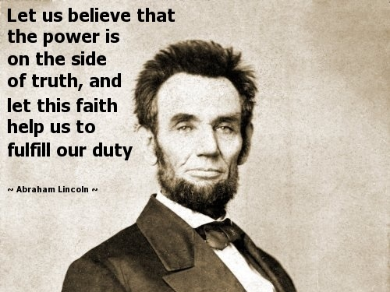

Slide 60
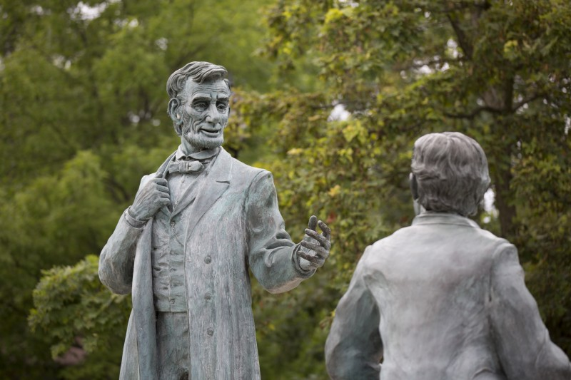
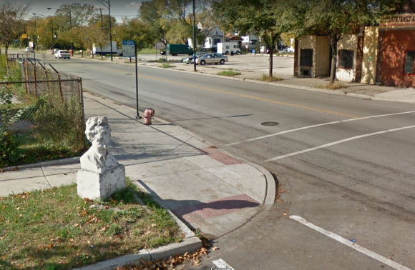
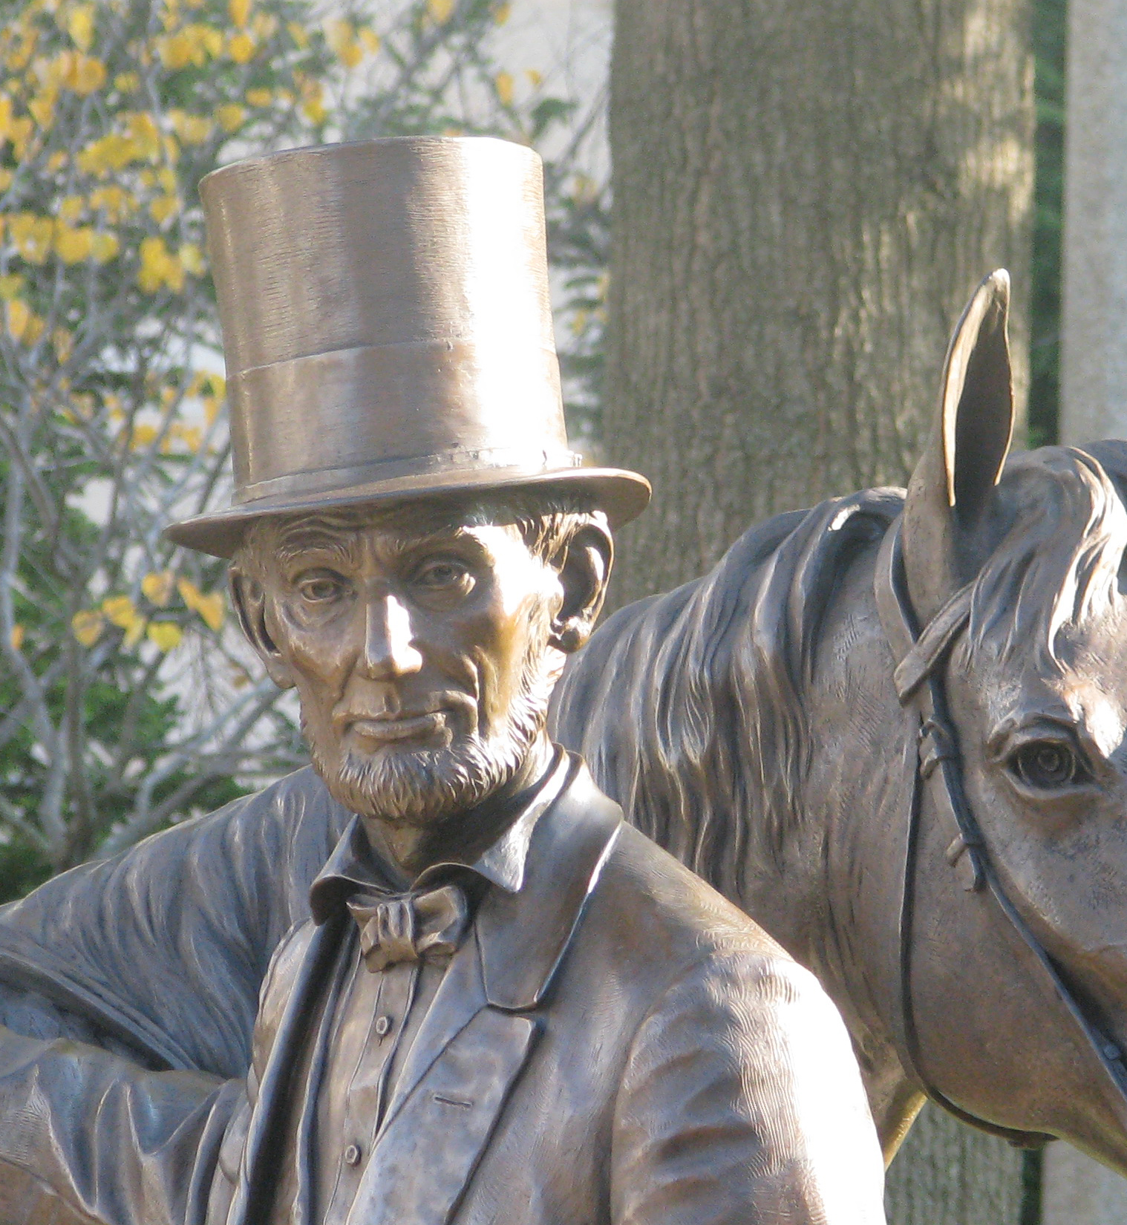
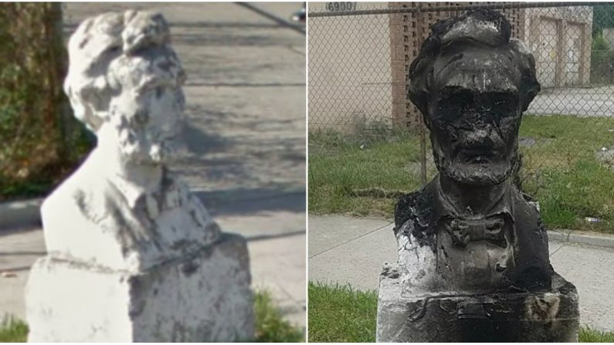
"And this is the condemnation, that the light has come into the world, and men loved darkness rather than light, because their deeds were evil." — John 3:19

Slide 61
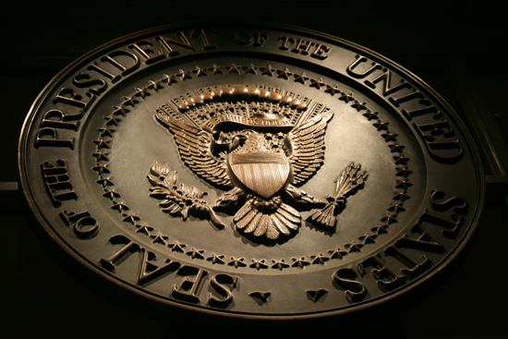
→ Death invokes an impetus to ignite faith
→ Greatness comes by a resolve of fearless integrity
→ Government should not oversee church organization
→ The power of the word can influence generations
→ Digesting the Bible increases the value of living
→ The Bible is God’s best gift to man
→ Those for God’s ways are not against Him
→ Courage of principle is derived of the divine
→ Hope should always be our anchor unto eternity
→ Despair, suspicion, & jealousy defeats true character
→ Living to appreciate the moment deepens life
→ All just victories are ordained by God
→ God’s providence wills the best of all outcomes
Arriving at the mercy of God appropriately humbles a soul
Notes:
Arriving at the mercy of God appropriately humbles a soul.

Slide 63
Please visit http://www.LoveFromGod.com to explore further
Ronald Bert Channel on
Notes:
Eternity never ends.

