Slide 2
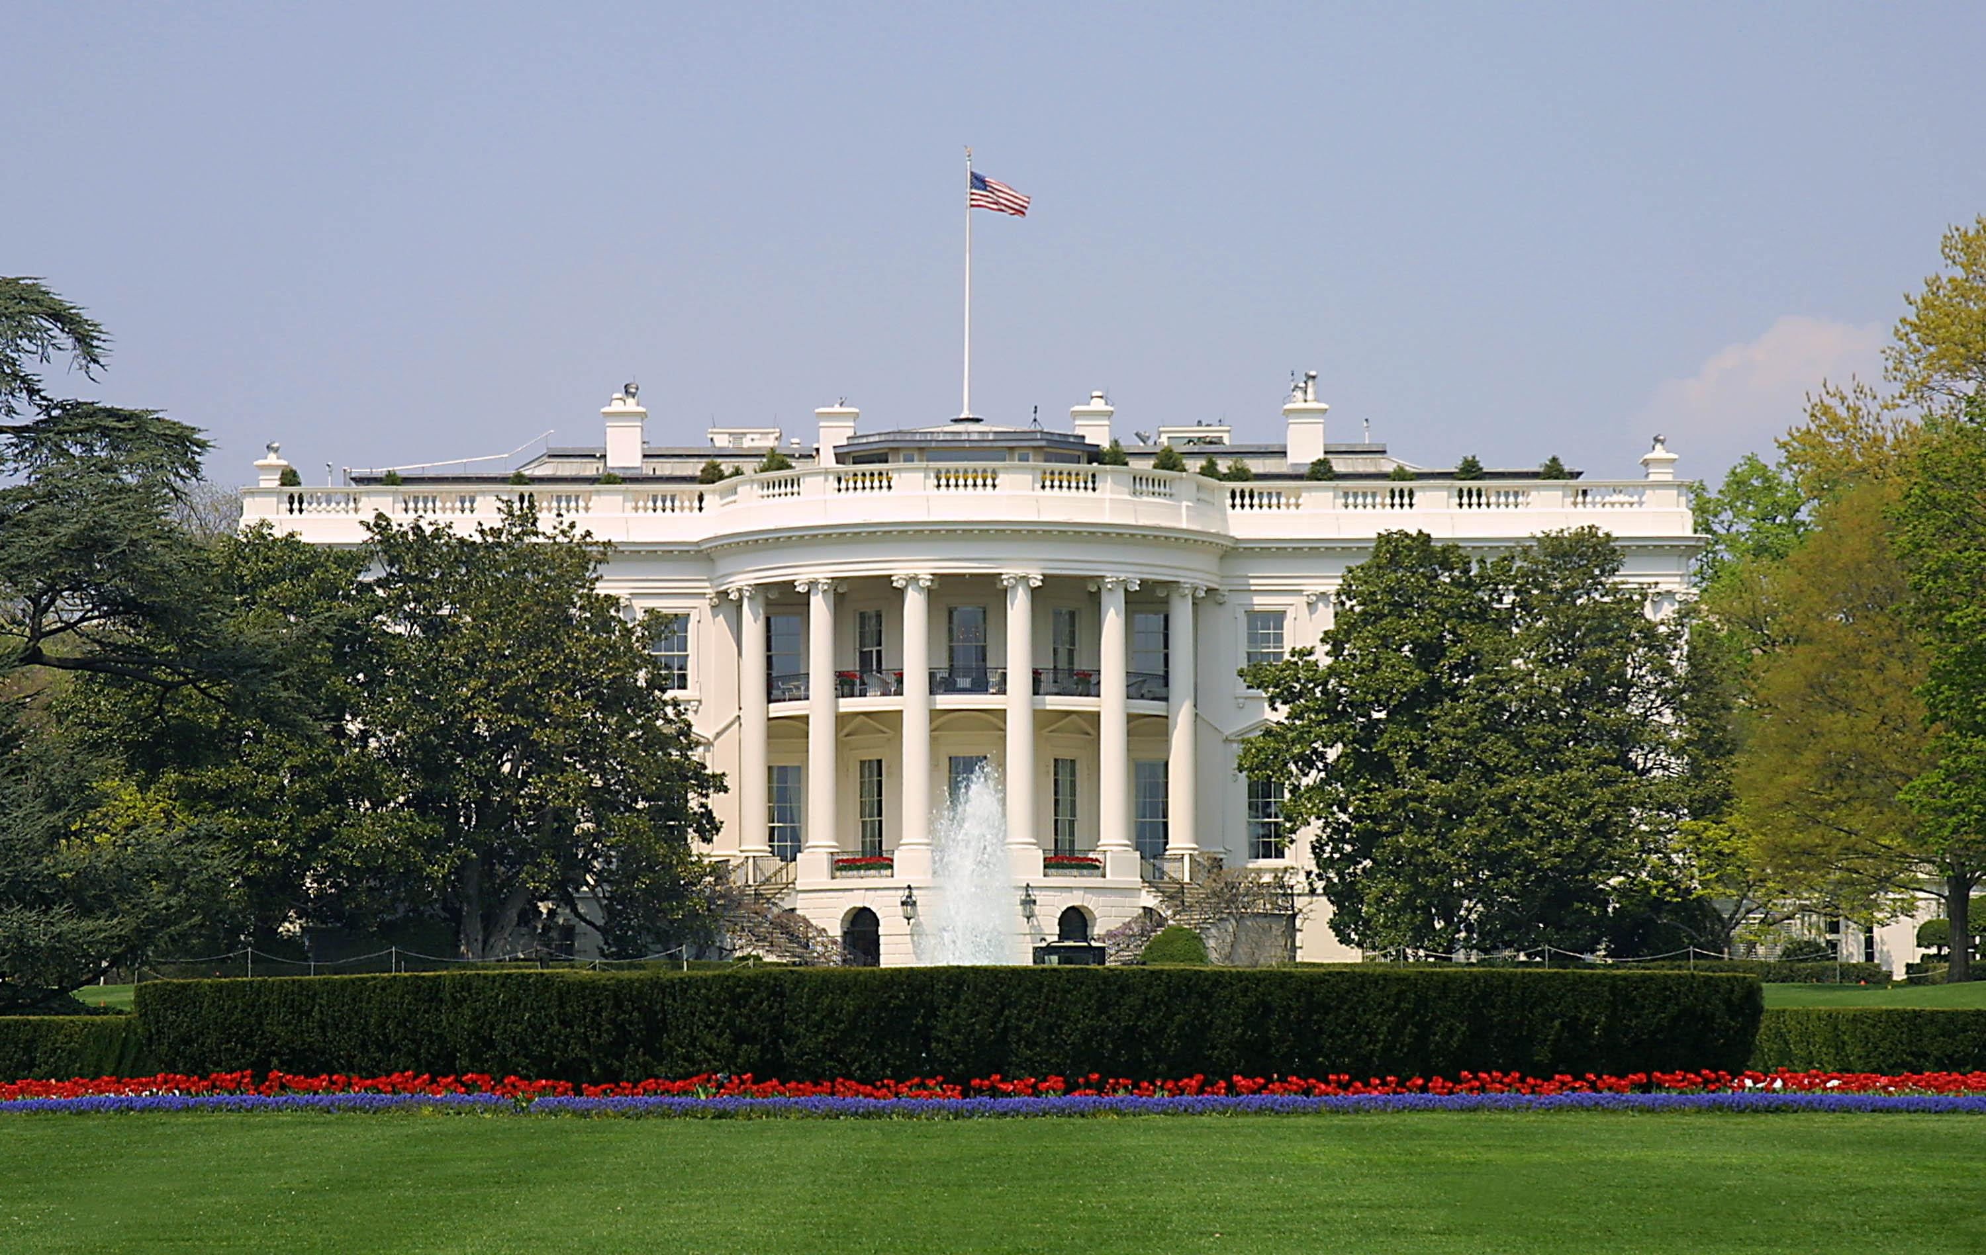
Presidential Quotes
Ron Bert
December 24, 2017

Slide 3
1. George Washington (1789-1797)

Slide 4
“It is the duty of all nations to acknowledge the providence of Almighty God, to obey His will, to be grateful for His benefits, and humbly to implore His protection and favor.”
acknowledge
Almighty God
obey His will
be grateful
humbly
implore

Slide 5
“It is impossible to rightly govern a nation without God and the Bible.”

Slide 6
“The thing that separates the American Christian from every other person on earth is the fact that he would rather die on his feet, than live on his knees!”

Slide 7
"I have often expressed my sentiments, that every man, conducting himself as a good citizen, and being accountable to God alone for his religious opinions, ought to be protected in worshipping the Deity according to the dictates of his own conscience."

Slide 8
"Oh, eternal and everlasting God, direct my thoughts, words and work. Wash away my sins in the immaculate blood of the lamb and purge my heart by the Holy Spirit. Daily, frame me more and more in the likeness of thy son, Jesus Christ, that living in thy fear, and dying in thy favor, I may in thy appointed time obtain the resurrection of the justified unto eternal life. Bless, O Lord, the whole race of mankind and let the world be filled with the knowledge of thy son, Jesus Christ."

Slide 9
"Do not let any one claim to be a true American if they ever attempt to remove religion from politics."

Slide 10
“Let us with caution indulge the supposition that morality can be maintained without religion. Reason and experience both forbid us to expect that national morality can prevail in exclusion of religious principle.”
national
morality
prevail
religious principle

Slide 11
“You do well to wish to learn … above all, the religion of Jesus Christ [In our schools].”

Slide 12
“The propitious smiles of Heaven can never be expected on a nation that disregards the eternal rules of order and right, which heaven itself has ordained.”
favorable

Slide 13
“How soon we forget history … Government is not reason, Government is not eloquence. It is force. And, like fire, it is a dangerous servant and a fearful master.”

Slide 14
“Religion is as necessary to reason as reason is to religion. The one cannot exist without the other.”

Slide 15
“Of all the dispositions and habits which lead to political prosperity, religion and morality are indispensable supports.”

Slide 16
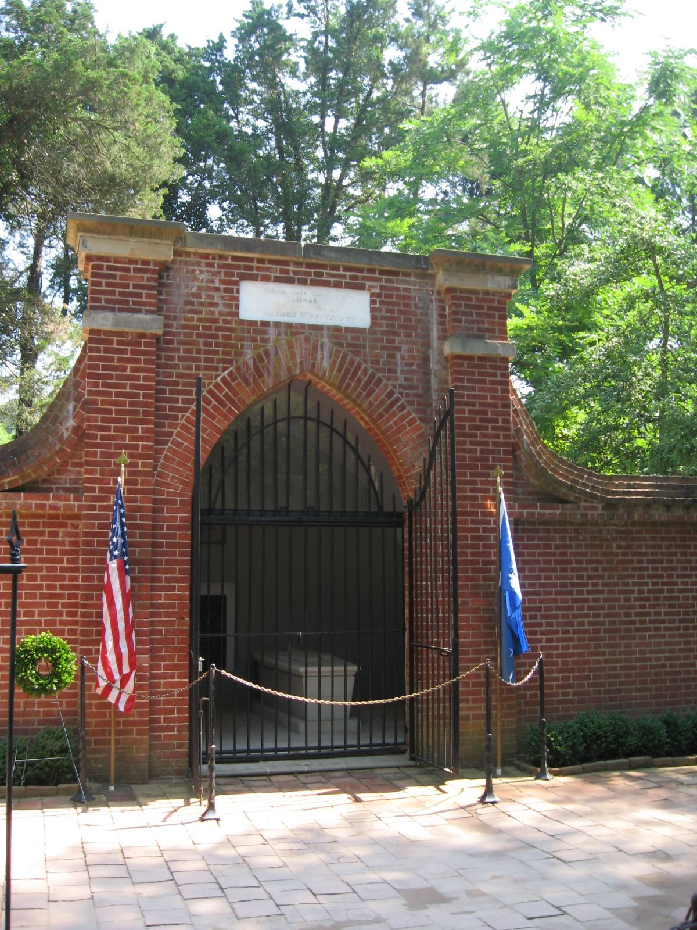
I beseech you therefore, brethren, by the mercies of God, that you present your bodies a living sacrifice, holy, acceptable to God, which is your reasonable service. And do not be conformed to this world, but be transformed by the renewing of your mind, that you may prove what is that good and acceptable and perfect will of God. For I say, through the grace given to me, to everyone who is among you, not to think of himself more highly than he ought to think, but to think soberly, as God has dealt to each one a measure of faith. — Romans 12:1-3

Slide 17
Confess your trespasses to one another, and pray for one another, that you may be healed. The effective, fervent prayer of a righteous man avails much. — James 5:16

Slide 18
2. John Adams (1797-1801)

Slide 19
“The question before the human race is, whether the God of nature shall govern the world by his own laws, or whether priests and kings shall rule it by fictitious miracles?”

Slide 20
“Twenty times in the course of my late reading have I been on the point of breaking out, “This would be the best of all possible worlds, if there were no religion at all!!!” But in this exclamation I would have been as fanatical as Bryant or Cleverly. Without religion, this world would be something not fit to be mentioned in polite company, I mean hell.”

Slide 21
“As the safety and prosperity of nations ultimately and essentially depend on the protection and the blessing of Almighty God, and the national acknowledgment of this truth is not only an indispensable duty which the people owe to Him.”
Almighty God
acknowledgment
duty

Slide 22
“We recognize no sovereign but God, and no King but Jesus!”

Slide 23
“Our Constitution was made only for a moral and religious people”. It is wholly inadequate to the government of any other.”

Slide 24
“Human passions unbridled by morality and religion…would break the strongest cords of our Constitution as a whale goes through a net.”

Slide 25
“As the government of the United States of America is not, in any sense, founded on the Christian Religion - as it has in itself no character of enmity against the laws, religion or tranquility of Musselmen, - and as the said States never have entered into any war or act of hostility against any Mehomitan nation, it is declared by the parties that no pretext arising from religious opinions shall ever produce an interruption of the harmony existing between the two countries.”

Slide 26
“The United States is not a Christian nation any more than it is a Jewish or a Mohameddan nation.”

Slide 27
“I consider a decent respect for Christianity among the best recommendations for public service.”

Slide 28
“The Christian religion is, above all the religions that ever prevailed or existed in ancient or modern times, the religion of wisdom, virtue, equity and humanity.”

Slide 29
“I have examined all religions, and the result is that the Bible is the best book in the world.”

Slide 30
“The Bible contains the most profound philosophy, the most perfect morality, and most refined policy, that ever was conceived upon the earth. It is the most republican book in the world.”

Slide 31
“But how has it happened that millions of fables, tales, legends have been blended with both Jewish and Christian revelation that have made them the most bloody religion that ever existed?”

Slide 32
“Religion and good morals are the only solid foundation of public liberty and happiness”

Slide 33
“Liberty cannot be preserved without a general knowledge among the people.”

Slide 34
“Abuse of words has been the great instrument of sophistry and chicanery, of party, faction, and division of society.”
dishonesty
deception

Slide 35
“Son of man, when a land sins against Me by persistent unfaithfulness, I will stretch out My hand against it; I will cut off its supply of bread, send famine on it, and cut off man and beast from it.” — Ezekiel 14:13

Slide 36
And he brought them out and said, "Sirs, what must I do to be saved?" So they said, "Believe on the Lord Jesus Christ, and you will be saved, you and your household." Then they spoke the word of the Lord to him and to all who were in his house. And he took them the same hour of the night and washed their stripes. And immediately he and all his family were baptized. Now when he had brought them into his house, he set food before them; and he rejoiced, having believed in God with all his household. — Acts 16:30-34
Believe
baptized
in
having believed in God

Slide 37
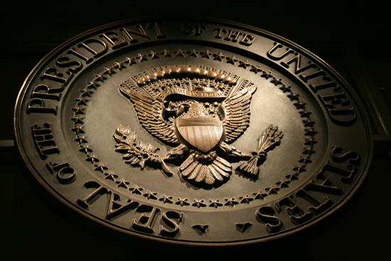
→ Duty to humbly, gratefully acknowledge, obey, God
→ Impossible to govern without God & the Bible
→ Each good soul is directly accountable to God
→ Morality can not be maintained without religion
→ It is good to teach Jesus Christ in our schools
→ To disregard God’s rules of order removes blessings
→ Political stability relies upon religion and morality
→ Humanity must ask if to be ruled by God or man
→ Lusts unbridled by morals & religion destroy society
→ The USA has no proclaimed national religion
→ Christianity = best religion of wisdom, virtue, etc.
→ Liberty and happiness hinge on Religion and morals
→ Deceit & trickery blind society from seeing truth
God’s truths shine through honest souls

Slide 39
Please visit http://www.LoveFromGod.com/presidential1.htm to explore further
Ronald Bert Channel on
Notes:
Eternity never ends.

