Slide 2
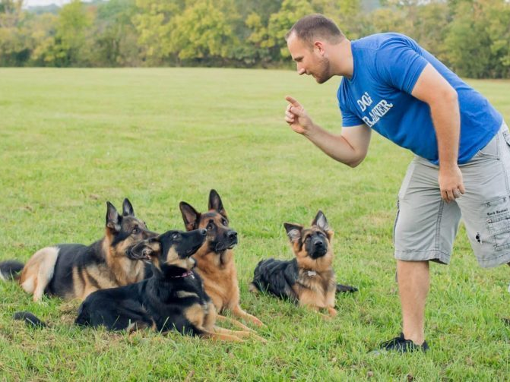
Obedience
Ron Bert
September 22, 2019

Slide 3
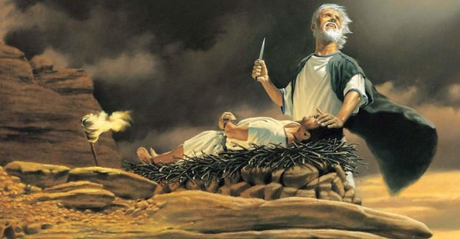
… and said: "By Myself I have sworn, says the LORD, because you have done this thing, and have not withheld your son, your only son - blessing I will bless you, and multiplying I will multiply your descendants as the stars of the heaven and as the sand which is on the seashore; and your descendants shall possess the gate of their enemies. In your seed all the nations of the earth shall be blessed, because you have obeyed My voice." — Genesis 22:16-18
i
t
it
blessed
because you
WORD
have obeyed My voice
Notes:
It is the God’s word He wants us to know. His quest is to listen to see if we hear what He says, and then act upon it.

Slide 4
"Therefore you shall be careful to do as the LORD your God has commanded you; you shall not turn aside to the right hand or to the left. You shall walk in all the ways which the LORD your God has commanded you, that you may live and that it may be well with you, and that you may prolong your days in the land which you shall possess." — Deuteronomy 5:32-33
do
be careful
command
command
walk
in
the ways
command
it
Notes:
Repeated in both the new and old testaments, ensuring no misunderstandings, God instructs us to be careful to observe His commands so that it may be well with our souls. Key is to do as He says.

Slide 5
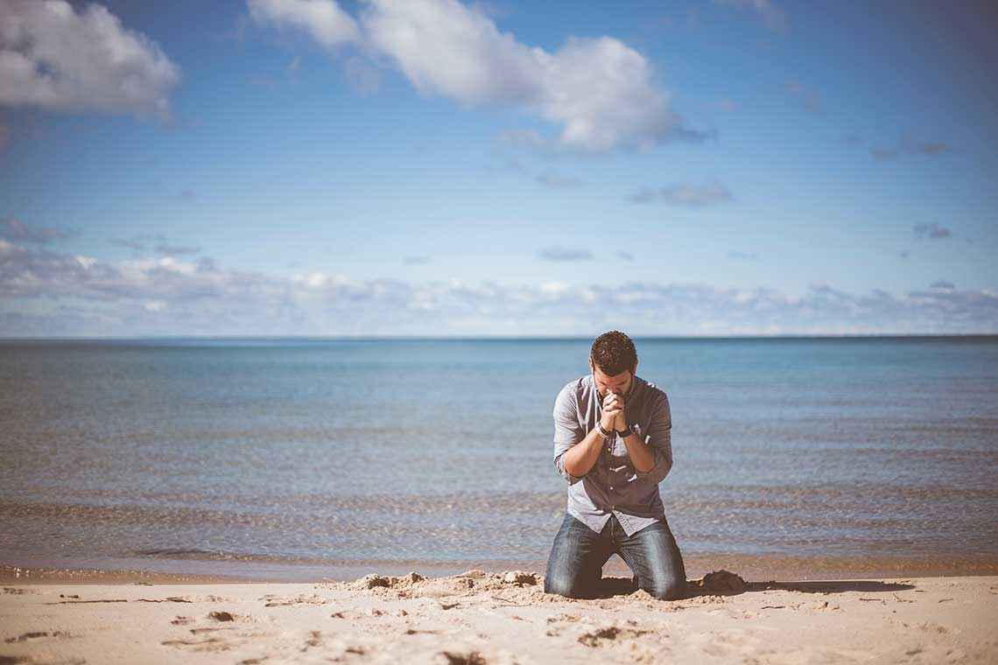
"Observe and obey all these words which I command you, that it may go well with you and your children after you forever, when you do what is good and right in the sight of the LORD your God." — Deuteronomy 12:28
"Observe and obey all these words which I command you, that it may go well with you and your children after you forever, when you do what is good and right in the sight of the LORD your God." — Deuteronomy 12:28
command
command
do
in
Notes:
A repeated main message of the Bible is to be good, and do what is right, as God is the witness.

Slide 6
"But they and our fathers acted proudly, Hardened their necks, And did not heed Your commandments. They refused to obey, And they were not mindful of Your wonders That You did among them. But they hardened their necks, And in their rebellion They appointed a leader To return to their bondage. But You are God, Ready to pardon, Gracious and merciful, Slow to anger, Abundant in kindness, And did not forsake them. — Nehemiah 9:16-17
command
did not
command
they were not mindful
Notes:
One of the stumbling blocks all face is pride void of humble acceptance that God is. Too often people follow people, and not the word of God. God is always ready and waiting for all, no matter how sinful, if the soul is hoping to become better in His sight. He never turns a repenting heart away, if genuine. We all must remember to ask for His help in both good and bad times.

Slide 7
"But this is what I commanded them, saying, 'Obey My voice, and I will be your God, and you shall be My people. And walk in all the ways that I have commanded you, that it may be well with you.' Yet they did not obey or incline their ear, but followed the counsels and the dictates of their evil hearts, and went backward and not forward." — Jeremiah 7:23-24
command
Obey My voice
did not
obey
but followed
obey
evil hearts
Notes:
Each of us has to ask what is at the bottom of our hearts. What our heart aches for is our greatest desire. If evil thoughts consume one, the course is that of destruction, for both personal and public health. Considering His word improves anyone for the better. The greatest battlefield is control of one’s own emotions and character of goodness, over that of bitterness and loss of composure.

Slide 8
Then Saul said to Samuel, "I have sinned, for I have transgressed the commandment of the LORD and your words, because I feared the people and obeyed their voice. — 1st Samuel 15:24
fear
obey
TRUST
Notes:
The counter to fear is trust. Mistakes and regrets will happen. Trusting we climb rather than fall defines the direction a soul travels. Forgiveness is a quality that heals all who live by it. To be forgiven, and to have peace of heart, one must be forgiving; it involves that higher quality of patience. All sanity hinges off of the truth as it is.

Slide 9
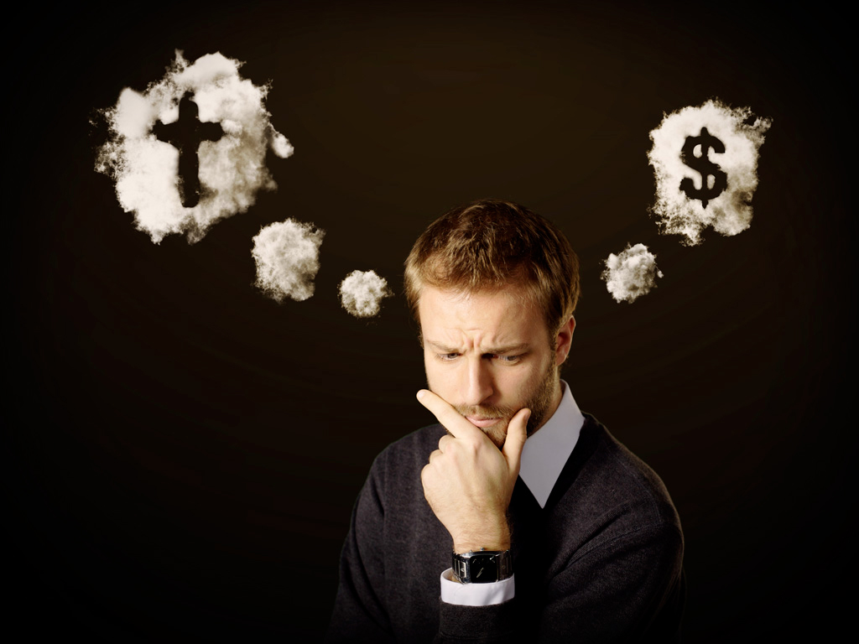
"No one can serve two masters; for either he will hate the one and love the other, or else he will be loyal to the one and despise the other. You cannot serve God and mammon." — Matthew 6:24
serve
serve God
Notes:
Hypocrites are double hearted loving and hating the focus of their desires. Stability only comes to those sure of their pursuit, be it either good or bad. As in making a milk-shake, evenly mixed and balanced ingredients create a smooth product. Adding inappropriate ingredients, as rocks or sand, make the whole unusable. So too with the soul, water and vinegar do not mix, goodness and evil can not co-exist.

Slide 10
"If you love Me, keep My commandments." — John 14:15
keep
keep
keep
Notes:
One word that many have a hard time embracing is the word “keep.” Keep involves the definite issues of promise and commitment. Selfish hearts do have problems enduring. and or remaining loyal. with desires sifting as the sands blow with no certain direction. Love has the quality of piercing the deepest height, no matter what moonlight wanes. Knowing who one is has no comparable value. Love is the highest pinnacle of life.

Slide 11
Jesus answered and said to him, "If anyone loves Me, he will keep My word; and My Father will love him, and We will come to him and make Our home with him. He who does not love Me does not keep My words; and the word which you hear is not Mine but the Father's who sent Me." — John 14:23-24
loves Me
keep
keep
My word
loves Me = keep My word
not love Me = not keep My words
do
not love Me
not keep
My words
Notes:
What one does is found by God unhidden in any forest. The doings of a heart declare nobility under God or despicable without Him.

Slide 12
But he who looks into the perfect law of liberty and continues in it, and is not a forgetful hearer but a doer of the work, this one will be blessed in what he does. — James 1:25
looks into
in
continues in it
doer
work
Notes:
Doing good works is the essential purpose for living. Adhering to the word of God enhances the wider view unseen by all unbelievers. Skeptics ride the anger waves bound in time without eternities chime.

Slide 13
Therefore gird up the loins of your mind, be sober, and rest your hope fully upon the grace that is to be brought to you at the revelation of Jesus Christ; as obedient children, not conforming yourselves to the former lusts, as in your ignorance; but as He who called you is holy, you also be holy in all your conduct, because it is written, "Be holy, for I am holy." — 1st Peter 1:13-16
He who called you in your ignorance
"Be holy, for I am holy"
as obedient children
not to former lusts
gird up your mind, be sober
rest your hope fully upon the grace
at the revelation of Jesus Christ
gird up
Be
mind, be sober
rest your hope fully
upon the grace
you
at the revelation of Jesus Christ
as obedient children
not
your
to
former lusts
in
work
your ignorance
be
He who called
"Be holy,
for I am holy"
Notes:
Each of us is that canvas ready to be written. How we work the goodness in us declares honest or dishonest hearts. Denial or acceptance colors the depth of a soul.

Slide 14
For the time has come for judgment to begin at the house of God; and if it begins with us first, what will be the end of those who do not obey the gospel of God? Now "If the righteous one is scarcely saved, Where will the ungodly and the sinner appear?" Therefore let those who suffer according to the will of God commit their souls to Him in doing good, as to a faithful Creator. — 1st Peter 4:17-19
what will be the end
obey
do
who do not obey the gospel of God
obey
in
commit to Him in doing good
commit
to Him in doing good
Notes:
In our climb to commit to Him in doing good, obedience to His truths must be observed.

Slide 15
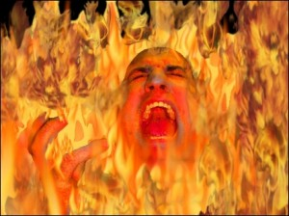
… in flaming fire taking vengeance on those who do not know God, and on those who do not obey the gospel of our Lord Jesus Christ. These shall be punished with everlasting destruction from the presence of the Lord and from the glory of His power, … — 2nd Thessalonians 1:8-9
do
do not know God
do
who do not obey
obey
obey
Notes:
There is no glory in evil works, and missing the word of God’s own truths is the greatest loss of life.

Slide 16
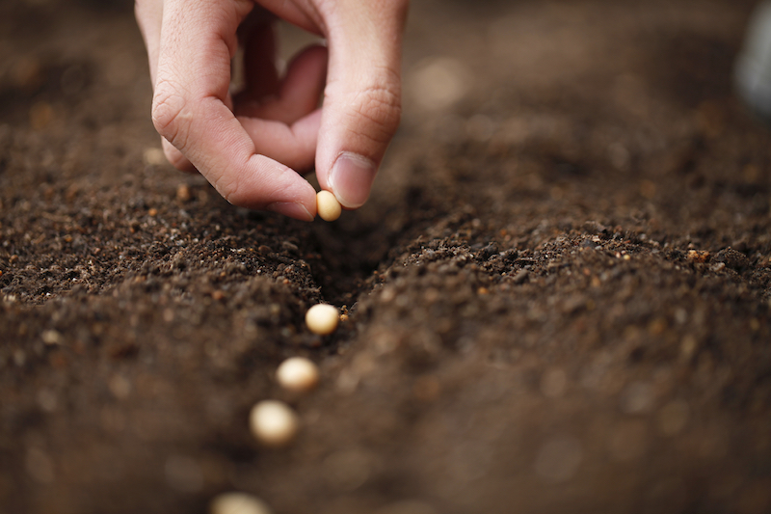
But as for you, brethren, do not grow weary in doing good. And if anyone does not obey our word in this epistle, note that person and do not keep company with him, that he may be ashamed. Yet do not count him as an enemy, but admonish him as a brother. — 2nd Thessalonians 3:13-15
do not
grow weary in doing good
anyone does not obey
obey
WARNING
do
in
do not keep company with him
do not grow weary in doing good
Notes:
The Bible is a book of promises and warnings; a call to conduct describing consequences and results of various human interactions. It is by no means easy to remain in good company when would be friends choose less than honorable directions. Resisting evil is His call to return.

Slide 17
Here is the patience of the saints; here are those who keep the commandments of God and the faith of Jesus. — Revelation 14:12
keep
d
o
do
Notes:
With eternity in sight, disciples pursue faith in the light of His promises through Jesus Christ. God is not an author of confusion, and He has not created the so many faux similarities that man declares in who He is. God has made it plain and clear without conflicting interests. All religious doctrines catering to man hold the darkness He has not lit.

Slide 18
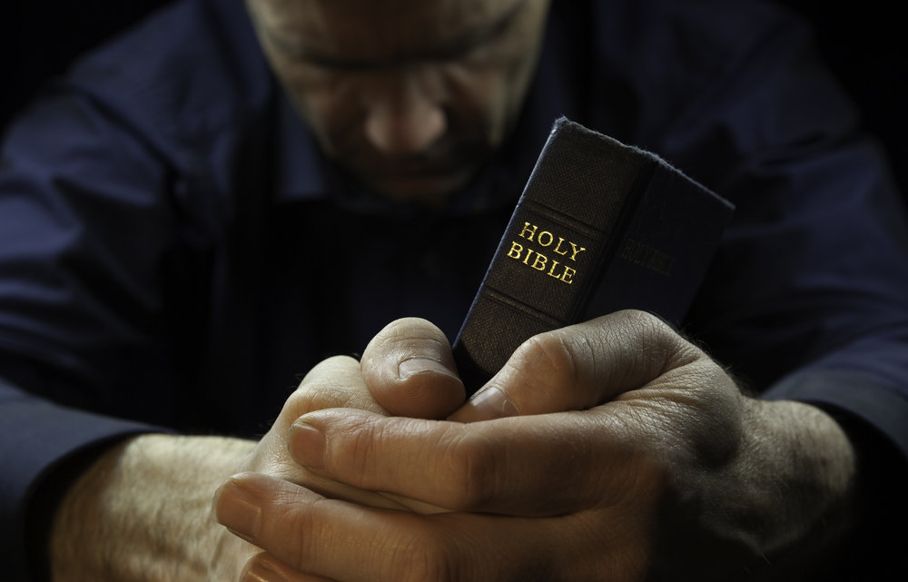
"If you know these things, blessed are you if you do them." — John 13:17
do
Notes:
Doing what He asks is found in His irreplaceable word.

Slide 19
→ By Abraham’s obedience all nations are blessed
→ The instruction is to be careful to walk in His ways
→ God does not want us to dismiss His presence
→ God’s kindness waits for any and all to return
→ Evil hearts do not follow God’s good word
→ Fear of opinions can defeat spiritual courage
→ Those that love God keep His word
→ Blessed are those practicing what God has directed
→ Use all ones intelligence to remain obedient
→ Committing one’s soul to God is an act of faith
→ Damnation awaits all who do not obey God’s word
→ Keeping commandments is a matter of enduring
→ God’s blessings come by following His word
In service one finds what cannot be bought
Notes:
In service one finds what cannot be bought

Slide 21
Obedience
2
Ron Bert
September 22, 2019

Slide 22
But Peter and the other apostles answered and said: "We ought to obey God rather than men. — Acts 5:29
obey
obey God
obey
Notes:
Without knowledge of God, divergence from His ways occurs, and does become polluted through self-seeking within unrestrained desires. Dismissing His truth embraces the lies of men.

Slide 23
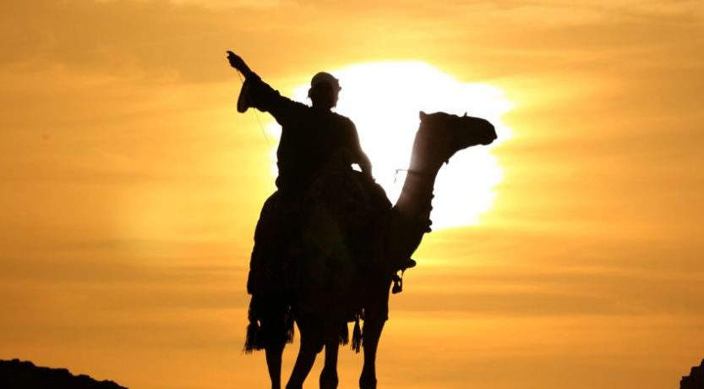
By faith Abraham obeyed when he was called to go out to the place which he would receive as an inheritance. And he went out, not knowing where he was going. — Hebrews 11:8
TRUST
By faith
obey
obey
call
obey
went out
obey
Notes:
Whatever journey we travel we must maintain faith in His will with trusting hearts.

Slide 24
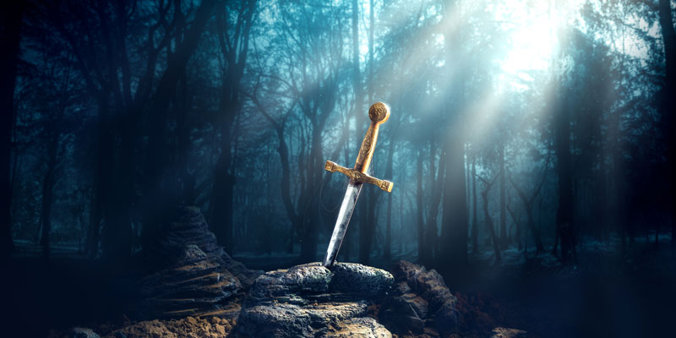
He also opens their ear to instruction, And commands that they turn from iniquity. If they obey and serve Him, They shall spend their days in prosperity, And their years in pleasures. But if they do not obey, They shall perish by the sword, And they shall die without knowledge. — Job 36:10-12
He opens their ear to instruction commands turn from iniquity
If they obey and serve Him
spend their days in prosperity
years in pleasures
But if they do not obey
They shall perish by the sword
die without knowledge
He
opens their ear to
He opens
their ear to instruction
instruction
commands
turn from iniquity
If they
obey
obey and serve Him
obey
Contentment
spend their days in prosperity
He opens
years in pleasures
But if they
their ear to instruction
do
do not obey
do not obey
They shall perish by
obey
the sword
die
Turmoil
without knowledge
Notes:
God has sent His word into the world through the Holy Spirit, and the love of His heart manifest in the flesh. These truths have been plunged into the earth for all to know, of His ways, and His desires for His children in the light. The choice is to live in contentment or be destroyed within turmoil.

Slide 25
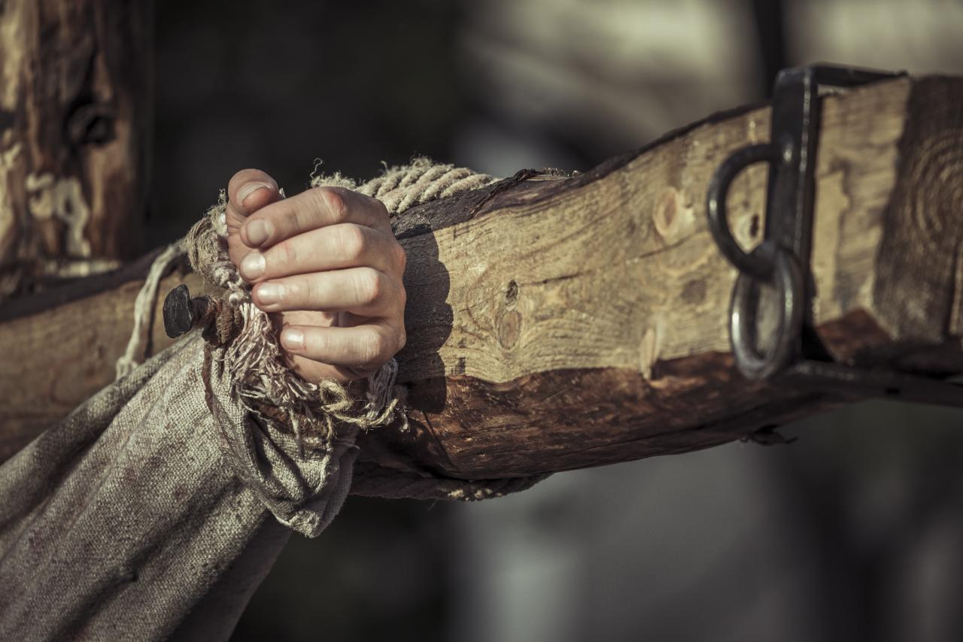
Therefore, as through one man's offense judgment came to all men, resulting in condemnation, even so through one Man's righteous act the free gift came to all men, resulting in justification of life. For as by one man's disobedience many were made sinners, so also by one Man's obedience many will be made righteous. — Romans 5:18-19
Adam
Christ
Holy Spirit
justification of life
obedience
righteous
Notes:
One good man took the fall for all the evils in the world. How many times since, and before, has sacrificial lambs, honest souls, been condemned for telling the truth? Injustice across the ages of man is the misery of unobtained justice that each unfairly soul has felt. Evil will forever steal joy from the upright.

Slide 26
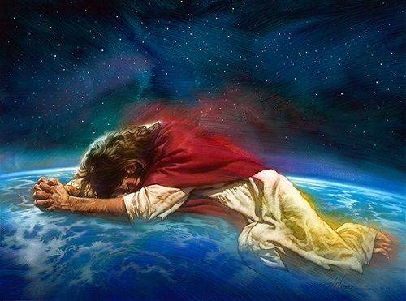
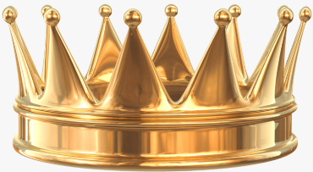
… who, in the days of His flesh, when He had offered up prayers and supplications, with vehement cries and tears to Him who was able to save Him from death, and was heard because of His godly fear, though He was a Son, yet He learned obedience by the things which He suffered. And having been perfected, He became the author of eternal salvation to all who obey Him, … — Hebrews 5:7-9
f
a
i
to
obedience
the
th
He learned obedience by the things
which He suffered
obedience to the faith
author
eternal salvation to all who obey Him
Notes:
Christ is the crown of truth. Suffering delivers strength to endure past previous comforts. Suffering deepens understanding and increases awareness. No one can know the pains of living without experiencing hardships, that one has had to have overcome, gaining that elevated wisdom. Heights of success come to those who have dug from the bottom.

Slide 27
Now who is able to establish you according to my gospel and the preaching of Jesus Christ, according to the revelation of the mystery kept secret since the world began but now has been made manifest, and by the prophetic Scriptures has been made known to all nations, according to the commandment of the everlasting God, for obedience to the faith -- to God, alone wise, be glory through Jesus Christ forever. Amen. — Romans 16:25-27
but now has been made manifest
God
made known to all nations
God
obedience to the faith
God
Notes:
That which establishes a heart rounds off the sanctuary where relaxing occurs. It is obedience that brings happiness to a soul. It is the hand of God that lifts us into comfort without measure. God rises beyond the bickering's of man.

Slide 28
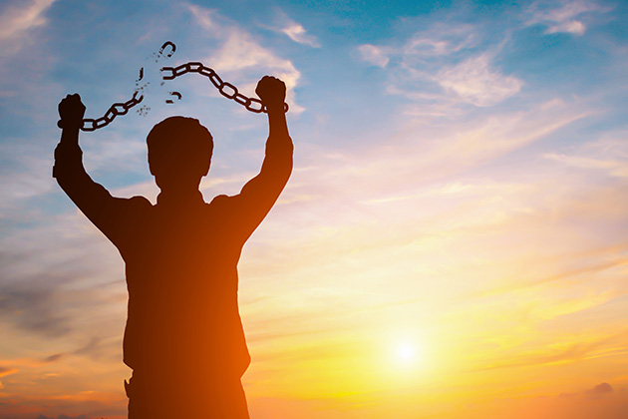
Do you not know to Him that to whom you present yourselves slaves to obey, you are that one's slaves whom you obey, whether of sin leading to death, or of obedience leading to righteousness? But God be thanked that though you were slaves of sin, yet you obeyed from the heart that form of doctrine to which you were delivered. And having been set free from sin, you became slaves of righteousness. — Romans 6:16-18
God
sin leading to death
obedience leading to righteousness
sin leading to death
slaves of sin
obedience leading to righteousness
obeyed from the heart
slaves of righteousness
God
slaves of sin
obeyed from
the heart
slaves of
righteousness
Notes:
If one desires to break the bondage of life’s despair, eternity and the promise of God must take precedence.

Slide 29
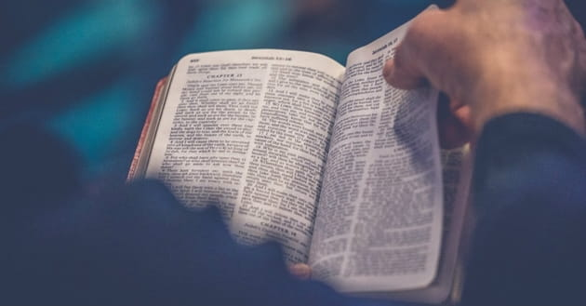
For though we walk in the flesh, we do not war according to the flesh. For the weapons of our warfare are not carnal but mighty in God for pulling down strongholds, casting down arguments and every high thing that exalts itself against the knowledge of God, bringing every thought into captivity to the obedience of Christ, and being ready to punish all disobedience when your obedience is fulfilled. — 2nd Corinthians 10:3-6
For though we walk in the flesh, we do not war according to the flesh. For the weapons of our warfare are not carnal but mighty in God for pulling down strongholds, casting down arguments and every high thing that exalts itself against the knowledge of God, bringing every thought into captivity to the obedience of Christ, and being ready to punish all disobedience when your obedience is fulfilled. — 2nd Corinthians 10:3-6
God
God
Notes:
Thoughts run as they do in the clouds, but if not controlled, they may damage the conscience of a soul. If comfort of thought is a desire, longing for God satisfies more than any store could supply.

Slide 30
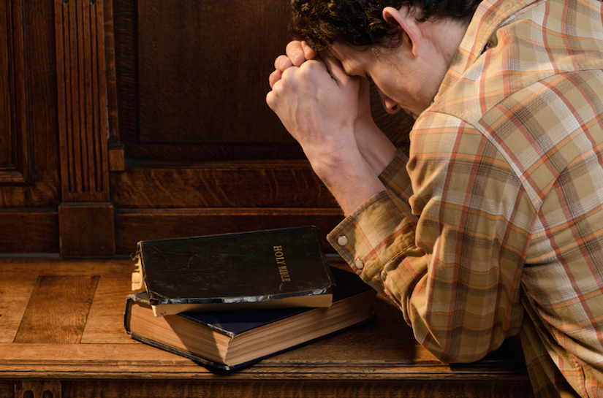
Bondservants, obey in all things your masters according to the flesh, not with eyeservice, as men-pleasers, but in sincerity of heart, fearing God. And whatever you do, do it heartily, as to the Lord and not to men, knowing that from the Lord you will receive the reward of the inheritance; for you serve the Lord Christ. — Colossians 3:22-24
obey
obey
God
do
do it
serve the Lord Christ
serve
Lord Christ
Lord Christ
Notes:
Advanced students have literally gone through several Bibles and multiple gluing attempts. Duct tape prolongs use as we ride the temporary where decay is unavoidable.

Slide 31
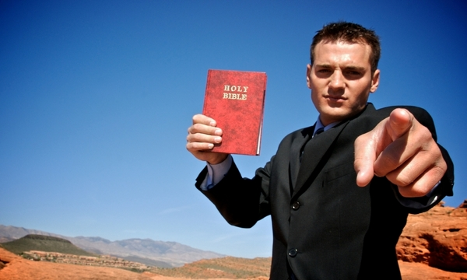
Remind them to be subject to rulers and authorities, to obey, to be ready for every good work, to speak evil of no one, to be peaceable, gentle, showing all humility to all men. — Titus 3:1-2
obey
obey
be ready
Notes:
To be ready one has to know what is asked of in the faith, and actually be a practitioner of these good works. God Himself calls out for reflect His image of goodness and truth. Practicing sin disavows one’s preparedness.

Slide 32
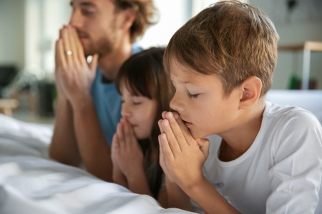
Children, obey your parents in all things, for this is well pleasing to the Lord. — Colossians 3:20
obey
well pleasing
obey
Notes:
Created for God’s pleasure, building excellence comes from legacies of deep faith.

Slide 33
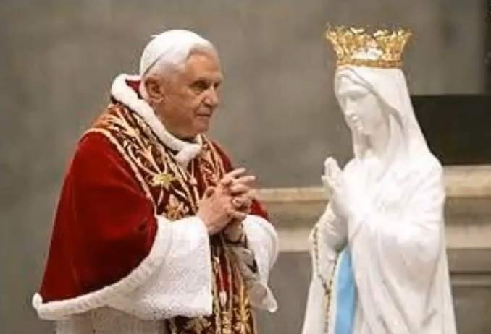
O foolish Galatians! Who has bewitched you that you should not obey the truth, before whose eyes Jesus Christ was clearly portrayed among you as crucified? — Galatians 3:1
obey
obey
not obey the truth
Notes:
There are earthly religions down here that do not adhere to the word of God, but rather, cater to their own doctrines created by traditions of men. There is only one holy Father and shame upon those that claim His name. We obey when we follow the word of God and not the false worship man has doctrinally devised.

Slide 34
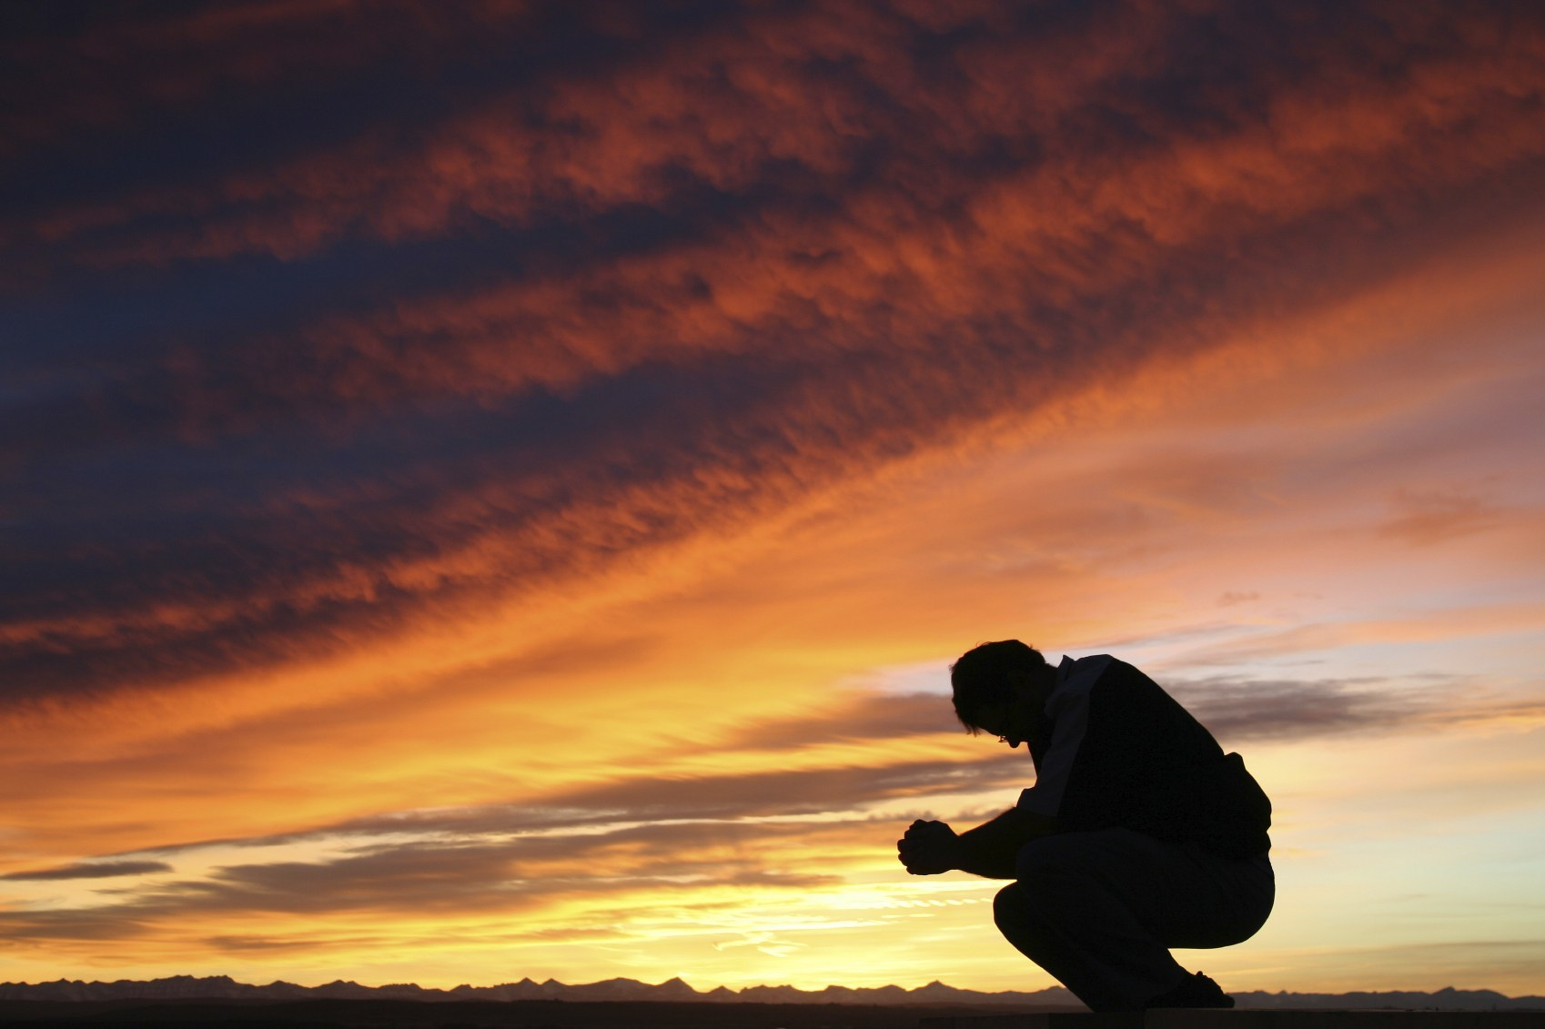
Therefore, my beloved, as you have always obeyed, not as in my presence only, but now much more in my absence, work out your own salvation with fear and trembling; — Philippians 2:12
obey
obey
your own salvation
own
Notes:
Relationship with God is purposed in its’ singular creation.

Slide 35
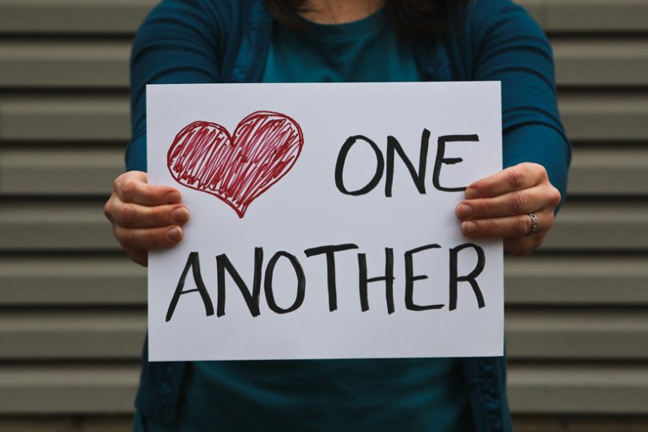
Since you have purified your souls in obeying the truth through the Spirit in sincere love of the brethren, love one another fervently with a pure heart, having been born again, not of corruptible seed but incorruptible, through the word of God which lives and abides forever, … — 1st Peter 1:22-23
obey
honest
in
in sincere love
with a pure heart
Notes:
Honest hearts do leave one vulnerable, to manipulations and abuses by those that would take advantage of this. In a hard world, to be wise is to be desired over those that would exercise deception. Honesty can invoke murderous behaviors in those that deny truth, and who prefer secretiveness within practices of sinfulness. Secret desires hide an open heart. No height can replace where honesty lifts a soul in the satisfaction of living.

Slide 36
"You are My friends if you do whatever I command you." — John 15:14
do
do
do
Notes:
There will always be a fence to climb, and woe the day we have none to see over. Valleys will come before each mountain that must be climbed. For clarity of vision, it can not be done alone. We all have His word to lift us to that next plateau.

Slide 37
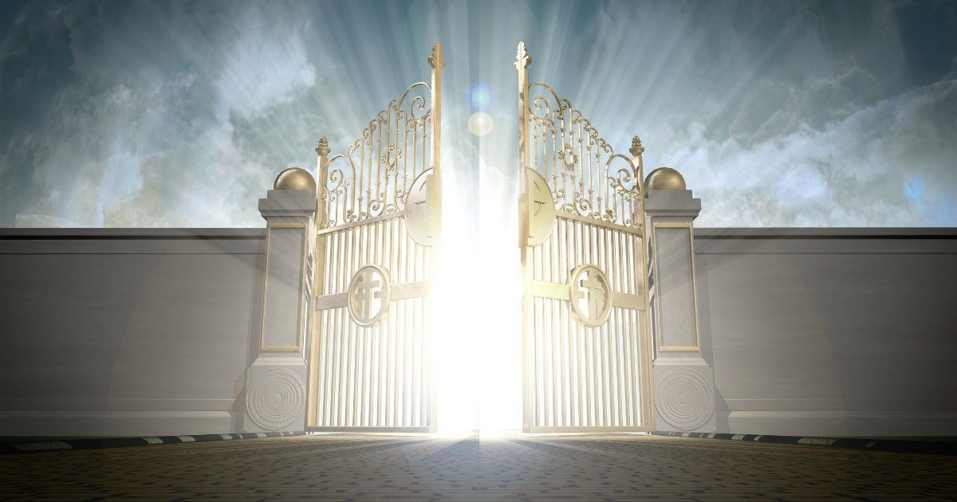
Blessed are those who do His commandments, that they may have the right to the tree of life, and may enter through the gates into the city. — Revelation 22:14
do
do His
do
tree of life
commandments
do His commandments
the right
tree of life
may enter
Notes:
If it is truly a desire to achieve heaven in the presence of God, one must work to do His commandments, to refresh one's life from the root He alone supplies, it is glory upon all who belong.

Slide 38
→ Obeying God takes priority over man’s lawlessness
→ Faith is obeying what can not be proved
→ Serving God obediently delivers tranquility
→ Jesus’ obedience reveals walks to become righteous
→ Refined through suffering deepens dedication
→ The gospel establishes obedience to the faith
→ Obedience renders a righteous heart; sinners die
→ Self-control exalting God’s knowledge is deliverance
→ Loyalty to God first delivers immeasurable rewards
→ We are called to be respectful of authority
→ Charlatans deceive away from the truth of Jesus
→ Obey the truth with a sincere pure heart
→ Obedience leads to salvation in heaven above
Obedience leads to an eternal reward otherwise missed
Notes:
Obedience leads to an eternal reward otherwise missed

Slide 40
Please visit http://www.LoveFromGod.com to explore further
Ronald Bert Channel on
Notes:
Eternity never ends.

