Slide 2
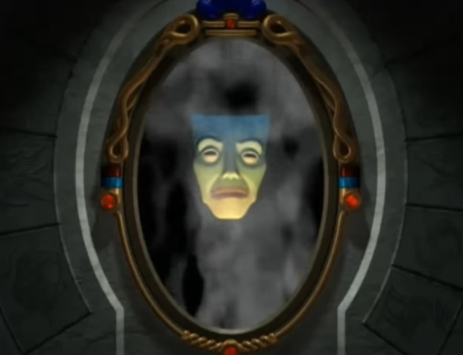
Mirror Mirror
Ron Bert
October 24, 2021
Notes:
One cannot see self if busy blaming others for situations dealt.

Slide 3
As in water face reflects face, So a man's heart reveals the man. — Proverbs 27:19
heart
heart reveals the man
heart reveals the man
heart
Notes:
The bottom of a heart divulges the deepest of desires.

Slide 4
For it is the God who commanded light to shine out of darkness, who has shone in our hearts to give the light of the knowledge of the glory of God in the face of Jesus Christ. — 2nd Corinthians 4:6
God
God
in
. .
has shone in our hearts
heart
Jesus Christ
Jesus Christ
Notes:
All have been touched with life’s presence. Without knowledge of God, social wisdom evaporates, and the chaos of disharmony curses all. God has given us the light to see and it is an individual choice to follow Him or the whims of man.

Slide 5
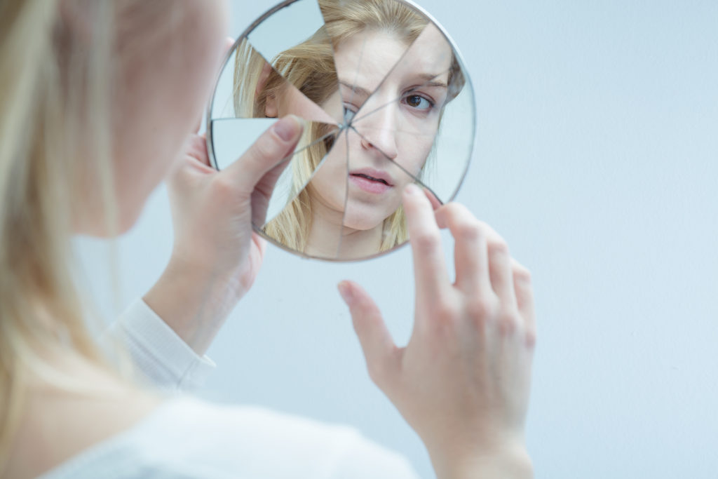
Examine yourselves as to whether you are in the faith. Test yourselves. Do you not know yourselves, that Jesus Christ is in you? --unless indeed you are disqualified. — 2nd Corinthians 13:5
. .
Examine yourselves
in
. .
in the faith
. .
Test yourselves
in
. .
Jesus Christ is in
Jesus Christ
Jesus Christ
you
you
Notes:
One could have a broken faith by not adhering to the principles which have been delivered by God. Rather people use humanistic unholy reasoning, excusing actions in self denial. We all have been afflicted and done wrong, however, this does change the order He calls out for under His creation. Concentration is often found difficult when purging the lower impulses of desire where lust has destroyed so many relationships of spirit. Trust is to lust as vinegar is to water. Spirit holds a depth unequaled.

Slide 6
What shall we say then? Shall we continue in sin that grace may abound? Certainly not! How shall we who died to sin live any longer in it? Or do you not know that as many of us as were baptized into Christ Jesus were baptized into His death? Therefore we were buried with Him through baptism into death, that just as Christ was raised from the dead by the glory of the Father, even so we also should walk in newness of life. — Romans 6:1-4
continue
in sin?
walk in
newness
of life
continue
in sin
grace
grace
?
die
to sin
baptized into Christ Jesus
do you not know
do you not know
baptized into Christ
Jesus
into His death
die
to sin
into His death
raised from
the dead
buried with Him
through baptism
raised from
the dead
buried with Him through baptism
walk in
newness
of life
Notes:
Baptism unites us in His sacrifice of life, to shield us from the wrath that is to come upon all sin. Knowledge of His forgiveness lifts a spirit closer to knowing God and His desire for us to walk in the goodness of life.

Slide 7
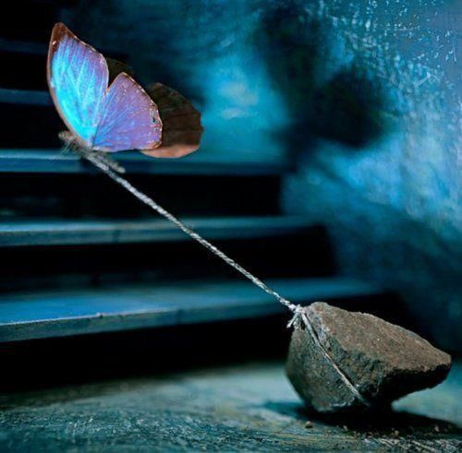
"But take heed to yourselves, lest your hearts be weighed down with carousing, drunkenness, and cares of this life, and that Day come on you unexpectedly. For it will come as a snare on all those who dwell on the face of the whole earth. Watch therefore, and pray always that you may be counted worthy to escape all these things that will come to pass, and to stand before the Son of Man." — Luke 21:34-36
take heed
take heed
"But take heed to yourselves, lest your hearts be weighed down with carousing, drunkenness, and cares of this life, and that Day come on you unexpectedly. For it will come as a snare on all those who dwell on the face of the whole earth. Watch therefore, and pray always that you may be counted worthy to escape all these things that will come to pass, and to stand before the Son of Man." — Luke 21:34-36
ear
weighed down
carousing
drunkenness
cares of
WARNING
this life
n
ear
ear
near
Watch
Watch
weighed down
drunkenness
carousing
cares of this life
that you may
that you may
escape all these things
escape all these things
Notes:
Endurance is a matter of living, and though all carry the weights of breathing, in the flesh, if one surrenders willingly to wickedness, the spiritual shield one needs for God’s salvation plan is dropped, and one will bear alone what is unbearable; eternal death.

Slide 8
"O Lord, righteousness belongs to You, but to us shame of face, as it is this day-to the men of Judah, to the inhabitants of Jerusalem and all Israel, those near and those far off in all the countries to which You have driven them, because of the unfaithfulness which they have committed against You." — Daniel 9:7
but to us shame of face
but to us shame of face
shame of face
shame of face
near
unfaithfulness
unfaithfulness
Notes:
To realize the shame of sin frees a soul from the guilty verdict, to a stance of regret, where repentance turns a contrite heart back to God, and the true purpose of living flourishes.

Slide 9
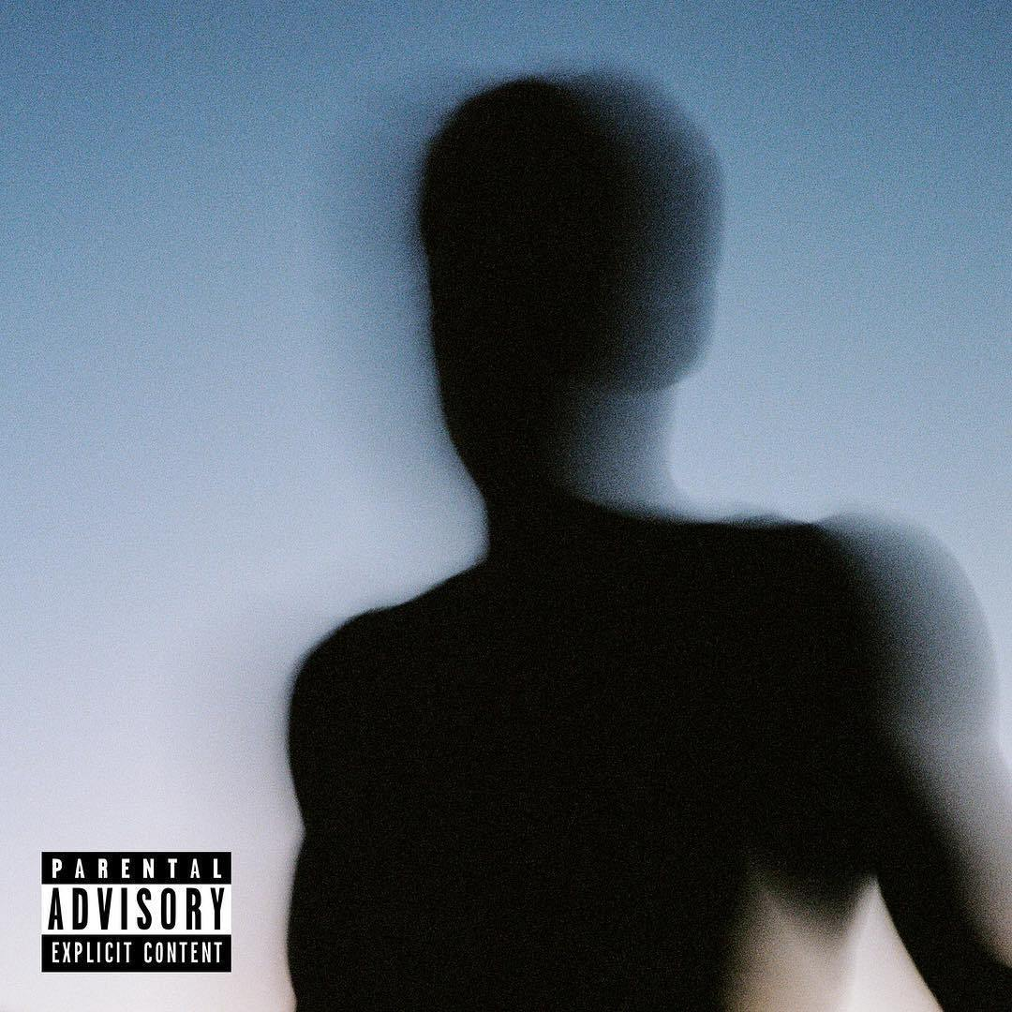
"O Lord, to us belongs shame of face, to our kings, our princes, and our fathers, because we have sinned against You." — Daniel 9:8
shame of face
we have sinned against You
we have sinned against You
Notes:
Sin is a shadow land event. Truth shines in the light, so often covered by the darkness, where soul’s choose to scheme upon each other. It is a devourous world where evil has nothing tender, and greed’s lust tramples the innocence of our child's heart.

Slide 10
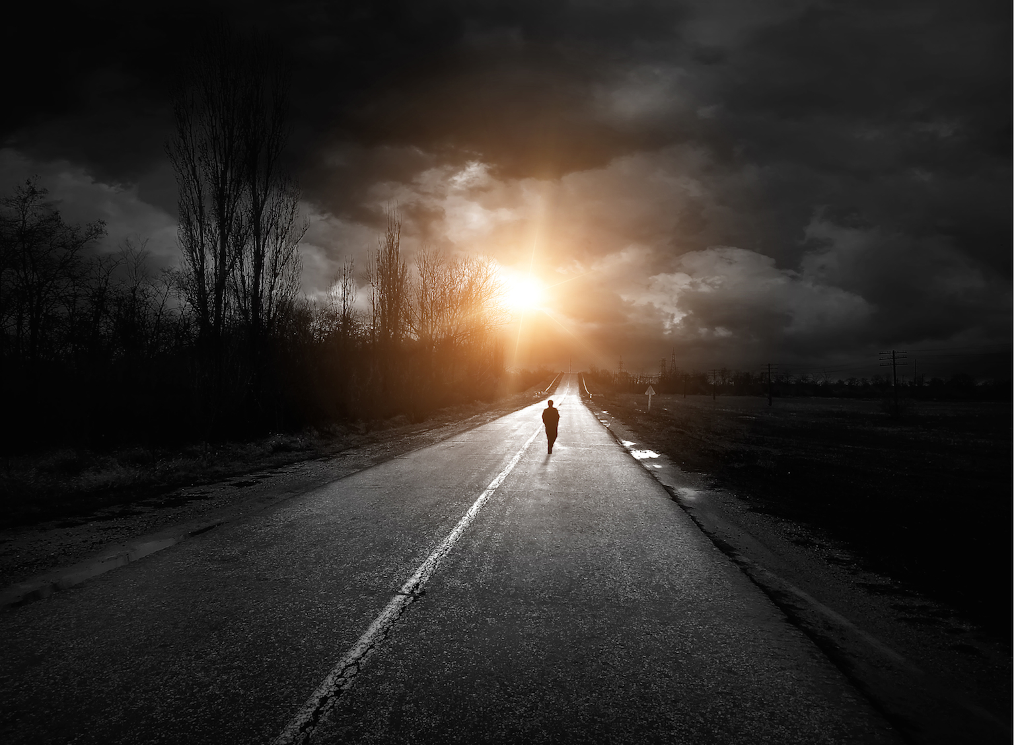
They do not consider in their hearts That I remember all their wickedness; Now their own deeds have surrounded them; They are before My face. — Hosea 7:2
They are before My face
consider in
in
. .
heart
I remember all
their
heart
wickedness
surrounded
They are
before My face
I remember all
their wickedness
Notes:
All is naked before God, and if we neglect to keep this knowledge Holy, the avalanche of evil comes upon a people, resulting with the tragic despair of hopelessness. What we ask for either defiles us or cleanses us. True purpose can not be achieved without free dreams in God’s own light.

Slide 11
They are
They are before My face
before My face
God
surrounded
I remember all
their wickedness
I remember all
their
wickedness

Slide 12
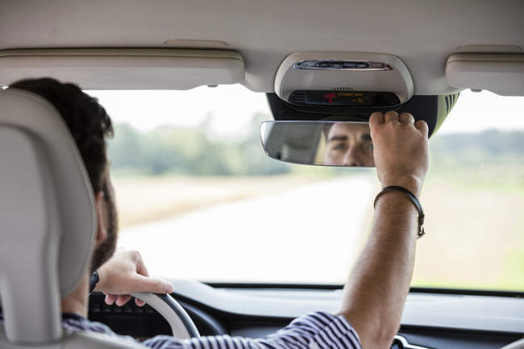
When I was a child, I spoke as a child, I understood as a child, I thought as a child; but when I became a man, I put away childish things. For now we see in a mirror, dimly, but then face to face. Now I know in part, but then I shall know just as I also am known. — 1st Corinthians 13:11-12
When I was a child, I spoke as a child, I understood as a child, I thought as a child; but when I became a man, I put away childish things. For now we see in a mirror, dimly, but then face to face. Now I know in part, but then I shall know just as I also am known. — 1st Corinthians 13:11-12
thought as a child
. .
. .
then face to face
I shall know just as I also am known
Notes:
To take notice of the self, and mistakes of love and hate, in pursuit of truth, reveals the sigh of a mature soul.

Slide 13
came to himself

Slide 14
"But when he came to himself, he said, 'How many of my father's hired servants have bread enough and to spare, and I perish with hunger! I will arise and go to my father, and will say to him, "Father, I have sinned against heaven and before you, and I am no longer worthy to be called your son. Make me like one of your hired servants."'" — Luke 15:17-19
came to himself
confess
I have sinned
. .
Notes:
Coming to yourself is that epiphany moment where God is God, and we are all but mere men. Arrogance has always dug holes where emptiness fills what is left over.

Slide 15
new man

Slide 16
… if indeed you have heard Him and have been taught by Him, as the truth is in Jesus: that you put off, concerning your former conduct, the old man which grows corrupt according to the deceitful lusts, and be renewed in the spirit of your mind, and that you put on the new man which was created according to God, in true righteousness and holiness. — Ephesians 4:21-24
if taught truth by Jesus:
put off your former conduct
↓
the old corrupt man
↙ ↘
be renewed in the spirit of your mind
put on the new man
created according to God
in true righteousness
and holiness
if
taught
by
the truth
truth
the truth
is in Jesus
=
in
Jesus
put off
is in Jesus
your former conduct
the old
man
corrupt
in
in the spirit of your mind
be renewed in the
in the spirit of your mind
spirit of your mind
put
God
on the new man
created
new man
in
according to God
in true righteousness
and holiness
Notes:
Coming to the word of God comes with blessings untold where truth unlocks a heart.

Slide 17
As was the man of dust, so also are those who are made of dust; and as is the heavenly Man, so also are those who are heavenly. And as we have borne the image of the man of dust, we shall also bear the image of the heavenly Man. — 1st Corinthians 15:48-49
shall
Flesh
shall
Spirit
bear the image of the heavenly
bear the image of the heavenly
Man
Man
Notes:
Marvelous is His truth where souls become the song of life rising from the dust.

Slide 18
Blessed are the pure in heart, For they shall see God. — Matthew 5:8
in
pure in heart
. .
pure in heart
shall
Notes:
Undeniable is the peace love holds in an unbroken heart believing in the promise of His stars ascending.

Slide 19
like Him

Slide 20
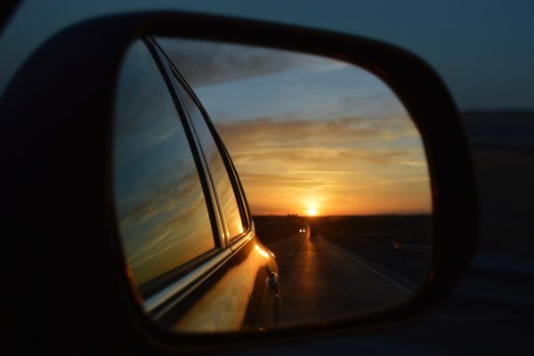
Beloved, now we are children of God; and it has not yet been revealed what we shall be, but we know that when He is revealed, we shall be like Him, for we shall see Him as He is. And everyone who has this hope in Him purifies himself, just as He is pure. — 1st John 3:2-3
h
o
worthy
. .
we shall be like Him
w
like Him
y
hope
t
r
Notes:
Hope is something seen ahead where the past has been left behind. True value is found in what one does today for tomorrow.

Slide 21
For I consider that the sufferings of this present time are not worthy to be compared with the glory which shall be revealed in us. — Romans 8:18
pray always
take heed
r
confess
i
mirror
worthy
o
hope
glory
m
r
r
newness of life
come to yourself
knowledge
Notes:
Vision has no expression to paint the love waiting for those faithful hearts hoping in His spoken truths.

Slide 22
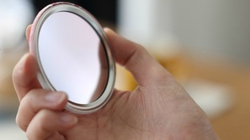
But be doers of the word, and not hearers only, deceiving yourselves. For if anyone is a hearer of the word and not a doer, he is like a man observing his natural face in a mirror; for he observes himself, goes away, and immediately forgets what kind of man he was. But he who looks into the perfect law of liberty and continues in it, and is not a forgetful hearer but a doer of the work, this one will be blessed in what he does. — James 1:22-25
be doers of the word
be doers of the word
mirror
mirror
immediately forgets
continues in it
in
continues in it
forgetful hearer
Notes:
One must see His truth as a special revelation calling a soul to action in the presence of God Himself.

Slide 23
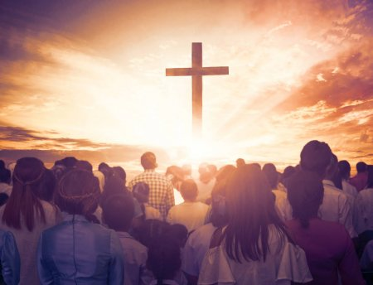
Now the Lord is the Spirit; and where the Spirit of the Lord is, there is liberty. But we all, with unveiled face, beholding as in a mirror the glory of the Lord, are being transformed into the same image from glory to glory, just as by the Spirit of the Lord. — 2nd Corinthians 3:17-18
transformed
honesty
unveiled face
unveiled face
mirror the glory of the Lord
mirror the glory of the Lord
mirror
glory
glory
transformed
Notes:
Freedom is a gift of God to be recreated in His image.

Slide 24
And do not be conformed to this world, but be transformed by the renewing of your mind, that you may prove what is that good and acceptable and perfect will of God. — Romans 12:2
transformed
renewing of your mind
renewing of your mind
God
God
Notes:
Heavenly truths do just that, transform us into creatures of God thankful for His offering of eternal life.

Slide 25
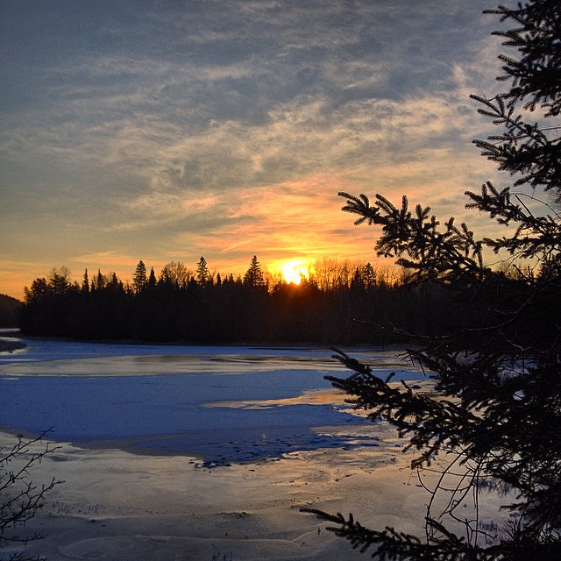
As for me, I will see Your face in righteousness; I shall be satisfied when I awake in Your likeness. — Psalms 17:15
God
in
. .
awake in Your likeness
Notes:
To be a child of God has no greater value.

Slide 26
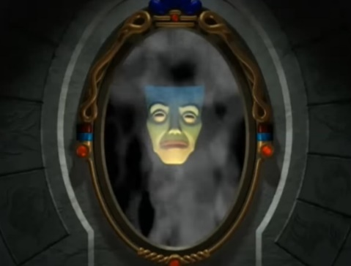
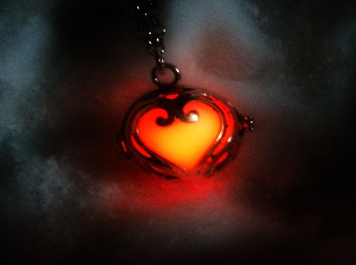
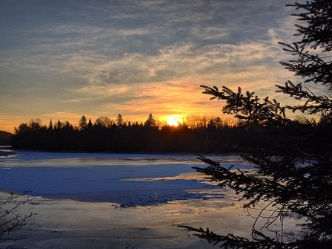
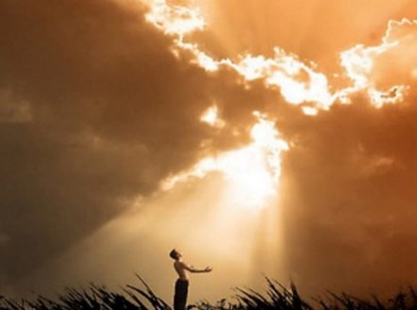

Slide 27
→ The heart of one reveals the person
→ Test: One must know Christ is in you or disqualified
→ Baptized in Christ we should walk in newness of life
→ Pray to be counted worthy at His appearing
→ Shame on all the faces of unfaithfulness
→ All the wickedness man is before the face of God
→ To see clearly one sees self for as one is
→ Coming to yourself is an act of humbling truth
→ Put off the old man and put on the new man
→ Sufferings now cannot compare to glory ahead
→ Forgetting God’s word only deceives awareness
→ Seeing God’s glory transforms us into His image
→ Be transformed by the renewing of your mind
Deep self reflection brings a heart back to God
Notes:
Deep self reflection brings a heart back to God.

Slide 29
Please visit http://www.LoveFromGod.com to explore further
Ronald Bert Channel on
Notes:
Eternity never ends.

