Slide 1
Notes:
Without light, there is no love.

Slide 2
Bert
Ron
December 20, 2015
March 28, 2021
Notes:
Love is what radiates all truth.

Slide 3
Ron
Bert
December 20, 2015
March 28, 2021
Notes:
Love reveals the deepest part of a soul.

Slide 4
Notes:
Love involves a condition of trust.

Slide 5
Notes:
Love associates with a desire to be close.

Slide 6
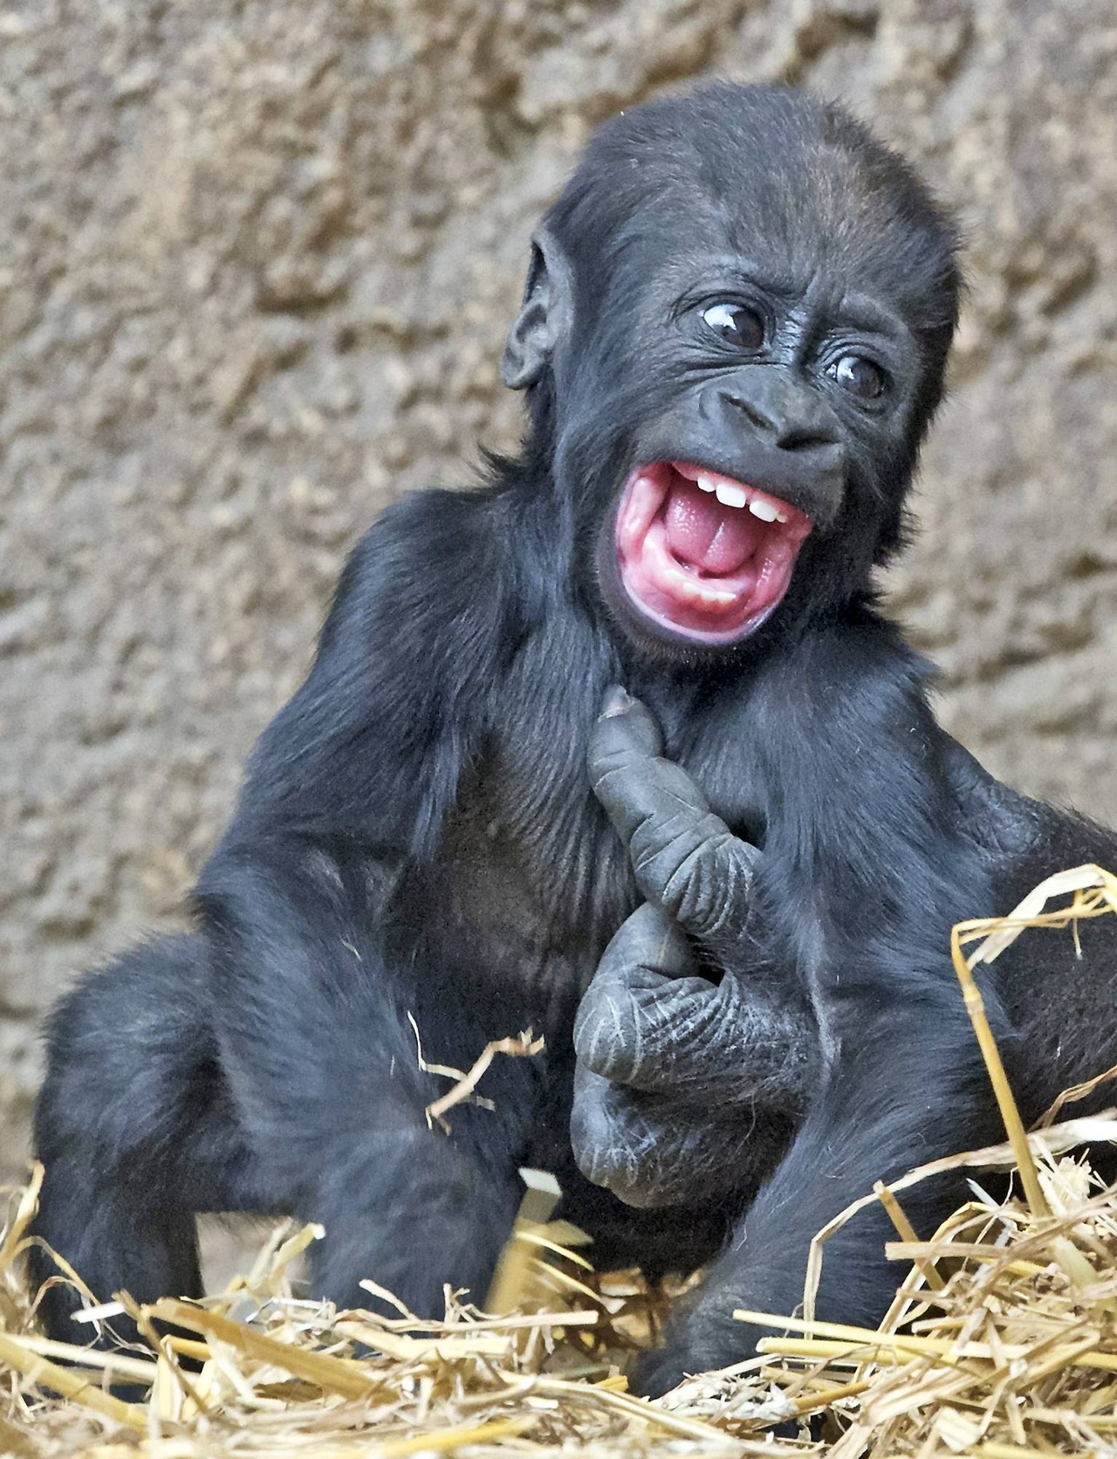
Notes:
Love engages an undivided attention often accompanied with the innocent joy of laughter. There is an enduring youthful exuberance to love. Such is the thrill of love.

Slide 7
Notes:
How can one define the light of love? Life is drawn to the light where love is given.

Slide 8
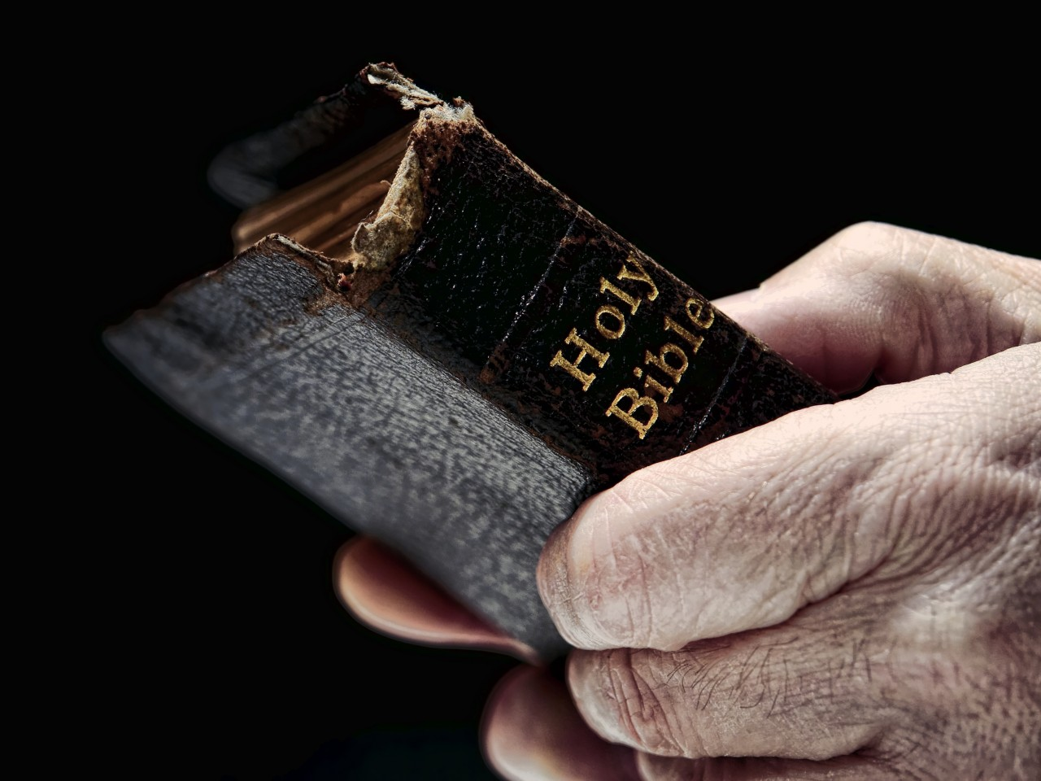
I love those who love me, And those who seek me diligently will find me. — Proverbs 8:17
love
love
will find me
will find me
Notes:
Love is best served on a two way street where the intersection meets in agreement. To find God is to know God.

Slide 9
This is love, that we walk according to His commandments. This is the commandment, that as you have heard from the beginning, you should walk in it. — 2nd John 1:6
love
This is love
This is love
=
walk according to His
commandments
walk in it
in
Notes:
True love is humbled by God in desire to be in service to Him. Each of us struggle with the failings the litter the past marches of man.

Slide 10
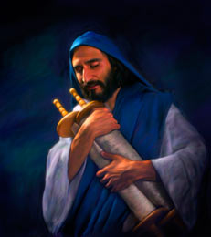
"If you love Me, keep My commandments. — John 14:15
love
keep
keep
Notes:
For the love of God, one yearns to be close pleasing Him. As a fly is attracted to the light, submission to His brilliant loving truths gains the holiness bravery seeks. In a world descending to indecency, His light lifts all who respond to the call.

Slide 11
"If you love Me, keep My commandments. — John 14:15
love
keep
keep

Slide 12
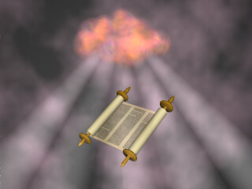
"He who has My commandments and keeps them, it is he who loves Me. And he who loves Me will be loved by My Father, and I will love him and manifest Myself to him." — John 14:21
?
who
keeps
is he who loves Me
=
is he who loves Me
love
love
show
reveal
certify
express
uncover
manifest
manifest
Notes:
The fulfillment of a heart can only find solace in obeying the Lord’s will. Godliness is considering God before dismissing Him for selfish pursuits.

Slide 13
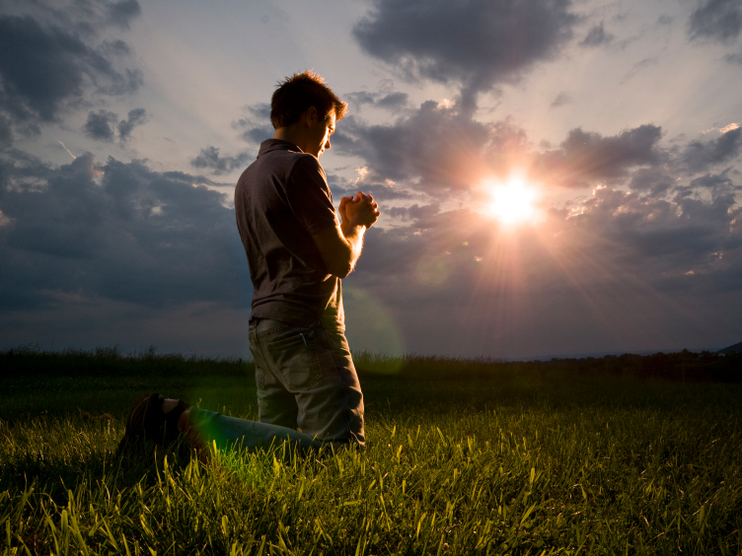
But if anyone loves God, this one is known by Him. — 1st Corinthians 8:3
love
God
is known
is known
Notes:
God sees all hearts, especially those that submit to Him in love. Freedom has been given that we choose the direction of character, be it coming to or turning away.

Slide 14
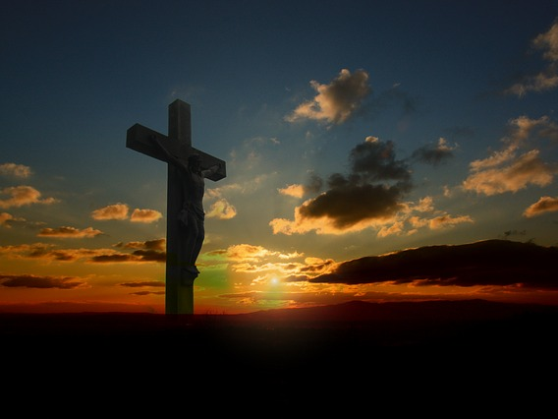
But God demonstrates His own love toward us, in that while we were still sinners, Christ died for us. — Romans 5:8
God
God
God sacrified Himself
for each one of us.
love
love
own
Christ died for us
Christ died for us
Christ
Notes:
God’s love is exposed in His sacrifice to redeem us in His purity. Part of being created in His image is the acts of giving.

Slide 15
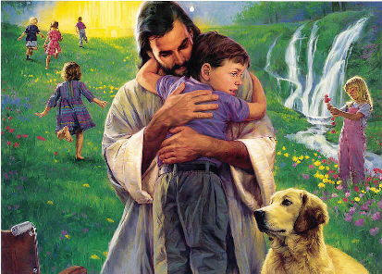
My little children, let us not love in word or in tongue, but in deed and in truth. — 1st John 3:18
love
in
in
in deed and in truth
in deed and in truth
in
in
Notes:
God looks for genuine hearts in the actions of love.

Slide 16
But whoever keeps His word, truly the love of God is perfected in him. By this we know that we are in Him. — 1st John 2:5
keeps
love
know
in Him
know
in
Him
in Him
Notes:
The light of a heart brightens when commitment in Him is sure. Connection to God is direct and not bisected through the behaviors of others. The question is who is one?

Slide 17
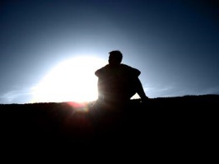
In this the children of God and the children of the devil are manifest: Whoever does not practice righteousness is not of God, nor is he who does not love his brother. — 1st John 3:10
of God
of the devil
practice righteousness
righteous
practice righteousness
love
righteous
love
Notes:
A true heart shines shamelessly in pursuit of His example of love. Selfless acts are derived of God where selfishness cleaves to the darkness of isolation.

Slide 18
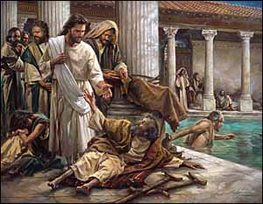
The LORD opens the eyes of the blind; The LORD raises those who are bowed down; The LORD loves the righteous. — Psalm 146:8
love
LORD loves
the righteous
LORD loves
righteous
the righteous
Notes:
For those that obey the Lord inherit the flow of His love.

Slide 19
The desire of the righteous is only good, But the expectation of the wicked is wrath. — Proverbs 11:23
righteous
es
s
goodness
wrath
good
n
wrath
Notes:
The closer to God brings the goodness of a soul to rise. Each must examine, that test of heart, to see whether it holds bitter wrath over the magic of love’s rising pursuits.

Slide 20
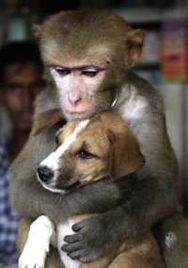
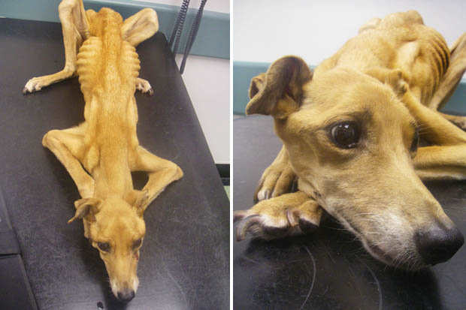
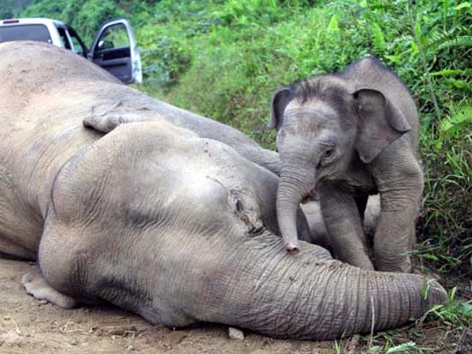
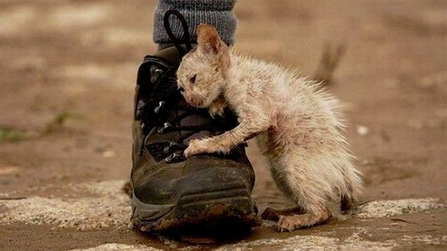
A righteous man regards the life of his animal, But the tender mercies of the wicked are cruel. — Proverbs 12:10
Neglect?
Sympathy?
righteous
wicked are cruel
wicked are cruel
Notes:
Righteousness is a cherishing of life for the life that is. Many abandon hope to hopelessness where disgust reigns over humble thankfulness.

Slide 21
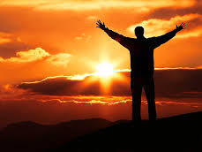
For with the heart one believes unto righteousness, and with the mouth confession is made unto salvation. — Romans 10:10
. .
For with the heart one believes unto righteousness, and with the mouth confession is made unto salvation. — Romans 10:10
with the heart
righteous
admission
divulgence
Secret?
acknowledgment
disclosure
honesty
confession is
. .
salvation
salvation
Hidden?
Notes:
Through one’s deepest of thoughts comes what is spoken from the heart. Salvation is not hidden in secret where hypocrites die.

Slide 22
salvation
salvation
Hidden?

Slide 23
Beloved, let us love one another, for love is of God; and everyone who loves is born of God and knows God. He who does not love does not know God, for God is love. — 1st John 4:7- 8
love
one
love
another
love
love
love
love
love
love
love
love
Notes:
To know love is the reason of life, and living for a higher cause beyond self, opening a heart to all that is greater. No thrill can replace the truth of that it is. Sharing is an external act building the internal toward untold heights.

Slide 24
In this the love of God was manifested toward us, that God has sent His only begotten Son into the world, that we might live through Him. In this is love, not that we loved God, but that He loved us and sent His Son to be the propitiation for our sins. — 1st John 4:9 -10
love
love of God
love of God
love of God
love of God
In
love of God
love
. .
this is love
love
love
God
God
sent His Son
. .
for our sins
. .
Notes:
To live through the love of God is the greatest a soul can achieve. Acknowledging what God has done reveals the deepest parts of knowing.

Slide 25
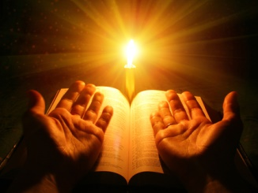
He has delivered us from the power of darkness and conveyed us into the kingdom of the Son of His love, … — Colossians 1:13
love
into
into
love
His love
His love
redemption
forgiveness of sins
Notes:
His love lifts us to eternity where He lives to unfold.

Slide 26
Beloved, if God so loved us, we also ought to love one another. No one has seen God at any time. If we love one another, God abides in us, and His Love has been perfected in us. — 1st John 4:11-12
love one another
God
love
Love
love one another
love one another
perfected
Love
His Love
His Love
perfected in us
perfected
in
perfected in us
Notes:
Love reflects the true nature of God, and to love is to be free of hate. As love pays for life, hate steals sinking in a heart’s death.

Slide 27
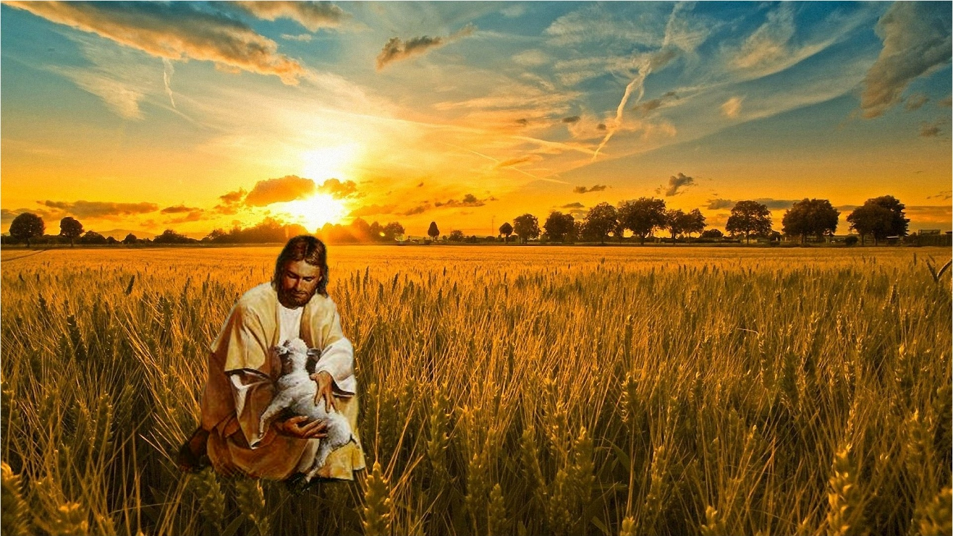
And we have known and believed the love that God has for us. God is love, and he who abides in love abides in God, and God in him. Love has been perfected among us in this: that we may have boldness in the day of judgment; because as He is, so are we in this world. — 1st John 4:16 -17
as He is
God is love ↓
God has love for us so are we
↘
who abides in love
↓ ↖
abides in God God in him
love
God has
for us
God
is love
he who abides in love
who abides in love
he who abides in love
in
abides in God
in
God in him
abides in God
in
abides in God
Love
perfected
in
may have
boldness
may have
in the day of judgment
in
as
He is
in
in
so are we
Notes:
Belief in God’s love for us deliverers a sure heart to know eternity waits. Confidence is the calm of life.

Slide 28
There is no fear in love; but perfect love casts out fear, because fear involves torment. But he who fears has not been made perfect in love. We love Him because He first loved us. — 1st John 4:18 -19
no fear in love
in
love
no fear in love
love
in
in
in
love
love
love
He first loved us
love
Notes:
Peaceful love can take pause in times of great sacrifice and suffering before it settles in His overwhelming healing light. He trusts that we may find Him and become whole in that He is. Trust is synonymous with love.

Slide 29
But above all these things put on love, which is the bond of perfection. — Colossians 3:14
love
love
love
perfection
perfection
Notes:
Perfection can only be had by love brilliantly purging the darkness.

Slide 30
If someone says, "I love God," and hates his brother, he is a liar; for he who does not love his brother whom he has seen, how can he love God whom he has not seen? And this commandment we have from Him: that he who loves God must love his brother also. — 1st John 4:20 -21
love
love
love
love
love
love
love
must love
love
must love
Notes:
Love is transparent and holds no animosity. For one to say he loves God and holds hate in his heart is a liar against the peace love delivers.

Slide 31
"A new commandment I give to you, that you love one another; as I have loved you, that you also love one another. By this all will know that you are My disciples, if you have love for one another." — John 13:34 - 35
one
another
one another
love
one
another
Notes:
To be of God, love must be the scepter of one’s heart.

Slide 32
Now the purpose of the commandment is love from a pure heart, from a good conscience, and from sincere faith, … — 1st Timothy 1:5
love from
↘
● a pure heart
● a good conscience
● sincere faith
God’s directives
love from
commandment
love from
commandment
love from
a pure heart
a good
a pure heart
a pure heart
conscience
sincere
faith
Notes:
Love is the only way to obtain a genuine life. To find one’s pure heart is to cleave to the noble qualities of a good conscience in the truth of a sincere faith derived of His word. God’s directives deliver the best a soul can be.

Slide 33
But concerning brotherly love you have no need that I should write to you, for you yourselves are taught by God to love one another; — 1st Thessalonians 4:9
taught by
taught by
one another
God to love one another
God
love
God to love one another
Notes:
God is clear that we must love if we are to be. What God teaches is for souls to return to the loving existence He intended from the beginning. The end of true love comes by the lies chosen over the truth.

Slide 34
Let love be without hypocrisy. Abhor what is evil. Cling to what is good. Be kindly affectionate to one another with brotherly love, in honor giving preference to one another; — Romans 12:9 -10
love
without hypocrisy
Be kind
Be kind
one another
one
another
Notes:
God wills that decent love would amplify over those that would cheat it and prowl upon the weak. It is weakness that fails to stand in the truth.

Slide 35
And above all things have fervent love for one another, for "love will cover a multitude of sins." — 1st Peter 4:8
ready
eager
passionate
intense
one another
one another
fervent
fervent
Notes:
Love has the healing force of forgiveness.

Slide 36
Hatred stirs up strife, But love covers all sins. — Proverbs 10:12
covers all sins
. .
Notes:
Love removes hardship enveloped in His love. To love is to remove the darkness and shine the light.

Slide 37
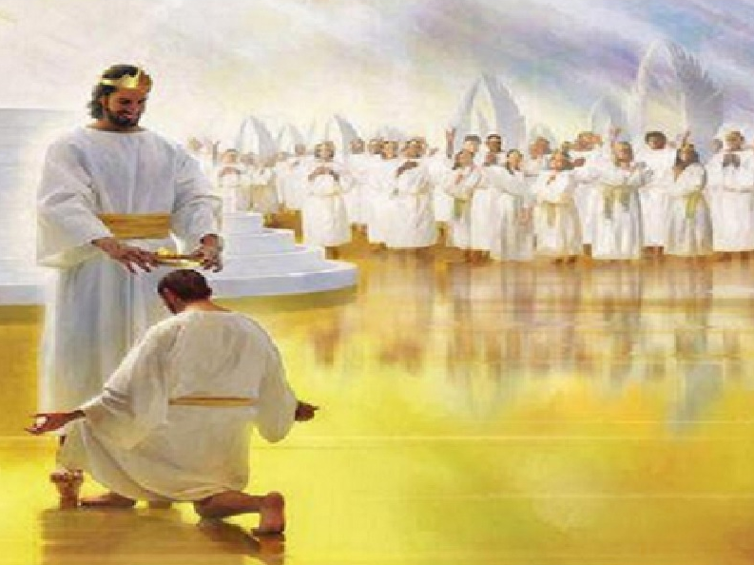
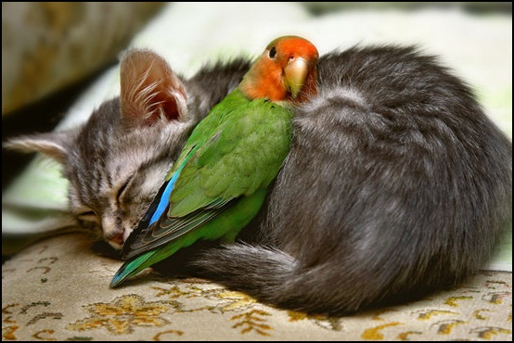
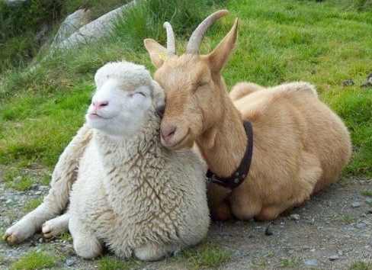
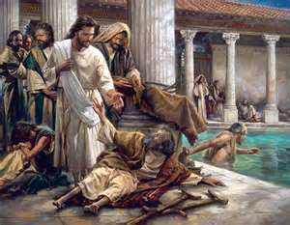
Honor all people. Love the brotherhood. Fear God. Honor the king. — 1st Peter 2:17
Love
Notes:
To love one another uncontemptuously is the challenge of the ages.

Slide 38
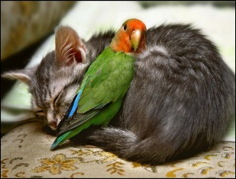
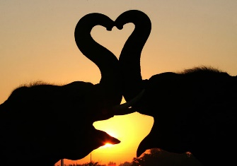
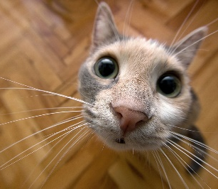
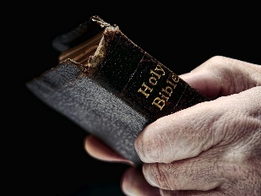
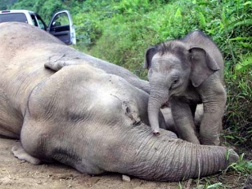
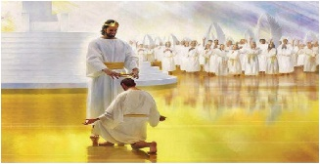

Slide 39
→ God loves those who love Him
→ Love walks according to His commandments
→ Keeping His word reveals our love for Him
→ God knows those who really love Him
→ He loves the sincere faith of the righteous
→ Love in deed and truth over shallow words
→ We should love one another & the brethren
→ Christ died to reveal how much God loves us
→ His love is such so we may live through Him
→ To love is to know God for God is love
→ We are in the kingdom of the Son of His love
→ Love has no fear and purges all hypocrisy
→ The bond of perfection, love covers all sins
God reveals Himself to believing hearts
Notes:
Will you embrace His will to submit and obey? It is a matter of life in the light.

Slide 40
Notes:
There is no greater hardship than facing darkness.

Slide 41
Bert
Ron
December 20, 2015
April 4, 2021
Notes:
Love is what radiates all truth.

Slide 42
Bert
Ron
PART 2
December 20, 2015
April 4, 2021
Notes:
Love reveals the deepest part of a soul.

Slide 43
Notes:
To care simply commands joy.

Slide 44
Notes:
No matter of any appearance, love always finds comfort.

Slide 45
Now concerning things offered to idols: We know that we all have knowledge. Knowledge puffs up, but love edifies. — 1st Corinthians 8:1
Uplifts
Unites
Informs
love
Enlightens
Educates
love
edifies
Teaches
Improves
Instructs
Notes:
Above all knowledge, love opens the mind to see.

Slide 46
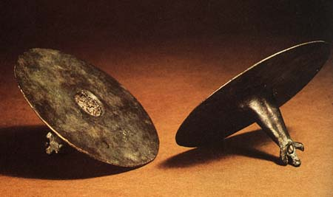
Though I speak with the tongues of men and of angels, but have not love, I have become sounding brass or a clanging cymbal. — 1st Corinthians 13:1
love
have not love
have not love
Notes:
Love holds a silence of heart excluding the noise of life.

Slide 47
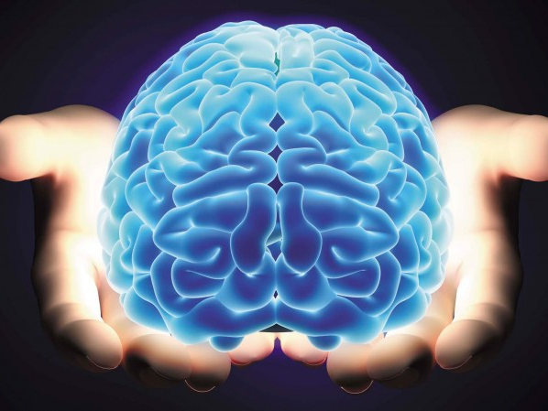
And though I have the gift of prophecy, and understand all mysteries and all knowledge, and though I have all faith, so that I could remove mountains, but have not love, I am nothing. — 1st Corinthians 13:2
understand all
all knowledge
love
all faith
have not love
have not love
love
I am nothing
I am nothing
Notes:
All that one could aspire to be or to attain is short of what one breath of love delivers.

Slide 48
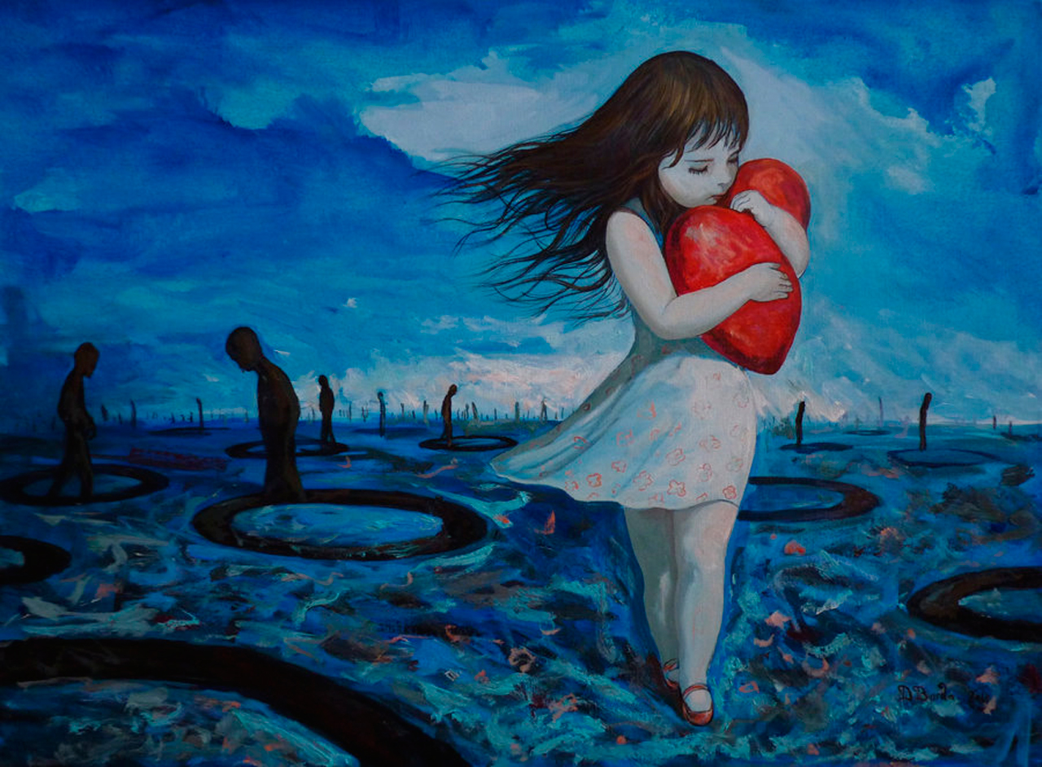
Love suffers long and is kind; love does not envy; love does not parade itself, is not puffed up; — 1st Corinthians 13:4
love
Notes:
Humbled love maintains through the hardships of pain.

Slide 49
… does not behave rudely, does not seek its own, is not provoked, thinks no evil; does not rejoice in iniquity, but rejoices in the truth; bears all things, believes all things, hopes all things, endures all things. Love never fails. But whether there are prophecies, they will fail; whether there are tongues, they will cease; whether there is knowledge, it will vanish away. — 1st Corinthians 13:5-8
truth
rejoices in the truth
in
. .
love
love
Love never fails
Love
. .

Slide 50
And now abide faith, hope, love, these three; but the greatest of these is love. — 1st Corinthians 13:13
faith
hope
love
love
LOVE
love
Notes:
Love connects a heart to the eternal.

Slide 51
Let all that you do be done with love. — 1st Corinthians 16:14
all
love
Notes:
The more one loves, the greater the strength of spirit reveals the soul.

Slide 52
And let us consider one another in order to stir up love and good works, not forsaking the assembling of ourselves together, as is the manner of some, but exhorting one another, and so much the more as you see the Day approaching. — Hebrews 10:24-25
one another
one another
stir up love
love
love
love
not forsaking the assembling
love
of ourselves together
Notes:
Desperate times call for the faithful to hold together for the greater purpose of love.

Slide 53
Now may our Lord Jesus Christ Himself, and our God and Father, who has loved us and given us everlasting consolation and good hope by grace, comfort your hearts and establish you in every good word and work. — 2 ^{nd} Thessalonians 2:16 -17
Now may our Lord Jesus Christ Himself, and our God and Father, who has loved us and given us everlasting consolation and good hope by grace, comfort your hearts and establish you in every good word and work. — 2 ^{nd} Thessalonians 2:16 -17
love
love
who has loved us
loved
who has loved us
love
good hope by grace
Notes:
In word and works love is established. By grace hope is a gift of God.

Slide 54
… that He would grant you, according to the riches of His glory, to be strengthened with might through His Spirit in the inner man, that Christ may dwell in your hearts through faith; that you, being rooted and grounded in love, may be able to comprehend with all the saints what is the width and length and depth and height -- to know the love of Christ which passes knowledge; that you may be filled with all the fullness of God. — Ephesians 3:16 -19
fullness of Christ
love
may be able
grounded in love
grounded in love
may be able
comprehend
comprehend
Christ
love of Christ
to know
to know
may be filled
may be filled
fullness of
Notes:
His light bathes us in the touch of His glory surpassing all knowledge. Only love enables us to know the extent of the purpose of God for His creation in our return to Him.

Slide 55
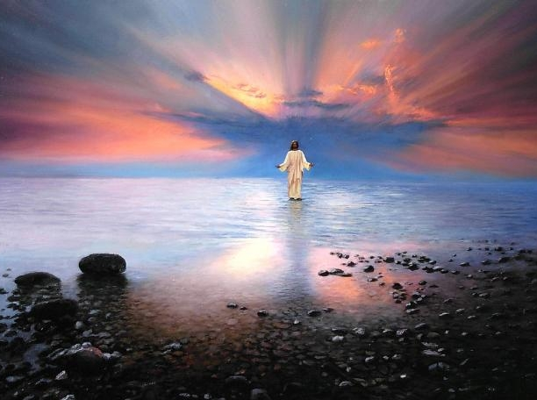
… till we all come to the unity of the faith and of the knowledge of the Son of God, to a perfect man, to the measure of the stature of the fullness of Christ; that we should no longer be children, tossed to and fro and carried about with every wind of doctrine, by the trickery of men, in the cunning craftiness of deceitful plotting, but, speaking the truth in love, may grow up in all things into Him who is the head -- Christ — Ephesians 4:13 -15
fullness of Christ
no longer
no longer
carried about
carried about
trickery of men
trickery of men
love
truth in love
in
truth in love
Notes:
No higher ideal is there than to speak the truth in love. The trickery and self-seeking of men often sway people to believe lies void of the truth, where the practice of hate and greed deny what He has announced.

Slide 56
And this I pray, that your love may abound still more and more in knowledge and all discernment, — Philippians 1:9
love
pray
pray
abound still more and more
abound still more and more
love
judgment
intelligence
perception
awareness
Notes:
Love is a mountain whose summit touches the top of the sky.

Slide 57
But you, beloved, building yourselves up on your most holy faith, praying in the Holy Spirit, keep yourselves in the love of God, looking for the mercy of our Lord Jesus Christ unto eternal life. — Jude 1:20 -21
pray
keep
love
Notes:
Prayers for mercy is what carries us into eternity.

Slide 58
But you, beloved, building yourselves up on your most holy faith, praying in the Holy Spirit, keep yourselves in the love of God, looking for the mercy of our Lord Jesus Christ unto eternal life. — Jude 1:20 -21
pray
in
love
love
love of God
God

Slide 59
For God has not given us a spirit of fear, but of power and of love and of a sound mind. — 2 ^{nd} Timothy 1:7
love
love
power
love
love
sound mind
Notes:
Only those who love with mature control of heart can reap the patience of a sound mind. The fearless ride chariots where they dust is left behind.

Slide 60
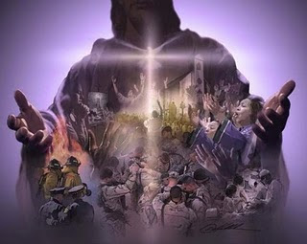
… fulfill my joy by being like-minded, having the same love, being of one accord, of one mind. — Philippians 2:2
love
like-minded
same love
one accord
love
one mind
Notes:
Love unites in the single truth of God.

Slide 61
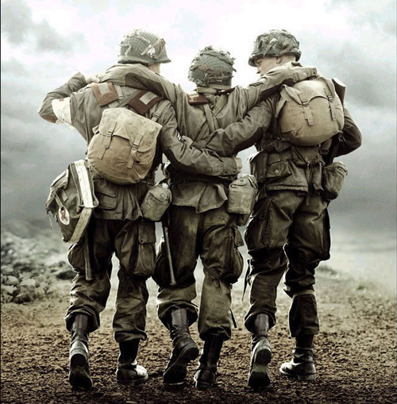
"Greater love has no one than this, than to lay down one's life for his friends. — John 15:13
love
love
Notes:
To love others with sacrifice defines a character of mercy and grace.

Slide 62
"But if you love those who love you, what credit is that to you? For even sinners love those who love them." — Luke 6:32
love
Only Love those who love you?
Notes:
Love is deeper than just a matter of local convenience, but it extends past the immediate to touch all that is ahead.

Slide 63
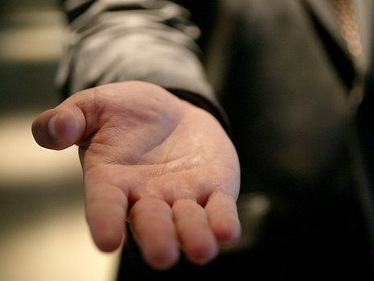
"But love your enemies, do good, and lend, hoping for nothing in return; and your reward will be great, and you will be sons of the Most High. For He is kind to the unthankful and evil." — Luke 6:35
love
do
good
good
Most High
He is kind
He is kind
Notes:
Truly enlightened are those that love His creation in sympathy for those that would despise it.

Slide 64
See that no one renders evil for evil to anyone, but always pursue what is good both for yourselves and for all. — 1st Thessalonians 5:15
Follow
Keep to
pursue
Quest
is good
Chase
good
all
Practice
Notes:
In the pursuit of goodness, love is realized.

Slide 65
"So they come to you as people do, they sit before you as My people, and they hear your words, but they do not do them; for with their mouth they show much love, but their hearts pursue their own gain." — Ezekiel 33:31
love
Hypocrite
do not do
do not do
love
pursue their own gain
pursue
pursue their own gain
Notes:
Distant hearts lack the sincerity of love.

Slide 66
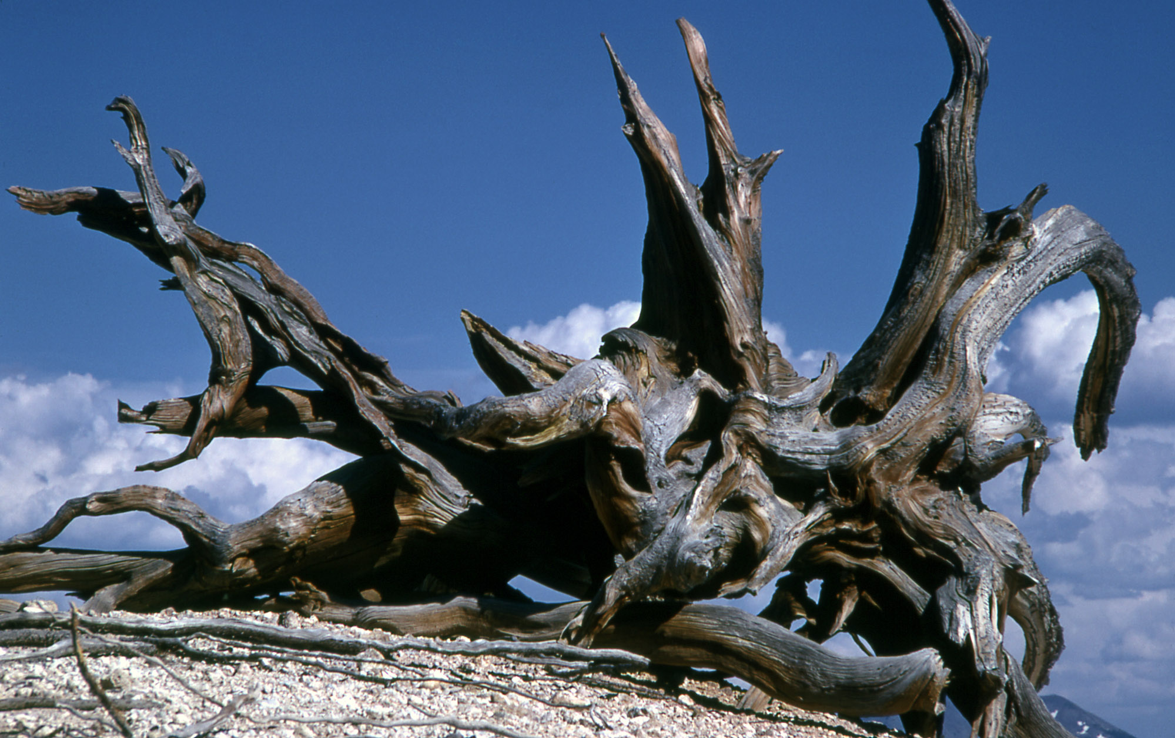
These are spots in your love feasts, while they feast with you without fear, serving only themselves. They are clouds without water, carried about by the winds; late autumn trees without fruit, twice dead, pulled up by the roots; — Jude 1:12
curse
love
spots
in
love
spots
love
serving
serving
Notes:
Deception invades truth leaving only an empty hole. Good soil can be hard to find when surrounded by cold stones and dead weeds.

Slide 67
Do not love the world or the things in the world. If anyone loves the world, the love of the Father is not in him. — 1st John 2:15
love
love
Attachment
love of
love of
Father is not in him
in
Father is not in him
Notes:
Desires exclusively embedded in worldliness lack the higher ideals of godliness.

Slide 68
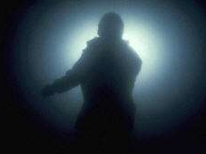
"He who loves his life will lose it, and he who hates his life in this world will keep it for eternal life." — John 12:25
love
love
New man
find salvation
Detachment
Old man
hardships
Notes:
To find God is to release selfish desires.

Slide 69
But the fruit of the Spirit is love, joy, peace, longsuffering, kindness, goodness, faithfulness, gentleness, self-control. Against such there is no law. — Galatians 5:22 -23
love
love
love
love
Notes:
Godliness has clear attributes as defined by fruits of the Spirit.

Slide 70
Flee also youthful lusts; but pursue righteousness, faith, love, peace with those who call on the Lord out of a pure heart. — 2 ^{nd} Timothy 2:22
Flee youthful lusts
pursue
● righteousness
● faith
● love
● peace
Flee
youthful lusts
pursue
pursue
pursue
righteousness
faith
love
peace
love
pure
love
pure
love
heart
heart
Notes:
As life matures in thoughtfulness, it brings reflection to light. The melody of life is more than mere flesh.

Slide 71
Let no one despise your youth, but be an example to the believers in word, in conduct, in love, in spirit, in faith, in purity. — 1st Timothy 4:12
love
be an example
love
be an example
in
in
love
in
love
in
in
in purity
in
Notes:
Good examples enhance the whole. Love is something shared.

Slide 72
Since you have purified your souls in obeying the truth through the Spirit in sincere love of the brethren, love one another fervently with a pure heart, having been born again, not of corruptible seed but incorruptible, through the word of God which lives and abides forever, … — 1st Peter 1:22-23
purified
purified
obeying
in sincere
love
in sincere
in
love
love one another
love
love one another
through the
through the
word of God
word of God
God
Notes:
The incorruptible love of Jesus endures forever.

Slide 73
Love does no harm to a neighbor; therefore love is the fulfillment of the law. — Romans 13:10
Owe no one anything except to love one another, for he who loves another has fulfilled the law. — Romans 13:8
love
Trust
who loves another
loves
who loves another
has fulfilled the law
has fulfilled the law
love
fulfillment of the law
fulfillment of the law
Notes:
Love is the fulfilment of what God wills for us.

Slide 74
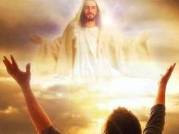
Now may the Lord direct your hearts into the love of God and into the patience of Christ. — 2 ^{nd} Thessalonians 3:5
love of God
love
patience
Christ
Christ
Notes:
Pray God that His love opens our hearts to see.

Slide 76
→ Knowledge puffs up, but love edifies
→ Without love, life is nothing
→ Love suffers long and is kind; love does not envy;
→ Love does not parade itself, is not puffed up;
→ God calls us to be rooted and grounded in love
→ Keep yourself in the love of God
→ Speak truth in love all having the same love
→ Stir up love & good works considering one another
→ Let all be done with love and love your enemies
→ Sacrifice is the greatest form of love
→ Do not love the materialism of the world
→ Love one another fervently with a pure heart
→ Love is the fulfillment of the law
Love is God and His call for us to live in Him
Notes:
The be washed in the sacrifice of His blood is to be bathed in His love.

Slide 77
Notes:
There is no love in darkness.

Slide 78
Please visit http://www.RonBert.com to explore further
Ronald Bert Channel on
Notes:
Eternity never ends.

