Slide 1
Notes:
Not all is lit.

Slide 2
Ron Bert
LIVING TRUTHS
March 20, 2016

Slide 3
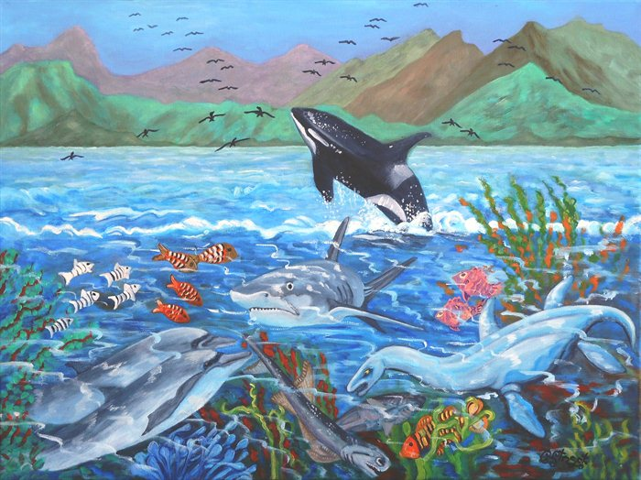
Then God said, "Let the waters abound with an abundance of living creatures, and let birds fly above the earth across the face of the firmament of the heavens." So God created great sea creatures and every living thing that moves, with which the waters abounded, according to their kind, and every winged bird according to its kind. And God saw that it was good. — Genesis 1:20-21
God
God
God created
God created
every living thing
every living thing
God

Slide 4
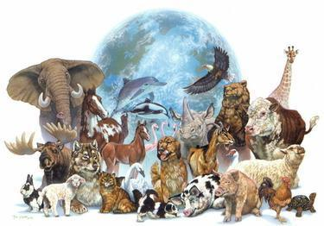
Then God said, "Let the earth bring forth the living creature according to its kind: cattle and creeping thing and beast of the earth, each according to its kind"; and it was so. — Genesis 1:24
God
living creature
living creature
each according to its kind

Slide 5
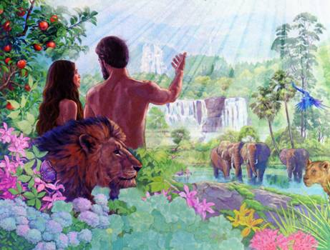
Then God said, "Let Us make man in Our image, according to Our likeness; let them have dominion over the fish of the sea, over the birds of the air, and over the cattle, over all the earth and over every creeping thing that creeps on the earth." So God created man in His own image; in the image of God He created him; male and female He created them. Then God blessed them, and God said to them, "Be fruitful and multiply; fill the earth and subdue it; have dominion over the fish of the sea, over the birds of the air, and over every living thing that moves on the earth."— Genesis 1:26-28
God
God
God
God
God
God
God
God
God
God
God
every living thing
every living thing

Slide 6
For the word of God is living and powerful, and sharper than any two-edged sword, piercing even to the division of soul and spirit, and of joints and marrow, and is a discerner of the thoughts and intents of the heart. — Hebrews 4:12
God
word of God is living
word of God is living
spirit

Slide 7
… having been born again, not of corruptible seed but incorruptible, through the word of God which lives and abides forever, … — 1ST Peter 1:23
… having been born again, not of corruptible seed but incorruptible, through the word of God which lives and abides forever, … — 1ST Peter 1:23
word of God
God
word of God
lives
forever
lives
forever

Slide 8
"This is that Moses who said to the children of Israel, 'The LORD your God will raise up for you a Prophet like me from your brethren. Him you shall hear.' This is he who was in the congregation in the wilderness with the Angel who spoke to him on Mount Sinai, and with our fathers, the one who received the living oracles to give to us, …" — Acts 7:37-38
God
living oracles
living oracles

Slide 9
"For in the resurrection they neither marry nor are given in marriage, but are like angels of God in heaven. But concerning the resurrection of the dead, have you not read what was spoken to you by God, saying, 'I am the God of Abraham, the God of Isaac, and the God of Jacob'? God is not the God of the dead, but of the living." — Matthew 22:30-32
God
God
God
God
God
God
God
God
of the living
of the living

Slide 10
But the LORD is the true God; He is the living God and the everlasting King. At His wrath the earth will tremble, And the nations will not be able to endure His indignation. — Jeremiah 10:10
God
God
living God
living God
living God
God

Slide 11
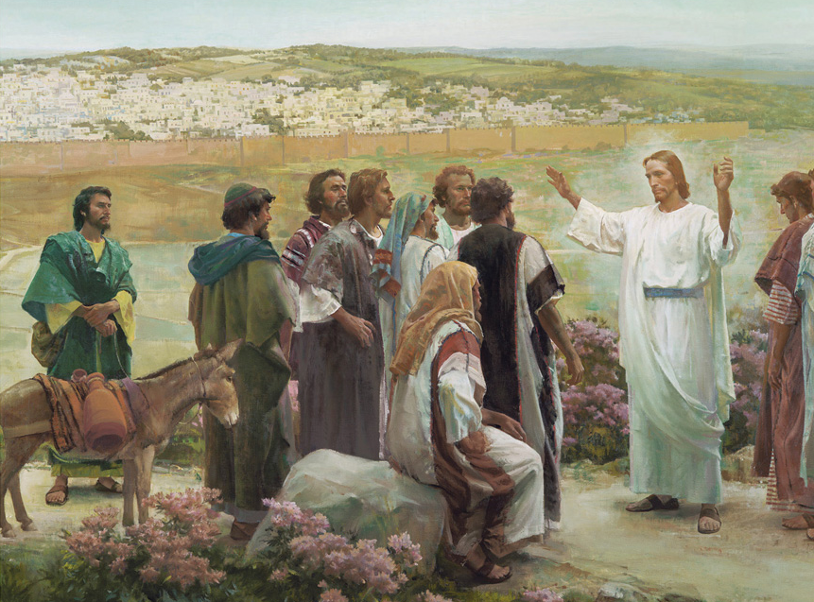
Simon Peter answered and said, "You are the Christ, the Son of the living God." Jesus answered and said to him, "Blessed are you, Simon Bar-Jonah, for flesh and blood has not revealed this to you, but My Father who is in heaven. And I also say to you that you are Peter, and on this rock I will build My church, and the gates of Hades shall not prevail against it. — Matthew 16:16-18
living God
living God
Rock
rock

Slide 12
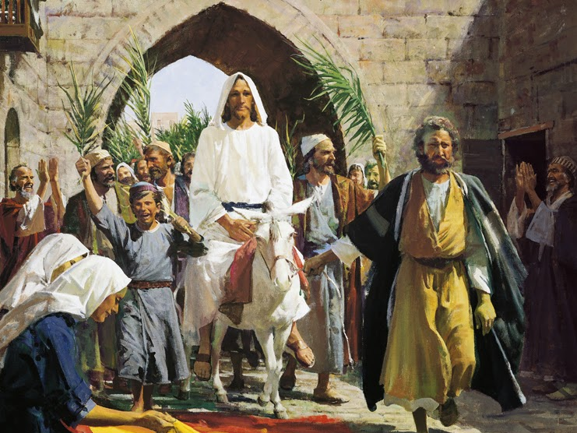
… and all drank the same spiritual drink. For they drank of that spiritual Rock that followed them, and that Rock was Christ. — 1ST Corinthians 10:4
Christ
Rock solid truth
that Rock was Christ
d
th
s
u
l
i
o
t
r
Christ
Rock
that Rock was Christ

Slide 13
Christ
"'I am the God of Abraham, the God of Isaac, and the God of Jacob'? God is not the God of the dead, but of the living." — Matthew 22:32
God
God
God
God
God
living

Slide 14
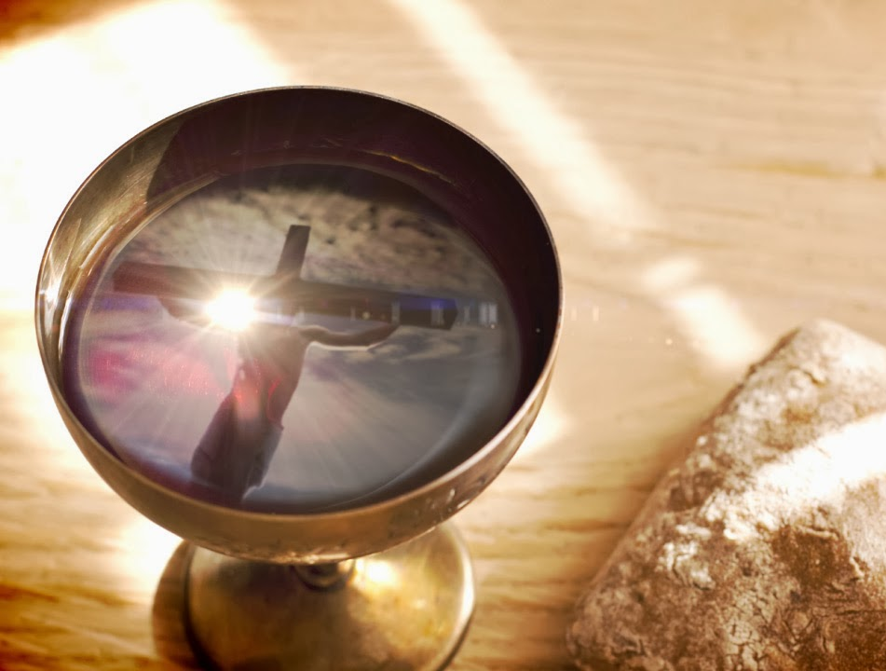
"Whoever eats My flesh and drinks My blood has eternal life, and I will raise him up at the last day. For My flesh is food indeed, and My blood is drink indeed. He who eats My flesh and drinks My blood abides in Me, and I in him. As the living Father sent Me, and I live because of the Father, so he who feeds on Me will live because of Me. This is the bread which came down from heaven --not as your fathers ate the manna, and are dead. He who eats this bread will live forever." — John 6:54-58
eternal life
eternal life
flesh is food
flesh is food
blood is drink
blood is drink
living
living Father
living Father
Through Him
feeds on Me will live
feeds on Me will live

Slide 15
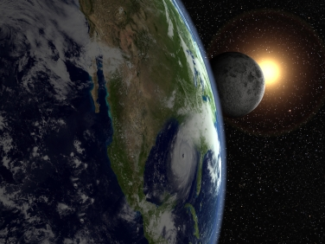
"I am the living bread which came down from heaven. If anyone eats of this bread, he will live forever; and the bread that I shall give is My flesh, which I shall give for the life of the world." — John 6:51
living
living bread
living bread

Slide 16
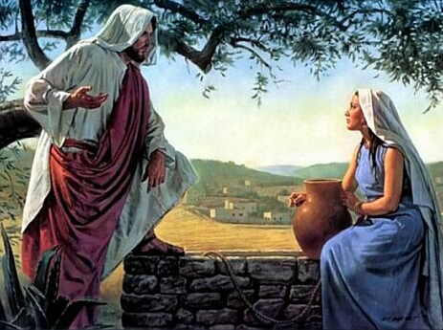
A woman of Samaria came to draw water. Jesus said to her, "Give Me a drink." For His disciples had gone away into the city to buy food. Then the woman of Samaria said to Him, "How is it that You, being a Jew, ask a drink from me, a Samaritan woman?" For Jews have no dealings with Samaritans. Jesus answered and said to her, "If you knew the gift of God, and who it is who says to you, 'Give Me a drink,' you would have asked Him, and He would have given you living water." — John 4:7-10
For the Tree of Life
Drink
Truth
Food
living
living water
living water
From the Rock
living water

Slide 17
The woman said to Him, "Sir, You have nothing to draw with, and the well is deep. Where then do You get that living water? Are You greater than our father Jacob, who gave us the well, and drank from it himself, as well as his sons and his livestock?" Jesus answered and said to her, "Whoever drinks of this water will thirst again, but whoever drinks of the water that I shall give him will never thirst. But the water that I shall give him will become in him a fountain of water springing up into everlasting life." — John 4:11-14
living water
living water
living water
it
n
in
ir
inner
spirit
fountain
er
fountain
sp
everlasting life
everlasting life

Slide 18
"He who believes in Me, as the Scripture has said, out of his heart will flow rivers of living water." — John 7:38
heart
flow rivers of
living
living water
living water
living water

Slide 19
"They shall neither hunger anymore nor thirst anymore; the sun shall not strike them, nor any heat; for the Lamb who is in the midst of the throne will shepherd them and lead them to living fountains of waters. And God will wipe away every tear from their eyes." — Revelation 7:16-17
the Lamb
lead
lead them to
living
living
living
fountains of waters
fountains of waters

Slide 20
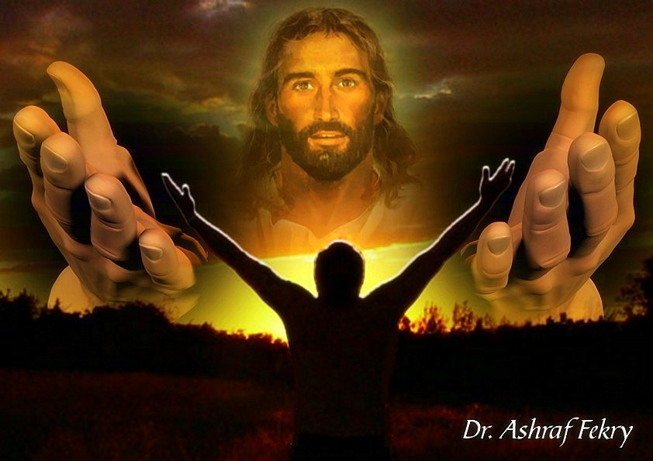
And so it is written, "The first man Adam became a living being." The last Adam became a life-giving spirit. — 1ST Corinthians 15:45
living
living being
living being
You open Your hand And satisfy the desire of every living thing. — Psalm 145:16
life-giving spirit

Slide 21
Therefore, brethren, having boldness to enter the Holiest by the blood of Jesus, by a new and living way which He consecrated for us, through the veil, that is, His flesh, and having a High Priest over the house of God, let us draw near with a true heart in full assurance of faith, having our hearts sprinkled from an evil conscience and our bodies washed with pure water. Let us hold fast the confession of our hope without wavering, for He who promised is faithful. — Hebrews 10:19-23
Jesus
living
living way
living way
true heart

Slide 22
Blessed be the God and Father of our Lord Jesus Christ, who according to His abundant mercy has begotten us again to a living hope through the resurrection of Jesus Christ from the dead, to an inheritance incorruptible and undefiled and that does not fade away, reserved in heaven for you, who are kept by the power of God through faith for salvation ready to be revealed in the last time. — 1ST Peter 1:3-5
living
hope
living
living hope
living hope
The fruit of the righteous is a tree of life, And he who wins souls is wise. — Proverbs 11:30
tree of life
tree of life

Slide 23
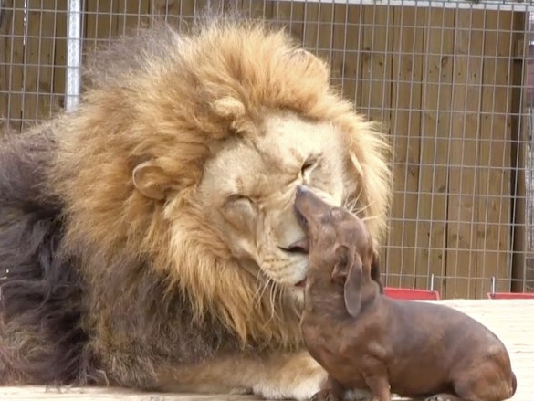
But for him who is joined to all the living there is hope, for a living dog is better than a dead lion. — Ecclesiastes 9:4
For the living know that they will die; But the dead know nothing, And they have no more reward, For the memory of them is forgotten. — Ecclesiastes 9:5
hope
living
hope
living
living
living know
living
living
living know
hope
living know

Slide 24
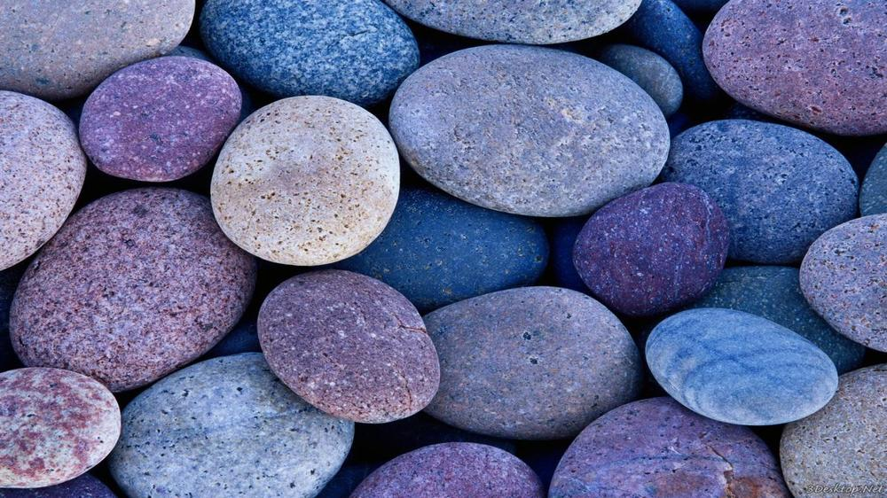
Coming to Him as to a living stone, rejected indeed by men, but chosen by God and precious, you also, as living stones, are being built up a spiritual house, a holy priesthood, to offer up spiritual sacrifices acceptable to God through Jesus Christ. — 1ST Peter 2:4-5
living
living stone
Formed
living stone
Color
Remain or Perish
Bright or Dark
Size
Large or Small
Texture
sacrifices acceptable
sacrifices acceptable
Rough or Smooth
Luster
Weight
Amassed Quantity
Reflective Quality

Slide 25
I beseech you therefore, brethren, by the mercies of God, that you present your bodies a living sacrifice, holy, acceptable to God, which is your reasonable service. — Romans 12:1
living
living
living
acceptable
sacrifice
holy
sacrifice
holy
acceptable
living sacrifice

Slide 26
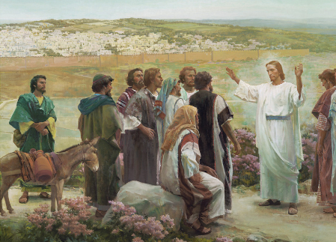
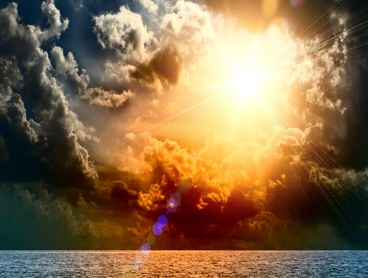
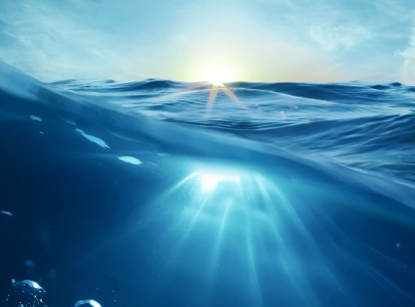
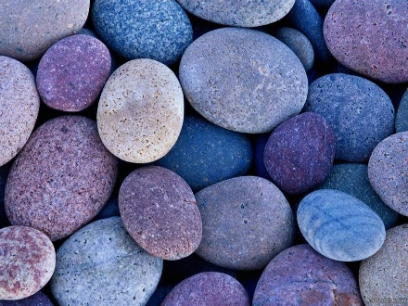

Slide 27
Living Creatures
→ God Created Living Creatures According to Kind
→ The Living Word of God Abides Forever
→ Living Oracles Were Given to Mankind
→ The Living God is Lord and King
→ The Living Father of Creation is
→ Living Bread is Spiritual Food from Heaven
→ Living Water is the Refreshment of Our Spirit
→ He Leads Us to Living Fountains
→ Living Beings Know His Life-Giving Spirit
→ A Living Way has Been Given by Jesus
→ Living Hope has come through faith in Jesus
→ Living Stones Build Stamina Offering Sacrifice
→ Be a Living Sacrifice Which is Reasonable Service
Living Word
Living Only has Life When Alive in God
Living Oracles
Living God
Living Father
Living Bread
Living Water
Living Fountains
Living Beings
Living Way
Living Hope
Living Stones
Living Sacrifice

Slide 29
Please visit http://www.RonBert.com to explore further
Ronald Bert Channel on
Notes:
Eternity never ends.

